Slide 1
Higgs Self-Coupling at the
Jan strube, for the ilc physics and detector study groups
ICHEP, Chicago 2016

Slide 2
Tri-Linear Higgs Self-Coupling
In the SM, self-coupling terms fixed by mass.
Other models can lead to potentially large deviations. Direct measurement is first handle on the shape of the potential; links to EW baryogenesis.
At the ILC: Measure the rate of double Higgs production
ZHH (500 GeV) or HHνν (1 TeV)
λ / λ_{SM}
Deviations in λ lead to a change in cross section

Slide 3
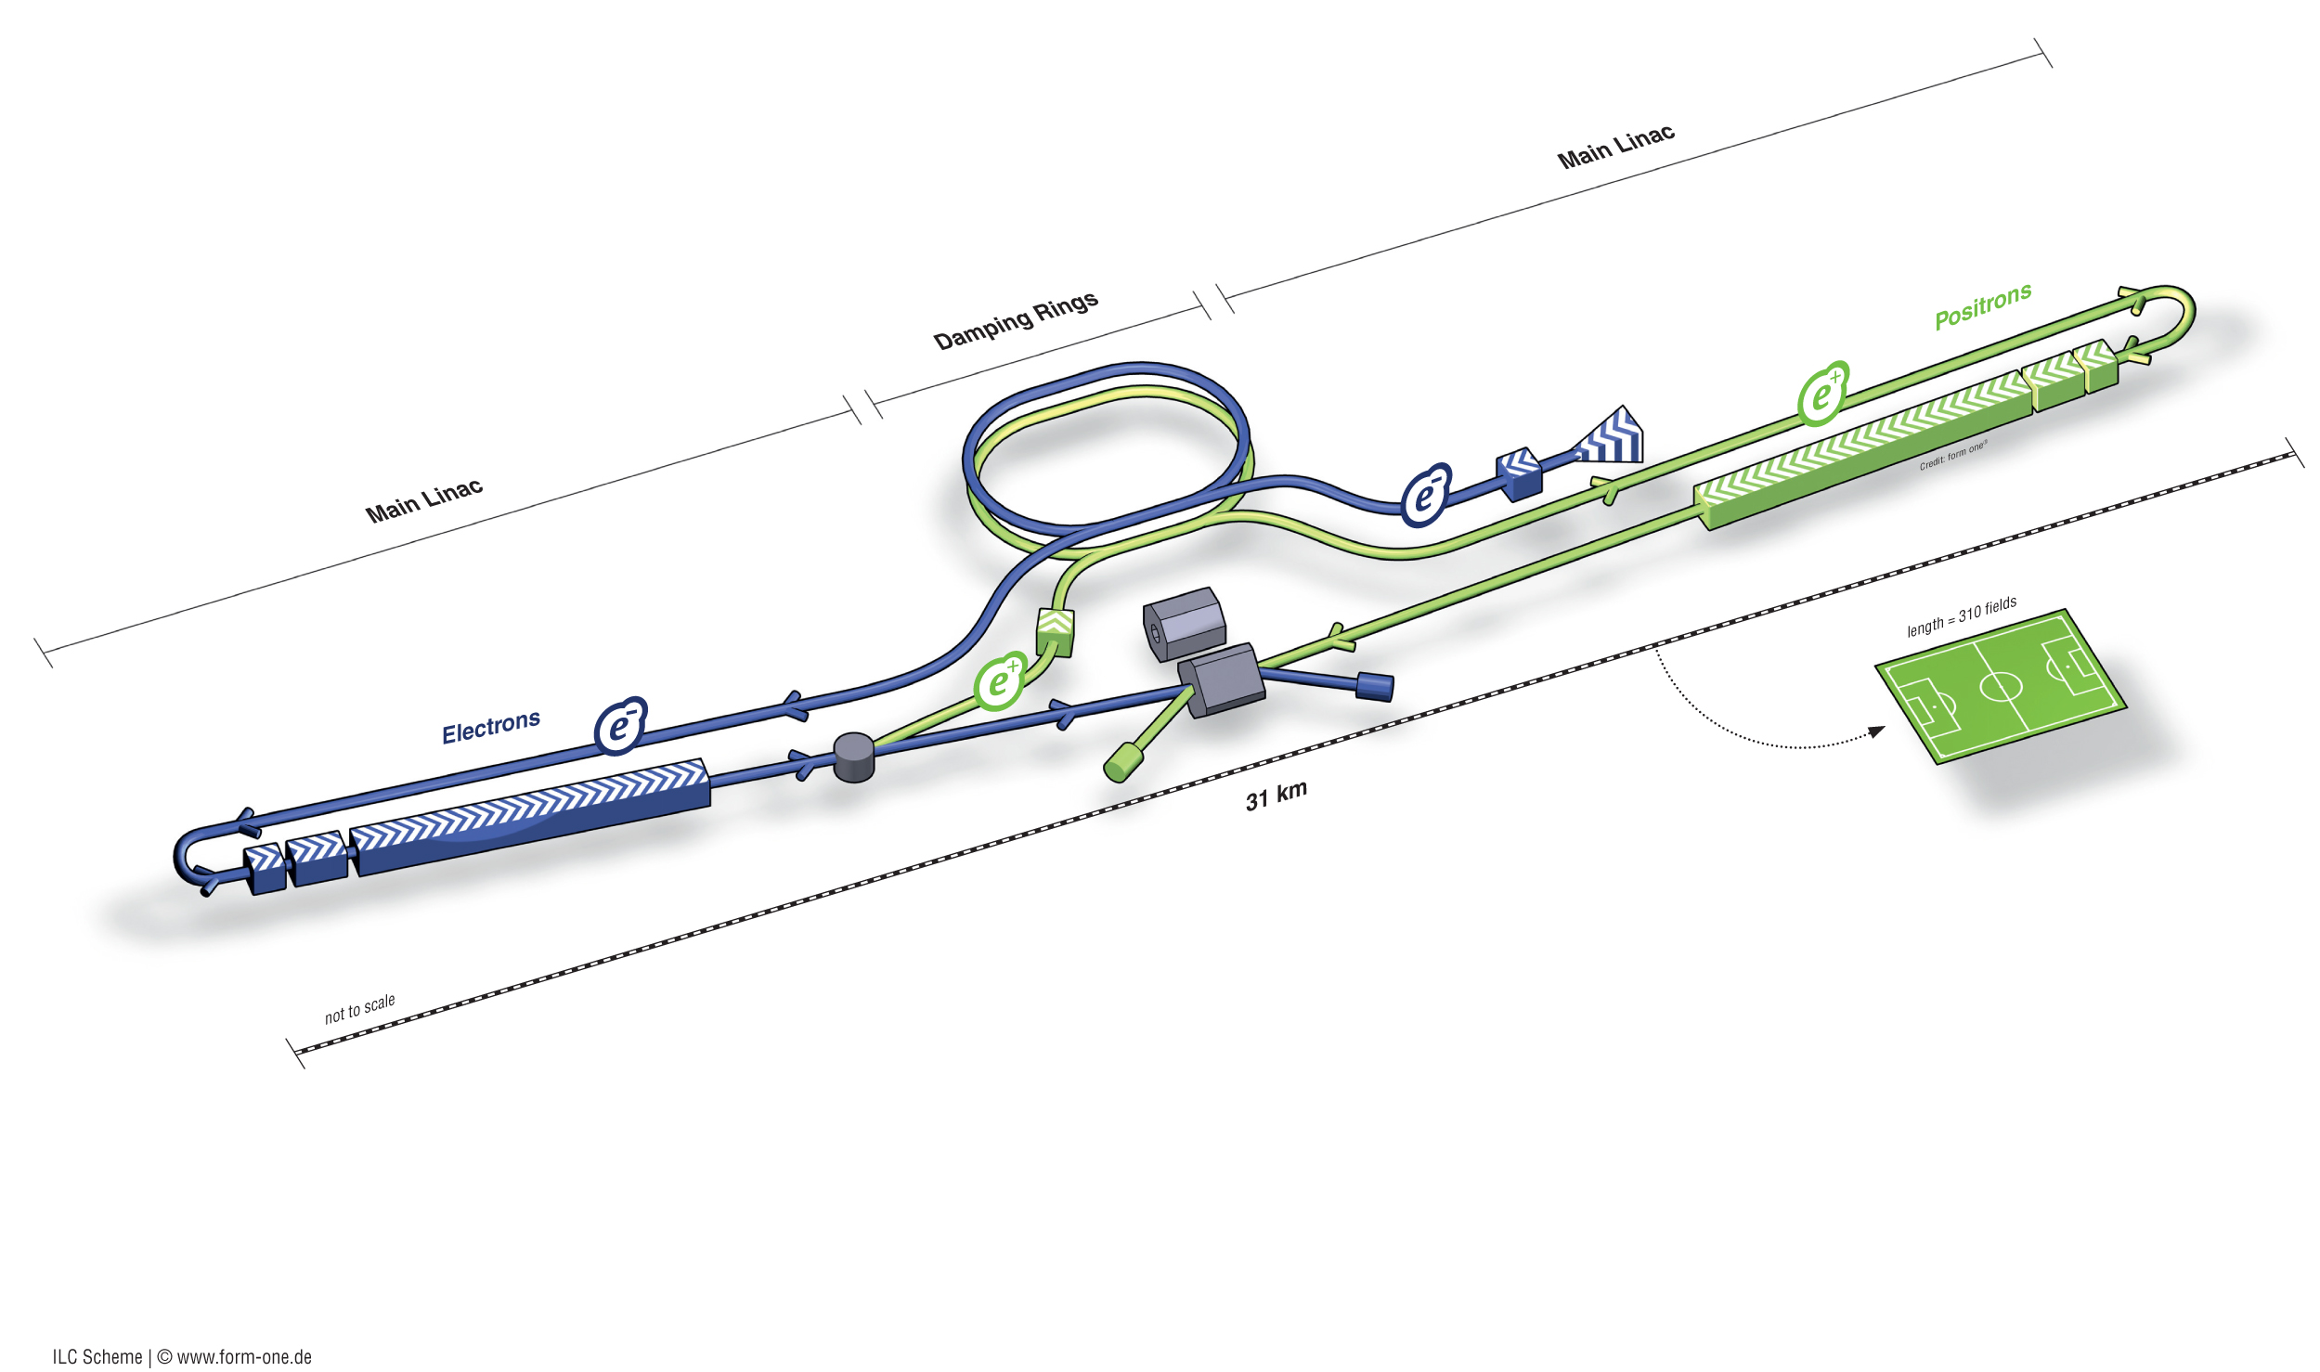

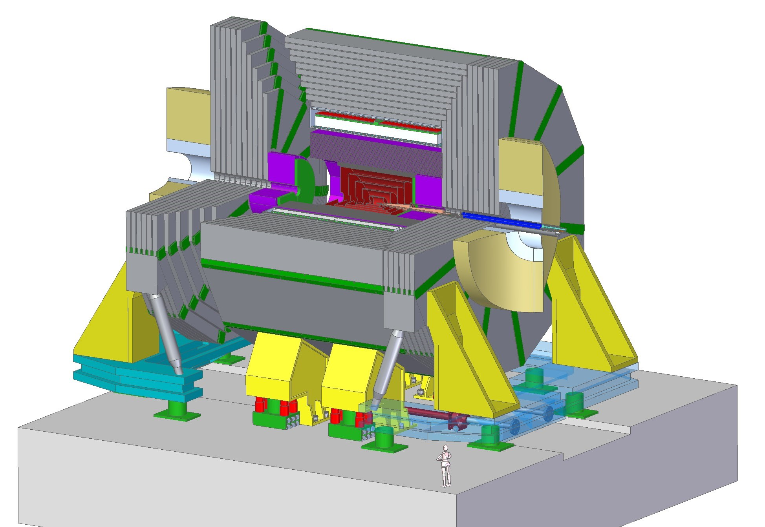
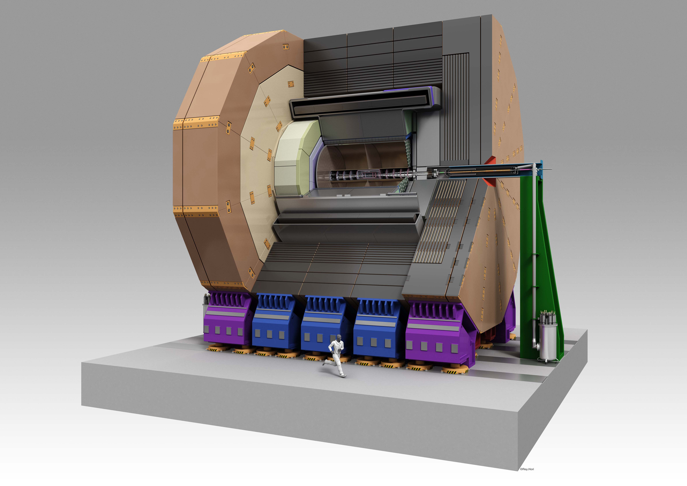
The International Linear Collider
The ILC Accelerator has published a TDR in 2012. The technology is being deployed in XFEL (DESY)
and LCLS (SLAC)
The Japanese government is reviewing the project and considering a bid to host. A candidate site in northern Japan is being studied in detail
Two detector concepts are being studied by groups in Europe, Asia, North America. Baselines have been reviewed by an international panel.

Slide 4

ILC Detectors
Detectors not at same scale
SiD
ILD
5 T field
Silicon Tracking
3.5 T field
Gaseous Tracking
Pixelated Si-W ECAL
Highly Granular HCAL
Optimized for Particle Flow (calorimeter inside coil)
No Trigger
Shared Beam Time in Push-Pull setup
Both can deliver the physics. Now shifting gears towards TDR.

Slide 5
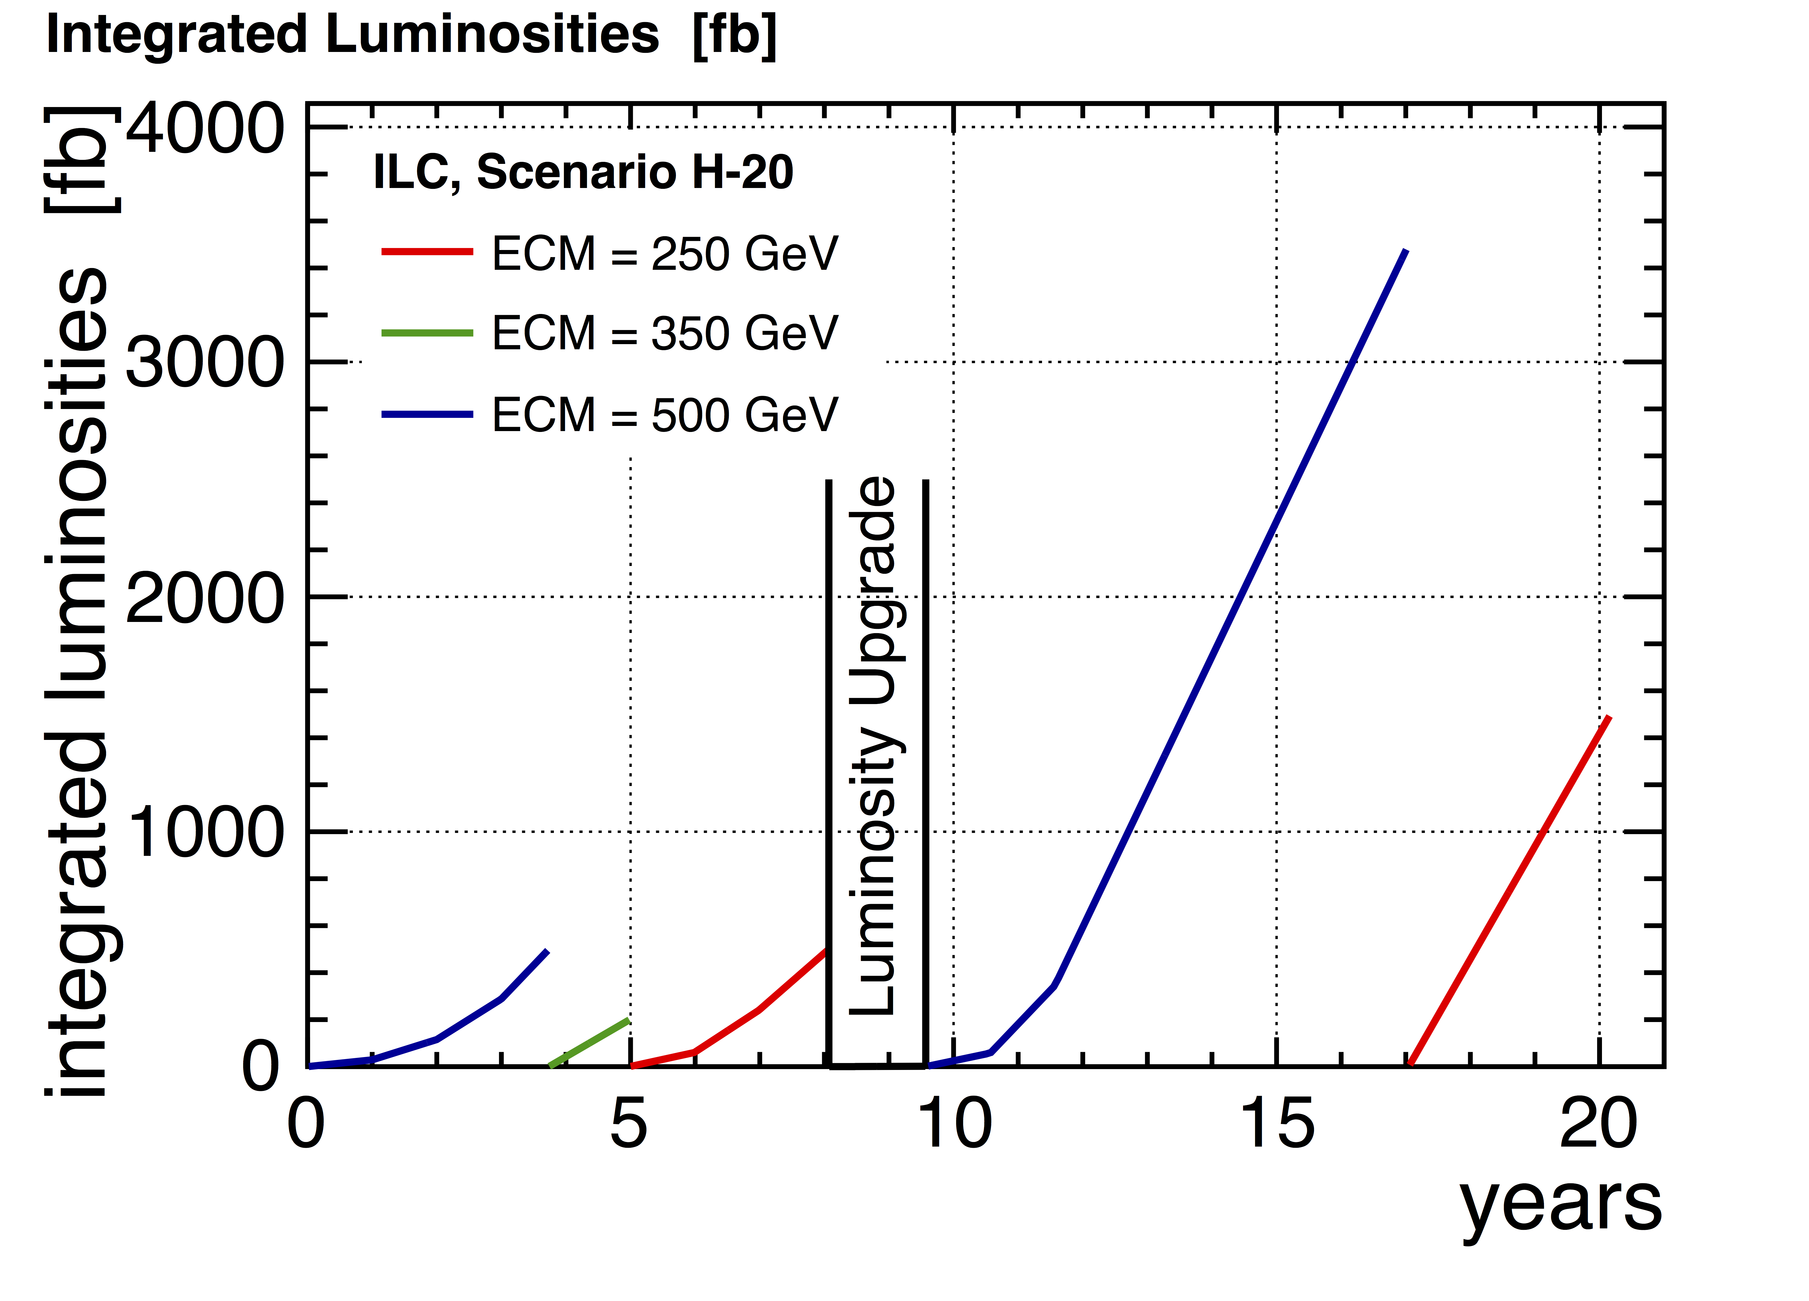
ILC Operating Scenarios arXiv:1506.07830
Start at baseline energy
  Pursue full program from day 1, including ttH, self-coupling, BSM searches
Add runs at thresholds for higher precision: 350 GeV (top), 250 GeV (ZH)
Run at other thresholds possible, informed by LHC or early ILC Data
Goal: per cent-level precision on (most) Higgs couplings
Possible upgrade to 1 TeV to improve ttH, self-coupling measurements, access potential heavy states

Slide 6
Higgs Production at the ILC
Baseline of 500 GeV
Years 5-8
Years 18-20
Year 4
Years 1-3
Years 10-17
The Higgs program at different energies
Recoil method: ILC staple
Z --> ll for precision
Z --> qq for higher cross section
Vector boson fusion cross section increases at higher energies

Slide 7
Higgsstrahlung at the ILC arXiv:1604.07524
Well-known initial state at ILC allows to measure the Higgs in a model-independent way: Reconstruction efficiencies the same for all decays to within < 1%
250 fb⁻¹ @ 250 GeV (left-handed):
Δσ_{ZH}/σ_{ZH} = 2.5%
Δm_{H}/m_{H} = 37 MeV
Sensitivity to invisible decays, certain CP violating scenarios

Slide 8
Flavor Tagging at the ILC arXiv:1506.08371
Higgs decays to jets benefit from excellent vertex detector
  b- and c-jets
b
c
Jet-clustering after vertex finding as to not break up the vertices
Specifically developed for ZHH reconstruction
Further improvements (Adaptive Vertex Fitting, PID, vertex mass improvements) under development.

Slide 9
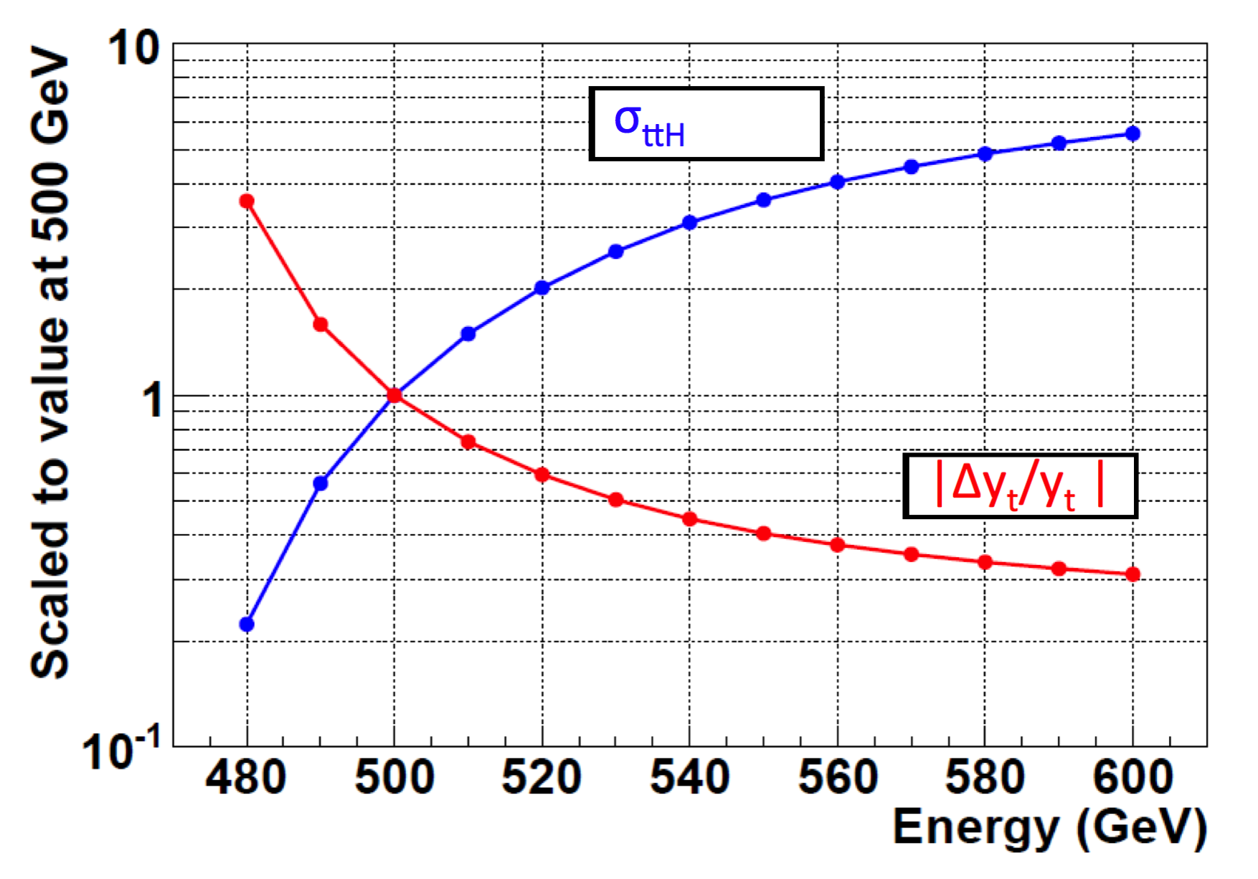
Top Yukawa coupling in the baseline
Main production channel of ttH at ILC
Cross section of ttH production at ILC with unpolarized beams
Coupling measurement at baseline energy: 18%,
In full program w/ luminosity upgrade: 6.3%
Important to reach at least baseline energy.
Potential at higher energy:
Coupling measurement in full program ~3%

Slide 10
Top Yukawa coupling at 1 TeV doi:10.1140/epjc/s10052-015-3532-4
Main production channel of ttH at ILC
ttH channel not sensitive to
top Yukawa coupling,~4% effect
Analysis in 6-jet+lepton and in 8-jet mode
Main background processes:
Other Higgs decays, ttZ, ttbb, tt
4% with 1 ab⁻¹ at 1 TeV with only left-handed polarization.
Expected precision with full ILC program + Energy upgrade: 2%

Slide 11
Other Higgs measurements
HL-LHC program will measure several Higgs couplings to <10%
The ILC program will improve upon this precision by ~ one order of magnitude.

Slide 12
Model-independent measurements at the ILC
HL-LHC program will measure several Higgs couplings to <10%
The ILC program will improve upon this precision by ~ one order of magnitude.
ILC will add measurements. Studies can be carried out in a self-contained and model-independent way
Notes:
Point out additions

Slide 13
Global Fit of Higgs couplings
parameter | ILC500 | ILC500 LumiUp
𝚪_{H} | 3.8% | 1.8%
g(HZZ) | 0.58% | 0.31%
g(HWW) | 0.81% | 0.42%
g(Hbb) | 1.5% | 0.7%
g(Hcc) | 2.7% | 1.2%
g(Hgg) | 2.3% | 1.0%
g(ττ) | 1.9% | 0.9%
g(Hγγ) | 7.8% | 3.4%
g(Hγγ)+LHC | 1.2% | 1.0%
g(Hµµ) | 20% | 9.2%
g(Htt) | 18% | 6.3%
Best measurement of cross section:
σ_{ZH} from recoil method. Error < 2.5%
Notes:
Point out additions

Slide 14
Precision Measurements are not optional
Supersymmetry
(MSSM)
Composite Higgs
(MCHM5)
ILC 250+500 luminosity upgrade
Notes:
This precision is not optional. It is absolutely essential to identify the nature of the discovered Higgs boson

Slide 15
ILC Operating Scenarios arXiv:1506.07830
Collision energy | 500 GeV (baseline) |  |  |  | 1000 GeV (possible upgrade)
Polarization (%) | +80/-30 | -80/+30 | -80/-30 | +80/+30 | +80/-20 | -80/+20 | -80/-20 | +80/+20
Int. Luminosity (fb) | 1600 | 1600 | 400 | 400 | 3200 | 3200 | 800 | 800
# HH events | ~260 | ~400 | ~60 | ~40 | ~440 | ~1040 | ~180 | ~90

Slide 16
Reconstruction of Double Higgs at the ILC
ZH
HH
ZZ
ZH
Excellent jet energy resolution allows to reconstruct fully hadronic decays; 4-8 jets: HH → 4b, HH→bbWW
Mass resolution in fully hadronic reconstruction of double Higgs production and dominant background at 500 GeV
Jet clustering techniques remain an active area: Recent addition: Valencia algorithm (dx.doi.org/10.1016/j.physletb.2015.08.055)
Shows improvement in VV reconstruction.
Not yet applied to ZHH.

Slide 17
Measurement Strategy
λ / λ_{SM}
Fortunate situation in the energy range of the ILC:
At ~500 GeV (ZHH):
cross section increases if λ > λ_{SM}
With 4 ab⁻¹ at ~500 GeV
Δσ/σ(ZHH) = 16%
Δλ/λ = 27%
At 1 TeV: (ννHH):
cross section increases if λ < λ_{SM}
With 8 ab⁻¹ at 1000 GeV
Δσ/σ (ννHH) = 13%
Δλ/λ = 10%

Slide 18
ILC Closure Test
(Barklow, Fujii, Tian) (preliminary)
At the ILC, λ is extracted from the cross section measurement of double Higgs production
Processes with sensitivity to HVV and HHVV coupling enter the production of double Higgs events. The ILC allows
model independent measurement of ZH production
measurement of HZZ and HWW couplings in Higgs decays
direct observation of double Higgs production
constraining TGC parameters with high precision
Studies of a few remaining effects ongoing. Preliminary results give us confidence that 10% error for λ holds in BSM scenarios.

Slide 19
Summary
The cubic Higgs self-coupling term is a direct handle on the shape of the potential
  Electroweak baryogenesis requires a non-SM value
Measurement in double Higgs production is challenging at any future collider
  Unique feature of the ILC: cross section increases with coupling
The ability to obtain a complete picture of the Higgs sector is an important aspect of interpreting deviations from SM production rates for double Higgs events.
The coupling precision obtainable in a complete ILC program including a 1 TeV upgrade is 10%
  Based on H → bb and H → WW reconstruction. Additional channels and further reconstruction improvements will further solidify this number.

Slide 20
Disclaimer
The numbers presented here are based on realistic simulation studies including beam background, with current reconstruction.
The LHC experiments are demonstrating how much clever approaches in analysis and reconstruction can improve error bars.

Slide 21
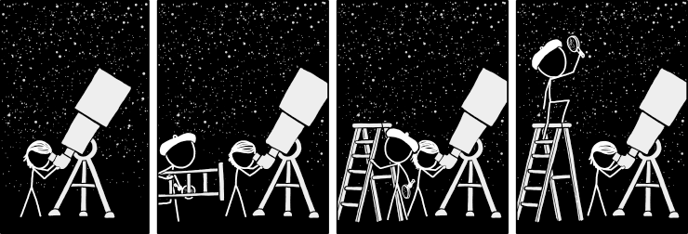
Backup
ILC
ILC
LHC
LHC
LHC
LHC
ILC
ILC

