Slide 1
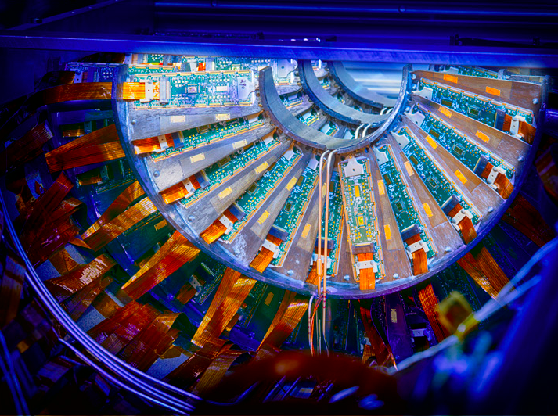



The CMS Phase1 Pixel Detector Upgrade
Petra Merkel
ICHEP 2016
4 August 2016

Slide 2
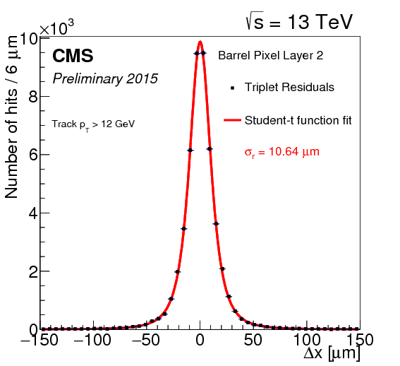
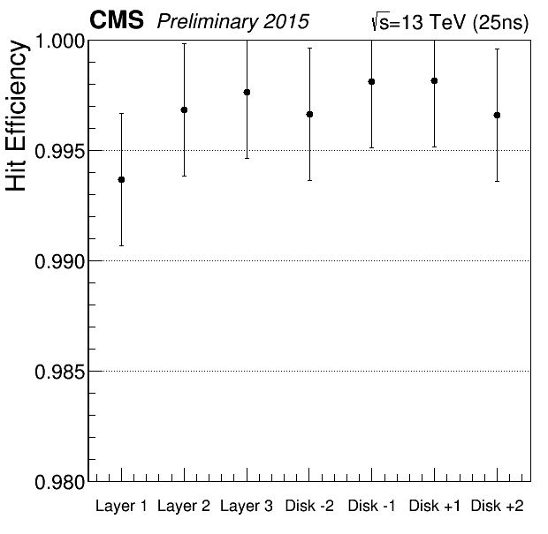
Reminder: the current CMS pixel detector
Present detector designed for 10³⁴cm⁻²s⁻¹ and 25ns bunch spacing
σ_{r}=10.6μm
66M pixels (100mmx150mm)
1m² of n⁺-in-n silicon sensors
Excellent resolution and efficiency
Excellent good-channel fraction and uptime in Run1 and Run2 so far
>99%

Slide 3
Phase1 pixel detector design
Installation during extended year-end technical stop 2016/17 in February’17
Smooth transition needed from installation to physics data taking; not much time for in-situ calibrations
  Sensor technology, pixel size and module concept very similar; need to fit into existing infrastructure
  Move from analog to digital readout chip (ROC) → reduced buffer overflow and inefficiency
  Move from 3- to 4-hit coverage → increase redundancy and track finding efficiency
  Move closer to the beam → improve vertexing and b-tagging
  Move from single-phase fluorocarbon (C6F14 ) to evaporative, bi-phase CO₂ cooling
1856 modules
124M pixels
1440 modules
66M pixels

Slide 4
Phase1 upgrade improvements
Present detector designed for 10³⁴cm⁻²s⁻¹ and 25ns bunch spacing
Expect twice as much before LS3 (2024)
  50 pileup events, hit rates of ~600MHz/cm²
Improve redundancy: from 3 to 4 layers (BPIX), from 2 to 3 disks on each end (FPIX); impacting tracking efficiency and purity
Move closer to beam: improve vertexing and b-tagging
Avoid hit inefficiency of up to 16% due to buffer overflow in readout chip (ROC) with new digital ROC
Reduce mass: use CO₂ cooling instead of water-glycol

Slide 5
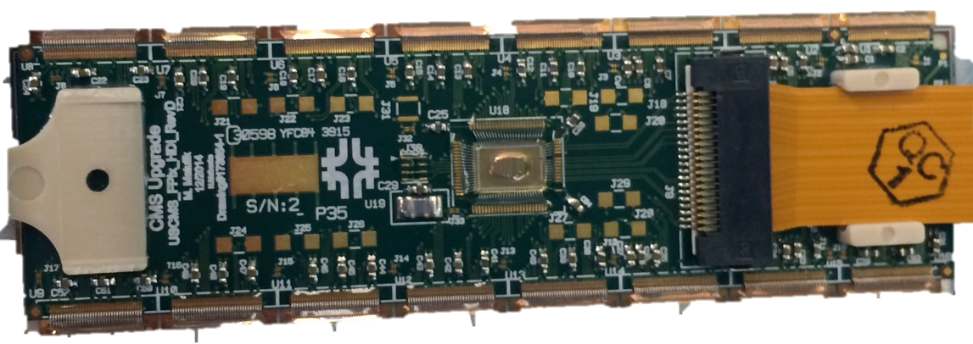
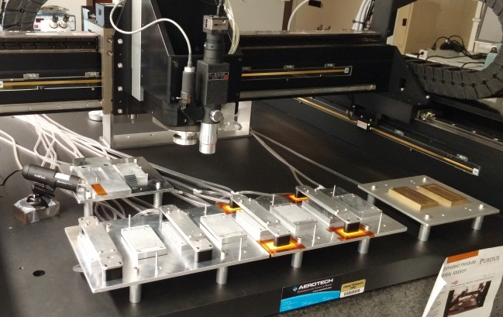
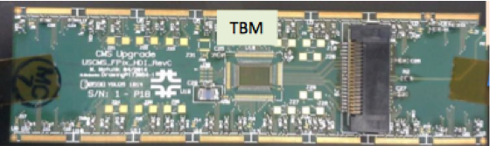
Pixel Modules
FPIX:
  Bump bonding done at vendor (RTI)
  Module assembly done in house at two institutions
BPIX:
  Bump bonding and module assembly done at vendors and in-house at several institutions
Module = Sandwich{ROCs+SiSensor+HDI}
  16 ROCs = >66k pixels
BPIX
HDI
Sensor
Bumps
ROCs

Slide 6
Readout Chip
New, digital readout chip based on present analog PSI46
Same technology (0.25μm CMOS) and column drain architecture
  40MHz analog → 160 Mbits/s digital (8 bit ADC)
  Increase of hit (32 → 80) and time stamp (12 → 24) buffer depth
  Additional readout buffer
  Smaller cross talk + improved comparator → threshold reduced from 3200e⁻ to ~2000e⁻ → better efficiency, resolution and longevity
Final version for BPIX L2,3,4 and FPIX performing very well
Special version for L1 (580 MHz/cm²) with cluster readout:
  Final version just received, first results indicate all previous problems solved and ROC is functioning well! Almost ready for L1 module production

Slide 7
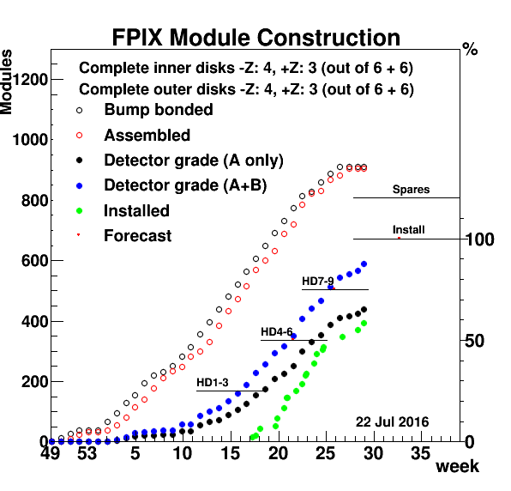
Module Production and Quality
FPIX
bad bumps
FPIX
FPIX
Preliminary
BPIX
BPIX
BPIX

Slide 8
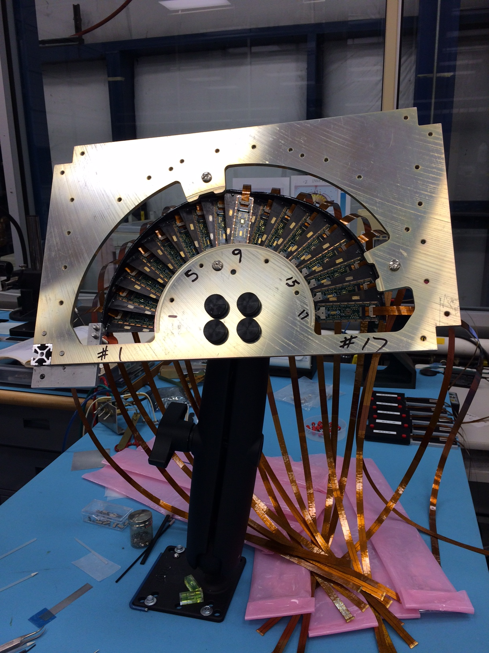
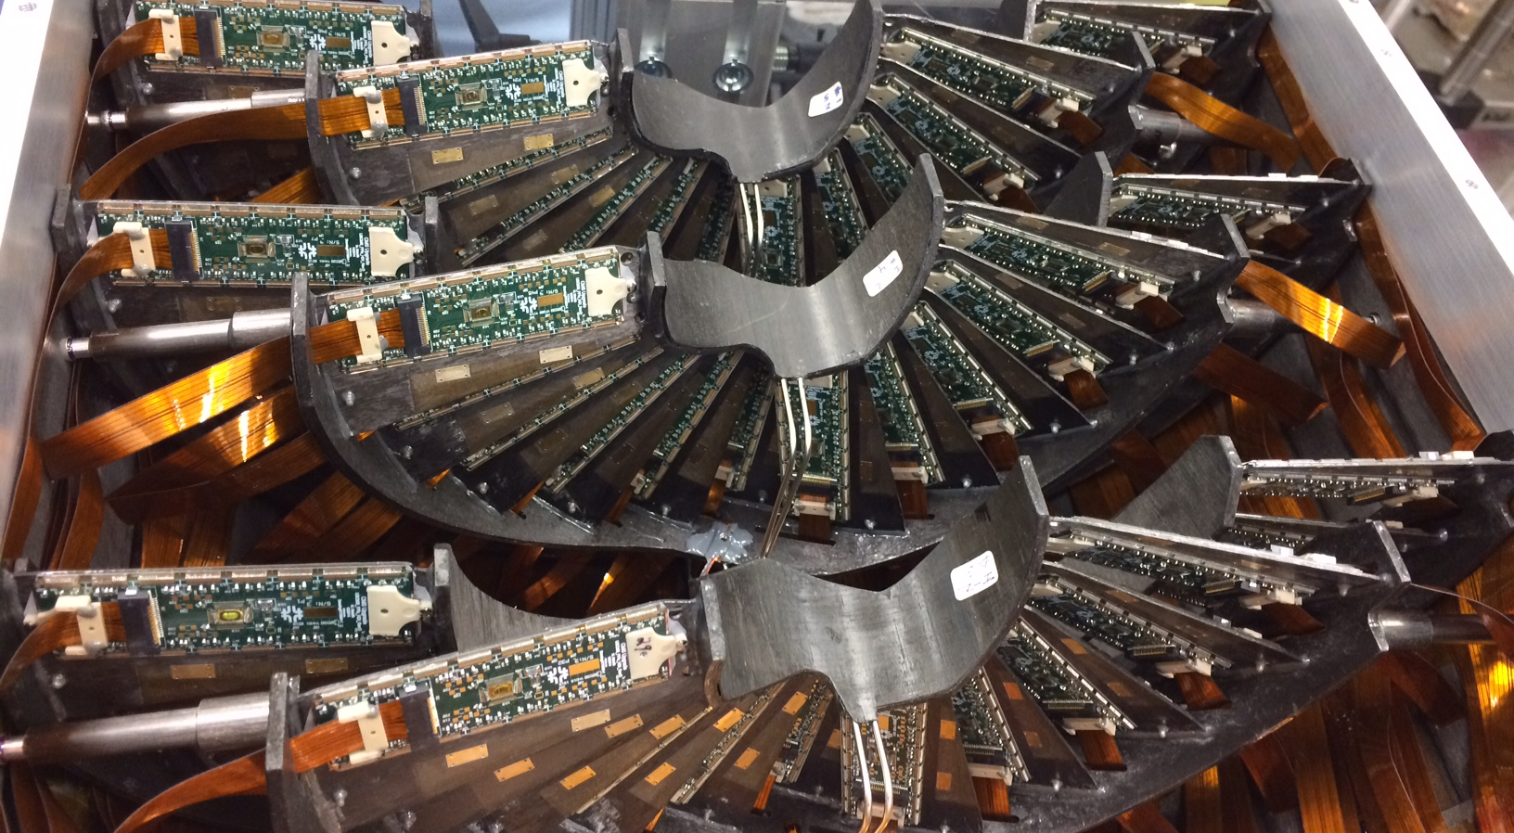
FPIX Detector Assembly

Slide 9
BPIX Detector Assembly

Slide 10
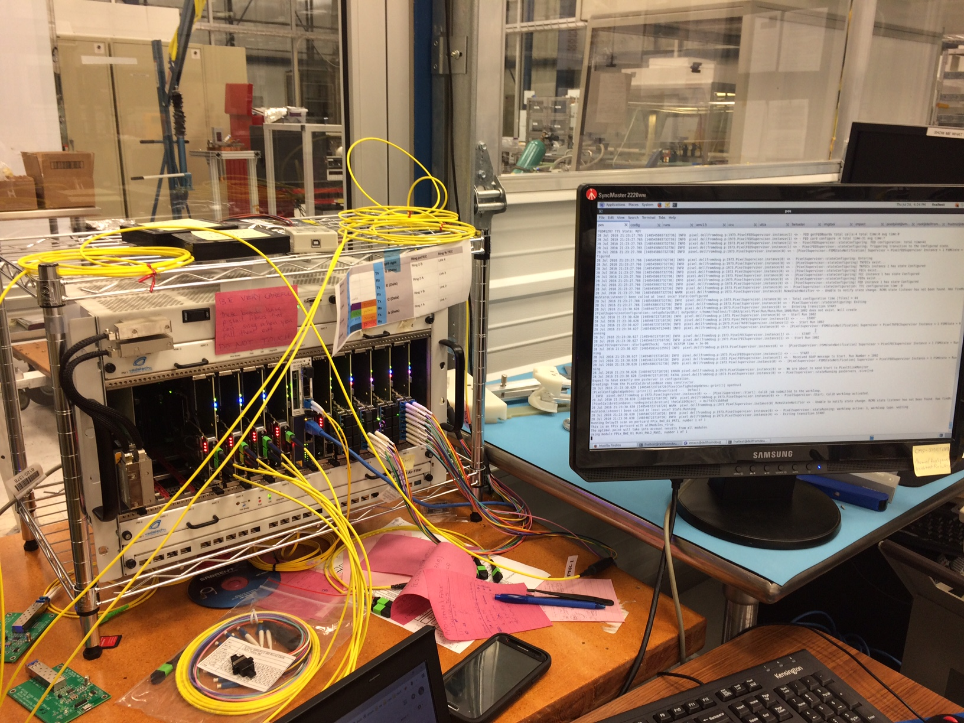
Commissioning and μTCA DAQ
All modules are fully qualified and calibrated at -20ºC on the bench
Full readout chain tested with final components in situ after assembly
New DAQ system (μTCA instead of VME)
Time for calibration inside CMS very short/non-existent
Close to final calibrations will happen in cleanroom at CERN before installation
Might include one quarter of FPIX into CMS cDAQ (from surface) to exercise whole chain
Already gained invaluable experience with pilot system (a few FPIX modules installed in 3rd disk position of current detector (since LS1)

Slide 11
Summary
CMS will replace its pixel detector in early 2017
This will maintain high quality physics data taking until HL-LHC upgrades
Newly designed readout chip, CO2 cooling, almost double the number of pixels, new DAQ technology; all within the framework of the existing infrastructure and power supplies
Module production going well, scheduled to finish in September
First two FPIX quadrants assembled; BPIX assembly will start soon
See related posters:
M.Alyari: FPIX Mechanical support and cooling
H.Weber: FPIX Electronics and system testing
V.Tavolaro: BPIX module qualification

Slide 12
BACKUP

Slide 13
Layer 1 PROC600 Innovations

