Slide 1

Linear Collider Software and Computing
N. Nikiforou, CERN/EP-LCD and University of Texas at Austin
On behalf of the CLICdp and ILD collaborations

Slide 2
Introduction
The LC community has a tradition of common software development and tool sharing
Software is shared by the detector concepts of both ILC and CLIC and the hardware R&D groups, and even projects like FCC, CEPC, …
  Detector design and optimization
  Technology studies
  Physics performance studies
The tools should be generic, flexible, and robust to be used with different detector concepts and their variations
Collaborative SW development, pooling of manpower and resources towards common goals

Slide 3

Linear Collider Software: iLCSOft
Event Data Model LCIO common to all detector concepts
Applications typically run via “processors” within a modular C++ application framework called Marlin
New common Detector Geometry Description and Simulation Framework: Detector Description 4 HEP (DD4hep)
Event Data Model: LCIO
Generator
Whizard,
Pythia, …
Simulation
DDG4, …
Recon-
Struction
Overlay,
Digitization
Tracking, PFA
Analysis
Vertexing
Jet Clustering
Flavor Tagging
Detector Geometry from DD4hep
This talk: focus on new developments from ILD and CLICdp

Slide 4
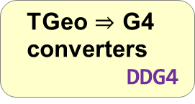
DD4hep – A single source of information
Compact
description
xml
Detector
drivers
c++
DD4hep aims to support the entire experimental lifecycle:
Detector design and Optimization
Construction
Operation, data taking, and analysis
Detector
constructors
python
Generic Detector
Description Model
Based on ROOT TGeo
c++
Geometry
Display
(Via ROOT OpenGL Viewer)
geoDisplay
Geometry
Display
(Via ROOT OGL Viewer)
teveDisplay
Extensions
where
required
TGeo $⇒$ G4
converters
DDG4
Reconstruction
Extensions
DDRec
Analysis
Extensions
Conditions DB
DDCond
Geant4
Program
ddsim
Event Display
(less geometry detail)
CED
Reconstruction
Program
Marlin
Analysis
Program
Alignment /
Calibration
DDAlign

Slide 5
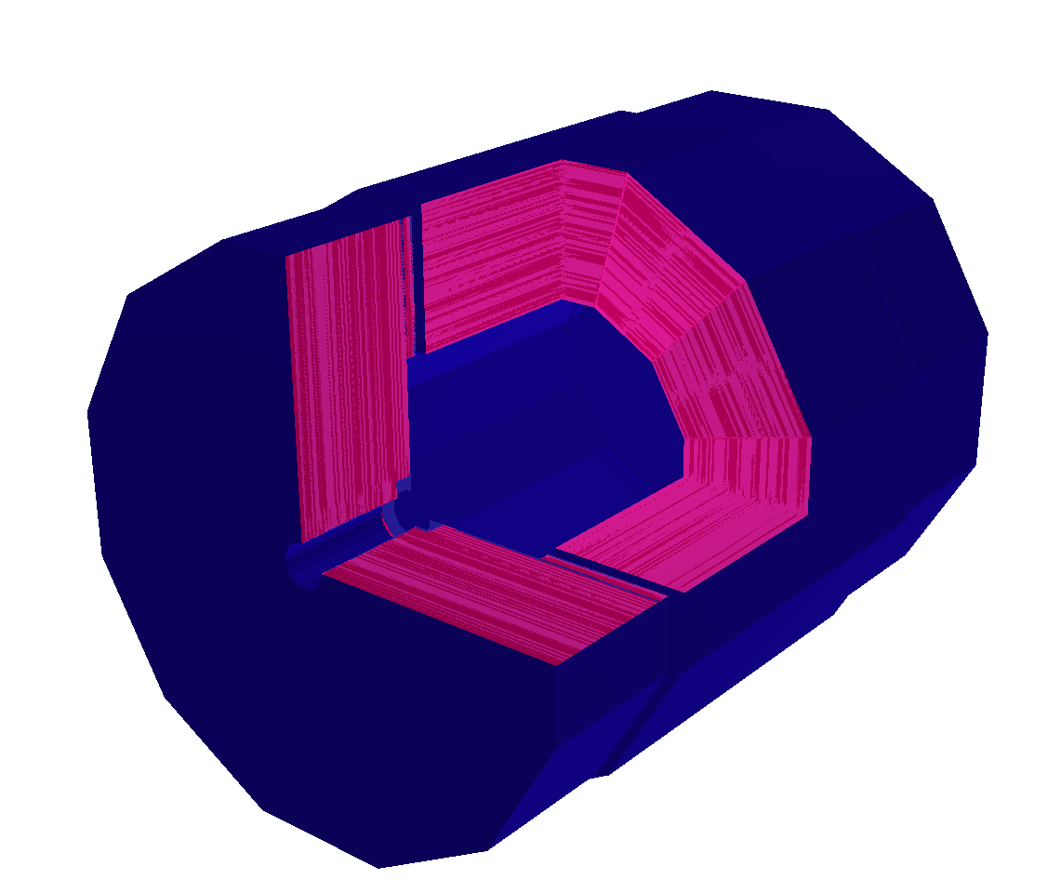
Detector drivers in DD4hep
<detector id="DetID_HCAL_Barrel" name="HCalBarrel" type="HCalBarrel_o1_v01" readout="HCalBarrelHits" vis="HCALVis" >
<dimensions nsides="HCal_symm" rmin="HCal_Rin" z="HCal_Z" />
<layer repeat="(int) HCal_layers" vis="HCalLayerVis" >
<slice material="Steel235" thickness="0.5*mm" vis="AbsVis"/>
<slice material="Steel235" thickness="19*mm" vis="AbsVis"/>
<slice material="Polysterene" thickness="3*mm" sensitive="yes"/>
<slice material="PCB" thickness="0.7*mm"/>
<slice material="Steel235" thickness="0.5*mm" vis="AbsVis"/>
<slice material="Air" thickness="2.7*mm"/>
</layer>
</detector>
Generic driver palette available: Scalable and flexible detector drivers
You can adapt/write your own
  User decides balance between detail and flexibility
Visualization, Radii, Layer/module composition in compact xml
  Example above
Volume building in C++ driver
  See backup
Once you have the detector geometry, you can extend it, i.e. add more information using the Reconstruction Extensions (next slide)

Slide 6
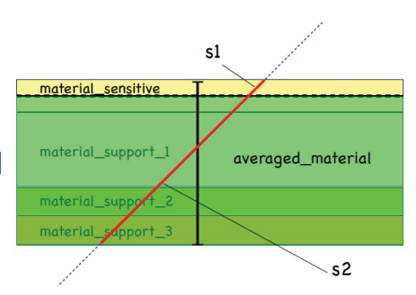
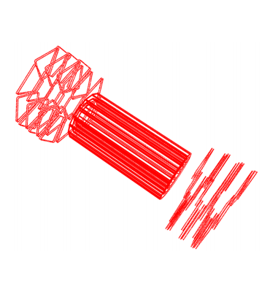
DDRec: Interface to Reconstruction
HCalBarrel
LayeredCalorimeterStruct
The user can attach any object that could help during reconstruction to a DetElement
  e.g. HCal barrel, ECal endcap, Vertex det., …
The subpackage DDRec currently offers two main options:
  Simple data structures that get filled by the detector constructor at creation time
    Detector layout, symmetry, extent, ..
    # layers, technology, material properties, …
  Surfaces: special type of extension foreseen mainly for tracking
    Measurement directions
    Material effects automatically averaged from the detailed model
extent
outer_symmetry
inner_symmetry
outer_phi0
layers
layers
LayeredCalorimeterStruct::Layer
distance
cellSize0
inner_thickness
inner_nIntLengths
outer_nRadLengths
…

Slide 7
DDG4: Gateway to Geant4
DD4hep performs in-memory translation of geometry from TGeo to Geant4
Plugin Mechanism
  Sensitive detectors, segmentations and configurable actions, …
Configuration mechanism (via Python, XML, ROOT)
  Physics lists, regions, limits, filters, fields, sensitive detectors, …
MC Truth history and linking
Support for different input/output file formats
Users can write own simulation applications with DDG4
We already provide a fully working and flexible simulation program called ddsim (next slide)

Slide 8
ddsim application
Python executable with many configuration options
  Configure most useful and common user options in the command line
    Even supports tab-completion of arguments and their options!
  Can also configure with a “steering file”
Mature, validation in parallel to DDG4 in advanced stage
To be used by ILD and CLICdp in the next large scale simulation productions
ddsim –h
usage: Running DD4hep Simulations: [-h] [--steeringFile STEERINGFILE]
[--compactFile COMPACTFILE] [--runType {batch,vis,run,shell}]
[--inputFiles INPUTFILES [INPUTFILES ...]] [--outputFile OUTPUTFILE] [-v PRINTLEVEL]
[--numberOfEvents NUMBEROFEVENTS] [--skipNEvents SKIPNEVENTS]
[--physicsList PHYSICSLIST] [--crossingAngleBoost CROSSINGANGLEBOOST]
[--vertexSigma VERTEXSIGMA VERTEXSIGMA VERTEXSIGMA VERTEXSIGMA]
[--vertexOffset VERTEXOFFSET VERTEXOFFSET VERTEXOFFSET VERTEXOFFSET]
[--macroFile MACROFILE] [--enableGun]
[--enableDetailedShowerMode] …
And much more… Continuously implementing more options!

Slide 9
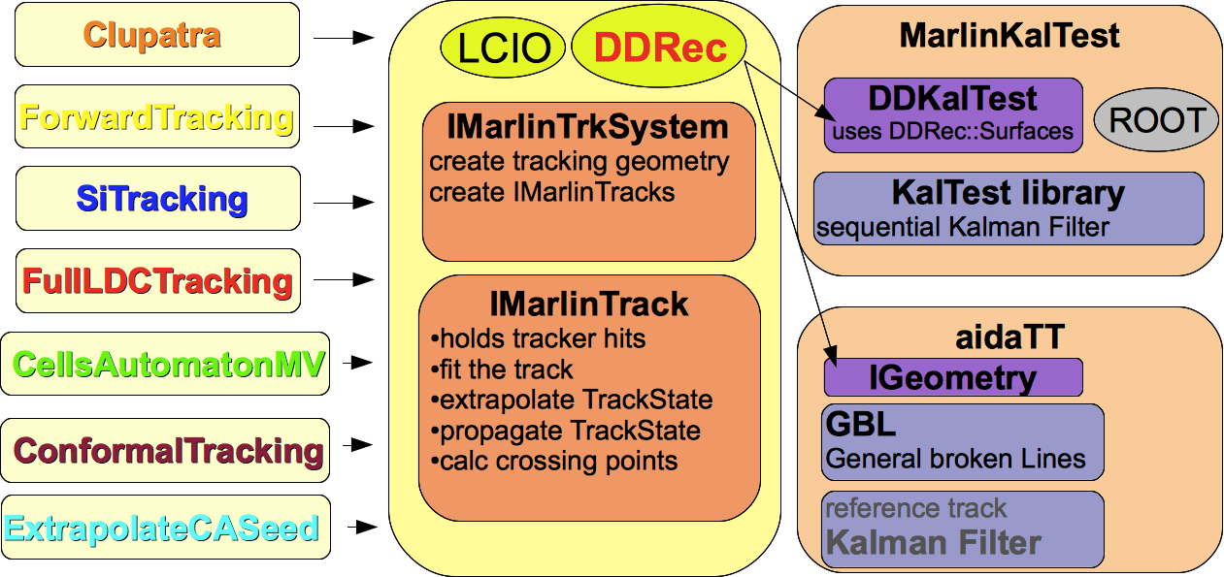
Tracking tools
A collection of pattern recognition tools and algorithms is available in iLCSoft, shared by the various detector concepts
  Even with different technologies: Si+TPC (ILD) Vs Full-Si (CLICdp and SiD)
MarlinTrk provides a common interface to pattern recognition
  Interfaced with DD4hep
  Could mix-and-match different pattern recognition algorithms with different track fitters
A generic Tracking Package is available to everybody out of the box

Slide 10
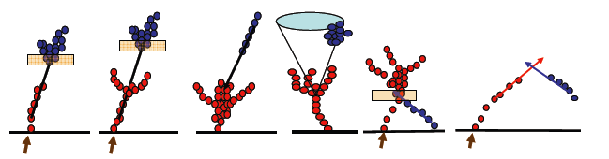
Particle Flow Reconstruction
Reconstruction of the individual
visible final state particles
PandoraPFA: Not tied to particular geometry or framework
  Customers: CLICdp, ILD, SiD, Calice, LAr-TPC, …
Run through DDMarlinPandora with DD4hep as single source of geometry information
  No material or other geometry info in processor parameters
  Preserve independence from particular detector geometry
Pandora Particle Flow Reconstruction
Auxiliary classes
DDMCParticleCreator
DDPandoraPFANew Processor
DDPfoCreator
DDGeometryCreator
Marlin Steering File
DDPandoraPFANewProcessor parameters:
Pandora Settings
Collection names
Calibration constants and cuts
TrackCreator algorithm
DDCaloHitCreator
DDTrackCreatorBase
DD4hep
LCDD instance in Marlin
DDTrackCreatorCLIC
OR
DDTrackCreatorILD
…

Slide 11
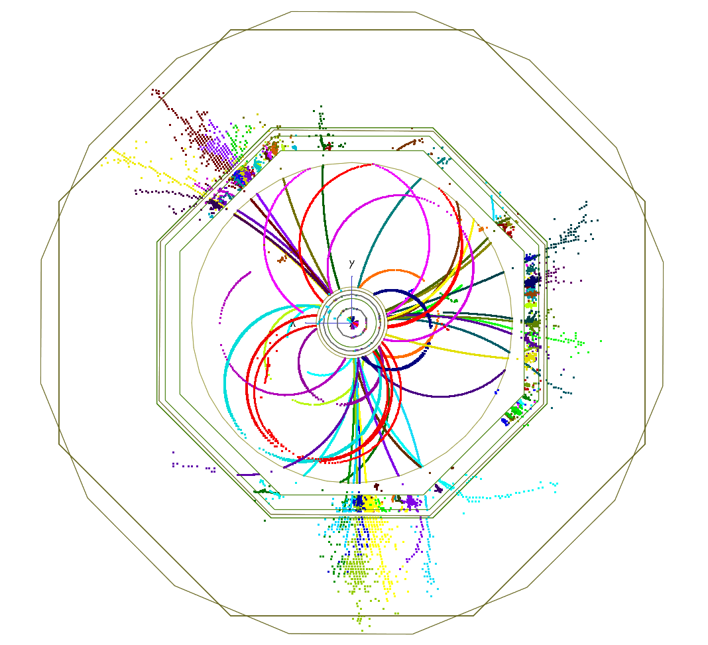
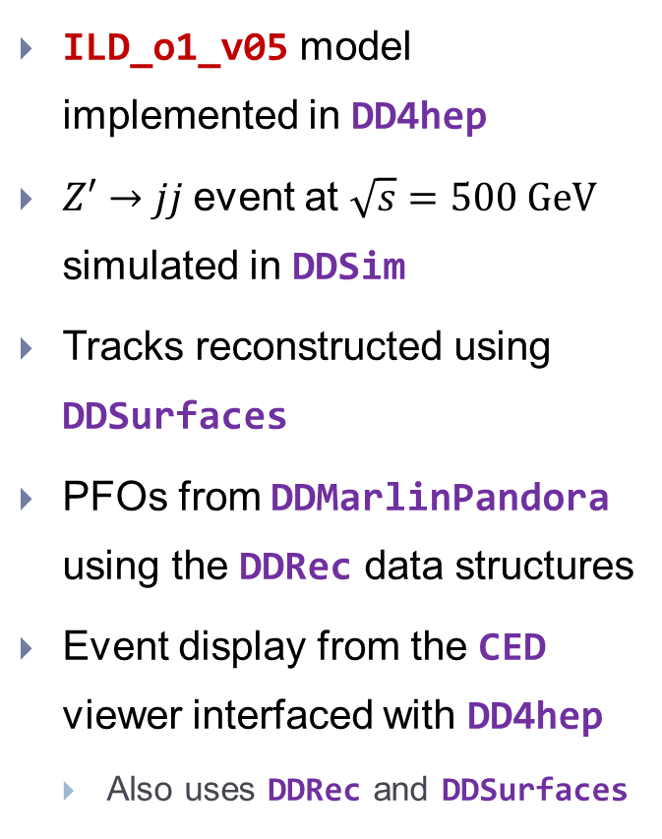
Event simulated, reconstructed and visualized fully with DD4hep
ILD_o1_v05 model implemented in DD4hep
$Z′→jj$event at $\sqrt{s}=500 GeV$ simulated in DDSim
Tracks reconstructed using DDSurfaces
PFOs from DDMarlinPandora using the DDRec data structures
Event display from the CED viewer interfaced with DD4hep
  Also uses DDRec and DDSurfaces

Slide 12

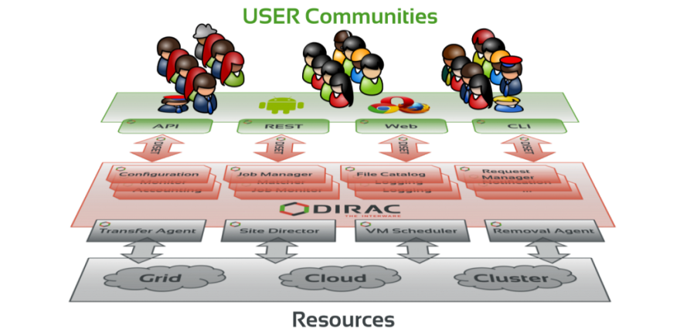
LC Computing with ILCDIRAC
iLCDirac is based on the DIRAC interware originally developed for LHCb
Dirac (Distributed Infrastructure with Remote Agent Control): High level interface between users and distributed resources
iLCDirac: Additional functionality to provide simple interface for the users to the LC Software
Central system for large scale productions
from ILCDIRAC ... Applications import DDSim
dd = DDSim()
dd.setVersion("ILCSoft-01-18-00")
dd.setDetectorModel("CLIC_o2_v03")
dd.setInputFile("LFN:/ilc/prod/clic/500gev/Z_uds/gen/0/00.stdhep")
dd.setNumberOfEvents(30)
Full Generation, Simulation, Reconstruction and Analysis chain from iLCSoft available on iLCDirac

Slide 13
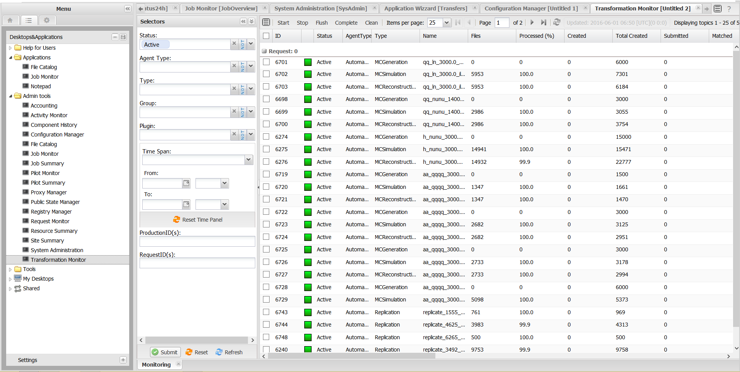
DIRAC Web interface
Nice clean interface for configuration and management of both large scale production and user jobs

Slide 14
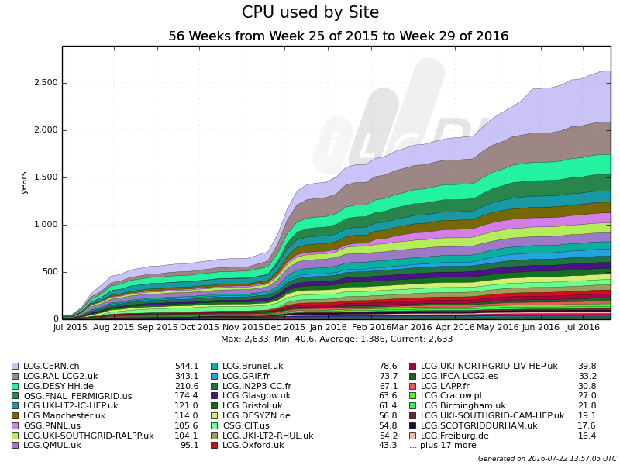
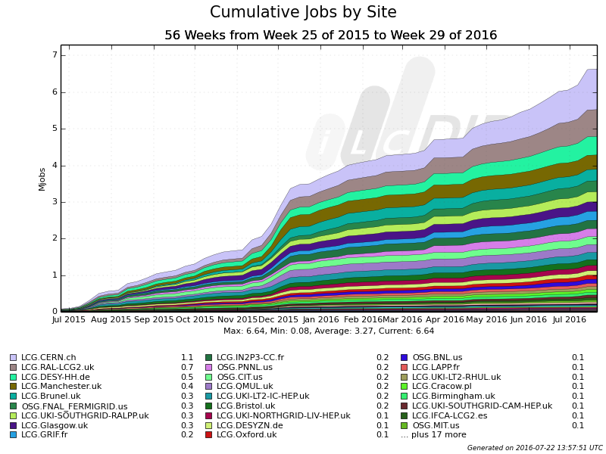
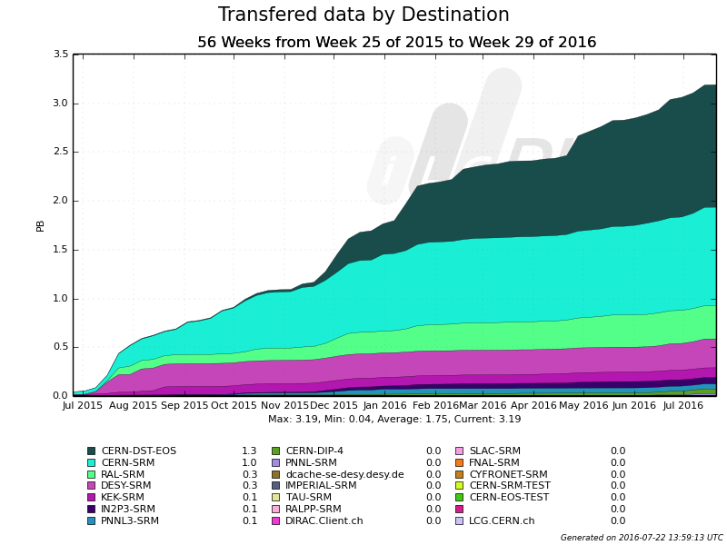
Utilization over the last year
Using some dedicated and many opportunistic resources from LCG & OSG
4 Million jobs, 2500 CPU years
  Peak of about 15 to 20 thousand jobs
Created and transferred almost 2 PB
Mainly simulation and reconstruction for detector optimization and physics benchmark studies

Slide 15
Summary
Effort to have as much as possible common software in the Linear Collider community
iLCSoft offers a collection of flexible tools for not just the LC community. It can be used out of the box to:
  Develop and optimize detector designs and simulation models
  Develop and test reconstruction algorithms and analysis tools
  Run the full generation, simulation, and reconstruction chain
Generic software tools made possible due to common EDM (lcio) and geometry support (DD4hep/DDRec/DDG4)
iLCDirac provides a unified interface to the grid resources used by the LC community

Slide 16
BACKUP SLIDES

Slide 17
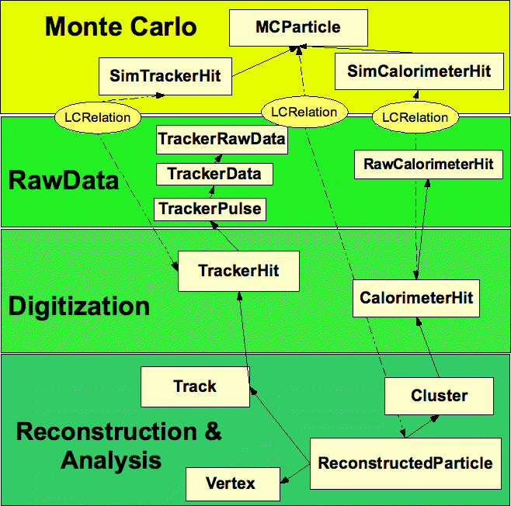
LCIO – Common Event Data Model
Common event data model (EDM) and persistency for linear collider community
  Joint DESY and SLAC (and LLR) project - first presented @ CHEP 2003
Used by ILD, SiD, CLICdp and test beams for more than 10 years
Common EDM proven to be crucial for collaborative SW development across detector concepts

Slide 18
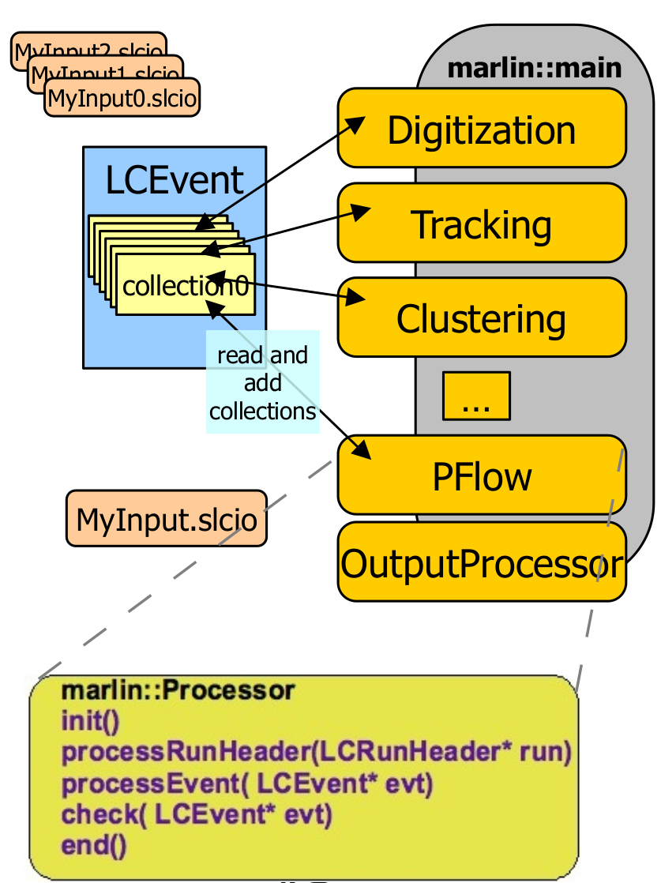
Marlin
Modular Analysis & Reconstruction for the LINear collider
modular C++ application framework for the analysis and
reconstruction of LC data
LCIO as transient data model
  event data bus/white board model
xml steering files:
  fully configure application
  order of modules/processors
  parameters global + processor
self documenting
  parameters registered in user code
consistency check of input/output collection types
Plug & Play of modules

Slide 19
DD4hep motivation and goals
Complete detector description
  Includes geometry, materials, visualization, readout, alignment, calibration, etc.
Support full experiment life cycle
    Detector concept development, detector optimization, construction, operation
    Easy transition from one phase to the next
Consistent description, single source of information
    Use in simulation, reconstruction, analysis, etc.
Ease of use
Few places to enter information
Minimal dependencies

Slide 20
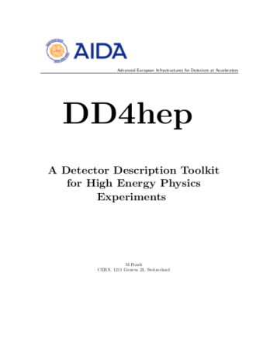
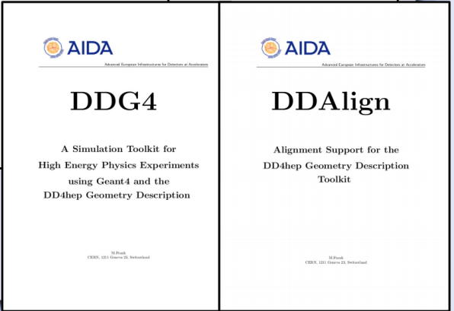
DD4hep components
DD4hep: basics/core
  Basically stable
DDG4: Simulation using Geant4
  Validation ongoing
DDRec: Reconstruction support
  Driven by LC Community
  Covered in this talk
DDAlign, DDCond : Alignment and Conditions support
  Being developed
http://aidasoft.web.cern.ch/DD4hep
DDRec
DDCond

Slide 21
Current DD4hep Toolkit Users
 |  | DD4hep | DDG4
ILD | F. Gaede et al., ported complete model ILD_o1_v05 from previous simulation framework (Mokka) |  | 
CLICdp | New detector model being implemented after CDR, geometry under optimization |  | 
SiD | Recently decided to move to DD4hep |  | 
CALICE | Started |  | 
FCC-eh | P. Kostka et al. |  | 
FCC-hh | A. Salzburger et al. | 
FCC-ee | Interest expressed, already used in studies | 
CEPC | Investigations ongoing | 
LHCb | Investigations started for LHCb upgrade | 
Feedback from users is invaluable and helps shaping DD4hep!

Slide 22
Describing a detector in DD4hep
Description of a
tree-like hierarchy of
“detector elements”
  Subdetectors or
  parts of subdetectors
Detector Element describes
  Geometry
  Environmental conditions
  Properties required
  to process event data
  Extensions (optionally):
  experiment, sub-detector or
  activity specific data, measurement surfaces, …
Detector
Ladder
Module
Vertex
.
.
.
Tracker
EndA
Sector1
…
ECal
EndB
Geometry
.
.
.
Alignment
Conditions
HCal
Readout
Visualization
…
Subdet. data
.
.
.
Reconstr. data
M. Frank

Slide 23
Geometry Implementation
Subdetector
Hierarchy (Tree)
M. Frank
Subdetector status
(conditions)
Alignment
Detectors
Conditions
0…n
Readout
Segmentation
DetectorElement
0…1
Visualization
children 1..n
detector: 1
placements: 0…1
visattr: 0…1
volume: 1
PlacedVolume
[TGeoNode]
LogicalVolume
Material
transform: 1
Envelope
[TGeoShape]
[TGeoMatrix]
GDML
content
Geometry
[TGeoBox]
[TGeoCone]
….
[TGeoTube]

Slide 24
LayeredCalorimeterStruct
HCalBarrel
LayeredCalorimeterStruct
e.g: attach a LayeredCalorimeterStruct to the DetElement for HCalBarrel
Developed with needs of Pandora in mind
Fill all the dimension, symmetry and other info (almost definitely known to the driver)
Fill a vector of substructures with info on the layers
  Sum/average material properties from each slice:
  nRadLengths += slice_thickness/(2*slice_material.radLength());
nIntLengths += slic_thickness/(2*slice_material.intLength());
thickness_sum += slice_thickness/2;
After you are done, add the extension to the detector:
  sdet.addExtension<DDRec::LayeredCalorimeterData>(caloData);
extent
outer_symmetry
inner_symmetry
outer_phi0
layers
layers
LayeredCalorimeterStruct::Layer
distance
cellSize0
inner_thickness
inner_nIntLengths
outer_nRadLengths
…

Slide 25
More DDRec Structures
More simple data structures available in DD4hep/DDRec/DetectorData.h:
  FixedPadSizeTPCData: Cylindrical TPC with fixed-size pads
  ZPlanarData: Si tracker planes parallel to z
  ZDiskPetalsData: Si tracker disks
  ConicalSupport: e.g. beampipe
Please consult documentation for conventions on the relevant quantities
Assuming the structures are filled according to the conventions, DDMarlinPandora will transparently (and correctly) convert the geometry and initialize Pandora

Slide 26
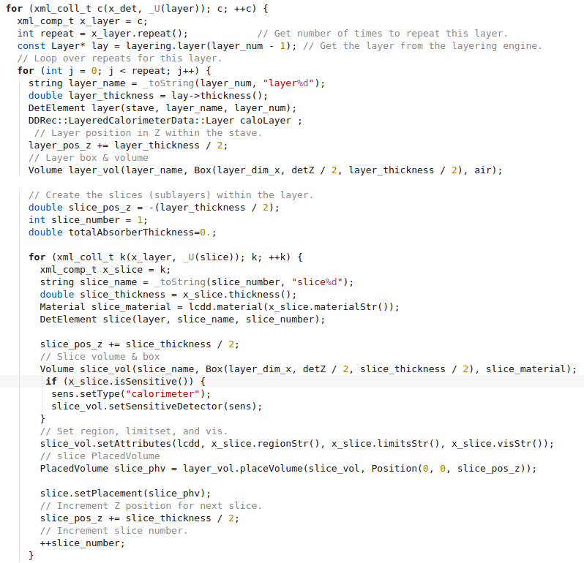
Example HCal Barrel Driver
Always within a function called
static Ref_t create_detector(LCDD& lcdd, xml_h e, SensitiveDetector sens) {
…
return sdet;
}
Macro to declare detector constructor at the end:
DECLARE_DETELEMENT(HCalBarrel_o1_v01, create_detector)

Slide 27
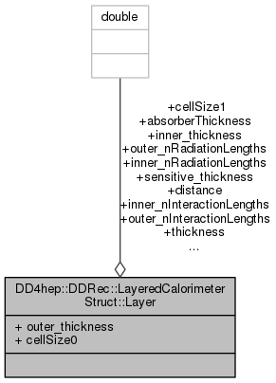
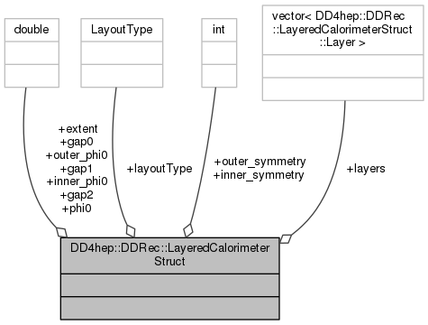
LayeredCalorimeterStruct

Slide 28
Measurement surfaces
Special type of extension, used primarily in tracking
Attached to DetElements and Volumes (defining their boundaries)
  Can be added to drivers via plugins without modifying detector constructor
They hold u,v,normal and origin vectors and inner/outer thicknesses
Material properties averaged automatically
Could also be used for fast simulation
Outlines of surfaces drawn in teveDisplay for CLICdp Vertex Barrel and Spiral Endcaps

Slide 29
DDG4: Gateway to Geant4
DD4hep facilitates in-memory translation of geometry from TGeo to Geant4
Plugin Mechanism:
  Sensitive detectors, segmentations and configurable actions, …
All shared with Reconstruction!
Configuration mechanism (via python, XML, CINT)
  Physics lists, regions, limits, fields, …
For example, configure and launch the simulation using python (next slide)

Slide 30
DDG4 configuration
DDG4 is highly modular
Easy to configure, especially if one uses the python dictionaries
Configure actions, filters, sequences, cuts, …
...
part = DDG4.GeneratorAction(kernel,
"Geant4ParticleHandler/ParticleHandler")
kernel.generatorAction().adopt(part)
part.SaveProcesses = ['Decay']
part.MinimalKineticEnergy = 1*MeV
part.KeepAllParticles = False
...
user = DDG4.GeneratorAction(kernel,
"Geant4TCUserParticleHandler/UserParticleHandler")
user.TrackingVolume_Zmax = DDG4.tracker_region_zmax
user.TrackingVolume_Rmax = DDG4.tracker_region_rmax
...

Slide 31
Where can I find all this?
DD4hep comes complete with example drivers and compact files in iLCSoft releases
  Under DD4hep/<version>/DDDetectors
  More examples and use cases under DD4hepExamples
For the Linear Collider Community we have another package: LCGeo
  We collect here the concrete implementations of Detector Models (currently for CLICdp and ILD)
    All their versions, additional specialized subdetector drivers if needed
  We also have use case examples, configuration files and tools including ddsim, a tool to run DDG4 simulation

