Slide 1

Will There Be
Energy Frontier Colliders
After the LHC?
Vladimir Shiltsev
Fermilab *, Batavia, IL , USA
Accelerator Physics Center
August 4, 2016
*FRA, LLC operates Fermilab under contract No. DE-AC02-07CH11359 with the U.S. DOE

Slide 2

Will There Be Energy Frontier
Colliders After LHC?
"Any headline that ends in a question mark can be answered by the word NO."
Betteridge's law of headlines
Ian Betteridge, a British technology journalist
Hinchliffe's rule
particle physicist Ian Hinchliffe
Davis' law
( who’s Davis ? )

Slide 3
( Yes or No ) = ( Physics × Feasibility )
PHYSICS case of post-LHC high energy physics machine depends on the LHC discoveries:
  it might call for a collider (if signals are clear)
  otherwise, search for signs of new physics in the neutrino/rare decays (Intensity Frontier) or astrophysics
FEASIBILITY of an accelerator is actually complex:
  Feasibility of ENERGY
    Is it possible to reach the E of interest / what’s needed ?
  Feasibility of PERFORMANCE
    Will we get enough physics out there / luminosity ?
  Feasibility of COST
    Is it affordable to build and operate ?
What can we learn/take from the past/present?

Slide 4
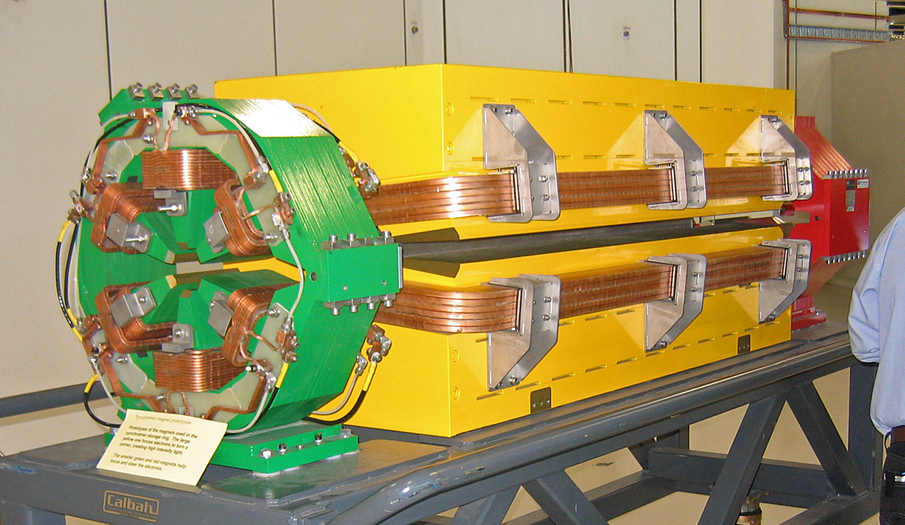
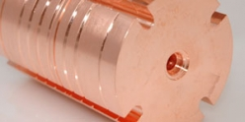
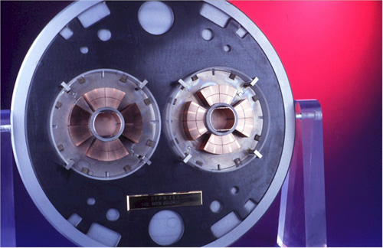
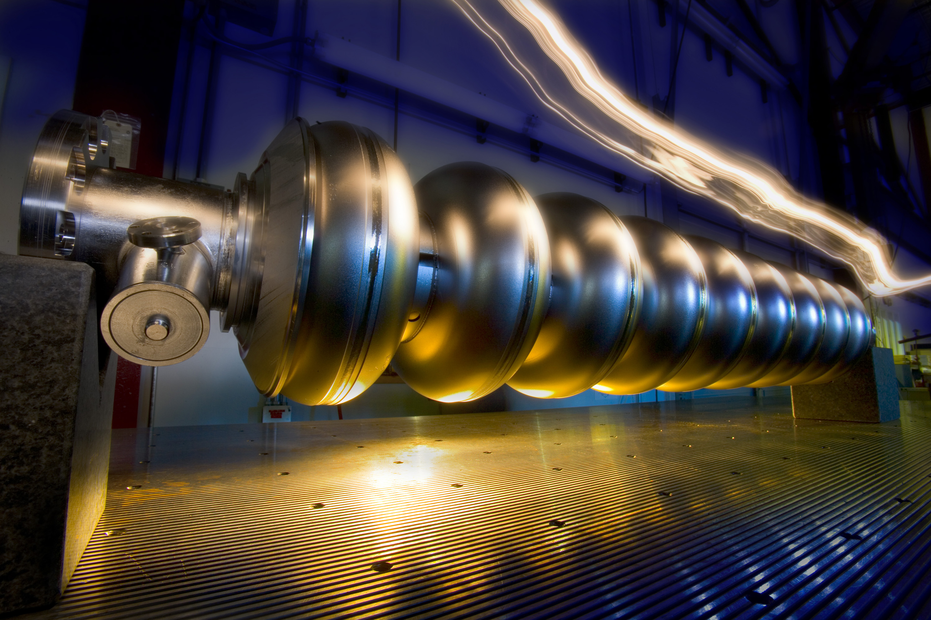
Four “Feasible” Technologies
Normal Conducting Magnets
Normal Conducting RF
SC magnets
SC RF
… in addition to “traditional” technologies of tunneling, electric power and site infrastructures, etc …

Slide 5
Analysis:
2014 JINST 9 T07002
17 “Data Points” - Costs of Big Accelerators:
Actually built:
  RHIC, MI, SNS, LHC
Under construction:
  XFEL, FAIR, ESS
Not built but costed:
  SSC, VLHC, NLC
  ILC, TESLA, CLIC, Project-X, Beta-Beam, SPL, ν-Factory
V.Shiltsev, A phenomenological cost model for high energy particle accelerators
Wide range :
  4 orders in Energy, >1 order in Power, >2 orders in Length
  Almost 2 orders in cost
    (normalized to US TPC)

Slide 6

αβγ - Cost Estimate Model:
Cost(TPC) = α L^{1/2} + β E^{1/2} + γ P^{1/2}
±33% estimate, for a “green field” accelerators
“US-Accounting” = TPC ! ( ~ 2 ×European Accounting )
Coefficients ( units: 10 km for L, 1 TeV for E, 100 MW for P )
  α≈ 2B$/sqrt(L/10 km)
  β≈ 10B$/sqrt(E/TeV) for SC/NC RF
  β≈ 2B$ /sqrt(E/TeV) for SC magnets
  β≈ 1B$ /sqrt(E/TeV) for NC magnets
  γ≈ 2B$/sqrt(P/100 MW)

Slide 7
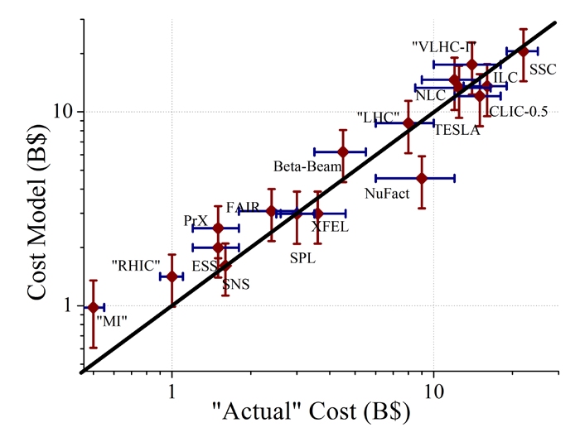
Total Cost vs Model (Log-Log)
The αβγ-model is good to +-30%
αβγ -

Slide 8
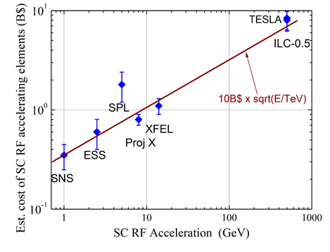
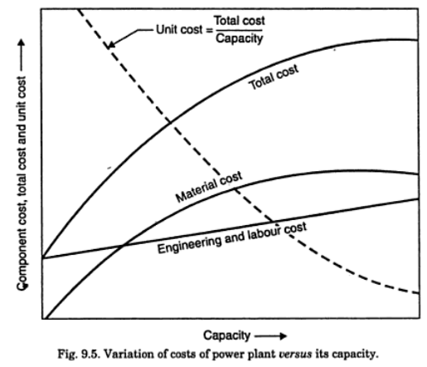
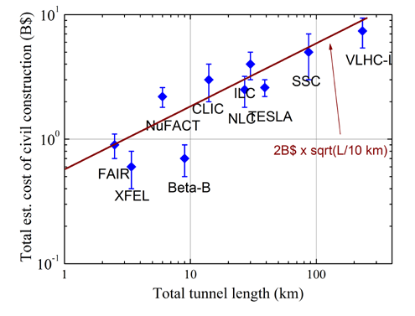

Illustrations
Comment:
Sqrt-functions are quite accurate over wide range because such dependence well approximates the “initial cost” – effect :

Slide 9




Take LHC as an Example:
αβγ – Model:
  40 km of tunnels
  14 TeV c.o.m SC magnets
  ~150 MW of site power
TOTAL PROJECT COST : 14B$ ± 4.5B$
CERN LHC Factbook (2009):
  6.5 BCHF, incl. 5 BCHF for accelerator
  (European Accounting)
  x 2 to US TPC → 10 BCHF=10B$
  Cost of existing injector complex ~30-40% 3-4 B$
  TPC : ~13-14B$
  (of which CERN paid 10 over ~8 yrs)
2009-003

Slide 10
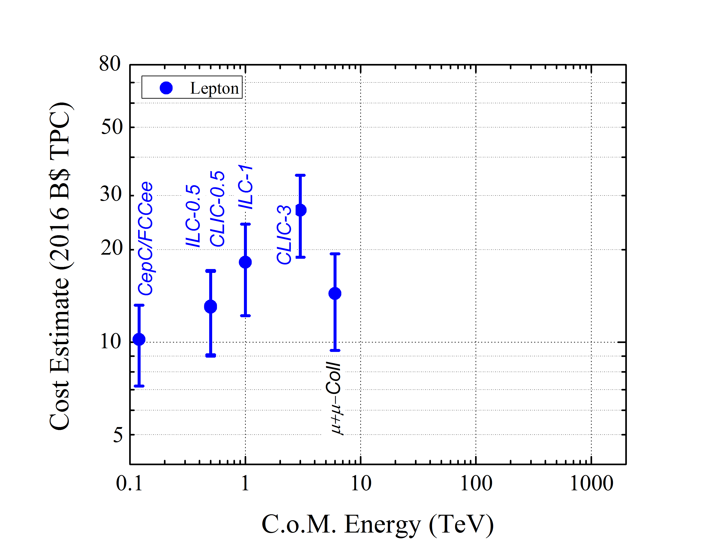
LHC reference

Slide 11
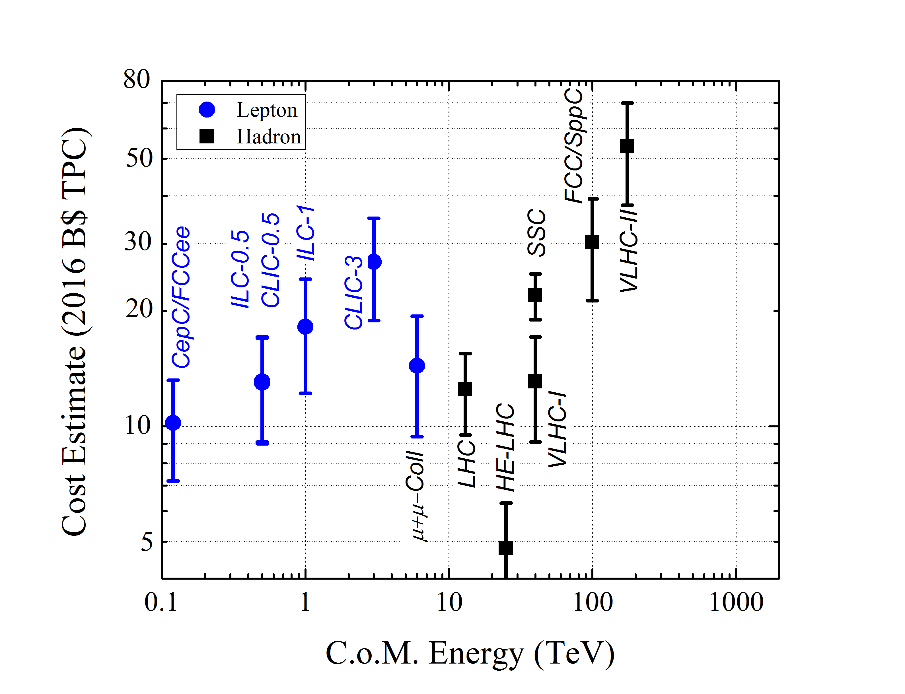
Option 1: re-use
LHC, inj, infrastr.

Slide 12
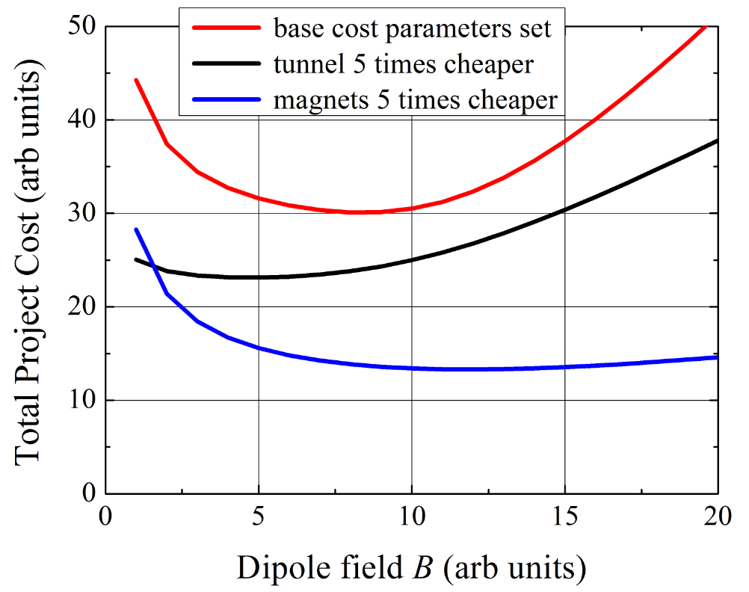
100 TeV pp : Qualitative Cost Dependencies
Option 2 : Develop Technology to Lower Cost
* for illustration purposes only

Slide 13
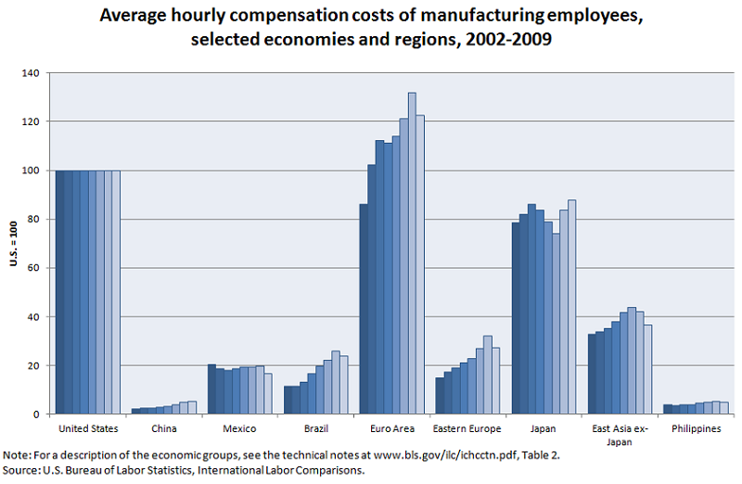
Option 3: “Move to China !”

Slide 14
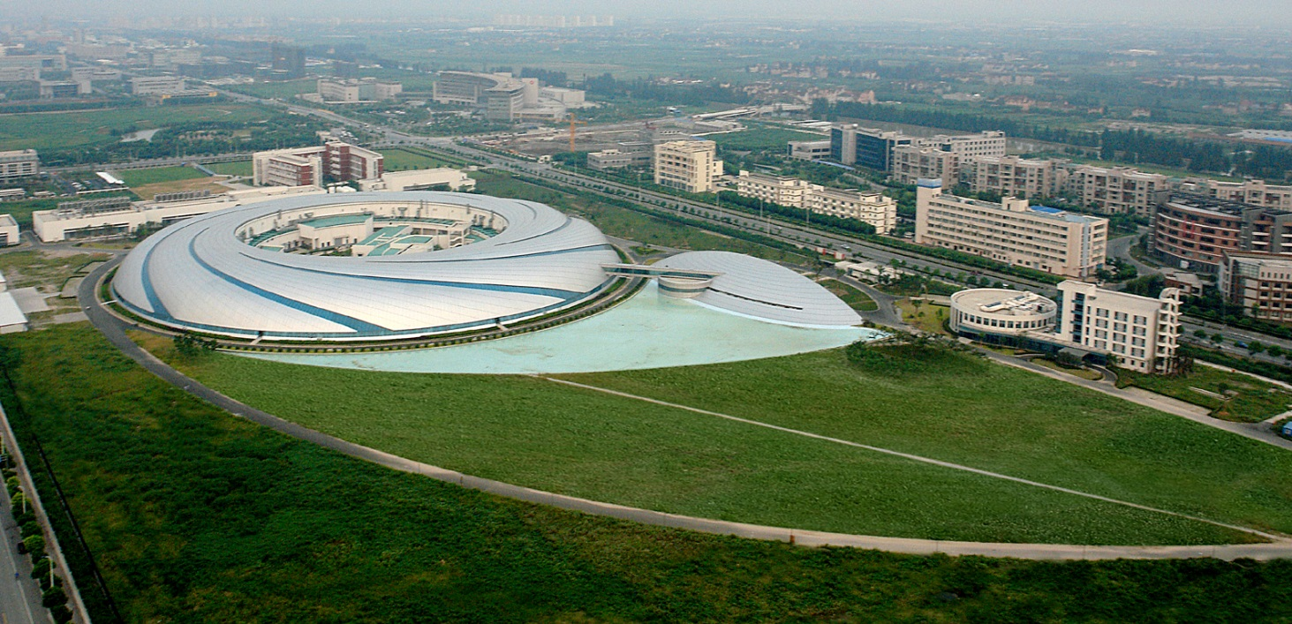
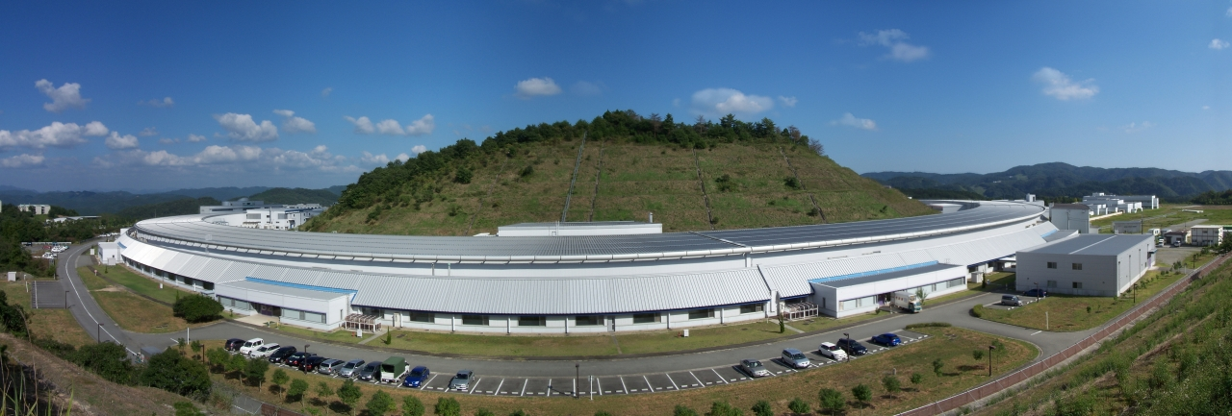
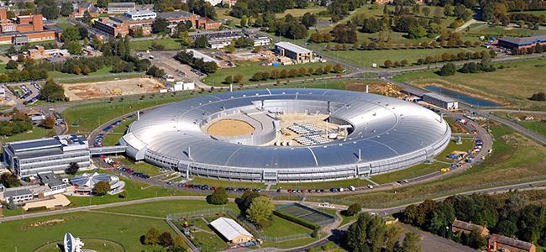
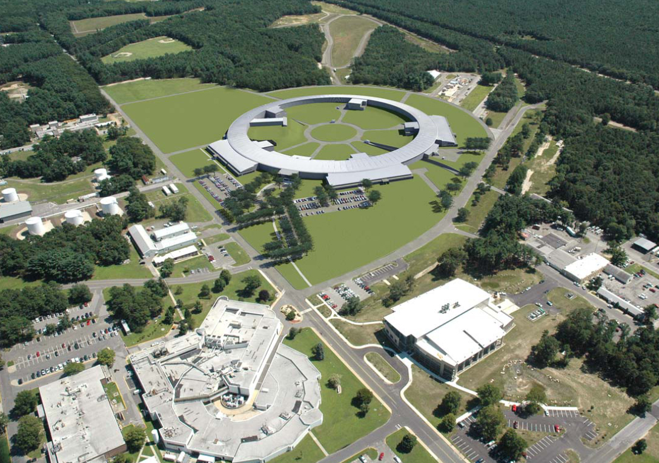
SSRF Spring-8 Diamond NSLSII
China Japan UK USA
432 m
3.5 GeV
1.2B RMB 2007
1436 m
8 GeV
11 BY
1997
562 m
3 GeV
383 M £
2007
792 m
3 GeV
912 M$
2015
Account infl’n, convert to USD and scale to sqrt(1 km):
350 M$ 772 M$ 1040 M$ 1024 M$

Slide 15
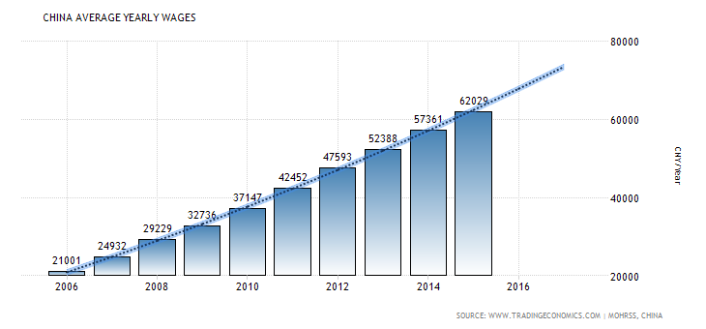
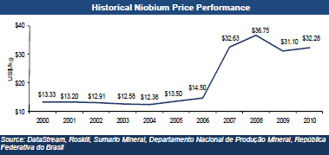
“Move to China !” - Caveats

Slide 16
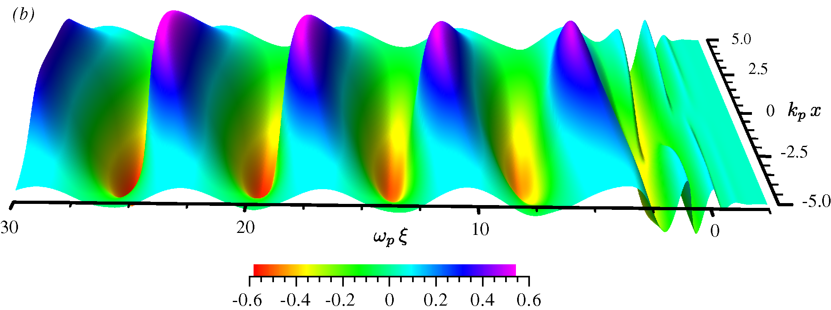
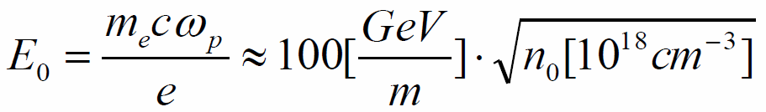
Option 4: New Technology- Plasma
Idea- Tajima & Dawson, Phys. Rev. Lett. (1979)
Plasma wave: electron density perturbation
Laser/beam pulse ~ λ_{p}/c
Option A:
Short intense e-/e+/p bunch
Few 10¹⁶cm⁻³, 6 GV/m over 0.3m
Option B:
Short intense laser pulse
~10¹⁸cm⁻³, 50 GV/m over 0.1m
First looks into “Plasma-Collider”: staging kills ! <E>~2 GV/m,ε

Slide 17
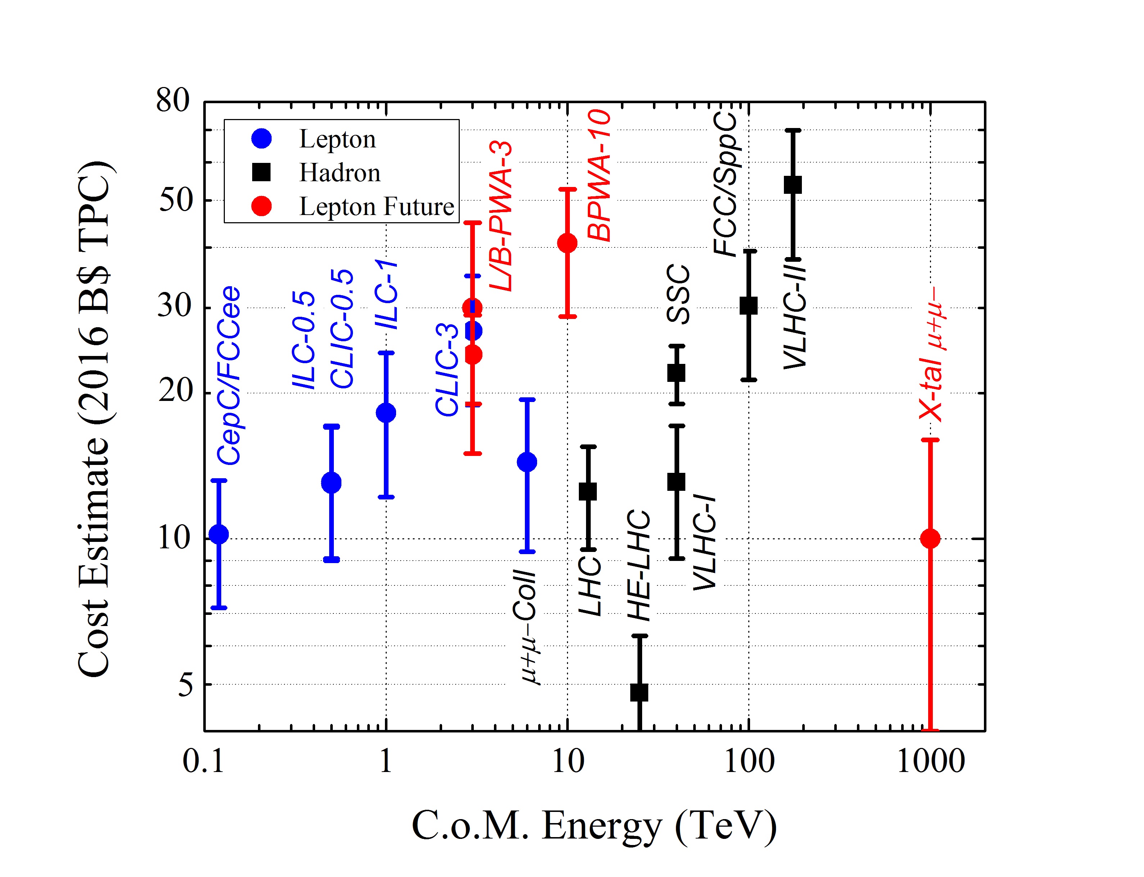
“Dream”
collider

Slide 18
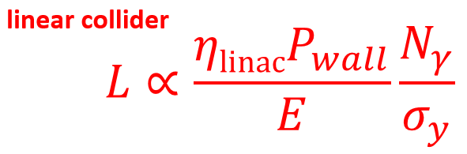
“Dream” Collider: Choices
Far Future “Energy Frontier” assumes
  300-1000 TeV (20-100 × LHC)
  “decent luminosity” (TBD)
Surely we know:
For the same reason there
is no circular e+e- collider above
Higgs-F there will be no circular pp
colliders beyond 100 TeV → LINEAR
2. Electrons radiate 100% beam-strahlung (<3 TeV) and in focusing channel
(<10 TeV) → µ+µ- or pp

Slide 19
“Phase-Space” is Further Limited
“Cost Feasibility”: for 20-100×LHC
  < 10 B$
  < 10 km
  < 10 MW (beam power, ~100MW total)
New technology should provide >30 GeV/m @
total component cost <1M$/m ( ~NC magnets now)
SC magnets equiv. ~ 0.5 GeV per meter (LHC)
3. Only one option for >30 GeV/m known now: dense plasma→ that excludes protons→ only muons

Slide 20
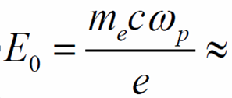
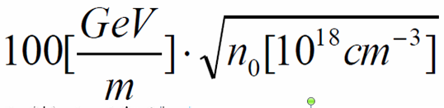
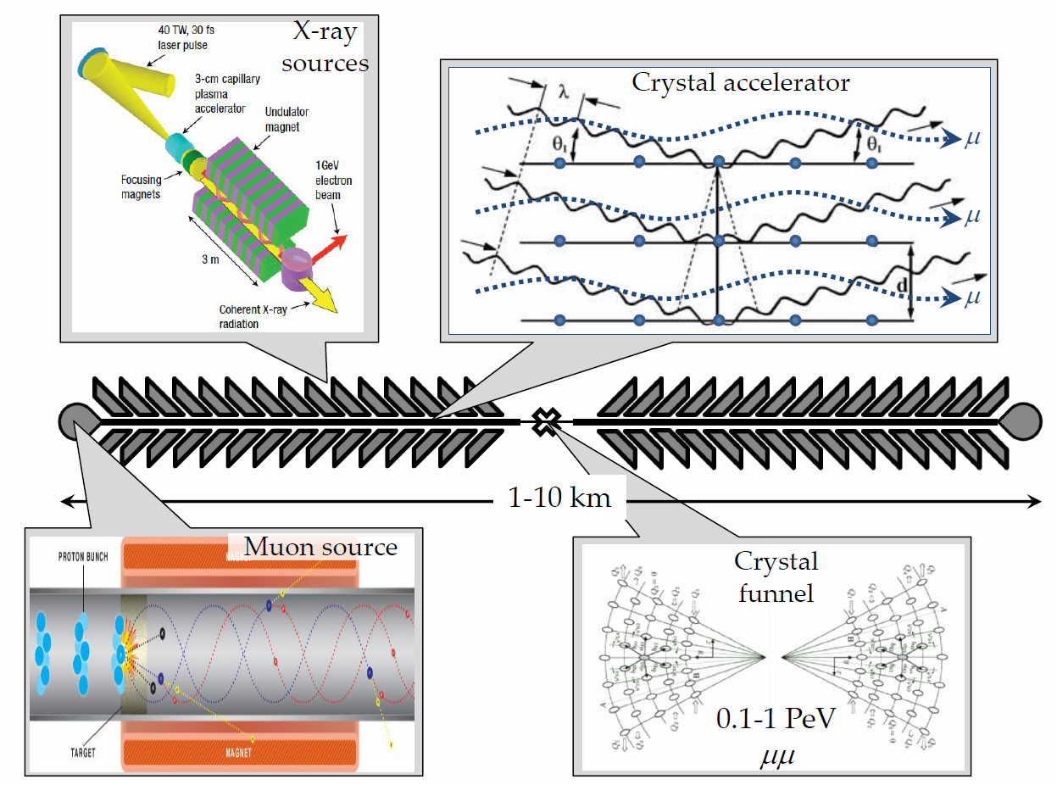
“Dream” Collider = Muons + Acceleration in Crystals + Continuous Focusing (Channeling)
n~10²² cm⁻³,
10 TeV/m →
V.Shiltsev, Phys. Uspekhy 55 965 (2012)
1 PeV =
1000 TeV
n_{μ} ~1000
n_{B} ~100
f_{rep} ~10⁶
L ~10³⁰⁻³²

Slide 21
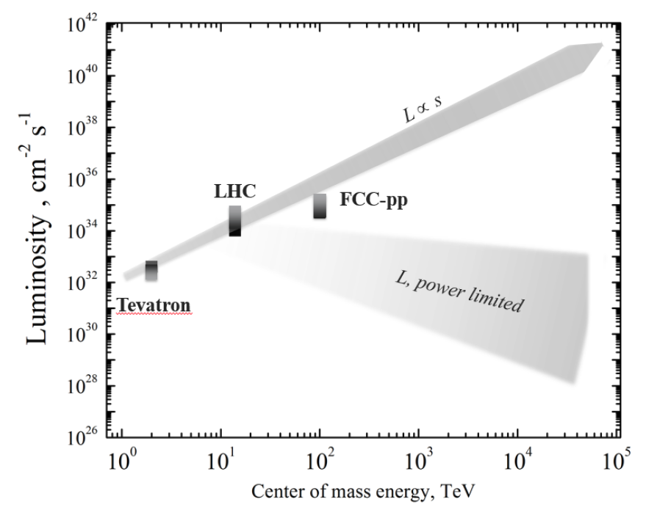
Paradigm Shift : Energy vs Luminosity
  fundamental problem : limited facility power → P_{b}=I_{b}E → I_{b}=P_{b}/E →
  L ~ P_{b}/E

Slide 22
HEP’s “Far” Future
Good News
  options EXIST
    300-1000 TeV muons in plasma/crystals
Bad News
  It will be
    High
    Energy
    Low
    Luminosity

Slide 23
So - Will There Be Energy Frontier Colliders after LHC?
(My) Short Answer is May Be
Long(er) Answer :
  it is LHC results dependent (motivation)
  if based on current technologies (SRF, SCMag, etc) only HE-LHC is cost feasible (<LHC), some are close (CepC/FCCee, ILC, Muon Coll, VLHC-I), others need significant R&D (FCC)…or in China (?)
  hopeful technology of plasma acceleration
  is very expensive now, need 3 decades of R&D; “dream” 1PeV Xtal μμ will be a H.E.L.L. collider

Slide 24
Thank You for Your Attention!

