Slide 1
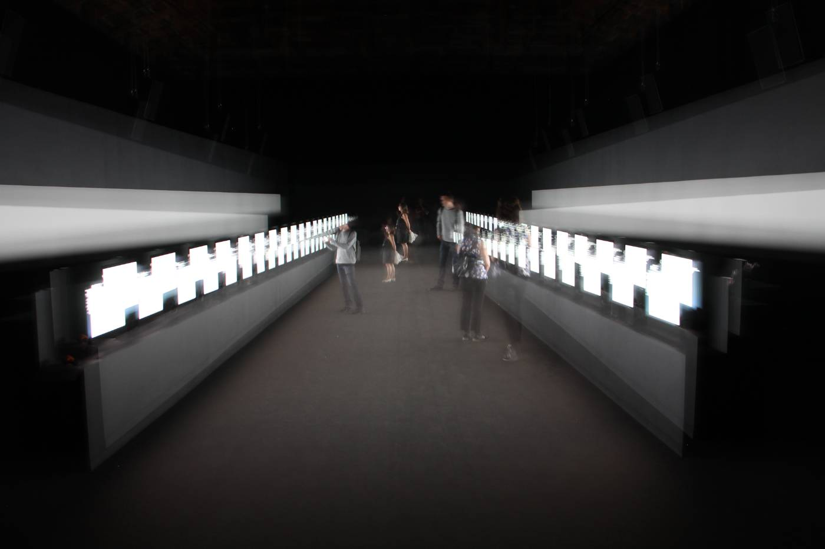
100 days
200 days
37 days
60 days
100 days
145 days
149 days
297 days
2015
2019
Supersymmetry. Ryoji Ikeda (JP), 2015. CERN Artist in Residency (COLLIDE Award)
Julie Haffner

Slide 2
Arts@CERN was born in 2011
CERN’s cultural policy Great Arts for Great Science
Leading arts and science program
20 artists per year
New expert knowledge in the arts
Fundamental aspect: scientists and CERN community involvement in artistic research
Julie Haffner

Slide 3
COLLIDE
Residency Award
  Flagship program: research on artistic practice by encountering the multi-world of particle physics
  Residency for up to 3 months at CERN
  COLLIDE International Award, COLLIDE Geneva, COLLIDE Pro Helvetia
ACCELERATE
Residency Award
  Country specific research award
  Two countries every year
  One-month residency
GUEST ARTISTS
  For established artists and cultural researchers
  Invitation to CERN for a short exploratory visit to learn about what CERN offers to arts and creativity
  Three- five visits per year
Julie Haffner

Slide 4
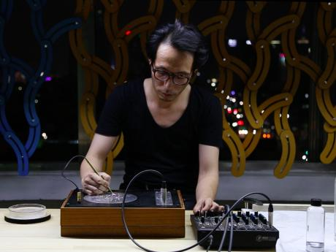
Yunchui Kim, COLLIDE International Artist 2016
International collaborations and funders
Network of international partnerships to reach other audiences and enrich Arts@CERN’s mission.
Arts@CERN partners are governmental and cultural institutions interested in working in collaboration with CERN.
Annual budget: CHF 210,000, CHF 125,000 fundraised by the Arts@CERN team.
Julie Haffner

Slide 5
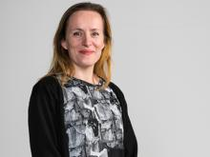
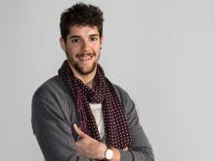
“Great Arts for Great Science”
100 days
200 days
37 days
60 days
100 days
145 days
149 days
297 days
CONTACT US
Monica.bello@cern.ch
Head of Arts@CERN
Julian.calo@cern.ch
Coordinator of Arts@CERN
FOLLOW US:
@artsartcern
http://arts.cern
2015
2019
Julie Haffner

