Slide 1
Search for SUSY in events with one lepton, jets and MET in CMS at √s=13 TeV
Artur Apresyan
on behalf of CMS Collaboration
38th International Conference on High Energy Physics
04/09/2016

Slide 2
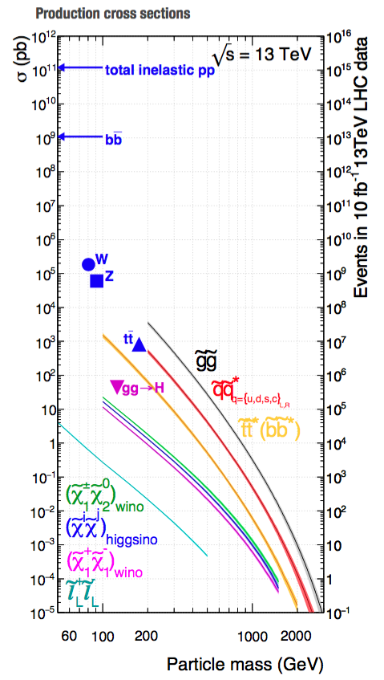
Searches with one lepton in final state
Sensitivity to production of gluinos, stops and EWK SUSY
Presence of a well identified lepton helps to reduce hadronic backgrounds
  Main backgrounds: ttbar and W+jets, QCD
Signatures with multiple tops: large fraction of signals have ≥1 lepton

Slide 3
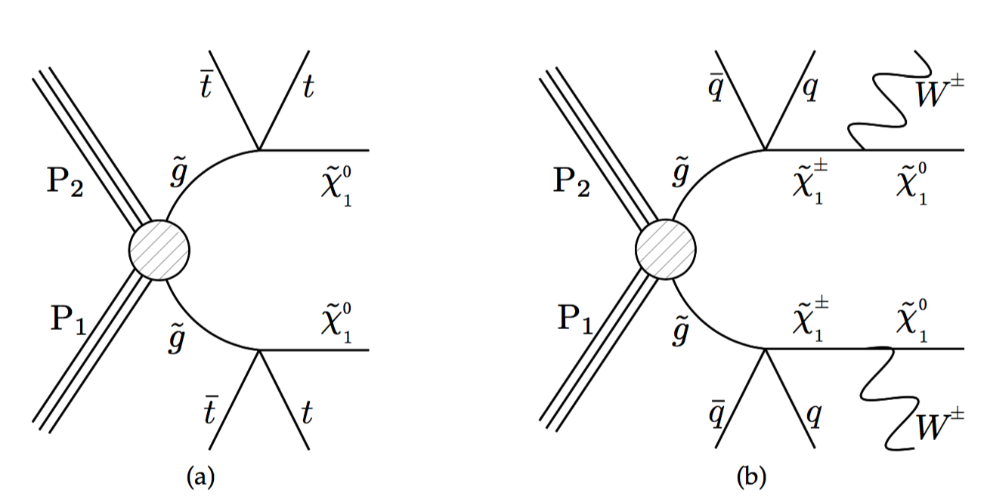
Gluino search with 1-lepton
SUS-16-019
Main backgrounds from ttbar and W+jets
Exploit the difference in W decay kinematics
Δφ
lepton
Δφ
W
Δφ is small for backgrounds
Δφ is spread out in signal, due to LSP

Slide 4
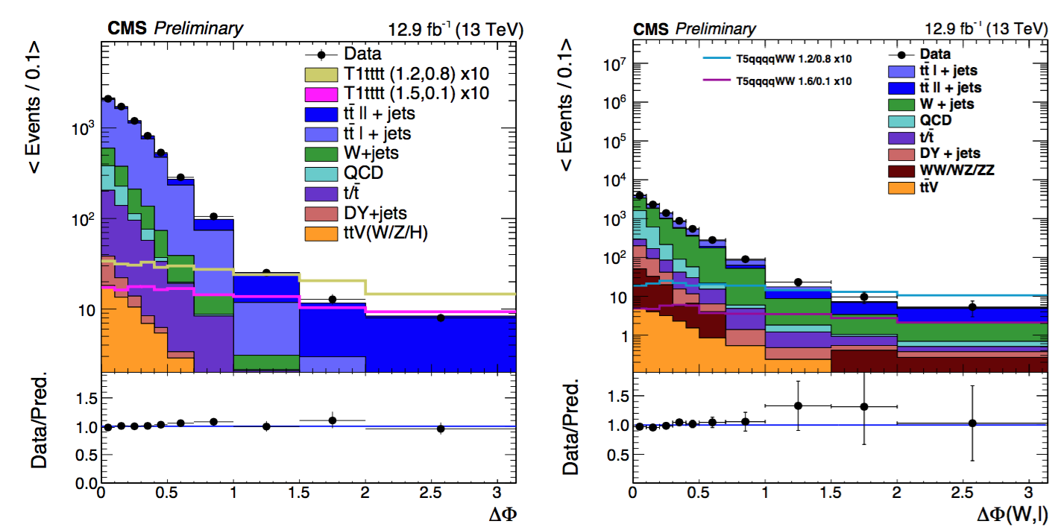
Gluino search with 1-lepton
SUS-16-019
Main backgrounds from ttbar and W+jets
Exploit the difference in W decay kinematics
Events with many b-jets
Events with 0 b-jets

Slide 5
Event selections
SUS-16-019
Event selection:
  Exactly 1 electron or muon p_{T} > 25 GeV
  ≥ 5 (0-b) or ≥ 6 (multi-b) anit-k_{t} jets
  H_{T} > 500 GeV; L_{T} > 250 GeV
Signal regions defined by sliding Δɸ cut: Δɸ > 0.5, 0.75, 1.0
0-b,
Less jets,
SR binned in LT, HT, Δɸ
Bkgd: ttbar and W+Jets
Many b-jets,
Many jets,
SR binned in LT, HT, Δɸ
Bkgd: mostly ttbar

Slide 6
ttbar and W+jets backgrounds
SUS-16-019
Use low Δφ regions to derive translation factors
  Translation factors R_{CS} derived in low N_{jet} sidebands
Multi-b SR: one R_{CS} for all EWK backgrounds
0-b SR: R_{CS} derived separately for W+jets and ttbar: fit N_{b} shape
Extrapolation from low to high N_{jet} obtained from MC
N_{jet}
>5/6 jets
signal region
R_{CS}
3-4/4-5 jets
sideband
x
Δφ

Slide 7
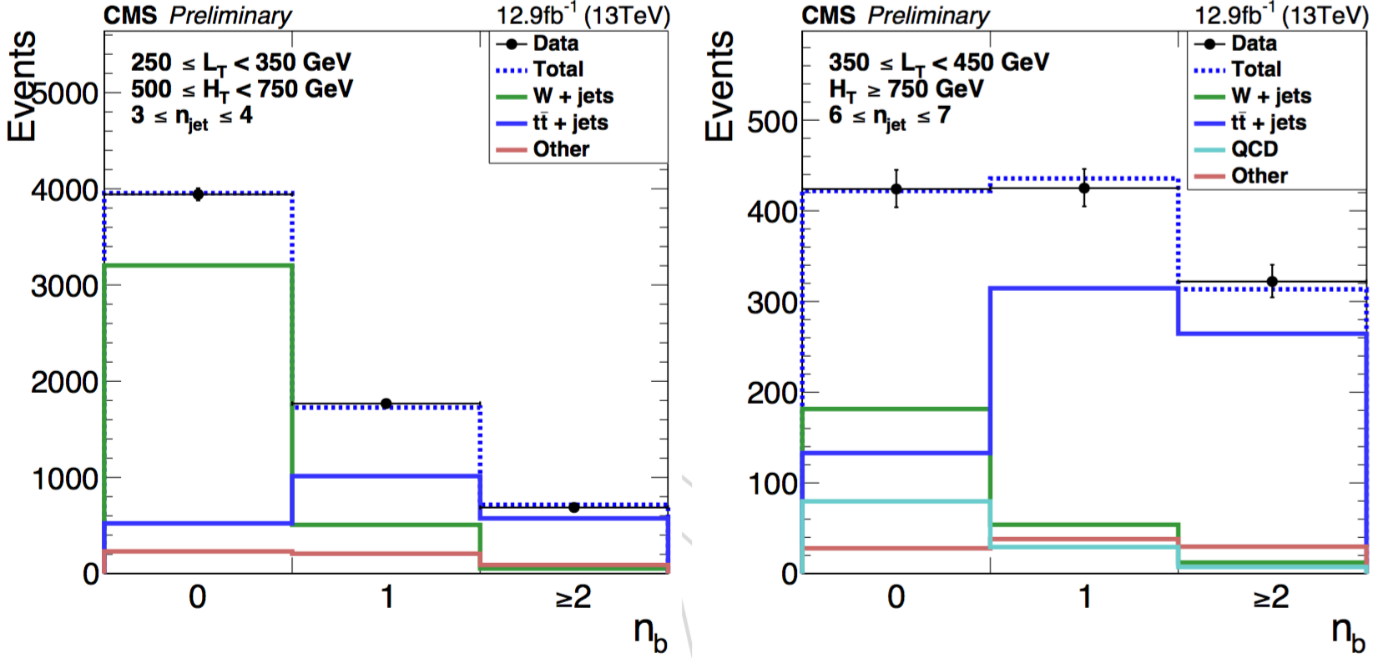
ttbar and W+jets backgrounds
SUS-16-019
Use low Δφ regions to derive translation factors
  Translation factors R_{CS} derived in low N_{jet} sidebands
N_{jet}
>5/6 jets
signal region
R_{CS}
3-4/4-5 jets
sideband
x
Δφ
Template fit to N_{b} to extract relative fractions of tt and W+jets

Slide 8
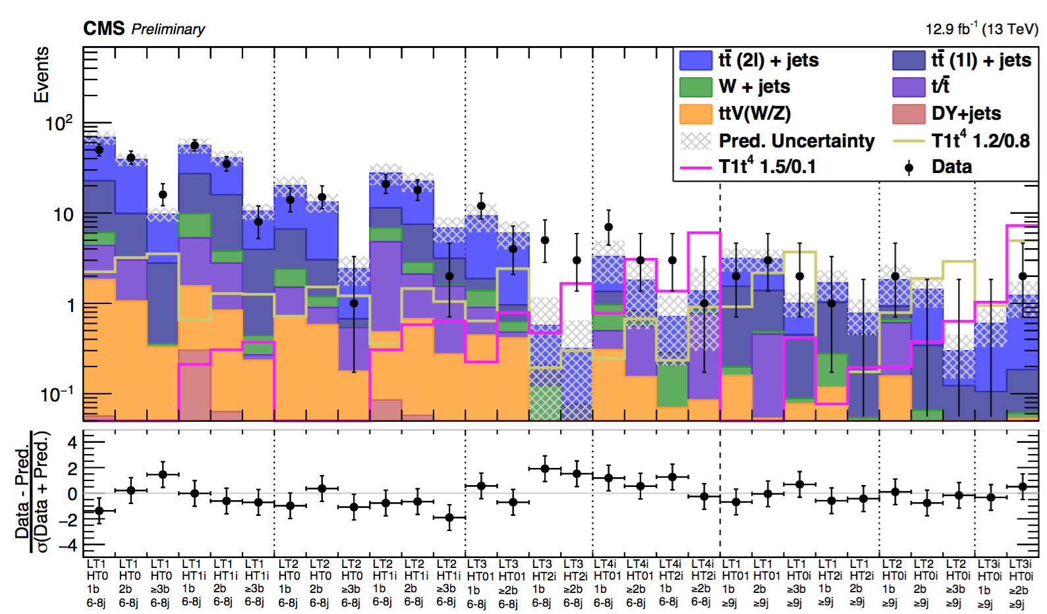
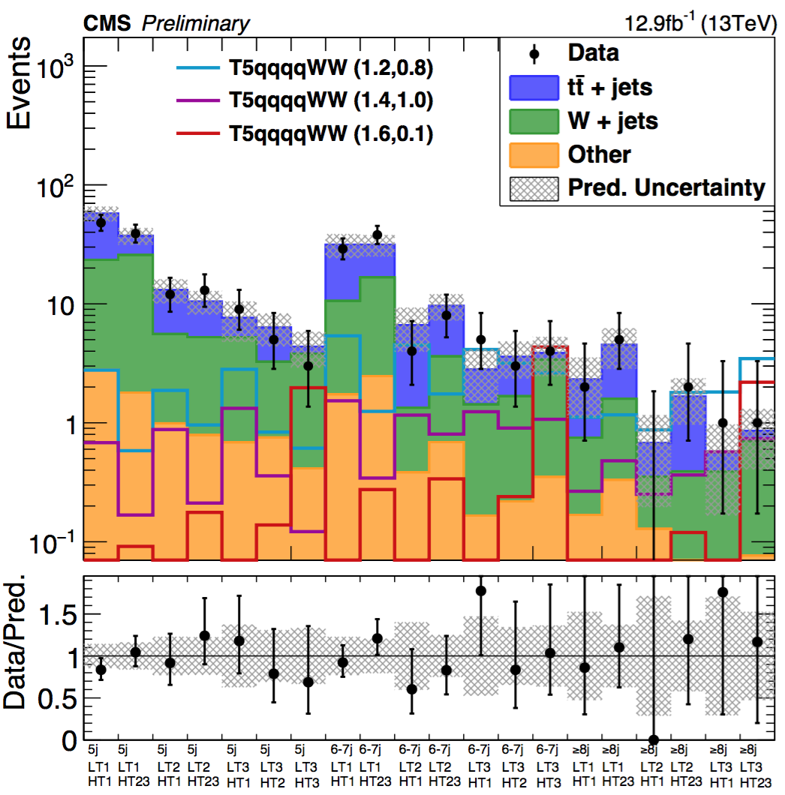
Results
SUS-16-019
multi-b
0-b
No significant deviations from data observed in the signal regions

Slide 9
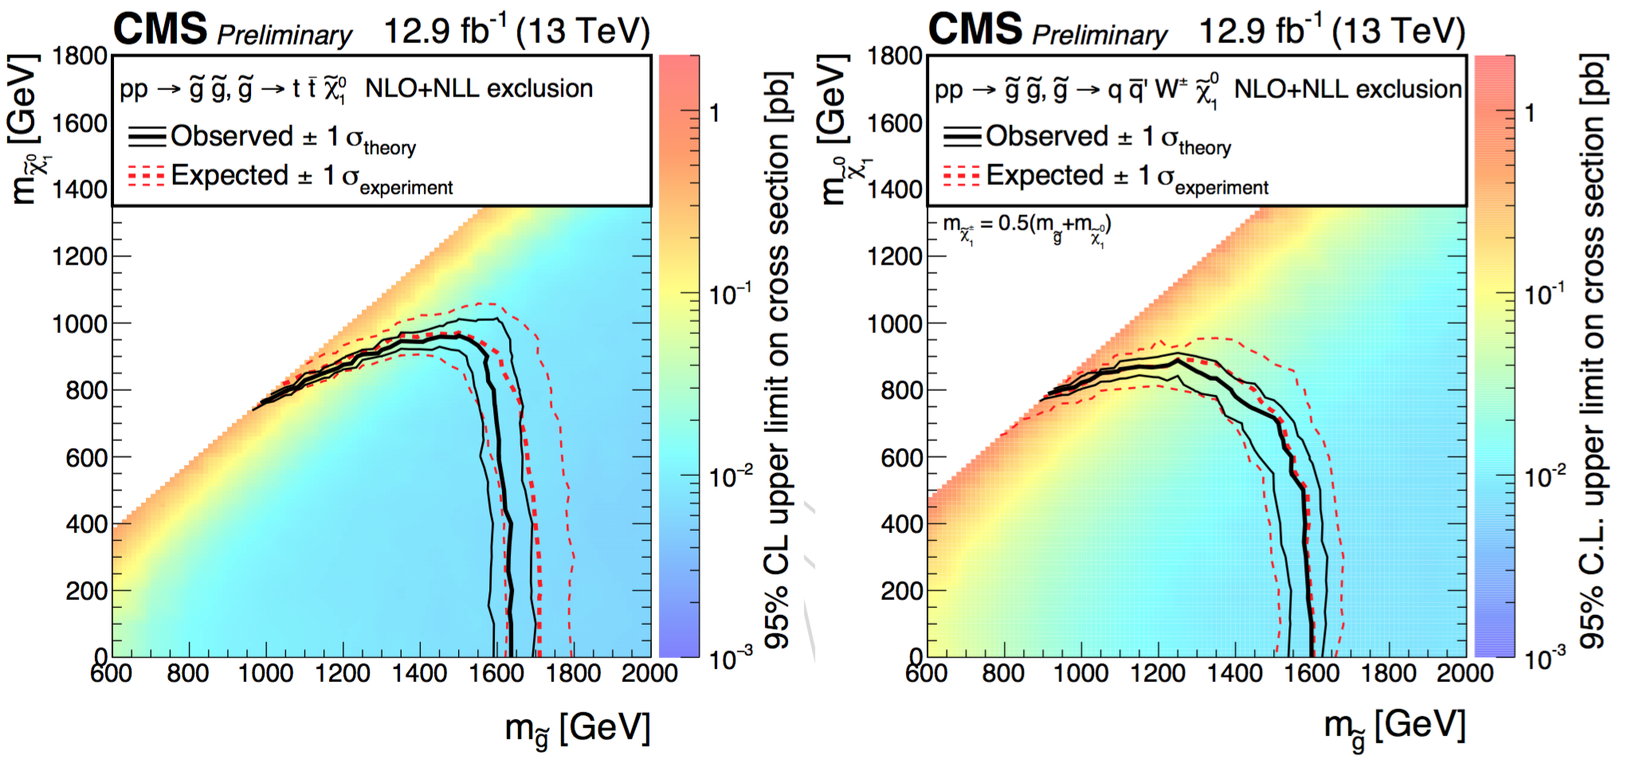
Results
SUS-16-019
Exclude gluino masses
  T1tttt: up to 1.65 TeV for neutralino masses ≤ 900 GeV
  T5qqqqWW: up to 1.6 TeV for neutralino masses ≤ 600 GeV

Slide 10
RPV gluino search in 0- and 1-leptons
SUS-16-013
Search for new physics with a high N_{jets} and N_{b} signature
  0 and 1 lepton final state
  No MET requirement
  Main backgrounds: QCD and ttbar
Benchmark model is RPV SUSY with gluino→tbs
  Using 2.7 fb-1 of 2015 data
Search for excess in N_{b} distribution
  Fit N_{b} distribution in bins of N_{j} and M_{J}

Slide 11
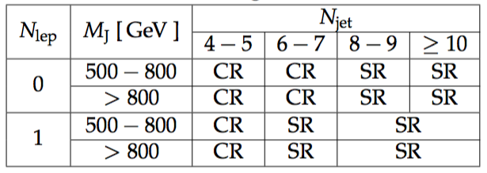
Event selections
SUS-16-013
0 or 1 lepton with P_{T} > 20 GeV
≥ 4 Jets with P_{T} > 30 GeV; N_{b} ≥ 1
H_{T} > 1500 GeV (1200 GeV) for 0-lepton (1-lepton) selection
M_{J} > 500 GeV; M_{J} is re-clustered from R=0.4 anti-k_{t} jets
Data sample split into control and signal regions based on N_{j}, N_{b}, and M_{J}

Slide 12
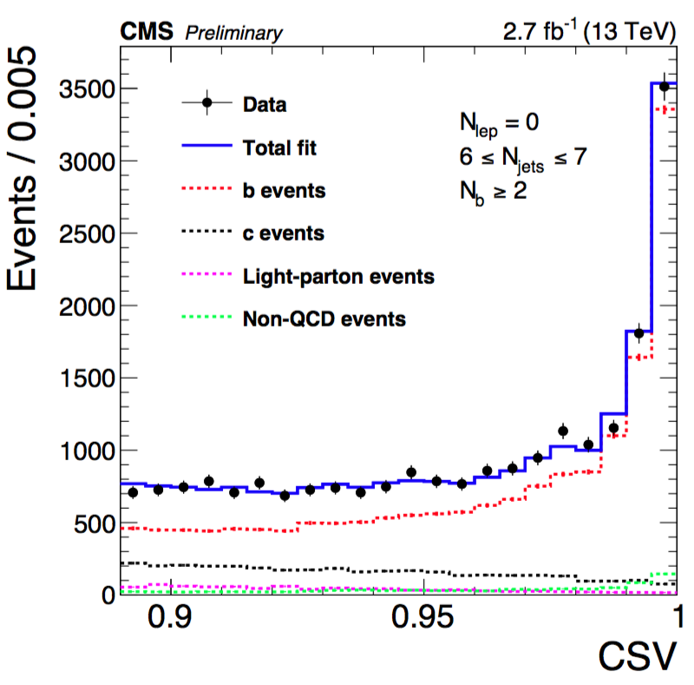
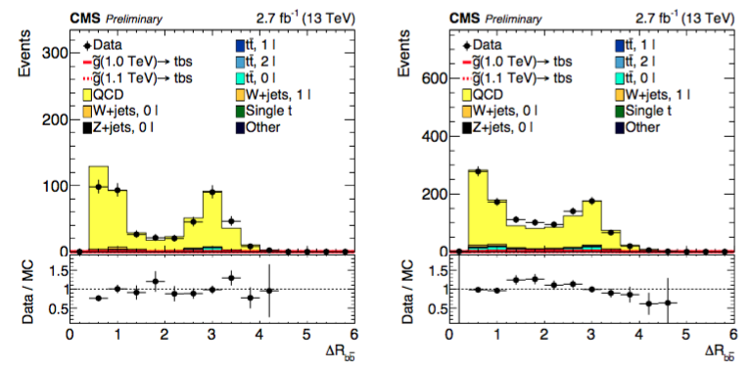
QCD background estimation
SUS-16-013
Flavor composition of QCD events may not be well-modeled
  Template fit to b-tag discriminant shape
  Reweight MC with fractions obtained from the fit
Vary the fit range; and fit in sideband to assess systematic uncertainty
Measure the uncertainty from gluon splitting mis-modeling
  Normalize in high ΔR_{bb} region; and measure mis-modeling in low ΔR_{bb}

Slide 13
Results
SUS-16-013
Likelihood template fit of N_{b} distribution in bins of N_{j} and M_{J}

Slide 14
Results
SUS-16-013
Data is found to be consistent with background expectation
Exclude RPV gluino production with masses below 1360 GeV

Slide 15
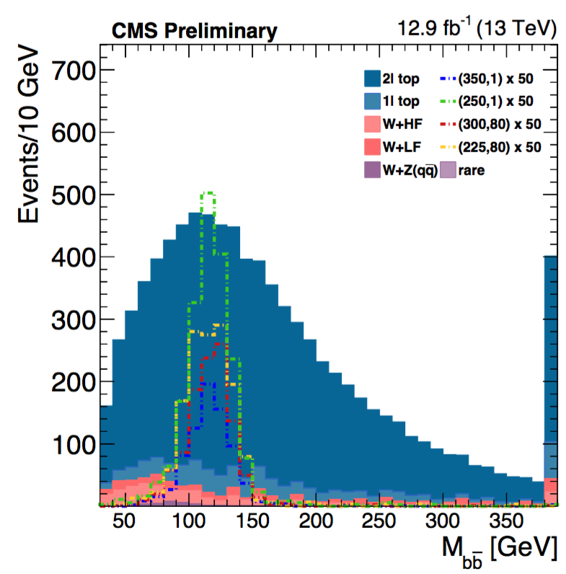
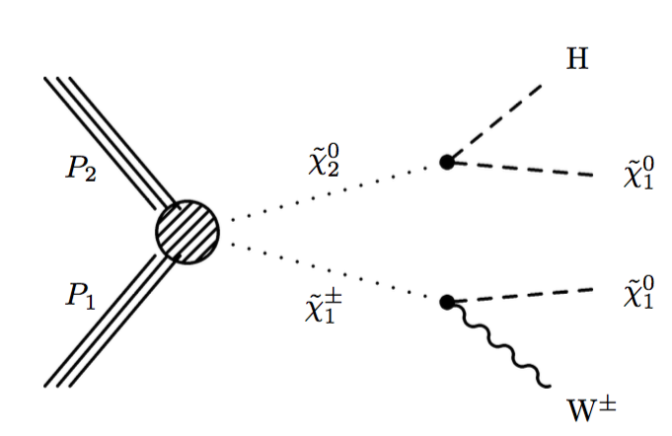
EWK SUSY searches
SUS-16-026
Chargino-netralino production
  χ ̃₂⁰ → Hχ ̃₁⁰: Higgs boson in the H→bb channel
  χ ̃₁± → Wχ ̃₁⁰: W boson leptonic decay
Search performed in M_{bb} distribution
  Extra MET from signal helps to separate backgrounds
Main backgrounds: ttbar and W+jets

Slide 16
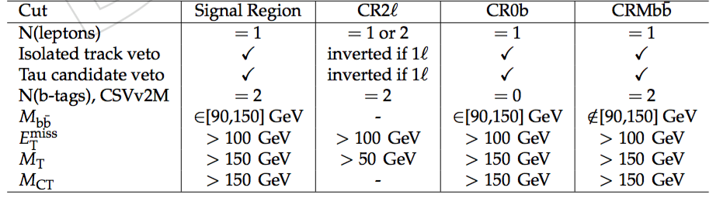
Event selection
SUS-16-026
Signal region 90 GeV < M_{bb} < 150 GeV
Suppress backgrounds
  Exactly two b-jets,
  1-lepton, veto additional leptons
  MET > 100 GeV, M_{T} > 150 GeV, M_{CT} > 150 GeV
Validate M_{bb} shape modeling of for 2l top
Validate tail modeling in W+jets
Derive corrections/systematics
Validate tail modeling 2l top
Derive correction/systematics

Slide 17
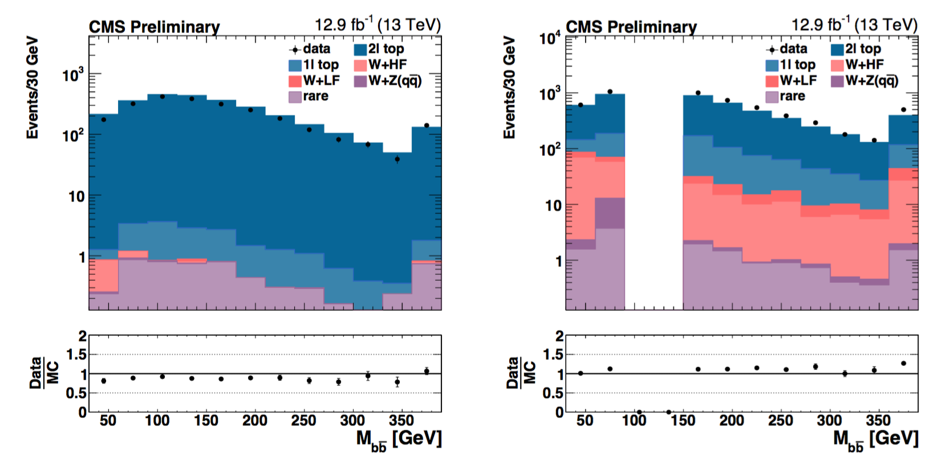
Background prediction
SUS-16-026
Backgrounds estimated with MC simulation,
  Dilepton top quark: ~90% of total background in SR
  Subdominant backgrounds: W+light jets, W+HF, W+Z(bb)
Good modeling of M_{bb} shape near signal region
  Assign stat error (20%) as systematic on modeling of 2l top

Slide 18
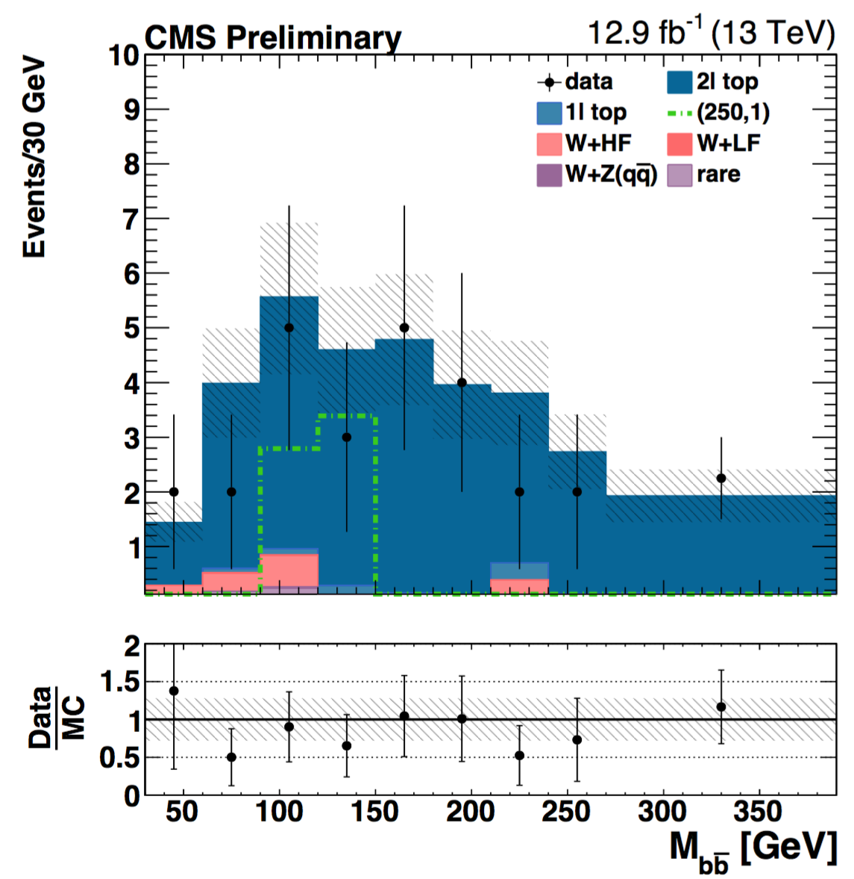
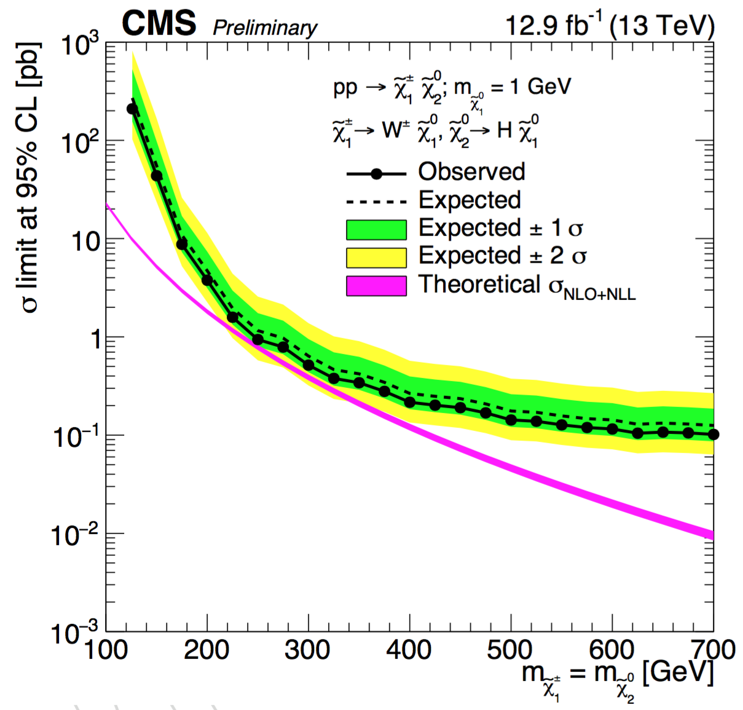
Results
SUS-16-026
Data agrees with the prediction in the signal region
Sensitivity close to exclude the models, σ limits around 1 pb

Slide 19
Summary
Searches for SUSY are entering a new era at 13 TeV with large datasets
  Gluino limits extended ~100 GeV beyond previous searches
  Nearing sensitivity for EWK SUSY production
Good modeling of SM backgrounds is observed in a variety of dedicated control regions
  Robust techniques for SM background estimation
Many improvements in the analysis techniques, many more results to come with quickly increasing datasets

