Slide 1
Micro Pattern Gaseous Detectors and potential applications beyond fundamental Physics
Filippo Resnati^{1,2}
on behalf of CERN EP-DT-DD Gaseous Detector Development team
¹CERN, ²ESS
ICHEP - Chicago - 6th August 2016

Slide 2
Outline
Brief overview of Micro-Pattern Gaseous Detectors
Four examples of their application beyond fundamental Physics
Intuitive, simple and versatile readout for MPGDs suitable for applications beyond HEP
Filippo Resnati - ICHEP - Chicago - 6th August 2016

Slide 3
Micro-Pattern Gaseous Detectors
Structures to provide suitable electric fields in gas to amplify the otherwise small amount of ionisation charge produced by the interacting particles
Filippo Resnati - ICHEP - Chicago - 6th August 2016

Slide 4
MPGDs: a rich family
extended
electrodes
MicroMeGas
Micro-bulk MM
CAT
Micro-RWell
TH-GEM
InGrid
MicroGroove
LEM
GridPix
MicroWell
GEMpix
RPWell
GEM
MHSP
MicroPic
MSGC
MicroDot
micro
electrodes
MicroWire
MicroPin
MicroGap
mesh-like
hole-like
Filippo Resnati - ICHEP - Chicago - 6th August 2016

Slide 5
Micromegas
cathode
+
-
metal mesh
-
120 um
pilar
segmented anode
Anode can be made resistive to reduce the discharge effects
Filippo Resnati - ICHEP - Chicago - 6th August 2016

Slide 6
GEMs
cathode
+
-
70 um
-
cathode2
50 um
-
-
anode2
-
140 um
-
-
-
-
-
-
-
-
-
-
-
-
-
-
segmented anode
-
-
-
-
-
-
Small gain of each stage reduces the discharge probability
Filippo Resnati - ICHEP - Chicago - 6th August 2016

Slide 7

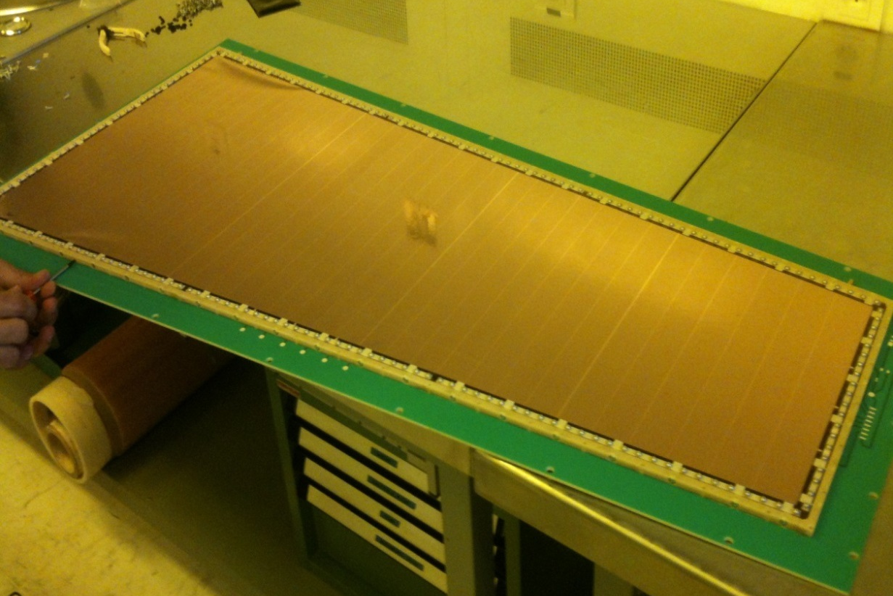

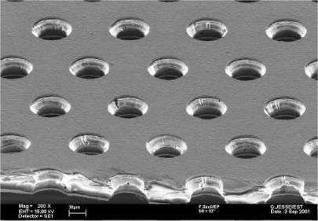


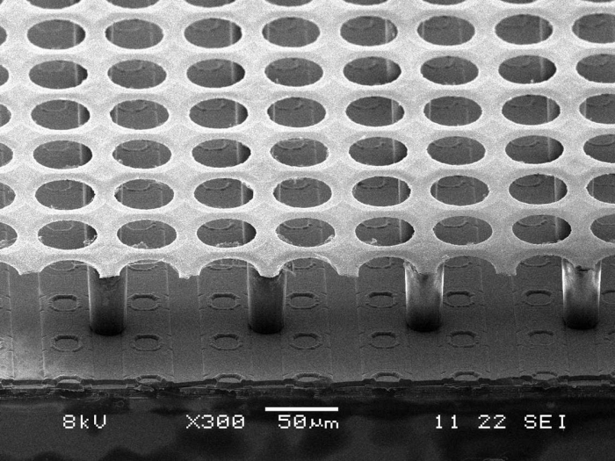
Two remarkable examples
GEM for upgrade
of the forward
CMS muon system
50 cm
120 cm
MM for ATLAS upgrade of the NSM
2 m
1 m

Slide 8
Beyond fundamental Physics
MPGDs found (and still finds) applications beyond fundamental Physics mainly (but not only) due to their imaging capabilities and the advantageous size over price ratio
Filippo Resnati - ICHEP - Chicago - 6th August 2016

Slide 9
Some examples
C-RAD GEMINI:
developments to obtain a radiation-hard detector based on GEMs for imaging and dosimetry during γ-ray treatments
Static XRF:
GEM detector used for X-ray fluorescence of artworks in order to unveil underlying paintings over large surfaces
Multigen 2D:
portable and battery-driven muon telescope based on Micromegas used for cosmic muon tomography
NMX at ESS:
development of a GEM based neutron detector with gadolinium converter for NMX instrument at ESS
Filippo Resnati - ICHEP - Chicago - 6th August 2016

Slide 10
C-RAD GEMINI
A strong trend has recently developed for using Electronic Portal Imaging Device (EPID) for online verification of the actually delivered dose distribution (Portal Dosimetry), an application for which none of the standard EPID detectors was designed nor optimised.
Detectors will be exposed to a very intense γ radiation.
Goals of the development:
- superior radiation hardness
- dose rate independence
- dose linearity
- zero ghosting
Filippo Resnati - ICHEP - Chicago - 6th August 2016

Slide 11
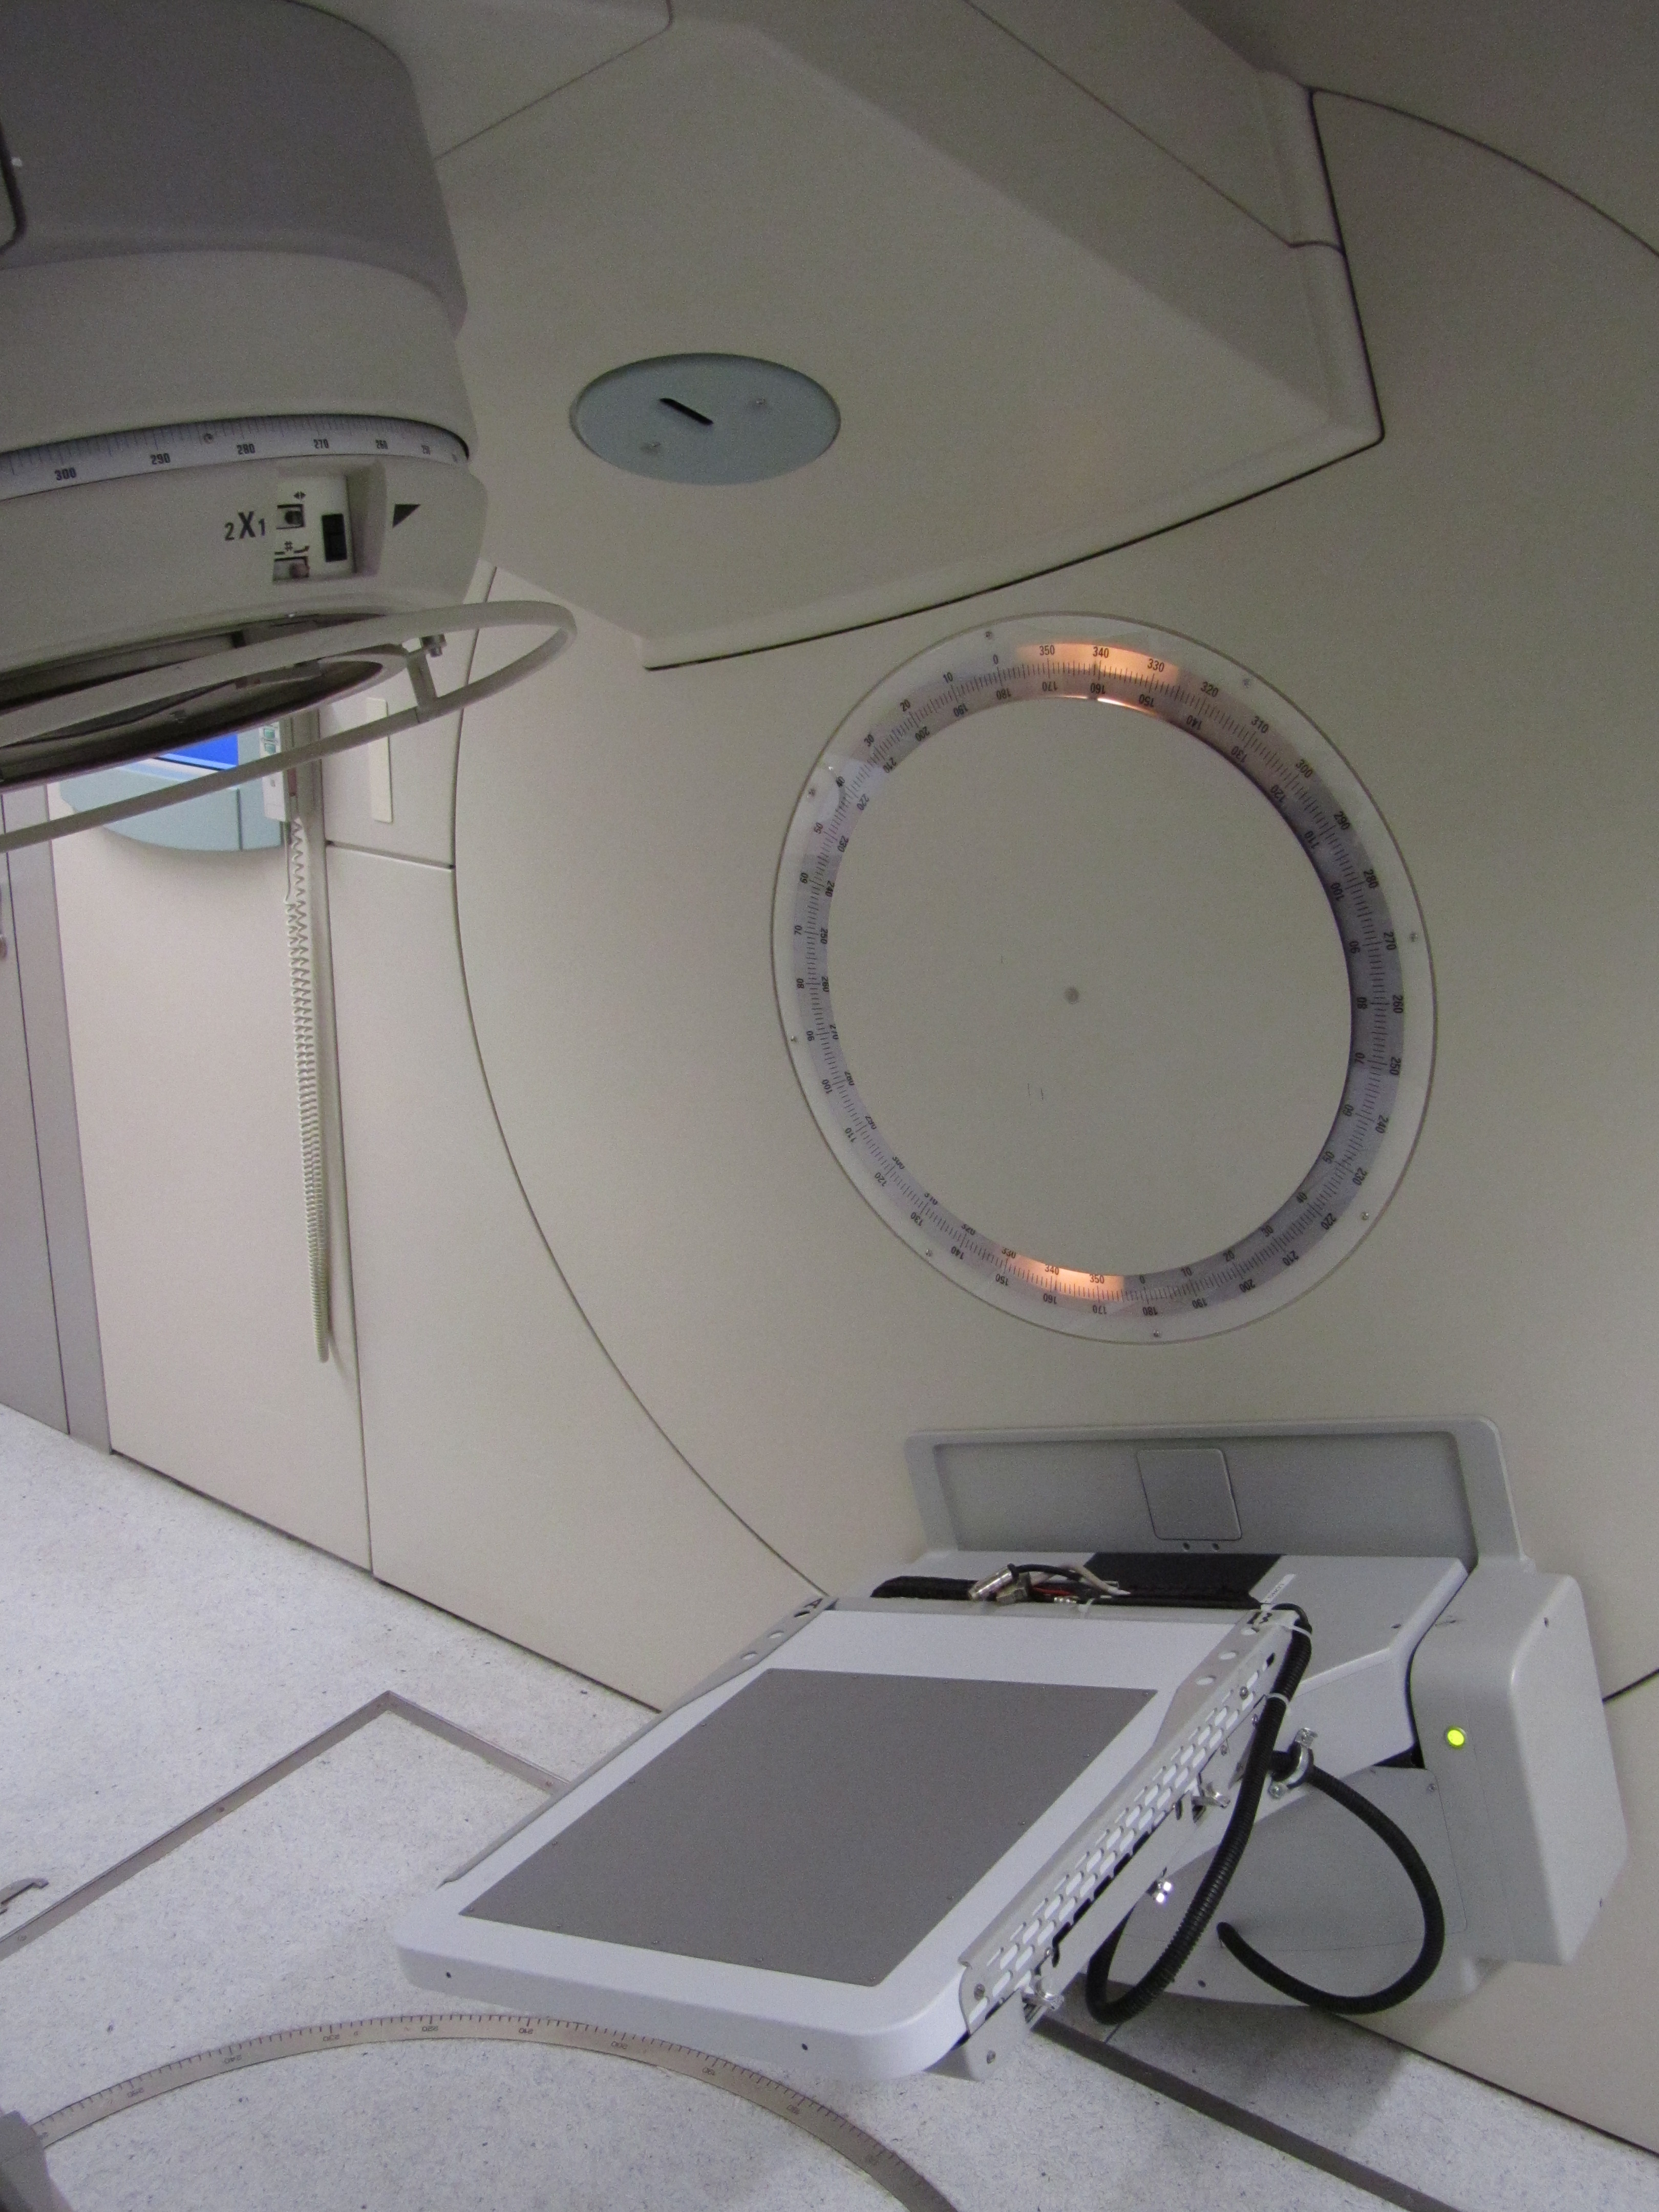
C-RAD GEMINI
C-RAD: Swedish company developing and commercialising the detector
GEMs ensures high flux capability, linear response and radiation tolerance
gamma
from 6 MV linac
patient
converter
+
+
-
-
GEM
electron
pixelated readout
dedicated
electronics
Filippo Resnati - ICHEP - Chicago - 6th August 2016

Slide 12
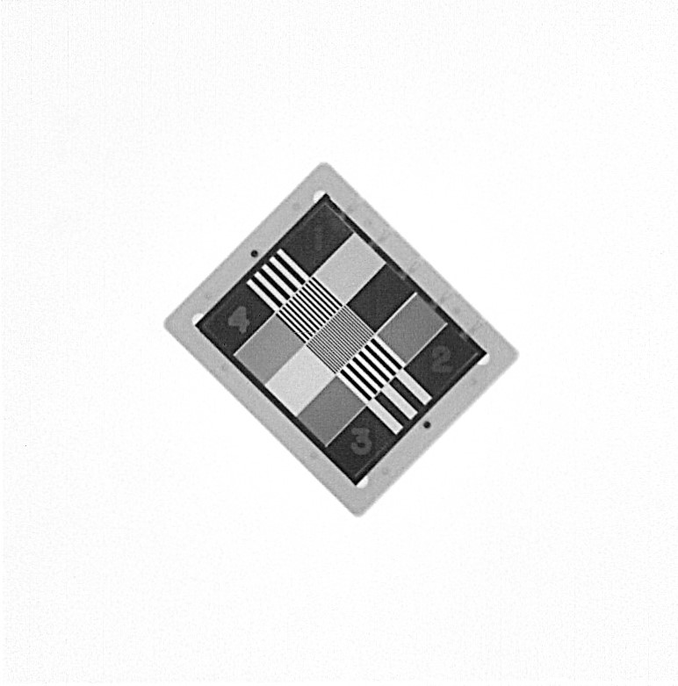
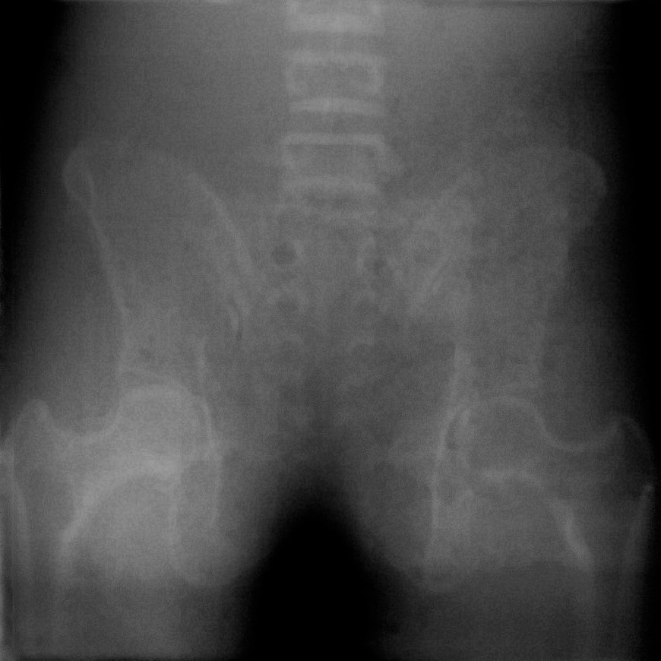
C-RAD GEMINI
6 MV linac, 1.5 MeV average gamma energy, 3 MU dose
QA object (resolution and contrast measure)
Pelvic phantom
40 cm
Filippo Resnati - ICHEP - Chicago - 6th August 2016

Slide 13
X-ray fluorescence
X-ray fluorescence can be used to unveil underlying paintings. Large surface can be achieved by scanning with extraordinary energy and position resolution.
Three main concerns:
- dangerous to move precious masterpieces
- dangerous to have moving parts near the masterpieces
- long time to scan
Filippo Resnati - ICHEP - Chicago - 6th August 2016

Slide 14
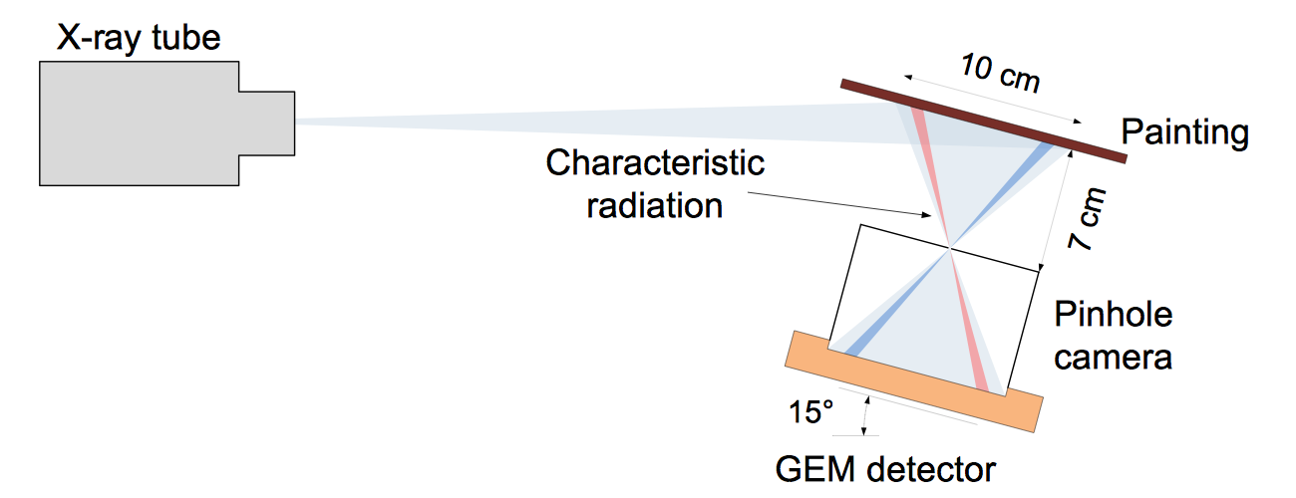
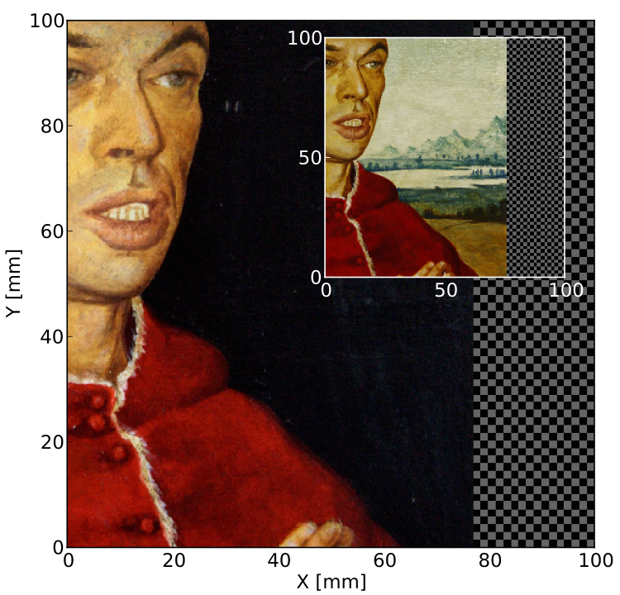
X-ray fluorescence
XRF imaging system for fast mapping of pigment distributions in cultural heritage paintings
A. Zielińska, 2013 JINST 8 P10011
- Position and energy sensitive method
- No position scan required
- The system can be brought to the museum
Filippo Resnati - ICHEP - Chicago - 6th August 2016

Slide 15
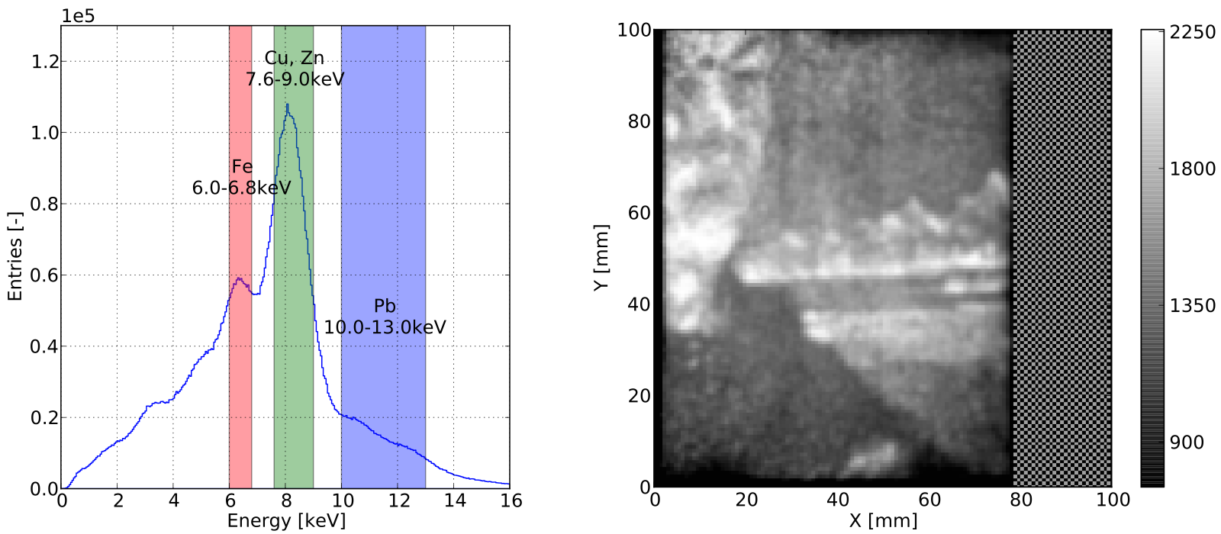
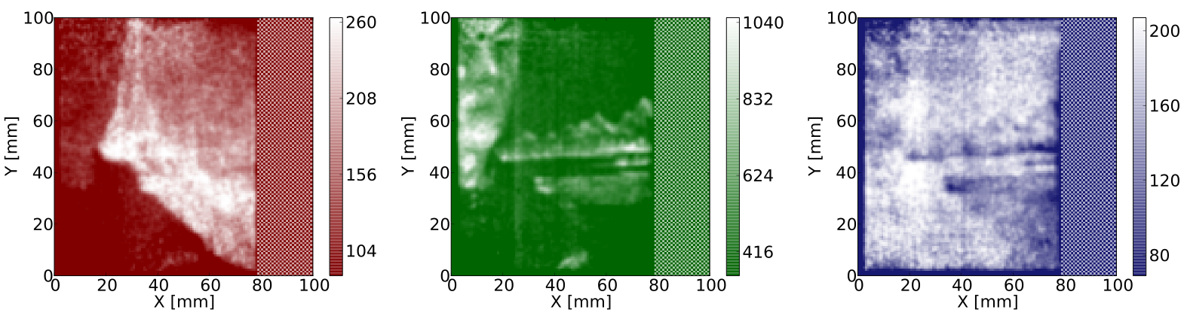
X-ray fluorescence
A. Zielińska, 2013 JINST 8 P10011
Filippo Resnati - ICHEP - Chicago - 6th August 2016

Slide 16
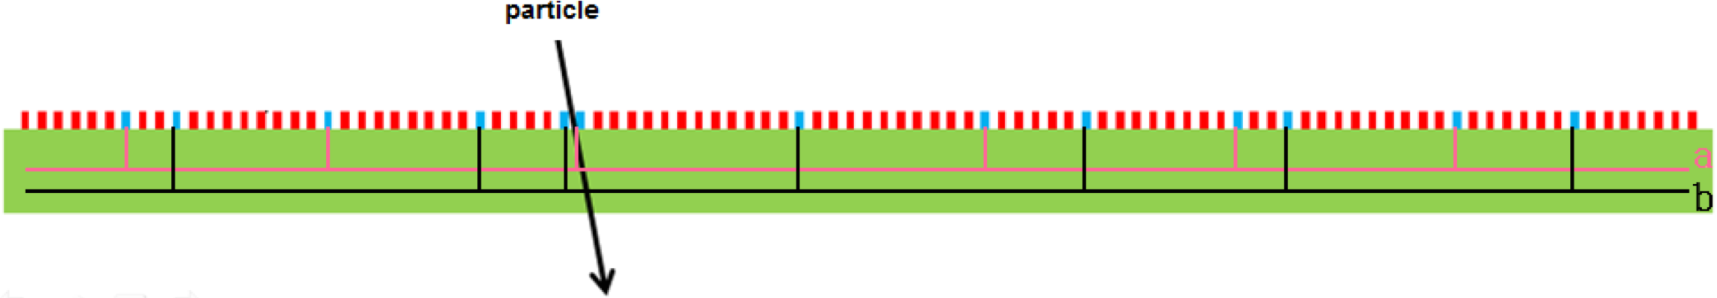
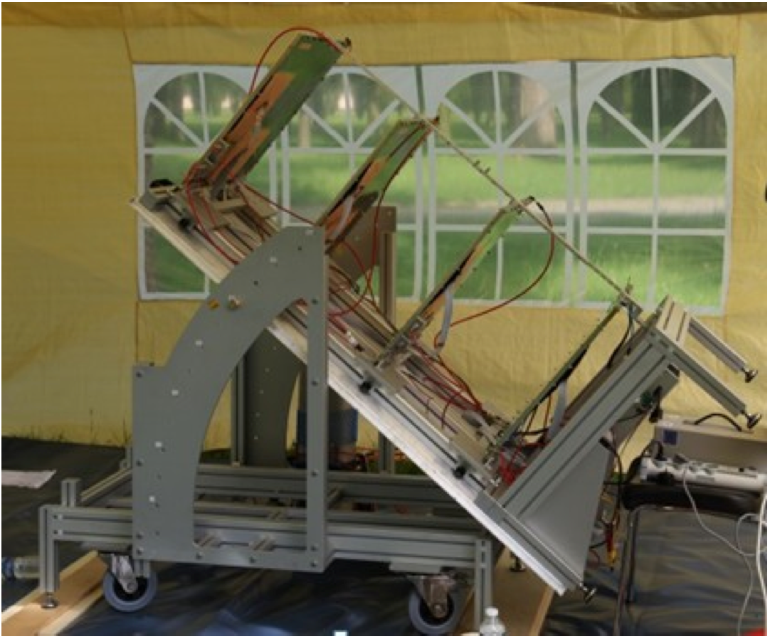
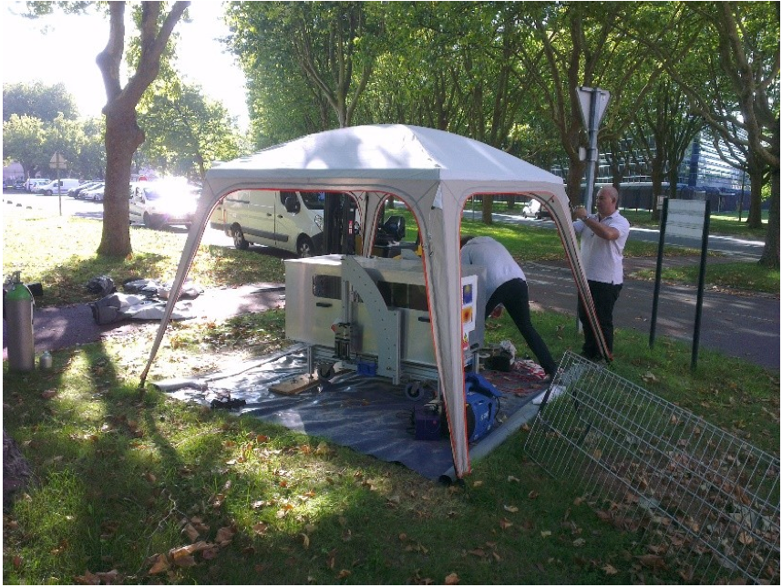
MM Multigen 2D
Autonomous detector operation outside the laboratory: power consumption is a main issue.
Reduce the number of electronic channels with genetic multiplexing 1024 strips -> 61 channels
Muon telescope
Battery and solar panel only
S. Bouteille et al., MPGD2015 contribution
https://indico.cern.ch/event/451078/contributions/1113856/attachments/1171977/1692457/RD51_SBouteille.pdf
Filippo Resnati - ICHEP - Chicago - 6th August 2016

Slide 17
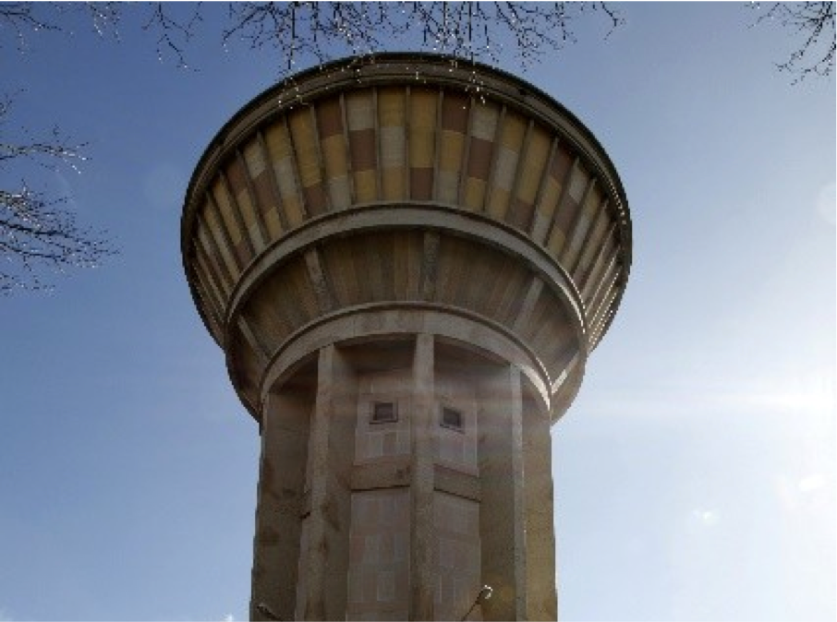
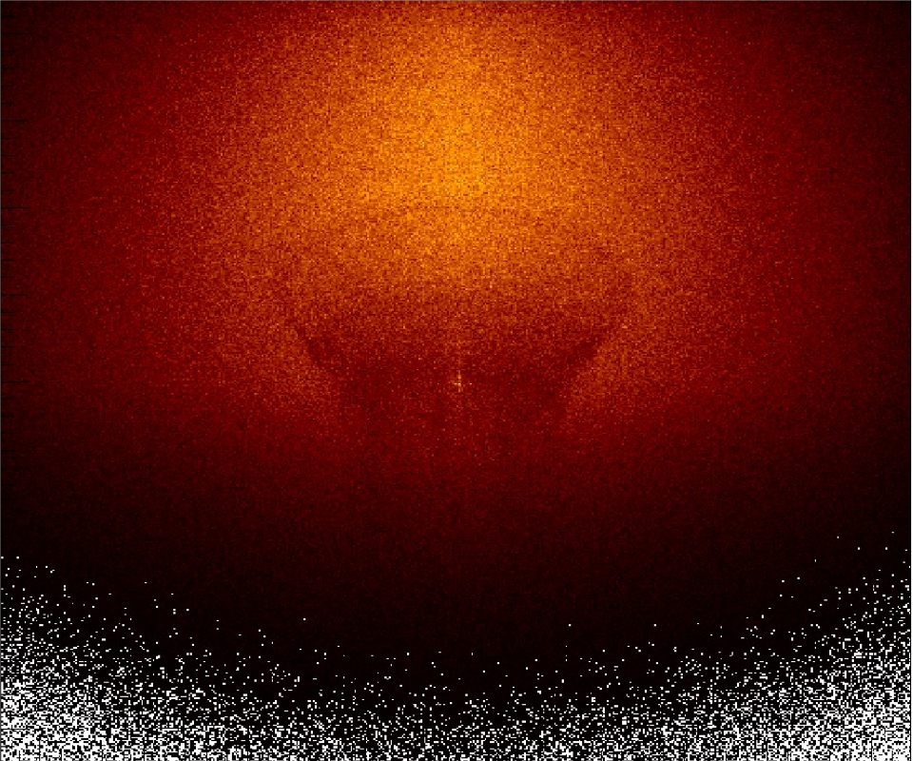
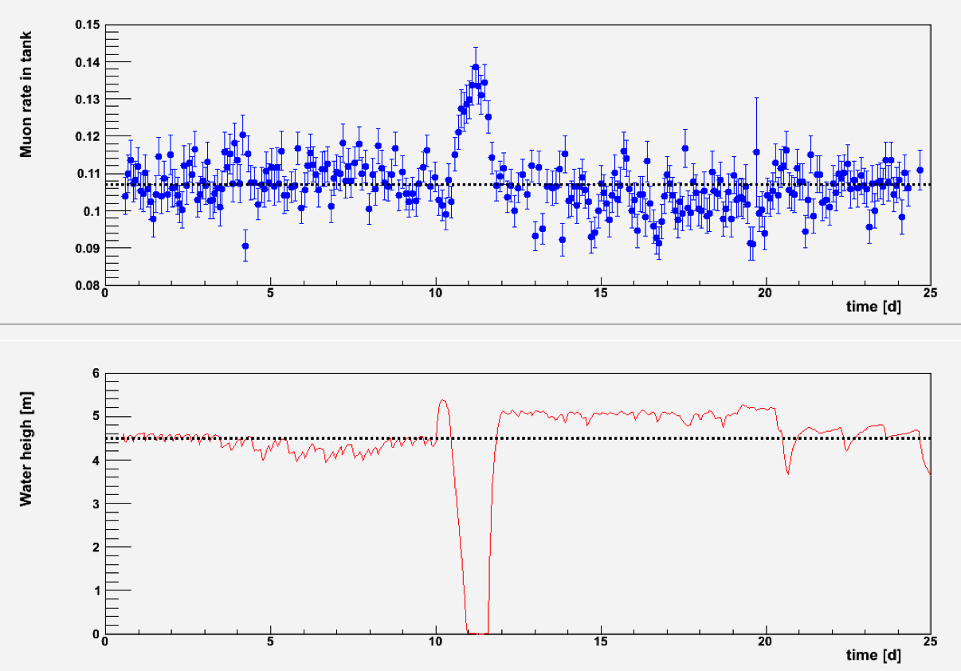
MM Multigen 2D
Muon flux intensity 4 weeks exposure
Muon tomography of a water tower
Dynamic study of the water content
S. Bouteille et al., MPGD2015 contribution
https://indico.cern.ch/event/451078/contributions/1113856/attachments/1171977/1692457/RD51_SBouteille.pdf
Filippo Resnati - ICHEP - Chicago - 6th August 2016

Slide 18
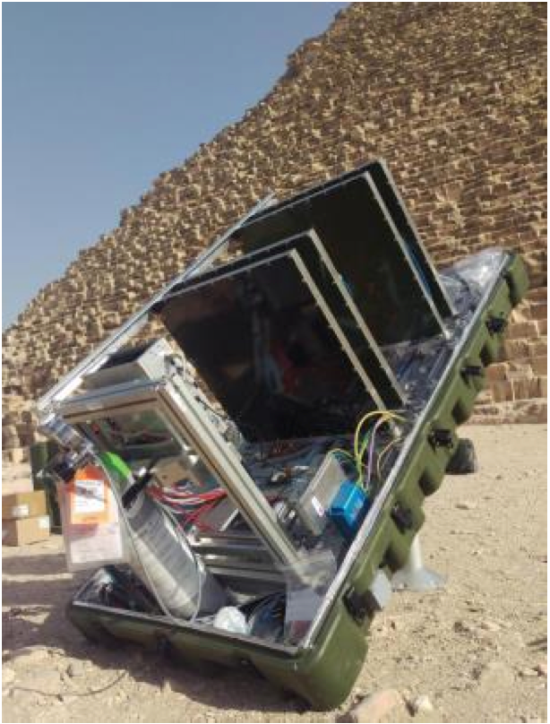
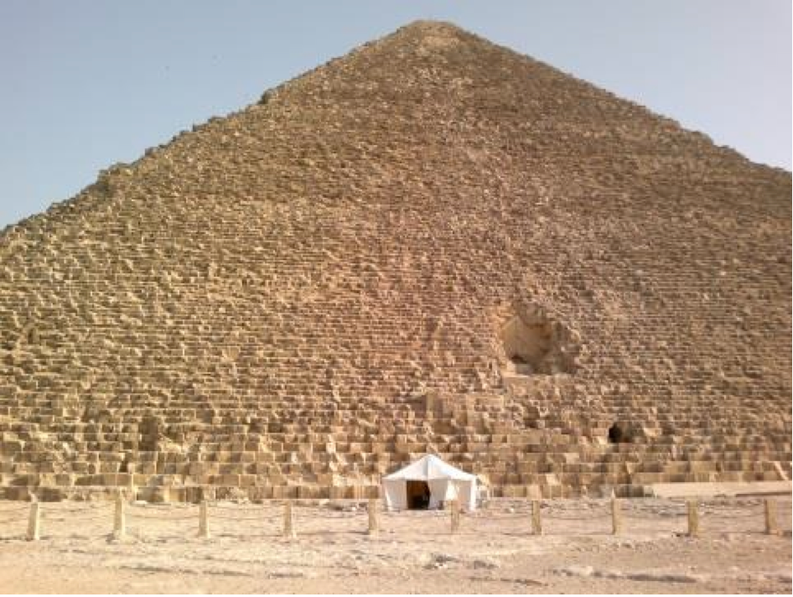
MM Multigen 2D
Muon tomography of the Cheops Pyramid is ongoing
S. Procureur et al., 2016 RD51 Collaboration Meeting
https://indico.cern.ch/event/532518/contributions/2195610/attachments/1286182/1913223/2016-06-07_-_RD51.pdf
Filippo Resnati - ICHEP - Chicago - 6th August 2016

Slide 19
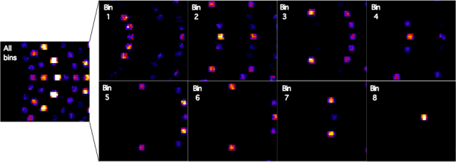
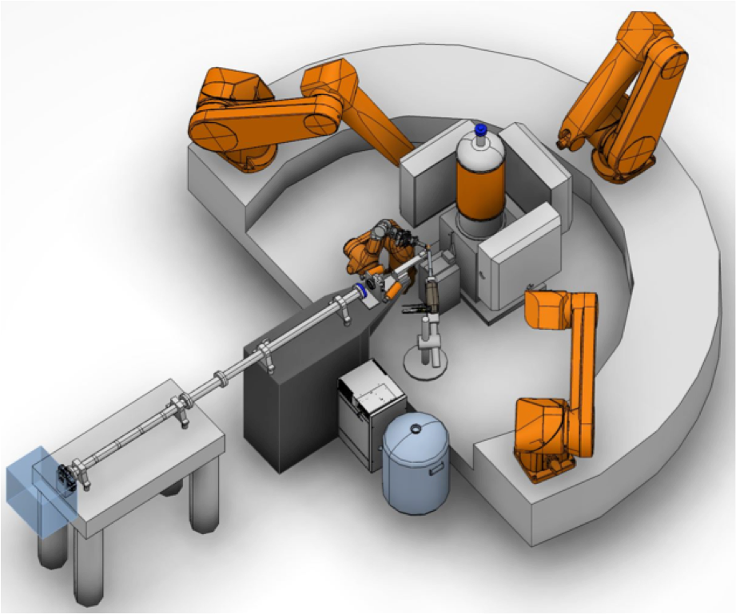
NMX at ESS
Neutron Macromolecular Crystallography instrument at ESS
Time binned diffraction pattern (simulation) from a 5 mm crystal
of perdeuterated rubredoxin at 20 cm from the detector (45º)
Detector requirements:
- 3x 60x60 cm² movable
- 20-100 cm operation distance
- time resolved (tens of us)
- <500 um X&Y spatial resolution
- <100 kHz/mm² local flux
- ~20% efficient
- γ rejection not critical
Filippo Resnati - ICHEP - Chicago - 6th August 2016

Slide 20
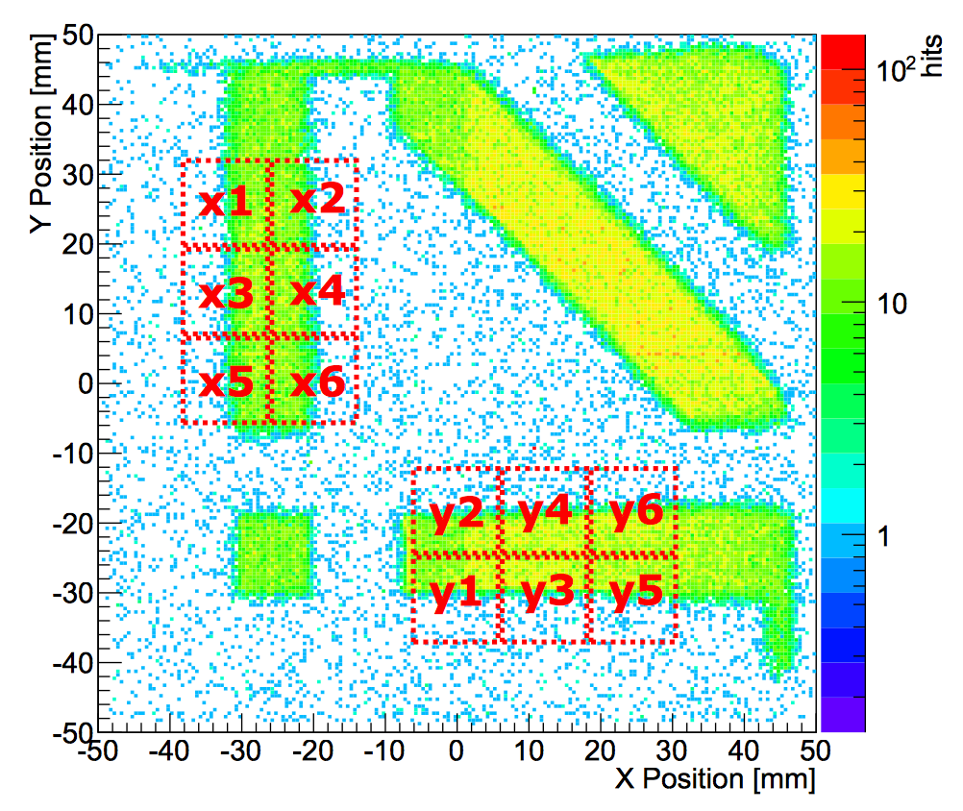
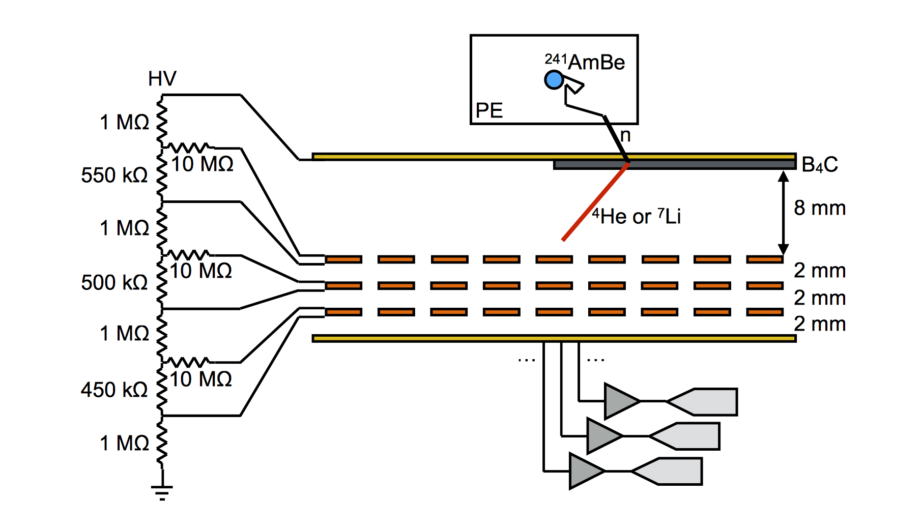
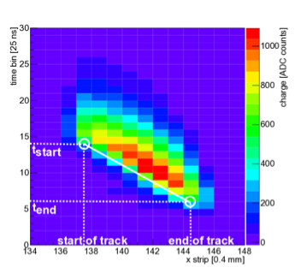
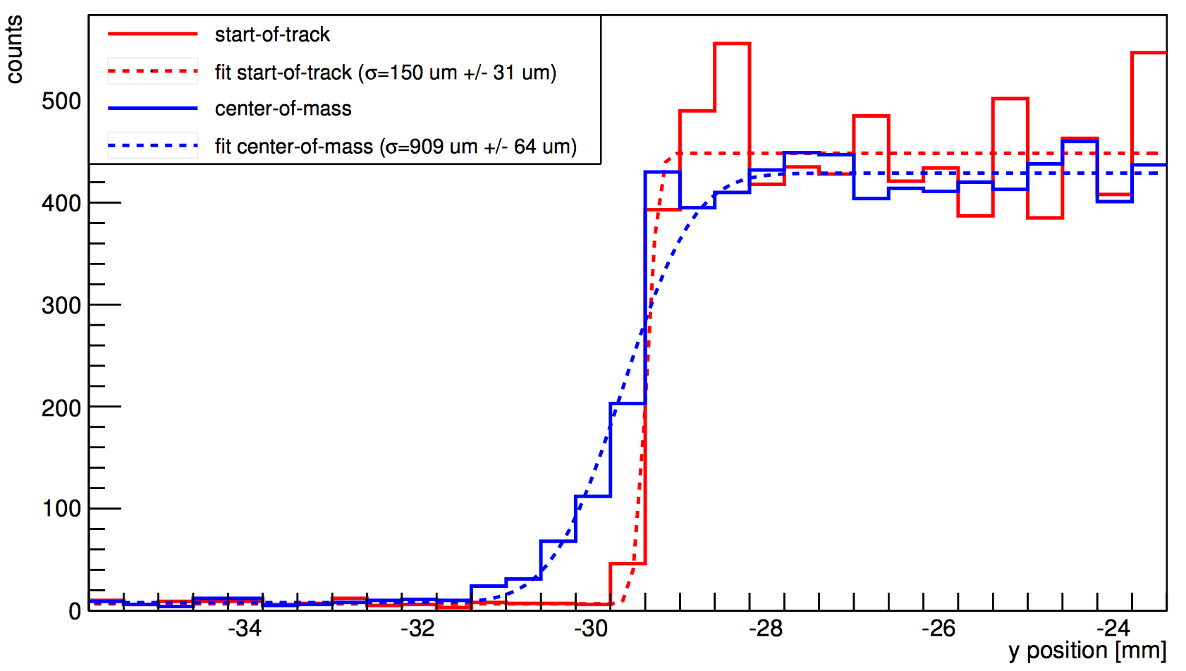
B-GEM & uTPC concept
D. Pfeiffer et al., JINST 10 (2015) P04004
Straight track of alfa
from ¹⁰B conversion
Intrinsic resolution
standard ~1 mm
uTPC < 200 um
Filippo Resnati - ICHEP - Chicago - 6th August 2016

Slide 21
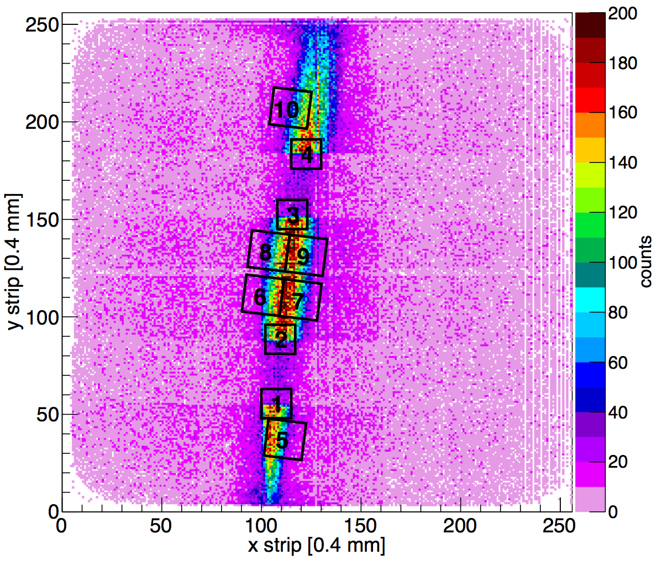
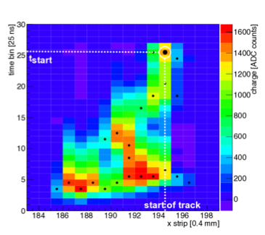
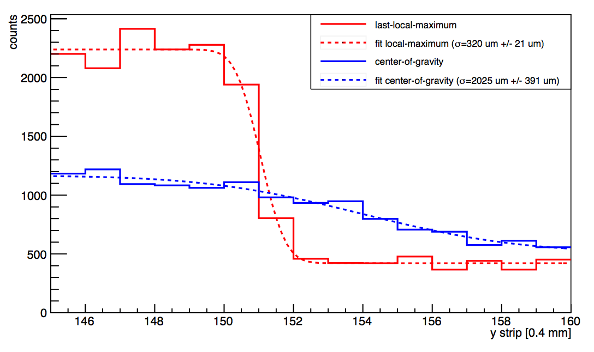
Gd-GEM & uTPC concept
D. Pfeiffer et al., JINST 11 (2016), P05011
Larger absorption cross section of gadolinium enables
the development of more efficient (O(15%)) detectors.
^{X}Gd + n -> ^{X+1}Gd⁺ + e⁻
Reconstruction of the curly tracks of the electron is more
challenging, but the start of the track is well recognisable.
Intrinsic resolution
standard > 2 mm
uTPC < 400 um
Curly track of electron
from Gd conversion
Filippo Resnati - ICHEP - Chicago - 6th August 2016

Slide 22
Other type of amplification
Almost unavoidably light is produced during charge avalanche.
Depending on the gas mixture, the scintillation can be copious and at the right wavelength.
Not many gas mixtures scintillate in the visible window, for which most of the light sensors are optimised.
CF4 is one of them and noble gases with CF4 admixtures are effective scintillators.
Light yield comparison
- common scintillator as NaI(Tl): ~40 ph/keV
- GEMs in Ar/CF4 (80/20) at a gain of 10⁵: ~10⁶ ph/keV
Filippo Resnati - ICHEP - Chicago - 6th August 2016

Slide 23
Optical readout
Record the light emitted during the Townsend avalanche with a camera using the detector as a scintillating plate
Advantages:
- Simplicity, like taking a picture
- Robustness, as a device off-the-shelf
- Versatility, several uses and environments
Filippo Resnati - ICHEP - Chicago - 6th August 2016

Slide 24
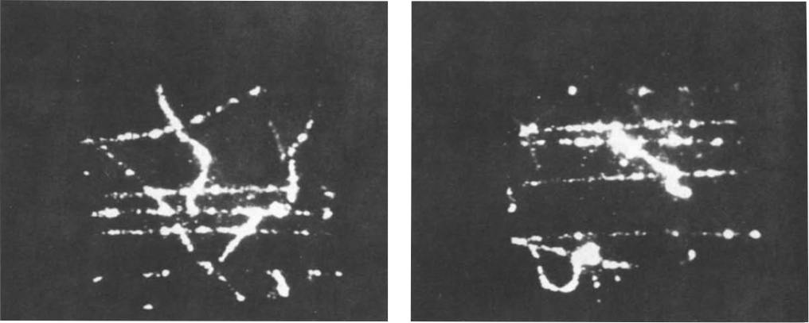
Only the techniques are new
Parallel mesh chamber filled with Ar/CH4/TEA 80%/8%/2%
seen through an image intensifier and a camera
Muons and delta rays
G. Charpak et al., NIM A258 (1987) 177
Filippo Resnati - ICHEP - Chicago - 6th August 2016

Slide 25
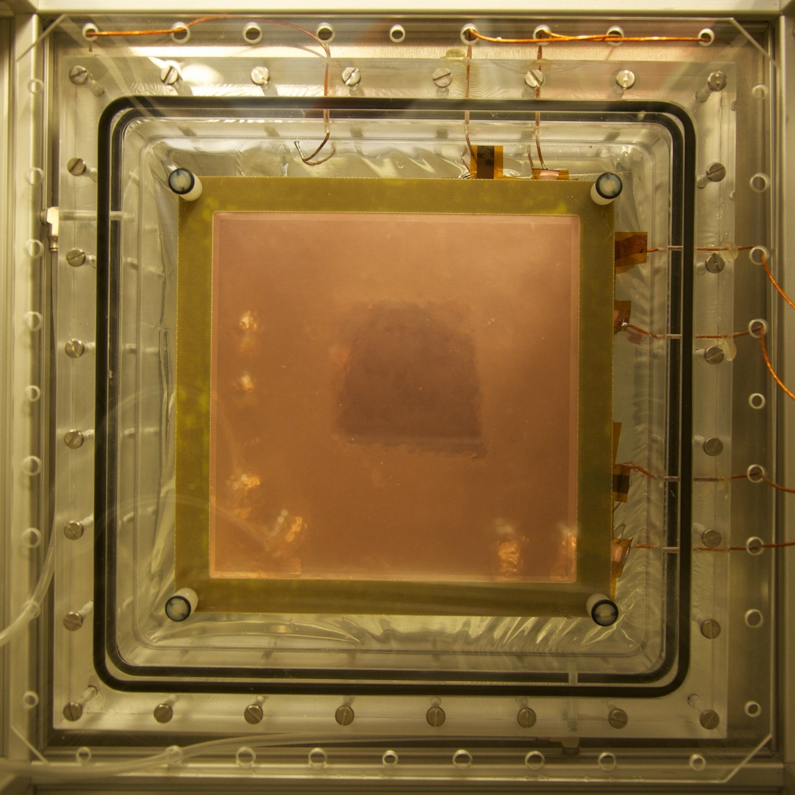

The setup
Ar/CF4 80/20
+
-
10 mm
-
10 cm
2 mm
2 mm
2 mm
plexiglass
+3 dioptre lens
25 mm f/0.95 lens
M = sensor size / image size
M ~ 0.1 -> Ω ~ 5x10-4
This implies:
large sensor, low noise,
fast lens and a lot of light
CCD camera
Filippo Resnati - ICHEP - Chicago - 6th August 2016

Slide 26
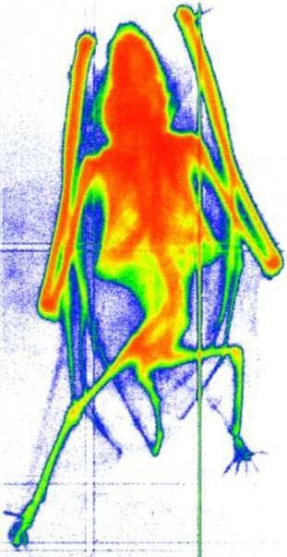
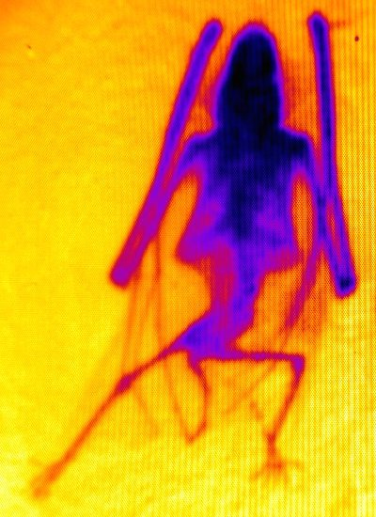
X-ray images
X-ray tube with W target at 20 kV - 40 kV at few mA
Charge acquisition (26/10/1998)
Light acquisition
~7 cm
Raw data:
fast (<1 s) acquisition
and no processing time
Filippo Resnati - ICHEP - Chicago - 6th August 2016

Slide 27

Fluoroscopy
50 ms exposure
10 Hz acquisition
Filippo Resnati - ICHEP - Chicago - 6th August 2016

Slide 28
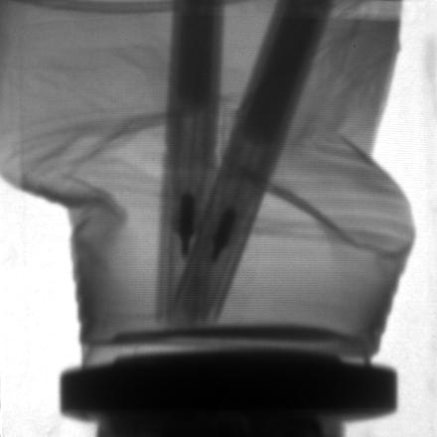
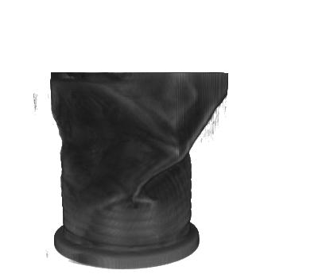
CT and 3D imaging
Image -> Sinograms -> Filtered Back Projection -> 3D image
Filippo Resnati - ICHEP - Chicago - 6th August 2016

Slide 29
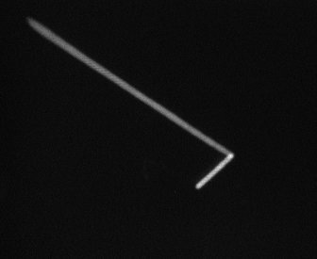
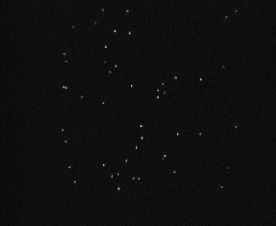
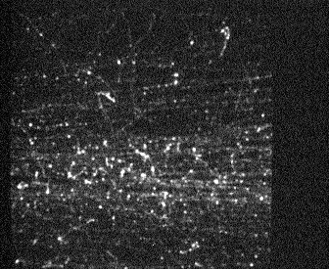
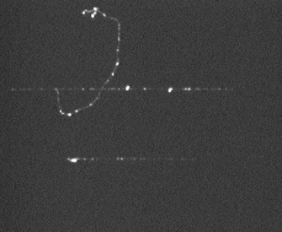
Single events
α from ²²⁰Rn & ²¹⁶Po
X-rays from ⁵⁵Fe
For hours in sealed mode at test beam
shower from a charged pion
muon and δ-ray
Filippo Resnati - ICHEP - Chicago - 6th August 2016

Slide 30
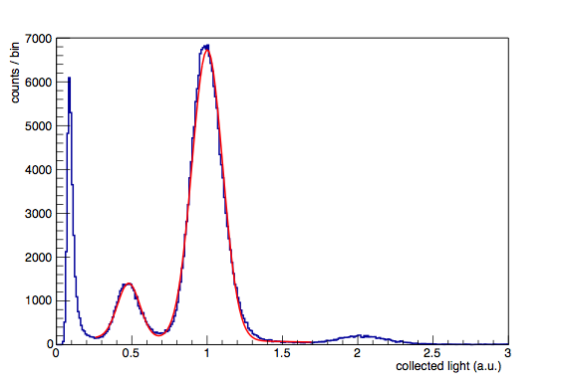
Quantitative analysis
⁵⁵Fe source
full energy
24.7% FWHM
over 10x10 cm²
escape
X-rays from ⁵⁵Fe
pileup
Filippo Resnati - ICHEP - Chicago - 6th August 2016

Slide 31
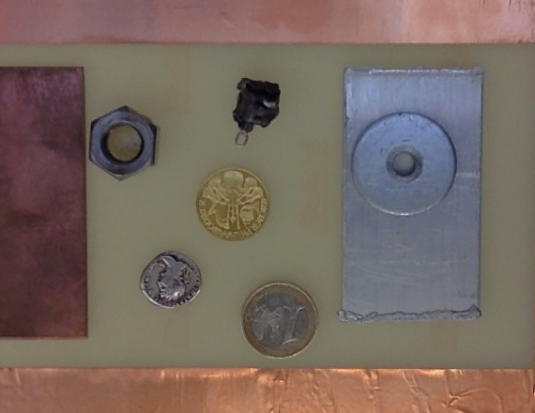
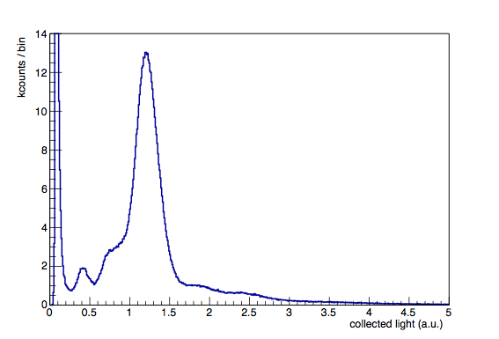
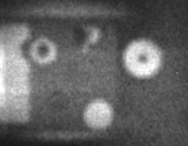

Fluorescence
Spatial- and energy-resolved
X-ray fluorescence of extended objects
17 cm
O(1 min)
O(20 min)
Filippo Resnati - ICHEP - Chicago - 6th August 2016

Slide 32
Applications under investigation
Optical readout may be also used for:
- X-ray crystallography
- UV imaging
- neutron imaging
- gamma imaging
…
Filippo Resnati - ICHEP - Chicago - 6th August 2016

Slide 33
Summary
Applications:
medical imaging in high dose treatments, nanodosimetry, X-ray fluorescence, cosmic muon tomography, radon detectors.
Fundamental research other than HEP:
neutron diffractometry, rare events searches (nuclear physics, dark matter, neutrino-less double beta, neutrino oscillation).
And possibly in the future:
X-ray crystallography over large surfaces, homeland security, online beam monitor for hadron therapy, …
Filippo Resnati - ICHEP - Chicago - 6th August 2016

