Slide 1
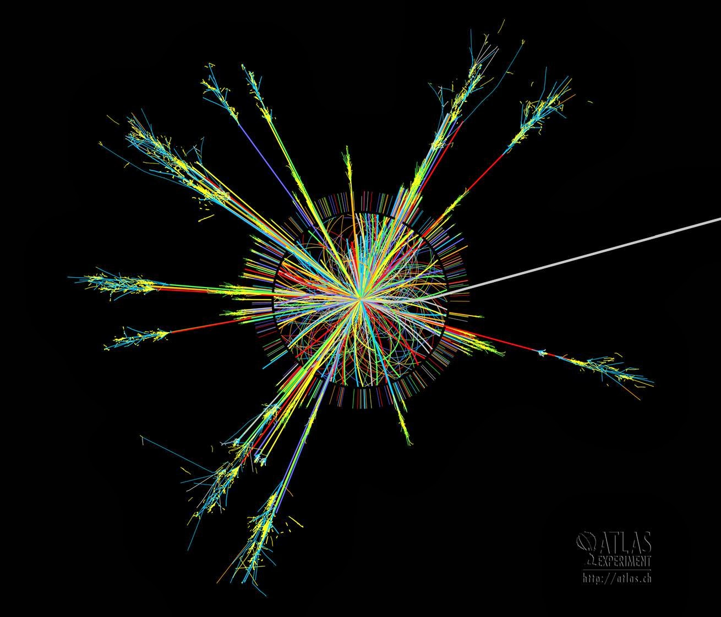
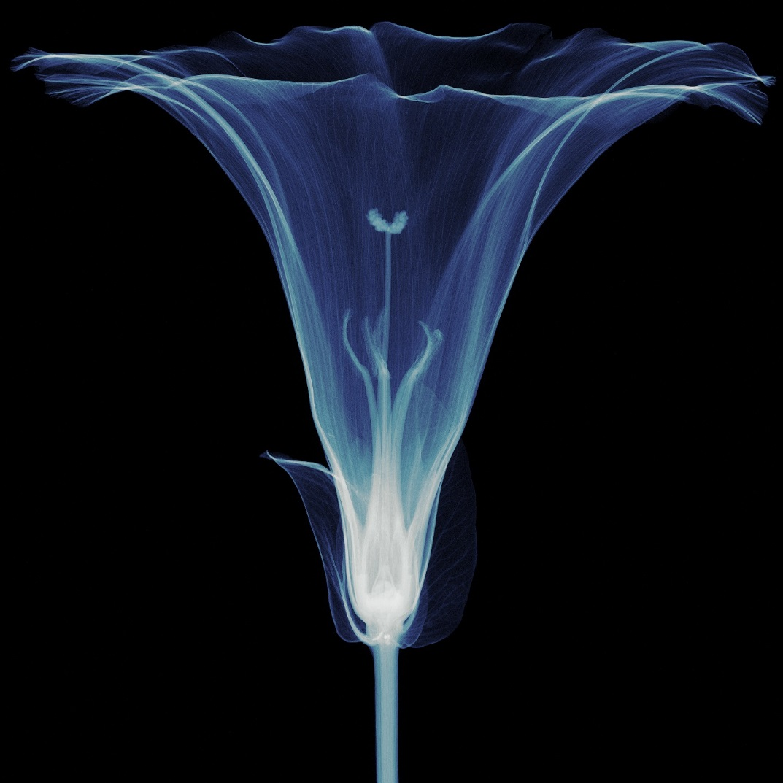
Maximizing the dissemination of HEP technologies to society:
the CERN model
D. Mazur
CERN Knowledge Transfer Group

Slide 2
Overview
A few words about CERN
What makes knowledge transfer at CERN unique ?
The cornerstones of our model:
  Focus on impact
  Open dissemination
  Protect only when strictly necessary
  CERN’s Knowledge Transfer Fund
  Local business impact with start-ups and SME’s
Dispelling a few myths

Slide 3
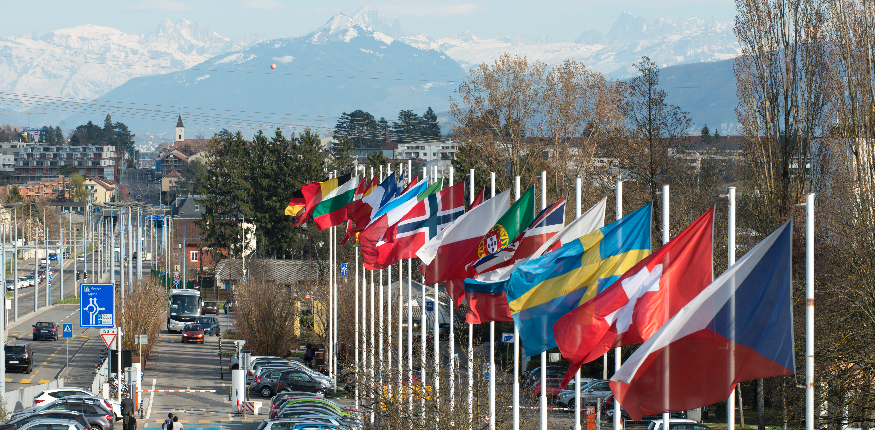
CERN: “Science for Peace”
~ 2300 staff
~ 1400 other paid personnel
~ 12500 scientific users
Budget (2016) ~1000 MCHF
Member States: Austria, Belgium, Bulgaria, Czech Republic, Denmark, Finland, France, Germany, Greece, Hungary, Israel, Italy, Netherlands, Norway, Poland, Portugal, Romania, Slovak Republic, Spain, Sweden, Switzerland and
United Kingdom
Associate Member States: Pakistan, Turkey
States in accession to Membership: Cyprus, Serbia
Applications for Membership or Associate Membership:
Brazil, Croatia, India, Lithuania, Russia, Slovenia, Ukraine
Observers to Council: India, Japan, Russia, United States of America; European Union, JINR and UNESCO
Notes:
3
----- Meeting Notes (09/01/2013 14:16) -----
nnn

Slide 4
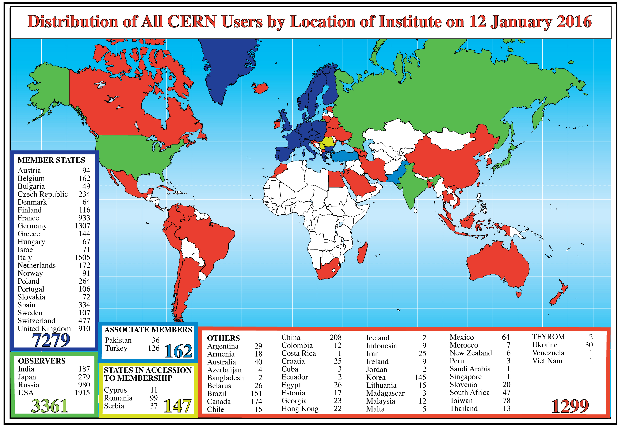

Slide 5

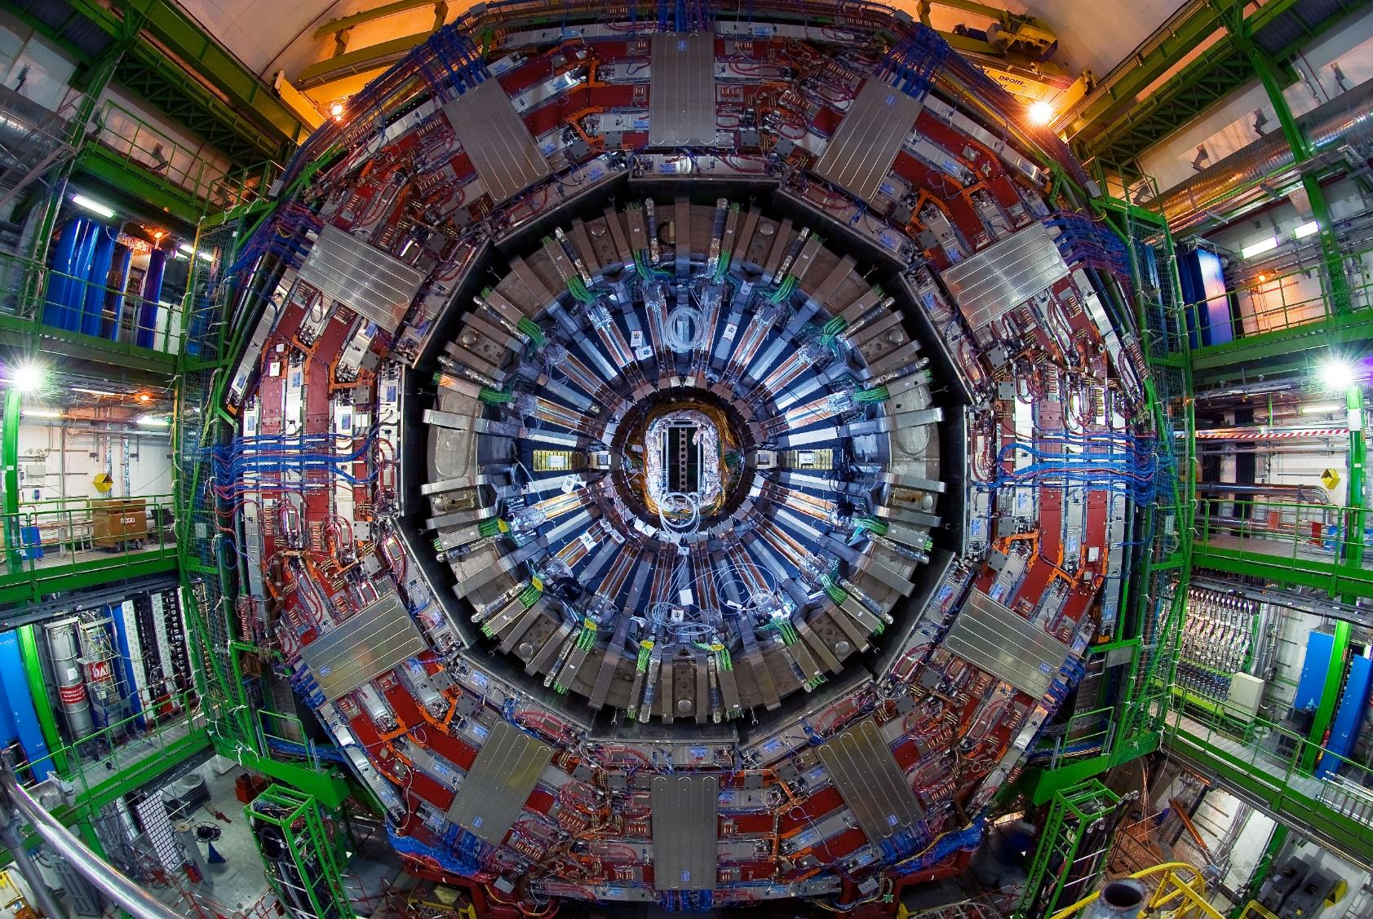
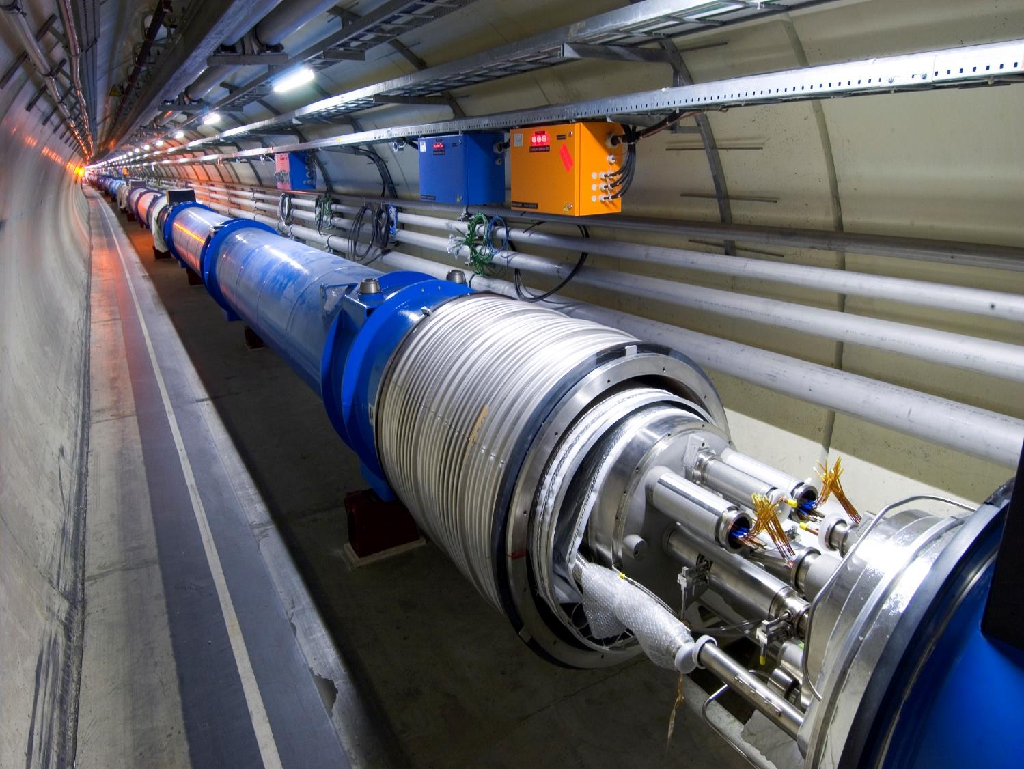
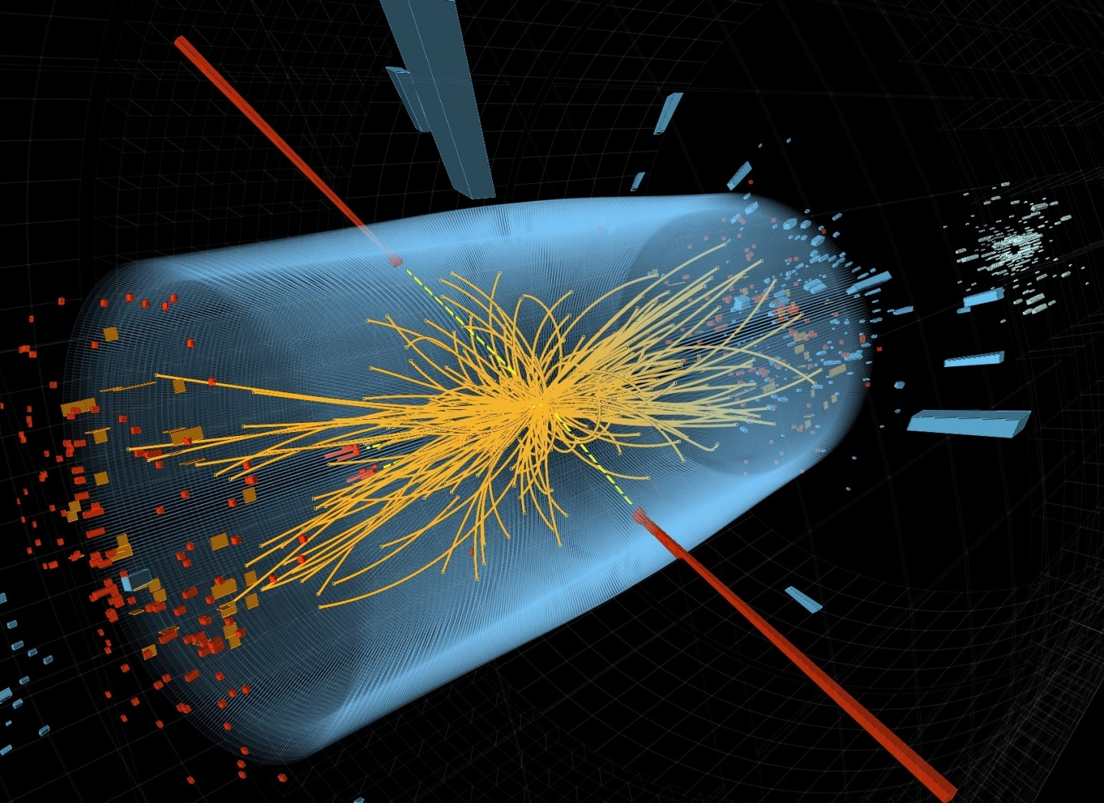
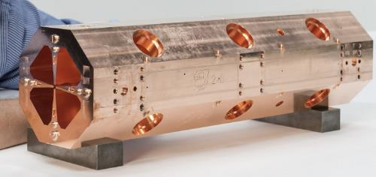
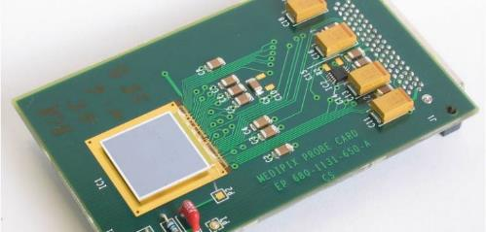
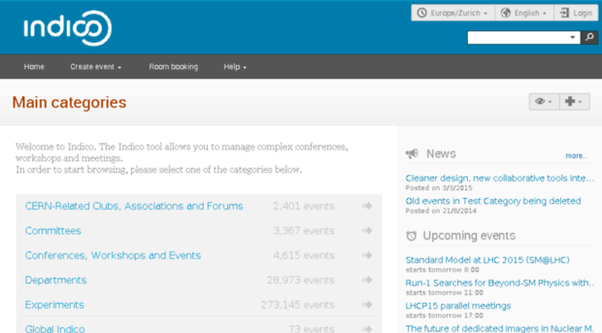
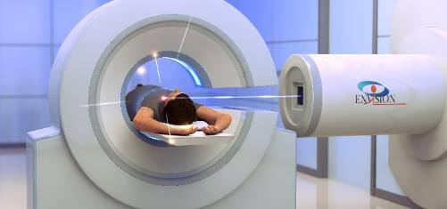
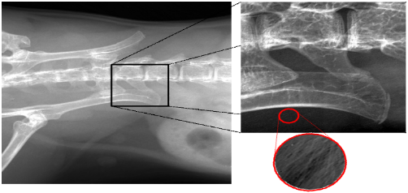
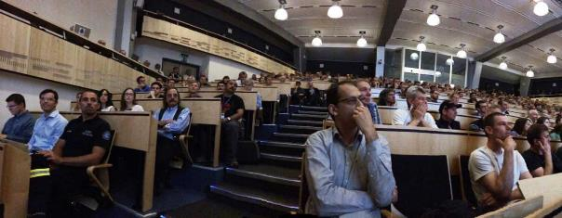
Accelerators
Detectors
Computing

Slide 6
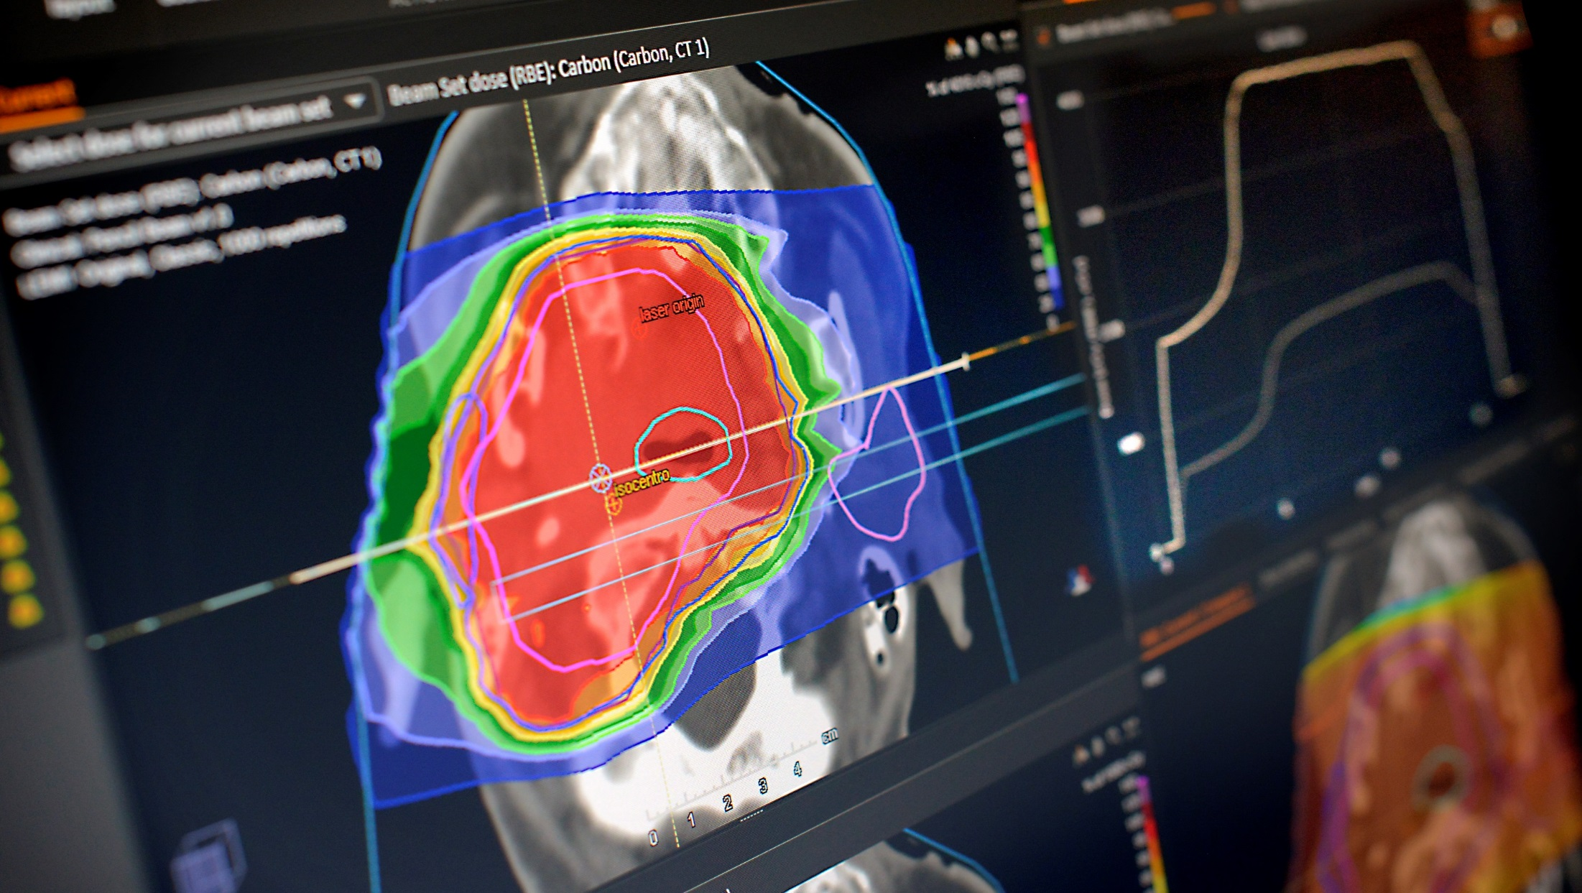
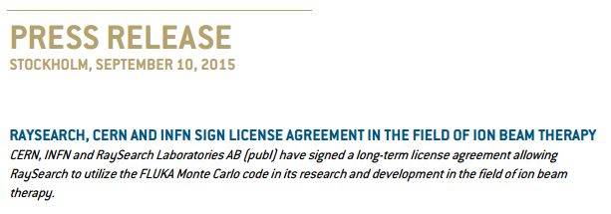
How to optimize therapy for patients ?
http://www.raysearchlabs.com/about/press/?year=2015&cisionid=1977472

Slide 7

How to make scientific instrumentation more performing ?
“ The unit features High Performance Time to Digital Converter chips developed by CERN.”
http://www.caen.it/csite/CaenProd.jsp?idmod=789&parent=11

Slide 8
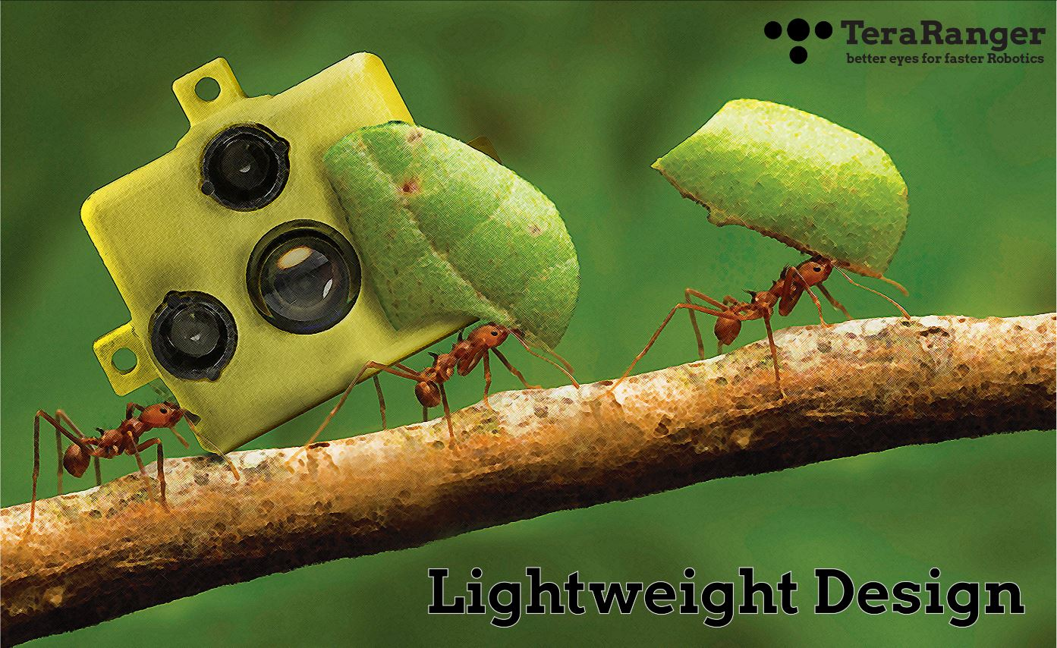
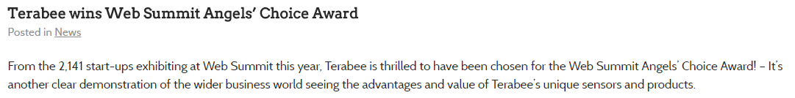
http://www.terabee.com/

Slide 9
What makes KT at CERN unique ?
Technologies for fundamental research
  Gap between CERN’s use and industry (Technology).
  Fundamental research is first and foremost priority (Time).
Global collaborations
  Shared ownership.
  Collaborative exploitation.
A culture of openness
  Open dissemination models – Software / Hardware.
  Building a bridge between industry’s interests and CERN’s openness.
An intergovernmental organization
  Duty of return to all 22 member states.
  Equal treatment.

Slide 10
How does this translate to our dissemination strategy ?
Focus on Impact
Open dissemination
Protect only when strictly necessary
Knowledge Transfer Fund
Create local impact in Member States

Slide 11
1. Focus on impact
Impact over revenue
  In general: exaggerated expectations on IP monetization.
  Focus on revenue orthogonal to wide dissemination
Strategic application domains:
  Medicine
  Aerospace
  Safety
Defining and monitoring impact

Slide 12
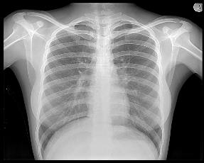
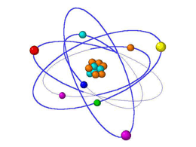
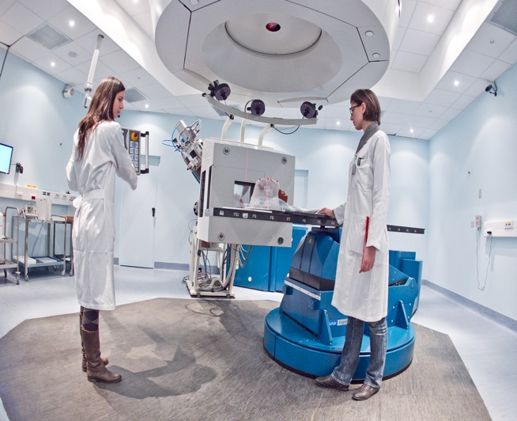
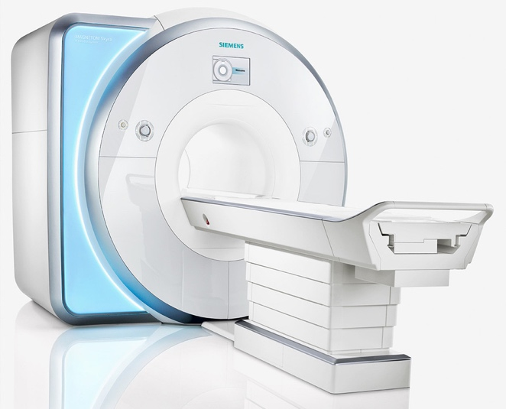
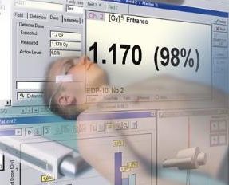
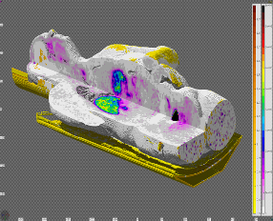
Impact – Medical Applications
Imaging | Radioisotopes | Hadron Therapy
MRI Systems | Dosimetry | Planning & Simulation

Slide 13
2. Open Dissemination
Open, public, free – what is the difference ?
The right tool for the right purpose:
Open Access Publications
http://library.web.cern.ch/OpenAccess
Open Datasets
http://opendata.cern.ch/
Open Source Software
Examples: Indico, Invenio, Root
Open Source Hardware
Examples: White Rabbit, Data Centre Environmental Sensor
CERN Open Hardware Licence:
http://www.ohwr.org/projects/cernohl/

Slide 14
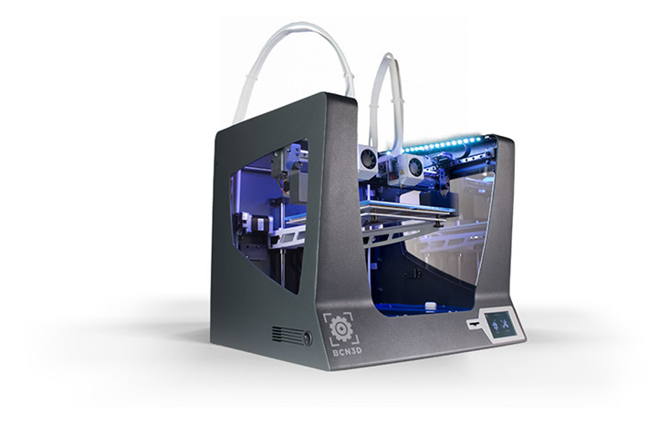
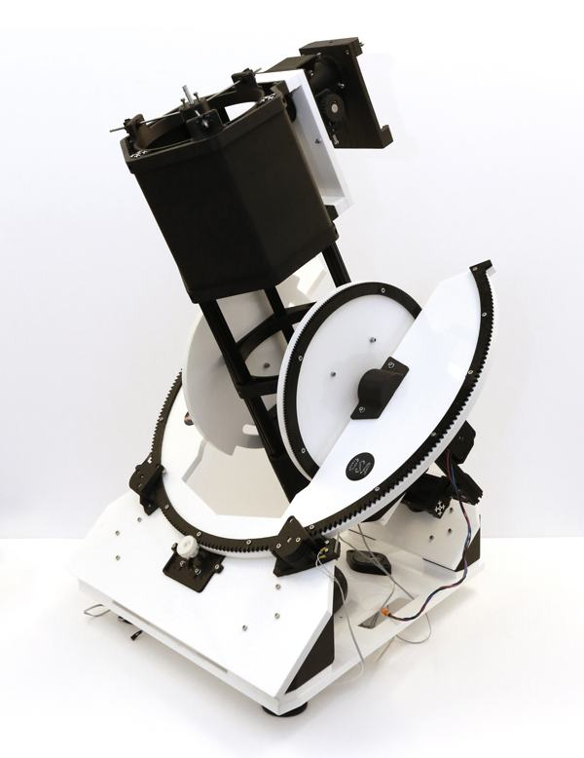
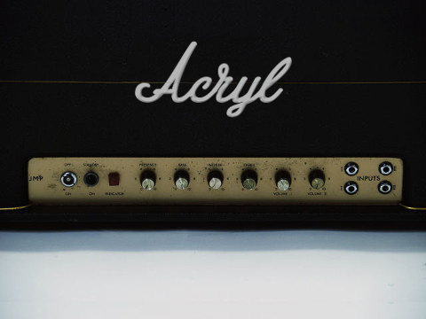
Did you know ?
The following projects have licensed their open designs under CERN OHL:

Slide 15
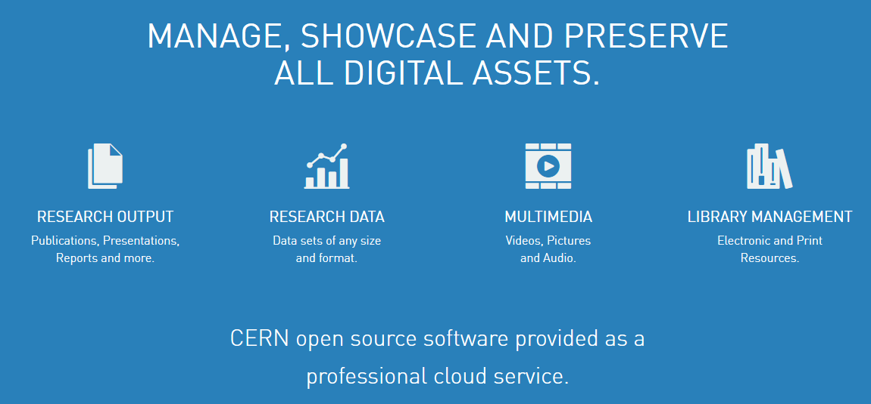
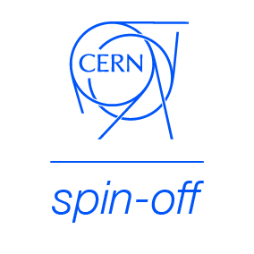
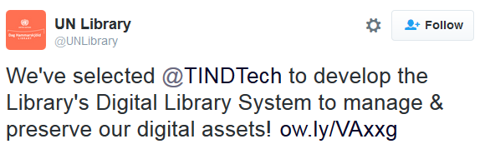


Example: TIND Technologies
http://tind.io

Slide 16
3. Protect only when strictly necessary
Protection comes at a cost:
  Patents at financial cost
  Trade secrets at an organizational cost
Patents are a poor indicator of innovation
When is there a benefit ? When dissemination would not happen in absence of either the patent or the trade secret

Slide 17
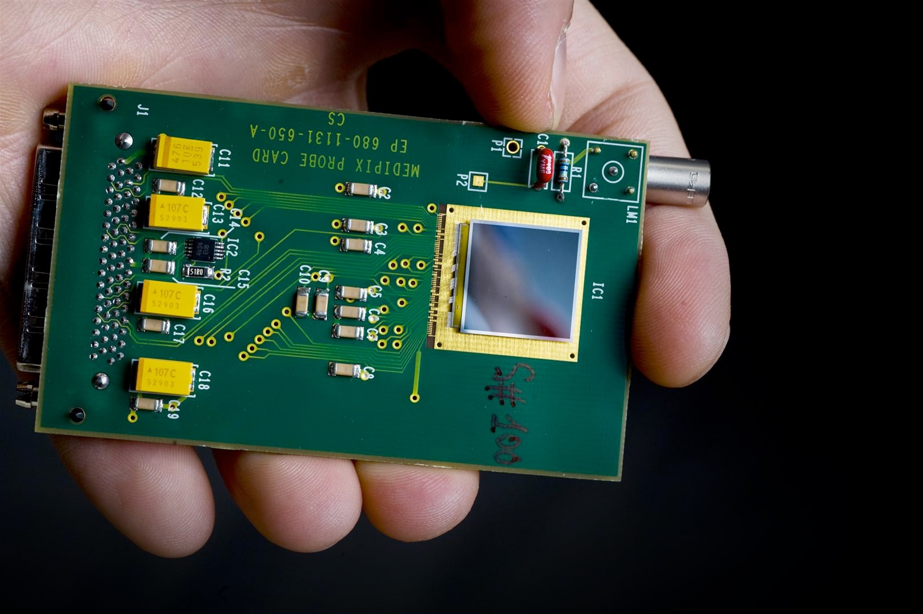
Example: Medipix

Slide 18
4. CERN’s KT Fund
How to encourage projects for innovative applications outside of HEP ?
1/3rd of KT revenues go to CERN’s Knowledge Transfer Fund (KT Fund)
Funding of innovative CERN projects with impact potential outside HEP.
At least one call per year:
  ~ 6 Projects
  ~ From CHF 25k to CHF 200k

Slide 19


Slide 20
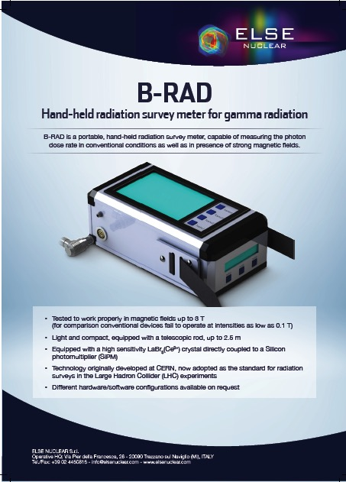
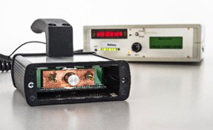
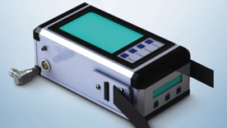
KT Fund Examples – B-Rad
Funded:
Prototype of a hand-held radiation survey meter operable in high magnetic fields
The KT Fund has catalysed the creation of
Off-the-shelf industrial-grade radiation survey meter by a company from a member state

Slide 21
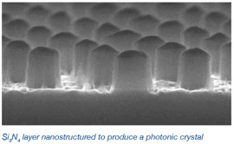
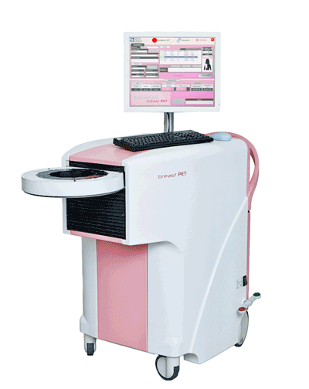




KT Fund Examples – Photonic Crystals
Funded:
Nanostructuring for improved light extraction from scintillating materials
The KT Fund has catalysed the creation of
An industry-driven collaboration to achieve breakthrough PET scanning performance for breast cancer diagnosis

Slide 22
5. Local Business Impact
CERN Network of Business Incubation Centres (BIC)
Benefits:
  Preferential access to CERN technologies
  40 hours of consultancy
  Access to CERN labels
  Seed funding (through local partner)
Entrepreneurship Development at CERN

Slide 23
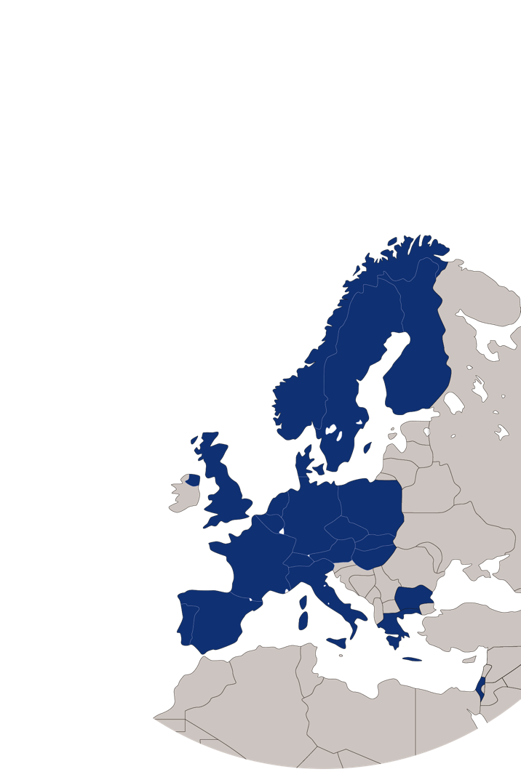
CERN BIC Network today
UK – STFC-CERN BIC
Netherlands – NIKHEF-CERN BIC
Norway – NTNU BIC of CERN Technology
Greece – Technopolis BIC of CERN Technology
Austria – Austria BIC of CERN Technology
France – InnoGEX BIC of CERN Technology
Finland – Finnish BIC of CERN Technology
Spain – Spanish BIC of CERN Technology
Italy – CERN-INFN R2I Innovation Network

Slide 24






CERN Spin-offs and
CERN Technology Start-ups
Sensor technology for drones | FR | Medical imaging devices | NL
Cloud-based Library Management | NO | Solar collectors | CH/ES
Particle therapy systems for cancer treatment | CH | Coatings for heat transfer | GB

Slide 25
Dispelling a few myths
Large collaborations and knowledge transfer are incompatible.
R&D in High Energy Physics is too far from the market.
Industry is only interested in closed and exclusive access

Slide 26







Technology Transfer Networks

Slide 27

CERN Knowledge Transfer Group
cern.ch/kt
Mail-KT@cern.ch
David.Mazur@cern.ch
Tel. +41 22 767 2623

