Slide 1
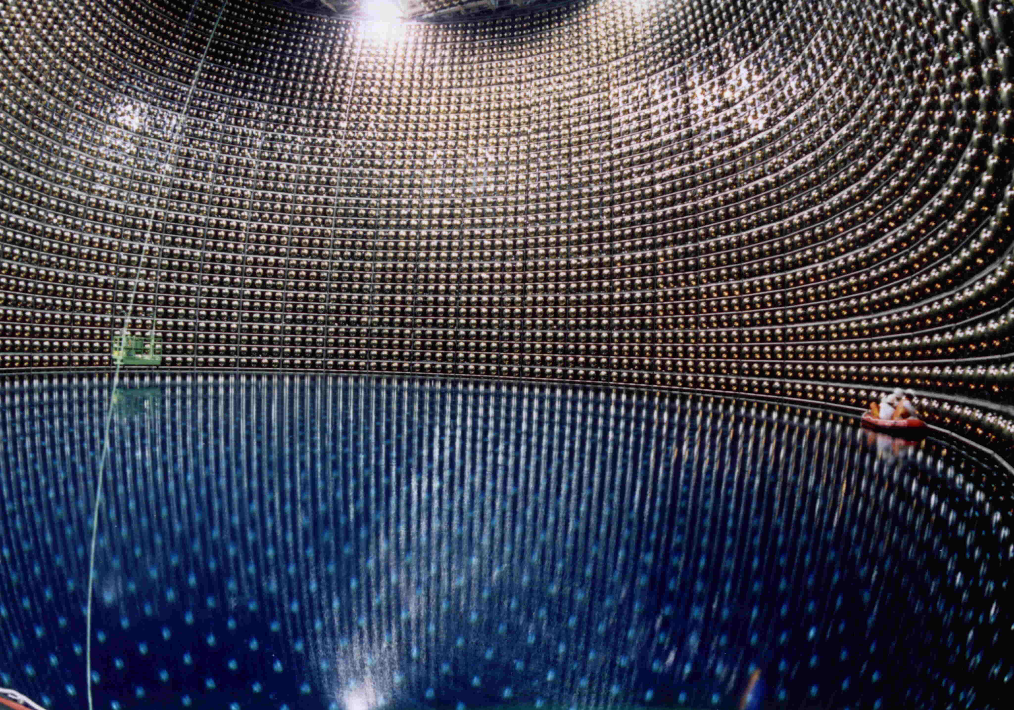
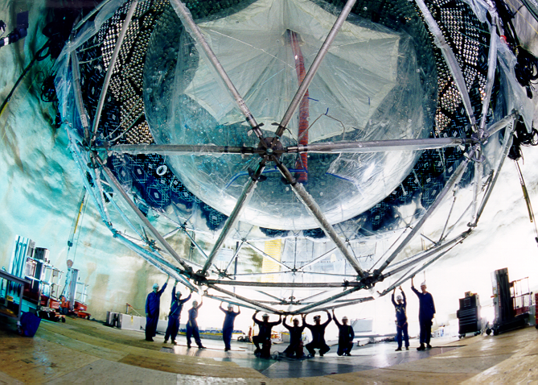
Discovery of Neutrino Oscillations
ICHEP 2016, Chicago, Aug. 8, 2016
Takaaki Kajita
Institute for Cosmic Ray Research, The Univ. of Tokyo

Slide 2
Outline
Early days
  - Solar neutrinos
  - Atmospheric neutrinos
Discovery of neutrino oscillations
  - Atmospheric neutrino oscillations
  - Solar neutrino oscillations
Status and future
Summary
Many thanks to Art McDonald for various information related to SNO
2

Slide 3
Early days
3

Slide 4
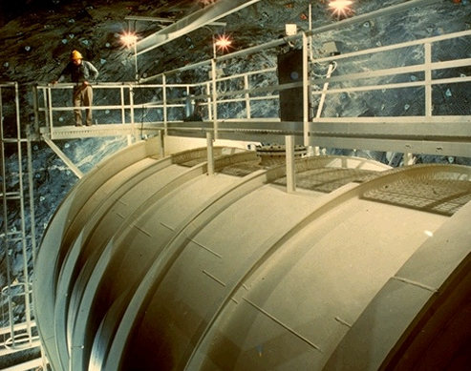
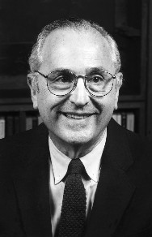
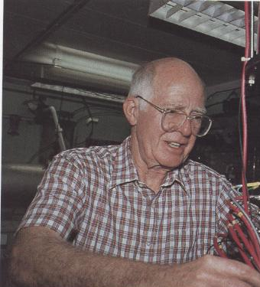
Solar neutrinos
R. Davis Jr.
Noble Laureate 2002
J. N. Bahcall
600ton
C₂Cl₄
Pioneering Homestake solar neutrino experiment observed only about 1/3 of the predicted solar neutrinos (1960’s).
4

Slide 5
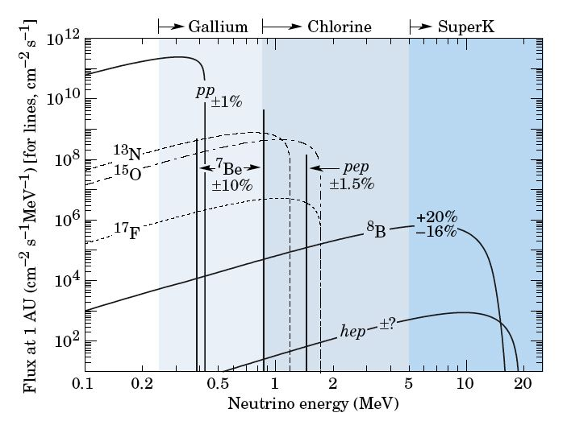
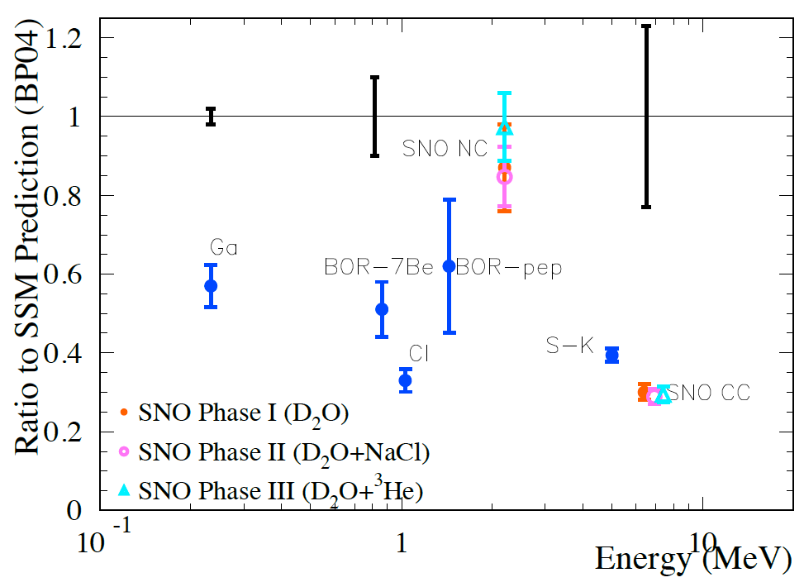
Results from solar neutrino experiments (before ~2000)
Bahcall et al.
^{Theory}
pp ν
⁸B ν
⁷Be, ⁸B ν
Subsequent solar neutrino experiments in the 80’s and 90’s confirmed the deficit of solar neutrinos.
5

Slide 6
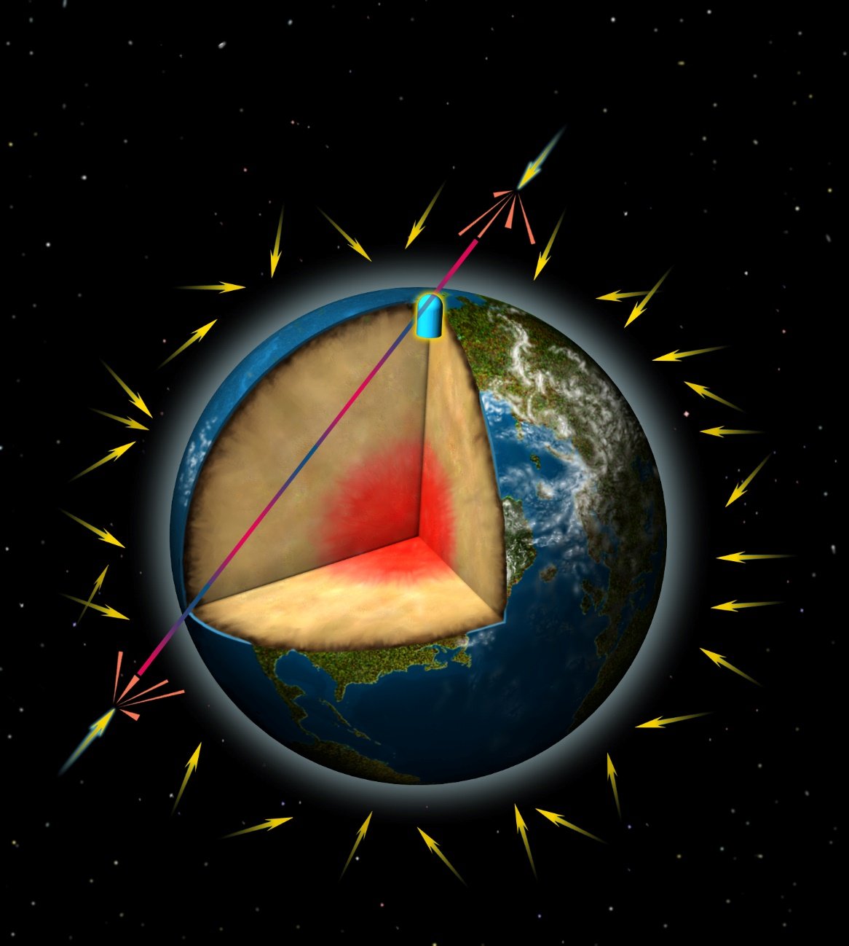
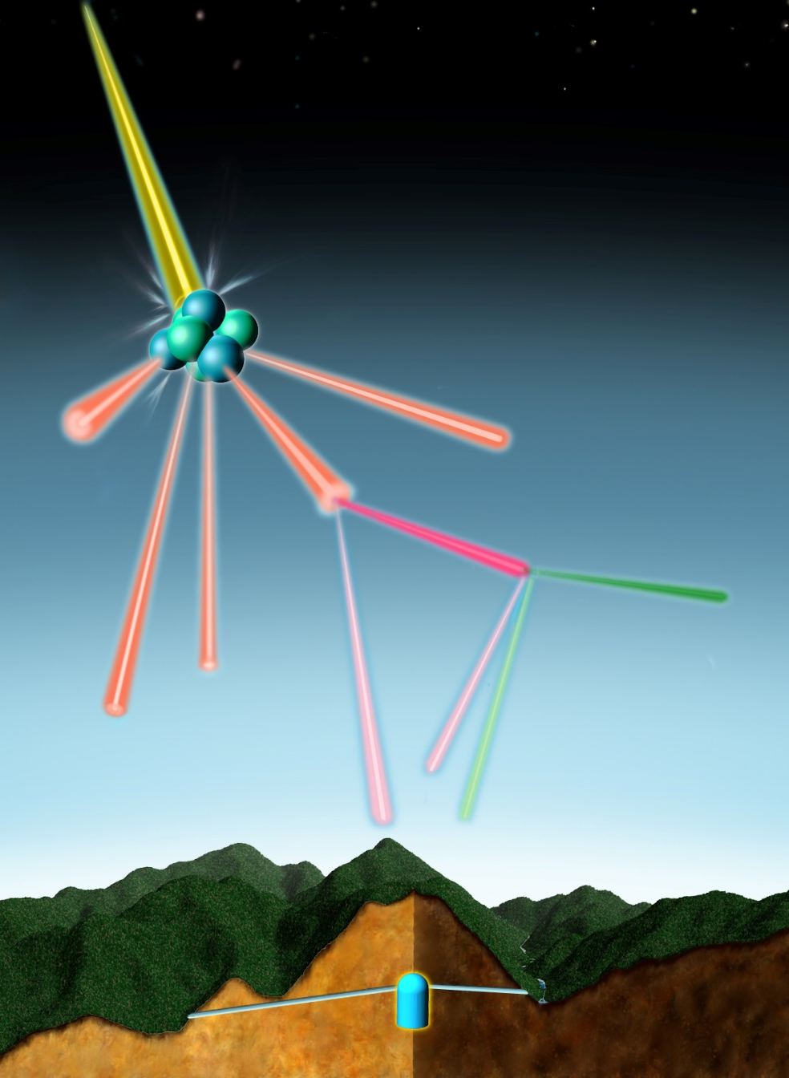
Atmospheric neutrinos
COSMIC RAY
INCOMING
COSMIC RAYS
AIR NUCLEUS
PION
Oscillating neutrino
MUON
ELECTRON
2 muon-neutrinos
1 electron-neutrino
Up/down ratio well understood (and 1).
Neutrinos travel long distances
ν_{μ} / ν_{e} ratio well understood
© David Fierstein, originally published in Scientific American, August 1999
6

Slide 7
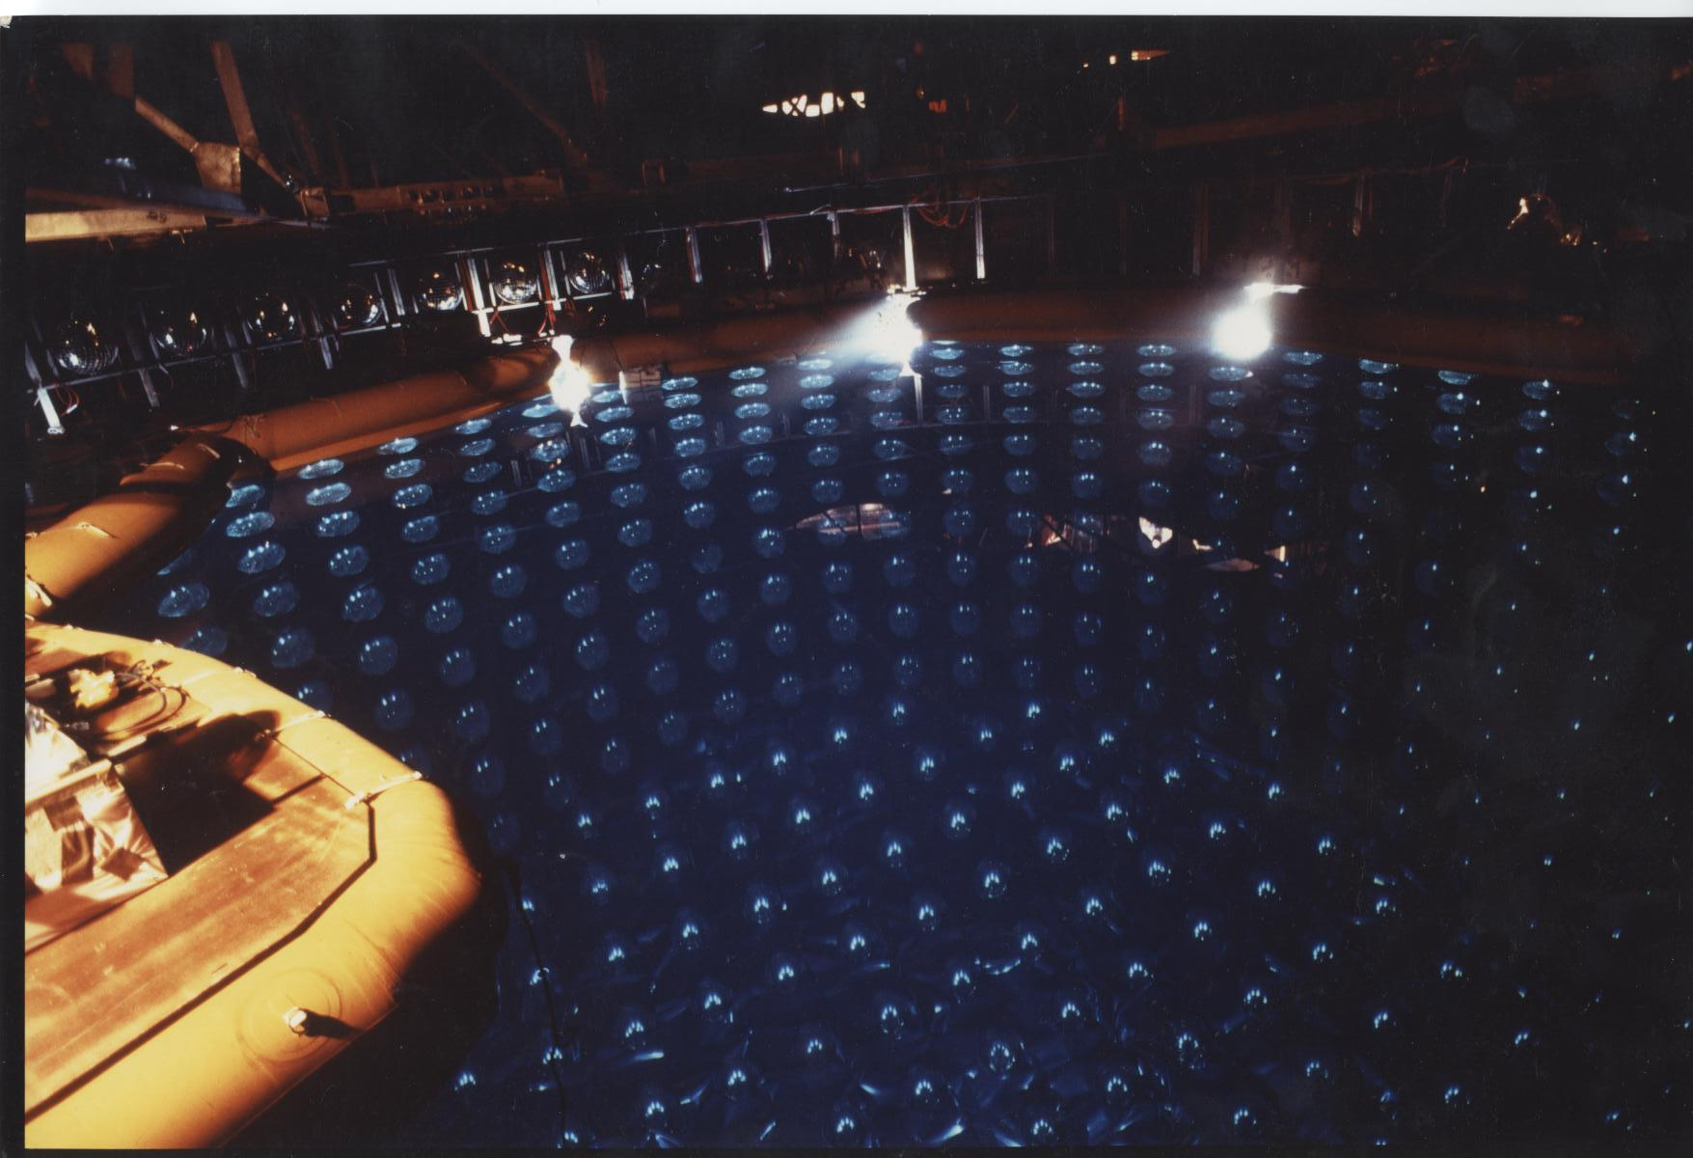
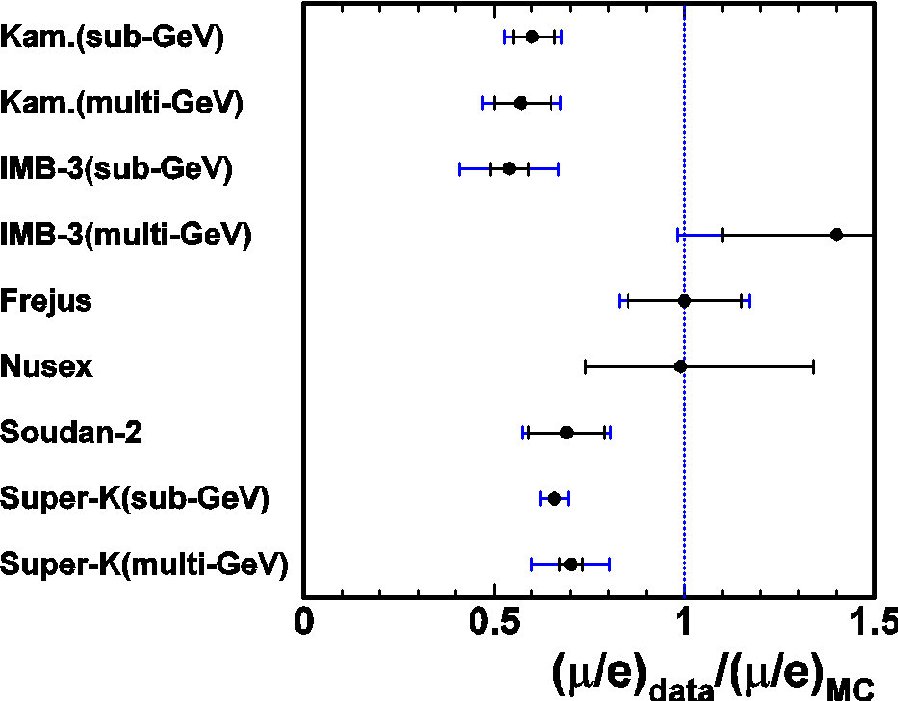
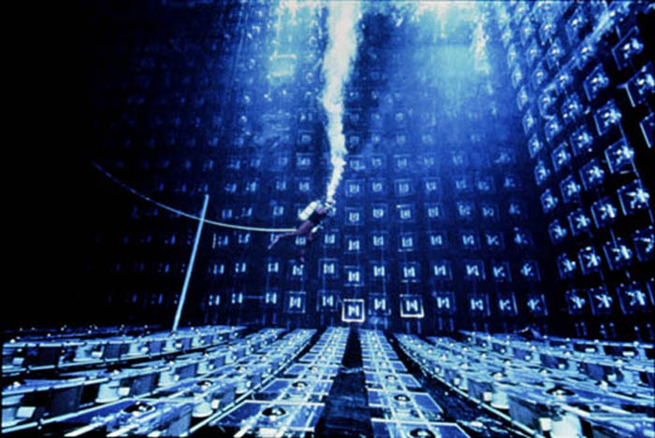
Atmospheric ν_{μ} deficit (1980’s to 90’s)
Proton decay experiments in the 1980’s observed many atmospheric neutrino events.
Because atmospheric neutrinos are the most serious background to the proton decay searches, it was necessary to understand atmospheric neutrino interactions.
During these studies, a significant deficit of atmospheric ν_{μ} events was observed.
Kamiokande (1988, 92, 94)
IMB (1991, 92)
7

Slide 8
Discovery of neutrino oscillations:
- Atmospheric neutrino oscillations
8

Slide 9
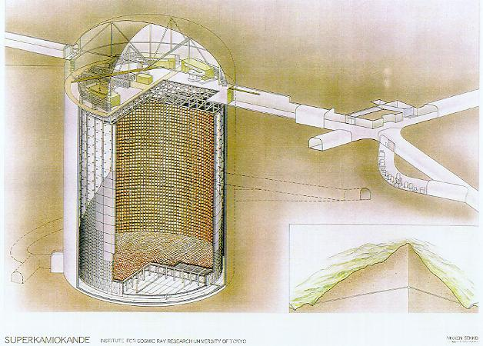
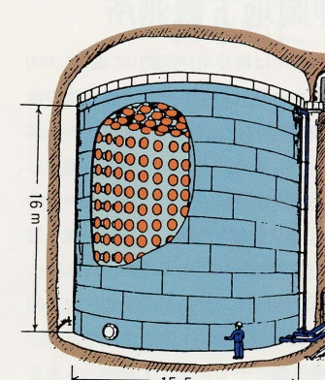








Super-Kamiokande detector
50,000 ton water Cherenkov detector (22,500 ton fiducial volume)
Exit
More than 20 times larger mass
~130 collaborators from:
４２ｍ
３９ｍ
１０００ｍ underground
9

Slide 10
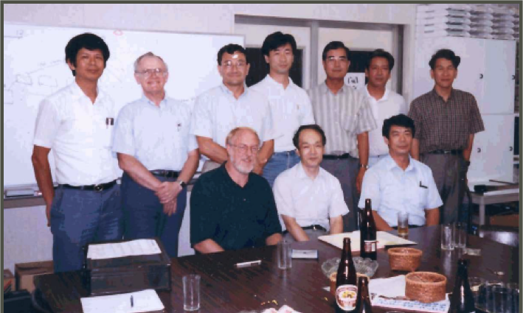
Beginning of the Super-Kamiokande collaboration between Japan and USA
Y. Totsuka
Y. Suzuki
TK
W. Kropp
H. Sobel
K. Nishikawa
A. Suzuki
@ Institute for Cosmic Ray Research, 1992
K. Nakamura
J. Arafune
(ICRR director)
J. Stone
10

Slide 11
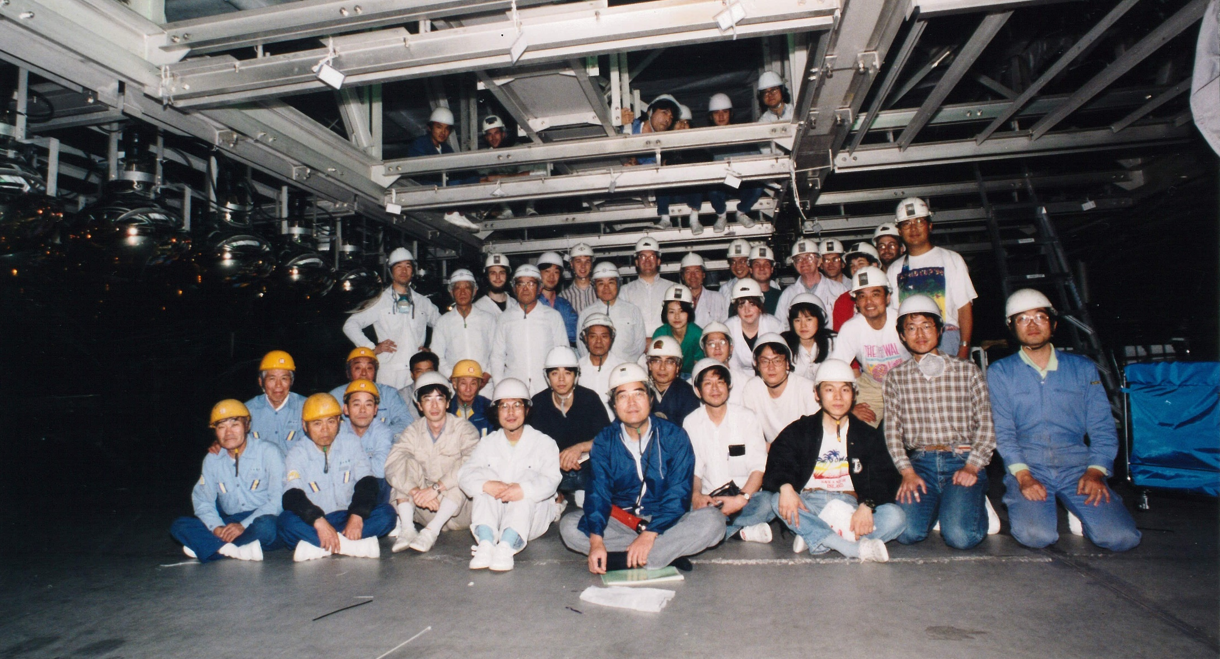
Constructing the Super-Kamiokande detector (spring 1995)
TK
Y.Suzuki
M. Nakahata
Y. Totsuka
11

Slide 12
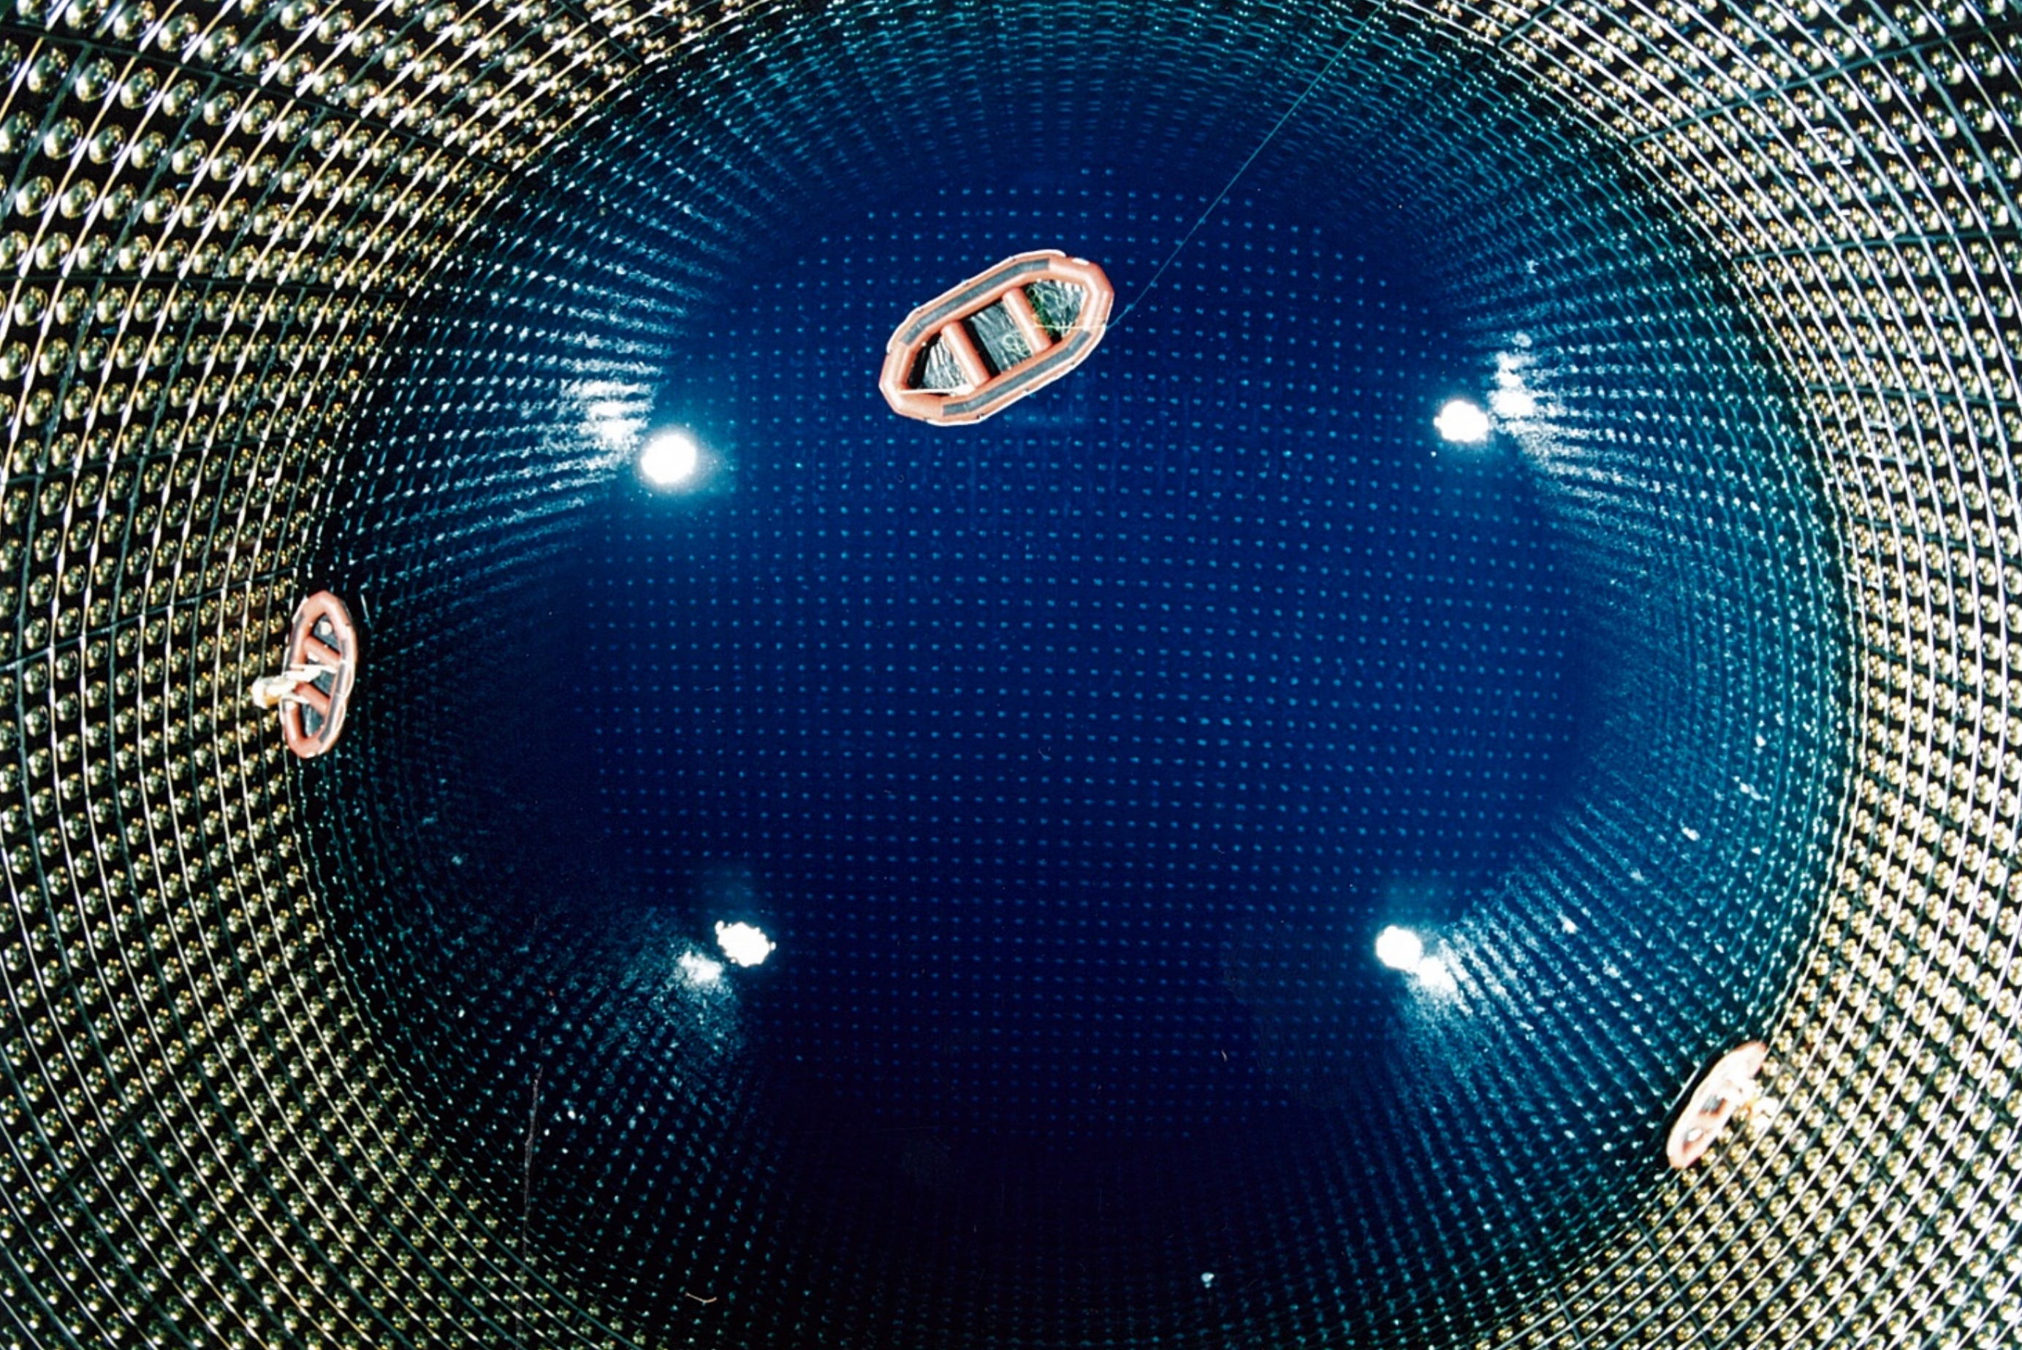
Filling water in Super-Kamiokande
Jan. 1996
12

Slide 13
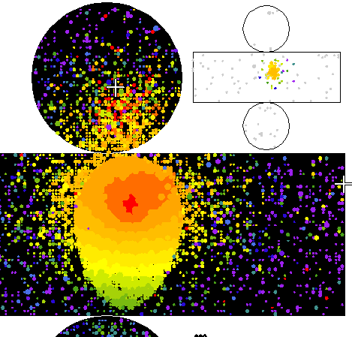
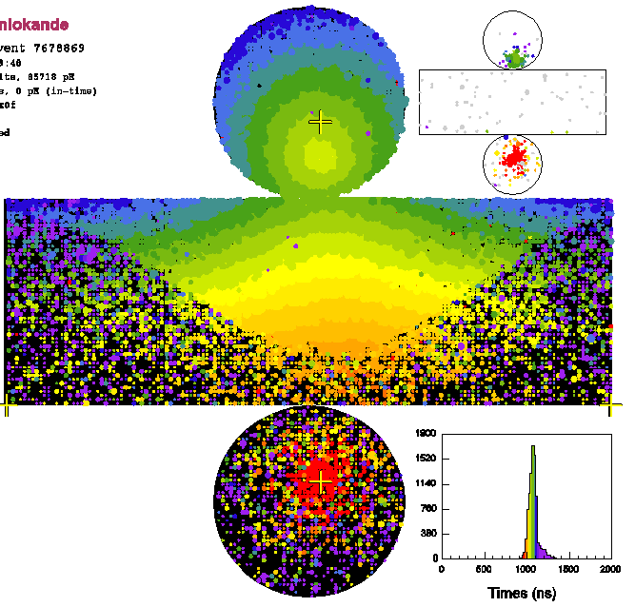
Event type and neutrino energy
Partially contained
1 ring μ-like
1 ring e-like
Upward going μ
All these events are used in the analysis.
13

Slide 14
What will happen if the ν_{μ} deficit is due to neutrino oscillations
Cosmic ray
Not long enough to oscillate
Down-going
Probability
(ν_{μ} remain ν_{μ})
Long enough to oscillate
Up-going
1 10 100 1000 10⁴
L(km) for 1GeV neutrinos
A deficit of upward going ν_{μ}’s should be observed! Kamiokande was too small. ➔ Super-Kamiokande
14

Slide 15
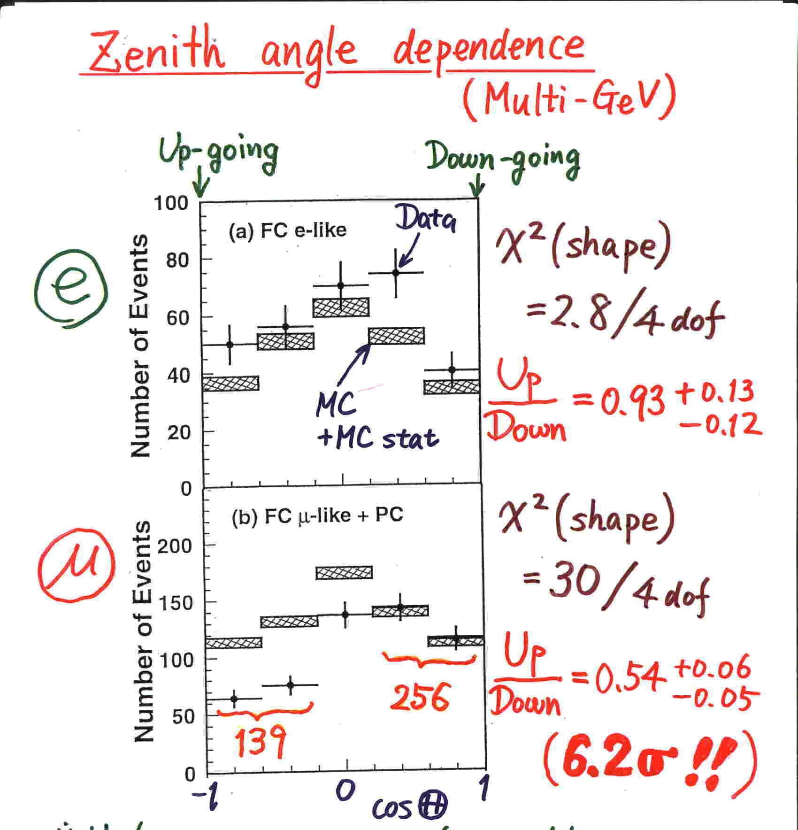
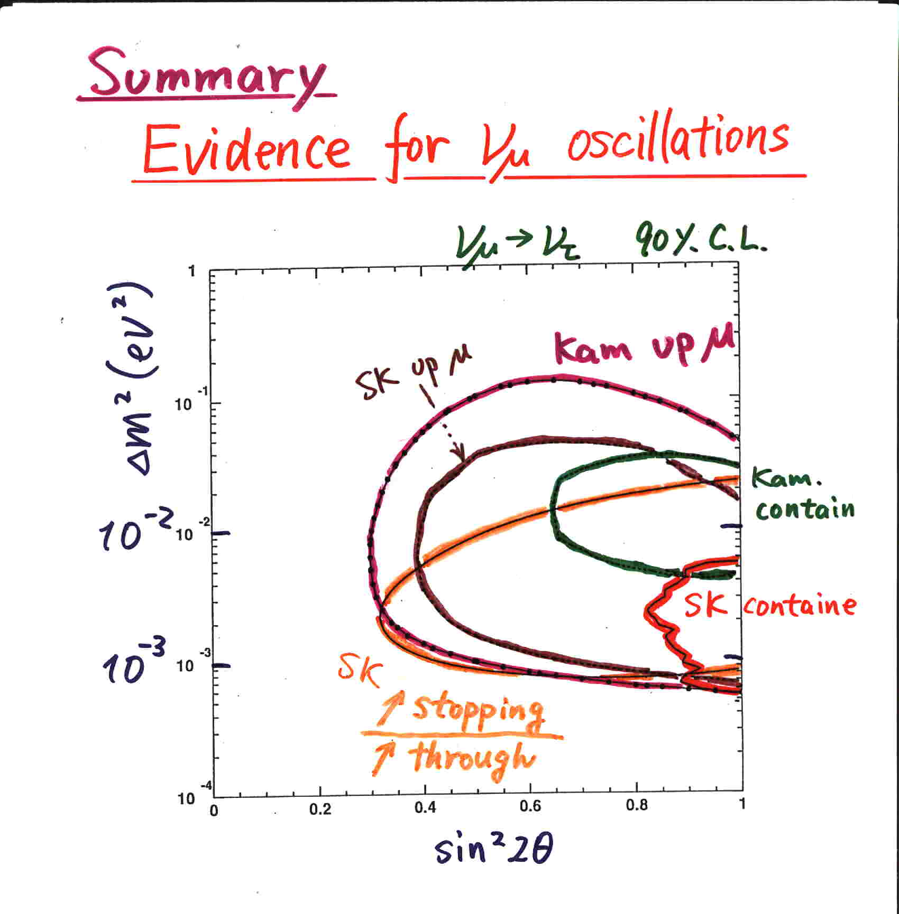
Evidence for neutrino oscillations (Super-Kamiokande @Neutrino ’98)
Y. Fukuda et al., PRL 81 (1998) 1562
Super-Kamiokande concluded that the observed zenith angle dependent deficit (and the other supporting data) gave evidence for neutrino oscillations.
15

Slide 16
Discovery of neutrino oscillations:
- Solar neutrino oscillations
16

Slide 17
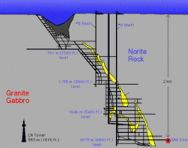
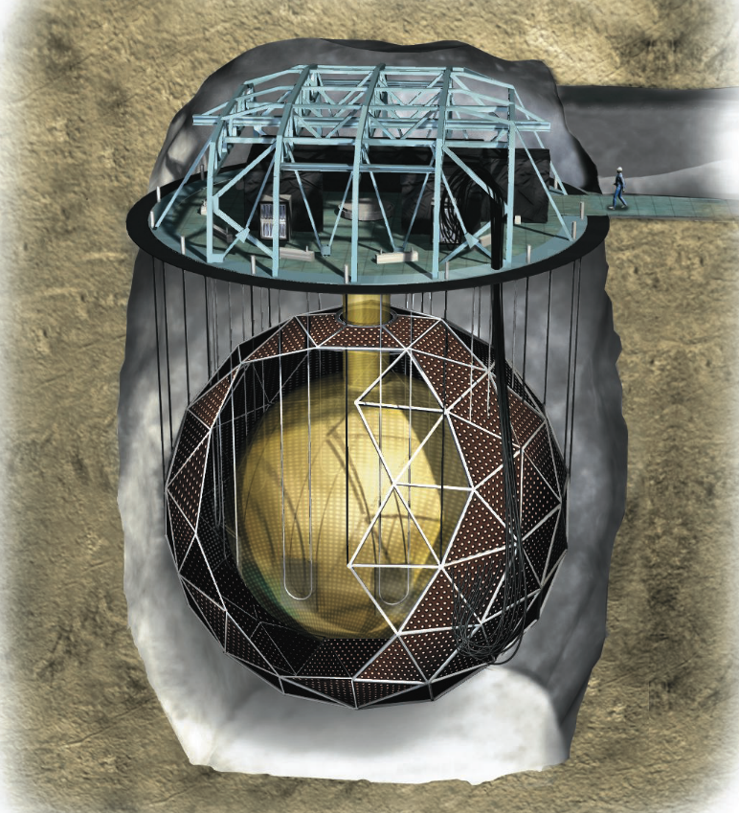

SNO detector
2km
1000 ton of heavy water

Slide 18

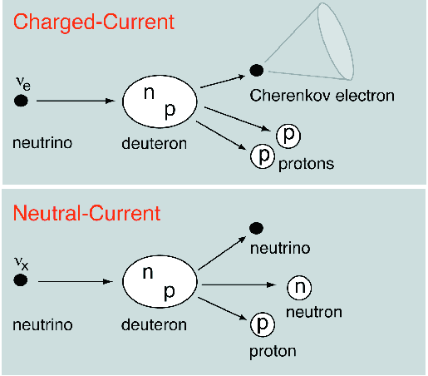
Unique signatures of heavy water (D₂O) experiments
Herbert Chen, PRL 55, 1534 (1985)
“Direct Approach to Resolve the Solar-neutrino Problem”
A direct approach to resolve the solar-neutrino problem would be to observe neutrinos by use of both neutral-current and charged-current reactions. Then, the total neutrino flux and the electron-neutrino flux would be separately determined to provide independent tests of the neutrino-oscillation hypothesis and the standard solar model. A large heavy-water Cherenkov detector, sensitive to neutrinos from ⁸B decay via the neutral-curent reaction ν+d→ν+p+n and the charged-current reaction ν_{e}+d→e⁻+p+p, is suggested for this purpose.

Slide 19
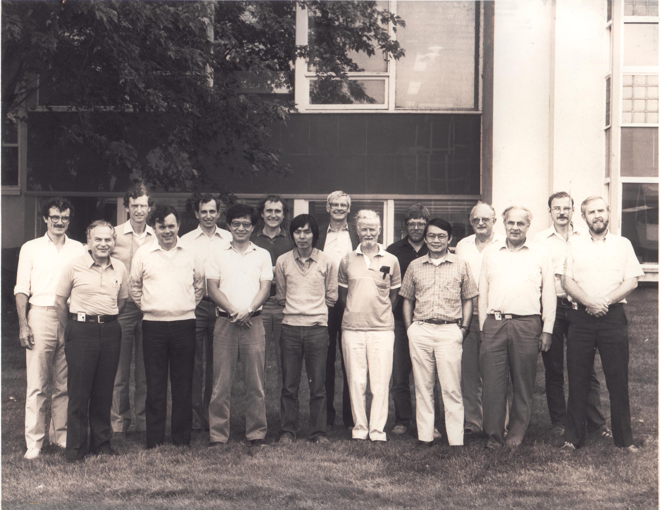
SNO Collaboration Meeting, Chalk River, 1986
McDonald
1987:US
1989:Director
1985
D.Sinclair: UK
Spokespersons
1984
G.Ewan: Canada
1984
H.Chen:
US
PROPOSAL TO BUILD A NEUTRINO OBSERVATORY IN SUDBURY, CANADA
D. Sinclair, A.L. Carter, D. Kessler, E.D. Earle, P. Jagam, J.J. Simpson, R.C. Allen, H.H. Chen, P.J. Doe, E.D. Hallman, W.F. Davidson, A.B. McDonald, R.S. Storey, G.T. Ewan, H.‑B. Mak, B.C. Robertson Il Nuovo Cimento C9, 308 (1986)

Slide 20
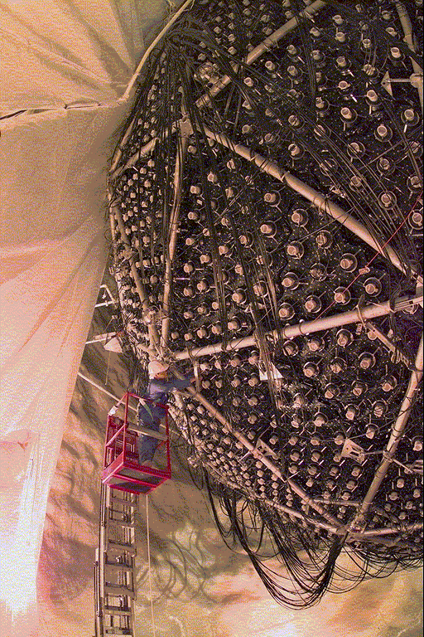
Constructing the SNO detector
One million pieces transported down in the 3 m x 3 m x 4 m mine cage and re-assembled under ultra-clean conditions.
Filled with pure and heavy water in April 1999.

Slide 21
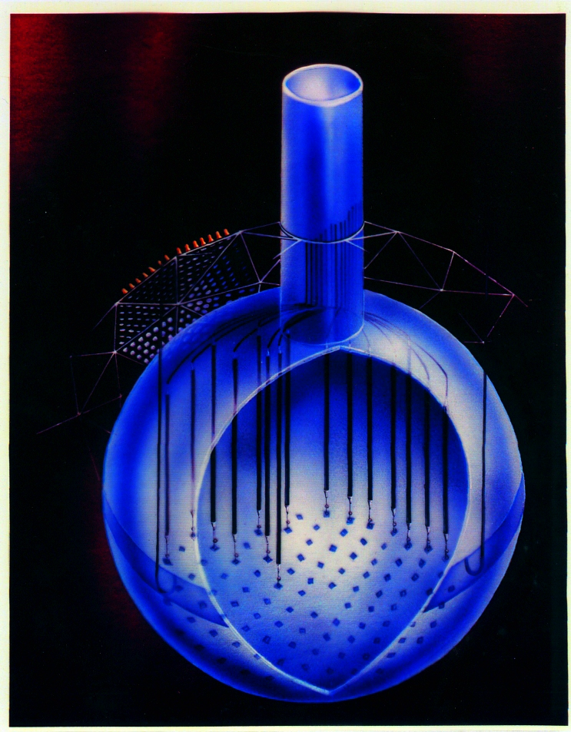
3 neutron detection methods (for νd → νpn measurement)
Phase I (D₂O)
Nov. 99 - May 01
Phase II (salt)
July 01 - Sep. 03
Phase III (³He)
Nov. 04-Dec. 06
n captures on
²H(n, γ)³H
Eff. ~14.4%
2 tonnes of NaCl
n captures on
³⁵Cl(n, γ)³⁶Cl
Eff. ~40%
400 m of proportional counters
³He(n, p)³H
Effc. ~ 30% capture
³⁵Cl+n
²H+n
8.6 MeV
6.25 MeV
³H
³⁶Cl

Slide 22
Evidence for solar neutrino oscillations
(A plot based on the salt-phase data)
SNO PRL 89 (2002) 011301
SNO PRC 72, 055502 (2005)
Three (or four) different measurements intersect at a point.
Evidence for (ν_{μ}+ν_{τ}) flux
SSM 68%CL
SNO NC 68%CL
SNO CC
68%CL
SNO ES 68%CL
SK ES 68%CL

Slide 23
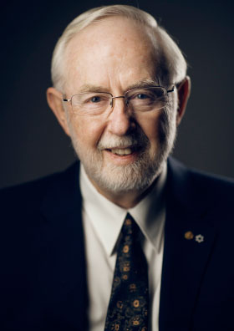
SNO results from 3 phases
all ν_{x}
^{Theory}
ν_{e}only
Art McDonald

Slide 24
Status and future
24

Slide 25
Neutrino oscillation studies
ν_{μ} → ν_{τ} oscillations (Δm₂₃, θ₂₃)
  Atmospheric: Super-K, Soudan-2, MACRO IceCube/Deepcore, …
  LBL: K2K, MINOS, OPERA, T2K, NOvA, …
ν_{e} → (ν_{μ}+ν_{τ}) oscillations (Δm₁₂, θ₁₂)
  Solar: SNO, Super-K, Borexino, …
  Reactor: KamLAND
θ₁₃ experiments
  LBL: MINOS, T2K, NOvA, …
  Reactor: Daya Bay, Reno, Double Chooz
Status (before Neutrino 2016)
Review of Particle Physics (2015)
K. Nakamura and S.T. Petcov, “14. Neutrino mass, mixing and oscillations”
Basic structure for 3 flavor oscillations has been understood!
25

Slide 26
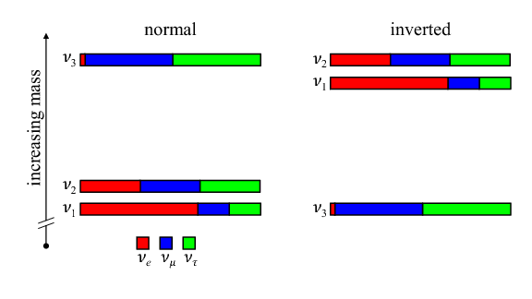
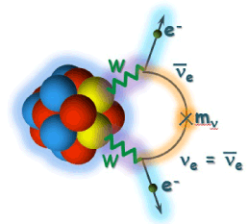
Agenda for the future neutrino measurements
Neutrino mass hierarchy?
CP violation?
?
Baryon asymmetry of the Universe?
Are neutrinos Majorana particles?
➔ Neutrinoless double beta decay
(taken from R. B. Patterson, Ann Rev Nucl Part Sci 65 (2015) 177-192.)
Absolute neutrino mass?
Beyond the 3 flavor framework?
(Sterile neutrinos?)
http://wwwkm.phys.sci.osaka-u.ac.jp/en/research/r01.html
26

Slide 27
Summary
“Proton decay experiments” in the 1980’s observed many contained atmospheric neutrino events, and discovered the atmospheric ν_{μ} deficit. Subsequently, in 1998, Super-Kamiokande discovered neutrino oscillations.
Solar neutrino experiments began in the 1960’s. Various solar neutrino experiments before 2000 observed the deficit of solar neutrinos. Then the SNO experiment discovered solar neutrino oscillations by the measurements of CC and NC reactions of solar neutrinos.
Since then, various experiments have studied neutrino oscillations.
The discovery of non-zero neutrino masses opened a window to study physics beyond the Standard Model of particle physics. Neutrinos might also be the key to understand the baryon asymmetry of the Universe.
It is very important to learn the most from neutrinos!
27

