Slide 1

LHC Accelerator Performance
Mike Lamont
for the LHC team

Slide 2
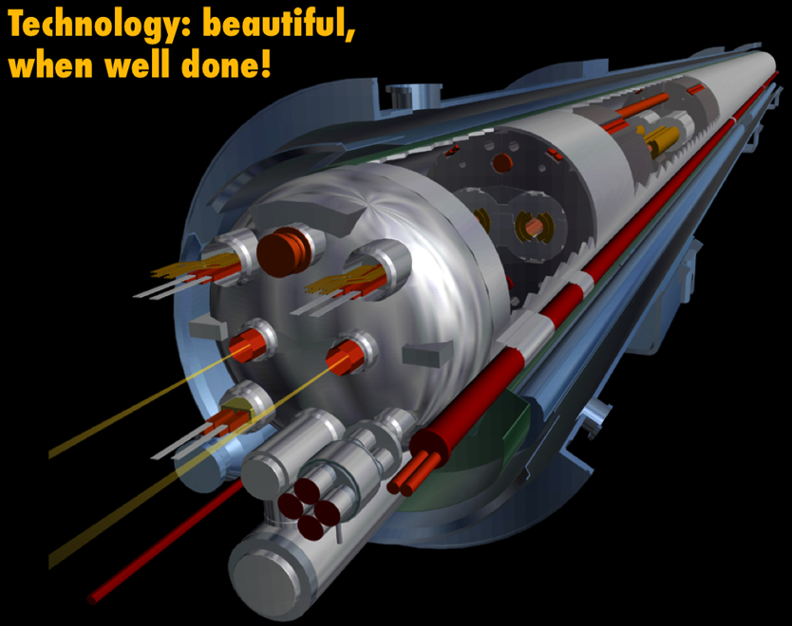
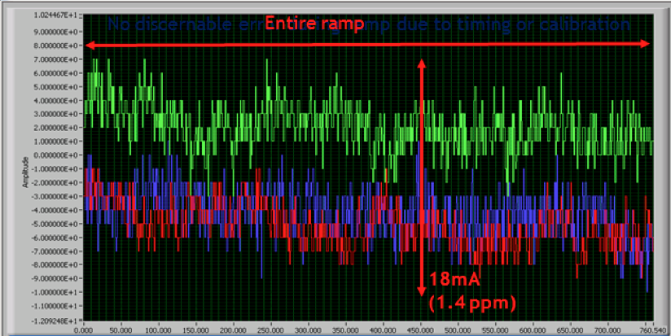
Exit Run 1(2010 – 2012)
Foundations well proven at 4 TeV
  Magnets, vacuum, cryogenics, RF, powering, instrumentation, collimation, beam dumps etc.
Huge amount of experience gained
  Operations, optics, collimation…
Healthy respect for machine protection
Main bend power converters: tracking error between sector 12 & 23 in ramp to 1.1 TeV

Slide 3
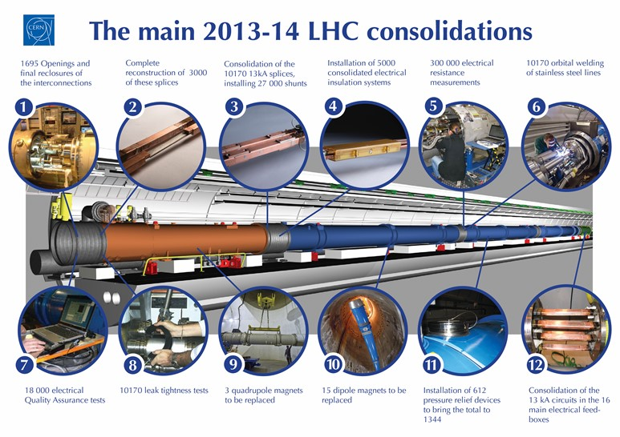
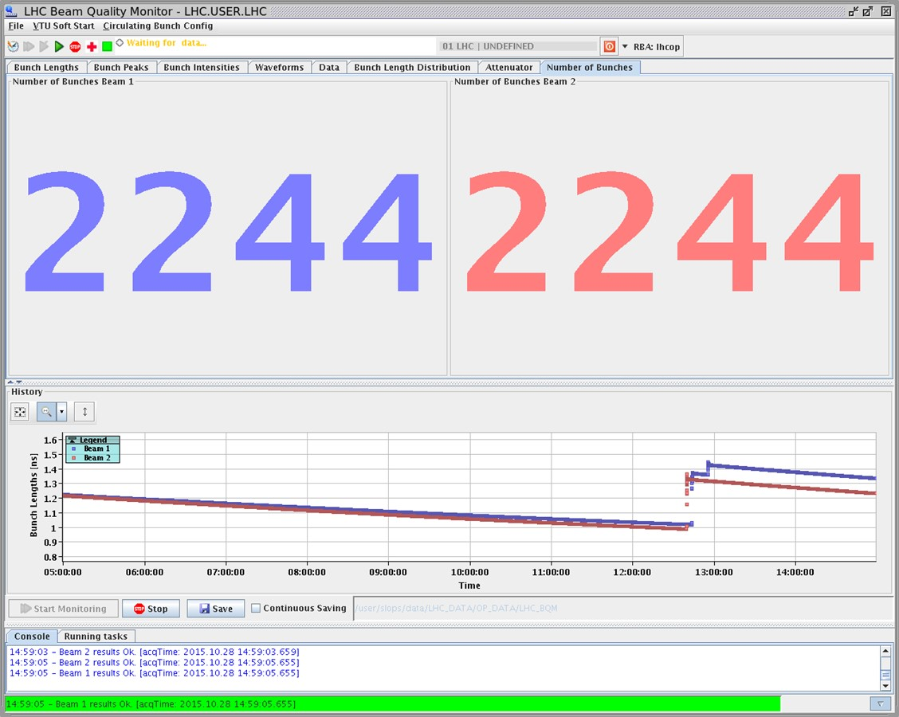
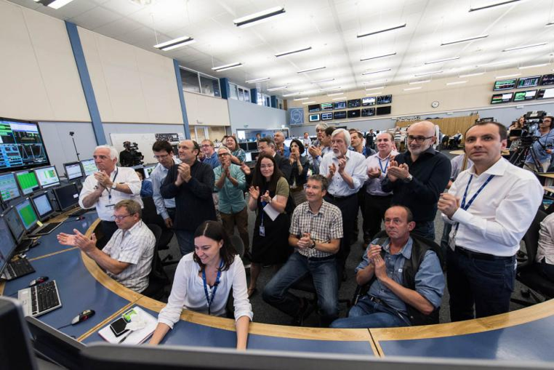

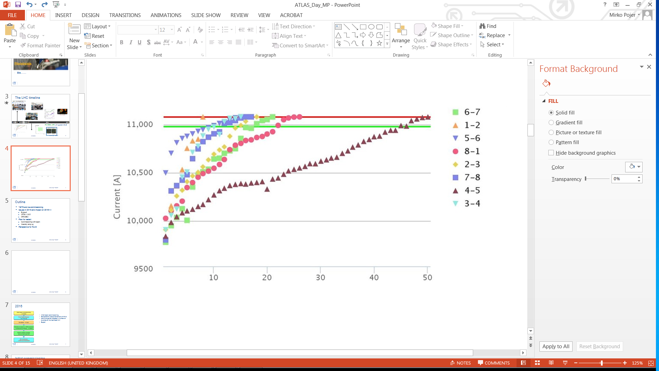
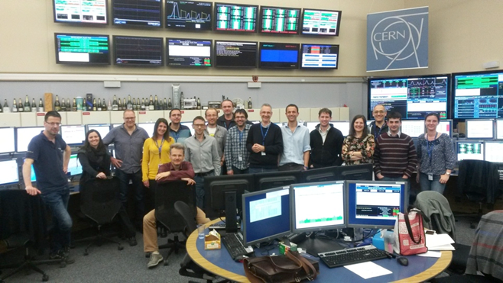
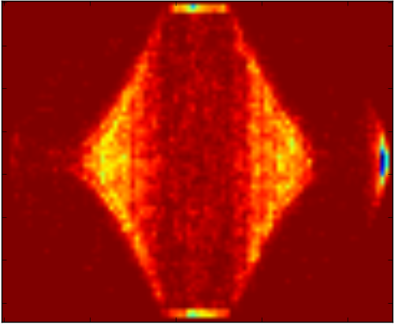
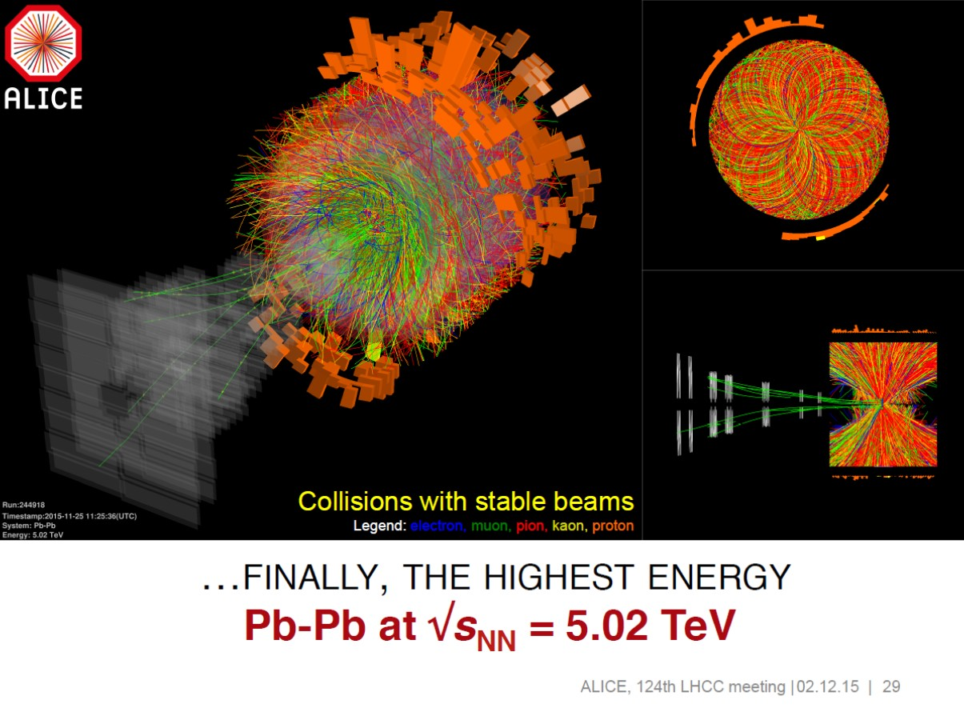

2013 - 2015
28th October
Physics with record number of bunches
Peak luminosity 5 x 10³³ cm⁻²s⁻¹
April ‘13 to Sep. ‘14
3rd June
First Stable Beams
5th April
1st B E A M
13-14
Aug 14-Apr 15
2015
Struggle
IONS
10th April
Beam at 6.5 TeV
Dipole training campaign

Slide 4
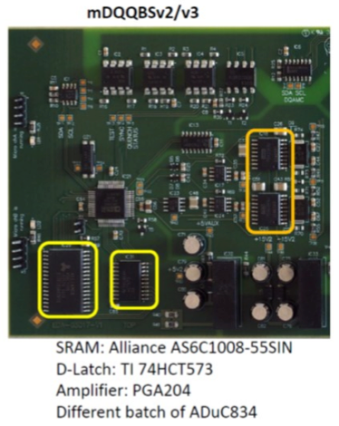
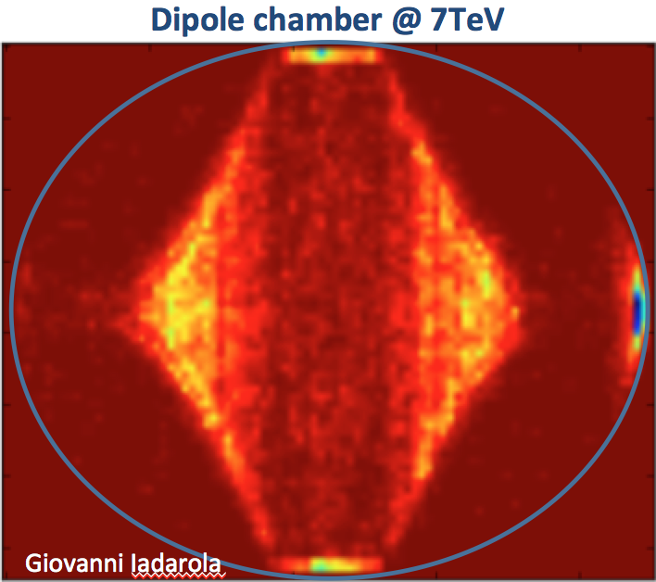
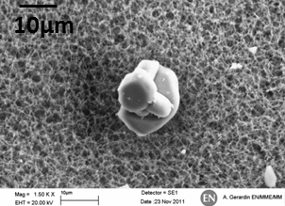
2015: re-commissioning year, relaxed parameters, some issues…
Electron cloud
Anticipated
Significant head load to cryogenics
UFOs
8 UFO dumps within 2 weeks (Sep 20 to Oct 5)
Conditioning observed
Radiation to electronics
Mitigation measures (shielding, relocation…)
Non-rad hard components used in LS1 upgrade
Exit 2015 with reasonable performance & hope for production in 2016

Slide 5
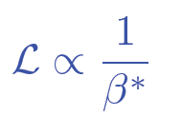
LHC 2016
Choose a relatively bold set of operational parameters based on past experience
Energy: 6.5 TeV
25 ns beam - nominal bunch population (~1.2e11)
Low emittance from injectors – variations possible
Squeeze harder in ATLAS and CMS
  beta* = 40 cm
  cf. 80 cm in 2015, 55 cm design

Slide 6
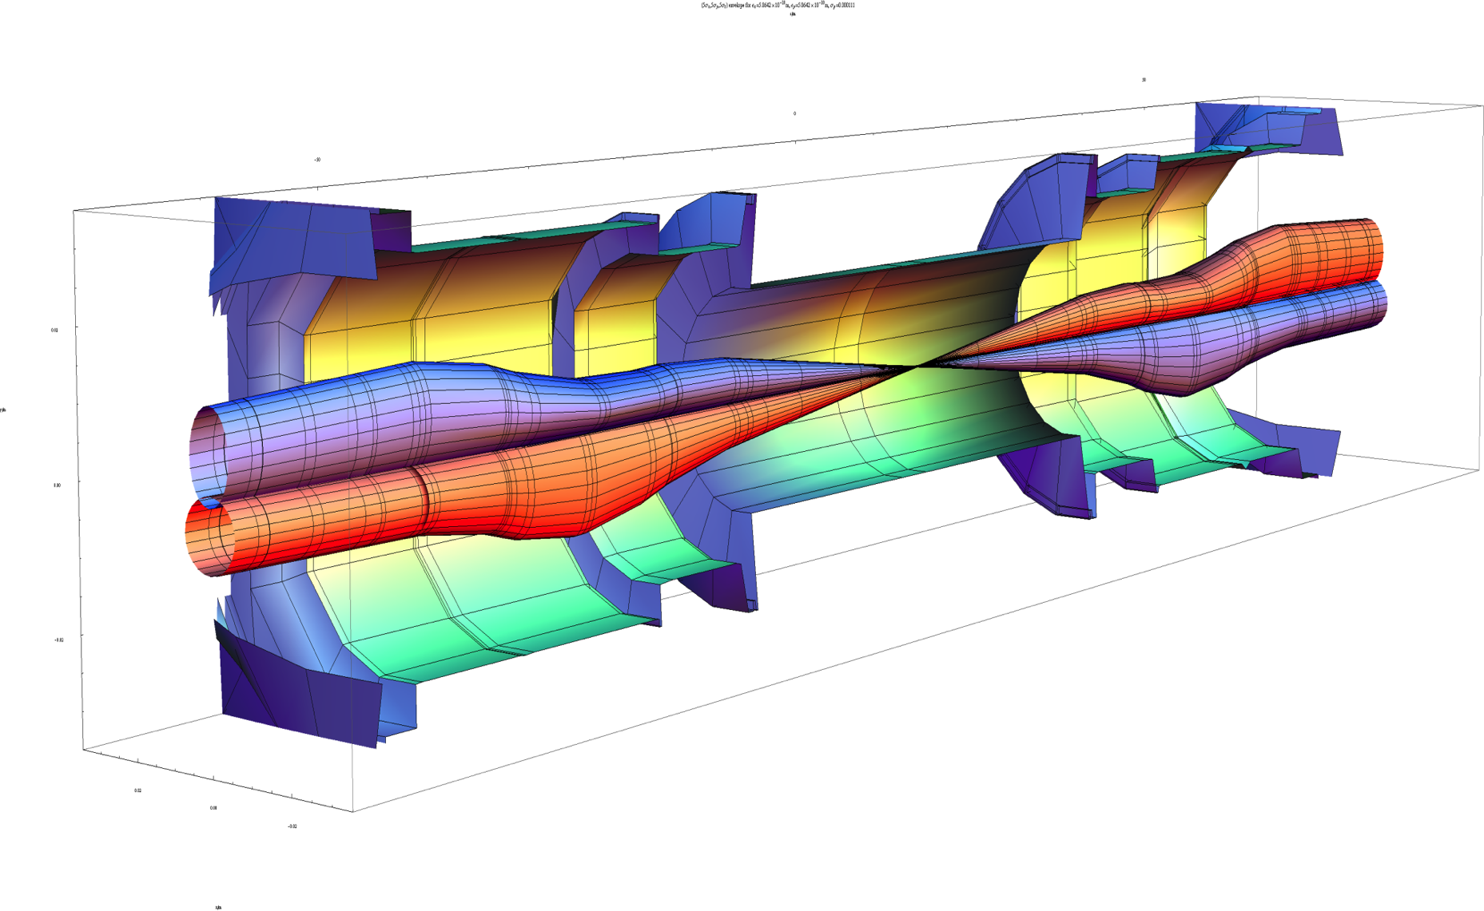
Squeeze in ATLAS/CMS
Lower beta* implies larger beams in the triplet magnets
Larger beams implies a larger crossing angle
Aperture concerns dictate caution – experience counts
β_{triplet} | Sigma triplet | β* | Sigma*
~4.5 km | 1.5 mm | 40 cm | 13 um
Image courtesy John Jowett

Slide 7

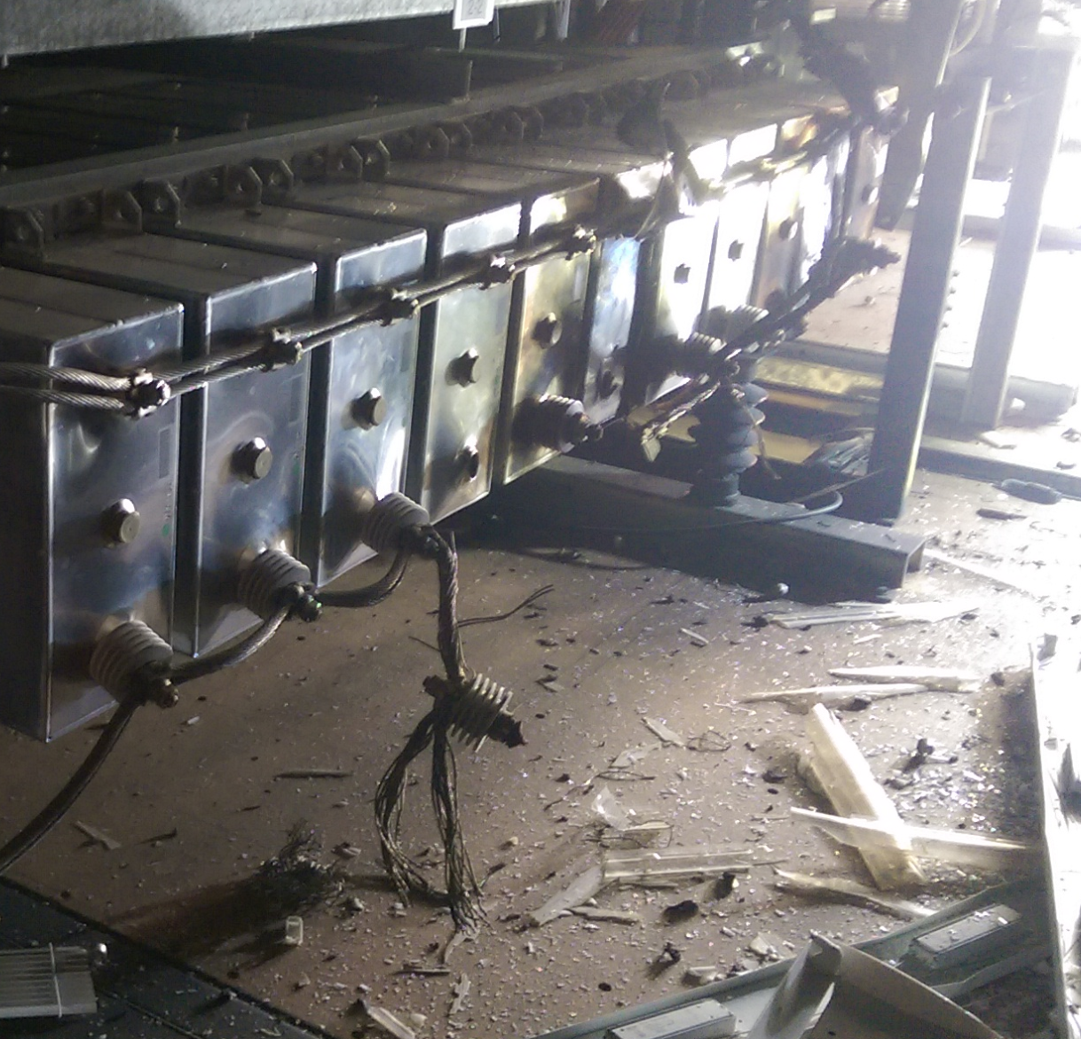
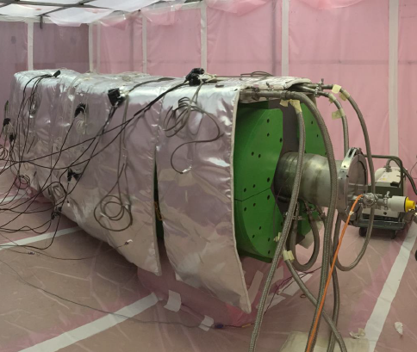
Overcome a few problems
WEASEL
PS MAIN POWER SUPPLY
SPS BEAM DUMP
Limited to 96 bunches per injection
2076 bunches per beam cf. 2750

Slide 8
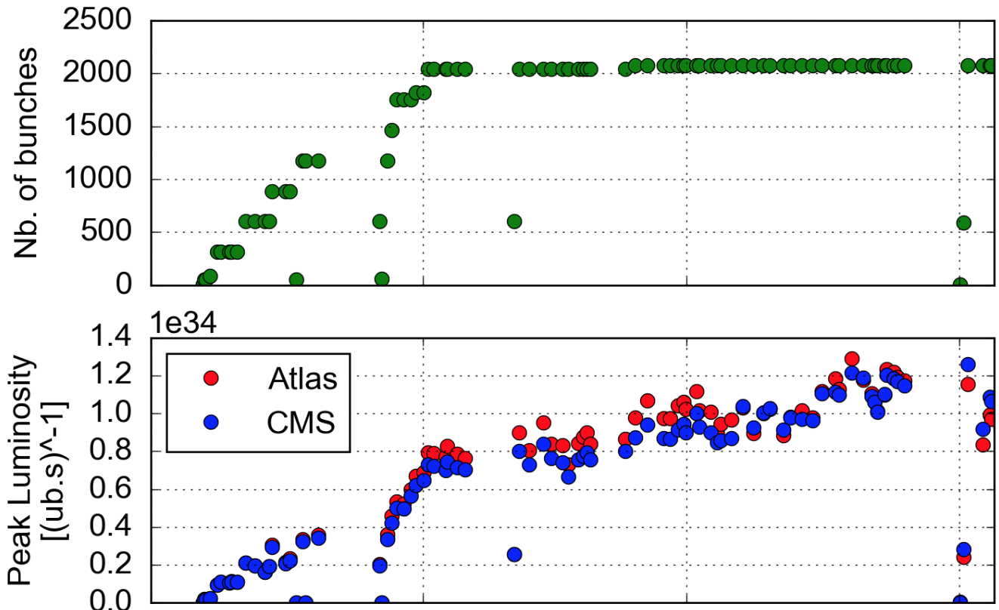

Peak luminosity
Reasonably quick ramp-up in number of bunches
  Limited by SPS beam dump to ~2100
  Electron cloud still very much with us but effects under control
10³⁴
Lower emittance from injectors
LHCb and ALICE: levelled operation at ~3x10³² and ~2x10³⁰ cm⁻²s⁻¹ respectively

Slide 9
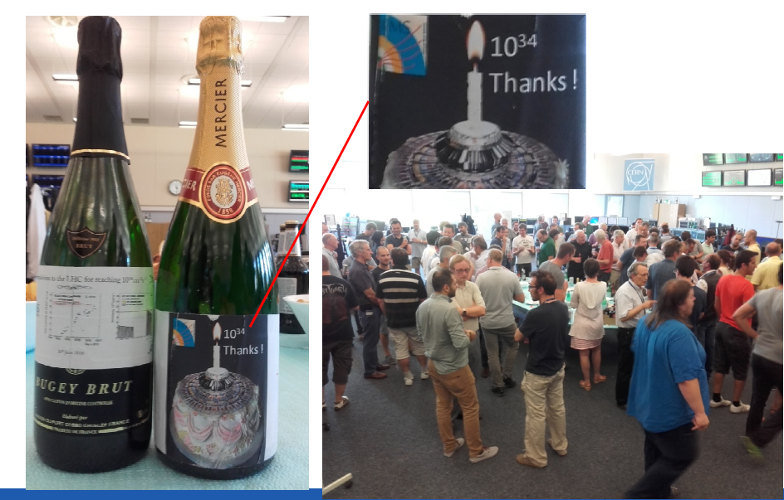
Design luminosity reached
  Reduced beta* and lower transverse beam sizes from the injectors compensating the lower number of bunches

Slide 10
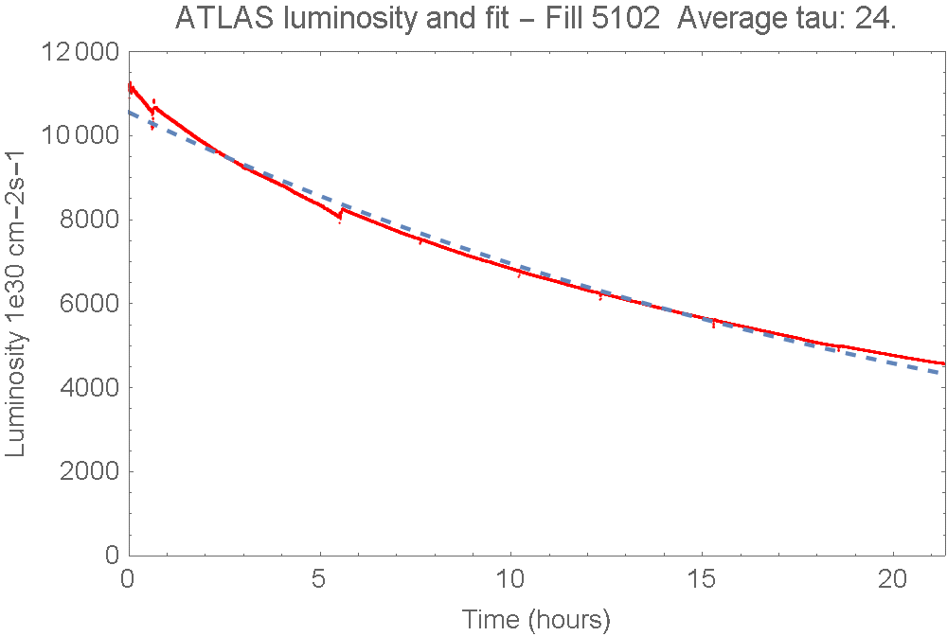
Luminosity lifetime
Excellent luminosity lifetime – main component - proton loss to inelastic collisions in ATLAS, CMS and LHCb

Slide 11
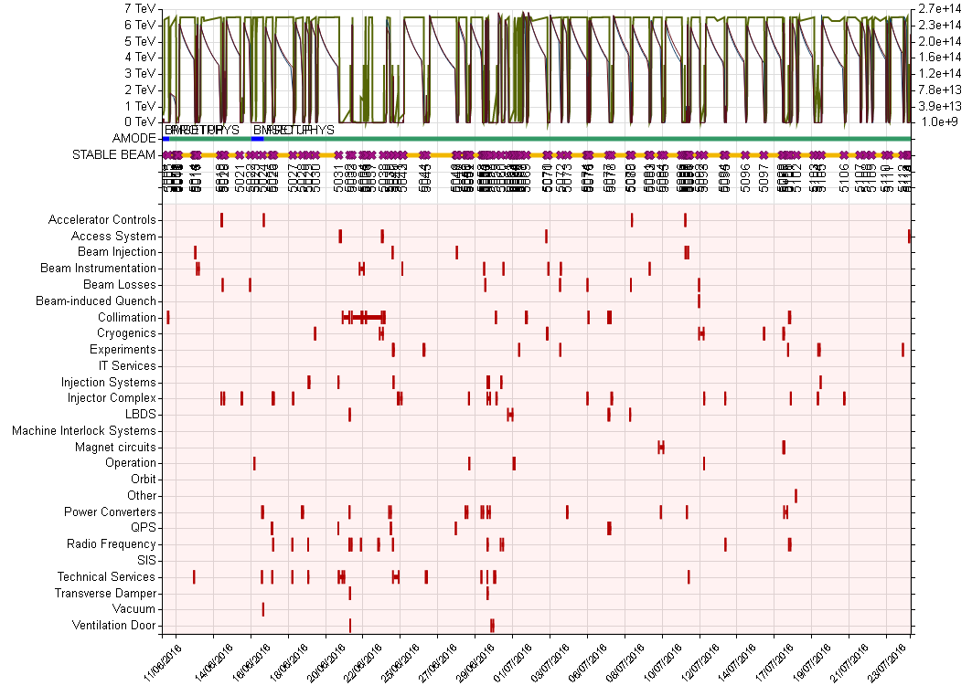
Then enjoy some remarkable availability
Heartbeat
Things that can go wrong
6 weeks

Slide 12
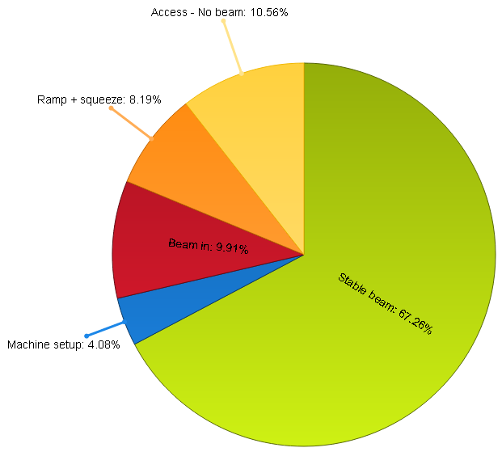
Availability: 11th June – 23rd July
Stable Beams 67%

Slide 13
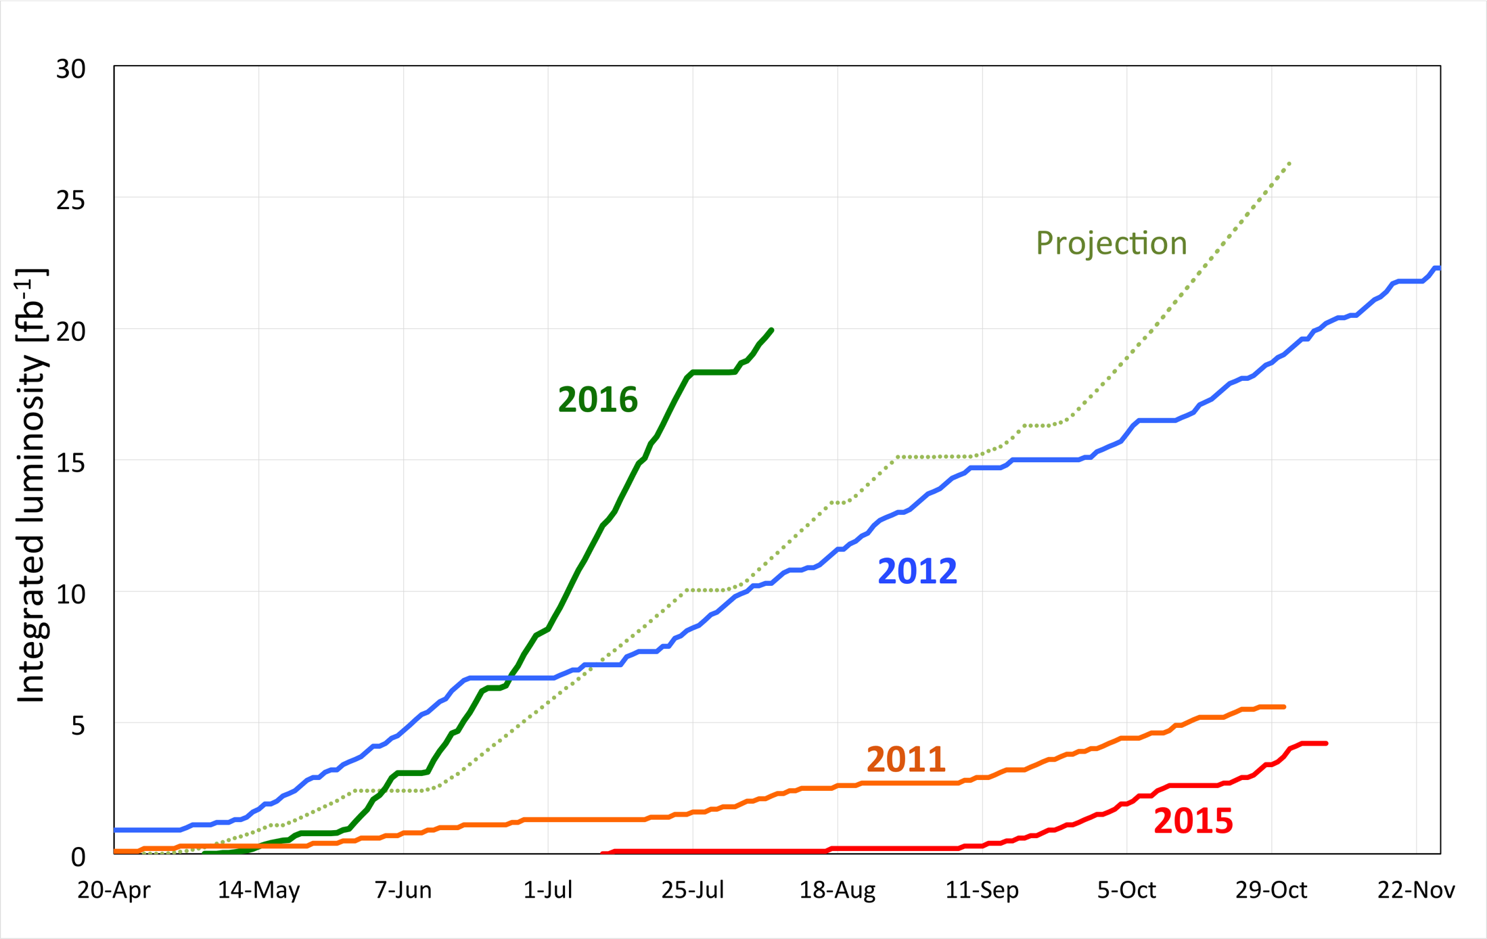
Integrated luminosity
~20 fb⁻¹ delivered to ATLAS & CMS
3 fb⁻¹/very good week

Slide 14

2016
No one is more surprised than we are
Good peak luminosity, excellent luminosity lifetime
Stunning availability
  Sustained effort from hardware groups
Few premature dumps – long fills
  UFO rate down, radiation to electronics mitigated

Slide 15
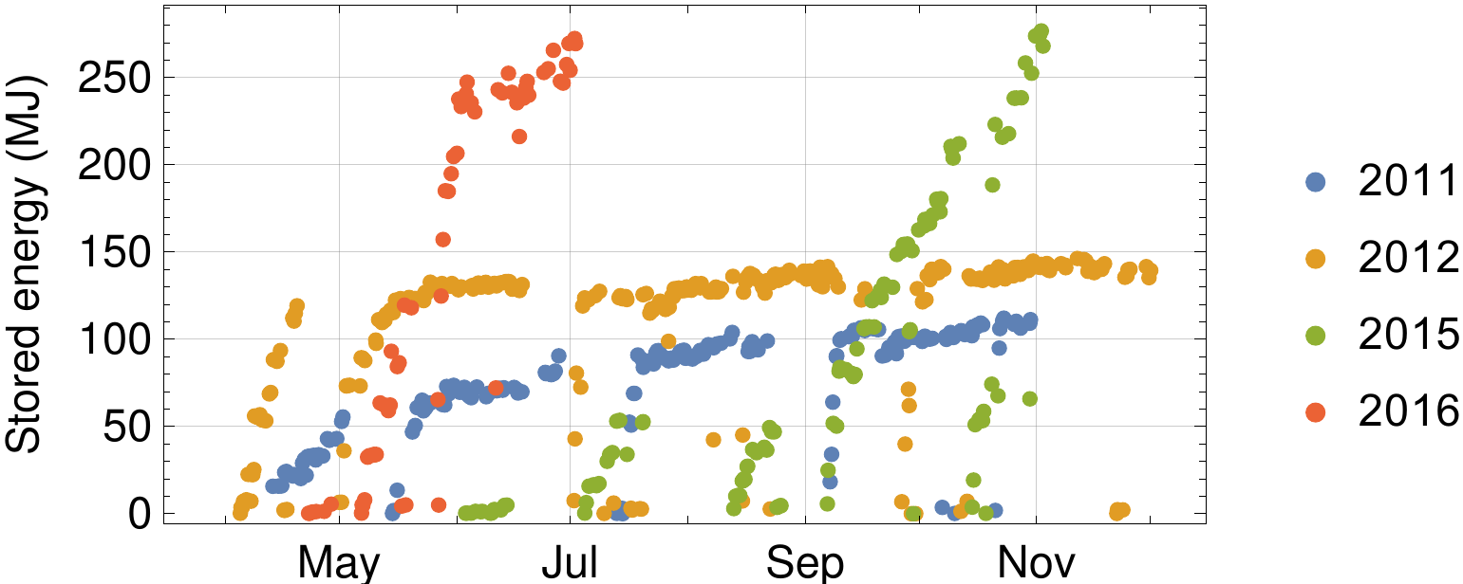
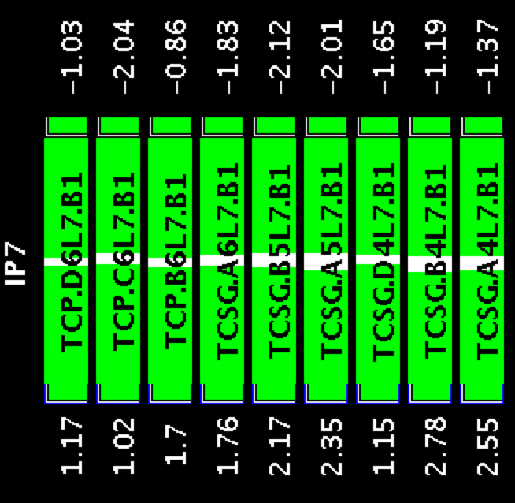
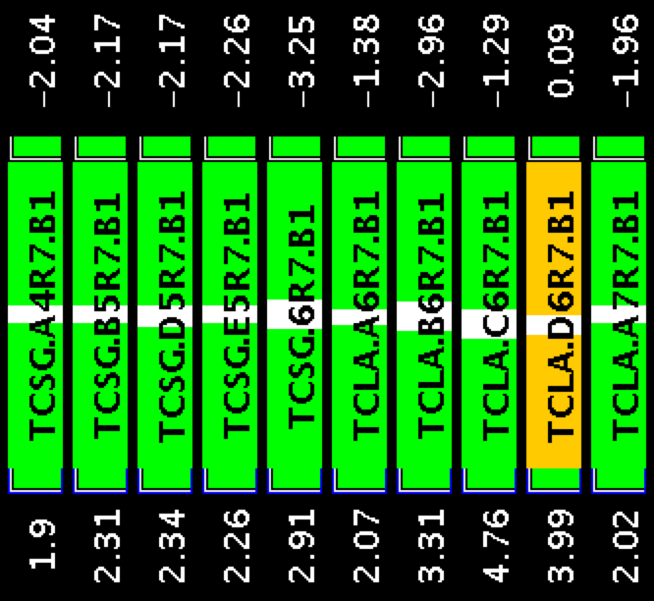
Stored energy per beam
B1 collimators IP7
Beam 1
2.2 mm gap

Slide 16
Machine status - summary
Excellent and improved system performance
Good beam lifetime through the cycle
Operationally things well under control
Magnetically reproducible as ever
Optically good, corrected to excellent
Aperture is fine and compatible with the collimation hierarchy.
Magnets behaving well at 6.5 TeV

Slide 17
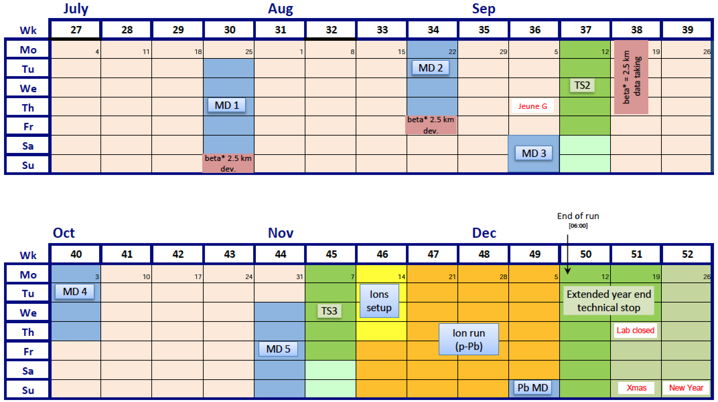
Incoming 2016
~9 weeks of proton physics left…
Proton-lead run at √s_{NN} of 5 and 8 TeV

Slide 18
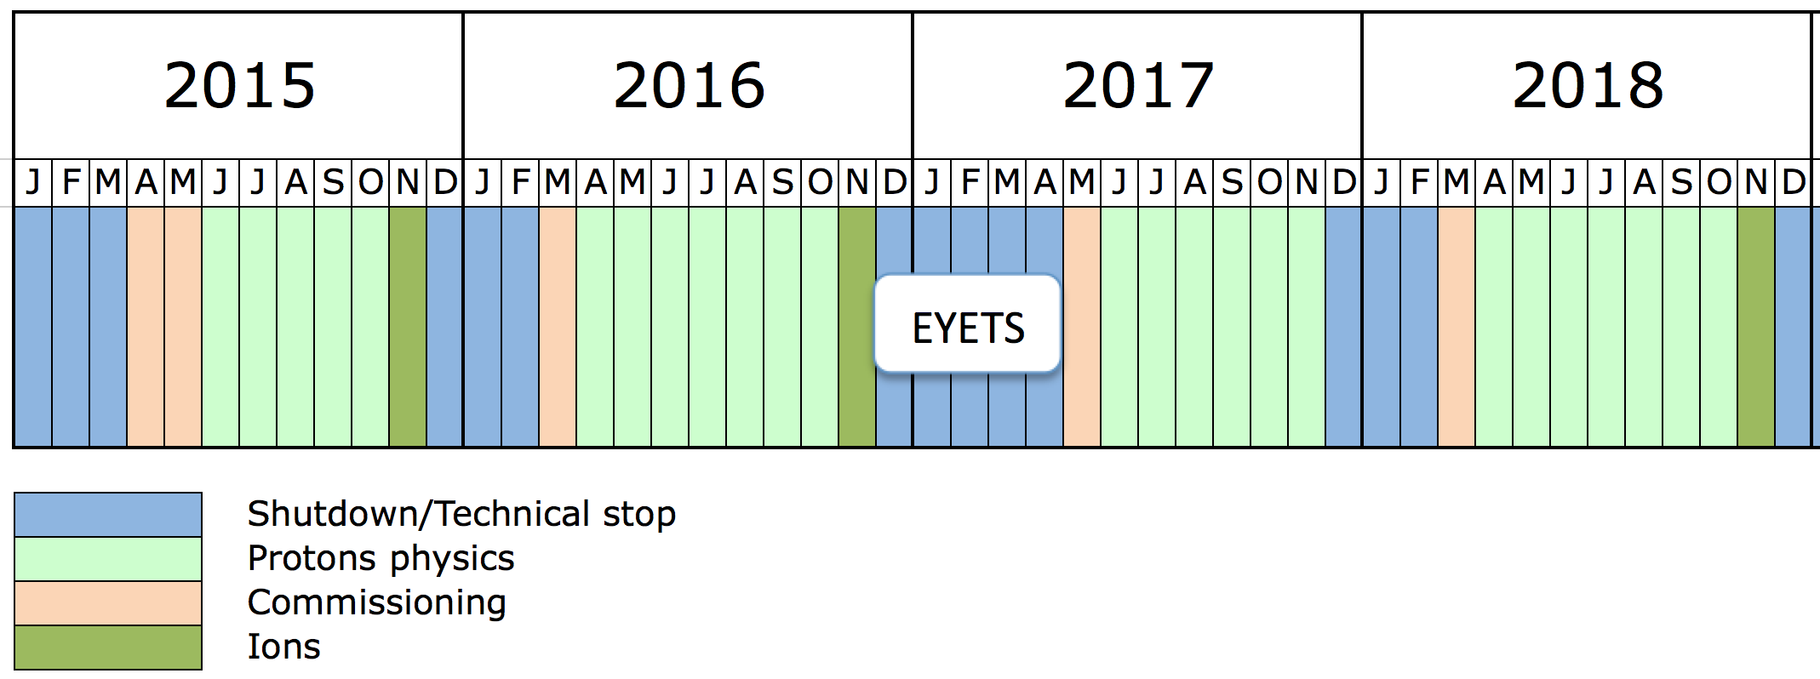
Run 2
Extended Year End Technical Stop – 20 weeks
CMS pixel upgrade; push 2 sectors towards 7 TeV
Peak luminosity limited to ~1.7e34 by inner triplets
~40 fb⁻¹/year in 2017 and 2018
Prepare for HL-LHC and post-LS2 LIU era
Prepare for 7 TeV operation

Slide 19
Conclusions (1/2)
Excellent peak performance
  Design luminosity (squeeze, beams from injectors)
  Still margin for improvement in Run 2
Good integrated delivery
  Remarkable availability
  Electron cloud conditioning slowly
  Fortunate that UFOs have conditioned down

Slide 20
Conclusions 2/2
Moved from commissioning to exploitation
LHC is enjoying the benefits of the decades long international design, construction, installation effort – foundations are good
Huge amount of experience & understanding gained and fed-forward
Progress represents a phenomenal ongoing effort by all the teams involved.

Slide 21

Please don’t do this!

Slide 22
Backup

Slide 23
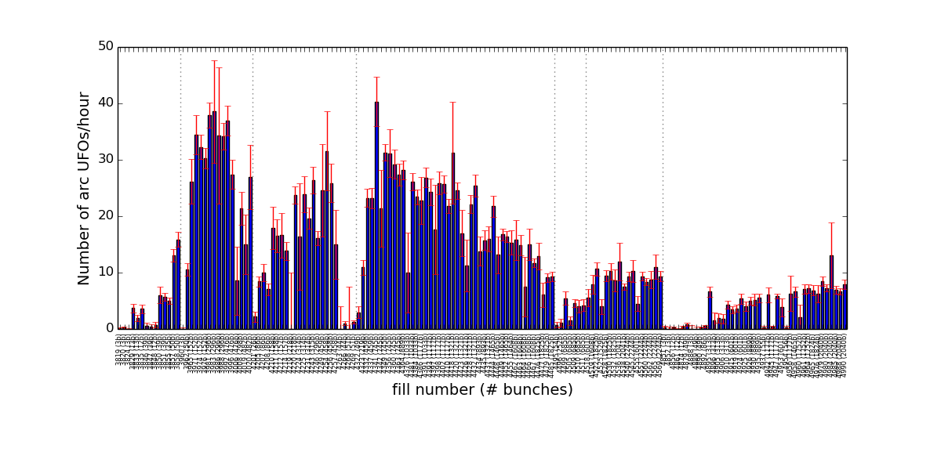
UFOs: Run 2 so far
2015
2016
arc UFOs (cell >11): rates similar to end of 2015
  did not lose conditioning over the Xmas stop

Slide 24
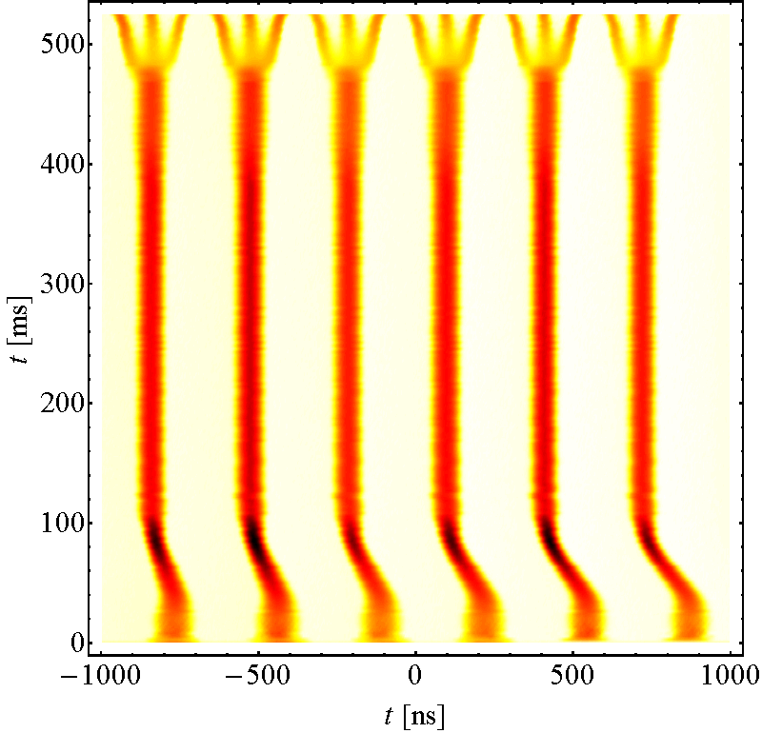
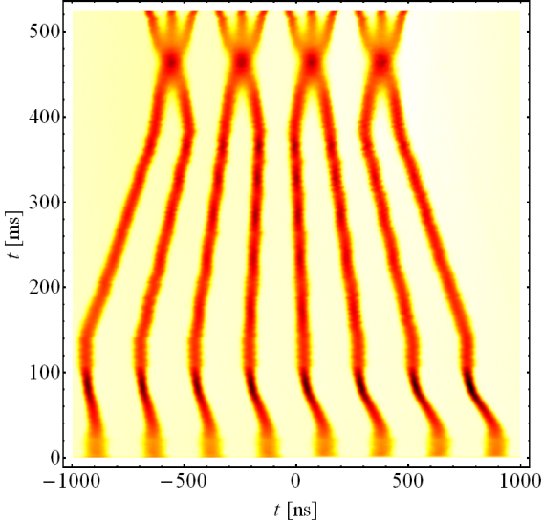
Beam from injectors
Lower than nominal emittance taken a step further
BCMS
(Batch Compression, Merging & Splitting)
Standard 25 ns scheme
PS circumference
Lower intensity, smaller bunches from PSB

Slide 25
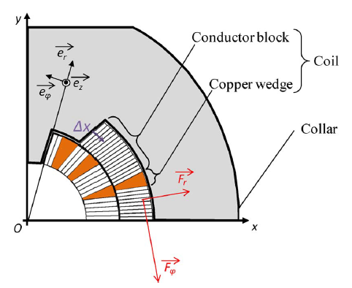
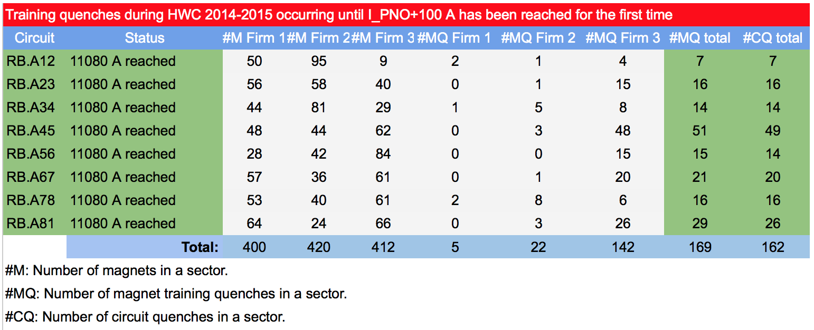
Dipole training 2/2
Training: frictional energy released during conductor motion
Campaign summary
All magnets have been trained to well over 7 TeV in SM18 before installation
Extensive re-training in situ was not expected

