Slide 2
WLCG HTTP* Deployment TF
DPM workshop
* + HTTPS + WebDAV + S3 ++
Oliver Keeble

Slide 3
Why?
All the pieces are now in place for HEP exploitation of the HTTP protocol.
Atlas and LHCb (at least) are developing their HTTP infrastructures.
The majority of storage systems are able to offer an HTTP interface.
ROOT support is available via davix, and studies have shown that this can allow HTTP to reach a performance comparable with that of the xroot protocol.
Projects are exploring how cloud data resources could be exploited, and in many scenarios this involves HTTP (S3), so the time is right to shake out the last problems.
At the moment there are many site misconfigurations and instabilities which could be tracked and fixed at the WLCG level for all experiments

Slide 4
Mandate
Define the minimum set of useful functions which must work for a site to "support HTTP for WLCG". Document what further functionality is desirable over HTTP, under what circumstances, and with what priority.
Put in place the necessary monitoring and validation tools.
Summarise advice for sites on deployment. Create baseline version information for the storage systems. Identify necessary changes to supporting services.
Track and support the deployment on the infrastructure until the point where maintenance is transferred to standard experiment operations.

Slide 5
Status
Twiki & mailinglist set up
  https://twiki.cern.ch/twiki/bin/view/LCG/HTTPDeployment
Membership
  Experiments - Atlas, CMS & LHCb
  Sites/Infrastructures - ASGC, BNL, CERN, GridPP, KIT, PIC & TRIUMF
  Storage systems - dCache, DPM, EOS, StorRM, xrootd
  WLCG monitoring is represented
5 meetings have occurred
  1st – setup, scope
  2nd – functional description of necessary interface
  3rd – strategy for monitoring & validation
  4th & 5th – finalising steps required to start contacting sites

Slide 6
Functionality
Full text
  https://twiki.cern.ch/twiki/bin/view/LCG/HTTPTFStorageRecommendations
TOC
  Basic Methods
  Authentication and Authorisation
  Space Reporting
  Checksums
  3rd party copy
  ACL Management
  Traffic Monitoring
  BDII Integration

Slide 7
Access monitoring
Transfers and access using gridftp and xroot are currently monitored on the infrastructure
  http://dashb-wlcg-transfers.cern.ch/ui/#
HTTP will have to be represented here too.
The TF agreed on two valid approaches:
  A properly formatted UDP stream, as implemented in the xrootd f-stream.
  Access summaries conforming to a documented json schema delivered over the messaging system
    http://wdtmon.web.cern.ch/wdtmon/dash/http.html (under review)
DPM (and xrootd of course) support the xrootd f-stream solution. dCache and StoRM will consider their options.

Slide 8
Monitoring/Validation
A shared probe has been provided for integration with the experiments’ SAM instances
Tests reflect the functionality identified as “required” by the TF (more detail in twiki)
  Plus auxiliary checks to aid operational debugging
  A failed PUT, ie read-only access, is acceptable (ie green) but visible

Slide 9
Site validation
GGUS Support Unit and all the necessary lists have been set up
Monitoring is happening, fed by endpoint lists from the experiments
  https://etf-atlas-preprod.cern.ch/etf/check_mk/index.py
  https://etf-lhcb-preprod.cern.ch/etf/check_mk/index.py
    Above LHCb link may not yet be active…
An operational plan has been drawn up and some test tickets have been dispatched

Slide 10
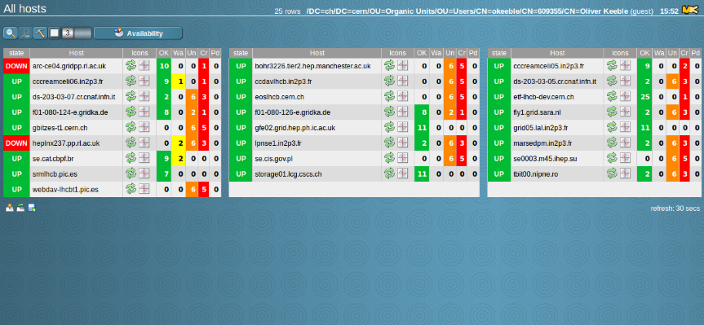
A view of the LHCb endpoints

Slide 11
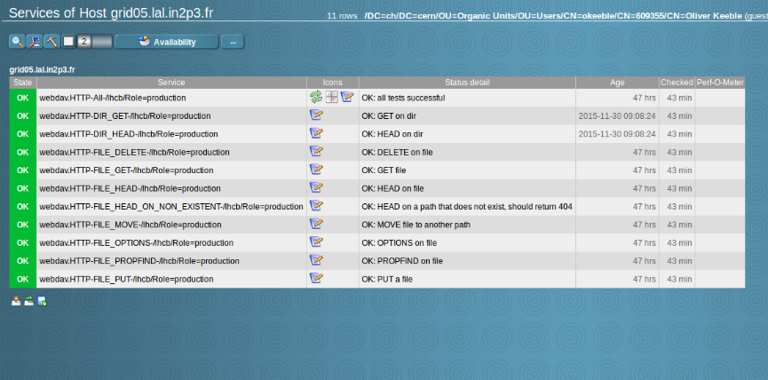
Well done LAL!

Slide 12
The DPM perspective
DPM has had a particular mission to be HTTP friendly
We want it to be possible to support HEP and other sciences with the leanest possible system
  This means HTTP
DPM HTTP checklist;
  Access – functionally complete, good performance, even with ROOT analysis thanks to Davix
  Transfer – 3rd party copy supported, even to S3
  Reporting – space used available via DAV
Sylvain will start testing such a system, with only HTTP and GridFTP interfaces

Slide 13
DPM & the HTTP TF
A large part of the motivation behind the HTTP initiative in WLCG is to make site management easier
The aim of the TF is to give the experiments a chance to fully embrace HTTP
  That depends upon the quality of service they find on the infrastructure
  If they adopt it, this will permit much simpler services to be run at sites
…so please help when we send you a ticket!!

Slide 14
Next Steps for the TF
Finalise visualisation of test results
  Check_MK interface
  SAM3 interface
Approve the operational plan
Start ticketing sites
Complete the docs the TF will deliver
  Required HTTP functionality
  How to implement transfer monitoring feeds

