Slide 1

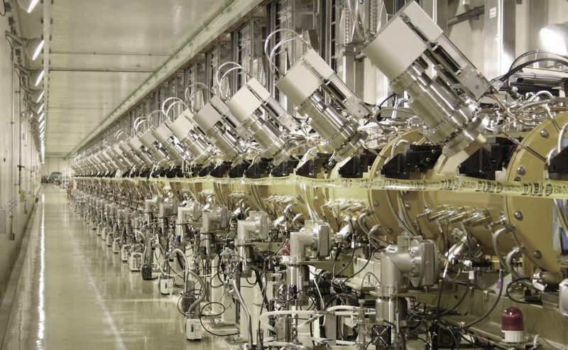
Module 1
Why linear accelerators
Basic linac structure
Acceleration in periodic structures

Slide 2
Definitions
Linear accelerator: a device where charged particles acquire energy moving on a linear path
RF linear accelerator: acceleration is provided by time-varying electric fields (i.e. excludes electrostatic accelerators)
A few definitions:
CW (Continuous wave) linacs when the beam comes out continously;
Pulsed linac when the beam is produced in pulses: τ pulse length, f_{r} repetition frequency, beam duty cycle τ × f_{r} (%)
Main parameters: E kinetic energy of the particles coming out of the linac [MeV]
I average current during the beam pulse [mA] (different from average current and from bunch current !)
P beam power = electrical power transferred to the beam during acceleration
P [W] = V_{tot} × I = E [eV] × I [A] × duty cycle

Slide 3
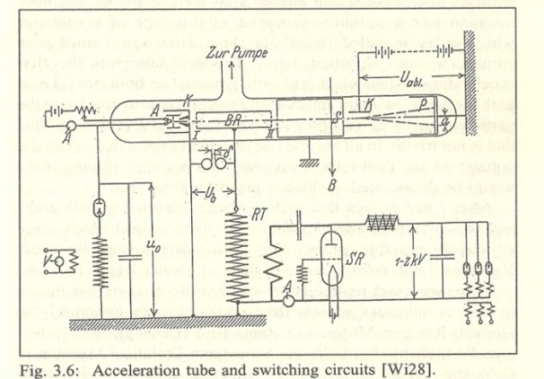
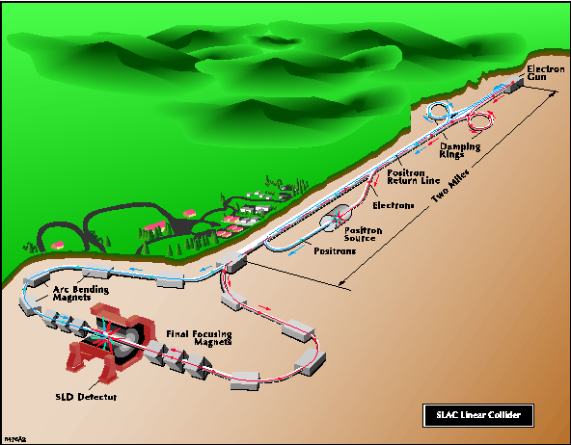
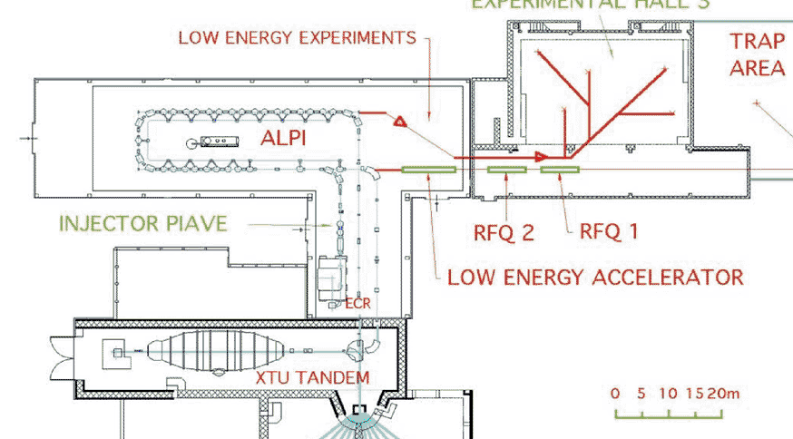
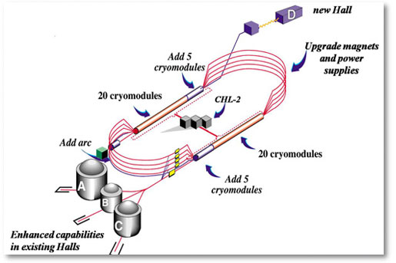
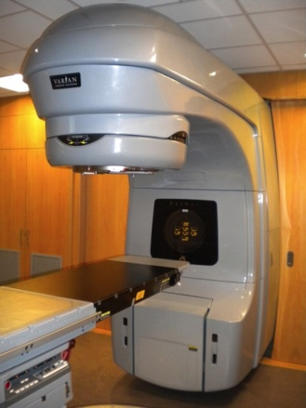
Variety of linacs
The first and the smallest: Rolf Widerøe thesis (1923)
The largest: Stanford Linear Collider (2 miles = 3.2 km) (but CLIC design goes to 48.3 km !)
One of the less linear: ALPI at LNL (Italy)
A limit case, multi-pass linacs: CEBAF at JLAB
The most common: medical electron linac (more than 7’000 in operation around the world!)
Notes:
What these machines have in common and why do we need linear accelerators

Slide 4
Why Linear Accelerators
 | LINACS |  | SYNCHROTRONS
 | Low Energy | High Energy | High Energy
Protons, Ions | Injectors to synchrotrons, stand alone applications synchronous with the RF fields in the range where velocity increases with energy. Protons : β = v/c =0.51 at 150 MeV, 0.95 at 2 GeV. | Production of secondary beams (n, ν, RIB, …) higher cost/MeV than synchrotron but: - high average beam current (high repetition rate, less resonances, easier beam loss). - higher linac energy allows for higher intensity in the synchrotron. | very efficient when velocity is ~constant, (multiple crossings of the RF gaps). limited mean current (limited repetition frequency, instabilities)
Electrons | Conventional e- linac simple and compact | Linear colliders do not lose energy because of synchrotron radiation – only option for high energy! | Light sources, factories can accumulate high beam intensities
« traditional » linac range
« new » linac range

Slide 5
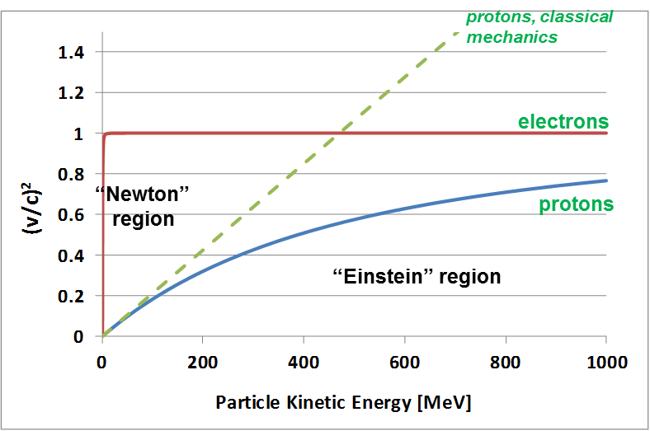
Proton and Electron Velocity
β²=(v/c)² as function of kinetic energy T for protons and electrons.
Classic (Newton) relation:
Relativistic (Einstein) relation:
Protons (rest energy 938.3 MeV): follow “Newton” mechanics up to some tens of MeV (Δv/v < 1% for W < 15 MeV) then slowly become relativistic (“Einstein”). From the GeV range velocity is nearly constant (v~0.95c at 2 GeV) → linacs can cope with the increasing particle velocity, synchrotrons cover the range where v nearly constant.
Electrons (rest energy 511 keV, 1/1836 of protons): relativistic from the keV range (v~0.1c at 2.5 keV) then increasing velocity up to the MeV range (v~0.95c at 1.1 MeV) → v~c after few meters of acceleration in a linac (typical gradient 10 MeV/m).
Notes:
Accelerating gradients that we can provide with a linac is nearly constant (2 MeV/m) --- synchrotron radiation ((beta*gamma)**4)/(r**2)

Slide 6
Basic linear accelerator structure
RF cavity
Focusing magnet
B-field
DC
particle
injector
bunching
section
?
E-field
d
Protons: energy ~100 keV
β= v/c ~ 0.015
Accelerating gap: E = E₀ cos (ωt + φ)
en. gain ΔW = eV₀Tcosφ
Acceleration → the beam has to pass in each cavity on a phase φ near the crest of the wave
The beam must to be bunched at frequency ω
distance between cavities and phase of each cavity must be correlated
Phase change from cavity i to i+1 is
For the beam to be synchronous with the RF wave (“ride on the crest”) phase must be related to distance by the relation:
… and on top of acceleration, we need to introduce in our “linac” some focusing elements
… and on top of that, we will couple a number of gaps in an “accelerating structure”
Notes:
How must be spaced the gaps? How should they be connected to the source of the wave? How many quadrupoles should we have?
Idea by 2 norwegians: Wideroe for the gap and the RF, Bill Hansen for the cavity

Slide 7
Accelerating structure architecture
When β increases during acceleration, either the phase difference between cavities Δφ must decrease or their distance d must increase.
d = const.
φ variable
d
Individual cavities – distance between cavities constant, each cavity fed by an individual RF source, phase of each cavity adjusted to keep synchronism, used for linacs required to operate with different ions or at different energies. Flexible but expensive!
Better, but 2 problems:
create a “coupling”;
create a mechanical and RF structure with increasing cell length.
φ = const.
d variable
d ∝ βλ
Coupled cell cavities - a single RF source feeds a large number of cells (up to ~100!) - the phase between adjacent cells is defined by the coupling and the distance between cells increases to keep synchronism . Once the geometry is defined, it can accelerate only one type of ion for a given energy range. Effective but not flexible.
Notes:
How must be spaced the gaps? How should they be connected to the source of the wave? How many quadrupoles should we have?

Slide 8
Linear and circular accelerators
accelerating gaps
d
accelerating gap
d
d=βλ/2=variable
f=constant
d=2πR=constant
f=βc/2d=variable
Linear accelerator:
Particles accelerated by a sequence of gaps (all at the same RF phase).
Distance between gaps increases proportionally to the particle velocity, to keep synchronicity.
Used in the range where β increases. “Newton” machine
Circular accelerator:
Particles accelerated by one (or more) gaps at given positions in the ring.
Distance between gaps is fixed. Synchronicity only for β~const, or varying (in a limited range!) the RF frequency.
Used in the range where β is nearly constant. “Einstein” machine
Note that only linacs are real «accelerators», synchrotrons are «mass increaser»!

Slide 9
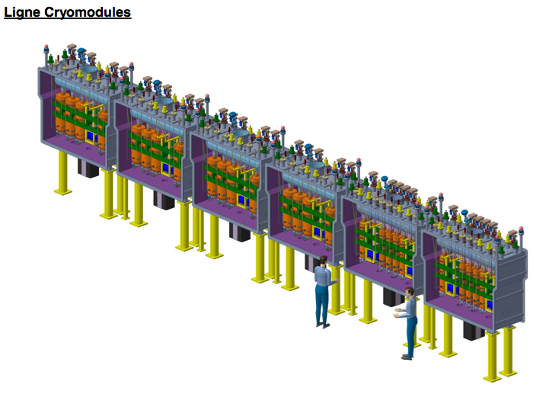
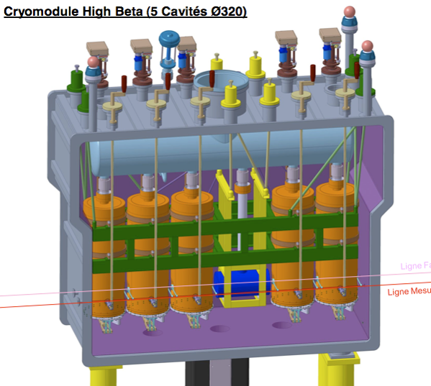
Case 1: a single-cavity linac
The goal is flexibility: acceleration of different ions (e/m) at different energies
→ need to change phase relation for each ion-energy
RF cavity
focusing solenoid
REX-HIE linac at CERN
(superconducting)
Post-accelerator of radioactive ions
2 sections of identical equally spaced cavities
Quarter-wave RF cavities, 2 gaps
12 + 20 cavities with individual RF amplifiers, 8 focusing solenoids
Energy 1.2 → 10 MeV/u, accelerates different A/m
beam

Slide 10
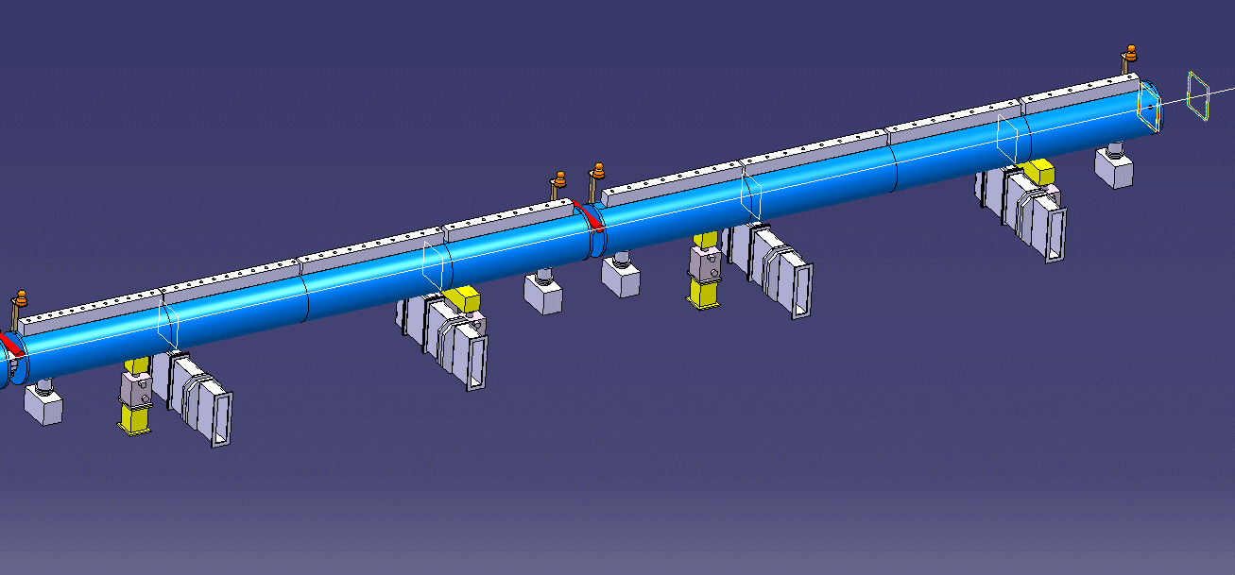
Case 2 : a Drift Tube Linac
d
10 MeV,
β = 0.145
50 MeV,
β = 0.31
Tank 2 and 3 of the new Linac4 at CERN:
57 coupled accelerating gaps
Frequency 352.2 MHz, λ = 85 cm
Cell length (d=βλ) from 12.3 cm to 26.4 cm (factor 2 !).

Slide 11
Intermediate cases
But:
Between the 2 “extremes” there are many “intermediate” cases, because:
  Single-gap cavities are expensive (both cavity and RF source!).
  Structures with each cell matched to the beta profile are mechanically complicated and expensive.
→ as soon as the increase of beta with energy becomes small (Δβ/ΔW) we can accept a small error and:
Use multi-gap cavities with constant distance between gaps.
Use series of identical cavities (standardised design and construction).
11

Slide 12
Synchronism condition in a multicell cavity
Typical linac case: multi-cell accelerating cavity with d=constant and phase difference between cells Δφ=π given by the electric field distribution.
Example: a linac superconducting 4-cell accelerating structure
Synchronism condition bw. particle and wave
t (travel between centers of cells) = T/2
d=distance between centres of consecutive cells
In an ion linac cell length has to increase (up to a factor 200 !) and the linac will be made of a sequence of different accelerating structures (changing cell length, frequency, operating mode, etc.) matched to the ion velocity.
For electron linacs, β =1, d =λ/2 → An electron linac will be made of an injector + a series of identical accelerating structures, with cells all the same length
Note that in the example above, we neglect the increase in particle velocity inside the cavity !

Slide 13
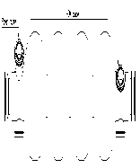
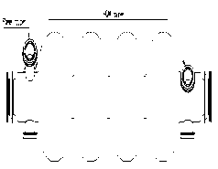
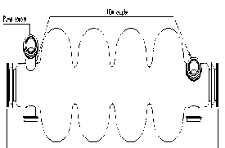
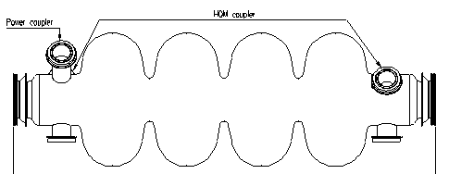
Sections of identical cavities: a superconducting linac (medium β)
The same superconducting cavity design can be used for different proton velocities. The linac has different sections, each made of cavities with cell length matched to the average beta in that section. At “medium energy” (>150 MeV) we are not obliged to dimension every cell or every cavity for the particular particle beta at that position, and we can accept a slight “asynchronicity” → phase slippage + reduction in acceleration efficiency from the optimum one.
β=0.52
β=0.7
β=0.8
β=1
CERN (old) SPL design, SC linac 120 - 2200 MeV, 680 m length, 230 cavities
Notes:
Cell length has to be matched to the increasing particle velocity

Slide 14
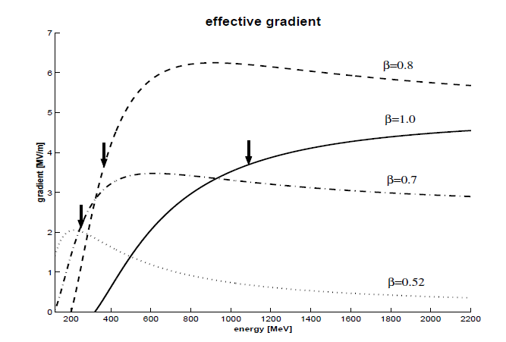
Effects of phase slippage
When sequences of cells are not matched to the particle beta → phase slippage
The effective gradient seen by the particle is lower.
The phase of the bunch centre moves away from the synchronous phase → can go (more) into the non-linear region, with possible longitudinal emittance growth and beam loss.
Very large at small energy (γ~1) becomes negligible at high energy (~2.5 °/m for γ~1.5, W=500 MeV).
Curves of effective gradient (gradient seen by the beam for a constant gradient in the cavity) for the previous case (4 sections of beta 0.52, 0.7, 0.8 and 1.0).

Slide 15
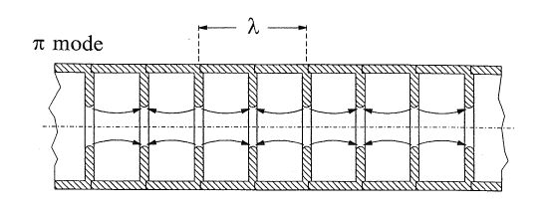
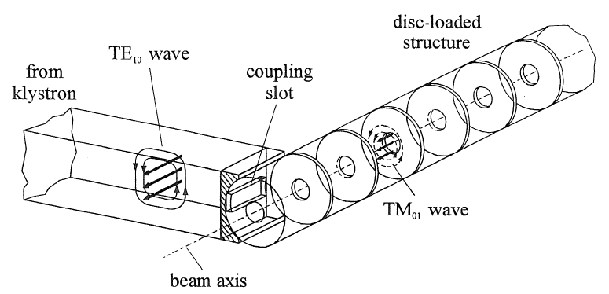
Electron linacs
In an electron linac velocity is ~ constant. To use the fundamental accelerating mode cell length must be d = βλ / 2.
the linac structure will be made of a sequence of identical cells. Because of the limits of the RF source, the cells will be grouped in cavities operating in travelling wave mode.
Pictures from K. Wille, The Physics of Particle Accelerators

Slide 16
Acceleration in Periodic Structures

Slide 17
Wave propagation in a cylindrical pipe
RF input
In a cylindrical waveguide different modes can propagate (=Electromagnetic field distributions, transmitting power and/or information). The field is the superposition of waves reflected by the metallic walls of the pipe → velocity and wavelength of the modes will be different from free space (c, λ)
To accelerate particles, we need a mode with longitudinal E-field component on axis: a TM mode (Transverse Magnetic, B_{z}=0). The simplest is TM01.
We inject RF power at a frequency exciting the TM01 mode: sinusoidal E-field on axis, wavelength λ_{p} depending on frequency and on cylinder radius. Wave velocity (called “phase velocity”) is v_{ph}= λ_{p}/T = λ_{p}f = ω/k_{z} with k_{z}=2π/λ_{p}
The relation between frequency ω and propagation constant k is the DISPERSION RELATION (red curve on plot), a fundamental property of waveguides.
TM01 field configuration
λ_{p}
E-field
B-field
Notes:
We will now build our own linac, and we will see how we can use the same principle for both proton and electron linacs. Propagation by multiple reflections, means that the velocity and wavelength will not be the same as in vacuum.

Slide 18
Wave velocity: the dispersion relation
The dispersion relation ω(k) can be calculated from the theory of waveguides: ω² = k²c² + ω_{c}² Plotting this curve (hyperbola), we see that:
There is a “cut-off frequency”, below which a wave will not propagate. It depends on dimensions (λ_{c}=2.61a for the cylindrical waveguide).
At each excitation frequency is associated a phase velocity, the velocity at which a certain phase travels in the waveguide. v_{p}=∞ at k=0, ω=ω_{c} and then decreases towards v_{p}=c for k,ω￫∞.
To see at all times an accelerating E-field a particle traveling inside our cylinder has to travel at v = v_{ph} → v > c !!!
Are we violating relativity? No, energy (and information) travel at group velocity dω/dk, always between 0 and c.
To use the waveguide to accelerate particles, we need a “trick” to slow down the wave.
k=2π/λ_{p}
v_{ph}=ω/k = (c²+ω_{c}²/k²)^{1/2}
v_{g}=dω/dk

Slide 19
Slowing down waves: the disc- loaded waveguide
Discs inside the cylindrical waveguide, spaced by a distance l , will induce multiple reflections between the discs.

Slide 20
Dispersion relation for the disc-loaded waveguide
Wavelengths with λ_{p}/2~ l will be most affected by the discs. On the contrary, for λ_{p}=0 and λ_{p}=∞ the wave does not see the discs → the dispersion curve remains that of the empty cylinder.
At λ_{p}/2= l , the wave will be confined between the discs, and present 2 “polarizations” (mode A and B in the figure), 2 modes with same wavelength but different frequencies → the dispersion curve splits into 2 branches, separated by a stop band.
In the disc-loaded waveguide, the lower branch of the dispersion curve is now “distorted” in such a way that we can find a range of frequencies with v_{ph} = c → we can use it to accelerate a particle beam!
We have built a linac for v~c → a TRAVELING WAVE (TW) ELECTRON LINAC
mode B
open waveguide dispersion curve
mode A
Notes:
Stop bands are typical of every periodic system (phonon in crystals, etc.)

Slide 21
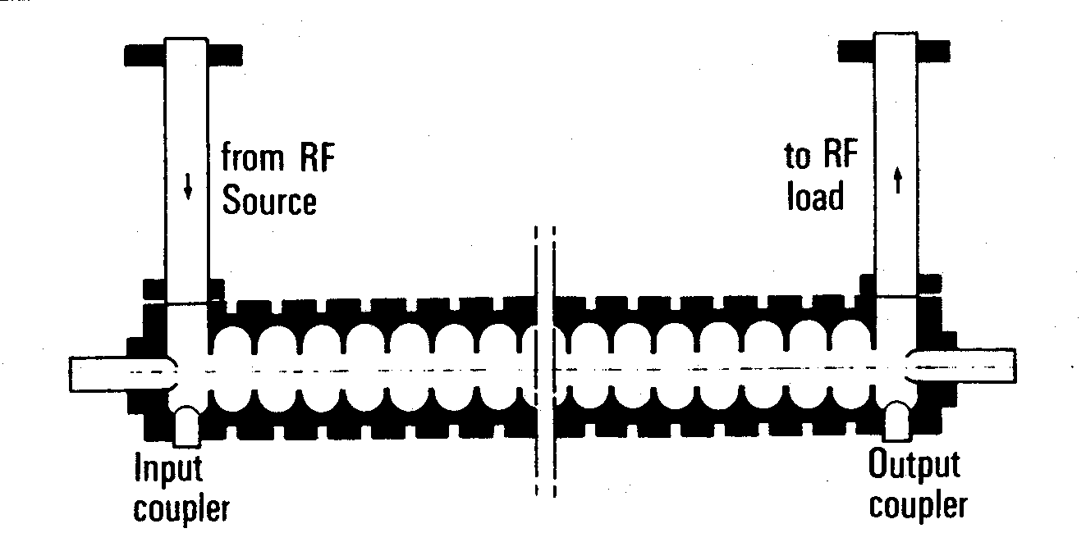
Traveling wave linac structures
beam
Disc-loaded waveguide designed for v_{ph}=c at a given frequency, equipped with an input and an output coupler.
RF power is introduced via the input coupler. Part of the power is dissipated in the structure, part is taken by the beam (beam loading) and the rest is absorbed in a matched load at the end of the structure. Usually, structure length is such that ~30% of power goes to the load.
The “traveling wave” structure is the standard linac for electrons from β~1.
Can not be used for protons at v<c:
1. constant cell length does not allow synchronism 2. structures are long, without space for transverse focusing

Slide 22
Standing wave linac structures
To obtain an accelerating structure for protons we close our disc-loaded structure at both ends with metallic walls → multiple reflections of the waves.
Boundary condition at both ends is that electric field must be perpendicular to the cover → Only some modes on the disc-loaded dispersion curve are allowed → only some frequencies on the dispersion curve are permitted.
In general:
the modes allowed will be equally spaced in k
The number of modes will be identical to the number of cells (N cells → N modes)
k represents the phase difference between the field in adjacent cells.

Slide 23
More on standing wave structures
STANDING WAVE MODES are generated by the sum of 2 waves traveling in opposite directions, adding up in the different cells.
For acceleration, the particles must be in phase with the E-field on axis. We have already seen the π mode: synchronism condition for cell length l = βλ/2.
Standing wave structures can be used for any β (→ ions and electrons) and their cell length can increase, to follow the increase in β of the ions.
Standing wave modes are named from the phase difference between adjacent cells: in the example above, mode 0, π/2, 2π/3, π.
In standing wave structures, cell length can be matched to the particle velocity !
Synchronism conditions:
0-mode : l = βλ
π/2 mode: 2 l = βλ/2
π mode: l = βλ/2

Slide 24
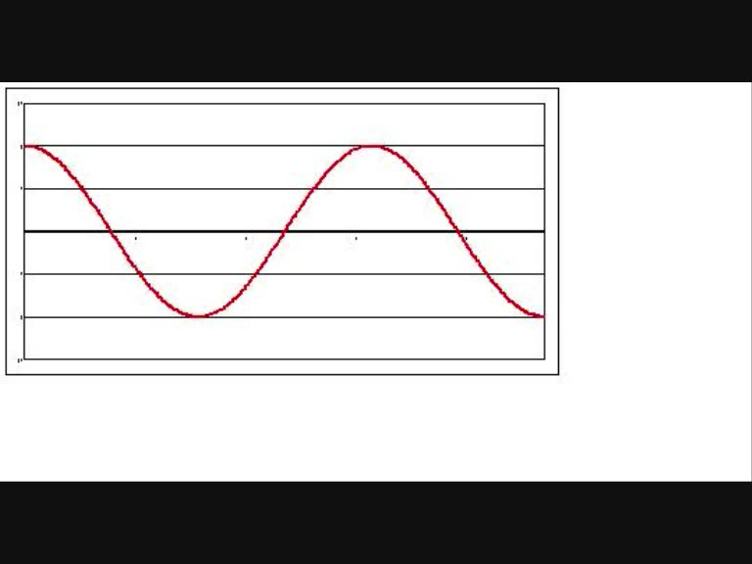
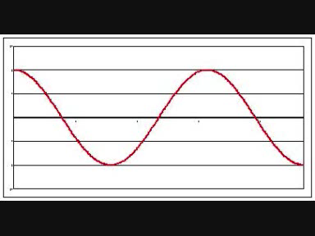
Acceleration on traveling and standing waves
TRAVELING Wave
STANDING Wave
E-field
position z
position z

Slide 25
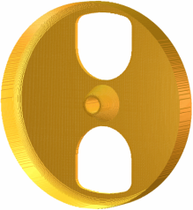
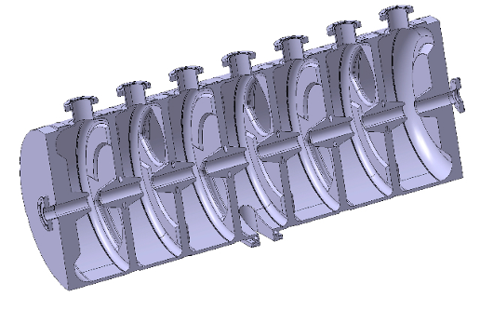
Practical standing wave structures
From disc-loaded structure to a real cavity (Linac4 PIMS, Pi-Mode Structure)
To increase acceleration efficiency (=shunt impedance ZT²!) we need to concentrate electric field on axis (Z↑) and to shorten the gap (T↑) → introduction of “noses” on the openings.
The smaller opening would not allow the wave to propagate → introduction of “coupling slots” between cells.
The RF wave has to be coupled into the cavity from one point, usually in the center.

Slide 26
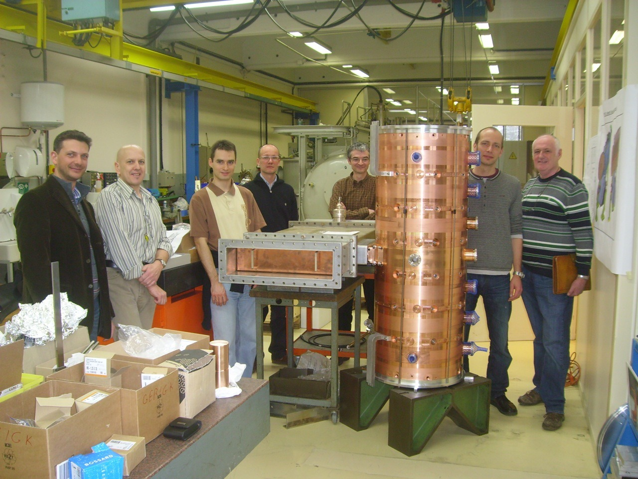
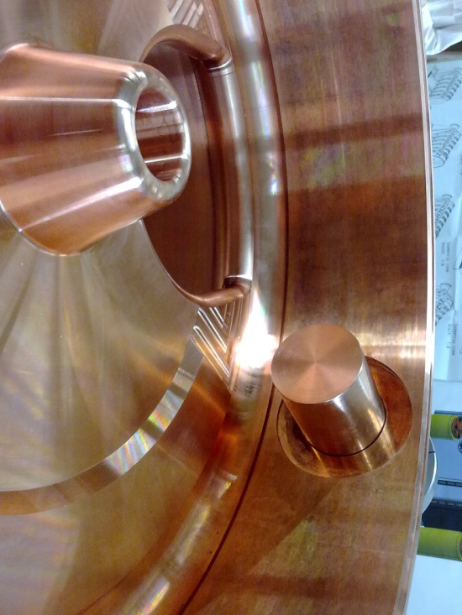
PIMS Prototype

Slide 27
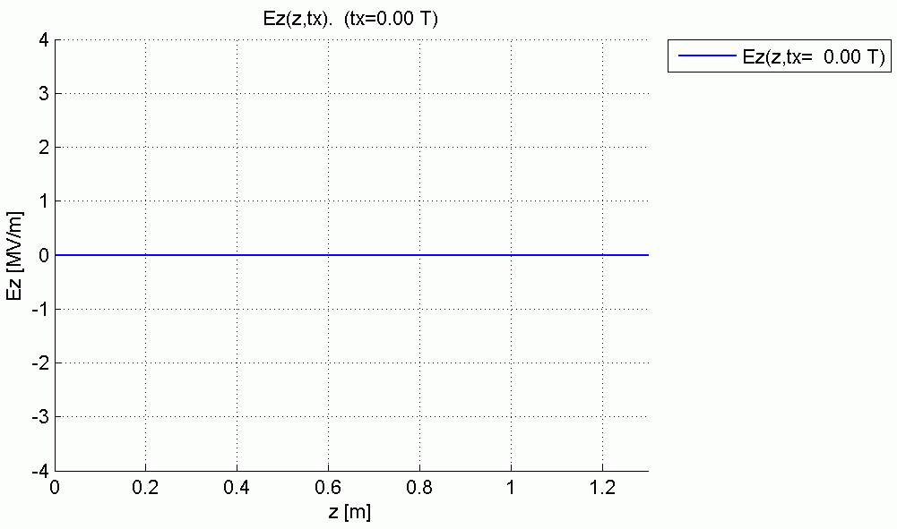
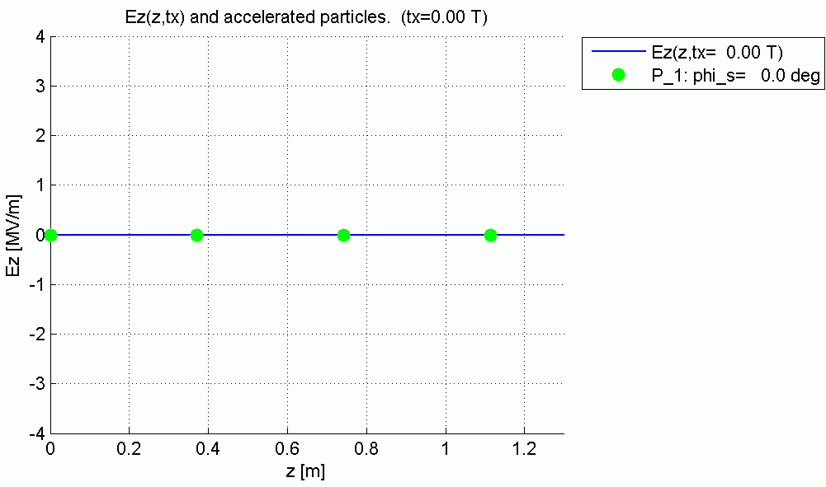
Synchronism in the PIMS
Animations by
R. Wegner, CERN

Slide 28
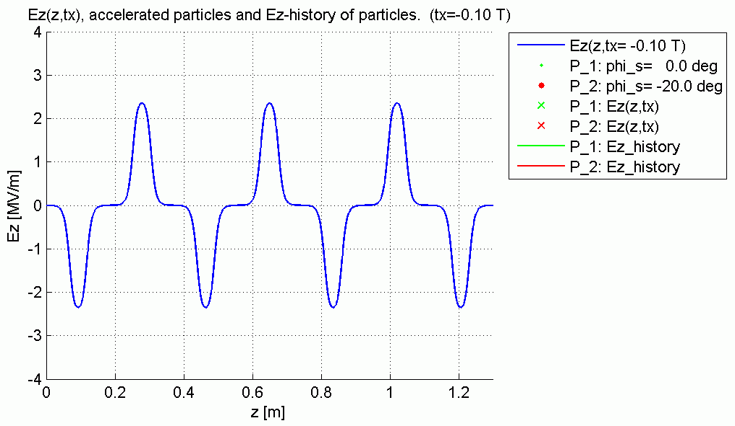
Acceleration in the PIMS
Animations by
R. Wegner, CERN

Slide 29
Comparing traveling and standing wave structures
Standing wave
Traveling wave
Chain of coupled cells in SW mode.
Coupling (bw. cells) by slots (or open). On-axis aperture reduced, higher E-field on axis and power efficiency.
RF power from a coupling port, dissipated in the structure (ohmic loss on walls).
Long pulses. Gradients 2-5 MeV/m
Used for Ions and electrons, all energies
Chain of coupled cells in TW mode
Coupling bw. cells from on-axis aperture.
RF power from input coupler at one end,
dissipated in the structure and on a load.
Short pulses, High frequency (≥ 3 GHz).
Gradients 10-20 MeV/m
Used for Electrons at v~c
Comparable RF efficiencies

Slide 30
Questions on Module 1 ?
- Types of linacs and domains of application
- Basic linac structure, synchronicity, single cell and multicell linacs
- Acceleration in a disc-loaded waveguide, standing-wave and traveling-wave structures

