Slide 1

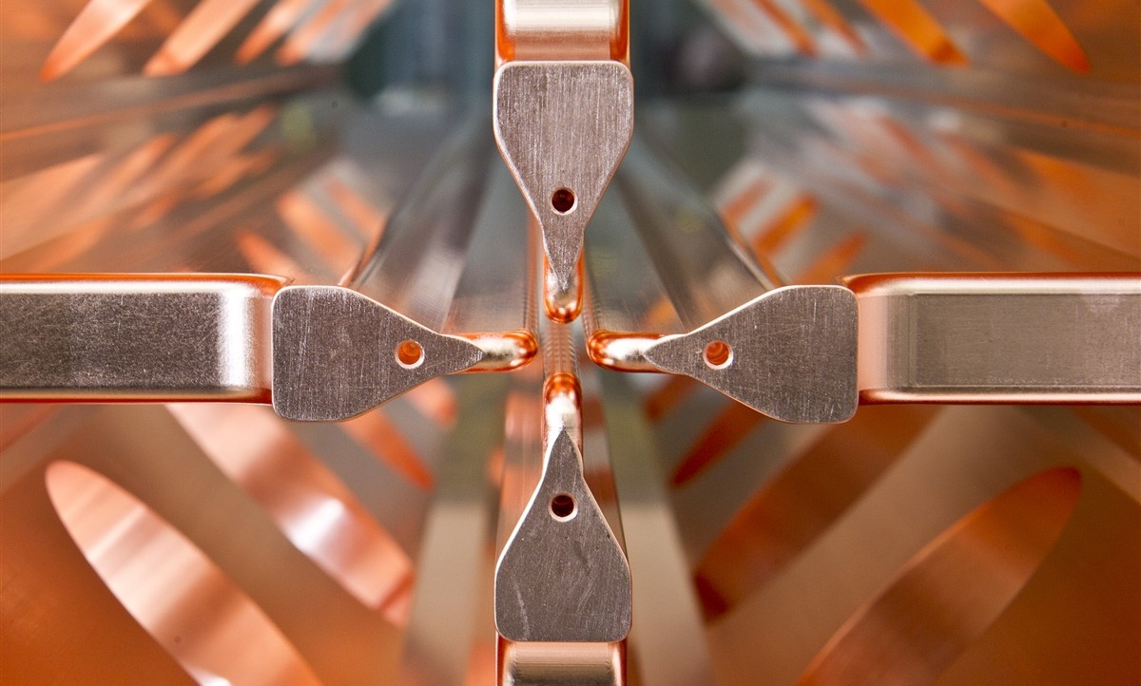
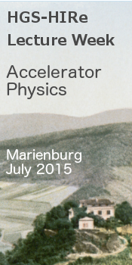
Introduction to RF Linear Accelerators
Maurizio Vretenar, CERN
Zell, 20-24 July 2015

Slide 2
Outline
Lecture 1 | Module 1 | Linacs in general, wave propagation
 | Module 2 | History of linacs
Lecture 2 | Module 3 | Types of linacs, coupled-cell systems
 | Module 4 | Linac anatomy, technology and ancillaries
Lecture 3 | Module 5 | Beam dynamics in linacs
 | Module 6 | Examples, architecture of a linac
Lecture 4 | Module 7 | RFQ resonator
 | Module 8 | Applications of linacs
Every 1.5 hour lecture is composed of 2 modules of 40’ each, followed by a question time.
Beware that the first module of a lecture contains more information and requires more concentration (if you wish to sleep, please select even modules).

Slide 3
Structure
Concentrate on concepts, use little mathematics during the lectures (the mathematic treatment you can always find in the books);
Give a general background on electron and ion linacs, then concentrate on protons and ions;
Try matching with the other teachers…
Questions are welcome:
  during lecture is something is not clear,
  after the lecture for additional explanations,
  informally in the days following the lectures.
  remember that no question is stupid.
The best questions usually come at breakfast the next day…

Slide 4
The lecturer
studies Applied Physics at Trieste University (Italy);
thesis work at CERN in 1985/86 on RFQ field stabilization;
linac design for European Hadron Facility (Karlsruhe and CERN) in 1986/87;
fellow at CERN for the design of the new RFQ2 in 1988/90;
CERN staff from 1991: construction and commissioning of the RFQ2 (1991-93), participation to design and commissioning of the heavy ion linac (1992-94);
responsible for Hadron Linac RF at CERN from 1995 to 2011; participation to medical linac projects (LIBO), special linac projects (decelerating RFQ), etc.;
responsible for the design of the SPL (Superconducting proton linac), 1999-2007;
responsible for the design of Linac4 (new H- linac at CERN) from 2001, Project Leader for Linac4 from 2008.
deputy RF group leader from 2012 to 2014.
coordinator of the EuCARD-2 Integrating Activity project for accelerator R&D from 2012.
coordinator of the compact RFQ project for medical application from 2013.

Slide 5
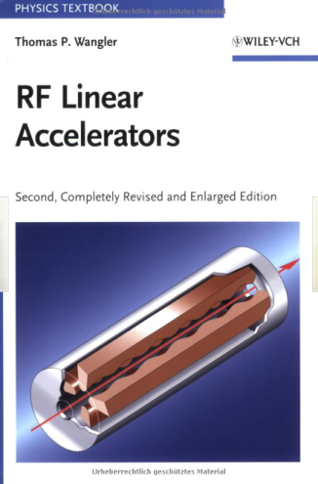
Some Bibliography
If you still read…
1. Reference Books:
T. Wangler, Principles of RF Linear Accelerators (Wiley, New York, 1998).
P. Lapostolle, A. Septier (editors), Linear Accelerators (Amsterdam, North Holland, 1970).
I.M. Kapchinskii, Theory of resonance linear accelerators (Harwood, Chur, 1985).
K. Wille, The physics of particle accelerators (Oxford Press, Oxford, 2001).
2. General Introductions to linear accelerators
M. Puglisi, The Linear Accelerator, in E. Persico, E. Ferrari, S.E. Segré, Principles of Particle Accelerators (W.A. Benjamin, New York, 1968).
P. Lapostolle, Proton Linear Accelerators: A theoretical and Historical Introduction, LA-11601-MS, 1989.
P. Lapostolle, M. Weiss, Formulae and Procedures useful for the Design of Linear Accelerators, CERN- PS-2000-001 (DR), 2000.
P. Lapostolle, R. Jameson, Linear Accelerators, in Encyclopaedia of Applied Physics (VCH Publishers, New York, 1991).
3. CAS Schools
S. Turner (ed.), CAS School: Cyclotrons, Linacs and their applications, CERN 96-02 (1996).
M. Weiss, Introduction to RF Linear Accelerators, in CAS School: Fifth General Accelerator Physics Course, CERN-94-01 (1994), p. 913.
N. Pichoff, Introduction to RF Linear Accelerators, in CAS School: Basic Course on General Accelerator Physics, CERN-2005-04 (2005).
M. Vretenar, Differences between electron and ion linacs, in CAS Small Accelerators, CERN- 2006-012.
M. Vretenar, Low-beta Structures, in CAS RF School, CERN 2011-07.
M. Vretenar, Linear accelerators, in CAS Advanced Accelerator Physics, CERN-2014-009.

