Slide 1

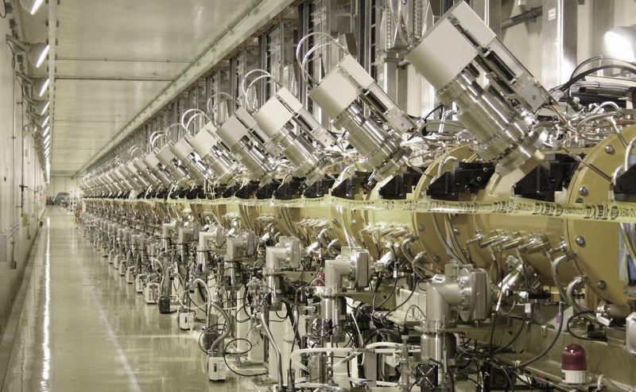
Module 3
Coupled resonator chains
Stability and stabilization
Acceleration in periodic structures
Special accelerating structures
Superconducting linac structures

Slide 2
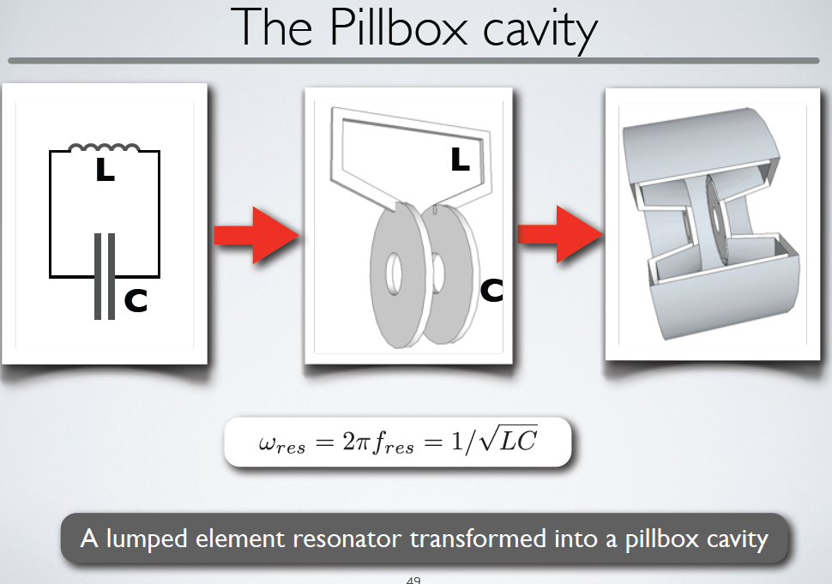
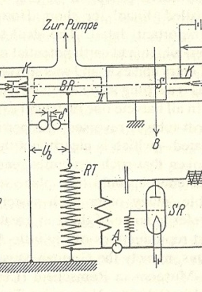
From the Wideröe gap to the linac cell
Notes:
The cavity resonator introduced by Hansen at SLAC

Slide 3
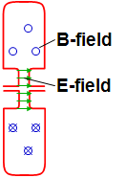
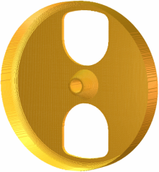
Coupling cavities
1. Magnetic coupling:
open “slots” in regions of high magnetic field → B-field can couple from one cell to the next
2. Electric coupling:
enlarge the beam aperture → E-field can couple from one cell to the next
How can we couple together a chain of n reentrant (=loaded pillbox) accelerating cavities ?
The effect of the coupling is that the cells no longer resonate independently, but will have common resonances with well defined field patterns.

Slide 4
Chains of coupled resonators
What is the relative phase and amplitude between cells in a chain of coupled cavities?
A linear chain of accelerating cells can be represented as a sequence of resonant circuits magnetically coupled.
Individual cavity resonating at ω₀ → frequenci(es) of the coupled system ?
Resonant circuit equation for circuit i (neglecting the losses, R≅0):
M
R
M
L
L
L
I_{i}
L
C
Dividing both terms by 2jωL:
General response term, ∝ (stored energy)^{1/2,}
can be voltage, E-field, B-field, etc.
Contribution from adjacent oscillators
General resonance term

Slide 5
The Coupled-system Matrix
A chain of N+1 resonators is described by a (N+1)x(N+1) matrix:
or
This matrix equation has solutions only if
Eigenvalue problem!
System of order (N+1) in ω → only N+1 frequencies will be solution of the problem (“eigenvalues”, corresponding to the resonances) → a system of N coupled oscillators has N resonance frequencies → an individual resonance opens up into a band of frequencies.
At each frequency ω_{i} will correspond a set of relative amplitudes in the different cells (X₀, X₂, …, X_{N}): the “eigenmodes” or “modes”.

Slide 6
Modes in a linear chain of oscillators
We can find an analytical expression for eigenvalues (frequencies) and eigenvectors (modes):
the index q defines the number of the solution → is the “mode index”
Frequencies of the coupled system :
Each mode is characterized by a phase πq/N. Frequency vs. phase of each mode can be plotted as a “dispersion curve” ω=f(φ):
each mode is a point on a sinusoidal curve.
modes are equally spaced in phase.
ω₀/√1-k
ω₀
ω₀/√1+k
0
π/2
π
The “eigenvectors = relative amplitude of the field in the cells are:
STANDING WAVE MODES, defined by a phase πq/N corresponding to the phase shift between an oscillator and the next one → πq/N=Φ is the phase difference between adjacent cells that we have introduces in the 1st part of the lecture.

Slide 7
Acceleration on the normal modes of a 7-cell structure
Remember the phase relation!
0
ω = ω₀/√1+k
q=0
0 (or 2π) mode, acceleration if d = βλ
Intermediate modes
π/2
ω = ω₀
q=N/2
π/2 mode, acceleration if d = βλ/4
…
π
ω = ω₀/√1-k
q=N
π mode, acceleration if d = βλ/2,
Note: Field always maximum in first and last cell!

Slide 8
Practical linac accelerating structures
Note: our equations depend only on the cell frequency ω, not on the cell length d !!!
→ As soon as we keep the frequency of each cell constant, we can change the cell length following any acceleration (β) profile!
Example:
The Drift Tube Linac (DTL)
Chain of many (up to 100!) accelerating cells operating in the 0 mode. The ultimate coupling slot: no wall between the cells!
Each cell has a different length, but the cell frequency remains constant → “the EM fields don’t see that the cell length is changing!”
d↑ → (L ↑ , C↓) → LC ~ const → ω ~ const

Slide 9
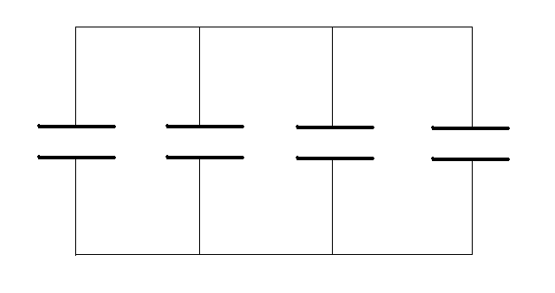
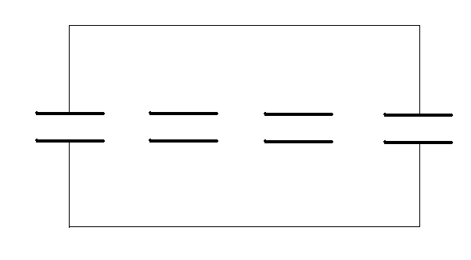
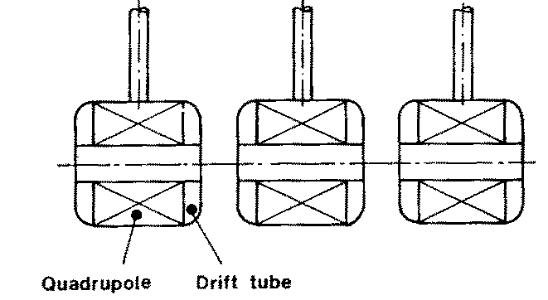
0-mode structures: the Drift Tube Linac (“Alvarez”)
RF currents
Disc-loaded structures operating in 0-mode
Add tubes for high shunt impedance
Maximize coupling between cells → remove completely the walls
2 advantages of the 0-mode:
the fields are such that if we eliminate the walls between cells the fields are not affected, but we have less RF currents and higher power efficiency (“shunt impedance”).
The “drift tubes” are long (~0.75 βλ). The particles are inside the tubes when the electric field is decelerating, and we have space to introduce focusing elements (quadrupoles) inside the tubes.
Disadvantage (w.r.t. the π mode): half the number of gaps per unit length!

Slide 10
The Drift Tube Linac
A DTL tank with N drift tubes will have N modes of oscillation.
For acceleration, we choose the 0-mode, the lowest of the band.
All cells (gaps) are in phase, then Δφ=2π
Distance between gaps must be βλ
The other modes in the band (and many others!) are still present.
If mode separation >> bandwidth, they are not “visible” at the operating frequency, but they can come out in case of frequency errors between the cells (mechanical errors or others).
operating 0-mode
mode distribution in a DTL tank (operating frequency 352 MHz, are plotted all frequencies < 600 MHz)

Slide 11
DTL construction
Standing wave linac structure for protons and ions, β=0.1-0.5, f=20-400 MHz
Drift tubes are suspended by stems (no net RF current on stem)
Coupling between cells is maximum (no slot, fully open !)
The 0-mode allows a long enough cell (d=βλ) to house focusing quadrupoles inside the drift tubes!
(at 90deg)
E-field
B-field

Slide 12
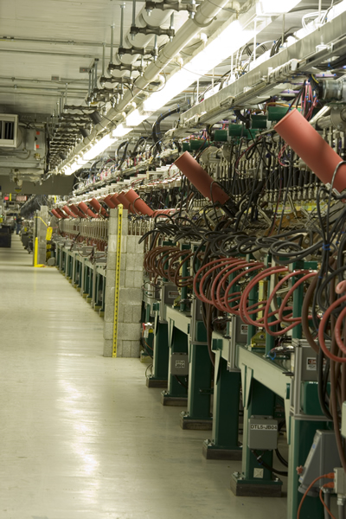
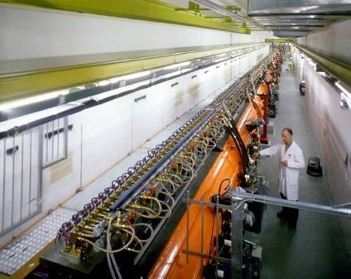
Examples of DTL
Top; CERN Linac2 Drift Tube Linac: 1978, 202.5 MHz, 3 tanks, final energy 50 MeV, tank diameter 1 meter.
Left: The Drift Tube Linac of the SNS at Oak Ridge (USA): 402.5 MHz, 6 tanks, final energy 87 MeV.

Slide 13
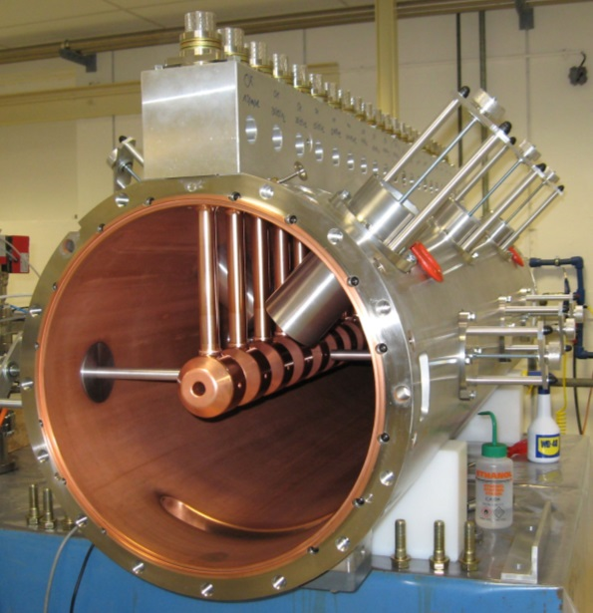
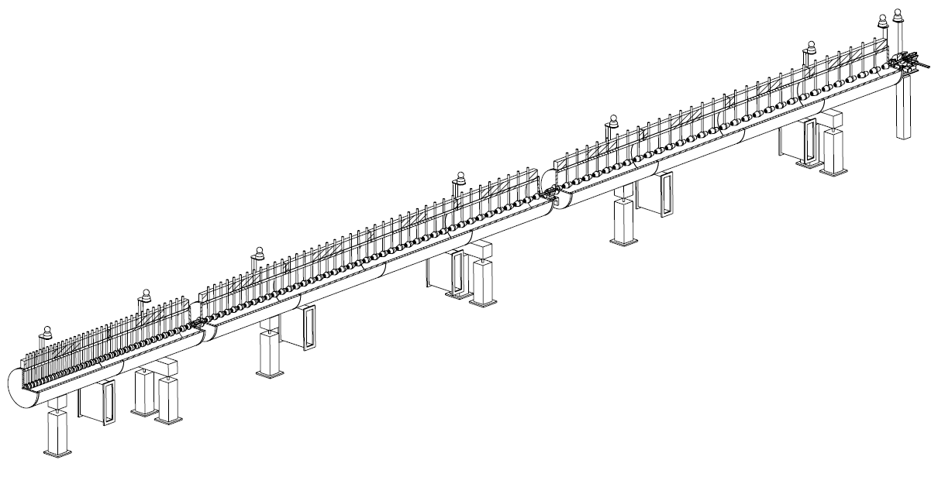
The Linac4 DTL
DTL tank 1 fully equipped: focusing by small permanent quadrupoles inside drift tubes.
352 MHz frequency
Tank diameter 500mm
3 resonators (tanks)
Length 19 m
120 Drift Tubes
Energy 3 MeV to 50 MeV
Beta 0.08 to 0.31 → cell length (βλ) 68mm to 264mm
→ factor 3.9 increase in cell length
beam

Slide 14
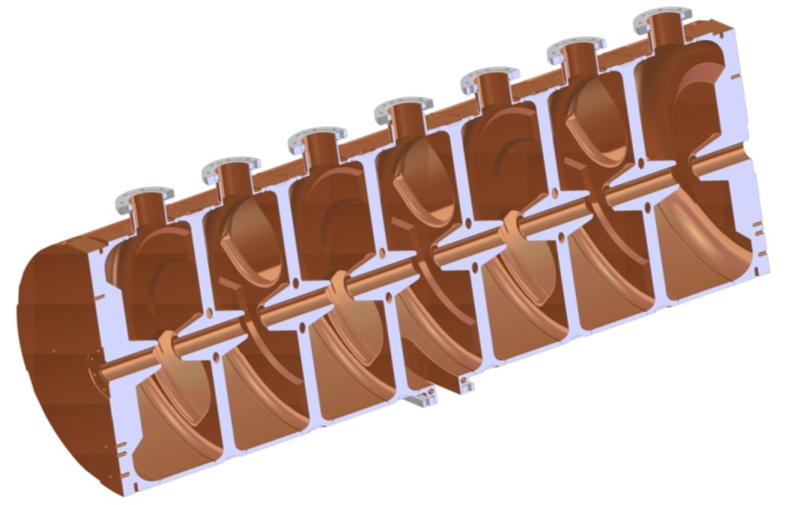
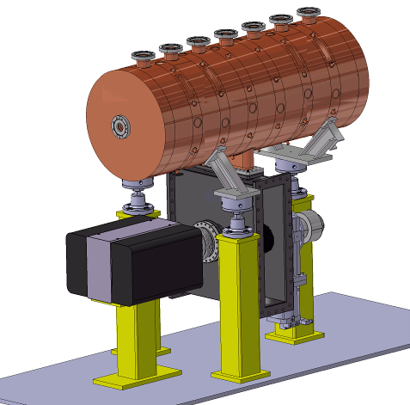
Pi-mode structures: the PIMS
PIMS = Pi-Mode Structure, will be used in Linac4 at CERN to accelerate protons from 100 to 160 MeV (β > 0.4)
7 cells magnetically coupled, 352 MHz
Operating in π-mode, cell length βλ/2.
RF input
Cells in a cavity have the same length.
When more cavities are used for acceleration, the cells are longer from one cavity to the next, to follow the increase in beam velocity.

Slide 15
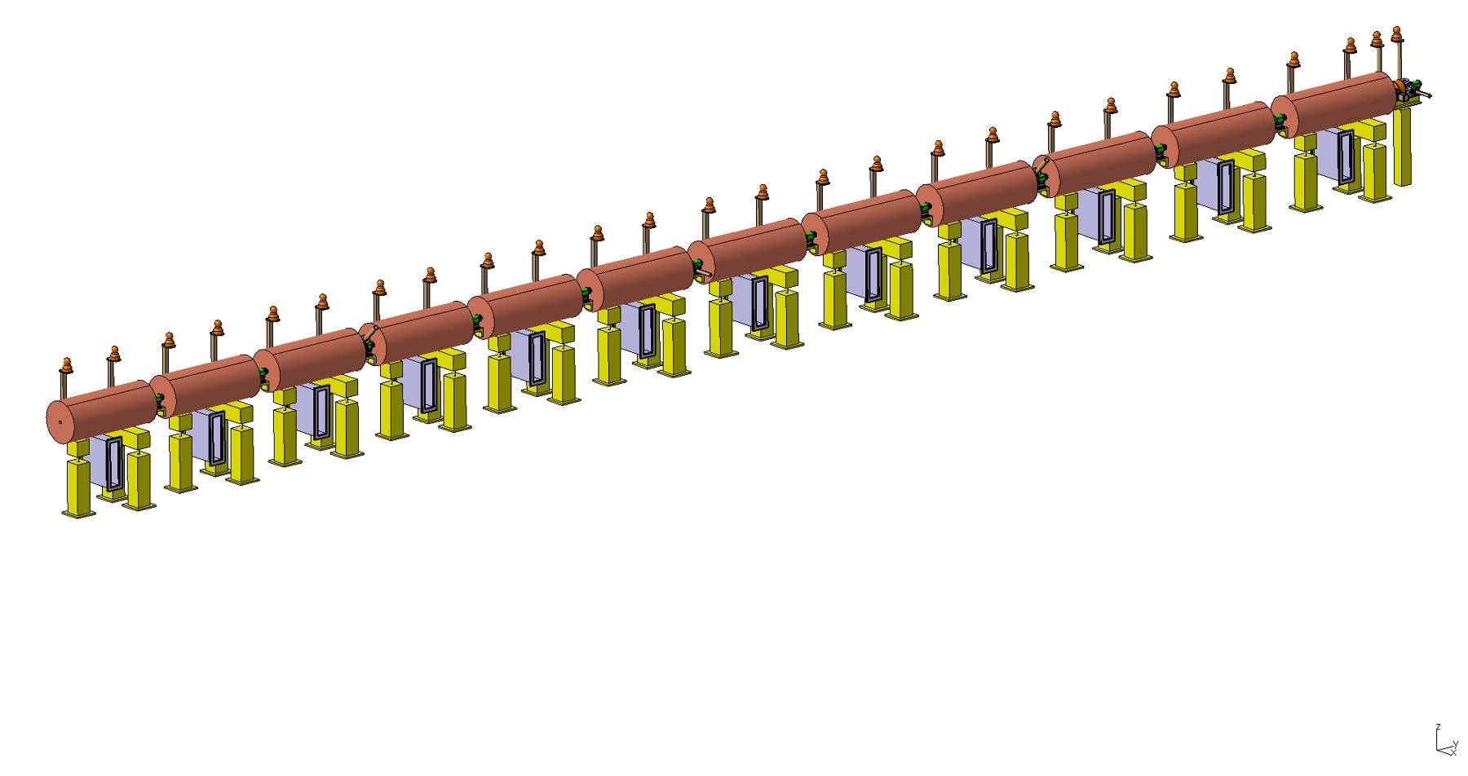
Sequence of PIMS cavities
Cells have same length inside a cavity (7 cells) but increase from one cavity to the next. At high energy (>100 MeV) beta changes slowly and phase error (“phase slippage”) is small.
160 MeV,
155 cm
Focusing quadrupoles between cavities
100 MeV,
128 cm
PIMS range

Slide 16
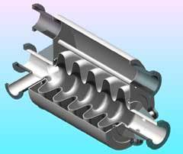
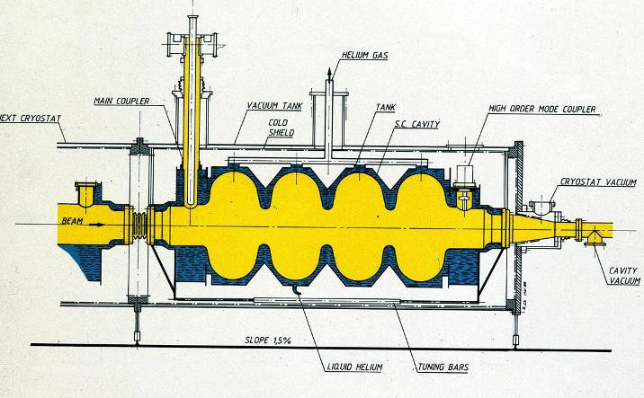
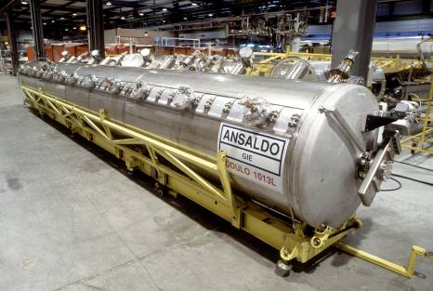
Pi-mode superconducting structures (elliptical)
Standing wave structures for particles at β>0.5-0.7, widely used for protons (SNS, etc.) and electrons (ILC, etc.) f=350-700 MHz (protons), f=350 MHz – 3 GHz (electrons)
Chain of cells electrically coupled, large apertures (ZT² not a concern).
Operating in π-mode, cell length βλ/2
Input coupler placed at one end.

Slide 17
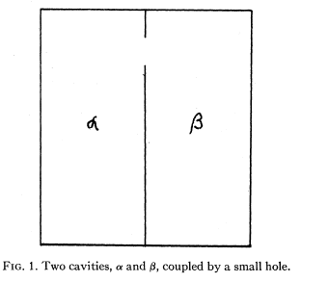
Coupling between two cavities
In the PIMS, cells are coupled via a slot in the walls. But what is the meaning of coupling, and how can we achieve a given coupling?
Simplest case: 2 resonators coupled via a slot
Described by a system of 2 equations:
or
E-field mode 1
E-field mode 2
If ω₁=ω₂=ω₀, usual 2 solutions (mode 0 and mode π):
with
and
with
Mode + + (field in phase in the 2 resonators) and mode + - (field with opposite phase)
Taking the difference between the 2 solutions (squared), approximated for k<<1
or
The coupling k is equal to the difference between highest and lowest frequencies.
→ k is the bandwidth of the coupled system.

Slide 18
More on coupling
Solving the previous equations allowing a different frequency for each cell, we can plot the frequencies of the coupled system as a function of the frequency of the first resonator, keeping the frequency of the second constant, for different values of the coupling k.
- “Coupling” only when the 2 resonators are close in frequency.
- For f₁=f₂, maximum spacing between the 2 frequencies (=kf₀)
f₁
f₀
maximum separation when f1=f2
case of 3 different coupling factors (0.1%, 5%, 10%)
For an elliptical coupling slot:
F = slot form factor
l = slot length (in the direction of H)
H = magnetic field at slot position
U = stored energy
The coupling k is:
Proportional to the 3rd power of slot length.
Inv. proportional to the stored energies.

Slide 19
Long chains of linac cells
☞ To reduce RF cost, linacs use high-power RF sources feeding a large number of coupled cells (DTL: 30-40 cells, other high-frequency structures can have >100 cells).
☞ But long linac structures (operating in 0 or π mode) become extremely sensitive to mechanical errors: small machining errors in the cells can induce large differences in the accelerating field between cells.

Slide 20
Stability of long chains of coupled resonators
Mechanical errors → differences in frequency between cells →
to respect the new boundary conditions the electric field will be a linear combination of all modes, with weight
(general case of small perturbation to an eigenmode system,
the new solution is a linear combination of all the individual modes)
The nearest modes have the highest effect, and when there are many modes on the dispersion curve (number of modes = number of cells, but the total bandwidth is fixed = k !) the difference in E‑field between cells can be extremely high.

Slide 21
Stabilization of long chains: the π/2 mode
Long chains of linac cells can be operated in the π/2 mode, which is intrinsically insensitive to mechanical errors = differences in the cell frequencies.
In presence of errors, the E-field will have components from the adjacent modes, with amplitude proportional to the error and to the mode separation.
Perturbing mode
Perturbing mode
Operating mode
→ Contribution from adjacent modes proportional to with the sign !!!
The perturbation will add a component ΔE/(f²-f_{o}²) for each of the nearest modes.
Contributions from equally spaced modes in the dispersion curve will cancel each other !!

Slide 22
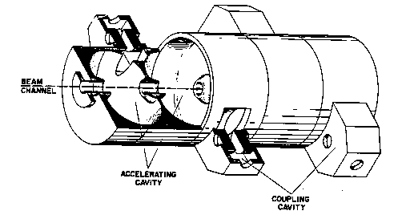
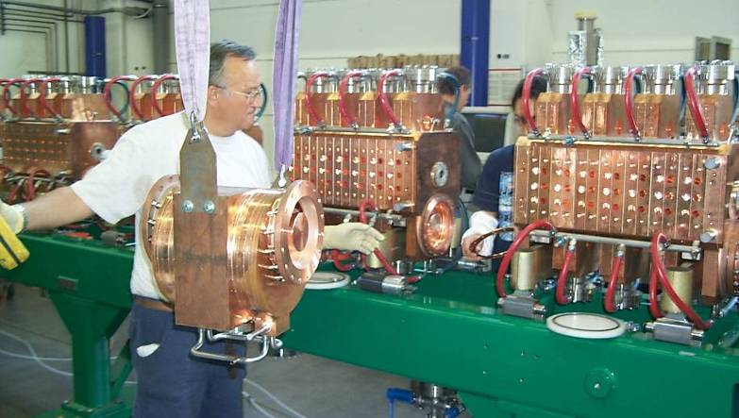
Pi/2 mode structures: the Side Coupled Linac
To operate efficiently in the π/2 mode, the cells that are not excited can be removed from the beam axis → they are called “coupling cells”, as for the Side Coupled Structure.
E-field
Example: the Cell-Coupled Linac at the SNS linac, 805 MHz, 100-200 MeV, >100 cells/module

Slide 23
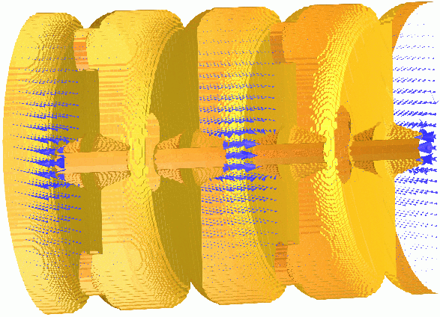
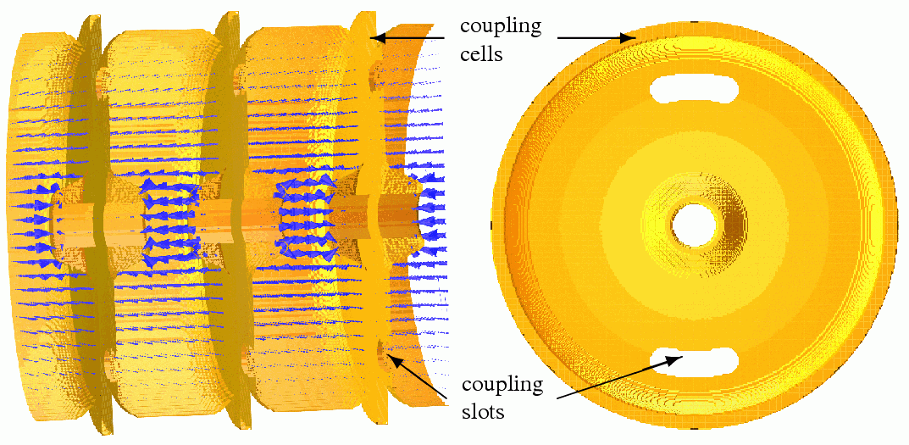
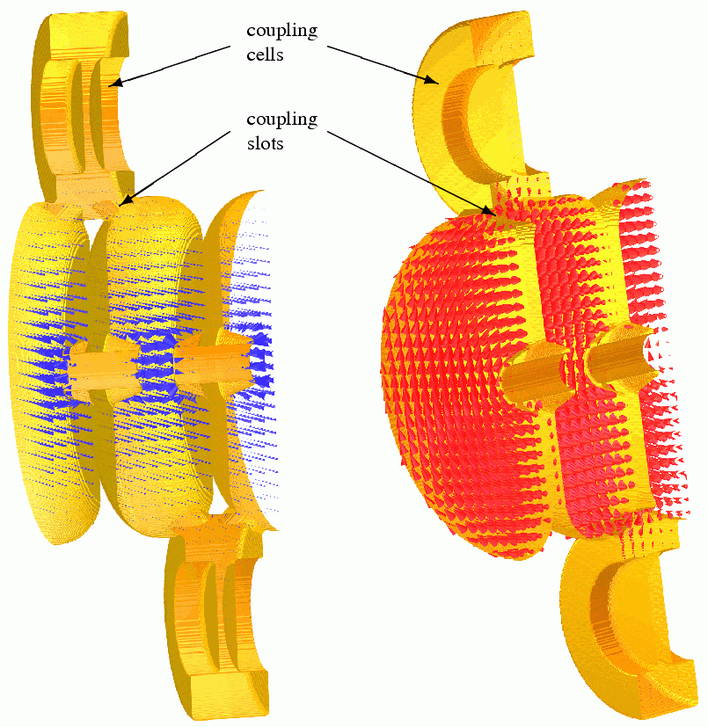
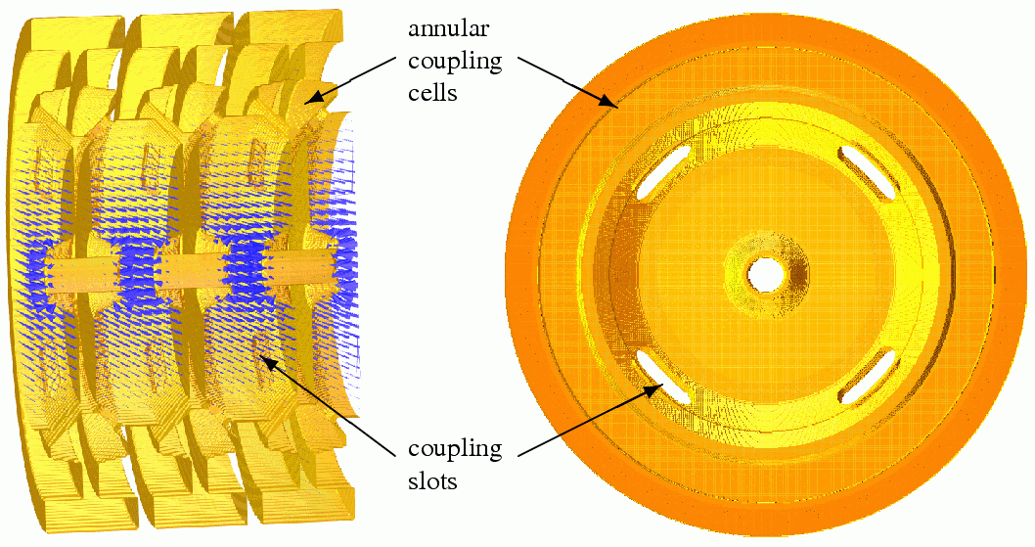
π/2-mode in a coupled-cell structure
Examples of π/2 structures
On axis Coupled Structure (OCS)
Annular ring Coupled Structure (ACS)
Side Coupled Structure (SCS)

Slide 24
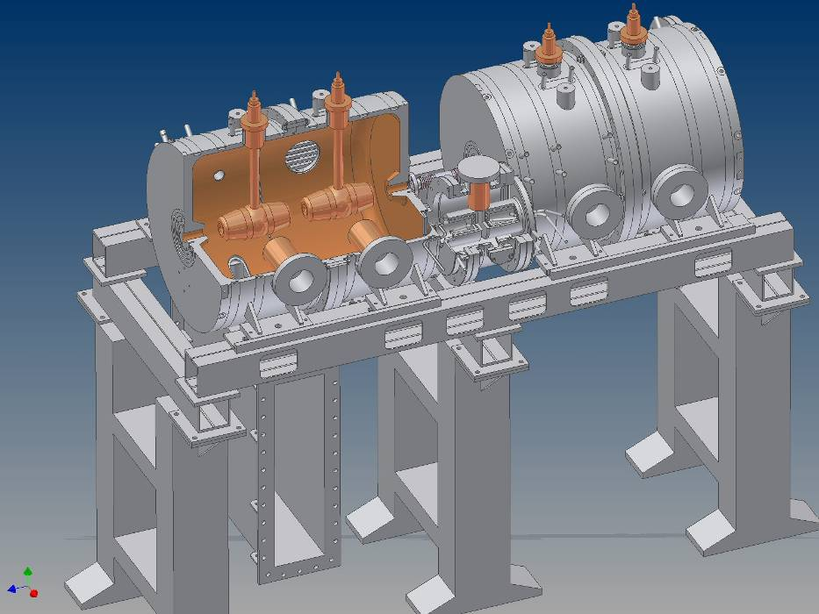
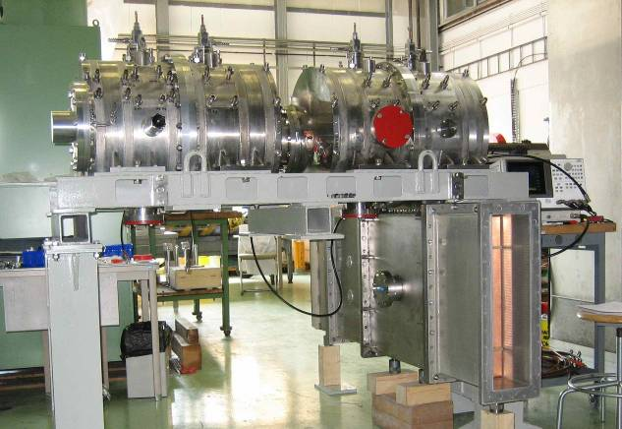
A mixed case: the Cell-Coupled Drift Tube Linac
Series of DTL-like tanks with 3 cells (operating in 0-mode), coupled by coupling cells (operation in π/2 mode)
352 MHz, will be used for the CERN Linac4 in the range 40-100 MeV.
The coupling cells leave space for focusing quadrupoles between tanks.
DTL-like tank (2 drift tubes)
Coupling cell
DTL-like tank (2 drift tubes)
Waveguide input coupler

Slide 25
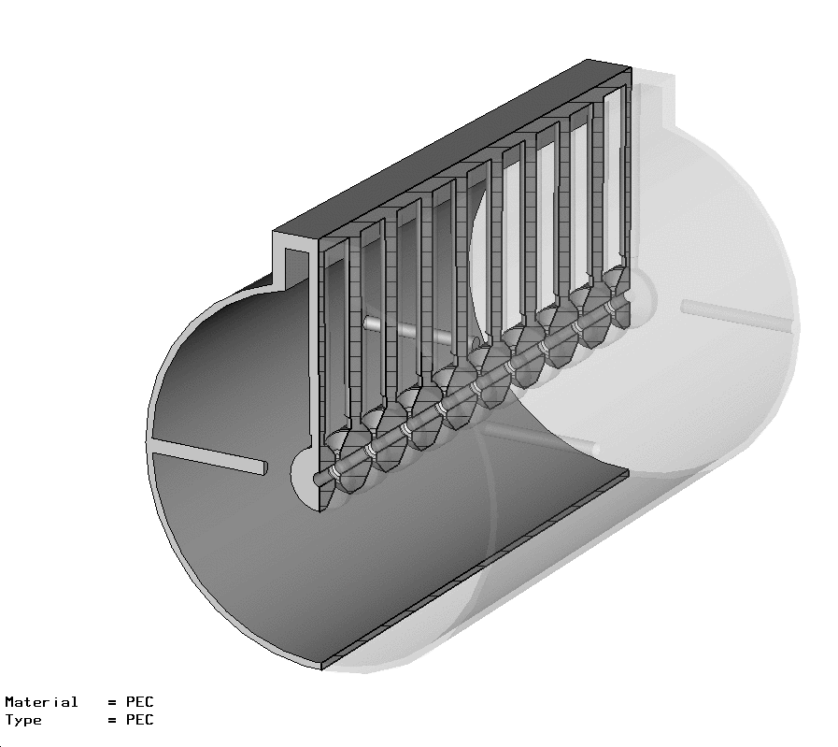
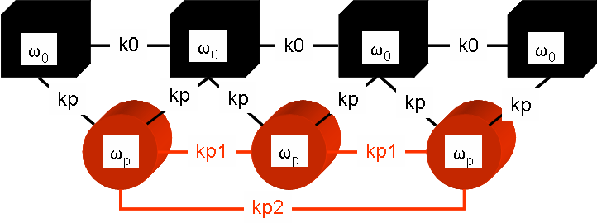
Pi/2 mode: the DTL with post-couplers
Post-coupler
In a DTL, can be added “post-couplers” on a plane perpendicular to the stems.
Each post is a resonator that can be tuned to the same frequency as the main 0-mode and coupled to this mode to double the chain of resonators allowing operation in stabilised π/2-like mode!
The equivalent circuit becomes extremely complicated and tuning is an issue, but π/2 stabilization is very effective and allows having long DTL tanks!

Slide 26
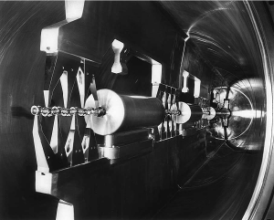
Alternative modes: H-mode structures
Interdigital-H Structure
Operates in TE110 mode
Transverse E-field “deflected” by adding drift tubes
Used for ions, β<0.3
CH Structure operates in TE210, used for protons at β<0.6
High ZT² but more difficult beam dynamics (no space for quads in drift tubes)
HSI – IH DTL , 36 MHz

Slide 27
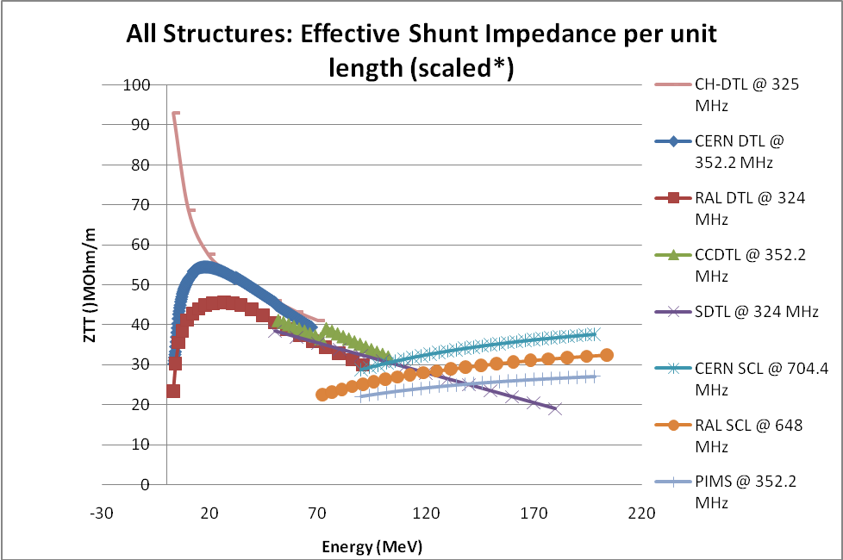
Comparison of structures – Shunt impedance
Main figure of merit is the shunt impedance
Ratio between energy gain (square) and power dissipation, is a measure of the energy efficiency of a structure.
Depends on the beta, on the energy and on the mode of operation.
However, the choice of the best accelerating structure for a certain energy range depends also on beam dynamics and on construction cost.
Comparison of shunt-impedances for different low-beta structures done in 2005-08 by the “HIPPI” EU-funded Activity.
In general terms, a DTL-like structure is preferred at low-energy, and π-mode structures at high-energy.
CH is excellent at very low energies (ions).

Slide 28
Traveling wave accelerating structures (electrons)
What happens if we have an infinite chain of oscillators?
becomes (N→h)
becomes (N→h)
ω₀/√1-k
All modes in the dispersion curve are allowed, the original frequency degenerates into a continuous band.
The field is the same in each cell, there are no more standing wave modes → only “traveling wave modes”, if we excite the EM field at one end of the structure it will propagate towards the other end.
ω₀
ω₀/√1+k
0
π/2
π
But: our dispersion curve remains valid, and defines the velocity of propagation of the travelling wave, v_{φ} = ωd/Φ
For acceleration, the wave must propagate at v_{φ} = c
→ for each frequency ω and cell length d we can find a phase Φ where the
apparent velocity of the wave v_{φ} is equal to c

Slide 29
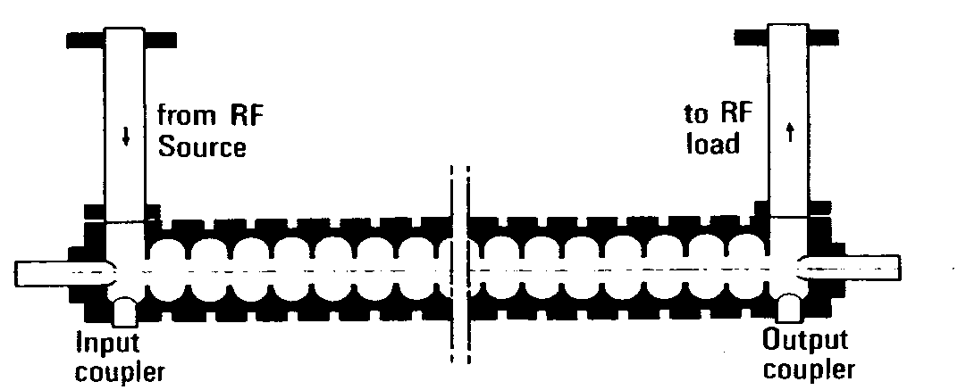
Traveling wave accelerating structures
How to “simulate” an infinite chain of resonators? Instead of a singe input, exciting a standing wave mode, use an input + an output for the RF wave at both ends of the structure.
beam
“Disc-loaded waveguide” or chain of electrically coupled cells characterized by a continuous band of frequencies. In the chain is excited a “traveling wave mode” that has a propagation velocity v_{ph} = ω/k given by the dispersion relation.
For a given frequency ω, v_{ph} = c and the structure can be used for particles traveling at β=1 The “traveling wave” structure is the standard linac for electrons from β~1.
Can not be used for protons at v<c:
1. constant cell length does not allow synchronism 2. structures are long, without space for transverse focusing

Slide 30
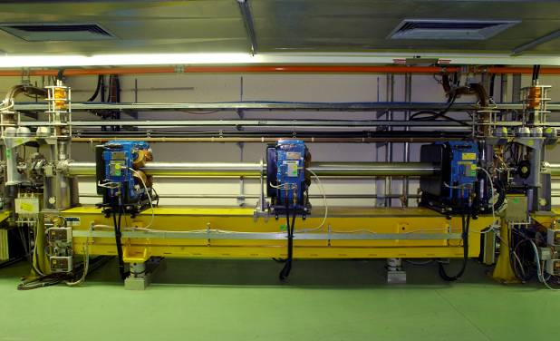
Example: the 3 GHz electron linac
A 3 GHz LIL accelerating structure used for CTF3. It is 4.5 meters long and provides an energy gain of 45 MeV. One can see 3 quadrupoles around the RF structure.

Slide 31
Superconducting low-beta structures

Slide 32
General architecture
For Superconducting structures:
Shunt impedance and power dissipation are not a concern.
Power amplifiers are small (and relatively inexpensive) solid-state units.
→ can be used the independent cavity architecture, which allows some flexibility in the range of beta and e/m of the particles to be accelerated.
In particular, SC structures are convenient for machines operating at high duty cycle.
At low duty, static cryogenic losses are predominant (many small cavities!)
However, even for SC linacs single-gap cavities are expensive to produce (and lead to larger cryogenic dissipation) → double or triple-gap resonators are commonly used!

Slide 33
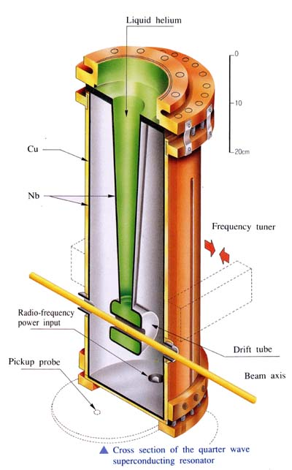
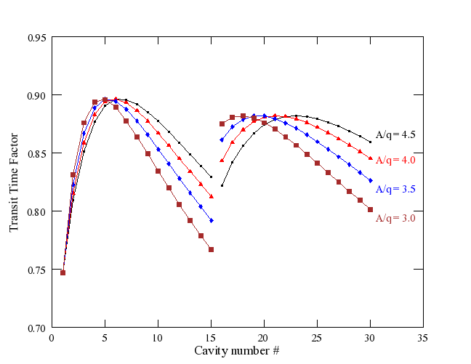
Quarter Wave Resonators
Simple 2-gap cavities commonly used in SC version (lead, niobium, sputtered niobium) for low beta protons or ion linacs, where ~CW operation is required.
Synchronicity (distance βλ/2 between the 2 gaps) is guaranteed only for one energy/velocity, while for easiness of construction a linac is composed by series of identical QWR’s → reduction of energy gain for “off-energy” cavities, Transit Time Factor (= ratio between actual energy gained and maximum energy gain) curves as below:
“phase slippage”

Slide 34
The Spoke cavity
Another option:
Double or triple-spoke cavity, can be used at higher energy (100-200 MeV for protons and triple-spoke).
HIPPI Triple-spoke cavity prototype built at FZ Jülich, now under test at IPNO
Notes:
Preaching to the converted…

Slide 35
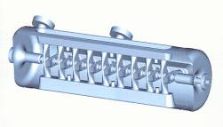
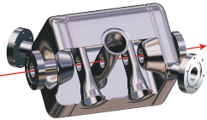
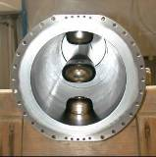

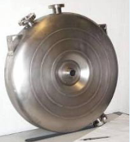
The superconducting zoo
Spoke (low beta)
[FZJ, Orsay]
CH (low/medium beta)
[IAP-FU]
QWR (low beta)
[LNL, etc.]
Re-entrant
[LNL]
HWR (low beta)
[FZJ, LNL, Orsay]
Superconducting linacs for low and medium beta ions are made of multi-gap (1 to 4) individual cavities, spaced by focusing elements. Advantages: can be individually phased → linac can accept different ions
Allow more space for focusing → ideal for low β CW proton linacs

Slide 36
Questions on Module 3 ?
- Coupled resonator chains
- Stabilization
- Periodic structures
- Superconducting low-beta structures

