Slide 1

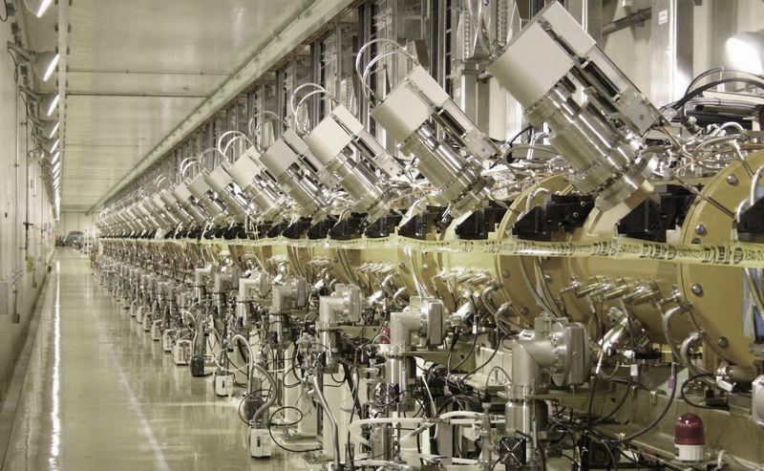
Module 2
History of Radio Frequency linacs

Slide 2
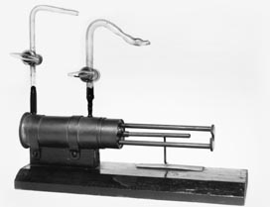
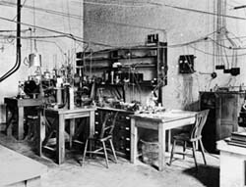
From Rutherford to the Particle Accelerator
1919: Ernest Rutherford’s historical experiment: some nitrogen nuclei are disintegrated by α-particles coming from radioactive decay of Ra and Th → start of a new era for science! But only few light atoms can be modified using particles from radioactive decays .
Men can transform the matter, the dream of the ancient alchemists!
1927: Rutherford in a famous speech at the Royal Society asks for “accelerators” capable to disintegrate heavy nuclei. Theory predicts the threshold for penetration of the nucleus at ~500 keV → from 1929, various labs start developing “particle accelerators” for >500 keV.
Reproduction of the Rutherford chamber: Bombardment of nitrogen atoms with alpha particles, producing oxygen and hydrogen nuclei.
Notes:
The dream of the alchemists from middle age, transform an element into something else…

Slide 3
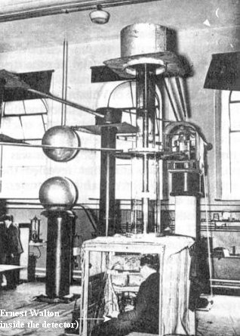
The early Accelerators
1927 to 1932, development of electrostatic accelerators:
Cockcroft and Walton (Cavendish Lab, Cambridge) → extend to higher voltages the “voltage multiplier” used for X-ray production.
Van de Graaf (Princeton) → develops the belt-charged static generator.
Others explore pulsed techniques, capacitor discharges, transformers, etc.
And the winners of the accelerator race are… Cockcroft and Walton, who in 1932 obtain disintegration of lithium by 400 keV protons. But:
higher energies are necessary to disintegrate heavier nuclei in quantities;
DC technologies are limited by breakdown to few MeV.
→ A new technology is needed...

Slide 4
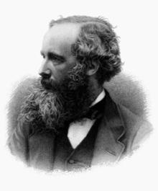
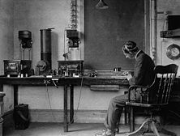
From Maxwell to the Radio
1864: Maxwell’s equations.
1873, Maxwell: Theoretical basis of wave propagation.
1888, Hertz: Experimental generation/reception of e.m. waves.
1891, N. Tesla, G. Marconi and others: wireless telegraph.
1905-14: early vacuum tubes (De Forest, triode in 1907).
1914-18: large quantities of tubes produced because of war effort, cost goes down. Improved technology: operation in vacuum (Langmuir, 1915), filament coating (1920).
1919-20: first attempts to broadcast with vacuum tubes using AM modulation, in the kHz range.
1920-25: start of regular radio broadcasting in most countries (1920: Argentina, US; 1923: Germany).
Notes:
1912: Titanic distress message, spark gap + crystal receiver
High Cgp capacitances prevented use at high frequencies, in 1916-26 improved (plate opposite to cathode, separate heating) and started to be used in all radio apparatus, up to few MHz frequency.

Slide 5
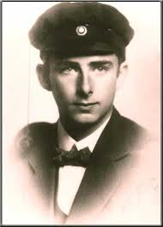
Marrying radio technology and accelerators
Who was the first to have the idea of using modern radio technology to build (linear) particle accelerators?
Remember:
the radio was around since 1920, and the technology became largely used in the 20’s
since 1927 the scientific community was looking for ideas to build high-energy particle accelerators…
?
A 26 year old PhD student…

Slide 6
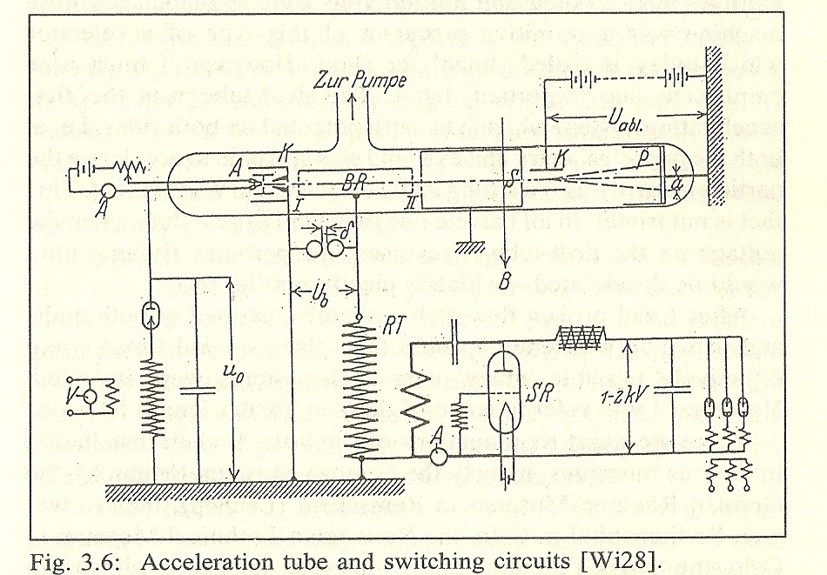
The first Radio-Frequency linac: Rolf Wideröe’s thesis
Rolf Wideröe: a Norwegian student of electrical engineering at Karlsruhe and Aachen.
The X-ray transformer that he had chosen for his PhD Thesis at Aachen University did not work, and he was forced to choose quickly another subject. Inspired by a 1924 paper by Ising, a Swedish professor (acceleration of particles using “voltage pulses”), in 1928 he put together for his thesis a device to demonstrate the acceleration of particles by RF fields:
Acceleration of potassium ions 1+ with 25kV of RF at 1 MHz → 50 keV acceleration (“at a cost of four to five hundred marks”…)
use of a triode and of radio technology (at the time limited to 1-2 MHz) → marrying radio technology and accelerators.
Use of a drift tube separating 2 accelerating gaps → invention of synchronous RF accelerators.
complete accelerator: ion source, RF accelerator, detector, all in vacuum
Notes:
Necessity is the mother of invention

Slide 7

The basic principle
ELECTROSTATIC acceleration
The voltage can be applied only to one gap
+
-
RADIOFREQUENCY acceleration
The voltage adds up over several gaps
DC voltage V₀
RF voltage
V₀cosωt

Slide 8
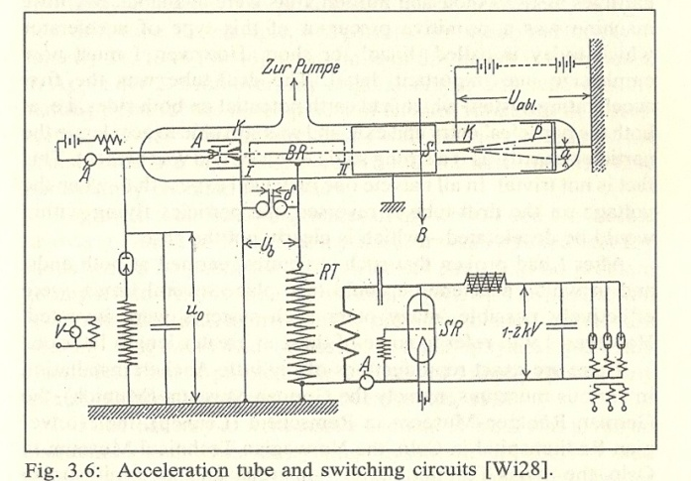
After the start, a stop…
Limitation of the Wideröe device:
for protons, needs high frequencies
(d=βλ/2, → taking d~10 cm, W=500 keV → f~50 MHz, λ~6 m)
☞ But a) higher frequency were not possible with the tubes of the time;
b) losses from a conventional circuit would have been too large!
→ after the PhD, Rolf Wideröe works for AEG to build HV circuit breakers and his thesis, published in the “Archiv für Elektrotechnik”, remains unnoticed.
... But the topic was hot!
Notes:
Deforest did not realize that his patent for the triode could be used for an oscillator – he used it as a detector with less Cpk.

Slide 9
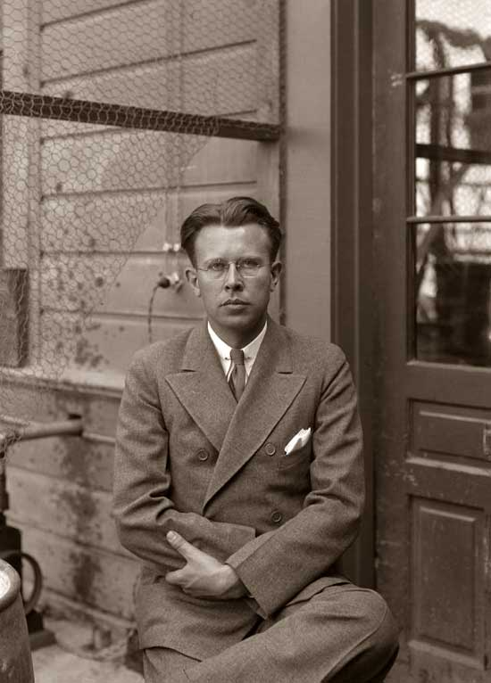
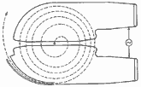
Ideas travel: from Aachen to Berkeley…
In the 1920’s, Ernest O. Lawrence (born 1901), young professor of physics at Berkeley, wants to join the “energy race”, and is looking for a new idea...
In 1929, during a conference, he goes to the university library and finds Wideröe’s thesis in the 1928 “Archiv für Elektrotechnik” (but he did not speak German...).
Immediately, he realised the potential of the idea of Radio-Frequency acceleration, and starts work with his PhD students on 2 parallel activities:
A Wideröe “linac” with several drift tubes, to accelerate heavy ions (Sloan and Lawrence).
A “cyclic” accelerator, bending the particles on a circular path around Wideröe’s drift tube (Livingston and Lawrence) → the cyclotron.
Notes:
Lucky not to understand German… in the text of Wideroe there was a chapter on why cyclic accelerators would not work…
Lawrence invented also a colour television tube, and the EM separation of isotopes that helped building the atom bomb.

Slide 10
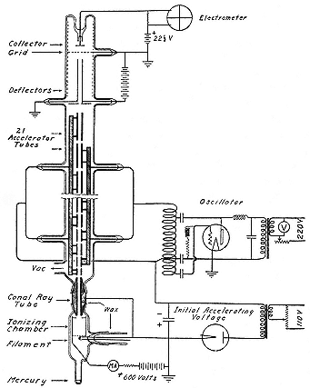
The Sloan-Lawrence structure
Sloan and Lawrence developed the first heavy ion linac:
In 1931, they built a Wideroe-type linac with 30 drift tubes and an applied voltage of 42 kV at 10 MHz frequency.
→ Acceleration of mercury ions at an energy of 1.26 MeV (=30 x 42 keV) for a current of 1 μA.
Upgraded in 1934 to 36 drift tubes and 2.85 MeV.

Slide 11
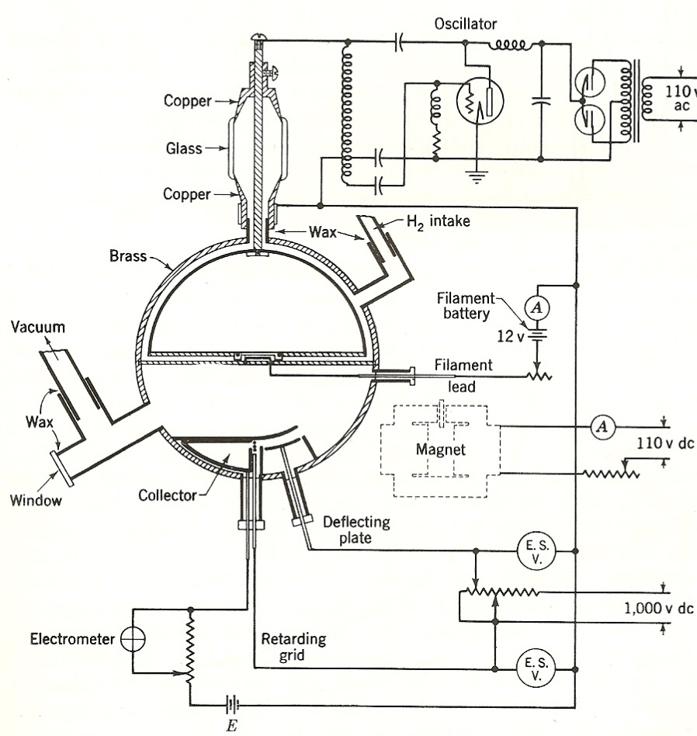
A competitor to linacs: the cyclotron
Acceleration in the gap between two “D” → long path of the particles in the D, frequencies ~1 MHz can be effectively used (3.5 MHz, 1st Berkeley cyclotron).
Fortunate “coincidence”: the revolution frequency does not depend on the beam energy → RF frequency is constant !
(but this simple cyclotron design can be used only at non-relativistic energies)
1931: the Berkeley cyclotron reaches 1.2 MeV with protons. First atom disintegrations in 1932.
1934: 5 MeV reached on a new larger machine accelerating protons and deuterons (used for the production of neutrons, discovered in 1932).
Scheme of the first Berkeley cyclotron, from S. Livingston’s PhD Thesis.
revolution frequency
Notes:
Another PhD thesis… again basically a radio transmitter plugged to a drift tube.

Slide 12
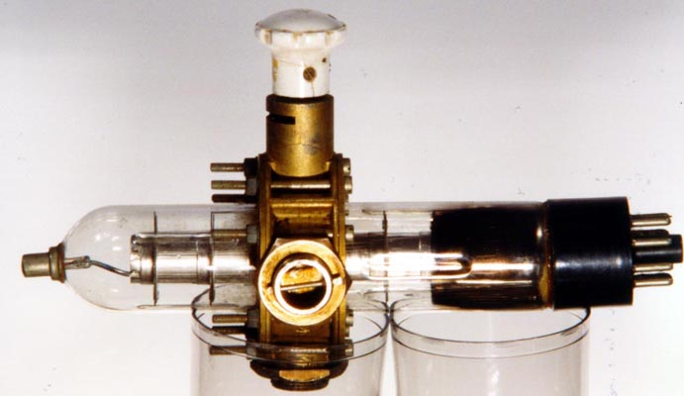
Higher frequencies – klystrons and cavities
Early RF systems (LC-based) were limited by leakage of RF power at high freq.
→ W. Hansen (b. 1909) at Berkeley starts to work on “cavity resonators” for higher frequency.
→ In 1937 Hansen moves to Stanford University where in 1937-39 together with the Varian brothers develops a new source of RF power, the klystron.
In 1948 the Varians leave Stanford to start their company (Varian Associates) and produce commercial klystrons → the klystron goes from accelerators to industry, and will equip the new TV broadcasting stations.
A WW2 3 Ghz klystron
Original klystrons were at mW levels, only after the war MW-level klystrons are developed at Stanford.
Note the interesting «virtuous circle»: from industry (radio transmitter) to science (accelerators) and back to industry (TV transmitters) in 20 years!
Notes:
William Hansen, of Danish origins, died in 1949 of beryllium exposure (lung disease).

Slide 13
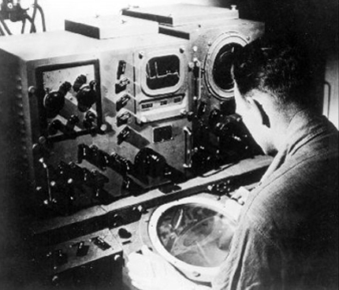
From industry to accelerators: WW II and the radar
The war effort recruited the best UK and US scientists: the klystron team at Stanford and the cyclotron team at Berkeley contribute to the development of radars. In 1940 is established the Radiation Laboratory at MIT, which will develop the modern radar technology.
Note that early radars were based on the magnetron, developed at Birmingham in 1930-40 (3-30 GHz). UK radar technology was shared with US from 1940.
The great boost to RF technology that made modern particle accelerator possible came from the radar development of WW II.
All the research at MIT was made public after the war (and produced great series of books on RF technologies).
Notes:
Klystrons in particular are good to be airborne – First magnetron based operational UK radar was used at Cape Matapan against Italian Navy on 17.3.1942. Ginzton, other books

Slide 14
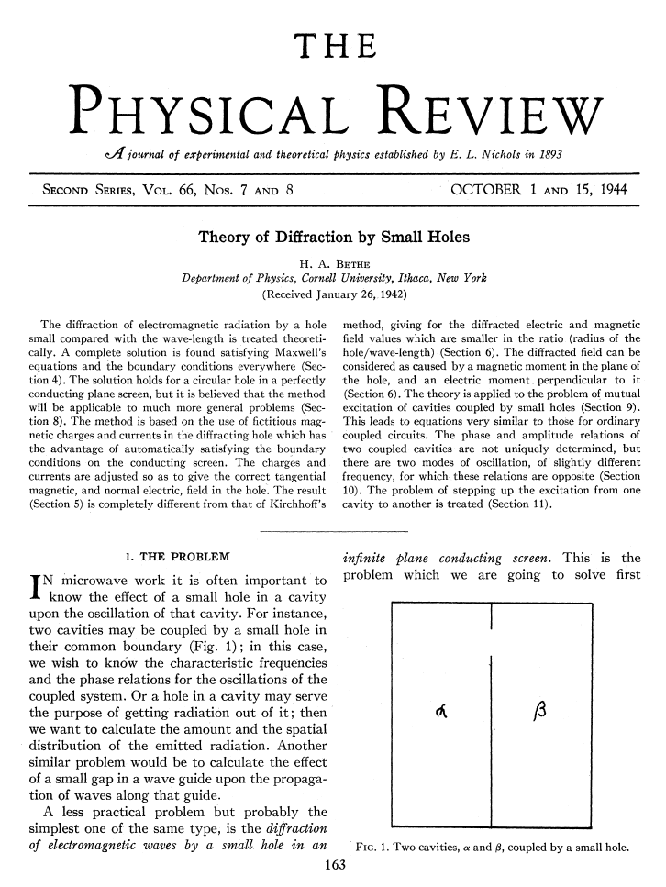
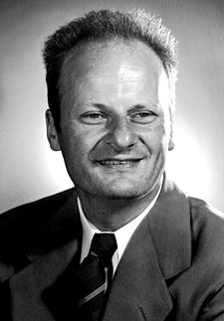
Scientists at war… an interesting example
Hans Bethe and the coupling cavity-waveguide
Theoretical physicist (nuclear physics, interaction particles/matter, ...)
Escaped to UK and then USA in 1933.
In 1941/42 was asked to contribute to the MIT work on radar, and given the problem of calculating the coupling from a hole between 2 cavity resonators.
The result was this paper, still the basis for understanding coupling problems in RF.
From 1942 Bethe left the RF field for the Manhattan Project, becoming one of the fathers of the atom bomb.
Notes:
From Cornell university (Livingstone).

Slide 15
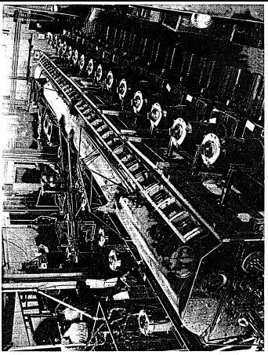
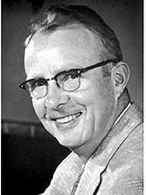
After the war, the big jump
Luis Alvarez and the Drift Tube Linac
The war effort gave the competences and the components to go to higher frequencies (in the MHz – GHz range) and to try acceleration of a proton beam to the MeV range using the Wideröe principle.
The 1st Drift Tube Linac by L. Alvarez and his team at Berkeley, reaches 32 MeV in 1947.
Alvarez, an experimental physicists, worked at MIT on radar during the war. In 1945 had the tools and the competences to build his own accelerator.
The “drift tubes” are inside a cavity resonator.
Frequency : Alvarez receives from the US Army a stock of 2’000 (!) surplus 202.56 MHz transmitters, built for a radar surveillance system. 26 were installed to power the DTL with a total of 2.2 MW. They were soon replaced because unreliable, but this frequency remained as a standard linac frequency.
Notes:
Consequence of the Pearl Harbour shock was that the US stocked thousands of antiaircraft systems in case of an invasion of California.

Slide 16
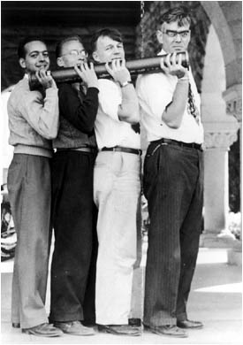
Another jump: higher frequencies and higher power
The Stanford Linear Accelerator
Development of the first electron linac (Ginzton, Hansen, Kennedy, 1948) at Stanford University.
Travelling-wave structures, iris loaded.
Important decision to separate the vacuum of the accelerator from the vacuum of the klystron through the use of “windows”.
3 GHz chosen as the highest frequency for which power sources were available (magnetron, 1 MW).
The Stanford team develops in 1946-49 a high-power klystron (8 MW) for its new linac.
William Hansen (right) and colleagues with a section of the first electron linear accelerator that operated at Stanford University in 1947. It was 3.6 meters long and could accelerate electrons to 6 MeV.
Notes:
Note that the problem of the windows was very difficult – Hansen died of a pulmonary disease due to the beryllium used for the windows.

Slide 17
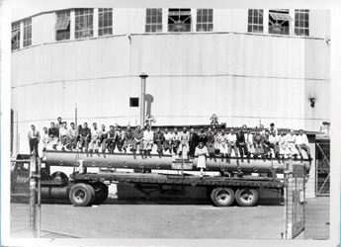
A visual comparison between high and low frequencies…
The previous photograph was advertising the advantages of the 3 GHz frequency… compared to a famous photo of Alvarez’s 1st tank at 202 MHz!
Berkeley Laboratory group seated on top of the vacuum tank of their 40-foot 32-MeV proton linear accelerator on the back of a flatbed truck, probably in 1947.
Notes:
1st cavity resonator built by Hansen (Stanford) for the klystron (lower power dissipation). 2nd by Alvarez for DTL, 3rd (actually TW) for the 3 GHz MarkII

Slide 18
After pre-history, the history of linacs
The focusing problem: in the first linacs, most of the particles were lost during acceleration → Alvarez used in his linac grids placed at the end of the drift tube hole, to avoid the RF defocusing: no defocusing, but losses on the grid → solution only after the invention of alternating-gradient focusing (1952) and the use of small quadrupole magnets (from 1954-55).
The technology problem: initial proton and ion linacs had a separate vacuum and RF envelope (a light sheet copper structure inside a big vacuum-tight cylinder). In the 70’s appeared the first linacs made of copper-clad stainless steel tanks with common RF and vacuum envelope. Copper-clad is not reliable, and at the beginning of the 80’s copper plating of steel (first mild, then stainless) made possible reliable structures with common envelopes.
The beam intensity problem: although alternating-gradient focusing allowed for beam transmissions coming close to 100%, several applications considered in the cold-war 70’s called for top beam intensity from linacs (fusion material irradiation, military tritium production, star wars,…) → development of sophisticated beam simulation codes and of the Radio Frequency Quadrupole (removes the intensity bottleneck at low energy!).

Slide 19
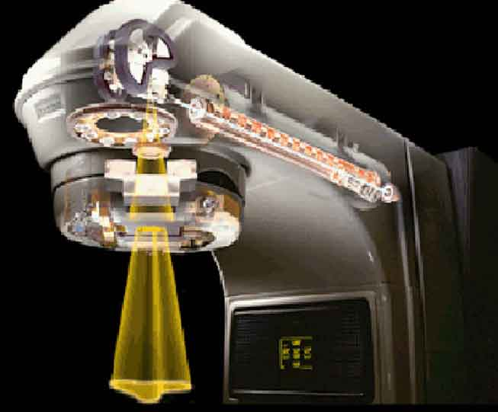
Maturity: energy, complexity, frequency, etc.
And now, it is no longer history...
Since the 70’s, we have seen a multiplication of linear accelerators around the world, going from the large colliders for physics to the small machines for industrial applications and medicine (> 7’000 electron accelerators for X-ray therapy are operational around the world !).
The trends for linacs are:
Increase in energy: linear colliders for electrons, spallation sources (and future neutrino facilities) for protons.
Increase in complexity and flexibility: tailor-made linacs in particular for heavy ion applications.
Increase in RF frequency, up to the 30 GHz of the original CLIC proposal;
But in the last 50 years, only one major breakthrough...

Slide 20
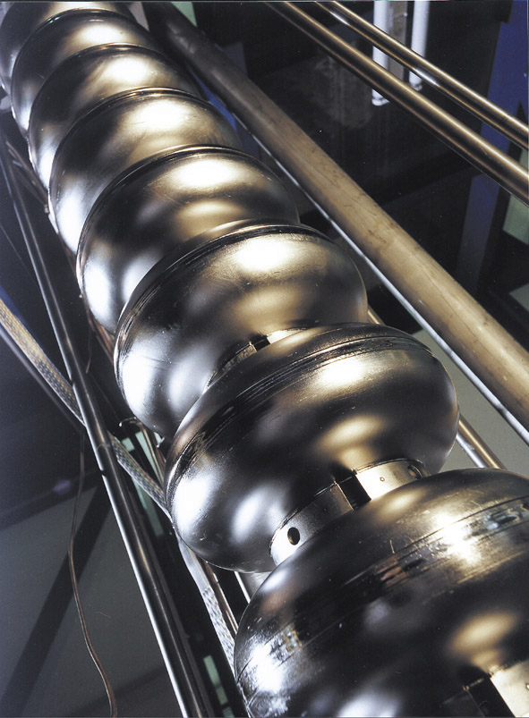
The rise of superconductivity
Superconductivity known since 1911, theoretical understanding (BCS theory) only in 1957.
1965: acceleration of electrons at Stanford in a lead-plated SC resonator.
1970’s: several SC cavity projects aiming at 2-3 MV/m (Stanford, Illinois, CERN, Karlsruhe, Cornell, Argonne).
Late 70’s – 80’s: impressive advance in the number of projects and in the gradient achievable, thanks to improved cleaning techniques (plus geometry optimisation and improvement in Nb quality). Gradients > 10 MV/m routinely obtained.
80’s - 90’s: Large scale SC projects, ATLAS and CEBAF in USA, HERA and LEP-II in Europe.
90’s – 00’s: impressive development for TESLA and then for the ILC. 35 MV/m design gradient for new SC systems.

Slide 21
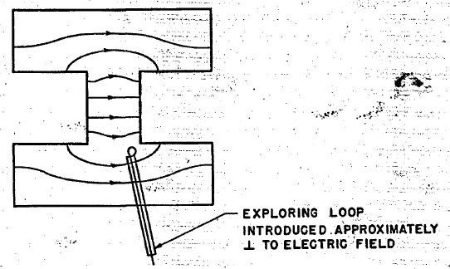
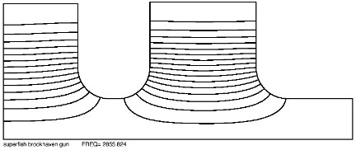
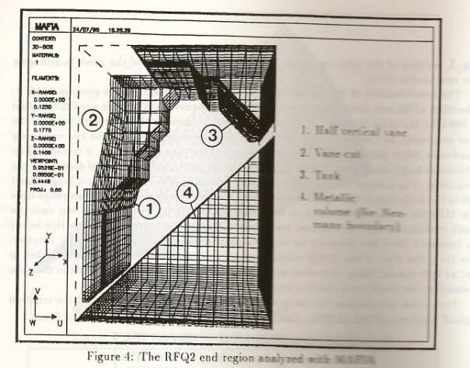
Progress in mapping the fields
Knowledge of the field distribution inside an accelerating cavity is essential to define the operating frequency, to compute the voltage, to dimension the coupler, etc.
1. The good old way: build a model and then measure frequency and explore fields with a probe.
(illustration from the original Alvarez paper on DTL)
2. From the beginning of the 80’s, modern computers allow to calculate frequency and fields in 2D (axis-symmetric cavities): SUPERFISH and URMEL.
3. At the end of the 80’s comes the first 3D software: the MAFIA package (DESY and LANL). Constantly improved, 3D packages allow nowadays to calculate complex shapes with amazing precision.
(1st 3D simulation of the CERN RFQ2 – 1987, 6000 mesh points)
Notes:
Important to close the loop and go to models after simulations! Feeling of mechanical fabrication and mechanical errors (most typical mistake of a new RF designer is to compute a shape precise at the 6th decimal digit, when fabrication errors affect already the 1st digit…

Slide 22
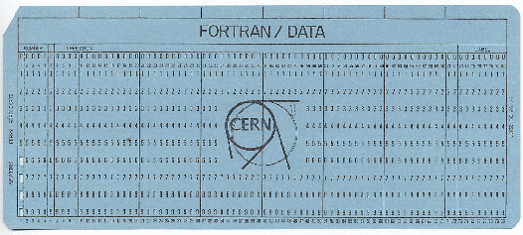
Progress in simulating the beam evolution
Until the 60’s, only analytical formulas for understanding the beam behaviour.
Pioneering computer codes appear in the 60’s: written in FORTRAN, data introduced with punch cards.
Best example: PARMILA from Los Alamos (Phase and Radial Motion in Linear Accelerators) allowed the construction of the 800 MeV LAMPF linac at the end of the 60’s. From an initial distribution of up to few 1000 particles, allows to calculate the evolution of beam parameters (emittance) in a focusing and accelerating channel based on standard structures (eg. DTL) and with a rough space charge treatment.
Modern codes (IMPACT, DYNAMION , TOUTATIS, HALODYN, LORAS, etc.) can treat millions of particles through real-field distributions with very precise space charge routines, calculating not only rms parameters but also halos and tails in beam distributions.

Slide 23
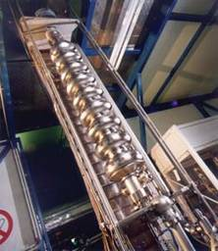
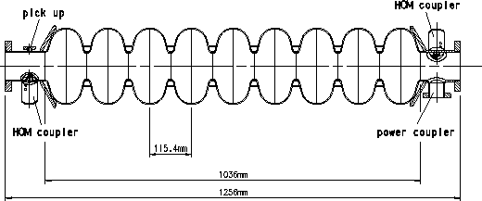
Modern trends in linacs
What is new (& hot) in the field of linacs?
Frequencies are going up for both proton and electron linacs (←less expensive precision machining, efficiency scales roughly as √f). Modern proton linacs start at 350-400 MHz, end at 800-1300 MHz. Modern electron linacs in the range 3-12 GHz.
Superconductivity is progressing fast, and is being presently used for both electron and ion linacs → multi-cell standing wave structures in the frequency range from ~100 MHz to 1300 MHz.
Superconductivity is now bridging the gap between electron and ion linacs. The 9-cell TESLA/ILC SC cavities at 1.3 GHz for electron linear colliders, are now proposed for High Power Proton Accelerators (Fermilab 8 GeV linac) !

Slide 24
Lecture 1 Questions
What are the main differences between circular and linear accelerators? What is their range of energy and beam current?
What are the relative advantages and disadvantages of constant distance and constant phase linear accelerating chains?
What characterizes wave propagation in a periodic structure?
What is the difference between phase velocity and group velocity?
What happens when a periodic structure is closed at both ends?
What is the difference between a traveling wave and a standing wave linac? What type of particle they can accelerate?
What are the advantages of RF accelerators over electrostatic accelerators?
What are the differences (if any) between the beam that can be produced by a linac and by a cyclotron (in terms of energy and pulse structure)?
What are the advantages of using cavity resonators around the drift tube structure?

