Slide 1

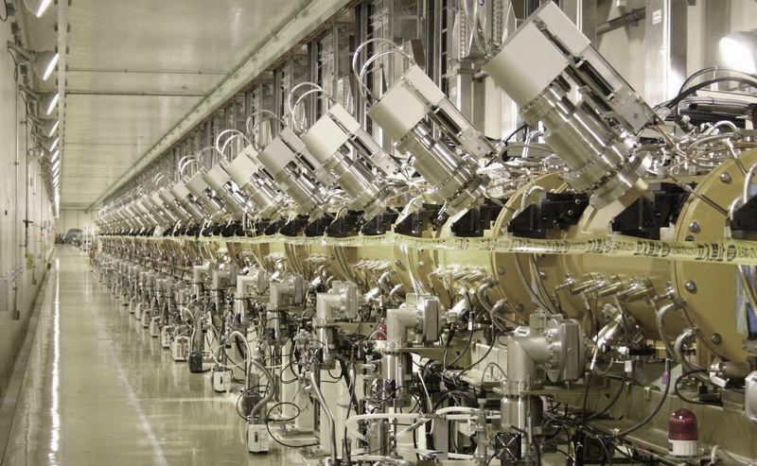
Module 5
A quick overview of beam dynamics in linear accelerators

Slide 2
Introduction
A linear accelerator requires an accurate beam optics design, in order to:
Minimize emittance growth (remember Liouville: emittance can only increase!);
Minimize beam loss, to: a) avoid activation of the accelerator (of the linac and of the following machine!) and b) reduce the requirements on the ion source.
Note that the operating regimes in linacs can be very different, between
μa peak currents for heavy ion linacs (~ 10⁵ particles / bunch)
mA peak currents for proton linacs (~ 10⁸ particles / bunch)
100’s mA peak currents for high-power proton linacs (~ 10¹¹ particles / bunch)
A’s peak currents for electron linacs

Slide 3
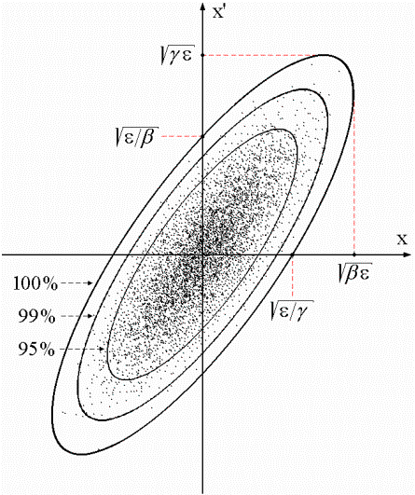
Beam emittance
Recall a basic definition that we will need in the following:
Beam emittance: is the volume in the phase space occupied by the particle beam. The space is 6-dimensional (x,x’,y,y’,W,φ) but are important the projections in the 3 dimensions: transverse emittance in x and y (ε_{x}, ε_{y}) and longitudinal emittance (ΔW, φ).
Liouville theorem: under the action of linear forces, the beam emittance is constant. (BUT: in presence of non-linear forces, it increases). Consequence: in an accelerator, where non-linear forces are often present, the emittance will progressively increase.
Beam brightness: beam current/transverse emittance.
Corresponds to the “density” in phase space. Preserving brightness means minimizing emittance growth.

Slide 4
Longitudinal dynamics
Ions are accelerated around a (negative = linac definition) synchronous phase.
Particles around the synchronous one perform oscillations in the longitudinal phase space.
Frequency of small oscillations:
Tends to zero for relativistic particles γ>>1.
Note phase damping of oscillations:
At relativistic velocities phase oscillations stop, and the beam is compressed in phase around the initial phase. The crest of the wave can be used for acceleration.
Notes:
This happens for every value of phi

Slide 5
Longitudinal dynamics - electrons
Electrons at v=c remain at the injection phase.
Electrons at v<c injected into a TW structure designed for v=c will move from injection phase ϕ₀ to an asymptotic phase ϕ, which depends only on gradient and β₀ at injection.
The beam can be injected with an offset in phase, to reach the crest of the wave at β=1
Capture condition, relating E₀ and β₀ :
Example: λ=10cm, W_{in}=150 keV and E₀=8 MV/m.
In high current linacs, a bunching and pre-acceleration sections up to 4-10 MeV prepares the injection in the TW structure (that occurs already on the crest)
Notes:
Again obtained solving the equation of motion dp/dt=eEcos(phi(z,t)).

Slide 6
Transverse dynamics - Space charge
Large numbers of particles per bunch ( ~10¹⁰ ).
Coulomb repulsion between particles (space charge) plays an important role and is the main limitation to the maximum current in a linac.
But space charge forces ~ 1/γ² disappear at relativistic velocity
Force on a particle inside a long bunch with density n(r) traveling at velocity v:
B
E
Notes:
Gauss law

Slide 7
Transverse dynamics - RF defocusing
RF defocusing experienced by particles crossing a gap on a longitudinally stable phase.
In the rest frame of the particle, only electrostatic forces → no stable points (maximum or minimum) → radial defocusing.
Lorentz transformation and calculation of radial momentum impulse per period (from electric and magnetic field contribution in the laboratory frame):
Bunch position at max E(t)
Transverse defocusing ~ 1/γ² disappears at relativistic velocity (transverse magnetic force cancels the transverse RF electric force).
Notes:
Particles experience a higher field in the 2nd half of a gap. Defocusing forces (2nd half of gap) are stronger than focusing forces (1st half).

Slide 8
Focusing
Defocusing forces need to be compensated by focusing forces → alternating gradient focusing provided by quadrupoles along the beam line.
A linac alternates accelerating sections with focusing sections. Options are: one quadrupole (singlet focusing), two quadrupoles (doublet focusing) or three quadrupoles (triplet focusing).
Focusing period=length after which the structure is repeated (usually as Nβλ).
The accelerating sections have to match the increasing beam velocity → the basic focusing period increases in length (but the beam travel time in a focusing period remains constant).
The maximum allowed distance between focusing elements depends on beam energy and current and change in the different linac sections (from only one gap in the DTL to one or more multi-cell cavities at high energies).

Slide 9
Transverse beam equilibrium in linacs
The equilibrium between external focusing force and internal defocusing forces defines the frequency of beam oscillations.
Oscillations are characterized in terms of phase advance per focusing period σ_{t} or phase advance per unit length k_{t}.
Ph. advance = Ext. quad focusing - RF defocusing - space charge
q=charge
G=quad gradient
l=length foc. element
f=bunch form factor
r₀=bunch radius
λ=wavelength
…
Approximate expression valid for:
F0D0 lattice, smooth focusing approximation, space charge of a uniform 3D ellipsoidal bunch.
A “low-energy” linac is dominated by space charge and RF defocusing forces !!
Phase advance per period must stay in reasonable limits (30-80 deg), phase advance per unit length must be continuous (smooth variations) → at low β, we need a strong focusing term to compensate for the defocusing, but the limited space limits the achievable G and l → needs to use short focusing periods N βλ.
Note that the RF defocusing term ∝f sets a higher limit to the basic linac frequency (whereas for shunt impedance considerations we should aim to the highest possible frequency, Z ∝√f) .
9

Slide 10
Electron linacs
Ph. advance = Ext. quad focusing - RF defocusing - space charge – Instabilities
Electron Linac:
Ph. advance = Ext. focusing + RF defocusing + space charge + Instabilities
For γ>>1 (electron linac): RF defocusing and space charge disappear, phase advance ￫0. External focusing is required only to control the emittance and to stabilize the beam against instabilities (as wakefields and beam breakup).
Notes:
If phase advance is too large, we run into instabilities. If it is too small beam becomes too large in size.

Slide 11
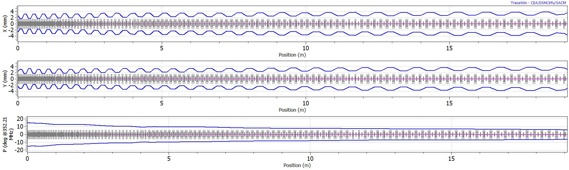
Phase advance – an example
Beam optics of the Linac4 Drift Tube Linac (DTL): 3 to 50 MeV, 19 m, 108 focusing quadrupoles (permanent magnets).
Oscillations of the beam envelope (coordinates of the outermost particle) along the DTL (x, y, phase)
Corresponding phase advance per period
Design prescriptions:
Tranverse phase advance at zero current always less than 90°.
Smooth variation of the phase advance.
Avoid resonances (see next slide).

Slide 12
Instabilities in linacs – the Hoffman plot
The “tune diagram” of a linac
Ratio between transverse phase advance and zero current phase advance (a measure of space charge)
Ratio between longitudinal and transverse phase advance
Linac4 DTL: the operating point(s) for all possible current levels are far from the resonances between transverse and longitudinal oscillations which are enhanced by space charge.
Effect of the resonances: emittance exchange, transverse emittance growth, migration of particles into the beam halo → particularly dangerous for high intensity machines (beam loss).

Slide 13
Focusing periods
Focusing usually provided by quadrupoles.
Need to keep the phase advance in the good range, with an approximately constant phase advance per unit length → The length of the focusing periods has to change along the linac, going gradually from short periods in the initial part (to compensate for high space charge and RF defocusing) to longer periods at high energy.
For Protons (high beam current and high space charge), distance between two quadrupoles (=1/2 of a FODO focusing period):
- βλ in the DTL, from ~70mm (3 MeV, 352 MHz) to ~250mm (40 MeV),
- can be increased to 4-10βλ at higher energy (>40 MeV).
- longer focusing periods require special dynamics (example: the IH linac).
For Electrons (no space charge, no RF defocusing):
focusing periods up to several meters, depending on the required beam conditions. Focusing is mainly required to control the emittance.
Notes:
Beta 7% at 3 MeV

Slide 14
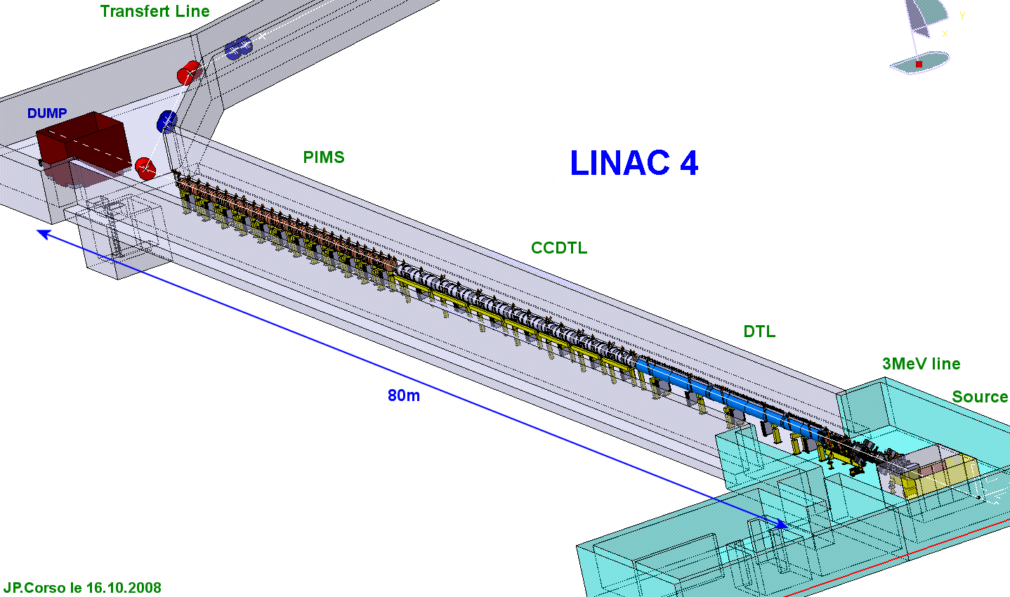
Architecture: cell length, focusing period
EXAMPLE: the Linac4 project at CERN. H-, 160 MeV energy, 352 MHz.
A 3 MeV injector + 22 multi-cell standing wave accelerating structures of 3 types
DTL, 3-50 MeV: every cell is different, focusing quadrupoles in each drift tube, 0-mode
CCDTL, 50-100 MeV: sequences of 2 identical cells, quadrupoles every 3 cells, 0 and π/2 mode
PIMS, 100-160 MeV: sequences of 7 identical cells, quadrupoles every 7 cells, π/2 mode
Two basic principles to remember:
1. As beta increases, phase error between cells of identical length becomes small → we can have short sequences of identical cells (lower construction costs).
2. As beta increases, the distance between focusing elements can increase.
Injector
Notes:
Forget about the acronyms, important are 2 elements

Slide 15
High-intensity protons – the case of Linac4
Transverse (x) r.m.s. beam envelope along Linac4
Example: beam dynamics design for Linac4@CERN.
High intensity protons (60 mA bunch current, duty cycle could go up to 5%), 3 - 160 MeV
Beam dynamics design minimising emittance growth and halo development in order to:
1. avoid uncontrolled beam loss (activation of machine parts)
2. preserve small emittance (high luminosity in the following accelerators)

Slide 16
Beam Optics Design Guidelines
Prescriptions to minimise emittance growth and halo formation:
1. Keep zero current phase advance always below 90º, to avoid resonances
2. Keep longitudinal to transverse phase advance ratio 0.5-0.8, to avoid emittance exchange
3. Keep a smooth variation of transverse and longitudinal phase advance per meter.
4. Keep sufficient safety margin between beam radius and aperture
Transverse r.m.s. emittance and phase advance along Linac4 (RFQ-DTL-CCDTL-PIMS)

Slide 17
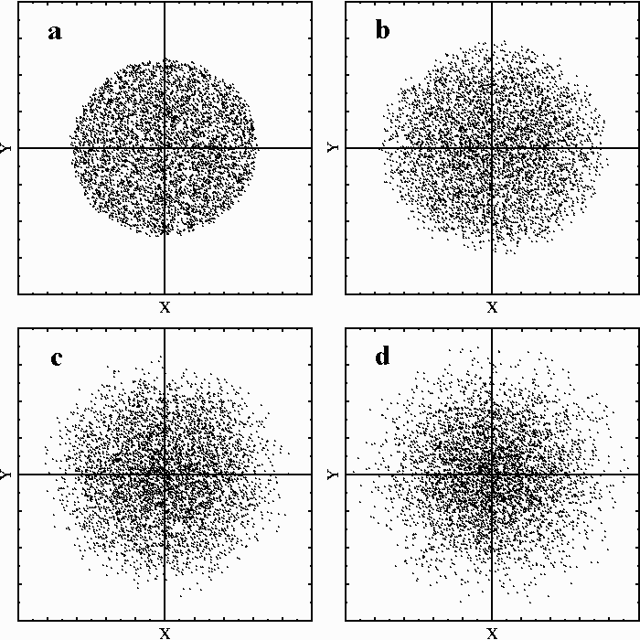
Halo and beam loss
Additional challenge on beam dynamics:
Beam loss has to be avoided not because it reduces current, but because activation due to beam loss could come to levels preventing access to the machine.
Commonly accepted loss limit for hands-on maintenance is 1 W/m.
For example, in the case of the SPL design at CERN (5 GeV, 20 mA, 5% duty cycle) this corresponds to a maximum loss at 5 GeV of 0.2x10⁻⁶/m, or 4 nA/m !!
In usual linacs, the beam distribution can be quite complicated, and presents a core surrounded by a “halo”. Halo formation has to be studied and controlled, but is at the limit of capability for modern computers

Slide 18
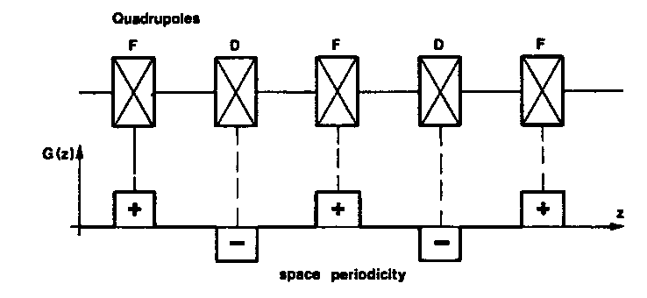
High brightness
Current and emittance are defined by the ion source: common ion sources have maximum currents ~ 80 mA for H-, ~ 200 mA for protons, in emittances of >0.02 π mm mrad.
In the linac, non-linearities in the focusing channel and in the space charge forces tend to increase the emittance and to decrease brightness.
Beam brightness: beam current/transverse emittance.
Corresponds to the “density” in phase space. Preserving brightness means minimizing emittance growth.

Slide 19
space charge – non linear effects
the more the beam is compressed in real space, the more the space charge effect is non linear
non linear space charge effect generates emittance growth
at low energy space charge is the limiting factor for the minimum emittance that can be produced out of an accelerator

Slide 20
Minimum emittance from space charge
(CHASMAN PLOT) FOR CERN RFQ2 (200MHz., 200 mA PROTONS)

Slide 21
emittance growth due to filamentation
velocity of rotation in the transverse phase space with no space charge doesn’t depend on the amplitude.
with linear space charge it is lowered but it still doesn’t depend on the amplitude
with non linear space charge it does depend on amplitude and therefore there are areas of the phase space move at different velocity. This generates emittance growth.

Slide 22
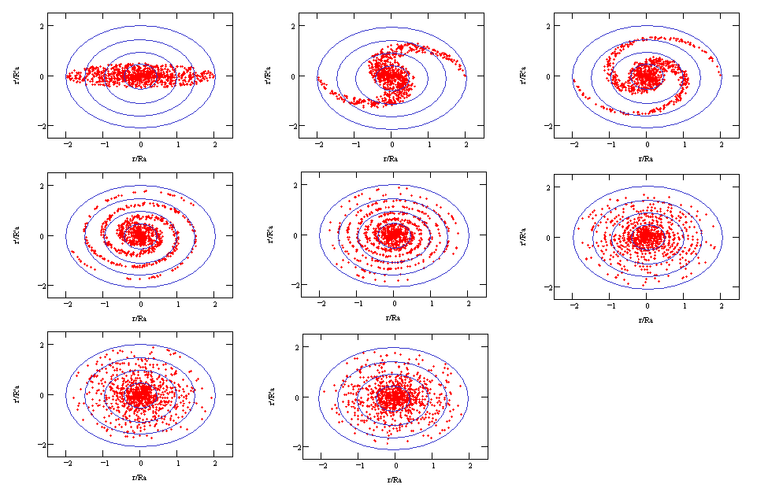
Non linear forces: filamentation

Slide 23
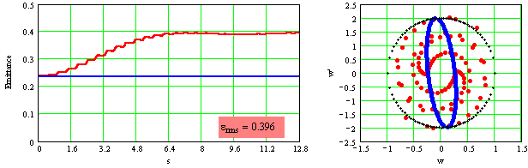
Filamentation: emittance increase
Evolution of the emittance along an accelerator under the influence of linear forces only (blue line) or non-linear forces (red line)
Linear force
Non linear force

Slide 24
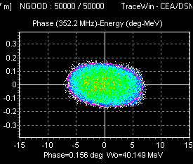
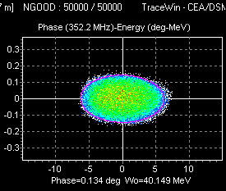
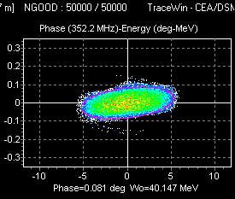
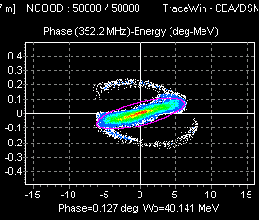
Space-charge filamentation in longitudinal plane
el_in=0.21
el_in=0.18
el_in=0.12
el_in=0.03
emittance r.m.s. in deg MeV
(1)
(2)
(3)
(4)

Slide 25
Questions on Module 5 ?
- Defocusing / focusing forces
- Space charge
- Focusing periods
- Filamentation

