Slide 1

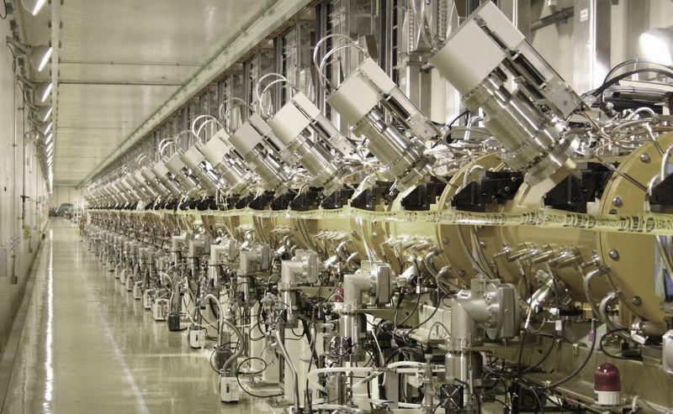
Module 4
Anatomy of a linear accelerator
Linac technologies
RF parameters and measurements

Slide 2
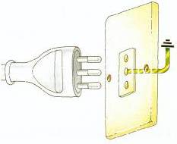
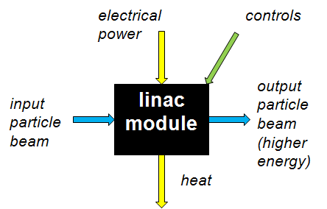
Linac building blocks
HV AC/DC power converter
AC to DC conversion efficiency ~90%
Main oscillator
RF feedback
system
DC to RF conversion efficiency ~50%
High power RF amplifier (tube or klystron)
RF to beam voltage conversion efficiency = SHUNT IMPEDANCE
ZT² ~ 20 - 60 MΩ/m
DC
particle
injector
buncher
ion beam, energy W
magnet
powering
system
vacuum
system
water
cooling
system
LINAC STRUCTURE
accelerating gaps + focusing magnets
designed for a given ion, energy range, energy gain

Slide 3
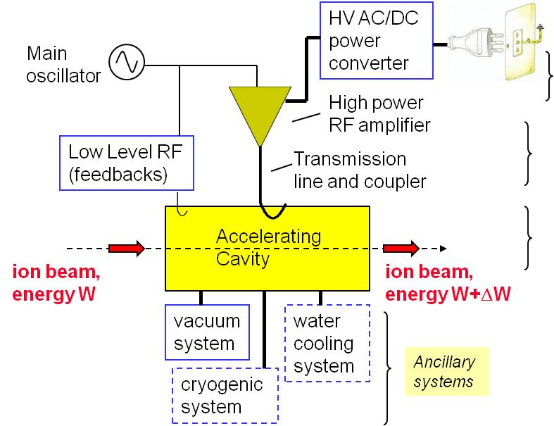
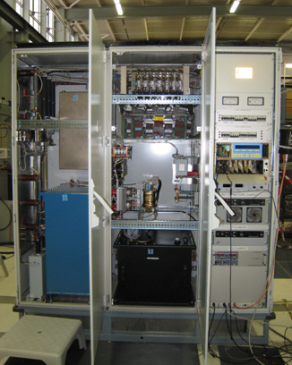
Anatomy - 1
The Power Converter
An essential ingredient for the reliability (high voltages!), stability (noise) and cost of a linac!
Made of rectifiers + HV transformer + energy storage when pulsed (can be a PFN).
If pulsed and HV, called “modulator”.
Topology and layout of the Linac4 modulator
Notes:
The source of energy

Slide 4
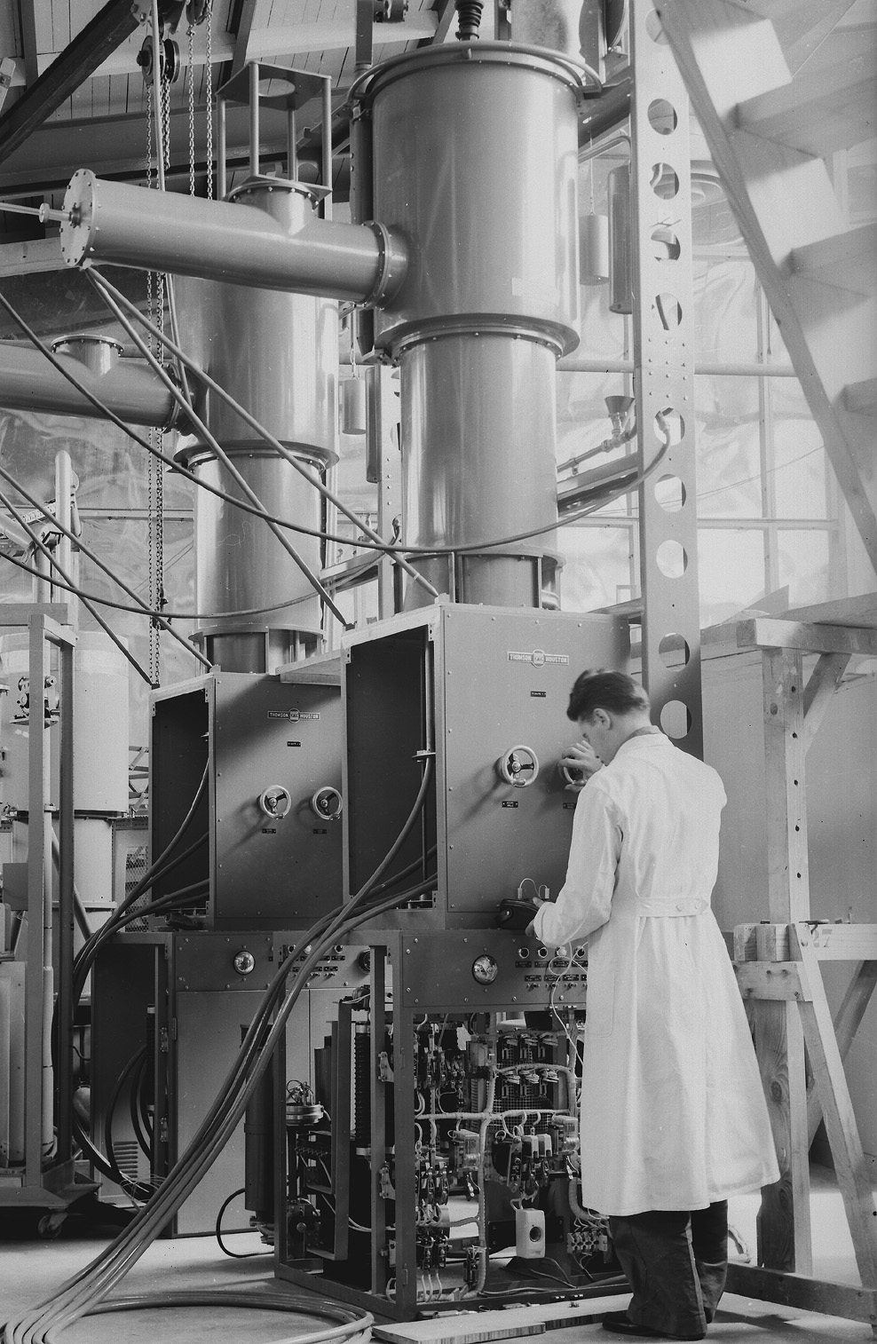
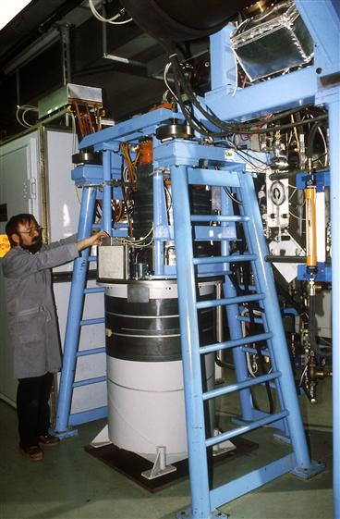
Anatomy - 2
The RF Amplifier
Usually an amplifier chain (sometimes called “transmitter”).
Provides the RF power, is based on an active device: RF tube (tetrode or triode), klystron or RF transistor (solid state).
The CERN Linac1 triode amplifiers (2 MW, 202 MHz) in a photo of 1959
The CERN LIL klystron (3 GHz)

Slide 5
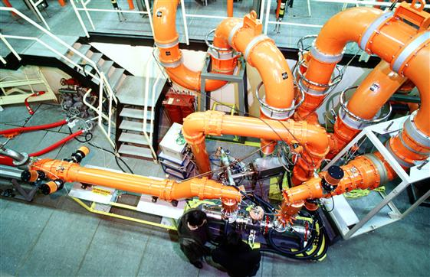
Anatomy – 3
The transmission line
Power has to be transported to the final load without reflections (matching), with minimum loss and reliably (no arcs!).
Coaxial (rigid or cable) or waveguide.
Rigid coaxial lines for the CERN TW 400 MHz RF system at the SPS

Slide 6
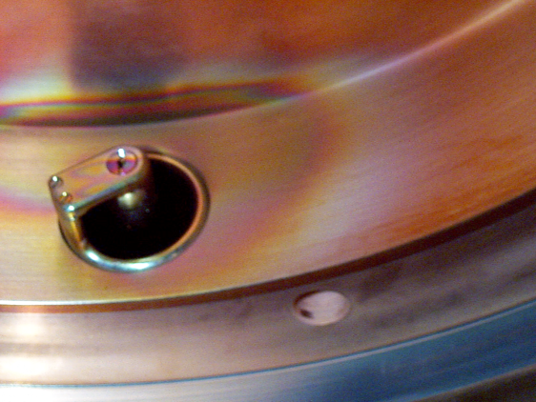
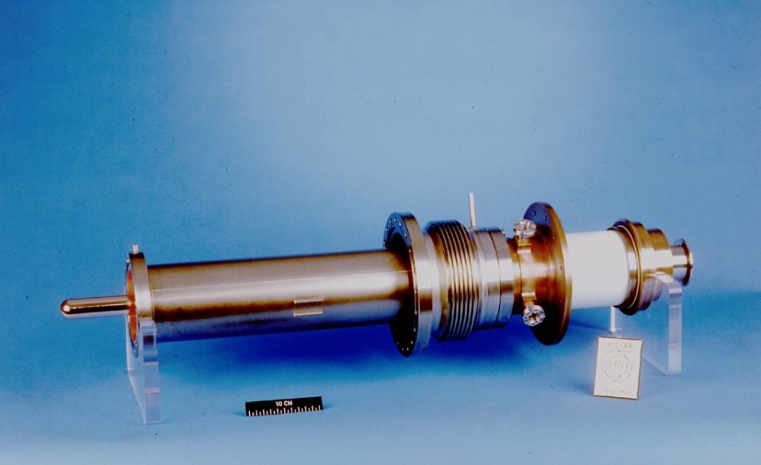
Anatomy - 4
The power coupler
Critical element, needs to transform the cavity impedance into the load impedance of the line (or into any wanted impedance), separating the vacuum in the cavity from the air (or dielectric) in the line (window).
Can be a loop, an antenna or an iris to a waveguide.
Antenna coupler for the LEP2 superconducting cavities.
Small loop coupler to a 400 MHz buncher after 15 years of operation, with traces of multipactoring

Slide 7
Anatomy - 5
The Low Level RF
Electronics aimed at stabilizing the voltage in the cavity against perturbations coming from inside the amplifier chain, from the cavity and from the beam.
Can be analog, analog/digital or digital.
The LHC LLRF (overview of one unit)

Slide 8
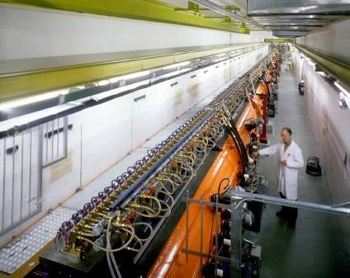
Anatomy – 6
The accelerating cavity
The heart of the system.
Accumulates electric energy in a series of gaps, with minimum power loss.
Essential is the synchronism between field and particles → the particles have to be at the right place at the right moment.
An RF cavity is a multidisciplinary object: integrates beam dynamics (sequence and position of gaps), electromagnetic design (E-field configuration), mechanical design (construction, joining techniques), vacuum, thermo mechanical issues (cooling or cryogenics),…
The CERN Linac2 accelerating cavities

Slide 9
The RF system
A closer insight of what the RF does is given by the equivalent circuit of an amplifier/cavity system
RF is the art of transporting energy by matching impedances
RF amplifier
transmission line
RF cavity
beam
Z_{i}
Z₀
Z₀
transmitter output coupler
resonator input coupler
active unit (tube or klystron):
current generator with internal impedance
output resonator of the transmitter (klystron): filters higher order harmonics and coupes to the line
transmission line
Cavity resonator
Beam: additional resistance (power given to the beam) + current generator out of phase

Slide 10
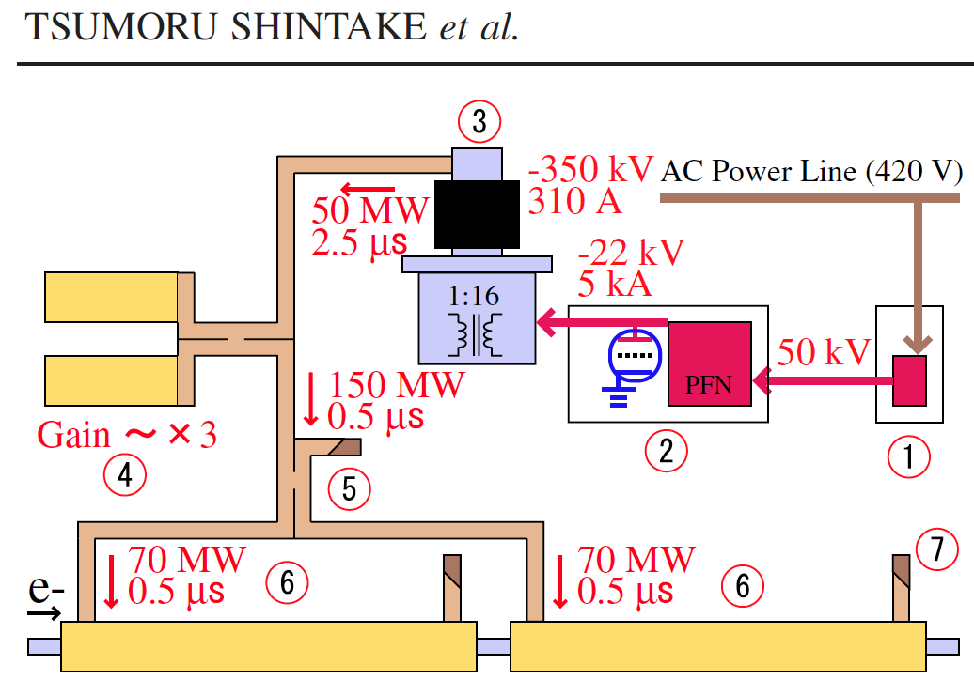
Electron linac building blocks
« Energy doubler », SLED

Slide 11
Linac Technologies
Notes:
We laid down the basis to understand our linacs, is now time to go into some more details

Slide 12
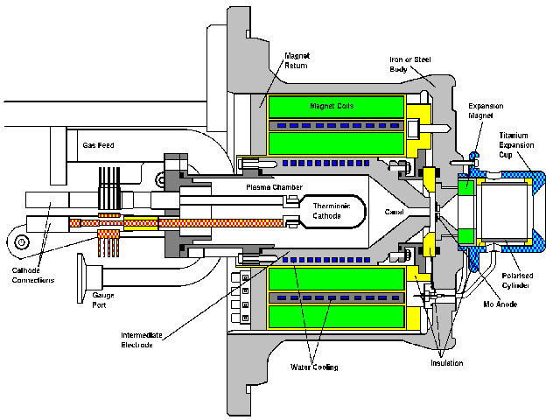
Particle production – the sources
Electron sources:
give energy to the free electrons
inside a metal to overcome the
potential barrier at the boundary.
Used for electron production:
thermoionic effect
laser pulses
surface plasma
Ion sources:
create a plasma and optimise its
conditions (heating, confinement and
loss mechanisms) to produce the desired
ion type. Remove ions from the plasma
via an aperture and a strong electric
field.
CERN Duoplasmatron proton Source
Photo Injector Test Facility - Zeuthen
262nm Laser

Slide 13
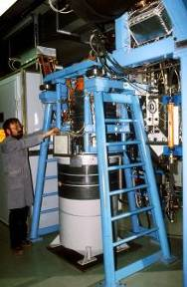

RF and construction technologies
Type of RF power source depend on frequency:
  ☞ Klystrons (>350 MHz) for electron linacs and modern proton linacs. RF distribution via waveguides.
  ☞ RF tube (<400 MHz) or solid state amplifiers for proton and heavy ion linacs. RF distribution via coaxial lines.
Construction technology depends on dimensions (￫on frequency):
  ☞ brazed copper elements (>500 MHz) commonly used for electron linacs.
  ☞ copper or copper plated welded/bolted elements commonly used for ion linacs (<500 MHz).
3 GHz klystron
(CERN LPI)
200 MHz triode amplifier
(CERN Linac3)

Slide 14
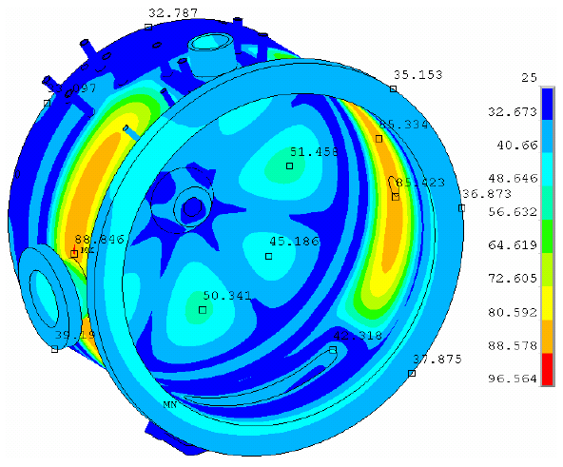
Construction technologies
Linac accelerating structure:
Set of parts joined together; needs to have:
A well defined vacuum envelope (no trapped volumes, special vacuum joints)
A well defined RF envelope (no leaking RF, good RF contacts between parts)
A stable mechanical structure under vibrations and thermal deformations
An effective cooling of the heat produced by the RF.
In most of the cases,
it is on the mechanical construction that you will win or lose your linac project…

Slide 15
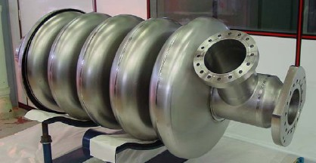
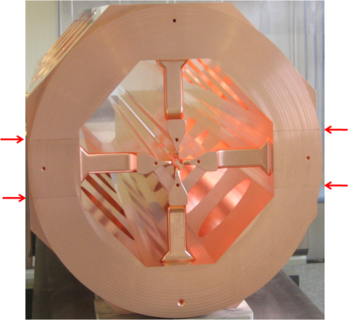
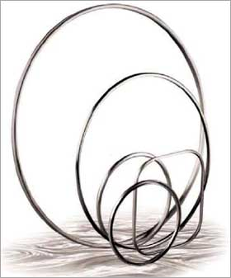
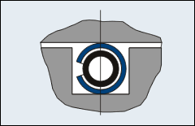
Joining techniques
 |  | vacuum | RF
Metal to metal | EB welding | ok | ok
 | Brazing | ok | ok
 | TIG welding | ok | ok
Gaskets | O-ring | ok (lifetime) | no
 | Conflat | ok | no (s. steel)
 | Wires (Al, In, Au, Cu,..) | ok (difficult) | ok
 | Spring cont. | no | ok (power)
 | C-seals | ok | ok
Additonal | Shrink-fitting | no | dangerous
 | Knife-edge | dangerous | ok
EB=Electron Beam
TIG=Tungsten Inert Gas
C-seals also known as Helicoflex

Slide 16
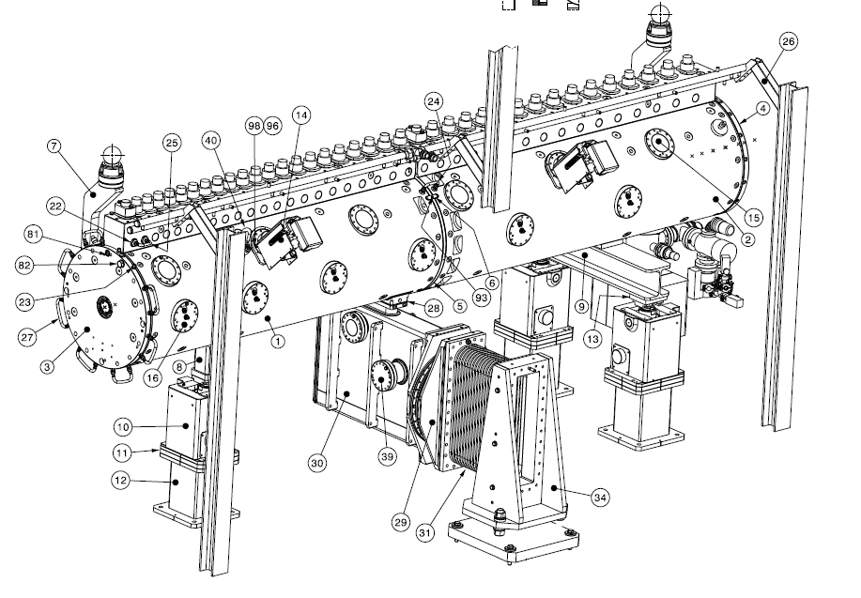
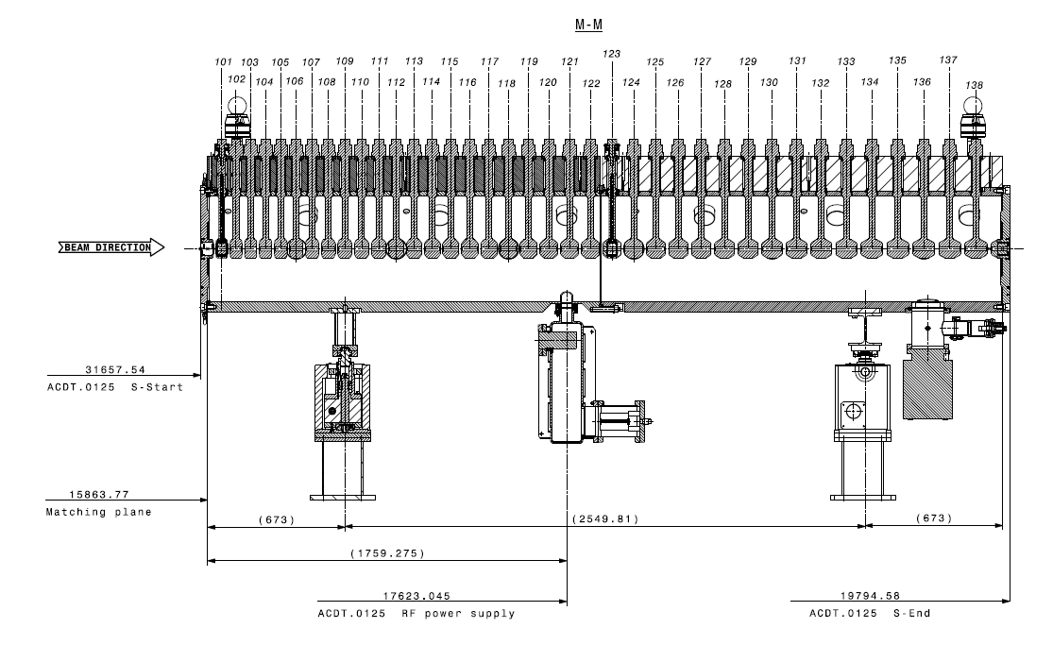
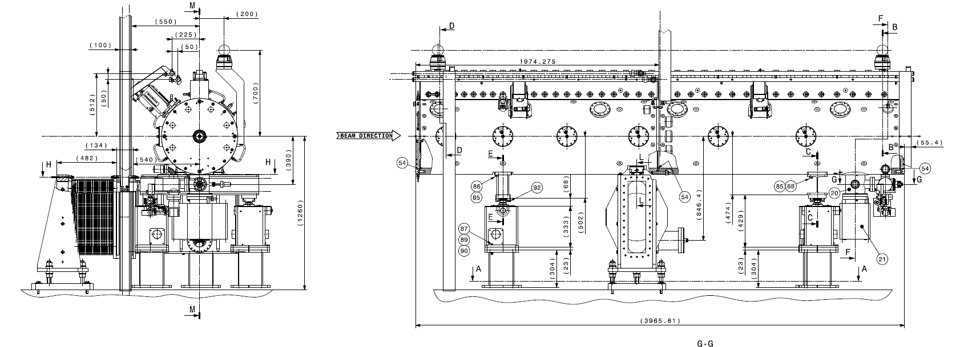
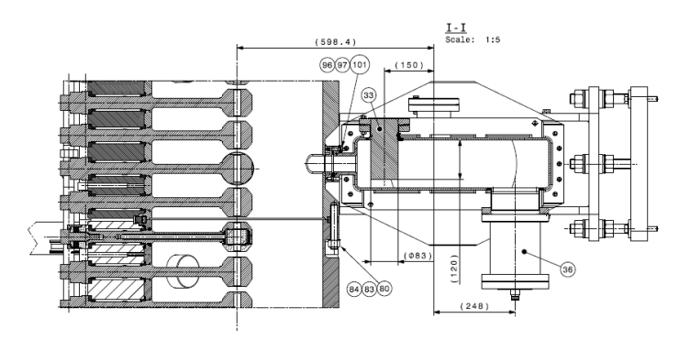
Example: Linac4 DTL Tank1
a puzzle of several thousand elements…

Slide 17
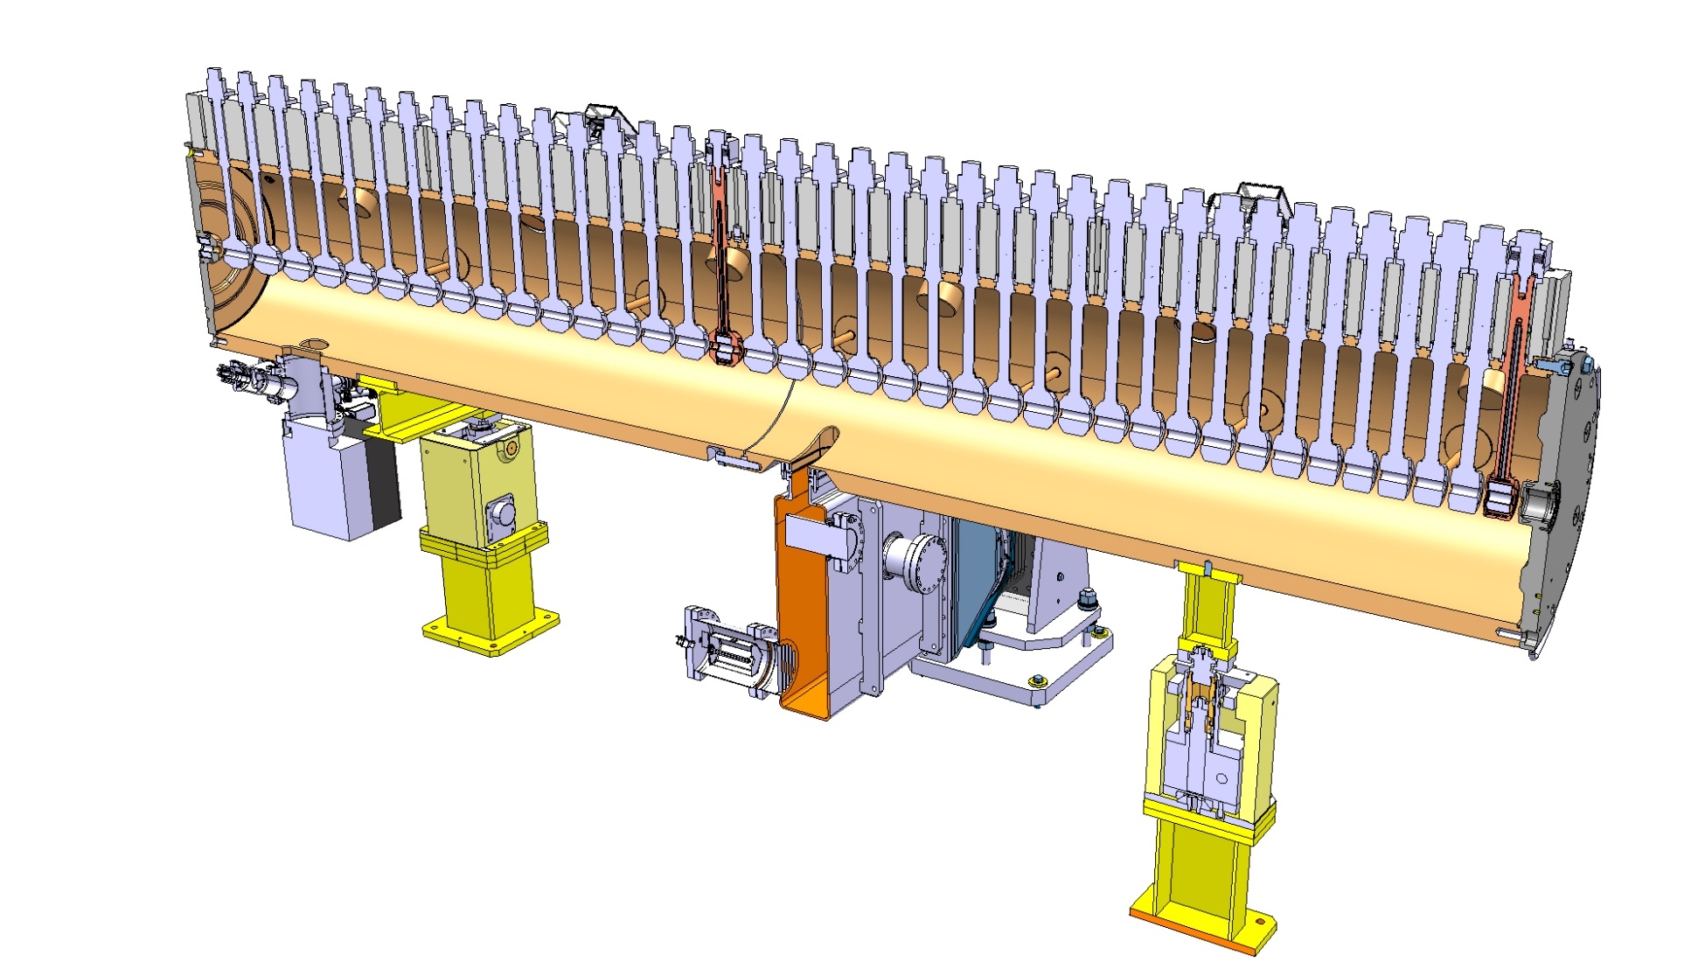

Slide 18
Important RF parameters (and how to measure them…)

Slide 19
Energy gain
-L/2
L/2
Particle crossing an RF gap in a linac cell of length L:
E-field is
Voltage is
Energy gain by a particle crossing the gap at phase φ is:
The shape of E_{z} depends on gap length and aperture radius
E₀ mean field
with a Transit Time Factor defined as:
For E(z) even function of z
« Panofsky equation » very simple, but the physics is in the transit time factor!

Slide 20
Transit time factor
energy gain by a particle in the middle of the gap at t=0
design parameter, (see Module 6)
cell length, βλ or βλ/2
energy gain by a particle crossing the gap with infinite velocity at t=0
from frequency, gap geometry and particle velocity
synchronous phase angle, from beam dynamics (longitudinal stability)
The Transit Time Factor T tells us how much of the E-field that we have provided on the gap has been really seen by a particle moving at velocity v=βc.
Is the ratio between 2 integrals (0 ≤T ≤ 1)
Neglecting the increase in velocity in the gap:
E
E(z)
E(z)cosωt(z)
For the simplest case E(z)=E₀ (-g/2, g/2):
T is a characteristic of your design; it can be easily calculated by the RF design codes
z
-g/2
g/2

Slide 21
Shunt Impedance
Design of an accelerating system → goal is to maximize acceleration ΔW for a given power delivered to the cavity P_{c} . Can we define a figure of merit to compare different designs?
We define a « shunt impedance » Z as ; exactly twice the shunt resistance in the equivalent parallel circuit
The figure of merit is (considering maximum acceleration at φ=0 and taking the square of the energy gain in volts, to give consistancy to the units):
ZT² is the effective shunt impedance, depends only on the geometry (and on RF frequency and particle velocity). Unit is ohms (usually MΩ, or MΩ/m if referred to the unit length). Can be easily calculated by computer codes, and then used to calculate the cavity power and the final power efficiency:
ATTENTION!!!
Usually in linacs we use Z, while for other RF systems and in other literatures is used R_{p}: difference by a factor 2 !
R_{p}

Slide 22
Power efficiency
Main design parameters: beam current and effective gradient
synchronous phase
Shunt impedance per unit length
For a normal conducting linac with low beam loading, the RF power efficiency (proportional to the wall plug efficiency) is proportional to peak beam current, shunt impedance, and cosine of the synchronous phase. It is inversely proportional to the effective gradient → long linacs with low gradient have a higher efficiency (but higher construction cost…)

Slide 23
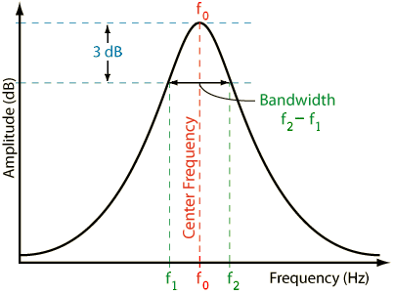
The 3 cavity parameters
A resonator (= a mode in a linac accelerating cavity) is defined by a set of 3 parameters.
They can be:
(Capacitance, Inductance, Resistance)
(Frequency, Q-value, R/Q)
R/Q is a geometrical parameter, basically tells you the ratio between current and voltage in your system
L₀
R_{p}
C₀
An RF transmission measurement can easily allow to get (f, Q) from the 3db bandwidth.
(precaution: to measure Q₀; we need a sufficiently low ioupling. If input coupling is too large, is measured the Q loaded (Q_{l}), given by the parallel of the cavity R and the transformed output impedance of the measurement device).
resonator
RF in
RF out

Slide 24
Measurement of R (R/Q)
The most difficult measurement (and for this reason one usually relies on simulation codes).
Direct voltage calibration: : we need to measure the power and then the voltage from an X-ray measurement
Perturbation measurement:
a small perturbation (introduction of an object in a resonant cavity) shifts the frequency by one half of the ratio between change in magnetic minus electric energy and the total stored energy → knowing ΔU it is possible to calculate U !!!
R/Q:

Slide 25
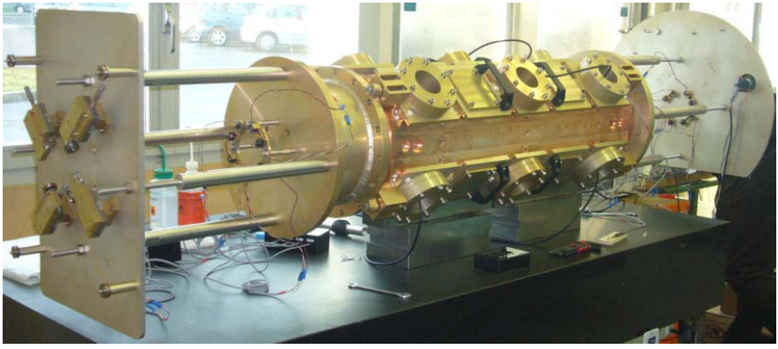
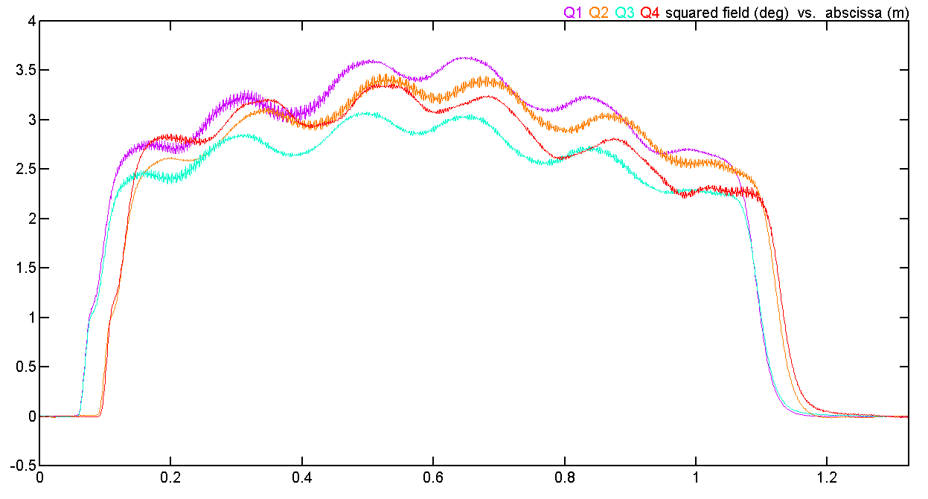
Field measurements
Motor
“bead-pull” perturbative measurement.
A small metallic bead is slowly moved inside the resonator.
Slater’s perturbation theorem: the variation in resonant frequency is proportional to the difference between square of electric field and square of magnetic field at the position of the bead.
Bead in regions of pure E or pure B field: easy way to plot the longitudinal field distribution.
It is a relative measurement (or needs calibration of the bead)
Bead
Cavity
PC+controller
RF power in
RF out
Generator Network Analyzer Detector

Slide 26
Questions on Module 4 ?
- Building blocks of a linear accelerator unit and their interrelations
- Construction: from a sketch to the drawing board to the metal
- From accelerators to circuit theory, how accelerator parameters are defined by electrical parameters

