Slide 1

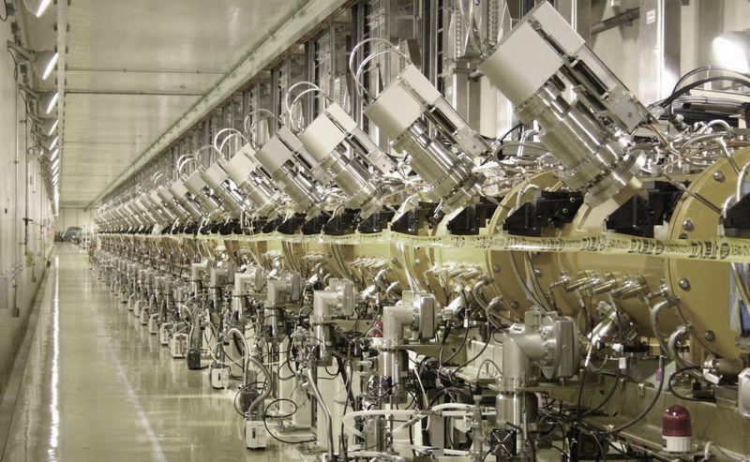
Module 7
Low-energy acceleration
The Radio Frequency Quadrupole
RFQ resonators
RFQ construction
Overview of RFQs

Slide 2
Low-energy acceleration of protons and ions
Low energy →
for protons,
between ~ 50 keV (source extraction) and ~ 3 MeV (limit for an effective use of the DTL) → range β = 0.01 – 0.10
Why it is a problem?
We have seen that at low energy we need strong focusing (strong space charge!), but the short cell length (~βλ) limits the length of quadrupoles, for ex. βλ(1MeV,352MHz) = 3.9cm
in this region the beam needs to be bunched → standard bunching systems are quite ineffective (~50% beam loss…).
At low energy, the usual accelerating structures have low efficiency (low shunt impedance).
The “old” solution:
Increase as much as possible the extraction voltage from the source → huge HV installations, up to the maximum of some 800 kV.
Add a bunching section (1 or 2 cavities) after the source extraction.
Start the first accelerating structure (usually a Drift Tube Linac) from the minimum possible energy.

Slide 3
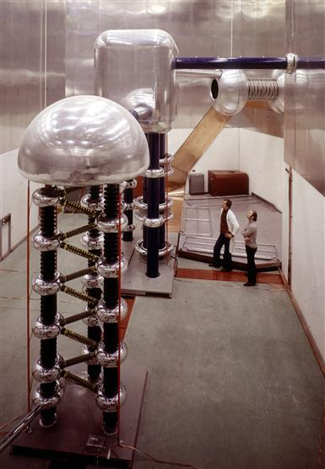
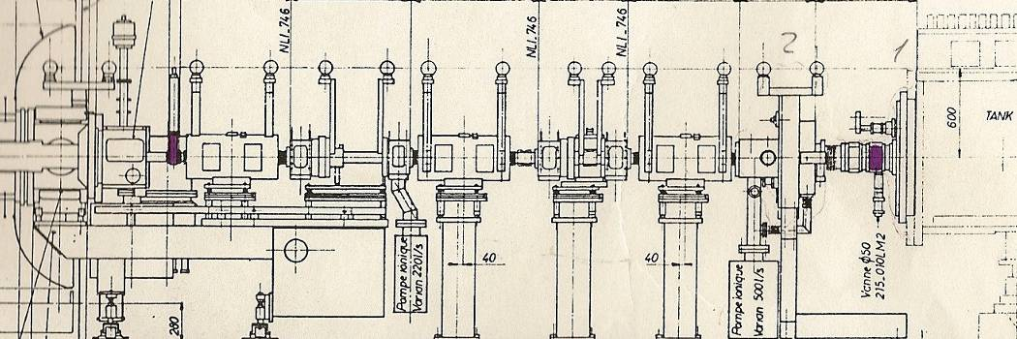
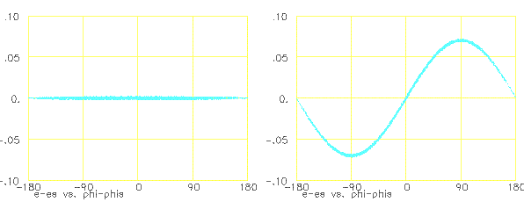
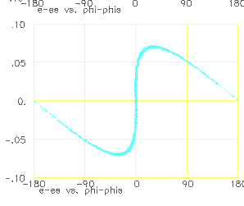
The classical solution: HV column + LEBT + bunching
5.6m
Double harmonic buncher (200-400 MHz)
DTL
W
φ
Principle of single-harmonic bunching
Useful beam (inside DTL acceptance)
Drawbacks:
Large and expensive HV column
Reliability (800 kV…)
Bunching efficiency (~50%)
Long line with inefficient magnetic focusing (∝ β)
Difficult DTL at low energy (short tubes and quads)
Large emittances for high currents

Slide 4
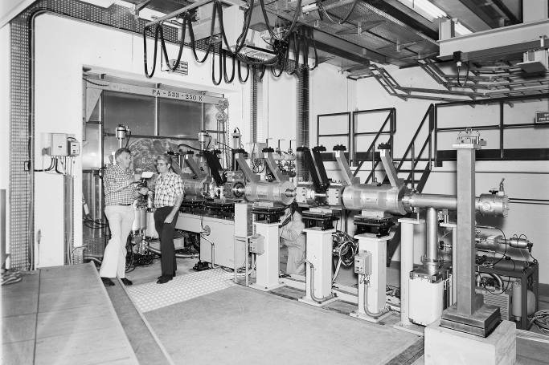
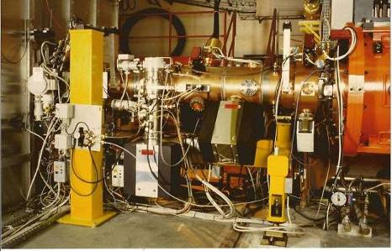
RFQ compared to the old pre-injectors
The old pre-injector at CERN (1976):
Source+ Cockroft Walton +line+bunching
The new RFQ2 pre-injector at CERN (1993):
Source+LEBT+RFQ
3.2m

Slide 5
New ideas – history of the RFQ
The driving force for the development of something new for the low-energy section was the research in URSS and USA on high-current proton accelerators. The idea is to break the limitation to current coming from space charge in the beam transport and from bunching losses.
1960’s: Early works of I. Kapchinski at ITEP (Moscow): idea to use at low energy an electric quadrupole focusing channel, excited at RF frequency, and modulated to add a longitudinal field component providing adiabatic bunching and acceleration.
1969: an RF resonator is designed around Kapchinski’s electrodes by V. Tepliakov (IHEP). First paper on the RFQ by Kapchinski and Teplyakov (in Russian). First experimental RFQ in Russia (1974).
1977: the idea arrives at Los Alamos (USA), introduced by a Czech refugee.
1977-1980: the Los Alamos team is enthusiastic about this idea (for their Fusion Material Irradiation), makes some improvements to the original Kapchinski structure and develops a new resonator design. The first complete RFQ is built at Los Alamos and successfully operated (for a few hours…) in 1980.
1980’s: the RFQ principle spreads around the world, more RFQs are built in the USA and in Europe (1st CERN RFQ: 1984). Long and difficult learning curve (RFQs are not simple devices…).
1985-1995 : reliable RFQ designs exist and progressively replace the old pre-injectors in most accelerator laboratories (CERN: 1993). Different design and applications are proposed all over the world.
1995-now : new RFQs are designed and built for extreme applications, like high intensity (CW, high current) or compact high-frequency.

Slide 6
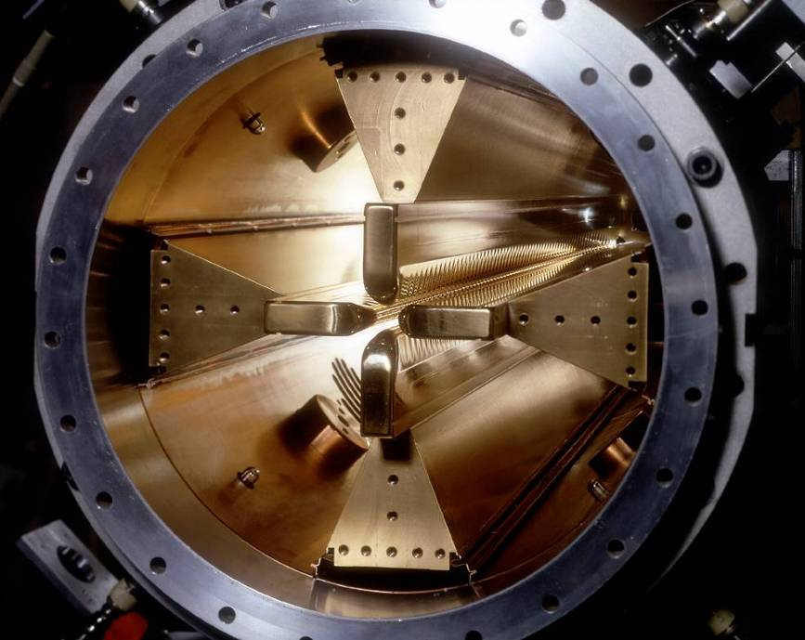
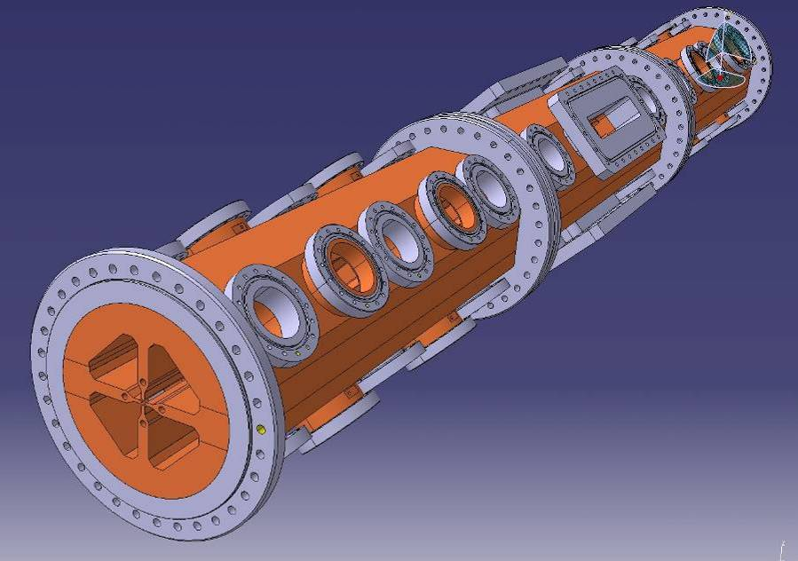
The Radio Frequency Quadrupole (RFQ)
RFQ = Electric quadrupole focusing channel + bunching + acceleration
~1-3m
New and performing accelerator.
Compact and critical structure, where beam dynamics, RF and mechanical aspects are closely interconnected.

Slide 7
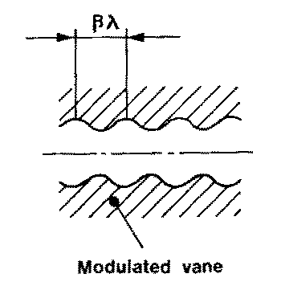
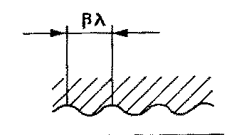
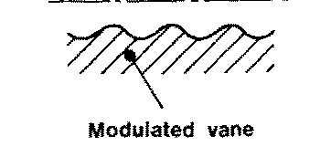
The basic RFQ principle
1. Four electrodes (called vanes) between which we excite an RF Quadrupole mode → Electric focusing channel, alternating gradient with the period of the RF. Note that electric focusing does not depend on the velocity (ideal at low β!)
+
−
−
2. The vanes have a longitudinal modulation with period = βλ → this creates a longitudinal component of the electric field. The modulation corresponds exactly to a series of RF gaps and can provide acceleration.
+
−
+
Opposite vanes (180º)
Adjacent vanes (90º)

Slide 8
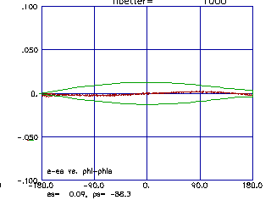
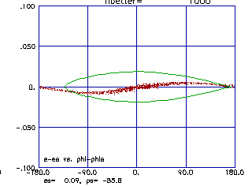
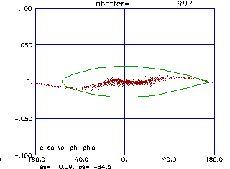
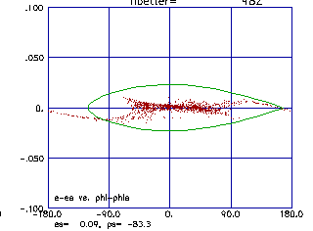
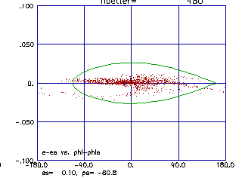
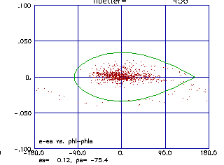
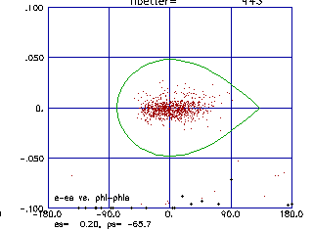
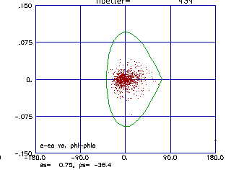
Bunching and acceleration
3. The modulation period (distance between maxima) can be slightly adjusted to change the phase of the beam inside the RFQ cells, and the amplitude of the modulation can be changed to change the accelerating gradient → we can start at -90º phase (linac) with some bunching cells, progressively bunch the beam (adiabatic bunching channel), and only in the last cells switch on the acceleration.
☞ An RFQ has 3 basic functions:
Adiabatically bunching of the beam.
Focusing, on electric quadrupole.
Accelerating.
Longitudinal beam profile of a proton beam along the CERN RFQ2: from a continuous beam to a bunched accelerated beam in 300 cells.

Slide 9
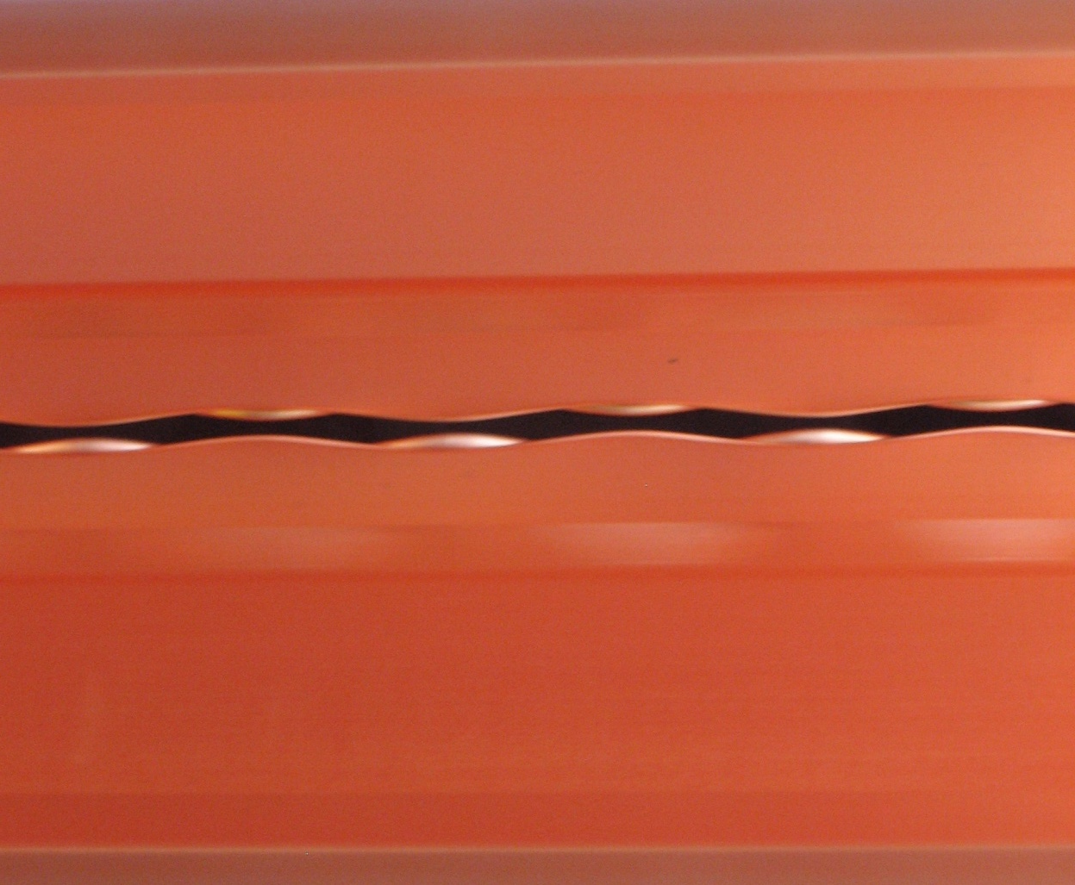
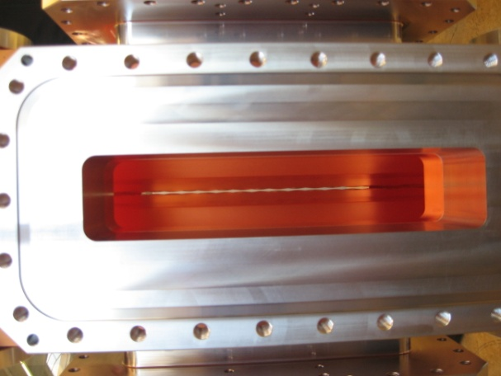
Peeping into an RFQ…
Looking from the RF port into the new CERN RFQ (Linac4, 2011)

Slide 10
RFQ beam dynamics
An RFQ is made of a sequence of cells (length βλ → in 1 m we can have > 100 cells) where the beam dynamics designer can vary 3 parameters for each cell:
Aperture a (defines the focusing strength)
Modulation factor m (defines the longitudinal component)
The beam phase φ, phase difference between bunch center and RF wave (defines the bunching and/or accelerating action).
+ 1 more parameter that is common to all cells or can be changed only smoothly: the RF voltage V.
a = minimum aperture
m = modulation factor (ratio bw. max and min aperture)
cell length/βλ = changing the length of the cell with respect to the optimum length for a given beta will change the RF phase seen by the beam.
Notes:
I find a solution, and I build the electrodes that generate this solution

Slide 11
The Kapchinski potential
In order to define the 3-dimensional shape of the RFQ electrodes, Kapchinski introduced an analytical expression for the fields in an RFQ channel :
The region between the vanes is small w.r.t. the wavelength → static approximation, we can use the formulae for static fields.
The potential in the intervane region is then a solution of the Laplace equation, which in cylindrical coordinates can be solved by a series of Bessel functions.
Kapchinski’s idea: of all the terms in the series, take only the 2 that are interesting for us (the transverse quadrupole term + a longitudinal focusing and accelerating term) and try to build some electrodes that give only those 2 terms.
k=2π/βλ
Transverse quadrupole term
“Longitudinal” term
→ an RFQ cell is defined by the 2 parameters, A₀ and A₁₀ (plus the phase)
→ the 3 dimensional profile of an RFQ electrode must correspond to an
equipotential surface of V(r,theta,z)
11

Slide 12
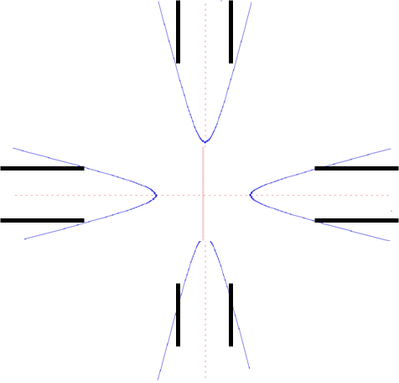
RFQ beam dynamics - 2
→ The electrodes have to follow equipotential surfaces of this equation
The equipotential surfaces giving the 2-term RFQ potential are hyperbolic surfaces with a longitudinal sinusoidal modulation.
→ The vanes in the 1st generation of RFQs were perfect truncated hyperbolae.
V=voltage applied between 2 adjacent vanes
The constants A₀, A₁₀ depend on the geometry, and can be related to the modulation factors and to the intervane voltage V:
But truncated hyperbolic surfaces are difficult to machine, while modern field calculation codes allow to use vane profiles that cannot be analyzed analytically.
→ after the first generation of RFQs, the designers are now using simplified vane profiles with constant curvature radius or simplified surfaces → introduction of multipoles, can be calculated and kept within acceptable limits.

Slide 13
Parameters of the RFQ
Transverse
focusing coefficient
limited by sparking
Transverse field distortion due to modulation (=1 for un-modulated electrodes)
Longitudinal bunching and accelerating field
Accelerating efficiency : fraction of the field deviated in the longitudinal direction
(=0 for un-modulated electrodes)
cell length
Transverse focusing B is the external focusing contribution to phase advance (see linac lecture)

Slide 14
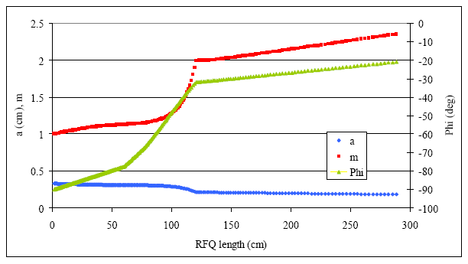
Example of an RFQ Beam Dynamics design
The new CERN Linac4 RFQ:
352 MHz, 45 keV to 3 MeV, 303 cells, 3 m length, 70 mA beam current
Beam transmission 95 % (calculated)
The first ~200 cells are used for adiabatic bunching of the beam: the synchronous phase is slowly increased from -90 to -20 deg → bunching with low beam loss!

Slide 15
RFQ sections

Slide 16
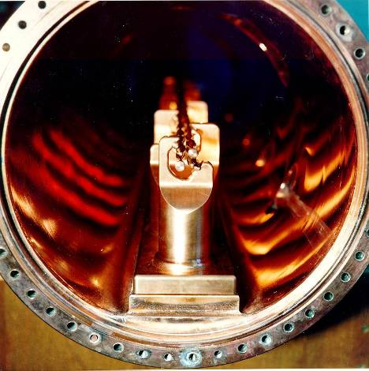
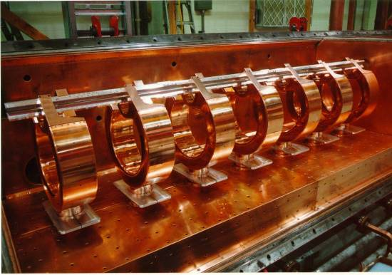
The RFQ resonator
Problem:
How to produce on the electrodes the quadrupole RF field?
2 main families of resonators: 4-vane and 4-rod structures
plus some more exotic options
(split-ring, double-H, etc.)
Remark:
what is the ideal frequency for an RFQ?
Cell length βλ/2 at injection should be mechanically achievable, of the order of few mm.
For heavy ions,
β~10⁻⁴ – 10⁻³
corresponding to
f~ 10 – 100 MHz
For protons,
β~10⁻² makes higher frequencies possible, but beam dynamics (focusing ~f⁻²) and technology limit to
f ~ 200 – 400 MHz

Slide 17
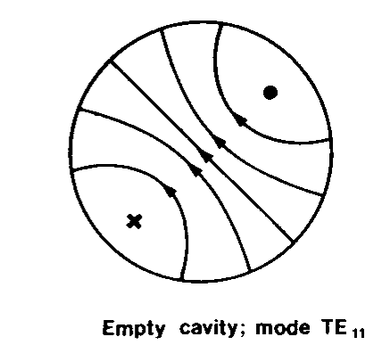
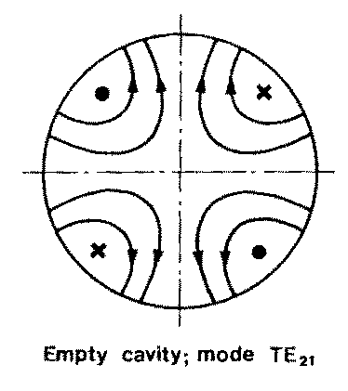
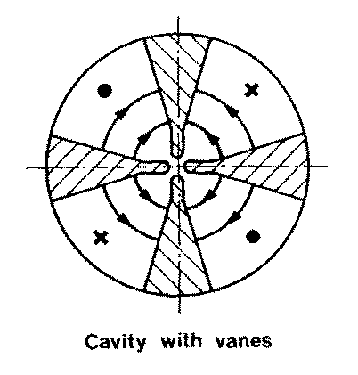
The “4-vane” RFQ
B-field
Basic idea:
An empty cylindrical cavity can be excited on different modes.
Some of these modes have only transverse electric field (the TE modes), and in particular going up in frequency one can find a “quadrupole” mode, the TE210.
The introduction of 4 electrodes (the vanes) can then “load” the TE210 mode, with 2 effects:
  Concentrate the electric field on the axis, increasing the efficiency.
  Lower the frequency of the TE210 mode, separating it from the other modes of the cylinder.
Unfortunately, the dipole mode TE110 is lowered as well, and remains as a perturbing mode in this type of RFQs.
E-field

Slide 18
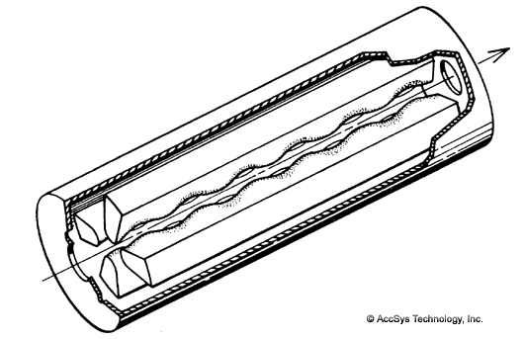
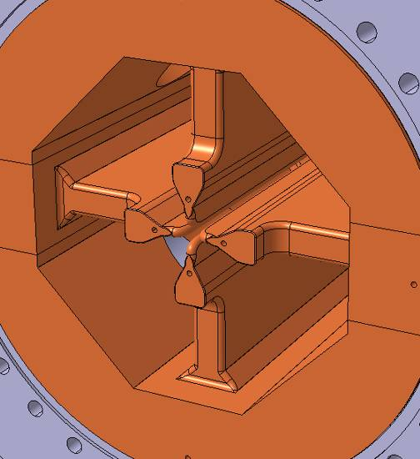
The 4-vane RFQ
The RFQ will result in cylinder containing the 4 vanes, which are connected (large RF currents!) to the cylinder along their length.
A critical feature of this type of RFQs are the end cells:
The magnetic field flowing longitudinally in the 4 “quadrants” has to close its path and pass from one quadrant to the next via some openings at the end of the vanes, tuned at the RFQ frequency!
Field excitation via a loop or an iris in one (or more) quadrants
B-field

Slide 19
Field symmetry and errors
Why RFQs are so demanding in terms of tolerances?
Beam dynamics wants a pure quadrupole mode (no dipole components, flat voltage along the RFQ).
But the TE210 quadrupole mode is not the only one: at frequencies close to the TE210 operating one there are all modes of the TE21 band (quadrupoles) and of the TE11 band (dipoles).
Errors in the RFQ geometry (deviations from quadrupole symmetry) will induce errors in the electric field (dipole components, longitudinal errors) inversely proportional to the frequency separation between operating and perturbing modes.
Mode spectrum (after tuning) of a 425 MHz, 2.75m long RFQ (3.9 λ) – a limit case!
In order to keep the e.m. field error <~1% as required by beam dynamics are needed:
Careful design and in same cases stabilising schemes (to keep perturbing modes far from operating mode).
Tight mechanical tolerances in vane position (Linac4 RFQ: errors < 30 μm).
Correction schemes to flatten the voltage (local tuners, end cells, etc.).

Slide 20
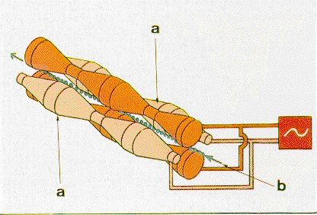
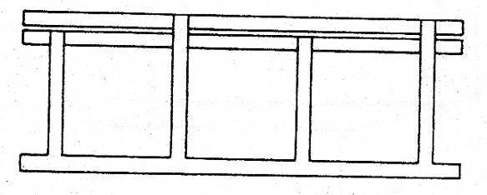

The 4-rod RFQ
An alternative solution is to machine the modulation not on the tip of an electrode, but on a set of rods (machining on a lathe, old design) or on some small “vanelets”.
The 4 electrodes are then brought to the correct quadrupole potential by an arrangement of quarter-wavelength transmission lines. The set-up is then inserted into a cylindrical tank.
Cost-effective solution, becomes critical at high frequencies → dimensions become small and current densities go up.
Power densities are higher than in the 4-vane → more problems for high power applications.
Commonly used for heavy ions and protons at low frequency – low duty cycle (f <200 MHz). Under development versions for high duty
+
-
<λ/4

Slide 21
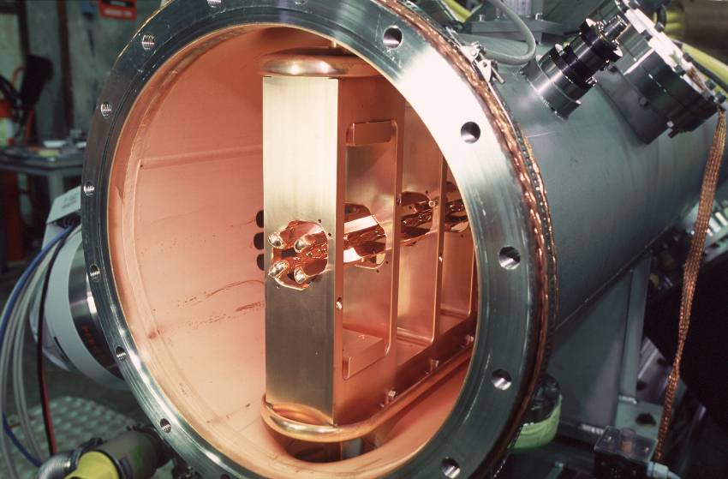
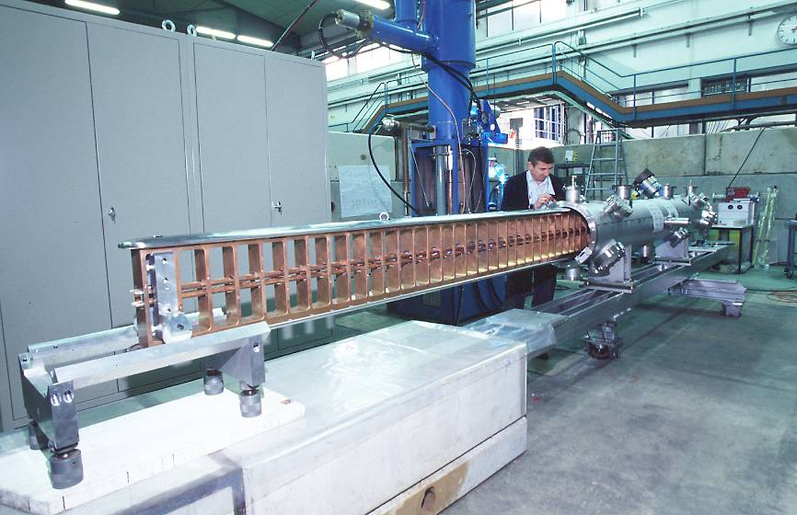
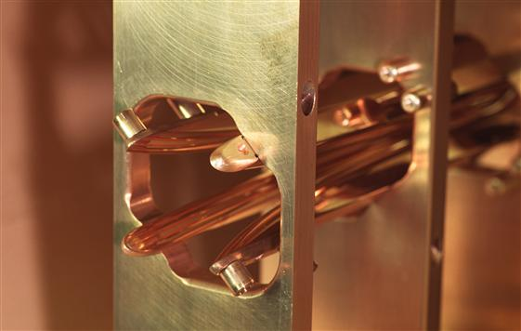
Alternative “4-rod” geometries
The electrodes can also be “vane-like” in structures using doubled λ/4 parallel plate lines to create the correct fields.

Slide 22
Length of an RFQ
Longitudinally, the RFQ behaves like a waveguide terminated at both ends by a metallic plate
valid for 4-vane – quadrants are like waveguides
valid for 4-rods – strongly coupled cells
In the dispersion curve of a waveguide only some modes are allowed because of the terminations.
In the RFQ length L we must have an integer number of wavelengths; we can then take the fundamental waveguide relation:
The length of an RFQ is limited by field errors: the higher (L/λ)² , the higher will be the field error induced by a given perturbation (eg. error in the position of the vanes or in the tuning of the 4-rod cells) → the longer the RFQ, the closer the higher-order modes come to the operating mode and the more difficult becomes to keep the field flat.
Rule of thumb (4-vane): L < 2λ → no problem, 2λ < L < 4λ → need some care
  L > ~4λ → require segmentation and resonant coupling

Slide 23
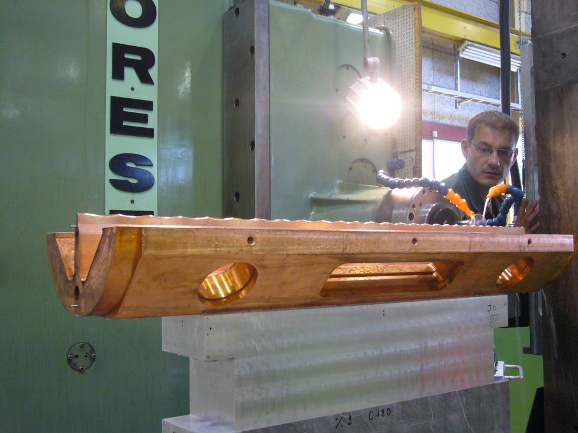
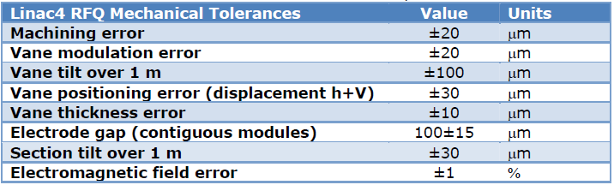
Mechanical aspects – tolerances
Two main mechanical problems:
1. The need to achieve the tight tolerances in vane machining and positioning required by beam dynamics and RF.
RF and beam dynamics both require tight tolerances in the position of the electrodes (Linac4 RFQ: <30 μm).
RF: presence of dipole and/or longitudinal components.
Beam dynamics: introduction of multipoles (Linac4 RFQ average aperture r₀ = 3.3 mm, 1% of aperture is ~30 μm). Minimum aperture a = 1.8 mm !!
Machining of a vane for the new CERN RFQ (linac4)

Slide 24

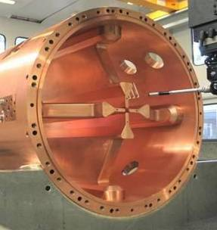
Mechanical aspects – joining RFQ parts
2. The need to assemble a LEGO®8 of several components (tanks, vanes or rods, supports, etc.) that have to fit together keeping the tolerances and providing a good quality RF contact (large currents flowing!).
4-vane, high frequency: furnace brazing of 4 copper elements
4-vane, low frequency: EB welding or bolting of copper or copper plated elements
SPIRAL2, CEA-CNRS, France
RFQ1 and RFQ2, CERN
TRASCO, LNL, Italy
IPHI, CEA-CNRS, France

Slide 25
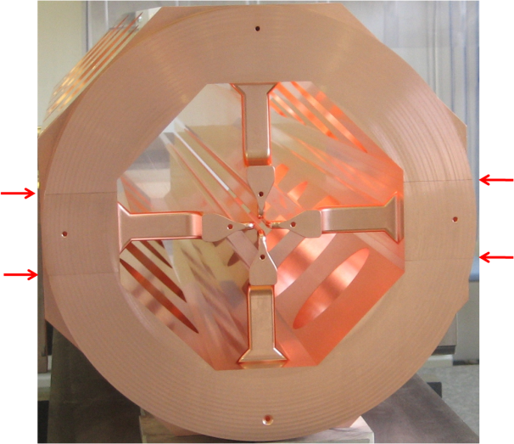
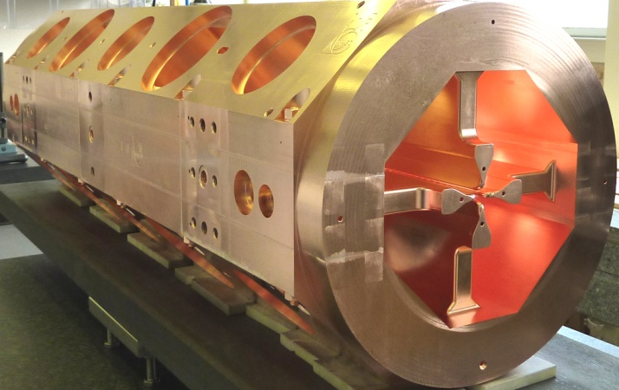
Errors before and after brazing
Linac4 RFQ:
☞ 3 segments of 1 m, each formed by 4 parts brazed together
☞ Required error in vane positions <30 μm
☞ Achieved by a) precise machining of the contact surfaces and b) appropriate thermal treatments to minimize vane deformation during brazing.
Errors before and after brazing <25 μm

Slide 26
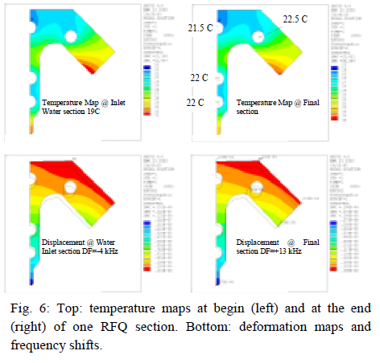
RFQ – thermal aspects
High (beam) power RFQs need to dissipate large amounts of RF power in small volumes (vanes are “thin” to maximize shunt impedance).
Thermal deformations can lead to large voltage variations and to beam loss.
Need to carefully design and dimension the cooling channels to keep High (beam) power RFQs need to dissipate large amounts of RF power in small volumes (vanes are “thin” to maximize shunt impedance).
Thermal deformations can lead to large voltage variations and to beam loss.
Example: thermal study of the TRASCO RFQ (CW, 352 MHz, 1 kW/cm) – courtesy of LNL, Legnaro

Slide 27
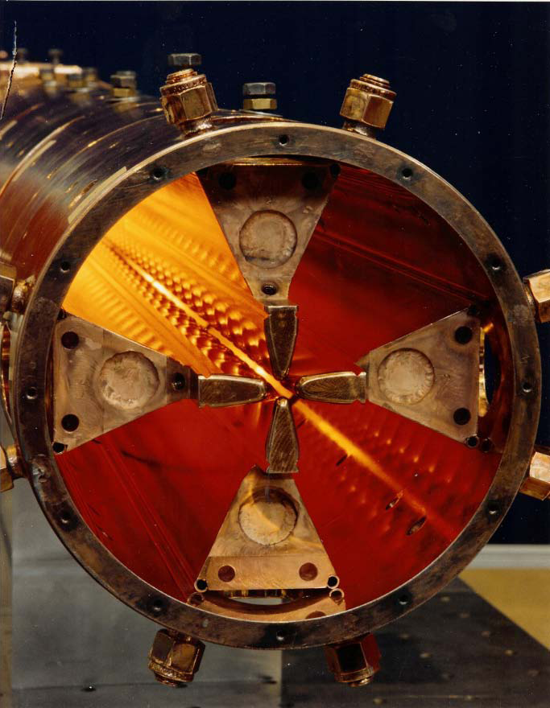
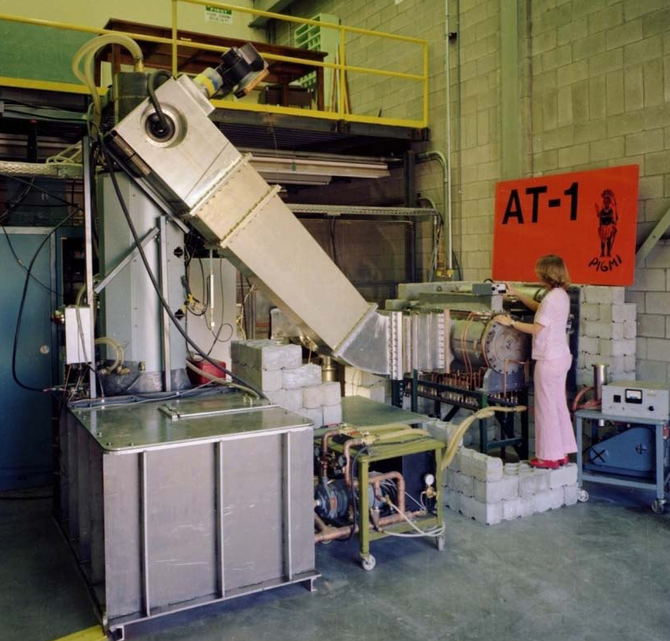
The 1st 4-vane RFQ
Proof of Principle (POP) RFQ, Los Alamos
1980 – the 1st vane-type RFQ
100 KeV - 650 KeV, 30 mA , 425 MHz

Slide 28
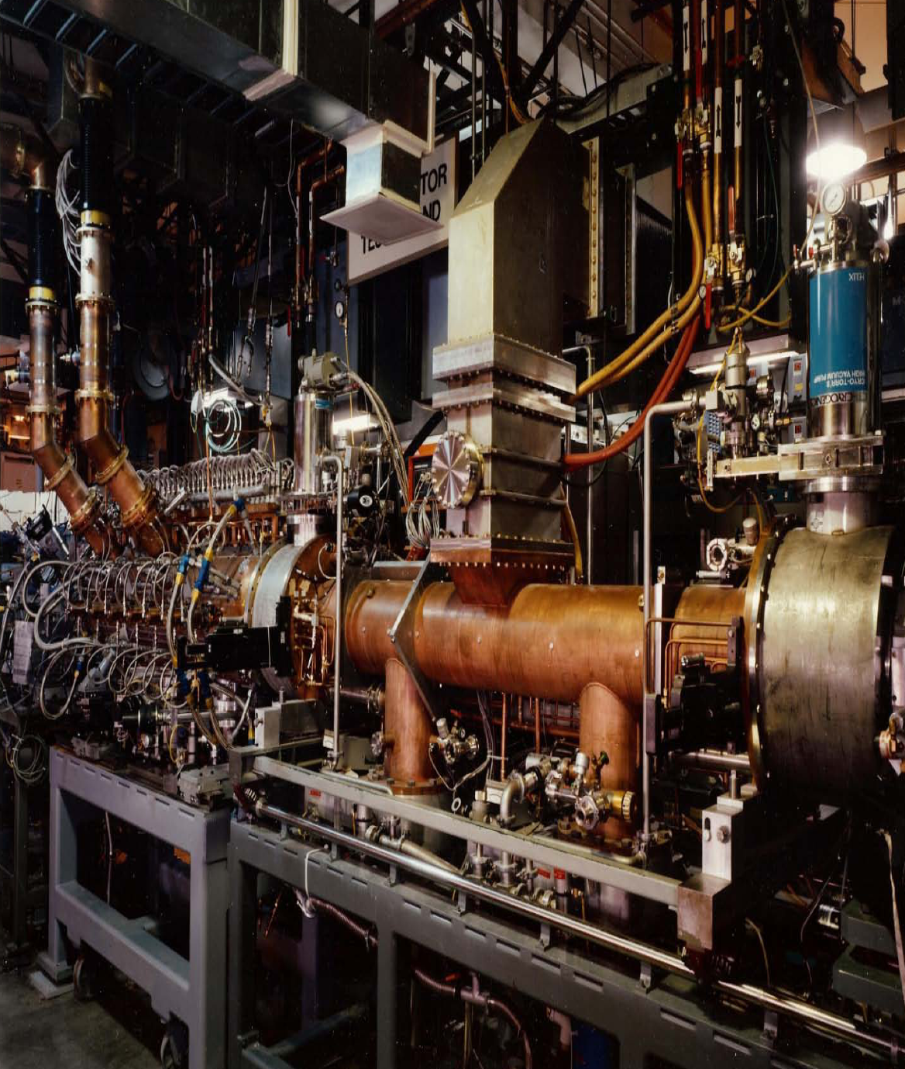
Examples of RFQs – 1
“Star Wars” RFQ (now de-classified), 1983, LANL
2 MeV, 100 mA, ~5% duty, H-minus, 425 MHz
Cu plated carbon steel vanes and cavity, manifold coupled
Demonstrated very small emittance H-minus beams

Slide 29
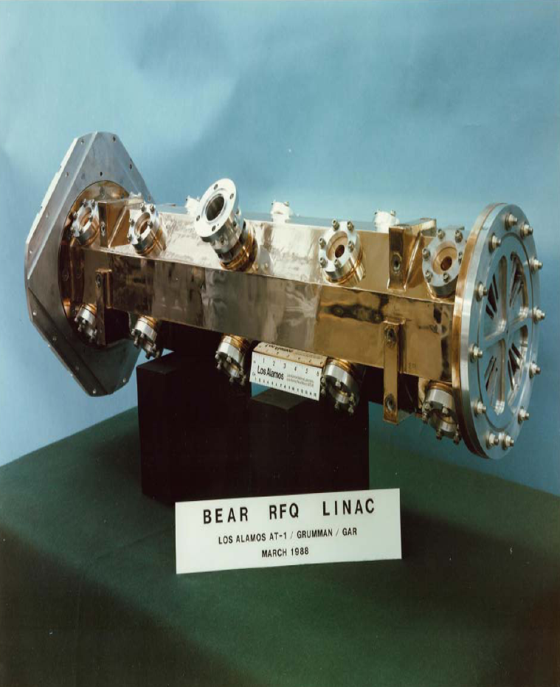
Examples of RFQs - 2
“BEAR” RFQ (beam experiment aboard a rocket)(partly classified) 1989
30 KeV – 1 MeV, 20 mA, <1% duty H-minus
425 MHz, solid-state RF system
Cu plated Al quadrants, joined by electroforming, 55 kg
Operated in sub-orbital flight with a “neutral” beam, LANL

Slide 30
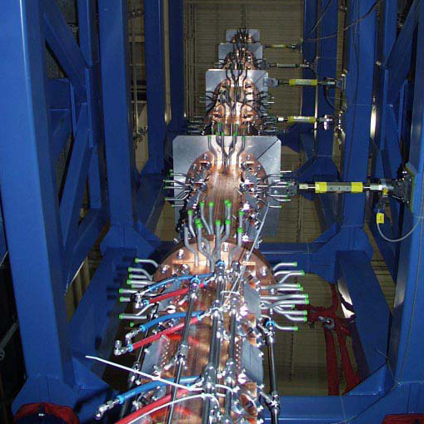
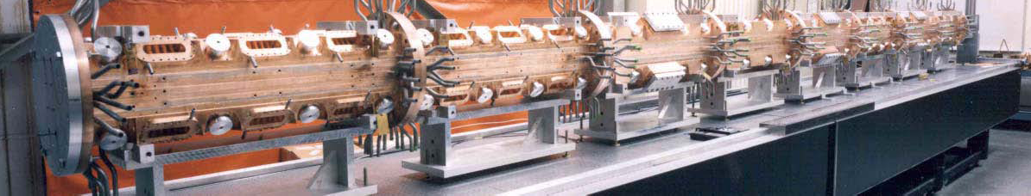
Examples of RFQs - 3
The first high-beam-power RFQ
LEDA RFQ (low energy demonstration accelerator)
1999 - 2000
75 keV-6.7 MeV, 100 mA cw protons
350 MHz
Brazed OFE Cu quadrants
Resonantly coupled, 8 m long, LANL

Slide 31
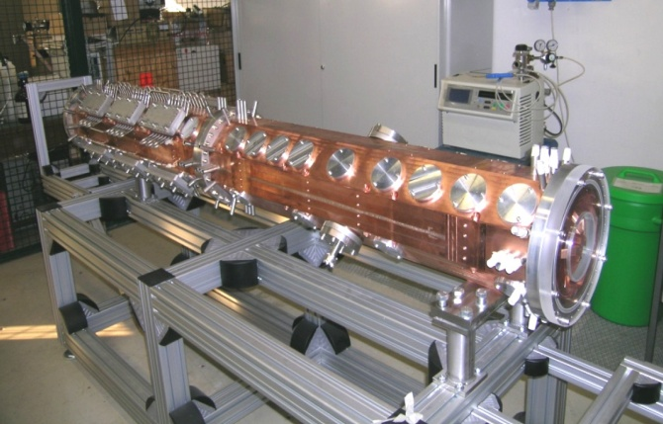
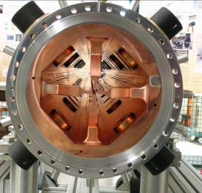

Examples of RFQs - 4
High frequency (352 MHz), high duty cycle (CW)
for ADS studies and other applications.
2 RFQs in construction in Europe:
TRASCO@LegnaroINFN
IPHI@Saclay.CEA

Slide 32

Examples of RFQs - 5
Low frequency (35 MHz), high duty cycle (CW)
for post-acceleration of radioactive ions.
The ISAC-II RFQ at TRIUMF (Canada)

Slide 33

Examples of RFQ - 6
Superconducting RFQs:
Only one operating Superconducting RFQs built so far in the world (INFN Legnaro, Italy).
The modulation is extremely difficult to realise in Nb → a superconducting RFQ is limited to few cells at low frequency → heavy ions.
LNL superconducting RFQ: 2 separate structures, 1.4 m and 0.8 m, 41 and 13 cells
On proton RFQs with high intensity, the unavoidable beam loss during the bunching process would be very dangerous for a superconducting structure.
Al prototype and the final installation of the superconducting RFQ at LNL, Italy

Slide 34




Examples of RFQ - 7
Medium frequency (176 MHz), high duty cycle (CW),
4-rod design
for high-intensity deuteron and proton acceleration.
The SARAF RFQ, built by NTG for the Soreq Nuclear Research Center in Israel.

Slide 35



Examples of RFQs - 8
The CERN Linac4 RFQ
45 keV – 3 MeV, 3 m
80 mA H-, max. 10% duty cycle
Commissioned in 2013

Slide 36



Examples of RFQ - 9
The compact high-frequency RFQ being built at CERN (commissioning early 2016)
40 keV – 5 MeV, in only 2 m
750 MHz, max. 5% duty cycle
For medical and industrial applications
Highest frequency in the world
Modulation test machining

Slide 37


The 750 MHz RFQ
Two modules (500 mm) out of 4 have been successfully brazed in June 2015

Slide 38
Low-energy proton linacs
DTL, 3 MeV to 80 MeV, high current, high (>200 MHz) frequency
Interdigital structures (IH, CH) 3 MeV to 80 MeV, low current, lower (>350 MHz) frequency
Ion source
Low Energy Beam Transport (LEBT), 2 solenoid or electrostatic
RFQ, 1 MeV to 5 MeV depending on application
Medium Energy Beam Transport (MEBT), match to following structure with space for diagnostics etc.
HV extraction, 20-100 kV
Pulsed beam (1-100 Hz)
10 MeV in 5 – 10 meters

Slide 39
RFQ bibliography
T.P.WANGLER, ”Space charge limits in linear accelerator”,LA-8388 (Los Alamos)
R.H.STOKES and T.P.WANGLER, ”Radio Frequency Quadrupole and their applications”, Annual Review of Nuclear and Particle Science , 1989
K.R. CRANDALL,R.H.STOKES and T.P.WANGLER, “ RF Quadrupole Beam dynamics Design study”,1979 Linear Accelerator Conference
M.WEISS, “ Radio Frequency Quadrupole” , CERN-PS/87-51 (CAS Aarhus,1986)
M. PUGLISI, “Radio Frequency Quadrupole”, CERN 87-03 (CAS Oxford, 1985)
RFQ chapter in Wangler, RF Linear Accelerators

