Slide 1

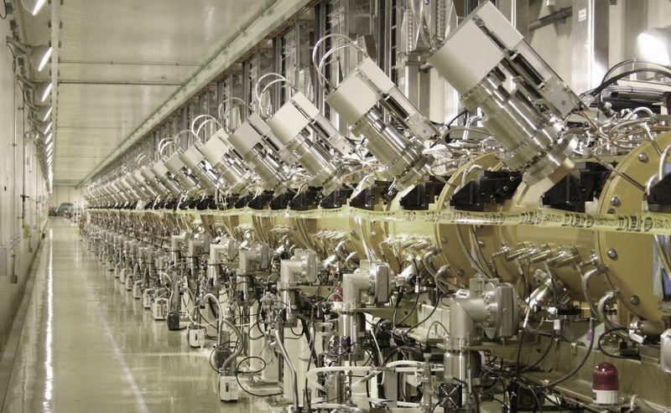
Module 8
Applications of linacs

Slide 2
Overview
Linac applications beyond the usual fields of:
Injectors for synchrotrons (usually for particle physics)
Stand-alone accelerators for nuclear physics;
In particular:
Applications of High-Power Proton Accelerators (neutron science, energy production, fusion material testing, new physics applications)
Industrial and Medical applications

Slide 3

Key questions: what does the man in the street need?
More and better science – we all agree!
More and better life – we all agree, too…
WP4 Accelerator applications
June 2015: Kick-off meeting of APAE: document for policy-makers on applications of interest in Europe and for which technology developed for research can have an impact.
People in the street need the LHC (and now the FCC…) but need as well more and better medical isotopes, better materials, better semiconductors, improved security, etc.
Notes:
What makes life better…

Slide 4
Existing accelerators
~30’000 !
Recherche |  | 6%
 | Physique des particules | 0,5%
 | Physique nucléaire, de l’état solide, des matériaux | 0,2 a 0,9%
 | biologie | 5%
Applications médicales |  | 35%
 | Diagnostic/traitement par X ou électrons | 33%
 | Production de radio-isotopes | 2%
 | Traitement par protons et ions | 0,1%
Applications industrielles |  | 60%
 | Implantation d’ions | 34%
 | Découpage et soudure par électrons | 16%
 | Polymérisation, … | 7%
 | Traitement par neutrons | 3.5%
 | Tests non destructifs | 2,3%

Slide 5
Linacs for production of intense secondary particle beams for applied science and energy

Slide 6
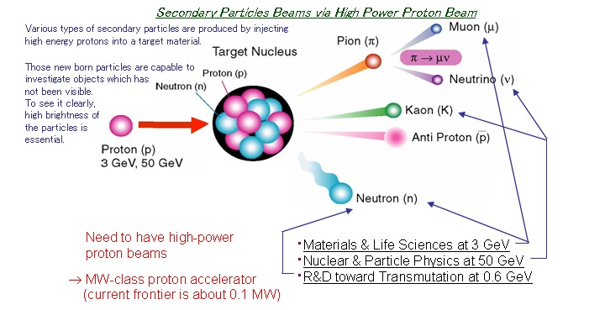
Secondary particle beams
. Energy production (Accelerator Driven Systems), > 2 GeV
. Radiactive Ion Beams (ISOL), > 1 GeV
(courtesy of JPARC)

Slide 7
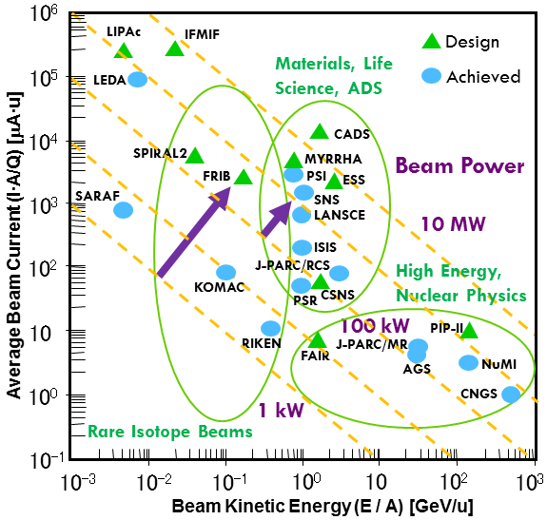
Beam power
Figure of merit for accelerators at the intensity frontier is beam power P=W×I×duty cycle
Production rate (cross-section) for most of the particles in high-intensity applications is independent on the energy (above a certain threshold) but proportional to beam power.
The new generation of accelerators under project or construction aims at moving the power from the 100 kW’s range to the MW’s range.
A MW-class machine presents a large number of challenges and requires the development of specific technologies.
Jie Wei, IPAC 2014

Slide 8
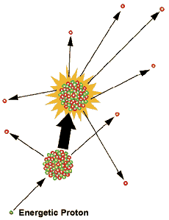

Neutron scattering:
Spallation Neutron Sources
Neutrons are ideal probes to map the molecular and magnetic structure and behavior of materials (high-temperature superconductors, polymers, metals), and biological samples → Application to fundamental physics, structural biology and biotechnology, magnetism and superconductivity, chemical and engineering materials, nanotechnology, complex fluids, ...
Traditionally, neutrons were produced by nuclear reactors; nowadays, are used linear accelerators at energy ≥ 1 GeV
2 linac-based facilities operational (SNS at Oak Ridge – USA and J-PARC at Tokai – Japan) and a third is in construction (European Spallation Source at Lund – Sweden).

Slide 9
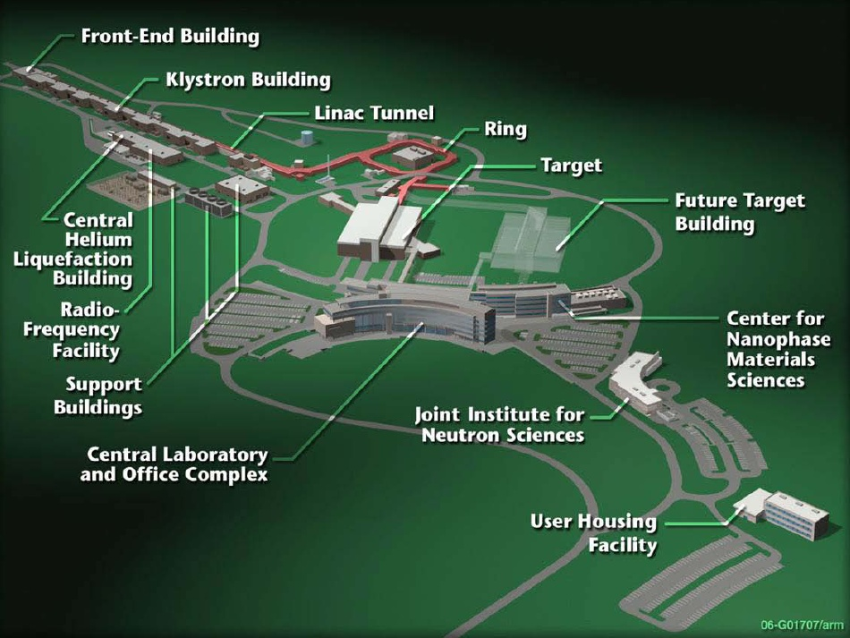
US Spallation Neutron Source
US Spallation Neutron Source (Oak Ridge)
World’s highest power proton source (1 MW)
1 GeV, 5% duty

Slide 10
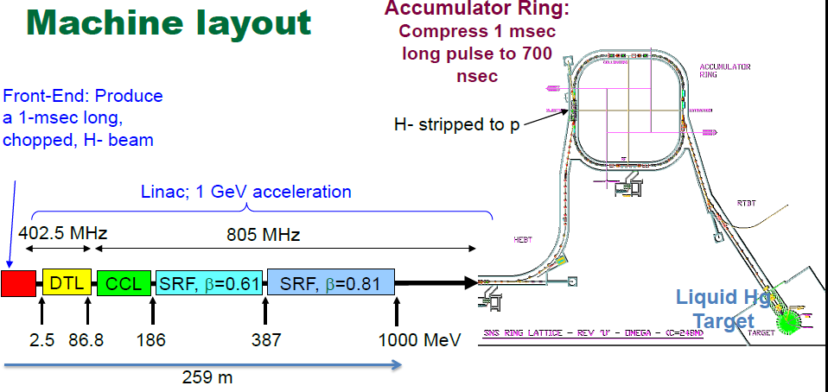
SNS - layout

Slide 11
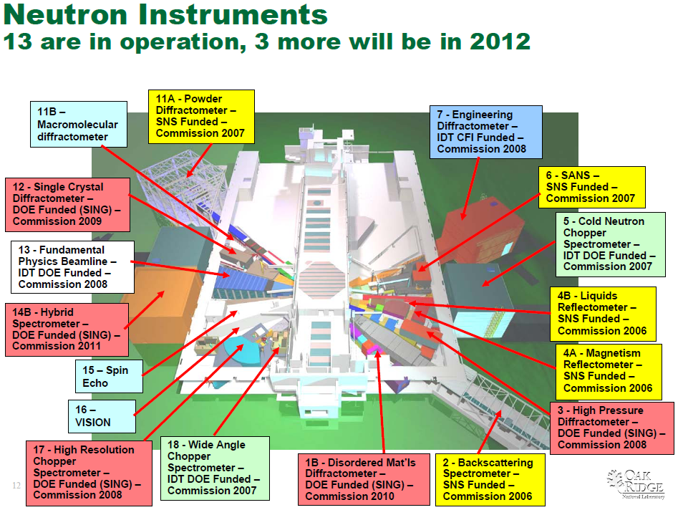
SNS – Scientific Program

Slide 12
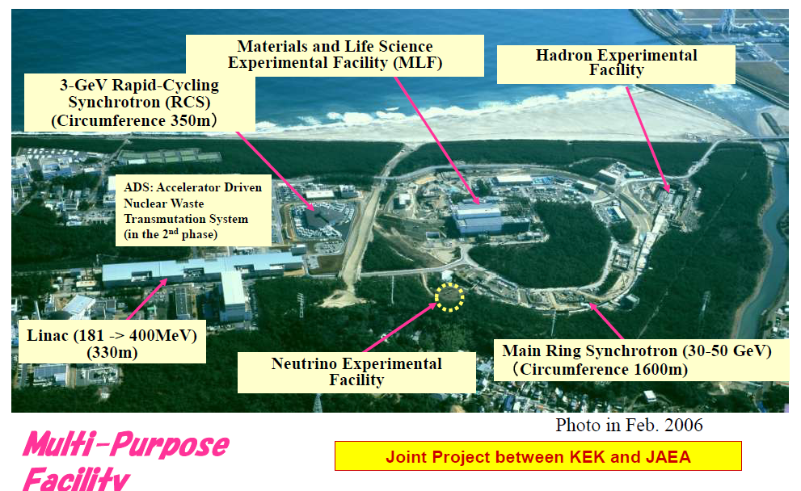
A multi-purpose facility: JPARC (Japan)
Accelerator commissioned in 2006/07.
Start of user operation (neutrons and muons) in 2008,
max. 120 kW.

Slide 13
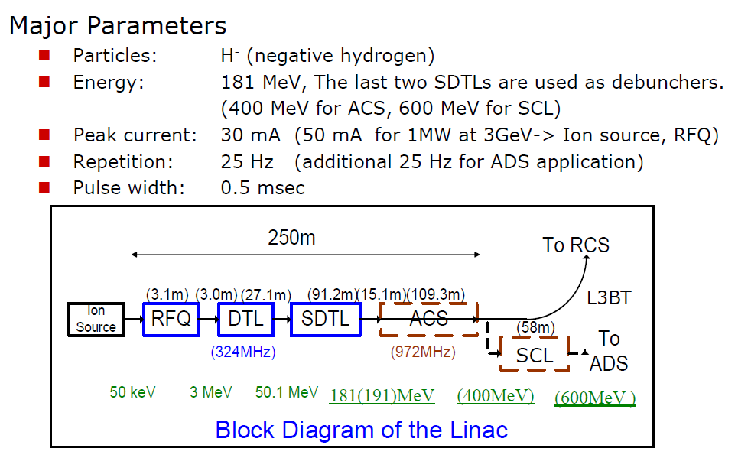
JPARC main parameters

Slide 14
Beam Power (3GeV)

Slide 15
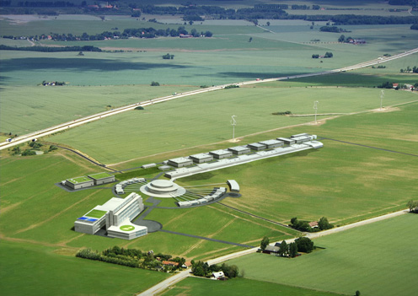
European Spallation Source
The ESS is beingbuilt in Lund (Sweden).
Will provide the EU neutron science community with a modern facility replacing the old reactor-based ILL in Grenoble (France).
Expect to complete construction in 2025.
5 MW long-pulse: no need of an accumulator/compressor like SNS.
He-cooled rotating tungsten wheel target (to avoid management of activated Hg as in SNS).

Slide 16
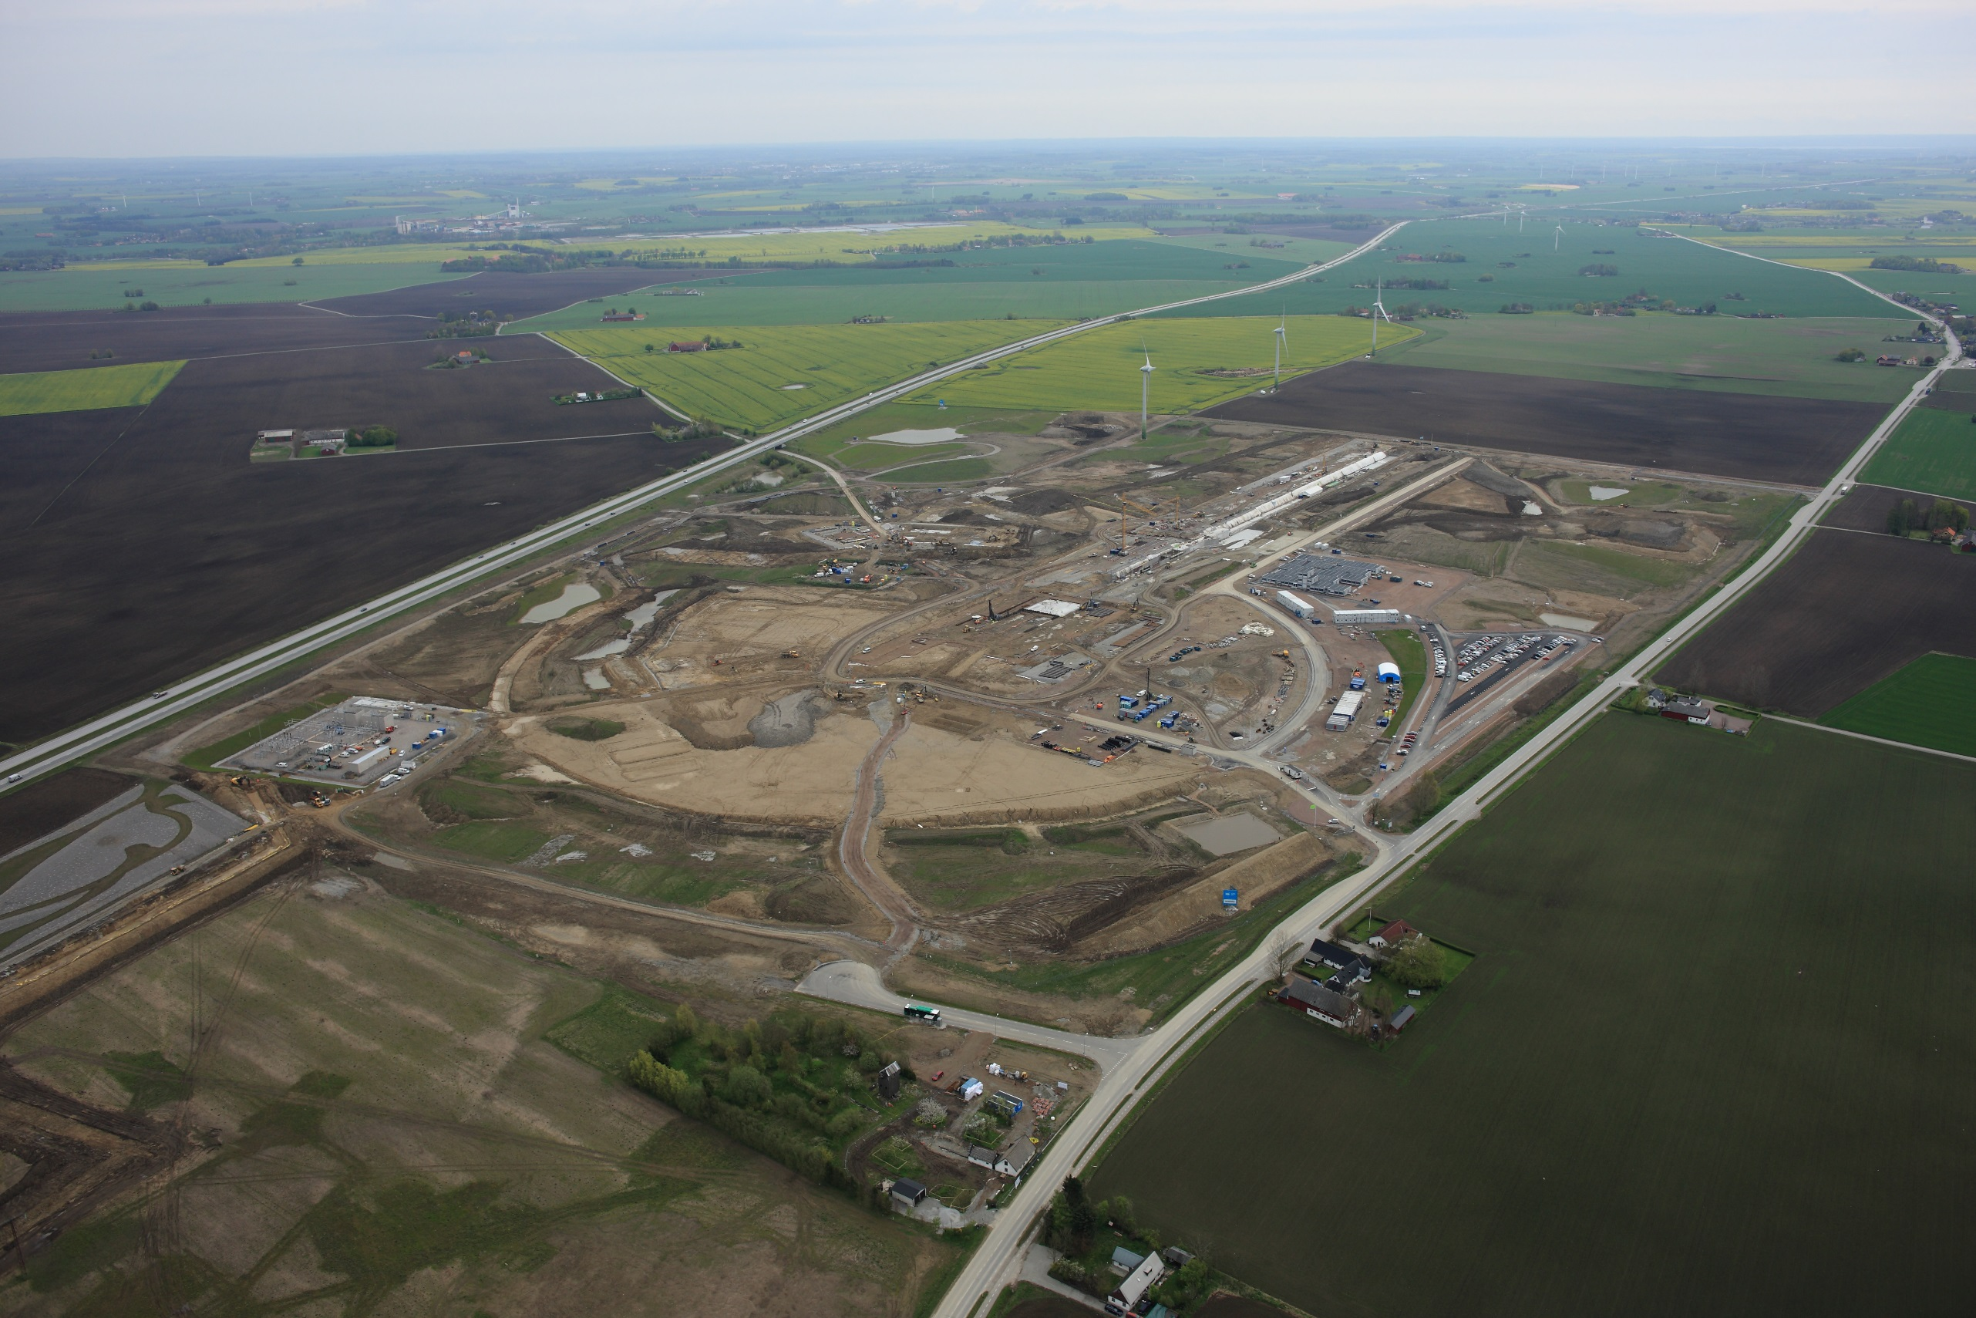
Update from the ESS site
Protons
Neutrons
Target

Slide 17
Accelerator technical performances
Key parameters:
    -2.86 ms pulses
    -2 GeV
    -62.5 mA peak
    -14 Hz
    -Protons (H+)
    -Low losses
    -Minimize energy use
    -Flexible design for mitigation and future upgrades
Design Drivers:
High Average Beam Power
5 MW
High Peak Beam Power
125 MW
High Availability
> 95%
352.21 MHz
704.42 MHz
2.4 m
4.6 m
3.8 m
39 m
56 m
77 m
179 m
Target
Source
LEBT
RFQ
MEBT
DTL
Spokes
Medium β
High β
HEBT & Contingency
75 keV
3.6 MeV
90 MeV
216 MeV
571 MeV
2000 MeV

Slide 18
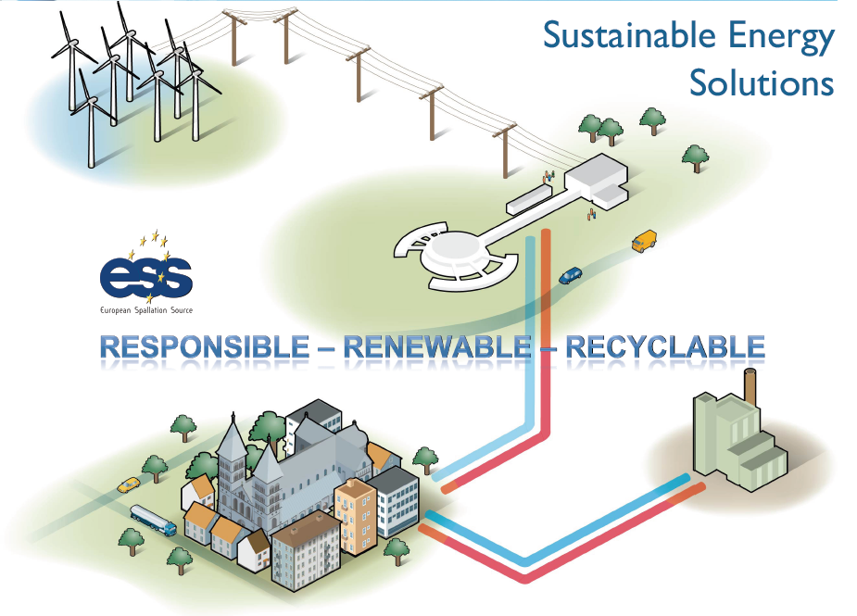
ESS Energy Management
Modern facilities like the ESS need to be “green”, to be accepted socially and politically and to prepare for a sustainable future.
This is an important technical challenge involving:
Higher efficiency RF;
Recuperation of cooling water (operation at higher temperature and pressure);
More PMQ-based beam transport

Slide 19
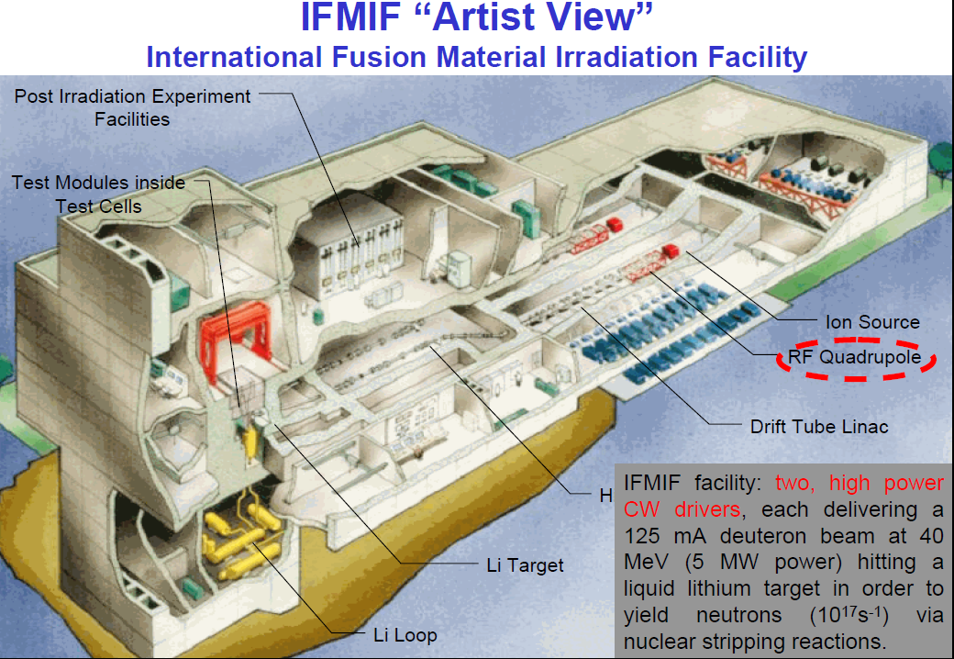
Linacs for fusion material testing: IFMIF
Test under strong neutron fluxes of materials to be used in ITER

Slide 20
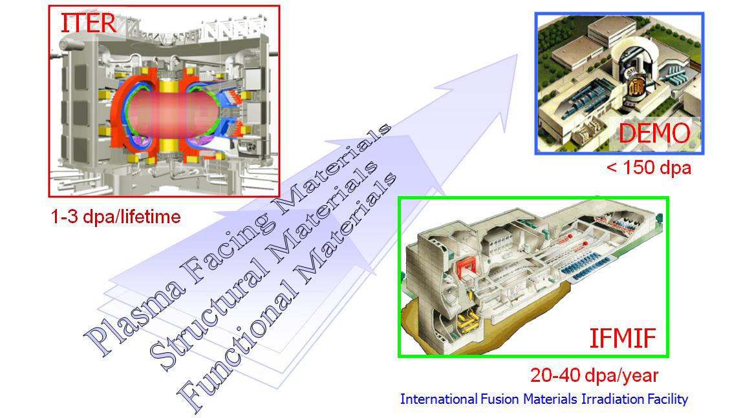
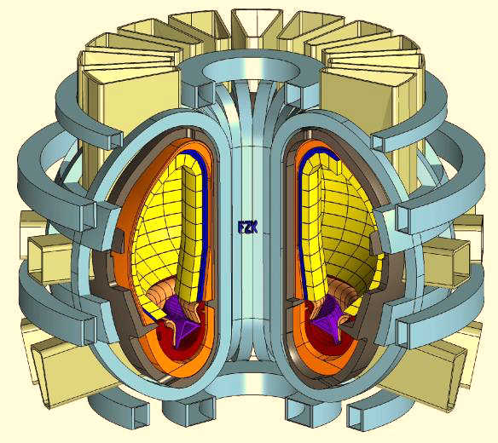
Advanced materials on the critical path to fusion
DEMO = Fusion Power Plant Demonstrator (after ITER)
Fusion Power: 2.5 GW ( x 5 ITER )
Reactor Efficiency: 37-45%

Slide 21
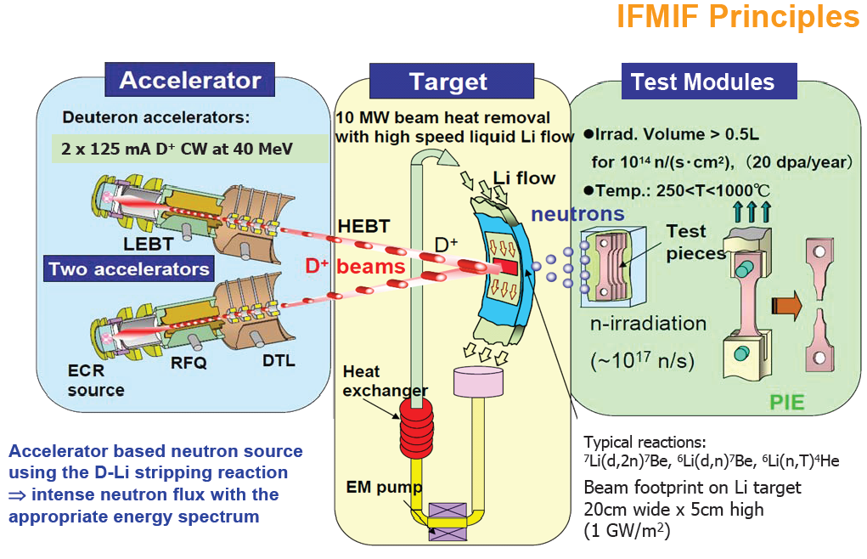
IFMIF principles

Slide 22
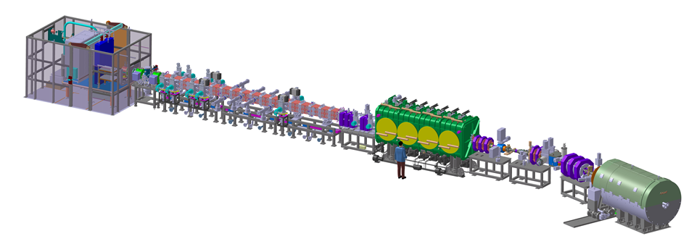
LIPAc in construction
Equipment designed (finished)
and constructed in Europe
Installed and commissioned in Rokkasho
★
Rokkasho
★
Oarai
Injector + LEBT
CEA Saclay
RFQ
INFN Legnaro
JAEA Tokai
SRF Linac
CEA Saclay
CIEMAT Madrid
MEBT
CIEMAT Madrid
HEBT
CIEMAT Madrid
BD
CIEMAT Madrid
Diagnostics
CEA Saclay
CIEMAT Madrid
36 m
RF Power
CIEMAT Madrid
CEA Saclay
SCK Mol
LIPAc = Linear IFMIF Prototype Accelerator
includes all critical accelerator components
to be tested at nominal beam current at BA site

Slide 23
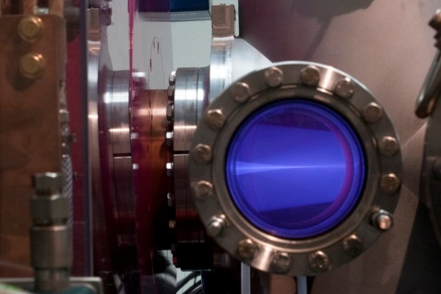
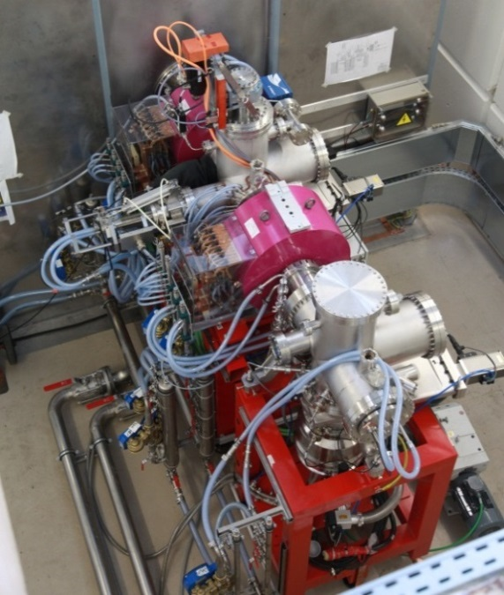
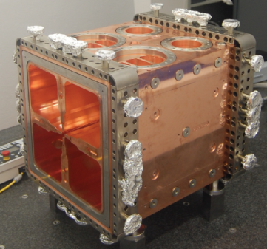
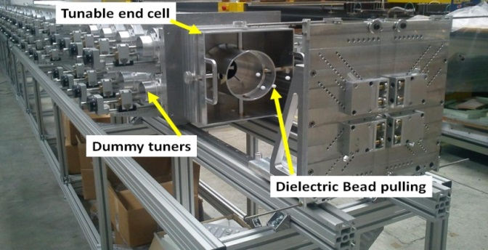
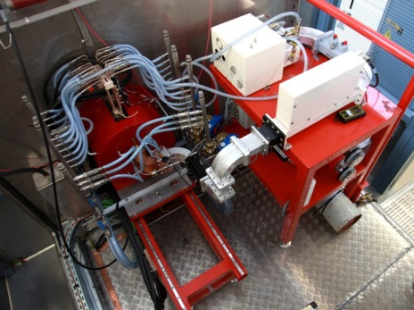
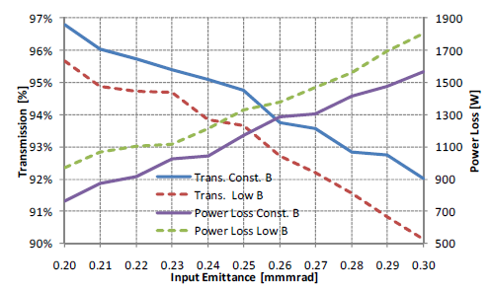
Injector (CEA, Saclay)
RFQ (INFN, Legnaro)
World longest
D⁺ (95% species fraction)
Ion Source ECR (2.45 GHz) - CW
E = 100 keV
I = 140 mA
emittance of 0.25 π mm·mrad
Availability > 95%
Acceptance tests in Saclay successfull
Commissioning in Rokkasho on-going
175 MHz; I_{input}= 130 mA ; E_{out}= 5 MeV
Up to 10mA beam losses allowed
Max surface field 25.2 MV/m (1.8 Kp)
18 module (9.8 m long)
Tuning demonstrated in an Al full scale prototype
3-module RFQ successfully conditioned
at 178 kW in CW (nominal field)

Slide 24
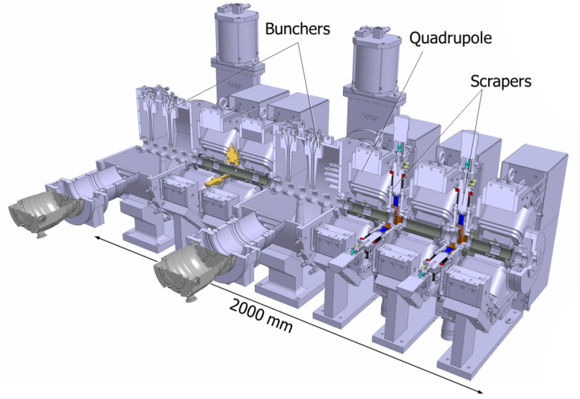
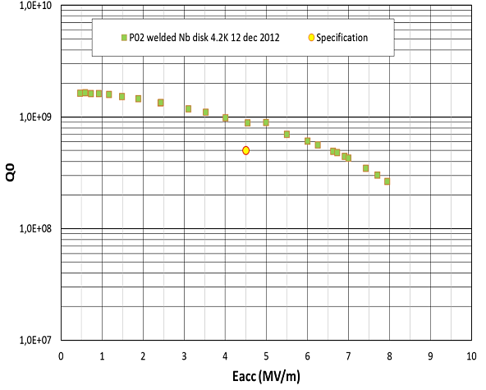
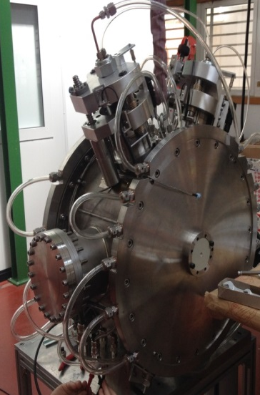
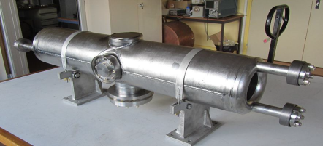
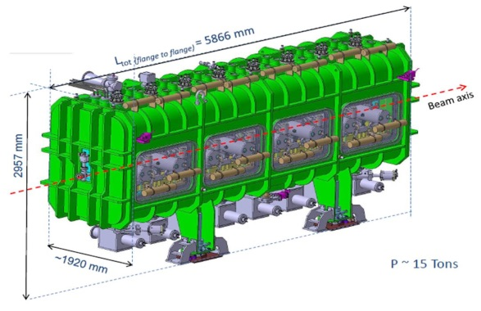
MEBT (CIEMAT, Madrid)
SRF Cryomodule (CEA, Saclay)
Prototype cavity
very compact ∼ 2 m, many components
5 quadrupoles & steering coils
2 bunchers (5 gaps IH), 2 movable scrapers
BPMs (in the center of quads)
turbomolecular pumps on bunchers
(1300 l/s /buncher)
High Power Test of the Buncher successful
up to CW operation at the target value (350 kV)
Contracts being launched
Assembly in Japan being assessed
8 resonators (β=0.094) E_{acc}=4.5 MeV/m
8 solenoid packages + steerers & BPM
Max transm. RF power = 70 kW
Cavity licensing process unexpectedly difficult and time consuming
Assembly in Japan being assessed

Slide 25
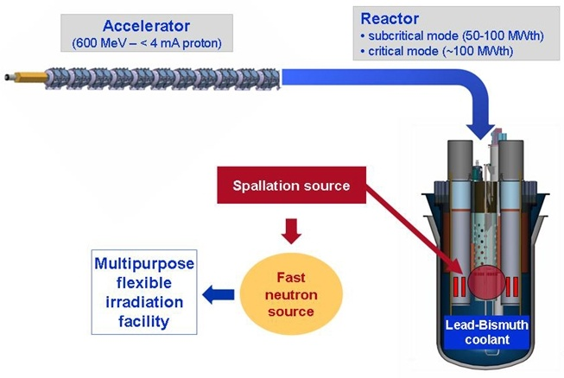
Accelerator Driven Systems
A linac coupled to a spallation source provides the missing neutrons to maintain the reaction in a subcritical reactor.
Can be used for a transmutation facility processing long-life nuclear waste and transforming it into shorter lifetime waste.
In addition, it could be used for energy production allowing alternative fuel cycles (thorium) and with no safety concerns (subcritical).
The MYRRHA Project (Multi-purpose hYbrid Research Reactor for High-tech Applications) based at Mol (BE) is the European way to an ADS demonstrator: in the ESFRI list, partly supported by EU and by the Belgian government, looking for other international partners.
ADS demonstrator + fast neutron irradiation facility

Slide 26
The transmutation issue
U²³⁵
n
Actinides
Minor Actinides
n
Uranium
Fission
n
U²³⁸
Pu
Np
Am
Cm
U²³⁸
n
^{Plutonium}
^{Neptunium}
^{Americium}
^{Curium}
Minor Actinides
Long lived (>1,000 years)
Very radiotoxic
Very hot
The European Strategy for Partitioning & Transmutation: 4 building blocks
  Process a sizable amount of spent fuel from commercial LWRs
    Separate plutonium (Pu), uranium (U) and minor actinides (MA),
  Fabricate at a semi-industrial level the dedicated fuel
  Design and construction of one or more dedicated transmuters
  Process the dedicated fuel unloaded from the transmuter
    Fabricate new dedicated fuel

Slide 27
Energy Production
Advantages/disadvantages of accelerator driven systems as compared to conventional reactors:
Pros | Cons
Safety: subcritical reaction, allows for immediate switch-off | High reliability (→cost) required for the accelerator, to protect structures from thermal shocks
Possibility to operate below criticality opens the way to new reactor concepts | Reduction in net plant power efficiency due to power consumption of accelerator
Simple reactor control by modulating accelerator current | Increased complexity (and cost)

Slide 28
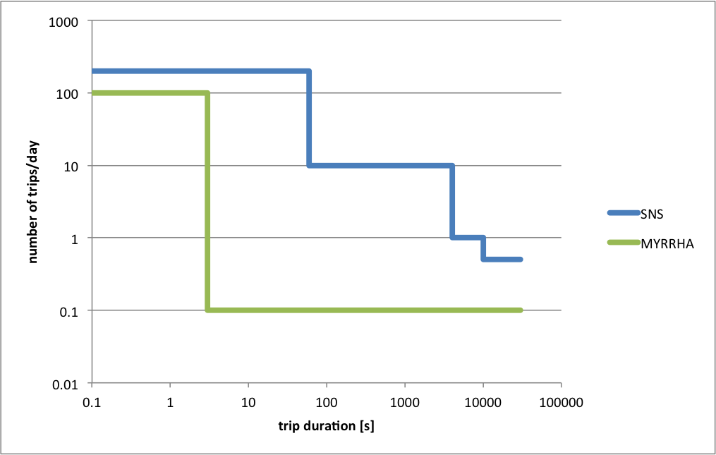
The reliability challenge
Beam trips longer than 1 sec are forbidden to avoid thermal stresses & fatigue on the ADS target, fuel & assembly & to provide good plant availability.
Present SPECIFICATIONS
Less than 5-10 beam trips (>1-3sec) per 3-month operation cycle (MYRRHA)
Reliability guidelines have been followed during the ADS accelerator design
  1. Strong component design (“overdesign”)
  All components are derated with respect to technological limitations
  2. Inclusion of redundancies in critical areas
  Possible doubled front-end (hot stand-by injector), solid-state RF power amplifiers where possible…
  3. Enhance the capability of fault-tolerant operation
  “Fault-tolerance” = ability to pursue operation despite some major faults in the system
  Expected in the independently-phased superconducting linac, especially for RF faults (RF systems = critical reliability area)

Slide 29
EU: The Myrrha project
MYRRHA Project
Multi-purpose hYbrid Research Reactor for High-tech Applications at Mol (BE)
Development, construction & commissioning of a new large fast neutron research infrastructure to be operational in 2023
❶ ADS demonstrator
❷ Fast neutron irradiation facility
❸ Pilot plant for LFR technology
Main features of the ADS demo
50-100 MWth power
k_{eff} around 0.95
600 MeV, 2.5 - 4 mA proton beam
Highly-enriched MOX fuel
Pb-Bi Eutectic coolant & target
2010: MYRRHA is on the ESFRI list, and is officially supported by the Belgium government at a 40% level (384M€, w/ 60M€ already engaged)

Slide 30
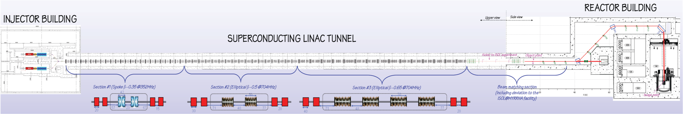
The MYRRHA accelerator

Slide 31
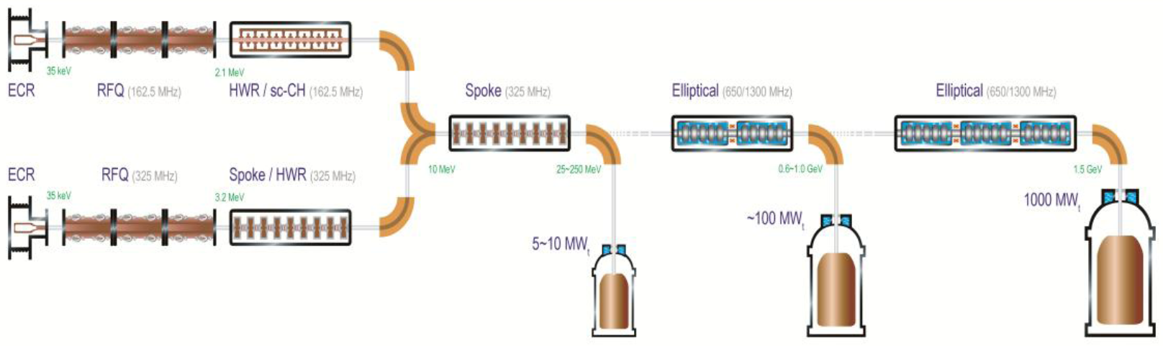
Roadmap of ADS project in China
2014.06, 2.1 MeV/10 mA/CW
Goal in 2015.06, 5 MeV
Injector II, 162.5 MHz
Goal in 2015.12, 10 MeV
Goal in 2016.09, 25 MeV
Injector I, 325 MHz
Stage 1: Research facility (CIADS)
(250 MeV, 10 mA, 10 MWt)
Y2017-2022, 2.25 B CNY
“Strategic Technology Pilot Project”
of the Chinese Academy of Sciences
Key technology R&D
Y2011-2017, 1.78 B CNY
Stage 2: Demo facility (CDADS)
(1.2~1.5GeV, 10~25 mA, 100 MWt)
Y2030

Slide 32
Industrial applications of linacs
 | Goal | Examples | Accelerator
Material processing (electrons) | Improve polymer resins inducing cross-linking of polymer chains → higher stress resistance | Heat-shrinkable films for food packaging, tires and cable insul. Gemstone irradiation | Electrons, 100 keV-10 MeV
Sterilization | Kill microroganisms | Sterilization of medical products Food processing (public acceptance!) | Electrons, ~10 MeV
Wastewater treatment | Distruction of organic compounds | Russia, Korea, USA, Brazil | Electrons, ~10 MeV
Non-destructive testing | Detect discontinuities in a material (cracks, etc.) | Inspection of pipelines, ships, bridges, etc. (depth + variable energy) | Electrons for X-rays, 1-15 MeV, portable (9 GHz)
Cargo inspection | Screening of trucks or containers for illegal objects | Many ports, customs, etc. | Electrons for X-rays, 3-6 MeV
Ion implantation | Alter near-surface properties of semiconductors (doping) | Semiconductor industry (arsenic, boron, indium, phosphorus,…) | Ions, from low to high energy (5 MeV)
PET isotope production | Production of radiotracers for Positron Emission Tomography | Linacs are smaller and have less res. activation than cyclotrons | Protons, 7 MeV
Neutron testing | Neutron generation for non-destructive inspection | Inspection of materials, cargo, etc. | Protons, 1-10 MeV
More than 20’000 industrial linacs in operation in the world.
A large fraction is made of small electrostatic machines for ion implantation (10’000 units).

Slide 33
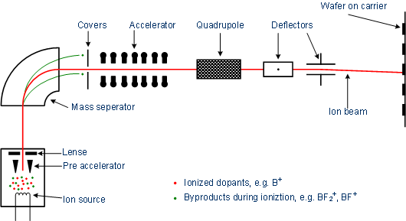
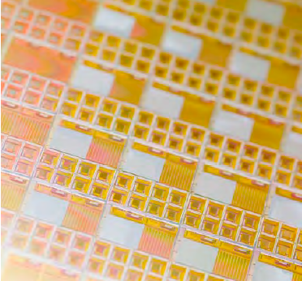
Ion implantation system

Slide 34
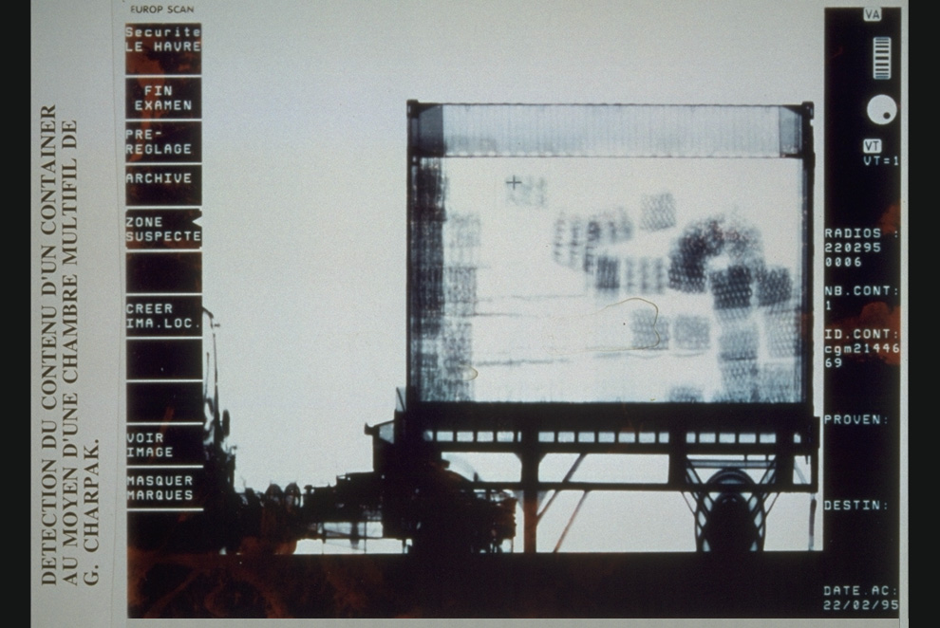
Cargo screening

Slide 35
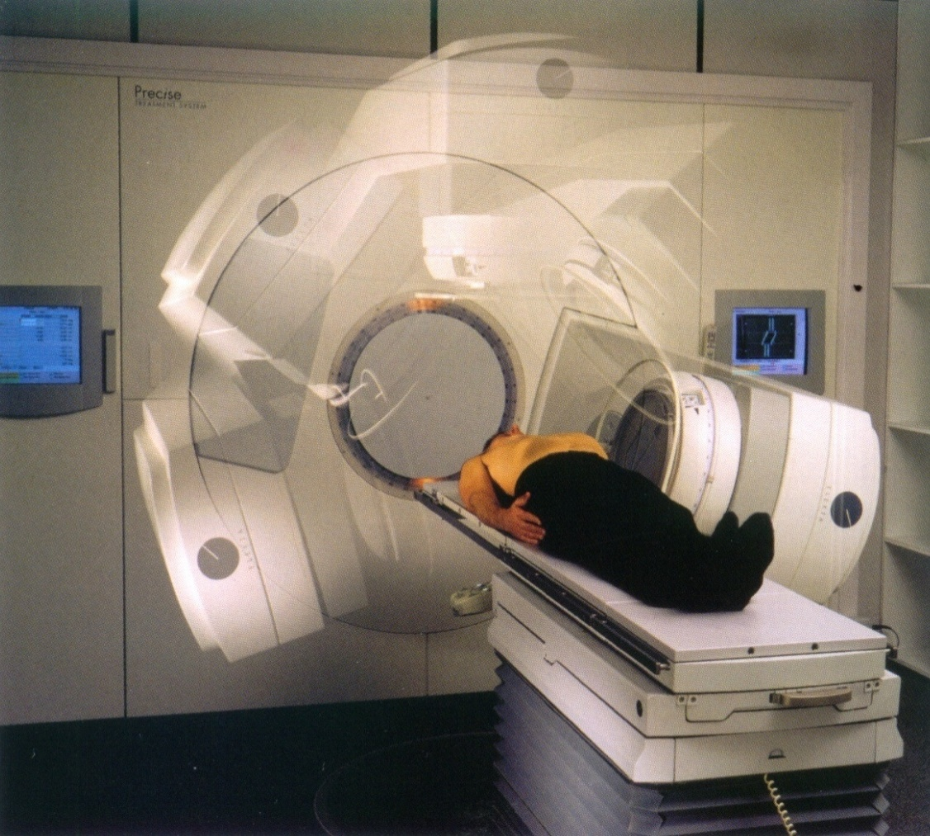
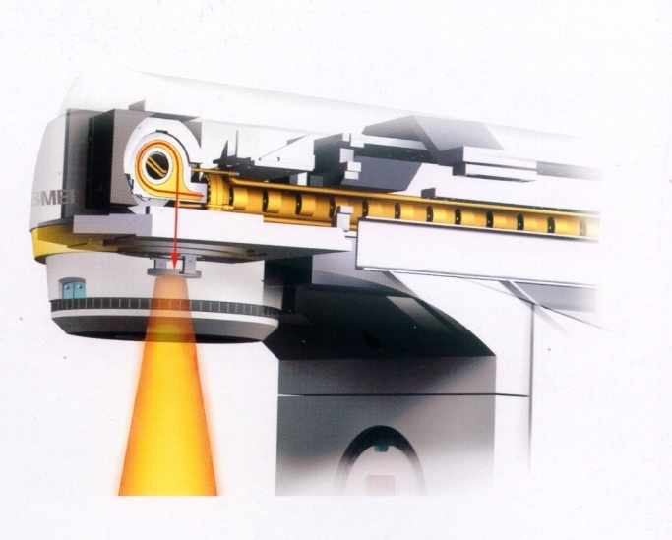
Radiotherapy with linear accelerators
Courtesy of Elekta
electrons
X
Linac for electrons
@3 GHz
5-20 MeV
X
20 000 patients per year every 10 million inhabitants
  >7000 electron linacs in the world for radiotherapy
35

Slide 36
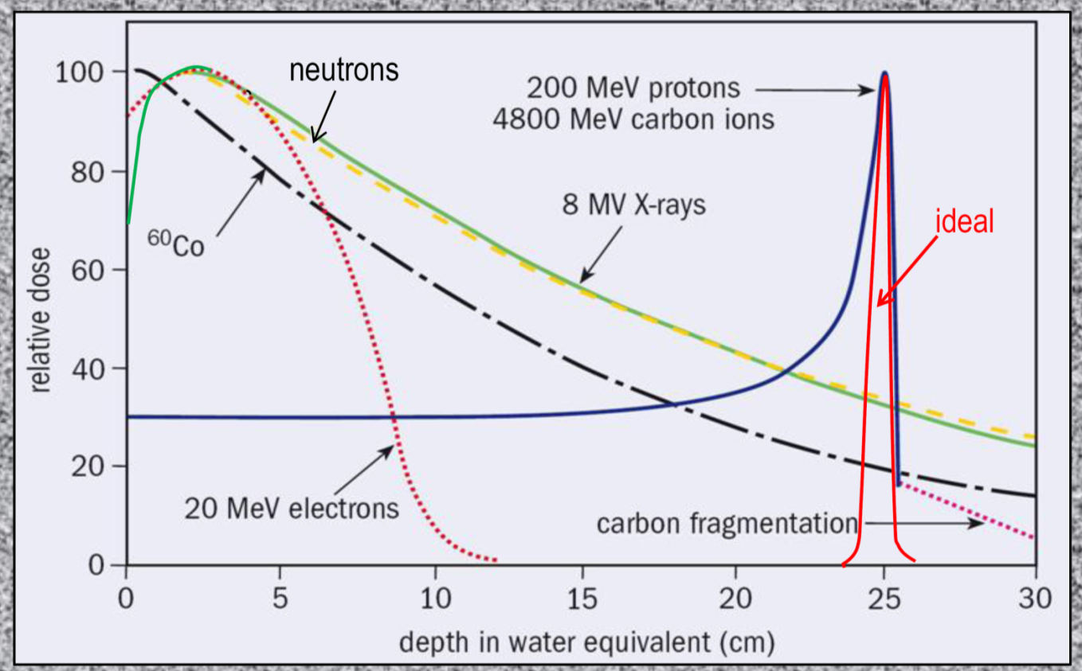
Hadrontherapy
‘Hadrontherapy’: cancer therapy modalities which irradiate patients with beams of hadrons. The “Bragg peak” allows to concentrate the radiation dose on a deep tumour, minimising the dose to the adjacent tissues.
Hadrontherapy is an alternative to usual irradiation with X-rays from e- linacs.
Most used hadrons: protons and carbon ions.
Protontherapy is rapidly developing: more than 65'000 patients treated, 5 companies offer turn-key solutions.
Carbon ions, used for about 6000 patients, have a larger radiobiological effectiveness and require more radiobiological and clinical studies to define the best tumour targets.

Slide 37
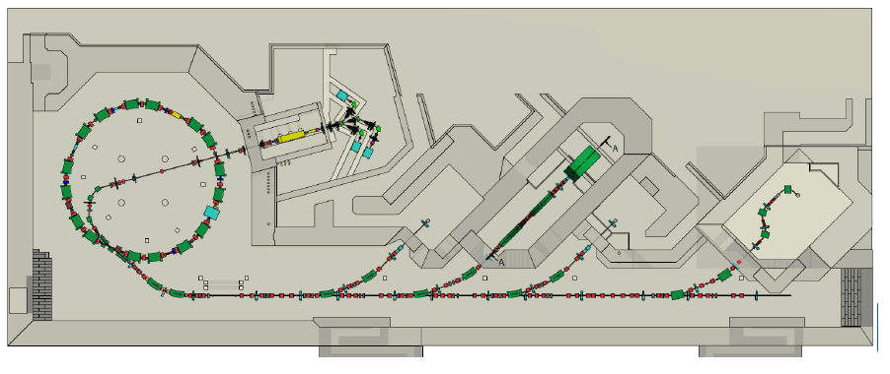
MedAustron
Recently commissioned at Wiener Neustadt
Linac: protons and carbon ions (2 sources+hot spares), 7 MeV/nucleon,
RFQ+IH, 216.8 MHz, stripping after linac

Slide 38
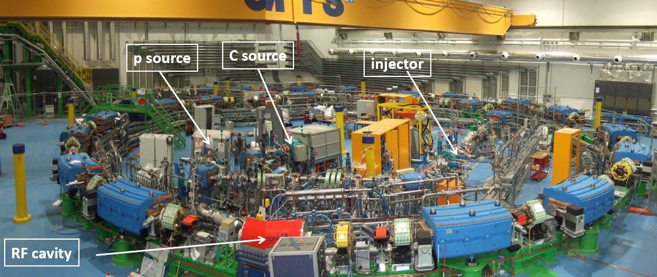
The synchrotron area in October 2008
CNAO in Pavia (Italy)

Slide 39
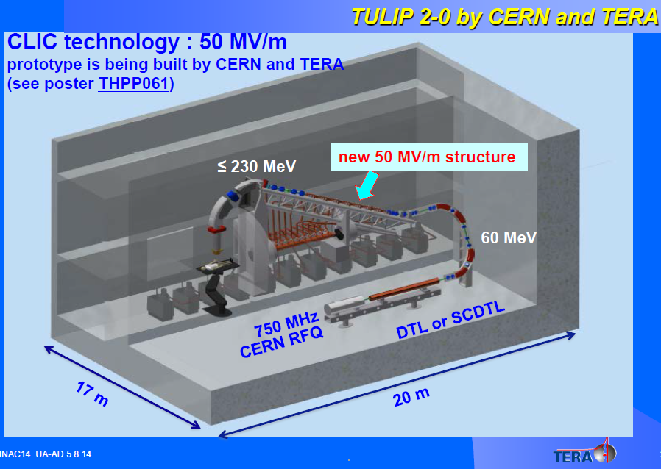
New challenges in hadrontherapy accelerators
Challenges for the new generation machines:
More compact (to fit in conventional hospitals): often cyclotron based, trend to single-room facilities.
Avoid complicated and expensive gantries.
The TULIP concept (TERA Foundation), compact linac rotating around the patient.
First single room facility: Still River synchrocyclotron rotating around the patient

Slide 40
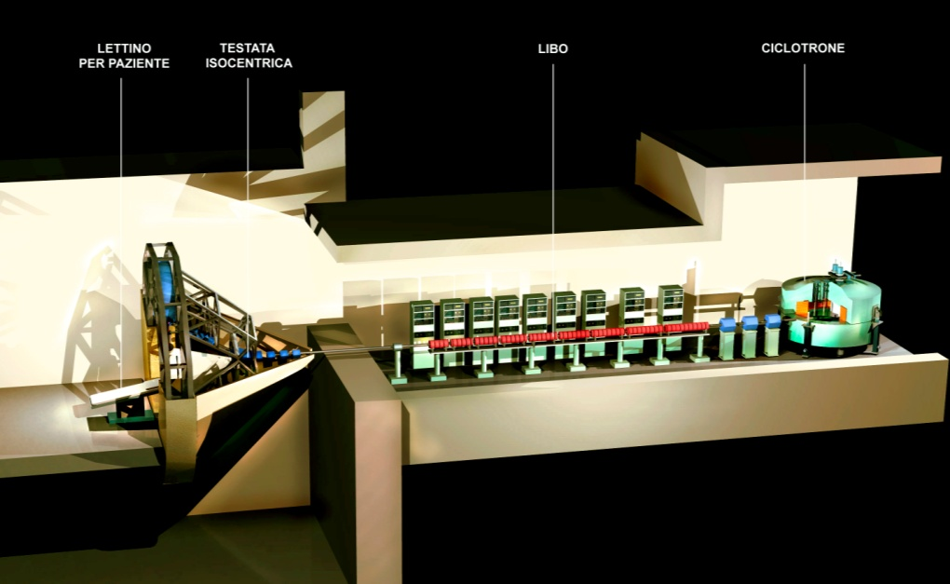
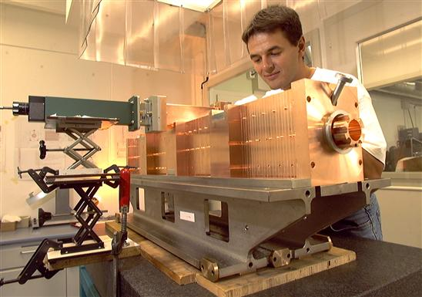
Compact proton linacs for hadrontherapy
The LIBO (LInac BOoster) project (1993 – 2003)
Development of a 3 GHz Side-Coupled module as prototype for a compact linac to be used after a commercial cyclotron, to increase proton energy from about 70 MeV (existing cyclotrons) to values interesting for deep tumour treatment (200 MeV).

Slide 41
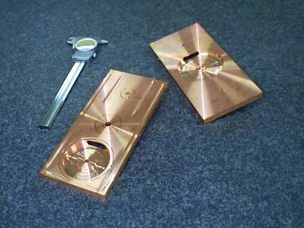
The LIBO prototype
1st module, 62-74 MeV
3 GHz (e- linac standard)
4 Side-Coupled tanks of 13 accelerating cells each, connected by bridge couplers of 3 cells each: a module contains 109 coupled cells in 1.3 m !

Slide 42
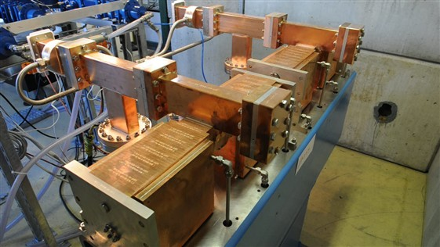
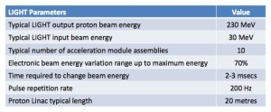
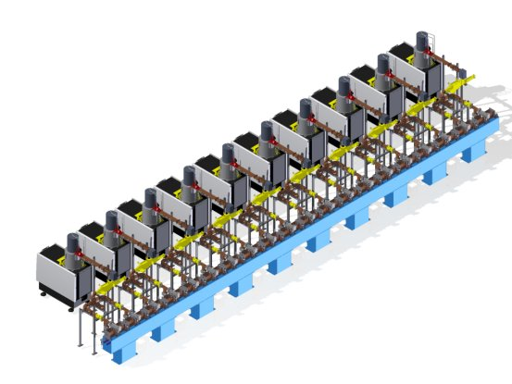
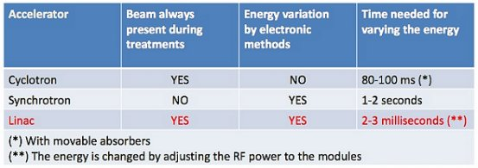
Compact proton linacs for hadrontherapy / 2
LIGHT (Linac for Image Guided Hadron Therapy) project developed by the ADAM company in collaboration with CERN (related to TERA)
Recently built and successfully tested a prototype unit (2 modules).
Modular design, compact, output energy variation
Conventional proton linac as injector

Slide 43
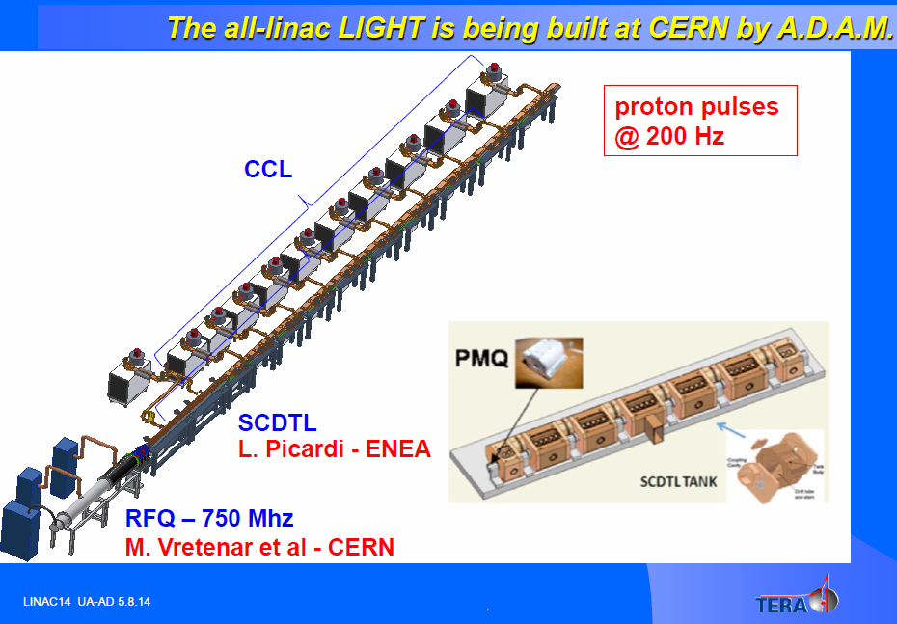
RFQ for Proton therapy
2 examples of proton therapy linacs using the HF-RFQ as injector

Slide 44
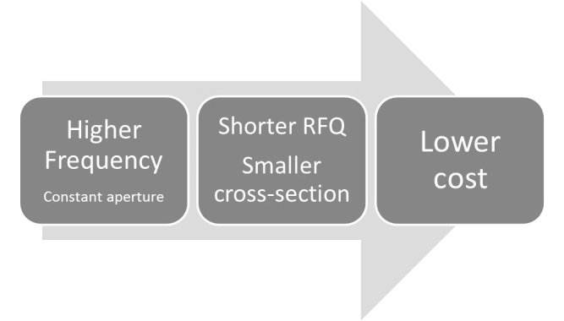




The 750 MHz RFQ project at CERN
1990 RFQ2 200 MHz 0.5 MeV /m Weight : 1000 kg/m Ext. diameter : 45 cm | 2007 LINAC4 RFQ 352 MHz 1MeV/m Weight : 400kg/m Ext. diameter : 29 cm | 2014 HF RFQ 750MHz 2.5MeV/m Weight : 100 kg/m Ext. diameter : 13 cm
New development at 750 MHz
Smaller, less expensive construction
More cells/unit length, shorter
But:
Lower current capability
Same range of RF power
HIGHER FREQUENCY
Initial RFQs in the 200 MHz frequency range
Later, 400 MHz range (Linac4, 352 MHz).
New frequency range 700 – 800 MHz
Fabrication cost per meter about 50% at 750 MHz w.r.t. 350 MHz

Slide 45



Linacs vs. cyclotrons
Industrial and medical applications: standard low-energy accelerator is the cyclotron.
Most of scientific applications: low-energy acceleration provided by linear accelerators.
Two different (competing?) technologies coming from the same origin, the work of Ernest O. Lawrence team at Berkeley in the 30’s – great success of the cyclotron, interest for linacs came only after WWII when high RF frequencies became available.
 | Principle | Operation | Focusing | Extraction | Beam quality | RF power | Cost | Maintenance
CYCLOTRON | Cyclic (magnet based) | CW | Weak | Lossy | Average | Low | Low | Higher
LINAC | Linear (RF based) | Pulsed | Strong | Clean | Good | High | High? | Lower
E. O. Lawrence
12 MeV section (from left, DTL1, RFQ, source) of the CERN Linac4 under commissioning at CERN. Linac4 is 80 meters, 160 MeV, 80 MEUR (500 kEUR/MeV building and infrastructure included)

Slide 46
Technological Roadmap
1. Injector for proton therapy linac
5 MeV
2. Isotope production in hospitals
10 MeV
3. Brachytherapy isotopes or Technetium production in dedicated centers
20 MeV
Low current
Low duty cycle (<1%)
Low current
Medium duty cycle (<5%)
Includes DTL linac
High current
High duty cycle (10%)
In construction
Design
Preliminary design
Develop a modular high-frequency RFQ design covering 3 applications:
Increasing complexity from one step to the next, will profit of experience from previous step
Proton therapy RFQ at 750 MHz (submultiple of 3 GHz), others in range 700-800 MHz

Slide 47
Basic parameters
 | Step 1 | Step 2 | Step 3
Application: | Injector for Hadron Therapy Accelerator | PET Isotope Production | ^{99m}Tc Production | Isotope Production for Brachytherapy
Particle: | p⁺ | p⁺ | p⁺ | α / d⁺
Beam energy (MeV) | 5 | 10 | 18 | 20
Accelerator length (m) | 2 | 4 | ≈10 | ≈10
Average current (mA) | 0.015 | 0.02 | 1 | ~0.1
Peak current (mA) | 0.3 | 0.5 | 10 | ~1
RF Frequency (MHz) | 750 | 750 | 704 | 704
Duty Cycle (%) | < 1 | 4 | 10 | 10
Peak RF Power (kW) | 400 | 800 | ≈1500 | ≈1500
Note: higher current (~10 mA) can be obtained with a lower frequency RFQ (eg. 350 MHz)

Slide 48



The isotope RFQ system
To be installed in hospitals (or movable on a lorry?)
2 (or more) movable targets.
Target shielded by layers of iron and borated (6%) polyethylene, overall radius <0.9 m.
Maximum calculated dose at shielding 2 μSv/h

Slide 49

Parameters for isotopes
2 RFQs
Input energy = 40 KeV
Total Length = 4.0 m
Output Energy = 10 MeV
Frequency 750 MHz
Average current = 20 μA
Peak current = 500 μA
Duty cycle = 4 %
Peak RF power < 800 kW
Total weight (RFQ): 500 kg
Mains power < 65 kW
Cooling ~ 100 l/min
No radiation around accelerator and target.
Easy operation (one button machine).
High reliability
Minimum footprint (15 m2)
Production for PET scans of ¹⁸F and ¹¹C

Slide 50



The miniature accelerator: a linac?
Next challenge: the miniature accelerator!
Brings protons above Coulomb barrier
Could fit in your kitchen (or in a standard industrial environment)
Allow you to stay next to it while it works (low radiation!)
Is cheap, reliable and maintenance-free
AVAILABLE IN THE VIRTUAL WORLD:
In “The SIMS” (life simulation video game) you can already buy:
“the smallest and cheapest particle accelerator in the world. Produce new subatomic particles in the comfort and intimacy of your home. Notice: a wrong usage could destroy the planet.”

