Slide 1

Inner Triplet System
Introduction to system
Device modelling
Design Entry HDL Schematics AMS simulations
By Scott Rowan
LHC-CM
Notes:
I’m the new guy...
Name, 3 weeks
I.T system
4 sections to presentation

Slide 2
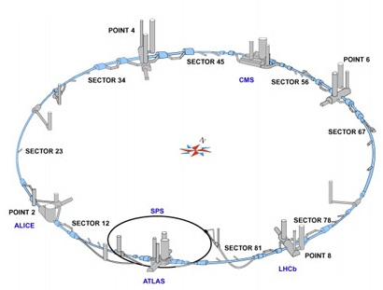
The Inner Triplet System
The Large Hadron Collider
The Inner Triplet System is present at either side of the 4 main colliders of the LHC and determines the flow of current through the beam focusing, superconducting magnets.
Two different setups; Type 1: ATLAS & CMS; Type 2: ALICE & LHCb
Notes:
The LHC, in case you somehow didn’t know that.
Both sides either collider
2 types

Slide 3
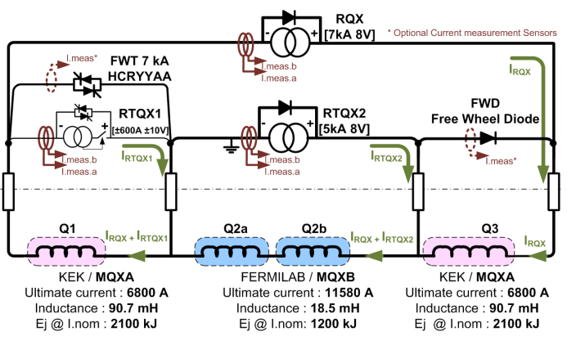
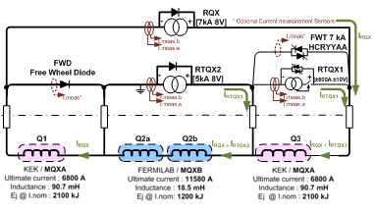
The Inner Triplet System
Type 1: ATLAS & CMS, FWT in parallel with Q1, FWD in parallel with Q3
Type 2: ALICE & LHCb, FWT in parallel with Q3, FWD in parallel with Q1
Notes:
ATLAS/CMS FWT Q1, FWD Q3
ALICE/LHCb FWD Q1, FWT Q3

Slide 4

Components - Type 1
3x Power Converters, RQX, RTQX1 & RTQX2
4x Superconducting Magnets; 2x MQXA (KEK); 2x MQXB (FERMILAB)
Free Wheel Diode in Parallel with Q3
Free Wheel Thyristor & Crowbar in parallel with Q1
Notes:
Focusing on type 1,
List components, point at them

Slide 5
Components – Power Converters
RQX - 7kA 8V; Internal FWD path constructed of 40x 245NQ015R schottky diodes in parallel.
RTQX2 - 5kA 8V; Internal FWD path constructed of 20x 245NQ015R schottky diodes in parallel.
RTQX1 - ±600A ±10V; Internal bi-directional Crowbar (2x TZ459N thyristors) & External bi-directional FWT path construct or 2x T3709N thyrisitors in parallel in either direction.
Note additional FWD (in parallel with Q3) is construct of 2x D4457N rectifier diodes in parallel.
Free Wheel Diode
Free Wheel Thyristor
Power Converters
Notes:
Don’t wanna bore you.
Took ages to find info on component names so...

Slide 6
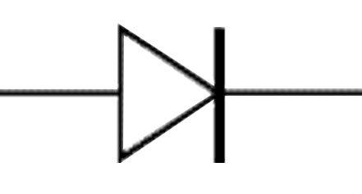
Device Modelling - Diodes
Using AMS Model Editor it is possible to simulate a diode by entering a number of parameters.
Two main approaches to establishing these parameters…
Manual calculation/reading from datasheet, or taking values from the datasheet and using them in conjunction with AMS Model Editor - Device Characteristic Curves option. This is an iterative optimising application and will generate a result based on your inputs.
Obligatory picture of a diode to break up text.
Notes:
Modellin diodes, AMS
2 Main approaches, manual calc, using DCC w datasheet

Slide 7
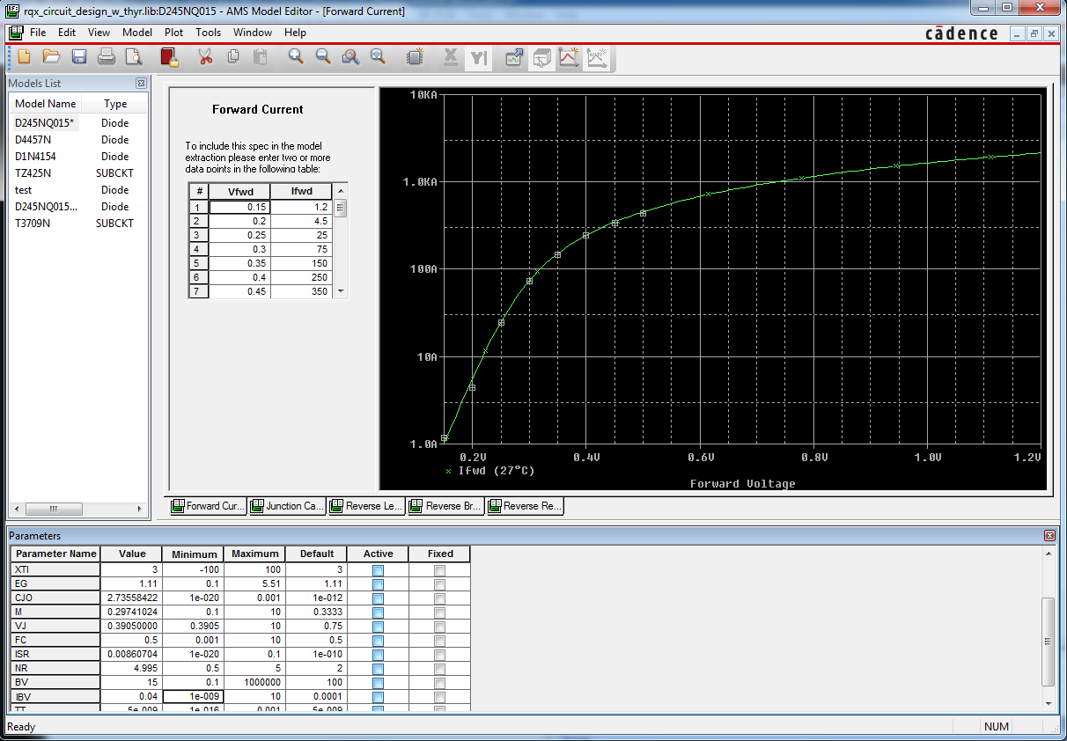
Device Modelling - Diodes
AMS Model Editor - Device Characteristic Curves in action…
Entered values from datasheet
Resultant Plot of both entered values and solution
Several tabs for different characteristics
Parameter values calculated by software
Notes:
DCC explain

Slide 8
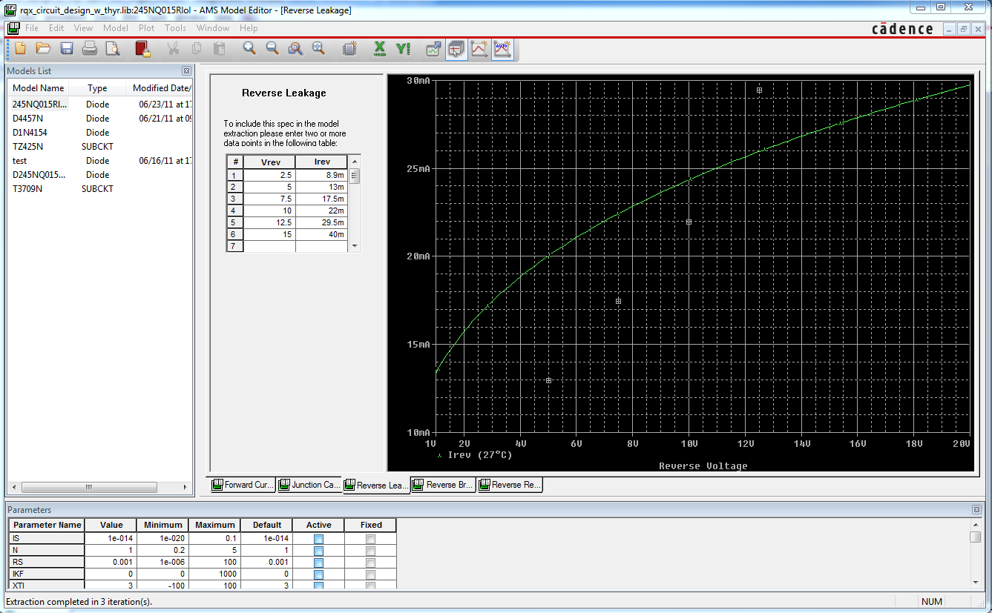
Device Modelling - Diodes
Cause for inaccuracies, particularly in reverse leakage.
As you can see the editor does not attempt to solve with an exponential as the plots from the data clearly show.
Solution calculated by DCC
Entered values from datasheet
Notes:
DCC explain potential inaccuracies

Slide 9
Device Modelling - Diodes
Resultant values from datasheet in conjunction with DCC application:
D245NQ015R Schottky Diode
D4457N Rectifier Diode
Parameters | Abb | Values
Saturation Current | IS | 1.93186E-02 | A
Emission Coefficient | N | 1.15684E+00
Resistance | RS | 2.37362E-04 | Ω
High-Inject Knee Current | IKF | 2.60259E+02 | A
Saturation Current Temp coeff | XTI | 3.00000E+00
Energy of Bandgap | EG | 1.11000E+00 | eV
Junction Capacitance | CJO | 2.85375E-09 | F
Grading Coefficient | M | 3.02598E-01
Junction Potential | VJ | 3.90500E-01 | V
Depletion Capacitance coeff | FC | 5.00000E-01
Recombination Current | ISR | 5.38782E-02 | A
Emission Coefficient of ISR | NR | 4.99500E+00
Reverse Breakdown Voltage | BV | 1.50000E+01 | V
Reverse Breakdown Current | IBV | 4.00000E-02 | A
Carrier Transit Time | TT | 5.00000E-09 | s
Parameters | Abb | Values
Saturation Current | IS | 4.21700E-03 | A
Emission Coefficient | N | 2.59000E+00
Resistance | RS | 1.71970E-05 | Ω
High-Inject Knee Current | IKF | 1.00000E+03 | A
Saturation Current Temp coeff | XTI | 3.00000E+00
Energy of Bandgap | EG | 1.11000E+00 | eV
Junction Capacitance | CJO | 1.00000E-12 | F
Grading Coefficient | M | 3.33300E-01
Junction Potential | VJ | 7.50000E-01 | V
Depletion Capacitance coeff | FC | 5.00000E-01
Recombination Current | ISR | 1.00000E-10 | A
Emission Coefficient of ISR | NR | 2.00000E+00
Reverse Breakdown Voltage | BV | 2.00000E+02 | V
Reverse Breakdown Current | IBV | 6.00000E-02 | A
Carrier Transit Time | TT | 1.00000E-02 | s
Notes:
Resultant diode model and its parameter values are several iterations

Slide 10
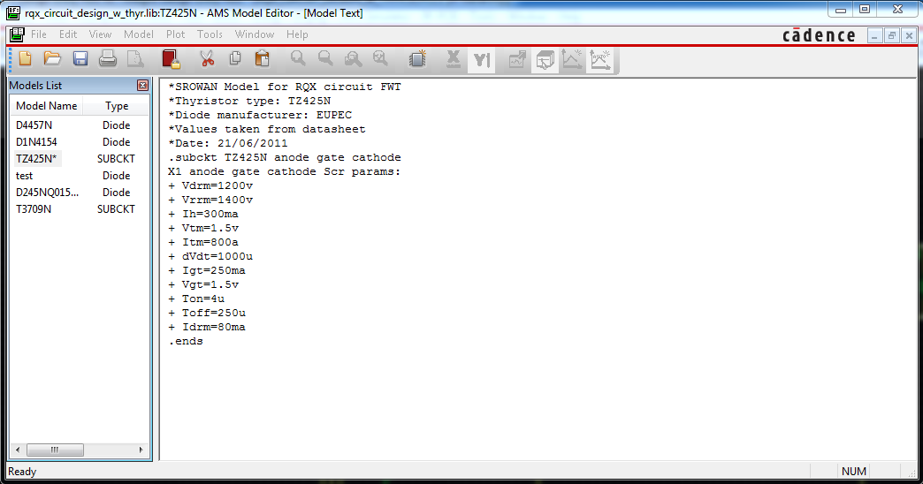
Device Modelling - Thyristors
The DCC application does not have a thyristor model.
Luckily the datasheets contained all the information to directly enter the values for the parameters required to model a thyristor.
Entered values from datasheet
Several different models created
Shown above is the model parameters entry for the TZ425N thyristor.
The T3709N thyristor is modelled in the same way.
Notes:
Thyristors, no model, all standard model parameters in data sheet

Slide 11
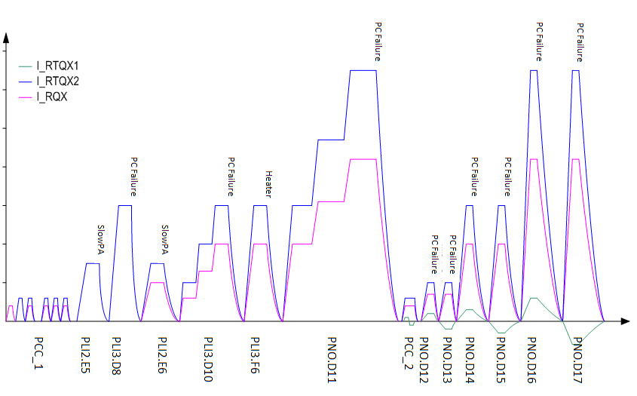
Device Modelling - PCs
Power Converters are modelled using ideal current sources with a programmable stimulus.
Stimuli are programmed to simulate a multitude of tests e.g. PCC.T1, PLI3.d10, PNO.D16 etc...
Initial tests, single PCs Low current
Final tests, all PCs High current
Notes:
PCs are
run with test stimulus
Based on real test, pic shown

Slide 12
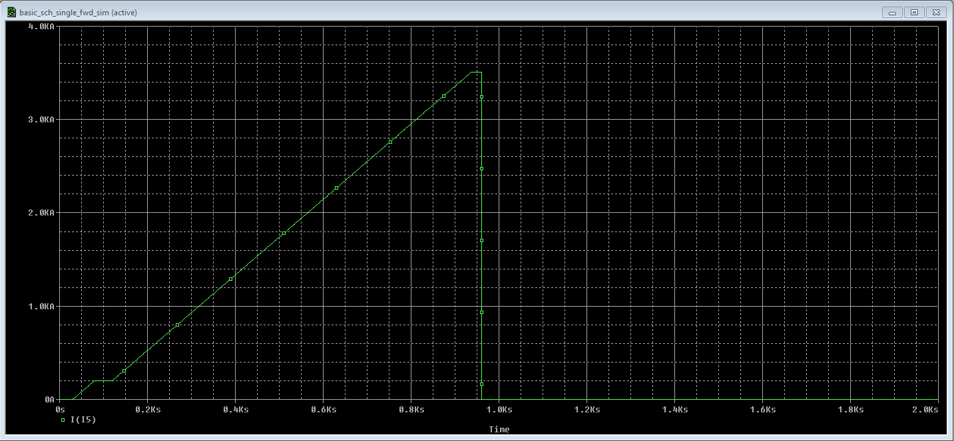
Device Modelling - PCs
The stimulus is manually programmed into the design file of the project.
Example of PNO.D16 stimulus text for the RTQX2 power converter, simulating PC shutoff at 90% nominal current:
.STIMULUS RTQX2_PNO.D16 PWL
+ TIME_SCALE_FACTOR = 1
+ VALUE_SCALE_FACTOR = 1
+ ( 0, 0 )
+ ( 31, 0 )
+ ( 80, 200 )
+ ( 120, 200 )
+ ( 937.5, 3510 )
+ ( 960, 3510 )
+ ( 960.05, 0 )
+ ( 10k, 0 )
Point of PC Shutoff
50ms to drop to zero.
Notes:
PC, modelled by ideal current source
For e.g PNO.d16
Txt example and solution

Slide 13
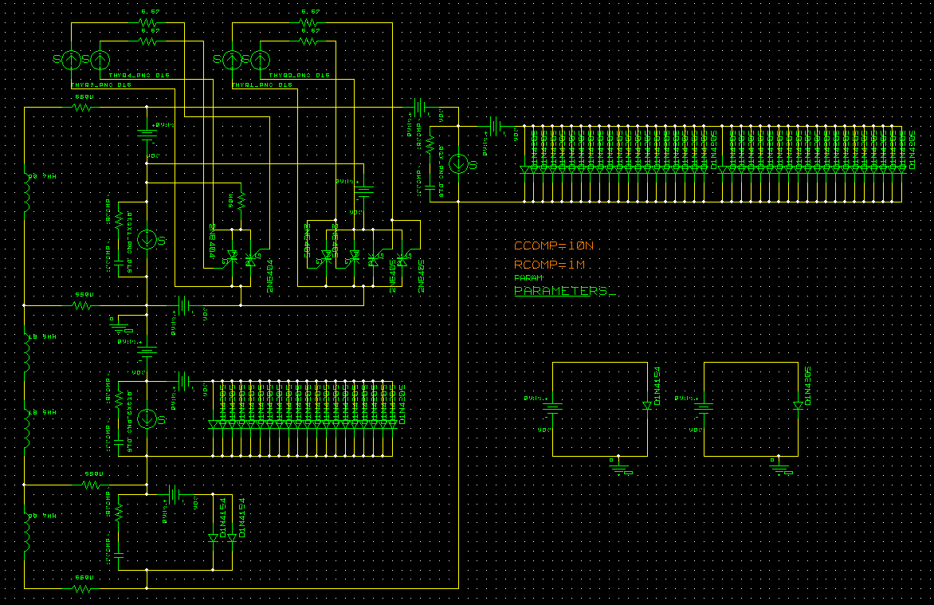
Design Entry HDL
The circuit schematic is constructed using Cadence Design Entry HDL.
It’s green. Very green.
Notes:
Schematic.
It’s green

Slide 14
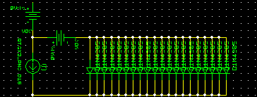
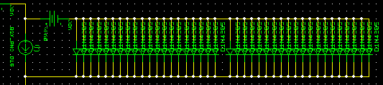
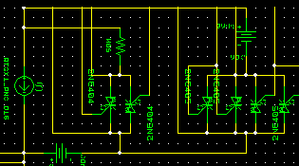
Design Entry HDL - PCs
RTQX2
20x 245NQ015R block
RQX
RTQX1
Free wheel Thyristor
Crowbar
Notes:
Ignore v sources
Rtqx2 1 block
Rqx 2 blocks
Rtqx1 crowbar and fwt set up

Slide 15
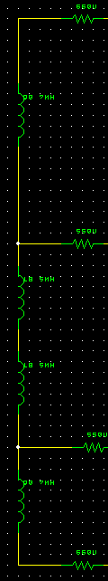
Design Entry HDL - Magnets
Magnets are currently modelled as a simple inductor.
The resistances shown are those which represent the cable resistance of the bus-bar.
I have also begun using Analogue Behavioural Modelling (ABM) components to simulate a linear increase in resistance.
Note: This is merely to help understand the current flow and is not an accurate quench modelling technique.
MQXA magnet inductance
Q2a magnet bus-bar
Notes:
Magnets, inductor
Bus-bar resistance
Abm, quench

Slide 16
AMS Simulator
To see the results of a simulation I will be using AMS simulator and comparing the plot with measurements taken from the system itself.
At the moment, I am merely using AMS simulator as a diagnostic tool to assist me in creating an accurate model. For e.g. Parametric sweeps of model/global parameters.
Onward...
Notes:
AMS, compare with measured values of the system itself
Diagnostic tool

Slide 17
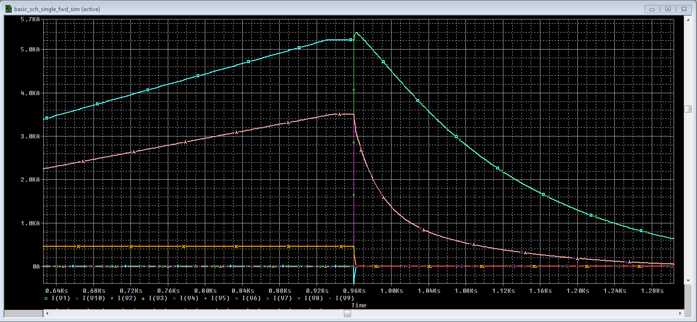
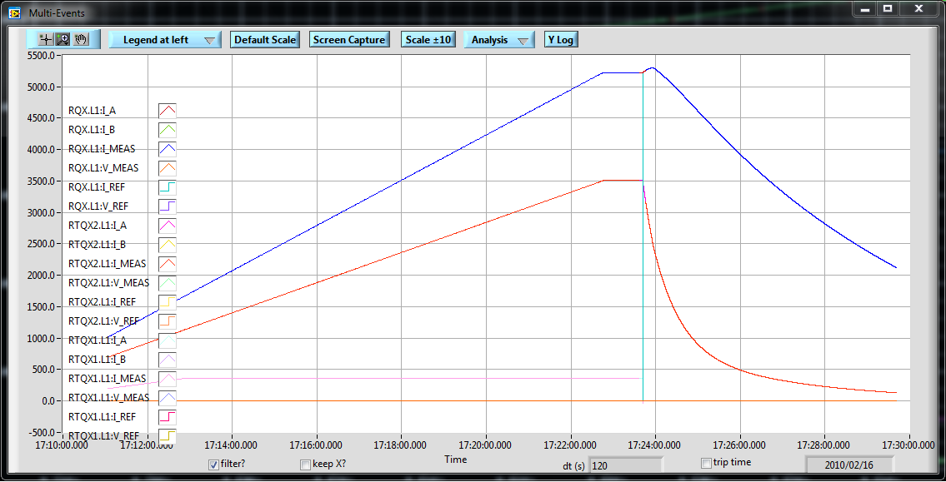
AMS Simulator
AMS simulation
Simulation of PNO.d16 test run.
PM Browser results take from RQX.L1, 16/02/10
PM Browser Measurements
Bump
As you can see there is already major similarities in the discharge characteristics. Much to be done though...
Exponential decay during discharge
Notes:
Some early results... PNO.d16
Major similarities already
Exponential decay
Bump - technical term (induced current/emf perhaps?)
Likely to be just current flow

Slide 18
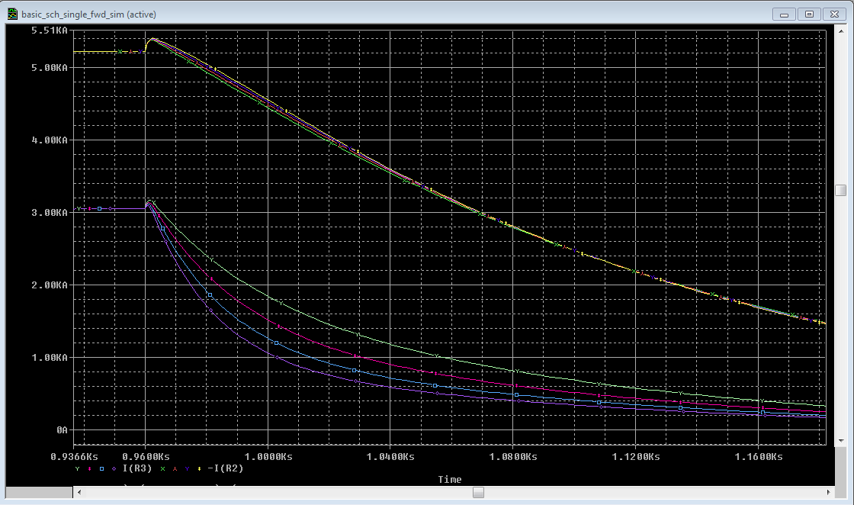
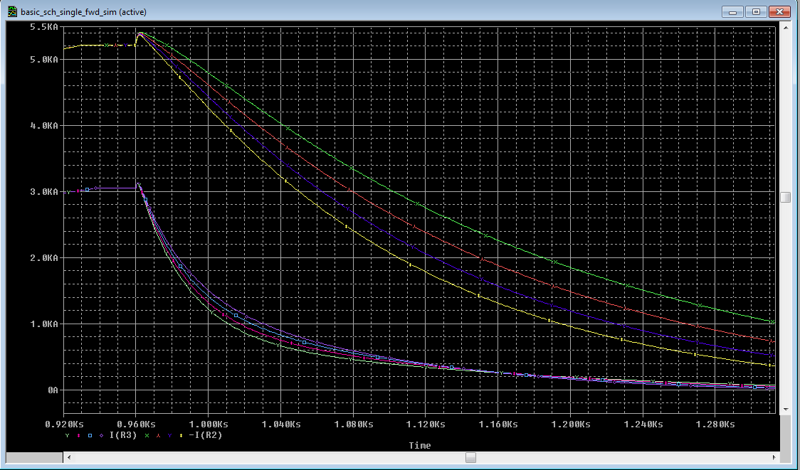
AMS Simulator - Resistance
0.3mΩ sweep of R_Innerloop.
Major components alone don’t account for all effects. Cable resistance must be included.
Max differences of ~1kA
Parametric sweep of bus-bar resistance show that accurately calculating resistance in the circuit is essential.
0.3mΩ sweep of R_Outerloop.
Notes:
Component effects,
Resistance of cables (high current, low voltage)
Sweeps
Diff up 1kA

Slide 19
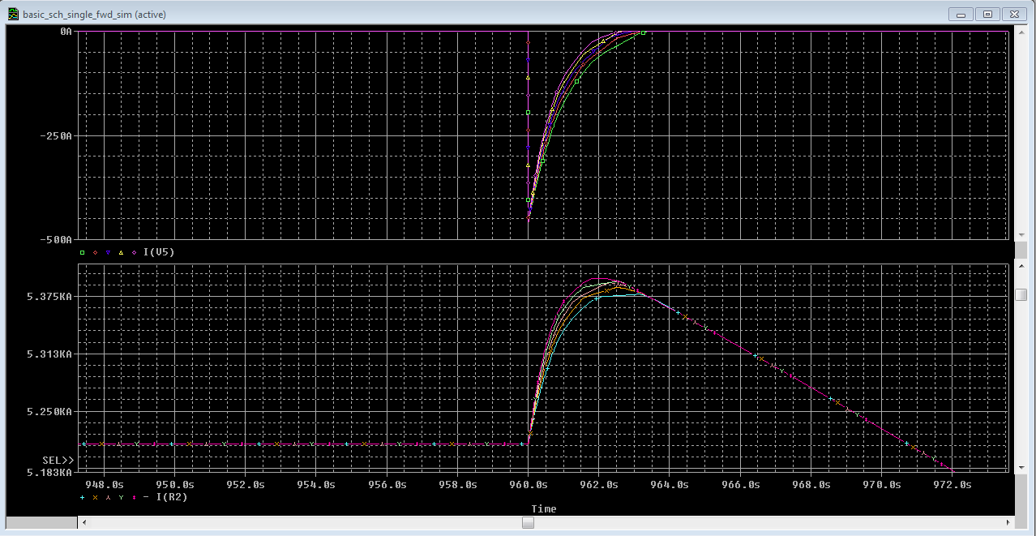
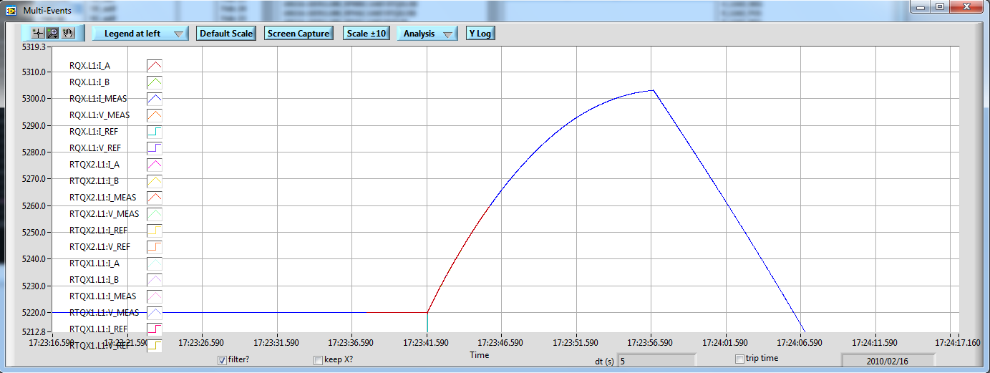
AMS Simulator - Resistance
20mΩ sweep of RCrowbar.
It was found that the initial increase in current after shutoff (the bump) is due Q1 current being allowed to discharge across the RTQX1 crowbar.
Current through crowbar after PC shutoff
Comparison with PM Browser
Its curve characteristics are highly dependant on the series resistance and the model parameters of the crowbar thyristor.
Notes:
The bump, crowbar thyristor turned on, current chooses it’s path to discharge, adding to main current loop.
Crowbar, current from mqxa Q1
1st graph, 2 plots sweep of 20mohm and top is the current in crowbar

Slide 20
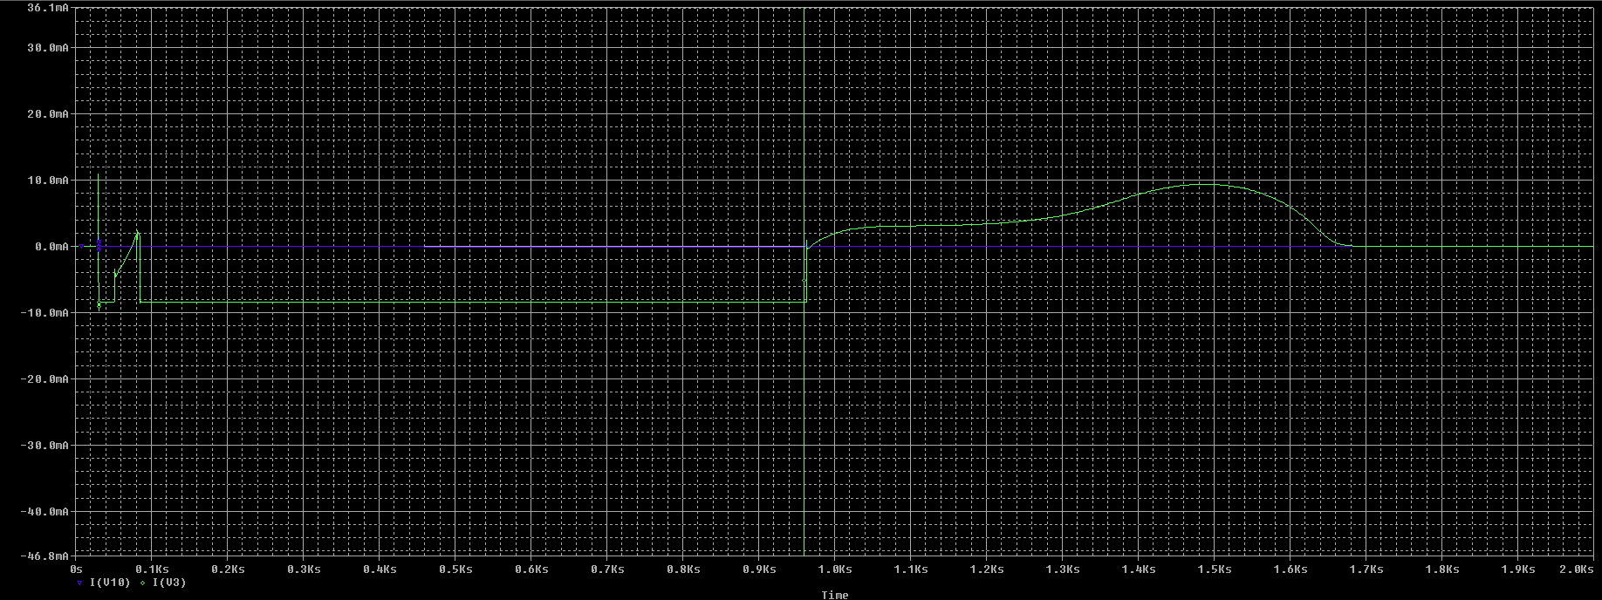
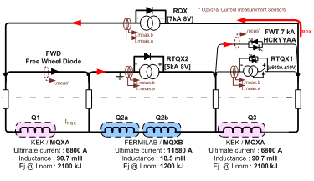
AMS Simulator - FWT & FWD
In normal operation or PC failure use of paths is still negligible at best (<100ma)
When a quench or diode failure occurs the operation of the FWD and FWT comes into play with a quick discharge mode. Hopefully future simulations will confirm this.
Notes:
FWT & FWD not in use in normal operation or pc failure.
Type 2 diode failure, quick discharge loop.

Slide 21
What Next?
Direct comparison of exported results of both measured and simulated plots.
Calculation and inclusion of more accurate cable resistances throughout (e.g. Path from PCs to and from internal diodes).
Begin implementing thermal influences.
Gain a more in-depth understanding of current flow/direction during PC failure and quenches.
Go see Mont Blanc for my birthday (3rd July).
Notes:
What next?

Slide 22
ANY QUESTIONS?
Thank you for listening
By Scott Rowan
LHC-CM

