Slide 1

Inner Triplet System
Recap
Updates
AMS/PM comparison
Unexplained anomalies
Further work
By Scott Rowan
TE-MPE-PE

Slide 2
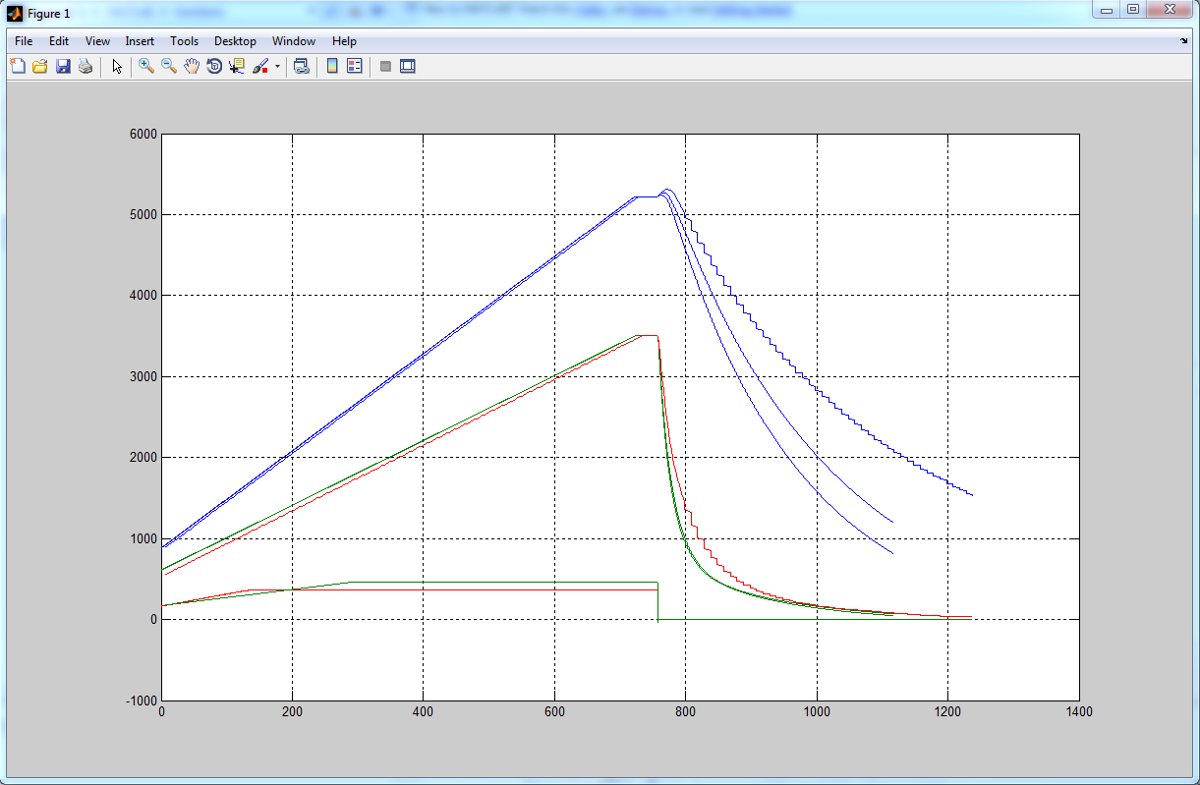
Recap
Last presentation found similarities in curve characteristics, including RQX bump, but rather inaccurate.
1st AMS/PM comparison, as of last month. (max error ~1kA)
RQX.L5/R5 PNO.D16, FPA at 90% Inom
AMS simulation result
(resolution of excel data)
RQX.L5 & RQX.R5 PM plot

Slide 3
Reasons for Errors & Solutions thus far
Missing information on databases (design info as well as measured)
Miscalculation of resistances
Inaccurate parameters for thyristors/diodes
Low frequency simulations
Missing information resolved (to an extent) after further meetings with H. Thiesen
Recalculation with more accurate equations/resistance per unit length
Device modelling errors resolved by using excel along with the equation to establish the most pertinent. Trial and error optimisation in the AMS model editor was also used.
Use of ABM with break function to accurately measure specific points in a simulation without taking up too much time/memory…
e.g BREAK((TIME+300U)*FLOOR(TIME/679)*(1-FLOOR(TIME/700)))

Slide 4
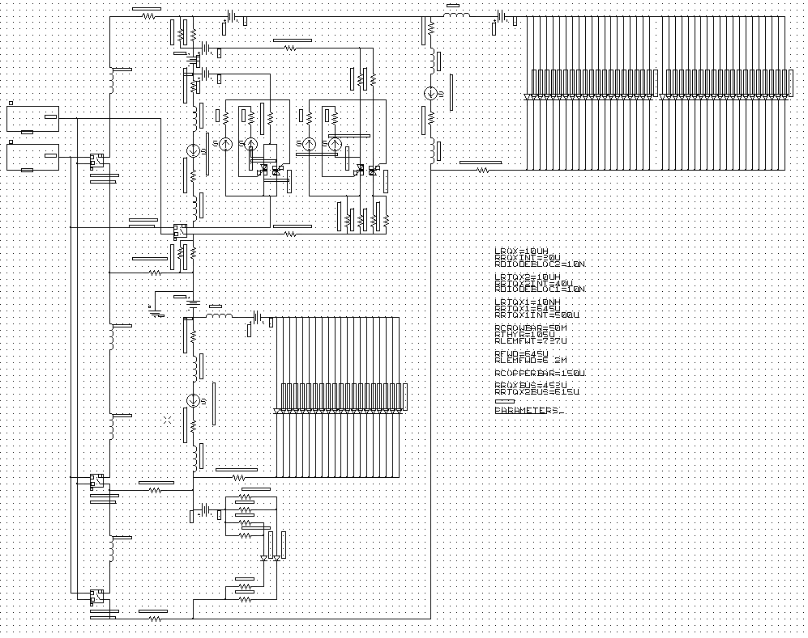
Updates - Schematic
Internal impedances
Thyristor triggering altered
Cable/LEM resistances
Use of variable parameters
Cable/LEM resistances

Slide 5
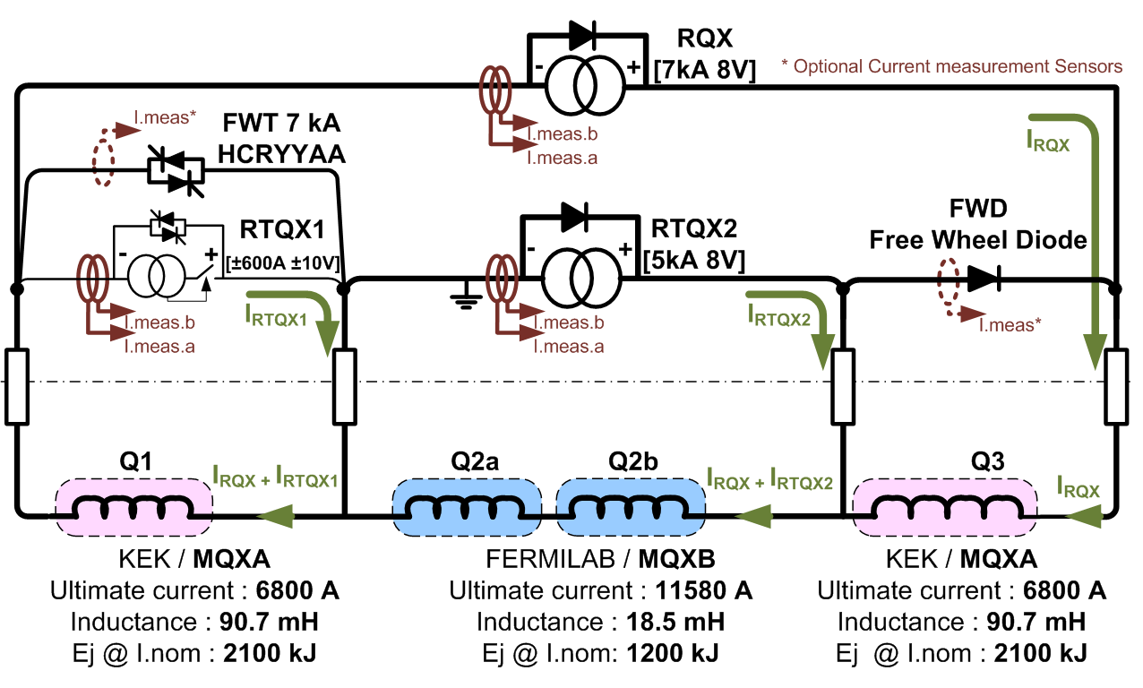
Updates - Cable Resistances
Red
Orange: used for LEM par to FWD input
Green: used for LEM par to FWT input
Bar: used between RTQX1 and FWT
Purple
Purple
RQX/RTQX2 busbar resistance taken from layout database
Use of various resistance per unit length gave results as follows:
Copper resistivity
 |  |  | Resistivity(Ωm) @20°C | 1.75E-08 | 1.72E-08 | 1.68E-08
 | Area (m²) | Length(m)
PURPLE | 2.40E-04 | 9 | Resistance(Ω) | 6.56E-04 | 6.45E-04 | 6.30E-04
ORANGE | 2.50E-05 | 9 | R=((pL)/A) | 6.30E-03 | 6.19E-03 | 6.05E-03
RED | 3.00E-04 | 1.5 |  | 8.75E-05 | 8.60E-05 | 8.40E-05
GREEN | 3.50E-05 | 1.5 |  | 7.50E-04 | 7.37E-04 | 7.20E-04
BAR | 2.50E-04 | 2 |  | 1.40E-04 | 1.38E-04 | 1.34E-04

Slide 6
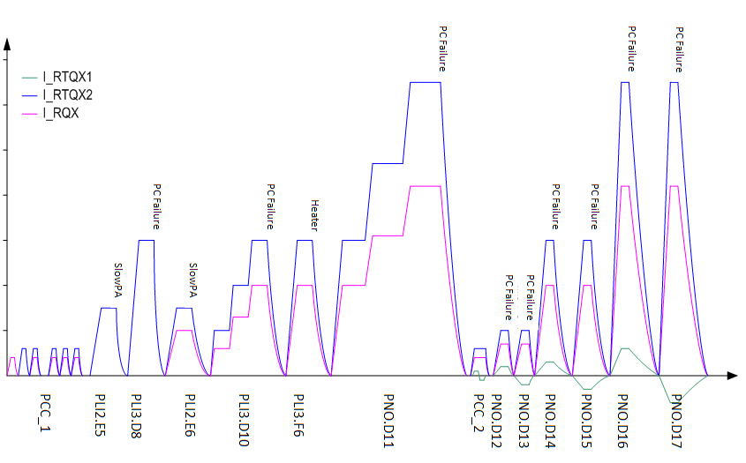
AMS/PM Comparison
PNO.D16/17
PLI3.D11
PNO.D12/13
All tests carried out using given data for RQX.R5
Naturally these are tested against the PM data for RQX.R5 tests.
All test are programmed to be simulated but I will only present those I deem most important

Slide 7
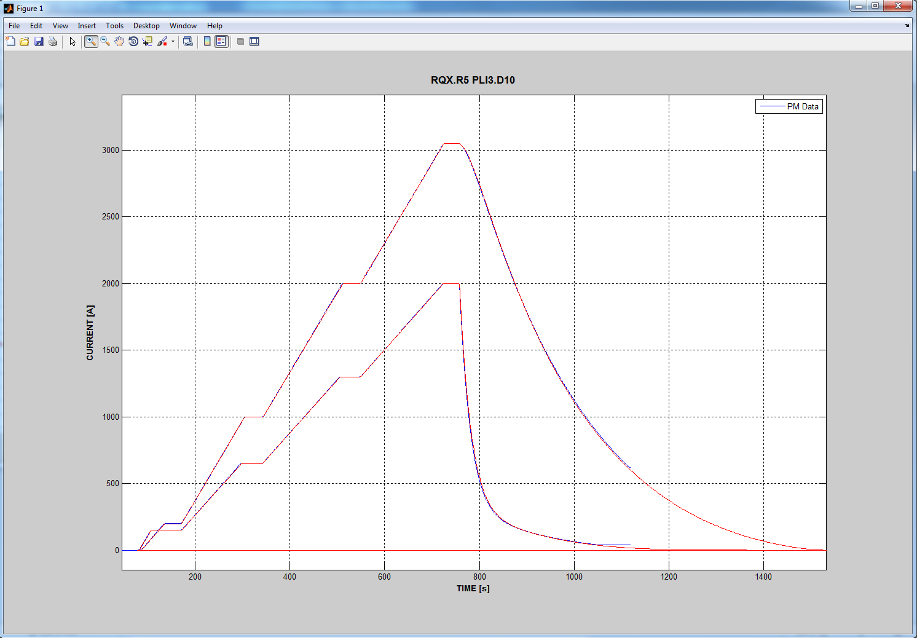
AMS/PM Comparison - PLI3.D10
RQX & RTQX2 ramped to 50% nom
RTQX1 not in operation in this test
Point of FPA
Discharge time constants vary with time,
this explains the error and is most likely
minor changes resistance with thermal effects
or minor reduction in magnet inductance with
current increase
Max error 20A
(<1% of Imax)
Ignore: script copy error

Slide 8
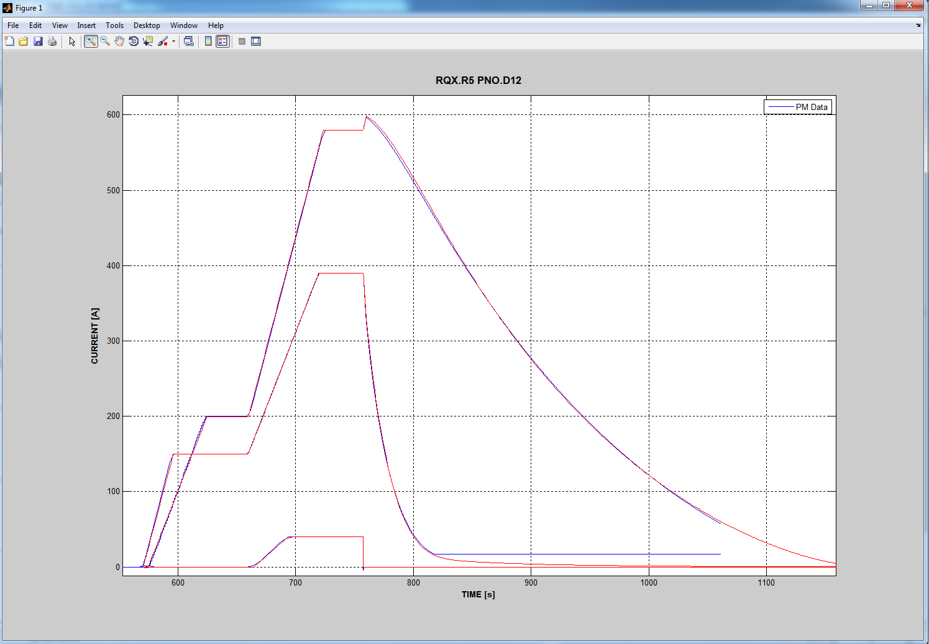
AMS/PM Comparison - PNO.D12
All converters ramped
to 10% nom before FPA
Point of FPA, note current stored in Q1
from RTQX1 transfer to RQX loop: less
resistance than thyr path
Max error 20A
(<1% of Imax)

Slide 9
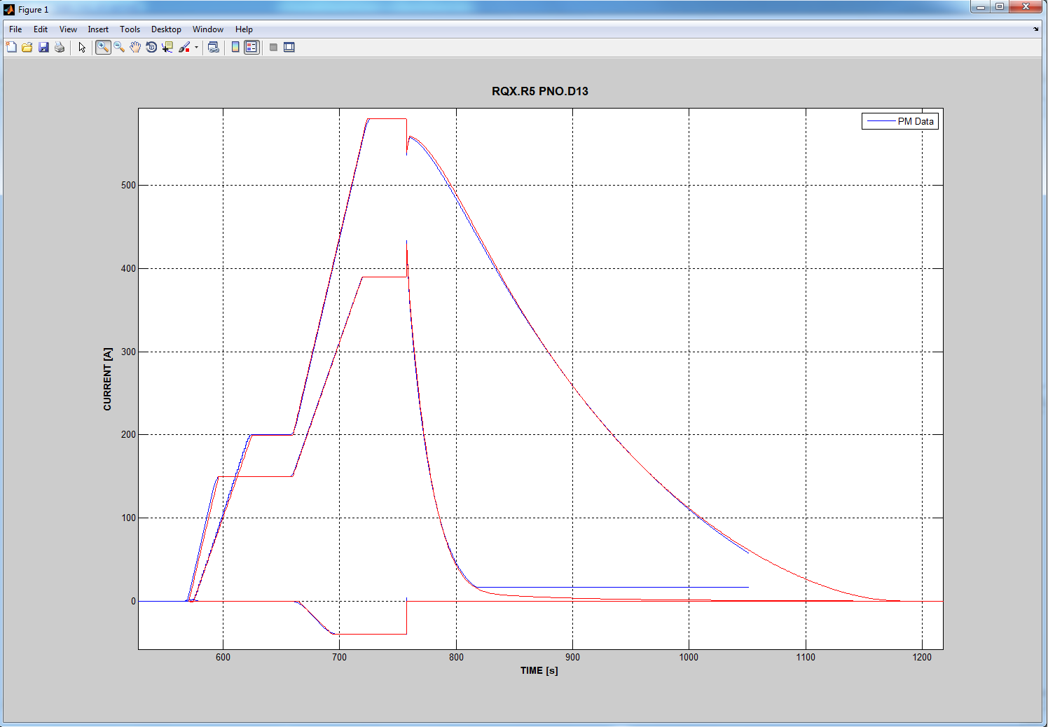
AMS/PM Comparison - PNO.D13
All converters ramped
to 10% nom before FPA
Point of FPA, note current stored in Q1
forced to transfer to RTQX2 loop, causing drop in RQX
Max error 20A
(<1% of Imax)

Slide 10
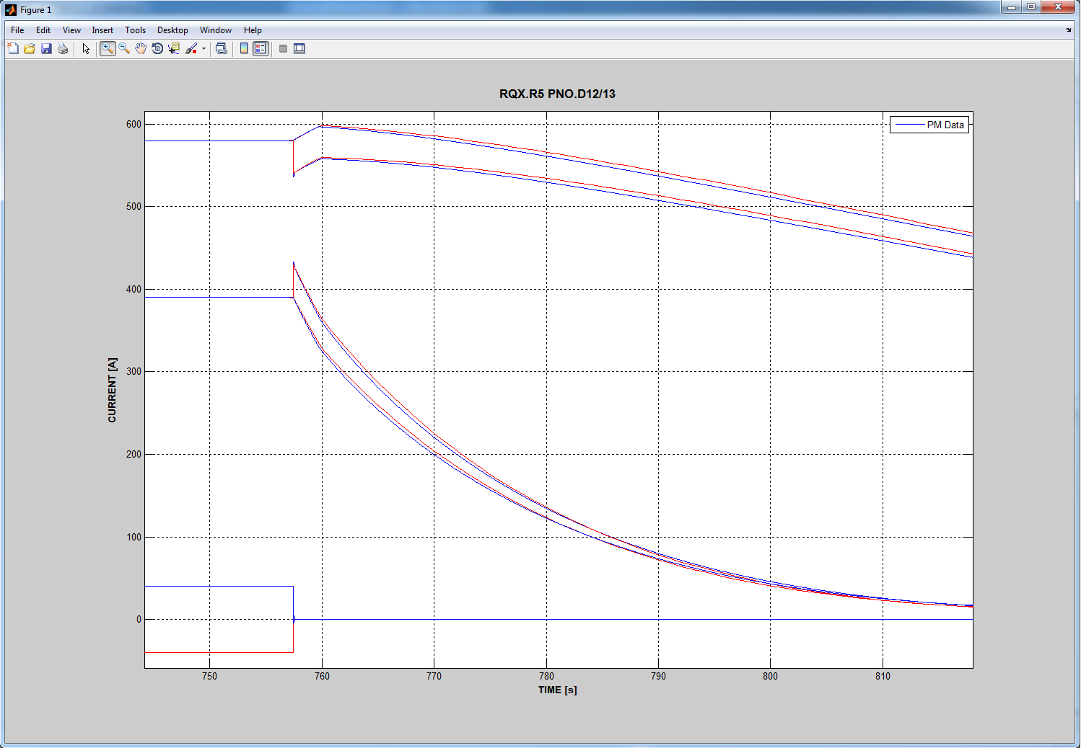
AMS/PM Comparison - PNO.D12/13 error
Note: minor errors with RTQX1 off are greatly
amplified when in operation, assuming main error
lies in FWD/FWT path

Slide 11
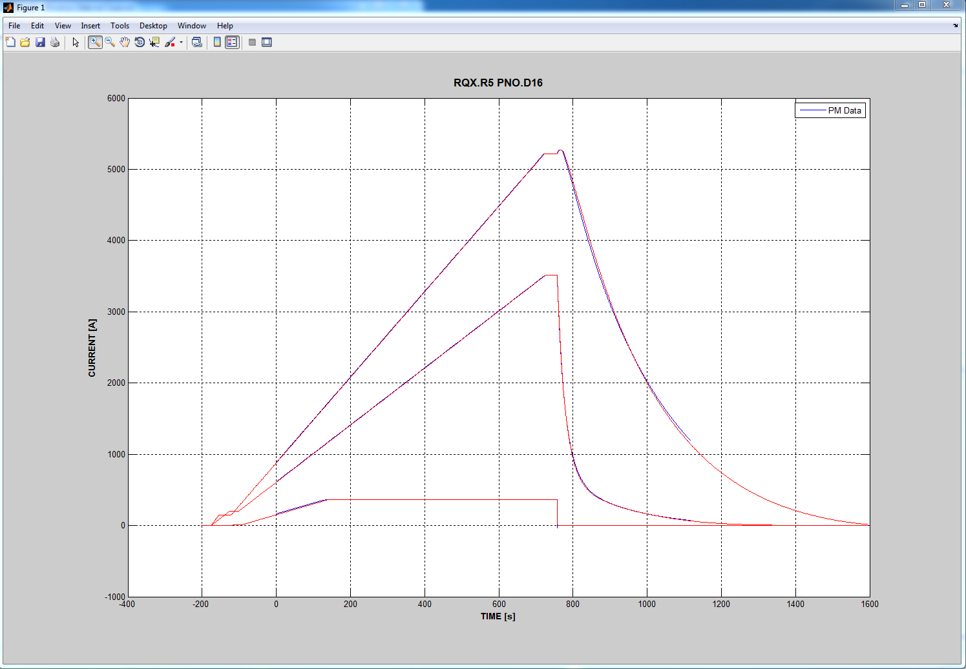
AMS/PM Comparison - PNO.D16
Point of FPA, note current stored in Q1
chooses RQX loop rather than thyristor loop causing bump in RQX
All converters ramped
to 90% nom before FPA
Max error 80A
(<2% of Imax)

Slide 12
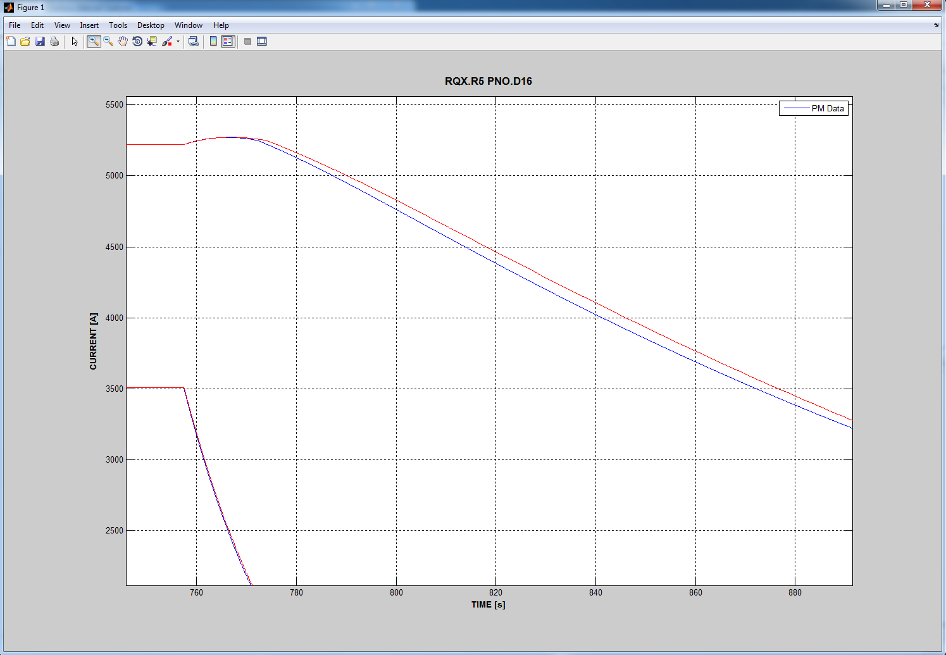
AMS/PM Comparison - PNO.D16 error
Main error: due to time at which current
stops flowing through thyrsitor path. Main
Controlling parameter unknown (ideality
factor?)
Main time constant remains steady, small
discrepancies can again be explained to
thermal increase in resistance / current
decrease in inductance over time.

Slide 13
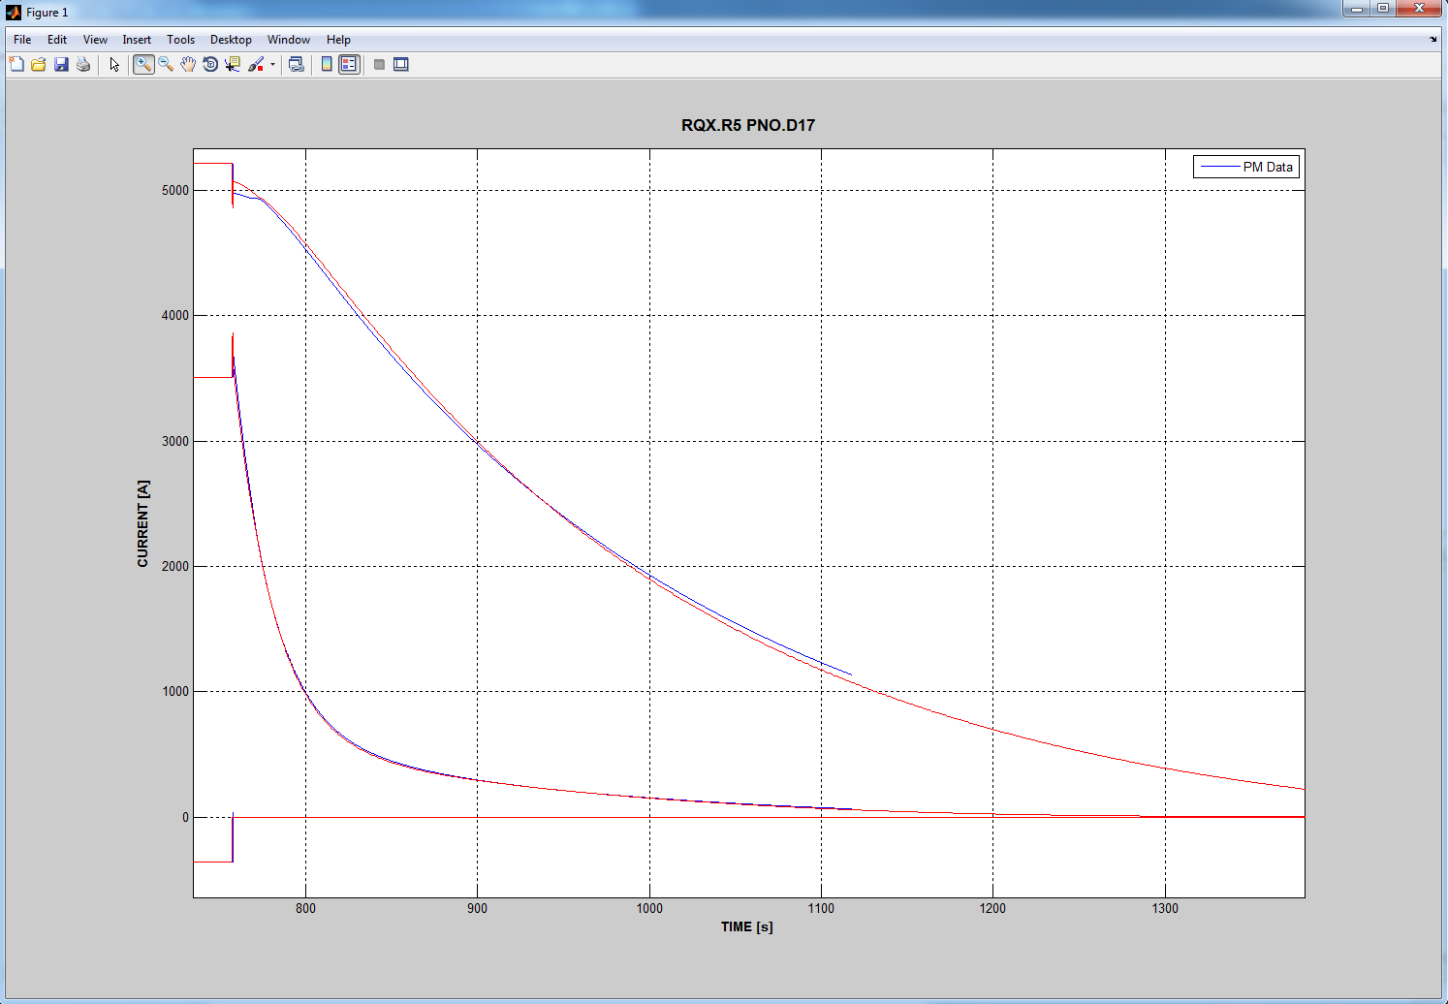
AMS/PM Comparison - PNO.D17
No idea, discovered yesterday
Expected change in time
constant (large current test)

Slide 14
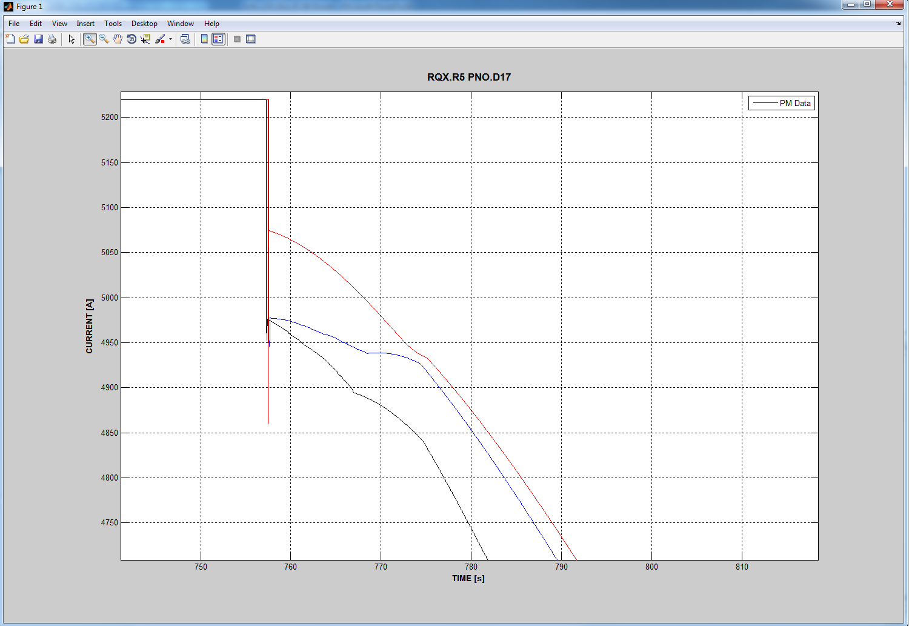
Unexplained Anomalies
Discharge anomaly: shown with RQX.L5 to conform
Noticeable kink in simulation, somewhat corresponds

Slide 15
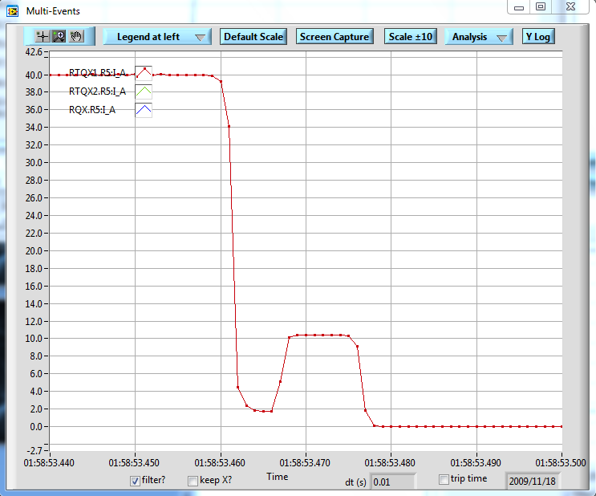
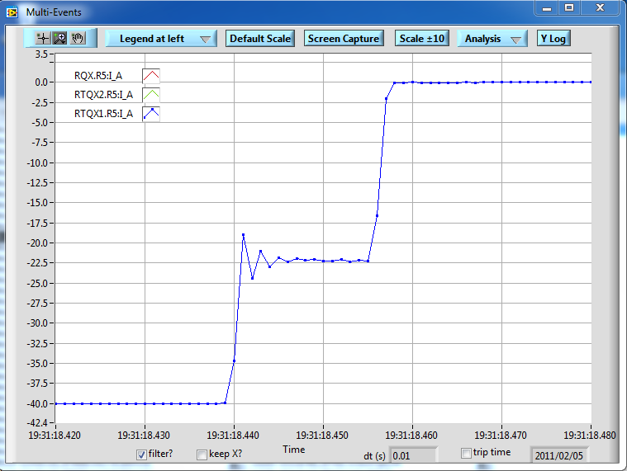
Unexplained Anomalies
Apart from PNO.D17 RQX transient of course...
I_A measurements don’t correspond to I_MEAS, note in both cases I_MEAS reads above/below 0A
I_A RTQX1 in positive operation
always wavers from -2A-2A back
up to 10A before falling to 0A.
I_A RTQX1 in negative
operation oscillates for
10ms at 10-20A

Slide 16
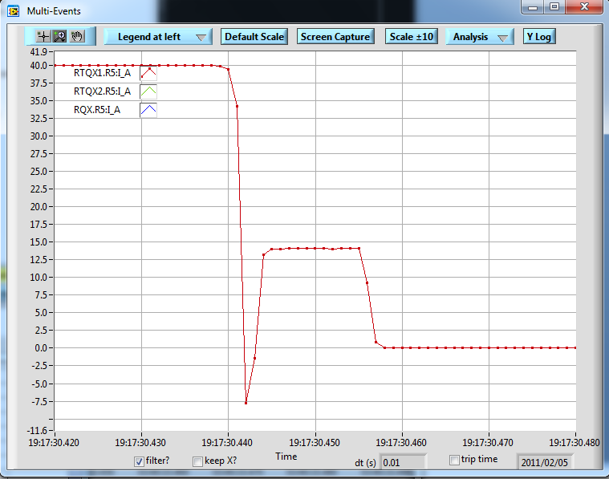
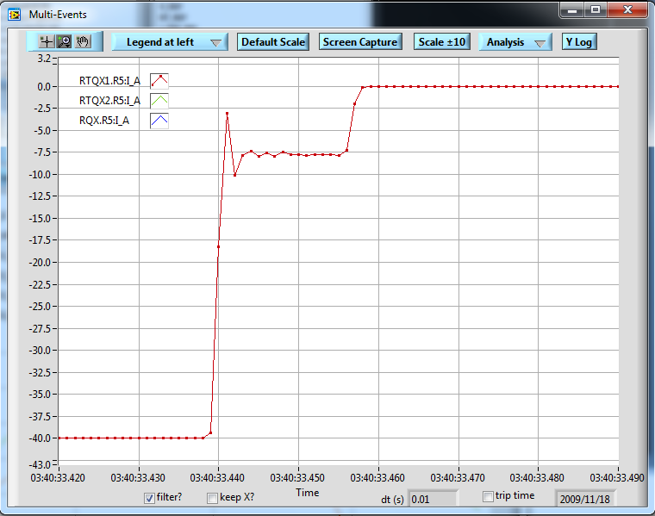
Unexplained Anomalies
RQX.R5 PNO.D12 09
RQX.R5 PNO.D12 11
RQX.R5 PNO.D13 09
RQX.R5 PNO.D13 11

Slide 17
Further Work
Test circuit model against PM with ALICE/LHCb circuit set-up/parameters
Enquire about, study, and test inductance variance with current and resistance variance with temperature properly.
Begin quench modelling
Enjoy my holiday, going to Inverness then to a music festival in English...
Note: Full database of RQX circuit events is now available to me.

Slide 18
ANY QUESTIONS?
Thank you for listening
Thanks to...
Emmanuele Ravaioli
Hugues Thiesen
Davide Valentinis
By Scott Rowan
TE-MPE-PE

