Slide 1
RQTL circuit
First Simulation results
Thanks to E. Ravaioli
Antonopoulou Evangelia
August 2011

Slide 2
General Information – RQTL circuits
Type | 600A
Imax | 600A
Converter | RPMBA
Magnet | MQTLI
# of m. | @@
EE | Yes

Slide 3
General characteristics
RQTL
  RQTL7
  RQTL9
  RQTL10
  RQTL11

Slide 4
General characteristics
RQTL
  RQTL7
    Nb of magnets: 1
    EE system: Internal to PC
    Ltot=0.12 H
    Parallel Protection Resistor per Magnet= 0.2 Ω
  RQTL9
  RQTL10
  RQTL11

Slide 5
General characteristics
RQTL
  RQTL7
  RQTL9
    Nb of magnets: 2
    Extraction Resistance: 0.7Ω
    Ltot=0.24H
    Parallel Protection Resistor per Magnet= 0.2 Ω
  RQTL10
  RQTL11
RQTL9.R7
RQTL9.L7
RQTL9.R3
RQTL9.L3

Slide 6
General characteristics
RQTL
  RQTL7
  RQTL9
  RQTL10
    Nb of magnets: 1
    EE system: Internal to PC
    Ltot=0.12 H
    Parallel Protection Resistor per Magnet= 0.2 Ω
  RQTL11

Slide 7
General characteristics
RQTL
  RQTL7
  RQTL9
  RQTL10
  RQTL11
    Nb of magnets: 1
    EE system: Internal to PC
    Ltot=0.12H
    Parallel Protection Resistor per Magnet= 0.2 Ω

Slide 8
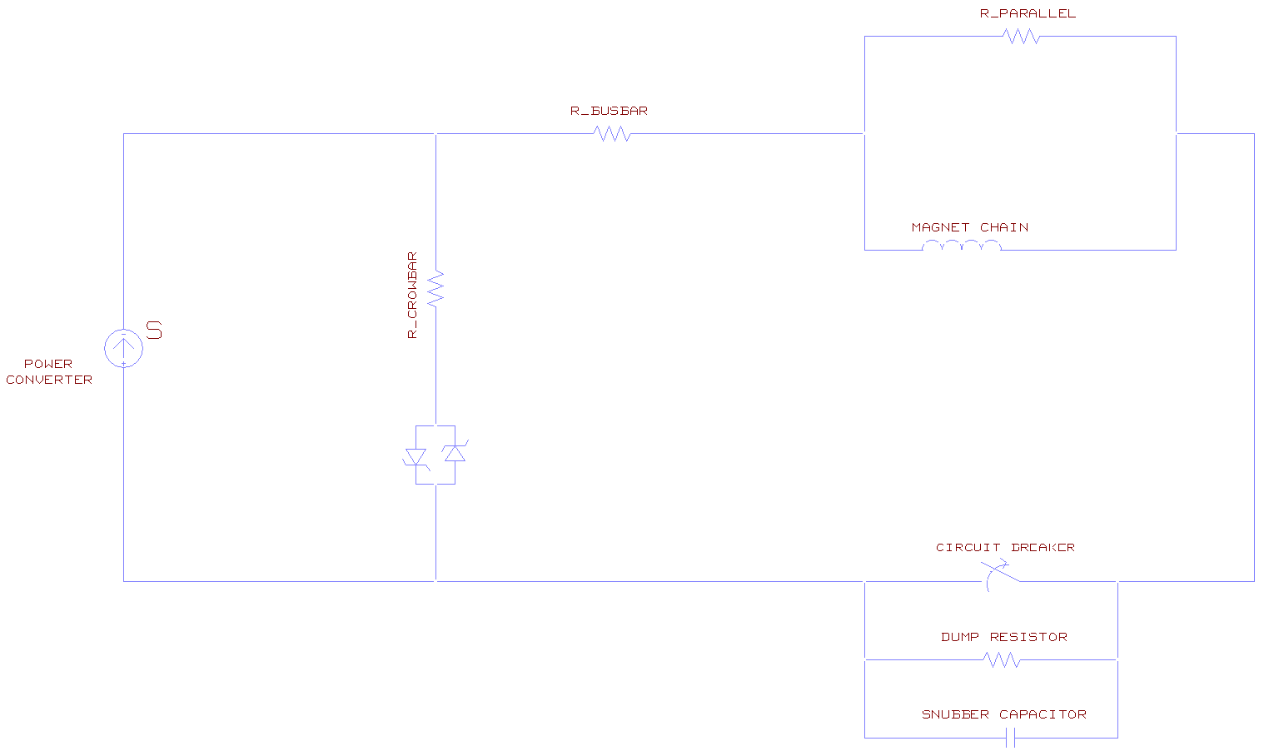
RQTL9 Structure

Slide 9
RQTL9 Structure

Slide 10
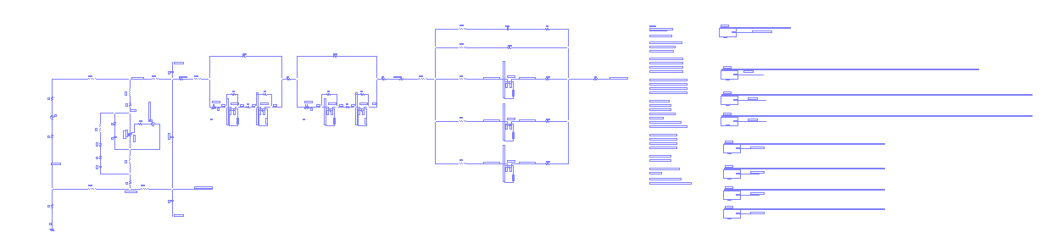
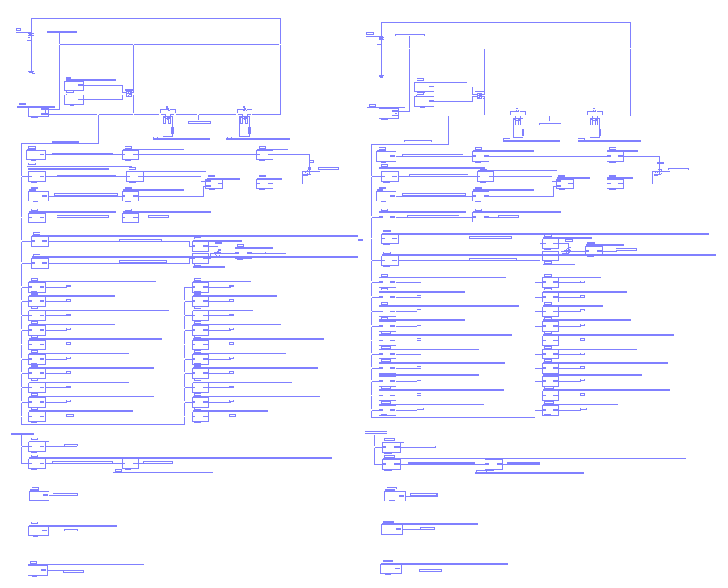
Simulation Schematic-RQTL9 circuit(1/2)
Main Circuit
Thermal Model

Slide 11
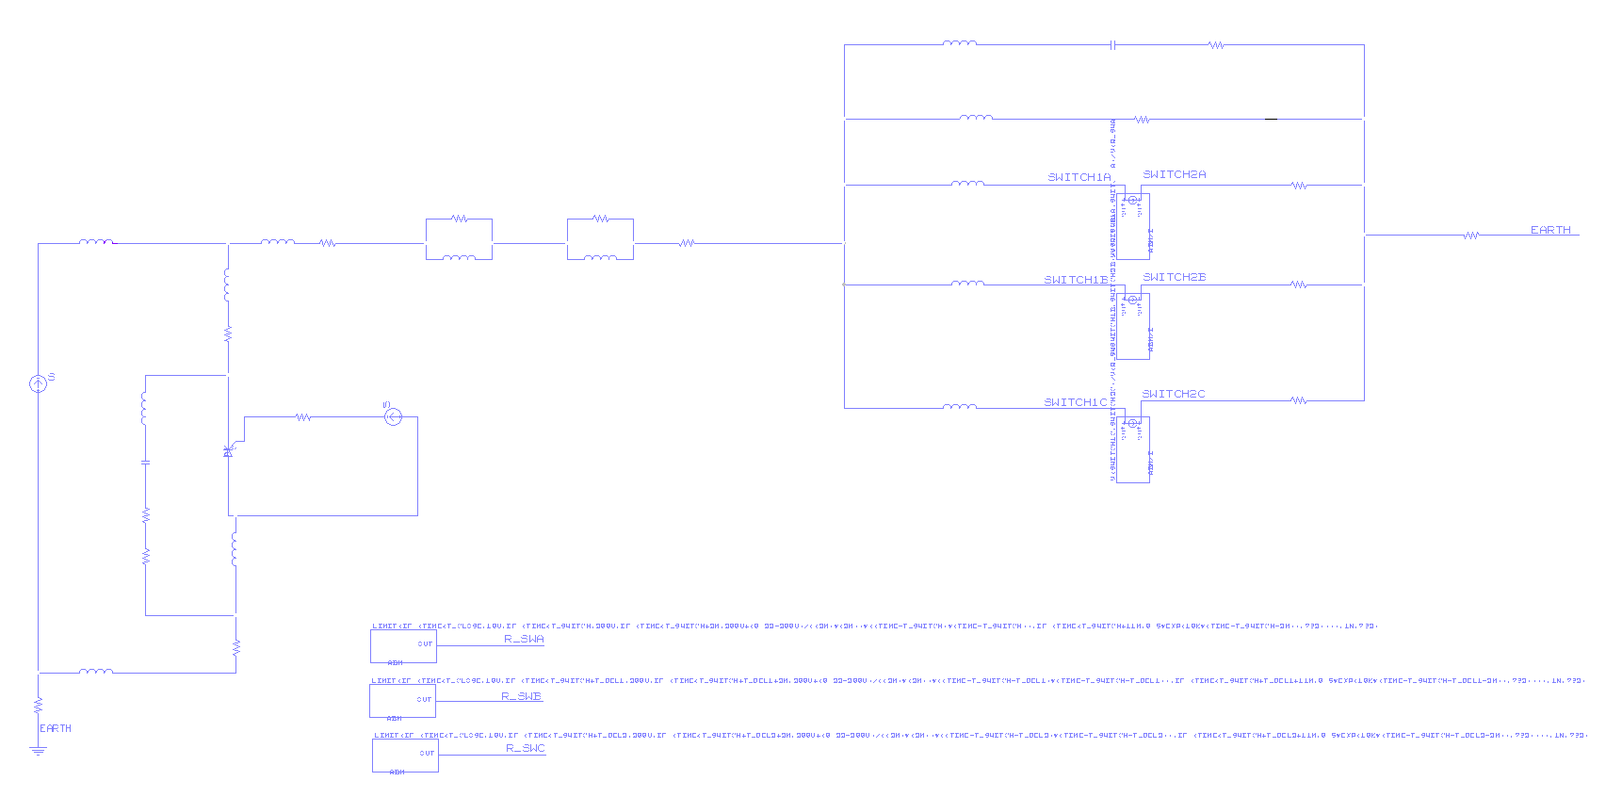
Simulation Schematic-RQTL9 Circuit (Main Circuit)
Power Converter
EE System
Magnets and Parallel Resistances
Crowbar
Resistance of the Busbar
Simulation of the Switches
Earthing point

Slide 12
Simulation Schematic-RQTL9 Circuit (Main Circuit)
Power Converter
EE System
Magnets and Parallel Resistances
Crowbar
EE system: Internal to the PC
Resistance of the Busbar
Simulation of the Switches
Earthing point

Slide 13
Simulation Schematic-RQTL9 circuit(2/2)
Thermal Model
Electrical resistance
Thermal resistance
Thermal capacitance
Thermal resistance
of the insulation layer
Magnetic transfer function
Magnetic field
Inductance
Magnet 1
Magnet 2

Slide 14
Simulation Schematic-RQTL9 circuit(2/2)
Thermal Model
Electrical resistance
Thermal resistance
Thermal capacitance
Thermal resistance
of the insulation layer
Magnetic transfer function
Magnetic field
Inductance
Magnet 1

Slide 15
Simulation of a Quench in an RQTL9 circuit
(ex. : .RQTL9.R7B2)
(nb of magnets=2, with EE system)

Slide 16
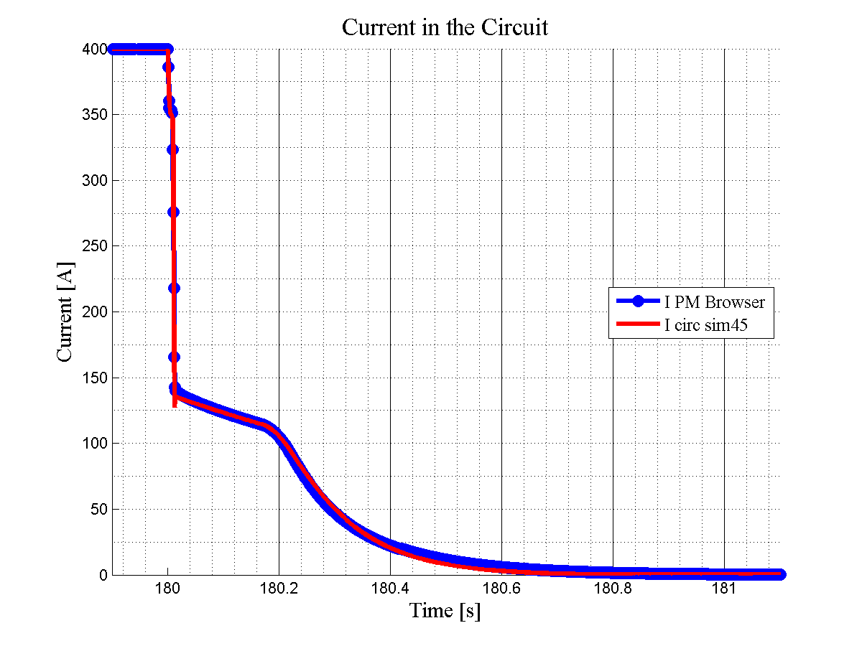
Shut down of the power converter
Simulation: RQTL9.R7B2
PM_Browser event:
110512-161946.920_RPMBB.RR77.RQTL9.R7B2
Opening of the switch in the EE system
Quench of the magnets

Slide 17
Simulation: RQTL9.R7B2
PM_Browser event:
110512-161946.920_RPMBB.RR77.RQTL9.R7B2

Slide 18
R=0,046Ω
Simulation: RQTL9.R7B2
PM_Browser event:
110512-161946.920_RPMBB.RR77.RQTL9.R7B2
R=0,25Ω
R=0,47Ω

Slide 19
Simulation: RQTL9.R7B2
PM_Browser event:
110512-161946.920_RPMBB.RR77.RQTL9.R7B2

Slide 20
τ= 5,21s
Simulation: RQTL9.R7B2
PM_Browser event:
110512-161946.920_RPMBB.RR77.RQTL9.R7B2
τ=0,95s
τ=0,51s

Slide 21
Ipar
Simulation: RQTL9.R7B2
PM_Browser event:
110512-161946.920_RPMBB.RR77.RQTL9.R7B2
Icirc

Slide 22
Ipar
Simulation: RQTL9.R7B2
PM_Browser event:
110512-161946.920_RPMBB.RR77.RQTL9.R7B2
Icirc

Slide 23
Simulation: RQTL9.R7B2
PM_Browser event:
110512-161946.920_RPMBB.RR77.RQTL9.R7B2
Ipar
Icirc

Slide 24
Simulation: RQTL9.R7B2
PM_Browser event:
110512-161946.920_RPMBB.RR77.RQTL9.R7B2
Ipar
Icirc

Slide 25
Simulation: RQTL9.R7B2
PM_Browser event:
110512-161946.920_RPMBB.RR77.RQTL9.R7B2
Ipar
Icirc

Slide 26
Simulation: RQTL9.R7B2
PM_Browser event:
110512-161946.920_RPMBB.RR77.RQTL9.R7B2
Ipar
Icirc

Slide 27
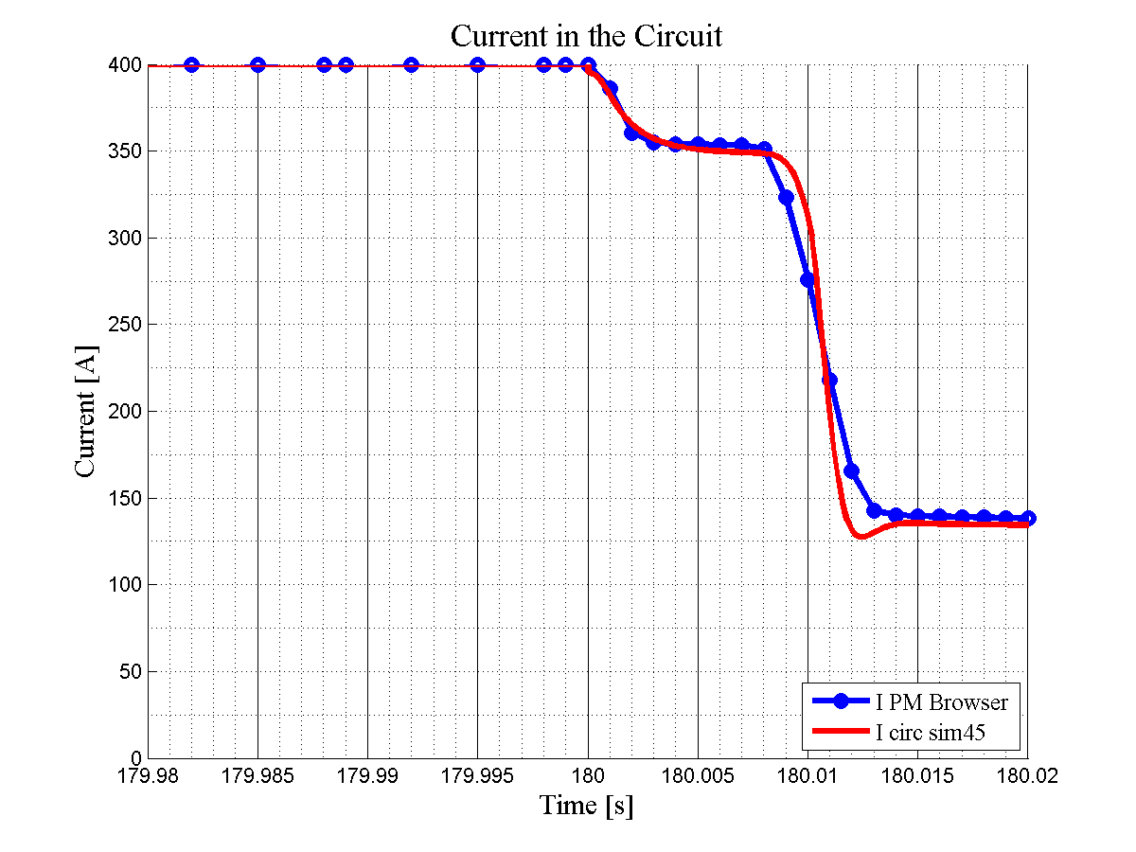
Simulation: RQTL9.R7B2
PM_Browser event:
110512-161946.920_RPMBB.RR77.RQTL9.R7B2

Slide 28
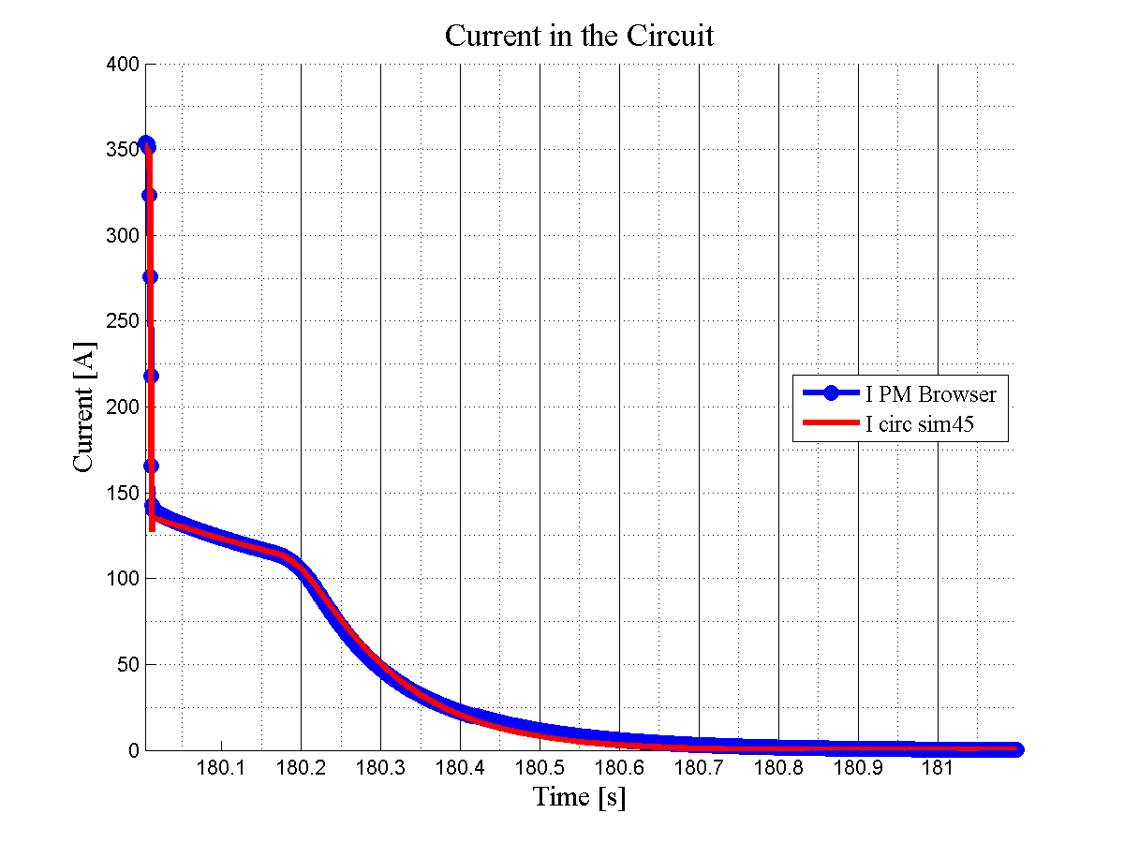
Simulation: RQTL9.R7B2
PM_Browser event:
110512-161946.920_RPMBB.RR77.RQTL9.R7B2

Slide 29
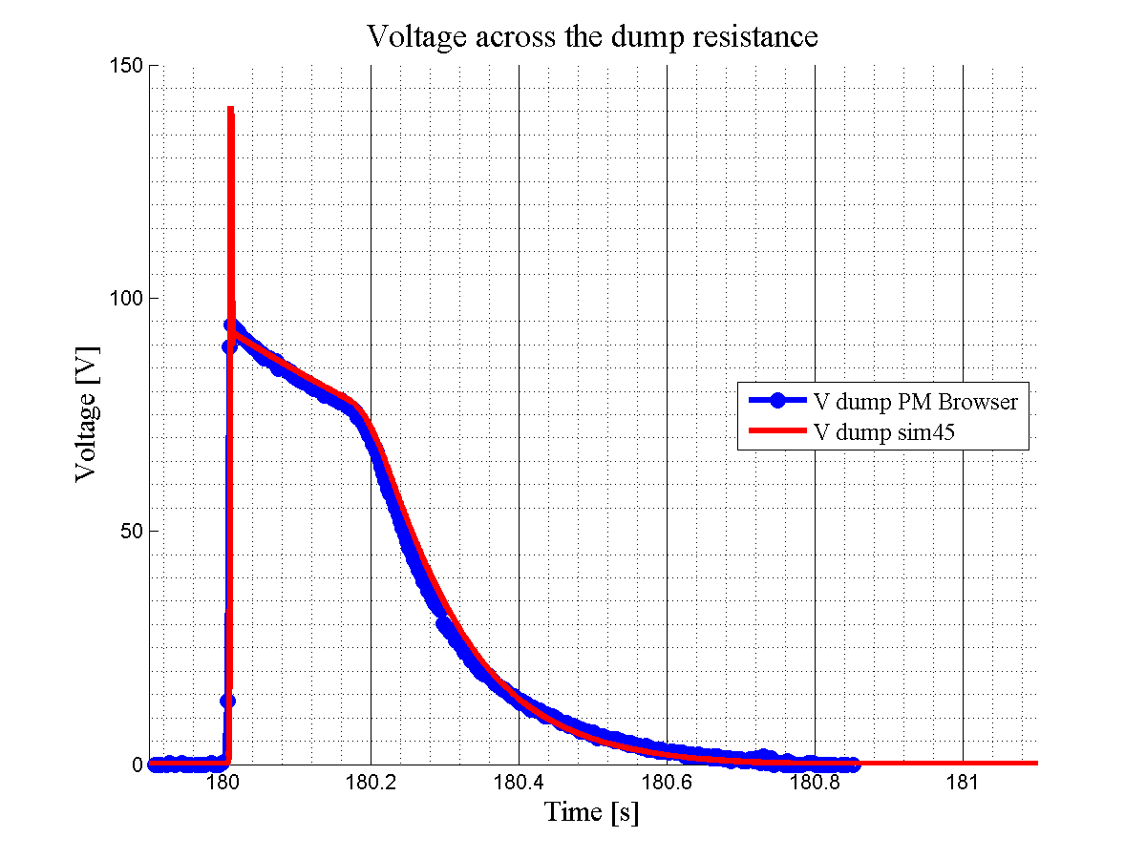
Simulation: RQTL9.R7B2
PM_Browser event:
110512-161946.920_RPMBB.RR77.RQTL9.R7B2

Slide 30
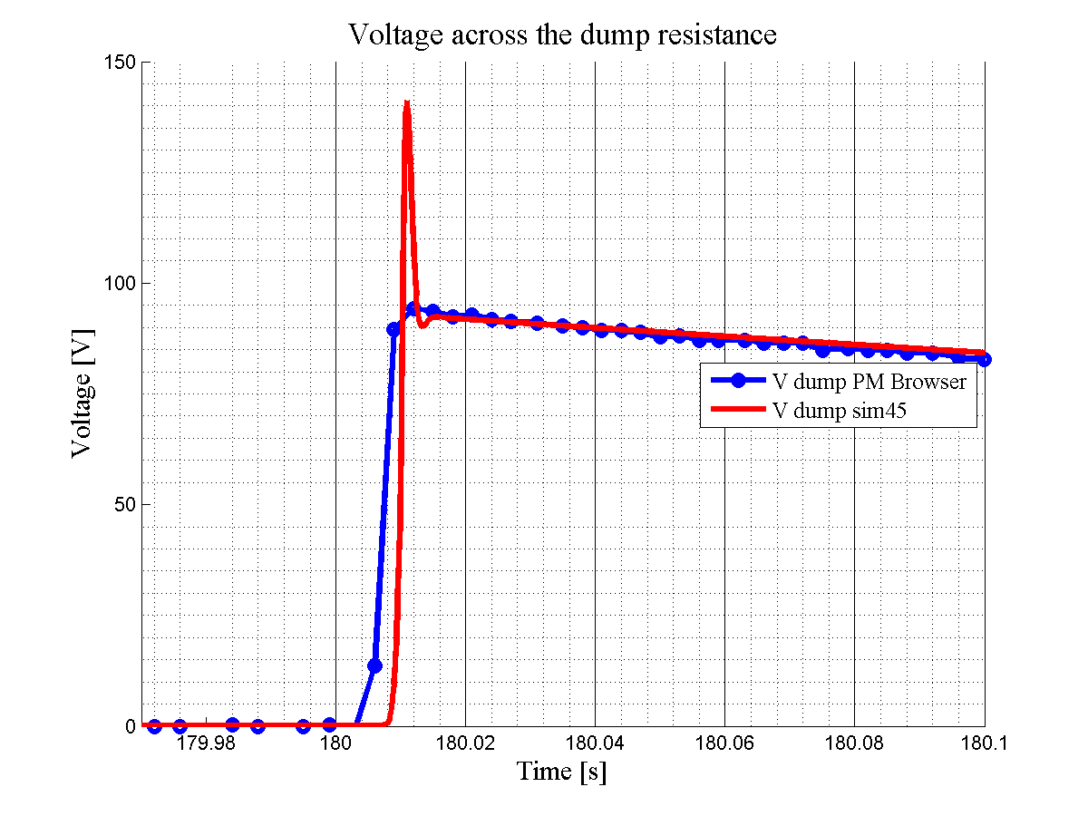
Simulation: RQTL9.R7B2
PM_Browser event:
110512-161946.920_RPMBB.RR77.RQTL9.R7B2

Slide 31
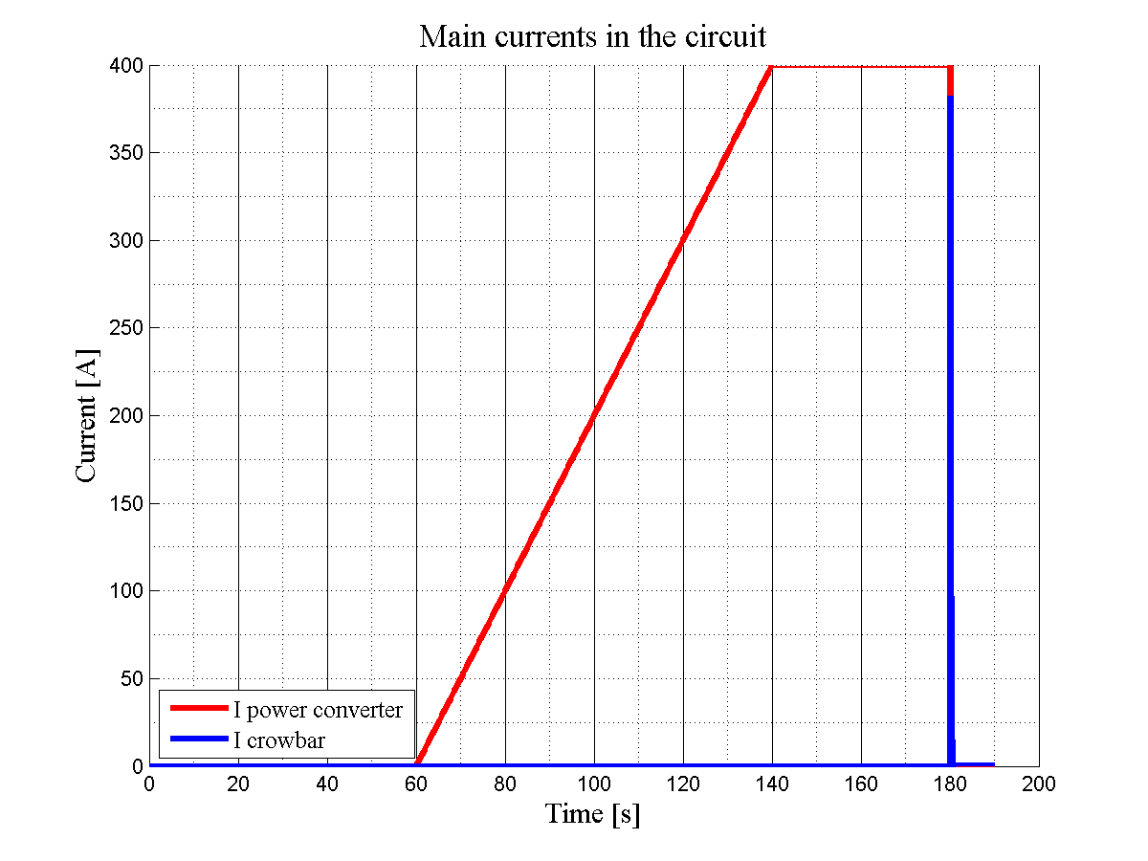
dI_{PC}/dt = 5 A/s
Simulation: RQTL9.R7B2
PM_Browser event:
110512-161946.920_RPMBB.RR77.RQTL9.R7B2
I_{PC} = 400 A
Switch off the Power Converter
1
2
3

Slide 32
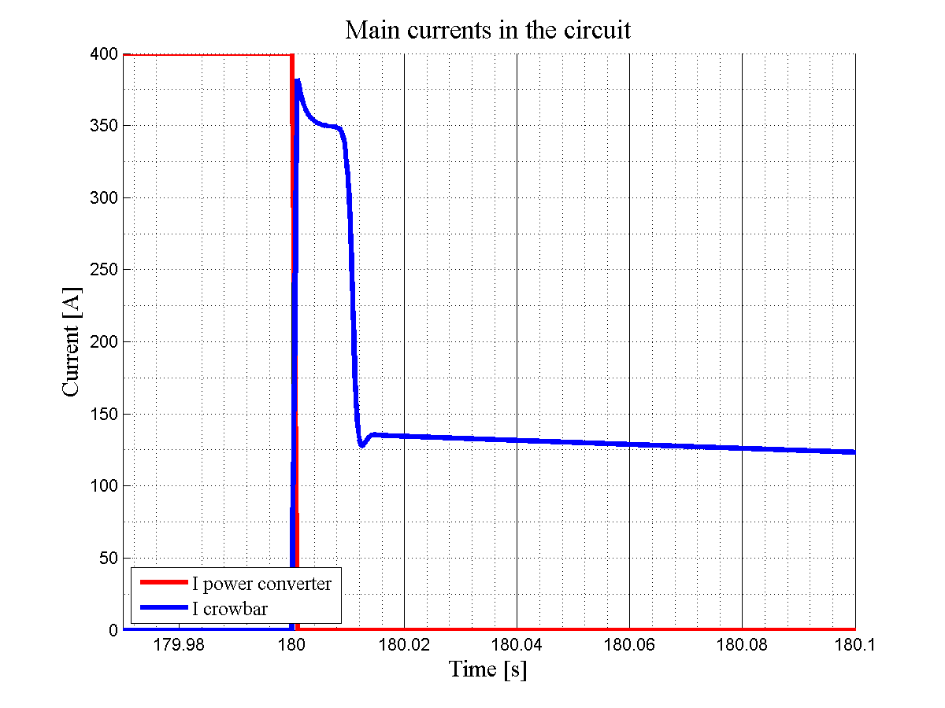
Simulation: RQTL9.R7B2
PM_Browser event:
110512-161946.920_RPMBB.RR77.RQTL9.R7B2

Slide 33
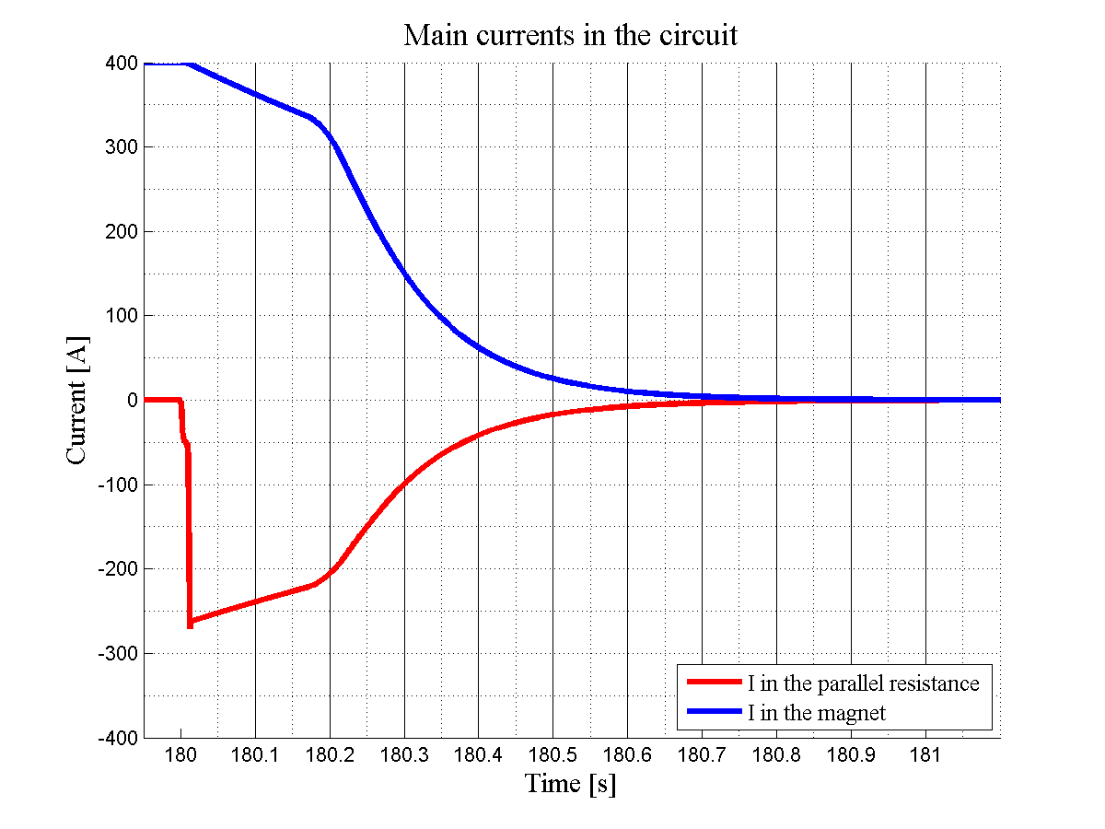
Simulation: RQTL9.R7B2
PM_Browser event:
110512-161946.920_RPMBB.RR77.RQTL9.R7B2

Slide 34
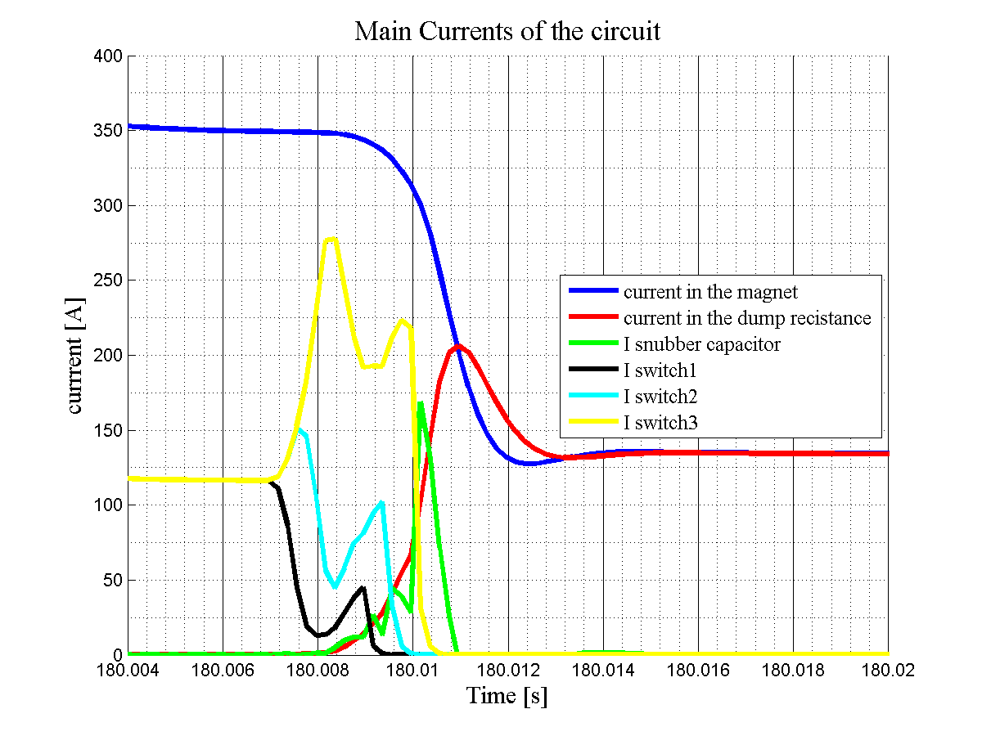
Simulation: RQTL9.R7B2
PM_Browser event:
110512-161946.920_RPMBB.RR77.RQTL9.R7B2

Slide 35
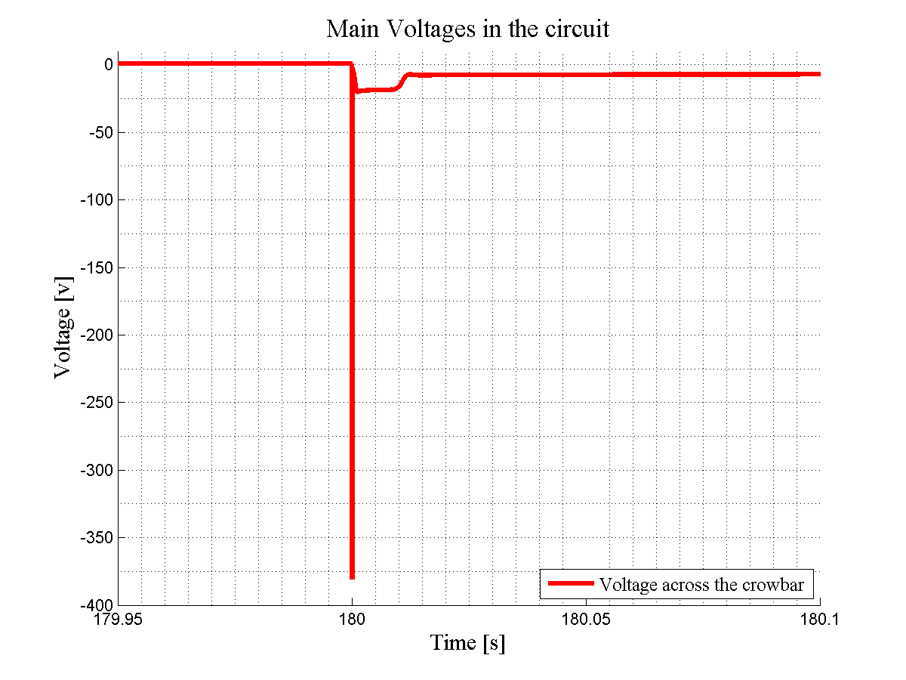
Simulation: RQTL9.R7B2
PM_Browser event:
110512-161946.920_RPMBB.RR77.RQTL9.R7B2

Slide 36
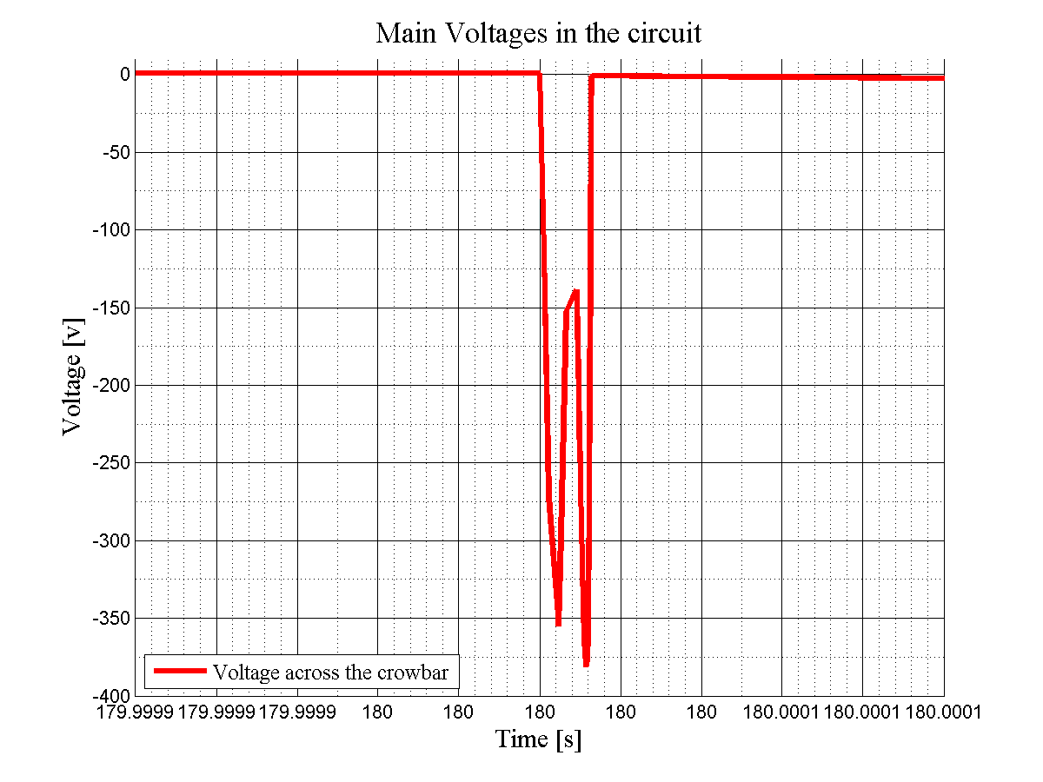
Simulation: RQTL9.R7B2
PM_Browser event:
110512-161946.920_RPMBB.RR77.RQTL9.R7B2

Slide 37
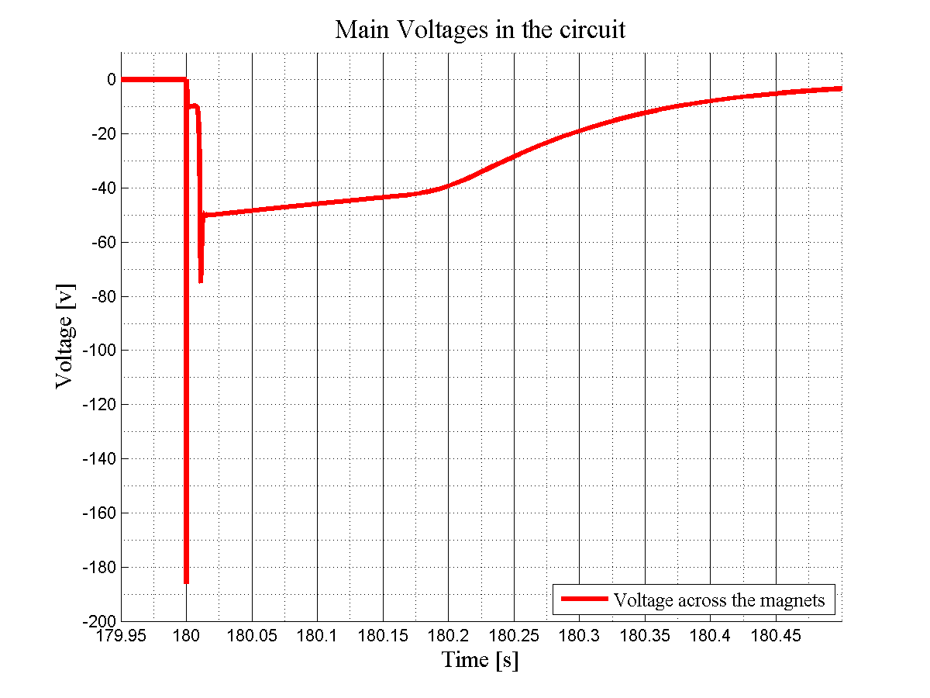
Simulation: RQTL9.R7B2
PM_Browser event:
110512-161946.920_RPMBB.RR77.RQTL9.R7B2

Slide 38
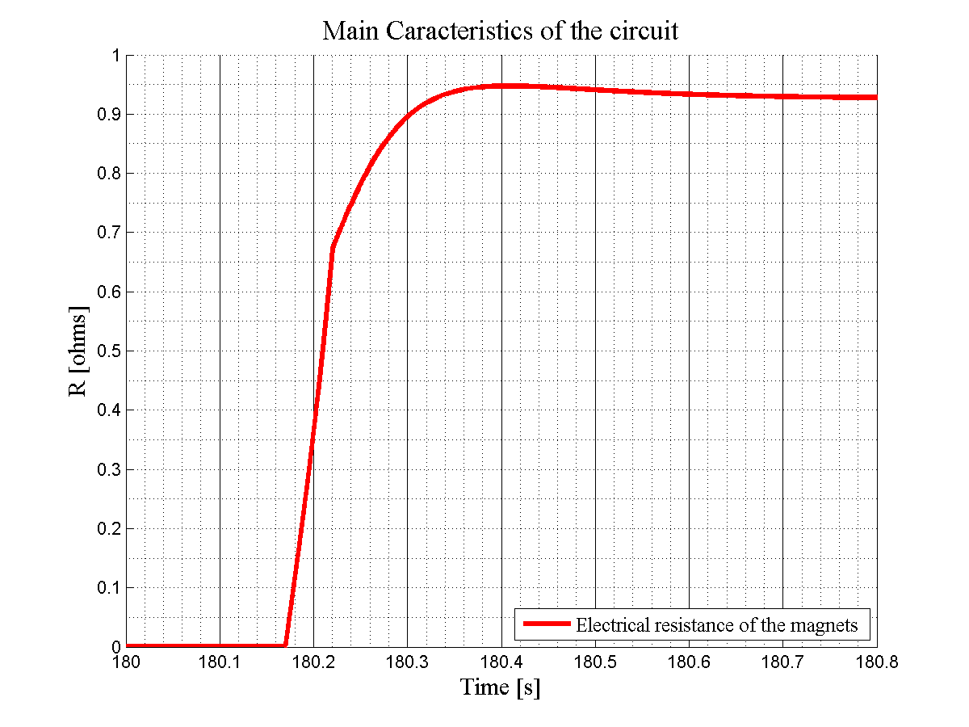
Simulation: RQTL9.R7B2
PM_Browser event:
110512-161946.920_RPMBB.RR77.RQTL9.R7B2

Slide 39
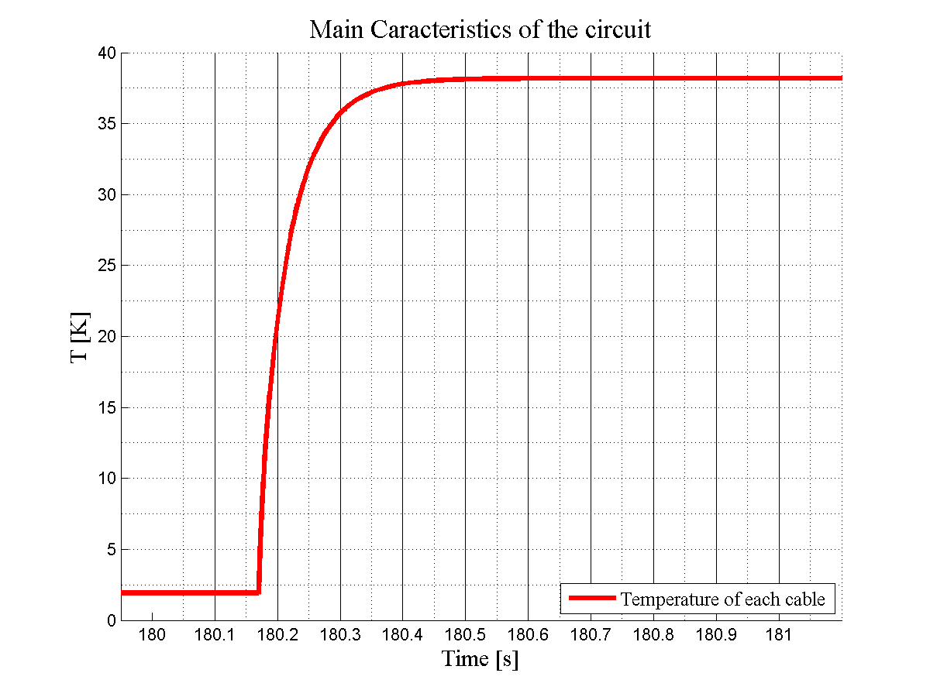
Simulation: RQTL9.R7B2
PM_Browser event:
110512-161946.920_RPMBB.RR77.RQTL9.R7B2

Slide 40
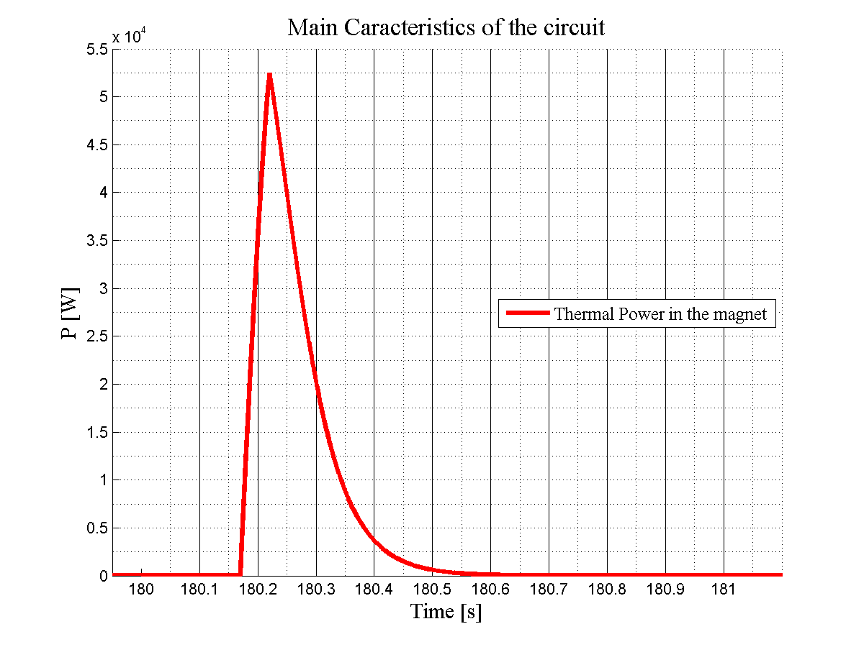
Simulation: RQTL9.R7B2
PM_Browser event:
110512-161946.920_RPMBB.RR77.RQTL9.R7B2

Slide 41
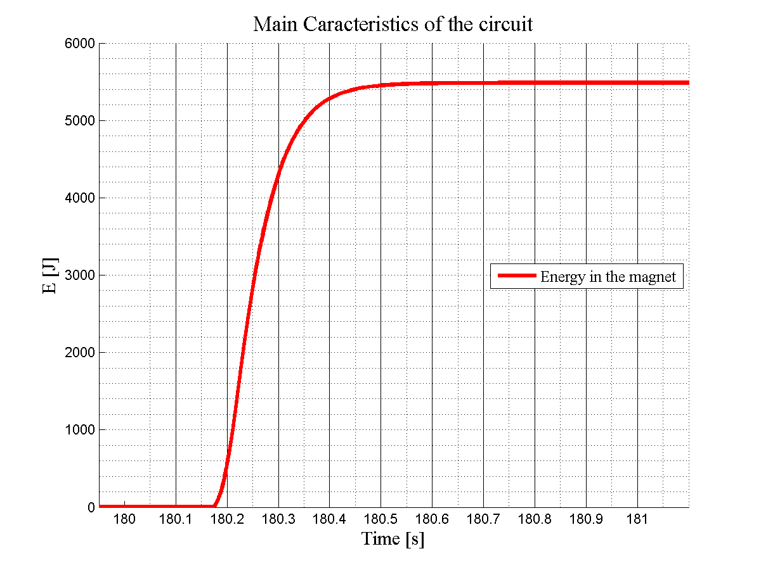
Simulation: RQTL9.R7B2
PM_Browser event:
110512-161946.920_RPMBB.RR77.RQTL9.R7B2

Slide 42
Simulation of a Quench in an RQTL11 circuit
(ex. : RQTL11.R2B1)
(nb of magnets=1, EE system: internal to the PC)

Slide 43
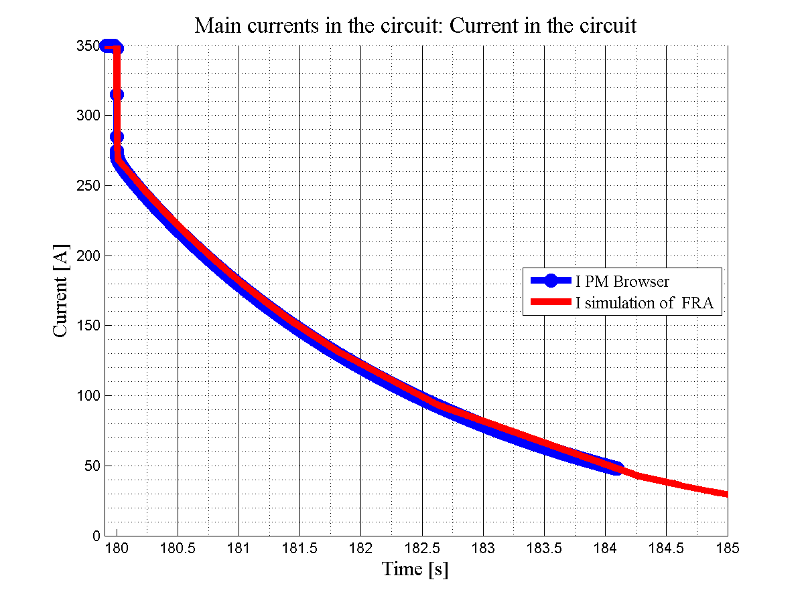
Simulation: RQTL11.R2B1
PM_Browser event:
110212-022034.620_RPMBA.UA27.RQTL11.R2B1

Slide 44
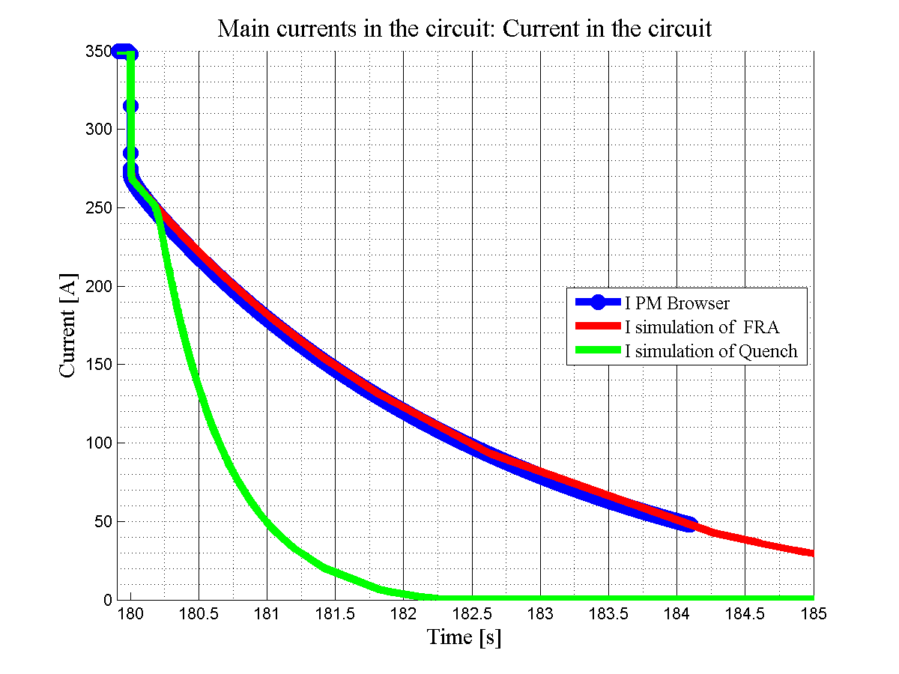

Slide 45
R=0,043Ω
R=0,99Ω

Slide 47
τ=2,74s
τ=0.12s

Slide 48
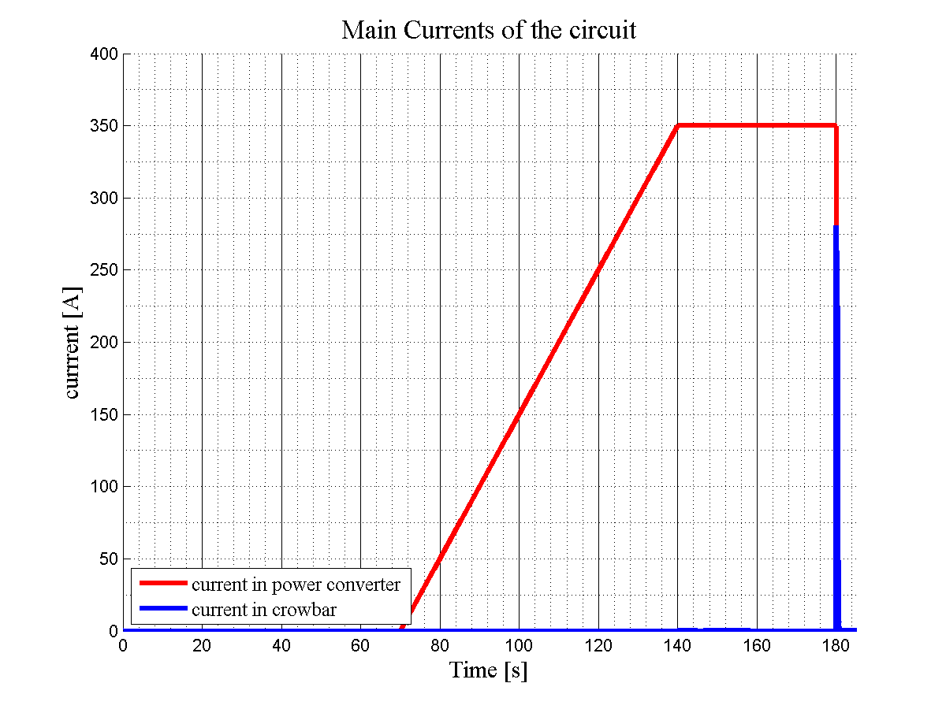

Slide 49
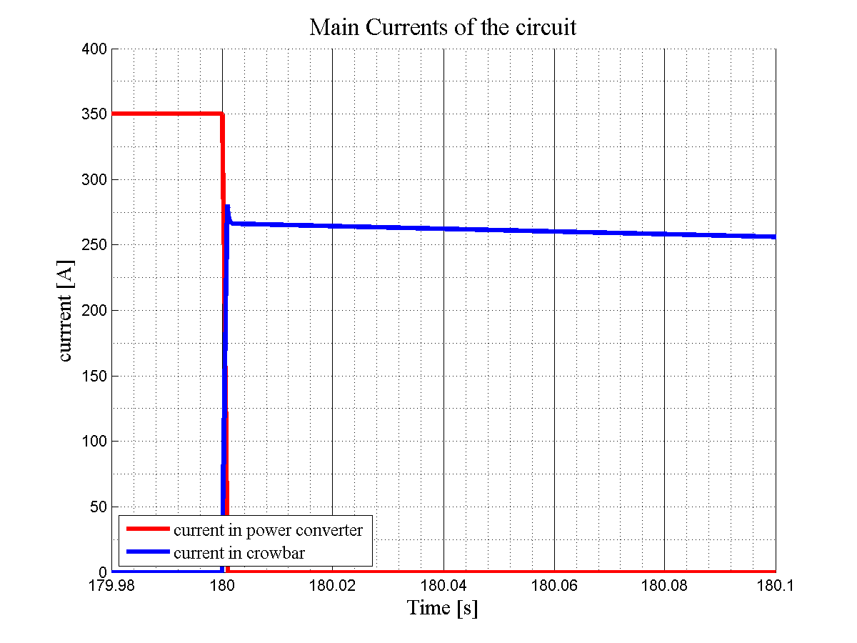

Slide 50
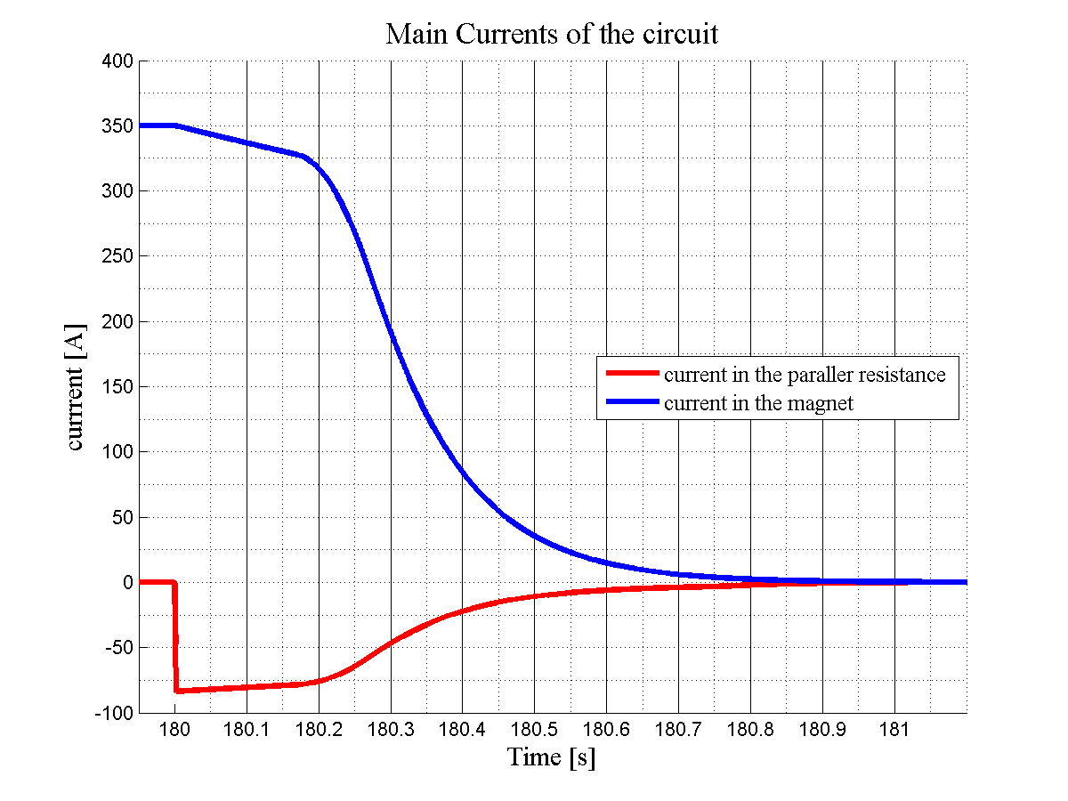

Slide 51
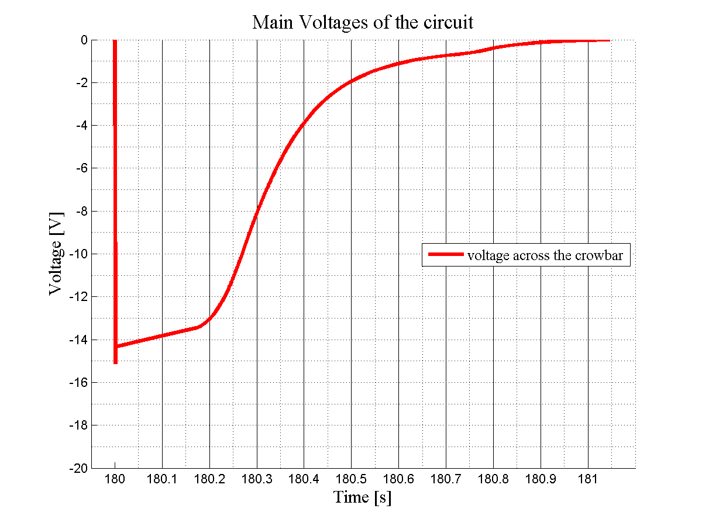

Slide 52
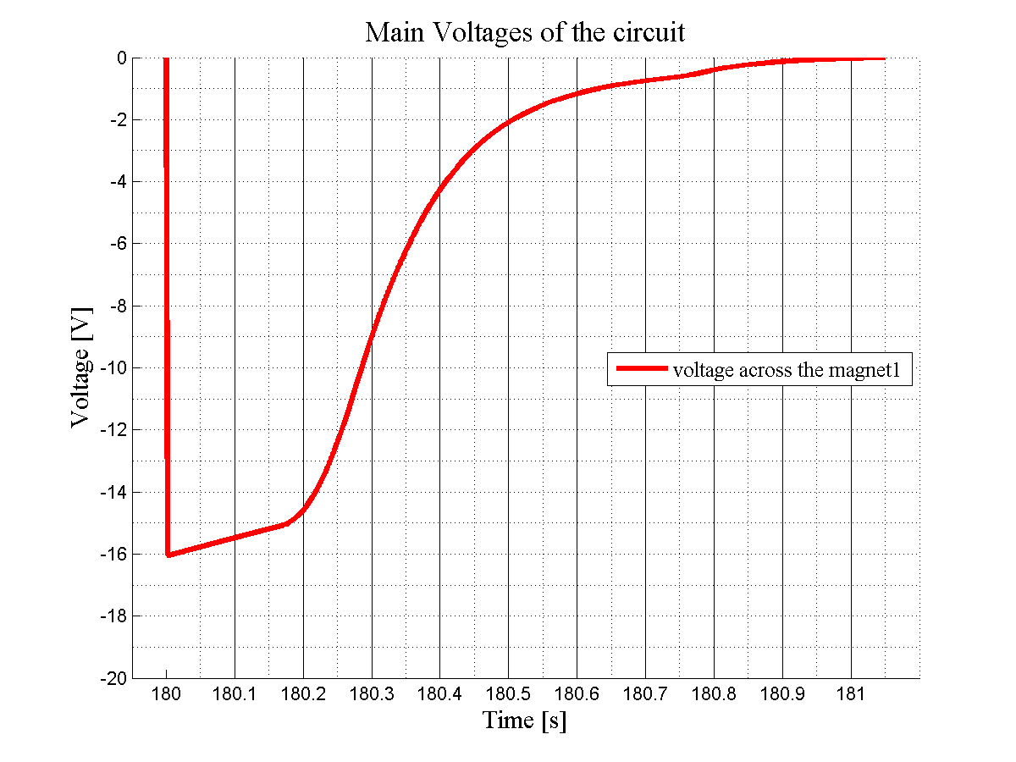

Slide 53
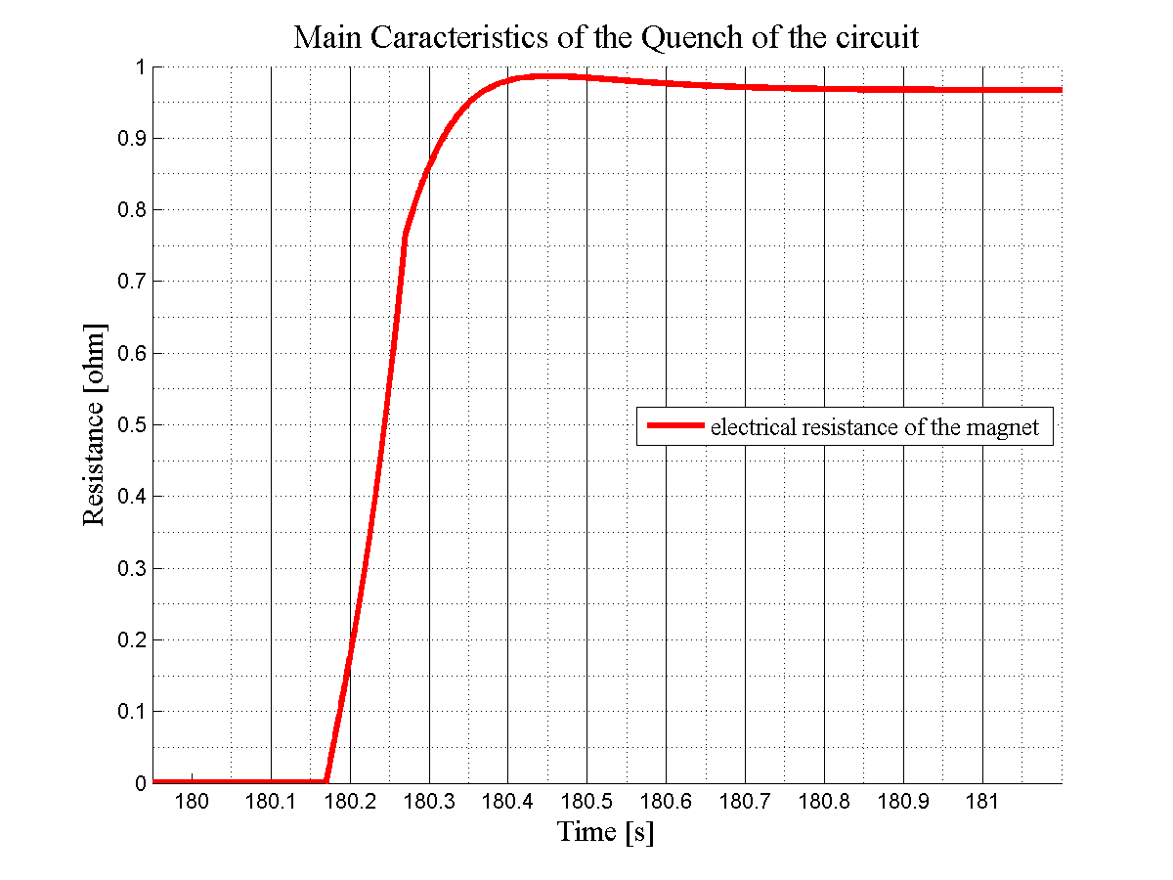

Slide 54
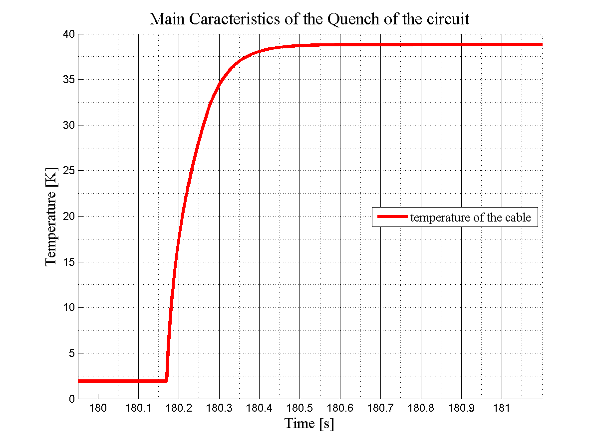

Slide 55
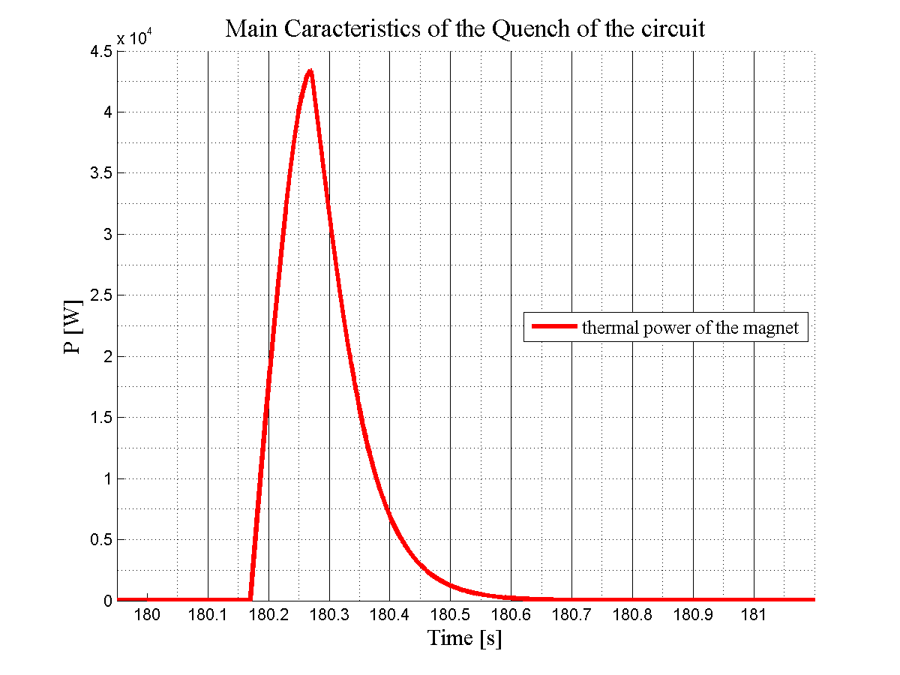

Slide 56
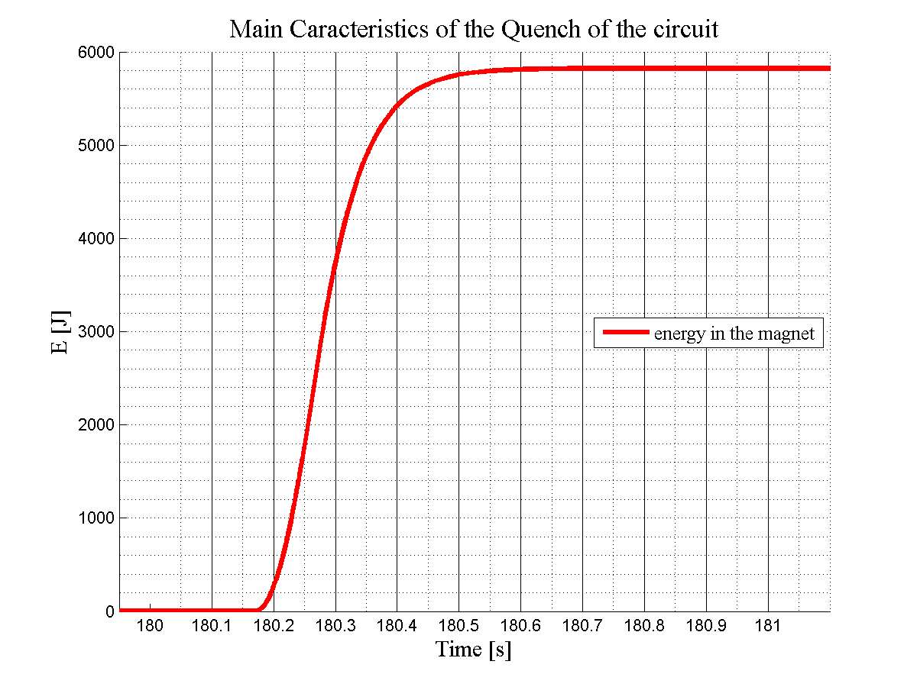

Slide 57
Calculation of the τ
RQS
L/mag | 0.031
nb mag | 4 | Rpc | 0.051242
Ltot | 0.124 | τpc | 2.419871
Rcrow | 0.05 | Rsw | 0.429878
Rcirc | 0.00401 | τsw | 0.288454
Rpar/mag | 0.25 | Rq | 1.029878
Rpar_tot | 1 | τq | 0.120403
Ree | 0.7
Rq/mag | 0.15
Rqtot | 0.6
RQTL9
L/mag | 0,12 |  | Ω
nb mag | 2 | Rpc | 0,046031
Ltot | 0,24 | τpc | 5,21391
Rcrow | 0,05 | Rsw | 0,252495
Rcirc | 0,0023 | τsw | 0,950512
Rpar/mag | 0,192 | Rq | 2,104495
Rpar_tot | 0,384 | τq | 0,114042
Ree | 0,685
Rq/mag | 0,926
Rqtot | 1,852
RQTL11
L/mag | 0.12 |  | Ω
nb mag | 1 | Rpc | 0.043874
Ltot | 0.12 | τpc | 2.735076
Rcrow | 0.05 | Rsw | 0.043874
Rcirc | 0.00687 | τsw | 2.735076
Rpar/mag | 0.192 | Rq | 0.990222
Rpar_tot | 0.192 | τq | 0.121185
Ree | 0
Rq/mag | 0.966
Rqtot | 0.966

Slide 58
Further steps
Investigation and better approach of the opening of the crowbar in order to reduce the voltage peak. (…adding more capacitance across??)
Find and simulate more events about RQTL11
Make a list with the events

Slide 59
Merci beaucoup pour votre attention
Ευχαριστώ για την προσοχή σας
Grazie per la vostra attenzione
Thank you for your attention
Dank u voor uw aandacht
Köszönöm a figyelmet

