Slide 1
RD2 circuit
Configuration
Antonopoulou Evelina
October 2011

Slide 2
General Characteristics
Type | IPD
Circuit | RD2
# of circuit | 8
I_max | 4670A
Converter | RPHGB
Magnet | MBRC
# of magnet | 1
Powering Subsector ML2
I Nominal | 6000 A
R tot Measured | 0.000630 Ohm
L tot | 0.052 H
max(di/dt) : | 18.147 A/s

Slide 3
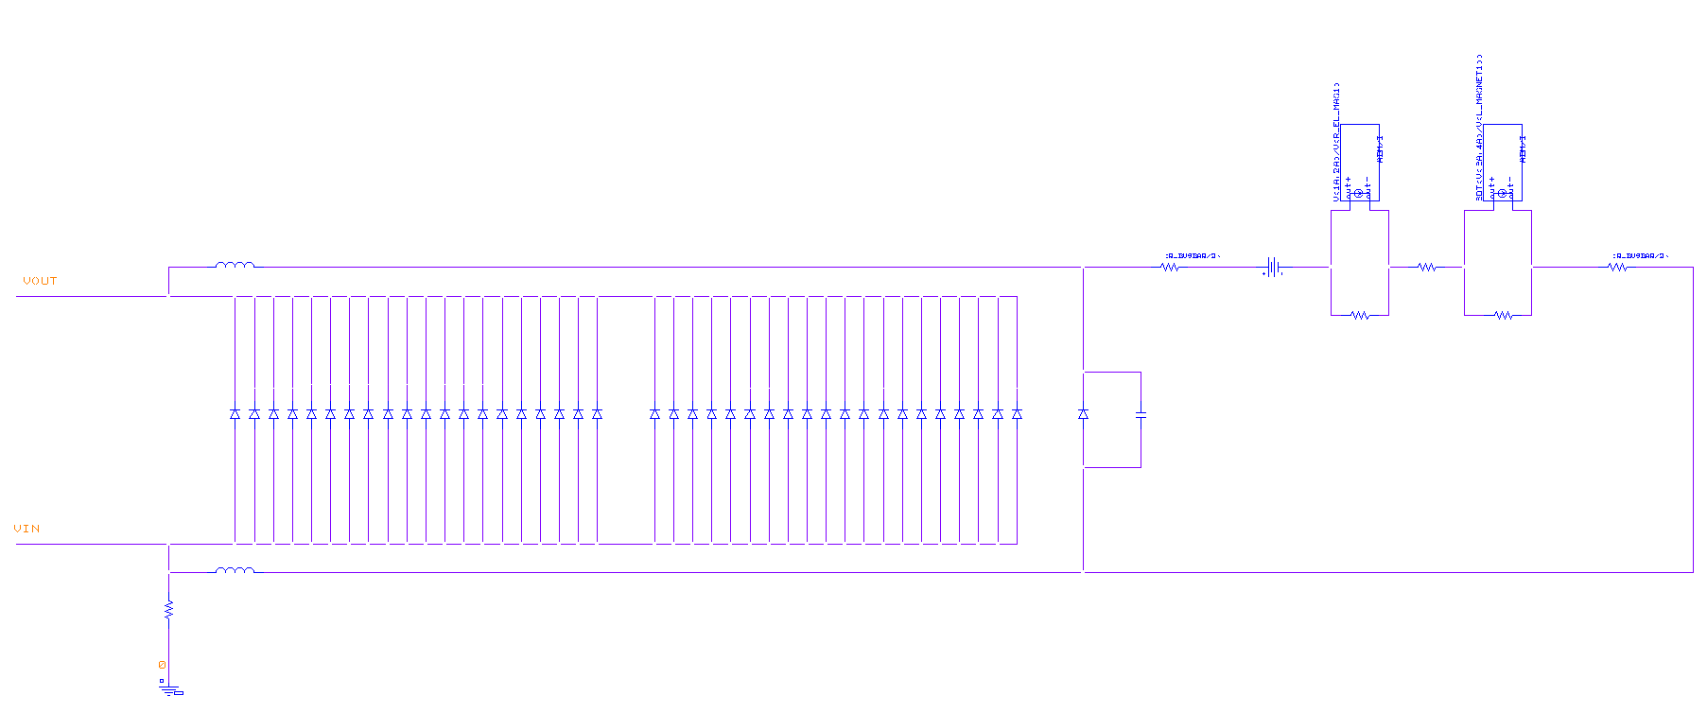
PSpice Model-Circuit Configuration
magnet
Rack Free-Wheeling Schottky Diodes
Modules [2x20]
Rack Additional
Free-Wheeling Schottky Diodes
Modules [x1]
R cable
Earthing point

Slide 4
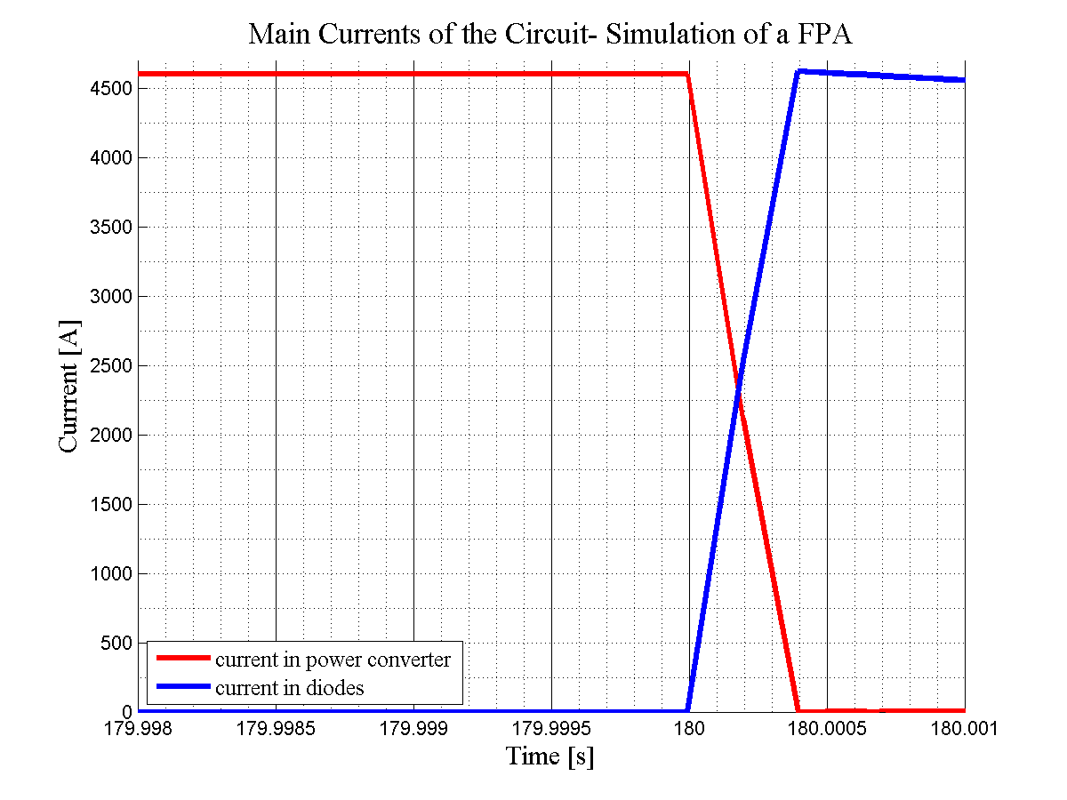
Simulation: RD2.L2
PM_Browser event:
090928-195107.700_RPHF.UA23.RD2.L2

Slide 5
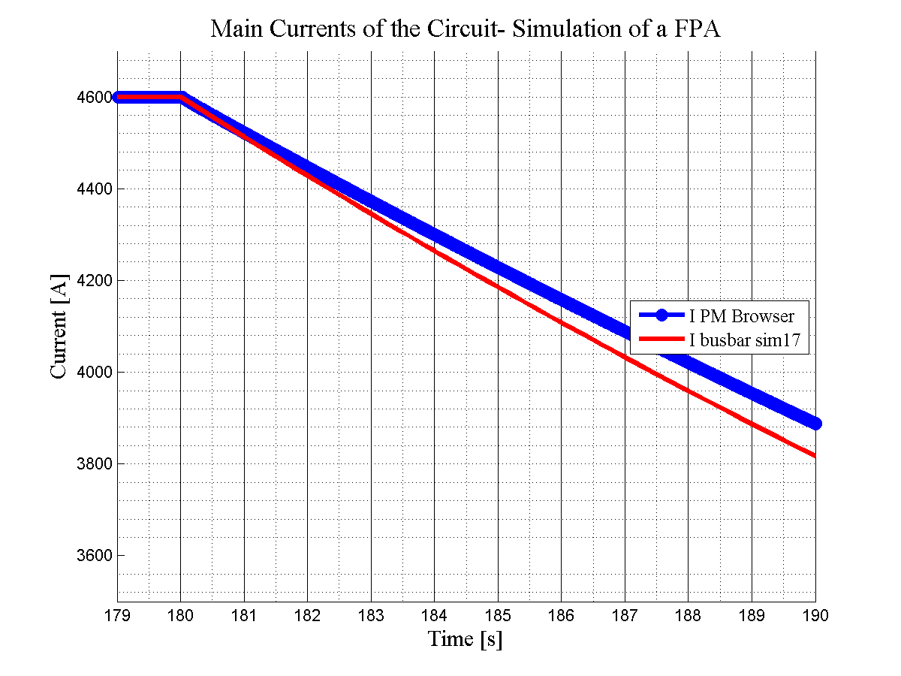

Slide 6
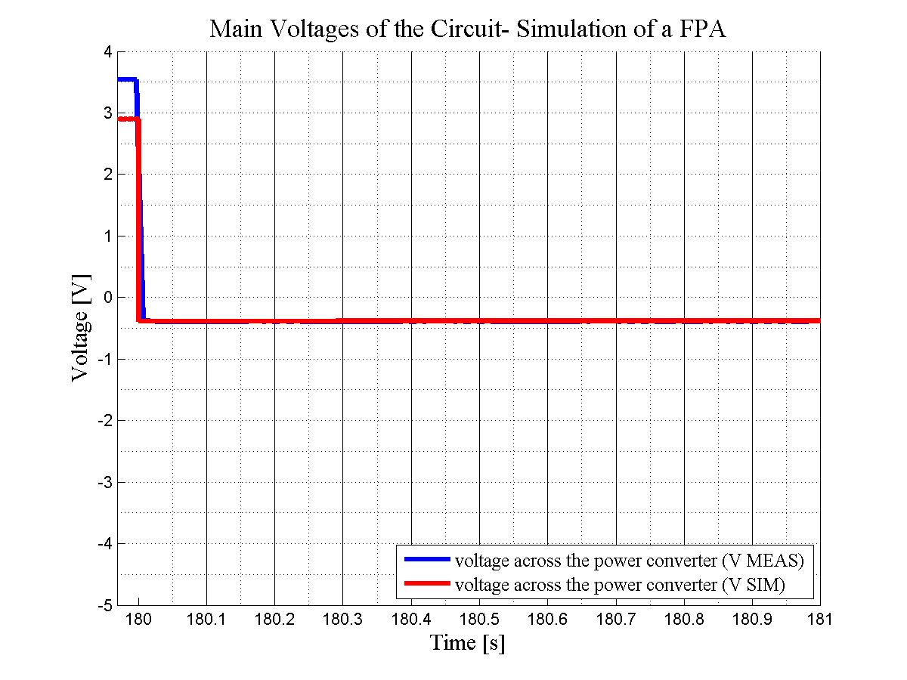
Simulation: RD2.L2
PM_Browser event:
090928-195107.700_RPHF.UA23.RD2.L2

Slide 7
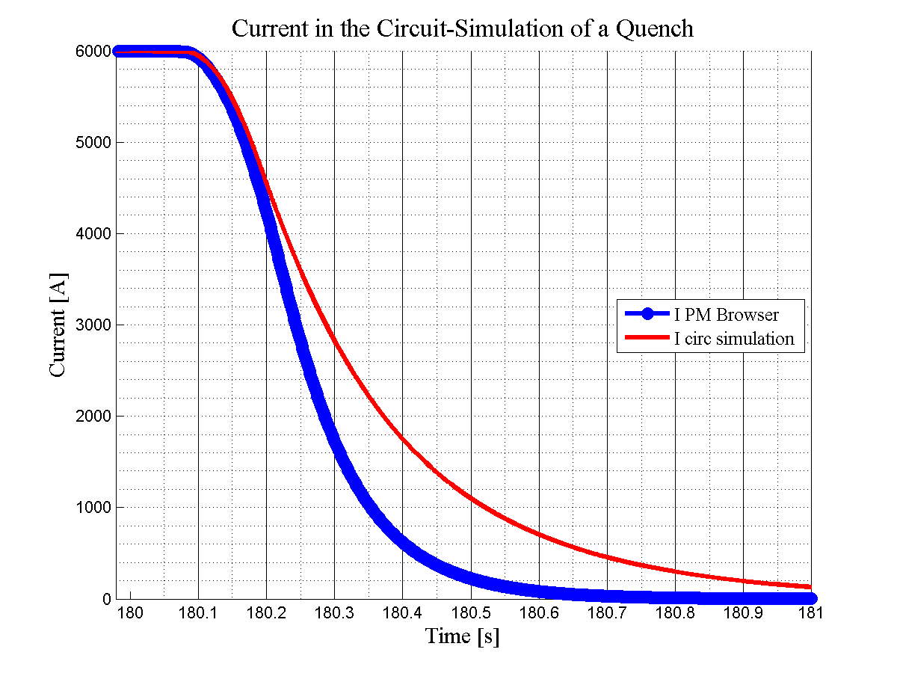
Simulation: RD2.L2
PM_Browser event:
080806-085706.460_RPHF.UA23.RD2.L2

Slide 8
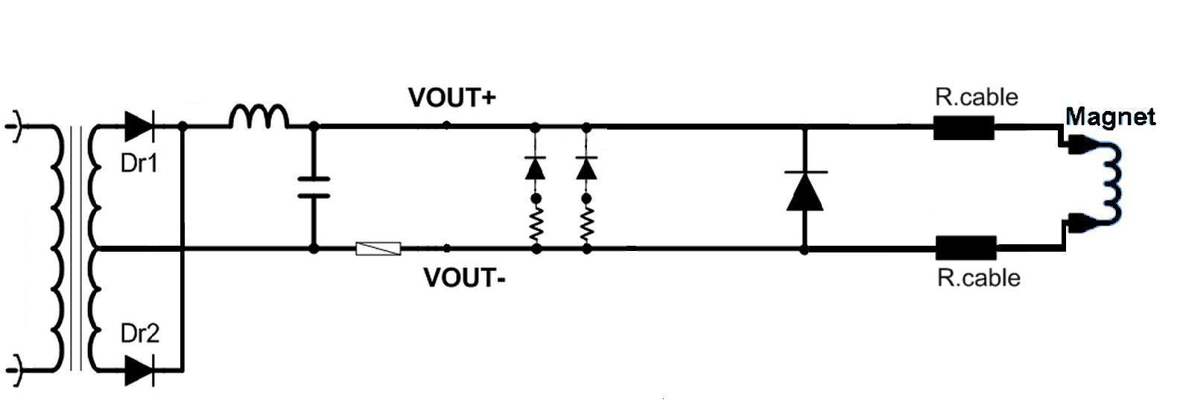
Circuit Configuration

Slide 9
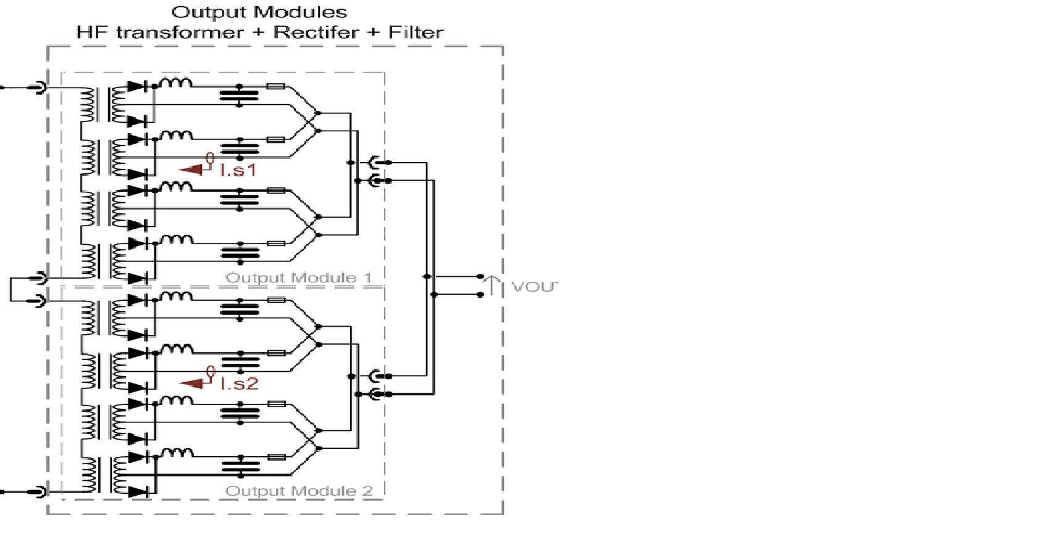
Sub Converter Configuration (output module)

Slide 10
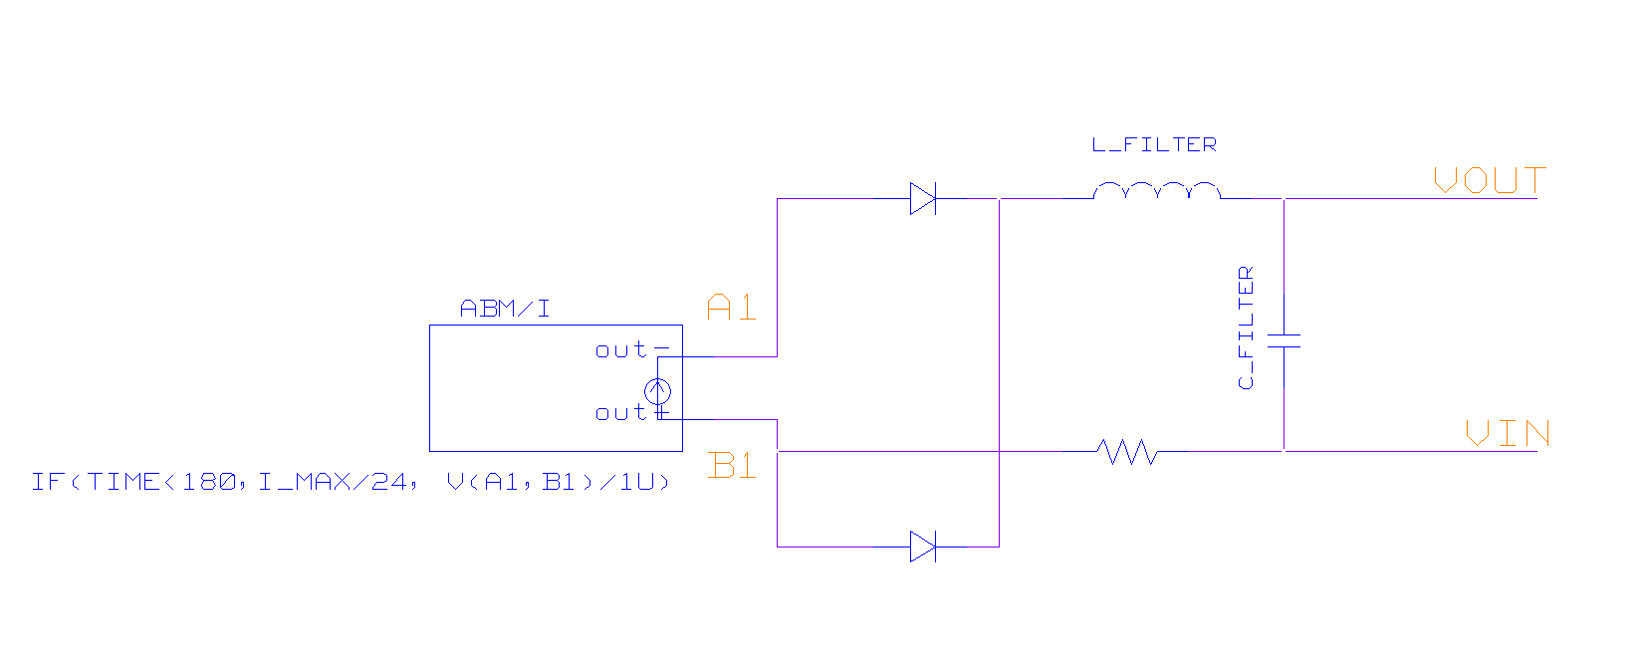


PSpice model of the modules of sub converter
The power converter is modeled with an ABM component:
  time< time_close: power converter
  time> time_cloce: resistance

Slide 11
Conclusion
A PSpice model of the RD2 circuit has been developed, in order to analyze the transients following the FPA and quench of a magnet and to optimize the choice of the components.
The system is simulated based on 3 different paths provided by Free-Wheeling Diodes providing a safe path for magnet current. The number of Free-Wheeling diodes (20x per card) depends on the converter type.
The inaccuracy occurred, despite the correct choice of the components and the parameters of the model, is due to the omission of the 3rd path used to interlock and stop the converter, which is internal to it.
The additional group of the parallel diodes added in series to the main circuit may solve this inaccuracy. Under these circumstances, hopefully, the same PSpice model will be sufficient to approach quite precisely the measurements recorded by the PM_Browser.

Slide 12
Merci beaucoup pour votre attention
Ευχαριστώ για την προσοχή σας
Grazie per la vostra attenzione
Thank you for your attention
Dank u voor uw aandacht
Köszönöm a figyelmet

