Slide 1

Inner Triplet System
Recap
Thermal model of magnets
RQX circuit event list
Quench analysis/simulations
Interesting anomalies
Further work
By Scott Rowan
TE-MPE-PE

Slide 2
Recap
Last presentation found the basic model accurate when comparing with PM data to within 0.08% with 2 Power converters and within <1% with all 3 power converters, at high current. This was deemed acceptable and the implementing the thermal model was to implemented.
The model was only tested against RQX.R5 at the time, however other circuits have since been tested, changing only the main parameters, giving the same model accuracy.

Slide 3
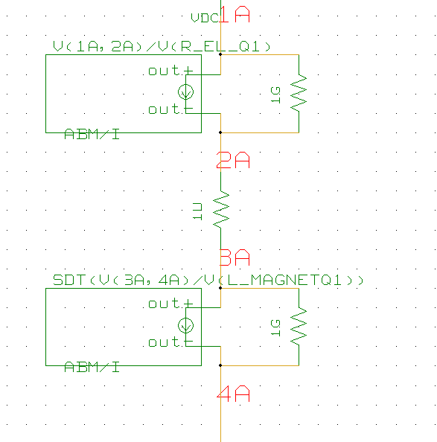
Thermal Model of Magnets
Use of ABM components instead of standard ideal inductors.
The ABMs , as mentioned in a previous presentation, can be programmed with nearly any equation.
Clever use of similar equations make it possible to represent thermal effects as electrical equivalents. e.g. a voltages/currents representing impedances.
ABM for resistance equiv
ABM for inductance equiv

Slide 4
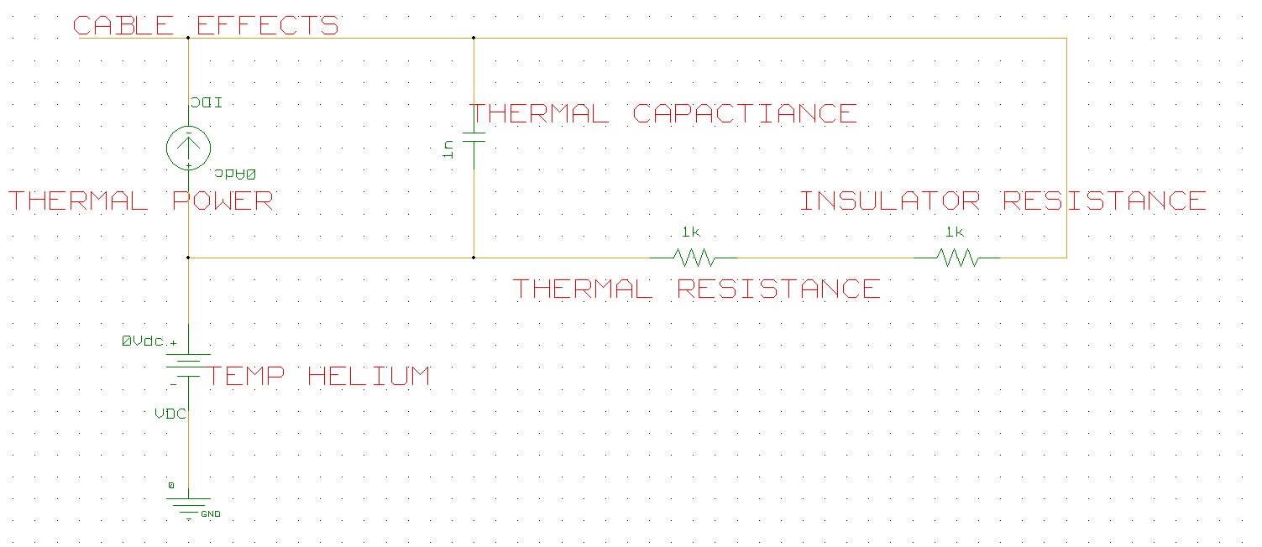
Thermal Model of Magnets
All equations calculated using an array of ABM components…

Slide 5
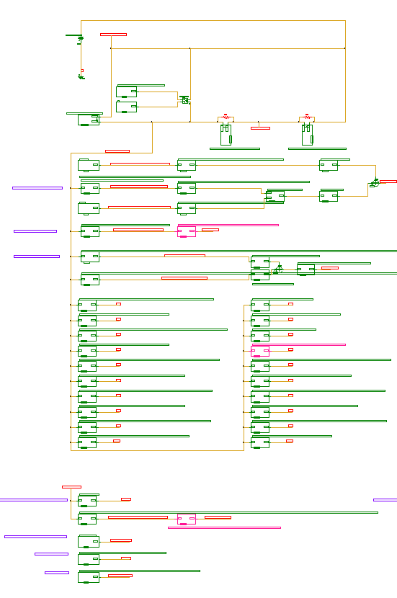
Thermal Model of Magnets
Thermal model circuit as previous
ABM components with equations to model Electrical resistance. Takes into account the ratio of Cu/NbTi
Q factor operations. These determine % of cable which has risen in temperature above 1.9K during a quench.
ABM components with equations to model Thermal resistance.
ABM components with equations to model Thermal capacitance. The array of components contain formulae to account for current regions.
ABM components with equations to model Insulation resistance.
ABM components with equations for Magnetic Transfer function, Magnetic Field and Inductance.

Slide 6
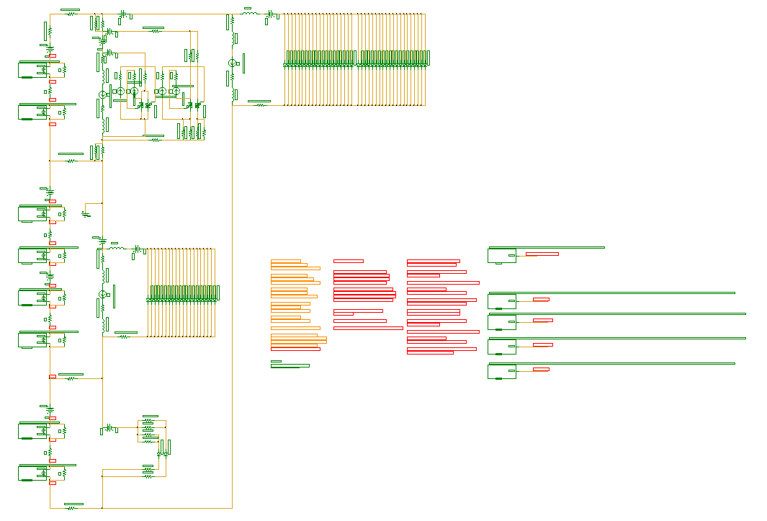
Schematic Updates
Many new parameters relating to the thermal model of the magnets
ABM components to model each of the 4 magnets
ABM controls for initiating quenches and specifying a desired Q factor

Slide 7
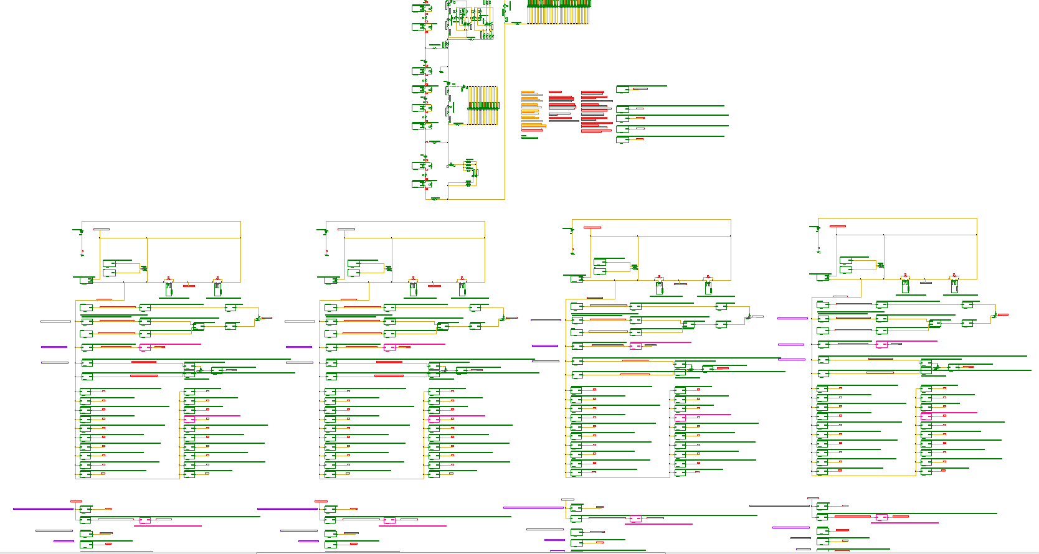
Schematic Updates
Each magnet has its own corresponding thermal model circuit.
Q1
Q2a
Q2b
Q3
At maximum zoom out of software… still doesn’t fit….

Slide 8
Thermal Model Parameters
MQXA (KEK)
MQXB (Fermilab)
MQXA Parameters
 | inner | outer
Total wire length | ~1550 | ~1650 | m
Diameter of strand | 815 | 735 | um
No. Strands | 28 | 33
Insulation Thickness | 50 | / | um
Inductance | 90.7 | / | mH
Transfer function | 1.203 | /
Ratio Cu/NbTi | 1.2 | 1.9
RRR | 193 | 226
MQXB Parameters
 | inner | outer
Total wire length | 672 | 760 | m
Diameter of strand | 808 | 650 | um
No. Strands | 14 | 16
Insulation Thickness | 25 | / | um
Inductance | 90.7 | / | mH
Transfer function | 1.203 | /
Ratio Cu/NbTi | 1.3 | 1.8
RRR | 85 | 85

Slide 9
RQX Event List - Commissioning
Quenches
Event timestamp | Circuit Name | Test Name | Current (RQX)
12-FEB-11 11.51.33.053000 PM | RQX.R2 | PIC2 CIRCUIT QUENCH VIA QPS | 200 | A
11-FEB-11 06.54.06.782000 PM | RQX.L1 | PIC2 CIRCUIT QUENCH VIA QPS | 200 | A
11-FEB-11 05.19.26.040000 PM | RQX.R8 | PIC2 CIRCUIT QUENCH VIA QPS | 200 | A
10-FEB-11 06.43.42.152000 PM | RQX.L5 | PIC2 CIRCUIT QUENCH VIA QPS | 200 | A
09-FEB-11 05.22.42.239000 PM | RQX.R1 | PIC2 CIRCUIT QUENCH VIA QPS | 200 | A
. | . | . | . | .
. | . | . | . | .
05-NOV-09 08.37.25.198000 PM | RQX.L1 | PLI3.f6 | 3100 | A
16-SEP-08 07.08.43.244000 PM | RQX.R2 | PLI3.f6 | 3100 | A
30-AUG-08 02.10.59.934000 PM | RQX.R1 | PLI3.f6 | 3100 | A
26-AUG-08 05.26.58.105000 PM | RQX.R5 | PLI3.f6 | 3100 | A
07-AUG-08 08.18.05.087000 PM | RQX.L5 | PLI3.f6 | 3100 | A
Other faults
Event timestamp | Circuit Name | Test Name
06-NOV-10 02.41.51.826000 PM | RQX.R8 | PNO.d16
06-NOV-10 11.46.56.903000 AM | RQX.R8 | PNO.d16
16-FEB-10 06.17.26.023000 PM | RQX.R1 | PNO.d17
16-FEB-10 06.15.19.960000 PM | RQX.R8 | PNO.d17
16-FEB-10 03.57.03.739000 PM | RQX.L1 | PNO.d16
16-FEB-10 12.28.18.267000 AM | RQX.L1 | PNO.d16
06-FEB-10 04.09.40.656000 PM | RQX.R2 | PNO.d14
. | . | .
. | . | .

Slide 10
RQX Event List - Normal Operation
Quenches
Event timestamp | Circuit Name | Current (RQX)
28-JUL-11 18.03.00.511570 PM | RQX.L2 | 460 | A
Only one? Let me explain...
Other faults
Event timestamp. | Circuit Name | Comments
20-JUN-10 11.25.00.511570 PM | RQX.R8 | collimator adjustement of TCTVB.4R8/TCT.IP8.B2.2.V, beam losses behind collimator, beam dumped by BLMQI.03R8.B1I30_MQXA
06-NOV-10 09.59.05.166234 AM | RQX.R8 | Triplet R8 PC fault
24-APR-11 04.37.31.278106 PM | RQX.R8 | Outgassing of the gauges near triplet R8 (S81) due to the cryo problem of the previous week (hypothesis). Clean dump with high current and trains of 72b at 3.5 TeV.
30-APR-11 02.45.02.389540 AM | RQX.R2 | Vacuum spike close to the triplet in R2. VAC suspects however more localised spikes than seen previously in R8 (still to be fully understood). Clean dump
02-JUN-11 09.50.17.680917 PM | RQX.L8 | UFO on B1 in triplet MQXA 1L8, still quite far below threshold for LHC BLMs.
07-JUN-11 07.28.40.003255 AM | RQX.R1 | Powering Failure from triplet R1 due to bad current reading on RTQX2.R1. Bug in FGC which later was fixed. Losses in dump region, also on Q4.L6 and R6 (factor 2 above threshold in the 40us RS). Dump otherwise clean.
. | . | .
. | . | .

Slide 11
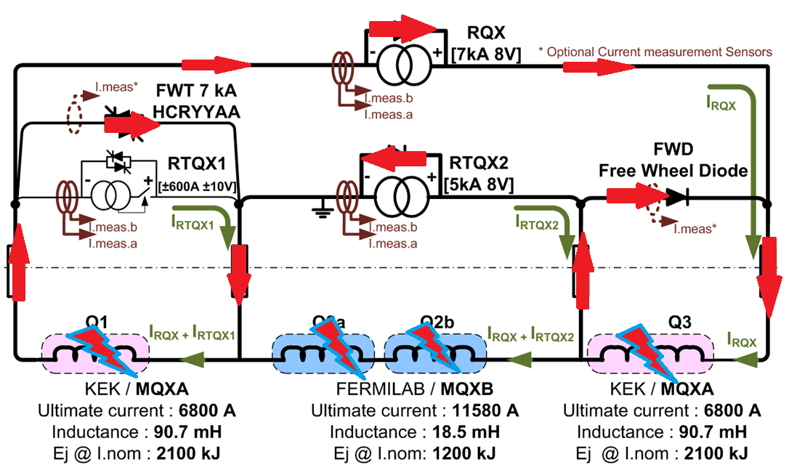
Circuit Analysis During Quench
During a quench the magnets stop being superconductive and, due to the inherent increase in resistance, the flow of current is forced to pass through both the FWD and FWT path creating a Fast Abort Loop.
In the Inner Triplet System, any quench detection or QPS trigger shutdowns the power converters, triggers the FWT and fires the heaters for the full length of 4 magnets.

Slide 12
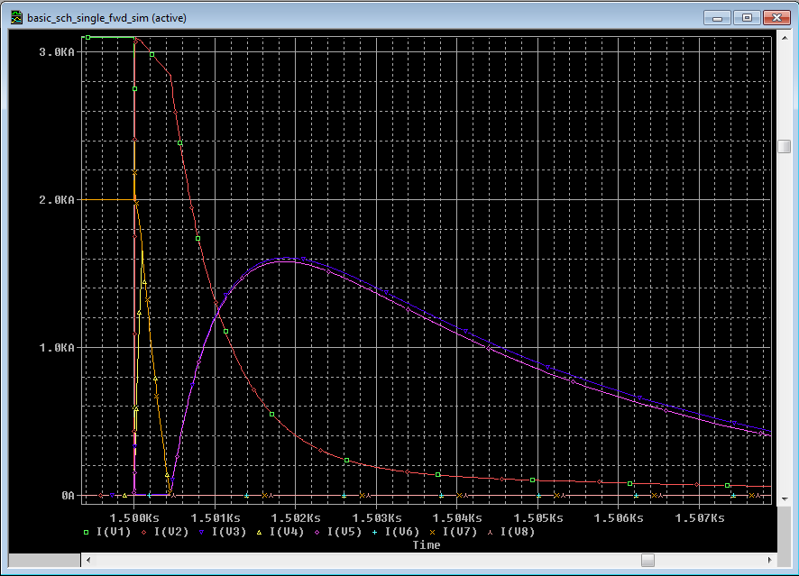
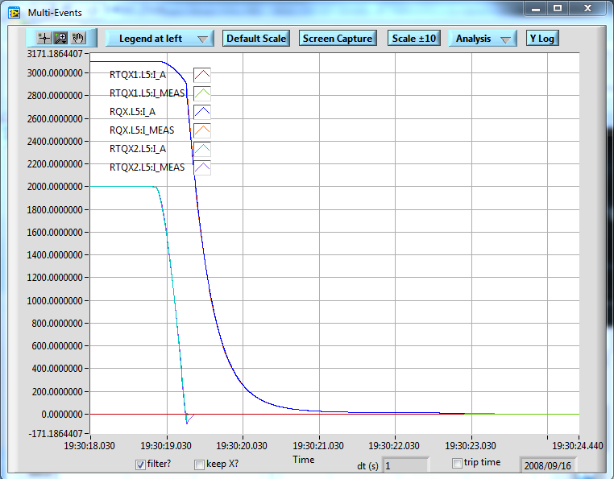
Quench Analysis/Simulations
Focusing on PLI3.f6, due to it being widely accessible for all circuits and comfort in the knowledge the results are as expected.
Change in time constant as RTQX2 hits 0A
Almost all current is forced into the FWT and FWD paths
RTQX2 2kA to 0A in <500ms
Negative current in RTQX2

Slide 13
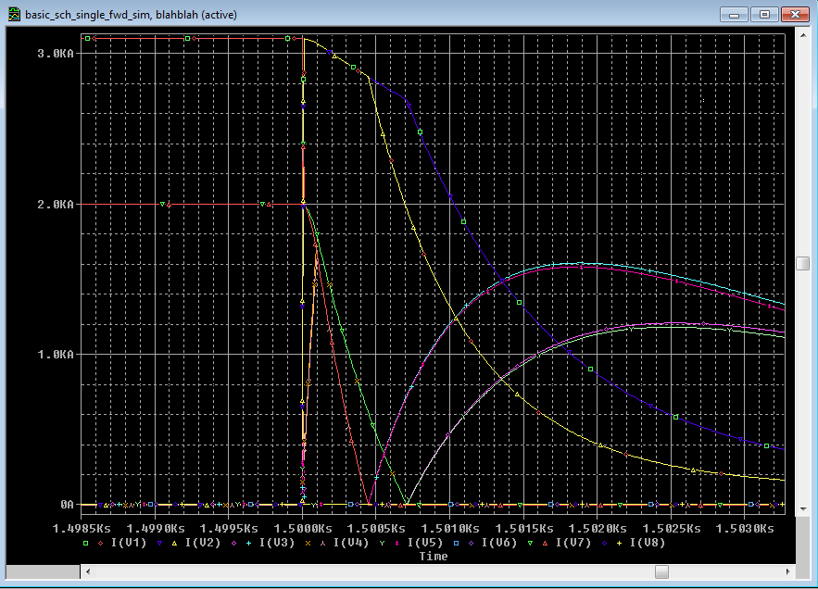
Quench Analysis/Simulations
Sweeps show the effects of the most influential parameters. Those chosen are parameters which different between the inner and outer coil layers.
Varying parameters that differ from inner to outer coil gives drastic differnces
Conclusion: I would deem it necessary to model the inner and outer coils separately. (yes, that means 8 separate thermal models circuits… )

Slide 14
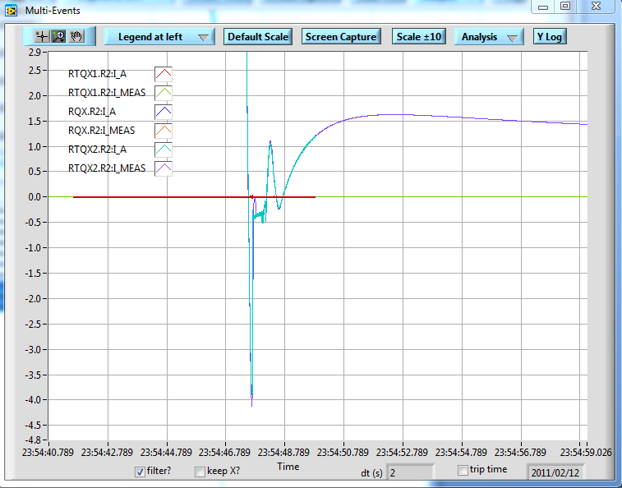
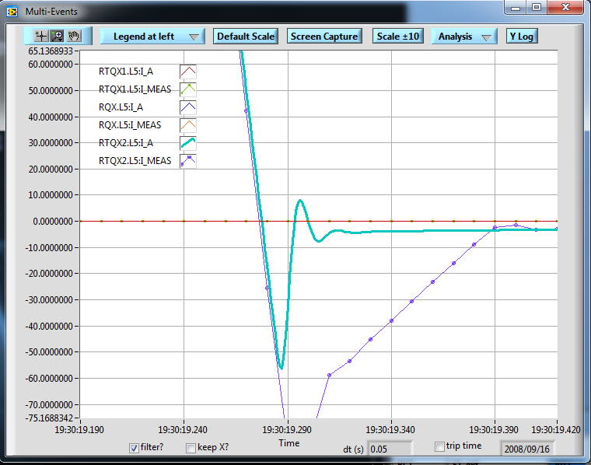
Interesting Anomalies
RTQX2 path is force negative beyond that of the maximum reverse current of the diodes

Slide 15
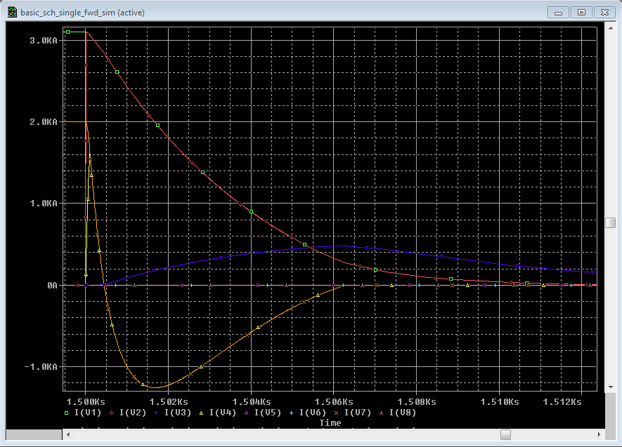
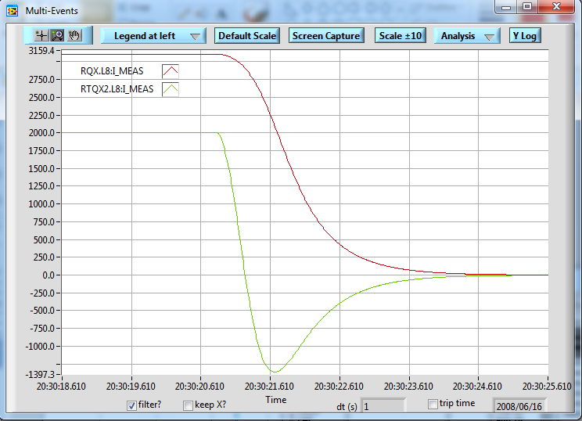
Interesting Anomalies
Successfully modelled (by accident). Fault caused due to not firing the FWTs or having a fault in the FWD path.
RTQX2 path is forced negative far beyond that of the maximum reverse current of the diodes. < -1kA

Slide 16
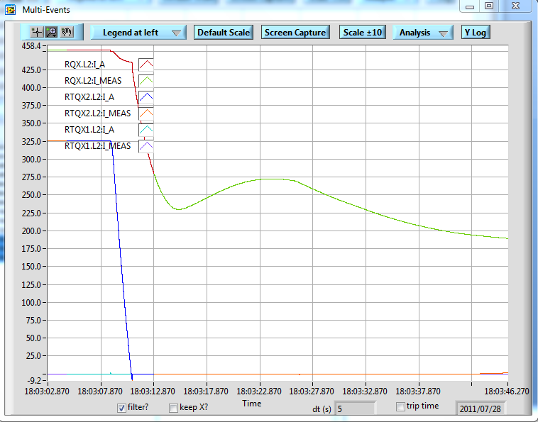
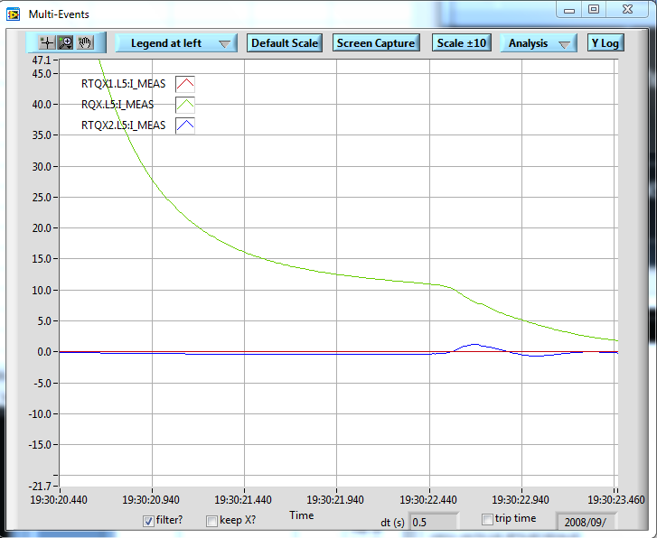
Interesting Anomalies
Huge oscillations in RQX path. Quench recovery??
Wavering near the end as RQX tails of to 0A.

Slide 17
Further Work
Test and compare other thermal model equivalent (rectangle cable approximation)
Implement separate thermal model circuits for inner/outer coils for both magnet types.
Find more quench events, preferably at high current with all 3 PCs active.
Accurately model/analyse said quench events.
Take my girlfriend to Paris for her birthday...

Slide 18
ANY QUESTIONS?
Thank you for listening
Thanks to...
Emmanuele Ravaioli
Andrea Musso
By Scott Rowan
TE-MPE-PE

