Slide 1
Circuit modeling & synthesis

Slide 2
Modeling
Starting from a measured transfer function, the idea is, in the first step, to do a curve fit in Matlab.
Examples of TFM at cold, in the tunnel:

Slide 3
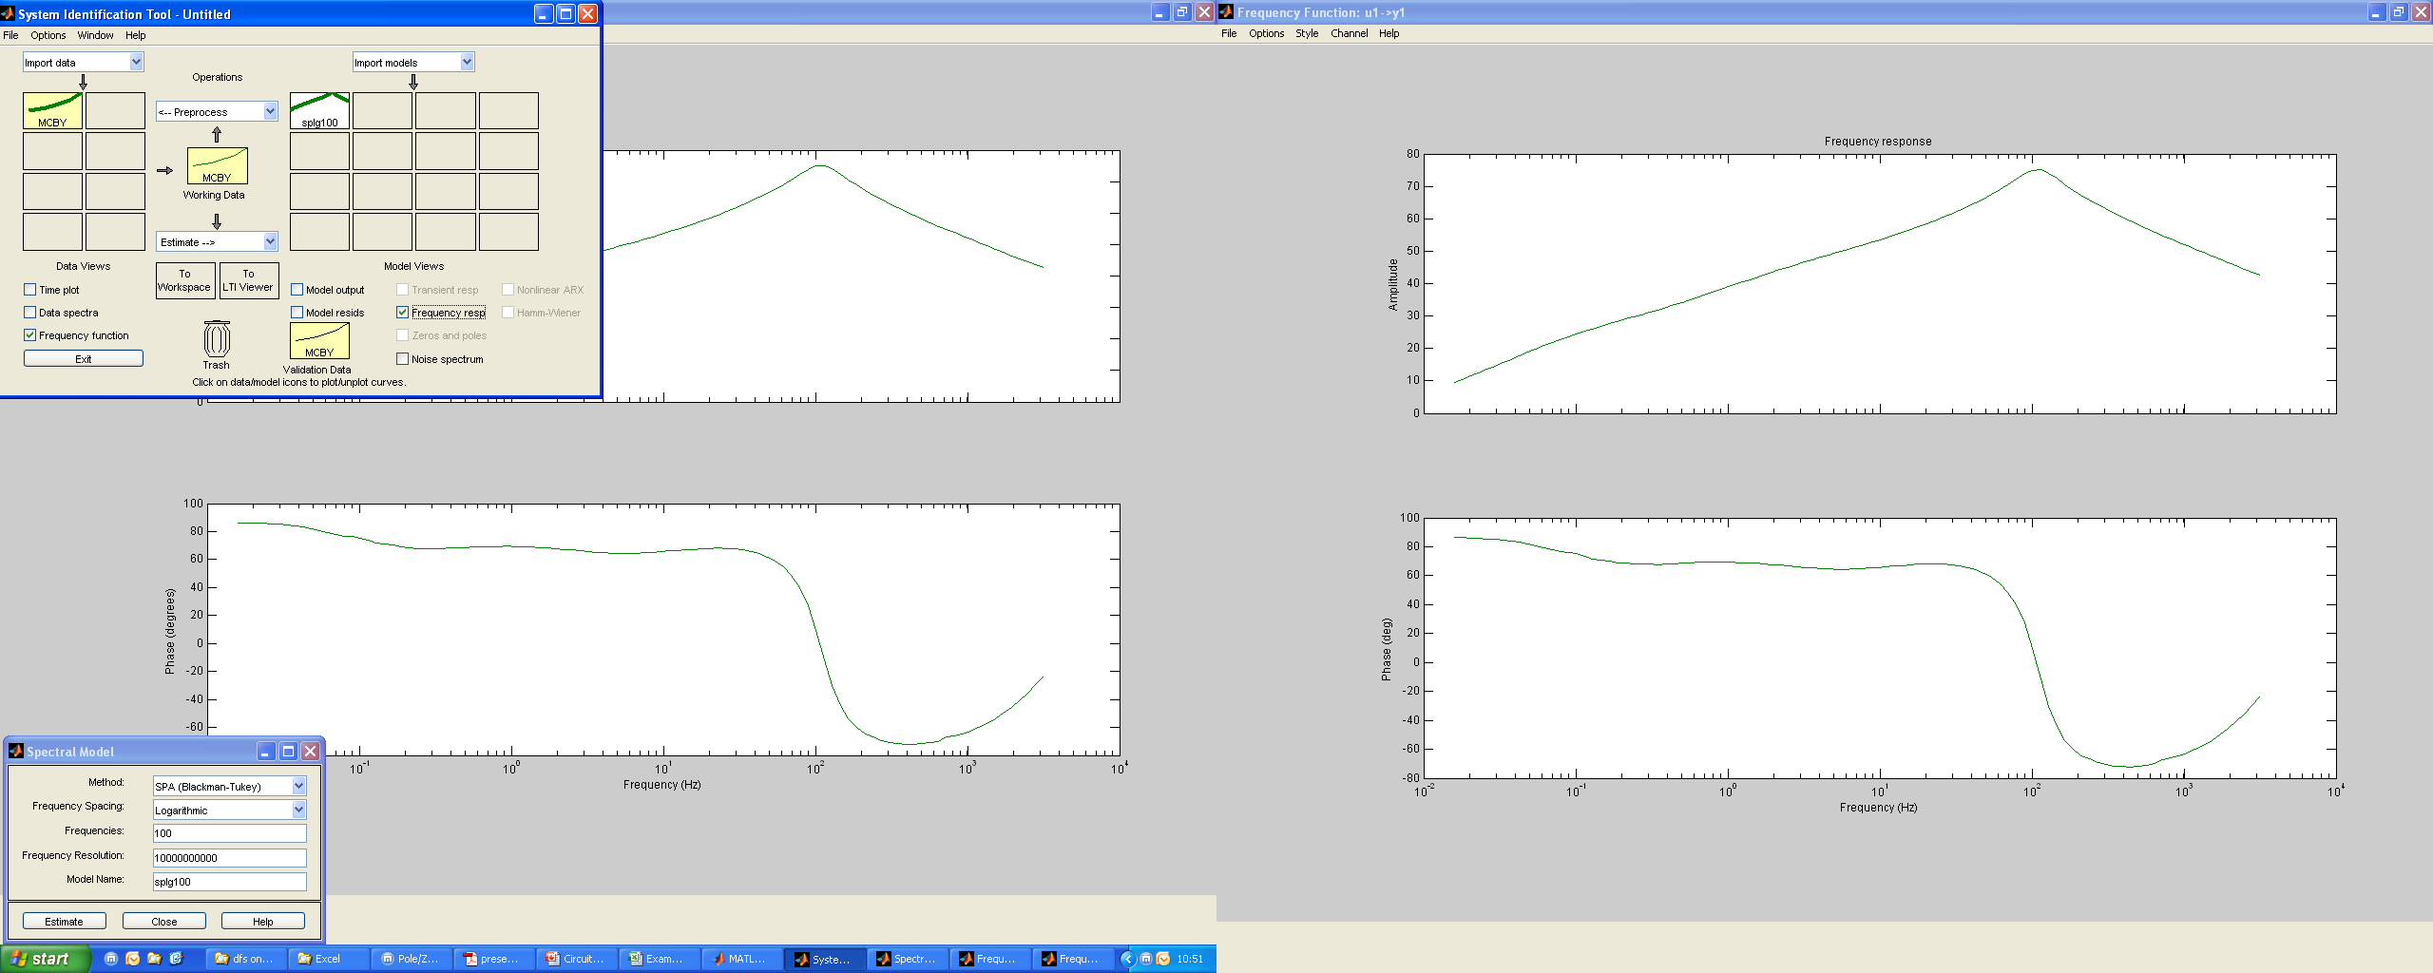
Modeling
Curve fit in Matlab, using the system identification toolbox.

Slide 4
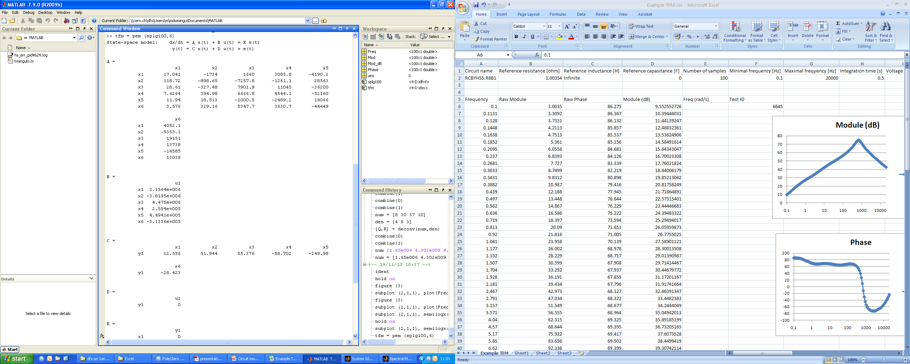
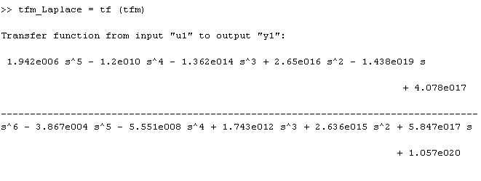
Modeling
Transformation of the estimated
model to the state space model.
It’s done using the “pem” command
in Matlab, and specifying the
maximum order of the polynomials.
Transformation from the state space model to the Laplace transform

Slide 5



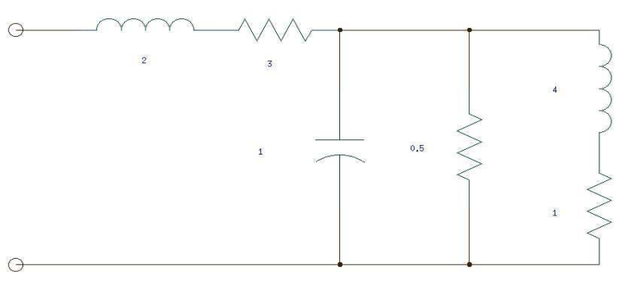
Synthesis: Continued fractions decomposition
Once we get to the Laplace transform, we start the synthesis of the circuit.
The method used is the continued fractions decomposition: through polynomial divisions, a Laplace transform could be expressed as:
Example:
This corresponds to ((1Ohm in series with 4 H) in parallel with 0.5 Ohm and 1 F) in series with 3 Ohm and 2 H

Slide 6

Synthesis: Continued fractions decomposition
Practical example with the real Laplace transform of the measured MCBY:
First division:
Z0=0, Y1=5.15^-7-0.0167
We have found a negative value for a component (R=-0.0167!!!!). This is the main disadvantage of this method.
Even if it’s mathematically correct, and could be simulated in Pspice giving good results, some people couldn’t accept it, because it doesn’t have a physical meaning.

Slide 7
Synthesis: Foster cells
Alternative way to find the final circuit is Foster’s method.
There are two different methods that will result in both LC circuits:
  Foster 1: Impedance
  Foster 2: Admitance
It seems that is possible to get positive values for all the components, but is NOT guaranteed in all the cases.
Two matlab scripts (one for each method) are giving automatically the values of the components.

Slide 8
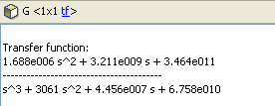
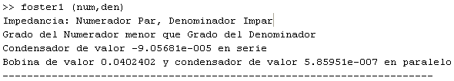
Synthesis: Foster cells
Practical example with a third order TF from a MCBY
We apply the first script to the TF:

Slide 9

Synthesis: Foster cells
As we find a negative value for a component, we apply the second method:
By now, this method has been tested with several TF, and always one of the solutions is giving all positive values. Anyway, as I said, taking in account the theory behind Foster’s method, the positive values are not guaranteed.

Slide 10
Step response
In parallel with this, it was suggested to see if it’s possible to model the magnet from a step response, due to the difficulties of doing a TFM with high current in a 13kA circuit.
With a step response, we should get a second order model as maximum. This could lead us to miss part of the behavior, specially at high frequency.
In the other hand, it could be perfectly enough (depending on the precision needed) and the setup for the measurement with current is much easier.
A little mock-up is already done to compare the model coming from the step response and the model coming from the frequency response of a commercial inductance.

Slide 11
Missing points
Still missing points:
  Do the schematics with these components in Pspice, and check that the response in frequency is acceptable.
  Test the scripts to know if we are going to get any negative value that we couldn’t avoid.
  Compare the results of step response and frequency response models.
Hopefully, they should be ready for the next meeting.

