Slide 1
RQS circuit
Simulation results of Quench
Thanks to E. Ravaioli
Antonopoulou Evangelia
June 2011

Slide 2
General Information – RQS circuit
Type | 600A
Imax | 600A
Converter | RPMBA
Magnet | MQS
# of m. | 4
EE | Yes

Slide 3
Powering subsector A12
Circuit RQS.A12B2
Power Converter Attributes
Rcrowbar | 0.05Ω
Main parameters
R tot measured | 0.004010Ω
L tot | 0.124 H
Inductance per aperture | 0.031 H
Quench Protection System
Energy Extraction | DQEMC
Extraction Resistance | 700 mΩ
Parallel Protection Resistor per Magnet | 0.25 Ω

Slide 4
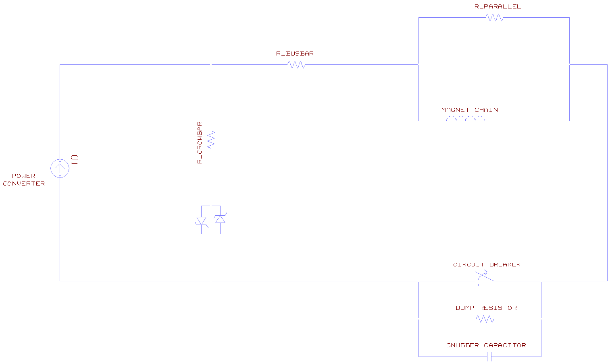

Slide 5
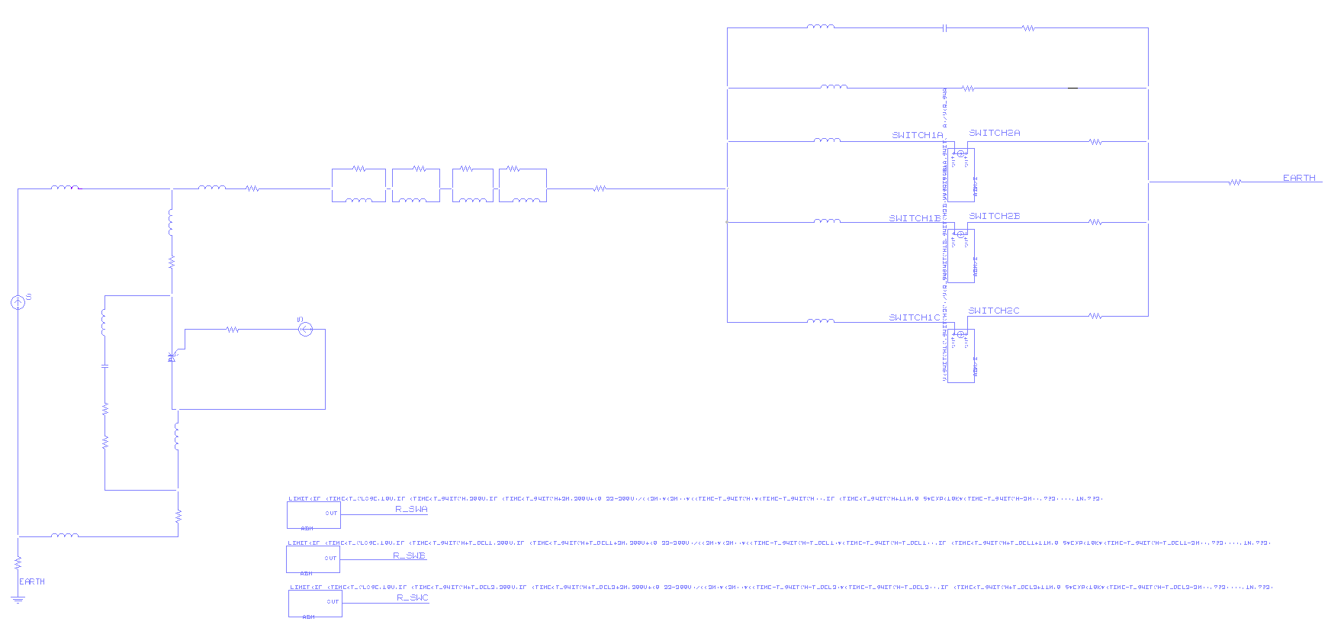
Improved Schematic-RQS circuit (Main Circuit)
Power Converter
EE System
Magnets and Parallel Resistances
Crowbar
Resistance of the Busbar
Simulation of the Switches
Earthing point

Slide 6
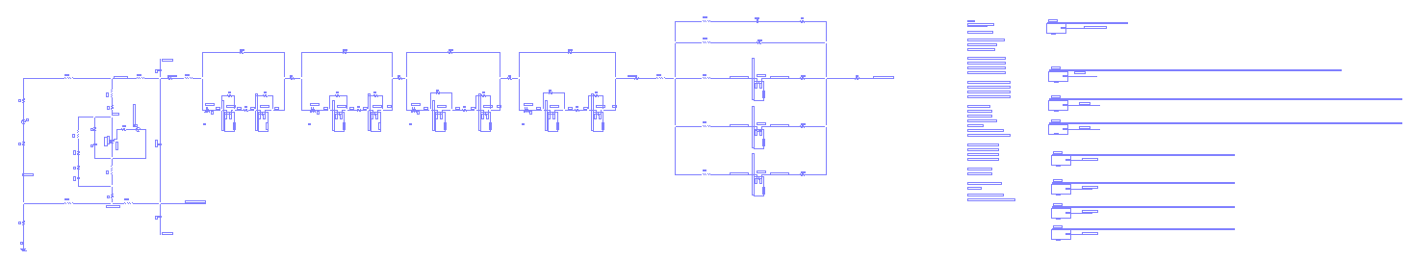
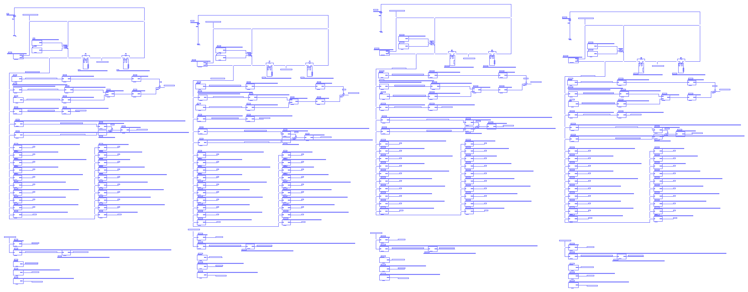
Latest Schematic-RQS circuit(1/2)
Main Circuit
Thermal Model

Slide 7
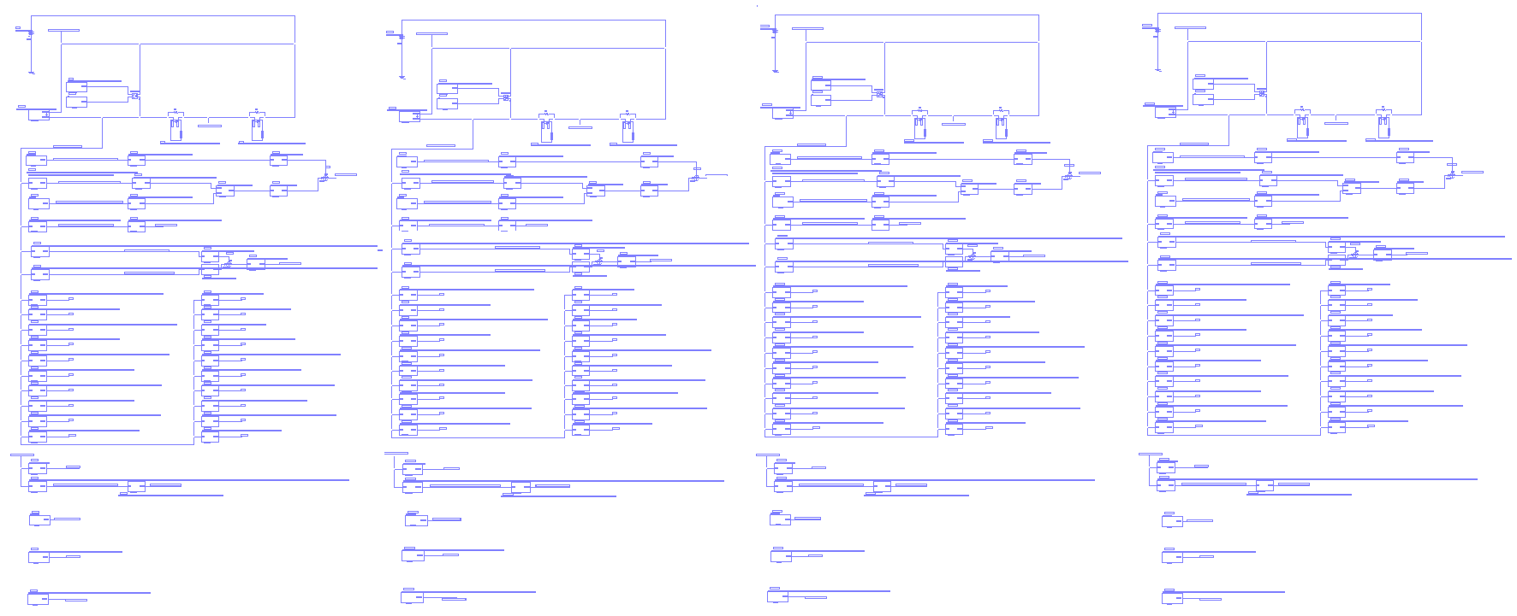
Latest Schematic-RQS circuit(2/2)
Thermal Model
Electrical resistance
Thermal resistance
Thermal capacitance
Thermal resistance
of the insulation layer
Magnetic transfer function
Magnetic field
Inductance
Magnet 1
Magnet 2
Magnet 3
Magnet 4

Slide 8
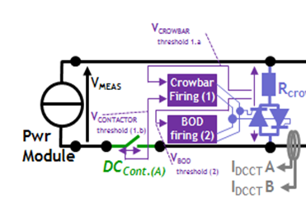
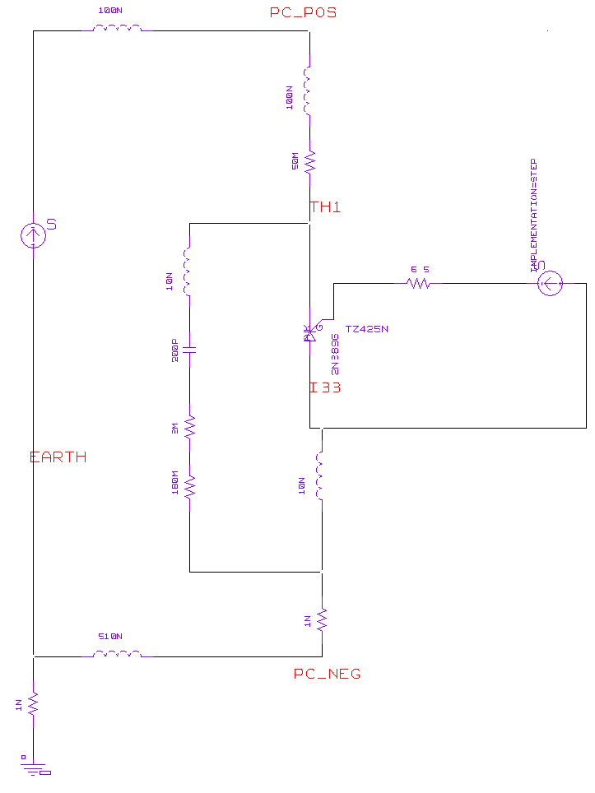
Crowbar
The system is based on a 50 mΩ Power Resistance series back-to-back thyristors being fired at a given output voltage, and then providing a safe path for magnet current

Slide 9
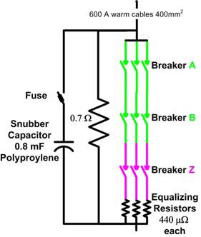
Energy Extraction System
In all 600 A DC-current corrector circuits, the extraction facilities are inserted in series with the magnet chain. During normal operation the ex-traction breaker remains closed, herewith by-passing the dump resistor. In case of a fast power aboard or a quench of a magnet, the extraction breaker will be forced open, herewith switching the current to the dump -resistor. The extraction equipment is based on three individual, series-connected, high-speed, electro-mechanical AC circuit breakers

Slide 10
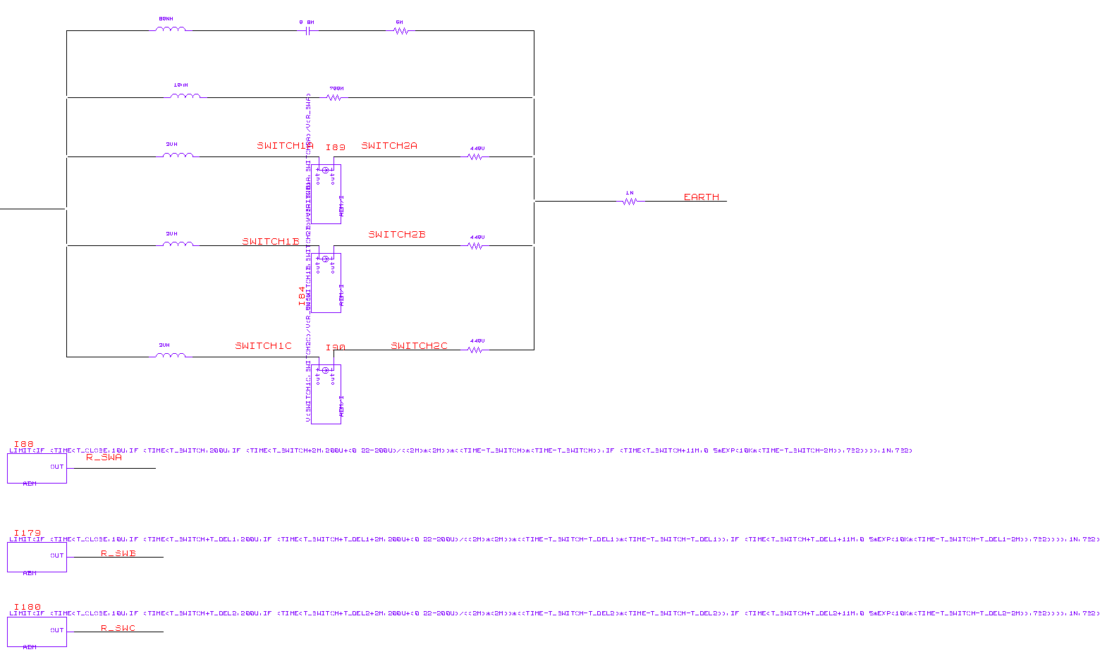
Simulation of the Energy Extraction System

Slide 11
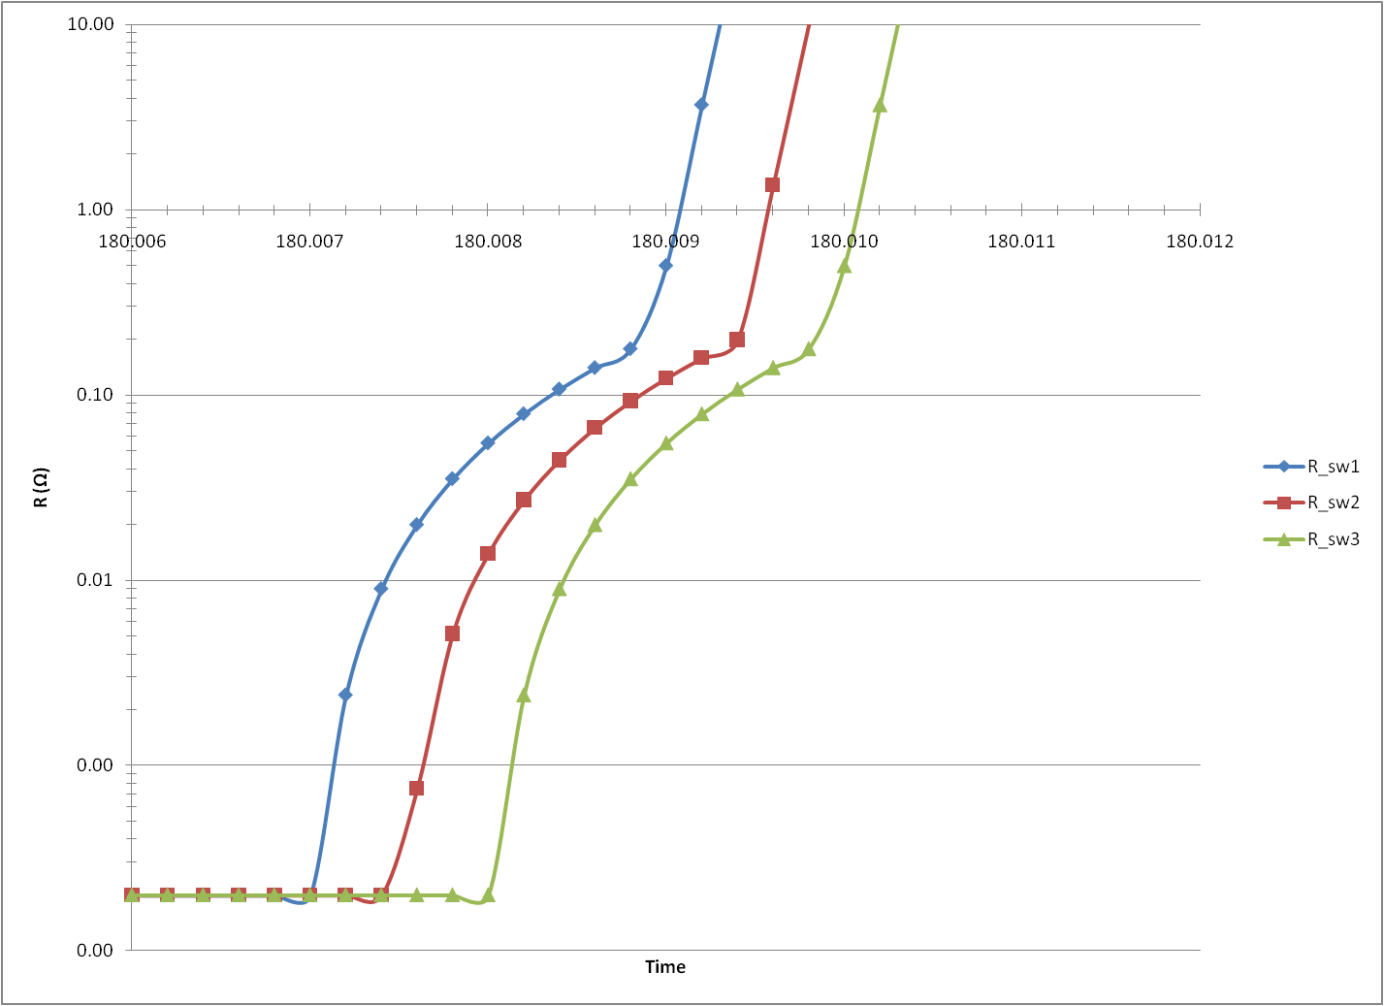
The resistance of the switches in the EE system
Resistance of the switches:
Parabolic=2ms
exponential=11ms

Slide 12
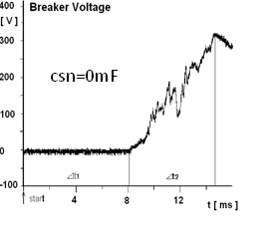
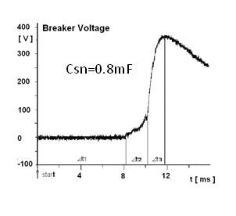
Snubber Capacitor
The electrical arc, between the breaker’s contacts, causes significant erosion of the contact surfaces. In the LHC 600 A EE systems the arcing time attains typically 7 ms at ultimate current leading to sufficient damage and required maintenance after just a few commutations. To minimize the arc influence and reduce the opening time, a capacitor bank is introduced across the breakers with the following characteristics:
- The capacitor voltage rating shall exceed the peak extraction voltage of 420 V.
- Internal inductance (Lesr < 80 nH) and resistance (Rs < 6 mΩ shall be low.
- Gives a capacitor value between 0.14 and 1.4 mF. Experiments have shown that the optimized capacitor value is 0.8mF.

Slide 13
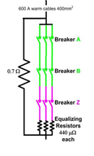
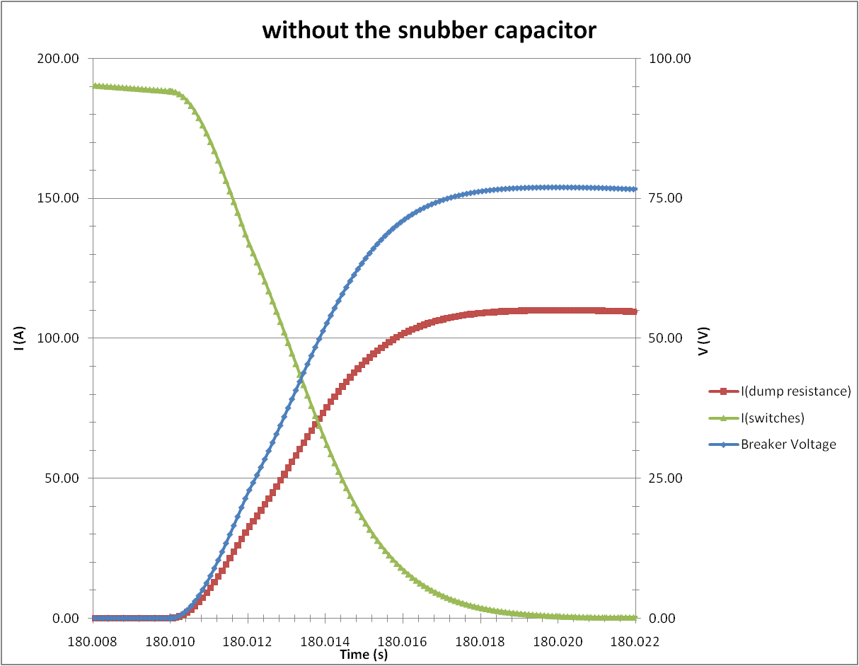
Simulation results of the influence of the snubber capacitor (1/3)
Without the snubber capacitor the arcing time attains 8ms

Slide 14
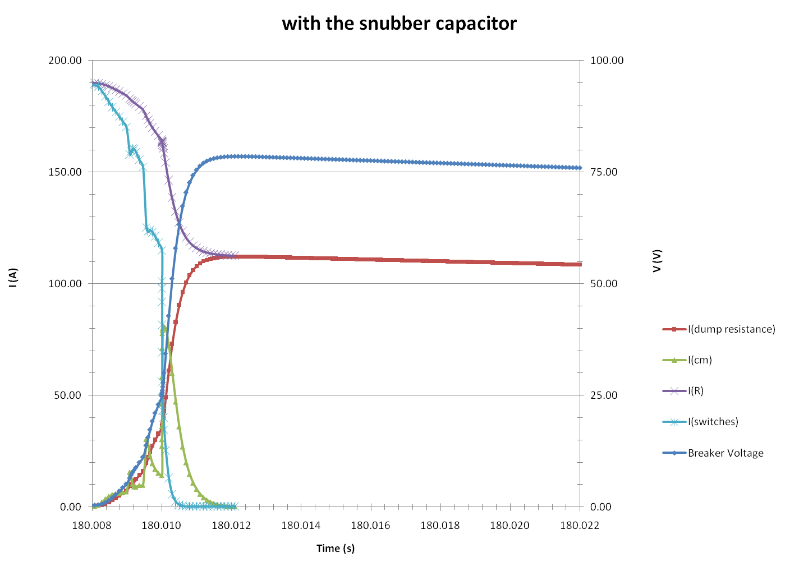
Simulation results of the influence of the snubber capacitor (2/3)
With the snubber capacitor the opening time is reduced in 3ms

Slide 15
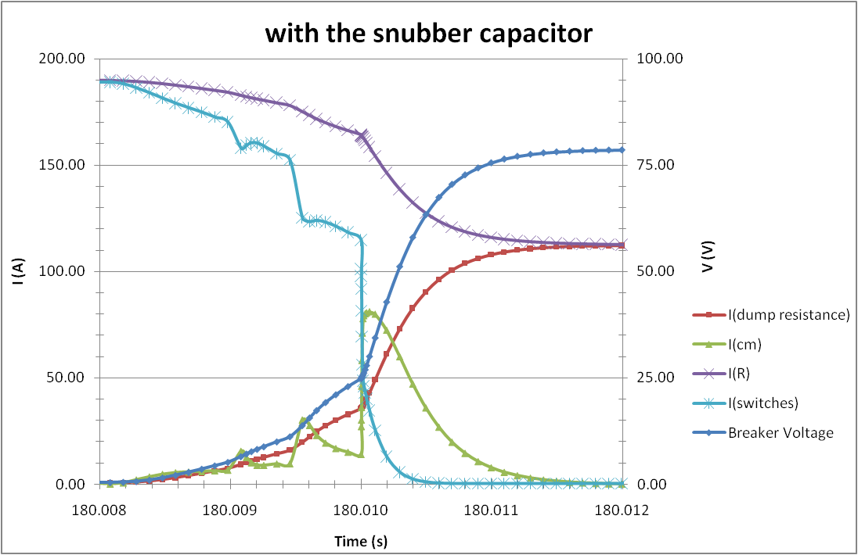
Simulation results of the influence of the snubber capacitor (3/3)

Slide 16
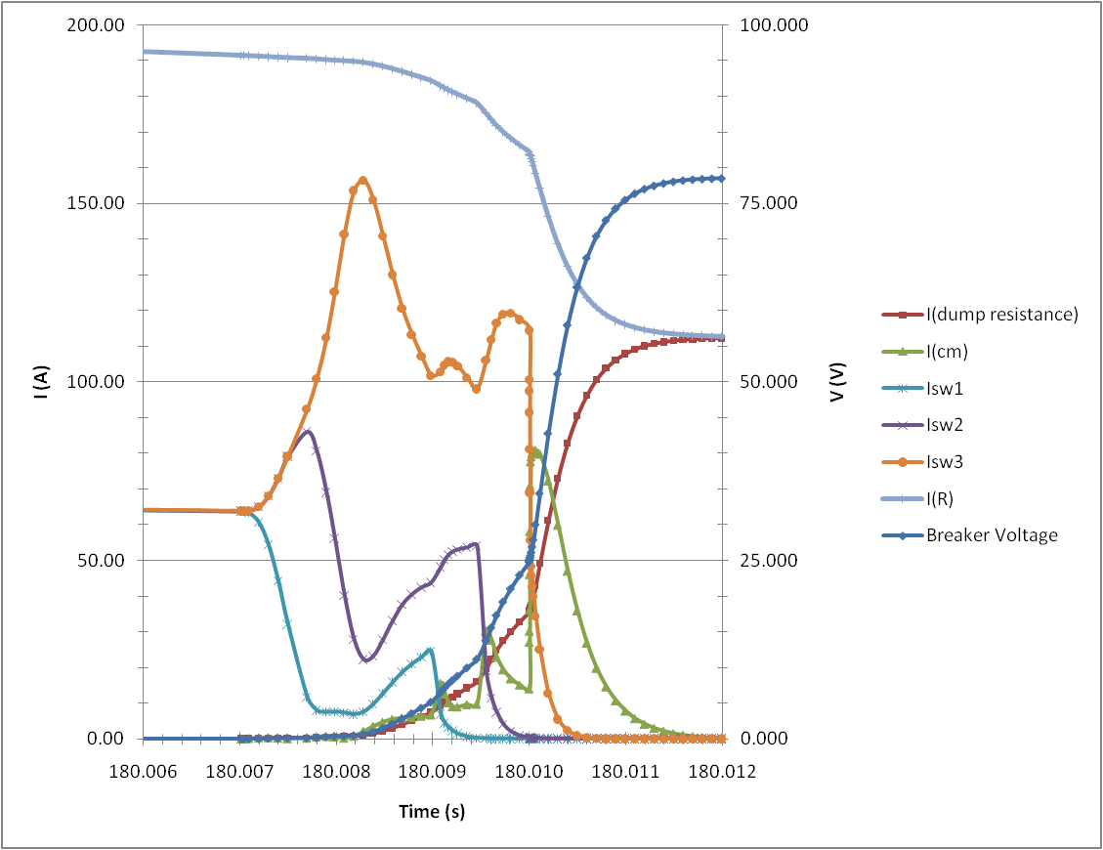
Simulation of the switches’ opening

Slide 17
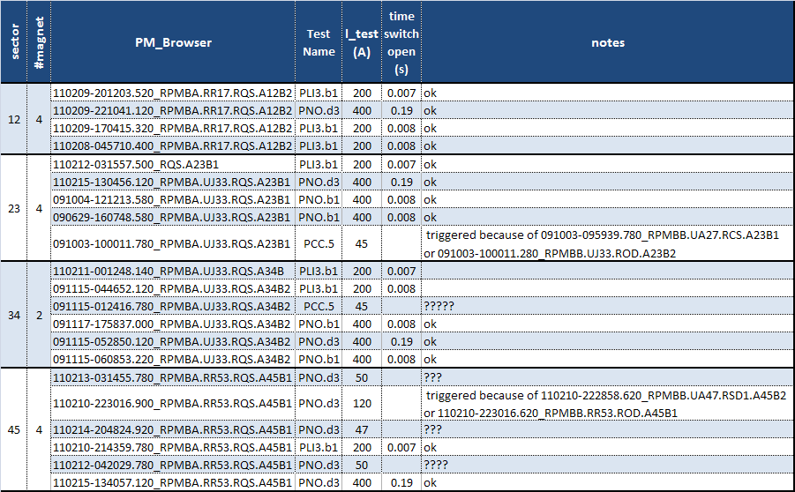
Data of PM_Browser

Slide 18
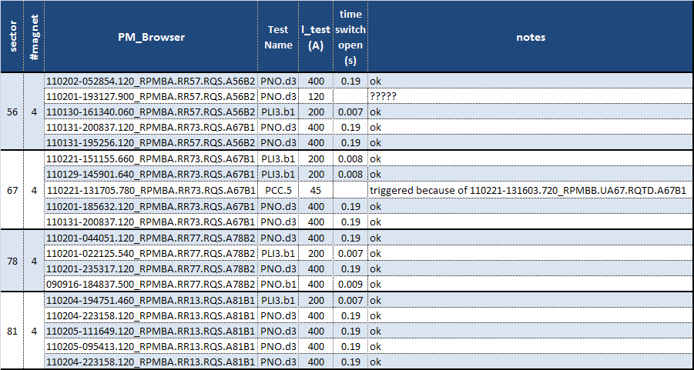

Slide 19
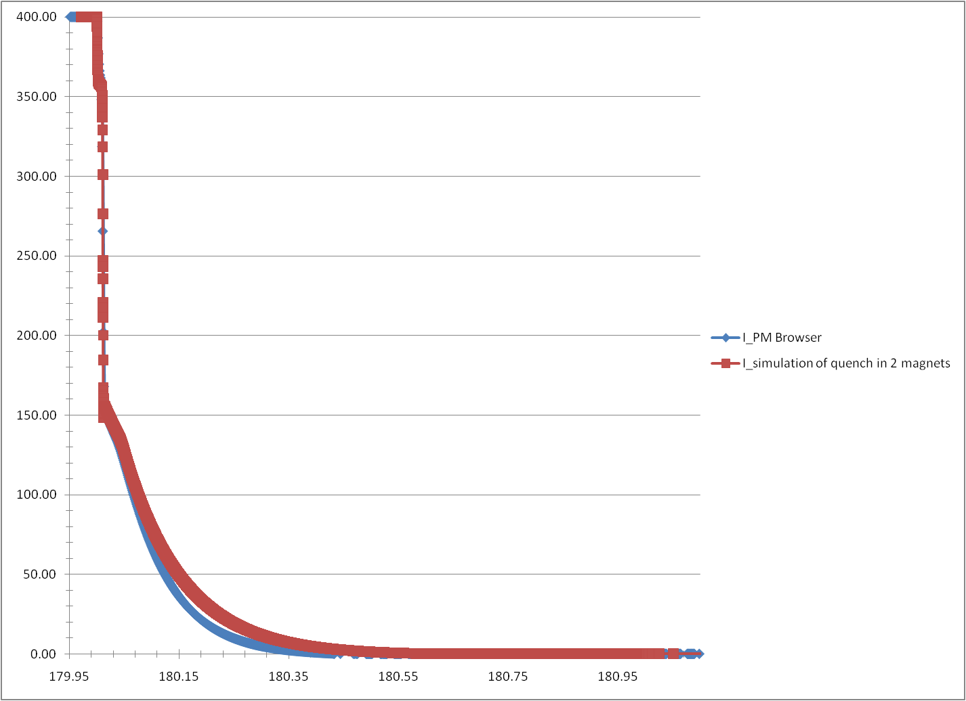
Current in the RQS circuit comparison with PR_Browser data
Simulation: RQS.A34B2
PM_Browser event:
091115-060853.220_RPMBA.UJ33.RQS.A34B2

Slide 20
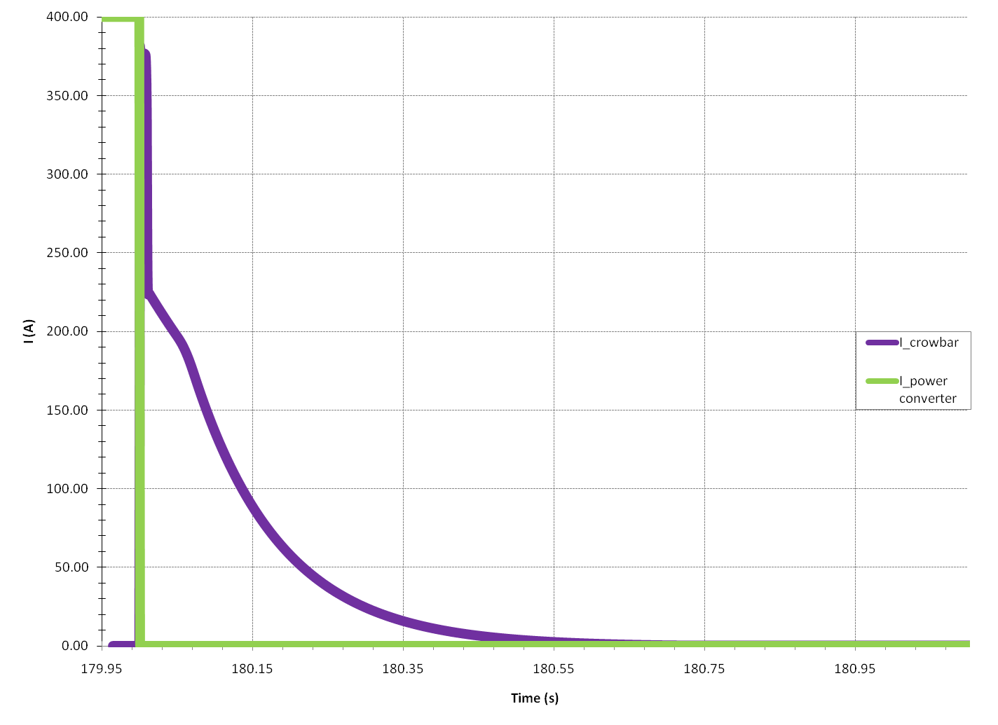
Current in the Power Converter and the Crowbar
When the Power Converter is shutted down all the current pass by the crowbar until the discharge of the circuit.

Slide 21
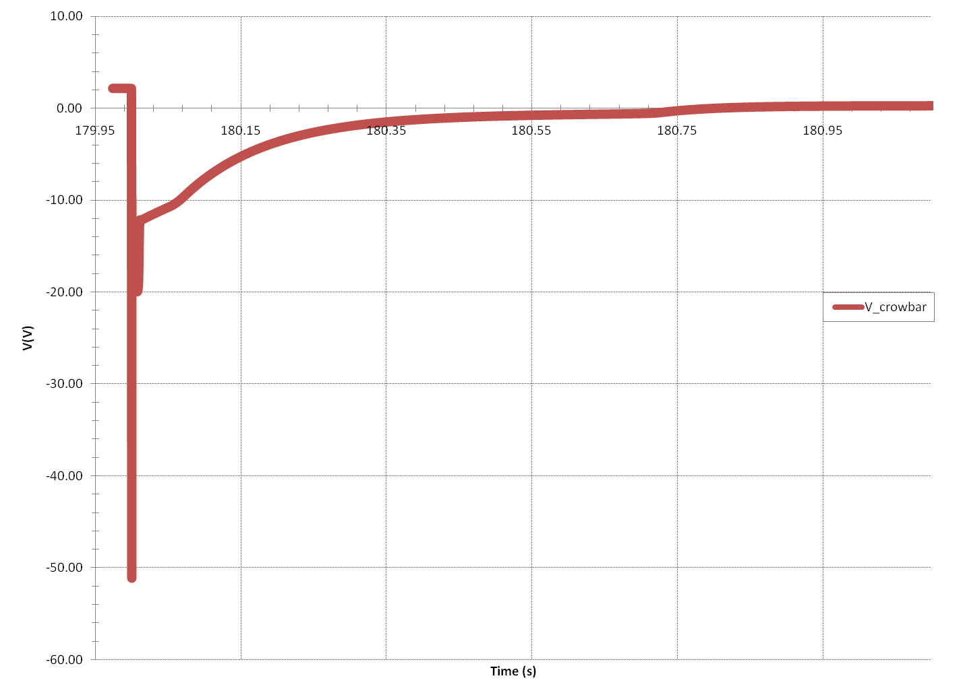
Voltage across the Crowbar

Slide 22
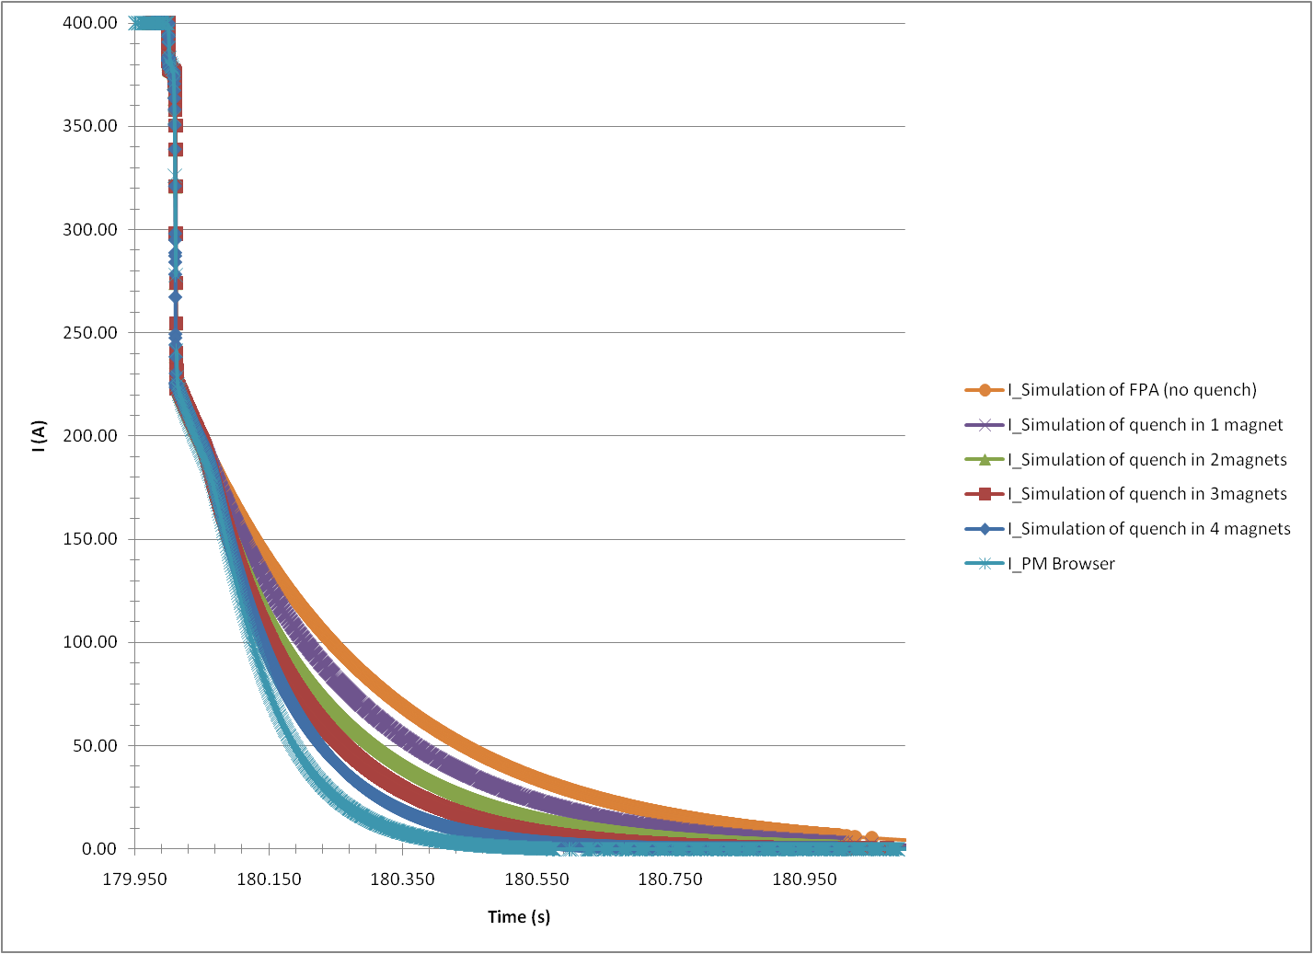
Current in the circuit

Slide 23
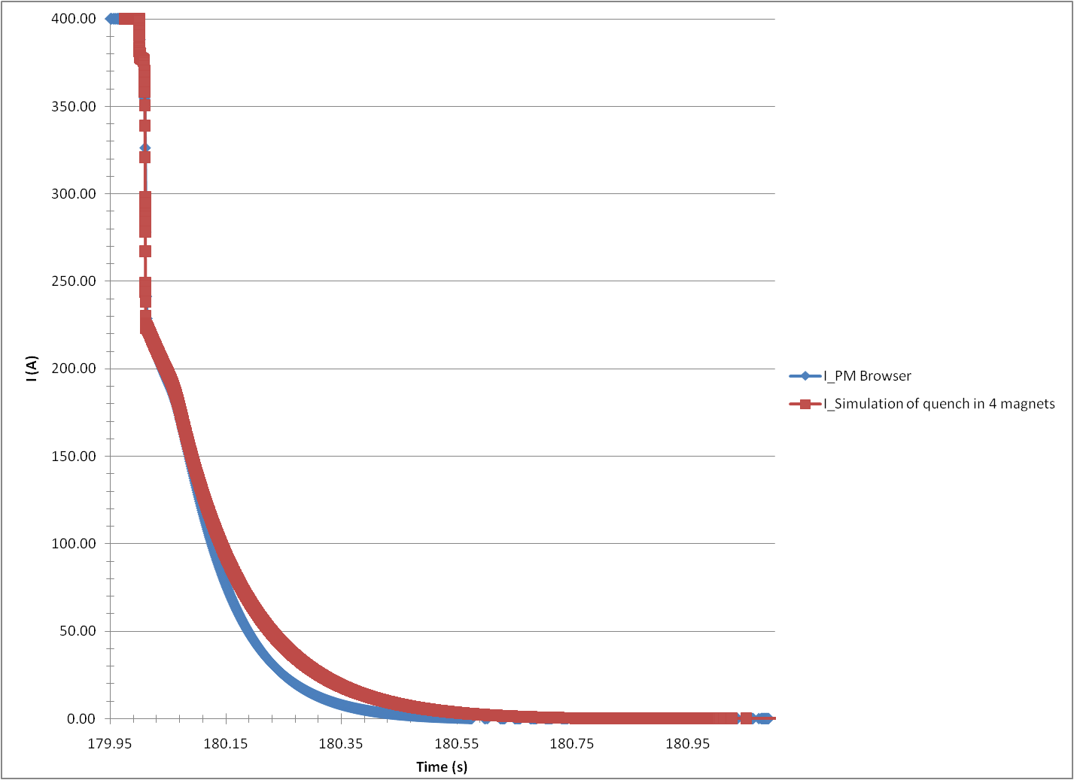
Current in the RQS circuit comparison with PR_Browser data
Shut down of the power converter
Simulation: RQS.A23B1
PM_Browser event:
091004-121213.580_RPMBA.UJ33.RQS.A23B1
Opening of the switch in the EE system

Slide 24
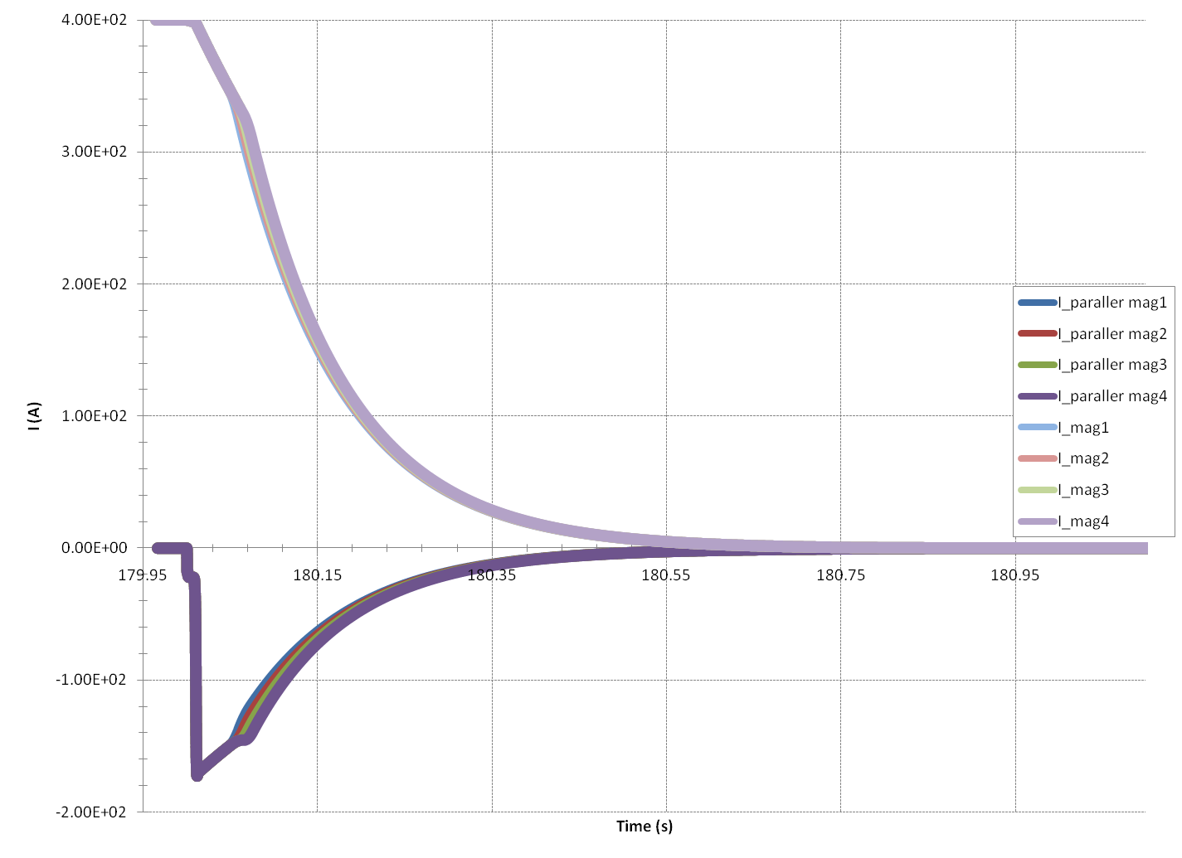
Current of the magnets and their parallel resistance
After the shut down of the power converter, current pass by the parallel resistances of the magnets in order to protect them.
This current has the opposite direction of the current of the circuit.

Slide 25
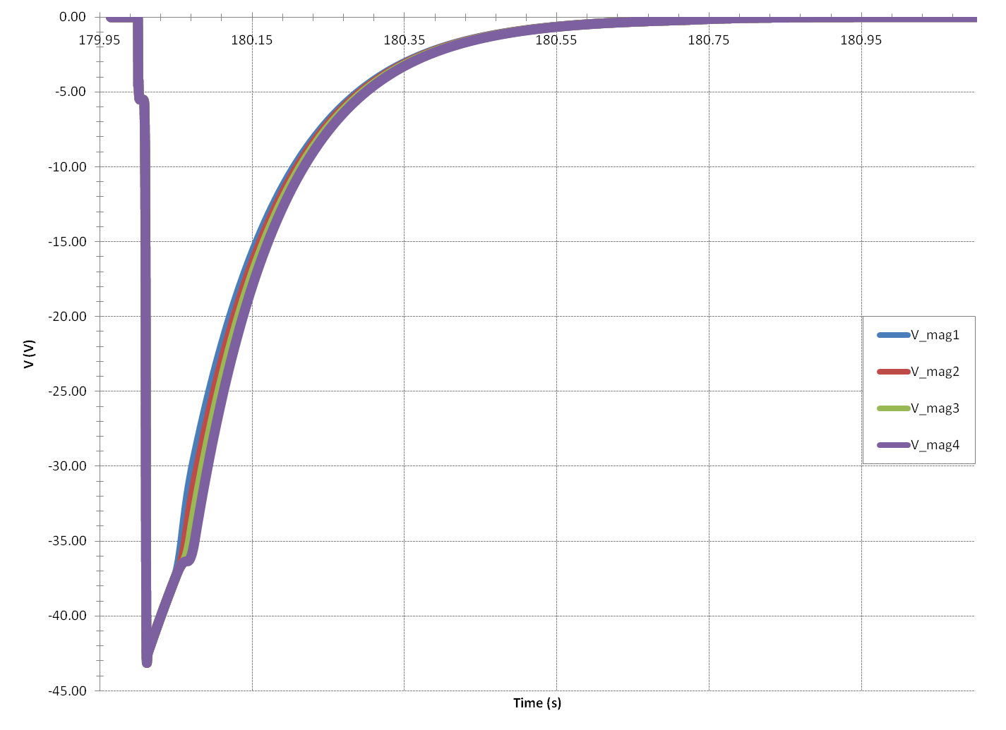
Voltage drop across the magnets

Slide 26
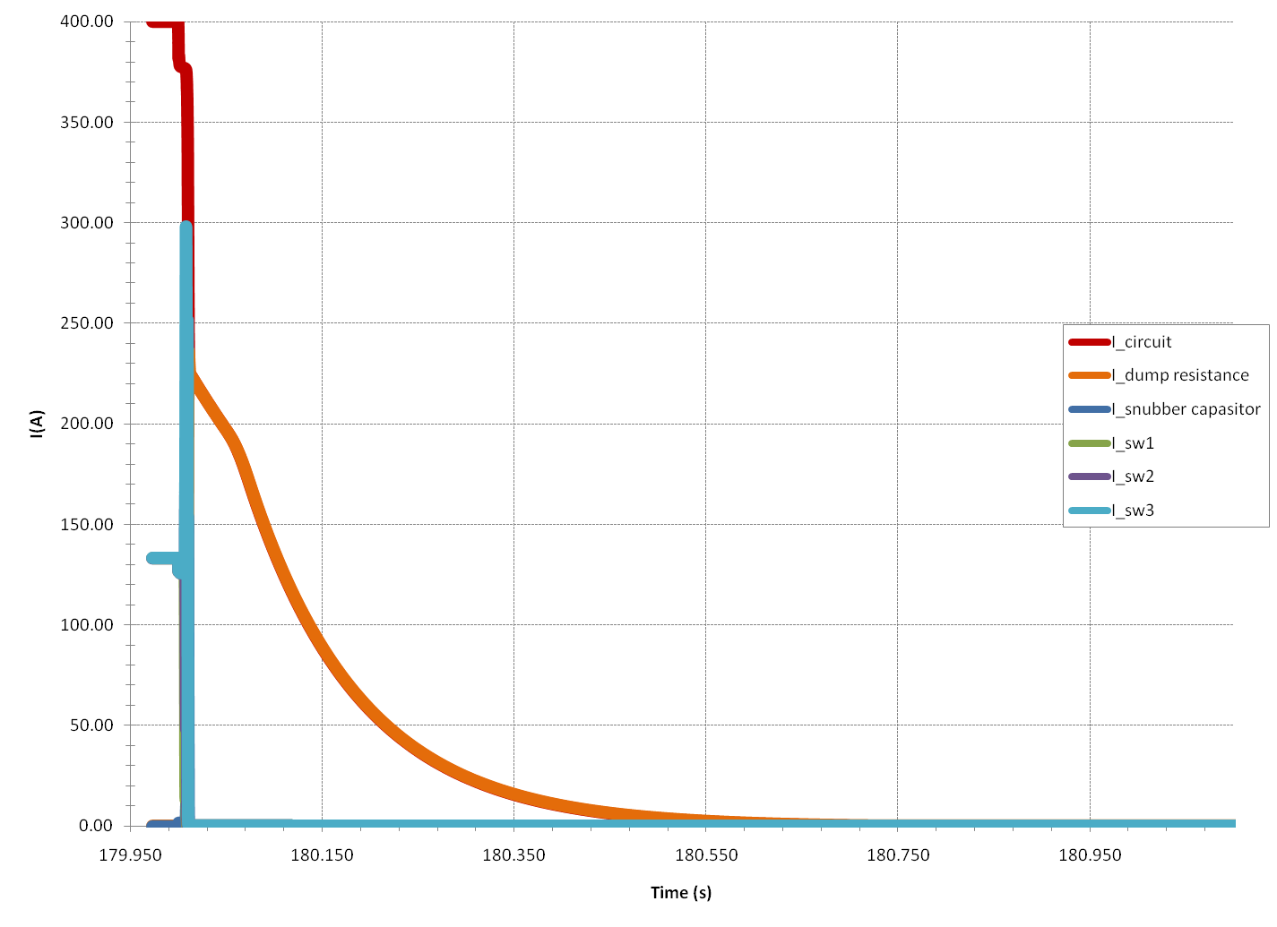
Current in the EE system(1/2)

Slide 27
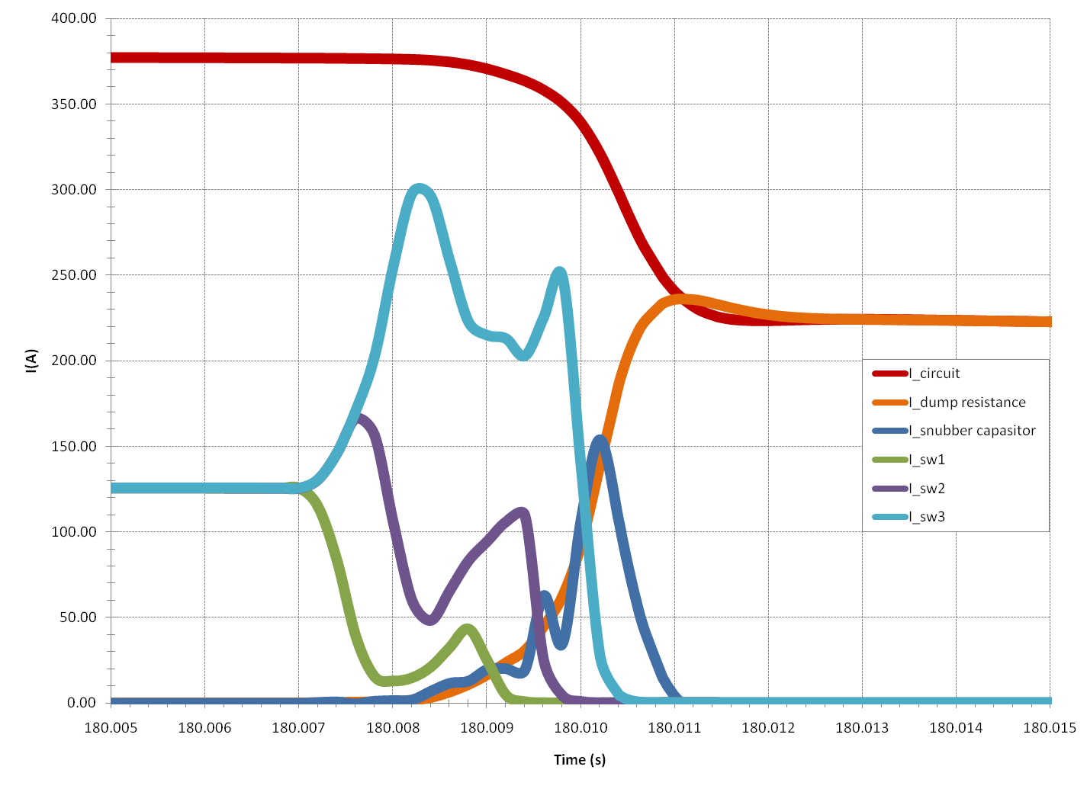
Current in the EE system(2/2)

Slide 28
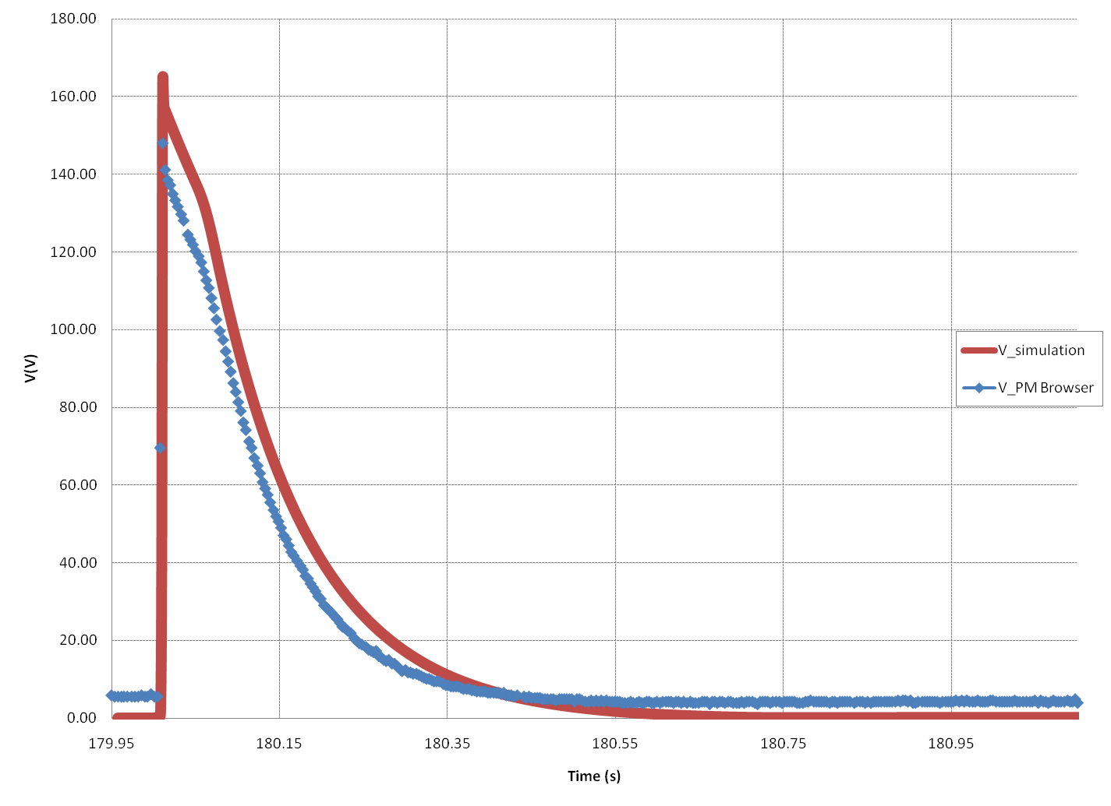
Voltage in the Dump resistance
Simulation: RQS.A23B1
PM_Browser event:
091004-121213.580_RPMBA.UJ33.RQS.A23B1

Slide 29
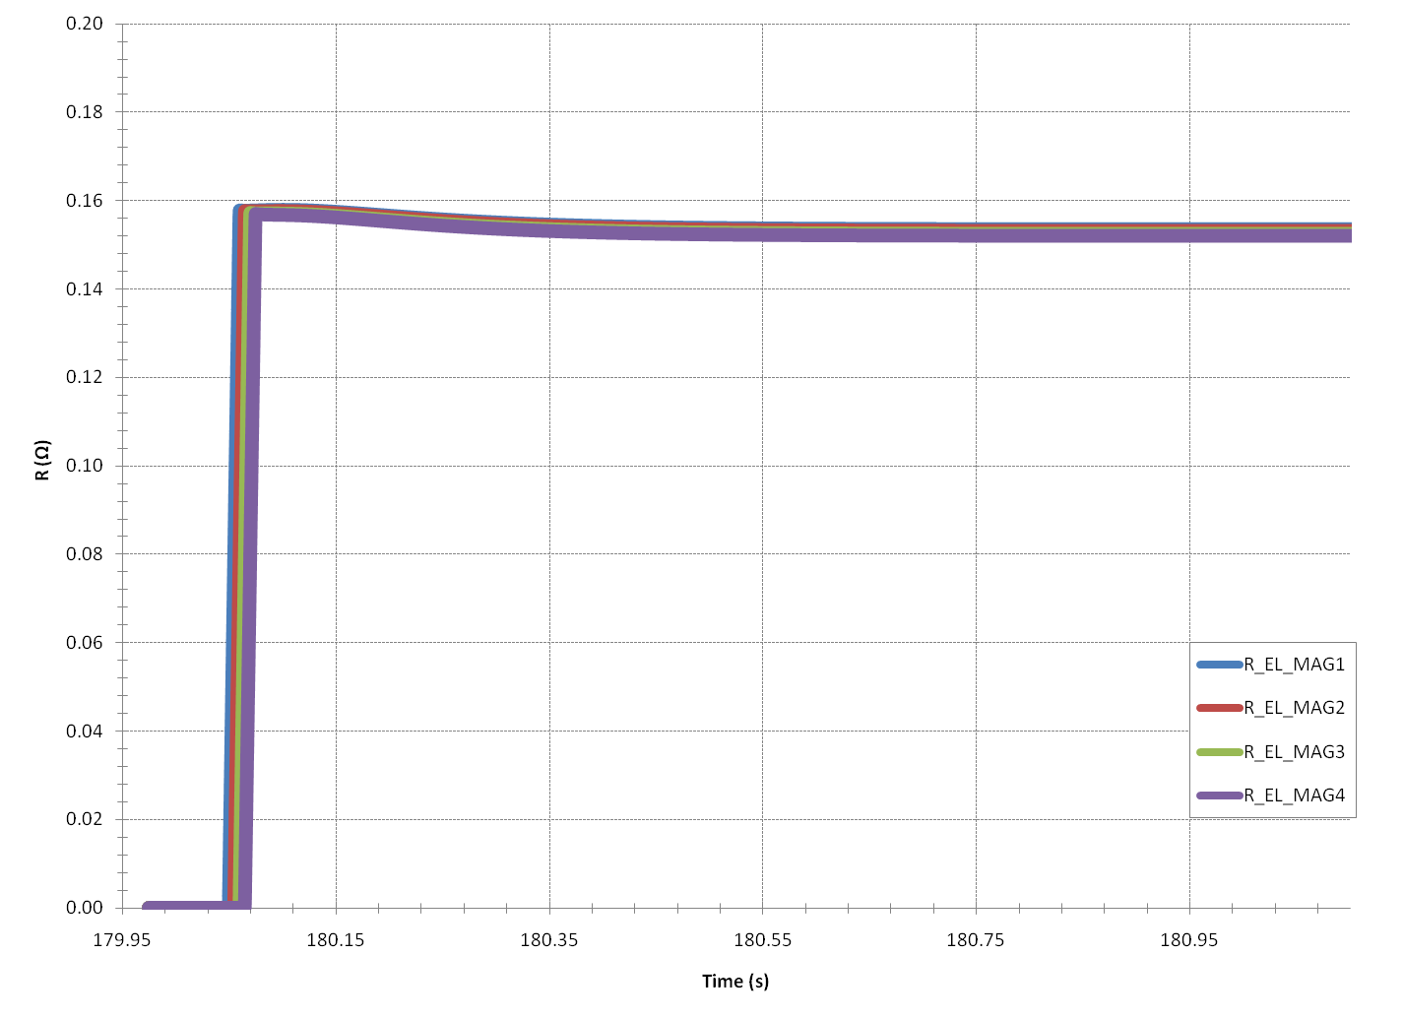
Electrical Resistance on the magnets

Slide 30
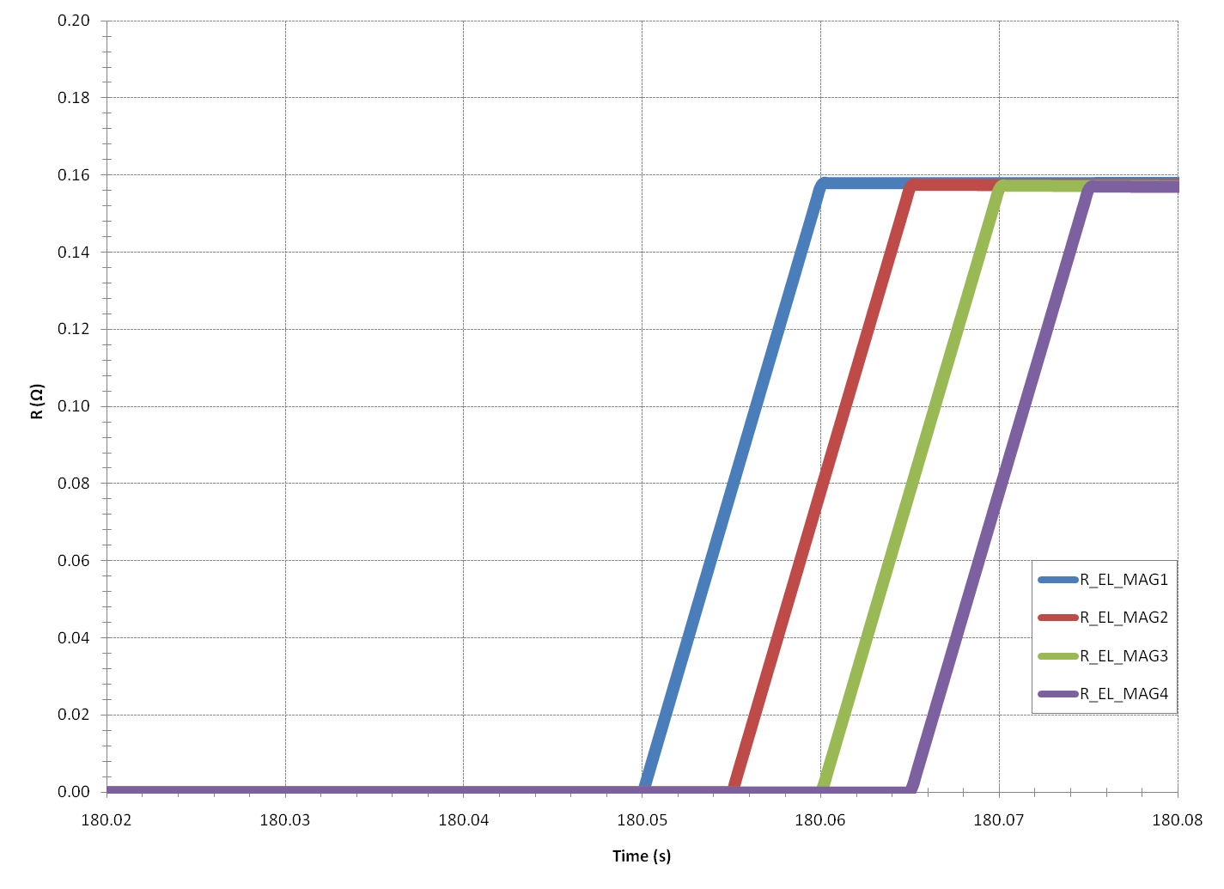
Electrical Resistance on the magnets

Slide 31
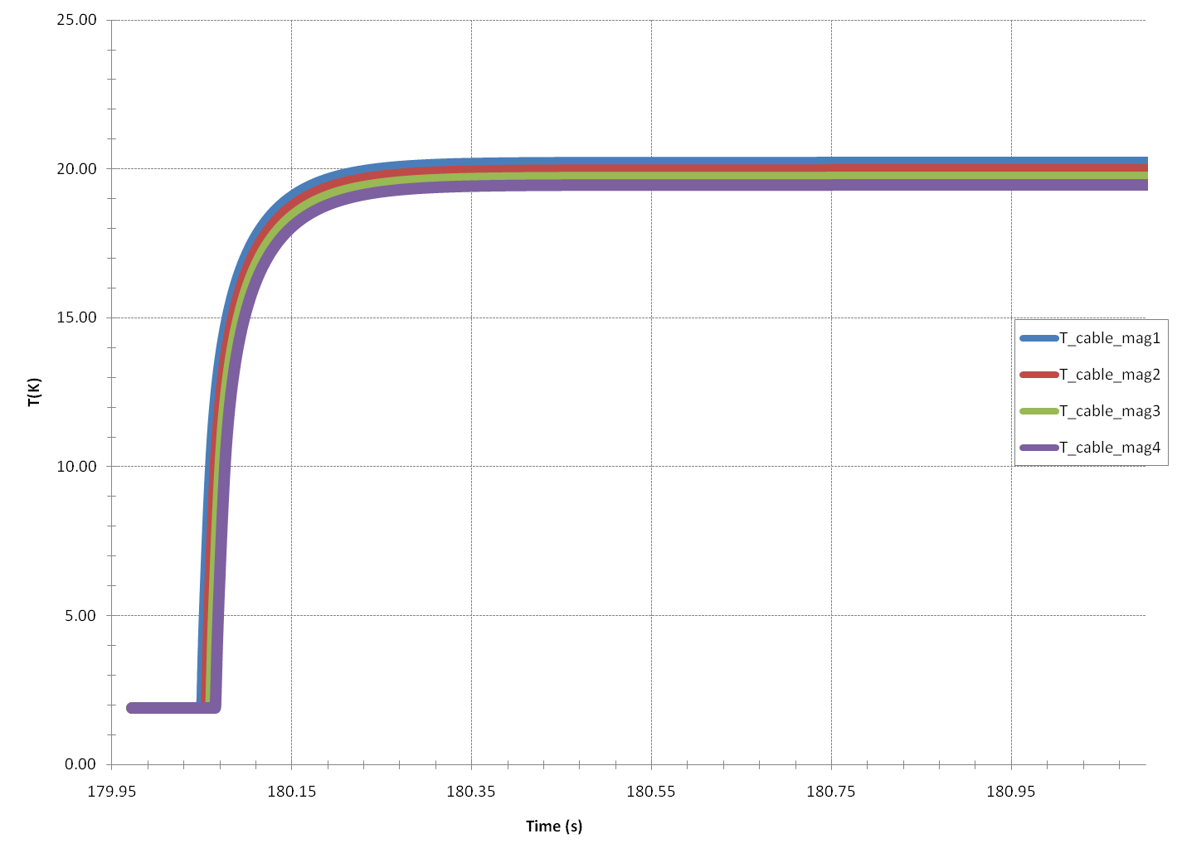
Temperature of the cable

Slide 32
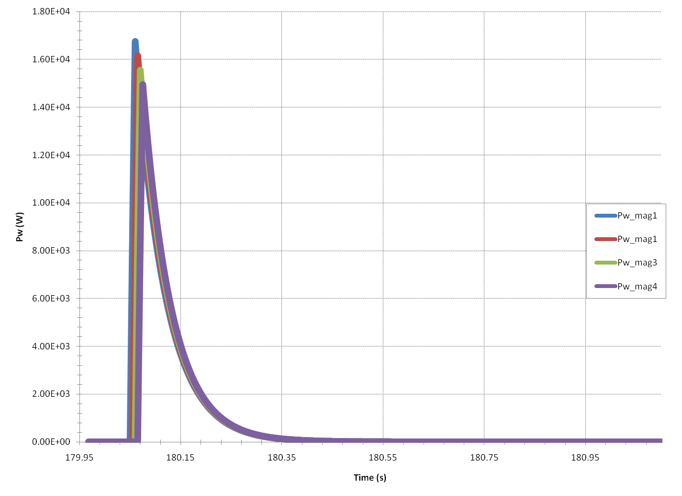
Thermal Power dissipated in the magnet due to quench

Slide 33
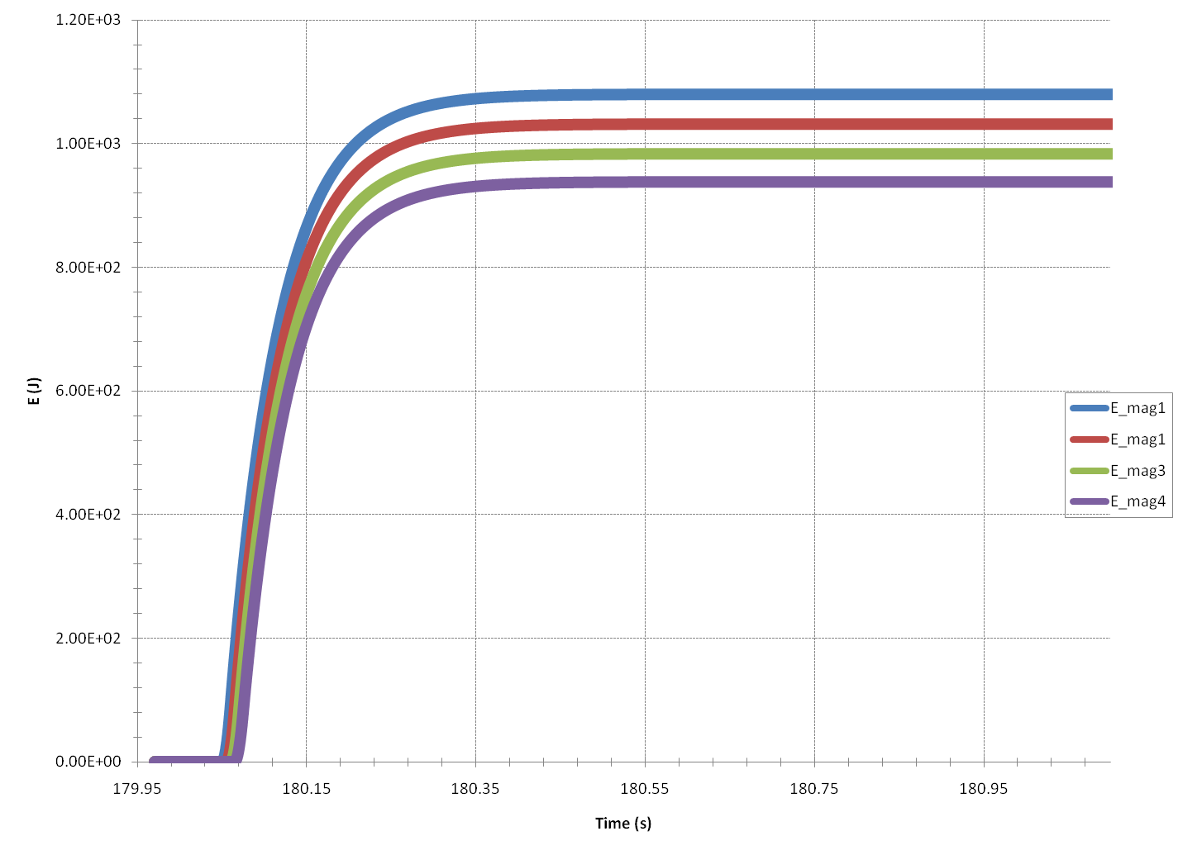
Energy dissipated in the magnet due to quench

Slide 34
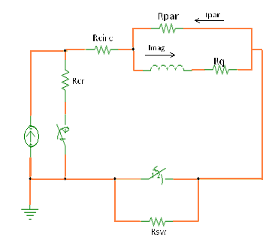
Calculation of τ circuit with 2 magnets (RQS.A34B2)

Slide 35
Calculation of τ circuit with 4 magnets (RQS.A34B2)

Slide 36
Further steps in due course
Investigation of the missing resistance in order to be more accurate in the simulation of the quenches
Clarification of the misunderstanding test and comparison of the data of PM_Browser with my simulation

Slide 37
Thank you for your attention
Merci beaucoup pour votre attantion
Ευχαριστώ για την προσοχή σας

