Slide 1



UFO Interactions at 6.5 TeV
Bernhard Auchmann, Scott Rowan
11/12/2014

Slide 2
Outline
Introduction
What is a UFO and why do we care?
What are the typical stages of a UFO interaction?
6.5 TeV Operation
Numerical Modelling of UFO interactions
Monte Carlo
Validation (Work in Progress)
Conclusions/Further Work

Slide 3
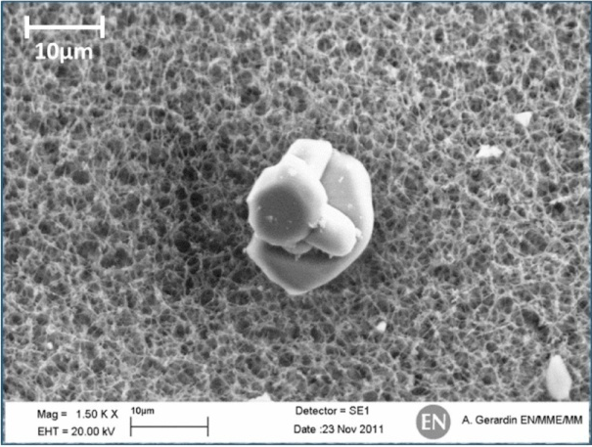
Introduction
What is a UFO-to-beam interaction?
When an “unidentified falling object”, likely a dust macroparticle, falls into the beam and results in disruptive losses, a beam dump and or magnet quench
Why do we care?
It is predicted that such event will be more likely to cause a beam dump at 6.5 TeV due to the increased energy and reduced quench margins. The resultant loss to availability could be an issue for physics production
R~10 µm
T. Bar CERN-THESIS-2013-233
What can be done?
Accurate simulations of the BLM signals can help determine the likelihood of such events causing a beam dump and could allow BLM thresholds to be optimised to improve system availability

Slide 4
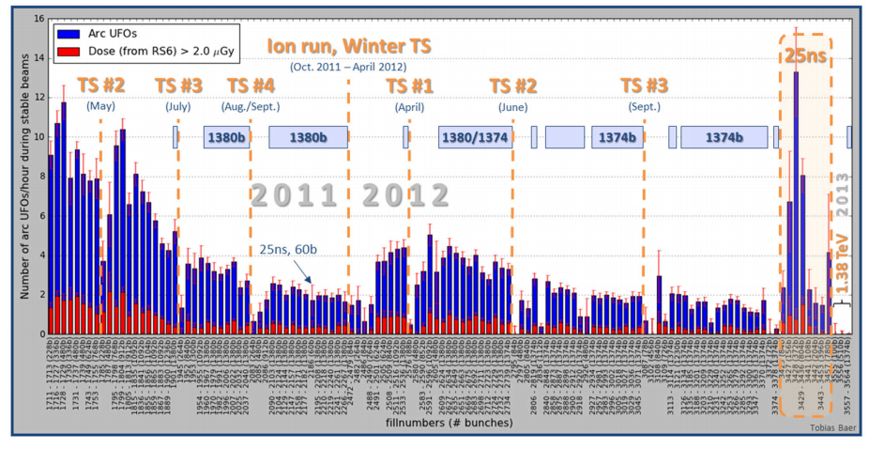
Are such events common?
UFO events per hour across Run 1
– a ‘conditioning’ has been witnessed. Notable increase after long shutdown periods and with an increase in bunch frequency to 25ns spacing
16/hr
No. Arc UFOs/hour
( yes, per hour!)
BLM Dose in Arc, May 2011-Dec 2012.

Slide 5
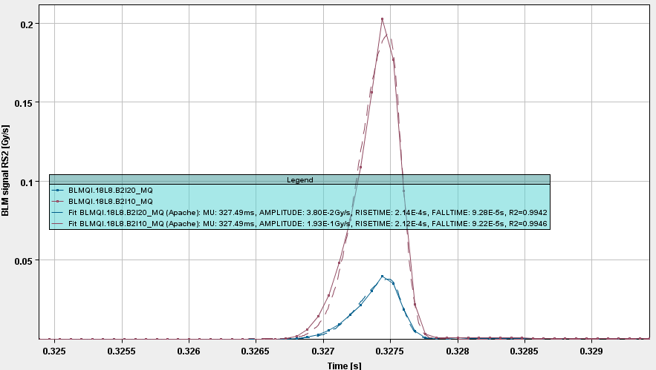
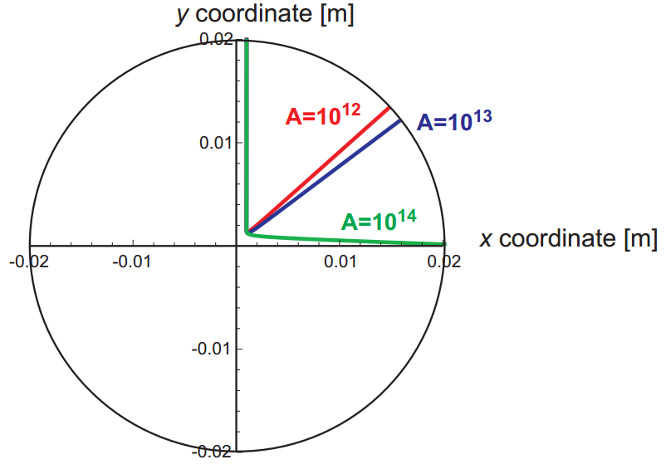
UFO-to-beam interactions
A typical UFO interaction can be described as follows:
A macroparticle (dust) falls from the top of the beam screen towards the beam with gravity, eventually colliding and causing significant losses
The macroparticle then becomes ionized through inelastic collisions with the beam and the scattering of high-energy secondary electrons
The now positively charged macroparticle is subsequently repelled away from the beam due to its electric field
Measured UFO event rise/fall time
0.2 Gy/s
Aysmmetric Gaussian
BLM Signal
F. Zimmermann et al. IPAC’10
UFO simulation for a given mass, A.
Time [500us/div]

Slide 6
BLM Signal Predictions

Slide 7
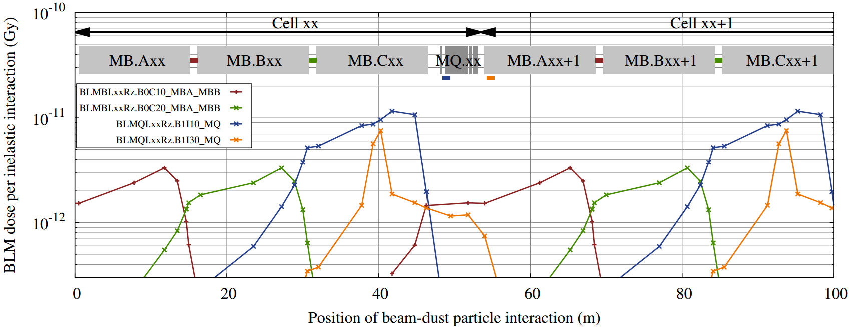
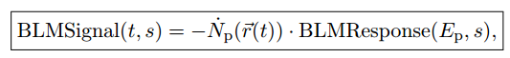
FLUKA Results 6.5 TeV
BLM ‘response’ at 6.5 TeV along a typical arc cell, according to FLUKA.
FLUKA expected doses for new BLM locations
A. Letcher - Sept 2014
The expected BLM ‘signal’ is therefore simply the product of the BLM ‘response’ and the no. of proton losses:

Slide 8
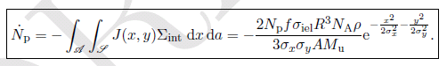
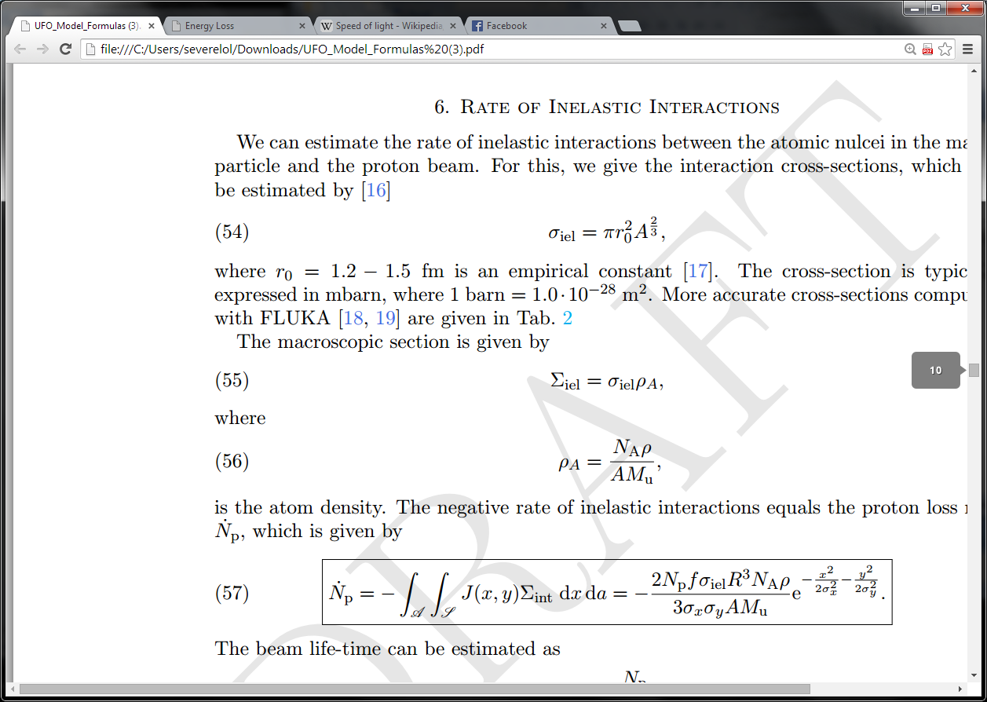
Numerical Model
The proton loss rate can be defined as the integrated number of interactions across the macroparticles ‘flight path’
– as a function of no. of protons, beam dynamics and UFO size & material
complete with watermarks!
Where:
(nucleus interaction cross-section)
(sum = cross-section * atomic density)
Now, how do we predict the ‘flight path’ of the macroparticle itself?
By the acceleration and charge rate of the UFO of course!!!

Slide 9
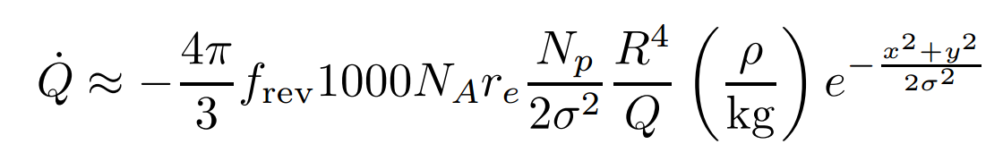
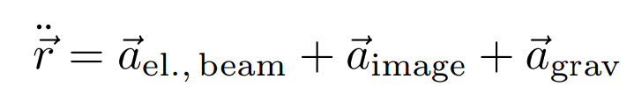
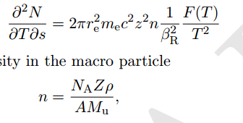
Numerical Model
Previous studies have attempted to simulate the loss-rates due to a UFO interaction. See below Zimmerman’s UFO interaction equations circa 1993-2011
(charge rate)
Presented previously
– origins and simplicity met with immediate scrutiny!
(acceleration)
Investigation found the Charge-rate equation to be derived from the Bethe-Bloch formula for stopping power due to Bremsstrahlung
(no. of secondary electrons)
(electron density of particle)
Where:

Slide 10
Charge Rate Equation

Slide 11
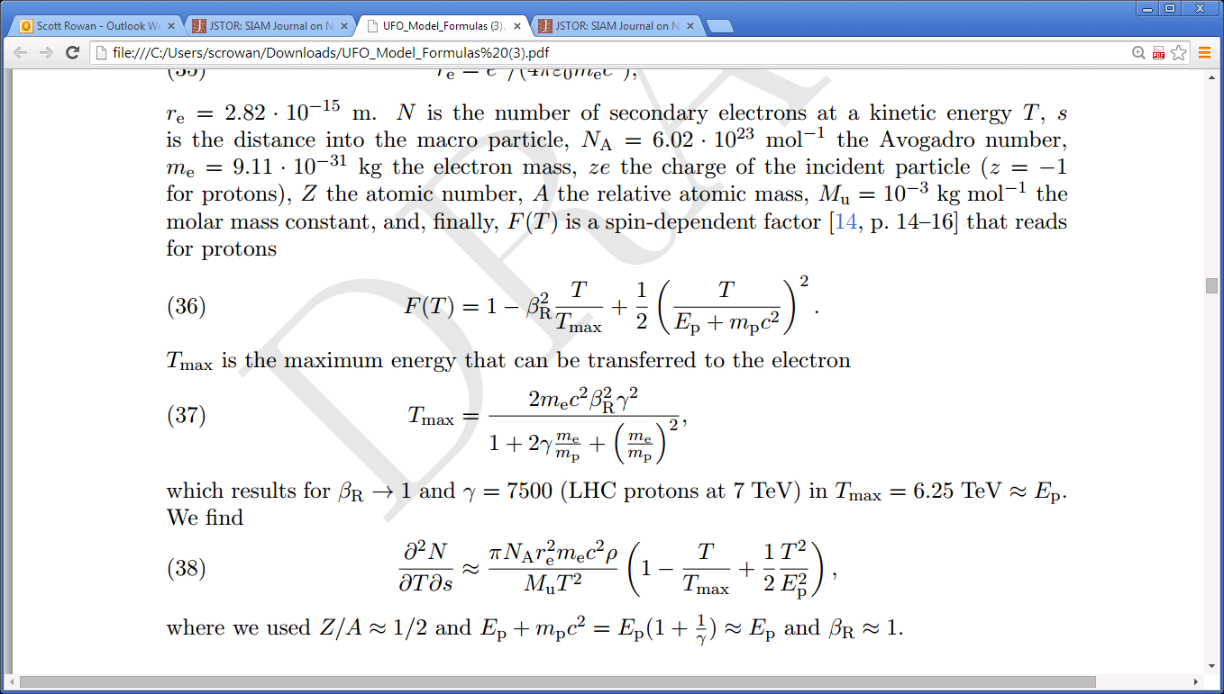
Numerical Model
Evaluating spin dependent factor and maximum energy transfer:
Spin dependant factor as a function of energy, T
Where:
As the proton beam approaches the speed of light, i.e. , the resultant rate of interactions approximates as:
Secondary electrons as a function as the interacting particles tend towards the speed of light.
Expression in bracket vanishes in the integration (see next slide).

Slide 12
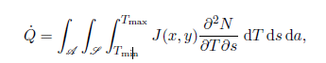
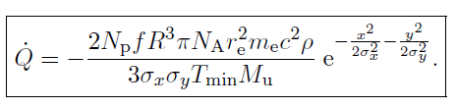
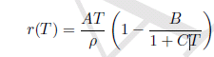
Numerical Model
The UFO charging-rate can be described as the integral of the number of interactions over a given UFO cross-section ‘A’, the path of the incident proton current density ‘J’ and the energy transferred during a collision:
The resulting charge-rate equation then becomes as follows:
For derivation, see Doc.
Another major factor is the ‘practical range’ of an electron, with given energy ‘T’, within a material, and can be given by the empirical relation:
Where: A, B & C are constants

Slide 13




Numerical Model
Another major factor is the ‘practical range’ of an electron, with given energy ‘T’, within a material, and can be given by the empirical relation:
Where: A, B & C are constants
It allows to determine whether the knock-on electron has enough energy to leave the macro-particle along an average path out of the sphere.
Eventually, the ‘Tmin’ minimum energy for ionization is given by:
Average path length
Energy to traverse average path length.
Electrostatic potential

Slide 14
Acceleration

Slide 15
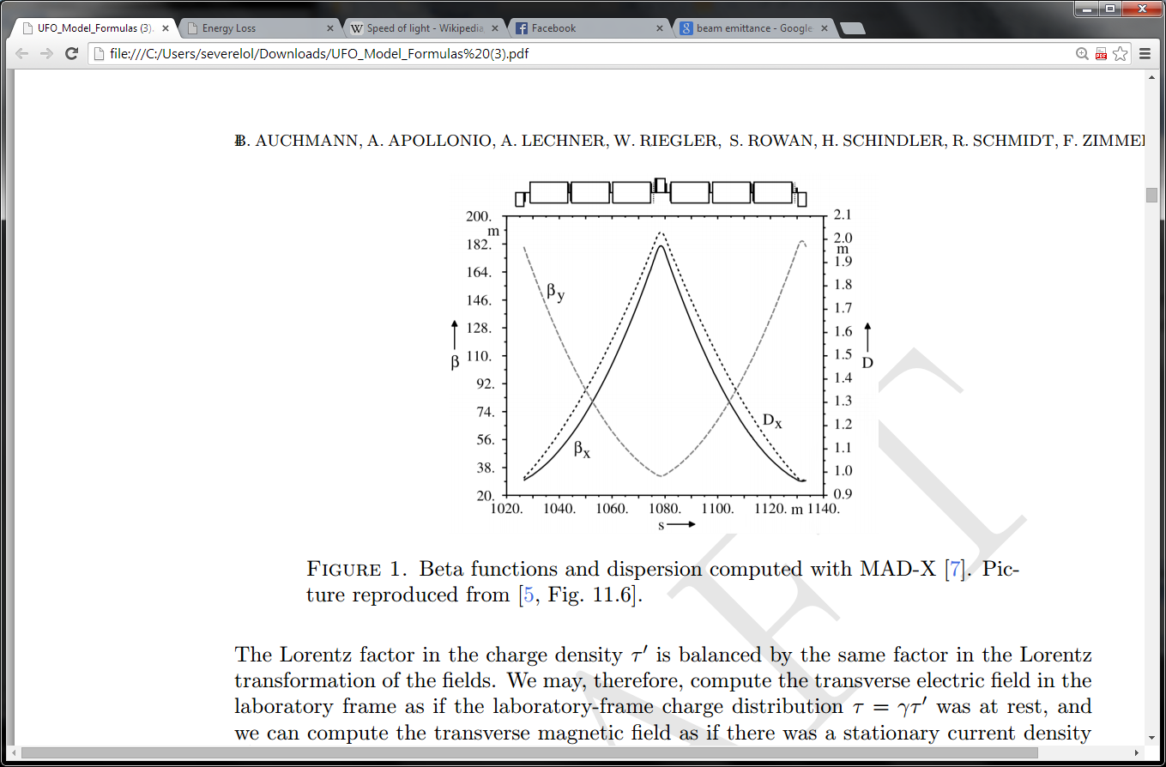
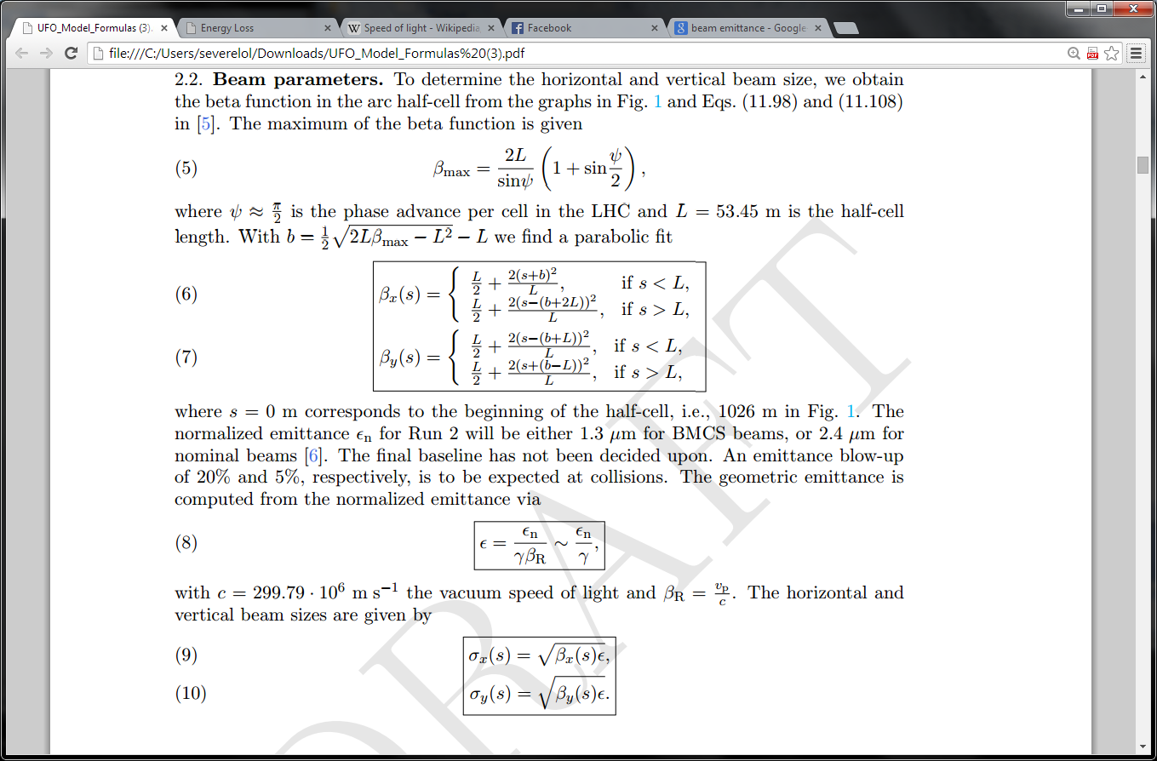
Numerical Model Revisions
No reason to alter the acceleration equation as defined by Zimmerman
(beam field)
(mirror currents)
(gravity)
To accurately model the beam fields, however, functions for vertical and horizontal beam sizes as a function of longitudinal location had to be implemented
Parabolic Fit for beta
Relation to beam size

Slide 16
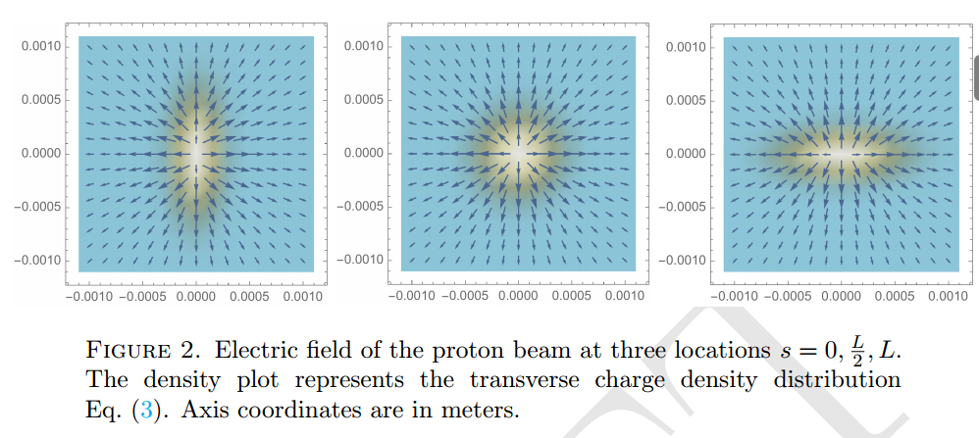
Numerical Model Revisions
Pretty Beam field plots along a standard arc cell as implemented in Mathematica

Slide 17
Numerical Model Results (preliminary)

Slide 18
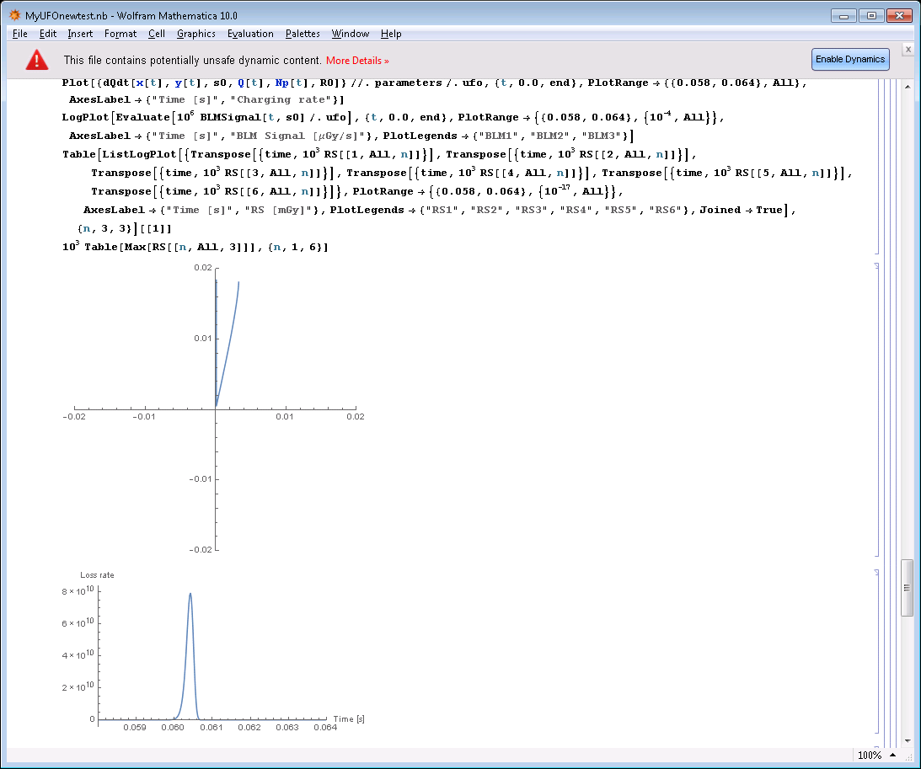
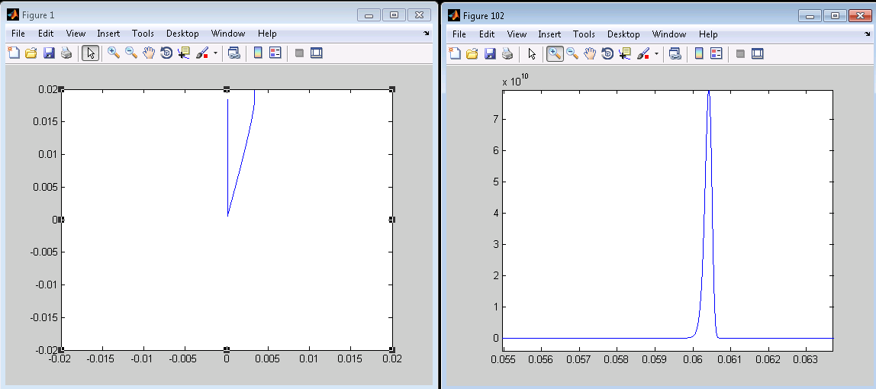
Numerical Model Results
Mathematica & MATLAB simulations of UFO interaction and corresponding loss rate
Flight Path
Loss Rate (p/s)
8x10^10 p/s
Loss rates within expected orders of magnitude
(maybe a little low)
Mathematica
Flight Path
Loss Rate (p/s)
8x10^10 p/s
Matching results for similar input parameters
MATLAB

Slide 19
MATLAB Monte Carlo

Slide 20
Input distributions
To properly simulate a variety of UFO events a Monte Carlo simulation was constructed with input distributions for:
Longitudinal Location along a full arc cell (uniform)
Transverse distribution across beam screen (uniform)
Chosen to be between +/-3mm for just now
Macroparticle Radius based on dust study in SM12 (lognormal)

Slide 21
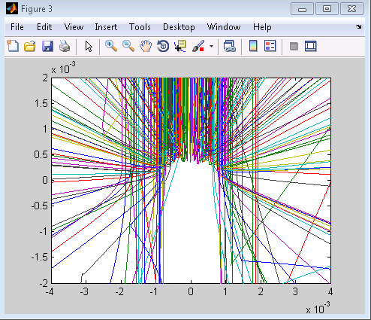
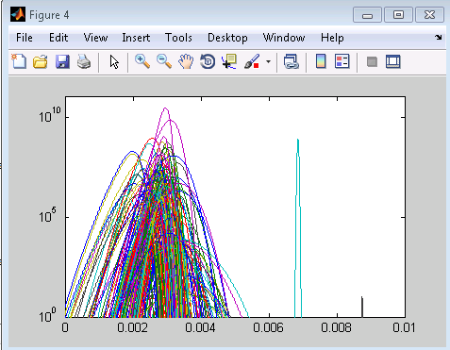
Results (very preliminary)
Monte Carlo ran with time step of 50us, 150 iterations...
Loss Rate (p/s)
10^10 (p/s)
10ms
Ignore crazy reflected ones
- Will implement restrictions
So now, simply just apply the aforementioned forumla!

Slide 22
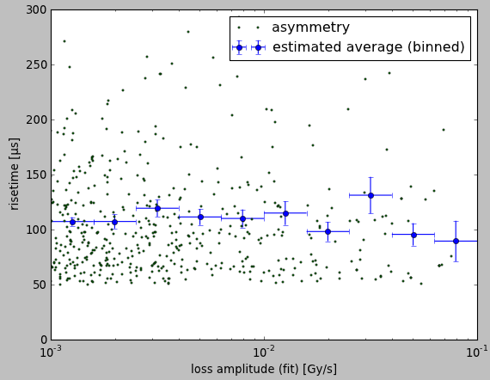
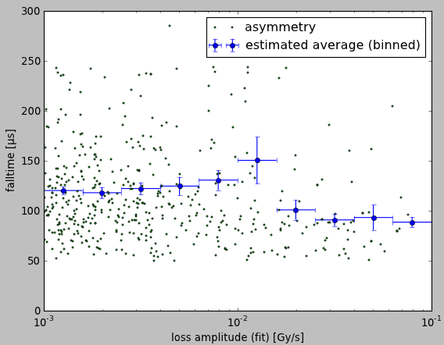
Validation
Goal is to have a randomized Monte Carlo simulation produce results similar to measure data (in progress)
Measured UFO study buffer
Circa 2012
“PRELIMINARY” T. Bar – Sept 2012

Slide 23
What’s Next?
Validated with Run 1 statistics
Filter results by those which fall within the ‘UFO event’ criteria
If max(RS(640 s; t; s))/640 s > 0:1 Gy/s then UFO!
Categorise filtered results as either:
‘beam-dump’
‘avoidable beam-dump’
‘quench despite beam-dump’
Analyse results to better predictions of the affect of UFO interactions at the onset of 6.5 TeV
Enjoy Christmas with a nice whisky!
Notes:
Mention UFO bu

