Slide 1

Validation of automated simulation framework
Michal Maciejewski
TE-MPE-PE
19.03.2014
Notes:
Hello everyone and thanks for coming.
I have a pleasure to present today summary of my first quarter here at CERN.
I will describe automated object oriented simulation framework.

Slide 2
Acknowledgements
Many thanks to Emmanuele for his support, guidance and patience during design and validation of Simulink Framework.

Slide 3
Outline
Simulink Framework Status
Model validation against QH measurements
Summary

Slide 4
Simulink Framework Status
 | Features on 12.2013 | Additional features on 03.2014 | Missing features
Simulink Features | 2D electro-thermal model | Automatic Run of Simulation Sets | GUI
 | One Excel File | Proper structure for input/output files, libraries, scripts, etc | Executable Models
 | Simscape | Link between simulations, post-processing, and data analysis | Automatic estimation of model parameters
 | OOP | Semi-automatic generation of plots showing simulation results | Automatic/Semi-Analytical calculation of Frequency Transfer Function
Notes:
(changing parameters, changing model structure)
(semi-automatic measurement/simulation comparison)
(15 minutes from choice of parameters to final plots generation)
– no need to have Matlab installed!

Slide 5
Simulink Framework Status
 | Features on 12.2013 | Additional features on 03.2014 | Missing features
New Physics / New “Hardware” | IFCL, ISCL | IFCL due to magnetic field changes in the X,Y direction | semi 3D model: 3rd dimension for 1-5 blocks
 | Dynamic inductance effects | L(I) due to iron yoke saturation and SC filament magnetization | 2D heat exchange improvement
 | Simplified Magnetic field calculation | Extended Magnetic field calculation (field in the X,Y direction depending on the current in each half pole)
 | Heat Exchange Calculation | Quench Heaters
 |  | Automatic connection of poles in different electrical order, automatic connection of CLIQ in different positions
 |  | Power Supply model: Current Source/Voltage Source
 |  | Automatic Calculation of the contact area between blocks (for Heat Exchange calculation)*
*By Kevin Sperin
Notes:
(simply a LUT)
(only for the turn where the quench starts and its neighbours; only for a limited time window where quench occurs)

Slide 6
Simulink Framework Status
 | Features on 12.2013 | Additional features on 03.2014 | Missing features
Properties | Properties for Cu, NbTi, kapton, Helium | Properties for Nb3Sn, G10 | Material library
 |  |  | Wire/Cable library
Notes:
(only for the turn where the quench starts and its neighbours; only for a limited time window where quench occurs)

Slide 7
Simulink Framework Status
 | Features on 12.2013 | Additional features on 03.2014 | Missing features
Performance Optimization | Dynamic Part Stability Check | Report Generation | LUT for material properties
 |  | Test Cases | Composite Components
 |  | Performance improvement | Performance improvement
 |  |  | Parameters Range Check
 |  |  | Vector signals
 |  |  | Extended documentation
Notes:
(only for the turn where the quench starts and its neighbours; only for a limited time window where quench occurs)

Slide 8
Quench Heater Connection – 6x62 A
P2
P1
P3
P4

Slide 9
Quench Heater Connection – 6x62 A
P2
P1
P3
P4

Slide 10
12.8 kA, QH 6x62 A – 8x18 model

Slide 11
12.8 kA, QH 6x62 A - 8x18 model

Slide 12
12.8 kA, QH 6x62 A - 8x18 model

Slide 13
12.8 kA, QH 6x62 A 8x9 model

Slide 14
12.8 kA, QH 6x62 A - 8x9 model

Slide 15
9 kA, QH 6x62 A
EE Trigger

Slide 16
9 kA, QH 6x62 A

Slide 17
6 kA, QH 6x62 A
EE Trigger

Slide 18
6 kA, QH 6x62 A

Slide 19
3 kA, QH 6x62 A
EE Trigger

Slide 20
3 kA, QH 6x62 A

Slide 21
Summary
Most important features are already implemented.
Framework is currently a subject of validation against measurements from last test campaign.
Good estimation of quench start due to quench heaters.
QH simulation underestimates the quench resistance because of the 8th half-pole

Slide 22
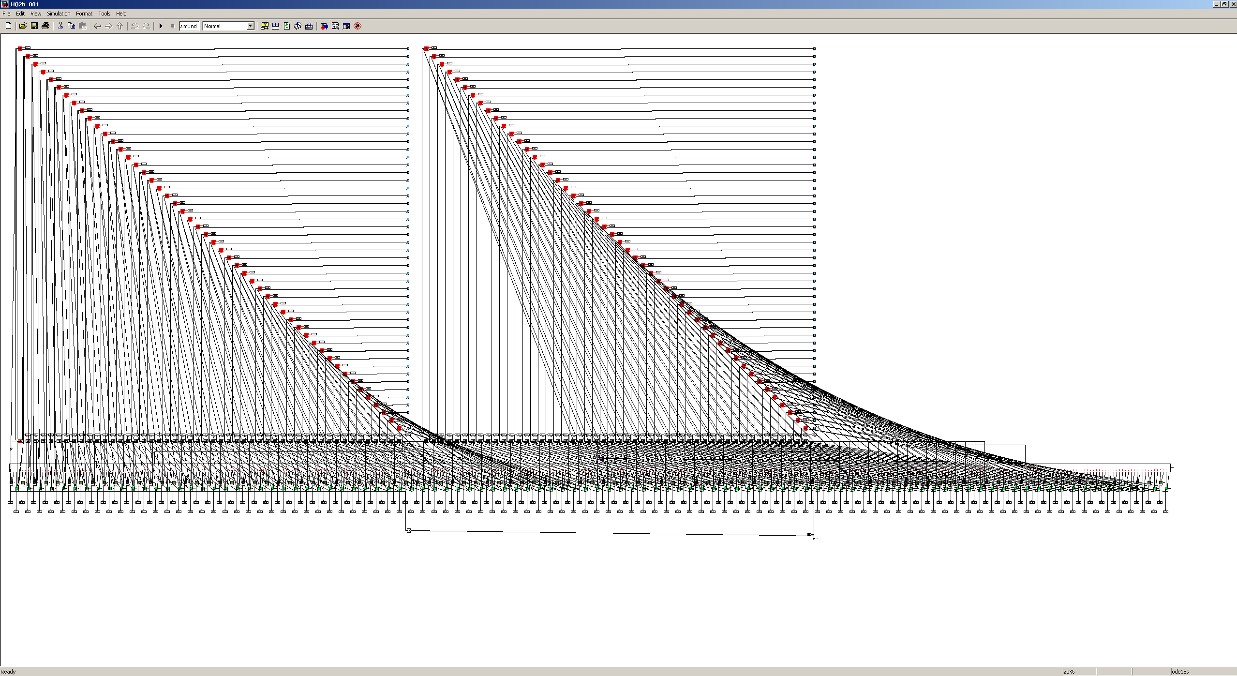
Thank you for attention!

