Slide 1
Accounting
John Gordon
WLC Workshop 2016, Lisbon

Slide 2
Outline
Not a technical discussion of what is happening in the next couple of months.
What is the long-term vision?
Cloud and Grid
Required Future Developments
Viewing and Downloading

Slide 3
Why Accounting?
Accounting should provide an independent, neutral record of resource usage from the point of view of:
  User
  VO
  Site
  e-infrastructure
  ‘Management’ (Country, Project, other)
Does your bank trust you to produce your own bank statements and balances?
Notes:
A provocative opener. I don’t really want to discuss at this point.

Slide 4
Grid and/or Cloud
While cloud accounting exists and is actively being developed, most existing use of cloud by LHC seems to be using VM-based batch workers which use traditional grid accounting.
  This includes VAC and Condor. Is this going to change?
  Experiment-based VMs which handle workloads like a pilot job does but run for a long time (a la Dirac) will bypass grid accounting and can/should use the cloud accounting of VMs.
  If all work ends up running in some cloud then can we move to cloud-only accounting?
  How to handle the grid+cloud mix?
  How do we handle the public/private cloud division?
  Is this future known or does it depend on other discussions at the workshop?
Notes:
Some of the actions in Laurence’s report have been done – Tier1 (0 sites) and T2 (5 sites) Reports

Slide 5
Cloud
Tier2 view but only 5 T2s are reporting cloud usage to APEL. (no Tier1s). Of these only 1 runs LHC work. There is LHC usage at non T2 sites.
  I know there are many tests using cloud infrastructures. Can more of them please report accounting of their VMs.
  It is not necessary to join the EGI FedCloud but if you don’t meet their criteria you may not be visible in EGI accounting, only in the WLCG views.
The infrastructure is in place.
Working on Monthly reporting (currently whole duration of VM gets accounted once)
Biggest omission is cputime. I know one pays for wall but the user has a right to know what use they have made of the VM paid for.
Issue – how to combine with commercial cloud usage.

Slide 6
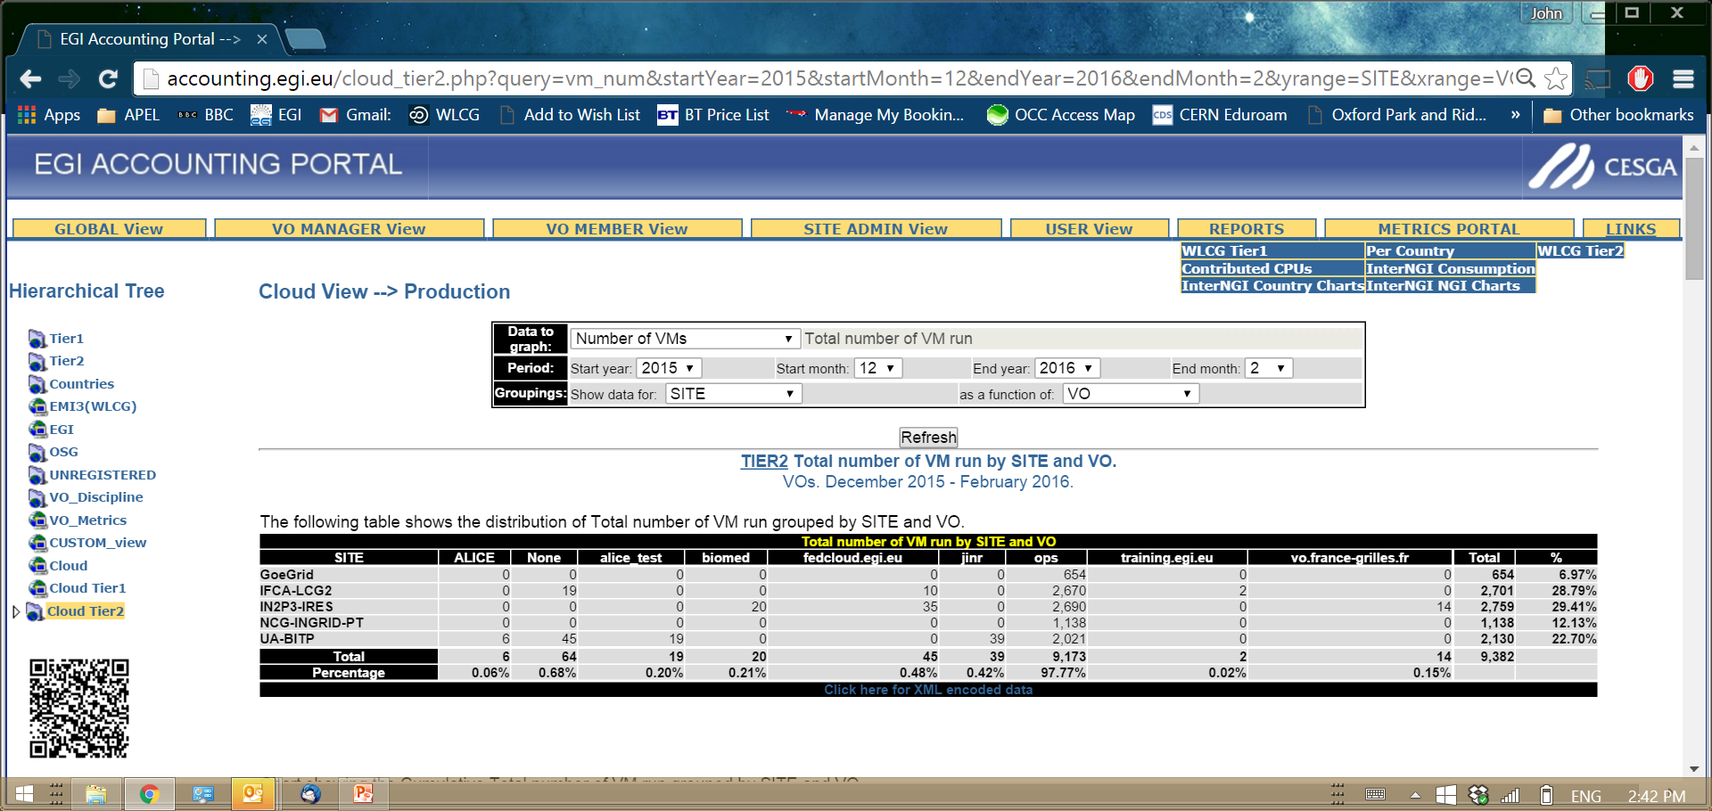
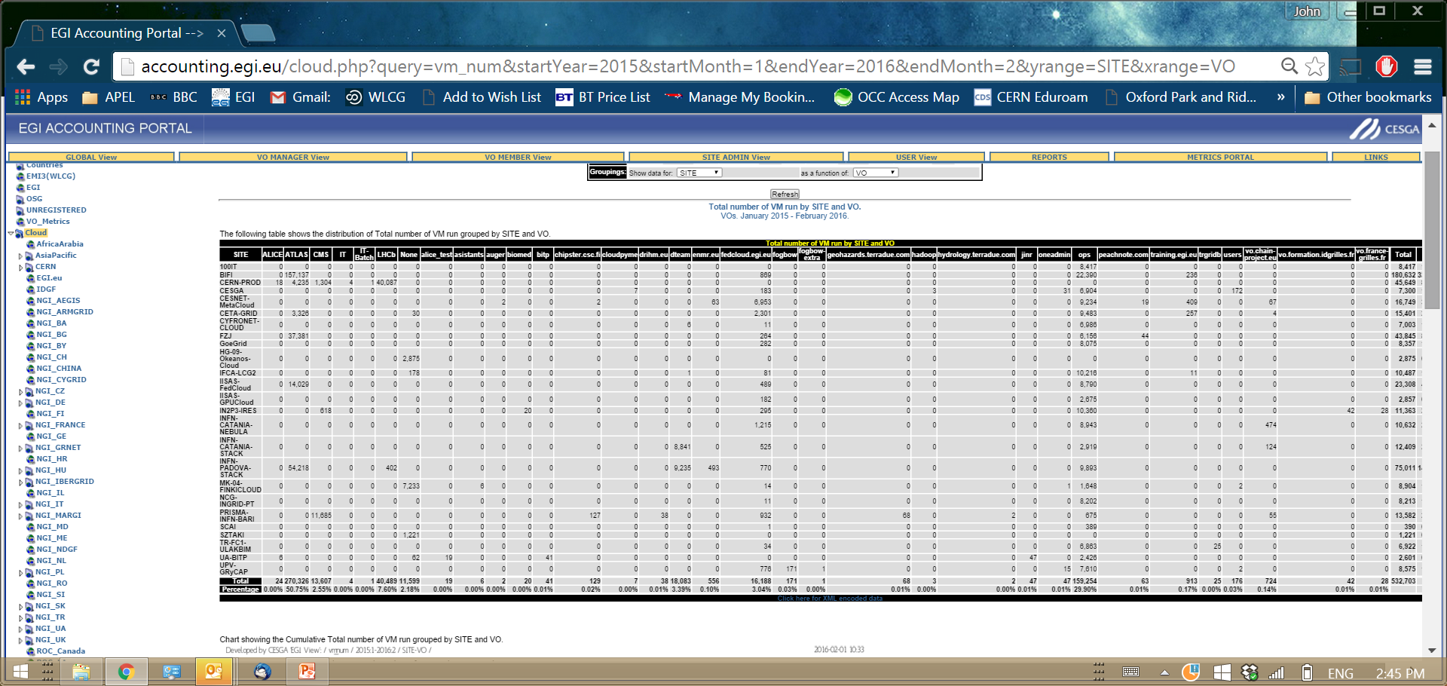

Slide 7
Accessing Accounting Information
The current portal allows limited data mining via 2-D views of a small number of parameters driven by an interactive web portal.
The portal will develop a REST interface that will allow a more programmatic download of data into experiment (or other) tools.
Experiments should be aware and can influence this development.
  What do you want to download? In what format(s) do you want it?
Dynamic access to low latency accounting for global allocations and real-time access control.
Notes:
Last bullet is difficult and a lot of work.

Slide 8
What Else Can We Account?
Storage under development.
Data Usage
Many other fields which can be recorded but we don’t currently bother (I/o, networking, memory, ???)
GPU? FPGA?
Network
Notes:
Bound be unknown new things by Run 3.

Slide 9
Other Issues
Benchmarking
Wallclock vs CPUtime
  APEL currently collects and displays both.
  A political decision

Slide 10
Benchmarking
APEL Repository needs benchmarking information to calculate normalised values for the accounting reports.
  sites that send job records send us raw cpu, wall and benchmark. We normalize.
  sites that send summaries normalize at their end and send us both raw and normalized cpu&wall.
  Non-APEL clients gather data and populate the same schema.
  In both cases the client obtains benchmark from TL BDII.
Although APEL was designed to read SubCluster benchmarks these are overriden when a site’s batch system scales its reported times. In this case (almost all sites) CPUScalingReference is used to normalise.
  When a batch system scales cpu the results are exact for each WN. No error introduced by averaging benchmark over the cluster.
  For systems that don’t scale, (GE, LSF) the APEL parser uses the scale factor providedb to normalise
APEL allows reporting one of a set of benchmarks. (SI2K, HS06)
  This allows a smooth migration when changing but comparing data cross sites and time requires an agreed conversion.
  In theory the UR could be extended to allow multiple benchmarks but the algorithms for handing, converting, etc would need to be clear and agreed.
APEL benchmark retrieval is a simple query. Could be moved to an alternative source within the timescale of a client update at all sites.

Slide 11
Wallclock or CPU?
APEL currently collects and displays both.
No technical work to collect
A political decision on what matters
Reports would need reworking

Slide 12
Discuss!

Slide 13
Wallclock and Overcommitment
 | Job1 |  |  |  |  | Cpu=3 | Wall=3
 |  |  |  | Job2 |  | Cpu=3 | Wall=3
 |  |  |  |  |  | CPU=6 | Wall=6
 |  | Job3 |  |  |  | Cpu=3 | Wall=6
 |  | Job4 |  |  |  | Cpu=3 | Wall=6
 |  |  |  |  |  | CPU=6 | WALL=12
CPU is reproducible and measured by OS. Wall can change depending on conditions.
Many reasons for overcommitment, not all planned. I/O, expedited jobs, low pri work.
Licence to generate wallclock with the uncertainties that introduces.
Can be managed by (eg) benchmark/jobslot but who can guarantee it will. Major variations will be spotted in efficiency, but will minor?

Slide 14
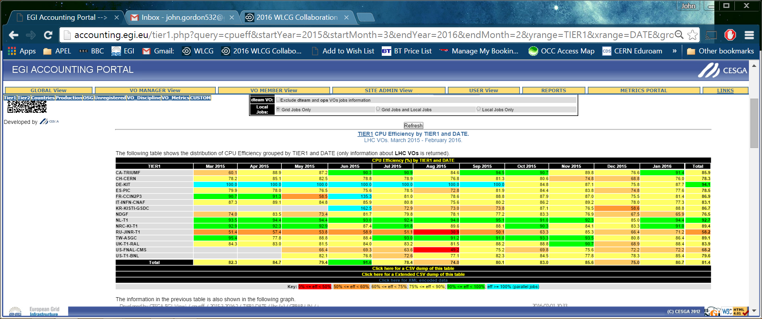
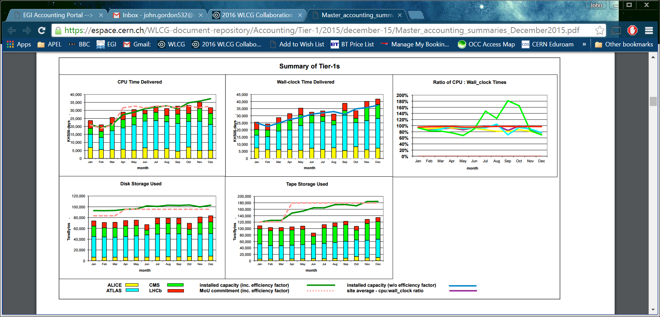

Tier1 Efficiency

Slide 15
Job Features
MJF gathers benchmarking information from the resource and gives this to the payload. Is this consistent? Raw power/cpu or normalised by batch system?
How? Sites supply $JOBFEATURES/hs06_job to each job so the information should be there to work it out from each host's HS06/processor rather than just working with cluster-wide averages.
Some experiments like ATLAS use benchmarking information to calculate resource utilisation. How? From REBUS? Is it consistent?
Who/what else uses benchmarking?

