Slide 1
Tunnel Fire Dynamics and Evacuation Simulations
James Priest, PhD & James Niehoff
DGS-SEE Seminar on Fire Protection for Physics Research Facilities
7 & 8 October 2015

Slide 2
Introduction (Background)
Presentation data based on Hughes Associations Inc. (HAI) report and presentation of May 2010, in support of a International Linear Collider (ILC) conceptual design addressing a single tunnel 100m (328ft.) and 30m (100ft.) below the surface
Main LINAC & Damping Ring Tunnel diameter sizes included 4.5m (14.75ft), 5.0m (16.4ft) 5.5m (18ft), and 6.5m (21.3ft)
Total lLC Tunnel length 29.6km (18 miles)
Pumps, oil filled transformers, mineral oil, office furniture, office related equipment (significant combustible loads) will be located above ground

Slide 3
Goals
Understand the spread of fire and smoke in the Main LINAC and Damping Ring tunnels
  Understand fire and smoke behavior for a range of tunnel diameters
Determine the fire size required to create untenable conditions in the tunnel before occupants can evacuate
Analyze the fuel loads in the Main LINAC and damping ring tunnels and base caverns and assess fire scenarios
Develop guidelines for tunnels and base caverns that will allow occupants in the tunnel to evacuate safely in the event of a fire

Slide 4
Approach
Research tunnel fire dynamics
Model representative tunnel fire scenarios using FDS to analyze the effects of:
  Smoke movement
  Fire size
  Fire location (tunnel or base cavern)
Determine the time required for occupants to evacuate
Determine the maximum fire size that will allow occupants to evacuate safely

Slide 5
References (Partial)
Beard A. and Carvel R., “The Handbook of Tunnel Fire Safety,” Thomas Telford Publishing, London 2005
Hu, L., H., Huo, R., Chow, W.K., Wang, H.B., & Yang R.X, “Decay of Buoyant Smoke Layer Temperature along the Longitudinal Direction in Tunnel Fires,” Journal of Applied Fire Science, 2005
Babrauska V., “Heat Release Rates,” Chapter 3, Society of Fire Protection Engineering Handbook of Fire Protection Engineering 4th Edition, National Fire Protection Association (NFPA) Quincy, MA 2008
Bryan, J. “Behavioral Response to Fire and Smoke,” Chapter 12, Society of Fire Protection Engineering Handbook of Fire Protection Engineering 4th Edition, National Fire Protection Association (NFPA) Quincy, MA 2008

Slide 6
Tunnel Fire Dynamics
Smoke movement in level, naturally ventilated tunnels
U
Smoke layer moves uniformly in both directions away from fire at velocity U
U
Entrained air
Entrained air
Fire location
Near the fire, the smoke layer is hot (strong buoyancy) and remains close to the ceiling with little mixing.
As the smoke moves away from the fire, cooling occurs causing smoke to loose buoyancy. Descending smoke mixes with the entrained air and is drawn back towards the fire. This is referred to as “back-layering”

Slide 7
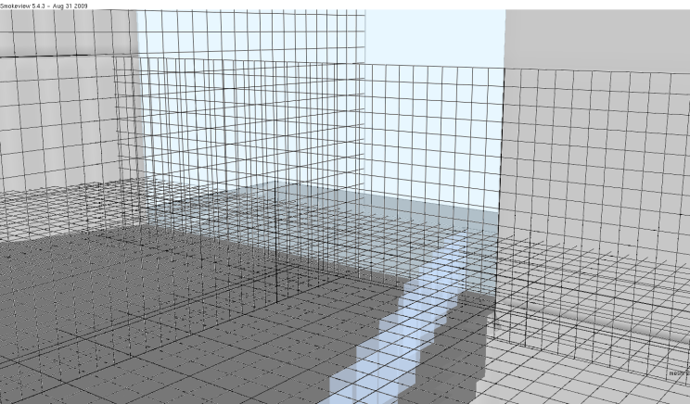
Fire Dynamics Simulator (FDS) (How)
Developed by the National Institute of Standards and Technology (NIST)
  Computational fluid dynamics (CFD) software
  Specifically formulated to calculate heat and smoke transport from fires
  Extensively validated against experimental data
Model comprised of one or more numerical domains (meshes)
  Each domain divided into rectilinear numerical grid

Slide 8
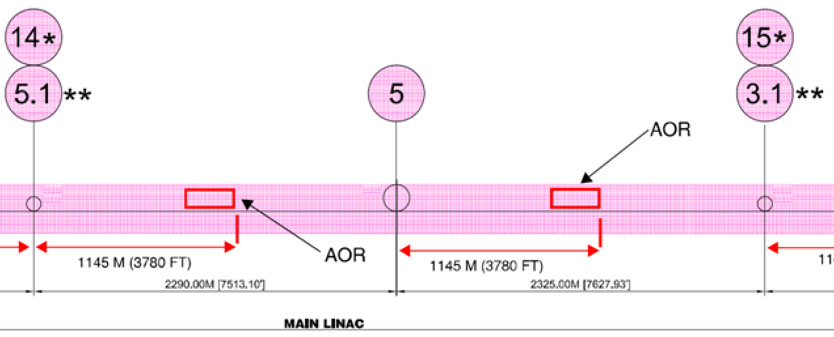

Main LINAC Fire Scenarios
Representative fire scenarios
  Model using the Fire Dynamics Simulator (FDS)
Scenario 1: Fire located between vertical exits representing the maximum travel distance to vertical exits
Scenario 2: Fire in base cavern represents the maximum travel distances for occupants to area of refuge (AOR)

Slide 9
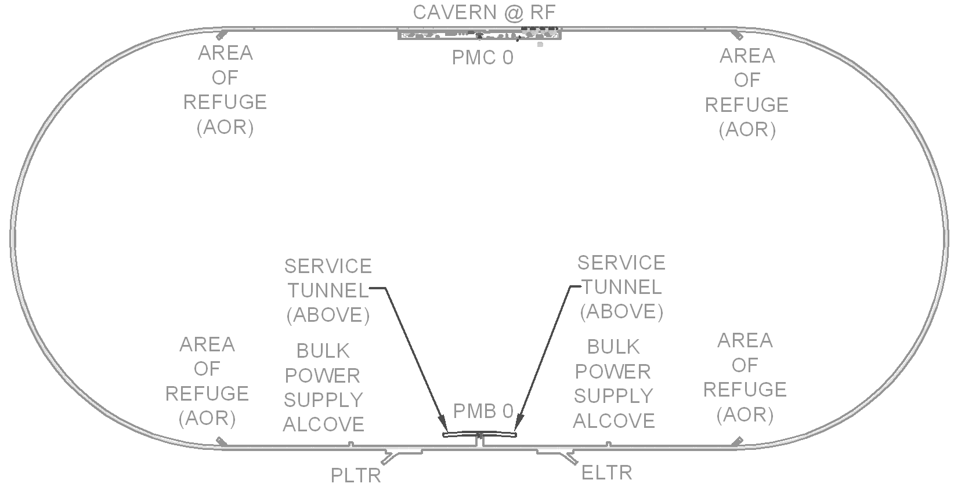
Damping Ring Fire Scenarios
Representative fire scenarios
  Fire scenarios not modeled in damping ring base cavern and straight section housing wigglers since it is isolated from open tunnel areas by isolation barriers
Scenario 1: Fire located in straight portion of damping ring
Scenario 2: Fire located in curved portion of damping ring

Slide 10
Fire Model: Potential Fire Scenarios
Cable Tray Fires
  Low cable loadings
  Cables embedded under concrete floors or encased in rigid conduit
Miscellaneous Combustibles
  Trash
  Other combustibles
Pool / spill fires
  Rapid growth
  Primary fuel present is transformer oil (mineral oil)
  Multiple components in ILC tunnel and base cavern contain oil
  One 76 meter section of tunnel may contain up to 470 gallons of oil
  Largest quantity of oil in single component is a 100 gallon tank housed in a step down transformer
Pool / spill fires represent the most demanding fire scenarios

Slide 11
Pool/Spill Fires
Pool fires are defined as the burning of liquids in a contained area (i.e. dike) → burning area is constant
Spill fires refer to the burning of an unconfined area of liquid fuel
  Continuous spill → burning is fed by a flow of spilling fuel
  Unconfined spill → fixed volume of fuel is spilled on a surface and burns until fuel is consumed
Pool/spill fires grow to peak size at rapid rate
  Model fires as instant growth, steady burning
Incremental fire sizes simulated for each scenario in FDS model
  Determine maximum fire size which allows for safe egress of tunnel occupants
  Determine maximum pool fire area
  Determine maximum spill rate

Slide 12
Fire Modeling Approach
Create tunnel geometry in FDS
  Tunnel geometry remote from fire incorporating 12.7cm (5 inches) x 12.7cm (5 inches) x 30cm (12 inch) cells
Model Main LINAC, base caverns, and Damping Ring for a range of tunnel diameters
  4.5m (14.75ft), 5.0m (16.4ft) 5.5m (18ft), and 6.5m (21.3ft) tunnel diameters
Model tunnel length of 500m (1,600ft.) to determine maximum smoke filling rates.
Determine expected occupant travel speeds and use FDS models to determine maximum fire size that can be tolerated such that the smoke travel rate is less than the occupant travel speed.

Slide 13
Assumptions and Limitations
Hughes recommends sprinkler protection throughout; however, 5m diameter tunnel was also modeled without sprinklers
Excludes any construction scenario
Tunnel Ventilation
  Airflow velocities were assumed to be less than 1 m/s
  Smoke exhaust is not modeled, nor assumed to be provided
  Airflow effects in tunnel caused by temperature-driven flow in vertical shafts and/or wind effects above ground were not considered – vertical shafts were considered sealed
  No considered for smoke may vent from the base cavern fire into vertical access shafts – again access shafts were considered sealed

Slide 14
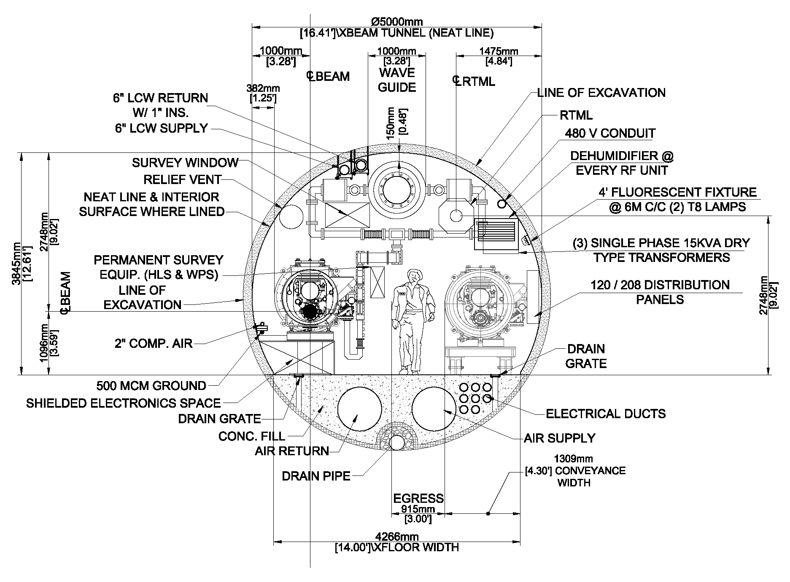
Main LINAC Section Drawing

Slide 15
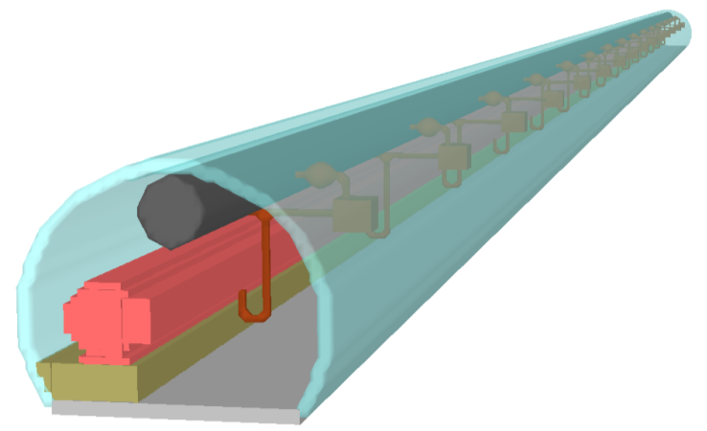
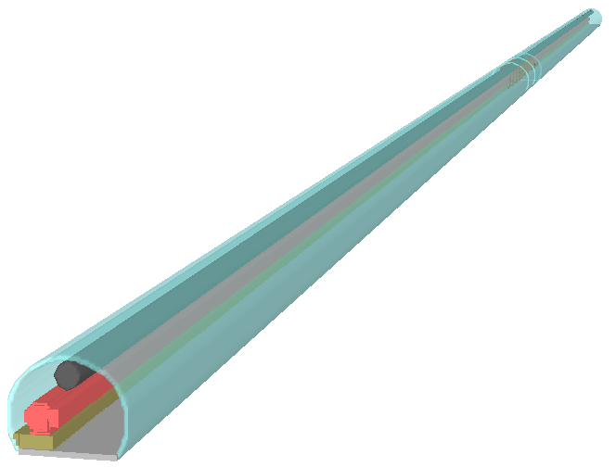
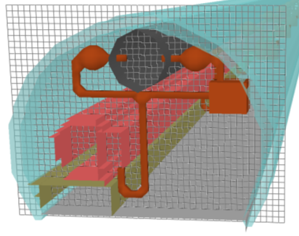
Main LINAC Tunnel FDS Geometry
22 m long near-field tunnel section
Fire modeled in center of high-fidelity tunnel section
12.7cm cells – isometric view showing grid
400 m long tunnel section.

Slide 16
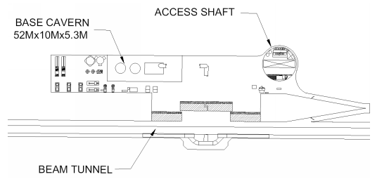
Base Cavern

Slide 17
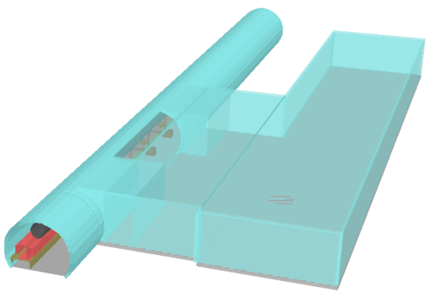
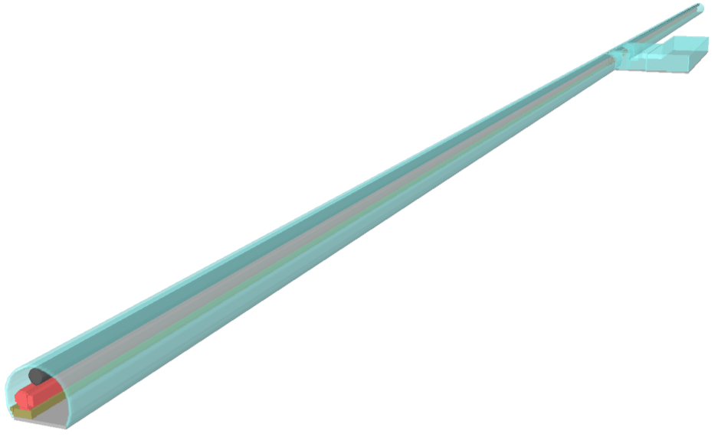
Base Cavern and Tunnel FDS Geometry
Base cavern height assumed to be approximately the same height as tunnel
Fire Location
(Near Tunnel)

Slide 18
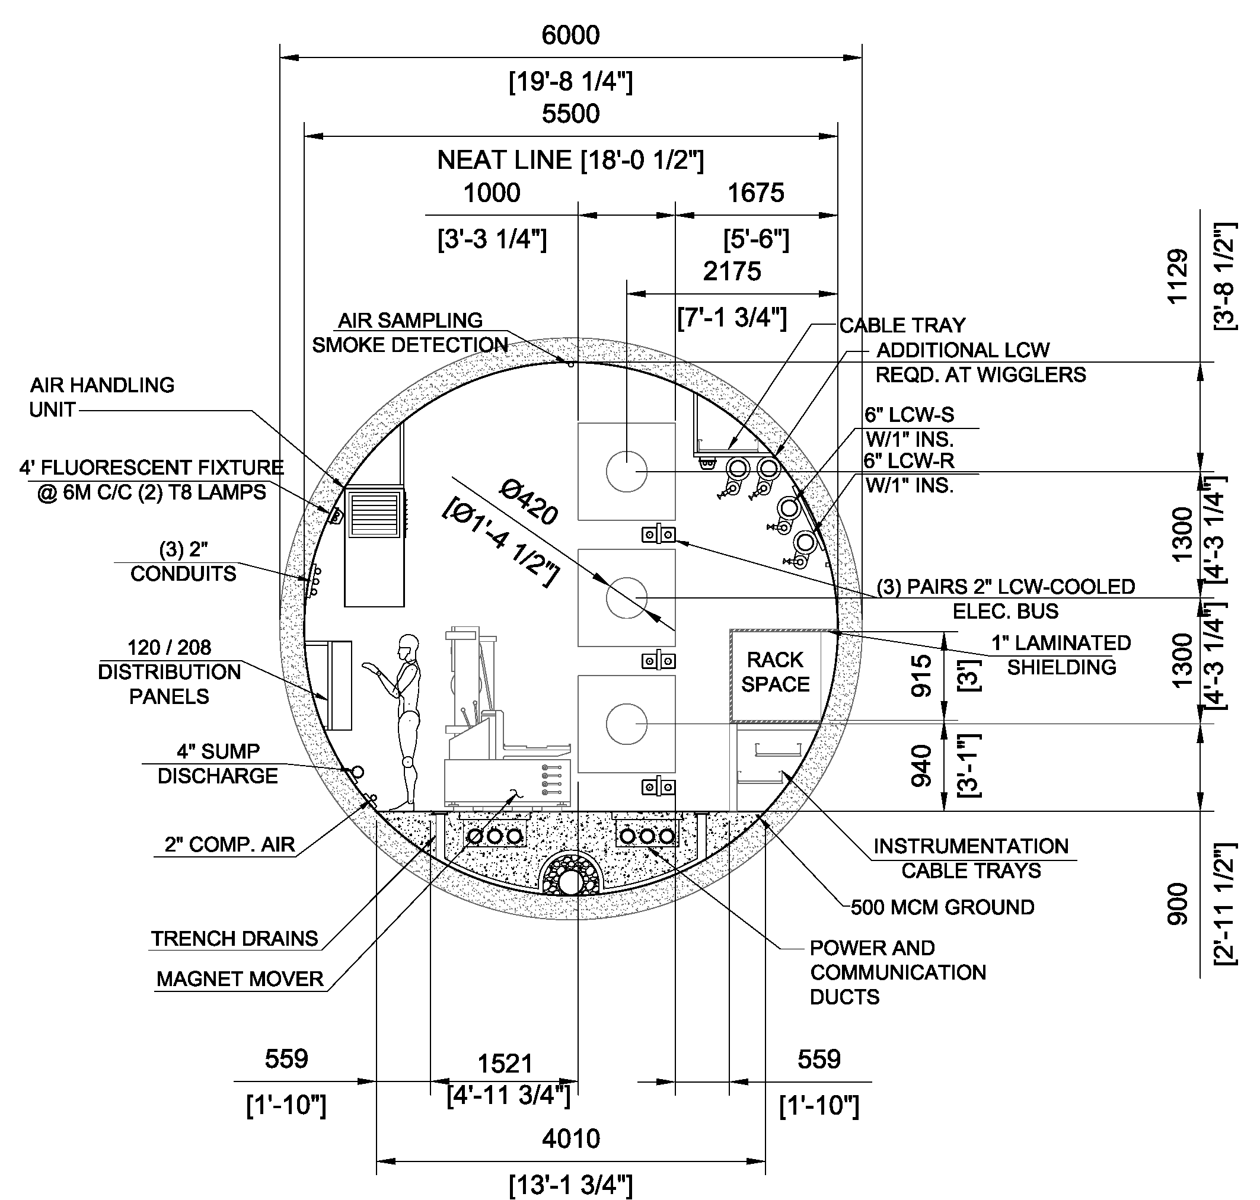
Damping Ring Drawing Section

Slide 19
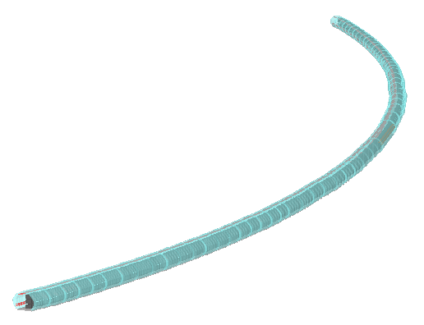
Curved Damping Ring Tunnel FDS Geometry
Curved and straight tunnel sections modeled
Fire located in center of high-fidelity tunnel section

Slide 20
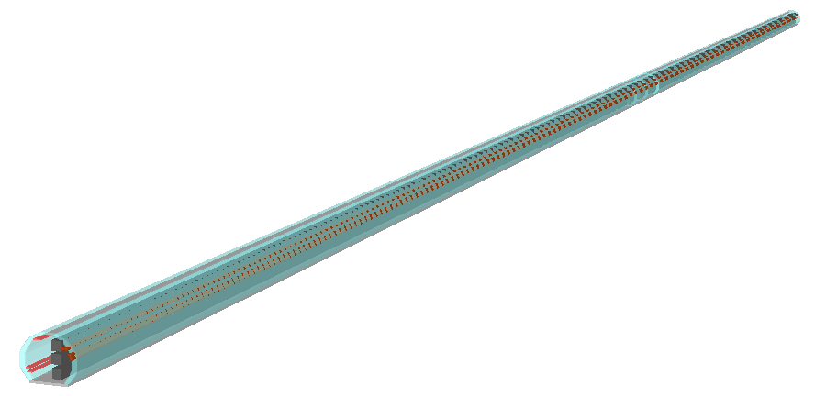
Straight Damping Ring Tunnel FDS Geometry
Curved and straight tunnel sections modeled
Fire located in center of high-fidelity tunnel section

Slide 21
Occupant Egress
Occupant load of 50 people per egress area (tunnel space between two shafts)
  Approximately 70 m² (753.5 sq. ft.) per occupant
Given the low occupancy load in the tunnel:
  Queuing (congestion) would not occur in tunnel during an emergency
  Occupant travel speeds would be consistent with normal “walking speeds” on uncongested, level pathways
    Occupant loadings of lesser density than 3.3 m² (35.5 sq. ft.) per occupant would not be expected to reduce travel speeds
Occupant characteristics
  Occupants are generally assumed to be able-bodied adults who are awake and aware of their surroundings
  It is possible that occupants may be injured during an evacuation causing reduced walking speeds

Slide 22
Walking Speed
A review of data on walking speeds indicates:
  Average walking speeds of 1 m/s to 1.4 m/s for adults without locomotion disabilities
  Average walking speed of 0.95 m/s for adults with crutches or with a locomotion disability requiring no walking aid
  Average walking speed of 0.72 m/s for adults with locomotion disability who require pauses for rest
Walking speed criteria for analysis
  1 m/s to escape from area of fire origin and beyond initial “back-layering” of smoke
  0.7 m/s once the occupant has moved beyond initial “back-layering” to allow for brief rest periods without being overcome by smoke

Slide 23
Tenability Criteria
The rate at which tenability decreased in the tunnel was assessed using the following criteria.
  Quantities measured 1.8 meter (6 feet) above floor
Visibility is the critical tenability criterion (i.e. visibility is lost before other tenability criteria are exceeded)
  Results presented in terms of visibility
Criteria | Limit
Temperature | < 76 °C (168 °F)
CO Concentration | < 1,200 ppm
O₂ Concentration | > 17% by volume
Visibility | > 10 m (30 ft)

Slide 24
Results of FDS Modeling
For each tunnel diameter modeled, the maximum fire size which can be sustained while allowing occupants to outrun smoke was calculated
  Corresponding pool fire sizes and spill volumes were calculated
Sprinklers cool the smoke layer but only have a moderate effect on slowing the spread of smoke down the tunnel
  Sprinklers would be expected to limit fire spread
Limiting fire sizes calculated for the Main LINAC were the same as those for the straight damping ring sections
  Fire size is a more important driver than tunnel obstructions

Slide 25
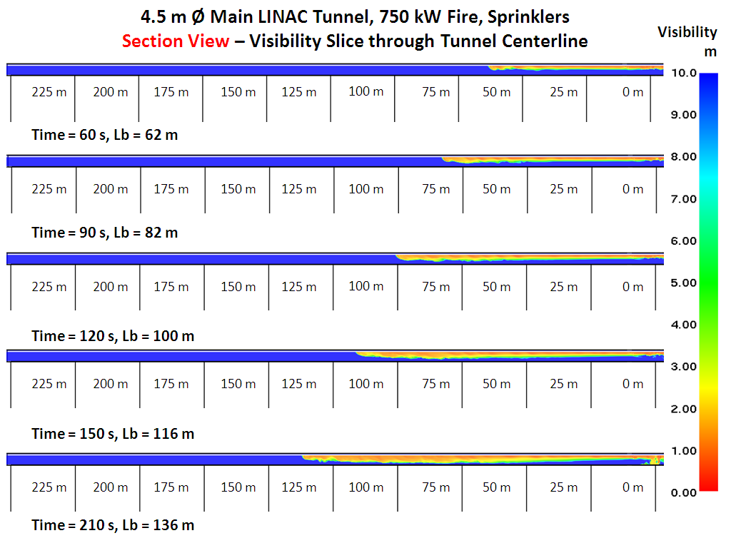
Main LINAC Tunnel Fire Results
Onset of back-layering
Back-layering fully developed

Slide 26
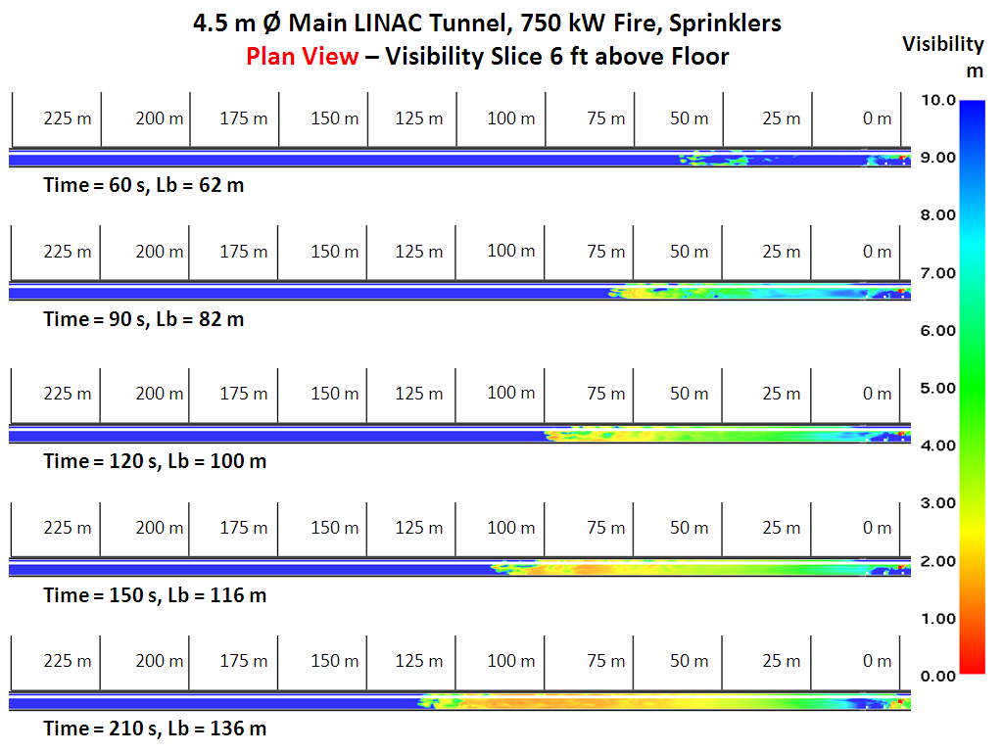
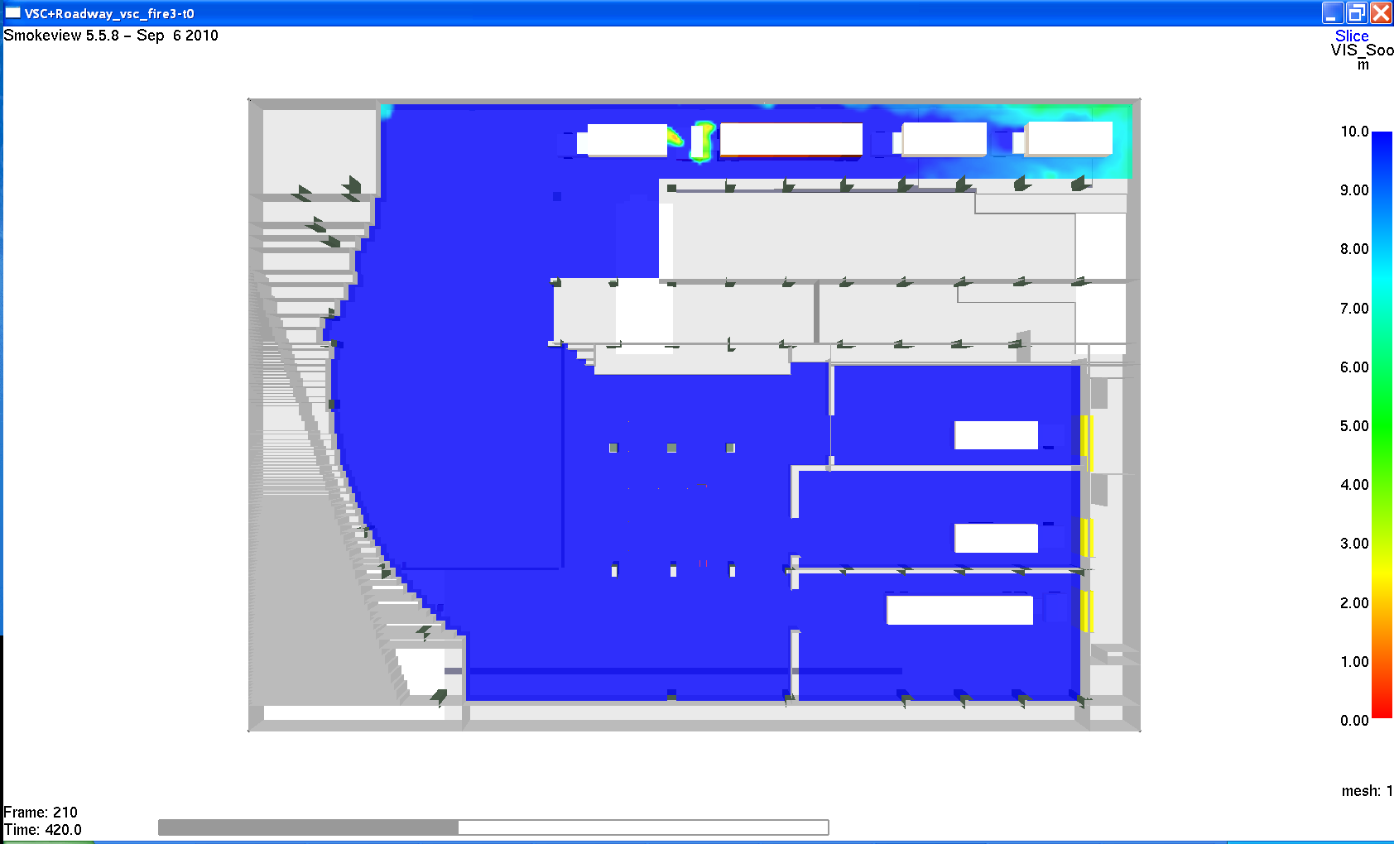

Main LINAC Tunnel Fire Results
Visibility
m
Onset of back-layering
Occupants must travel 1.0 m/s up to this point
Occupants travel 0.7 m/s beyond this point
Back-layering fully developed
Travel speed required to outrun back-layering = 1.03 m/s
Travel speed required to stay ahead of smoke layer = 0.63 m/s

Slide 27
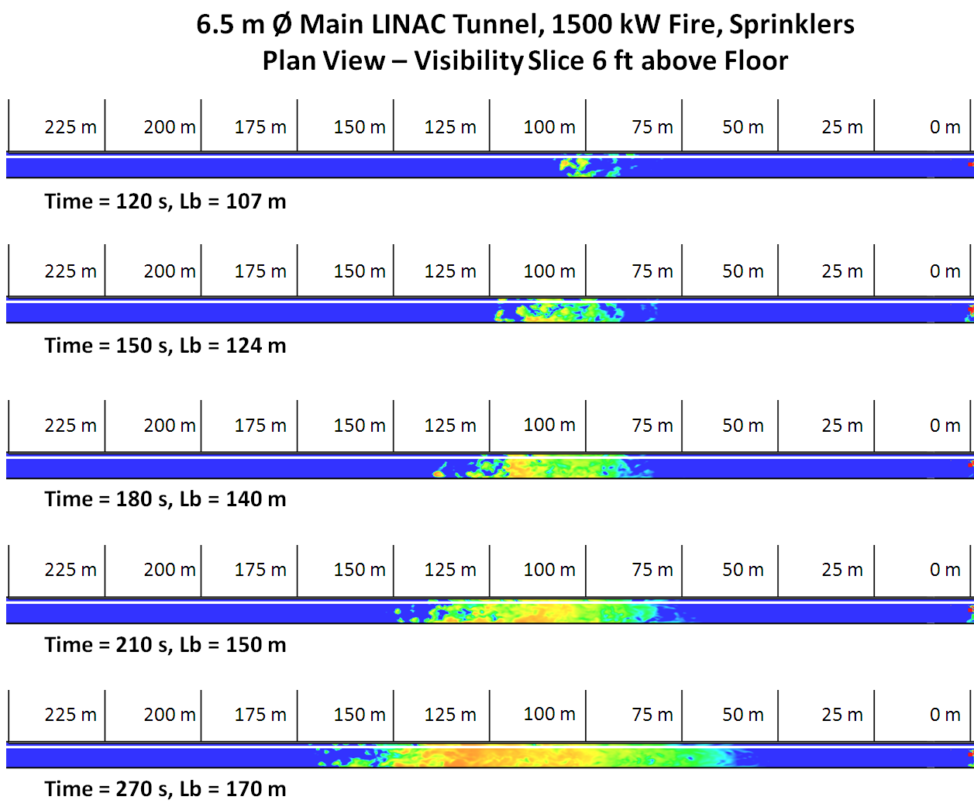
Main LINAC Tunnel Fire Results
Visibility
m
Onset of back-layering
Occupants must travel 1.0 m/s up to this point
Occupants travel 0.7 m/s beyond this point
Back-layering fully developed
Travel speed required to outrun back-layering = 1.03 m/s
Travel speed required to stay ahead of smoke layer = 0.63 m/s

Slide 28
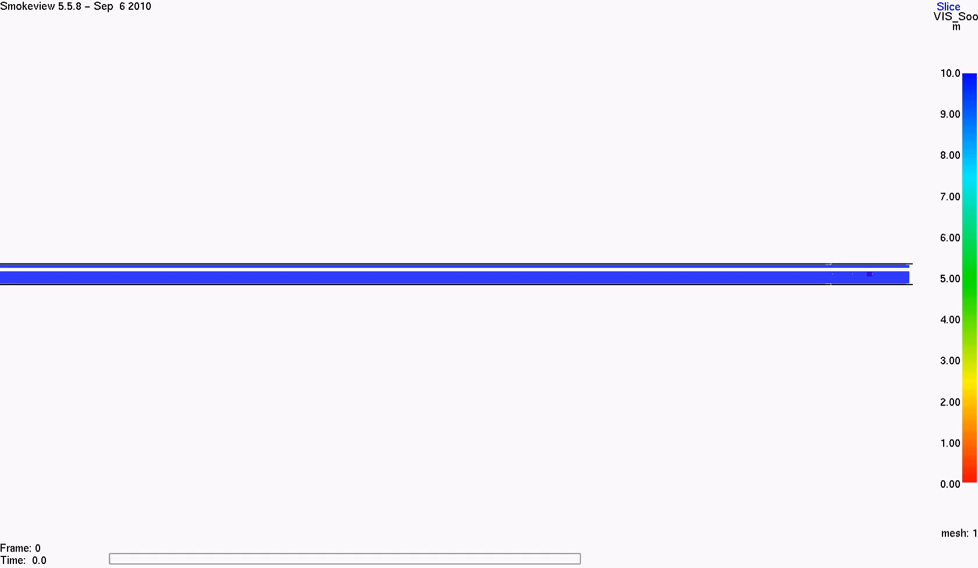
5m Tunnel Fire Animation 1,000kw Fire Size Plan View

Slide 29
Summary of Tunnel Fire Results
Tunnel Diameter (m) | Limiting Fire Size (kW) | Maximum Fuel Spill Area (m²) | Maximum Unconfined Spill Rate (L/min)
4.5 | 750 | 0.8 | 1.3
5.0 | 1,000 | 1.0 | 1.7
5.5 | 1,100 | 1.1 | 1.9
6.5 | 1,500 | 1.4 | 2.6
Results for Main LINAC apply to straight portions of damping ring tunnel
  Smoke movement is essentially the same in straight tunnels of the same diameter. The difference in obstructions between the Main LINAC and damping ring have a minimal effect.

Slide 30
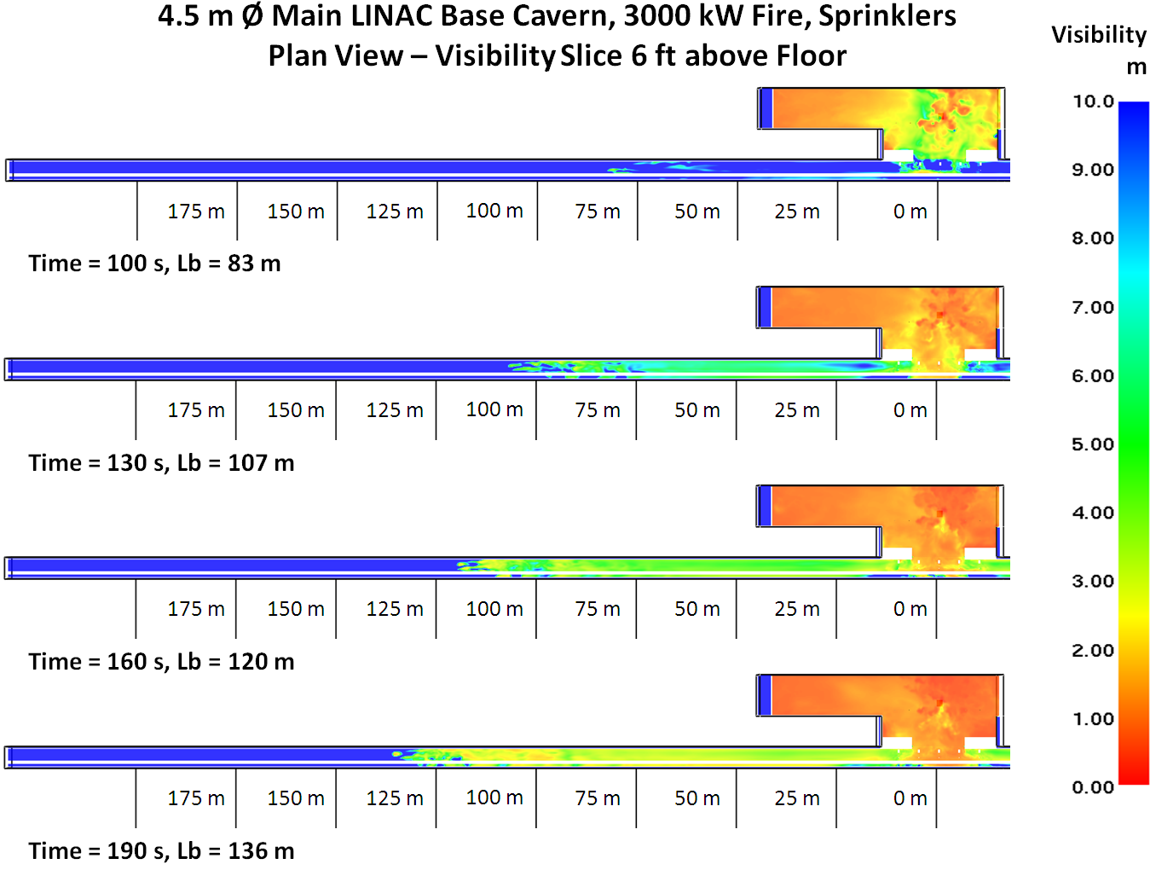
Base Cavern Fire Results
1.0 m/s
0.7 m/s
Travel speed required to outrun back-layering = 0.83 m/s
Travel speed required to stay ahead of smoke layer = 0.62 m/s

Slide 31
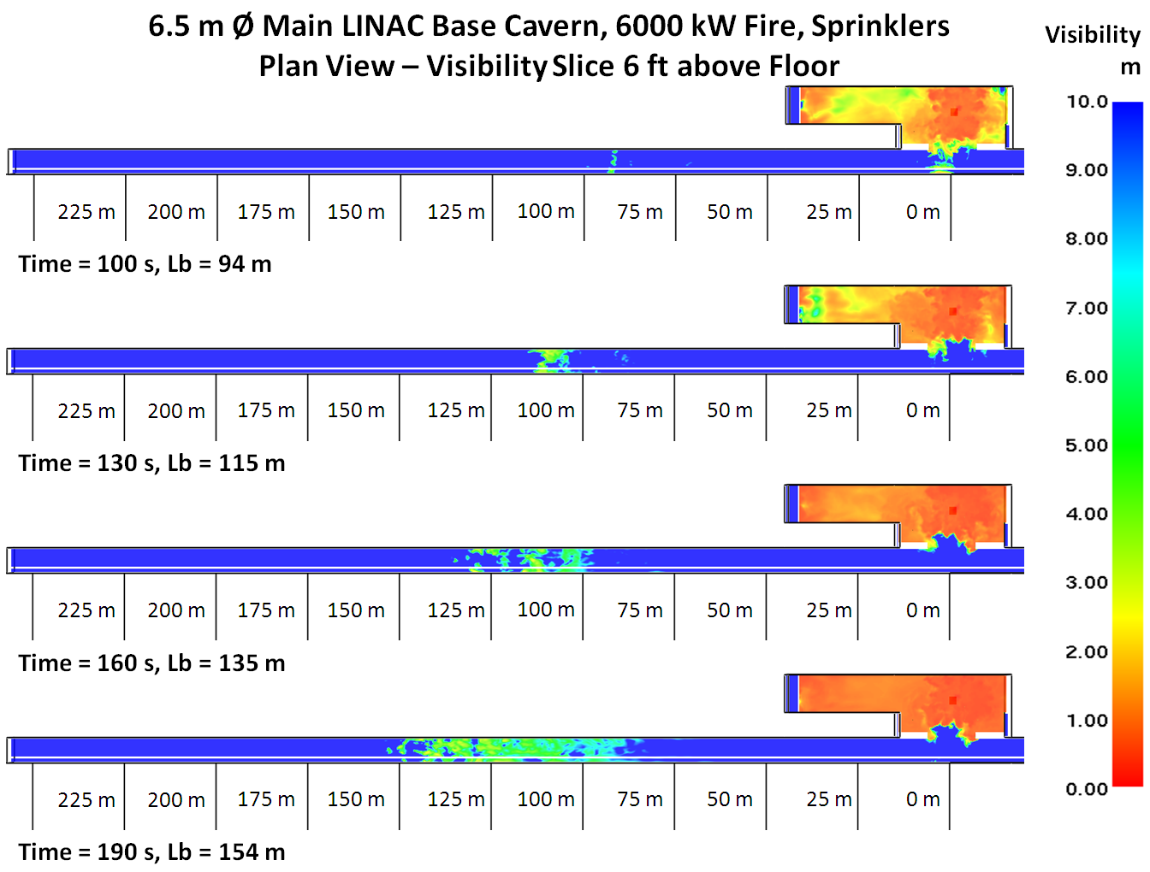
Base Cavern Fire Results
1.0 m/s
0.7 m/s
Travel speed required to outrun back-layering = 0.94 m/s
Travel speed required to stay ahead of smoke layer = 0.73 m/s

Slide 32
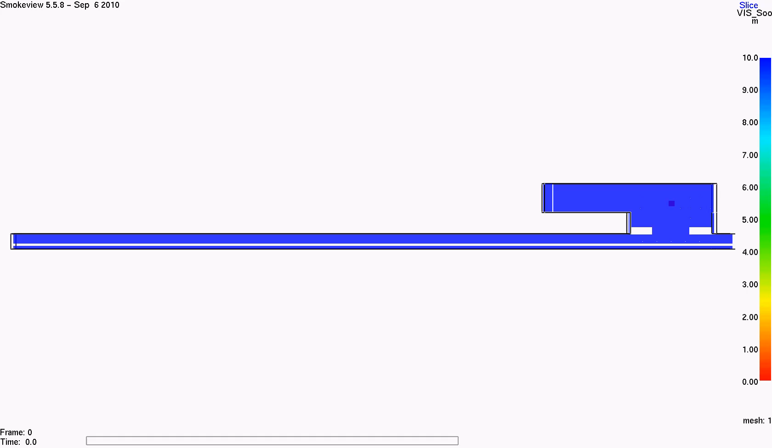
5m Base Cavern Fire Animation (4,000kw Fire Size) Plan View

Slide 33
Summary of Base Cavern Fire Results
Tunnel Diameter (m) | Limiting Fire Size (kW) | Maximum Fuel Spill Area (m²) | Maximum Unconfined Spill Rate (L/min)
4.5 | 3,000 | 2.4 | 5.1
5.0 | 4,000 | 3.0 | 6.8
5.5 | 4,500 | 3.3 | 7.7
6.5 | 6,000 | 3.6 | 10.2
Smoke spills out of the base cavern and impacts tunnel walls causing the ceiling jet velocity to decrease

Slide 34
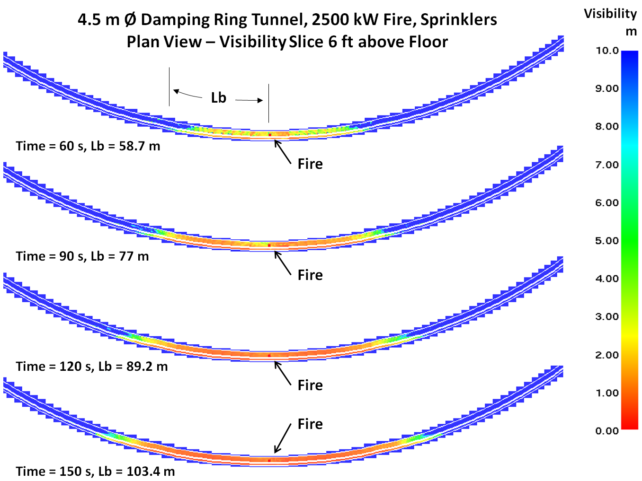
Damping Ring 4.5m Tunnel Fire Results
1.0 m/s
0.7 m/s
Travel speed required to outrun back-layering = 0.98 m/s
Travel speed required to stay ahead of smoke layer = 0.5 m/s

Slide 35
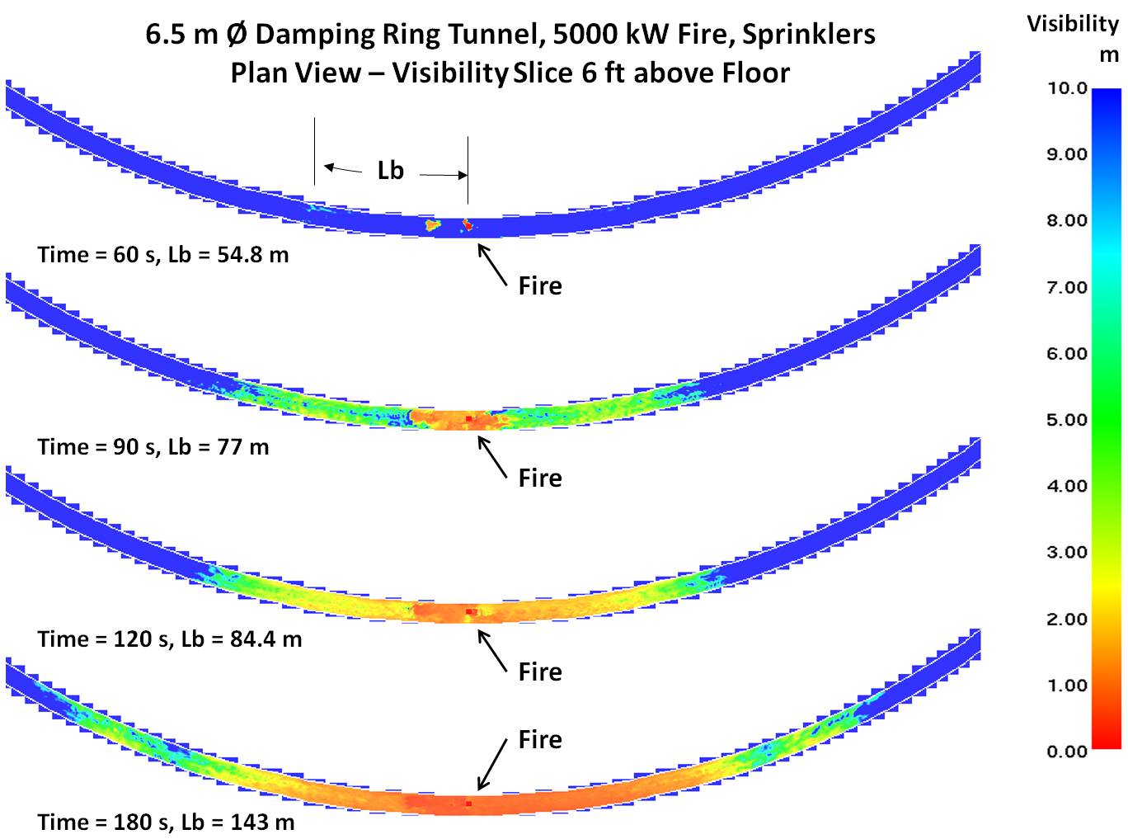
Damping Ring 6.5m Tunnel Fire Results
1.0 m/s
0.7 m/s
Travel speed required to outrun back-layering = 0.91 m/s
Travel speed required to stay ahead of smoke layer = 0.65 m/s

Slide 36
Summary of Damping Ring Fire Results
Tunnel Diameter (m) | Limiting Fire Size (kW) | Maximum Fuel Spill Area (m²) | Maximum Unconfined Spill Rate (L/min)
4.5 | 2,500 | 2.0 | 4.3
5.0 | 3,250 | 2.5 | 5.5
5.5 | 4,000 | 3.0 | 6.8
6.5 | 5,000 | 3.6 | 8.5
Results apply to curved sections of damping ring
Limiting fire sizes in curved section of tunnel increase over straight tunnel section
  The speed at which smoke descends to head-level decreases due to the curvature of the tunnel
The straight tunnel sections of the damping ring represent limiting fuel spill quantities for the damping ring

Slide 37
Compiled Tunnel Fire Results
Fire Location | Tunnel Diameter (m) | Limiting Fire Size (kW) | Maximum Fuel Spill Area (m²) | Maximum Unconfined Spill Rate (L/min)
LINAC / Straight Damping Ring Tunnel | 4.5 | 750 | 0.8 | 1.3
 | 5.0 | 1,000 | 1.0 | 1.7
 | 5.5 | 1,100 | 1.1 | 1.9
 | 6.5 | 1,500 | 1.4 | 2.6
Base Cavern | 4.5 | 3,000 | 2.4 | 5.1
 | 5.0 | 4,000 | 3.0 | 6.8
 | 5.5 | 4,500 | 3.3 | 7.7
 | 6.5 | 6,000 | 3.6 | 10.2
Curved Damping Ring Tunnel | 4.5 | 2,500 | 2.0 | 4.3
 | 5.0 | 3,250 | 2.5 | 5.5
 | 5.5 | 4,000 | 3.0 | 6.8
 | 6.5 | 5,000 | 3.6 | 8.5

Slide 38
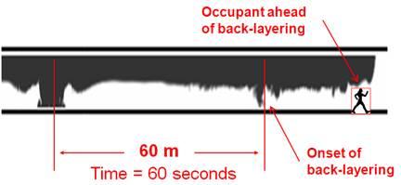
Egress Analysis
The Available Safe Egress Time (ASET) was greater then Required Safe Egress Time (RSET) – Visibility is lost at a rate 0.63 m/s travel egress speed of 0.72 m/s
In other words, occupants can comfortably walk faster than smoke can fill the tunnel for a given fire size and can reach the vertical shaft or area of refuge before being exposed to untenable conditions.

Slide 39
Conclusions
The travel distances referenced in NFPA 520 are validated, i.e., the maximum travel distance of 610m 2,000ft.) to an exterior access point or area of refuge will allow occupants to evacuate safely
The size of pool/spill fire (e.g., transformer oil) can be restricted by establishing fuel containment strategies
Increasing the tunnel diameter allows the combustible fuel loading in a tunnel to be increase without affecting the ability of occupants to evacuate safely
Administrative controls must be established as part of a combustible management strategy, e.g., transient combustibles may be present in the tunnel

Slide 40
Questions?

