Slide 1
DRAFT US Department of Energy
Underground Fire Protection Guide
James Priest, PhD & James Niehoff
DGS-SEE Seminar on Fire Protection for Physics Research Facilities
7 & 8 October 2015

Slide 2
Disclaimer
No US national safety organization wanted to develop a new standard or guide
This guide is still being vetted by the US Department of Energy community

Slide 3
Organization
Purpose
Applicability and Scope
Definitions
Fire Prevention
Fire Protection
Means of Egress
Fire Department Response
Underground Facility Rescue
Underground Facilities Services

Slide 4
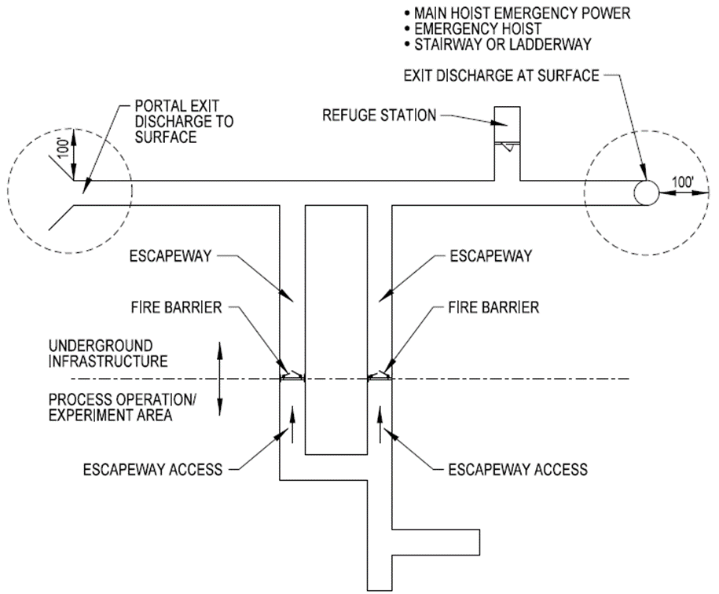
DOE Sample Facility

Slide 5
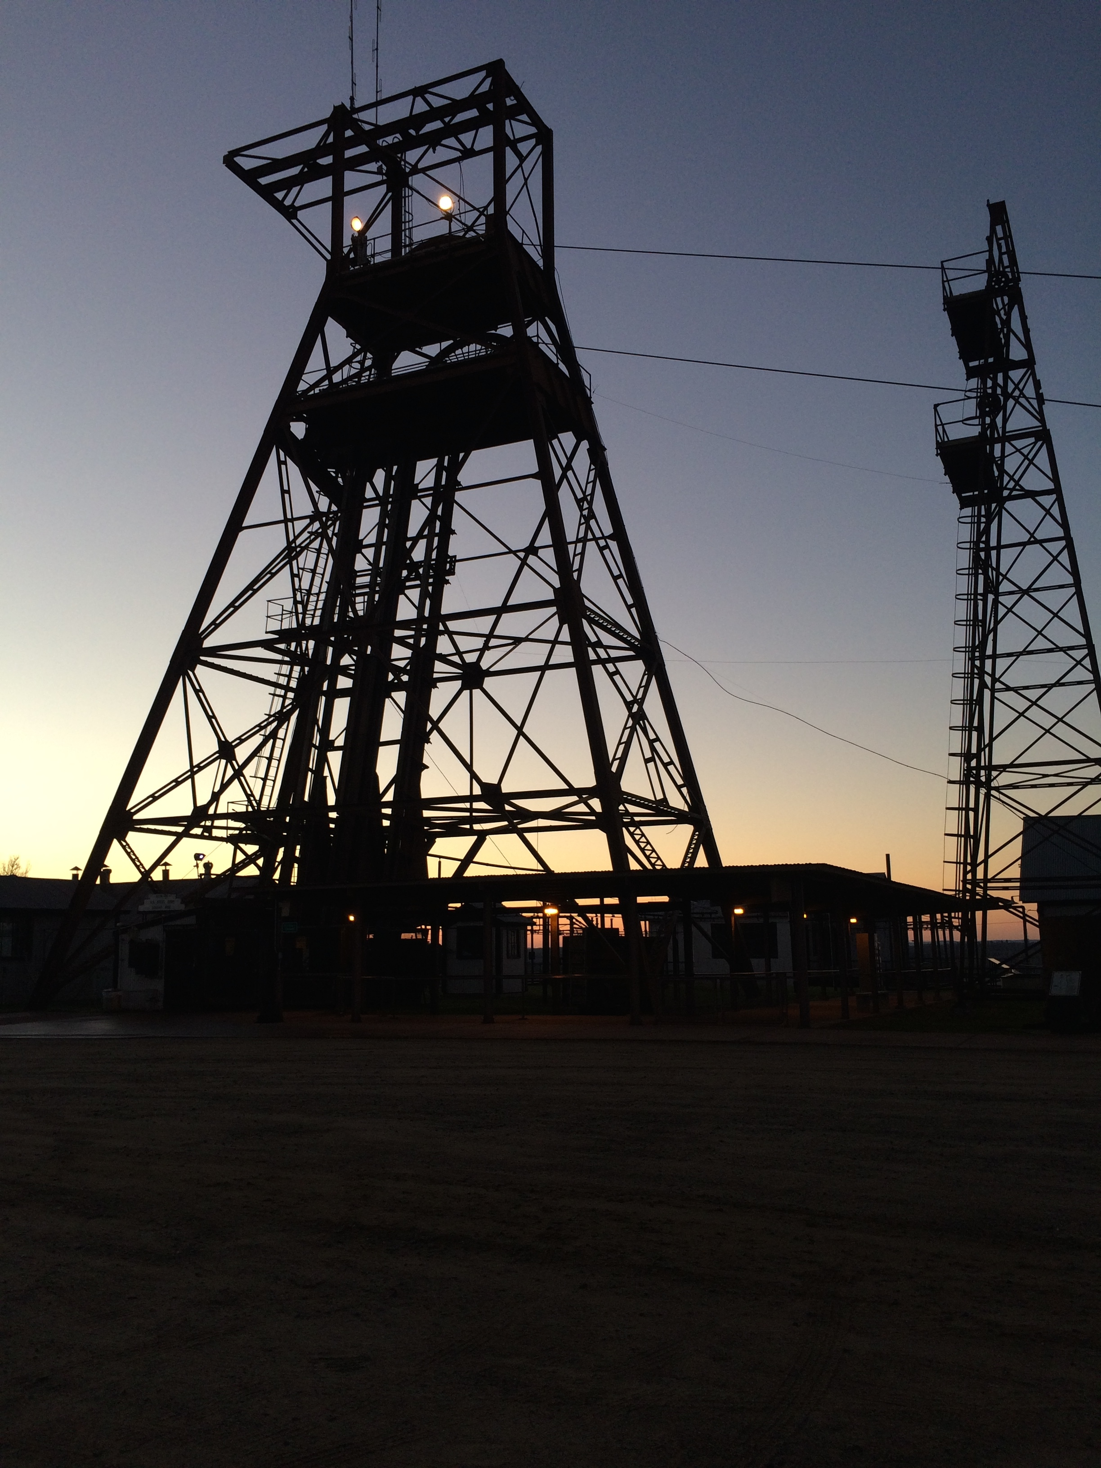
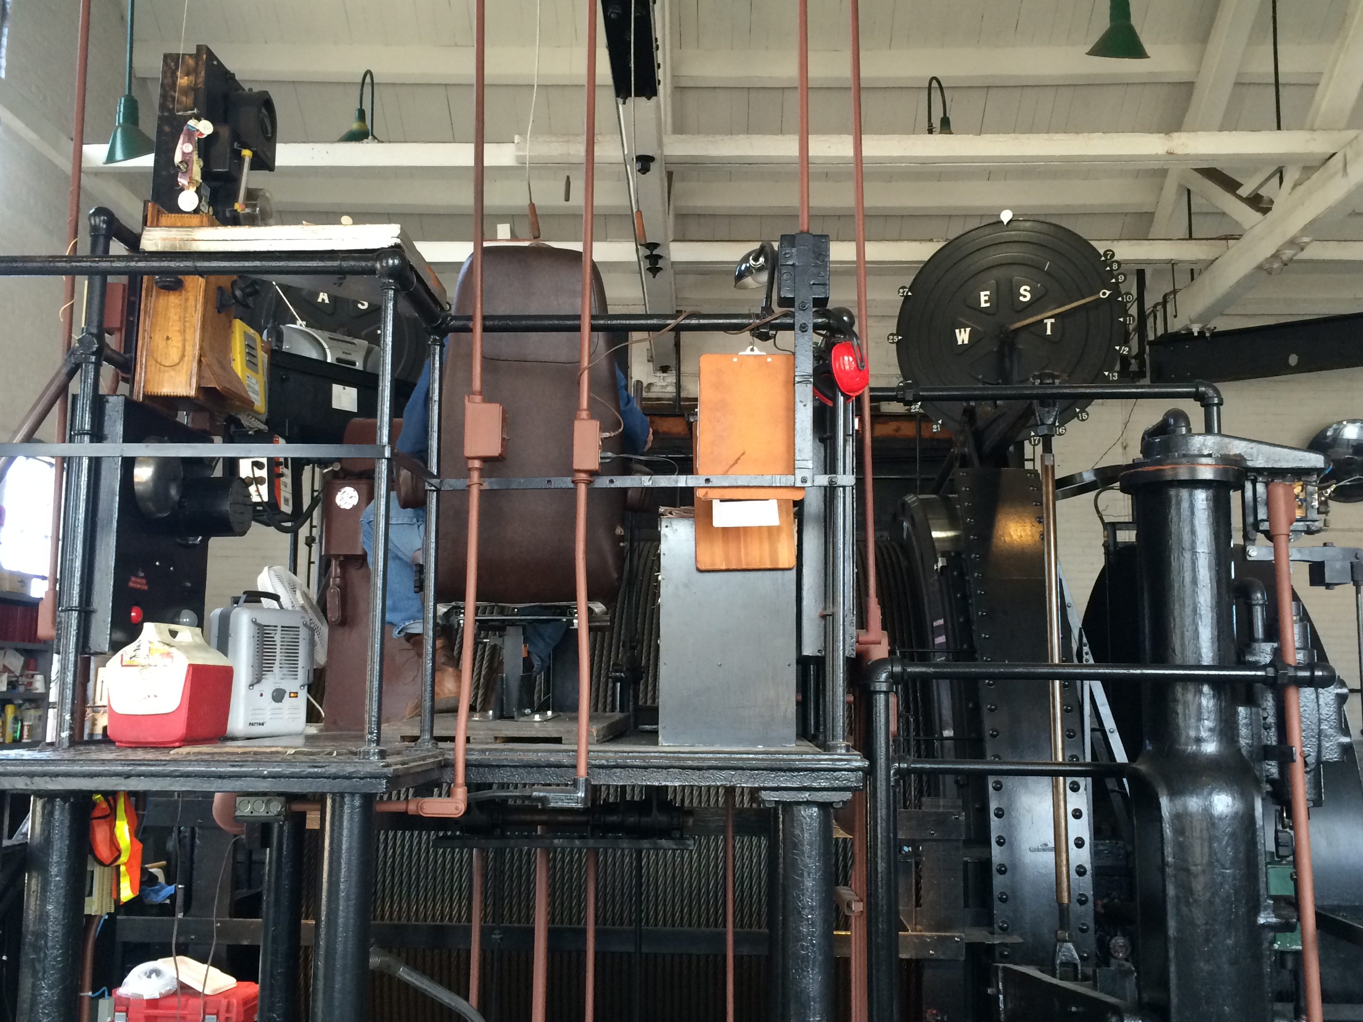
Soudan Mine

Slide 6
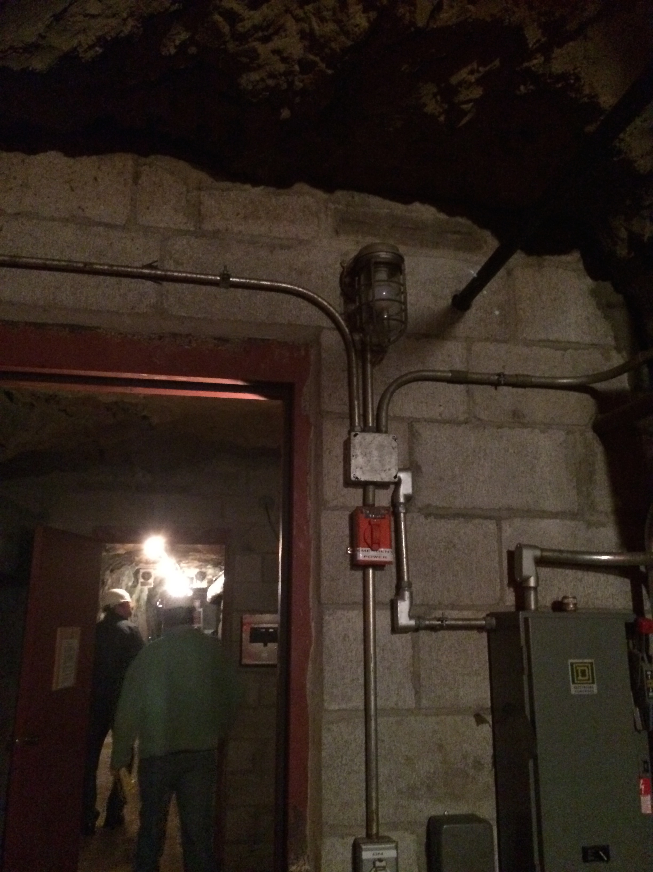
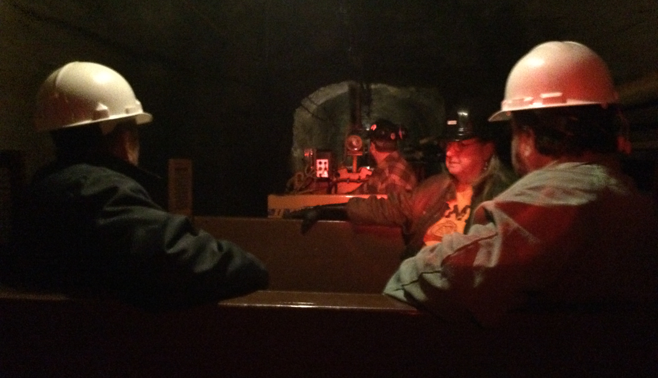
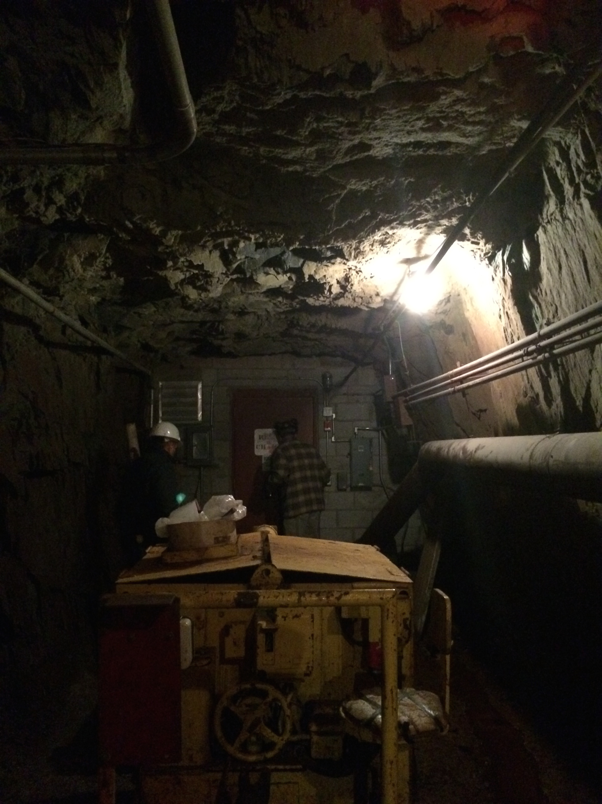
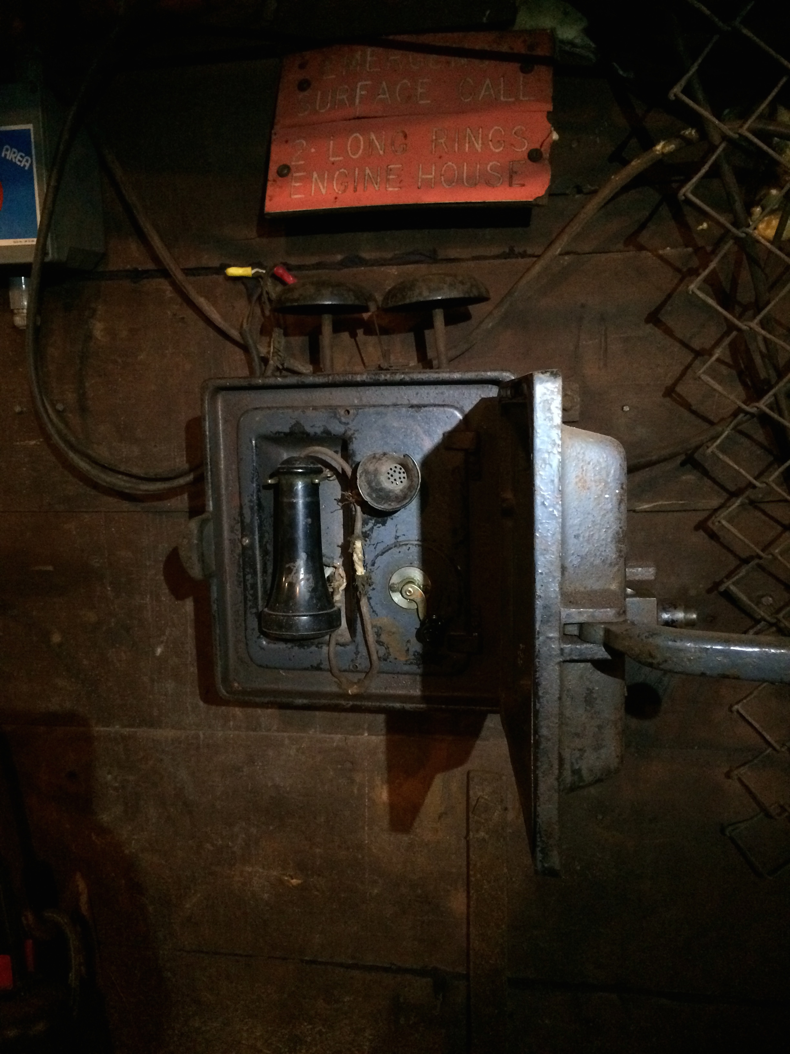

Slide 7
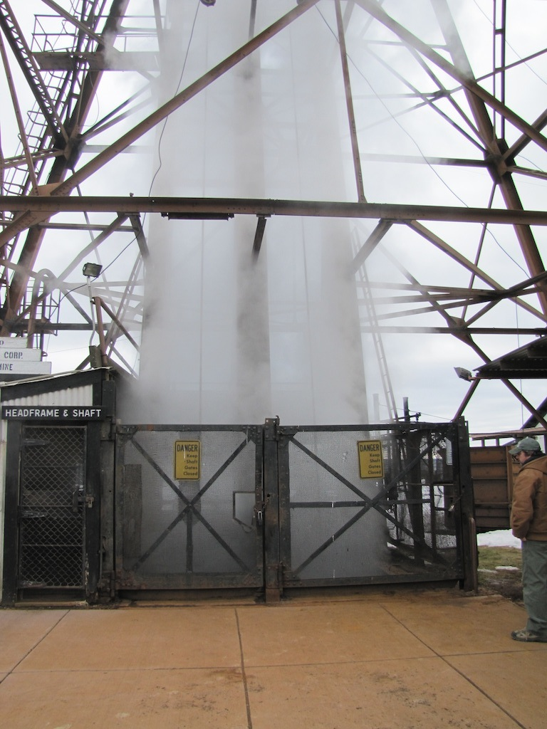
Soudan Mine Fire

Slide 8
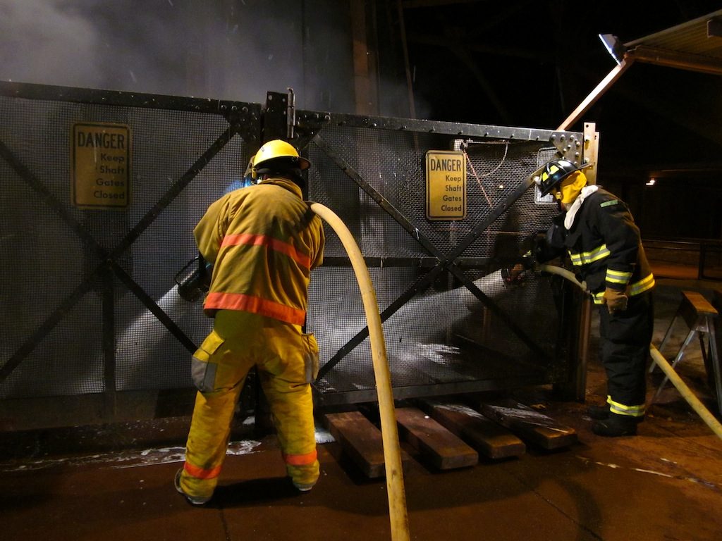

Slide 9
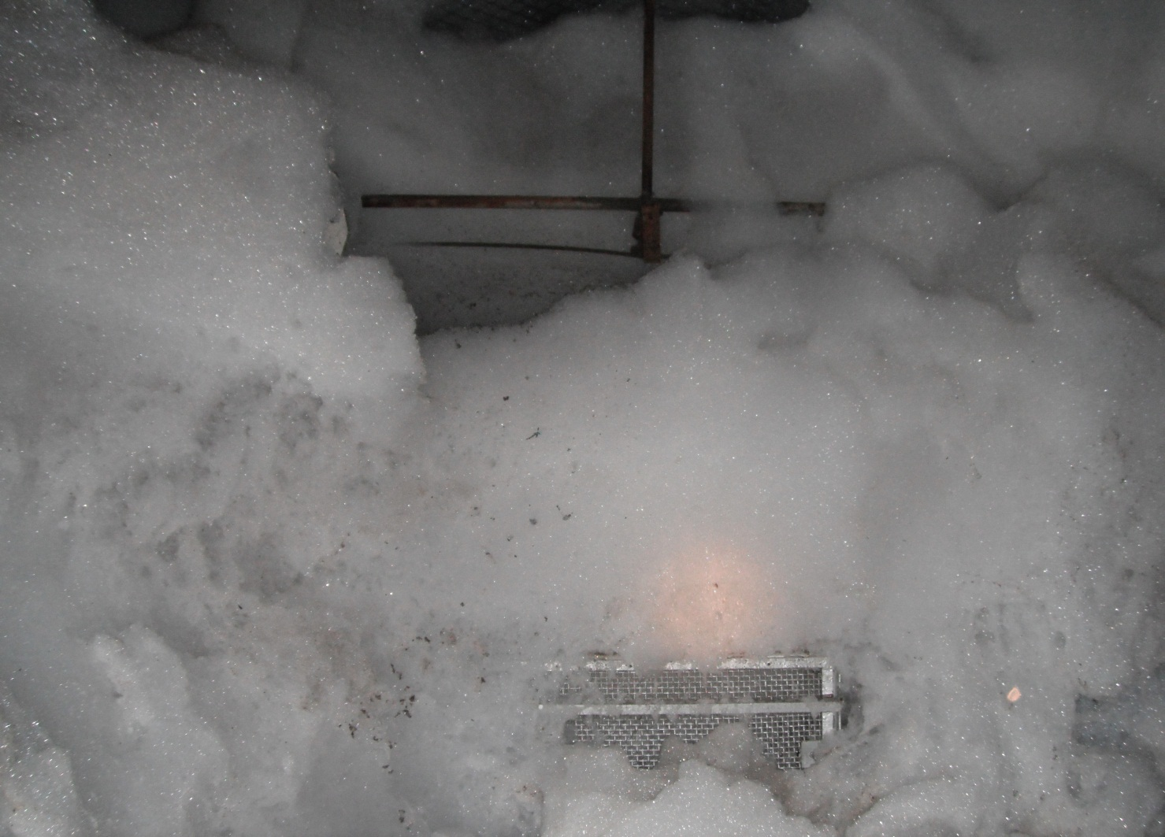

Slide 10
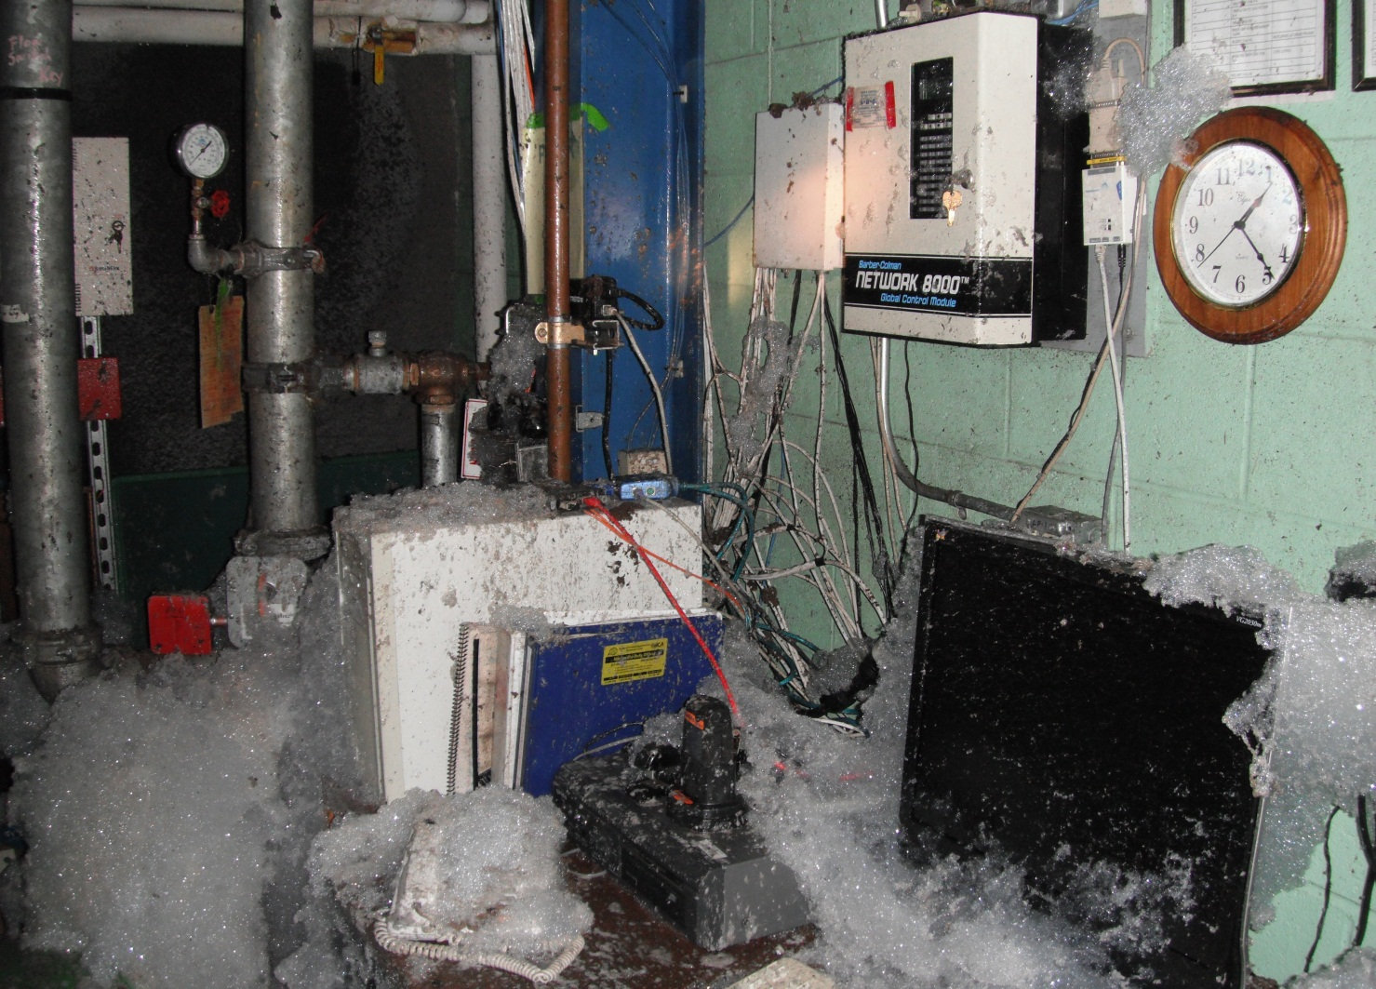

Slide 11
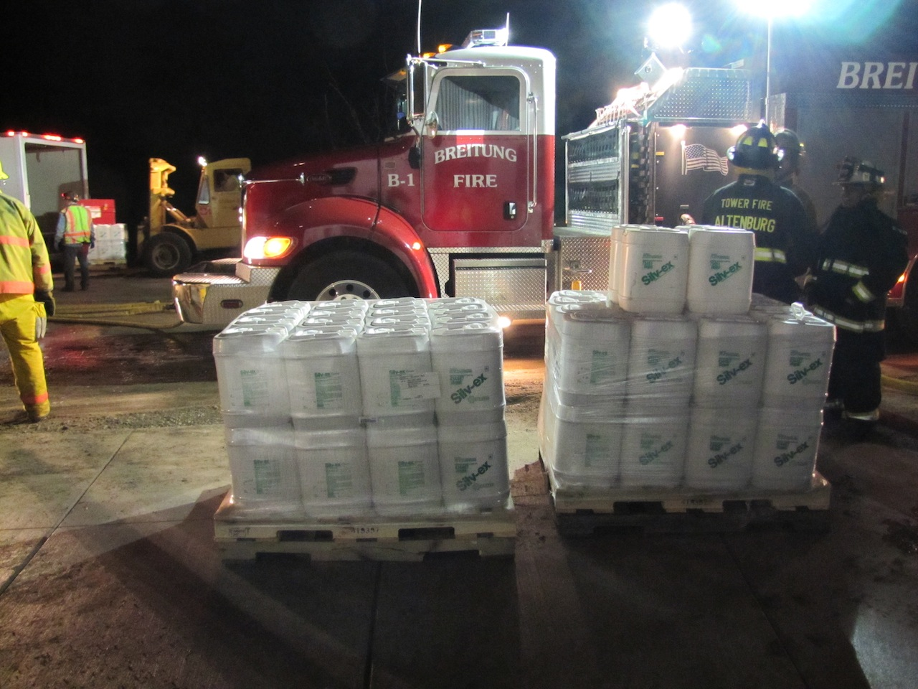

Slide 12
Facility | Location | Date | Hazard | Depth | Exits | Self Exiting Y/N | Limits on Number of People | Fire Suppression System | MSHA 57.1 or NFPA 520
Waste Isolation Pilot Plant (WIPP) | Chihuahuan Desert, outside Carlsbad, N.M. | March 26, 1999 | transuranic (TRU) waste | 2150 ft | 3: Salt Handling Shaft, Air intake Shaft, & Waste Shaft | No | 145 | Protect vehicles with dry chemicals, Alarms, fire brigades, shafts. | MSHA:
Yucca Mountain nuclear waste repository | Nye County, Nevada | Not yet | spent nuclear reactor fuel and other high level radioactive waste | 1,000 feet beneath the surface and 1,000 feet above the water table | 4 The North Portal, designated ventilation intake shafts, South Portal, North Construction Portal. | N/A | N/A | Automatic (sprinkler), refuge stations, Rescue, isolation, ventilation Firewater, Fire suppression, Fire detection, Fire alarm, Fire notification, Explosion protection, Fire barriers | MSHA: NFPA 520: No
SLAC Linac tunnel | Menlo Park, CA | 1967 (date of first linac beam) | Prompt radiation High intensity electron beam line for research purposes. | 25 feet | Ladders every 333 feet (total of 15). Three stairwells to surface. Exit to grade at west end. | Yes | During long downs, no more than 100 people in linac tunnels. | Air sampling smoke detection, wall mounted C02 portable fire extinguishers. Fire hydrants at surface. Two cross-tunnel fire barriers. | MSHA-no. NFPA 520-no.
SLAC Beam Switch Yard (BSY) | Menlo Park, CA | 1967 | Prompt radiation from high intensity electron beam for research purposes | 0 - 30 feet | One grade level exit, two ladders to surface, 5 exits through other tunnel spaces. | Yes | 50 employees maximum during long downs. | Combination of spot-type smoke detection and air sampling detection. Wheeled and portable CO2 fire extinguishers. | MSHA – No. NFPA 520—under review.
SLAC LCLS | Menlo Park, CA | 2007 (first beam) | Prompt radiation from electron and x-ray beam pulses used for research. | 0 – 70 feet | One grade exit, two stairwells, one ramp up to grade | Yes | Varies, but no more than 60 employees in any one fire area | Sprinklers, wall-mounted CO2 fire extinguishers, spot type/beam type/VESDA smoke detection (varies by area) | MSHA—no. NFPA 520-no.
Fermilab- NuMI | outside Batavia, Illinois, near Chicago | November 21, 1967 (as National Accelerator Laboratory | neutrino beam generated MI-65 Target Hall and MINOS Detector Hall) | 150 ft to 350 ft | 2-hour fire rated, 44-in width pressurized passageway, stair, & egress elevator | Yes | 50 Occupants | Emergency voice fire alarm system, heat & smoke detection, sprinklers | MSHA 57.1: n/a NFPA 520: Yes

Slide 13
Fermilab- ILC | outside Batavia, Illinois, near Chicago | Future | International Linear Collider – Conceptual Design Phase only. Currently this project is unfunded | 350 ft | 2 & refuge areas with 2 hour fire barriers, stairs > 44 in. Wide, and doors > 36 in. wide. | Yes | <50 Occupants | fire alarm system, heat & smoke detection, sprinklers | MSHA 57.1: n/a NFPA 520: Yes
Fermilab - LBNE | outside Batavia, Illinois, near Chicago | November 21, 1967 (as National Accelerator Laboratory | Long baseline neutrino experiment – Conceptual Design Phase | 320 ft | 2-hour fire rated, 44-in width pressurized passageway, stair, & egress elevator | Yes | 50 Occupants | Emergency voice fire alarm system, heat & smoke detection, sprinklers
University of Minnesota – Soudan Underground Laboratory | Near Ely Minnesota | 1900-est. mine 1980- est. lab | Several Experiments (MINOS long baseline neutrino experiment receives a beam of neutrinos from Fermilab). | 2,340 ft | Fire Rated Single Shaft Elevator |  | average -11; maximum- 36 | fire alarm system, heat & smoke detection, Automated suppressant system- sprinklers, Extinguishers, and 1 escape chamber (shafts), ventilation
Sanford Underground Research Facility - SURF (Deep Underground Science and Engineering Laboratory, DUSEL) | Homestake, SD | 2002 | Experiments LUX- the most sensitive detector yet to search for dark matter cryogens and other hazardous materials | 4850 ft below ground | 2: Primary and secondary | Yes |  | **two means of access/egress will be provided Notification of an emergency “stench gas” system | MSHA 57.1: Yes NFPA 520: Yes
Nevada National Security Site | Nye County, NV | 1950s | 8 active & 14 inactive facilities; hazards vary by facility but may include explosives, radioactive materials, wood, paper, oils, etc. | Varies from hundreds to thousands of ft | Shafts and portals depending upon the facility | Yes and no, varies by facility. One facility has 3 shafts and the others have portals | Varies by facility and by activity | Varies by facility: Portable fire extinguishers, fire alarm systems, squawk boxes, miners cap lamps & emergency lighting, refuge stations, no automatic suppression. | No & No**
Ultra Low Background Counting Laboratory 3425 Building PNNL | Richland, WA | 2010 | R&D Lab with some hazardous materials, cryogens | 40 ft | 2 exits – one at each end of the building | Yes | 30 – typically less than 10 |  | N/A This is a building built per IBC and NFPA 101

Slide 14
Go to Draft Guide

