Slide 2
DGS/SEE Seminar on Fire Protection for Physics Research Facilities
7 and 8 October 2015
CERN
Introduction status and perspectives
S. La Mendola DGS/SEE/XP

Slide 3
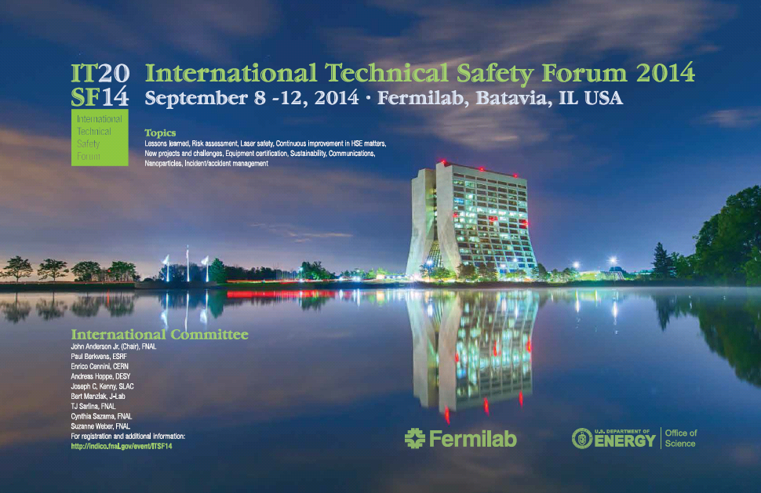
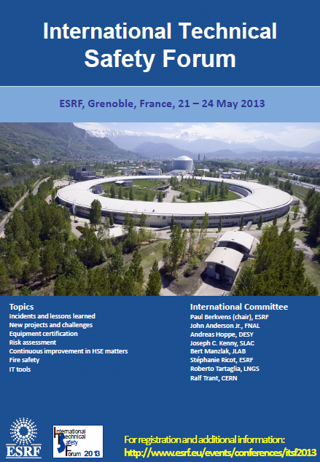
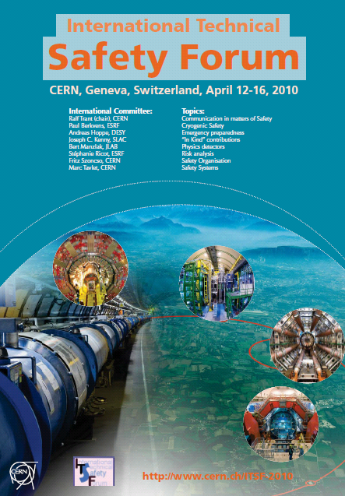
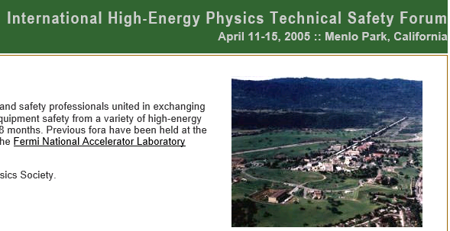
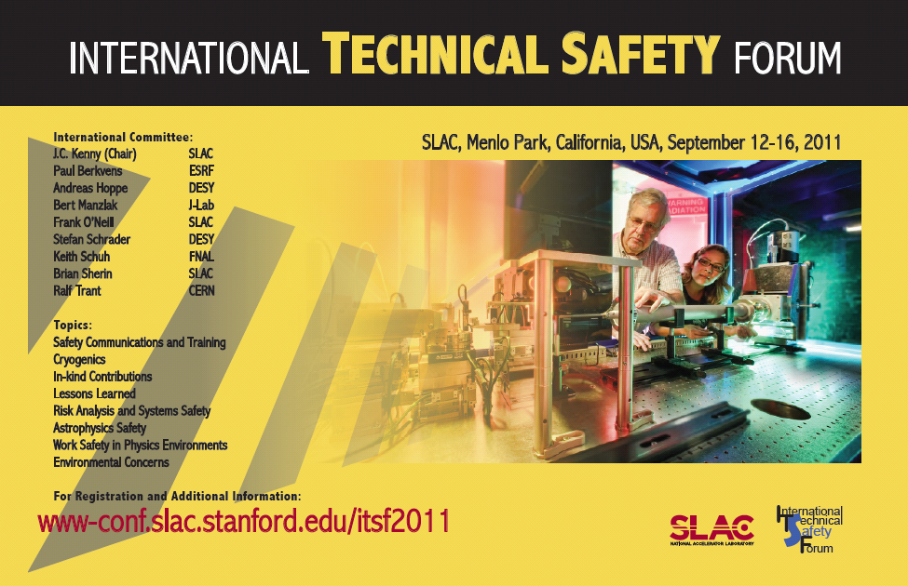
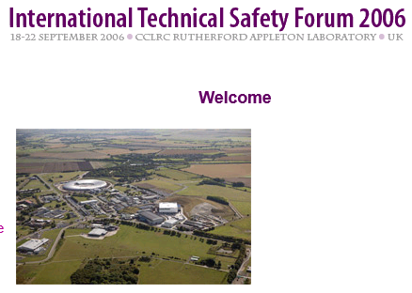
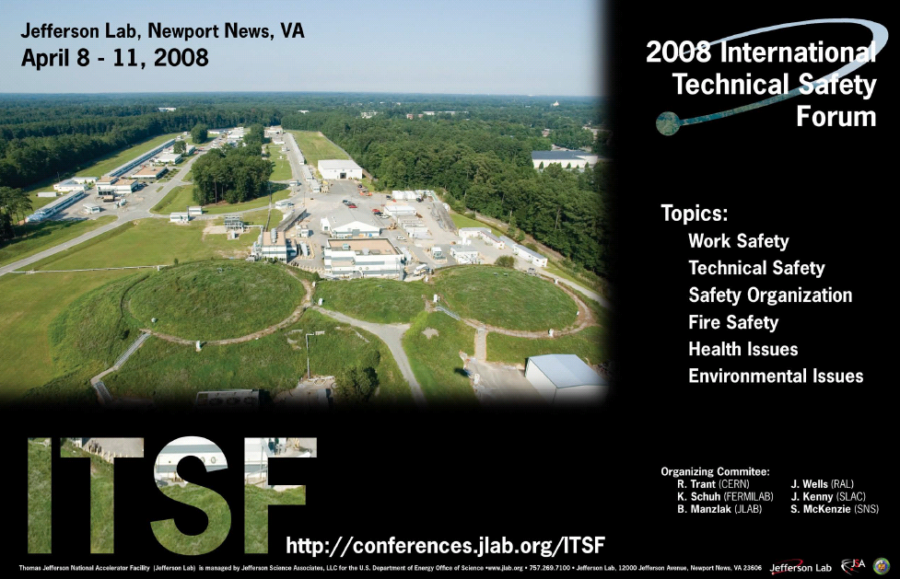
ITSF: a time-tested forum for exchanges on safety
Notes:
What is ITSF: the International Technical Safety Forum was founded in 1998 and meets every 18 months. Engineers, physicists, and safety professionals exchange there state-of-the-art ideas, processes, procedures, and technologies in personnel, environmental, and equipment safety from a variety of particle physics laboratories

Slide 4
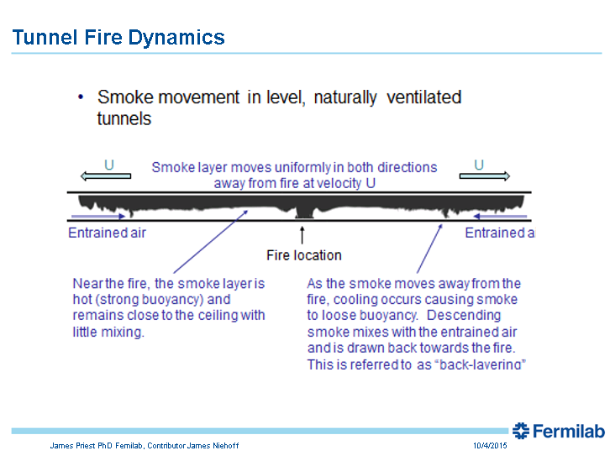
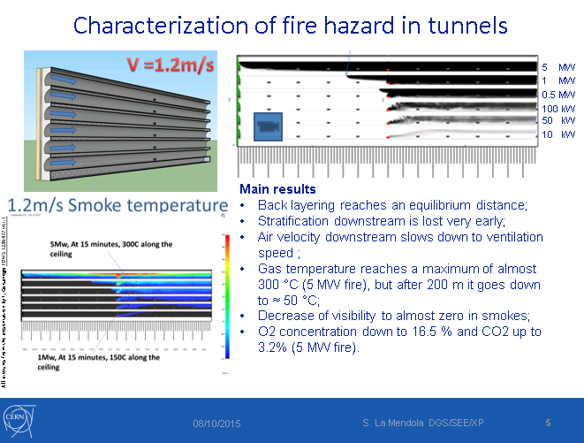
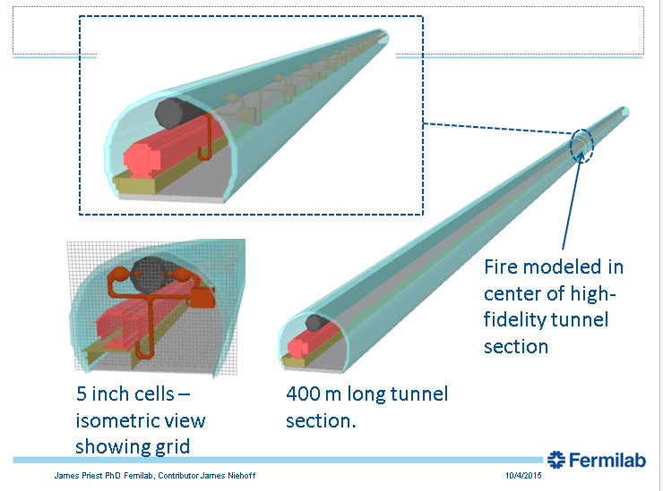
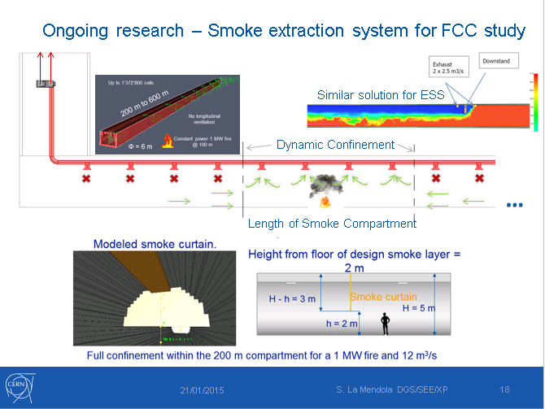
Fire safety challenges common to several labs
Notes:
During last ITSF at Fermilab we realized that we were exploring the same issues such as smoke propagation and evacuation of occupants from tunnels, smoke extraction and air management systems, etc.
It was obvious that synergies among labs might allow to progress more quickly and effectively in the study of these issues

Slide 5

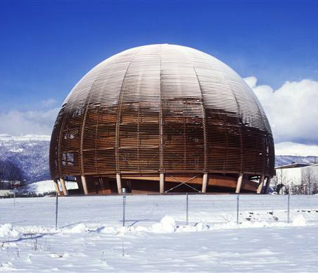
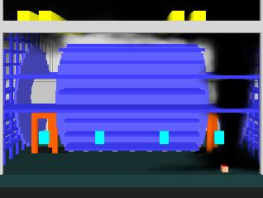

Why fire safety can be a ground for a common effort?
Fire safety objectives for ordinary surface buildings are reached through compliance with prescriptive compulsory rules.
For underground facilities, the objectives are validated thanks to performance-based fire risk assessments.
Notes:
Prescriptive rules are only appropriate for ordinary buildings with similar features (schools, hospitals, theatres, etc.). Complying with them is most often impossible for particle research facilities (think about length of evacuation paths…).
A quantitative performance-based assessment is therefore necessary for particle research facilities. This approach is officially recognised in many Countries in Europe and US.
Consistency of assumptions and tools is a key element to obtain reliable results.

Slide 6
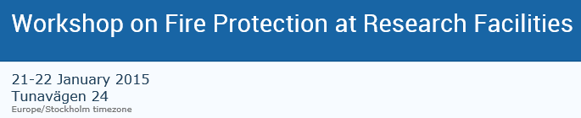





Workshop in Lund, a first concrete step to collaboration
Notes:
A first workshop on initiative of ESS and CERN was organized last January in Lund.
Participants shared current fire challenges and gave presentations of ongoing activities (studies, research, applications).

Slide 7
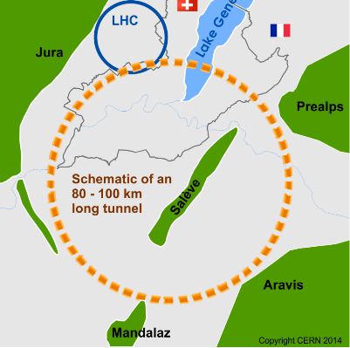
Workshop in Lund: collaboration topics
Main topic | Sub-topic
Hazard characterization | Burning behavior of commonly present items
 | Fire simulations
 | Oxygen Deficiency Hazard
 | Flammable gases
Passive fire protection
Active fire protection systems | Fire detection
 | Fire extinction
 | Smoke extraction and ventilation
Intervention of rescue teams
Life safety in underground facilities | Evacuation of occupants
Fire risk methodologies and tools | Collection, analysis and use of statistics
 | RAMS aspects
FCC study: a great opportunity to cooperate!
Notes:
A number of collaboration topics were identified and the FCC, Future Circular Collider study project was proposed as a framework for the collaboration.

Slide 8
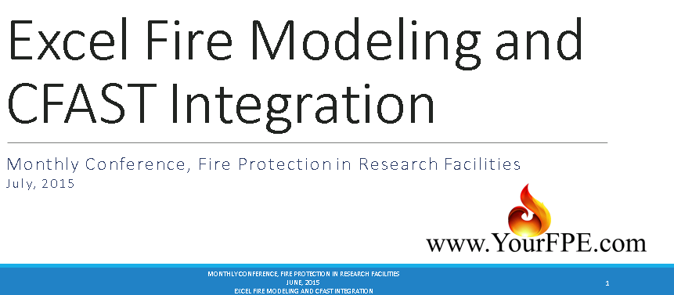
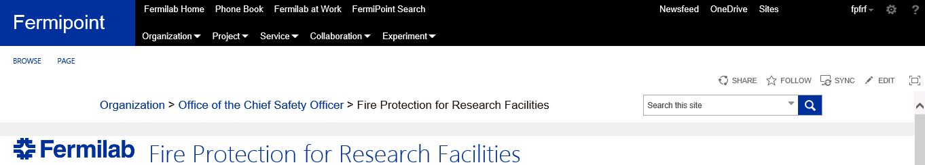
Staying in touch: Monthly video conferences
Organizational and technical issues are discussed.
A Fermipoint site is now available to exchange information .
Deliverables for FCC study are being discussed as well.
Notes:
The contact is kept close through monthly video conferences where technical and organizational issues for collaboration are discussed.
For example a presentation was given by R. Plonsky, ‎Fire Protection Engineer at Savannah River National Lab, on excel macros to creat input files for CFAST (zone fire model).
Moreover, a Fermilab Sharepoint (Fermipoint) was created for the collaboration. Thank you Fermilab! More about this in J. Priest’s presentation.

Slide 9
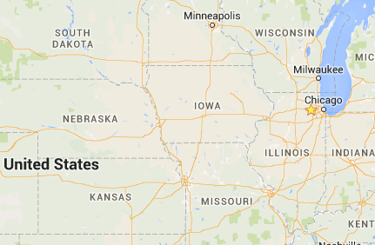
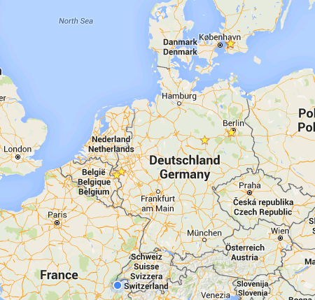

The network keeps growing
PhD student from the university of Wuppertal/Jülich Research Center at CERN
Collaboration agreements with Freie Universität of Berlin, Magdeburg (OVGU) and Lund (for HL-LHC)
Notes:
In parallel, CERN has agreement with other institutions: University of Berlin (signed collaboration agreement), Univ. Of Magdeburg Otto Von Guericke (Ph.D. student at CERN (M. Plagge), Univ. Of Wuppertal/Jülich Research Center Ph.D. student at CERN (Tristan Hehnen).
Another agreement is signed with Lund university to carry out fire risk assessment studies for the HL-LHC project.

Slide 10
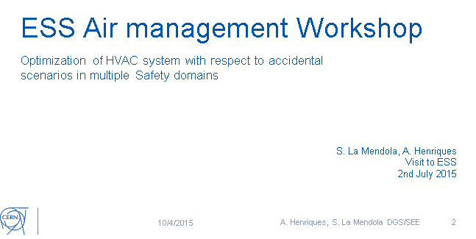
Another milestone: Workshop on air management at ESS
Notes:
A specific workshop on air management was organized by ESS where CERN specialists were invited to discuss about this subject.
A presentation was given covering air handling concepts both in normal and accidental scenarios (fire, helium spill, etc.).
Some recommendations from the draft report of the ventilation working group were given.

Slide 11
Fire protection: workshop at CERN
It marks a milestone in the collaboration road map (summary, current situation and next steps);
It includes the following topics:
Day 1 | General (introduction of participants, current challenges and ongoing activities);
 | Air management (smoke extraction) in radioactive facilities
 | Intervention strategies of fire brigade teams
 | Fixed extinguishing systems
Day 2 | Burning behavior of electric cables
 | Computational fire simulations
 | Performance-based structural fire design
 | Evacuation simulations
 | Draft standards for mine safety

Slide 12

Next steps: collaboration on FCC
Participating institutes sign a Memorandum of Understanding;
Deliverables are defined in an Institute Agreement;
4 IAs have been drafted on evacuation simulations, fire simulations, design fires, smoke extraction system, etc.
All documents (incl. MoUs) should now be signed.

Slide 13
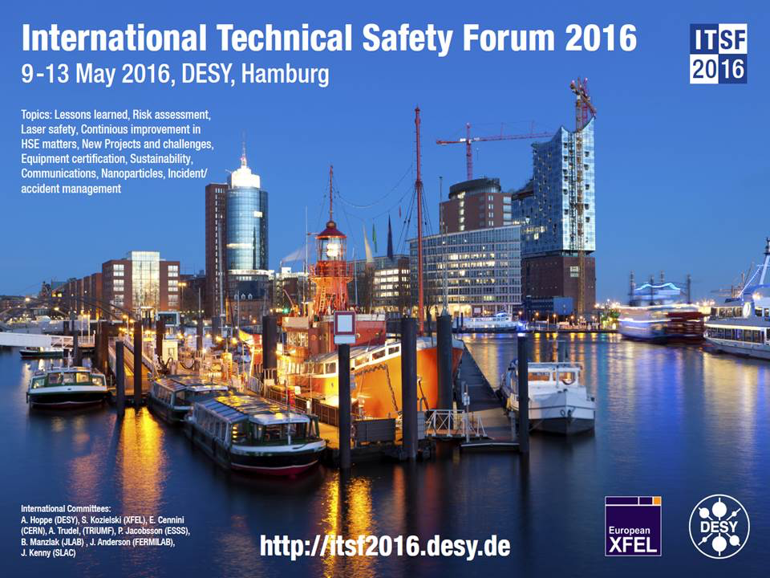
What’s next
A workshop on fire safety is expected to be included in ITSF 2016: opportunity to present the first advancements;
Signature of collaboration (MoUs, IAs) agreements and start of activities;
Participants remain in close contact via video conferencing or similar and share information through Fermipoint;
A workshop on fire safety is expected to be included in ITSF 2016: opportunity to present the first advancements;
New participants can join the network;

Slide 14
Questions?
Thank you for your attention!

