Slide 2
DGS-SEE Seminar on fire protection for physics research facilities
07-08 October 2015
CERN
Creating a cable material for fire simulation – first steps
Tristan Hehnen

Slide 3
Inhalt
Einleitung
Ausgangspunkt
  Kabelbrandmodelle am CERN
  CHRISTIFIRE Programm
  FIPEC Programm
  Brandversuche
  Kabel-/ elektrische Installationen
Bisher durchgeführte Arbeit
  Micro-Combustion Calorimetry
  Kabelmaterial
  Cone Calorimetry
  Cone Simulation
Ausblick
Literatur

Slide 4
Table of contents
Introduction
  Introduction
  Aim
  Starting ideas
Cable material first steps
  Micro-Combustion Calorimetry
  Cone Calorimetry
Future steps
  Prepared models

Slide 5
Introduction

Slide 6



Introduction
Member of the Doctoral Student Programme at CERN
Work supported by the Wolfgang-Gentner-Programme of the German Federal Ministry of Education and Research (BMBF)
Doctoral student at the Bergische Universität Wuppertal
Department: Computer Simulation for Fire Safety and Pedestrian Traffic
Supervisor:
Saverio La Mendola
Supervisor:
Armin Seyfried
Lukas Arnold
Duration of the doctoral programm: from Nov. 2014 to Nov. 2017

Slide 7
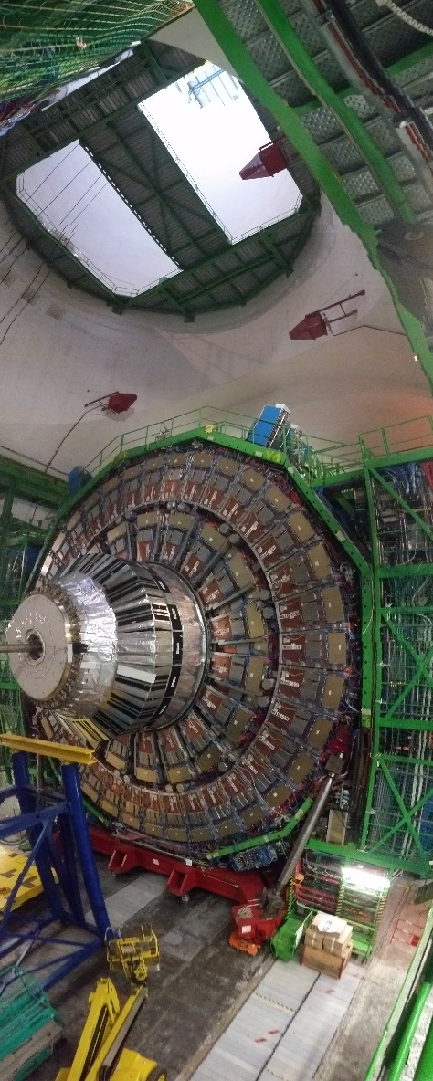
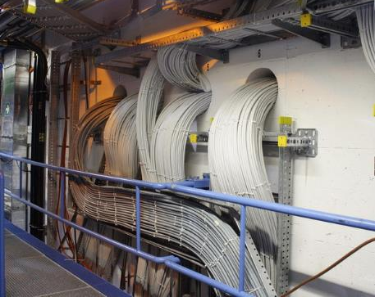
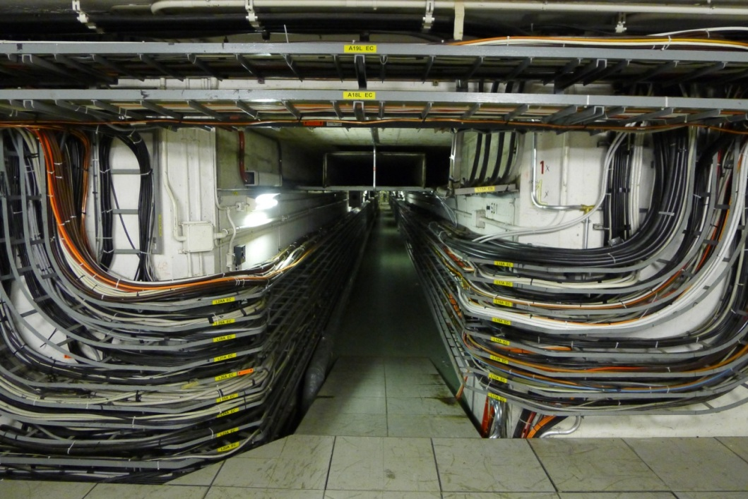
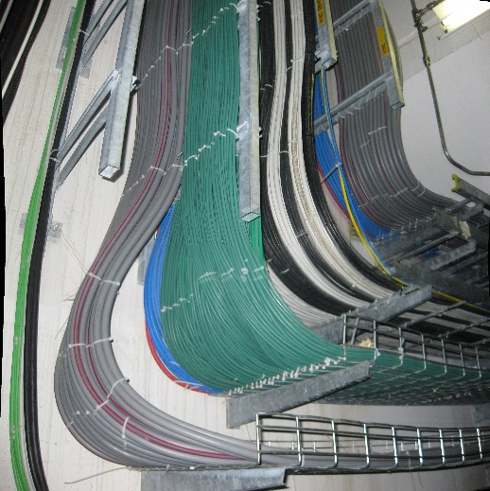
Aim
Investigate fire behaviour of electrical equipment
Cable trays first, maybe later cabinets and their interconnection
Create simple model(s) to estimate fire
propagation

Slide 8
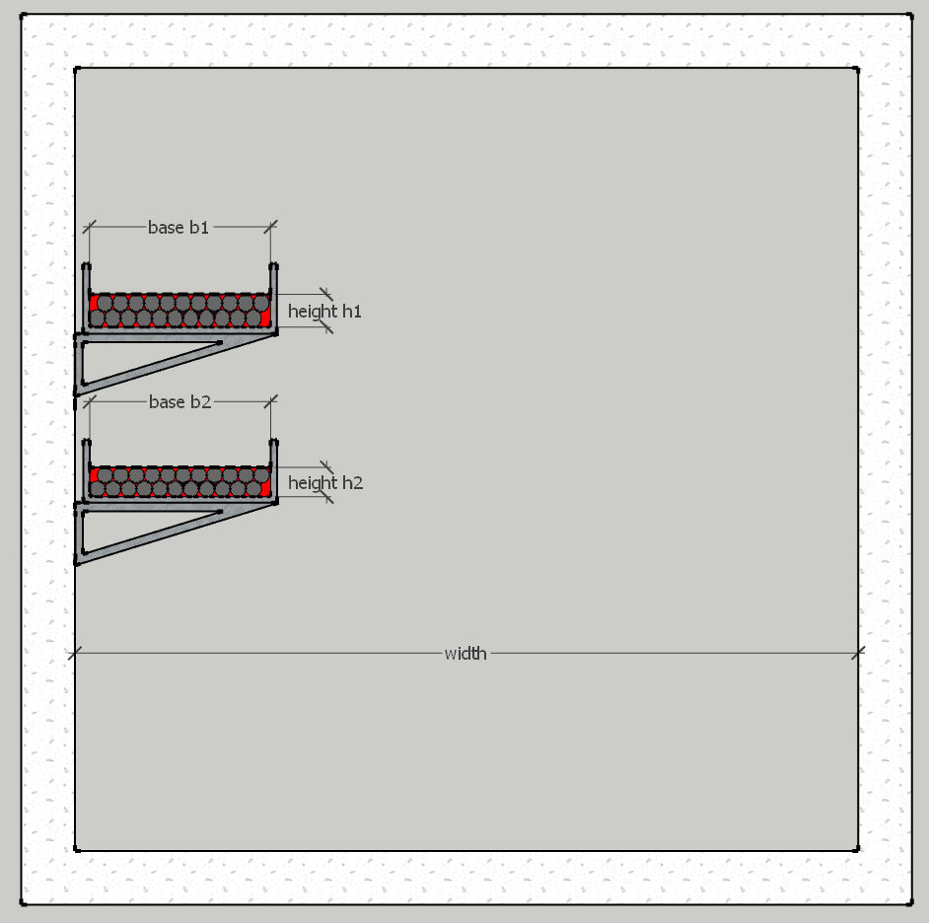
Starting ideas
Cable fire models at CERN
Work had been done by Fabio Corsanego DGS/SEE, based on the CHRISTIFIRE project conducted by U.S.NRC.
Conservative and simple model for fire load estimation of cables inside a tunnel
Guidelines for design fires, simplified the FLASH-CAT code into an Excel-sheet
Picture: CHRISTIFIRE, phase 1

Slide 9
Starting ideas
CHRISTIFIRE programme
Cable Heat Release, Ignition, and Spread in Tray Installations During Fire (CHRISTIFIRE)
Plenty of data recorded, able to be utilised in simulations
Pictures: CHRISTIFIRE, phase 1

Slide 10
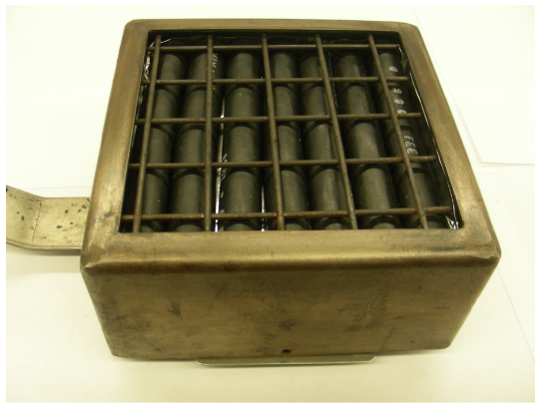
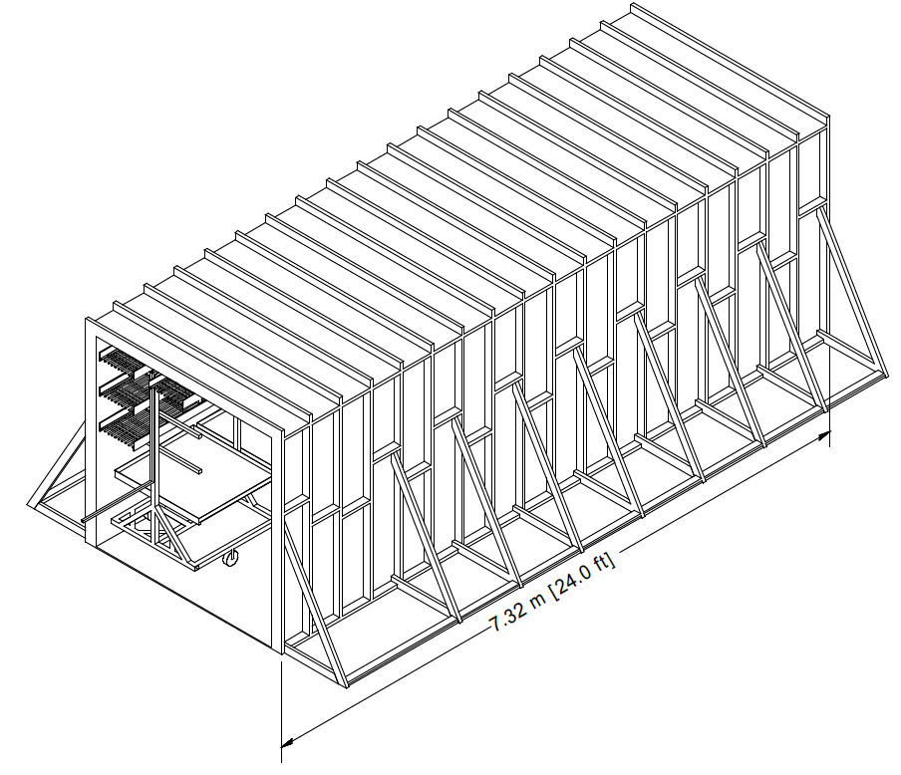
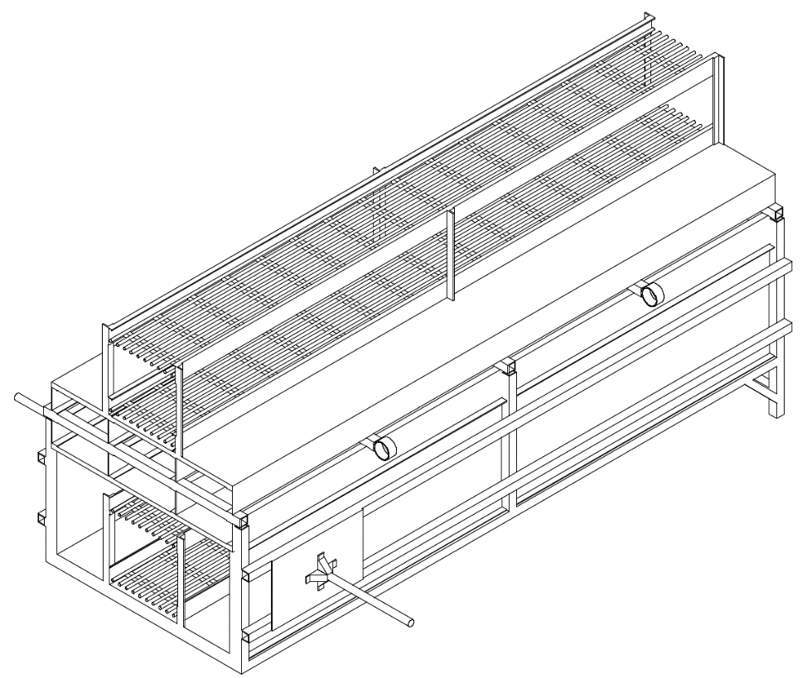
Strating ideas
CHRISTIFIRE programme
Phase 2:
  Additional 23 cables
  Small- and full-scale
  Corridor (2.4 m * 2.4 m * 7.3 m), up to four trays
  Shaft, two trays inside, two trays outside
Pictures: CHRISTIFIRE, phase 2

Slide 11
Cable material first steps

Slide 12
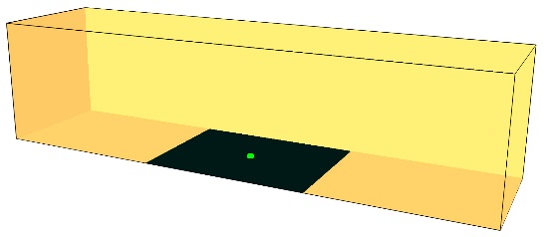
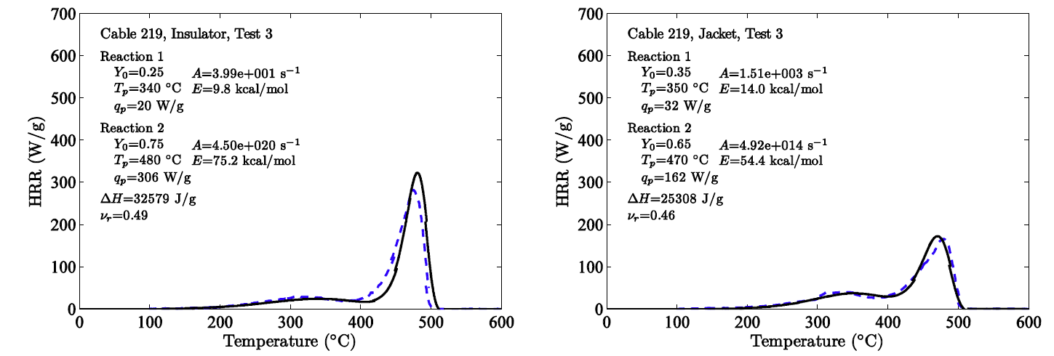
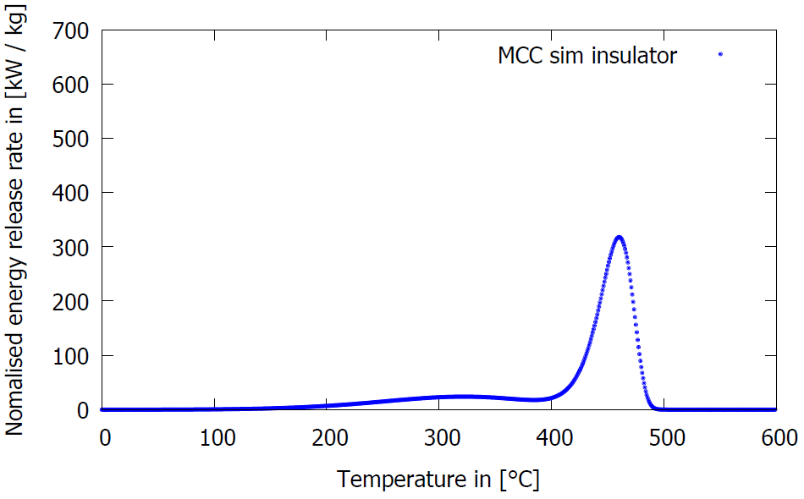
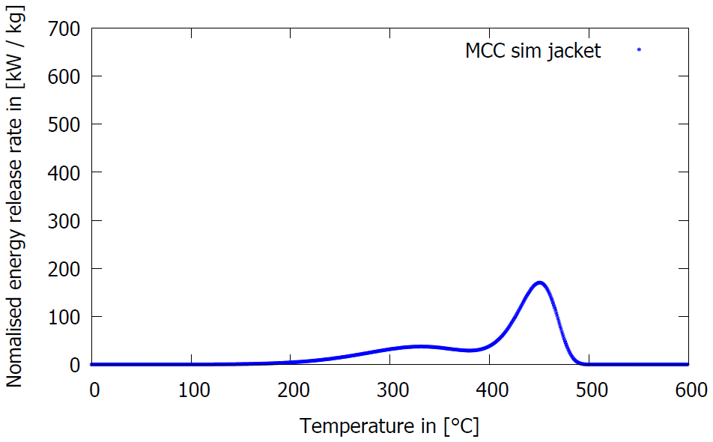
Cable material first steps
Micro-Combustion Calorimetry
MCC with CHRISTIFIRE data (cable #219); Simulation from FDS Userguide
Experiment
Simulation
Notes:
Try to explain better the bullet points
How about this?

Slide 13
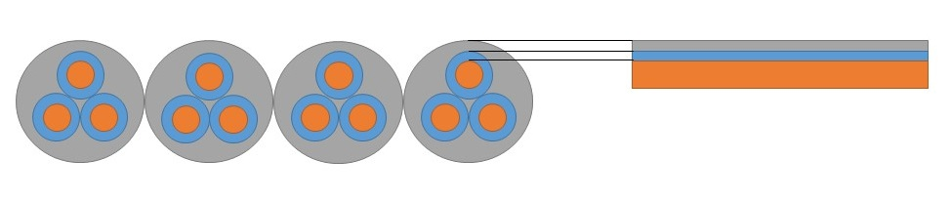
Cable material first steps
Structure of the SURF
Cable material
Layer 1
Material #219 to FDS
Projection of the circular cross section to a rectangle, width = cable diameter
  Layer 1 and 5: ~3,1 mm
  Layer 2 and 4: ~1,4 mm
  Layer 3 : ~0.1 mm
  BACKING=`INSULATED`
Layer 2
Layer 3
Layer 4
Layer 5
Insulation
Illustration: How to represent the cables?
Picture: T. Hehnen

Slide 14
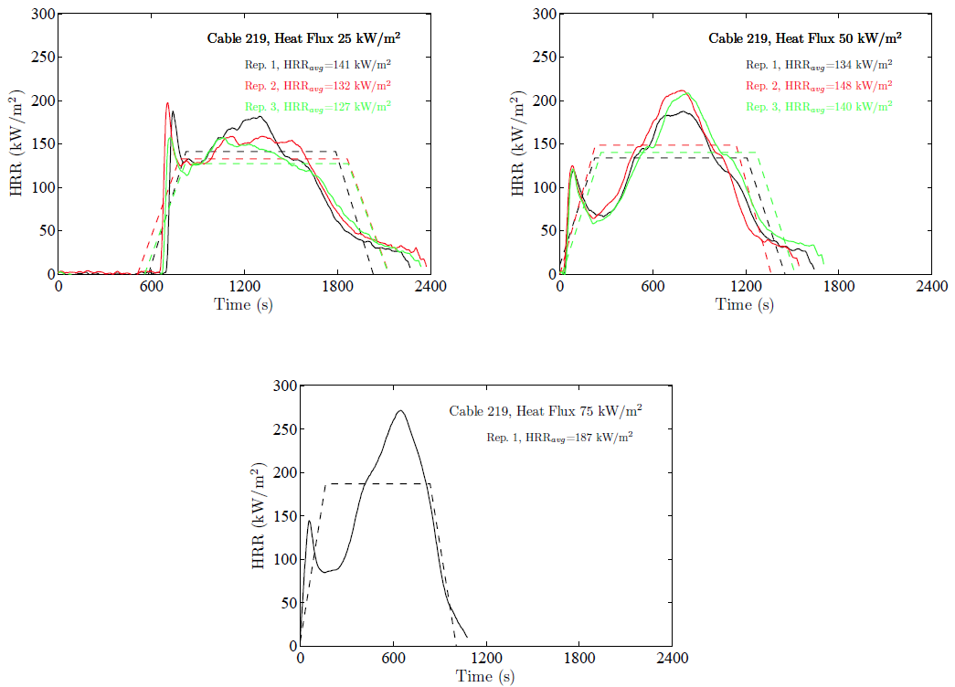
Cable material first steps
Cone Calorimetry
cable #219 in Cone test
Adjust material parameters to fit simulation to experimental results
Cone Calorimeter results
Picture: CHRISTIFIRE phase 1

Slide 15

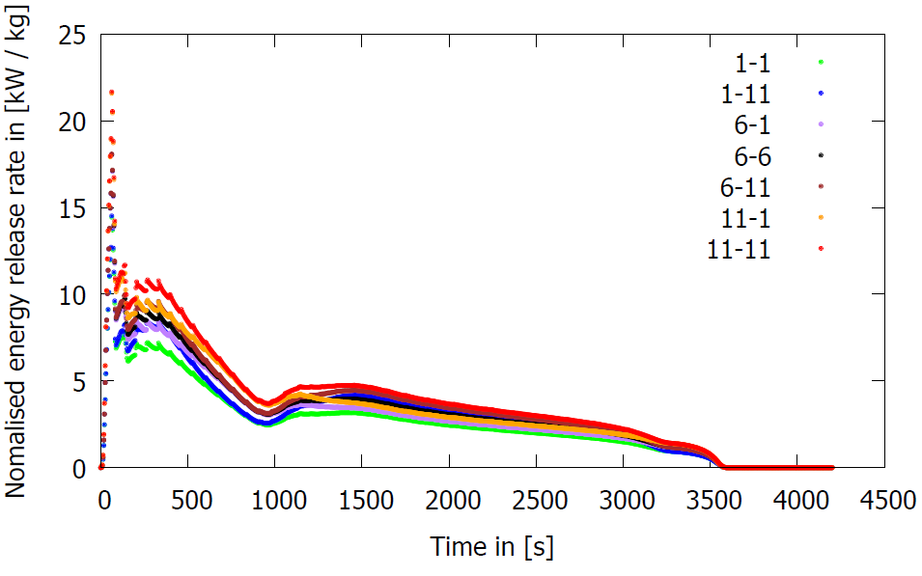
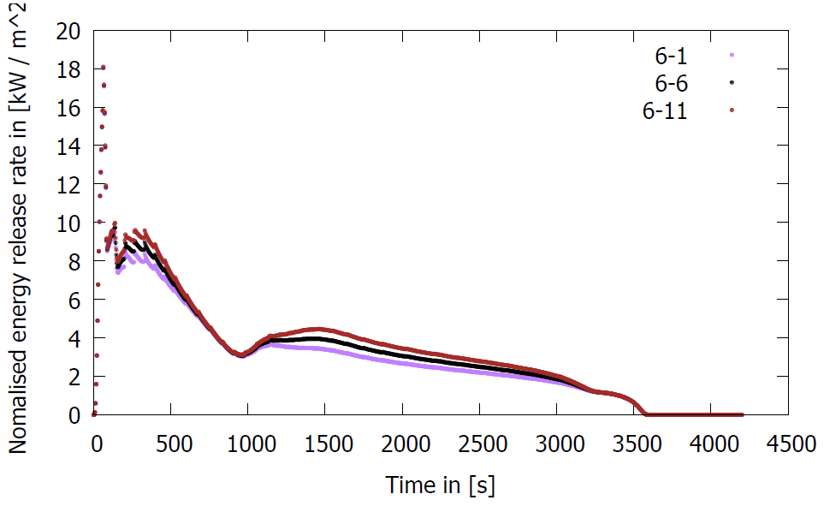
Cable material first steps
Cone Simulation
Variation of the heat of combustion, ± 20 %
Simulation in simplified Cone (from FDS Userguide)
Parameter from CHRISTIFIRE in black
Change of the heat of combustion
Notes:
Try to explain better the bullet points
How about this?

Slide 16
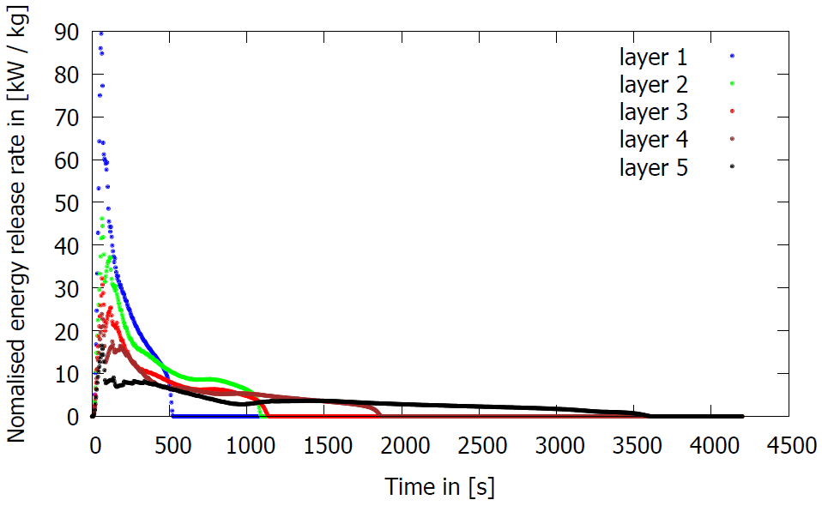
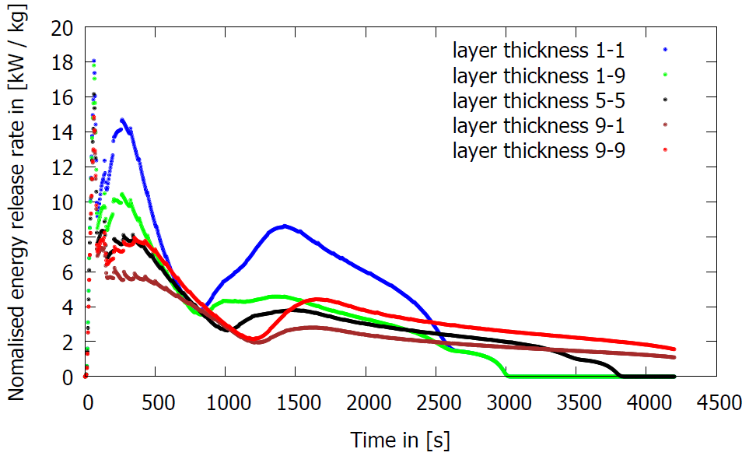
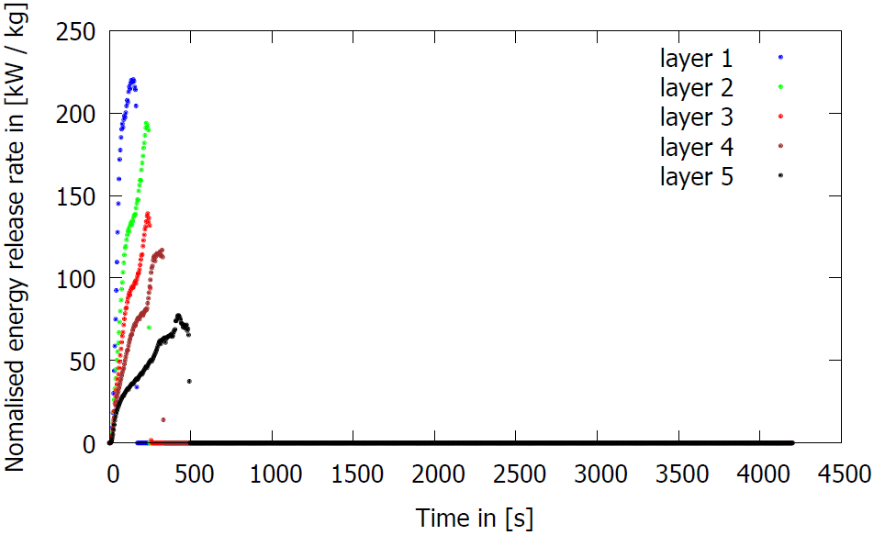
Cable material first steps
Cone Simulation
Change of the layer quantity (with ash)
Variation of the layer quantity, starting with top layer
Variation of the layer thickness, ± 20 %;
Parameter from CHRISTIFIRE in black
Change of the layer thickness
Change of the layer quantity (no ash)
Notes:
Try to explain better the bullet points
How about this?

Slide 17
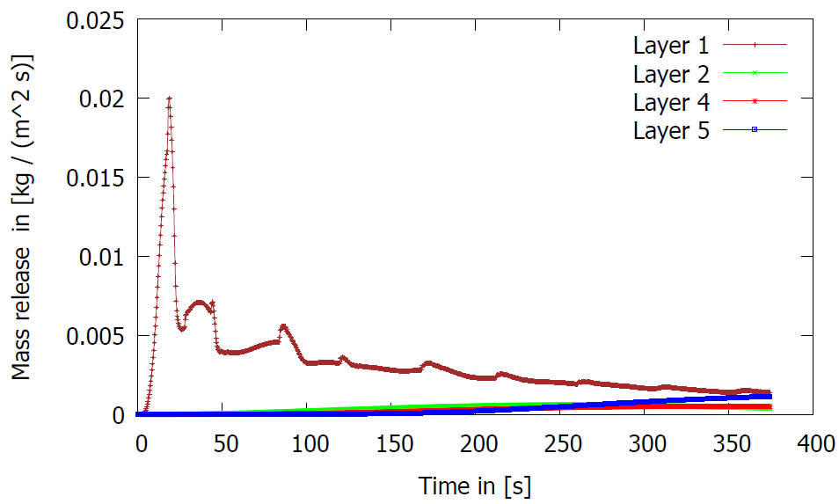
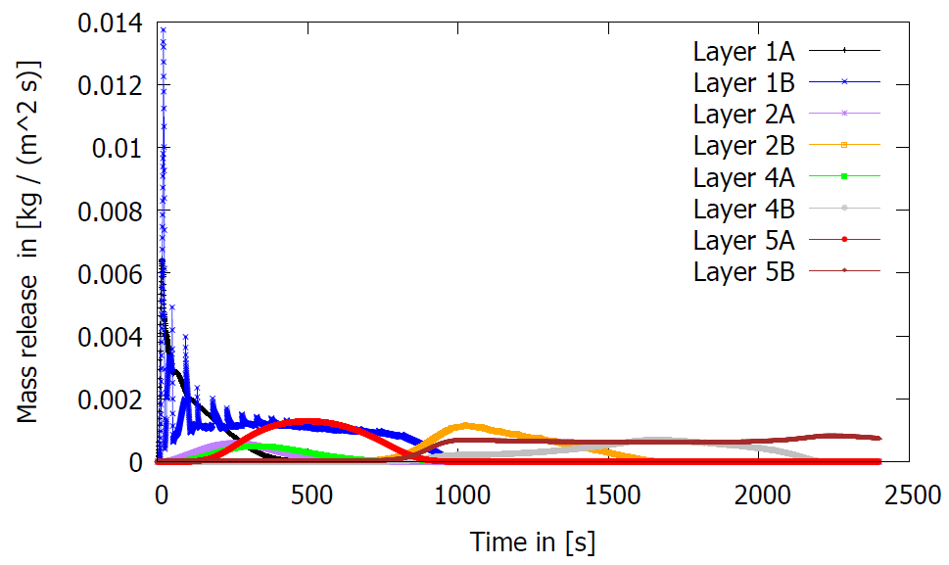
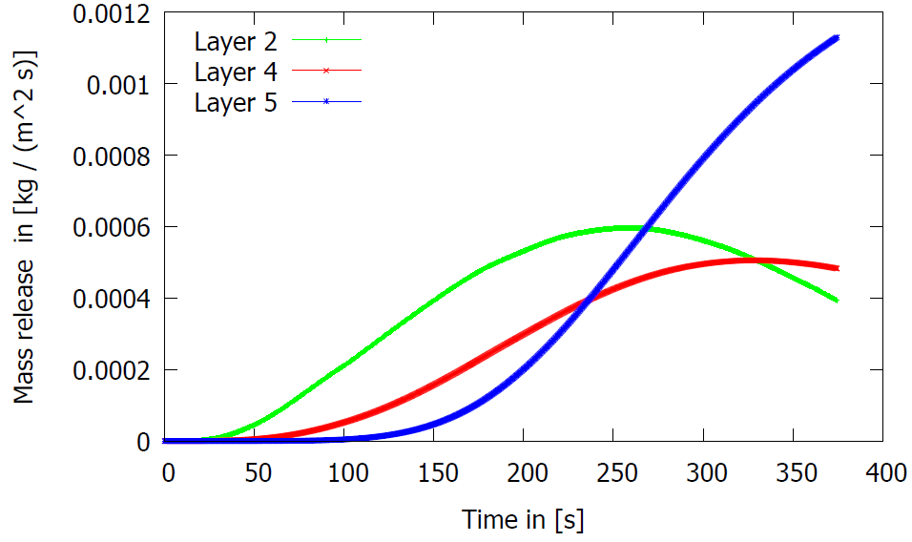
Cable material first steps
Pyrolysis: Layers
Cone Simulation
Pyrolysis monitored per layer
Layers 1-5, layer 3 is copper – no pyrolysis in the simulation
Simulation in „Coarse Cone“ (7,5 mm cells)
Pyrolysis: Layers (form above without layer 1)
Pyrolysis: Components and layers
Notes:
Try to explain better the bullet points
How about this?

Slide 18
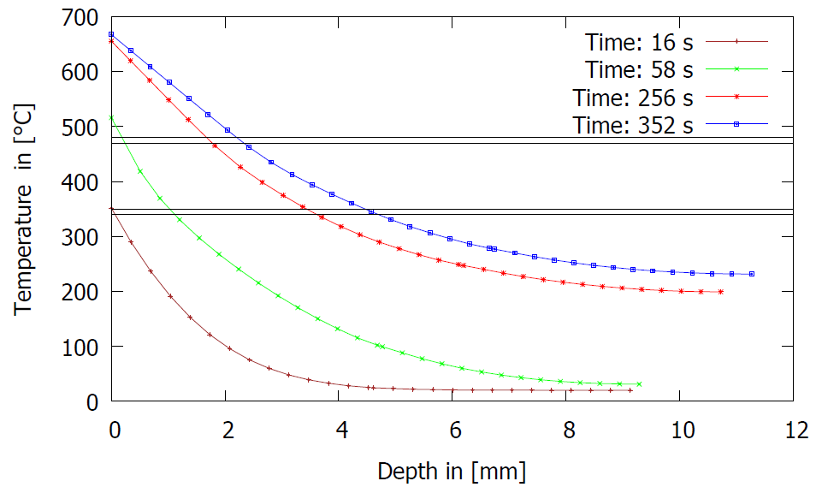
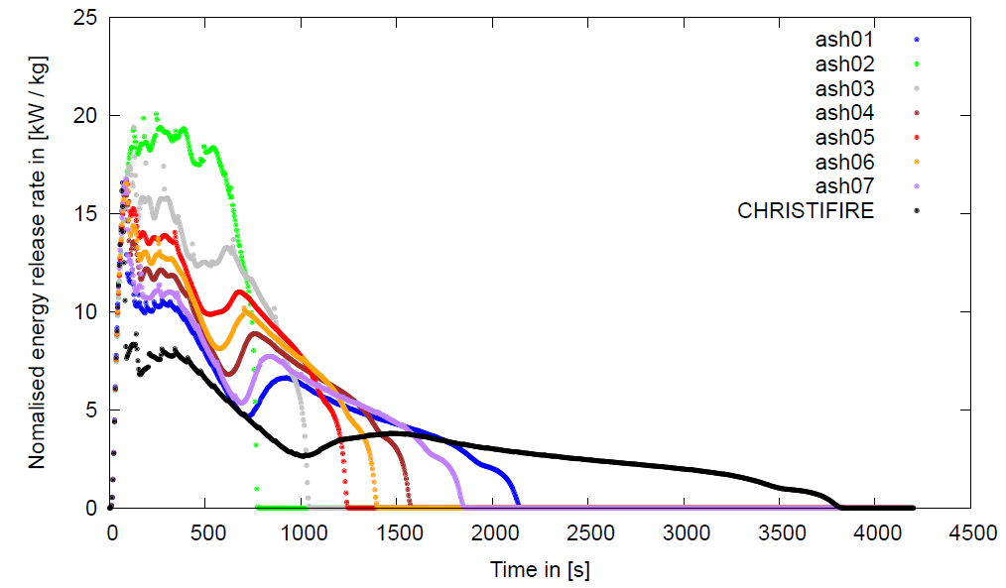
Cable material first steps
Cone Simulation
Heating of the different layers at different times
Changes in thermal properties of the ashes
Notes:
Try to explain better the bullet points
How about this?

Slide 19
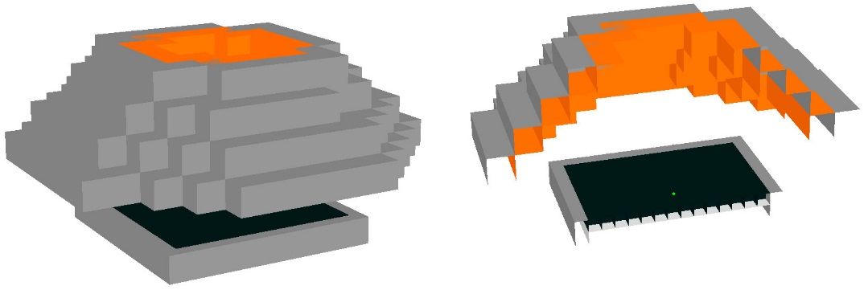
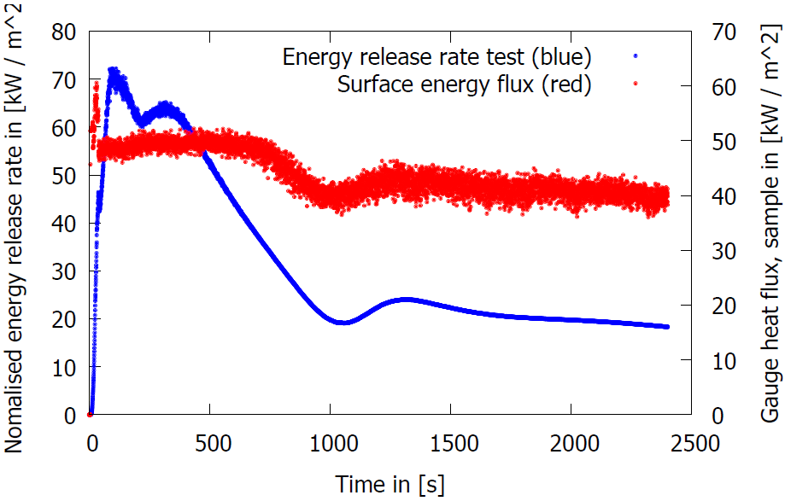
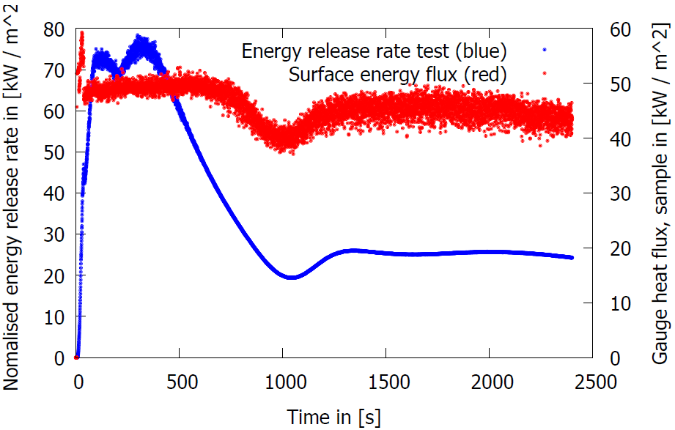
Cable material first steps
Cone Simulation
Cone with 7,5 mm cells
Variation of the heat of combustion
Simulation in „Coarse Cone“
(7,5 mm cells)
Change of the heat of combustion

Slide 20
Future steps

Slide 21
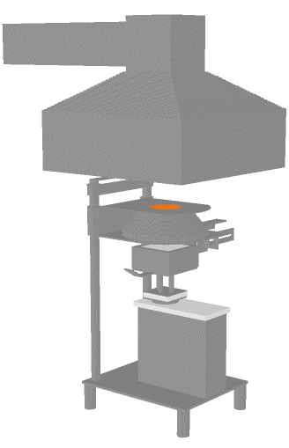
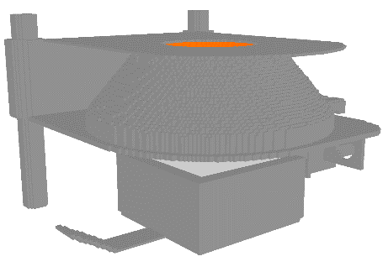
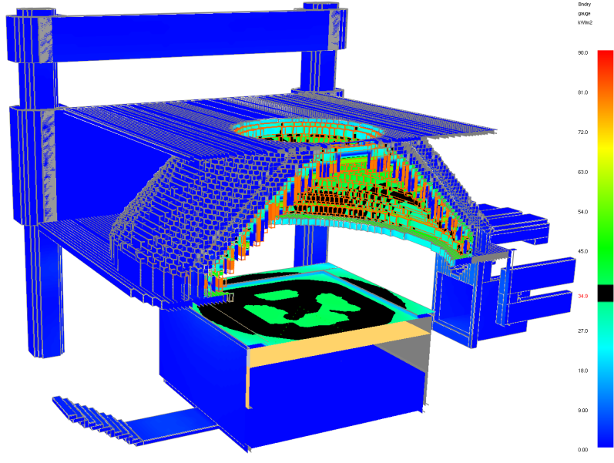
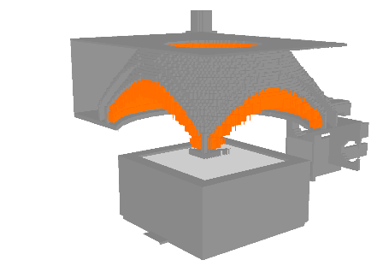
Future steps
Prepared models
High-resolution cone calorimeter
  Uniform mesh, cell size: 2 mm (cubes)
  Number of cells: 125,000,000 (whole),
  1,969,920 (only cone and specimen)
heater temperature: 598.69 °C, mean gauge heat flux at sample surface: 35.21 kW/m2
Pictures: T. Hehnen

Slide 22
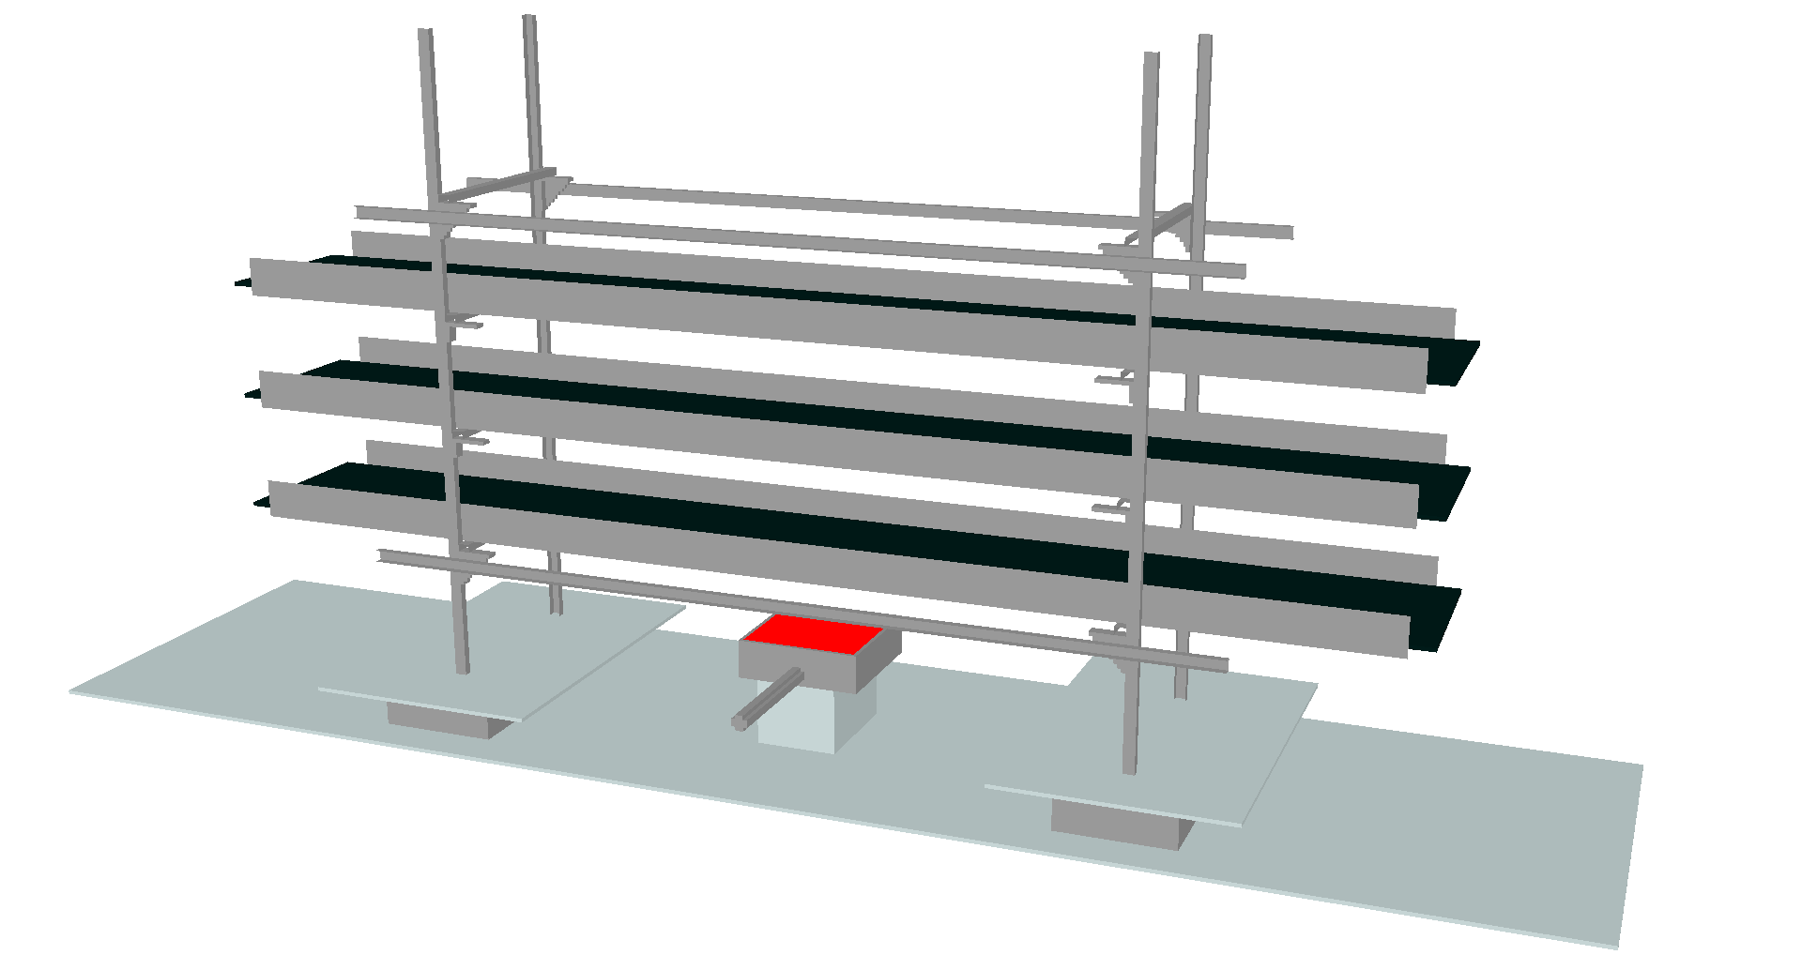
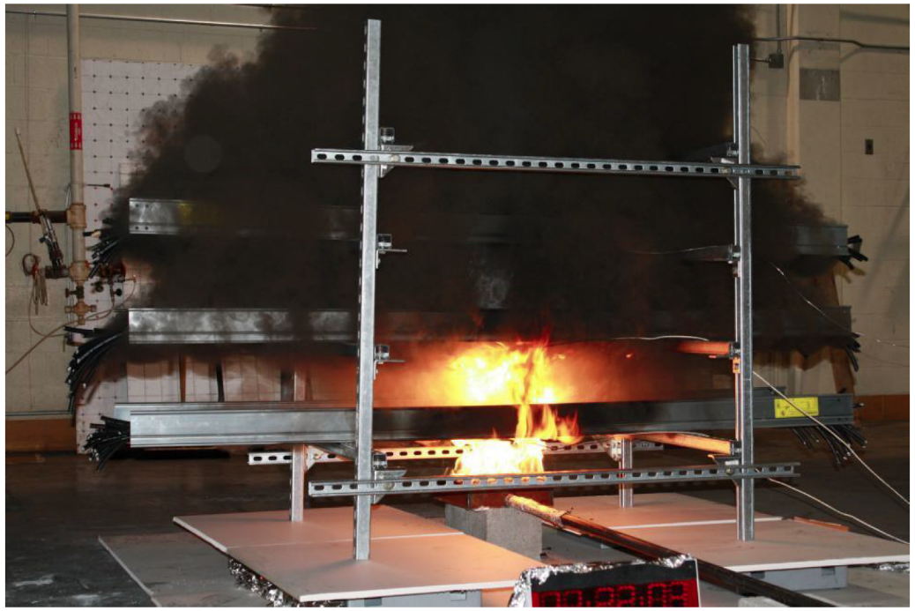
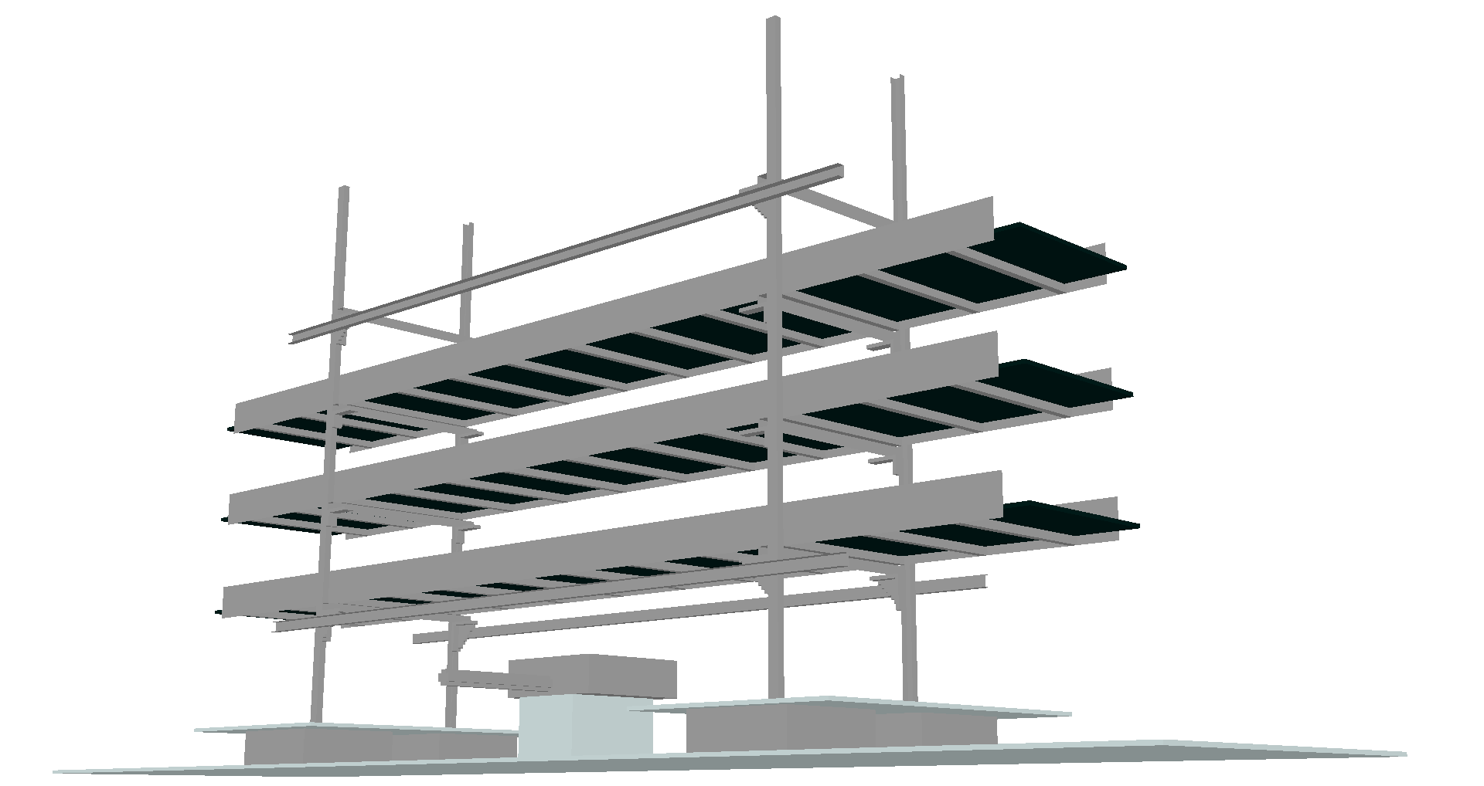
Future steps
Prepared models
Multiple cable tray experiment
  Uniform mesh, cell size: 1 cm
  Based on CHRISTIFIRE Phase 1 (MT Test 1)
Pictures: T. Hehnen, CHRISTIFIRE

Slide 23
Thank you for your kind attention!
Do you have any questions?

Slide 24
Literature
Excerpt
Influence of input parameters on the fire simulation, Trettin, C., Hagemann, P., Werrel, M., Wittbecker, F.-W., PROCEEDINGS Fire and Evacuating Modelling Technical Conference (FEMTC) 2014, Gaithersburg, Maryland, September 8-10
Babrauskas V. Ignition Handbook. Fire Science Publishers, Issaquah, WA 98027, USA, 1th edition, 2003. Co-published by the Society of Fire Protection Engineers.
Karlsson B., Quintiere J. G. Enclosure Fire Dynamics. CRC Press LLC, Boca Raton, Florida, 2000.
Drysdale D. An Introduction to Fire Dynamics. John Wiley & Sons, Southern Gate, Chichester, West Sussex PO19 8 Q, England, second edition, 1998.
Safety request form: “Request to characterize the burning behaviour of a vertical stack of horizontal cable trays.”, Answered by: F.Corsanego DGS/SEE, EDMS No.: 1357073 v1.0
Technical Note: “Fire modelling tools: Parameters for vertical and horizontal cable tray fire modelling. Results from real-scale tests.”, F.Corsanego, DGS-SEE, EDMS No.: 1097020 ver. 1
Guideline: “Fire modelling tools: Quick method to calculate the fire load of cable trays and cable ladders .”, F.Corsanego, DGS-SEE, EDMS No.: 1405658 ver. 1

Slide 25
Fire Performance of Electric Cables – new methods and measurement techniques, Final Report on the European Commission SMT Programme Sponsored Research Project SMT4 –CT96-2059, Interscience Communications Limited, West Yard House, Guildford Grove, Greenwich, London SE10 8JT, UK
Cable Heat Release, Ignition and Spread in Tray Installations During Fire (CHRISTIFIRE) Phase 1: Horizontal Trays, NUREG/CR-7010, Vol. 1, U.S.NRC, July 2012, McGrattan K., Lock L., Marsh N., Nyden M., Bareham S., Price M.,
Cable Heat Release, Ignition and Spread in Tray Installations During Fire (CHRISTIFIRE) Phase 2: Vertical Shafts and Corridors, NUREG/CR-7010, Vol. 2, U.S.NRC, July 2012, McGrattan K., Lock L., Marsh N., Nyden M., Bareham S., Price M.,
Coutin M., PlumecocqW., Melis S., Audouin L. Energy balance in a confined fire compartment to assess the heat release rate of an electrical cabinet fire. Fire Safety Journal, 52:34 – 45, 2012.
Dietmar Hosser and Volker Hohm. Application of a new model for the simulation of coupled heat transfer processes during fires to safety relevant objects in nuclear facilities. Fire Safety Journal, 62, Part B(0):144 – 160, 2013. Special Issue on PRISME – Fire Safety in Nuclear Facilities.

Slide 26
F. Bonte and N. Noterman and B. Merci. Computer simulations to study interaction between burning rates and pressure variations in confined enclosure fires. Fire Safety Journal, 62, Part B(0):125 – 143, 2013. Special Issue on PRISME – Fire Safety in Nuclear Facilities.
Lee B. T. Heat release rate characteristics of some combustible fuel sources in nuclear power plants. Technical report, U.S. Department of Commerce, National Bureau of Standards, Gaithersburg, MD 20899, 1985.
Mangs J., Paananen J., Keski-Rahkonen O. Calorimetric fire experiments on electronic cabinets. Fire Safety Journal, 38:165 – 186, 2003.
Tewarson A. Characterization of the fire environments in central offices of the telecommunications industry. Fire and Materials, 27:131 – 149, 2003.
Boulet P., Parent G., Acem Z., Rogaume T., Fateh T., Zaida J., Richard F. Characterization of the radiative exchanges when using a cone calorimeter for the study of the plywood pyrolysis. Fire Safety Journal, 51(0):53 – 60, 2012.
McGrattan K., McDermott R.,Weinschenk C., Overholt K. Fire Dynamics Simulator (Version 6) User’s Guide. Technical report, NIST, Gaithersburg, Maryland, USA, September 2014.

Slide 27
SC/GS. Criteria and standard test methods for the selection of electric cables and wires with respect to fire safety and radiation resistance. IS23 Rev. 3, CERN, CH-1211 Geneva 23, Switzerland, February 2005.
Staggs J. E. J. Convection heat transfer in the cone calorimeter. Fire Safety Journal, 44(4):469 – 474, 2009.
Staggs J. E. J. A reappraisal of convection heat transfer in the cone calorimeter. Fire Safety Journal, 46(3):125 – 131, 2011.
Stein A. B., Sparrow E. M., Gorman J. M. Numerical simulation of cables in widespread use in the nuclear power industry subjected to fire. Fire Safety Journal, 53(0):28 – 34, 2012.

