Slide 1
Information System Use Cases
WLCG Management Board
15th September 2015
Maria Alandes on behalf of the Information System Task Force

Slide 2
Introduction
New Task Force created on July 2015
  https://twiki.cern.ch/twiki/bin/view/EGEE/WLCGISEvolution
One of the main goals is to identify the existing use cases for the WLCG Information System
A document has been written with input from TF members representing LHC VOs and WLCG activities currently relying on the IS
  Document can be found attached in the Indico Agenda
  A summary will be presented in the following slides

Slide 3
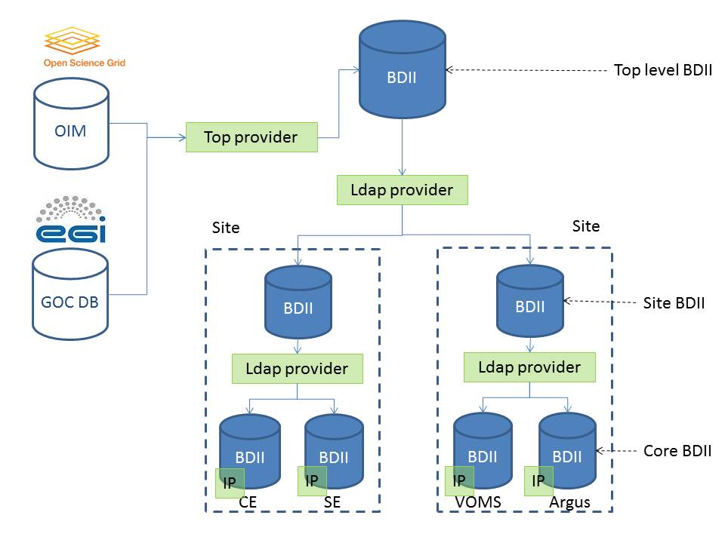
WLCG Information System Overview

Slide 4
Uses Cases Summary
The Information System is currently being used by all LHC VOs
Many activities in WLCG have also a dependency on it
Uses cases are many and there is no common pattern
  Some experiments use it for service discovery, others don’t
  Some experiments integrate the information in their workload management workflows, others don’t
GLUE 1.3 is the GLUE version used by all use cases
As far as clients are concerned, ldapsearch is widely used
  lcg-infosites is also used to a greater extent by sys admins

Slide 5
Drawbacks of the Information System
Known issues identified for a long time
  Already reported in 2012 at TEG reports
    https://twiki.cern.ch/twiki/bin/view/EGEE/ISTEG2012Summay
  Discussed in Infosys meeting
    https://indico.cern.ch/category/4475/
    GSR was an attempt to address these issues
      https://twiki.cern.ch/twiki/bin/view/EGEE/WLCGGISR
Some issues addressed in the past years
  Information accuracy and validation → glue-validator
  Information volatility → top BDII cache
Some issues inherent to the existing architecture
  Mix of static and dynamic information
Some issues recently discussed
  Lack of flexibility to aggregate across multiple types of inputs and formats
  Manual editing of certain classes of information is a desired functionality, while other classes will normally be collected automatically through information providers

Slide 6
Next steps
The collected use cases demonstrate the need to maintain a WLCG information system
A review of the current implementation is in any case needed since OSG will stop publishing in the Information System
  100% consensus and participation is needed to move forward and ensure interoperation
    EGI, OSG and NDGF will present their future plans at the next TF meeting https://indico.cern.ch/event/441747/
The main goal of the TF is to work on a new information system
  To address the identified drawbacks of the existing IS
  To address the collected use cases
  Next step would be to define the architecture of the new IS
    New doesn’t necessarily imply a new service written from scratch!
    Example: Extension of OIM and GOCDB to cover existing use cases
      GOCDB new features to be presented also at the next TF meeting
    Example: GSR
    … other possibilities to be explored
    All this will be discussed within the TF

Slide 7
REBUS requirements

Slide 8
New requirements for REBUS
During the discussion within the TF, the following requirements affecting REBUS have been collected:
  Experiments are using pledges per site and not per federation
    Sites are contacted by experiments to get this information
    Experiments would like to know what it is supposed to be available at a site
    It would be extremely useful if this could be provided by REBUS per site
    Even if it is an indicative value and not an actual pledge
  Definition of installed capacity (or a better name)
    An official definition of installed capacity is needed
      Some input already provided in the TF
      Experiments would like to know what it is actually available at a site → available capacity?

Slide 9
Additional material

Slide 10
Use of the Information System by the LHC VOs
 | BDII Dependency | Main Interface | GLUE version | BDII type | BDII query frequency
ALICE | YES | ldapsearch | GLUE 1.3 | Resource & site BDII | Every min
ATLAS |  |  |  | Top BDII | Every 2h
CMS |  |  |  |  | Bootstrap (*) Several times per hour (**)
LHCb |  |  |  |  | Every 12h
(*) Pilot infrastructure uses the Information System the first time a site is added
(**) Vofeed creation

Slide 11
Use Cases by the LHC VOs
 | Use Cases | GLUE 1 Attributes
ALICE | CE status | GlueCEStateStatus GlueCEStateWaitingJobs GlueCEStateRunningJobs
ATLAS | CE attributes HEP-SPEC06 and Logical CPUs | GlueSite and GlueCE attributes
CMS | CE service discovery CE attributes Logical CPUs | GlueCEUniqueID GlueCEPolicyMaxCPUTime GlueCEPolicyMaxWallClockTime
LHCb | CE service discovery CE attributes | GlueCE, GlueHost and GlueSE attributes

Slide 12
Use Cases by other activities in WLCG
 | Use Cases | GLUE 1 Attributes
SAM | Queue name | GlueCEUniqueID
REBUS | Site Capacities | GlueCE and GlueSE attributes
GFAL2 | SE endpoints | GlueService attributes
IT-SDC C5 reports | Site Capacity per OS, batch system, CEs and SEs | GlueCE, GlueSE, GlueHost and GlueSubcluster attributes
WLCG Google Earth Dashboard | Site coordinates | GlueSiteUniqueID GlueSiteLatitude GlueSiteLongitude
APEL accounting | HEP-SPEC06 Message broker discovery | CPUScalingReferenceSI00 GlueHostBenchmarkSI00 GlueService attributes

Slide 13
Feedback from sites
GridPP sites have also provided feedback on the way the Information System is used
More feedback from other sites could be collected in future versions of the document
Highlights
  Useful for service discovery and migration campaigns
  Contains too much information that is not used
  Mix of static and dynamic information
  GLUE 1 and GLUE 2 schema support is a burden

