Slide 1
A. Herlert, CERN PH-IS
ISOLDE scientific coordinator’s report
INTC meeting, November 3, 2008
Schedule and running period 2008
Status ISOLDE experiments and INTC shifts
Outlook 2009

Slide 2
Accelerator schedule 2008
Approved by CERN Research
Board November 28, 2007 (V4.1)
ISOLDE dates:
protons from PSB May 5
physics start ISOLDE May 9
protons stop November 12
(i.e. 27 weeks for physics)
Power cuts November 19+22
Stop of ISOLDE machines Dec 5
Stop of cooling water: Dec 17

Slide 3
ISOLDE beam requests 2008
Limits in key resources
  RILIS (installation of new solid state lasers, max 2000 h operation)
  UC_{x} targets (about 10 new units maximum)
Schedule:
  470 RIB shifts left after 2007 for approved experiments
  231 RIB shifts from new proposals and addenda at February INTC meeting 2008
    in total 701 RIB shifts for 2008
    120 additional RIB shifts from May INTC meeting not taken into account
  551 RIB shifts requested
    compare to 480 RIB shifts requested in 2007 with 407 scheduled shifts
    requested RILIS shifts: 337 --> more than 2700 h operation
    requested RIB shifts with UC target: 410 (together with RILIS: 308)
Notes:
3

Slide 4
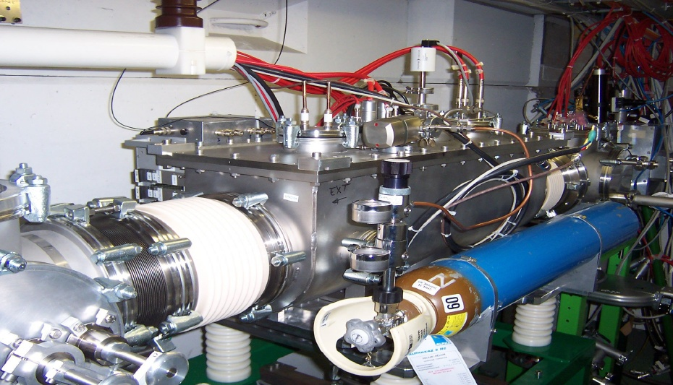
ISCOOL and new tape station
ISCOOL
  maintenance during shutdown
  2007/2008
  test in off-line period April 2008
  permanently installed in 2008
  running in transmission and
  bunch mode
  Added additional setup and
  development time for 2008 schedule
New tape station (IHPC Strasbourg):
  Installation planned for June 2008 but delayed
  Has been installed at LA2 beam line in September 2008
  try to make first on-line test end of the 2008 running period

Slide 5
ISOLDE schedule 2008 ("final")
ISOLDE dates 2008:
2 weeks off-line period
protons started May 5
physics started May 9
protons stop Nov. 12
27 weeks for physics
Scheduled:
31 IS experiments
(out of 46 requested)
24 target units
(4 old units)
12 UC + 1 ThO
(2 old UC units)

Slide 6
ISCOOL setup and development
added extra setup time
(not needed next year?)
dedicated MD periods for
beam development (off
line and on-line)
very good performance
for laser spectroscopy
experiments with bunched
beams to COLLAPS (need
further development)
higher He gas consumption
than expected (problem for
future operation?)

Slide 7
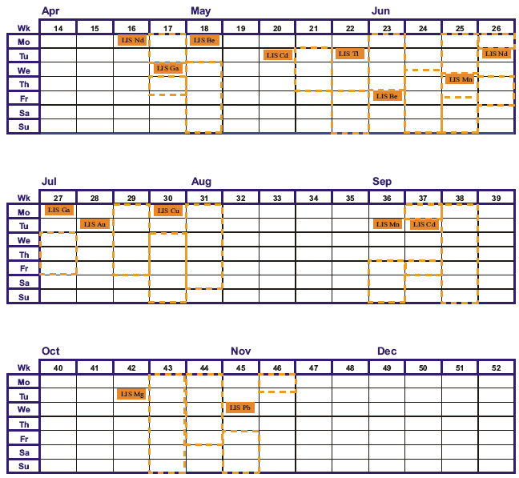
RILIS off-line and on-line shifts
15 runs (e.g. Au new beam)
rough estimate more than
1800h of operation (without
set up time - close or above
limit of 2000h)
beam development for new
Nd:YAG pump laser and
standard operation with
Nd:YAG lasers
Copper vapour lasers still
needed for some beams

Slide 8
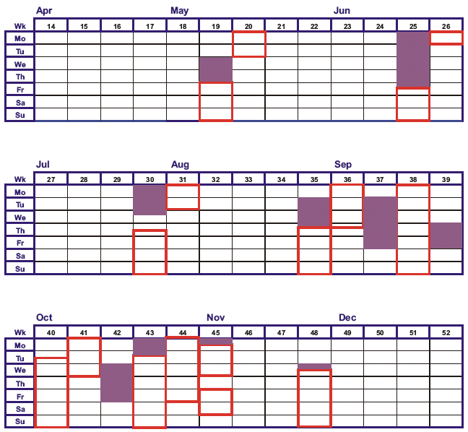
REX runs in 2008
7 on-line runs for IS
experiments
1 on-line and 1 off-line
development run for in-trap
decay studies and mass-
separation tests (F. Wenander,
A. Gustafsson)
Successful runs for
IS418: ^{100,102,104}Cd Coulex
IS452: ^{182,184,186,188}Hg Coulex
IS465: ^{202,204}Rn Coulex
IS468: ⁶¹Mn,Fe Coulex
IS470: 2n transfer ³⁰Mg
(³H target !)

Slide 9
Running period 2008 ... successful
Rough start in the beginning ...
  unstable controls
  limitation of proton beam intensity on GPS
  vacuum system partly in manual mode
... improved during the running period
  situation of controls improved ... vacuum still problematic
  remaining broken diagnostics to be repaired during shutdown
  intervention for ventilation system worked out: no limitation for GPS proton beam intensity
  new RILIS pump lasers in operation - very good performance
  good performance of targets - however, yield not in all cases suitable
  and also broken target units - in addition problems with HV (polluted extraction electrode?)
  a lot of successful runs this year - detailed report at next meeting
  (and some results at ISOLDE workshop)
... and some more runs to come (REX MD + Pb beam)

Slide 10
New and closed experiments at ISOLDE
New ISOLDE experiments in 2008 (so far)
    IS465 - IS476 (12 new experiments, 6 scheduled in 2008)
Closed ISOLDE experiments
    IS360, IS386, IS412, IS421, IS428
    IS406 (closed by INTC)
    IS436 (MISTRAL - experimental setup to be removed)
    more inactive experiments to be checked in the future
New installations
    CRIS beam line (start of installation November 2008 at former location of COMPLIS setup)
    β-NMR + tilted foil polarization (start of installation ongoing, experimental setup from HMI Berlin)

Slide 11
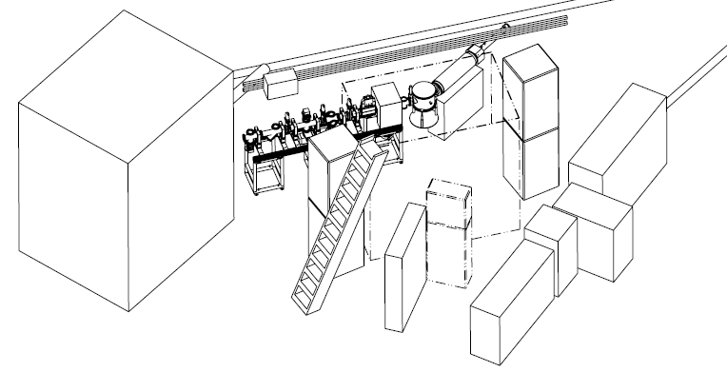
New experiment CRIS (K. Flanagan et al.)
CENTRAL BEAM LINE
COLLAPS
Start of installation November 2008
Initial safety discussion done

Slide 12
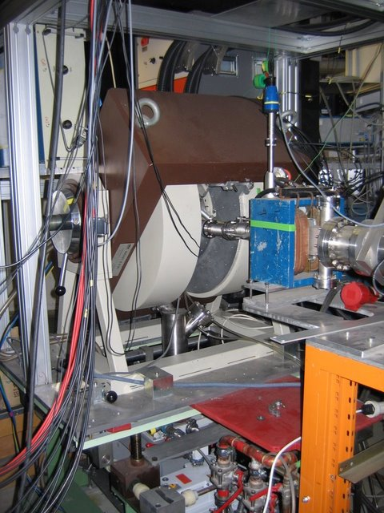
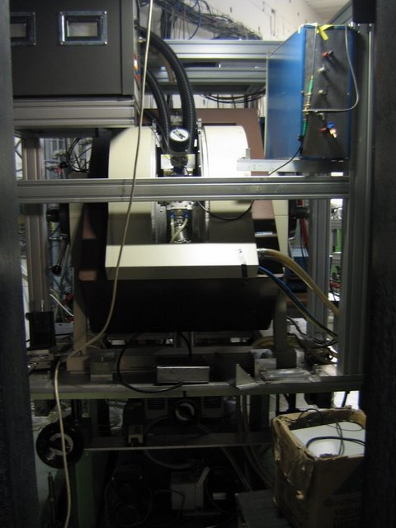
New experimental setup: β NMR
Setup from HMI Berlin (W.-D. Zeitz) + tilted foil chamber
Installation ongoing behind REX-LINAC (support by P. Imielski)

Slide 13
INTC shifts - evolution
203 more
shifts proposed
in November
INTC meeting

Slide 14
INTC shifts - evolution (II)

Slide 15
INTC shifts - evolution (III)

Slide 16
Accelerator draft schedule 2009
preliminary
ISOLDE dates:
protons from PSB April 6
physics start ISOLDE April 9
protons stop November 14
(i.e. 31.5 weeks for physics
as compared to 27 weeks
in 2008)
Start of n_TOF: May 11
Short period for shutdown
maintenance - try to schedule
off-line physics and/or development

