Slide 1


Do nuclear collisions equilibrate?
Paul Romatschke
Based on 1609.02820

Slide 2
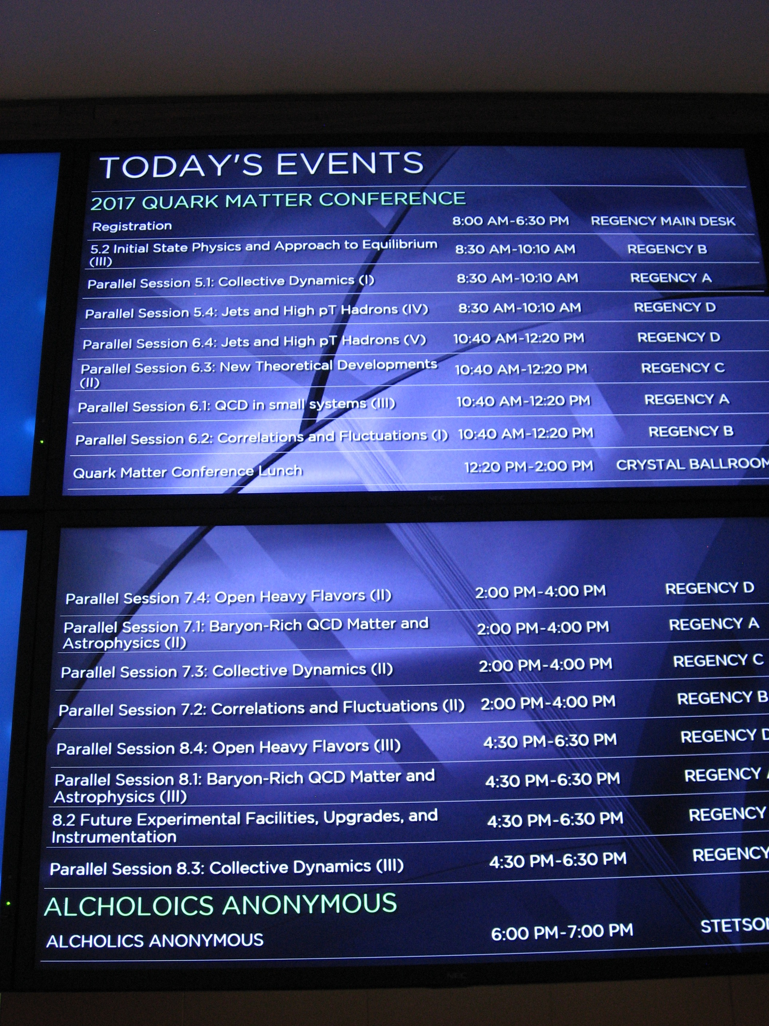

Slide 3
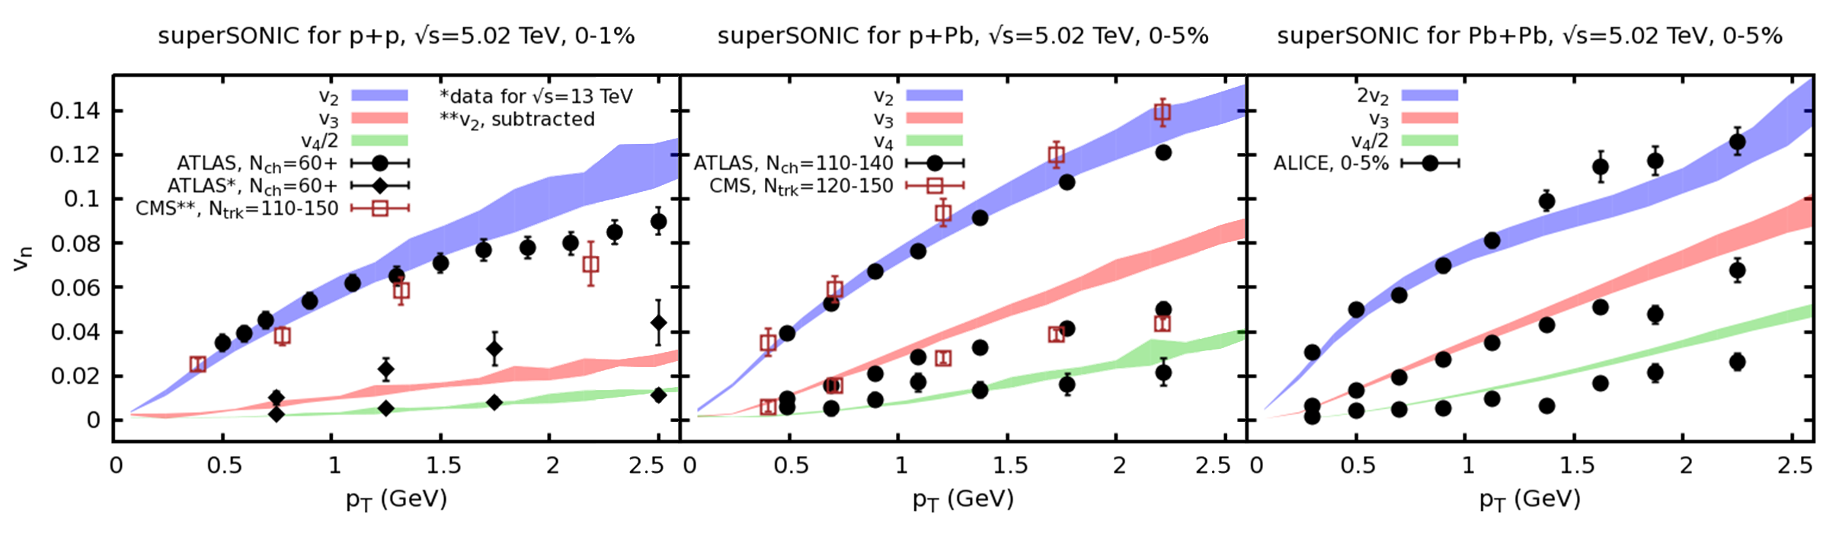
“Unreasonable” success of hydro
[1701.07145, see poster H8 by R. Weller]
“Blind luck” (?)
“Full equilibration in p+p” (?)
something else (?)

Slide 4
What do we know? versus
What do we believe?

Slide 5
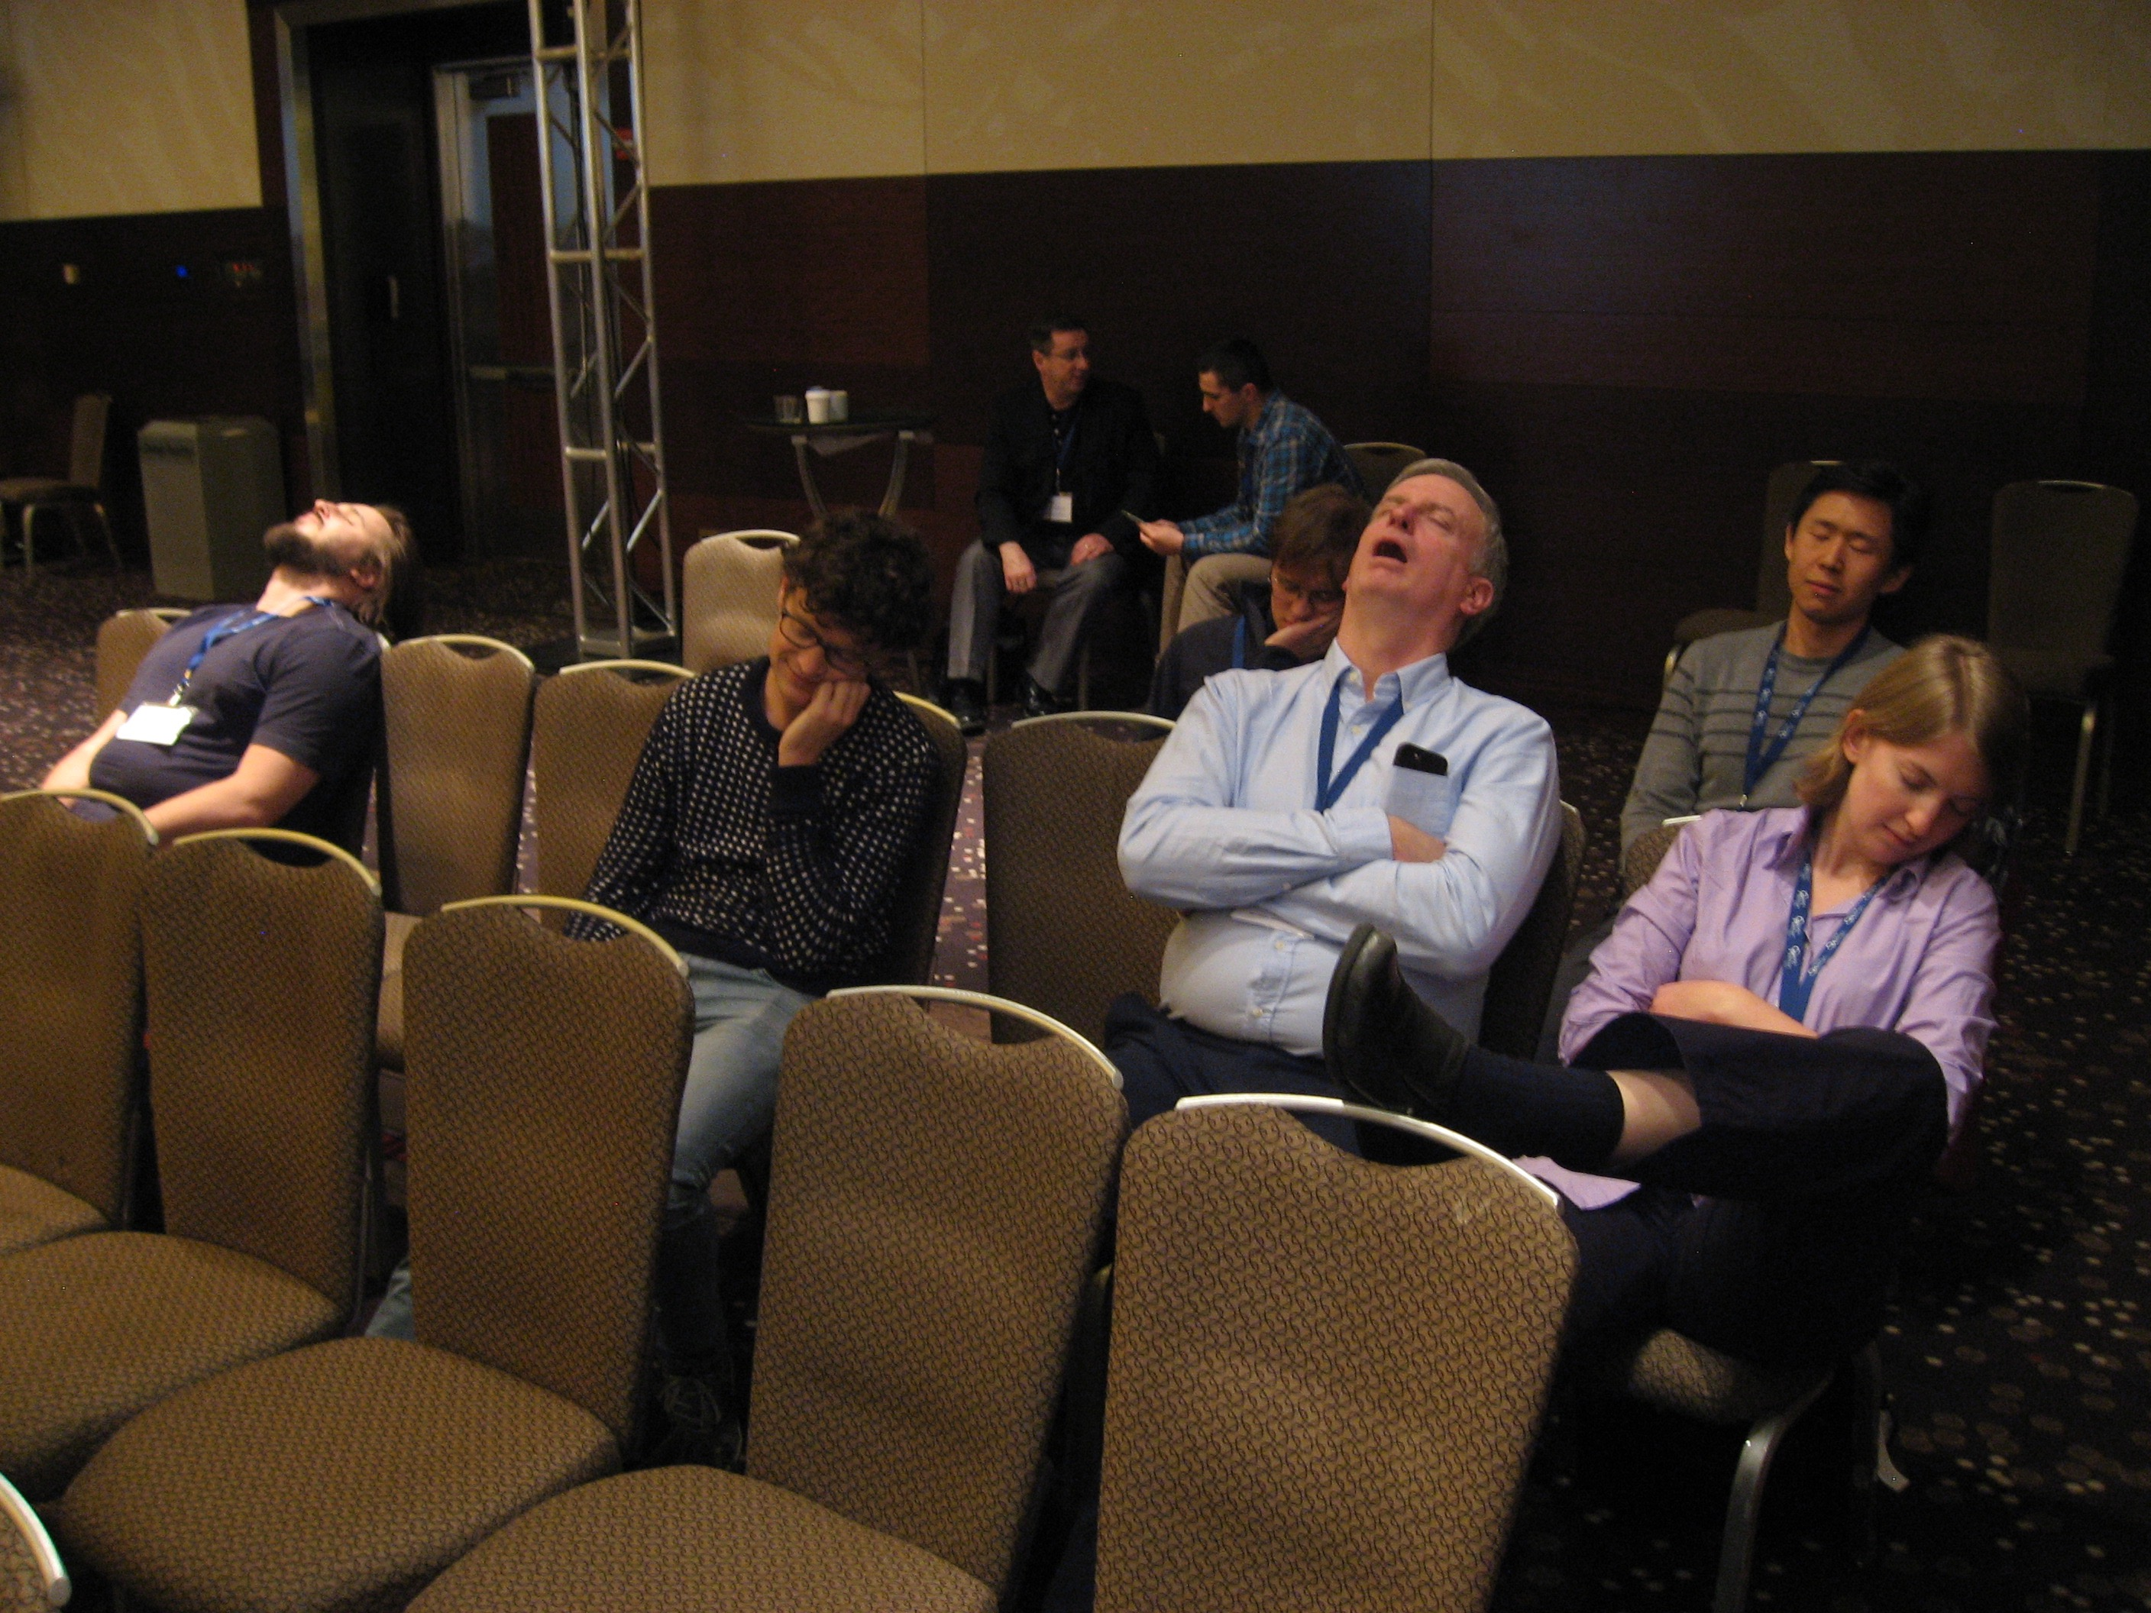
Proof of Saturation

Slide 6
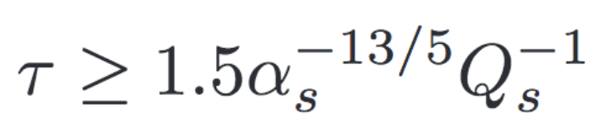
When is Hydro applicable?
Answer (version 2001):
System in local thermal equilibrium. For nuclear collisions, happens after
(or τ>6.9 fm if Q_{s}~1 GeV, α_{s}~0.3)
[Baier, Mueller, Schiff, Son, 2001]

Slide 7
When is Hydro applicable?
Answer (version 2005):
Thermal equilibrium not needed. Local isotropy will suffice, e.g.T^{ab}=diag(ε,p,p,p)
[Arnold, Lenaghan, Moore, Yaffe, 2005]

Slide 8
Hydro works away from isotropy
[adapted from 1512.05347]

Slide 9
When is Hydro applicable?
Empirical Fact: Hydro works quantitatively even for anisotropic systems
Onset of quantitative hydro description unrelated to thermalization or isotropization
New type of phenomenon (“hydrodynamization”=onset of hydro behavior)
[Casalderrey-Solana, Liu, Mateos, Rajagopal, Wiedemann, 1101.0618]

Slide 10
When is Hydro applicable?

Slide 11
Hydro as an EFT
Many derivations of hydro equations
Most general approach: Effective Field Theory (EFT)
Hydro = EFT of long-lived, long-wavelength excitations
EFT variables: pressure, energy density, fluid velocity

Slide 12
Hydro as an EFT
Write down quantities using EFT variables and their gradients
Energy-Momentum Tensor for relativistic fluid
No thermal equilibrium or particle description needed
Seems we need small gradients!

Slide 13
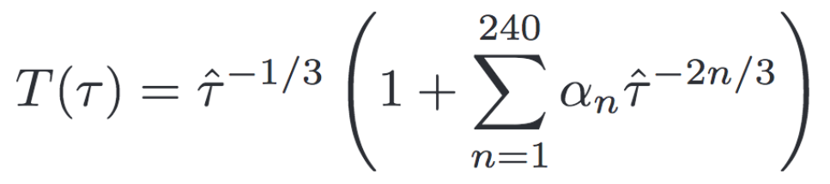
Hydro as an EFT
What if we had LARGE gradients?
Try to improve description by including higher orders in EFT gradient series
E.g. Bjorken flow, go to order 240 (AdS/CFT)
Find: α_{n}~n!, gradient series diverges
[1302.0697, 1503.07514, 1603.05344, 1608.07869, 1609.04803]

Slide 14
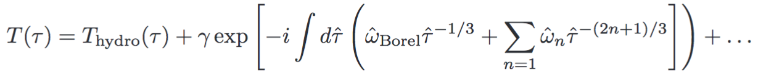
Hydro as an EFT
Gradient series diverges
But it is Borel-summable! [Heller et al, 1302.0697]
Borel-resumming AdS/CFT gradient series:
T_{hydro} is essentially standard Navier-Stokes
Extra pieces non-analytic in gradient expansion; this is why grad series diverges!

Slide 15
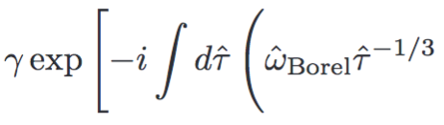


Hydro as an EFT
Borel resummation gives Hydro part and other (“Non-Hydro”) part
Non-hydro part:
w_{Borel}=±3.1193-2.7471 i [Heller et al, 1302.0697]
w_{QNM}=±3.119-2.747i [Starinets, hep-th/0207133]

Slide 16
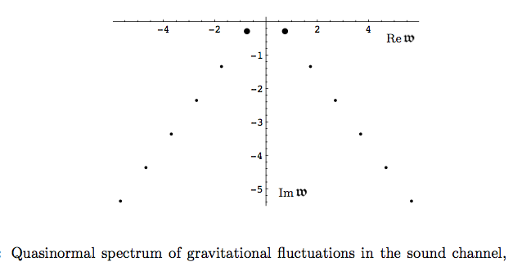
Hydro as an EFT
[Kovtun&Starinets, hep-th/0506184]

Slide 17
When is Hydro applicable?

Slide 18
When is Hydro applicable?
Answer (version 2016):
Hydrodynamics is applicable and quantitatively reliable as long as contribution from non-hydro modes can be neglected¹.
¹ If a local rest frame exists.
[PR, 1609.02820]
No need of thermal equilibrium!
No need of isotropy!

Slide 19
We know:
Hydro works even out of equilibrium

Slide 20
Implications
Hydro matching data does not indicate the presence of an equilibrated QGP

Slide 21
Implications
Hydro does not mean equilibrium

Slide 22
Do nuclear collisions equilibrate?
Let’s check: use hydro to measure “non-equilibriumness”

Slide 23
Implications for HIC
[PR, 1609.02820]

Slide 24
We know:
Nuclear collisions always out-of-equilibrium!
Not new: This has been known to all hydro practitioners for a decade

Slide 25
Do nuclear collisions equilibrate?
No

Slide 26





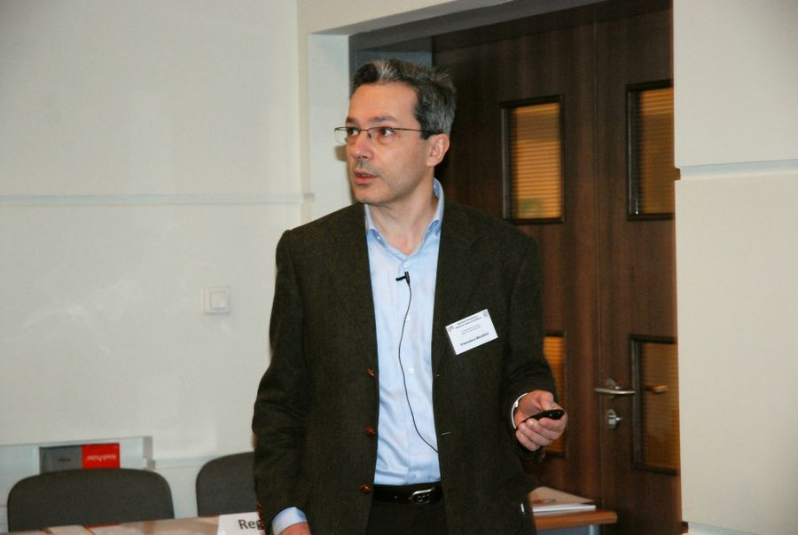
Reaction from Colleagues
If someone looks like crocodile and behaves like crocodile,
then it is crocodile
anonymous
You can’t just say no??
This is a very destructive attitude!

Slide 27
Does this mean we should all go home now?
No equilibration, no problem:
Can probe non-equilibrium QCD
Extreme experimental hydrodynamics: flow in small systems (did anyone check e⁺ e⁻ yet?)
Can study non-hydro modes in QCD
Nuclear collisions are much richer subject than expected a decade ago!

Slide 28
Thank you for your attention
[you may go home now]

Slide 29
Bonus Material

Slide 30
What about the EoS?
Hydro equations need EoS to close
In equilibrium, can take lattice QCD EoS
Do we have an EoS out of equilibrium?

Slide 31
EoS out of equilibrium
“Pre-thermalization”: EoS establishes to equilibrium value on timescales dramatically shorter than equilibration time
[Berges, Borsanyi, Wetterich, PRL93 (2004)]
t_{eq}~95 m⁻¹

Slide 32
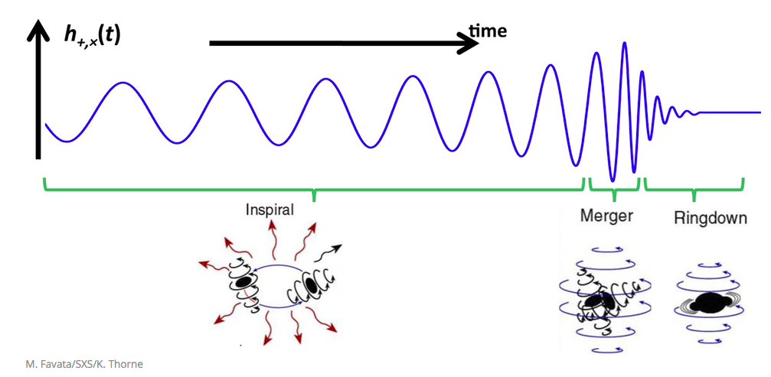
What are non-hydro modes?

Slide 33
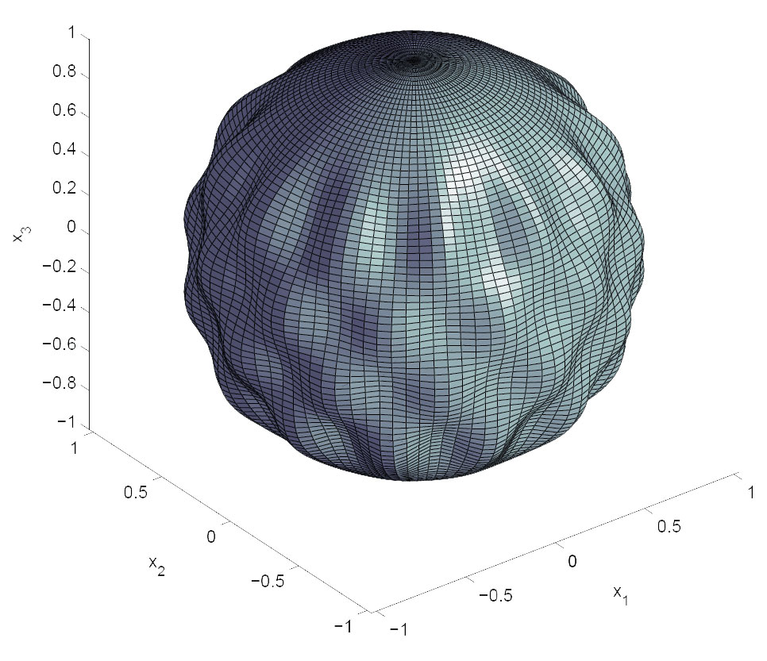
Quasi-Normal Modes

Slide 34
When do non-hydro modes become important?

Slide 35
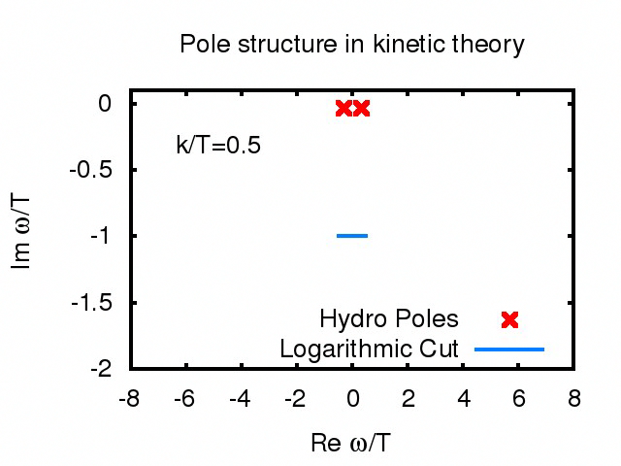
[based on PR, 1512.02641]

Slide 36
Hydrodynamic Modes disappear above some critical wave number k>k_{c}
Implies: no (not even approximate) hydro description above k_{c}

Slide 37
“Destruction” of Hydro Modes also in gauge gravity duality
[Grozdanov, Kaplis, Starinets, 1605.02173]

Slide 38
QCD
Interaction strength
[PR, 1609.02820]

Slide 39
Implications for Nuclear Collisions
Non-hydro modes breakdown scale
k_{c}=4-7 T
k_{c}⁻¹~L=(7 T)⁻¹~0.15 fm
L=0.15 fm
Non-hydro mode argument says hydro has to break down for L<0.15 fm

Slide 40
Implications for Nuclear Collisions
Smallest QCD liquid drop size L=0.15 fm
Proton nucleus radius 0.86 fm>>L
Non-hydro mode argument says hydro can work for p+p!

Slide 41
Implications for HIC
Also diffusion is probably working in this way
E.g. constitutive equation such as J=σE out of equilibrium
Could explain longer-than-expected lifetime of magnetic field in HICs (good news for CME?)

Slide 42
Implications for Cosmology?
Viscous cosmologies: effects from dissipation
Once viscous effects become interesting, standard hydro picture would say theory has broken down
New (non-hydro) picture: viscous effects may be order O(1), yet theory still applies if non-hydro modes are subdominant
May be interesting to look at non-hydro modes in cosmology context

