Slide 1
BABY-MIND status and Plans
Overview: Baby-MIND was born of the FP7 AIDA WP 8
-- two steps: TASD (Totally Active Scintillator Detector)
and Baby-MIND (Magnetized Iron Neutrino Detector)
-- TASD = scintillator planes readout with siPMs to be placed in Morpurgo magnet
in H8 beam at CERN
-- measurements = electron pion muon tracking in magnetic field
test charge separation
-- TASD to be made modular to serve as readout for baby-MIND
-- Baby-MIND to be built as «toroid-inspired» magnet with ~3cm thick plates, 1.5 T
central part instrumented and tested in CERN beam.
-- seen as test of large MIND and included in LBNO, then WA105
Development: Baby-MIND invited to take part in WAGASCI measurement of
cross-sections in water vs scintillator in T2K ND280 pit.
➔ becomes a real experiment
➔ this requires new scintillator design
(WLS, siPM, connectors and electronics are the same)

Slide 2
Status :
-- construction status (see Etam’s report)
2/3 of TASD completed,
electronics design nearly complete,
siPM and WLS procured
magnet design principle decided
design under completion.
-- magnetization is original and very elegant → more homogeneous, 1.5T field
-- FP7 is finished, reports written etc...
-- partially covered by H2020 AIDA2 because of magnet.
-- agreed with CERN to be part of neutrino platform activities
-- agreed with WAGASCI colleagues to be part of WAGASCI experiment
need some more formalities WRT CERN (proposal, plan for tests, MOU)
... and funding for people.

Slide 3
On WA105 vs Baby-MIND
AB to the WA105 spokesperson and SPSC chair on 10 June 2015:
1. The "TASD and Baby-MIND" project is a work-package of the EU-FP7 AIDA project and for this purpose has its own existence independently of WA105.
It is a collaboration involving several institutes with UNI Geneva as Workpackage leader.
The TASD construction is essentially completed and the detector will be tested in the
'Morpurgo magnet' on the H8 beam-line. These TASD detector modules can be used
for a test of the MIND concept with magnetized iron plates whose design is under completion
in collaboration with CERN specialists.
2. In the context of the Laguna-LBNO project we have made a study of the possible implementation of a large MIND detector at the far detector location (DONE). We have also studied a near detector based on a TPC filled with high pressure Argon gas, which very naturally includes a MIND-like spectrometer. (DONE)
NB there is no MIND or HPTPC in the DUNE project

Slide 4
3. (WA105) In the context of beam-test experiments with a large liquid argon detector, there is a physics case for using a spectrometer to verify and calibrate the measurement of muon momentum in Argon using multiple scattering, an important physics ingredient for using the far detector in an oscillation experiment. To this effect we have signed the WA105 proposal and are members of the collaboration.
The assigned location is, however, by no means a good place to test the Baby-MIND in its own right.
4. the WA105 DLArg MOU with CERN does not include any Magnetized iron project, it is limited to the construction of the Double Phase liquid Argon.
5. There are many other uses of the Baby-MIND for physics experiments, and there is
no understanding or commitment of exclusivity of the Baby-MIND detector with WA105.
6. In particular the Baby-MIND is now included in the WAGASCI experiment in Japan where it will be used as spectrometer for a measurement of the scintillator to water cross-section ratios, an important ingredient for the determination of the number of expected events in the SuperKamiokande Water Cherenkov (far) detector based on the scintillator-based near detector of T2K.

Slide 5
7. A separate MOU with CERN is drafted for the Baby-MIND project in which the CERN contribution is mainly the design cost and construction of the magnet, not including the transport to the location of use outside CERN.
What we are requested to do:
submit to the SPSC before Octobre a short document (~10 pages) describing
-- the project
-- the various contributions
-- the beam tests foreseen at CERN
following which it will be possible to schedule a public presentation ?
bonjour Alain
et merci pour ces clarifications écrites qui correspondent à ce que nous avions discute au telephone. Peux-tu me confirmer que pour le point 7 tu prevois de soumettre au SPSC d'ici Octobre un petit document (~10 pages) decrivant le projet, les diverses contributions et beam tests prevus au CERN, moyennant quoi une presentation publique pourra être programmée ? Merci ! Claude.

Slide 6
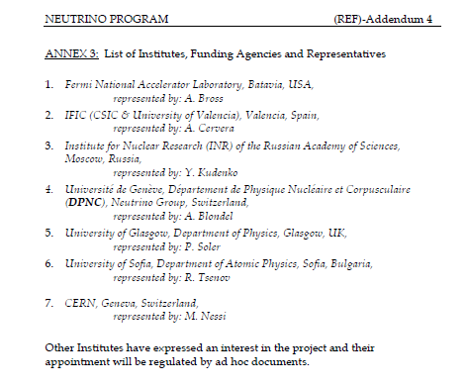
it is agreed with CERN that
CERN will build the magnet
pending agreement of SPSC.

Slide 7
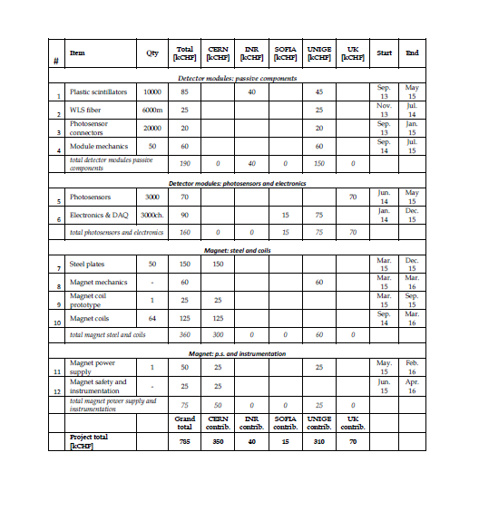

Slide 8
Manpower
-- this will become a real experiment
data taking in test beam: 2016
neutrino and antineutrino data taking in 2017
-- can do PhD thesis on technology plus physics results
-- cross-sections, full acceptance angular distributions for (anti) neutrino events
good muon/pion separation
-- the neutrino flux in T2K is very well known!
very useful results.
Happy to discuss support and travel issues

