Slide 1

Baby-Mind Magnetic Module Design
A. Dudarev, G. Rolando, E. Noah, H. Pais Da Silva and H.H.J. ten Kate
Baby-MIND update meeting #1
July 29, 2015

Slide 2
1. Constrains and goals
Plate length is 3500 mm (size of the vertical pit)
Plate thickness is 30 mm (optimized for physics)
Plate height is 2000 mm
Coil thickness is less than 10 mm
Power dissipation to be minimised (stacking and no active cooling)
The module plate has to be magnetised by low current and a predictable and homogeneous magnetic of field distribution at 1.5 T has to be guaranteed.

Slide 3
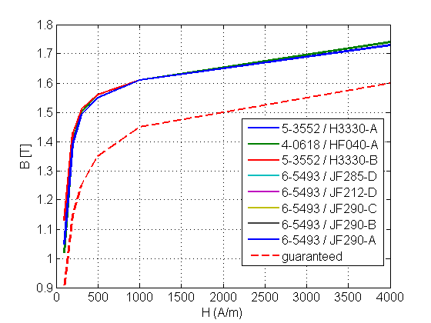
2. Magnetisation of a steel plate (ARMCO)
For an infinitively long plate with good properties, a < 300 A/m coil will do the job, but when plate properties are only “as guaranteed”, the power dissipation will be 40 times higher!

Slide 4
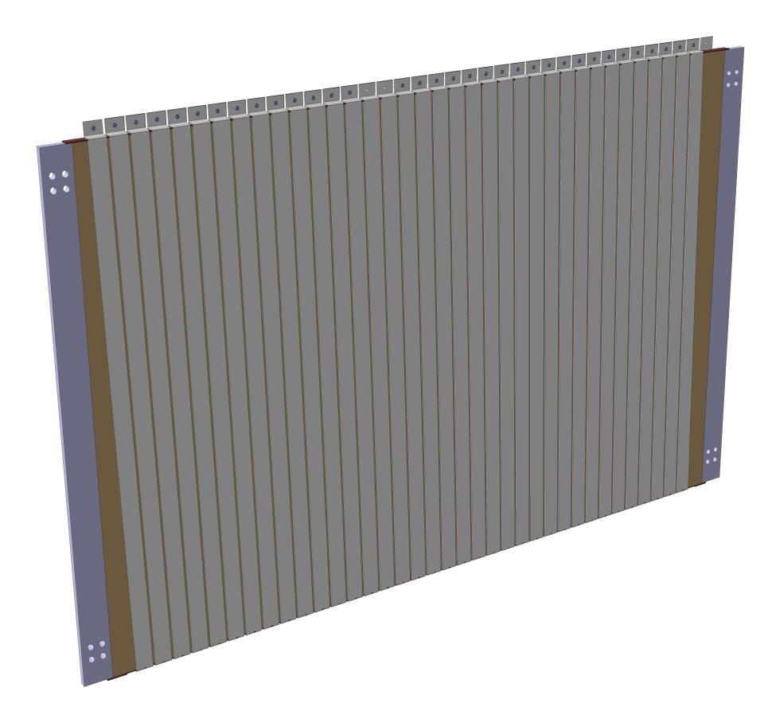
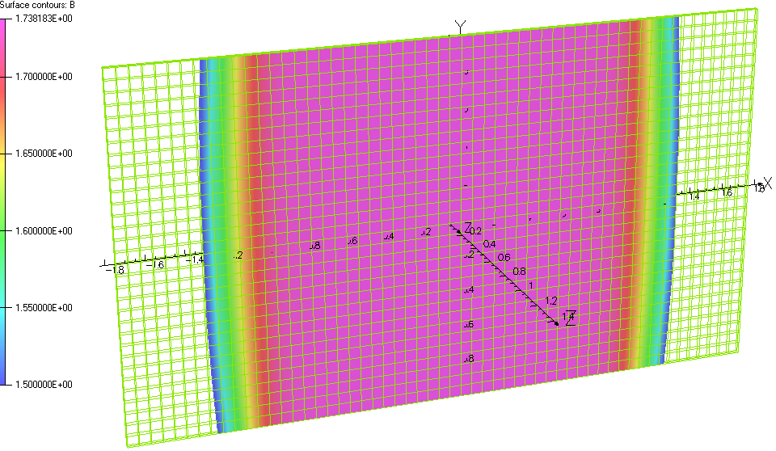
3. “Ideal” plate with no gap
300 A / 1 m of coil (4 mm thick Al) corresponds to a power dissipation of less than 3 W/m
but with a total of 50 kA it will be more than 6 kW/m!

Slide 5

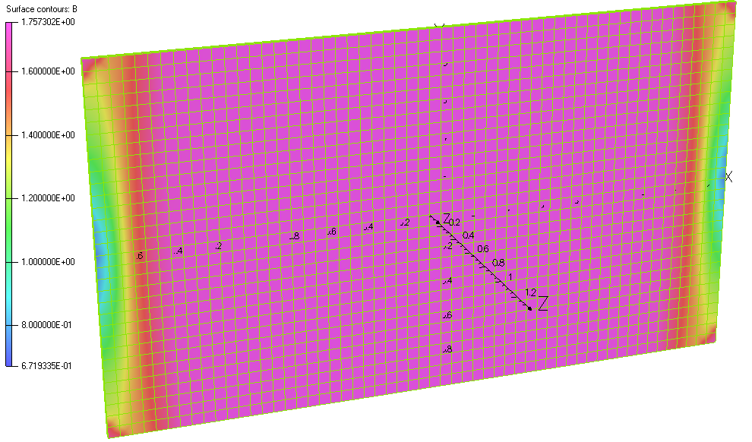
4. Repulsion force between neighbouring plates
“Plus” and “Minus” current make “Zero” field outside the plate.
The only interaction is due to effects at the plate edges where the field lines go outside.
But even in the case of no flux return it is small and affordable.
Example:
Force between two plates with 100 kA total current and no gap between coils is only 6500 N (≈650 kg).

Slide 6
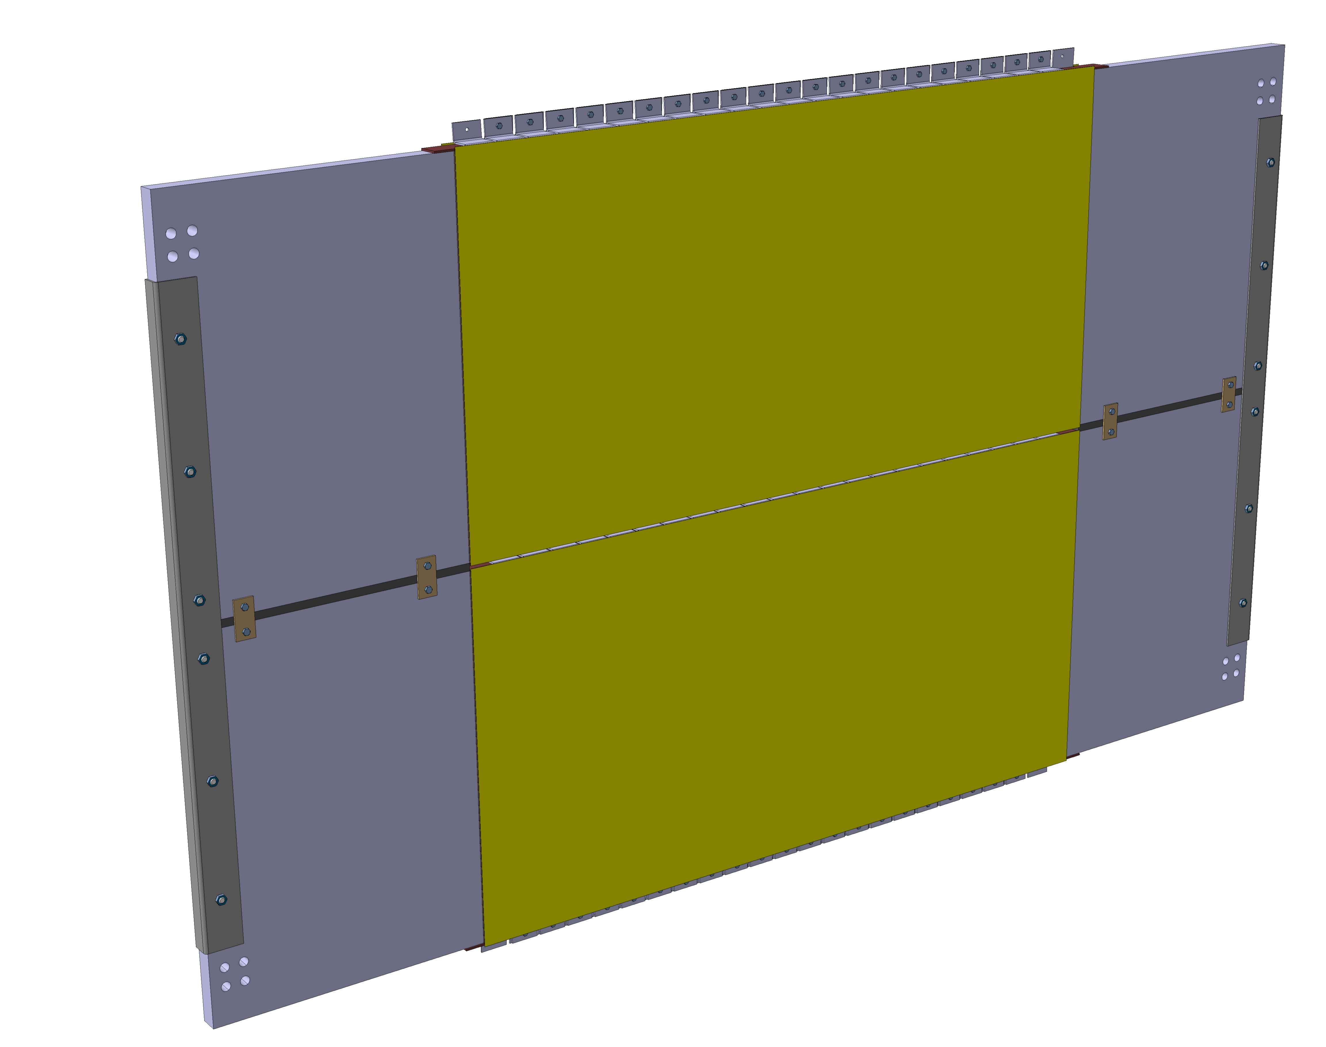
5. Flux return
Magnetic circuit is like in a “transformer”.
6

Slide 7
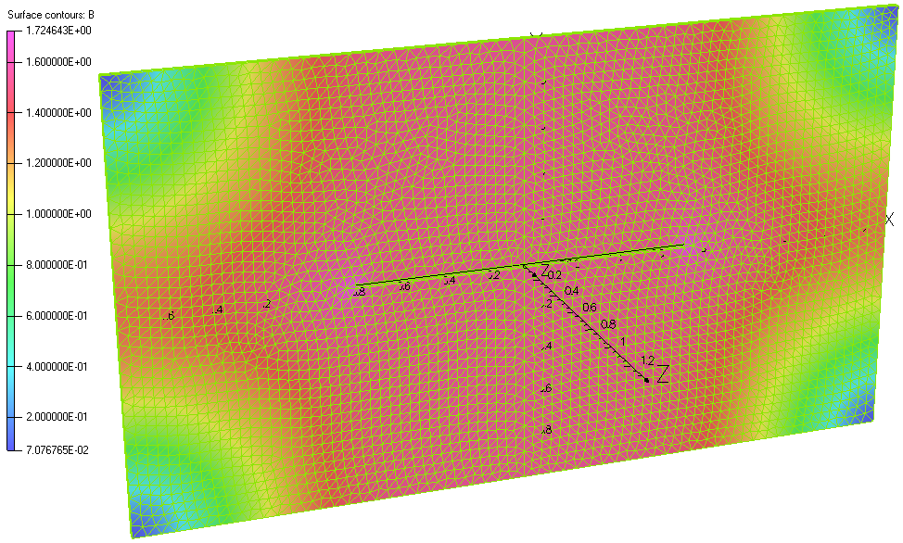
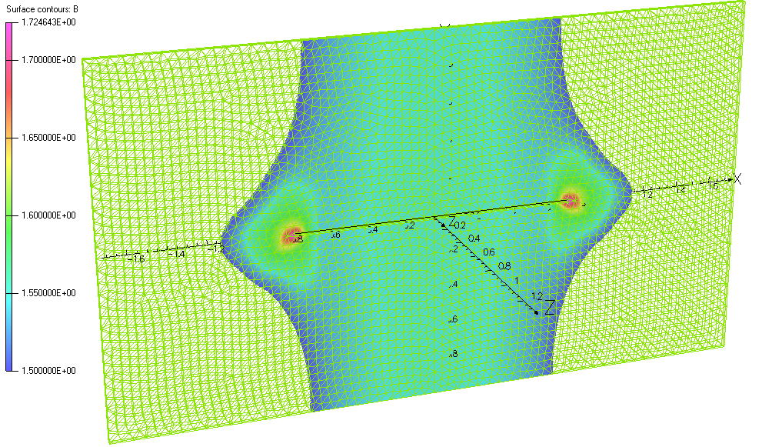
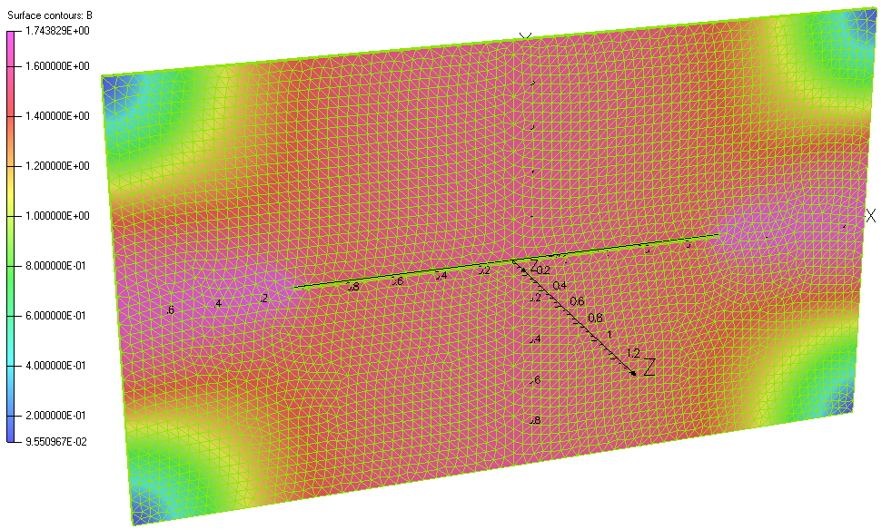
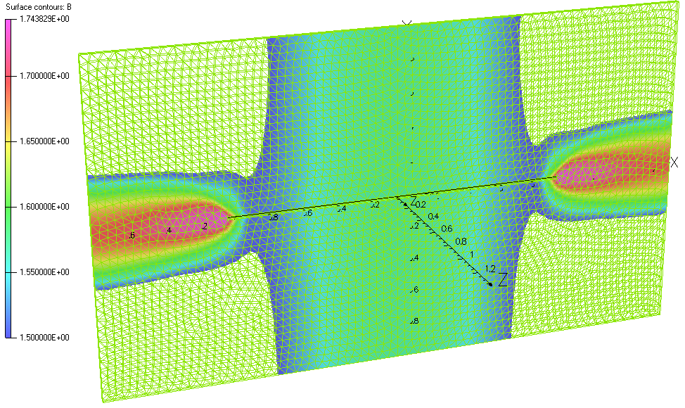
6. Single plate with 20 mm slot
1.5 m coils with current of 2*800 A
2.0 m coils with current of 2*1500 A

Slide 8
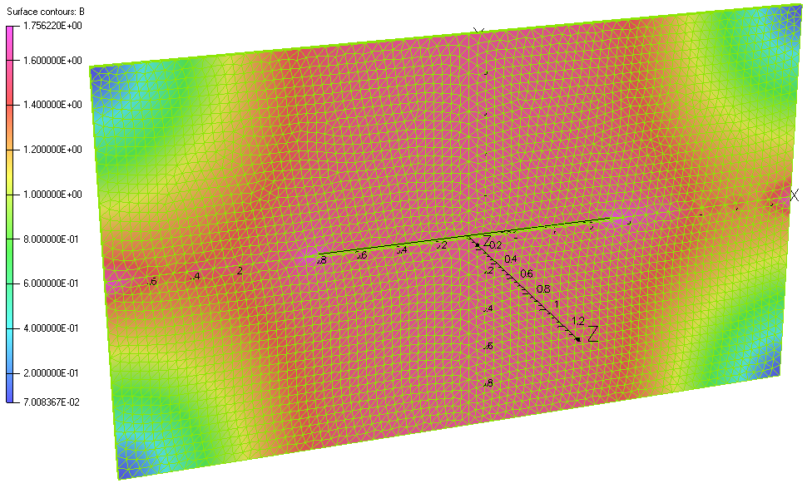
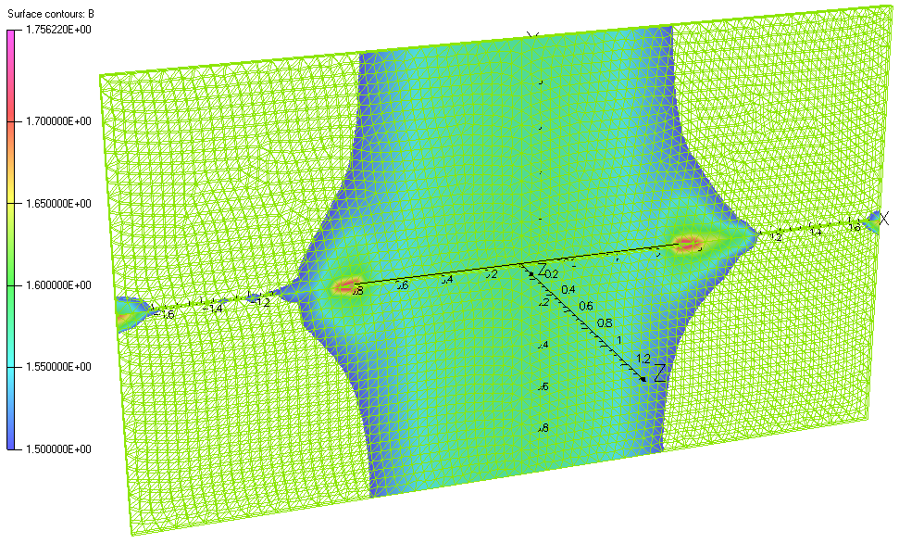
7. Single plate (top) vs two plates with gap 1 mm (bottom)
1.5 m coils with current of 2*800 A
1 mm gap
1.5 m coil with current of 2*1500 A

Slide 9
8. To return flux properly extra material has to be added
2.8 m for
10 mm plates to stay within coil envelope
9

Slide 10
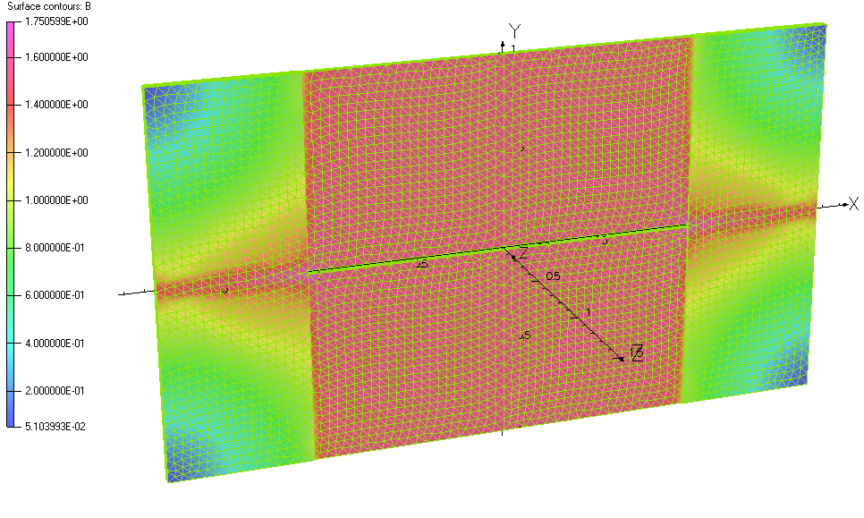
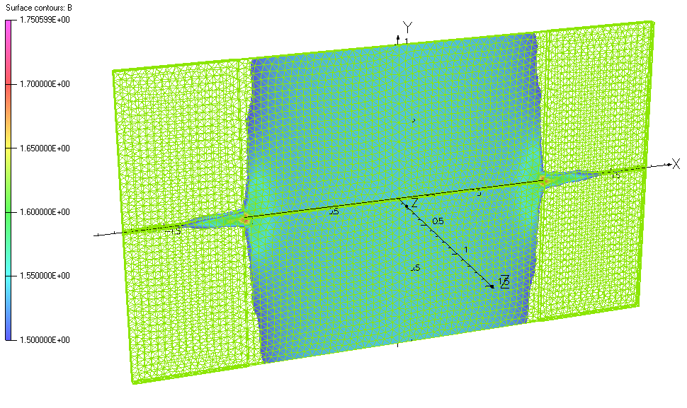
9. Single plate no gap (top) vs two plates with shim, 2 mm gap, and 10 mm extra side plates (bottom)
2.0 m coils with no gap at current of 2*1500 A
2.0 m coils with current of 2*800 A

Slide 11
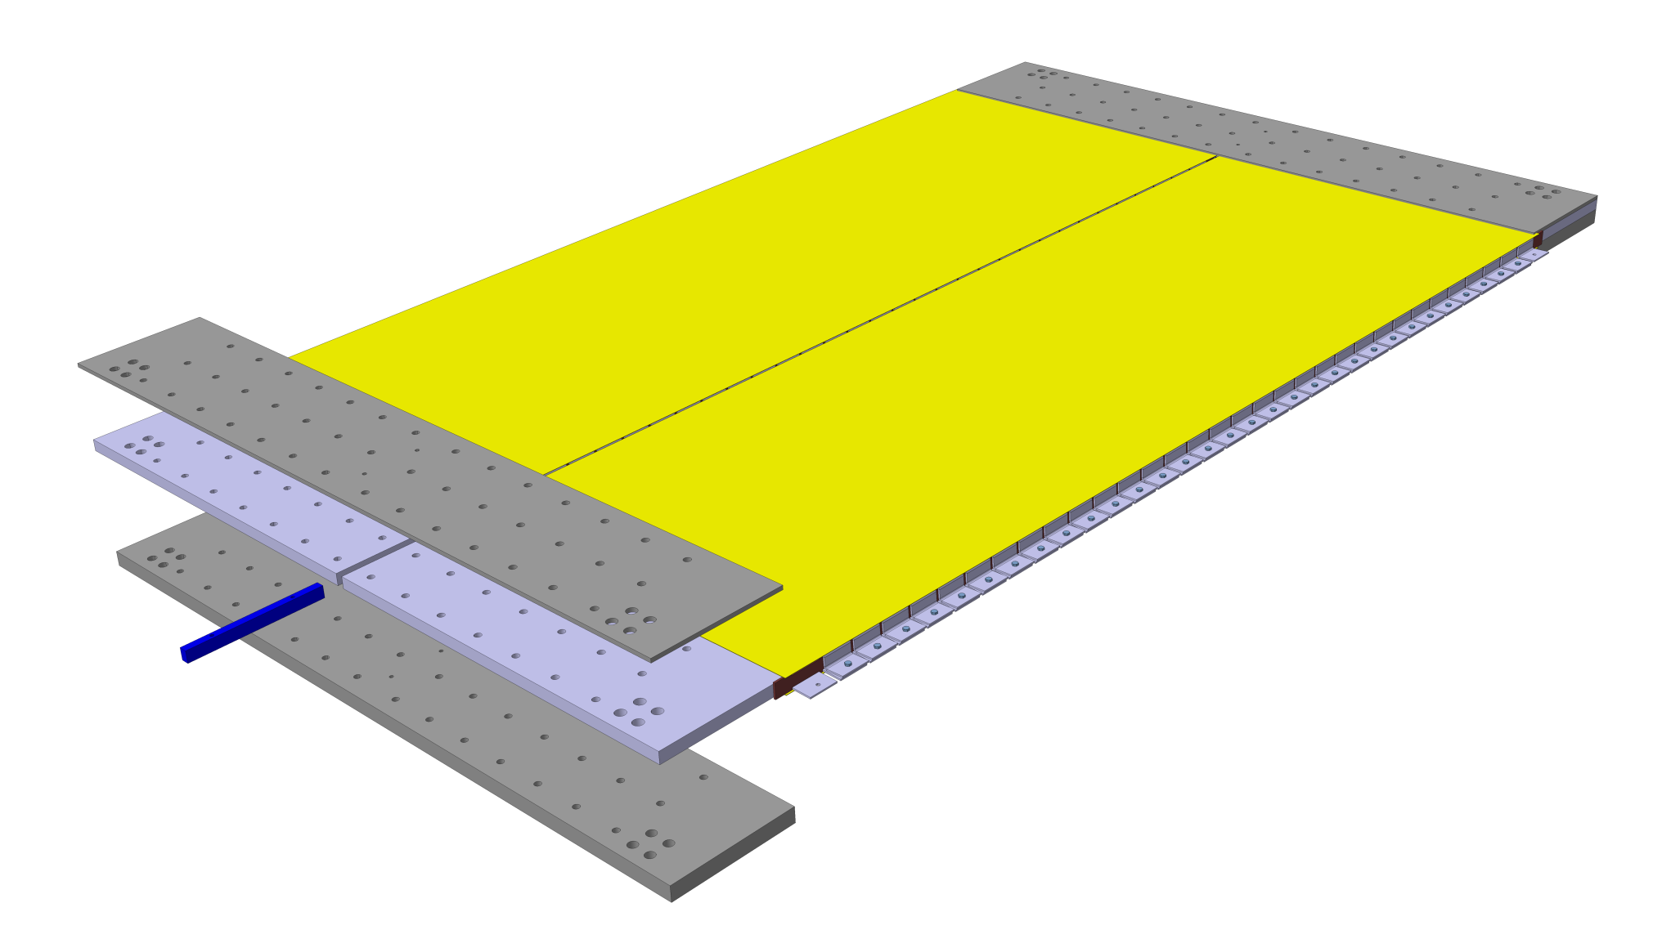
10. Baby MIND detector module (for 3.5 m)
2.8 m for
detector panel

Slide 12
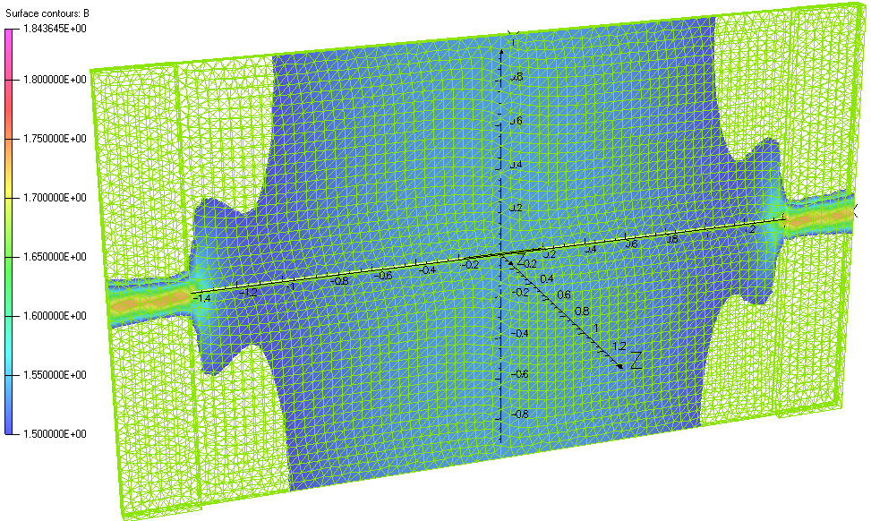
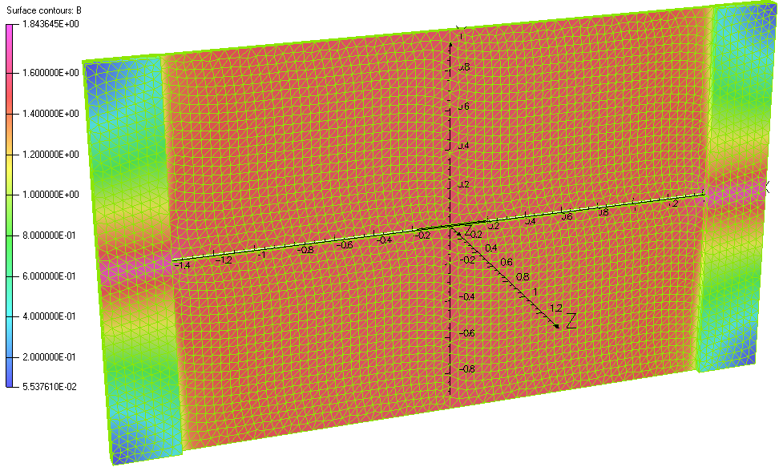
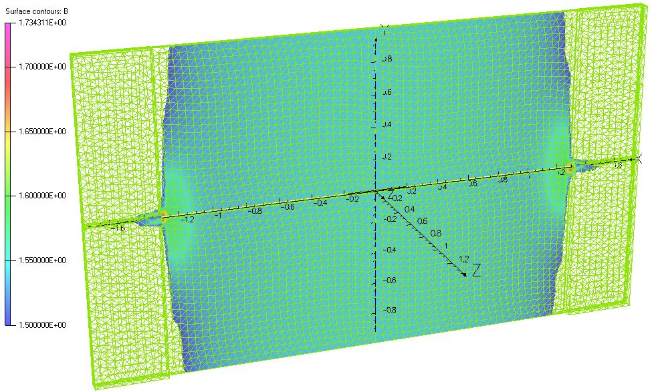
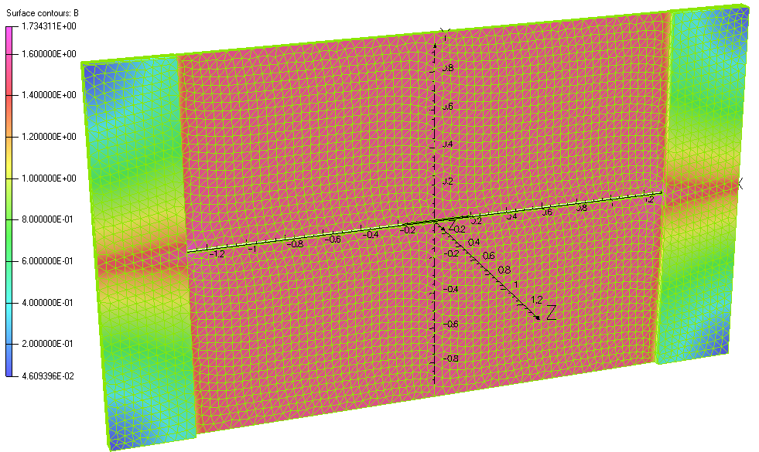
11. Longer variants that can be selected as well
2.8 m coils with current of 2*1500 A
2.6 m coils with current of 2*1200 A

Slide 13
12. Stacking of detector modules does not look nice
But there is a way to reduce extra thickness!

Slide 14


13. Two slits allow to reduce the thickness
One
Two

Slide 15
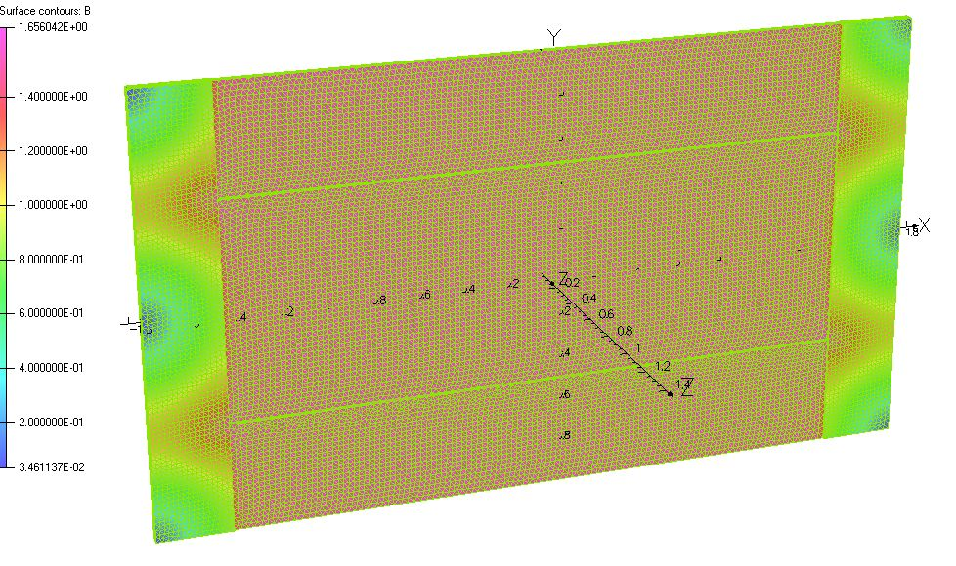
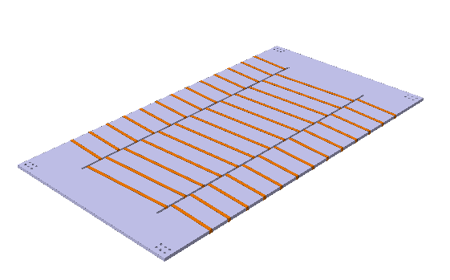
14. Two-slit variant proposed
It is a bit more challenging for coil manufacturing
but certainly doable.

Slide 16
15. Current, voltage and power consumption
For all cases the power dissipation is less than 100 W per module if the conductor thickness is >3 mm.
Operating current depends on number of turns but it will be about 100 A.
Voltage is also low and is within a few volt, a single standard power supply can charge all modules.

Slide 17
16. Conclusion and Outlook
Magnetic design made is based on using raw magnetic steel plates with minimum machining.
Effect of slit size and gaps between the plates in one module was analysed.
Optimum flux return, and thus most uniform magnetic field across detector surface is achieved by adding extra side plates adjacent to the coils.
A nearly perfect magnetic design was achieved and is proposed for approval.
Final dimensions still to be agreed based on installation site study, where after the design can be frozen and production can start.
Manufacturing of a full-size exercise module is foreseen for October-November 2015, where after production may start medio March-April 2016, however, provided single module design is frozen and steel plates ordered in September the latest.

