Slide 1
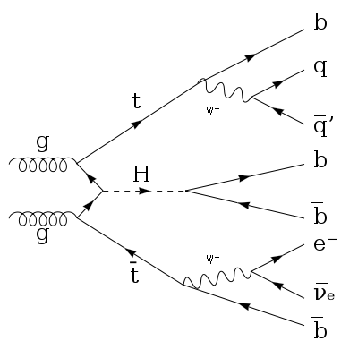
TTBar/ TTBarH Kinematics
AnalysisTop 2.3.20
/TTHNtupleAnalysis

Slide 2
Signal TTBarH _ sample (just used 5 files )
/afs/cern.ch/work/r/rsoualah/samples/mc15_13TeV.341270.aMcAtNloHerwigppEvtGen_UEEE5_CTEQ6L1_CT10ME_ttH125_inc_semil.merge.DAOD_TOPQ1.e3921_s2608_s2183_r6630_r6264_p2372_tid05809550_00/DAOD_TOPQ1.05809550._000004.pool.root.1
/afs/cern.ch/work/r/rsoualah/samples/mc15_13TeV.341270.aMcAtNloHerwigppEvtGen_UEEE5_CTEQ6L1_CT10ME_ttH125_inc_semil.merge.DAOD_TOPQ1.e3921_s2608_s2183_r6630_r6264_p2372_tid05809550_00/DAOD_TOPQ1.05809550._000025.pool.root.1
/afs/cern.ch/work/r/rsoualah/samples/mc15_13TeV.341270.aMcAtNloHerwigppEvtGen_UEEE5_CTEQ6L1_CT10ME_ttH125_inc_semil.merge.DAOD_TOPQ1.e3921_s2608_s2183_r6630_r6264_p2372_tid05809550_00/DAOD_TOPQ1.05809550._000016.pool.root.1
/afs/cern.ch/work/r/rsoualah/samples/mc15_13TeV.341270.aMcAtNloHerwigppEvtGen_UEEE5_CTEQ6L1_CT10ME_ttH125_inc_semil.merge.DAOD_TOPQ1.e3921_s2608_s2183_r6630_r6264_p2372_tid05809550_00/DAOD_TOPQ1.05809550._000017.pool.root.1
/afs/cern.ch/work/r/rsoualah/samples/mc15_13TeV.341270.aMcAtNloHerwigppEvtGen_UEEE5_CTEQ6L1_CT10ME_ttH125_inc_semil.merge.DAOD_TOPQ1.e3921_s2608_s2183_r6630_r6264_p2372_tid05809550_00/DAOD_TOPQ1.05809550._000030.pool.root.1

Slide 3
Background TTBar_sample (just used 5 files )
/afs/cern.ch/work/r/rsoualah/samples/mc15_13TeV.410000.PowhegPythiaEvtGen_P2012_ttbar_hdamp172p5_nonallhad.merge.DAOD_TOPQ1.e3698_s2608_s2183_r6630_r6264_p2353_tid05562695_00/DAOD_TOPQ1.05562692._000028.pool.root.1
/afs/cern.ch/work/r/rsoualah/samples/mc15_13TeV.410000.PowhegPythiaEvtGen_P2012_ttbar_hdamp172p5_nonallhad.merge.DAOD_TOPQ1.e3698_s2608_s2183_r6630_r6264_p2353_tid05562695_00/DAOD_TOPQ1.05562695._000022.pool.root.1
/afs/cern.ch/work/r/rsoualah/samples/mc15_13TeV.410000.PowhegPythiaEvtGen_P2012_ttbar_hdamp172p5_nonallhad.merge.DAOD_TOPQ1.e3698_s2608_s2183_r6630_r6264_p2353_tid05562695_00/DAOD_TOPQ1.05562697._000031.pool.root.1
/afs/cern.ch/work/r/rsoualah/samples/mc15_13TeV.410000.PowhegPythiaEvtGen_P2012_ttbar_hdamp172p5_nonallhad.merge.DAOD_TOPQ1.e3698_s2608_s2183_r6630_r6264_p2353_tid05562695_00/DAOD_TOPQ1.05562701._000001.pool.root.1
/afs/cern.ch/work/r/rsoualah/samples/mc15_13TeV.410000.PowhegPythiaEvtGen_P2012_ttbar_hdamp172p5_nonallhad.merge.DAOD_TOPQ1.e3698_s2608_s2183_r6630_r6264_p2353_tid05562695_00/DAOD_TOPQ1.05562702._000037.pool.root.1

Slide 4
Event Selection
Event Selection:
Cut flow for Jet >= 4 btagged jet >=2 ( for TTBar) & >= 4 ( for TTBarH)
To Be Done!

Slide 5
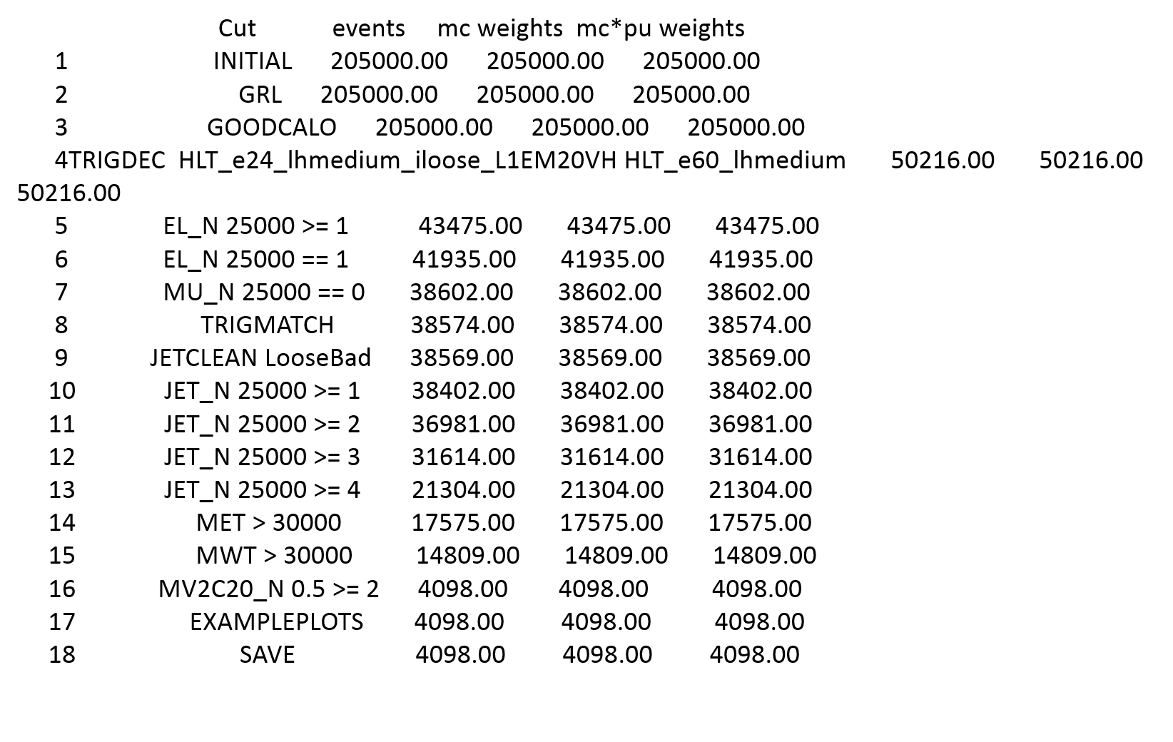
CutFlow : Background TTBar / el + jets
 | cut | events
1 | Initial
2 | GRL
3 | EL_N 25000 >= 1
4 | EL_N 25000 == 1
5 | MU_N 25000 == 0
6 | TRIGMATCH
7 | JETCLEAN LooseBad
8 | JET_N 25000 >= 4
9 | MET > 30000
10 | MWT > 30000
11 | MV2C20_N 0.5 >= 2

Slide 6
Cutflow: Background TTBar / el + jets
 | cut | events
1 | Initial
2 | GRL
3 | EL_N 25000 >= 1
4 | EL_N 25000 == 1
5 | MU_N 25000 == 0
6 | TRIGMATCH
7 | JETCLEAN LooseBad
8 | JET_N 25000 >= 4
9 | MET > 30000
10 | MWT > 30000
11 | MV2C20_N 0.5 >= 2

Slide 7
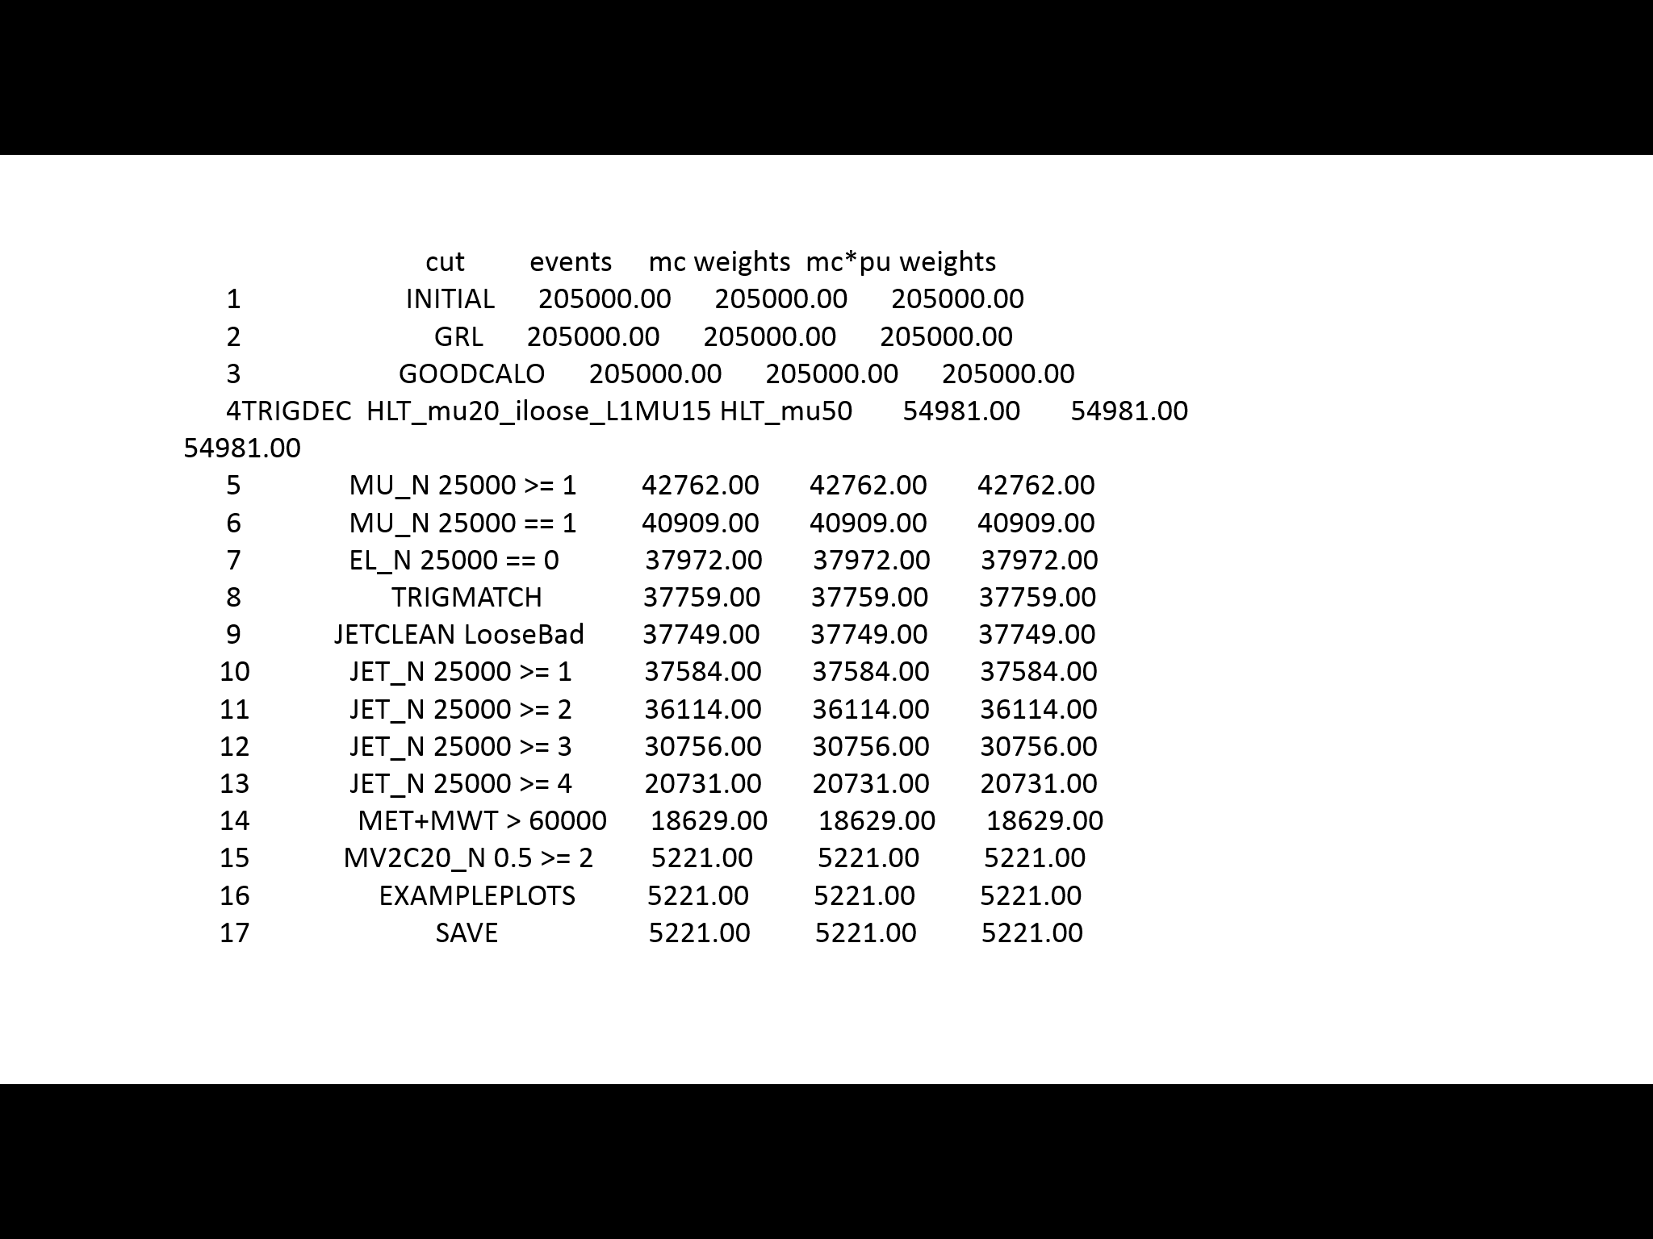
Cutflow: Background TTBar / mu + jets

Slide 8
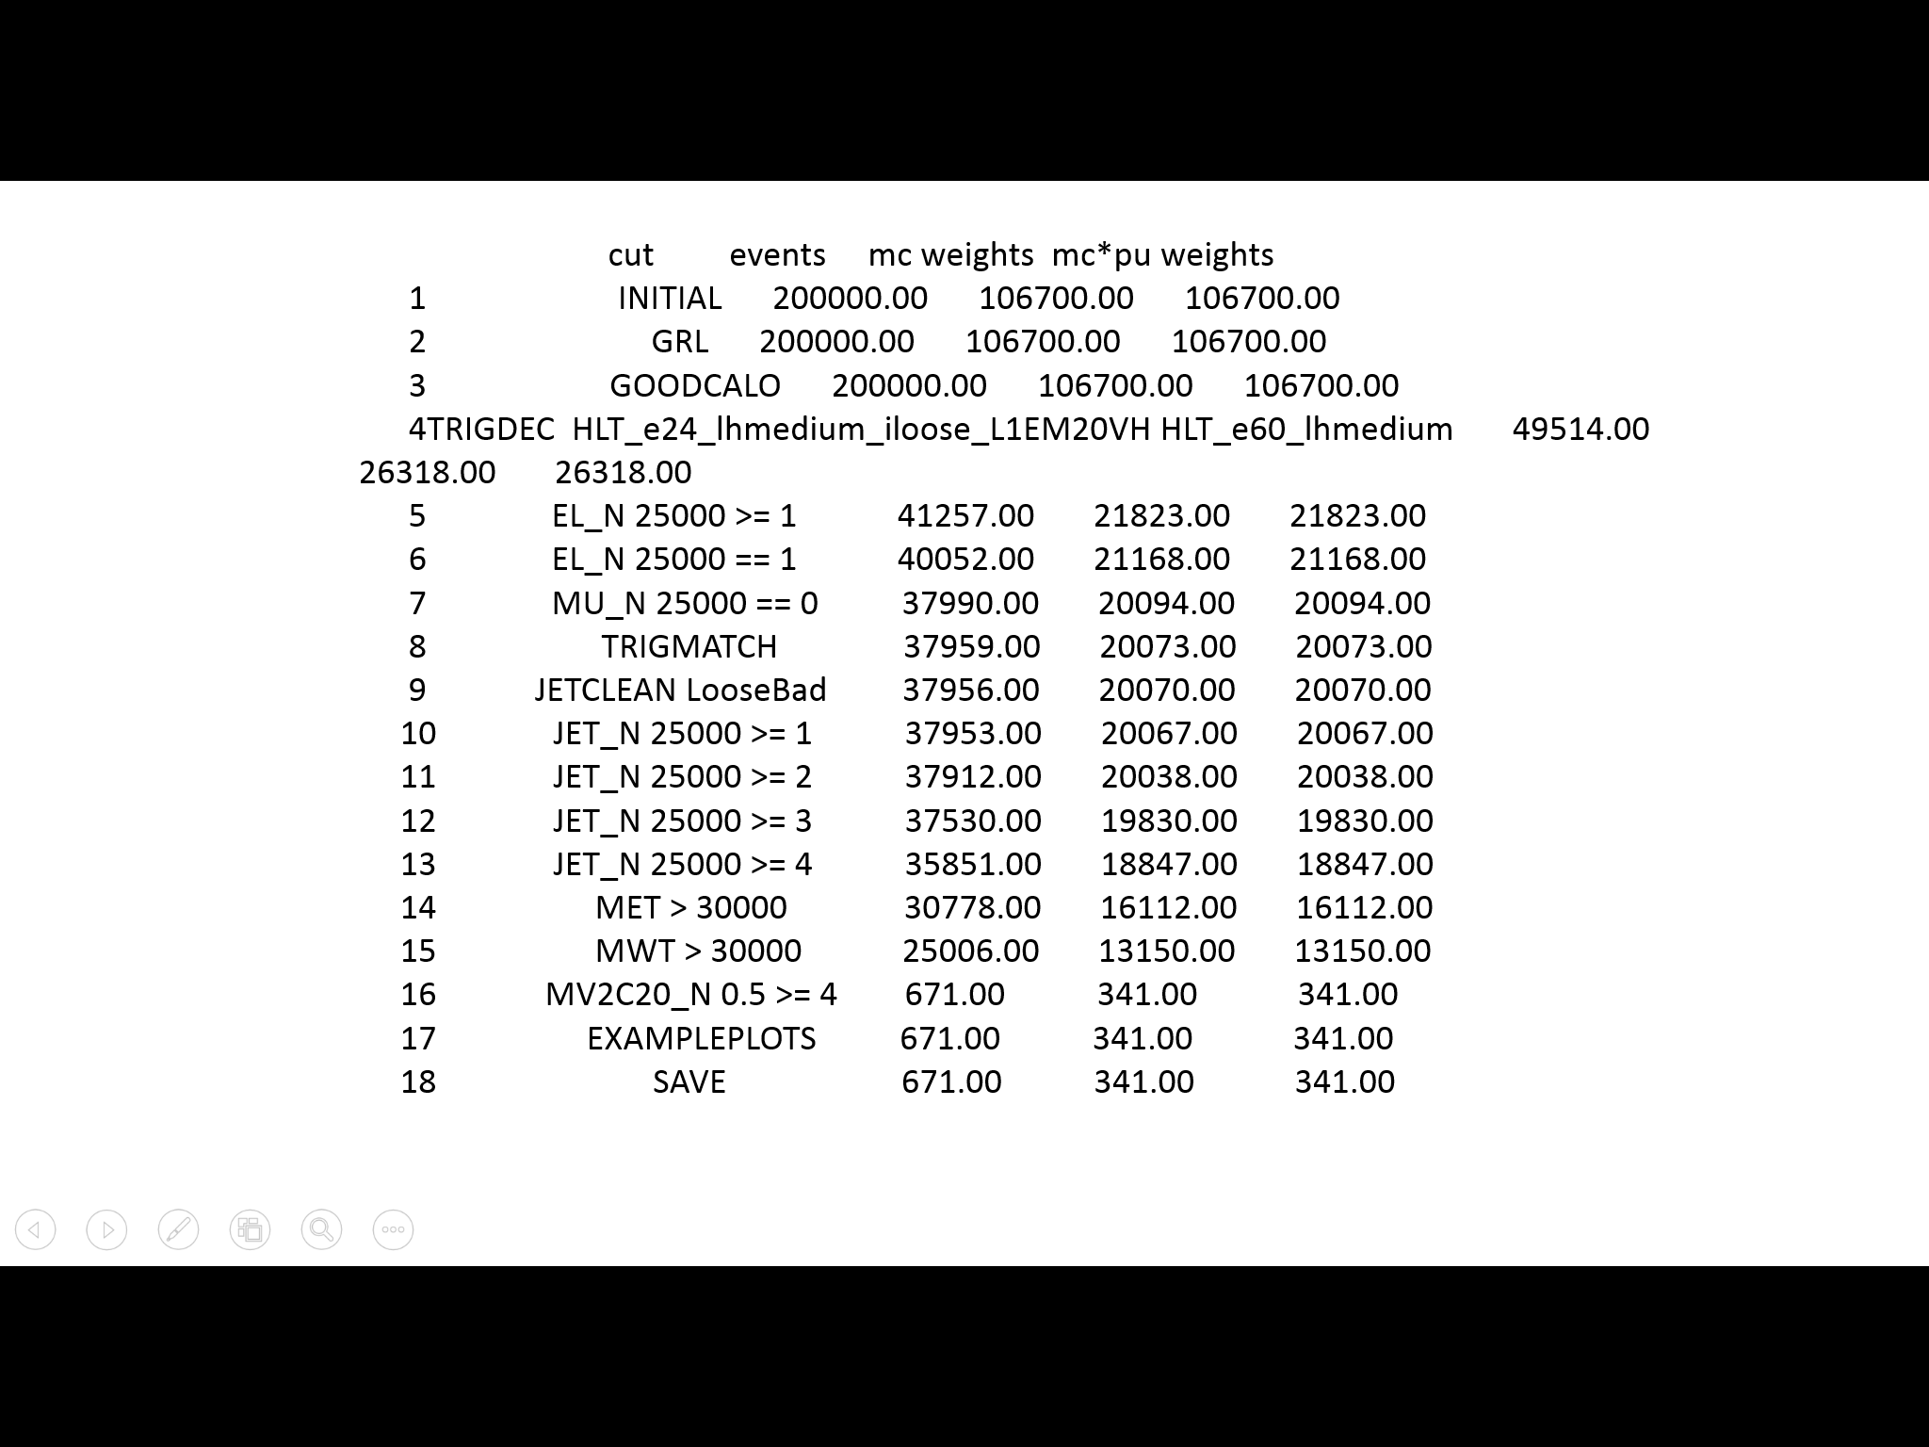
Cutflow: Signal TTBarH / el + jets

Slide 9
Signal TTBarH / el + jets

Slide 10
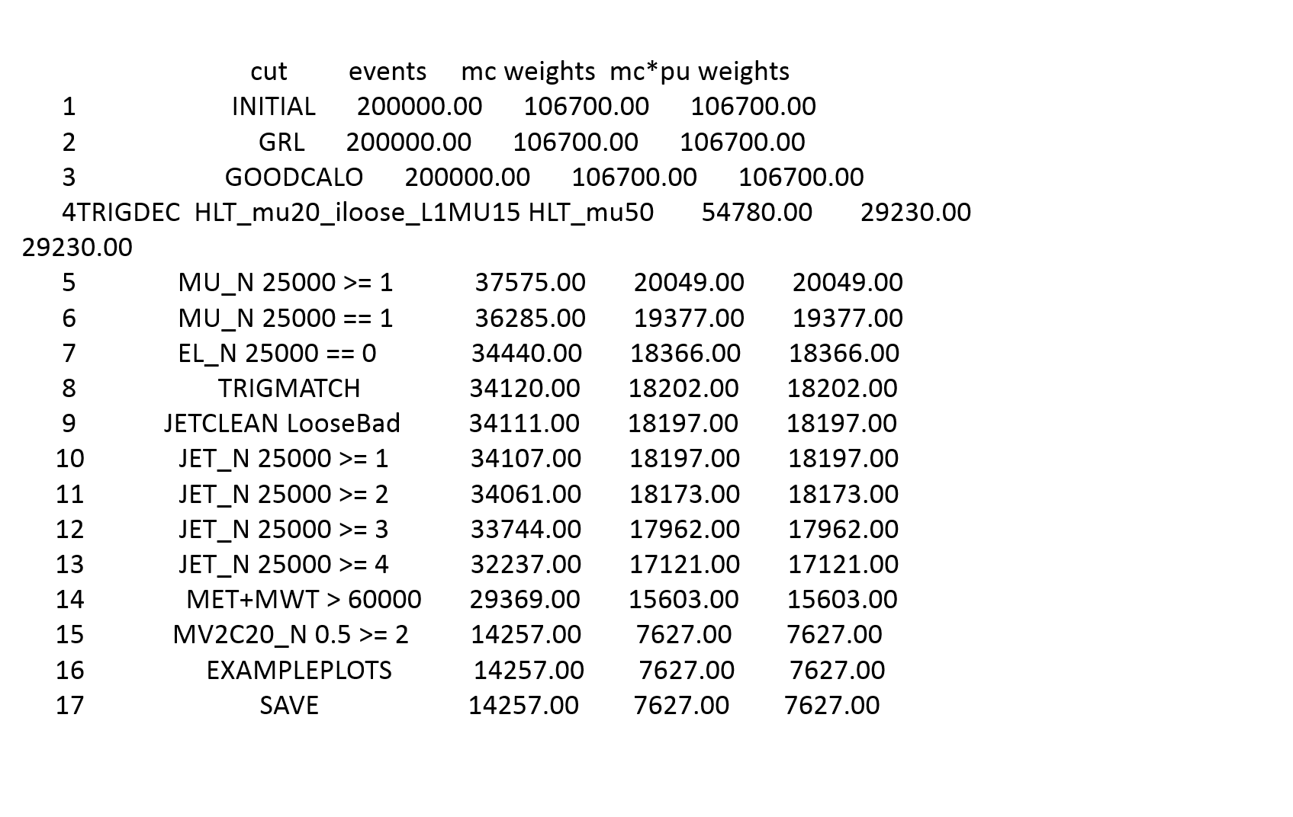
Signal TTBarH / Mu + jets

Slide 11
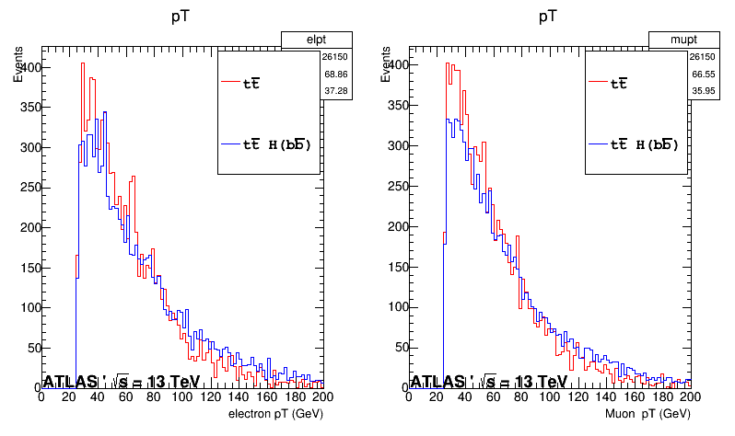
Some Kinematic Distributions:
Lepton pt

Slide 12
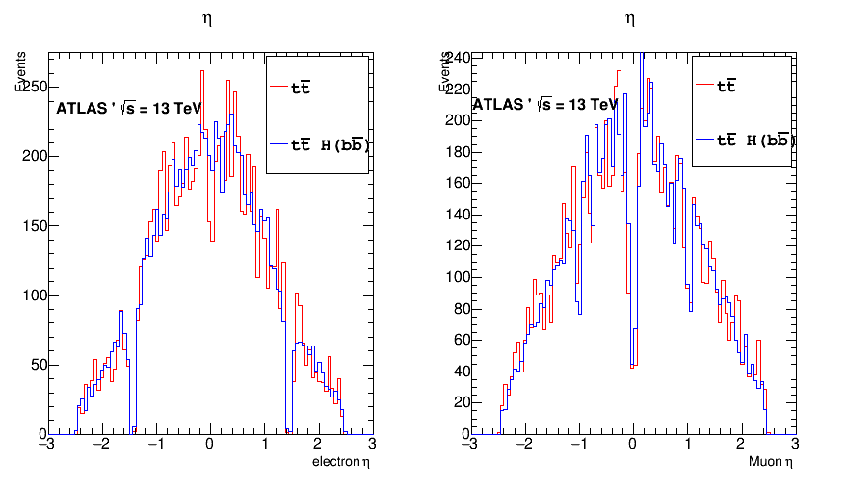
Lepton eta

Slide 13
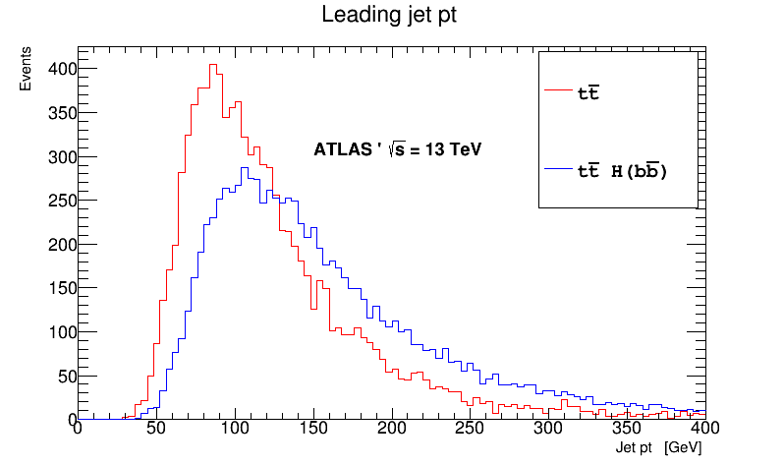
Leading Jet pt

Slide 14
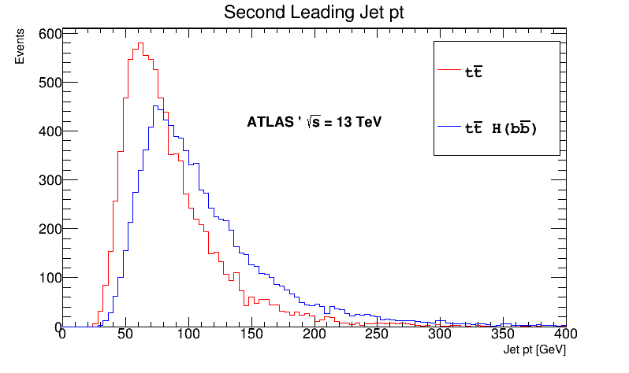
Second leading Jet pt

Slide 15
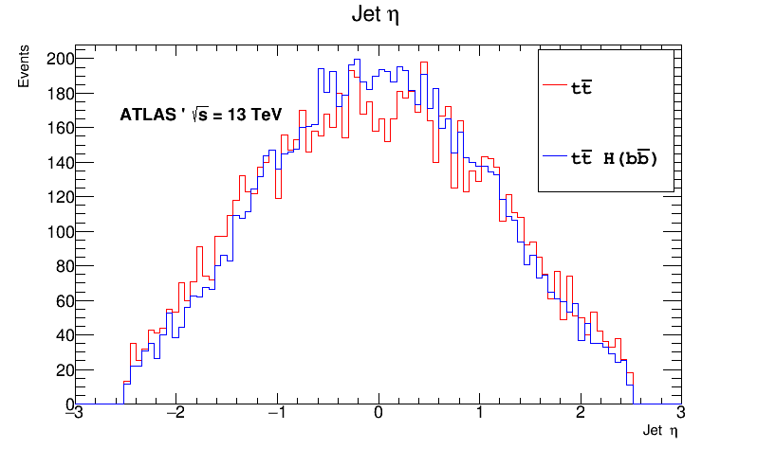

Slide 16
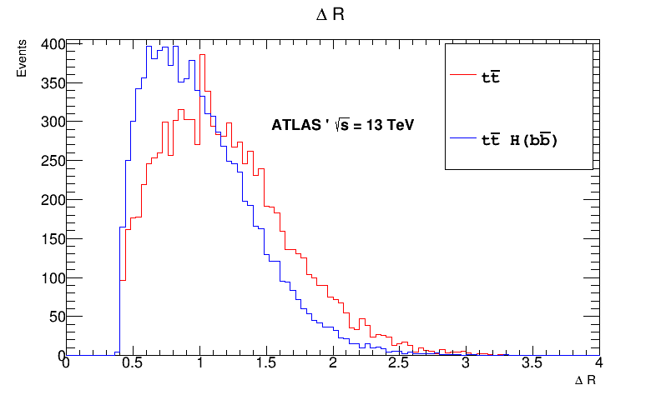
Delta R

Slide 17
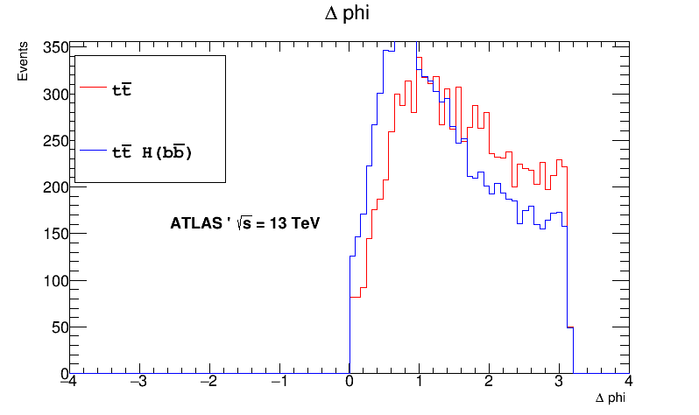
Delta Phi

Slide 18
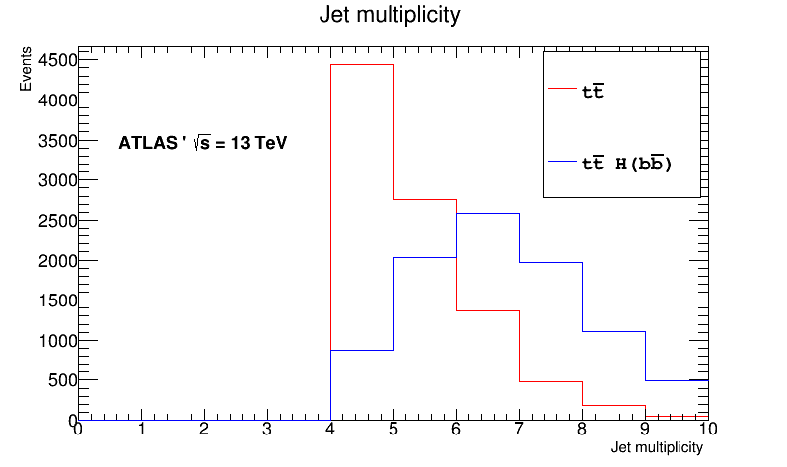
Jet Multiplicity

Slide 19
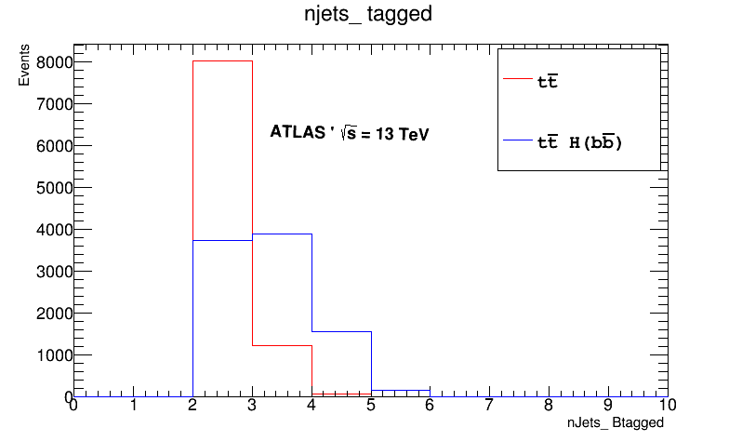
N Jets - Tagged

Slide 20
N Jets - Tagged
>=4 (TTBar H )

Slide 21
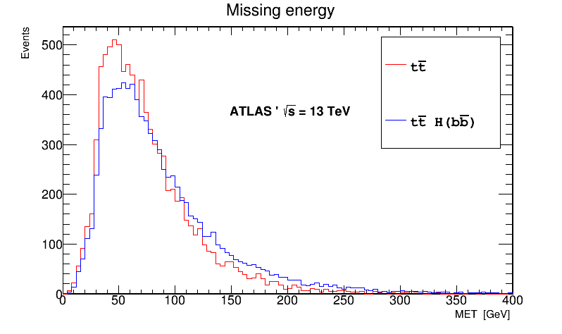
Missing Energy

Slide 22
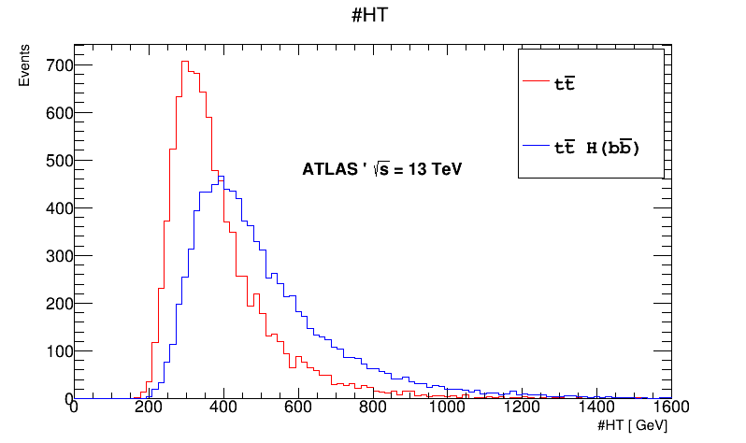
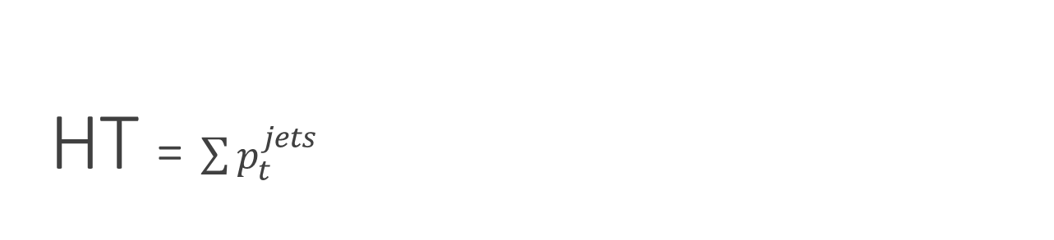
HT = $\sum{p_{t}^{jets}}$

Slide 23
Further work
1 - Next time we will look to other Regions and use another new functionalities of the
code: TTHNtupleAnalysis which provides a flat Ntuples:
2- I'll use new package which is supposed to handle the statistical part of the analysis:
TtHFitter: https://twiki.cern.ch/twiki/bin/view/AtlasProtected/TtHFitter
Next week, hopefully we will have nice plots with some data and MC comparisons
with 13 TeV results !
Data Cutflow:
https://docs.google.com/spreadsheets/d/1QkK_NUXLj4NKLXHNEPslDERasluntvdfhmm2_A8Crg4/edit#gid=0

