Slide 1
How to obtain clean injections
Florian Burkart
for TE-ABT
with many inputs from T. Bohl, B. Dehning, L. Drosdal, V. Kain, R. Steerenberg, O. Stein, …

Slide 2
Outline
Injections in 2015
Transversal losses
Longitudinal losses
  Diamond based beam loss monitors
  Loss mitigations
Conclusion

Slide 3
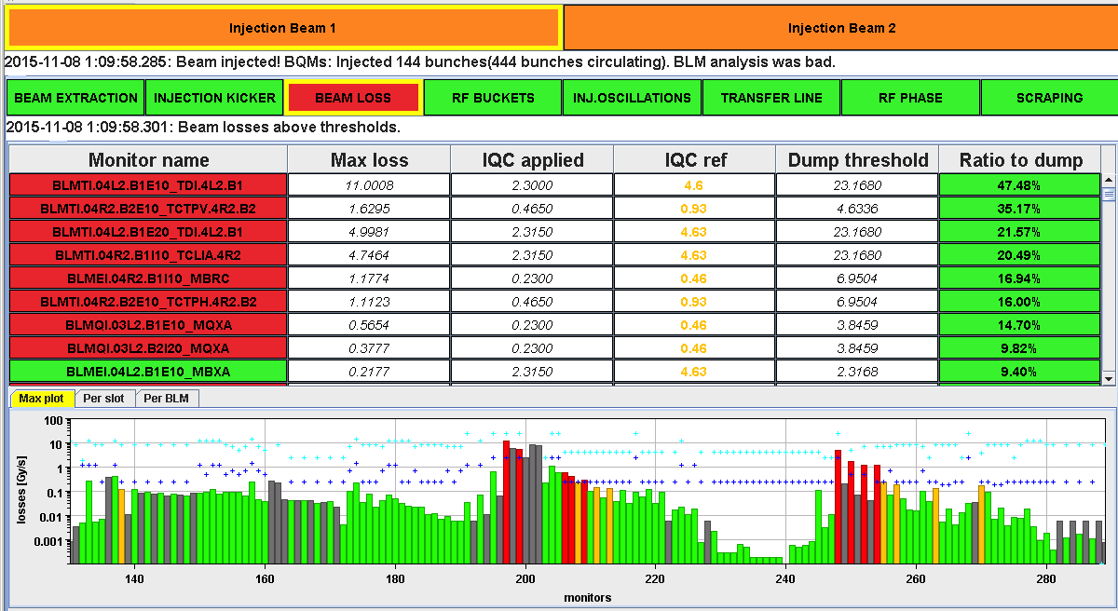
144 bpi, 25 ns, 2015
In 2015:
Up to 93 % dump threshold on the TDI was reached.

Slide 4
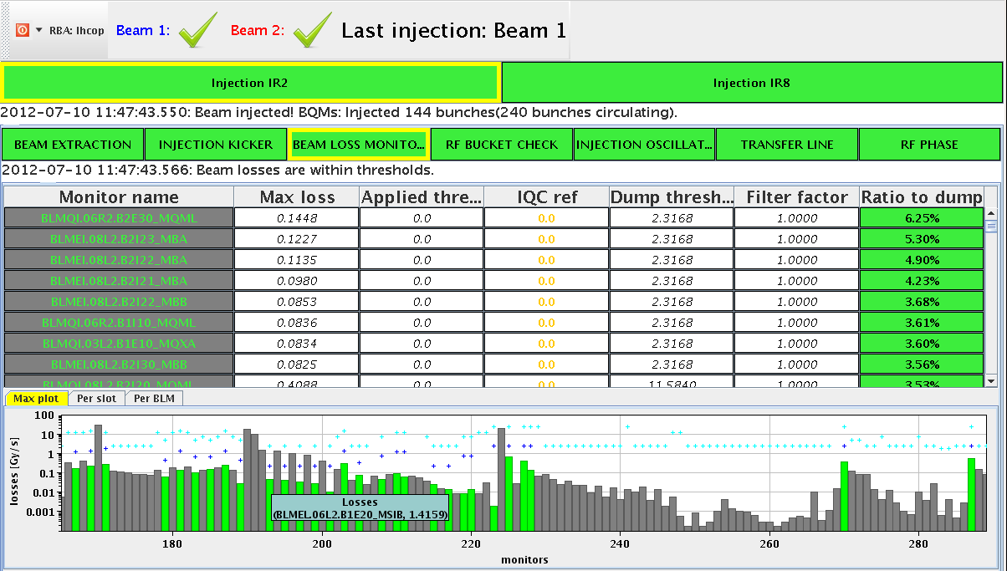
144 bpi, 25 ns, 2012
Injected up to 288 bunches with factor 25 smaller loss level at TDI
Losses dominated from TL shower

Slide 5
Reminder - Transversal losses
During Run 1 operation, TLs orbit drifts have been observed, together with large shot-to-shot trajectory variations.
The main source of shot-to-shot orbit variation in the SPS-to-LHC TLs was identified and also mitigated. Investigations with Model Independent Analysis (MIA) revealed the SPS extraction septa as the main source for both lines. At the end of 2011 work was started to improve the power converter of the MSE.6 (TI2) which lead to improved stability. Work continued on the MSE.4 during LS1.
The main source of trajectory drift was considered to be the SPS orbit variation.
L. Drosdal et al., "Analysis of LHC Transfer Line Trajectory Drifts", IPAC'13
L. Drosdal et al., "Sources and Solutions fot LHC Transfer Line Stability Issues", IPAC'12

Slide 6
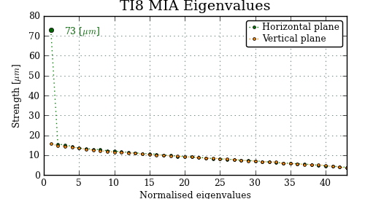
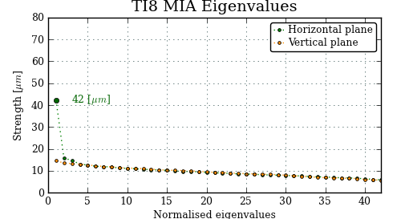
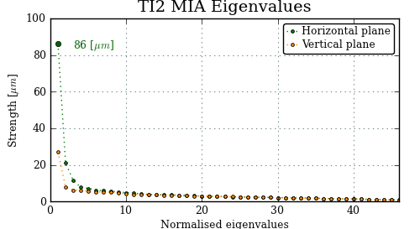
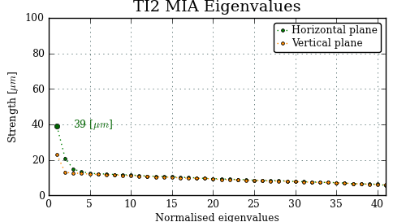
Results MIA for TI2 and TI8
APRIL 2012
NOVEMBER 2014
Shot-by-shot trajectory variations reduced by factor 2.
Thanks to big effort from EPC!
Done during LHC Run I.

Slide 7
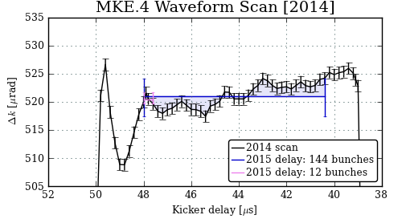
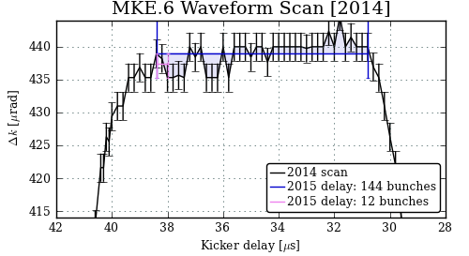
MKE waveform scans
MKE.4 waveform improved, but not as much as expected
  Optimised delay: 48.1 μs
MKE.6 waveform is flat (no change)
  Optimised delay: 38.5 μs
Note: MKE4 generators will be modified during YETS!

Slide 8
Transversal losses – orbit drifts
SPS orbit stability analysis ongoing.
  Almost 1000 orbits have been saved at extraction.
  An orbit drift, mainly at the BPCE4, can be observed.
  The source of error is assumed to be a single element => single dipole error
  Main bend field variation in the area of MBA.11190 in LSS1 might lead to the observed orbit change – more measurements needed.
  Correlation between temperature and orbit drift to be analysed in detail.
TL collimator settings:
TCDIs at 5 σ (with nom. emittance).
Initial setting at 4.5 σ.
Was increased in 2011.

Slide 9
Comparison to run 1
Less MSE ripple
No bump in LHC → smooth steering.
Optimized delay for first bunch on MKE f.t..
But higher losses on the TDI!
→ Longitudinal losses …

Slide 10
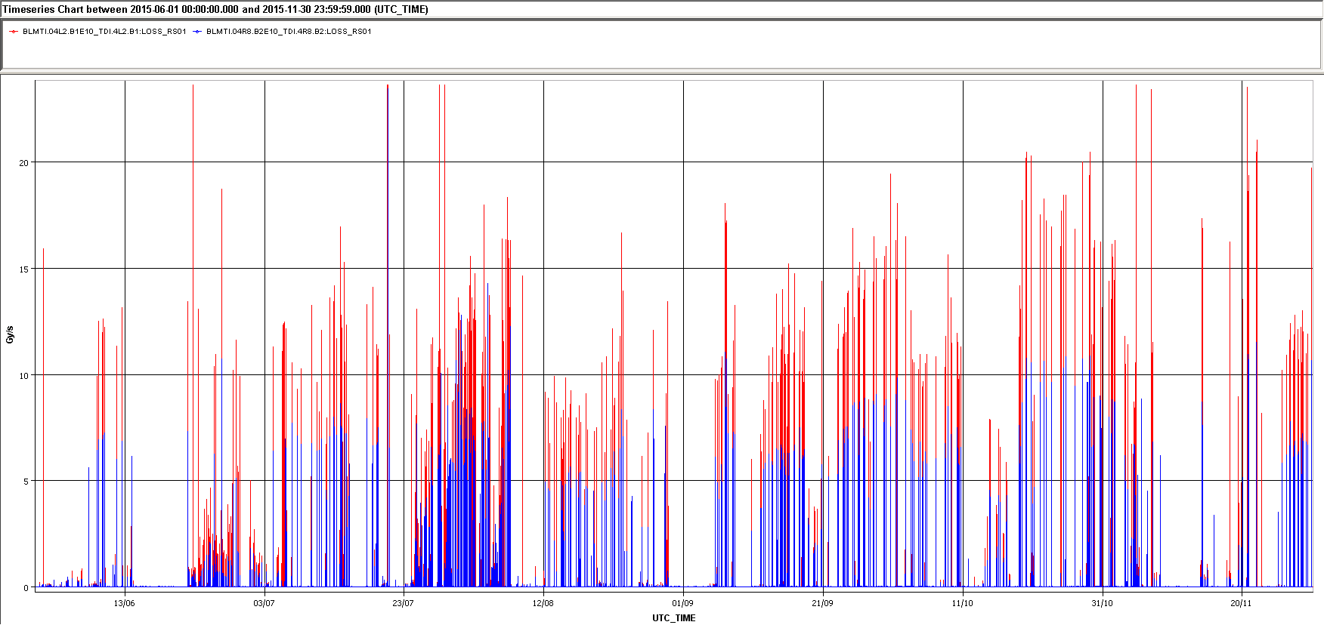
Losses at the TDI 2015
BLM TDI.4L2.B1
BLM TDI.4R8.B2
2244b
B1 144 b injections reached 30-93% of dump threshold on the TDI
B2 around 10 - 60%
Difference due to LSS6-MKE: tr = 6us, LSS4-MKE: tr = 1 us
476b
1465b
152b
commissioning
scrubbing
June
November

Slide 11
Diamond detectors
pCVD diamond based beam loss monitors, CIVIDEC.
Active area: 1 cm².
Thickness: 500 μm.
E field strength: 1 V / μm.
Nanosecond time resolution.
Radiation hard.
Characterized between 1 – 1E8 MIPs.
Can be installed at cryogenic temperatures.
Vacuum compatibility.
RF shielded.
Aim:
Bunch-by-bunch loss data.
Detect ghost bunches and RF – recapture at injection.
Study UFOs.
Can be used for beam based alignment.
etc.

Slide 12
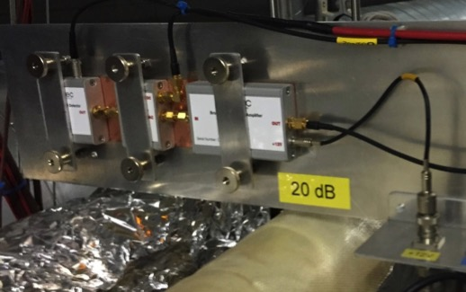
dBLMs around LHC
In total: 8 dBLMs.
Extraction losses at the PS – position: installed close to septum MU16.
Extraction losses at the SPS – position: installed close to TPSG TI2 and close to the septum TI8.
Injection losses at LHC – position: IR2 and IR8, downstream of TDI.
Global losses and post-mortem event recordings in left and right IR7, downstream TCPs.
Extraction losses at LHC – position: IR6, downstream of TCDQ.
Transfer line losses – position close to TCDI in TI2 and TI8 – to be discussed.
Global losses in the SPS – position: close to TIDP, tbd – to be discussed.
Close collaboration with BE-BI-BL, (Bernd Dehning et al.)
dBLM
3 DAQs installed.
OASIS scope (PS)
Oscilloscope (IP2, IP6, IP7, IP8, SPS)
ROSY CIVIDEC, Scope and Histogram unit (IP7)
New DAQ card will be developed by BI.
LHC beam pipes

Slide 13
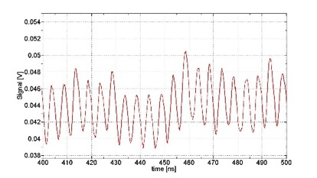
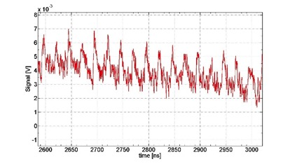
Losses @ TDI for 144b B1
2/3 of losses
5 ns – 200 MHz
SPS re-captured beam
25 ns - injected beam
1/3 of losses

Slide 14
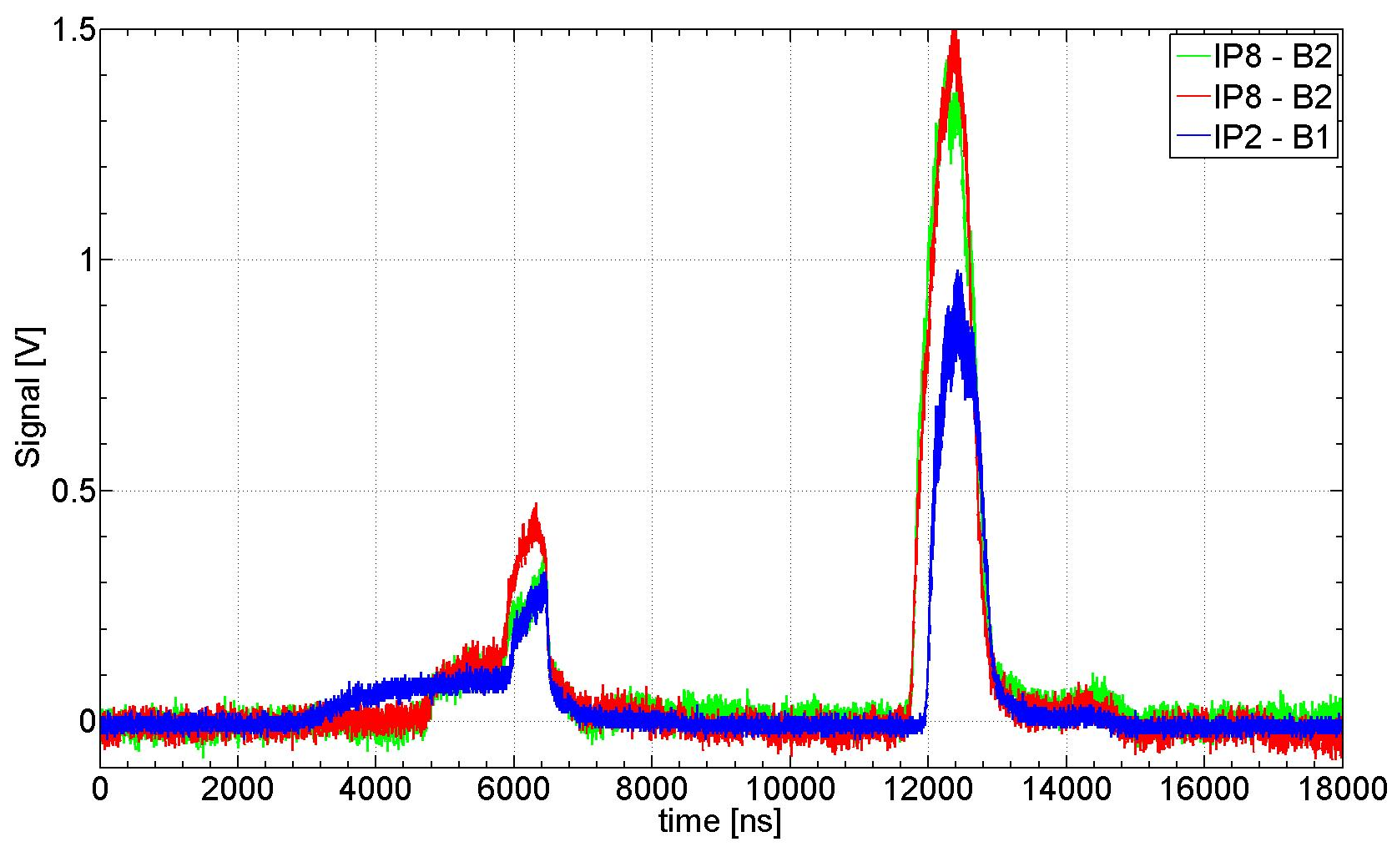
Losses @ TDI for 144b B2
Signal amplitudes not directly comparable as dBLMs not installed symmetrically at the TDIs.
Shorter f.t. of MKI8
Shorter, due to faster
rise time of MKE4

Slide 15
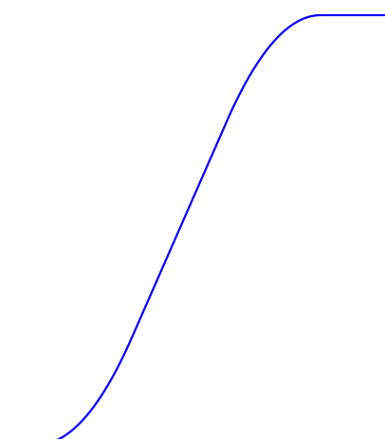
Loss distribution
TDI
TCDIs
TCDIh activation in TI2 high (11 µSv/h), no value available for TI8.
TPSG
SPS
MKE6 rise time: ~ 6 mu sec
Losses at injection are now better understood.
dBLMs at the TCDIs would help to understand the longitudinal losses in the LHC as well as the location and intensity of the re-captured beam in the SPS.
dBLM data available in IQC would help to check injection losses faster.
Operational specs for dBLMs and data implementation will be discussed beginning of 2016.

Slide 16
Injection Quality Check Tool
OP tool with input from other groups (ABT, BI, RF)
Aim: help to identify cause of “dirty” injections.
Detailed studies during TCDI setup validation with TL loss maps showed that source of TL losses can be identified.
Suggestions with run 2 experience:
  to review the thresholds for the color code / warning levels.
  to highlight TL collimator name causing losses to allow for better steering.
Measurements
Simulations

Slide 17
Loss mitigation
Losses from LHC un-bunched beam
  Injection gap cleaning in LHC
  Reduces losses on TDI from a few percent to below a percent - marginal gain compared to satellite loss level.
Losses from satellites injected into LHC
  LHC
    Increase MKI pulse length
      Can be done immediately within TDI limits.
      Inject satellites close to the batch in a clean way into LHC.
      Possibility to clean them before next injection with injection gap cleaning.
      Should make the losses on ALICE/LHCb BCMs cleaner.
    Blind out dump trigger during injection.
      Hides the problem.
      Does not improve for ALICE/LHCb.
  SPS
    B2 losses will be similar to B1 after SPS MKE4 modifications in the coming YETS.
    Ramp program optimisation – can be done immediately, but not a huge gain expected.
    MKQ kick to clean the machine around the batch – to be optimized.
  PS
    Optimisation of bunch length and extraction kicker flattop at extraction – already fairly optimised.

Slide 18
MD results – MKI f.t. increase
Losses at the TDI went down to 18 % (from ~ 50%) of dump threshold

Slide 19
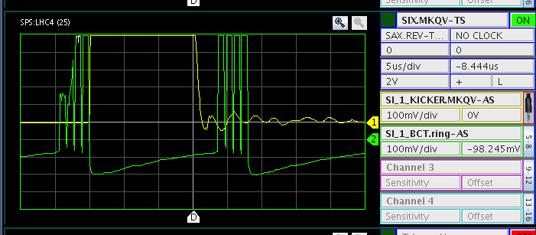
MKQ kick in the SPS – tested during MD
MKQ kick
4 batches
4 batches one turn later

Slide 20
MD results - SPS MKQ on/off

Slide 21
Zoom
With MKQ off: 25% loss reduction in the first part
Particles lost on TDI with full impact parameter: ~4E9p (average: 6.2E6 p / 5ns).
Detailed analysis ongoing for different impact parameters.
Losses at the TDI went down to 30 % (from ~ 50%) of dump threshold.

Slide 22
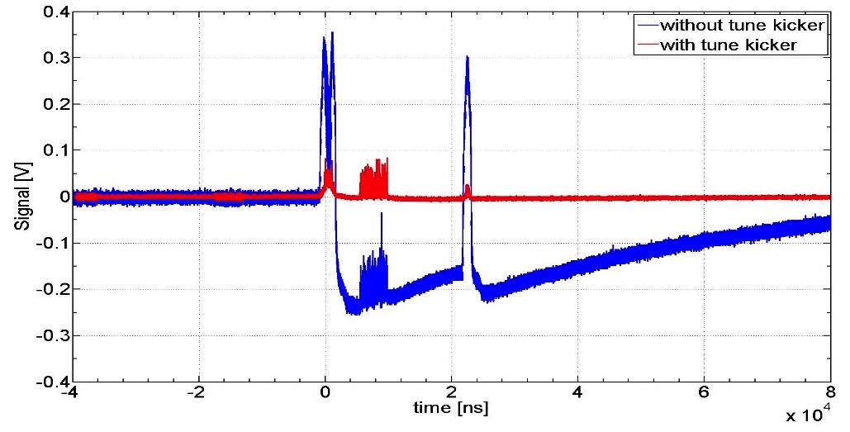
Losses at the TPSG in LSS6

Slide 23
Outlook
288 b injections: MKI f.t. length 7.8 mu sec
Re-captured beam behind the 288 bunches train might overlap with the fall time of the MKE → losses at the TPSG / TCDIs. See second slide concerning injections in 2012.
Otherwise, the MKQ kick can be optimized.

Slide 24
Conclusion
Losses during injections reached up to 93 % dump threshold on TDI.
Transversal losses well understood and under control, further studies ongoing.
Longitudinal losses due to re-captured beam / ghost bunches coming from SPS.
Measured with dBLMs installed close to the TDIs in IP2 and IP8.
  Specs for operational and expert tool to be defined.
On request of OP, ABT can provide input to revise IQC thresholds.
Possible loss mitigations:
  MKI f.t. length increase (within limits) – ghosts properly injected into LHC.
  SPS tune kicker to clean around batches.
To be followed-up during injection setup.

Slide 25
Thank you for your attention!

Slide 26
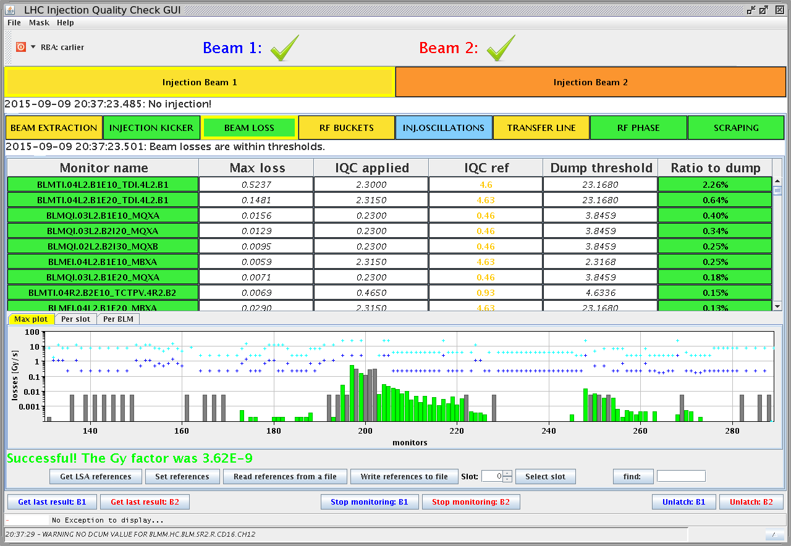
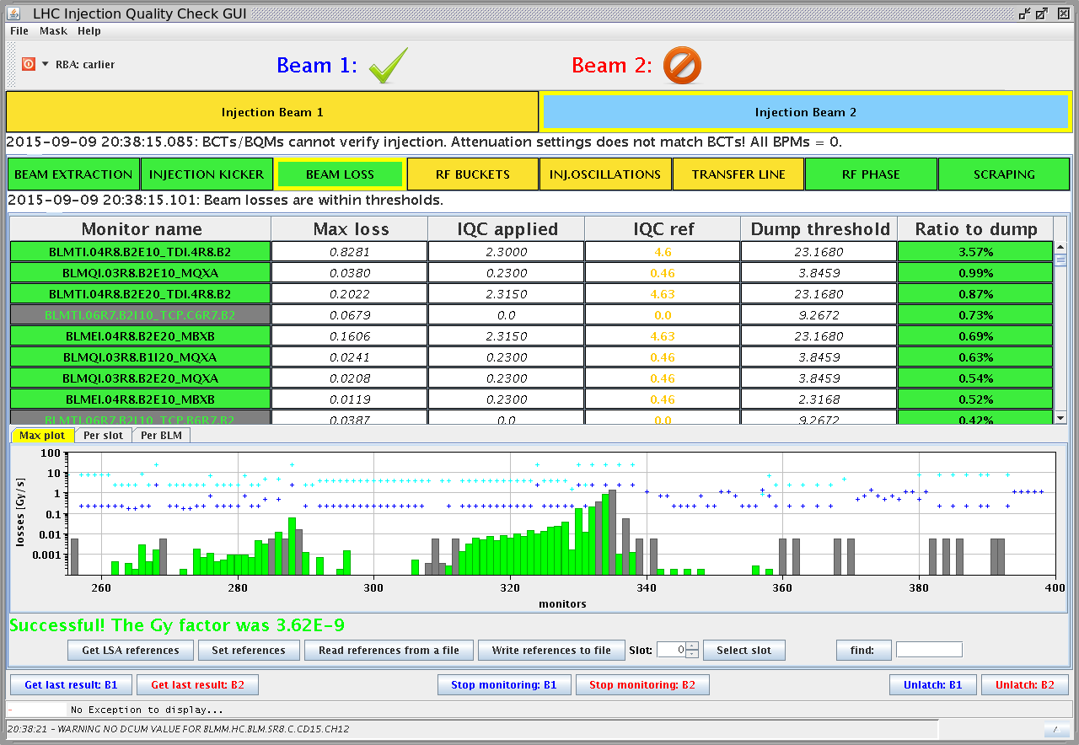
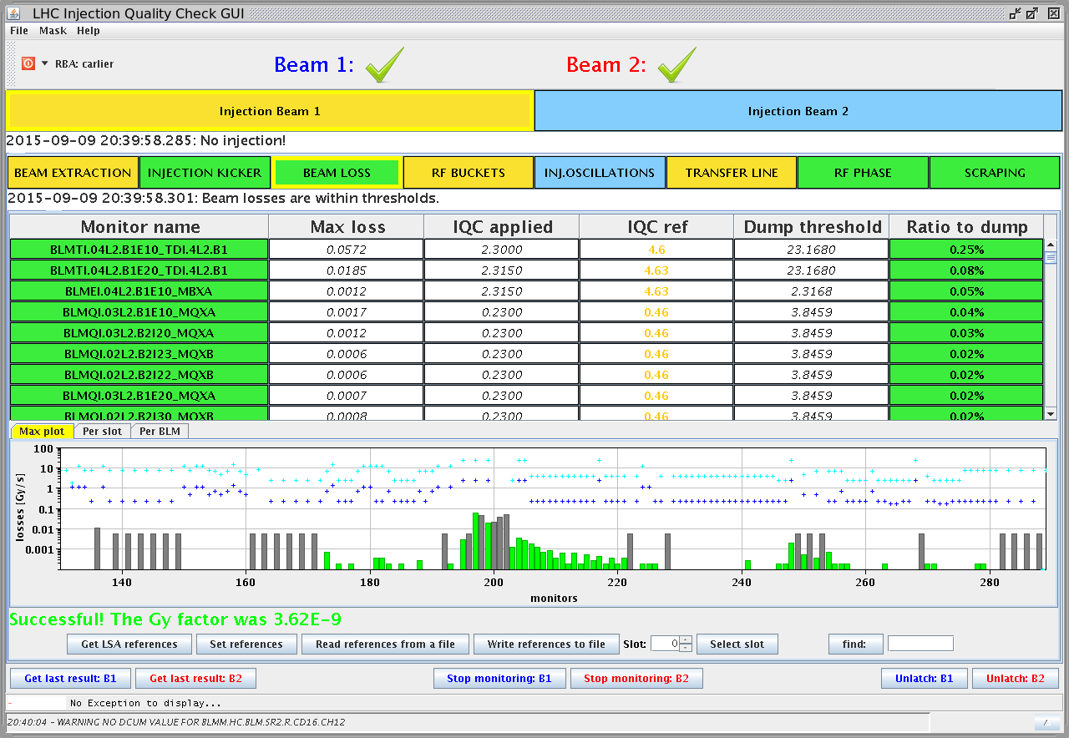
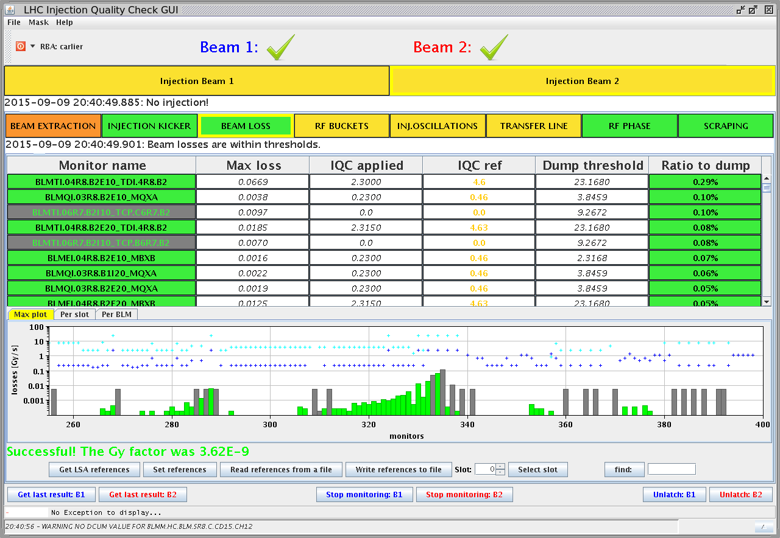
LHC Injection gap cleaning
B1
B2
Losses without cleaning: 3 - 5%
Losses with cleaning: 0.2 – 0.3%

Slide 27
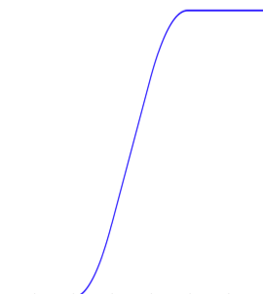
B1 – B2 difference
Dumped in SPS?
14% higher dump intensity for B2 extraction
No losses at extraction for both
LSS6-MKE: tr = 7us
LSS4-MKE: tr = 1us
Dumped on TDI
B1-MKI:
tr = 1us
B2-MKI:
tr = 1us
LBOC, 23rd June 2015

