Slide 1
BLM Thresholds Evolution And 2016 Proposal
M. Kalliokoski, B. Auchmann, B. Dehning, E. Effinger, J. Emery, V. Grishin, E.B. Holzer, S. Jackson, B. Kolad, A. Lechner, A. Mereghetti, E. Nebot Del Busto, O. Picha, C. Roderick, M. Sapinski, E. Skordis, M. Sobieszek, C. Xu and C. Zamantzas
6th Evian Workshop
16/12/2015

Slide 2
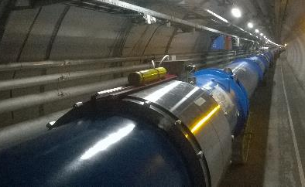
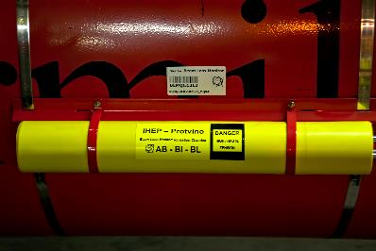
Beam Loss Monitoring System of the LHC
BLM system consists of 3929 monitors
Three types:
  Ionization Chamber (IC),
    Parallel plate chambers, 50cm long with an active volume of 1.5 l, 61 electrodes
    N₂ at 100 mbar overpressure
    3630 monitors in LHC
  Little Ionization Chamber (LIC)
    Same gas properties as IC,
    3 electrodes
    108 monitors in LHC
  Secondary Emission Monitor (SEM)
    Same geometry as with LIC,
    10⁻⁷ bar vacuum
    191 in LHC
3518 ICs are connected to Beam Interlock System

Slide 3
BLM Thresholds
Running Sum | Integration Time [s]
RS01 | 40e-6
RS02 | 80e-6
RS03 | 320e-6
RS04 | 640e-6
RS05 | 2.56e-3
RS06 | 10.24e-3
RS07 | 81.92e-3
RS08 | 655.36e-3
RS09 | 1.31072
RS10 | 5.24288
RS11 | 20.97152
RS12 | 83.88608
Beam abort thresholds can be set independently for each monitor in the form of a 12×32 table
  12 running sums from 40 µs to 83.9 s
  32 energy levels from 246 GeV to 7.86 TeV
    Injection from SPS is at 450 GeV so first energy level is never used
    Values above 7 TeV have not been calculated, Elvl 29 highest

Slide 4
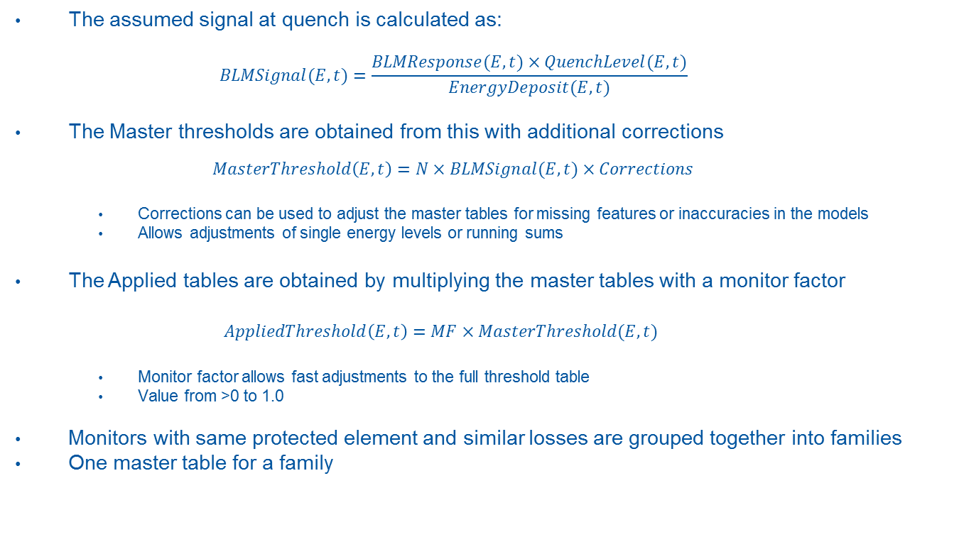
BLM Thresholds
The assumed signal at quench is calculated as:
  $$BLMSignal(E,t)=\frac{BLMResponse(E,t)×QuenchLevel(E,t)}{EnergyDeposit(E,t)}$$
The Master thresholds are obtained from this with additional corrections
  $$MasterThreshold\left(E,t\right)=N×BLMSignal(E,t)×Corrections$$
    Corrections can be used to adjust the master tables for missing features or inaccuracies in the models
    Allows adjustments of single energy levels or running sums
The Applied tables are obtained by multiplying the master tables with a monitor factor
$AppliedThreshold\left(E,t\right)=MF×MasterThreshold(E,t)$
    Monitor factor allows fast adjustments to the full threshold table
    Value from >0 to 1.0
Monitors with same protected element and similar losses are grouped together into families
One master table for a family

Slide 5
Run 2 Thresholds

Slide 6
Threshold Modifications for Run2
During 2015 over 5700 changes to the thresholds were made
  Initial settings + corrections from operational experience
During Run 1 there were 176 families, for Run 2 we have at the moment 119 families
  75 completely new ones, more to come
Details of the changes, see proceedings of the BIQ workshop, B. Auchmann’s Chamonix 2014 presentation and edms document LHC-BLM-ECR-0035

Slide 7
Prioritized List of Threshold Updates
Implemented before startup
Arc and DS thresholds (UFO-induced quenches, new BLM locations).
Injection regions (New monitors/monitor configurations).
Inner triplets, IPQs, IPDs (updated beam-loss scenarios, quench levels).
Remaining injection-region monitors (beam-loss scenarios, quench levels)
MQWs (improved beam-loss scenarios, new damage-level analysis).
Collimators near experiments (FLUKA models, updated damage levels)
Remaining collimators (FLUKA models, updated damage levels)
DS-region horizontal BLMs on MBs for ion runs and injection
Roman pots, kickers, septa, MBWs, new scenario for Q1.
In absence of updates, pre-LS1 thresholds apply.
Green: Deployed since Run 1.
Blue: Analysis complete. To be implemented in TS1.
Violet: Analysis approaching completion. To be implemented “en-bloc” in TS 2 or earlier.
Orange: Analysis not yet started.
Implemented during TS1
Updated by TS3
Updated during TS2
Implemented during TS3
Updated during TS2

Slide 8
Examples of Threshold Adjustments
Monitor factors for cold magnets were initially set to 0.333 for ARC and DS monitors and 0.1 for LSS monitors to assumed quench level
To avoid unnecessary beam dumps from UFOs the MFs were increased to 0.499 and 0.333 respectively (see B. Auchmann’s talk)
Thresholds of monitors on Roman Pots of TOTEM and ALFA experiments were initially kept at the Run 1 values
Operational experience required modifications to the threshold values
  ALFA UFOs
  TOTEM new installations and operational requirements
    Different corrections were required

Slide 9
Implementation of Thresholds

Slide 10
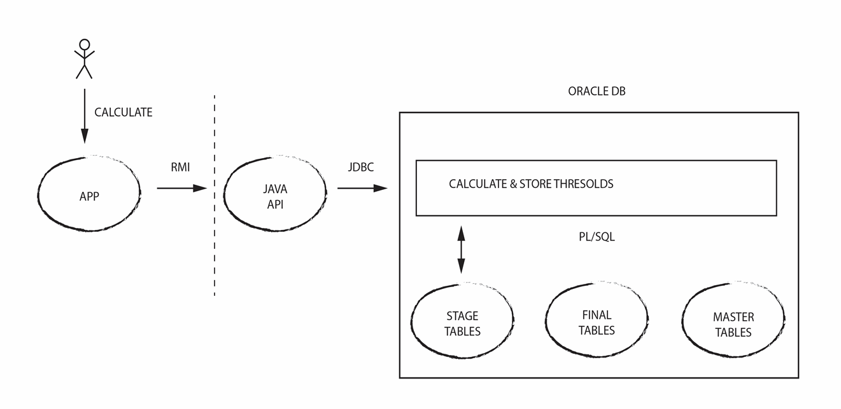
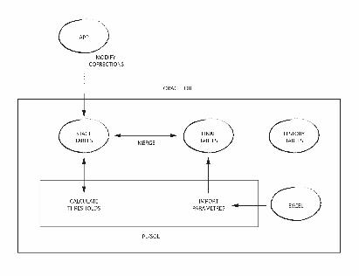
LSA-Based Threshold Generation Application
During Run1 the threshold modifications were made with various C++ scripts
The final tables were submitted directly to database
For Run2 a new application which makes the calculations directly on the database level was developed
Faster but also more safe method to modify thresholds
M. Sobieszek

Slide 11
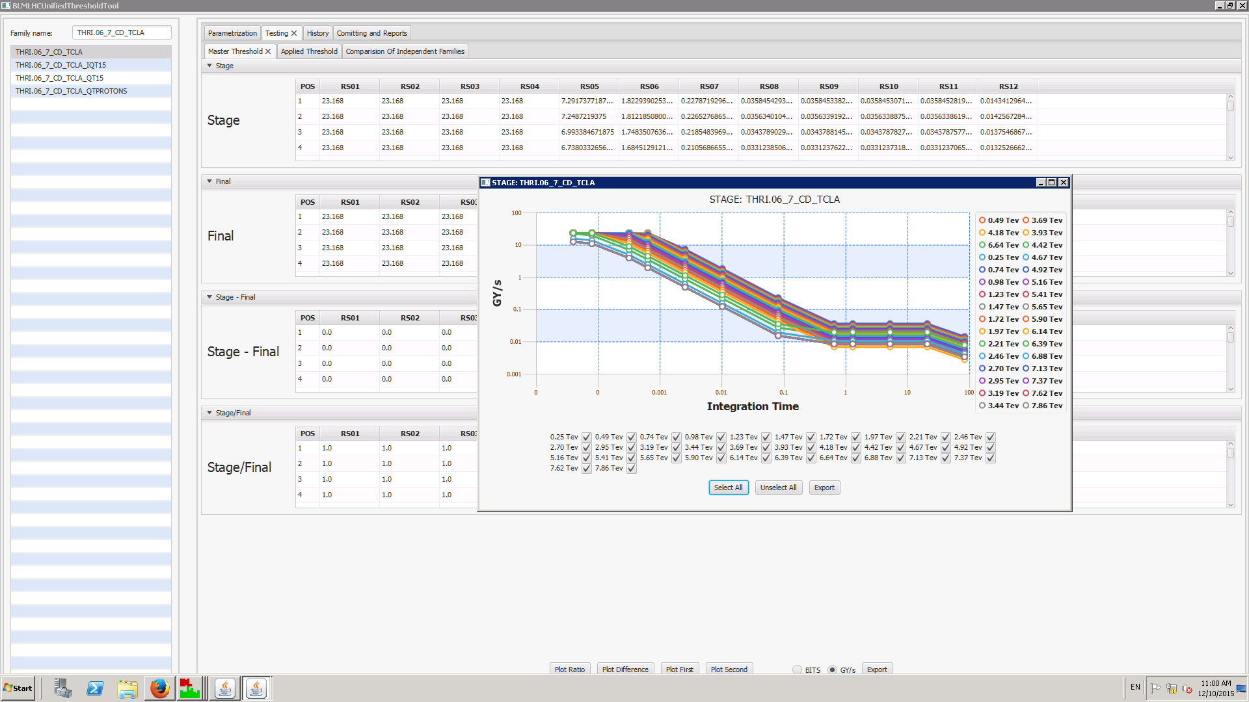
LSA-based Threshold Generation Application
B. Kolad,

Slide 12
Cronjobs Application
Application which compares LSA values between two timestamps
Runs automatically every day to check the changes
Can be launched manually to check the threshold changes
In addition to threshold values, checks also other flags that are written during the refresh of master
  Filters, BIS connection etc.
C. Xu

Slide 13
Making the Changes
New functions and QP3 tables are introduced to the database
New families are created
  User selects the parameters and creates a new family
  Corrections are selected and the threshold tables are calculated
  Changes are written to final tables
  Changes are checked within the threshold working group and approved by MPP, an ECR is written, changes are presented to LMC
  Monitors are moved to new families
  Two BLM experts signs the refresh of master tables
Cronjobs is run to check the changes
LSA settings are generated and the changes are driven
Monitor factors are changed (default 0.1)
Cronjobs is run to check the changes

Slide 14
Implementation of New Thresholds
For all changes to master thresholds, an ECR is written
6 ECRs for the permanent changes
2 additional ECRs describing the changes for the MDs

Slide 15
Testing the Threshold Levels

Slide 16
Quench Tests
Collimation Quench Test with heavy ions 13/12/2015
BLMEI.09L7.B2I30_MBB

Slide 17
Quench Tests
% of Thresholds | B2I21_MQ | B2I10_MQ | B2I25_MBA | B2I24_MBA | B2I23_MBA | B2I22_MBA | B2I21_MBA | B2I30_MBB | B0T10_MBB-MBA | B2I22_MBB | B2I21_MBB
RS01 | 0.2 | 0.4 | 0.7 | 0.6 | 1.3 | 0.6 | 0.7 | 2.0 | 0.9 | 0.4 | 0.6
RS02 | 0.1 | 0.3 | 0.6 | 0.6 | 0.8 | 0.6 | 0.7 | 2.0 | 0.9 | 0.4 | 0.6
RS03 | 0.2 | 0.6 | 0.9 | 0.8 | 0.8 | 0.8 | 0.9 | 2.7 | 1.6 | 0.5 | 0.8
RS04 | 0.3 | 0.9 | 1.7 | 1.6 | 1.6 | 1.5 | 1.8 | 5.1 | 2.3 | 1.0 | 1.5
RS05 | 0.5 | 1.8 | 1.4 | 1.3 | 1.3 | 1.2 | 1.5 | 4.2 | 4.6 | 0.8 | 1.2
RS06 | 0.8 | 2.8 | 3.6 | 3.2 | 3.3 | 3.1 | 3.7 | 10.4 | 7.0 | 2.0 | 3.0
RS07 | 3.0 | 10.0 | 8.3 | 7.4 | 7.6 | 7.3 | 8.6 | 23.6 | 25.3 | 4.7 | 6.6
RS08 | 16.7 | 55.6 | 33.0 | 29.5 | 30.5 | 29.0 | 34.3 | 93.5 | 139.0 | 18.4 | 26.3
RS09 | 24.1 | 80.3 | 57.6 | 51.4 | 52.8 | 50.5 | 59.4 | 162.2 | 199.8 | 32.0 | 45.2
RS10 | 35.1 | 117.0 | 122.3 | 108.6 | 111.8 | 107.6 | 126.5 | 344.8 | 293.7 | 68.0 | 96.7
RS11 | 17.2 | 57.2 | 82.7 | 73.9 | 76.0 | 72.9 | 85.6 | 233.3 | 143.2 | 46.5 | 66.0
RS12 | 4.3 | 14.5 | 23.9 | 21.3 | 22.0 | 21.1 | 24.8 | 67.4 | 36.3 | 13.5 | 19.1
Collimation quench test with heavy ions

Slide 18
Quench Tests
% of Thresholds | B0T20_MBA-LEFL | B2E24_MBA | B2E23_MBA | B2E22_MBA | B2E21_MBA
RS01 | 0.7 | 0.3 | 0.4 | 0.2 | 0.2
RS02 | 0.4 | 0.2 | 0.3 | 0.1 | 0.1
RS03 | 0.2 | 0.1 | 0.2 | 0.1 | 0.1
RS04 | 0.2 | 0.1 | 0.3 | 0.1 | 0.1
RS05 | 0.2 | 0.1 | 0.4 | 0.1 | 0.0
RS06 | 0.3 | 0.2 | 1.0 | 0.1 | 0.0
RS07 | 1.3 | 1.3 | 5.3 | 0.7 | 0.1
RS08 | 7.7 | 7.5 | 31.3 | 3.8 | 0.6
RS09 | 11.2 | 10.9 | 45.9 | 5.6 | 0.9
RS10 | 18.4 | 17.8 | 75.3 | 9.1 | 1.4
RS11 | 20.1 | 19.4 | 82.2 | 9.9 | 1.5
RS12 | 18.9 | 18.2 | 77.3 | 9.4 | 1.5
BFPP quench test

Slide 19
Proposal for 2016

Slide 20
Planned Threshold Changes for 2016
To avoid unnecessary beam dumps due to UFOs, an additional ad-hoc correction to the MB and MQ monitors in ARCs and DSs will be implemented (see B. Auchmann’s talk)
New models are being developed for the monitors on collimators (see A. Mereghetti’s talk, coming next)

Slide 21
Planned Threshold Changes for 2016
Monitor Factors will be unified based on locations
  E.g. all monitors in ARCs will have same monitor factor in standard families
  If different thresholds are needed, changes are made to master level
Based on quench test results, an increase to long Running Sums for MB and MQ monitors

Slide 22
Planned Threshold Changes for 2016
Lowering of the RS11-12 for ion families might be needed
  Analysis of the QT result ongoing
Separate ion-proton run thresholds will be studied and implemented if needed

Slide 23
Summary and Conclusions
Over 5700 modifications to the thresholds were made during 2015
New tools allow faster changes to threshold values with improved safety
Main changes in 2016 will be made to collimators (A. Mereghetti’s talk)
For other families, mainly ad-hoc adjustments to current values are foreseen
New thresholds for monitors at experiments (ALICE, AFP etc.)

