Slide 2
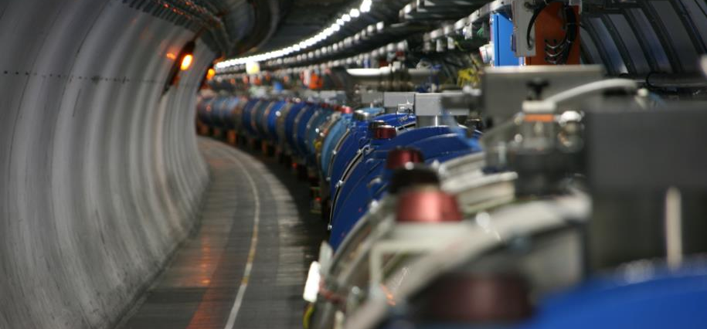
6
6th Evian Workshop
15-17 December 2015
Hardware commissioning and machine check-out after YETS
Mirko Pojer
on behalf of the Powering Test and Machine Check-out teams
  With many kind inputs by a several people, in particular M. Bernardini, V. Montabonnet, H. Thiesen, R. Denz, B. Salvachua, G. Valentino, E. Carlier, E. Bravin, T. Lefevre, E. Piselli, C. Zamantzas, B. Puccio, J-C. Garnier

Slide 3
Outline
The present schedule
  Driving activities defining the length of YETS ‘15-’16
  The critical activities that could impact the time of restart
The powering tests
  Activities with a possible impact
  The list of powering tests for next year re-commissioning
  The organization
Machine check-out
  Machine check-out objectives
  Preliminary list of requested checks
Concluding remarks

Slide 4
Driving activities (machine side)
Cooling & Ventilation
  3 weeks of stop for the SF, SU, UW (mechanical cleaning of the cooling towers,
  mechanical and electrical maintenance, bugs fixing)
Cryogenics
  The maintenance is needed on all cryo-plants
    Heavier maintenance and consolidation are needed in IP4 (A) & IP6 (A), heavy corrective maintenance (repairs) is needed in IP8 (B)
  The baseline is to keep the Helium in the arcs except sectors 7-8 and 8-1
    the magnets will be filled with LHe in cold standby at 3.5 K – 4 K
    The LSSs will be in GHe at 20 K.
    The DFBs will be empty with the current leads in cold standby
  The Sectors 7-8 and 8-1 will be emptied, and in cold stand by with Ghe
  RF cryo start on 22nd of February to allow the RF conditioning (4wks requested)
  The last cryostarts will be back on 4th of March (earlier in Sectors 1-2, 3-4, 4-5, 7-8)
UPS TESTS on the whole machine
  Recently approved by LMC
  The tests can be done only after the cryo start
  The UPS tests constitute a hard limit for the readiness of all systems

Slide 5
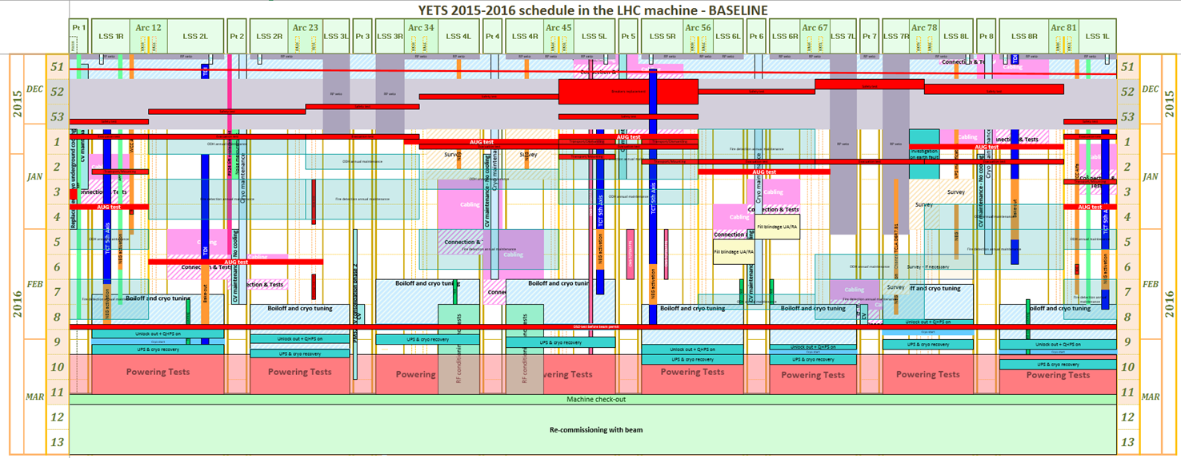
The present schedule
https://espace.cern.ch/en-dep-mef-lpc/YETS2015-2016/Global%20Schedules/LHC_YETS2015_16_LinearSchedule_20151130.pdf
Key dates:
  DSO tests (machine in general mode before)
    Patrol scheduled on W8 for the DSO tests
    DSO tests on February 26 (and 27)
  March, 1 – beginning of UPS tests (could be integrated in the general AUG tests?)
  March, 4 – LHC tunnel closed and beginning of powering tests
  March, 16 – end of powering tests, experiments closed and (official) beginning of machine check-out
  March, 21 – beginning of beam commissioning
It would be important to close the experiments already from Mon.14 during night time

Slide 6
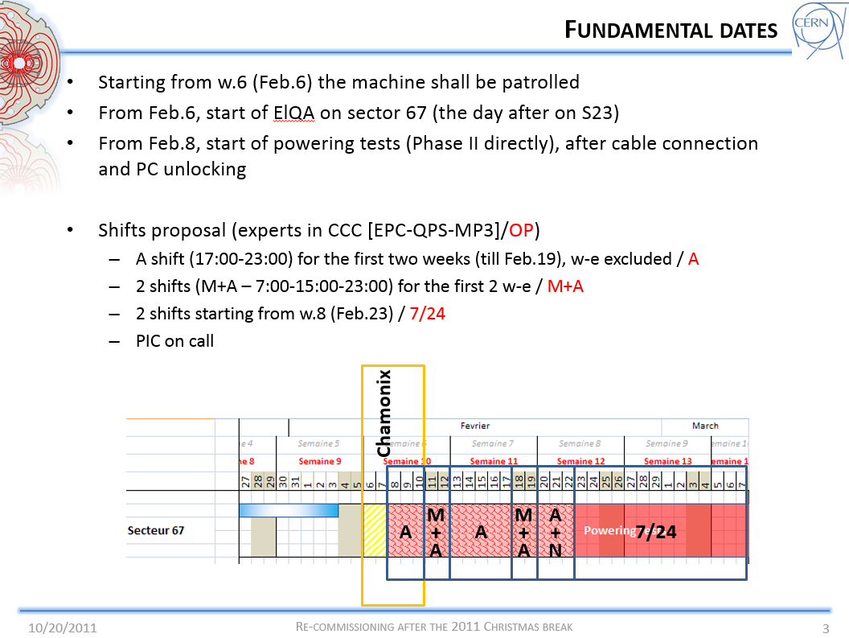
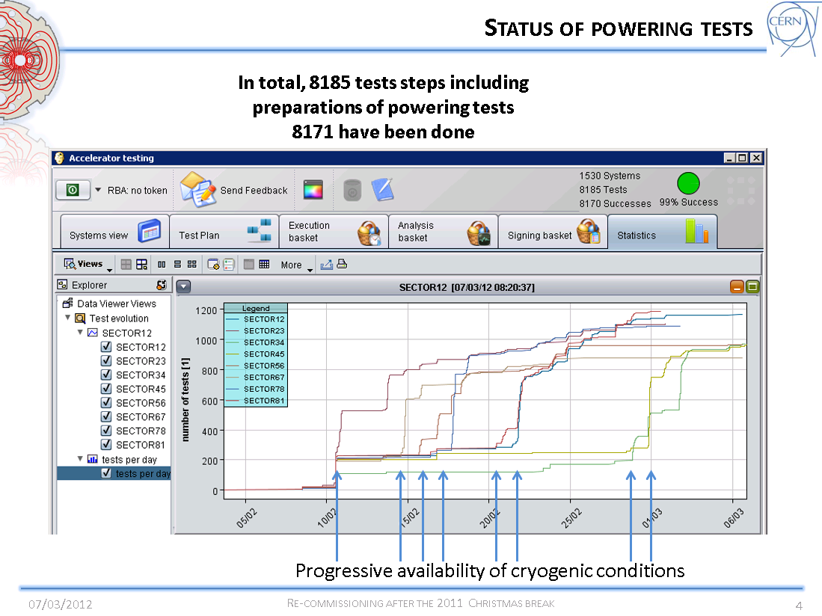

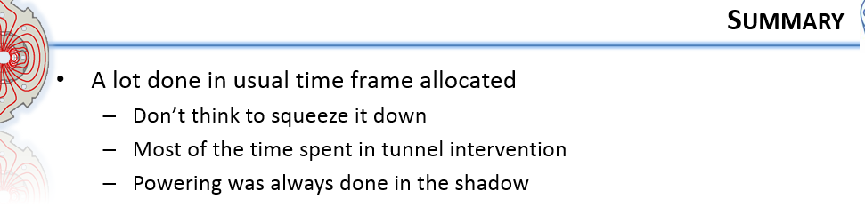
An example from Run I

Slide 7
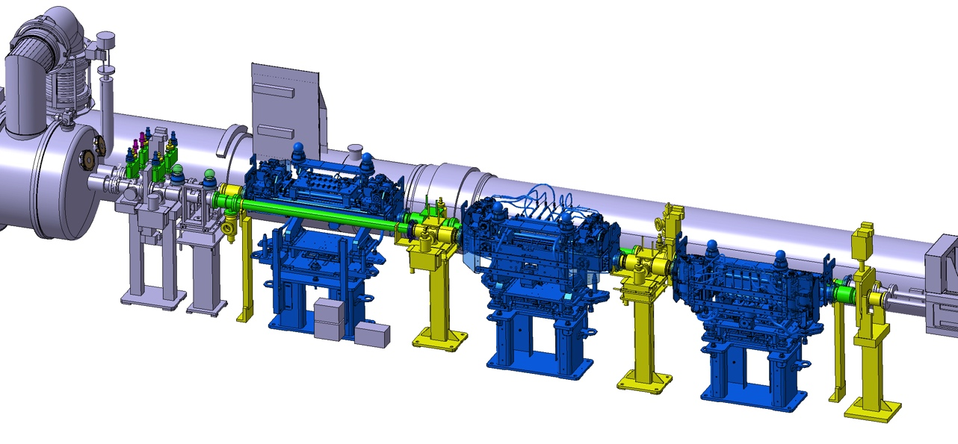
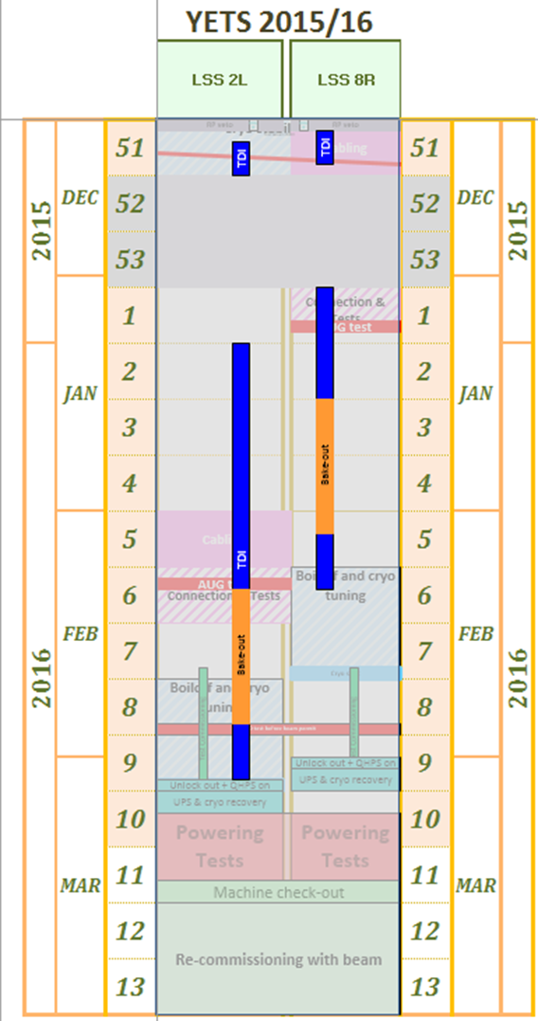
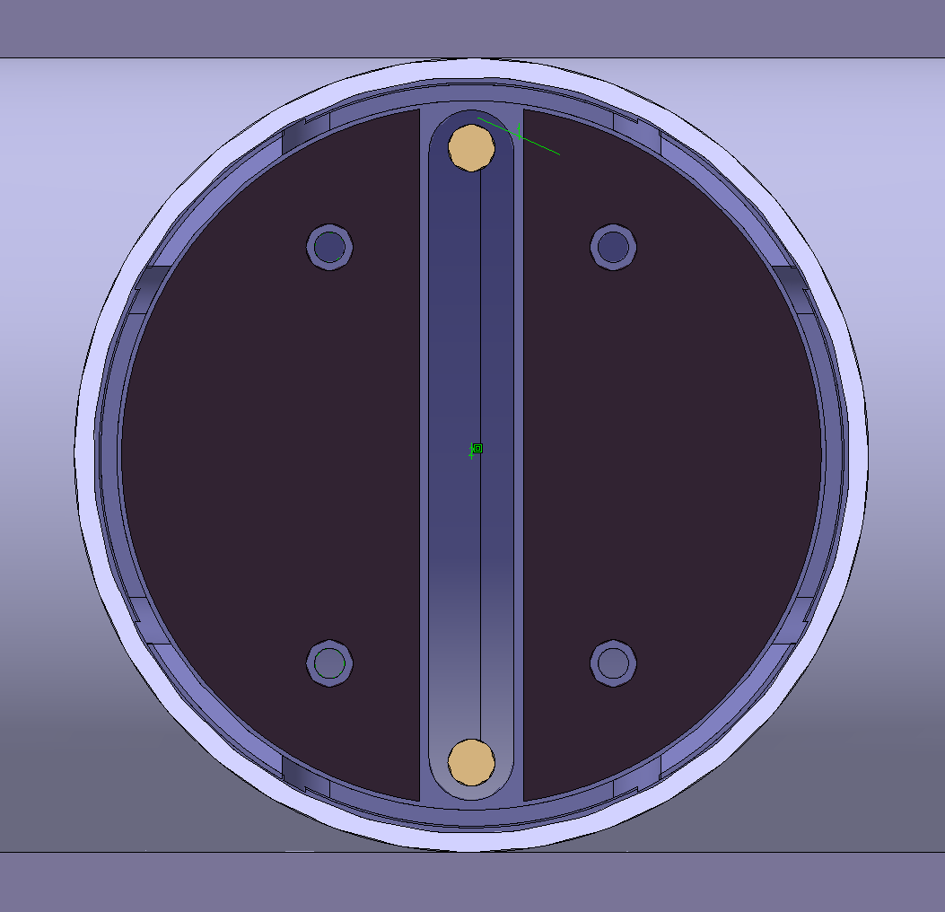

Critical activities with possible impact
Collimators 5th Axis
  12 Collimators will be removed and re-installed in LSS1 and in LSS5
  Vacuum layout to be modified, to recover the TCTP collimators’ 5th axis translation
  Due to RP issue, the activity can only start on 4th January
TDI replacement
  Minor contingencies are included in the baseline
  Both TDI removed during W51 and reinstalled during W1&W2
Change of ferrite of the Beam Wire Scanner in LSS4
  Due to the late delivery of ferrite, the final decision about the installation will be taken by end of January
3D integration view 4L1

Slide 8

Outline
The present schedule
  Driving activities defining the length of YETS ‘15-’16
  The critical activities that could impact the time of restart
The powering tests
  Activities with a possible impact
  The list of powering tests for next year re-commissioning
  The organization
Machine check-out
  Machine check-out objectives
  Preliminary list of requested checks
Concluding remarks

Slide 9
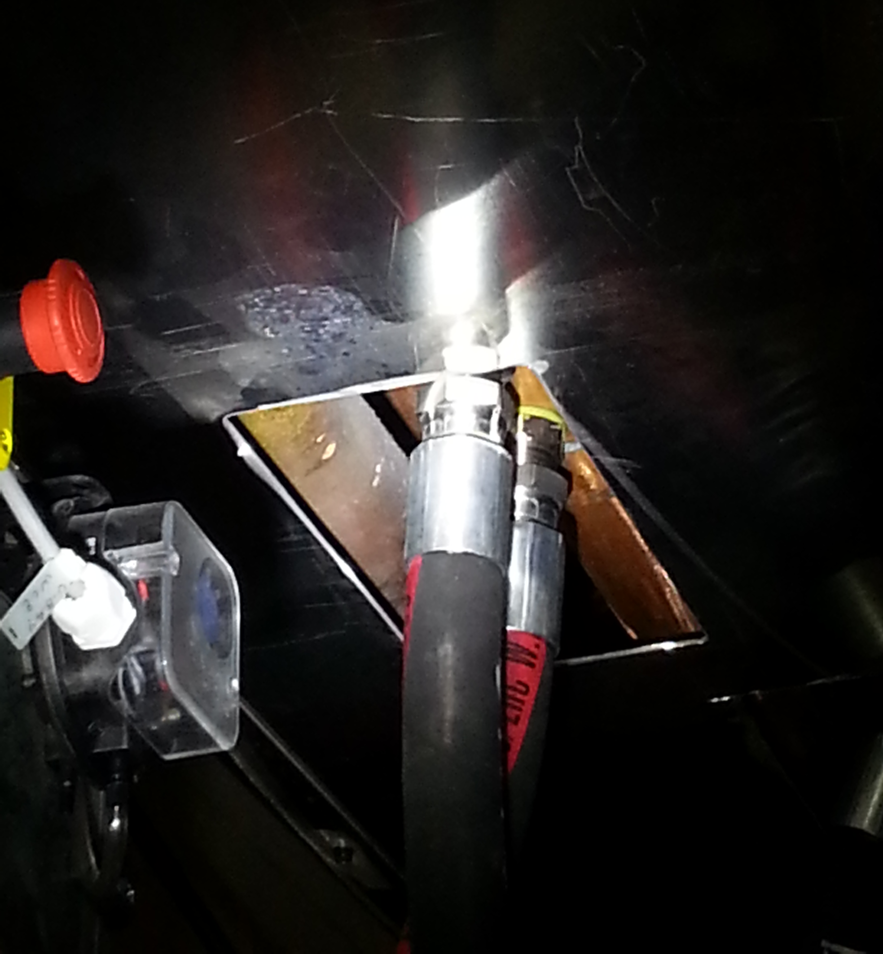
Activities that could impact the PT
CS/CM should be there at the beginning
Cryogenics
Services (CV, EL,…)
Power converter
MPE
  ElQA
  QPS
  EE
PIC
EN/EL
Visual inspection on warm bus-bars
should be conducted by EN/EL to avoid
surprises when restarting
Must be OK for the UPS tests
No intervention foreseen during YETS

Slide 10
EPC
FGC CPLD & Software upgrade
  FGC CPLD Upgrade
    Need local access all over the machine for the reprogramming
    Version already tested in S78
    Test : PIC2 – PERMIT / POWERING FAILURE to be repeated
  FGC Software Upgrade
    Correction of bugs seen during Run 2
    Tests to be foreseen
Current Calibration of
  the main dipoles
  the main quadrupoles.
  the inner triplets
  the RMSIs
Additional intervention of maintenance / power module replacement
No major impact on re-commissioning
PIC tests already in the baseline

Slide 11
MPE - QPS
Could strongly impact the commissioning time!!
Installation & commissioning of radiation tolerant detection systems for 600 A circuits
  RR13, 17, 53, 57, 73 and 77
Installation & commissioning of new detection systems for circuits RU.L4 and RU.R4 (‘undulator’). Activity in conjunction with the upgrade of the corresponding current sensors performed by EE team
Upgrade of the firmware for the nQPS DAQ systems allowing easier recovery from local bus errors (436 units concerned).
  Locations: 8 sectors
Installation of a test system for the measurement of conical joints in the warm 13 kA circuits.
  Location: UA23 (t.b.c.)
  Requires lock-out and grounding of the associated power converter.
All DQHDS will be switched off during the YETS. Locations: 8 sectors
  The QPS team foresees as well a test of the QPS interlocks
Important to get a sector ASAP!
Test bench for HW and SW is needed!
Impact to be assessed
All must be up and running for the UPS tests!

Slide 12
MPE - EE
General and specific overhaul of the 32 installations of energy extraction in the LHC main dipole and quadrupole circuits.
  Locations: UAs (even points), RRs (13,17,53,57,73,7) & R34, R37
  Requires lock-out and grounding of the associated power converters
Supervision of a general overhaul of the energy extraction breakers of the ‘Atlas’ powering circuits for the superconducting Solenoid and Toroid.
  This task will be performed by an IHEP team of specialists.
  Location: Atlas (“power cavern”)
All must be up and running for the UPS tests!

Slide 13
MPE - ElQA
Check is part of the cryo tuning
Study of a possible relocation in point 6 of the CL heater sources and the Proximity Equipment related to a possible displacement of the RQ5.L6 quad
Checking and re-making, if required, the signal transmission line from the DQLCT of B23.L7, heater #1
ELQA investigations of the earth fault on the circuit RCS.A78B2 (near DFB)
  Decision taken by LMC to do the type test
  Final test to be discussed later
ELQA integrity verifications at the end of YETS
  Depending on the temperature variations and the interventions on the circuits.
To be verified before powering (IST)
Additional verification to be done
Would require more extensive test!
Impact on re-commissioning depends on the list of ElQA tests

Slide 14
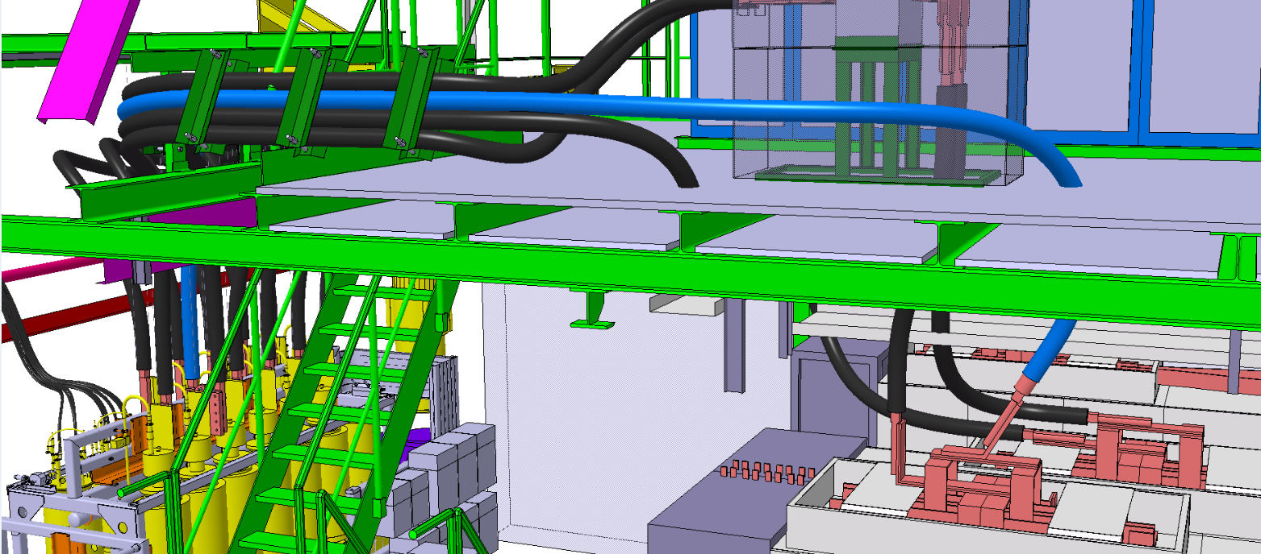
RQ4.L/R1 modification
ALFA project: adding one more WCC per RQ on Q4 circuit around point 1
Short-circuit test + 24h heat run to be done during the YETS
Complete re-commissioning of the 2 circuit during powering

Slide 15
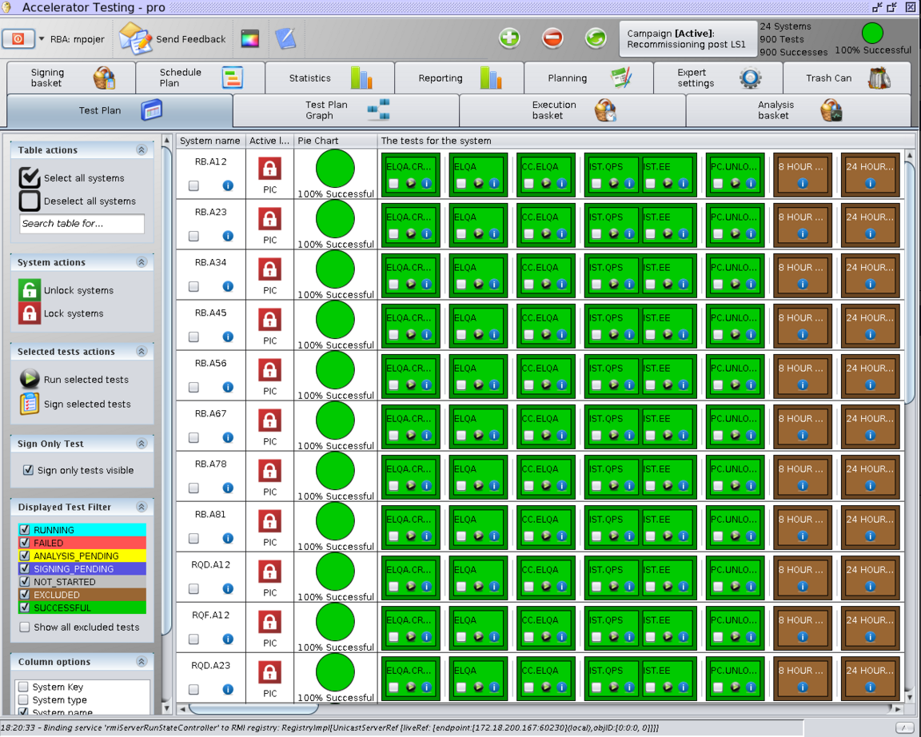
List of powering tests to be done
60A
    All tests
80-120A
    PIC2
    PNO.d1
600A
    PIC2
    PLI3.b1-SOF
    PNO.d3
    PNO.a3
IPQs
    PIC2
    PNO.a7
    All tests (excluding PNO.f4) for RQ4.L/R1
IPDs
    PIC2
    PNO.a8
ITs
    PIC2
    PNO.a9
RQs
    PIC2
    PNO.b3 (4h)
RBs
    PIC2
    PNO.b2 (4h)
2200
80
16
600
300
40
8
2000
200
100
400
16
400
48
400
8
80
Almost 7000 tests!!!

Slide 16
Warm magnets
RMSI Point 2 and 8 [EIS]
  Installation of a new Control Crate for a better reliability and an optimisation of the spare card management (Analog Card will become Standard)
  Rework at the level of the EIS for a better diagnostics
  1 day of test per converter: mise-hors-chaine will be needed
  No intervention on power part
RD34.LR7 [EIS]
  Change of a DIVISOR MODULE card to solve a voltage measurement issue
  1 day of test: mise-hors-chaine will be needed
  No intervention on power part
RD34.LR3 [EIS]
  Change of the ACTUACTOR board
  ½ day of test: mise-hors-chaine will be needed
  No intervention on power part
LHCB Dipole
  RPTI.SR8.RBLWH.R8
    Installation of a new Control Crate to solve the issue of PC PERMIT bad contacts
    Tests to be foreseen
  RBXWSH.R8
    Partial DC cable replacement (EN/EL)
    1 day for test (EN/EL)
Exchange of some coil retainers in point 3 and possibly point 7 during the YETS on all the MQW magnets
  Verification by powering the circuits (ramp up and down)
  No cable disconnection → no polarity check needed
EPC
MSC

Slide 17
Organization
From March 4, the machine will be closed (excluding urgent, spot interventions)
Powering tests will be executed all around the clock
Team availability
  OP – 3x8h
  MP3 – 3x8h
  EPC – 2x8h (7:00-23:00) + 1 shift on call
  PIC – 1 extended shift
Tunnel accesses (exclusively related to powering) will be during the normal working hours

Slide 18
Outline
The present schedule
  Driving activities defining the length of YETS ‘15-’16
  The critical activities that could impact the time of restart
The powering tests
  Activities with a possible impact
  The list of powering tests for next year re-commissioning
  The organization
Machine check-out
  Machine check-out objectives
  Preliminary list of requested checks
Concluding remarks

Slide 19
Machine check-out in a nutshell I
Drive all relevant systems in a synchronized way through the standard operational sequence
Check functionality of the control system from the control room high level applications
Check the beam instrumentation acquisition chain
Check synchronization
Check all equipment control functionality
Check machine protection and interlock systems
During this phase many machine protection test without beam are accomplished
All system have to be declared operational
Test the readiness of the LHC to inject and accelerate a low intensity beam
The Beam can not be injected and circulate without closing the BIS loop

Slide 20
Machine check-out in a nutshell II
BIS system:
  LBDS connected
  All clients connected to the loop
Condition to close the BIS LOOP in nominal condition:
  LHC access Key on Beam mode
  LHC Vacuum valves open
  Hardware commissioning finished; all circuits ON and no faults
  No interlock from non-maskable clients
LBDS
  BETS
  XPOC
  Synchronization LBDS and RF
  Full check-out tests needed with system fully connected
    Energy tracking tests up to 6.5 TeV
    Arming the system connected to BIS once beam permits are OK
    Circulate and dump sequence
    Machine protection tests with loop closed

Slide 21
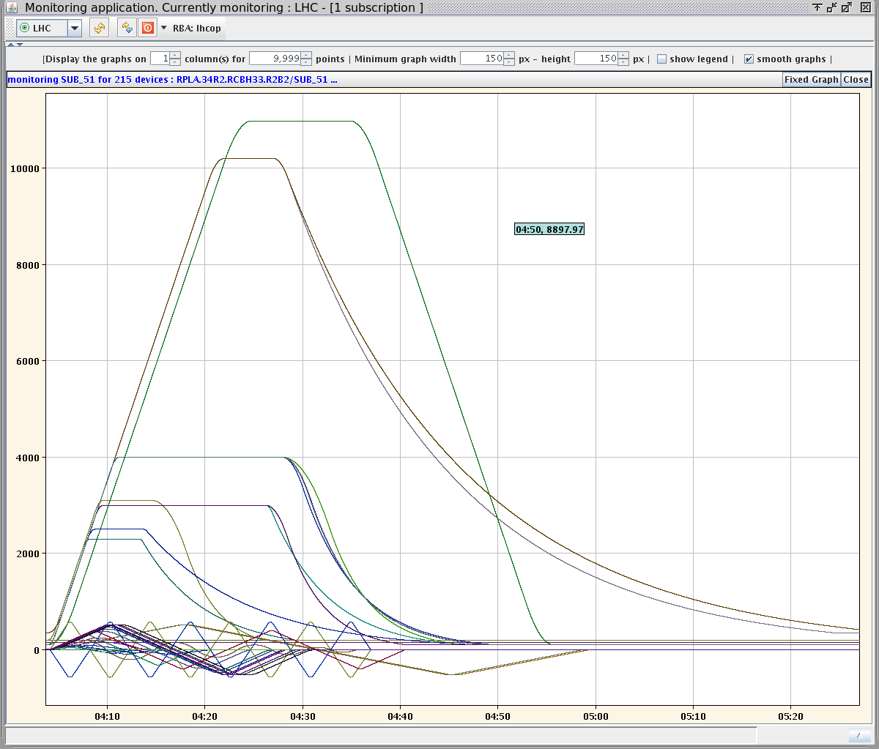
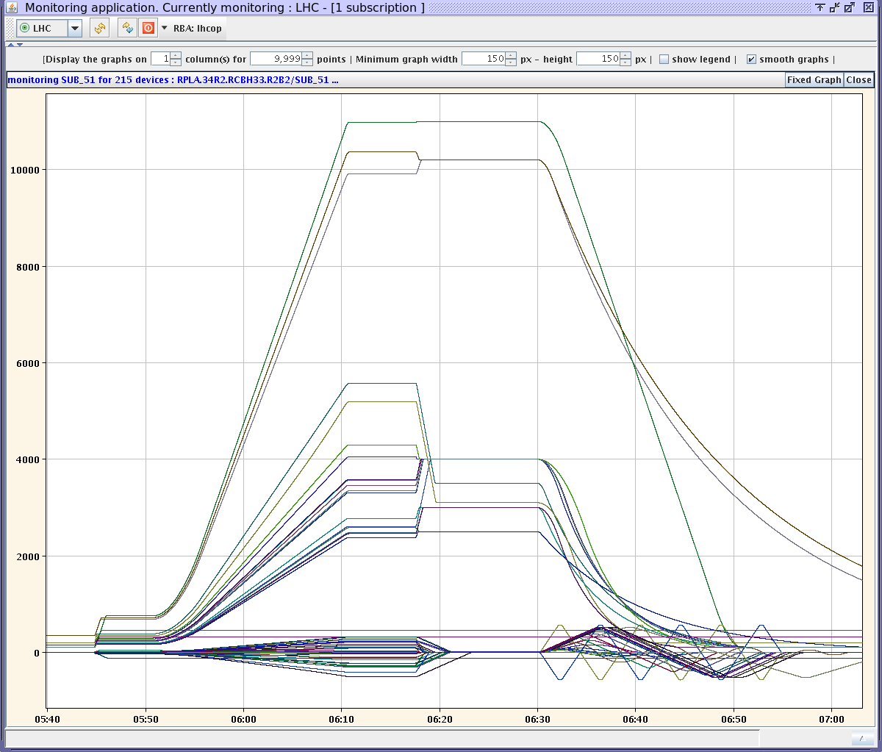
Final global powering with op. functions
Pre-cycle
Ramp +
Ramp-down

Slide 22
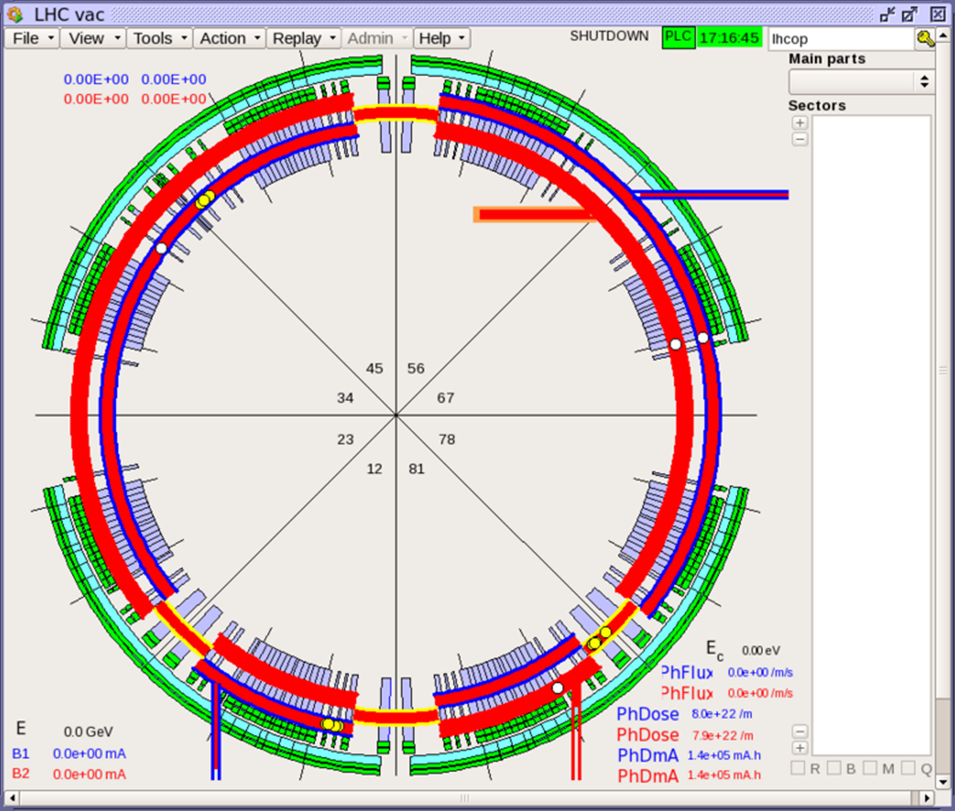
Vacuum
Ring and expts’ : all sectors valves will have to be operational and interlocks will be tested by VSC and OP

Slide 23
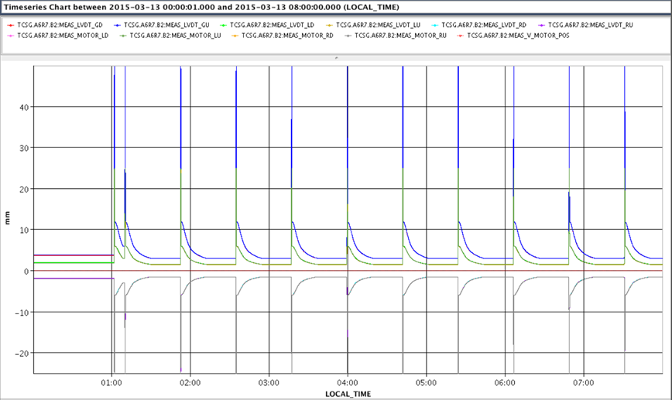
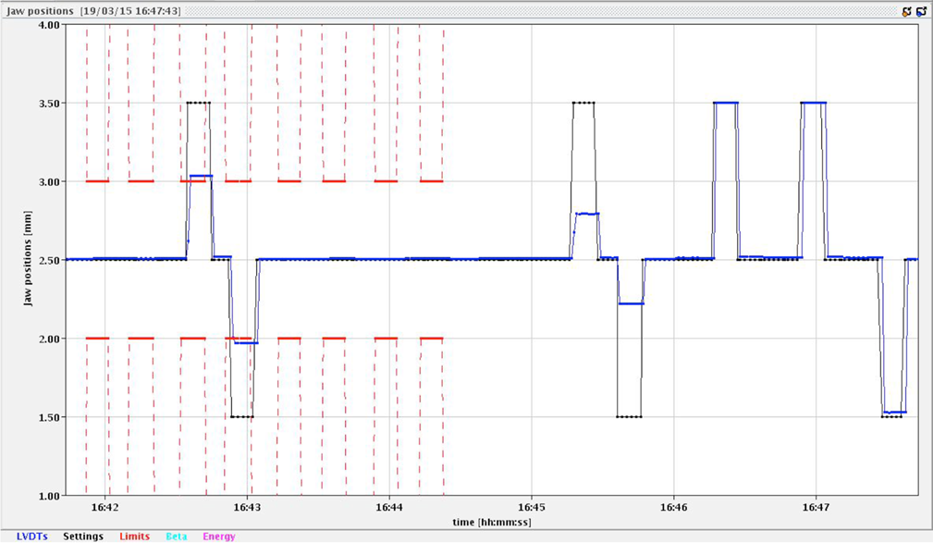
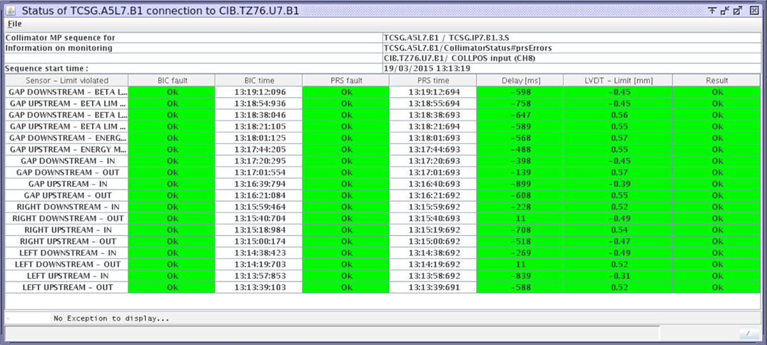
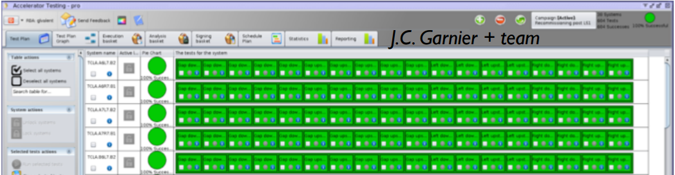
Collimators
Hardware and FESA should be tested with systematic ramps
Machine protection tests to check position, energy and best-star interlocks
Injection protection tests (to check also the interlock chain)
Collimators with BPMs: no special test before beam
  However a simulator to optimize the BLM alignment is available, and could be tested during 3-4 hours without beam with as many collimators, to move them in parallel

Slide 24
LBDS
LBDS
Replacement TSDS ELMA crates (redundant power supplies monitoring)
  Full revalidation of the system needed during cold checkout
Visual inspection MKD/MKB generators
  Revalidation by short reliability run in local at the end of the EYETS
Replacement of 2/3 GTO switches (bad switch ratio)
  Revalidation by short reliability run in local at the end of the EYETS
UPS tests at the end of the YETS
Full recalibration at the end of the YETS
General software maintenance
TCDQ
Calibration verification

Slide 25
Kickers
MKI
Upgrade thyratron heating system
Implement fast vacuum acquisition of MKI interconnects
Surveillance low voltage power supply in timing system
Replacement fine delay V850 module by SVEC-FD module
General software maintenance
MKQAc
Upgrade from RIO3/LynxOS to MEN-A20/SLC6
Verification HV contacts in AC-Dipole generators
General software maintenance
  Will be fully tested before machine closure

Slide 26
Beam instrumentation
BLM
  Test of the successful transition of USER_PERMIT (5’x8 sectors)
    The BLM system sets its USER_PERMIT to FALSE
    The transition of each separate connection of BLM USER_PERMIT to FALSE and the signal arrival at the BIC
    The test must be performed on at the centre crate of each sector (i.e. device cfv-s**-blmc). Results are to be documented in MTF
  Test the change of the threshold values according to the beam energy signal received (1h)
    The main dipoles circuits in sectors 45, 56, 67 and 78 are ramped from injection to physics energy (7 TeV or less) or a simulation energy ramp is transmitted by the timing system
  Check of the correct detection and propagation to the SIS for requesting a beam dump due to missing HV power supply on the system's detectors (1h)
    Using the expert tools reduce the value of all HV power supplies to values lower or equal to 900 V
BPM
  Will do BPM Fibre connectivity tests and software checks as much as they can to validate the new FESA3 server (BPMD class and BPMLHC class)
  Intensive check of FW and SW:
    Calibration, logging process, Post-Mortem buffers

Slide 27
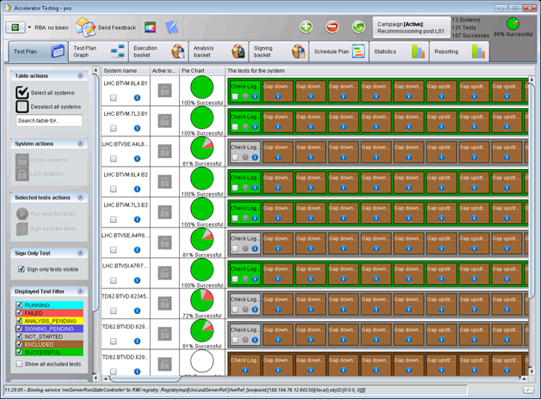
Beam instrumentation
WS (mostly qualified with beam)
  Check of the movements
  Check of the FESA class
  Check of the new functionalities of the FESA class: background suppression, threshold limit, for ions and protons. The idea is to fake the TGM in order to test different conditions
Standard checks on BTV images/movements, applications get data, sequences work etc.
Acc_testing GUI being used and more and more systems should be added

Slide 28
RF
Must have 4 weeks available for RF conditioning and commissioning,
  Need to do some major controls validation on the new FESA3 software with some conditioned cavities before proceeding with full LLRF setting-up
  No big activity for LLRF, just the usual 2 weeks (without beam) to complete the setting-up of the loops after cavities are conditioned (the setting-up of RF synchro and capture is then done in the background of machine setting-up)
Additional time is requested for conditioning the klystron with higher cathode current
  At present the power is sufficient because the voltage is reduced to 10 MV in physics. We used 12 MV during run 1 (and the LHC design assumed 16 MV!). If, for any reason, we have to increase the voltage above 12 MV, the 250 kW saturation will not be sufficient and we will need the design 300 kW.

Slide 29
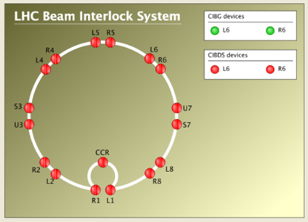
MPE critical changes
Normal checks before beam
BIS – no additional tests needed
  Displacement of many socket-outlet blocks (reglettes)
    in all cases these units prevent the access to the VME redundant power supplies (namely ‘Wiener’ P.S.) (to be coordinated with EN-EL)
    Locations: all UAs, US15, UJ33, USC55, TZ76, SR2 and SR8
WIC
  WIC upgrade to new generic code base: remote download followed by (partial) re-commissioning of the system – max half a day / point….
    Locations: US15, UA23, UJ33, UA47, USC55, US65, TZ76 & US86
SMP – only SW change, no HW – no additional tests
  Replacement of the VME-bus master module family : ‘RIO3’ type replaced by ‘MenA20’ type (this depends on successful lab tests still to be confirmed)
    Location: CCR
Misc
  Various SW upgrades (e.g. FMCM FESA class, QPS Swiss Tool, ACCTESTING,…) – time certainly needed to deploy and test!
  All issues should be cleaned before start of powering tests

Slide 30
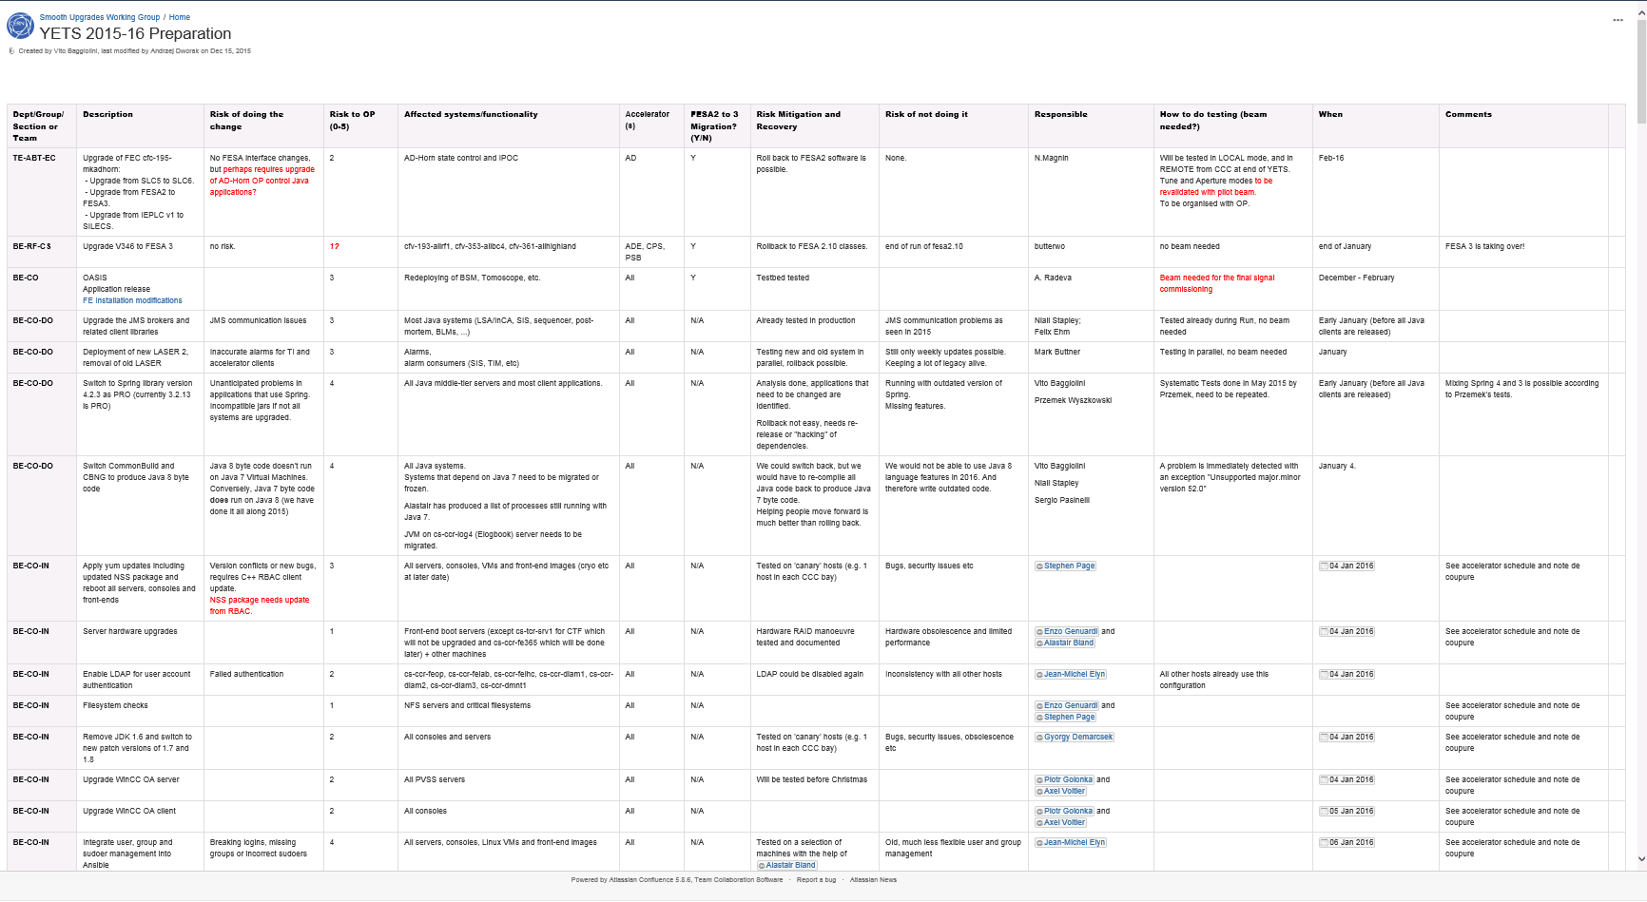
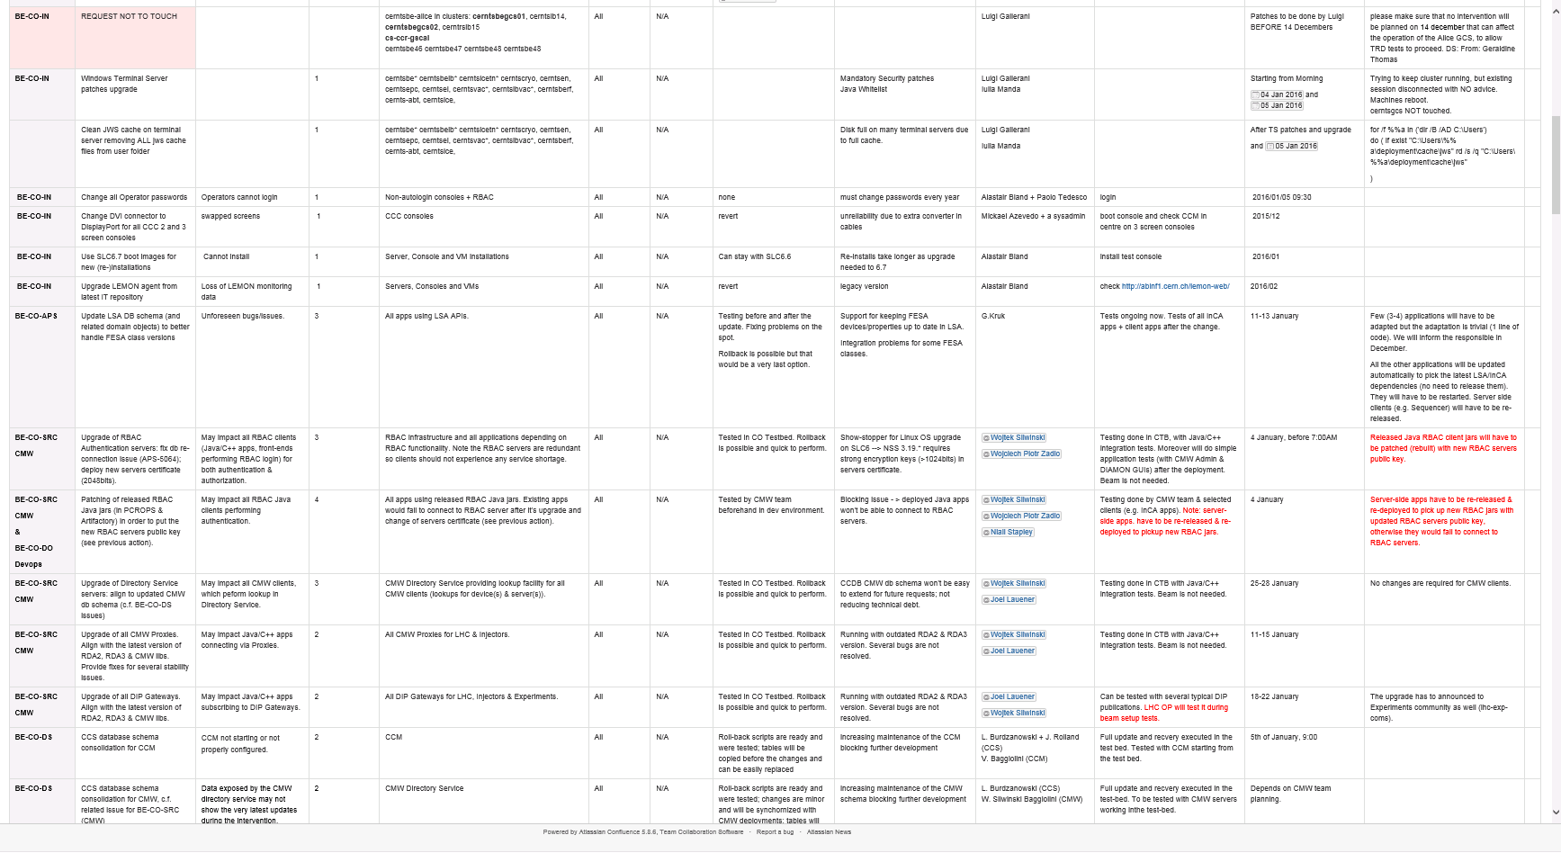
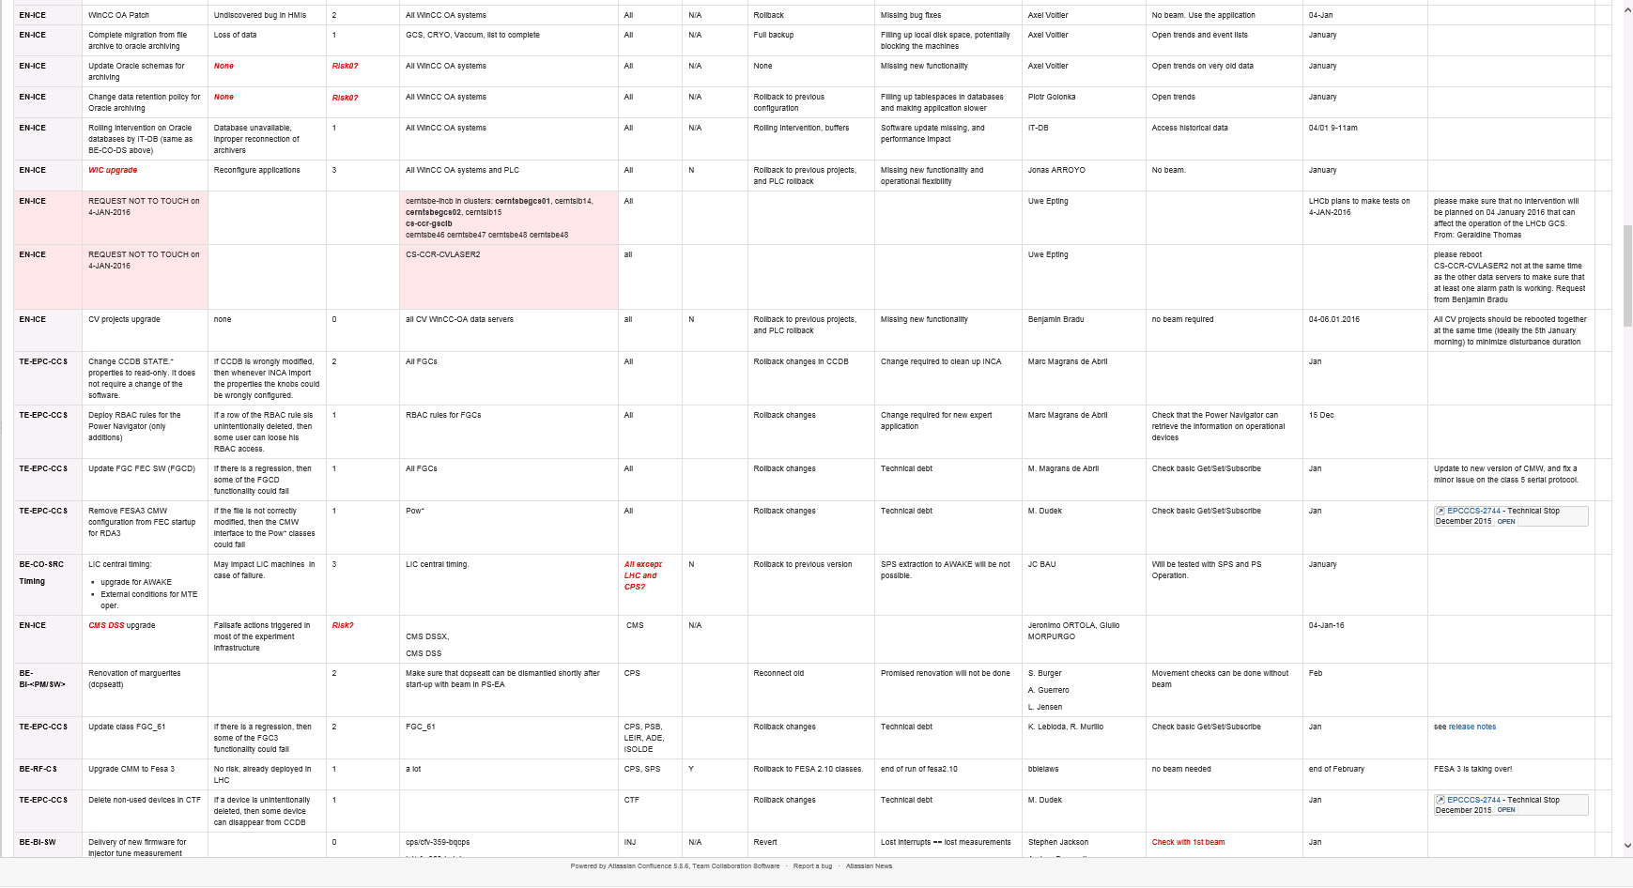
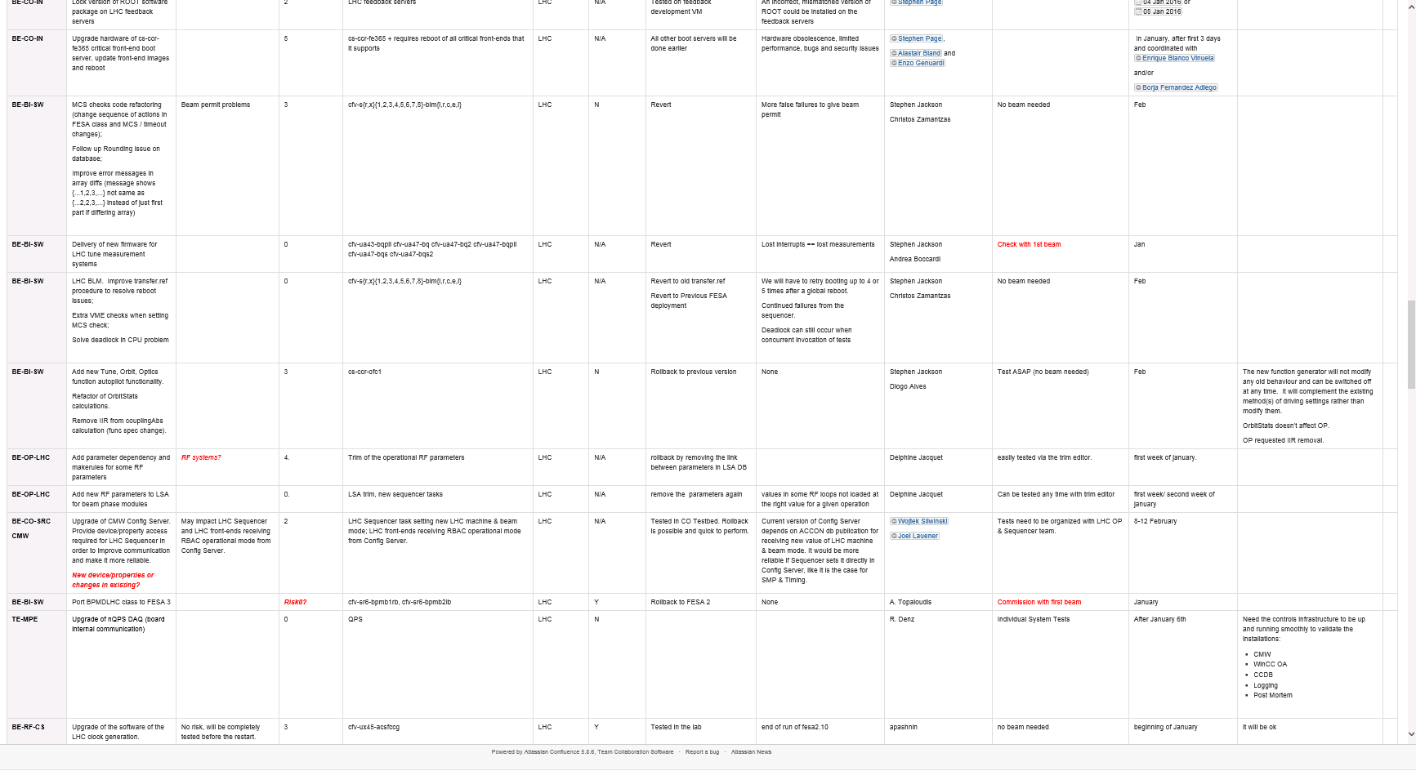
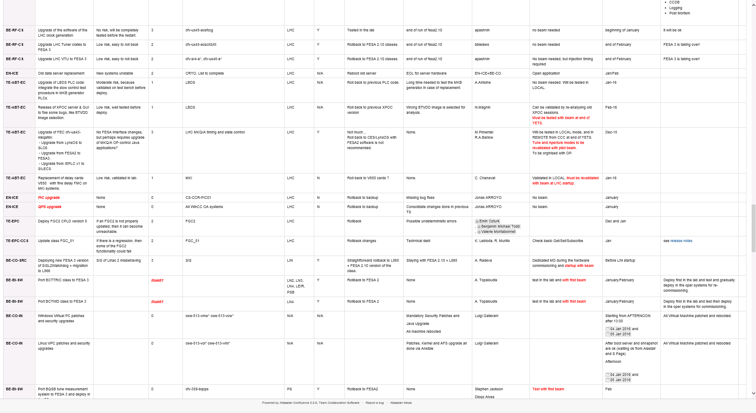
Controls
Many interventions
Porting to FESA3
Switch to Spring library version 4.2.3 as PRO
Java 8 byte code
Update LSA DB schema to better handle FESA class versions
Patching of released RBAC Java jars
Add parameter dependency and makerules for some RF parameters
……
We’ll have to test extensively before beam!
We’ll profit from the experience (and debugging) of the injectors!

Slide 31
Concluding remarks
The boundary conditions for the YETS are well defined; however
  Few critical activities could have an impact
  7000 tests have to be done in 12 days
As usual good coordination between PT and machine check-out will be fundamental for a smooth transition to the operational mode
  A lot of tests and verifications to be done
  All the systems finally connected together
We’ll have to work hard to prepare the machine in a coordinated and efficient way…also improving the communication in the LHC island…

Slide 32
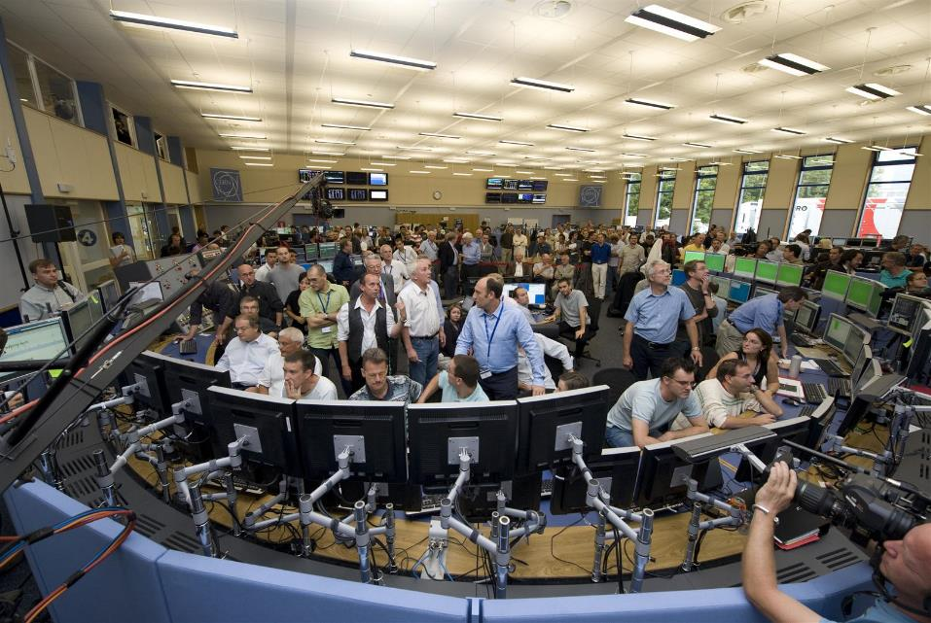
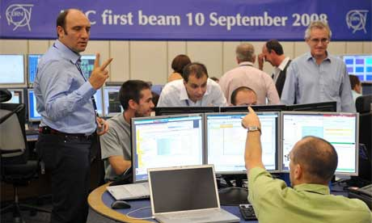
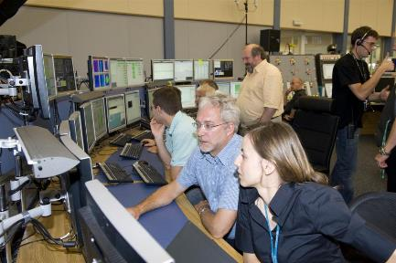
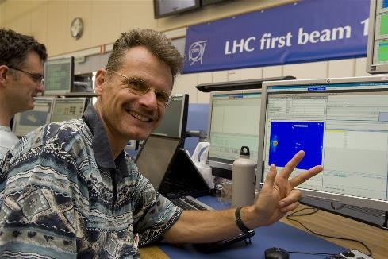

Slide 33

Thank you for the attention!
Merry Christmas!
3.6σ
4fb⁻¹
di-boson
2.6σ
m(γγ)=
745GeV
SUSY
2-photon resonances

