Slide 1
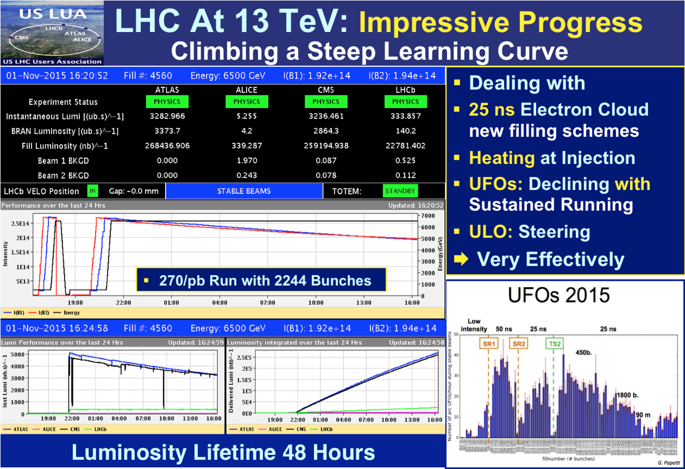

Slide 2
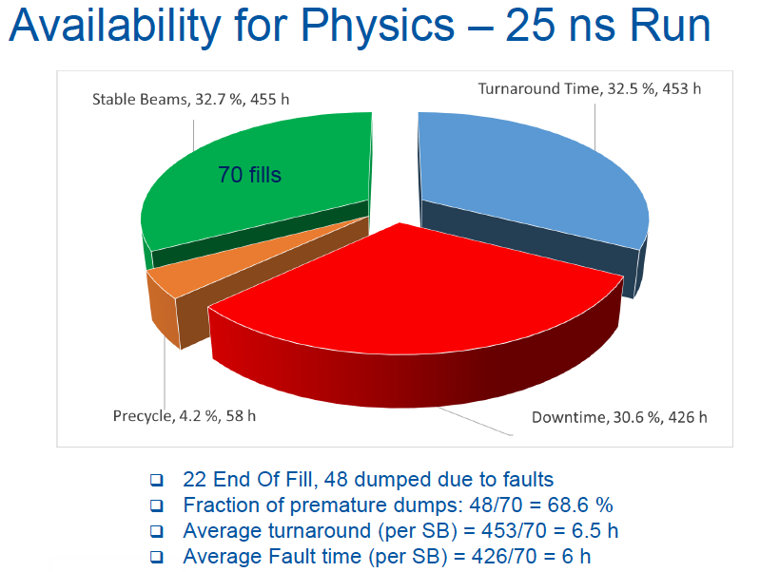

Slide 3
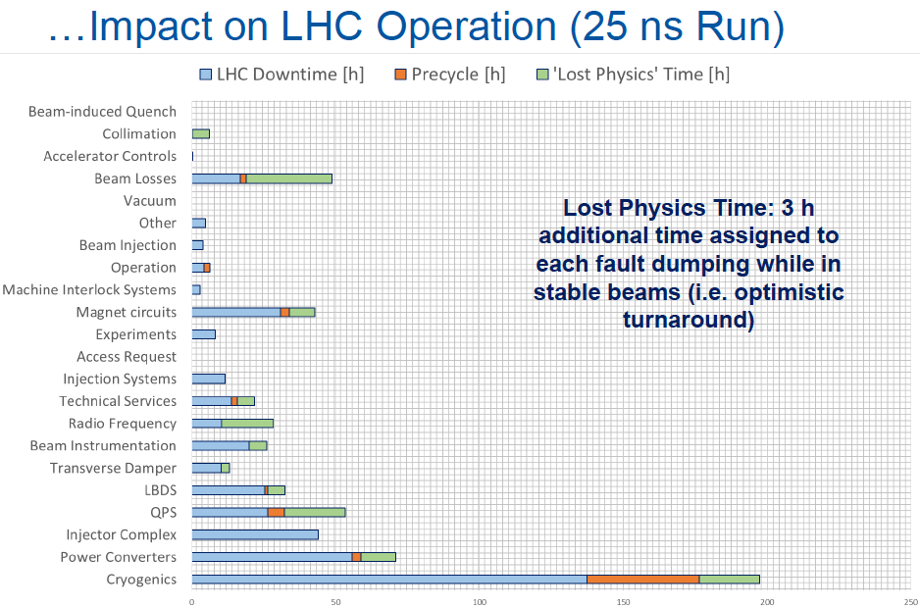
Availability
Andrea APOLLONIO
65.3 % availability during 25 ns Run (close to 2012)
Remarkable availability during Ion Run – 81 %!
Cryogenic system is the biggest contributor to LHC unavailability (~ 25 % as ‘child’ due to quench recovery)

Slide 4
Availability
"If you can not measure it, you can not improve it.” Kelvin
QPS – looking good
  excellent after card replacement
  comms issue to be resolved
  possible usability issues to be targeted
R2E – is it still an issue? YES!
  Major success all round
  no room for complacency (only 4 fb⁻¹ in 2015)
  power converters – 24 dumps per 35 fb⁻¹ year
RF – mature system – 300 kW in 2016

Slide 5
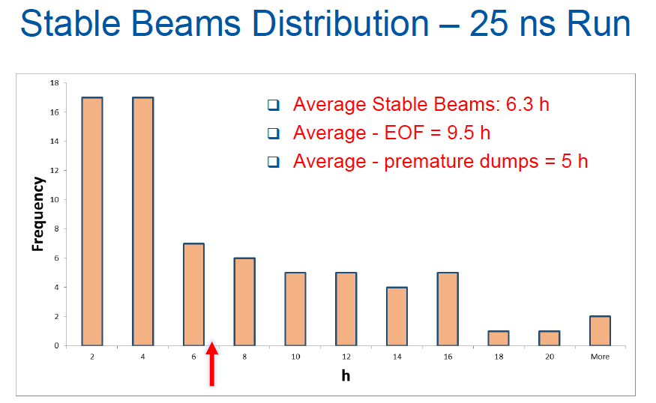
Target

Slide 6
Cryogenics
Cryogenic Run2 (2015) was a success with CM availability at 92.1 %
New configuration was applied and validated – room for modifications exists
Main failure – 4.5 K refrigerator – to be repaired in January 2016 plus other stuff
LS1 consolidations visibly helped
  (bravo all and R2E!, 0 SEU cases declared in 2015)
e-cloud thermal effect pushed the LHC cryo to the limits of capacity (over originally installed capacity foreseen for 4.5 - 20 K)
Triplet movement in 8 – plans?

Slide 7
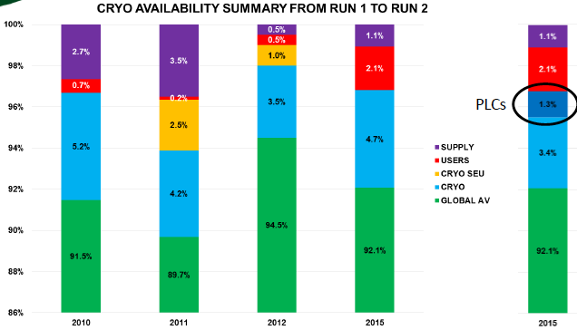

Slide 8
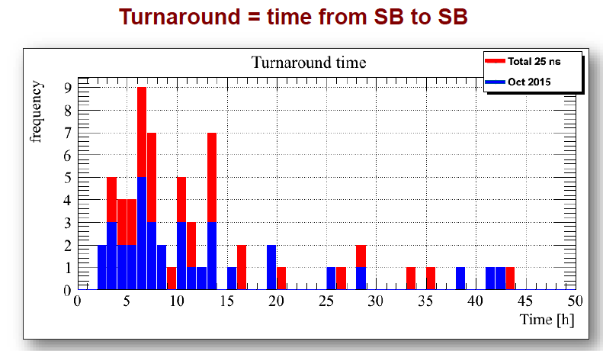
Operations
What?
Ramp, squeeze, collide – clockwork
Combined ramp & squeeze recommended
Injection – biggest scope for improvement

Slide 9
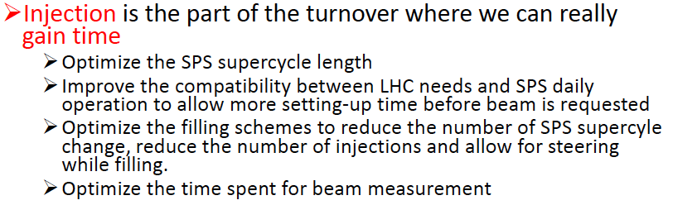
Injection
Incisive critical analysis from Delphine
IQC has lost its credit
  warning levels – long discussion – who’s responsible?
Steering while feeling – 50% of the time
SPS BQM rejects 20% of nominal
Wrestle with
  Cryogenics, TDI.B2, MKI.B2, ADT diagnostics

Slide 10
Feedbacks
  Good progress – critical – a lot more robust
  Team work!
Tune and b3 decay
  Interesting, interesting…
  Do we need a pre-cycle?
  Supplementary question – what can we get away without pre-cycling?

Slide 11

OMC get any beam time they ask for OK.

Slide 12
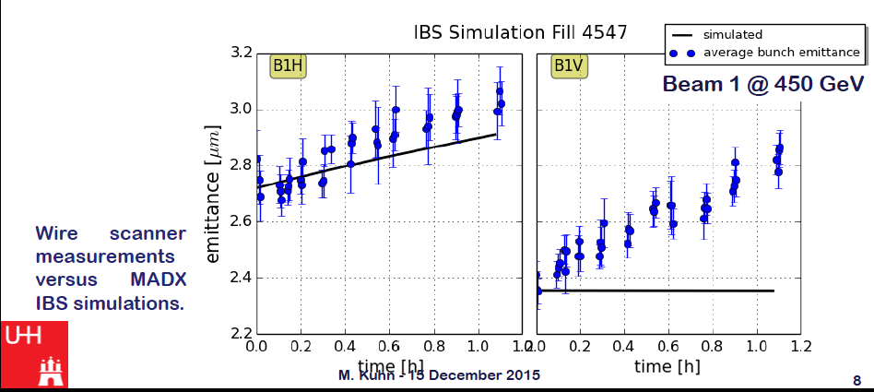
Maria Kuhn

Slide 13
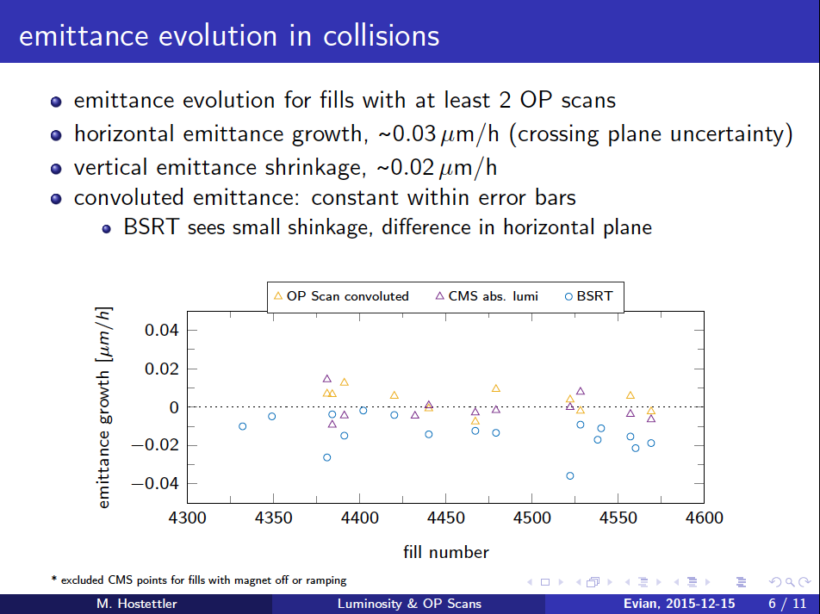

Slide 14
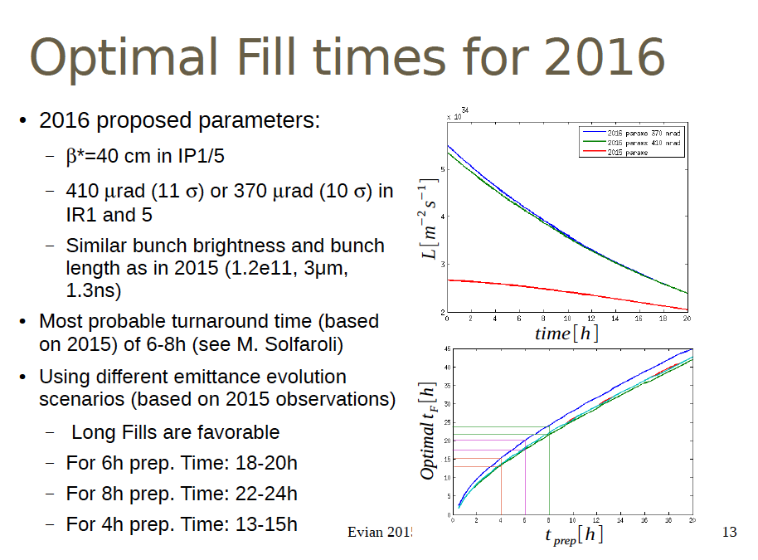

Slide 15
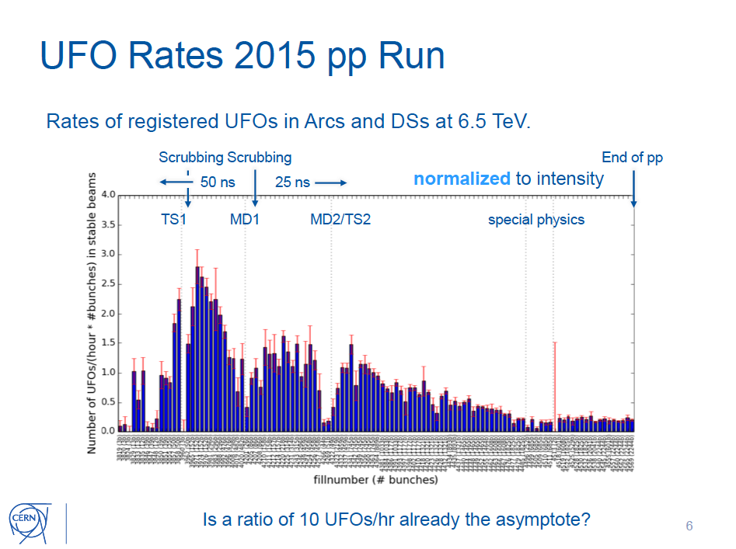
Bernhard Auchmann

Slide 16
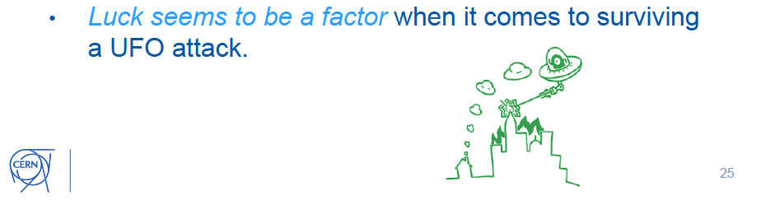
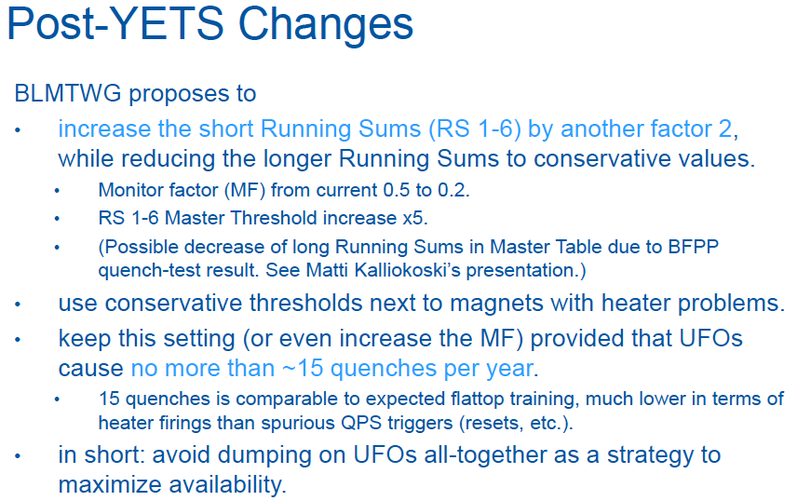

Slide 17
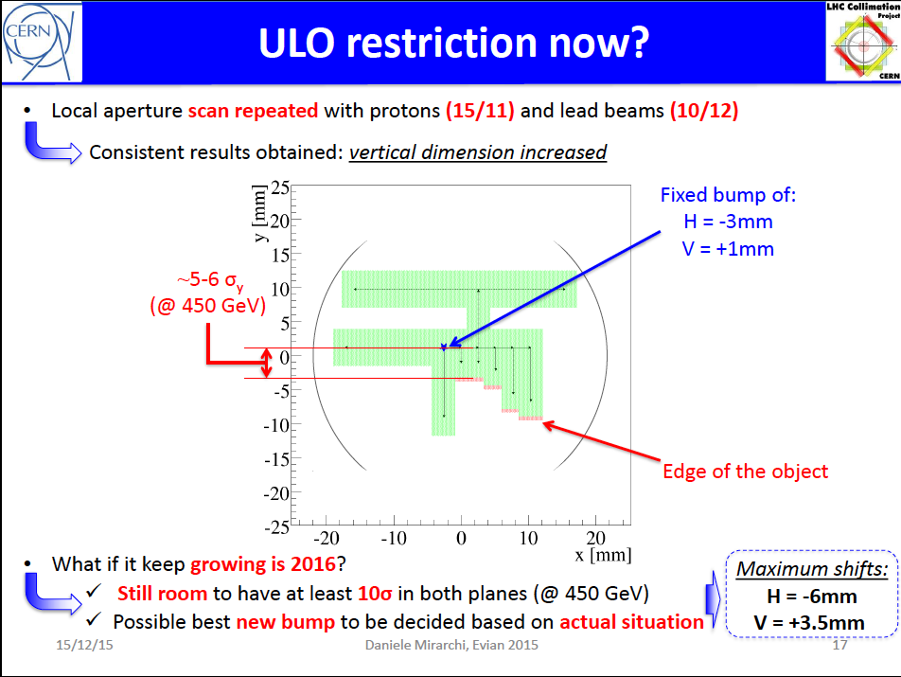

Slide 18
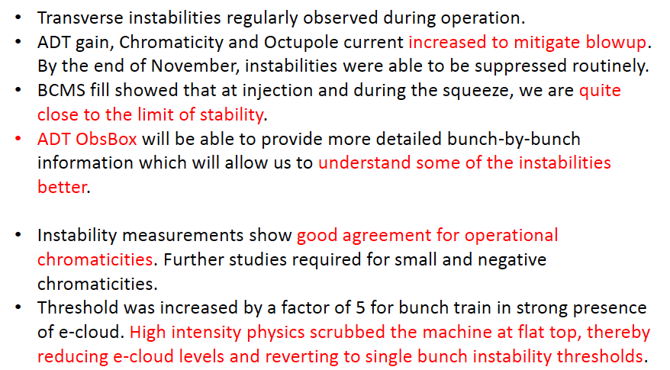
Instabilities
Lee Carver
Will be challenging again in 2016… defenses very nicely described by Kevin
Important to continue to validate model and improve understanding…

Slide 19
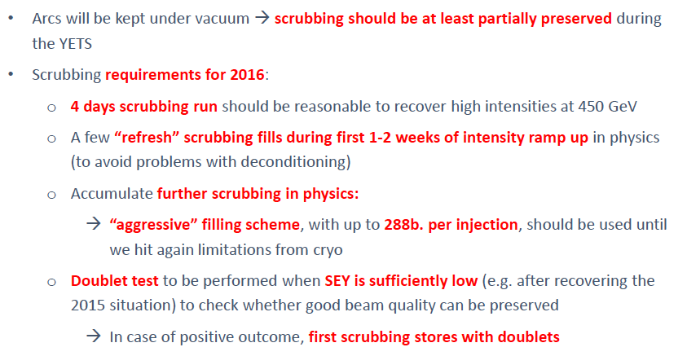
Scrubbing: Gianni’s proposal for the 2016 start-up

Slide 20
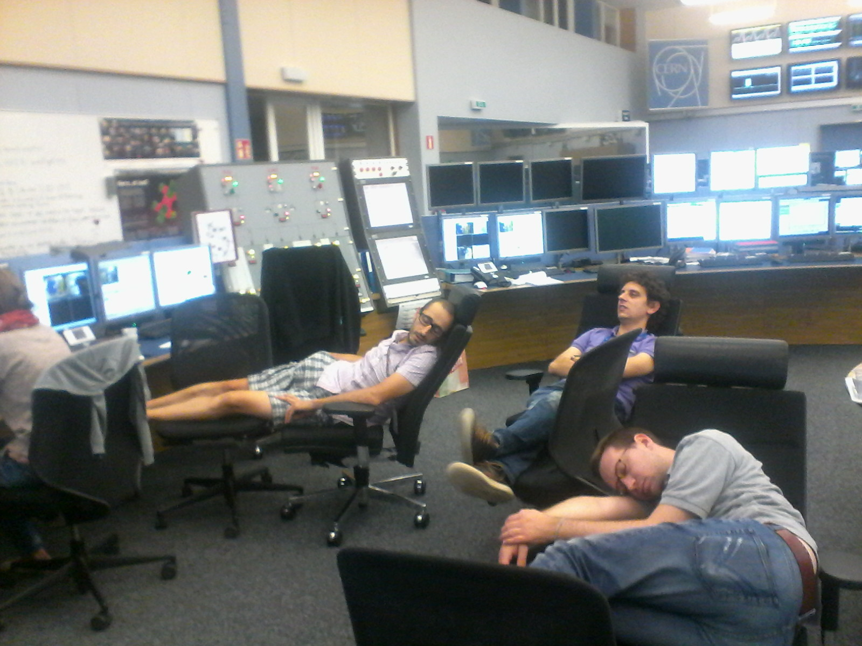
And please guys – no more sleeping on the job

Slide 21
Beam-beam
Message
  We’re in happy place – lower HO, lower LR
  So happy that high Q’, high oct – not a problem
  10 sigma (nominal emittance) is good
  370 microrad in 1&5 for beta* = 40 cm
  400 urad in ALICE, 2*250 in LHCb
Tatiana Pieloni

Slide 22
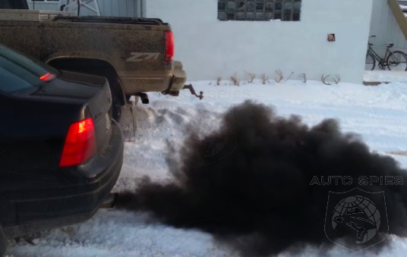
Outgassing TDIs should not longer be a problem
Thanks Anton

Slide 23
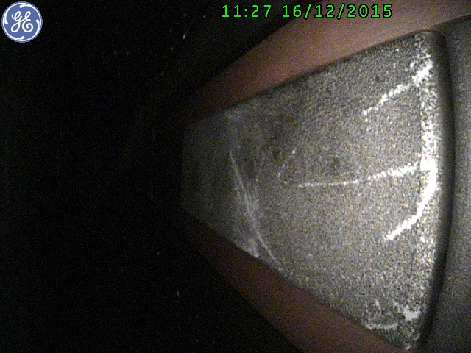


Slide 24


Gerd Kotzian

Slide 25
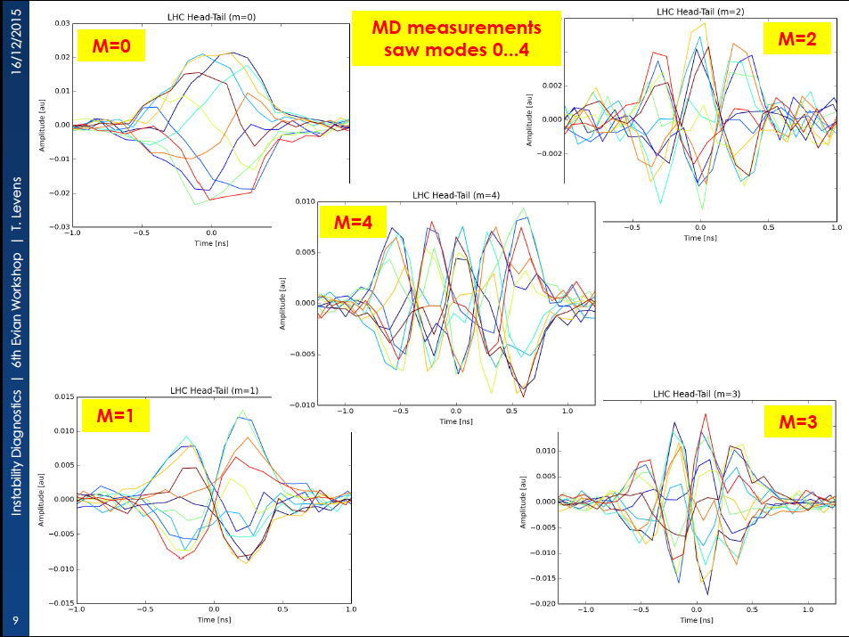
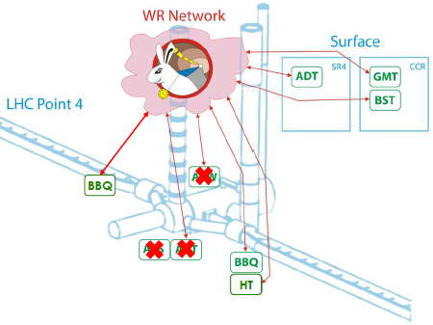
Beautiful - has to be a solution for data storage and robust software solution to exploit the combined systems

Slide 26
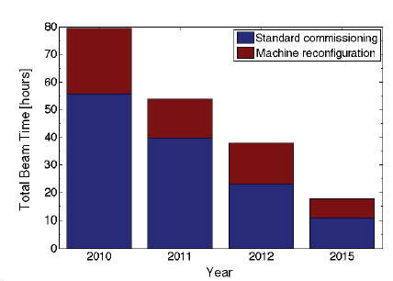
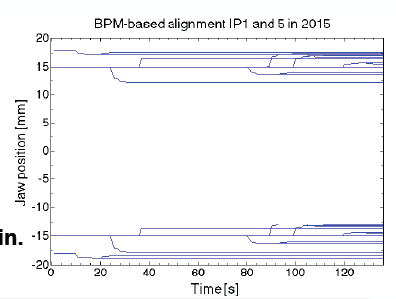
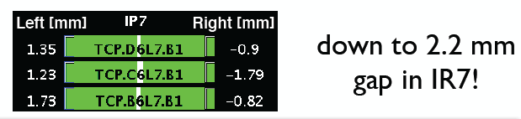
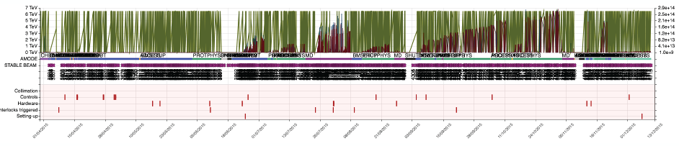
Gianluca Valentino

Slide 27
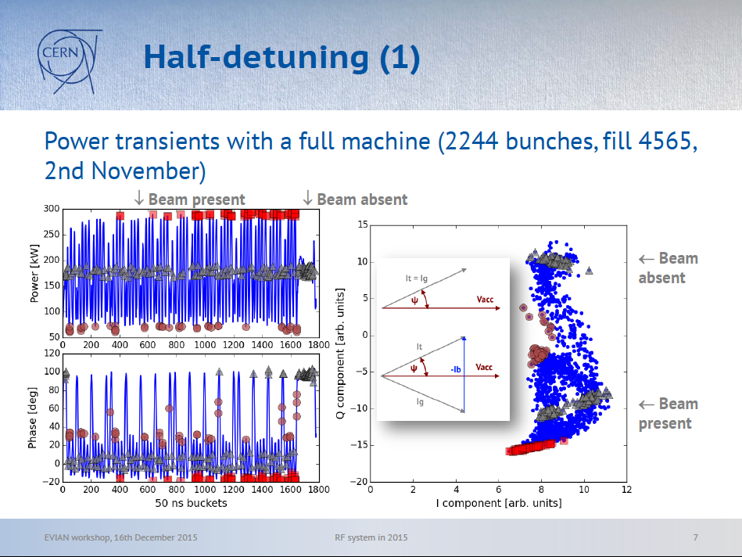
Helga Timko

Slide 28
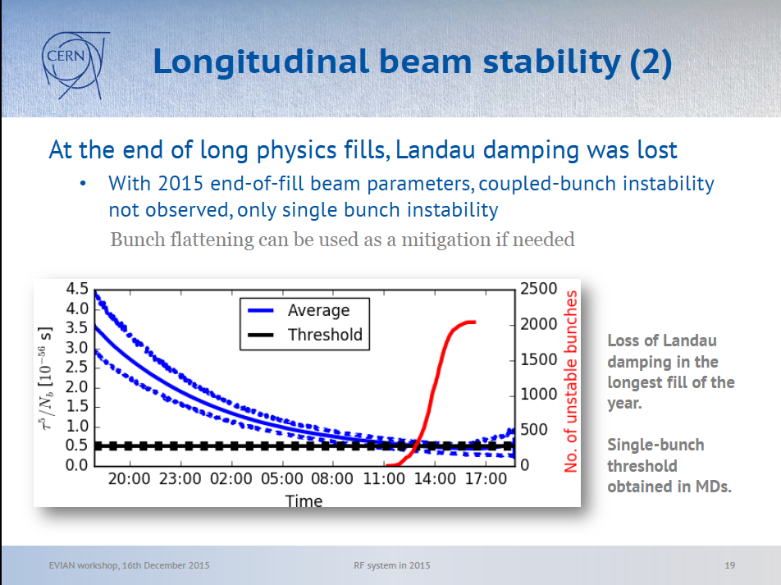
Helga Timko

Slide 29
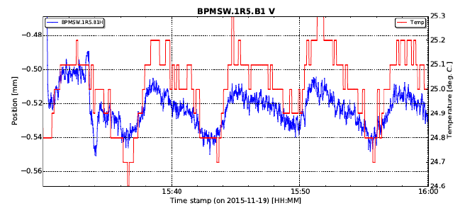
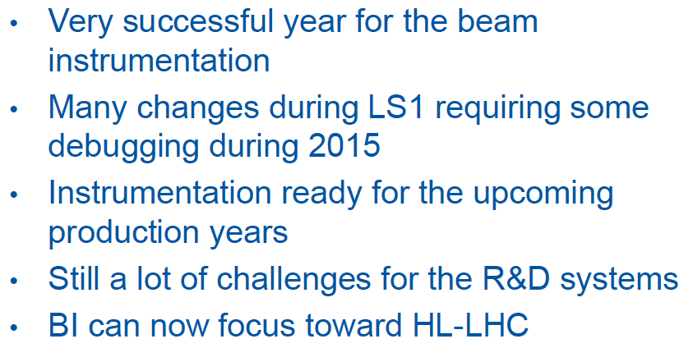
You can not be serious!

Slide 30

Summary
WS:
Deep understanding/investigation of the measurement precision in Run II.
Undergoing software improvements will improve even more the system.
Accuracy of the beam size measurement (absolute value) is <3 %
Precision of the beam size measurement (spread around absolute value) <9 %
BSRT:
Operationally reliable measurements in Run II,
  Accuracy of the beam size measurement is <6 %
  Precision of the beam size measurement <5 (B2 better than B1)
  At injection, it could replace the systematic WS checks at 1st injections
  => Spare OP time, however would be nice to have routine (monthly) checks
  at injection (<20 min).
Dedicated MD time (often confused with “Calibration”) for development will be crucial for Hi-Lumi.
BGI & BGV:
2016 will still be a commissioning year for both instruments.
Lovely talk including timely reminder about the difference between accuracy and precision.
LHC Profile Monitors Status- 6th Evian Workshop, G. Trad – 16/12/2015

Slide 31
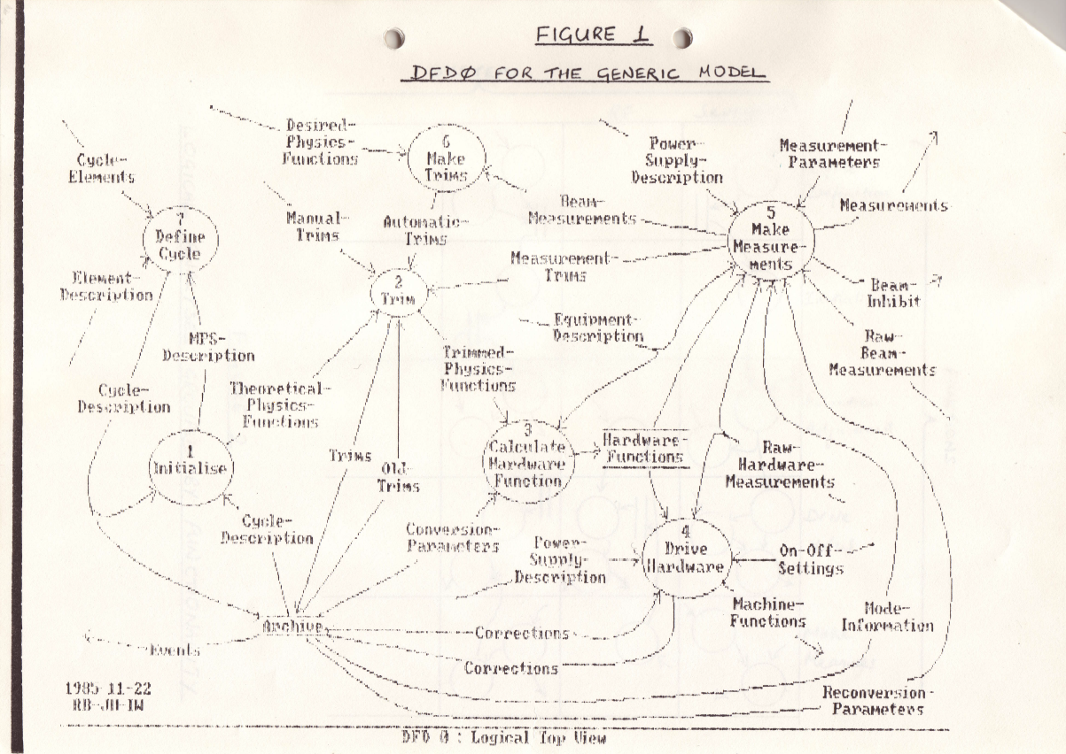
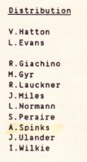

1985

Slide 32

We’ve come some way since LEP

Slide 33

Kajetan: let’s build some bridges

Slide 34
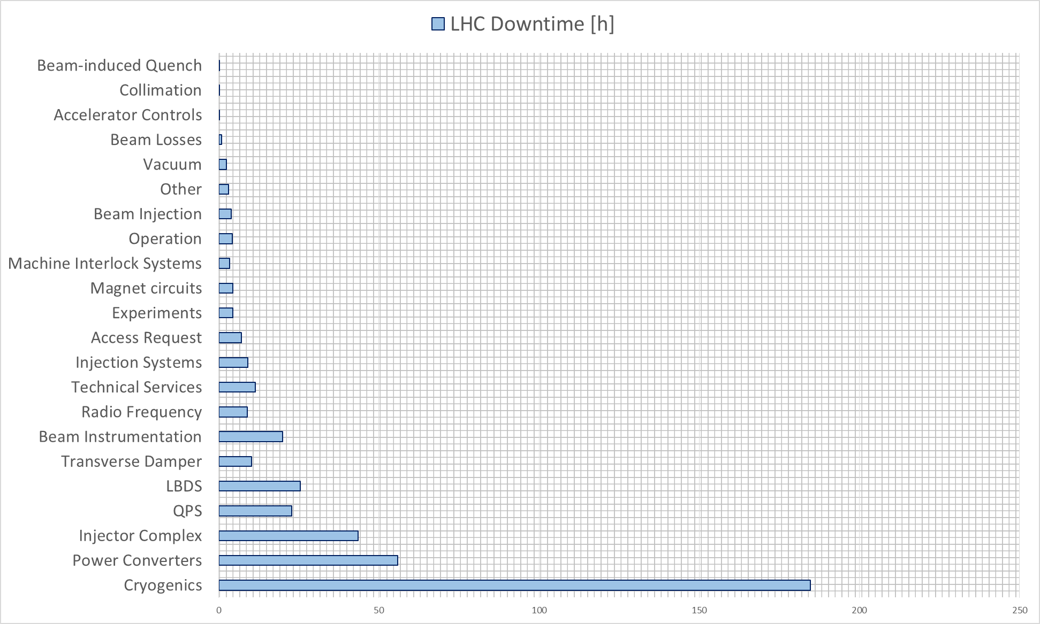

Controls

Slide 35


Slide 36
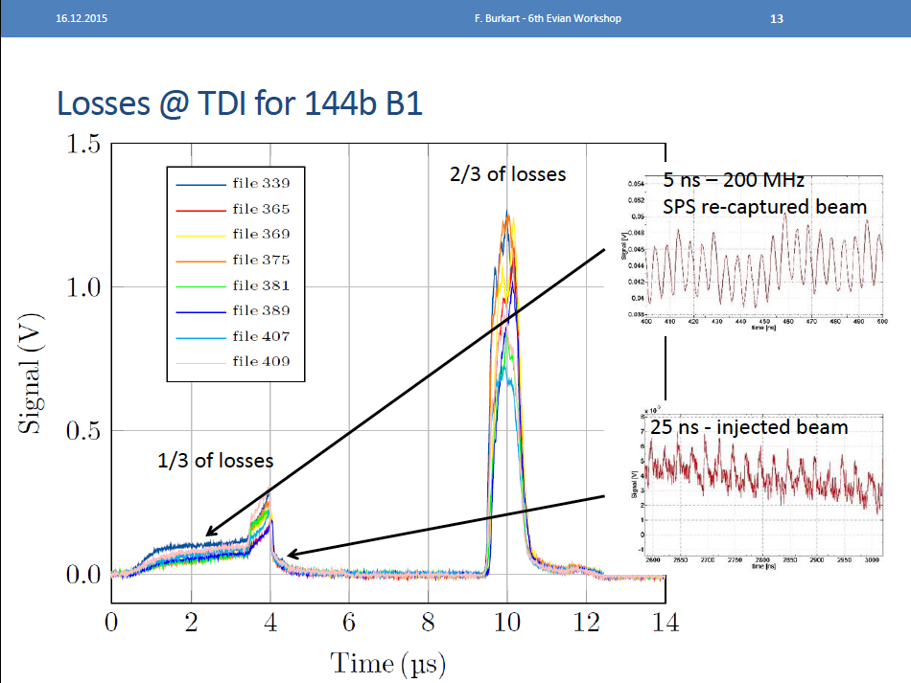

Slide 37

MPS ensured safe operation with up to ~280 MJ stored beam energy in 2015
“The condition upon which God hath given liberty to man is eternal vigilance.”
Daniel Wollmann

Slide 38


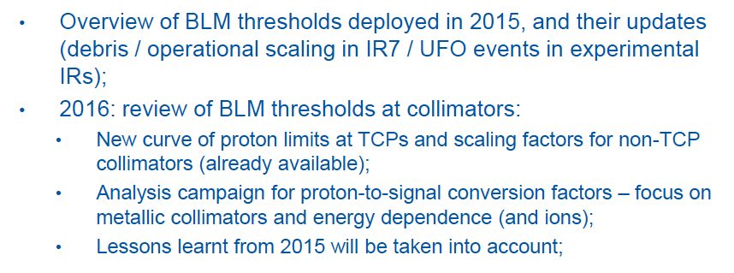
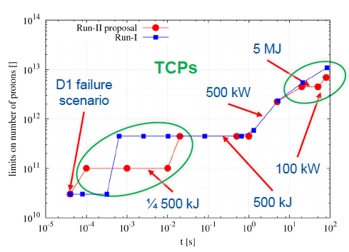

Slide 39

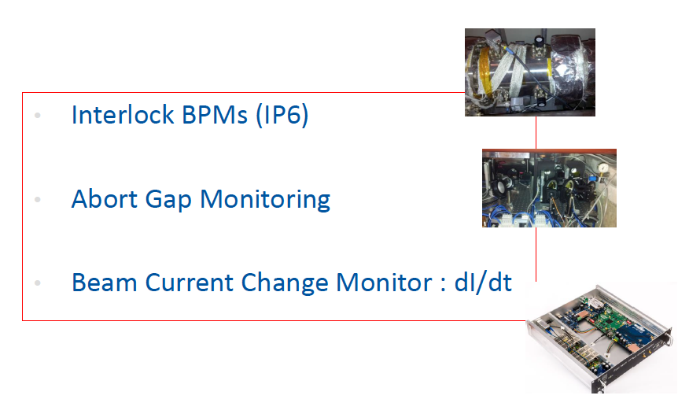


Slide 40
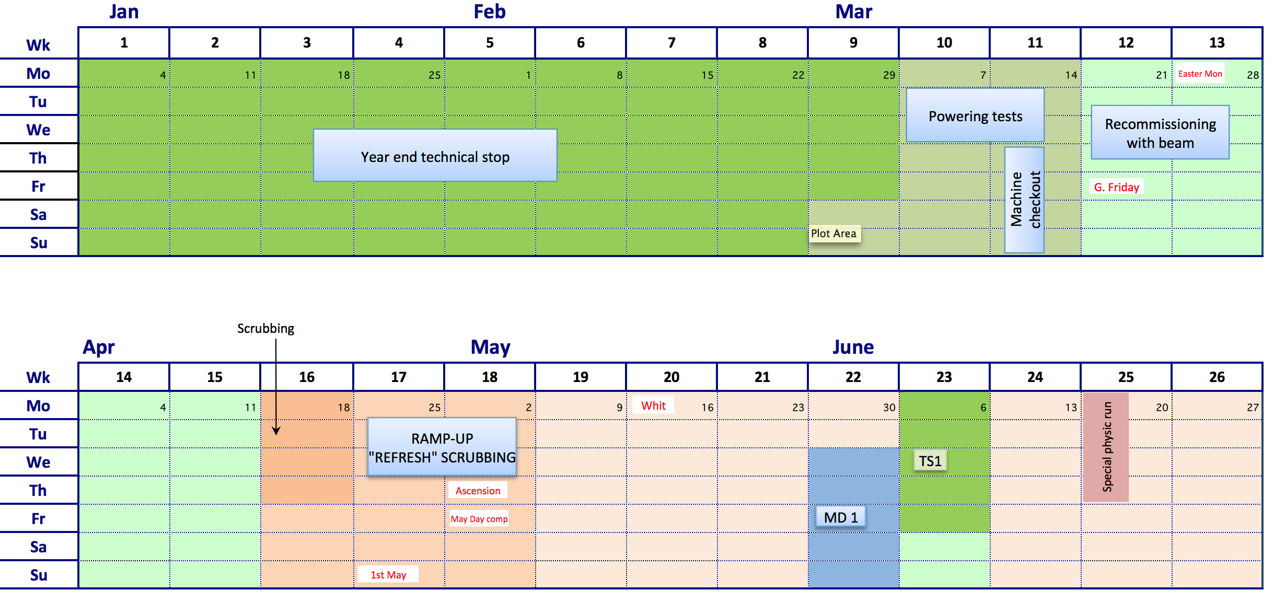
2016

Slide 41
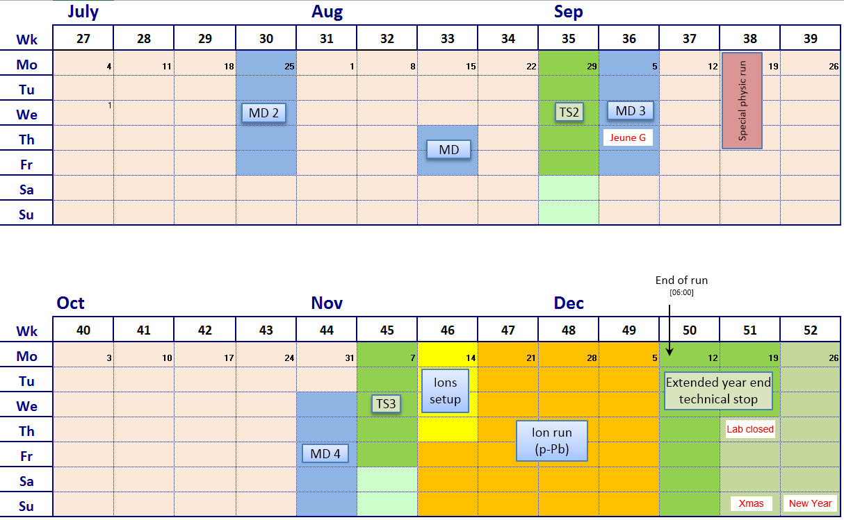
2016 Q3/Q4 (v1.0)

Slide 42
2016 version 1.0
Phase | Days
Initial Commissioning | 28
Scrubbing: 4 days initially and then as required during ramp-up | 7
Proton physics 25 ns | 152
Special physics runs (high beta*; 90 m; VdM (19 m) | 8
Machine development | 22
Technical stops | 15
Technical stop recovery | 6
Ion setup/proton-lead run | 4 + 24
Total | 266 days (38 weeks)

Slide 43

Can we get to β*=40 cm?
40 cm?
YES WE CAN!
*Provided aperture stays good

Slide 44
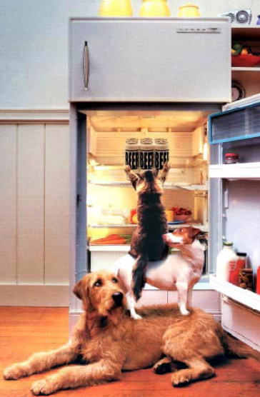
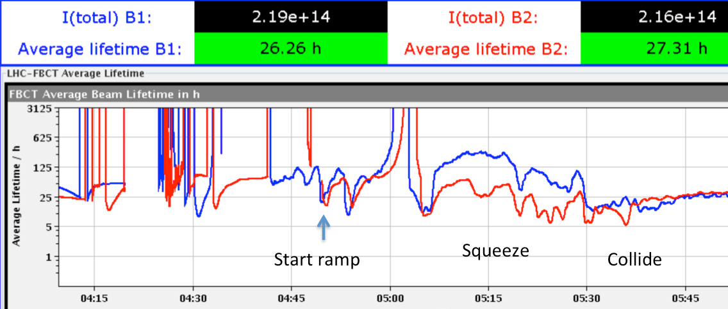
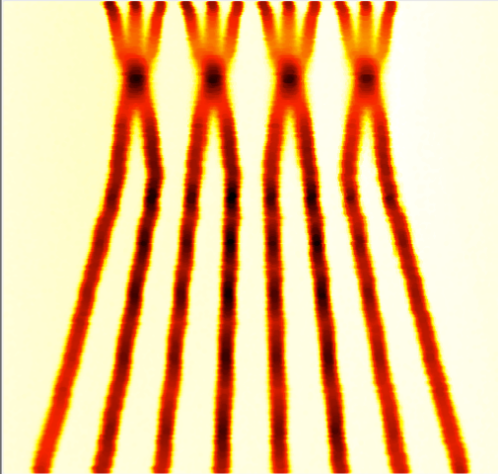

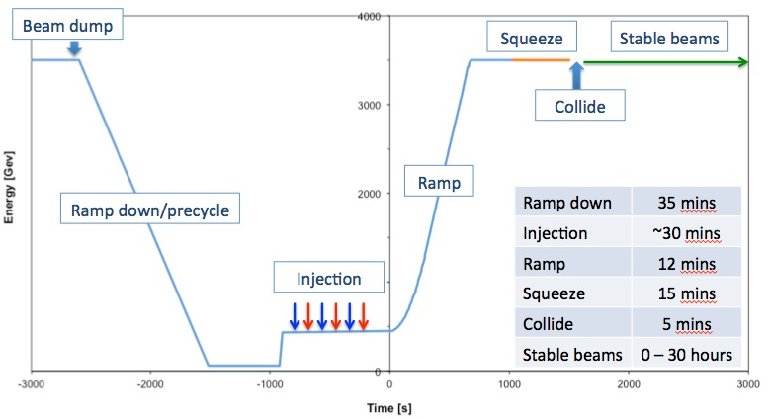
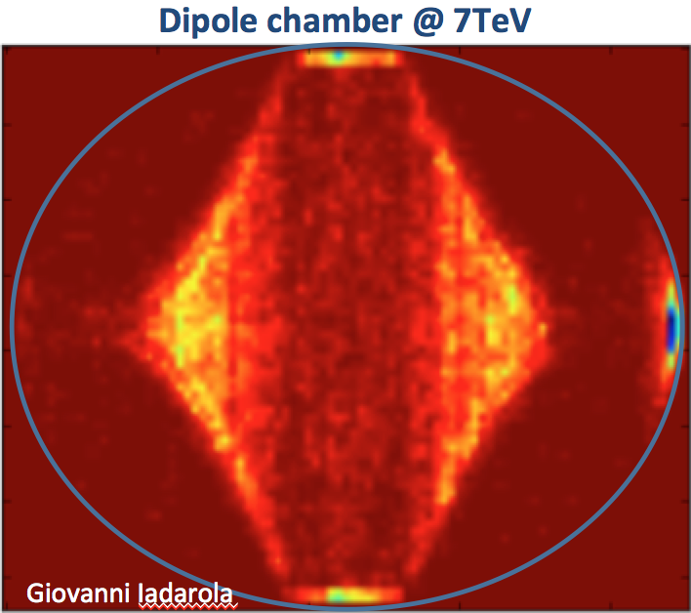
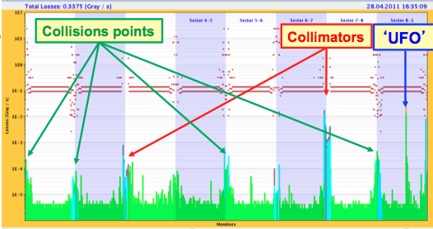
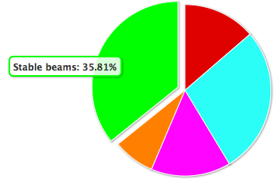
Teamwork
Beam from injectors
Beam performance
Exploitation
Mitigation
Machine protection
LHC
Eightfold
Path
System performance
RF, power converters, collimators, beam dumps, injection, magnets, vacuum, transverse feedback, machine protection, magnets, magnet protection, beam instrumentation, beam based feedbacks, controls, databases, high level software, cryogenics, survey, technical infrastructure, access, radiation protection
Availability

Slide 45
Phenomenal
In a new place – end of first year of operations after a long stop after Run 1.
  Having got over the hangover…
Benefits of the feed in of experience gained showing very clearly
Professionalism, understanding, exquisite level of detail, sophistication, maturity of tools
Harnessing of 21 century technology
Resources, talent, imagination and YOOF!!!

Slide 46
Many, many thanks…
Organization
  Everything: Sylvia
  Everything else: Malika & Brennan
  Technical coordination: Hervé
  Proceedings: Brennan and Sylvia
Session chairs – brilliantly done
Speakers - excellent set of talks!
Jamie

Slide 47
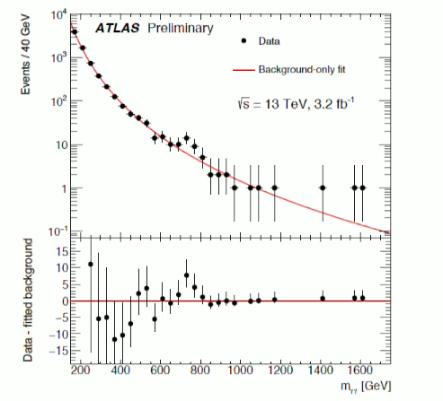

Happy Christmas!

