Slide 1
Quench performance 11T model magnets
Gerard Willering
CERN, TE-MSC-TF
23-09-2015
With contributions of Christian Loffler
Acknowledgement
All colleagues involved in preparing the magnet,
its instrumentation and testing.

Slide 2
Content
Instrumentation
Coil list
Training overview of all coils
Training per coil
Holding current test results
Ramp rate dependence and quench back
Flux jumps
- Differences in mechanics between 101 and 102

Slide 3
Introduction
DS11 T tests so far at CERN
When | Name | Coils | Conductor | OL ground wrap | Powering limitations
Summer 2014 | MBHSM101 | 105 | RRP 108/127 | 100 µm glass | Reached 96 % of I_{ss} at 1.9 K
November 2014 | MBHSP101 | 106 107 | RRP 108/127 RRP 108/127 | none 100 µm glass | Limitation in coil 107, only 4 quenches in 106, reached 82 % of I_{ss.}
June 2015 | MBHSP102 | 106 108 | RRP 108/127 RRP 132/169 | None 100 µm glass | Reached 88 % of I_{ss}, but coil 106 detrained down to 81 %. No hard limitation up to 12 T.
August 2015 | MBHSP103 | 109 111 | RRP 132/169 RRP 132/169 | 100 µm glass 200 µm glass
October 2015 | MBHDP101 | 106-108 109-111 | See above | See above

Slide 4
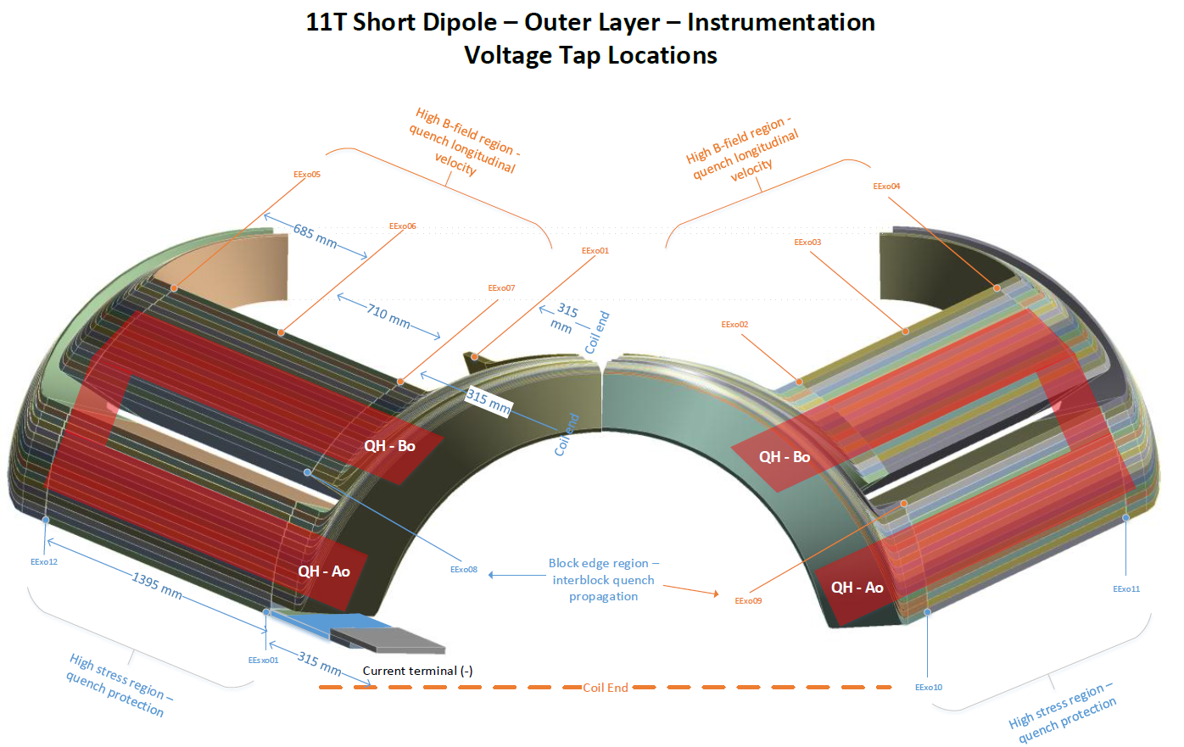
Image courtesy A. Jokinen

Slide 5
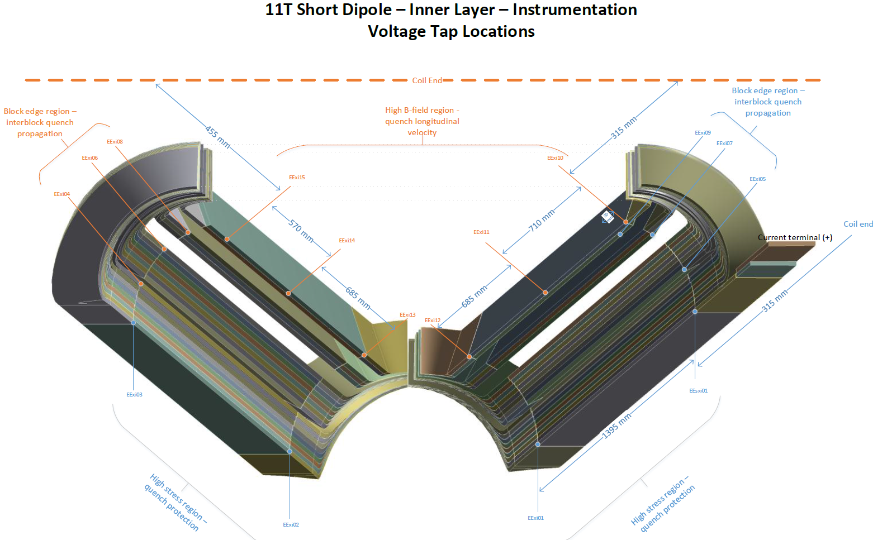
Image courtesy A. Jokinen

Slide 6
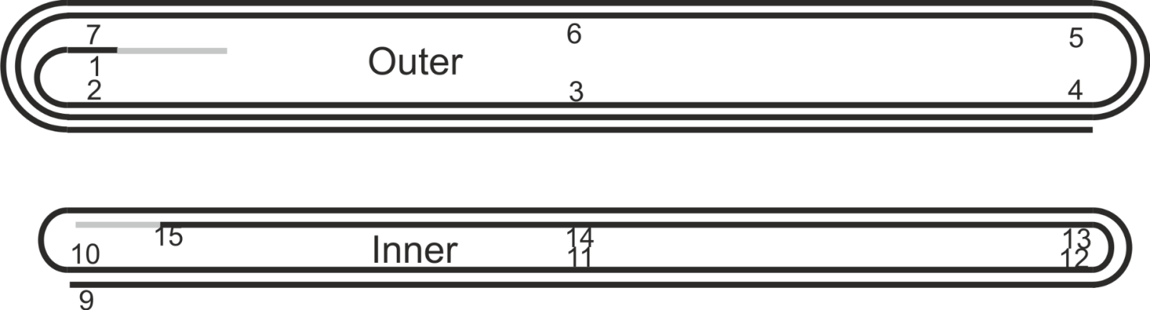
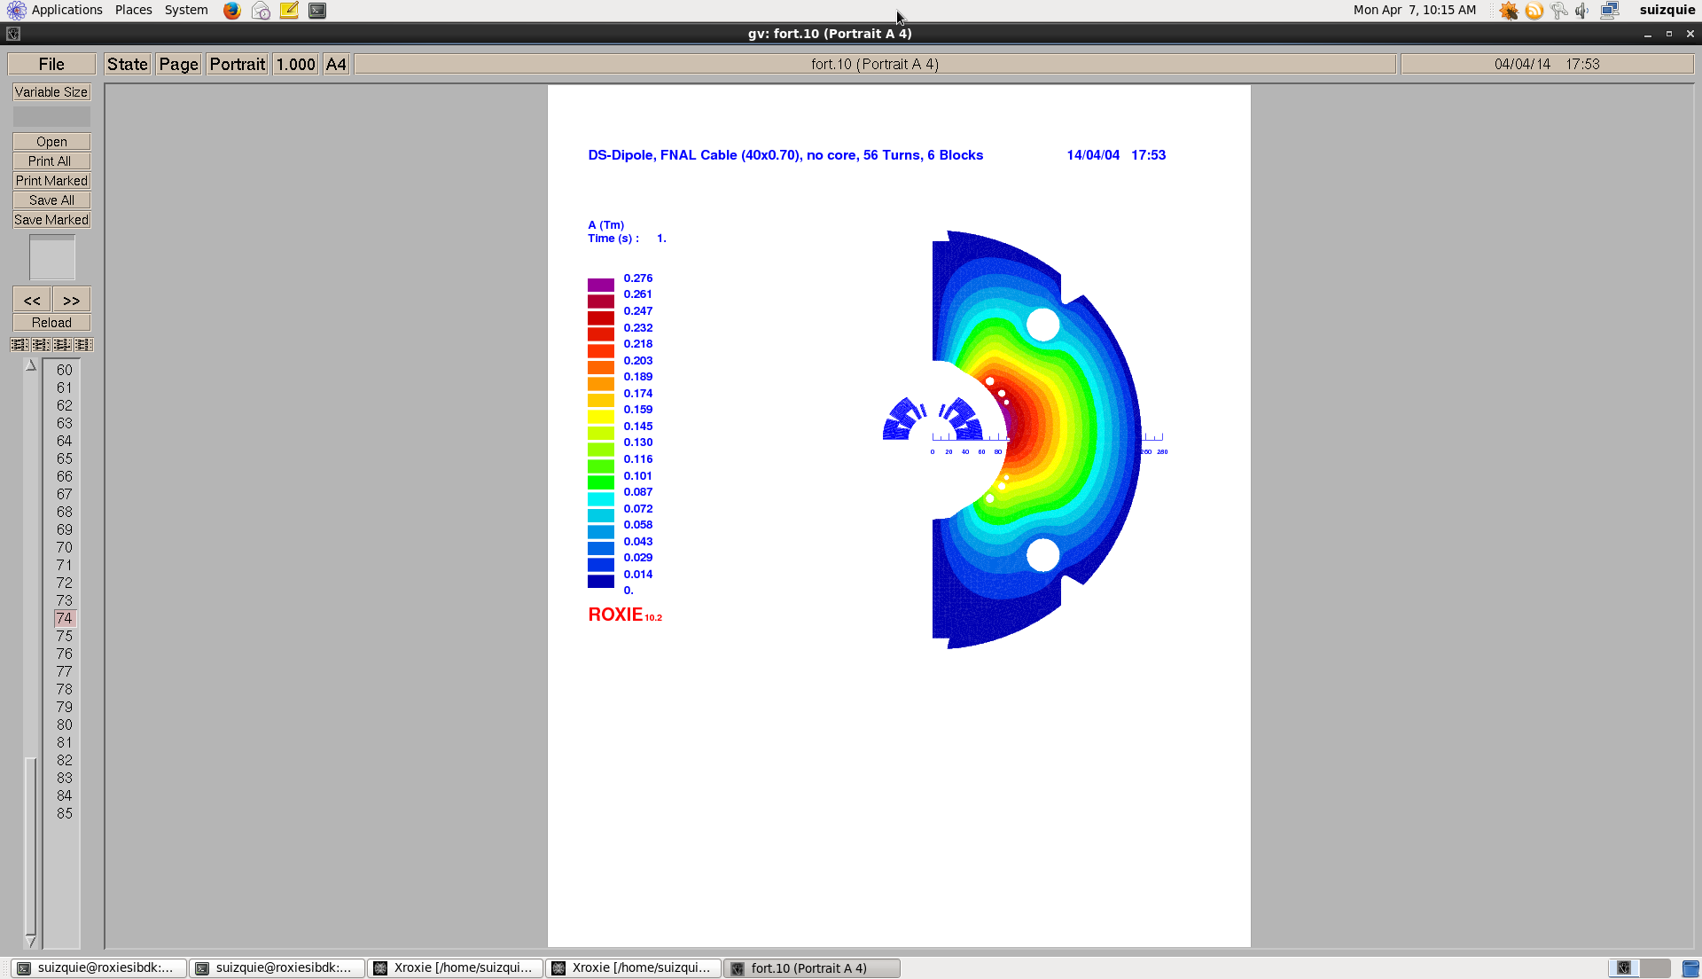
Coil instrumentation simplified view
Pole turns of the outer layer with Vtap names
Conductor blocks
4
3
6
Pole turns of the inner layer with Vtap names
2
1
5

Slide 7
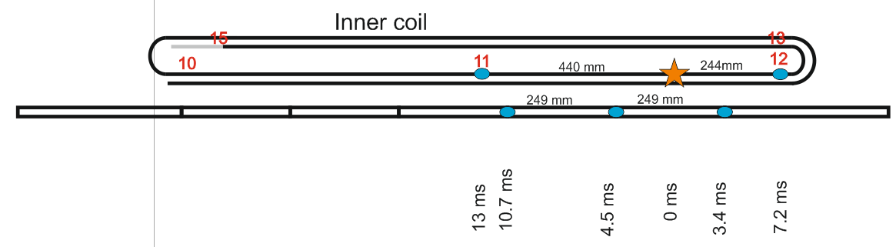
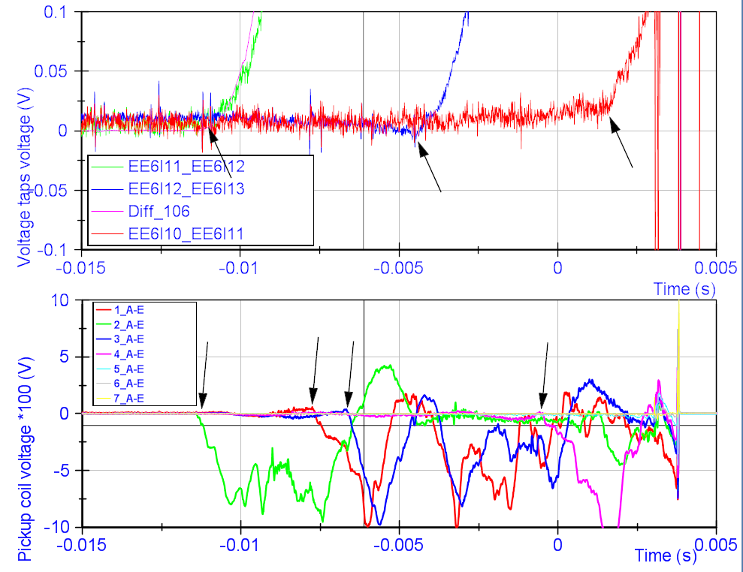
Quench localisation with pickup coils
Voltage taps
MM shaft
Onset time of signal
Voltage taps
MM segments
Very good agreement between the results for quench localisation.
Possibly more info can be extracted.
This will be a new standard measurement for the next series of tests.

Slide 8
Training of the 3 models
Name | Coils | I_{ss} *
MBHSM101 | 105 | 16.7
MBHSP101 | 106 | 14.5 14.4
MBHSP102 | 106 108 | 14.5 14.8
I_{ss} calculated by Susana with Roxy with extracted strand data from Bernardo.

Slide 9
Training of the 3 models
Training of MBHSP102 biased since coil 106 was already trained before.

Slide 10
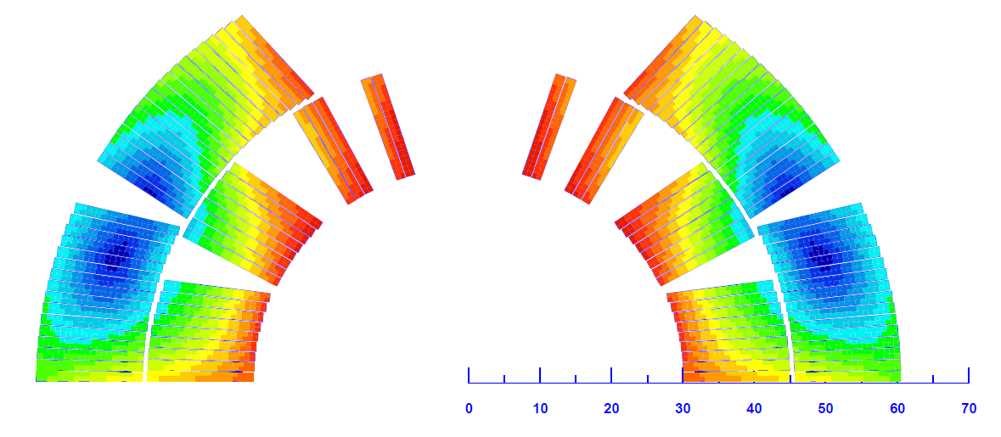
MBHSM101- coil 105
Initial training 4.3 K mainly around the pole
Initial training 1.9 K mainly on outer block 6
Slight detraining after the thermal cycle for 1.9 K, not for 4.3 K.
The training is rather random without real ‘weak spots’.
Roxie image by
S. Izquierdo Bermudez

Slide 11
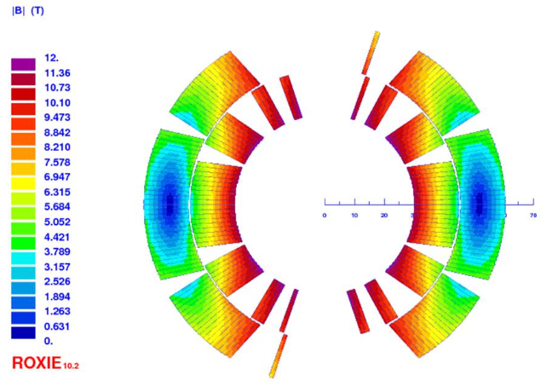
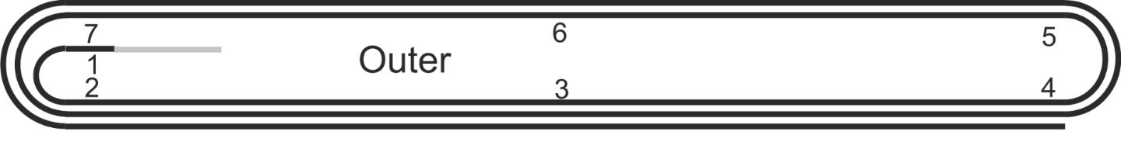
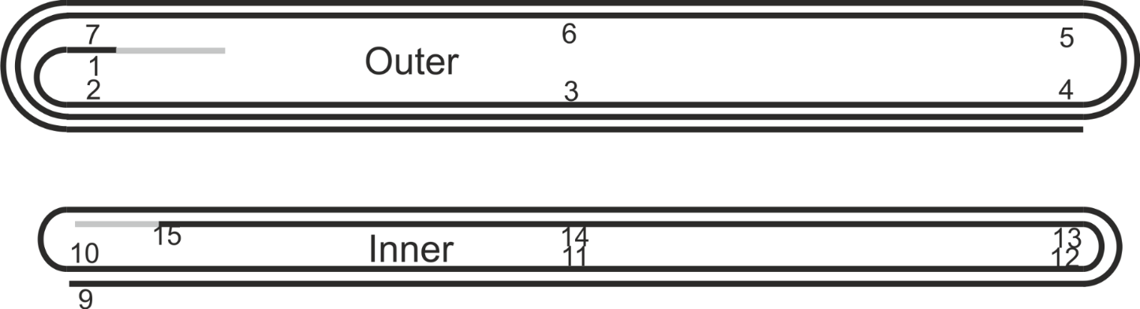
MBHSP101- coil 106-107
Initial training in the single aperture at 1.9 kA
4 quenches initiated in coil 106, no more quenches from 10.6 to 11.9 kA!!
Initial training looks OK for coil 107 except for 2 specific spots.
Target of 11.85 kA is reached.
S. Izquierdo Bermudez
Initial training
Location | # quenches
Coil 106 | 4
Coil 107 at O1 | 7
Coil 107 inner layer around key end | 6
Coil 107 around I12 | 1
2014-12-09 - 2nd international review HL-LHC 11 T dipole
Gerard Willering – Cold powering tests 11T model coils at CERN

Slide 12
MBHSP101- coil 106-107
Detraining or possible degradation in the single aperture at 1.9 K
The detraining and quenches around voltage tap O4 are remarkable in quench 19 to 22
A strong detraining quench followed in quench 24.
S. Izquierdo Bermudez
Quench 19 to 22 | Outer layer, close to Vtap O4
Quench 23, 25 | At Vtap O1
Detraining 24 (50 A/s) | Close to Vtap I12
2014-12-09 - 2nd international review HL-LHC 11 T dipole
Gerard Willering – Cold powering tests 11T model coils at CERN

Slide 13
MBHSP101- coil 106-107
After thermal cycle at 1.9 K
Quench 26 to 31 at 1.9 K show a rather limited quench current, always quenching in the same location.
Apparently the coil was degraded after thermal cycle for 6 quenches, but after the tests at 4.3 K the quench level increased to 11.76 kA.
All quenches from quench 25 at 1.9 K in O1
2014-12-09 - 2nd international review HL-LHC 11 T dipole
Gerard Willering – Cold powering tests 11T model coils at CERN
S. Izquierdo Bermudez

Slide 14
MBHSP101- coil 106-107
4.3 K powering
The lower quench current at 4.3 K at 0.85*I_{ss} is not expected.
At 10 A/s 3 quenches at 11177 ± 4 A with identical quench location and pattern.
The quench at 50 A/s occurred at 11095 A with similar quench pattern.
Quench location is at voltage tap O2
2014-12-09 - 2nd international review HL-LHC 11 T dipole
Gerard Willering – Cold powering tests 11T model coils at CERN
S. Izquierdo Bermudez

Slide 15
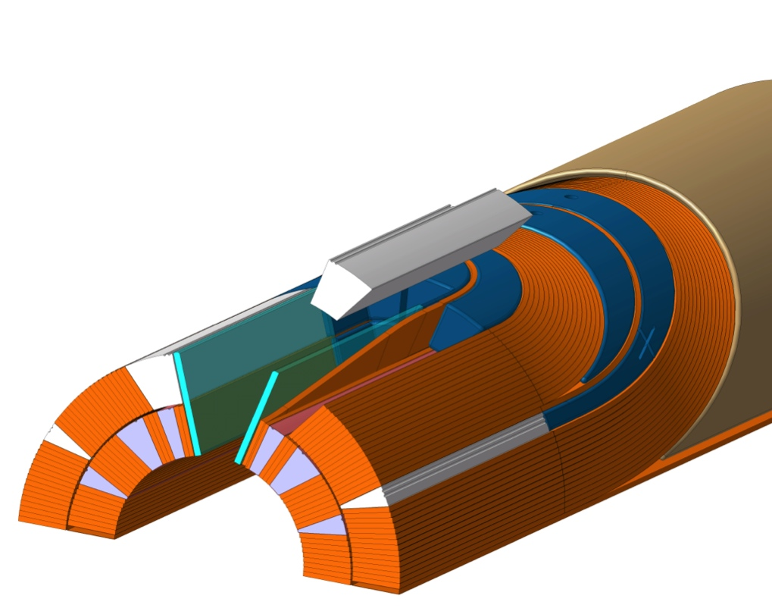
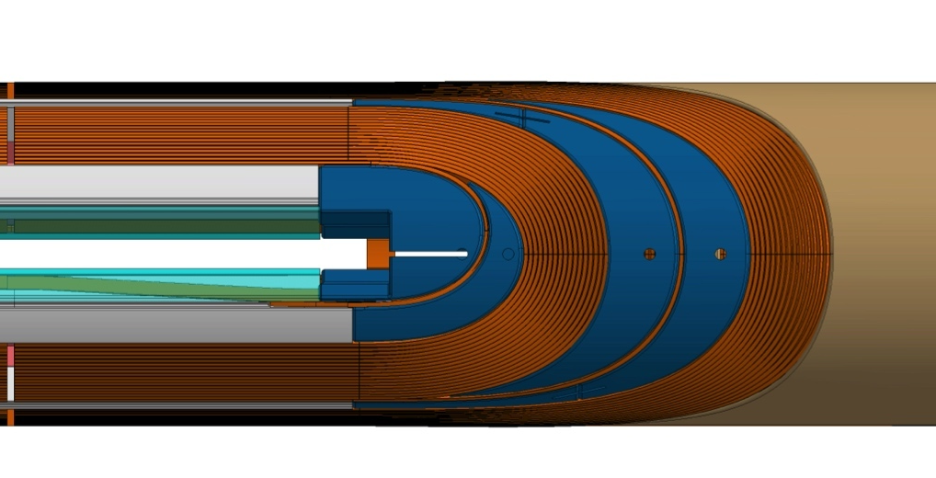
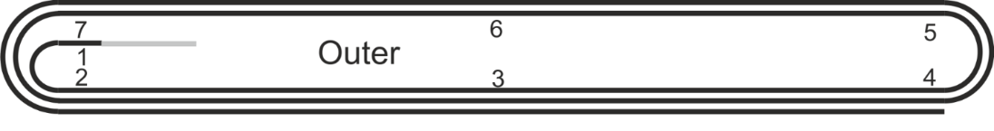
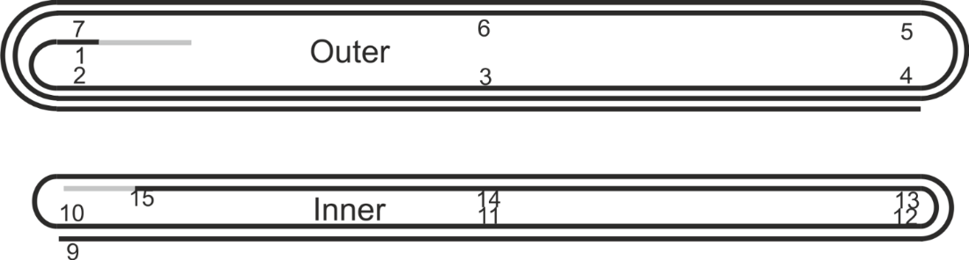
MBHSP101- coil 106-107
Summary of weak locations in coil 107
At voltage tap O1, just out of the layer jump.
    7 quenches during initial training
    Limiting point later on at 1.9 K
At voltage tap O2, opposite of O1.
  Limiting point at 4.3 K
Around voltage tap I12, close to the pole head with 6 training quenches and detraining.
X
1
Images courtesy N.Peray and D. Smekens
2
1
X
X
X
X
2
1
3
2014-12-09 - 2nd international review HL-LHC 11 T dipole
Gerard Willering – Cold powering tests 11T model coils at CERN

Slide 16
MBHSP102- coil 106-108
Training
6 quenches to nominal
10 quenches to initial target of 12.5 kA
Only 3 or 4 re-training quenches for coil 106 after de-collaring and re-collaring
Coil 108 only showed 4 or 5 (de)-training up to 12.3 kA, it never quenched again up to 12.8 kA.
Memory after thermal cycle is good, with one quench just below nominal.
Target of 12.8 kA (12 T) reached in the second cool down.

Slide 17
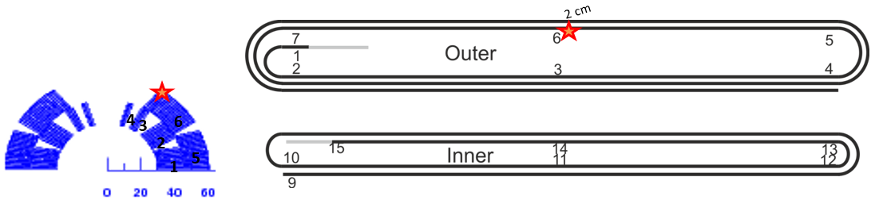
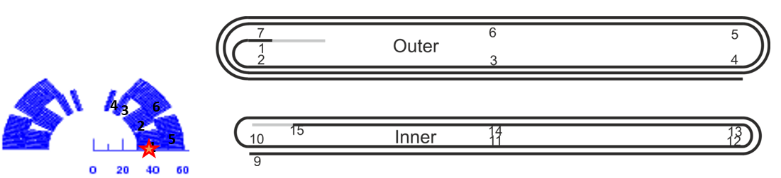
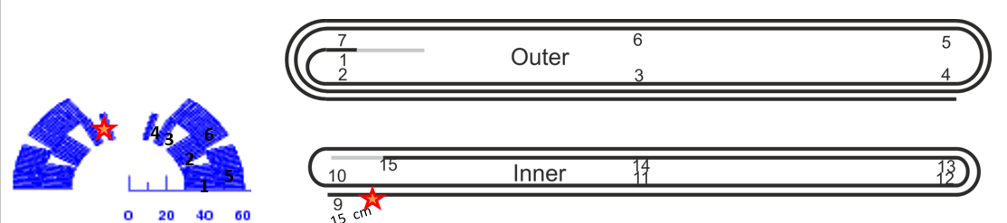
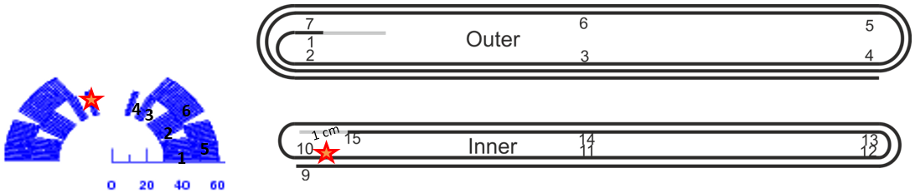
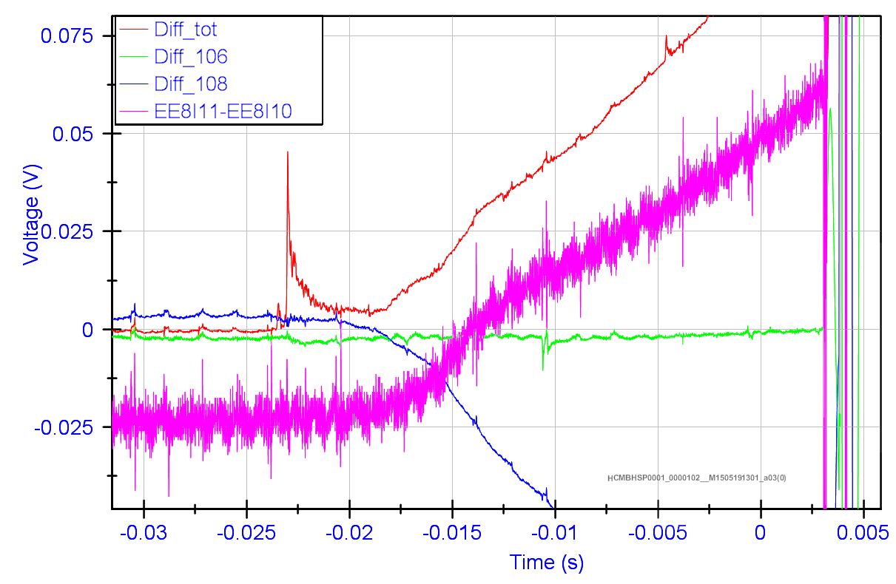
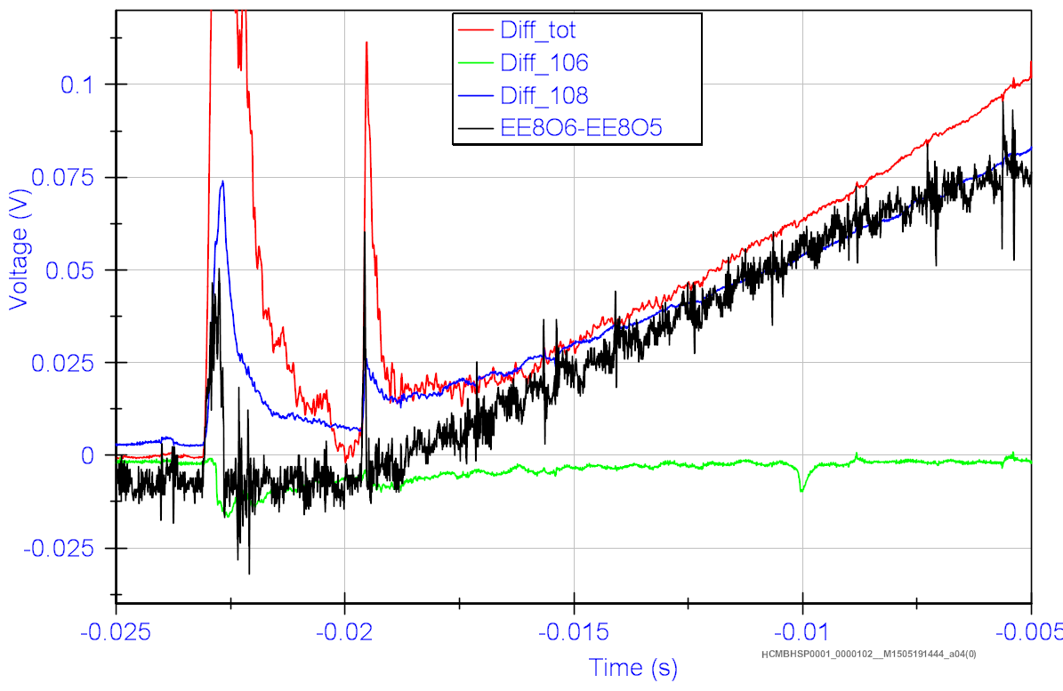
MBHSP102- coil 106-108
4 quenches in coil 108:
Quench 1, 2, 7, 9
7
2
9
1
Large precursors in the two low-current quenches (8 and 9.2 kA)
4 different quench locations.

Slide 18
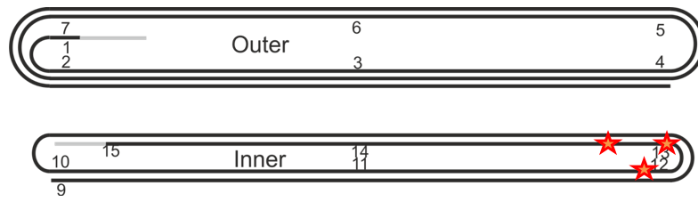
MBHSP102- coil 106-108
Training coil 106 – First 3 quenches
Quenches close to the head of the inner layer, high-field turn.
Confirms the quench location of the training of coil 106 in MBHSP101.

Slide 19
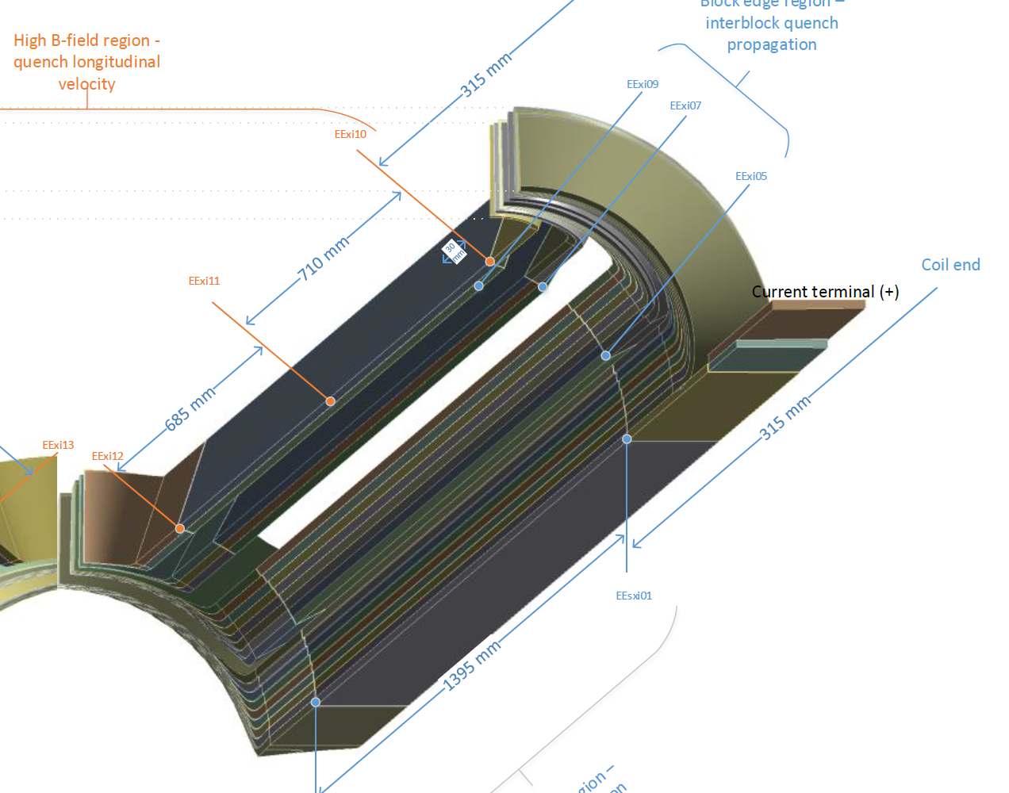
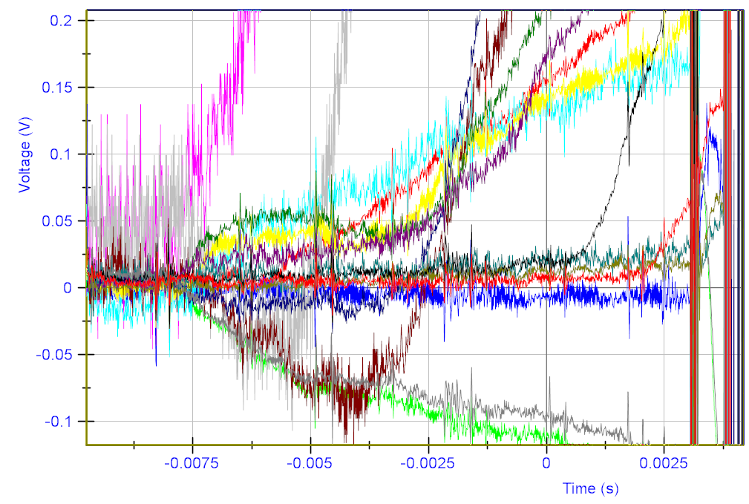
MBHSP102- coil 106-108
Training coil 106 – quench 8
Quench 8 was a “massive” quench:
In coil 106 the whole cross-section of the inner layer quenched within 1 ms at the coil head.
This was followed by a detraining in coil 108…
No special signals were seen in mechanical measurements.

Slide 20
MBHSP102- coil 106-108
Training coil 106 – Further training and detraining at 1.9 K
Quench location overview coil 106
Different training location than the first 3 training quenches and the training in MBHSP101.

Slide 21
MBHSP102- coil 106-108
Training coil 106 – Powering at 4.3 K
At 4.3 K two identical quenches at identical temperatures. Seems to be the limiting point of the coil, but difficult to conclude on 2 quenches.
Detraining to 11.5 kA in the same region. Very similar quench pattern as the 1.9 K (de)training quenches.

Slide 22
Resistance and RRR
Coil | Conductor | R _{Troom} (mΩ) | RRR
105 | RRP 108/127 | 422 | 95
106 | RRP 108/127 | 423 | 65
107 | RRP 108/127 | 422 | 75
108 | RRP 132/169 | 407 | 165
109 | RRP 132/169 | 400 | ??
111 | RRP 132/169 | 401 | ??
Data from electrical measurements in B927 at T_{room}, confirmed by measurements in SM18
Resistance from EESxOI to EESxOO, normalized to 293 K
Resistance at room temperature for 108/127 cables is 5 to 6 % higher.
RRR is much higher for coil 108 then 105, 106 and 107.
Can low RRR be directly related to the training in the coils?

Slide 23
Holding current tests
MBHSM101
40 minutes at 15 kA: no quench
MBHSP101
30 minutes at 11.3 kA followed by 30 minutes at 11.5 kA: no quench
MBHSP102
10 hours 11.85 kA: no quench
2.5 hour 12.3 kA: no quench
Not a single quench during flattop observed in any of the coils during any test at any current.

Slide 24
Ramp rate dependence of quench current
MBHSM101
  Same quench current at 10 and 50 A/s
MBHSP101
Erratic quench behaviour. No RR studies performed.
No quench at 80 A/s up to 11.25 kA.
MBHSP102
200 A/s: No quench to 11.85 kA
300 A/s: Quench at 10.8 kA

Slide 25
Quench back - Energy extraction tests – MBHSP102
EE switch opened, no QH firing. All resistance in the coil due to quench back.
Discharge from 11 kA, R_{EE} = 61 mΩ
Coil 106 and 108 have about the same start time of quench back, but resistance growth in coil 106 is much faster.

Slide 26
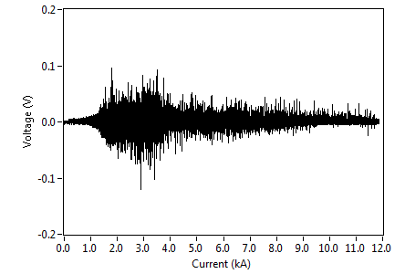
Flux jumps MBHSP102
Maximum peak -120 mV.
Measurement frequency 5 kHz
With a threshold of 50 mV, minimum validation time is needed of 5 ms if a single threshold and evaluation is taken for the full range.

Slide 27
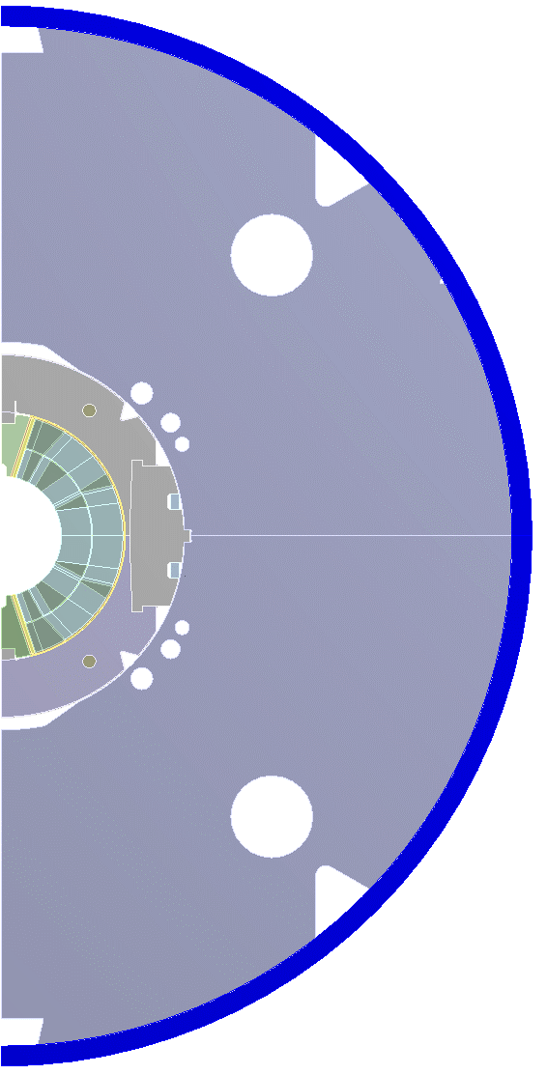
Preloading difference of MBHSP102 to MBHSP101
Added 50µm radial shim collar to coil
Added 50µm radial shim collar to yoke
Change in the layout of the transition region
  Length of last loading pole increased (85-240mm)
  Top Kapton-shim on loading pole replaced by steel-shim
No unplanned 0.25mm
midplane shim
Coil geometry is similar to 101

Slide 28
Mech. Behavior in radial direction of MBHSP102
Change of mechanical behaviour during the test campaign. Continues powering causes some sort of settling in the system.

Slide 29
Influence quench vs. no quench in MBHSP102 magnetic measurements to 11.8kA
30MPa less after ramp down
1st ramp after a training quench
2nd ramp after the 1st ramp of the MM

Slide 30
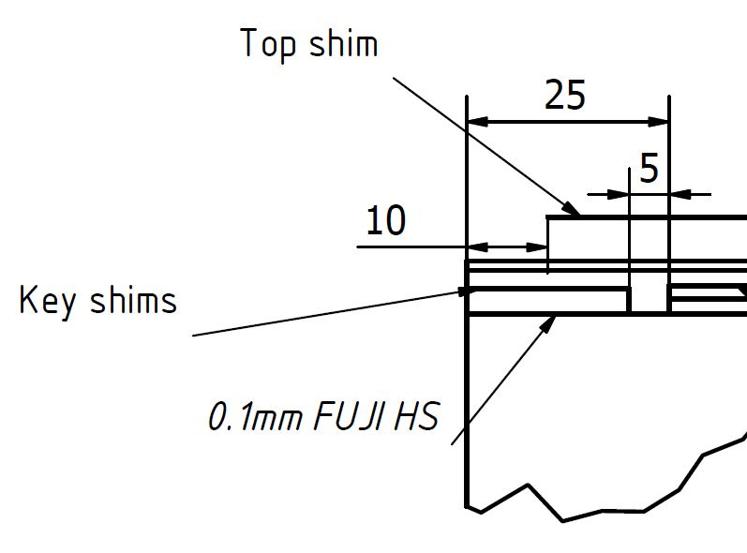
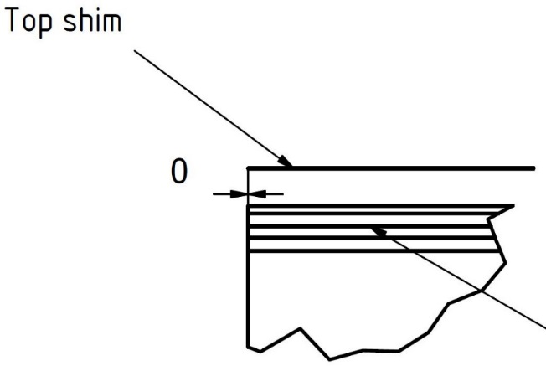
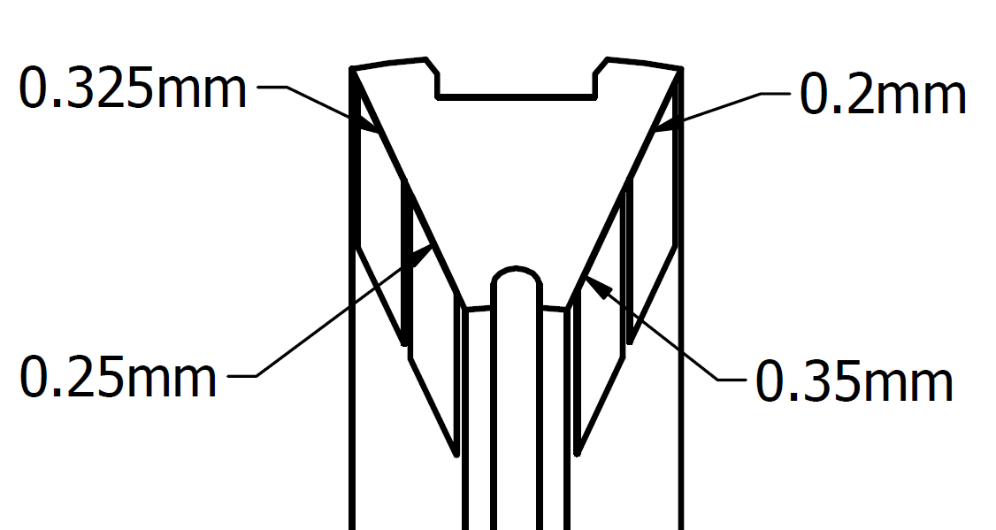
Changes for MBHSP103
Top shim = 50µm
2 x reduction every
20-30mm
MBHSP102
MBHSP103
Each key leg individually shimmed
Only adaption in the transition region with the top shim

Slide 31
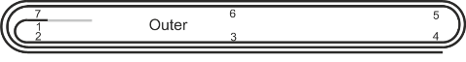
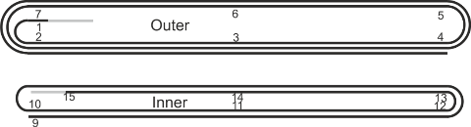
Summary of weak locations in coil 107
At voltage tap O1, just out of the layer jump.
    7 quenches during initial training
    Limiting point later on at 1.9 K
At voltage tap O2, opposite of O1.
  Limiting point at 4.3 K
Around voltage tap I12, close to the pole head with 6 training quenches and detraining.
X
1
Images courtesy N.Peray and D. Smekens
2
1
X
X
X
X
2
1
3
2014-12-09 - 2nd international review HL-LHC 11 T dipole
Gerard Willering – Cold powering tests 11T model coils at CERN

Slide 32
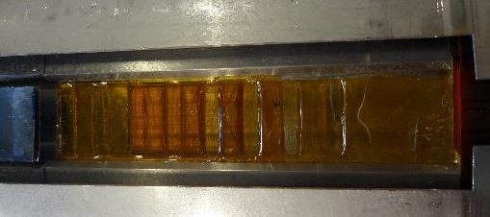
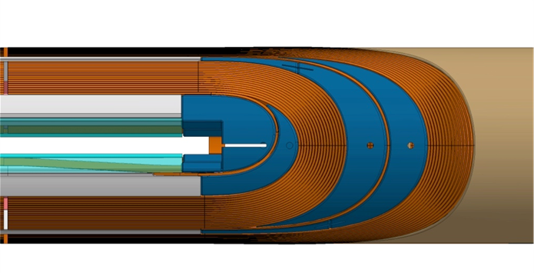
Summary for MBHSP101
Most of the quenches are in the key region
Shimming of the keys has not been strong enough
KEY

Slide 33
Discussion topics
Training quenches
  Mechanical origin? Do we
What triggers the erratic and detraining quenches ?
  108/127 coils with low RRR very sensitive to small perturbations??
  Mechanical origin??
Do we think detraining comes from local or more global movement and can higher RRR cure this (coil 108 only quenched 4 times up to 12.8 kA).

Slide 34
Backup slides

Slide 36
Training program
Training at 1.9 K, 10 A/s
Target current 12.5 kA
Training not interfered with other tests, only splice measurement.
4 Quenches per day

Slide 37
Stability test/holding current test
10 hours at nominal current, followed by a magnetic measurement cycle and a ramp to 12.5 kA without quench.
2.5 hours at 12.3 kA, no quench.
Note the length of the test days from 8h to 20h
No sign of any instability

Slide 38
Ramp rate dependence
No quench at 200 A/s up to nominal current.
Quench at 300 A/s at 10.8 kA.
No further ramp rate dependence tests are done, considering:
  quench back results
  High ramp rate without quench
  Limited test time

Slide 39
Magnetic measurements
3 flavours of magnetic measurements,
See presentation of Lucio next week for results

