Slide 1


FNAL – 21st September 2015
CERN Conductor and Cable Development for the 11T Dipole
B. Bordini, A. Ballarino, L. Oberli, D. Richter
Collaboration meeting on DS 11T Dipole grounds

Slide 2
Outline
Wire Specifications and Procurement
  specs and magnet margin
  material received so far
  procurement
Cable Parameters and Performance
  Specs and electrical performance
  CERN Cables in the Magnets tested so far
Conclusions

Slide 3
Wire Specifications for the Magnet Series
Cu: non-Cu=1.15 → J_{c}(4.22 K, 12 T)≈2450 A/mm²
For previous deliveries we accepted I_{c}> 390 A and RRR>100

Slide 4
Magnet Margin in Operating Conditions
Values extrapolated from I_{c} measurements
19.5 % Margin
4.4 K Margin

Slide 5
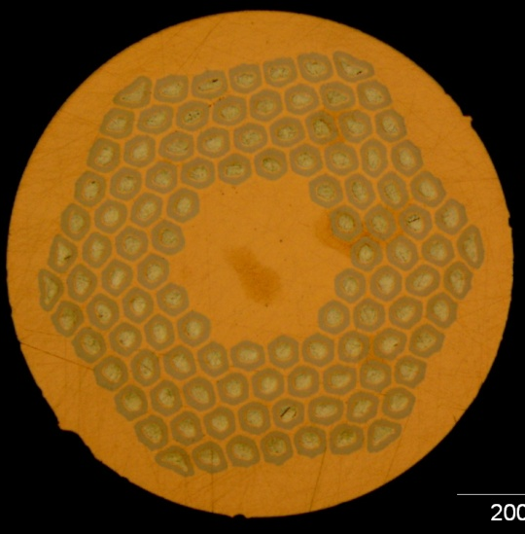
The importance of a large RRR
Larger RRR → conductor less sensitive to energy perturbations (epoxy micro-cracks, wire micro-motion etc.) that might initiate the self-field instability
Example, at 12 T and 1.9 K a perturbation of 3μJ on a 0.7 mm RRP 108/127 quenches the conductor:
  at 70% of its I_{c} if RRR 14
  At 85% of its I_{c} if RRR 130
0.7 mm RRP 108/127 wire
J_{c}(12 T, 4.3 K) ≈ 2800 A/mm²
Laser Energy ≈ 3μJ

Slide 6
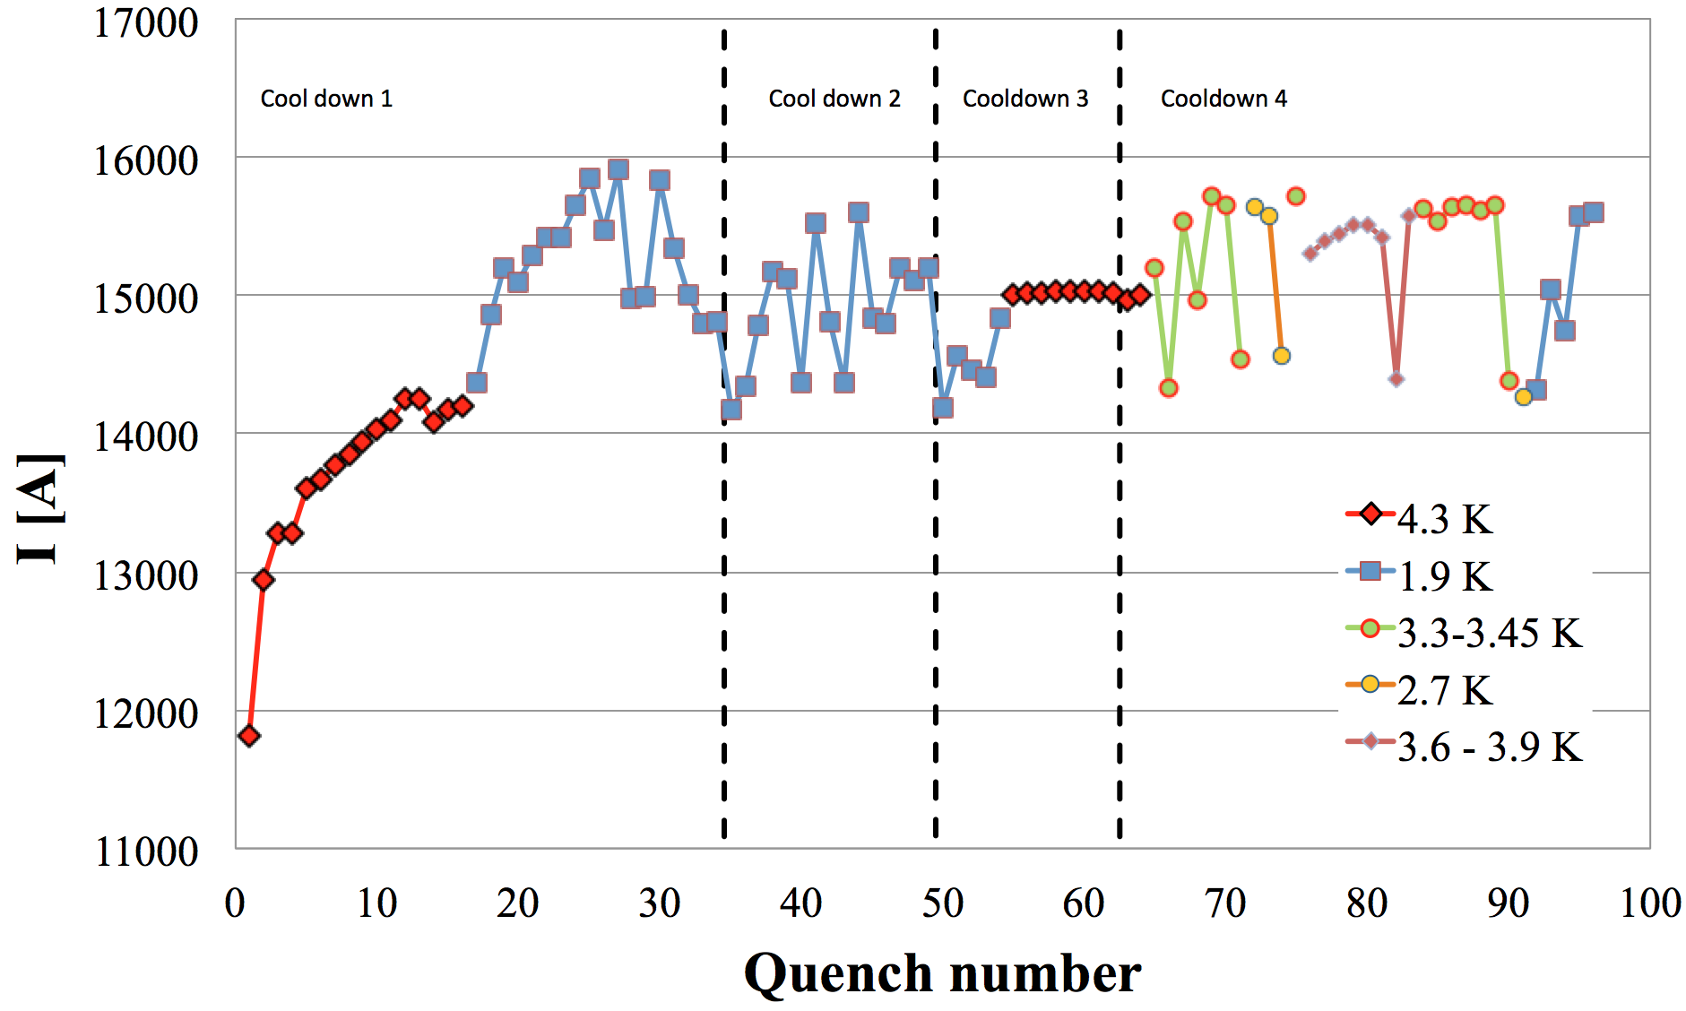
Instabilities in Magnets
1.9 K SS limit
4.3 K SS limit
SMC Magnet wound with the 11 T cable (based on the RRP 108/127 wire)
J.C. Perez et al. “The Short Model Coil (SMC) Dipole Performance Using the 11-T-dipole-type Nb₃Sn Conductor”

Slide 7
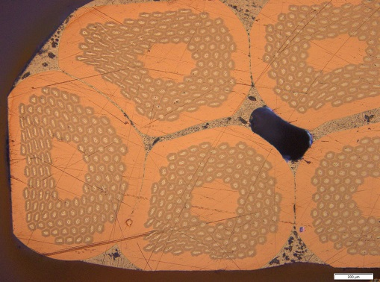
Why a RRR of 150 ?
The stabilizing effect of a high copper RRR (for the self-field instability at high field) starts saturating at values larger than 100
100 is a good target value for the local RRR of the wires that constitutes our Rutherford cable
During cabling the strand and its sub-elements get distorted and the Sn contained within them has more chance to diffuse and poison the Cu stabilizer
This distortion is particularly severe in the thin edge of a Key-stoned Rutherford cable
RRR of 150 in round wires in order to get a target value of 100 for the local RRR of the strand on the cable thin edge

Slide 8
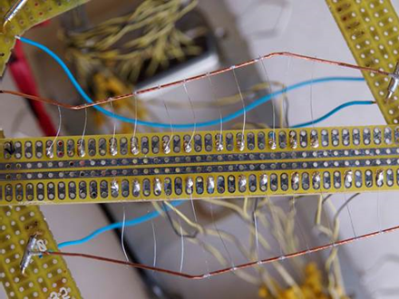
Local RRR on extracted strands
thin edge
thick edge
RRR virgin wire ≈ 160
Max value local RRR compatible with virgin wire
Min value local RRR ≈ 100

Slide 9
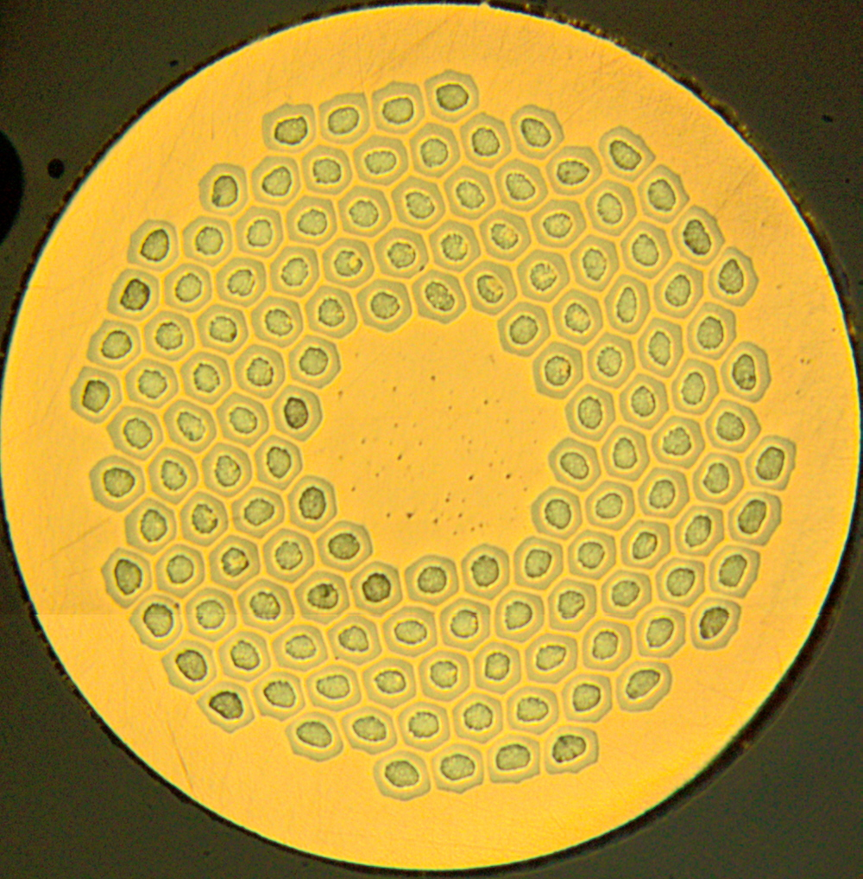
0.7 mm Wire Received so far
RRP 108/127
RRP 132/169
RRP 144/169
RRP 150/169
PIT 114
PIT 120
 | Layout | Cu to non-Cu | Sub-Element size | SE shape
RRP | 108/127 | 1.19 | 46 μm | Hex
 | 132/169 | 1.28 | 41 μm
 | 144/169 | 1.08
 | 150/169 | 1
PIT | 114 | 1.25 | 44 μm | Circular
 | 120 | 1.15

Slide 10
0.7 mm 169 restacks RRP Wire
I_{c} @ 12 T, 4.22 K & RRR
I_{c} New Spec., (A) | 438
I_{c} Average, (A) | 436.4
RMS, (A) | 25.1
150/169
I_{c} Average, (A) | 431
RMS, (A) | 24
132/169
144/169 & 150/169
I_{c} Average, (A) | 456
RMS, (A) | 24
Old Spec.
390 A
RRR Average | 185
RMS | 64
RRR Average | 172
RMS | 30
220 km of wire

Slide 11
0.7 mm PIT Wire
Received 135 km of wire
Other 40 km will be received in 2015
Today the PIT wire has a critical current about 1-7 % lower than specs with a RRR around 100
Bruker-EAS is collaborating with CERN to further improve the PIT conductor
A modification, which should bring the wire to specs with a limited impact to the wire layout and production, has been identified and Bruker-EAS has already started to implement it

Slide 12
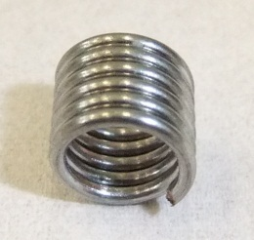
Magnetization of the 0.7 mm 132/169 RRP wire
Mini-coil Sample
Billet 16236 (A02)
reacted 50 hrs at 640 C
J_{c}(12 T, 4.2 K) ≈2640 A/mm²
RRR ≈ 200
Measurements by D. Richter
DM(1.9 K, 3 T)=228 mT
In this type of conductor the variability of the magnetization values are expected to be correlated only to the critical current density and the copper to non-copper ratio

Slide 13
Magnetization
RRP 132/169 vs PIT 120
mT
RRP - Billet 16236 (A02)
Reacted 50 hrs at 640 C
J_{c}(12 T, 4.2 K) ≈2640 A/mm²
Non-Copper 44.5 %
DM(1.9 K, 3 T)=228 mT
Tesla
PIT – Billet 36521 (A07)
Reacted 240 hrs at 620 C
J_{c}(12 T, 4.2 K) ≈2330 A/mm²
Non-Copper 45.6 %
DM(1.9 K, 3 T)=163 mT

Slide 14
Wire Procurement
Placed an order with OST for 500 km of wire;
  this quantity fulfills the conductor needs for the 11 T magnets that are expected to be installed in the LHC during LS2
The wire will have the 108/127 layout in order to guarantee a sufficient I_{c} margin during production
The first delivery is expected by February 2016 and the whole order will be completed by end 2016

Slide 15
11 T Cable Parameters
Strand diameter | mm | 0.7
Number of strands | - | 40
Cable width | mm | 14.7
Cable mid thickness | mm | 1.25
Keystone angle | deg | 0.79
Cable transposition pitch | mm | 100
Aspect ratio | - | 11.76
Thin edge | mm | 1.149
Thick edge | mm | 1.351
t/2d thin edge | % | 82.5
t/2d thick edge | % | 96.5
Packing factor | % | 87.3
With stainless steel (316 L) core - 12 mm width and 25 μm thickness

Slide 16
Effect of Core on the
Ramp-Rate Dependence
Cable measurement in FRESCA on a 11 T cable based on the RRP 108/127 without core
Without core there is a strong dependence of the quench current on the field ramp rate because of large inter-strand currents
Once the core was introduced this ramp rate dependence completely disappeared

Slide 17
11 T Cable Produced at CERN
Electrical Performance
Long lengths of cable have been produced at CERN by using the RRP and the PIT conductor
  RRP → I_{c} degradation below 3 % - RRR extracted strands (integral) above 100
  PIT → I_{c} degradation 6.1 % - RRR extracted strands (integral) above 60
By increasing 40 microns the mid-thickness of the cable and hence its thin edge, we limited the average I_{c} degradation of the PIT cable to less than 2 %

Slide 18
CERN Cables in the Magnets tested so far
Coils 105-107 were manufactured with an ‘old’ generation RRP 108/127 Ta doped –with relatively low RRR
Coil 107 also contains RRP 108/127 Ti doped from FNAL
Coil 108 is based on the RRP 132/169 Ti doped with large RRR (>100)

Slide 19
Heat Treatment & Witness Samples
Coil 106
A less aggressive heat treatment (with respect to the one proposed by OST): 48 hrs at 210 °C, 48 hrs at 400 °C, 50 hrs at 640 °C.
5 I_{c} Witness Samples: 2 Virgin and 3 Extracted
No RRR witness samples
RRR samples extracted from this cable were reacted with the same heat treatment
Estimates based on extracted samples
  large variability in the RRR results (from 180 to 40 in the virgin samples)
  In some cases the RRR values were extremely low (down to 40 for the virgin and 32 for the extracted).
I_{c}^{Min}(12 T, 4.22 K)=409 A

Slide 20
Heat Treatment & Witness Samples
Coil 108
Heat treatment proposed by OST: 48 hrs at 210 °C, 48 hrs at 400 °C, 50 hrs at 640 °C.
Estimates based on extracted samples
6 I_{c} Witness Samples: 3 Virgin and 3 Extracted
6 RRR Witness Samples: 3 Virgin and 3 Extracted
RRR virgin wires: 163-166
Lowest RRR extracted 128 (min local RRR 101)
I_{c}^{Min}(12 T, 4.22 K)=426 A

Slide 21
Conclusions
CERN has placed an order to OST for 500 km of RRP 108/127; this quantity fulfills the conductor needs for the 11 T magnets that are expected to be installed in the LHC during LS2
  The first delivery is expected by February 2016 and the whole order will be completed by end 2016
By using this conductor and the present cable parameters, CERN is confident to have:
  A margin on the load line of at least 20 % and a temperature margin of 4.4 K
  A minimum local RRR not significantly lower then 100
Today Bruker-EAS wire has a critical current about 1-7 % lower then specifications, however a modification, which should bring the wire to specs with a limited impact to the wire layout and production, has been identified and Bruker-EAS has already started to implement it

Slide 22
Conclusions
CERN has placed an order to OST for 500 km of RRP 108/127; this quantity fulfills the conductor needs for the 11 T magnets that are expected to be installed in the LHC during LS2
  The first delivery is expected by February 2016 and the whole order will be completed by end 2016
By using this conductor and the present cable parameters, CERN is confident to have:
  A margin on the load line of at least 20 % and a temperature margin of 4.4 K
  A minimum local RRR not significantly lower then 100
Today Bruker-EAS wire has a critical current about 1-7 % lower then specifications, however a modification, which should bring the wire to specs with a limited impact to the wire layout and production, has been identified and Bruker-EAS has already started to implement it

