Slide 1


Conductor and Cable development at FNAL
CERN-FNAL Collaboration Meeting on DS 11T Dipole grounds – FNAL, Sep. 21-23, 2015
Emanuela Barzi
September 21, 2015

Slide 2
Outline
Description of wires used in magnets - Cable specs
Cable fabrication and quality control, cable expansion
Uncored and Cored cable development and study
Cable test
Summary of cable fabrication

Slide 3
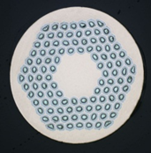
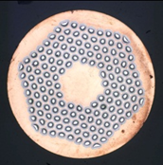
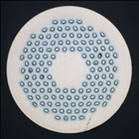

Wires used in Magnets
Advanced strand, to be proven in magnets
Baseline strand

Slide 4
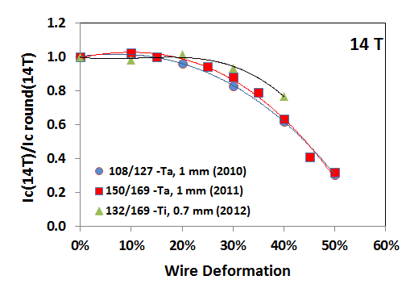
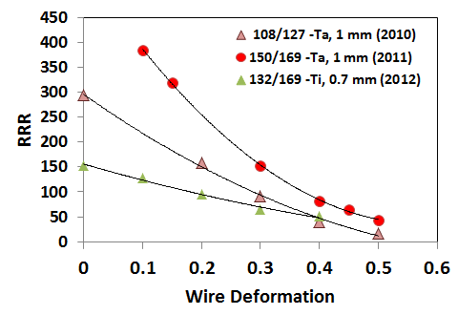
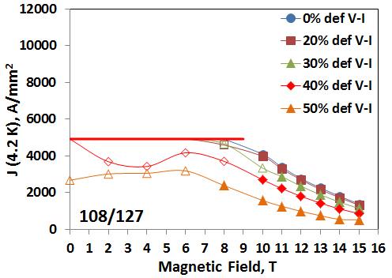
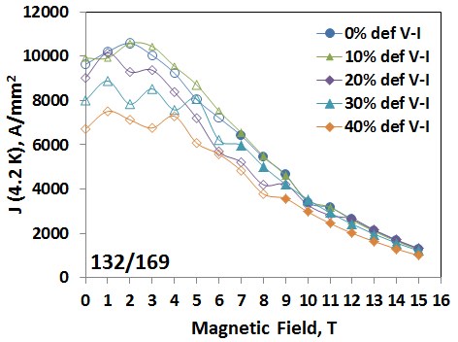
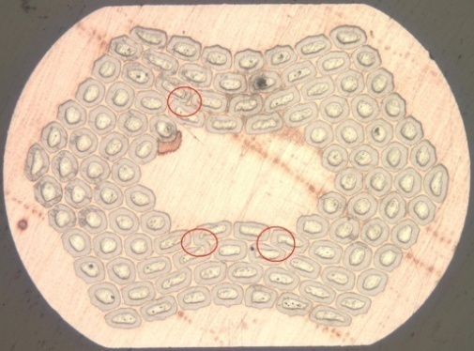
Wires used in Magnets (cont.)
“Progress in Nb3Sn RRP Strand Studies and Rutherford Cable Development at FNAL”, E. Barzi, D. Turrioni and A. V. Zlobin, IEEE Trans. Appl. Sup., article #6000808, V. 24, No. 3 (2014).

Slide 5
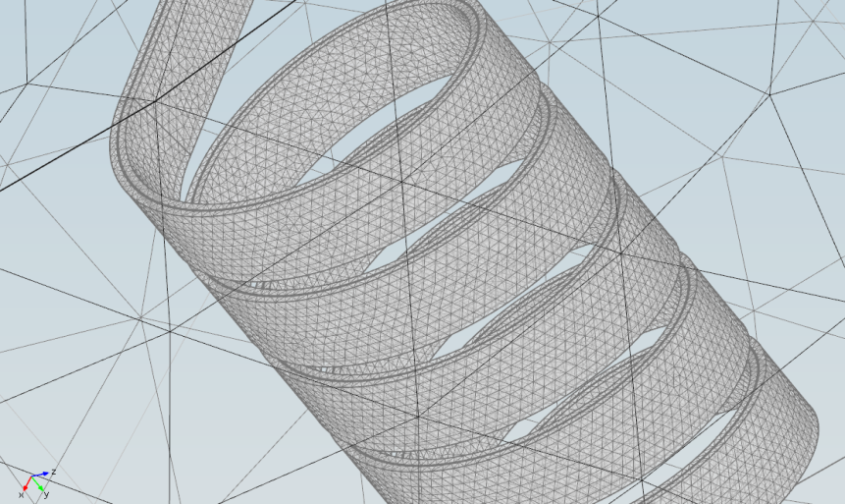
Test of 108/127 RRP Cable DM-CF-01-0b (MBHSP01) with SC Transformer
3D FEM Model
Cable Parameter | Value
Cable thickness | 1.3 mm
Cable width | 15.09 mm
Bifilar gap | 0.25 mm
Self-field correction 0.078 T/kA
“Progress in Nb3Sn RRP Strand Studies and Rutherford Cable Development at FNAL”, E. Barzi, D. Turrioni and A. V. Zlobin, IEEE Trans. Appl. Sup., article #6000808, V. 24, No. 3 (2014).

Slide 6
Cable Requirements
Factors used in selecting the initial cable geometry:
  To setup parallel cable fabrication lines at FNAL and at CERN ➔ max. No. strands ≤ 40
  To achieve required magnet transfer function of 11 T at 11.85kA ➔ Strand size ≤ 0.7 mm
  Critical current degradation due to cabling < 10%
Original cables were designed based on:
  Deformation of small edge 1-h/2d ≤ 20%. Large edge compacted by ~2% for mechanical stability.
  Width compaction, i.e. cable width/undeformed width > 1
  Cable packing factor ~ 86% ➔ 1.27 mm mid-thickness

Slide 7
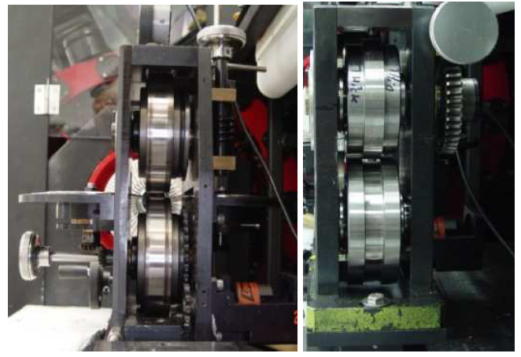
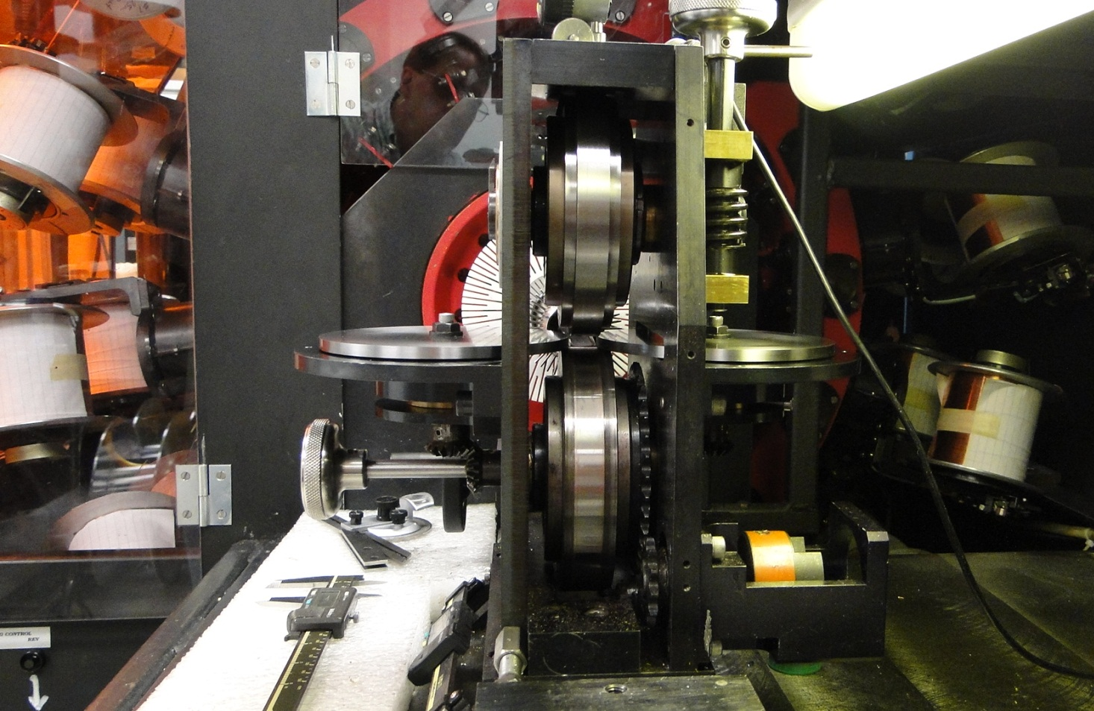
Cable Fabrication
In preparation to coil scale up to 5.5 m long, a new turk-head designed for one-pass cable fabrication was later tested and commissioned.
Original cable was made in two steps using forming fixture and keystoned rollers.

Slide 8
Example of Cable Measurements
Traveler | Type | Strand Design | No. strands | Strand size mm | Mandrel width mm | Cable width mm | Cable thickness mm | Lay angle° | PF % | SS Core | Length m
R&DT_110420_40_1_0 | R | Cu | 40 | 0.697 | 13.92 | 14.591±0.023 | 1.297±0.004 | 15 | 83.4 | N | 186

Slide 9
Cable Expansion for Tooling Design
The coil dimensions in the winding and curing tooling are determined by the unreacted cable cross section, whereas the coil dimensions in the reaction and impregnation tooling are based on the reacted cable cross section.
Experimental data indicate that the Nb₃Sn cable cross section expands anisotropically during reaction. The change in dimensions before and after reaction was measured for five keystoned nominal cables which were stacked on the flat face in a stainless steel straight fixture 1.22 m long. The cables were placed within a groove with enough room for the cables to expand freely in all three directions. Mica layers 0.15 mm thick were placed between the cables:
- The average width expansion was 2.6% ± 0.2%
- The average mid-thickness expansion was 3.9% ± 0.5%
- The average length decrease was 0.3%
N. Andreev et al., “Volume expansion of Nb₃Sn strands and cables during heat treatment”, Advances in Cryogenic Engineering, V. 48, AIP, V. 614, pp. 941-948 (2002).
E. Barzi et al., “Development and Fabrication of Nb₃Sn Rutherford Cable for the 11 T DS Dipole Demonstration Model”, IEEE Trans. Appl. Sup., V. 22, No. 3, pp. 6000805 (2012).

Slide 10
Development of Cables without Core
Post-magnet design R&D was performed to improve cable mechanical stability in the winding process.
  Keystoned cables were made within a range of mid-thicknesses to study sensitivity of electrical properties to compaction.
Reducing keystoned cable thickness of the uncored cable from 1.27 mm to 1.25 mm improved cable mechanical stability and reduces the risk of cable collapsing during fabrication with an I_{c} degradation still within specs.
“Development and Fabrication of Nb₃Sn Rutherford Cable for the 11 T DS Dipole Demonstrator Model”, E. Barzi et al., IEEE Trans. Appl. Sup., V. 22, No. 3, pp. 6000805 (2012).

Slide 11
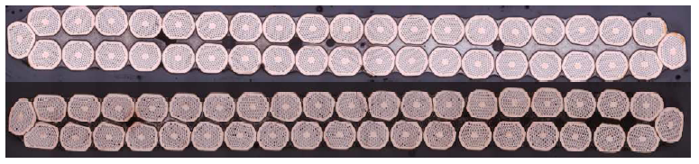
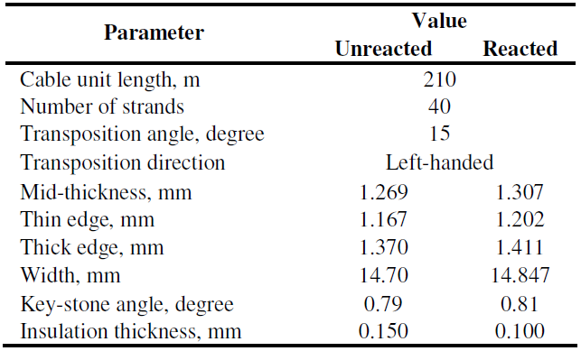
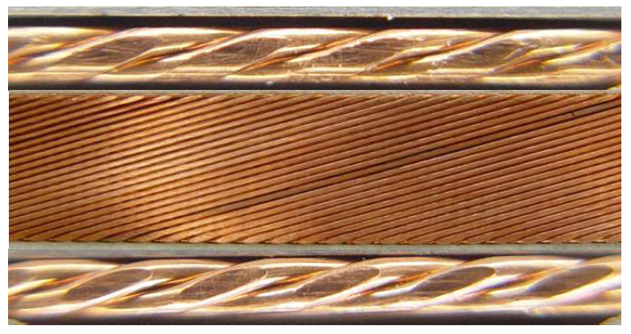
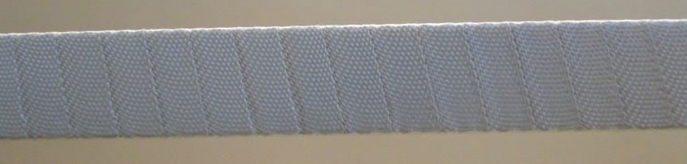
Specs v.1 → v.2 for Cable Production
1.25
1.27
V.2 specs were agreed upon with CERN.

Slide 12
Development of Cables with Core
R&D on cored cable technology to suppress eddy currents was started.
Cable ID | Step (No.) | RRP® wire design | Width before/after keystoning (mm) | Mid-thickness before/after keystoning (mm) | PF before/after keystoning (%) | Annea ling step
1 | 2 | 150-Ta | 14.48/14.66 | 1.320/1.270 | 84.8/87.1 | No
2 | “ | “ | 14.48/14.66 | 1.320/1.253 | 84.8/88.3 | “
3 | “ | “ | 14.48/14.68 | 1.320/1.230 | 84.8/89.8 | “
4 | 2 | 150-Ta | 14.57/14.68 | 1.338/1.270 | 83.4/86.8 | Yes
5 | “ | “ | 14.57/14.68 | 1.338/1.251 | 83.4/88.4 | “
6 | “ | “ | 14.57/14.69 | 1.338/1.232 | 83.4/89.6 | “
7 | 2 | 108-Ta | 14.59/14.70 | 1.336/1.270 | 83.0/86.7 | Yes
8 | “ | “ | 14.59/14.70 | 1.336/1.252 | 83.0/87.9 | “
9 | “ | “ | 14.59/14.71 | 1.336/1.230 | 83.0/89.4 | “
10 | 1 | 132-Ti | -/ 14.75 | -/ 1.271 | -/ 85.7 | No
11 | “ | “ | -/ 14.71 | -/ 1.250 | -/ 87.4 | “
12 | “ | “ | -/ 14.73 | -/ 1.230 | -/ 88.8 | “
“Progress in Nb3Sn RRP Strand Studies and Rutherford Cable Development at FNAL”, E. Barzi, D. Turrioni and A. V. Zlobin, IEEE Trans. Appl. Sup., article #6000808, V. 24, No. 3 (2014).

Slide 13
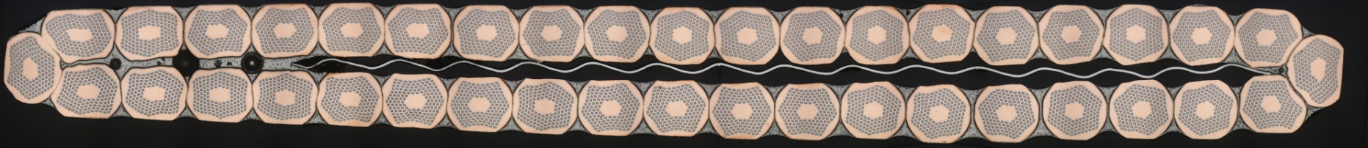
Development of Cored Cable Technology
Better field quality, better ramp rate dependence
40-strand (RRP-150/169) cable with stainless steel core 11 mm wide
Effect of Annealing
Keystoned Cable Compaction Study
Rectangular Cable Compaction Study
No Annealing
Keystoned Cable Compaction Study
Annealing

Slide 14
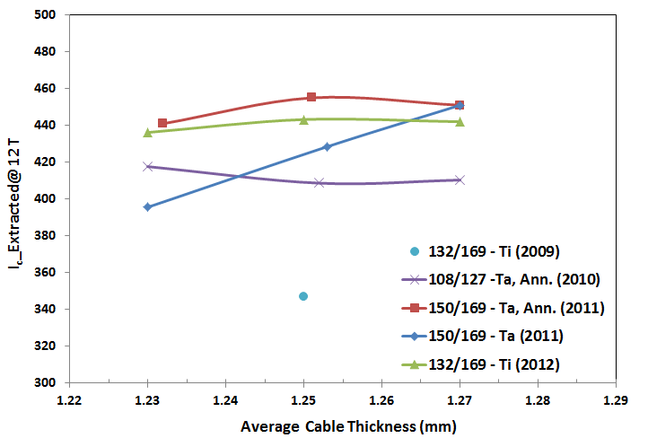
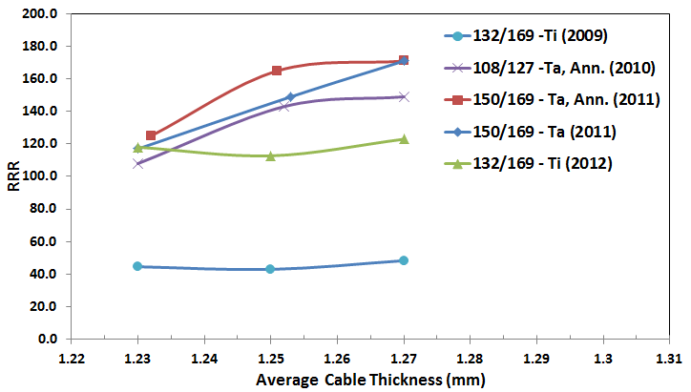
Summary of Studies for Cored Cables
A mid-thickness spec of 1.25 mm meets the I_{c} degradation requirements also in the case of a cored cable. This allowed using the same insulation thickness and preserving the same magnet design as when using uncored cable.
TheTi doped wire preserved its current carrying capabilities up to large cable compaction factors, even without any prior annealing. Its maximum Ic degradation at 12 T was ~2% at ~89% cable compaction. Consistently, the only two wires whose RRR values are independent of cable compaction are the Ti-doped.

Slide 15
Examples of Collaboration with CERN
  The Spec v.2 for the cable were discussed and agreed upon during E. Barzi’s visit at CERN in March 2012
  CERN produced the cable for the spare coil (MBH04) for the 1-1 demonstrator
  Traveler and reporting templates for cable production were discussed and exchanged during Barzi’s visit
  To prepare for automated quality control, CERN shipped one of their Inspection Systems following Dan Turrioni’s prior visit

Slide 16
Cables used for 1-pass Successful Commissioning
200m+ Superconducting cable with one single billet
Relative Rotation Experiment
SC Cable with Multiple Billets

Slide 17
Summary of Cable Production
Coil ID | Cable ID | Billets ID | Nb3Sn Type | Original cable length | Cable geometry | Core geometry | Cable fabrication
MBH02, MBH03 | DM-CF-01-0 | 12292, 12319, 12521-22, 13062-63, 13090 | 108/127 (Ta) | 414 m | 1.251±0.001 x 14.71±0.01 mm2, 15.0 deg | None | Jul. 2011, 2-pass w/intermediate anneal
MBH05, MBH07 | DM-CF-02-0B | 13548, 13613 | 150/169 (Ta) | 120 m, 230 m | 1.251±0.002 x 14.69±0.01 mm2, 15.0 deg | 11.0 mm x 25 μm SS | Sep. 2011, 2-pass w/intermediate anneal
MBH08 | DM-CF-07-03-01 | 14144, 14145, 14194, 14195, 9772 | 108/127 (Ta), 114/127 | 138 m | 1.252±0.004 x 14.71±0.01 mm2, 14.0 deg | 11.7 mm x 25 μm SS | Nov. 2012 1-pass
MBH09 | DM-CF-07-03-01B | 14144, 14145, 14194, 14195, 14700 | 108/127 (Ta) | 180 m | 1.249±0.002 x 14.70±0.01 mm2, 14.8 deg | 11.0 mm x 25 μm SS | Nov. 2012 1-pass
MBH10, MBH11 | DM-CF-07-03-01C | 14144, 14145, 14194, 14195, 14700 | 108/127 (Ta) | 220 m | 1.245 x 14.72 mm2, 15.0 deg | 11.0 mm x 25 μm SS | Nov. 2012 2-pass w/intermediate anneal
1-pass successful commissioning | DM_CF_08_01 | 11444 | 132/169 (Ti) | 216 m | 1.251 x 14.73 mm2, 15.6 deg | 9.5 mm x 25 μm SS | Mar. 2013 1-pass
 | R&D_CF_04_13 | A101 | Hard Cu | 600 m | 1.250 x 14.71 mm2, 16.8 deg | 11 mm x 25 μm SS | Oct. 2013 1-pass
MBH12, MBH13, MBH14 | DM-CF-07-13 | 15043, 15044, 15045, 15244, 15245, 15290 | 108/127 (Ti) | 374 m | 1.251±0.001 x 14.71±0.01 mm2, 16.8 deg | 11.0 mm x 25 μm SS | Oct. 2013 1-pass

Slide 18
Backup Slides

Slide 19
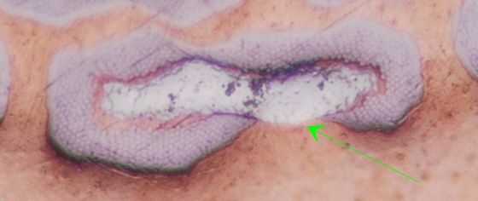
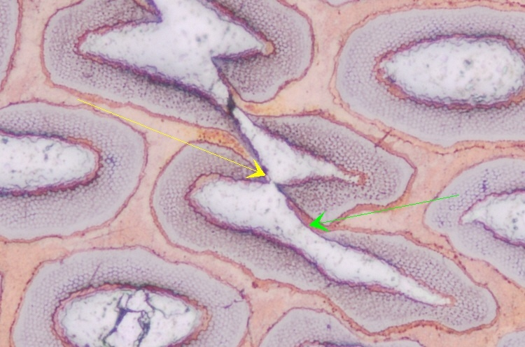
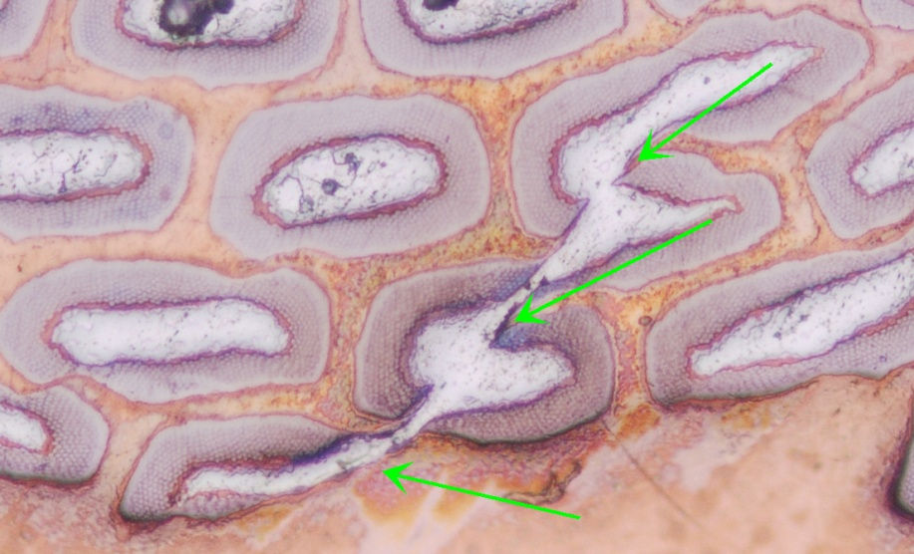
RRP Wires
The original cable development for the 11 T dipoles was done using Nb₃Sn wires of the Restacked-Rod Process (RRP) type by OST. This technology has a delicate internal structure made of Nb/Sn subelements in a Cu matrix. Subelements are prone to merging together when subject to plastic strain, as during cabling. This phenomenon was taken into account in the cable development.
Pictures by Marianne Bossert

Slide 20
First Cables
R&D preliminary to magnet design
  R&D was performed on keystoned cables 14.7 mm and 15.1 mm wide. As expected (see plot), during cabling it was found that 15.1 mm required 41 strands for stability ➔ 14.7 mm width was chosen.

Slide 21
Data Acquisition
Turk head Mitutoyo Dial Indicator ( 1 µm resolution )
Mitutoyo Digimatic Multiplexer MUX-10
Keystoning tooling Dial Indicator ( 1 µm resolution )
Mitutoyo Micrometer ( 1 µm resolution )
PC
Measurements of the two dial indicators are acquired every 3 cm at 1 m/min of production speed.

Slide 22
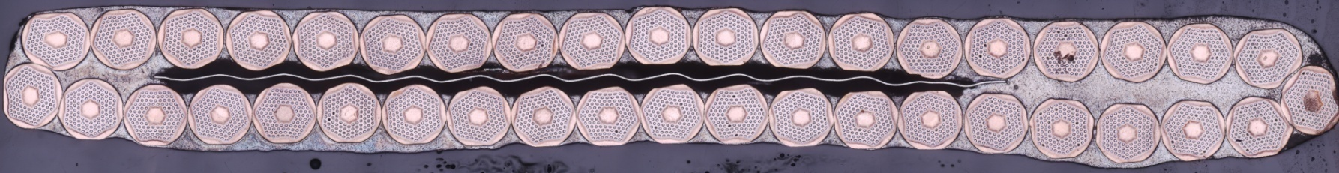
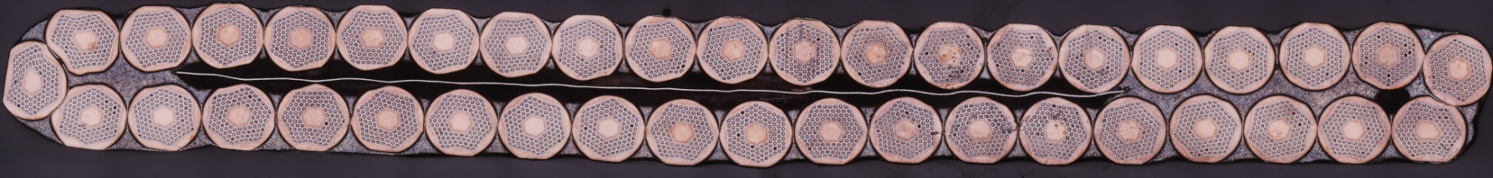
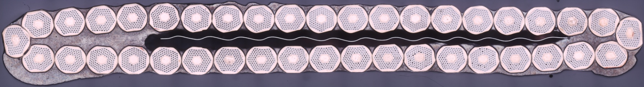
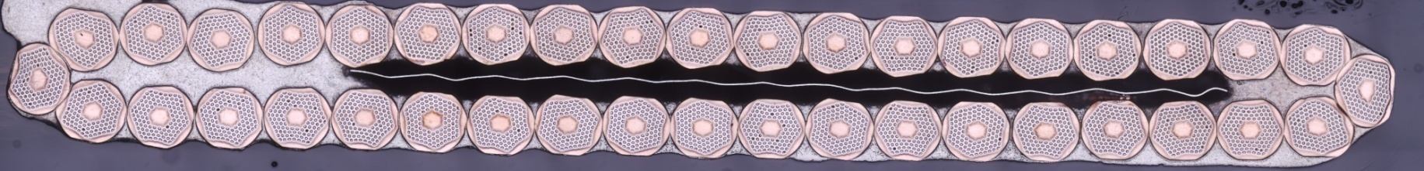
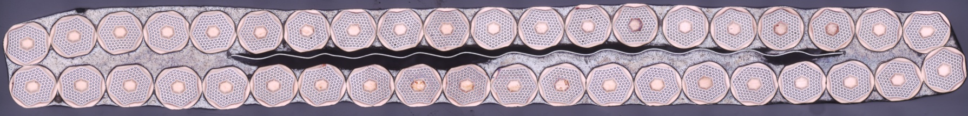
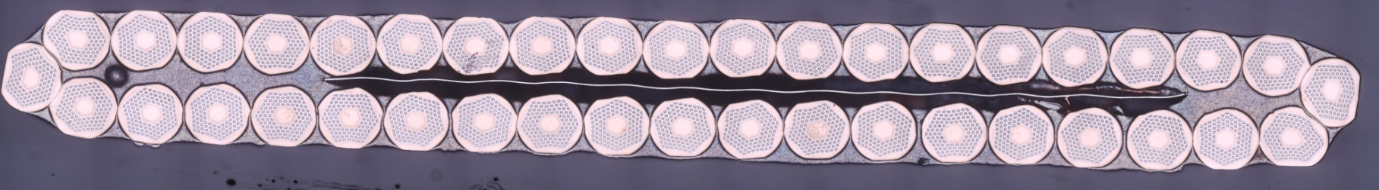
Cable Cross Sections for Microscopic Analysis
CS 1
CS 2
CS 3
CS 4
CS 5
CS 6

Slide 23
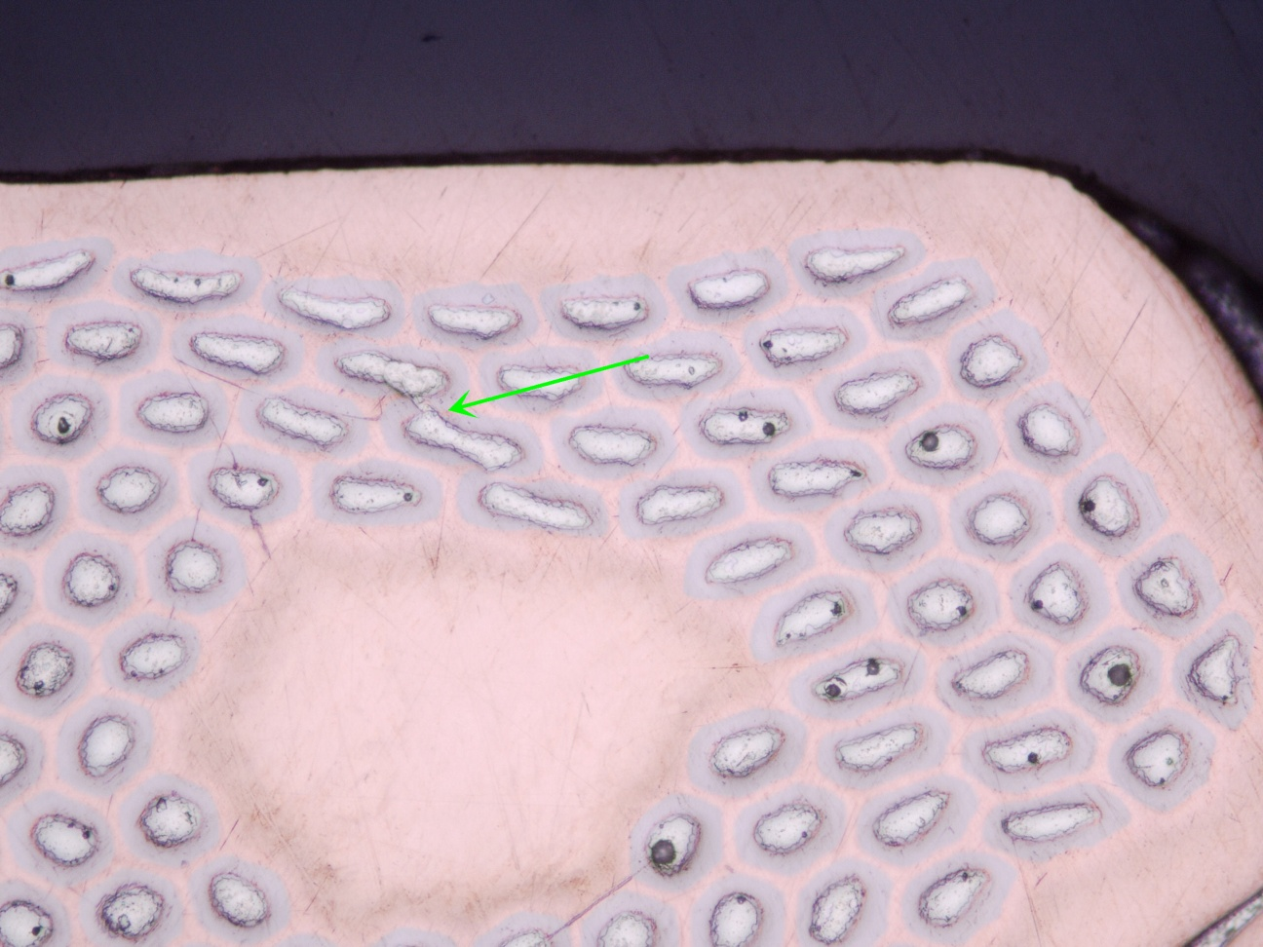
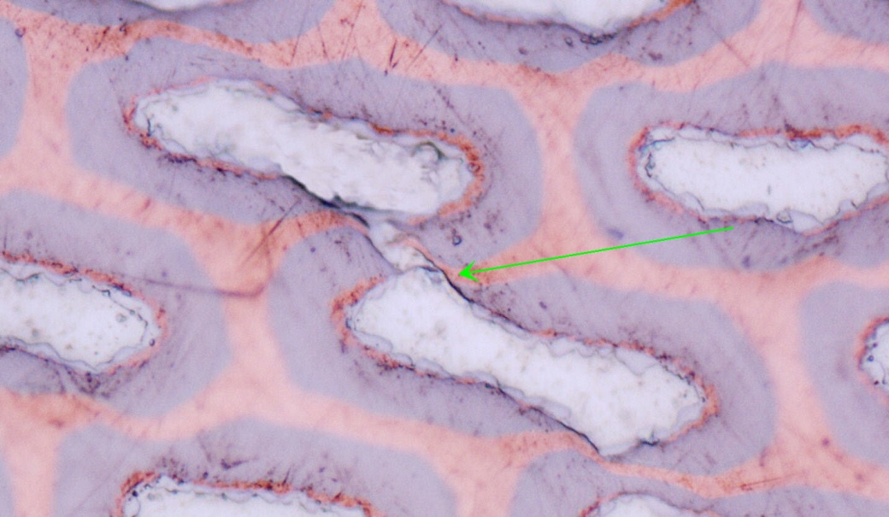
Example of Analysis
Cross Section 2, Strand 1
of cable R&DT_101109_40_1_1
(with core)

Slide 24
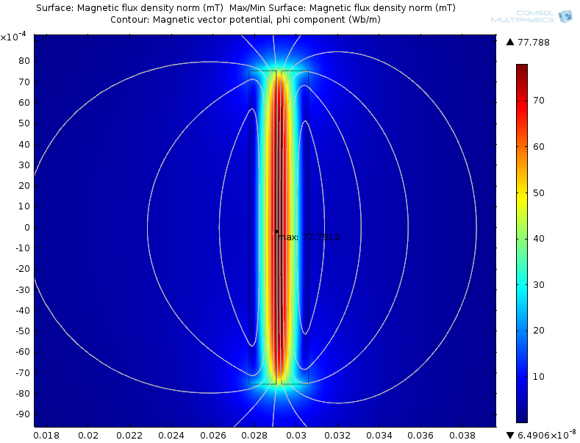
Self-Field Calculations for Cable Test
Cable Parameter | Value
Cable thickness | 1.3 mm
Cable width | 15.09 mm
Cable gap | 0.25 mm
Self-field correction 0.078 T/kA
“Commissioning of 14T/16T Rutherford Cable Test Facility with Bifilar Sample and Superconducting Transformer”, E. Barzi, Vadim Kashikhin, Vito Lombardo, Allen Rusy, Daniele Turrioni, and Alexander Zlobin, AIP Conf. Proc. 1573, 1192 (2014).

Slide 25
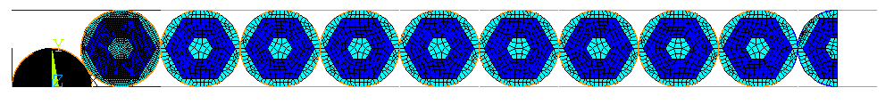
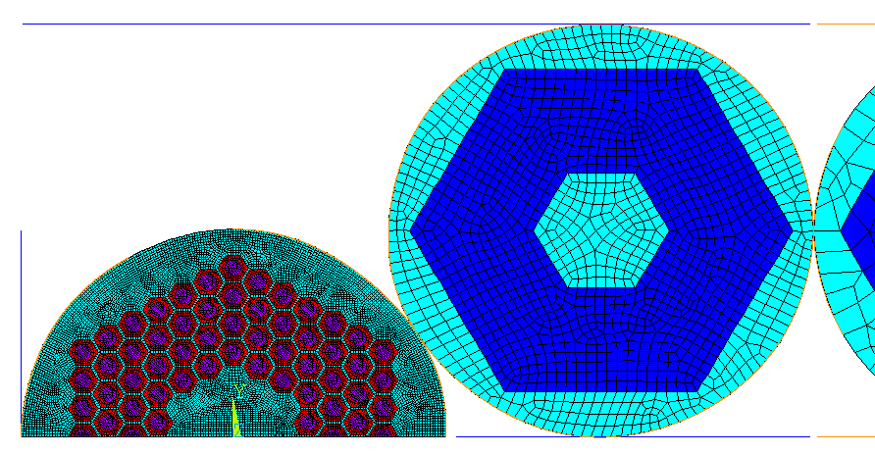
FEM as Aid in Cable Design (1)
Purpose of mechanical analyses and experiments is to identify upper limits to plastic deformation to avoid damage, and to understand the influence of the various geometrical parameters in the manufacturing process.
“FEM Analysis of Nb-Sn Rutherford-type Cables”, E. Barzi et al., IEEE Trans. Appl. Sup., V. 22, No. 3, pp. 4903305 (2012).
“Superconducting strand and cable development for the LHC upgrades and beyond”, E. Barzi et al., IEEE Trans. Appl. Sup., V. 23, No. 3 (2013).

Slide 26
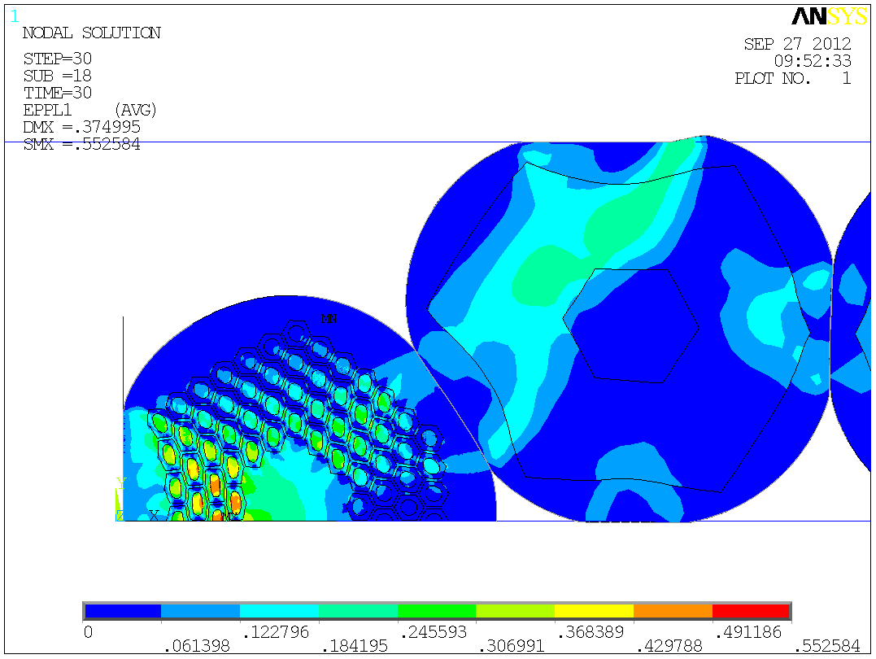
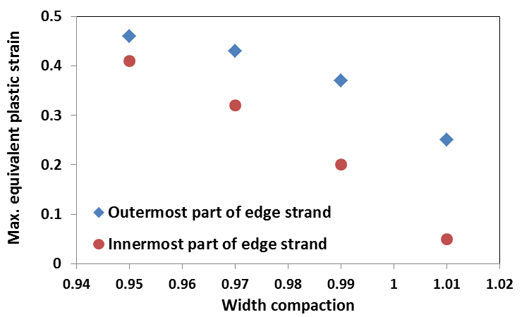
FEM as Aid in Cable Design (2)
Analysis of Strain Sensitivity to Width Compaction w_{C}
w_{C} = width_{cable}/ width_{undeformed}

Slide 27
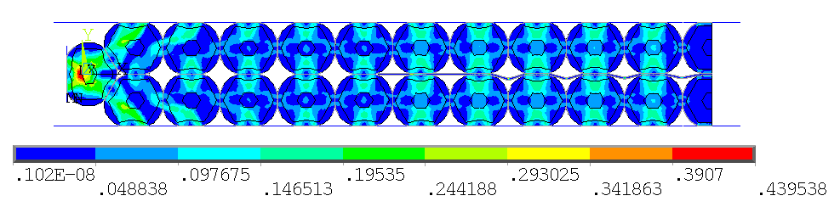
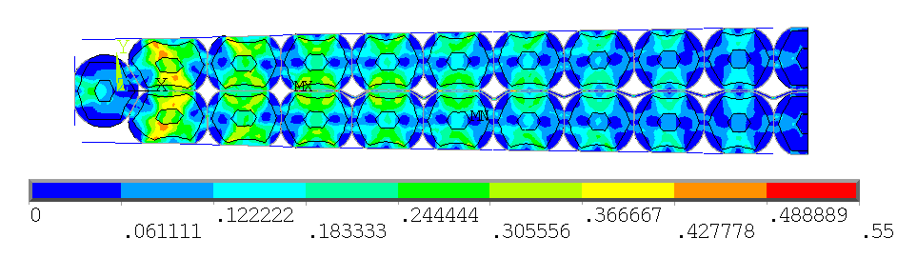
FEM as Aid in Cable Design (3)
Modeling of a Core in the Cable
Rectangular stage
Keystoned stage
Core assumes a wavy behavior, which is compatible
with a non-linear buckling phenomenon

