Slide 1
11T Magnet Test Plan
Guram Chlachidze
CERN-FNAL Collaboration Meeting on DS 11T Dipole Grounds
September 21-23, 2015 @ FNAL

Slide 2
Introduction
11T Test Program is based on significant experience of working with Nb₃Sn magnets at FNAL
First FNAL Nb₃Sn models (HFDA)
LARP technological quadrupoles (TQC and TQS)
Short and Long models of LQ and HQ for LARP
Joint R&D program won 11T magnets initiated in parallel at FNAL and CERN
Coordination of activities at both Labs, including test preparation and planning
Soon after the very first test of 11T demonstrator CERN-FNAL common Test Protocol was developed
First attempt to standardize the magnet test procedure at CERN and FNAL
Defines major test steps and their sequence in test plan
Describes basic test parameters and settings
Makes easier comparison of test results at different Labs

Slide 3
11T Test Protocol
After several discussions the test protocol draft was presented at CERN-FNAL meeting on January 23rd, 2013
Lucio Fiscarelli and Hugo Bajas presented test protocols for quench performance study and field quality measurements

Slide 4
11T Test Protocol
11T R&D test plan was developed based on so called standard measurements, to be consistent with the future Production 11T magnet tests
Parameters of the standard tests are fixed and described in the Test Protocol
A set of extended measurements were added to the test plan
Test facility or magnet specific tests
Different test equipment (splice/energy loss measurements)
Minor deviations in test parameters at CERN & FNAL are expected
Pre-cycle parameters
Injection porch parameters
Parabolic and exponential parts
of post-injection current growth

Slide 5
Test Objectives
Main Test Objectives:
Quench performance study
Field quality measurements
Magnet Protection study
Study of mechanical properties
Test plan is developed and reviewed individually for each 11T magnet
Test plans for the first few prototypes reviewed at CERN
Requirements for Quench Integral (MIITs) budget and External energy extraction system
60 mΩ dump resistor for quench training: lower MIITs, fast quench recovery
Lower dump resistors used for quench protection studies 2.5, 5 and 10 mΩ
Uncontrolled Cool down and warm up for 11T magnets
Temperature gradient less than 150 K for cool down and 10-20 K for warm up

Slide 6
Test Sequence
Tests start at room temperature before cool down
Cool-down, system and magnet checks at 4.5 K before the quench training
Quench performance study
Starting with the quench training at 4.5 K: fast quench recovery, low LHe consumption
Similar training pattern at 4.5 K
and 1.9 K
First quench training at 1.9 K for
recent magnets: to be consistent
with the production magnet tests
LHe make rate increased recently
at MTF

Slide 7
Test Sequence (cont’d)
Magnetic measurements
Preliminary measurements before training
Full set of measurements after training
Quench protection and MIITs Study
High MIITs tests only at the end of testing
Splice resistance, energy loss and inductance measurements, fast extraction tests
Detailed list of tests varies from magnet to magnet
Quench Memory test
2nd thermal cycle depending on magnet performance
SG and voltage spike monitoring during the whole test

Slide 8
R&D Test Plan Details
Tests at room temperature: before cool down
RLQ measurements and Electrical integrity check (HiPot)
Hi-pot schedule: Coil to ground (with heaters grounded or floating) at 1000 V, strip heaters to ground (with coils grounded or floating) at 1000 V, Spot heaters to ground (with coils grounded or floating) at 100 V
Initial RRR measurements
“Warm” magnetic measurements to verify the coordinate system in the vertical position: z-scan at +/- 10 A
Cool-down, System and magnet checks at 4.5K before the quench training
  Strain gauge monitoring with 3 min interval between readings
  Quench detection and protection system checks, cold HiPot test
  Manual trips and heater provoked quenches at currents up to 5000 A
  Preliminary magnetic measurements before training, z-scan at I_{max} = 6500 A
  Adjustment of quench detection thresholds and protection settings
  No high current quenches before training starts

Slide 9
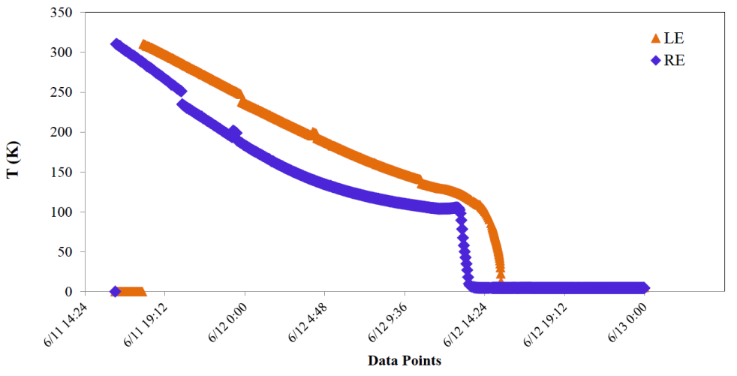
R&D Test Plan
Cool down of MBHSP01 MBHSM01 ramp rate study
Quench performance study at 1.9 K (or 4.5K)
  Quench training: first ramps at 20 A/s, then at mixed ramp rates: start at 50 A/s and then continue at 20 A/s
  Continue training until 5 consecutive quenches are observed with no significant gain
  Ramp rate study after reaching plateau at 1.9 K: ramp up at dI/dt = 10 - 350 A/s, ramp down starting at dI/dt = 300 A/s from I_{nom} or 90% of I_{max}; if quench occurs, identify the highest ramp rate not quenching the magnet

Slide 10
R&D Test Plan (cont’d)
Magnetic measurements at I_{nom} or 90% of I_{max}
Full set of measurements performed at 1.9K, few measurements at 4.5K for comparison
Accelerator (machine) cycle
Ramp rate dependence
Stair-Step measurements
Z scan at selected currents
Pre-cycles, ramp rates, injection porch, reset currents – all defined in the Test Protocol
Temperature dependence study after reaching plateau 1.9K – 4.5K
Start at 1.9K, quenches help to warmup the magnet
At standard ramp rate of 20 A/s unless unusual ramp rate dependence is observed during the quench performance study

Slide 11
R&D Test Plan (cont’d)
More performance tests at 4.5 K
Energy loss measurements: loops at different ramp rates from 500 A to 6500 A
Selected magnetic measurements for comparison with the 1.9 K data
Splice measurements
Quench protection studies at 1.9 K
Protection heater tests: delays as function of magnet current, dissipated power, time constant.
Quench propagation between
the OL and IL coils
Selected spot heater tests
Fast extraction tests
QI studies: maximum MIITs
to be specified

Slide 12
R&D Test Plan (cont’d)
Additional tests: Holding magnet at high current
Demonstrate capability to retain nominal current level or 90-95% of I_{max} for an extended period
Holding time up to 30 min
Tests during and after warm-up
RRR measurements at transition point and 300 K
Magnetic measurements at room temperature: z-scan at +/- 10 A
LARP HQ program: magnetic measurements during warm-up

Slide 13
Finishing R&D Test
The 2nd Test Cycle
Magnet quench memory check
Depending on magnet performance in TC1 and test facility schedule
Final electrical checkout after warm-up
SG and RLQ checkout
Changes in the test plan:
Low pre-load with risk of magnet damage
Magnet instrumentation failure
Data analysis and discussion of results
Preliminary results discussed at internal meetings
Full analysis presented at CERN-FNAL meetings
Summaries on 11T field quality, quench performance and protection study ill be presented today

