Slide 1
11T Magnet Protection
G. Chlachidze, A. Zlobin
CERN-FNAL Collaboration Meeting on DS 11T Dipole Grounds
September 21-23, 2015 @ FNAL

Slide 2
Introduction
11T magnet protection study at FNAL was focused on coil overheating and related issues
Quench Protection system should provide a reliable protection for all possible quenching scenarios
Quench protection in 11T magnets is provided by protection heaters on the outer coil surface
Traditional PH position in accelerator magnets, good thermal contact with coils and good ground insulation
Other heater locations previously tested: Inner layer heaters in LARP LQS and HQ models; Interlayer heaters in first Nb₃Sn models at FNAL (HFDA), as well as in short MQXB models (HGQ)
11T protection study results were presented at various conferences and workshops
ASC 2012 (Portland, USA), IPAC 2012 (New Orleans, USA), WAMSDO 2013 (CERN), IPAC 2014 (Dresden, Germany), ASC 2014 (Charlotte, USA), QXF Quench Protection Workshop in 2014 (CERN) and other conferences and collaboration meetings

Slide 3
Protection Study Objectives
Comprehensive protection study was done in a single aperture 11T models:
Effect of heater insulation thickness
Heater efficiency at different magnet currents
Quench temperature measurements
Heater efficiency in low-field (LF) and high-field (HF) coil blocks
Radial quench propagation from the outer to the inner coil layer
Longitudinal quench propagation velocity
Quench integral study with different dump resistors
Fast extraction tests
Only few tests were performed in dual aperture magnet MBHDP01
External energy extraction was part of this study
Low dump resistors 2.5 mΩ, 5 mΩ and 10 mΩ were implemented at VMTF
No dump condition was simulated by delaying the dump firing for 1000 ms

Slide 4
11T protection tests at FNAL
Protection test data are available for the following magnets:
MBHSP01 demonstrator with 2-m long coils #2 and #3 - June 2012
  0.7 mm diameter RRP 108/127 strand
  12 mm thick SS welded skin
MBHSP02 with 1-m long coils #5 and #7 - February 2013
  0.7 mm diameter RRP 150/169 strand
  12 mm thick bolted skin
  0.025 mm thick and 11 mm wide stainless steel core in the conductor
MBHSM01 mirror with coil #8 – December 2013
  Mix of 0.7 mm diameter RRP 108/127 and RRP 114/127 strands
  12 mm thick bolted skin
  0.025 mm thick and 11 mm wide stainless steel core in the conductor
MBHDP01 dual aperture magnet with coils #5 and #7 from MBHSP02 and coils #9 and #10 from MBHSP03

Slide 5
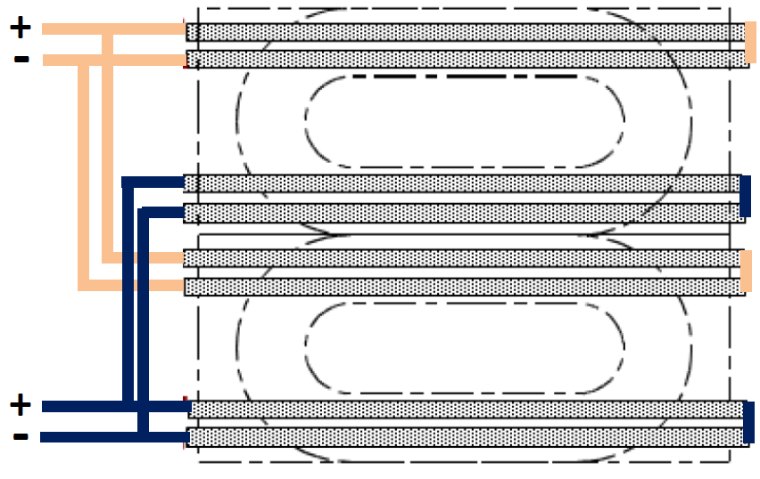
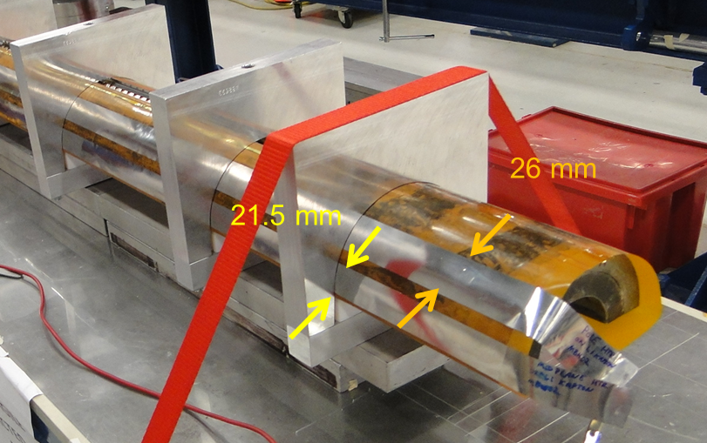
Protection Strip Heaters
11T coils are equipped with 2 protection heaters on the outer coil surface
  Each heater consists of two 0.025 mm thick stainless steel (SS) strips
  SS strips are 21.5 mm wide in the mid-plane (LF) and 26 mm wide in pole area (HF)
  Heaters cover 31 turns per quadrant or about 56% of total coil surface
Due to difference in width of heater strips the peak power density dissipated in the LF is about 50% more than in the HF area

Slide 6
Heater to Coil Insulation
  Strip Heaters are placed between the ground insulation layers of Kapton
MBHSP01: two different heater-to-coil insulations were investigated
  One pair of strips was placed between the 1st and 2nd Kapton layers (PH-1L) and another pair – between the 2nd and 3rd Kapton layers (PH-2L)
0.125 mm layer of glass on the outer coil surface was impregnated with all 11T coils
MBHSP02, MBHSM01, MBHDP01: only PH-1L heaters were used
PH-1L
PH-2L
PH-2L
PH-1L

Slide 7
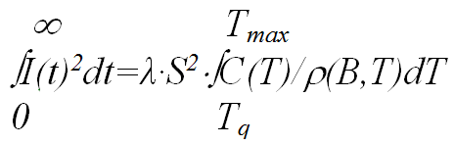
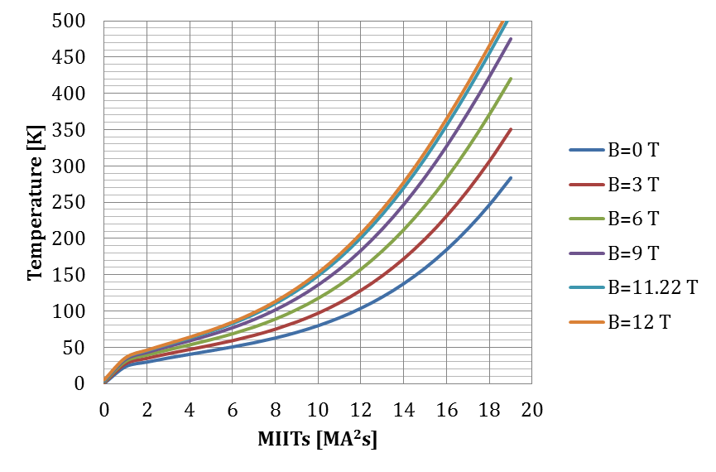
Cable Maximum Temperature
In adiabatic conditions
where
I(t) is the current decay after a quench (A)
Tq is the conductor quench temp. (K);
S is the cross-section of insulated cable (m²);
λ is fraction of Cu in insulated cable cross-section;
C(T) is the average specific heat of insulated cable (J/K/m³);
ρ(B,T) is the cable resistivity (Ω∙m).
FNAL-CERN calculations are consistent
CERN

Slide 8
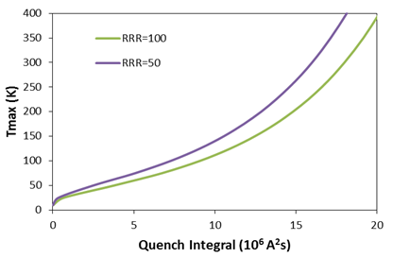
Quench Integral Limit
Additional corrections are required due to field change during current decay after quench and strand RRR:
Average temperature between B_{max} and B=0 (left)
Curves for RRR=100 and RRR=50 fit well (right)
  To keep T_{max} below 400 K - a safe limit for Nb₃Sn accelerator magnets – QI should be less than (19-21)*10⁶ A²s (MIITs) for the HF and LF coil blocks

Slide 9
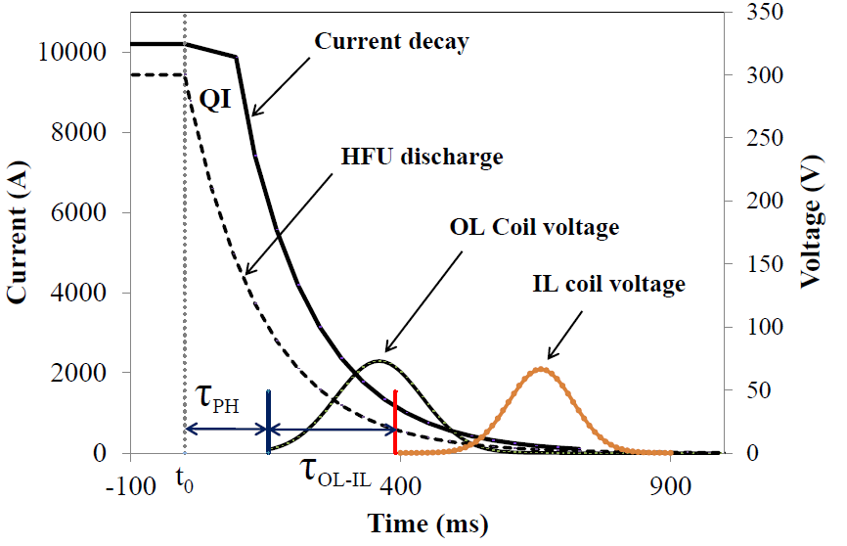
PH Test Procedure/Definitions
Manual trip at t₀=0: No dump (1000 ms delay), OL heaters fired, magnet
current decay starts
τ_{PH} Heater delay - delay between
the heater firing and the quench
start
τ_{OL-IL} - Quench propagation time
between the OL and IL coils
Peak heater power density is defined as P_{PH} = I_{PH}²∙R_{PH}/A, where
I_{PH} is the maximum heater current (A),
R_{PH} is the heater resistance (Ω)
A is the heater area (cm²)

Slide 10
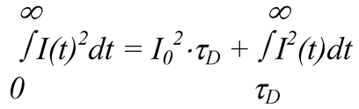
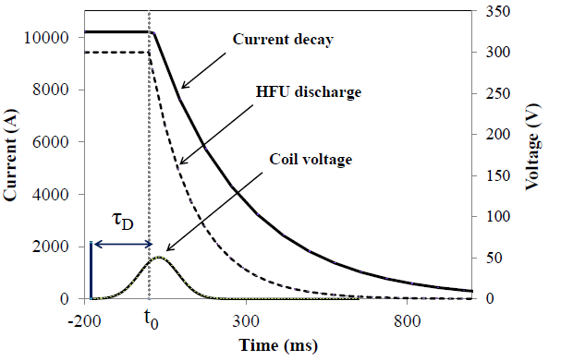
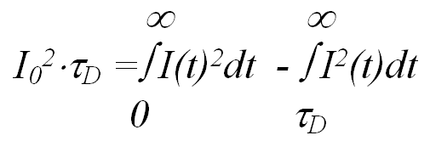
Budget Estimates
MIITs budget in a spontaneous quench is estimated as
where
I_{o} is the magnet quench current
τ_{D} is the total delay time including
the quench detection, protection
switch operation, heater delay time
I(t) is the current decay after quench
detection
Delay budget is estimated as

Slide 11
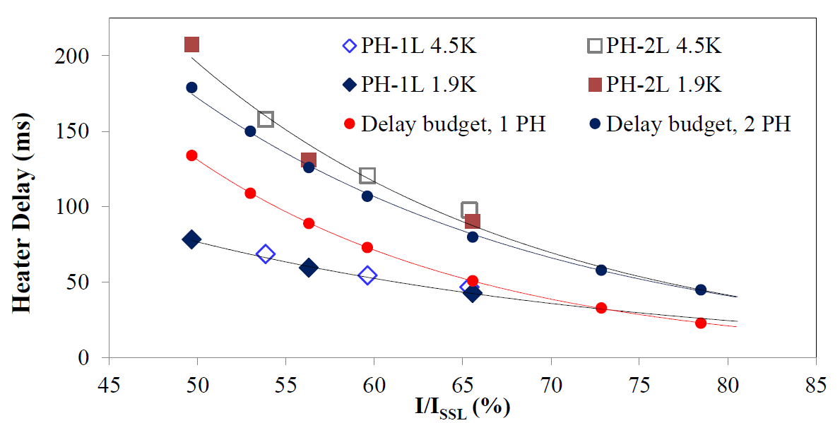
Heater Delay Budgets
Heater delay budgets estimated for the 1 PH or 2 PH operations in MBHSP01
Coil T_{max} is 400 K
Average quench detection time 10 ms
Protection switch operation time 5 ms
H-2L heaters with 2 layers of the Kapton insulation demonstrated large delays, providing no delay margin both for 1 PH or 2 PH operations
P_{PH} = 25 W/cm²
τ (RC) = 24 ms

Slide 12
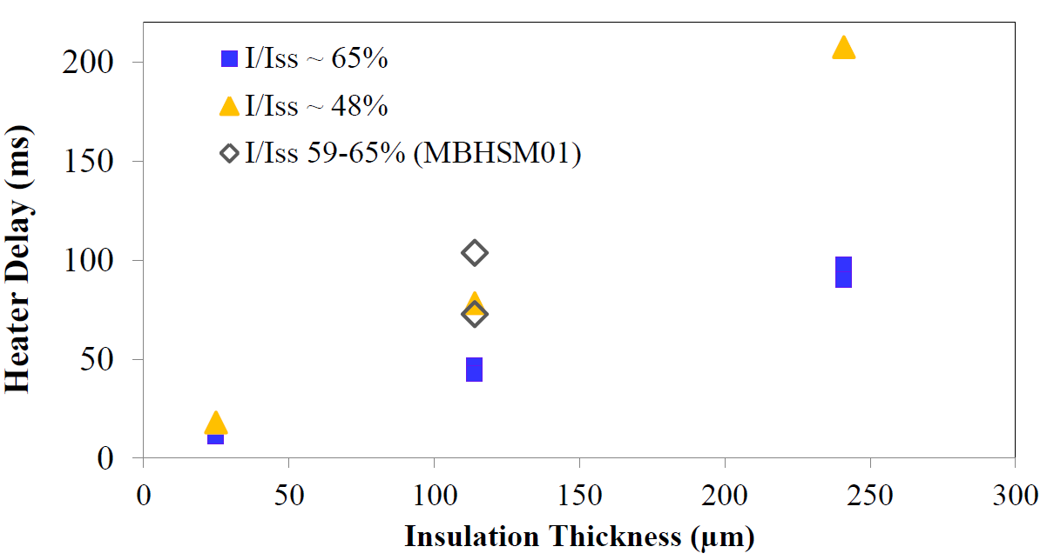
Effect of PH insulation
Peak power density of 15-20 W/cm² in MBHSM01 and 25 W/cm² for remaining data from different tests
PH delay is increasing proportionally to the insulation thickness
Insulation thickness could be reduced until it provides good electrical isolation between the coil and heaters

Slide 13
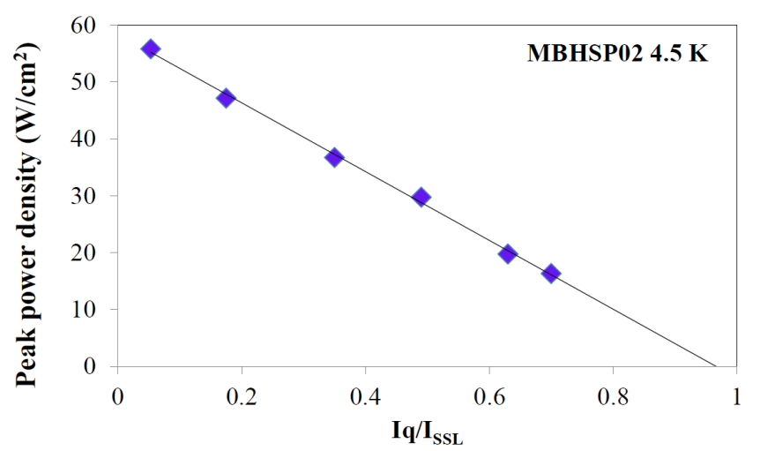
PH efficiency studies
The minimum peak power density required to quench the magnet estimated at different currents
2 OL heaters in protection, time constant of ~ 25 ms
Heater power density increased gradually until quench occurs
For P_{PH}≈55 W/cm² magnet is protected at all operation currents

Slide 14
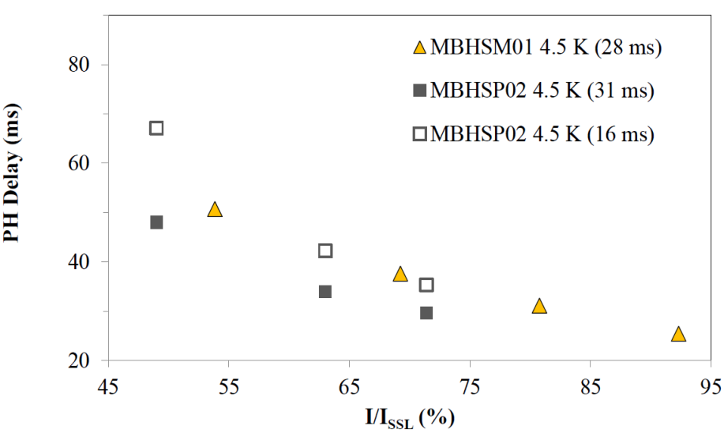
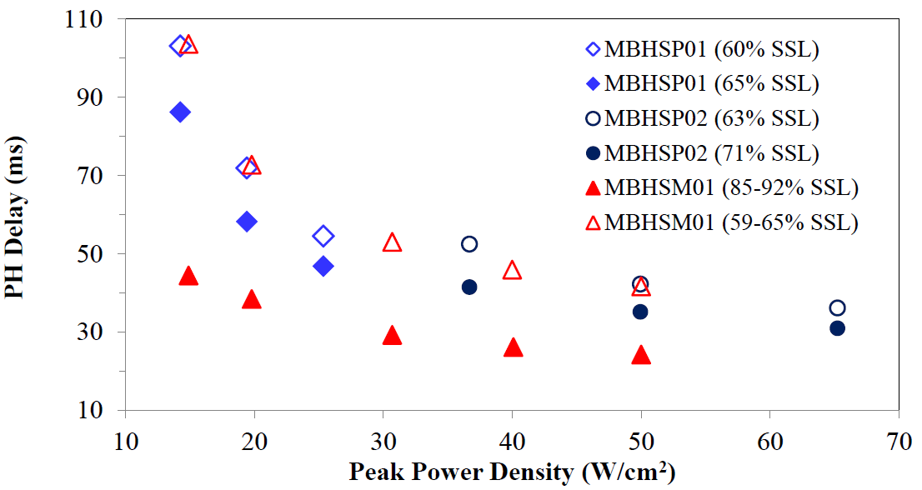
PH efficiency studies
PH delays consistent in different magnets
PH delays measured for the peak power
density of ~ 50 W/cm²
PH delay can be reduced by adjusting the
PH peak power density or time constant

Slide 15
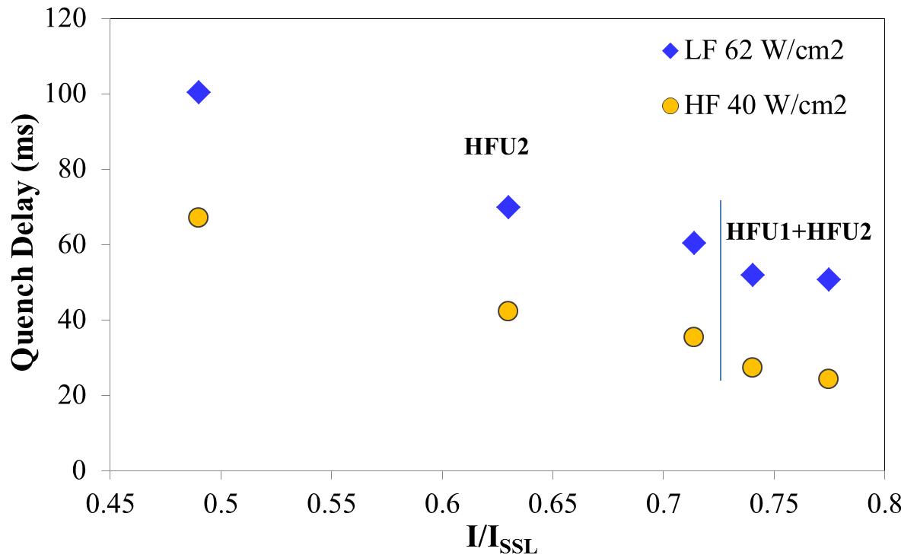

PH delay in LF and HF areas
Due to different heater width the peak power density is also different in low-field (LF) and high-field (HF) blocks
P_{LF} = 1.24∙P_{av} , P_{HF} = P_{av}/1.24 where P_{av}=I²(R_{LF}+R_{HF})/(A_{LF}+A_{HF})
The difference in quench time between LF and HF blocks is ~ 30 ms

Slide 16
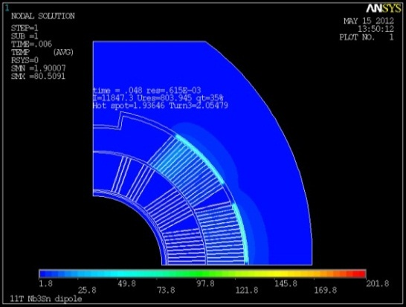
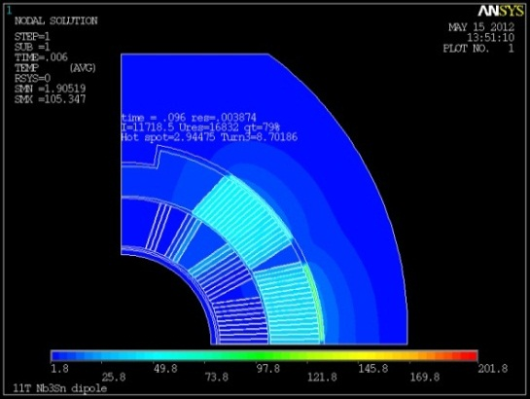
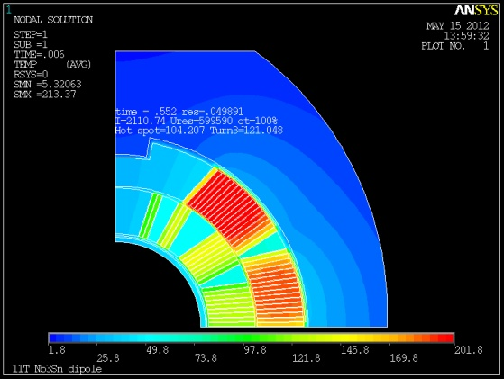
Radial & Azimuthal Quench Propagation
Heat transfer from the PH to the OL and then from the OL to the IL coil helps to spread and absorb the magnet stored energy
Temperature profile in the magnet after 48, 96 and 552 ms from the OL PH induced quench at a nominal current of 11.8 kA (ANSYS)
2D calculations - resistance in IL blocks #2 and #3
Radial quench propagation was measured in all 11T models
Currently standard measurement for all Nb3Sn magnets

Slide 17
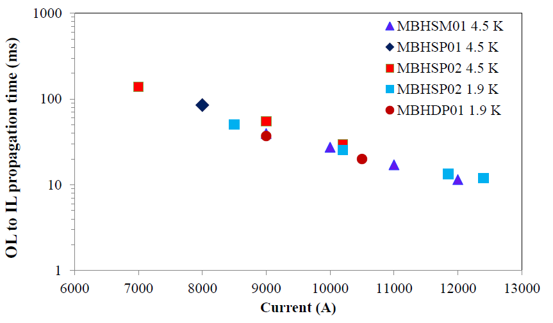

Radial Quench Propagation
OL to IL quench propagation time was measured in quenches with dump delayed for 1000 ms (No Dump)
Average peak power density was ~50 W/cm²
Δt(I_{nom})~25 ms, reproducible, OL pole block and IL 2nd block quenching first

Slide 18
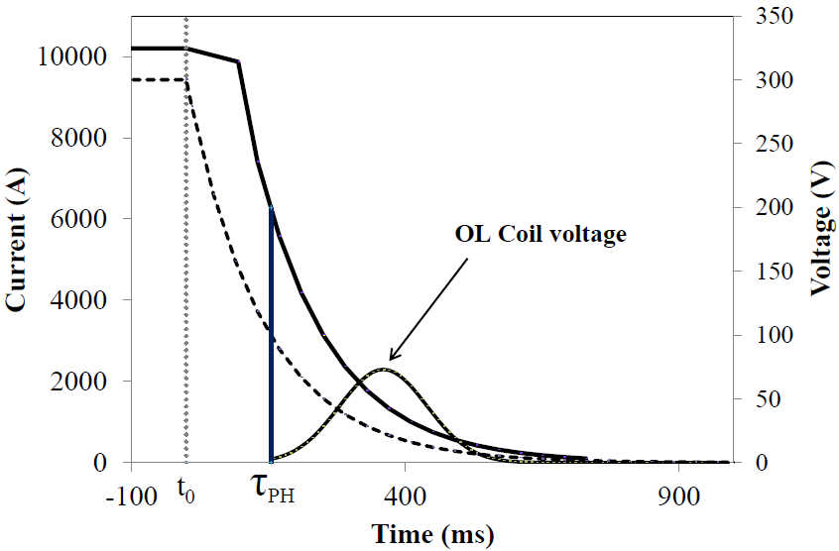
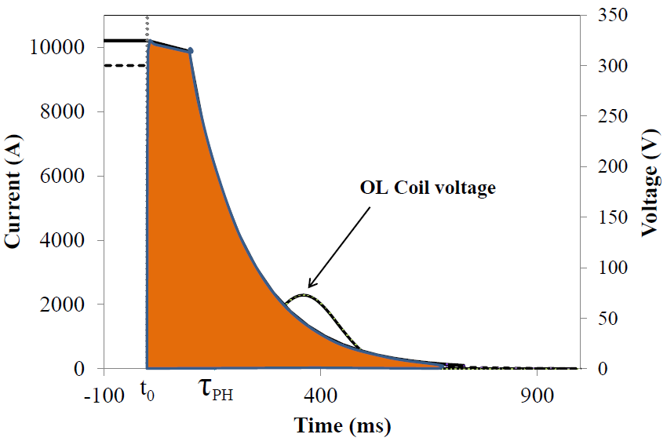
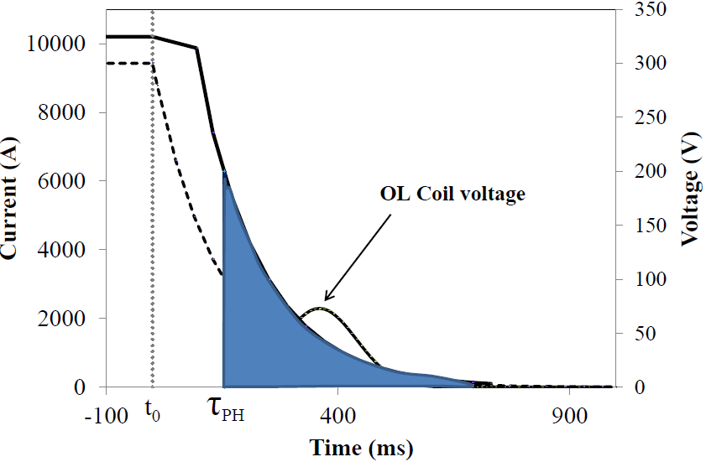
Quench Integral Study
The Quench Detection system was manually tripped at t₀; the OL heater induced quench will start after τ_{PH}
Decay QI was calculated for the whole current decay (t₀,∞), including the heater delay
Decay QI can be used to estimate expected QI in a spontaneous quench by adding MIITs corresponding to the quench detection time
Safe for magnet
Decay QI (t>0)

Slide 19
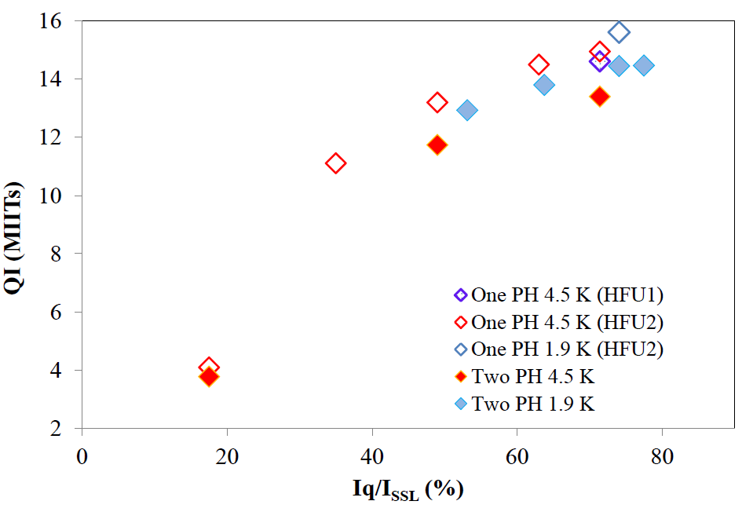
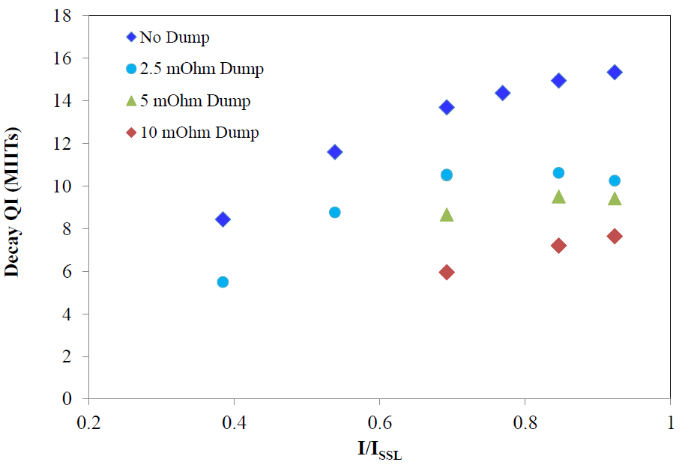
QI Study in 11T magnets
Decay QI for No Dump case (dump delayed for 1000ms) were estimated in MBHSP01/02 and MBHSM01 magnets
In MBHSM01 QI was estimated also for low dump resistors 2.5 mΩ, 5 mΩ and 10 mΩ
Decay QI(I_{nom}) is ~15 MIITs, therefore estimated QI budget of 19/21 MIITs (HF/LF) provides reasonable budget for quench detection time: ~28 ms in HF and ~42 ms in LF coil blocks
MBHSP01-02 Decay QI, “no dump”
MBHSM01 Decay QI

Slide 20
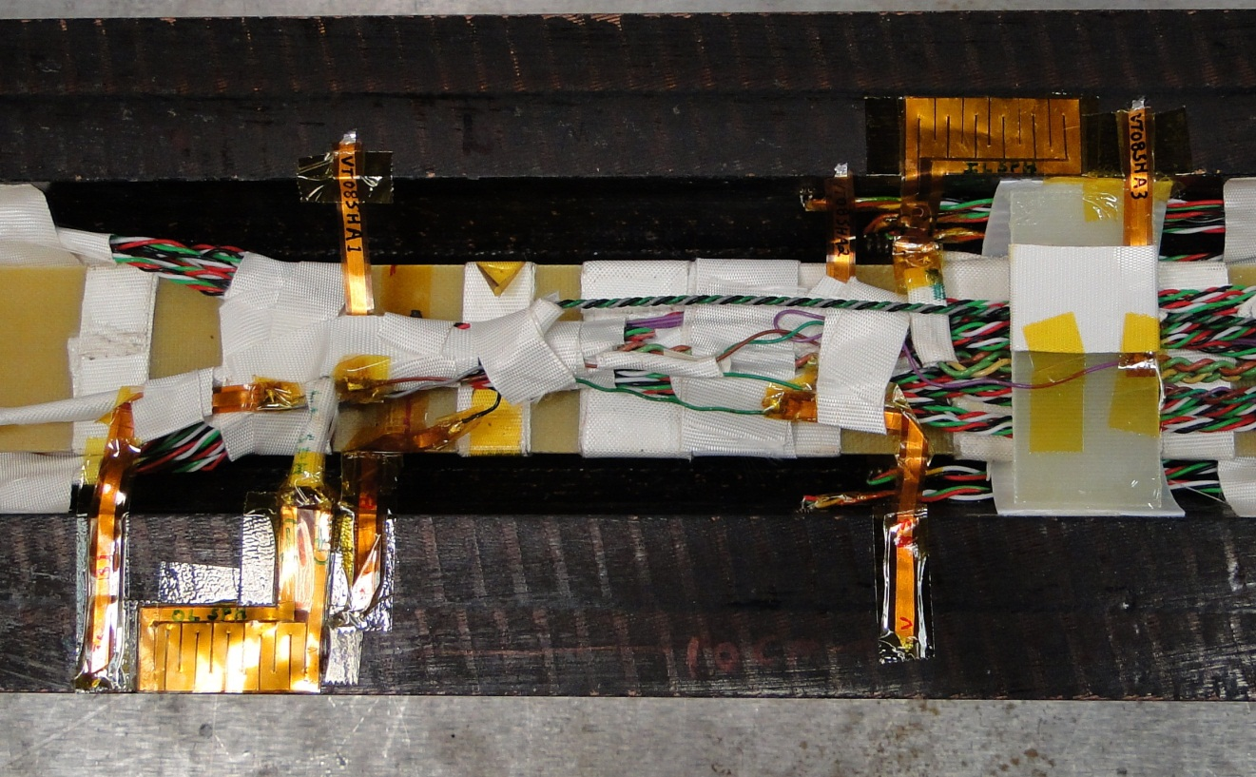
Spot Heater Tests
Spot heaters (SH) installed in MBHSM01 for estimation of the quench temperature and longitudinal propagation velocity
  VT installed in close proximity to the SH
IL Spot Heaters were lost
after cool down
5 cm
10 cm

Slide 21
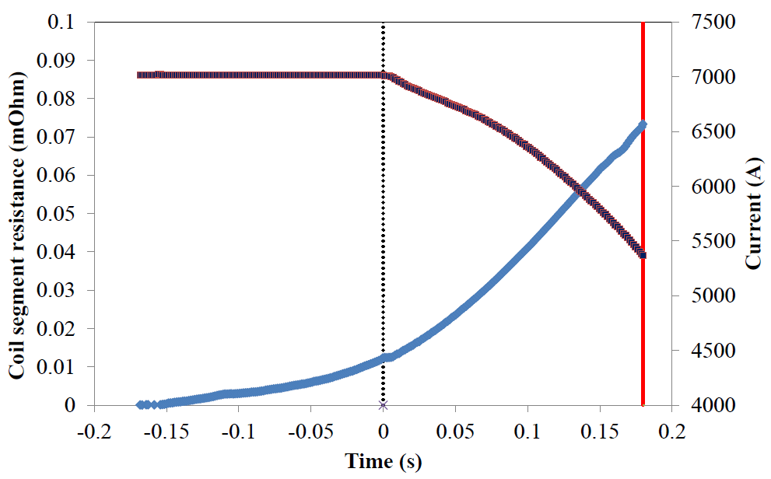
Spot Heater Tests at 4.5 K
Only OL spot heater was available for testing:
  Peak power density of ~26 W/cm² was deposited at different currents
  Dump was delayed for 70-250 ms to increase accumulated QI and reach higher temperatures
Dump Fired
Quench
Detected
SH Fired

Slide 22

Quench Temperature measurements
Coil temperature as a function of time was estimated in the OL mid-plane turn at different currents
Dashed lines connect points with the same QI
Coil temperature estimated from the equation
  Coil temperature was measured during the warm-up from 4.5 K to 200 K to calibrate the coil resistance change during the quench
Strong cooling effect in the coil
Heat transfer from the cable

Slide 23


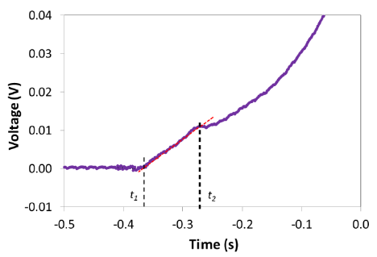
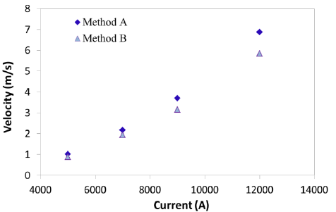
Longitudinal Quench Propagation
The OL spot heater quenches in MBHSM01 used to estimate the longitudinal quench propagation velocity
Voltage growth with time in the L=10 cm long
segment next to the SH
Method A: B: ~ L/(t₂-t₁)
L=10 cm
Cable Temperature increase
Quench Propagation

Slide 24
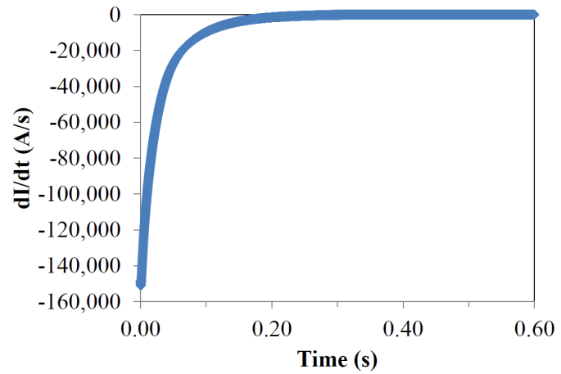
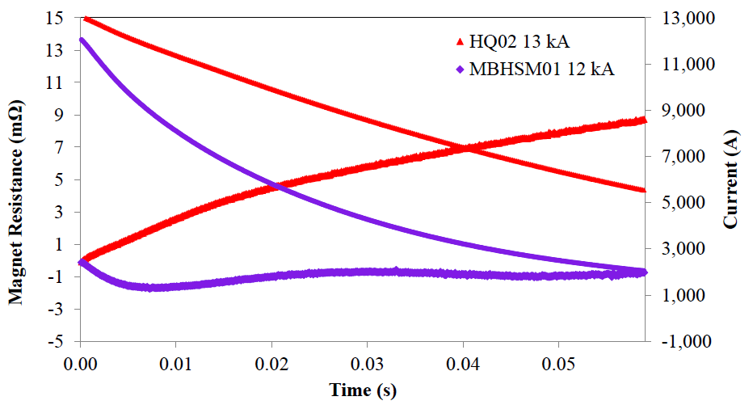
Fast extraction tests
The extraction dump is initiated at different currents w/o protection heaters.
No resistance increase was observed in the coil for the fast extraction at 12 kA
Effect of cored cable and small filament size
Whole coil resistance change in HQ02 and MBHSM01 magnets
Ramp rate for the fast extraction test

Slide 25
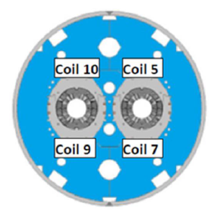
MBHDP01 Tests
Quench propagates between the magnet apertures
PH induced quenches in coils #5 and #7
Dump and heaters in the 2nd aperture delayed to see
quench development in coils #9 and #10
More tests will be done in TC2

Slide 26
Summary
Quench protection study was performed at currents up to 92% of SSL and for different external dump resistors in different 11T models
Operation with at least 2 OL protection heaters is required for adequate protection of 11T magnets
Reduced heater to coil insulation helps to increase the heater efficiency, but sufficient electrical insulation has to be provided
Estimated QI budget of 19-21 MIITs provides reasonable quench detection time budget of ~ 28 ms in the high field coil block
Minimum peak power density of ~55 W/cm² is required to quench magnet at currents I_{inj} < I < I_{nom}

Slide 27
Summary (cont’d)
Radial quench propagation was measured at different currents and temperatures
  Quite small delay at high currents helps to spread energy in the coil
Longitudinal quench propagation velocity was estimated in the mid-plane turn at different currents
Coil temperature increase with time after quench was studied at different currents
Fast extraction tests did not exhibit noticeable increase of the coil resistance

Slide 28
BACKUP SLIDES

Slide 29
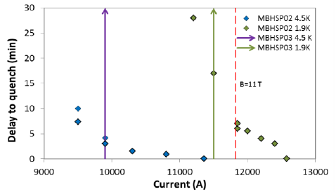
“Holding quenches”
No quenches in MBHSM01 (coil #8) after “holding” 13 kA at 1.9 K and 12 kA at 4.5 K
for ~22 min

Slide 30
Quench training of 11T magnets

