Slide 1
Collaboration Meeting on
DS 11T Dipole Grounds
Current baseline design, project status and plan
F. Savary, on behalf of WP 11
23 September 2015

Slide 2
OUTLOOK
Terminology and HL-LHC time line
Part I: Current baseline design
  Cable
  Cross section
  Cold mass assembly
  Integration, powering, trim
  Quench heaters and protection
Part II: Project status and plan
  Overall plan
  Model program
  Prototype
Conclusions

Slide 3
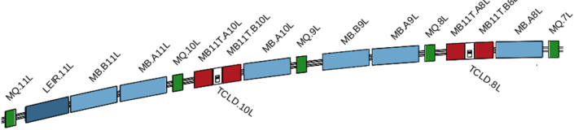
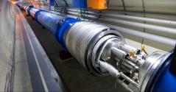
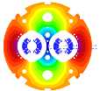
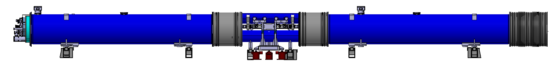
Reminder on terminology – CRYO-ASSEMBLY
Create space in the dispersion suppressor regions of LHC, i.e. a room temperature beam vacuum sector, to install additional collimators (TCLD), which are needed to cope with beam intensities that are larger than nominal, such as in the High Luminosity LHC (HL-LHC)
Replace a standard MB by a pair of 11T dipoles (the 11T dipole is also called MBH)
By-pass cryostat
15660 mm
11 T dipole cold mass
Interconnect
Space for Collimator

Slide 4
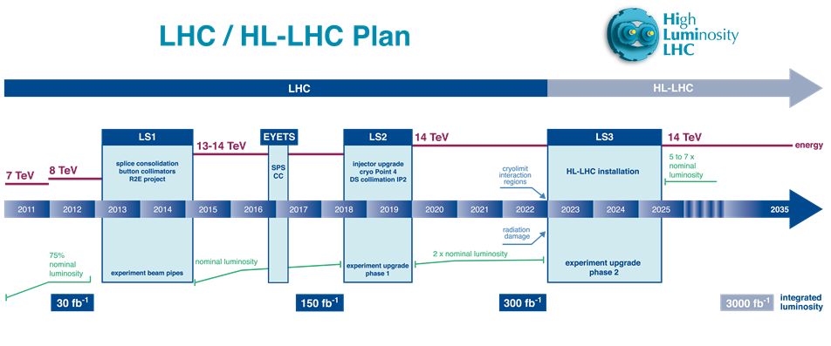
The DS 11T dipole on the HL-LHC timeline
Will start 6 months later
Will start a year later
First-of-a-kind shall be made before starting LS2
2nd unit immediately after
Possibly for IP2, however, installation during LS2 NOT ANYMORE in the baseline
In total up to 8 units
4 to 6 units to be installed
+ 2 spare units
6 additional units, of which:
  4 for installation in IP7
  2 spare units

Slide 5
Another solution under study for IP2 – Heavy ions
J.M. Jowett, Collimation Upgrade Meeting, 20/3/2015
Following 2013 Collimation Review:
  First installation (2 TCLD units) foreseen for ALICE Pb-Pb in LS2, subject to confirmation after 2015 Pb-Pb run and tests of bump mitigation techniques
Because of the form of the dispersion function in IR2, there is a possibility that we can combine bumps and an alternative location of the TCLD in the connection cryostat (missing MB)
  No 11 T magnets required
  Different but apparently simpler integration
  Significant orbit bump during luminosity operation!
  Option to include an additional horizontal corrector beside it

Slide 6
OUTLOOK
Terminology and HL-LHC time line
Part I: Current baseline design
  Cable
  Cross section
  Cold mass assembly
  Integration, powering, trim
  Quench heaters and protection
Part II: Project status and plan
  Overall plan
  Model program
  Prototype
Conclusions

Slide 7
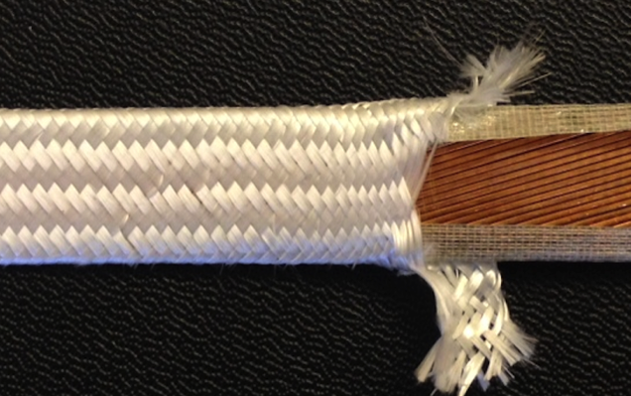
Conductor, cable and insulation scheme
Conductor (batch of 500 km)
  Type
  Diameter
  RRR
  Cu/non-Cu ratio
  Minimum strand critical current, I_{C} (12T, 4.222 K)
  RRP 108/127
  0.700 ± 0.003 mm
  > 150
  1.15 ± 0.1
  438 A
Cable
  Number of strands
  Width before reaction
  Mid-thickness before reaction
  Keystone angle
  Cable unit length
  40
  14.7 mm
  1.25 mm
  0.79 degree
  ~ 600 m
B. Bordini
Insulation scheme
  Mica tape, COGEBI FIROX®, thickness 80μ
  S2 glass gleeve
  Resin impregnation, CTD-101K
D. Smekens

Slide 8
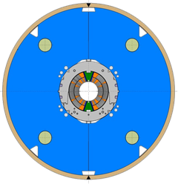
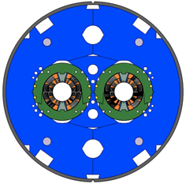
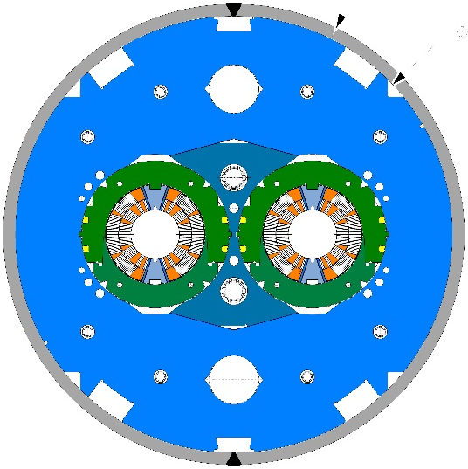
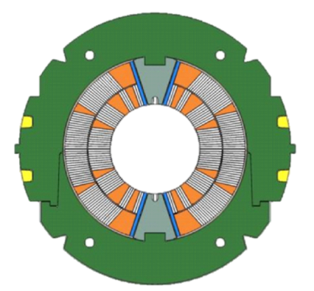
Cross-section
Shim added between central yoke and laminations to allow adjustment
Models
Model MBHDP101
Model MBHDP102 – Proto P1
+ first 2 cryo-assemblies + …
60 mm
Collared coils
Single aperture model
Two-in-one original
Two-in-one baseline
182 mm
534 mm
580 mm
570 mm
6 block Nb₃Sn coils of Ø 60 mm aperture
56 turns, 22 in inner layer, 34 in outer layer, no interlayer splice
Removable poles made of Ti
Separate stainless steel collars for each aperture
Vertically split iron yoke
Stainless steel shell of 15 mm thickness (2-in-1)

Slide 9
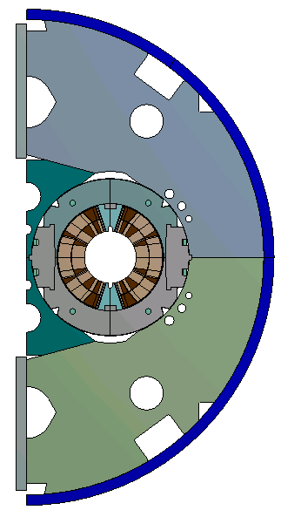
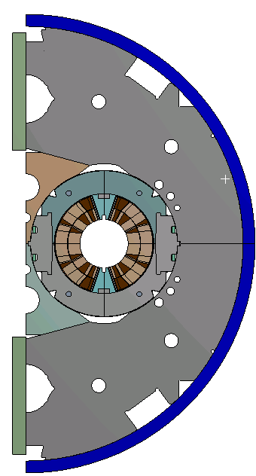
Structural assessment
F. Lackner, T. Lyon
Yoke Outer Radius: 275 mm
Shell thickness: 15 mm
1 rod hole
Yoke Outer Radius: 270 mm
Shell Thickness: 15 mm
2 rod holes

Slide 10
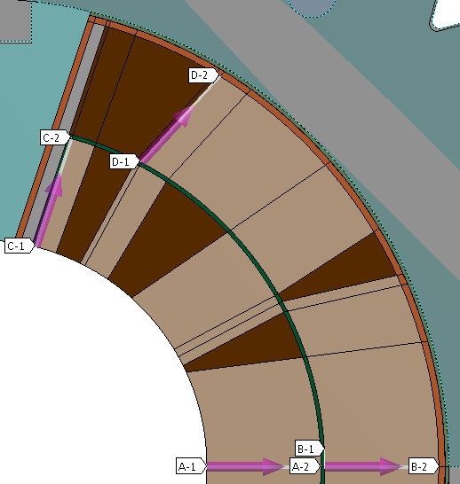
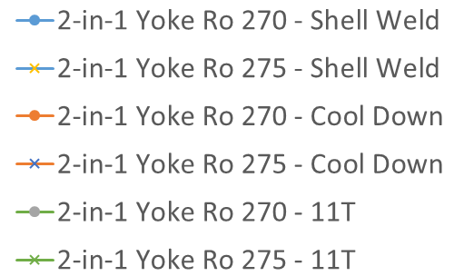
Structural assessment, 2
F. Lackner, T. Lyon

Slide 11
Cold mass assembly – LMBH_001
H. Prin, D. Smekens, A. Temporal

Slide 12
Cold mass assembly – LMBH_002
H. Prin, D. Smekens, A. Temporal

Slide 13
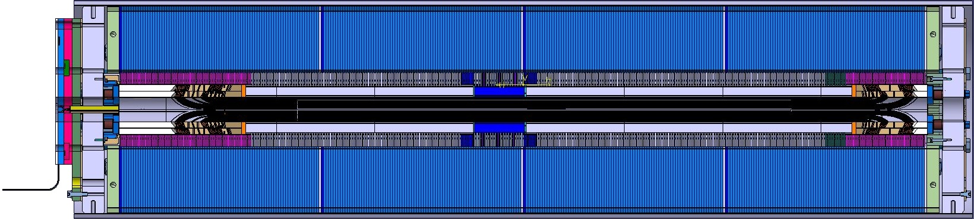
S. Izquierdo Bermudez
Magnetic Yoke
Magnetic Length
Coil Length
Total Yoke Length
250 mm non magnetic
150 mm non magnetic

Slide 14
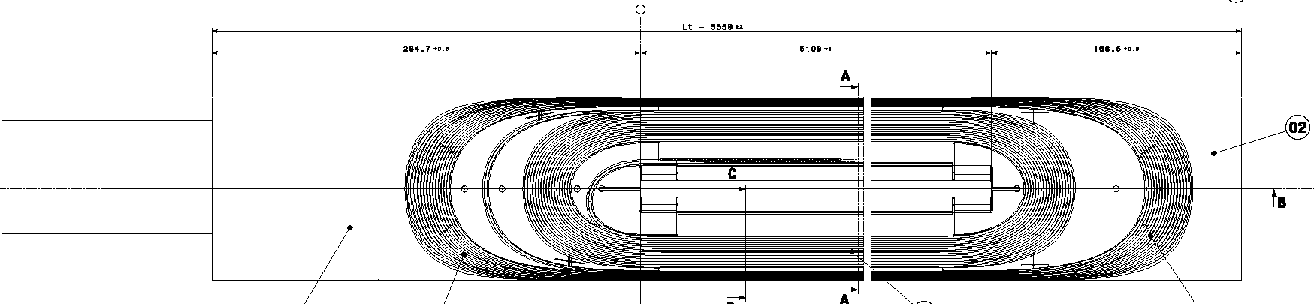
Longitudinal section of the coil
The length of the coil is not finalized yet, as there are still uncertainties, and there are key parameters that need to be determined:
  The variations of length during/after binder curing and reaction need to be determined on long coils
  The introduction of the cut-back (non-magnetic laminations in the ends) to avoid peak field in the transition region between the straight part and the ends, means that the coils shall be ~ 20 mm longer
  Also, the reduction of the yoke OD shall be compensated by an increase of the coil length of ∼ 5 mm
  A stacking factor of 98.5 % ± 0.25 % will be implemented (coils will have to be slightly longer)
  The transfer function shall be checked
Final length will be determined when the magnetic measurements are done on the prototype P1

Slide 15
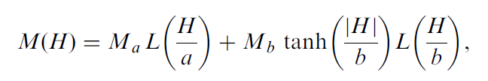
Transfer function
L. Fiscarelli, S. Izquierdo Bermudez
MBHSP102
Critical region!
  Possible sources of errors:
  Iron properties (the main source of errors)
        When using data measured during the LHC production, discrepancy decreases by 20 units (from ~70 to ~50 units)
  Stacking factor of the yoke laminations
      Can explain up to ~15 units
  Geometric
      Rather big displacements are needed to explain
      other 35 units (350 µm smaller coil gives ~15 units)
Modification on the BH data based on Wlodarski empirical relation.
Nom. Correspond to the parameters reported in S. Russenschuck book

Slide 16
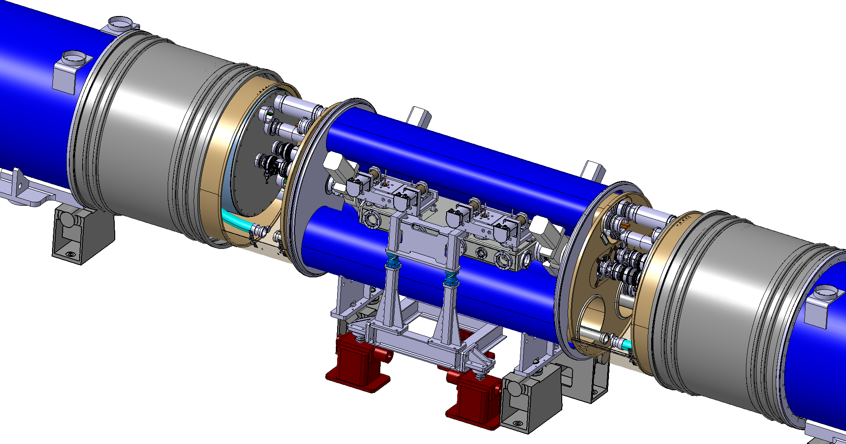
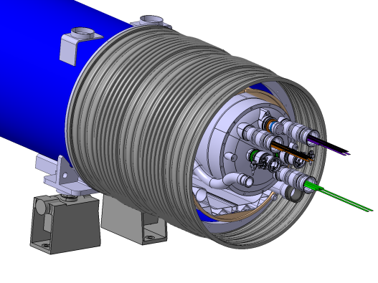
Integration
D. D. Ramos
LHC MB cryostat replaced by 3 cryostats + collimator, all independently supported and aligned
Same 15660 mm length between the interconnect planes as an in the LHC Main Dipole
By-pass cryostat between two 11 T magnets to integrate the collimator (600 mm jaws)
Same interfaces at the extremities: no change to nearby magnets, standard interconnection procedures & tooling

Slide 17
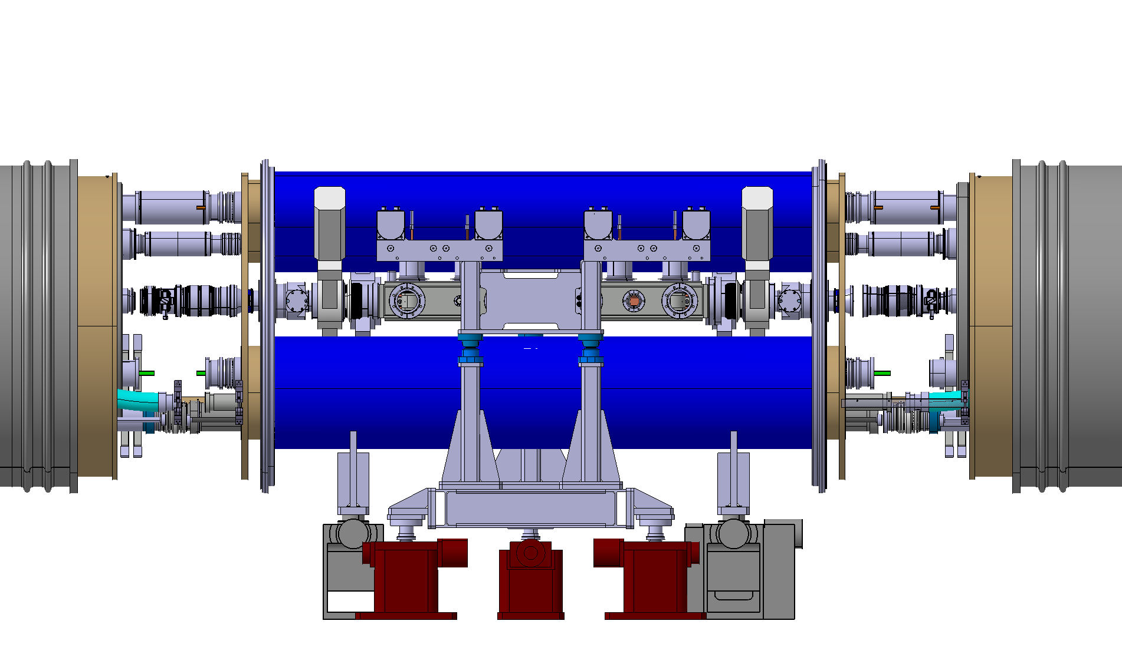
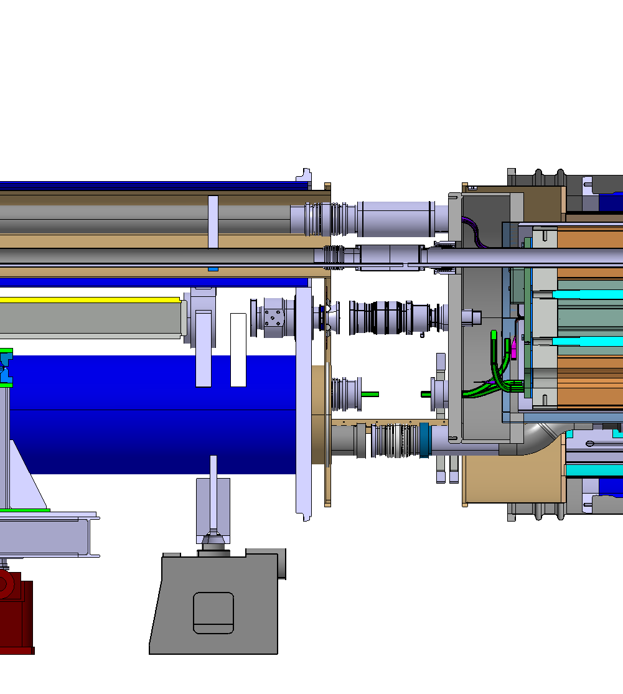
Integration 2
D. D. Ramos
Cold mass enlarged to Ø750 on the collimator side
Constant LHC arc outer flange diameter: Ø1055
Flexible interconnects for alignment independency and thermal contraction
  Busbar routing is now in the shadow of the beam screens and CWT!

Slide 18
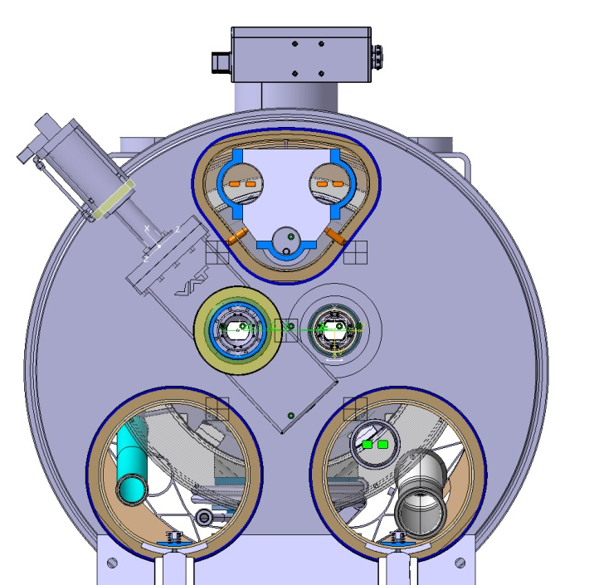
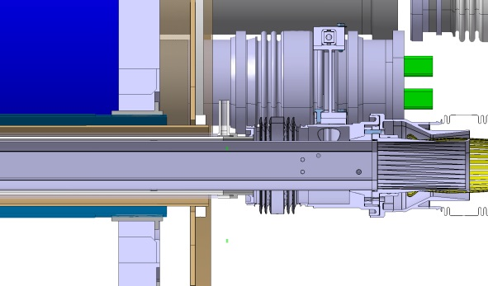
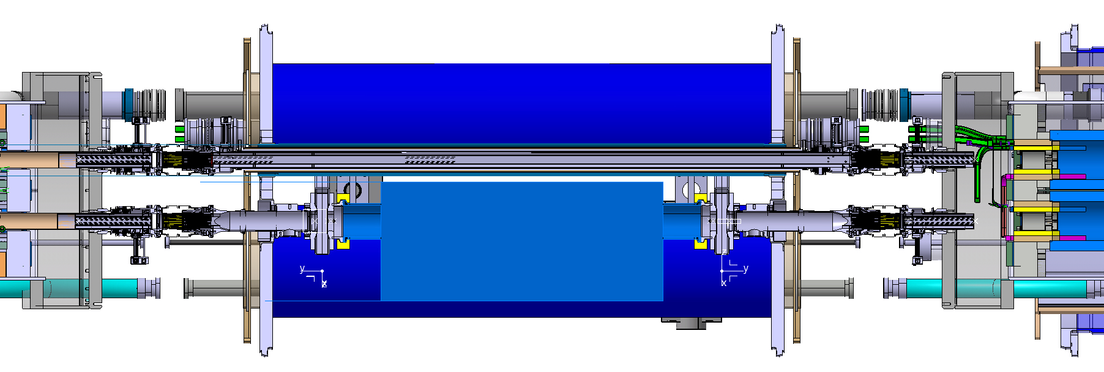
Integration 3
D. D. Ramos
Interconnects become longer because of the beam screens
Very compact cold line because of the sector valve RF shielding
Cold drift vacuum chamber
Vacuum group opts for cold line: “simpler” system, no failure prone sector valves
Transitions avoided because there are no sector valve on the other beam lines

Slide 19
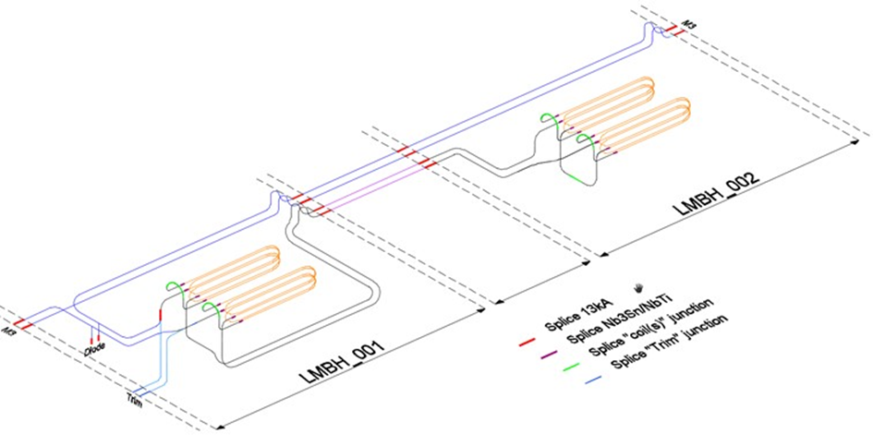
Electrical circuit – Powering
L. Grand-Clement, H. Prin
One protection diode for the 2 MBH
Resistance to radiations need t.b.c. (peak dose
value of up to ~1 MGy at the inner edge of
the coils [in the horizontal plane])
Only 2 types of cold masses
M3 line
I_{IN}
I_{OUT}

Slide 20
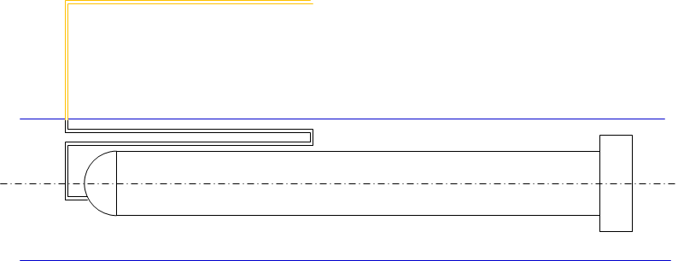
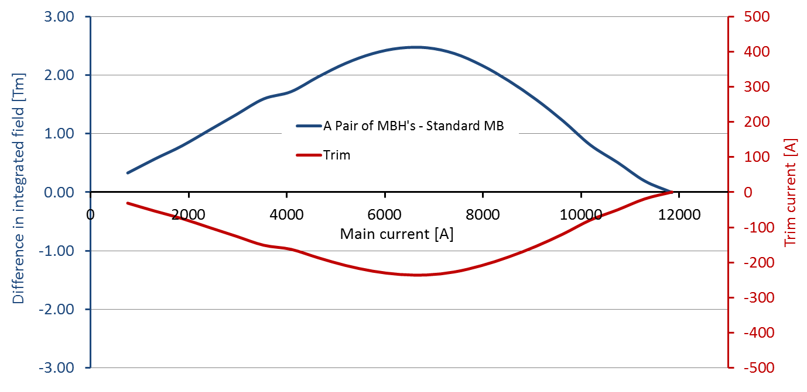
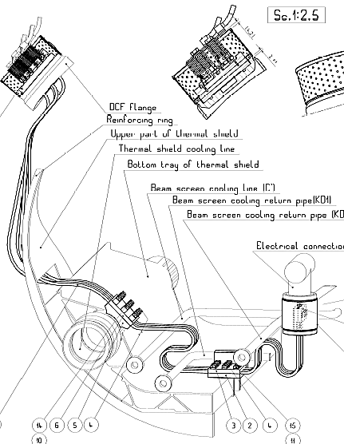
Electrical circuit – Trim
The integrated field of a pair of MBH’s is 119 Tm at 11.85 kA
The MBH is stronger than the MB below nominal current with a peak difference in integrated field around 6.5 kA
A trim current is used to correct for
this and avoid deformation of the
beam closed orbit
Conduction cooled leads:
about 3.6 W/kA to 1.9 K
RT copper cables → towards power converter
  Main characteristics of the trim power converter:
  Current rating: 0 – 250 A
  Voltage rating: ± 1.5 V + V_cable (< ± 40 V)
  Accuracy: 40 ppm (12 mA)

Slide 21
Quench heaters
S. Izquierdo Bermudez
Baseline after review of the analysis and
test results
  QH located on the outer surface of the
  outer layer, and impregnated with the coil
Inter-layer QH are under development
  Will not be tested/available before we start the fabrication of the coils for the prototype P1. However, will be hopefully available for the first series magnets
Quench heater circuit(s) redundancy needs to be defined, e.g.
  Protection still effective when one (or two) of the QH is (are) lost
    OR
  Additional circuit is available and may be connected in case there is a failure in the already connected/used circuit

Slide 22
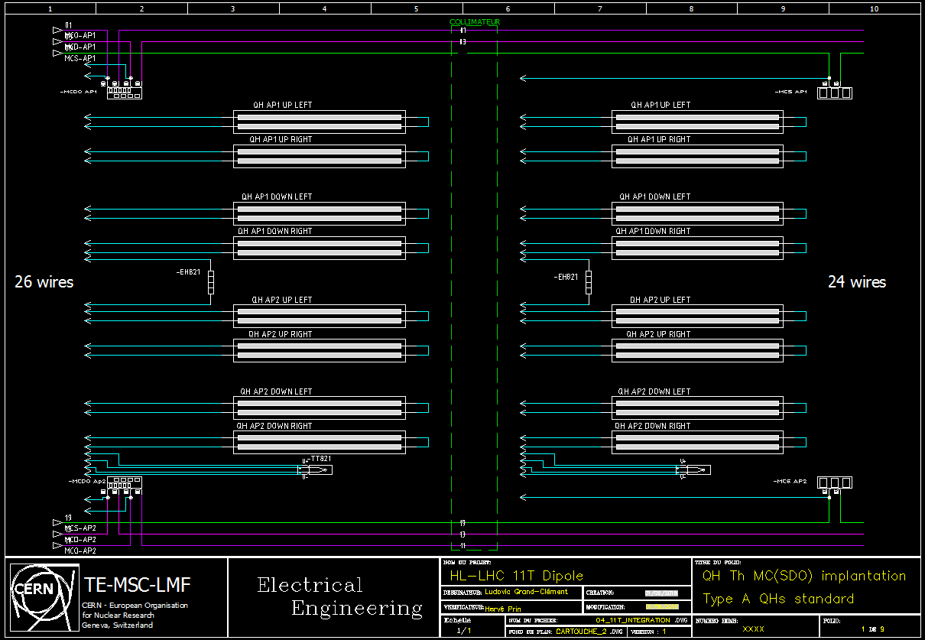
Electrical circuit – Quench heaters and protection
L. Grand-Clement

Slide 23
OUTLOOK
Terminology and HL-LHC time line
Part I: Current baseline design
  Cable
  Cross section
  Cold mass assembly
  Integration, powering, trim
  Quench heaters and protection
Part II: Project status and plan
  Overall plan
  Model program
  Prototype
Conclusions

Slide 24
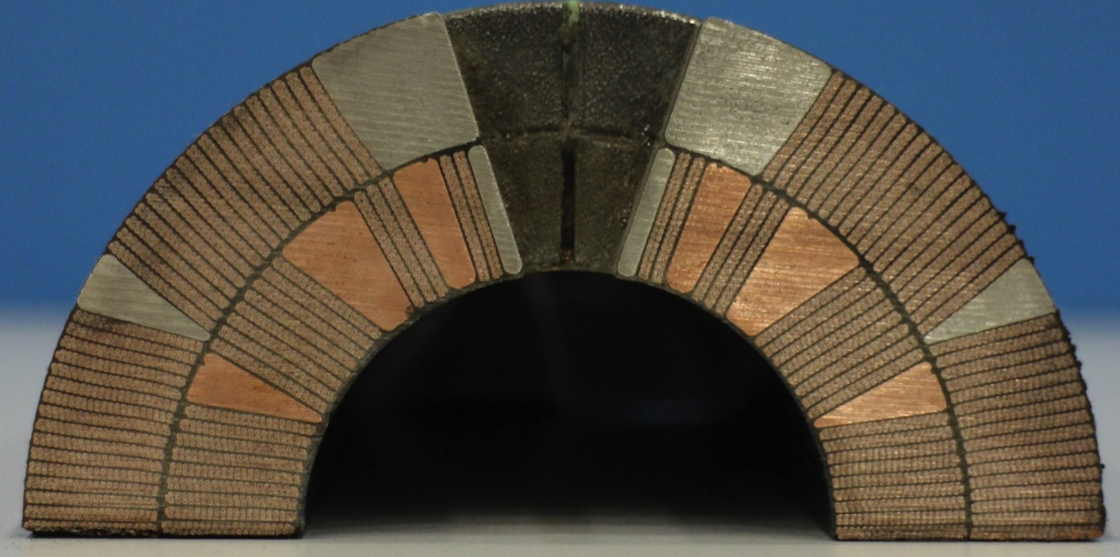
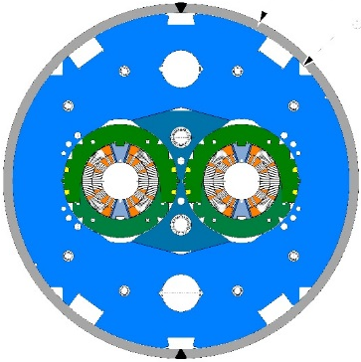
Model programme RRP cable
QH/Traces glued on outside surface of OL
QH/Traces impregnated on OL
QH/Traces impregnated on OL + interlayer QH
Coil
106
107
108
109
111
112
113
114
115
116
117
Single Aperture
SP101
SP102
SP103
SP104
SP105
SP106 (test 3rd Q 16)
Two-in-One
DP101
  Test Dec.15-Jan.16
DP102
  New yoke design
  Reduced OD
1
2
3

Slide 25
The DS 11T dipole on the HL-LHC timeline
Models RRP cable
On-going / Q4-2016
PROTOTYPE P1 - RRP
Q1-15 / Q1-17
Cold tests in first quarter of 2017
Production for LS2
Q4-2016 / Q2-2019
Start after cold tests of SP106 are done (inter-layer QH)
Models PIT cable
Q3-2016 / Q2 -2018
PROTOTYPE P2 - PIT
Q1-19 / Q4-20
Start after coils for LS2 are done
Production for LS3
Q2-2020 / Q2-2024
PIT and/or RRP

Slide 26
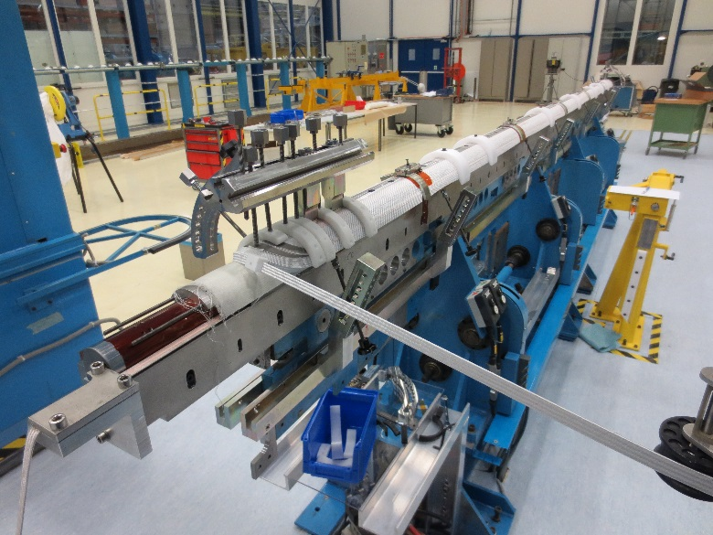
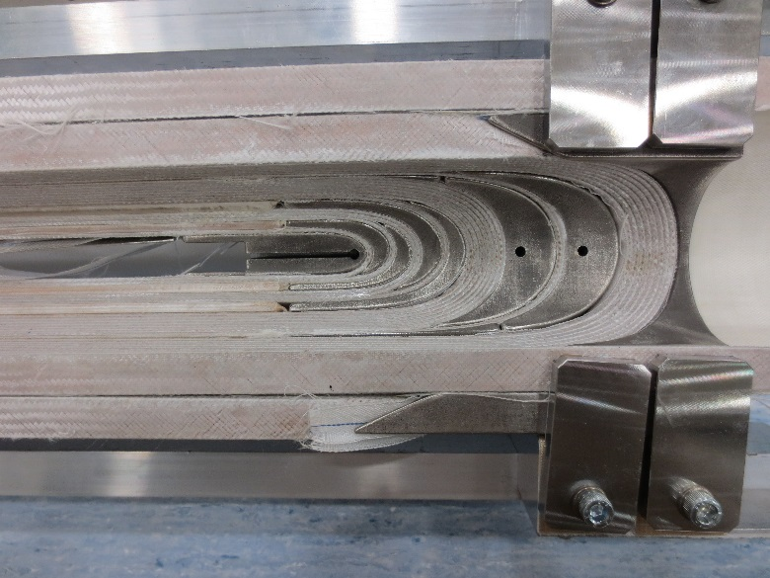
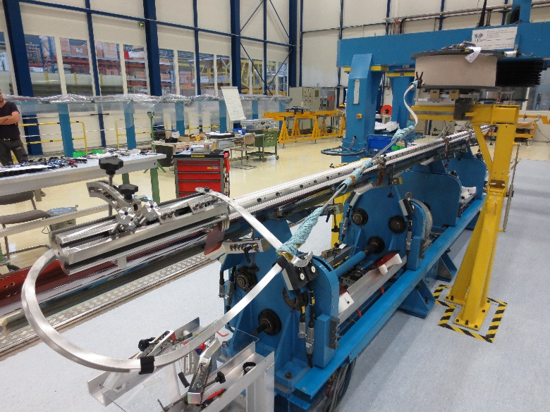
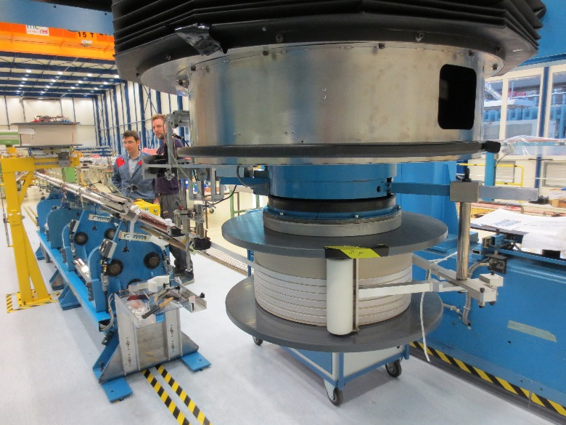
Production of first long coils in B180
2nd coil with braided Cu cable during winding
Detail of the 2nd Cu cable coil after curing
1st
Sc coil
Wound
& cured
3rd coil, with braided Sc cable during winding
New clutch / PCS for better control of the tension on cable during winding

Slide 27
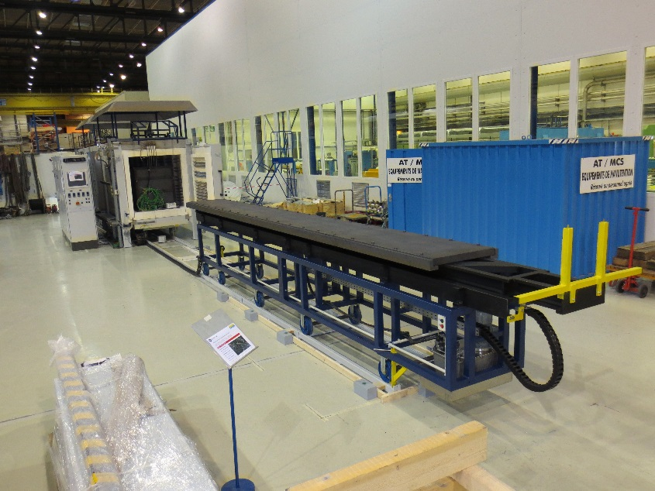
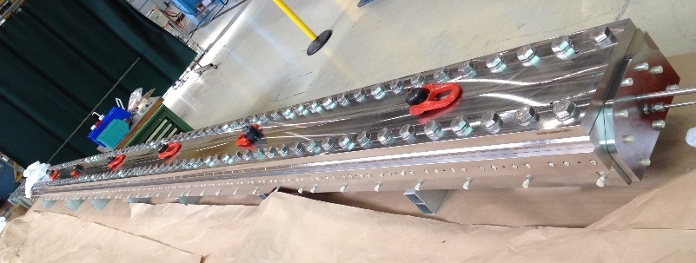
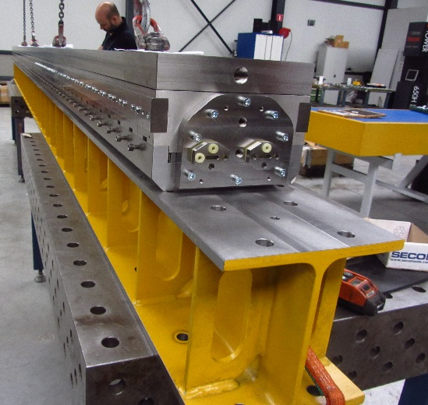
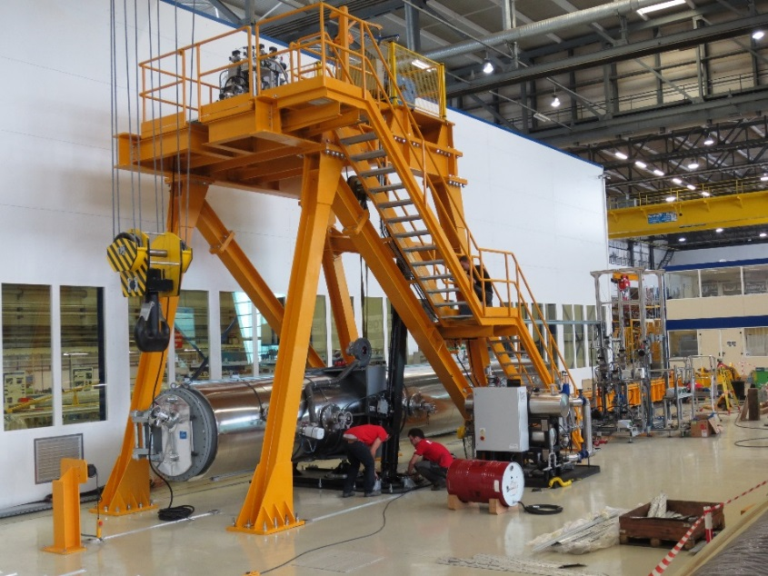
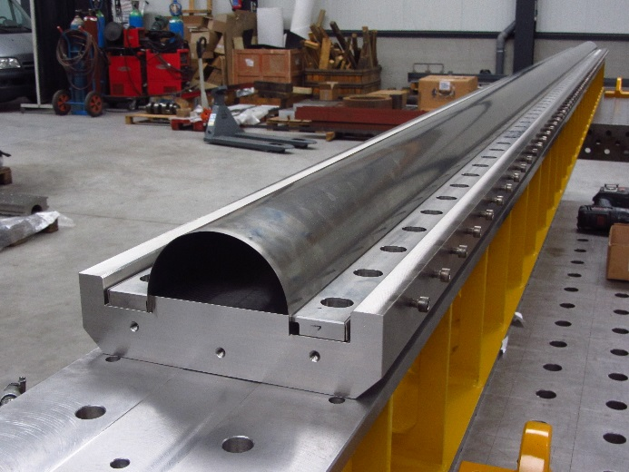
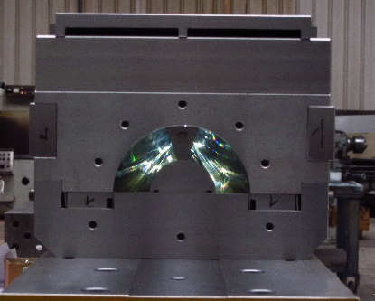
Tooling for the production of the long coils
6 m long reaction fixture
6.5 m long reaction furnace – fully operational
6 m long impregnation fixture
10.5 m long impregnation chamber

Slide 28
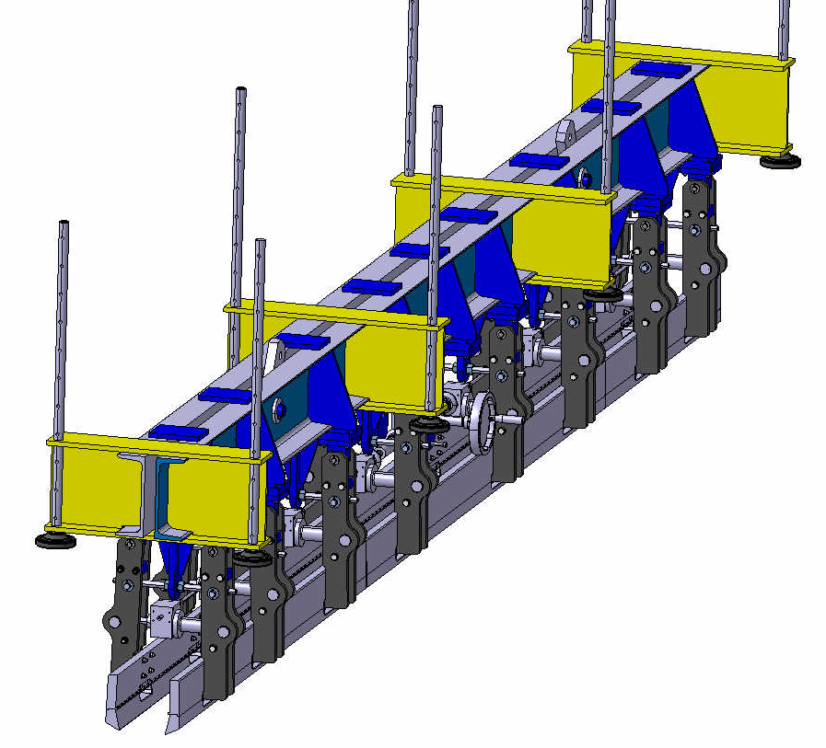
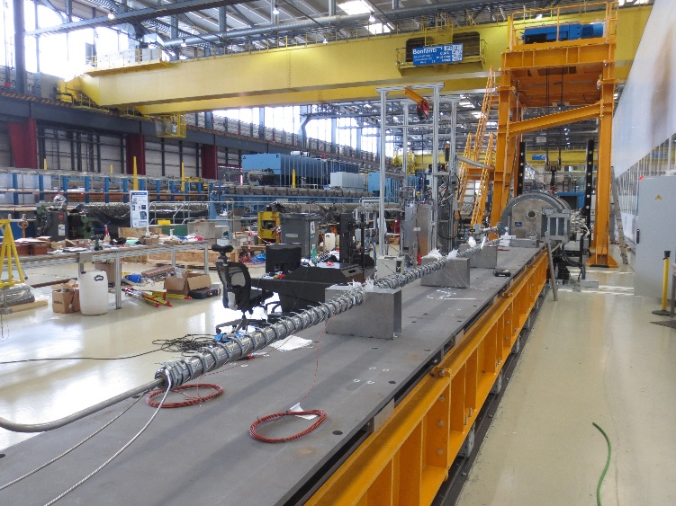
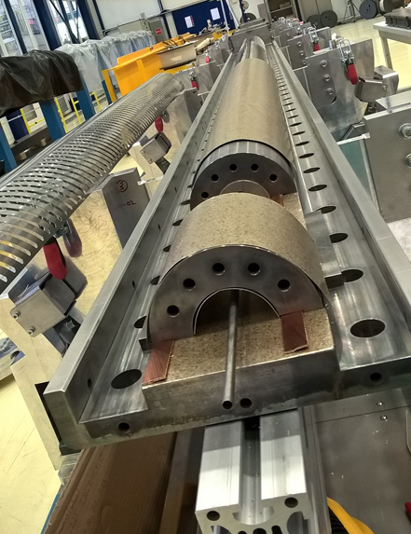
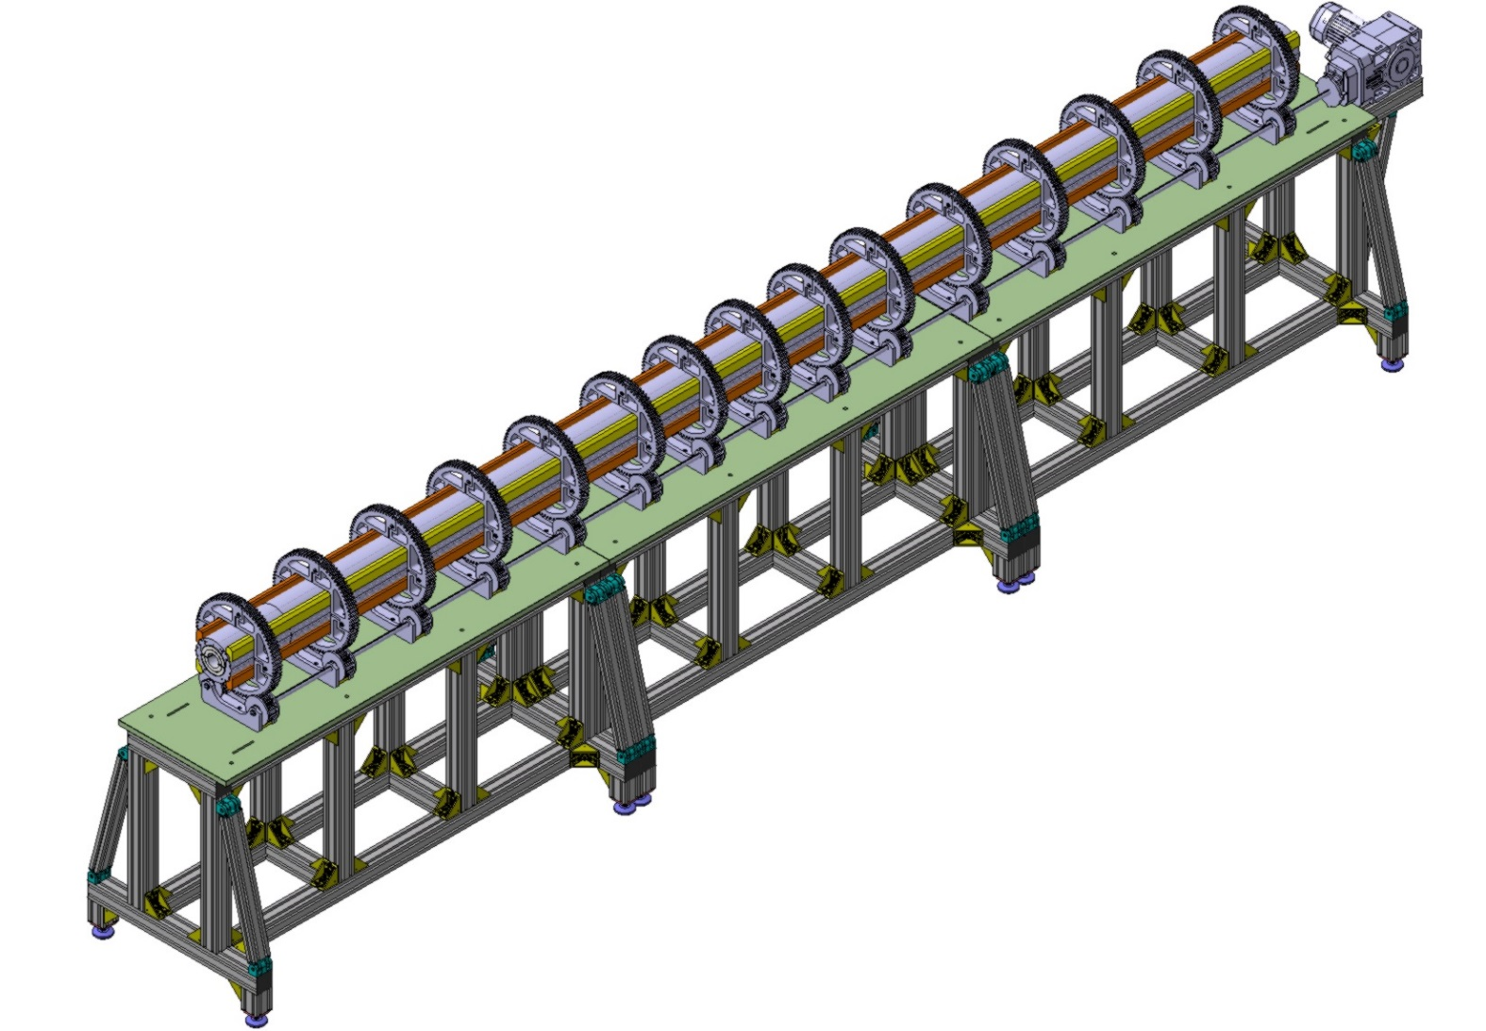
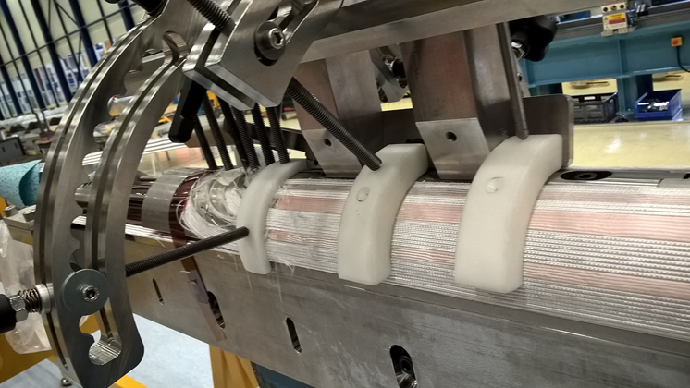
Other illustrations of tooling

Slide 29
Terminology and HL-LHC time line
Part I: Current baseline design
  Cable
  Cross section
  Cold mass assembly
  Integration, powering, trim
  Quench heaters and protection
Part II: Project status and plan
  Overall plan
  Model program
  Prototype
Conclusions

Slide 30
Conclusions
The DS 11T dipole plan was updated after the cost and schedule review of March 2015
The installation in LHC during LS2 is not anymore in the baseline but we are asked to be ready to install 2 cryo-assemblies during LS2 upon request
The baseline design was further developed with some adjustments. However, no major modifications
Some items need particular attention:
  Finalization and construction of the quench heaters
  Coil length
The engineering design of the full-length magnet, including the cryostat, is now well advanced
The major tooling is available in the Large Magnet Facility @ CERN

