Slide 1
Collaboration meeting on DS 11T Dipole grounds
FNAL, Sep. 21-23, 2015
Model Magnets Assembly at FNAL
Igor Novitski
September 21, 2015

Slide 2
MBHSP02
Model Magnets
Coil 5
Coil 7
Coil 2
Coil 9
Coil 7
Coil 9
Coil 3
Coil 10
Coil 5
Coil 10
Coil 8
MBHSP01
MBHSP03
MBHDP01
MBHSM01

Slide 3
Mechanical Models
Define “warm” magnet shim sizes
Check parts and tooling
Finalize collaring and yoke clamping procedures
“Study of Mechanical Models of a Single-Aperture 11 T Nb3Sn Dipole” presented at ASC 2012 (Portland, USA)

Slide 4
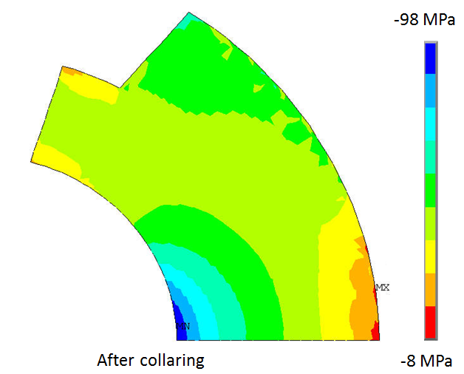
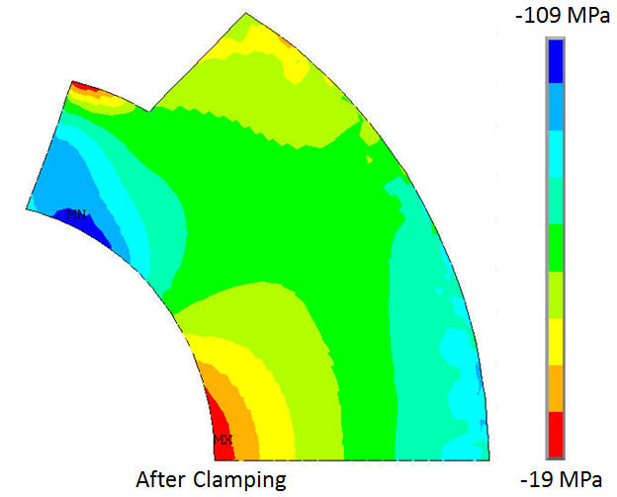
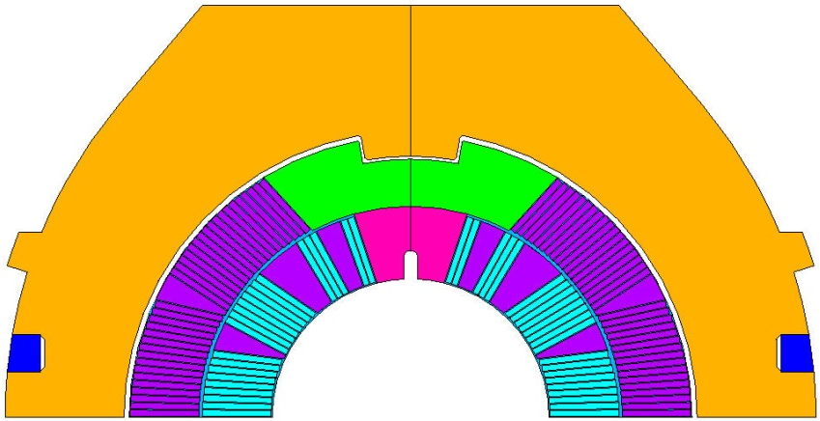

Coil Shims
FEA simplifies coil properties by using the cold elastic modulus
Coil warm and cold properties are different
Coil has an anisotropy in the azimuthal and radial directions
Warm magnet shims are different from calculated ones and need to be optimized with real parts to achieve the desired warm coil pre-stress.
Middle Plane
Shim
Yoke Shim
FEA results of the dipole mechanical structure
Position in coil | Azimuthal Coil Stress, MPa
 | Collared coil | Clamped yoke | Cold mass
Inner pole | -44 | -60 | -120
Outer pole | -64 | -55 | -87
Inner midplane | -97 | -58 | -79
Outer midplane | -51 | -55 | -108
Radial Shim
Azimuthal stress distribution in Nb₃Sn coil after collaring (top) and clamping (bottom).

Slide 5
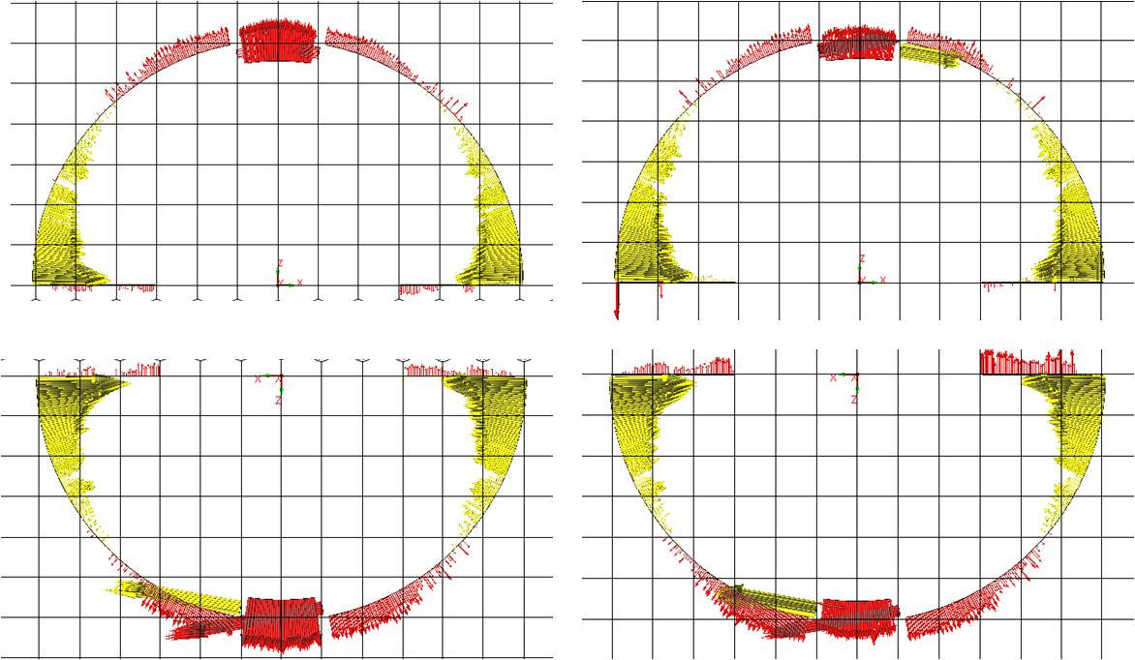
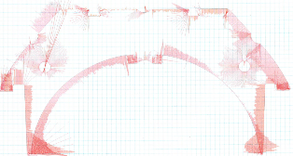
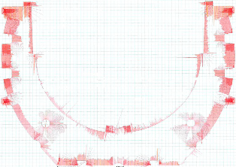
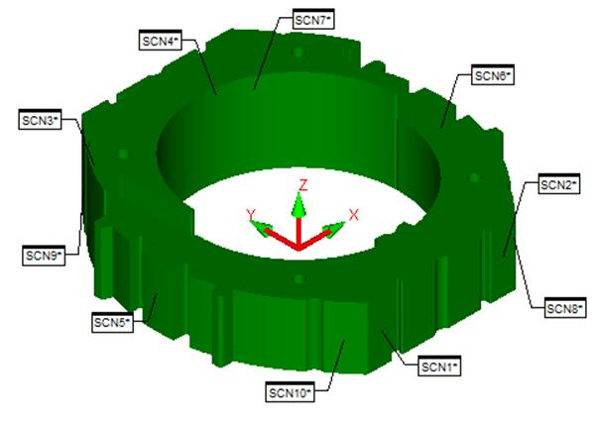
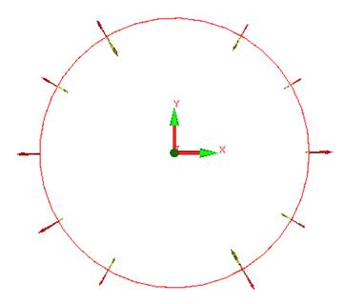
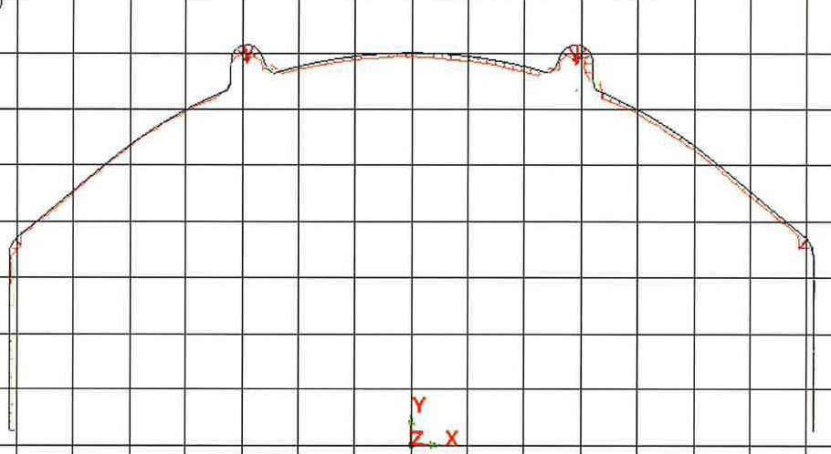
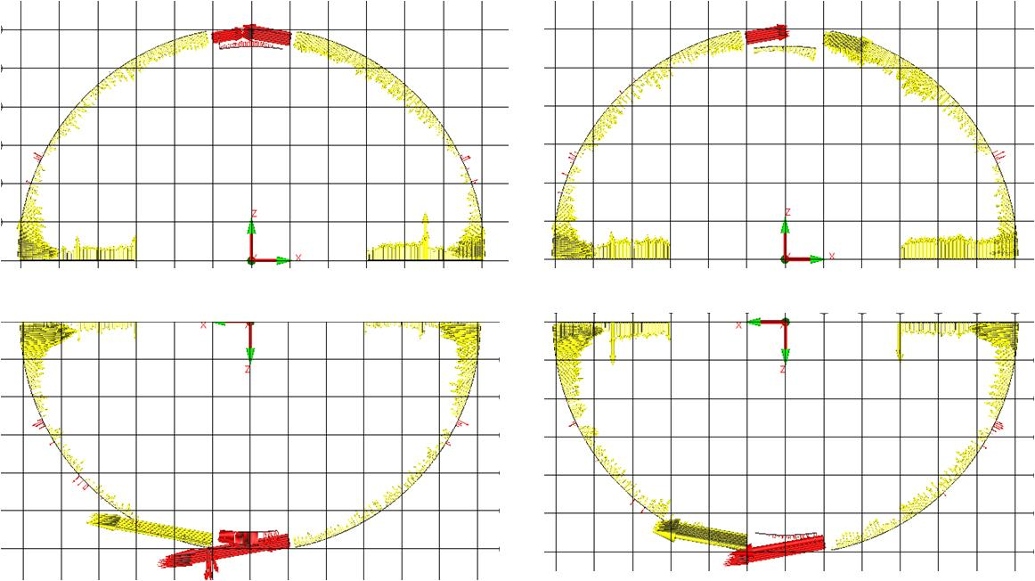
  Coil Cavity Size Control
The coil outer diameter (OD) and midplane were measured in the coil free state using a coordinate measuring machine.
A collar lamination profile after laser cutting performed on the optical table
The deviations of the collar inner surface from the design value are < 50 µm
The inner diameter of the assembled and keyed collar packs was also measured with a micrometer
Based on the coil and collar pack sizes the coil-collar interface was shimmed to compensate for collar fabrication errors.
The accuracy of wire-cut 25 mm thick yoke laminations is within ± 25µm on all working surfaces.
Coils become smaller radially and azimuthally by 50-100µm after been used in the MMs.
1 box =125 μm

Slide 6
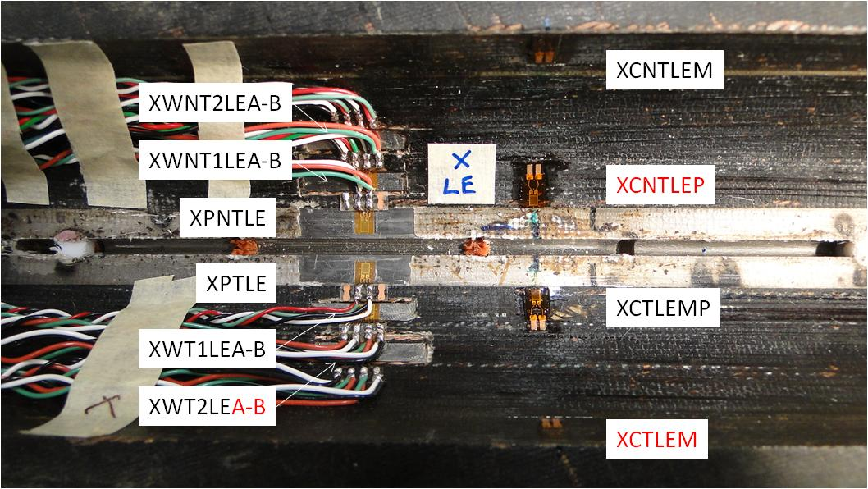
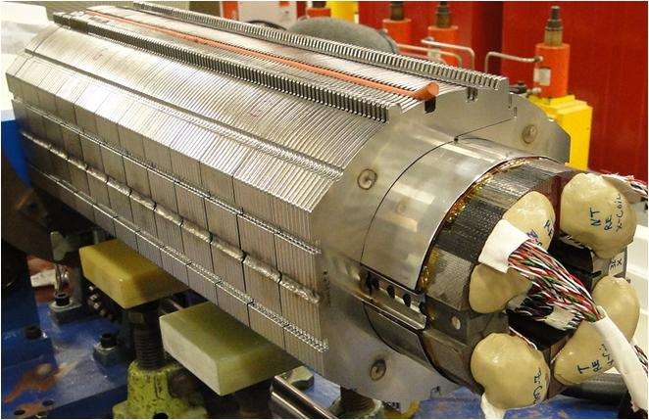
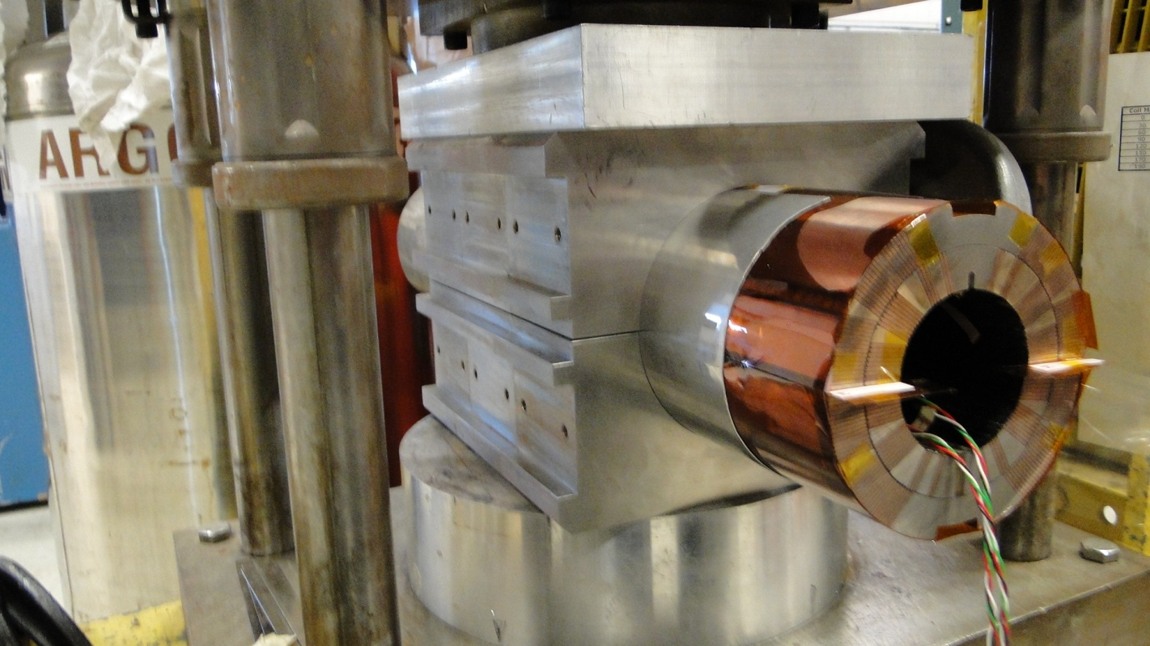
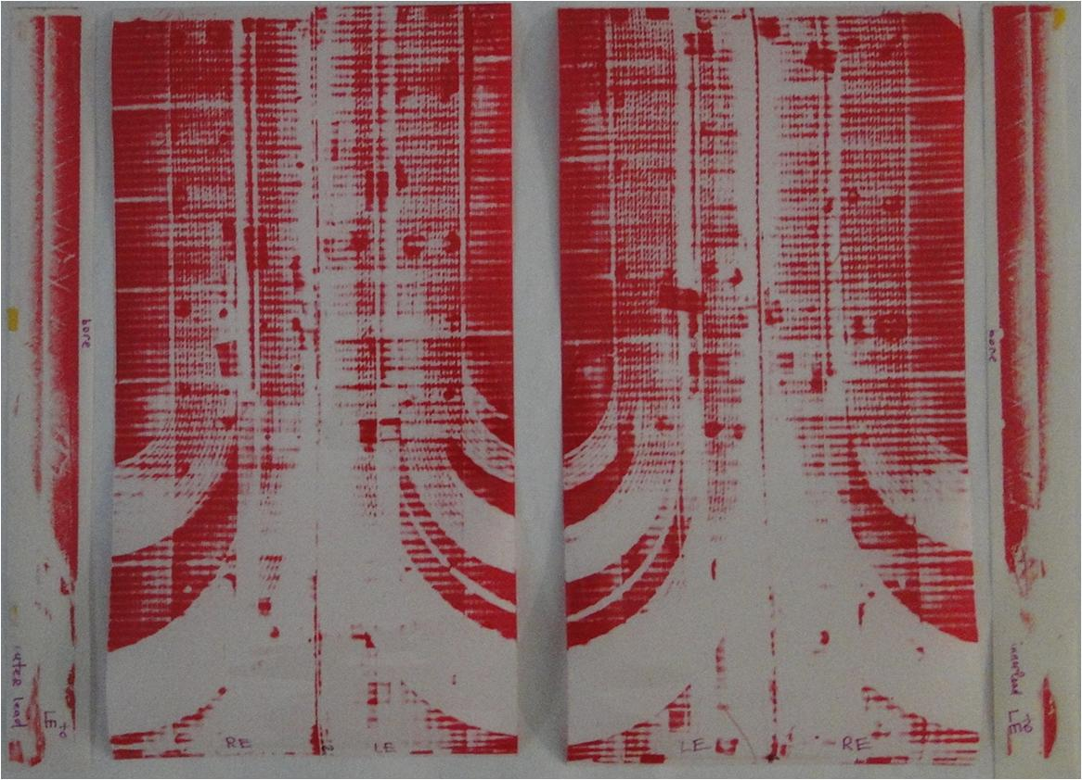
Mechanical Models
2 m long Nb₃Sn practice coil was cut into six pieces
Resistive strain gauges glued on the coil inner surface, on the stainless steel wedges and on the titanium poles
Fuji film measures stress gradients
Six collared models were built with different shimming (0-0.12mm)
One collared model was clamped twice
Magnet shim plan was finalized

Slide 7
MBHSP01 2m Long Magnet
RRP 108/127 conductor
No Core
Original ends
Laser cut collars
Collaring after MM
Shims after MM
Welded skin
Welded end plates
“Development and Test of a Single-Aperture 11 T Nb3Sn Demonstrator Dipole for LHC Upgrades” presented at ASC 2012 (Portland, USA)

Slide 8
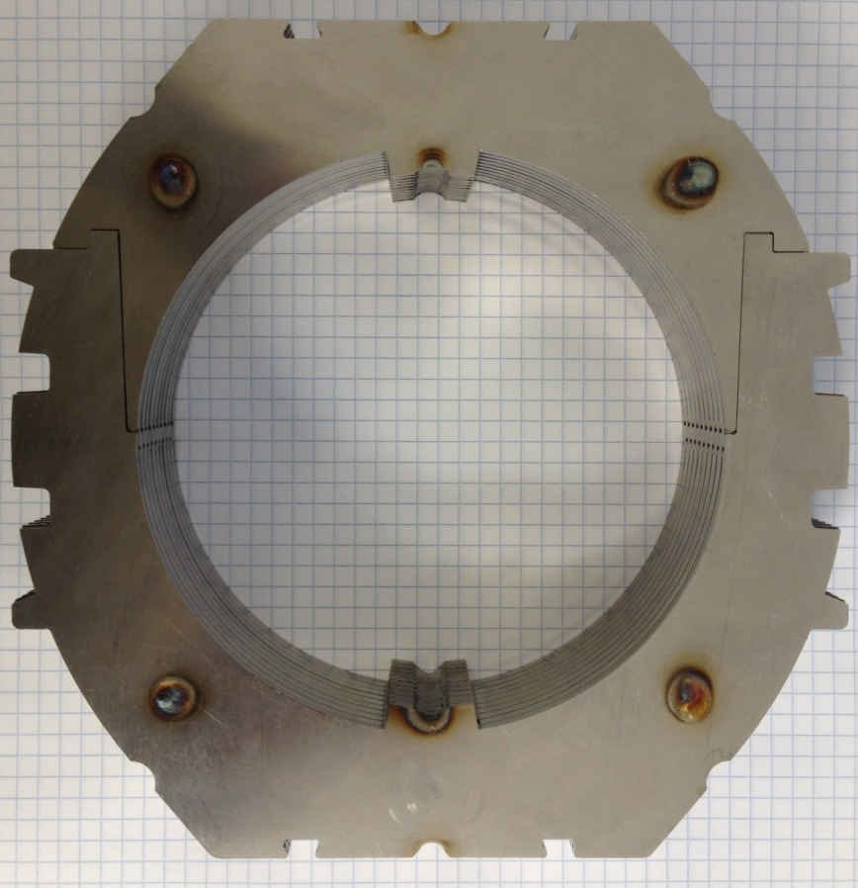
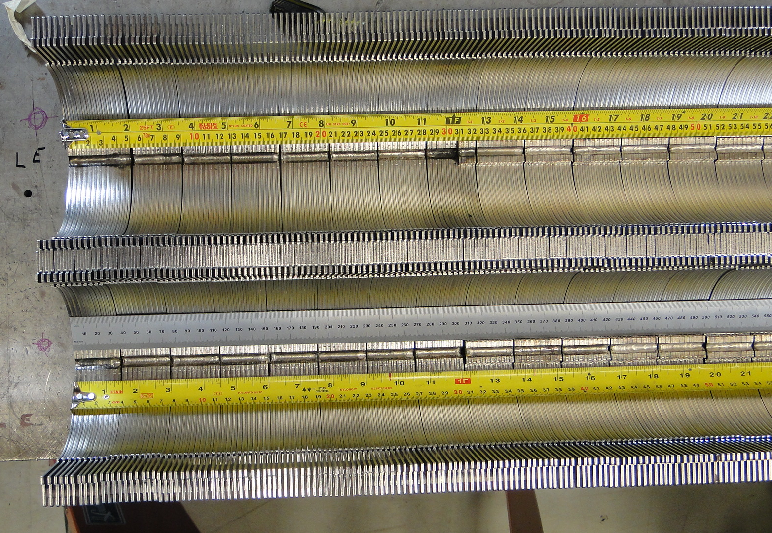
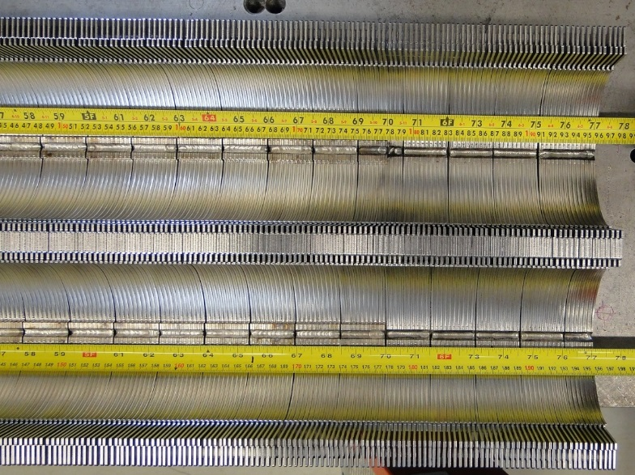
Collar Pack
  Use 0.127 mm shim between laminations.
  Welded longitudinally along the pole
  and on the O.D. above the pole.
  Have 2 pins each welded at the ends.
Parameter | Value
Collar material | Nirosta high-Manganese SS
Collar width, mm | 17.75
Lamination thickness, mm | 1.5
Collar pack length, mm | 38

Slide 9

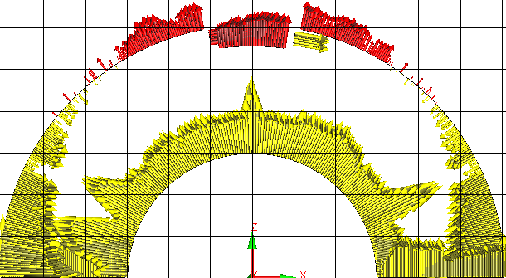
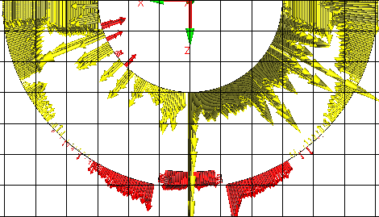
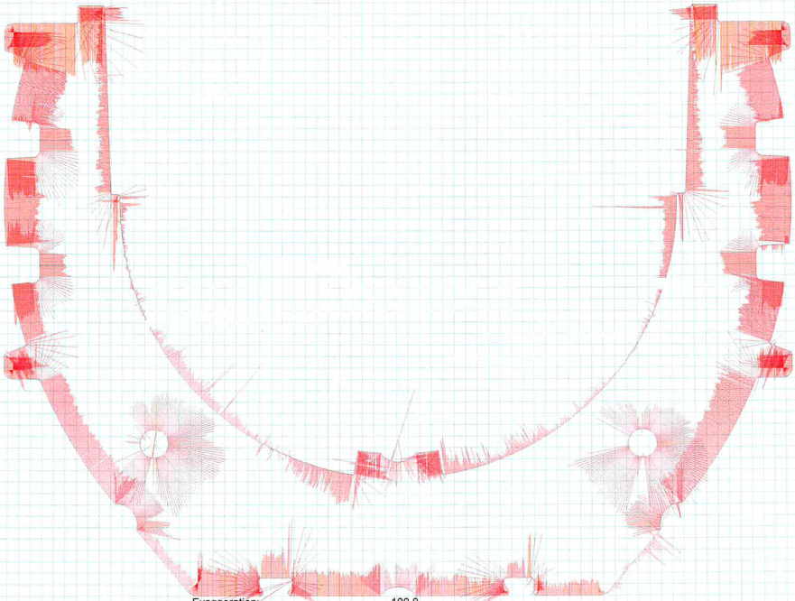
Size Control
MBHSP01
Wire EDM Iron lams
Laser Cut Collar lams
MBH02
445 mm from RE
1 box =125 μm
1 Box = 25.4 μm
MBH03
435 mm from RE

Slide 10
MBHSP01 Shim Plan
Taper Yoke Shim
175μm Radial Shim
Taper Yoke Shim
7mil Kapton
13mil Shim
325 μm Shim
7.5mil Shim
190 μm Shim
8.5mil Shim
215 μm Shim
9.5mil Shim
240 μm Shim
8.8mil Kapton
8.5mil Shim
215 μm Shim
7.5mil Shim
190 μm Shim
13mil Shim
325 μm Shim
220μm Middle Plane Shim

Slide 11
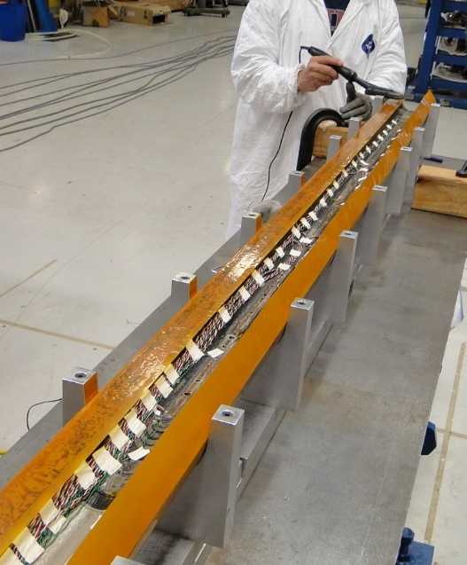
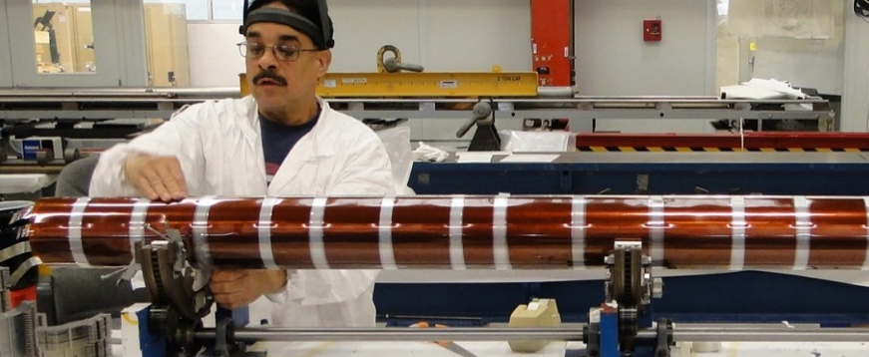
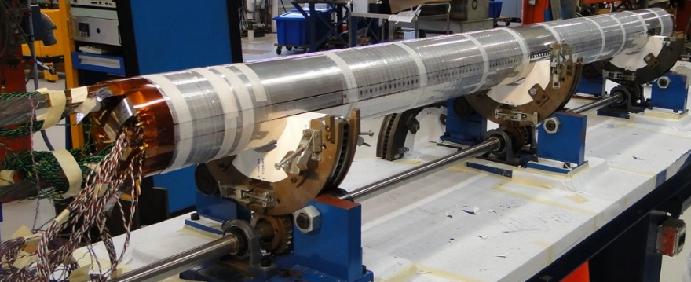
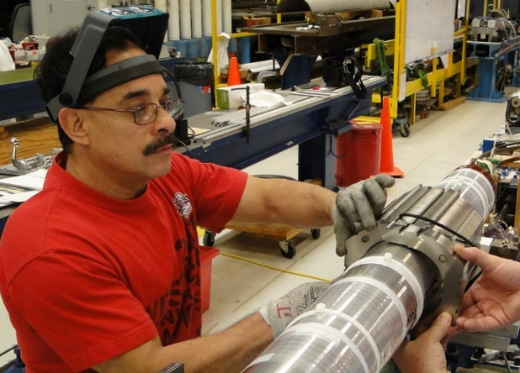
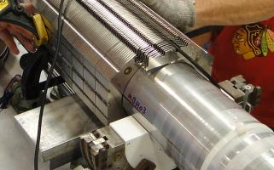
Coils assembly
A layer of 0.112mm (4.4mil) thick pre-preg Kapton ironed to the coil
The two coils, surrounded by ground insulation (5x0.127mm Kapton) and 0.5mm protection shoes
Coil assembly process developed with mechanical model
Upper and lower collar packs are shifted to interlock all collar packs together

Slide 12
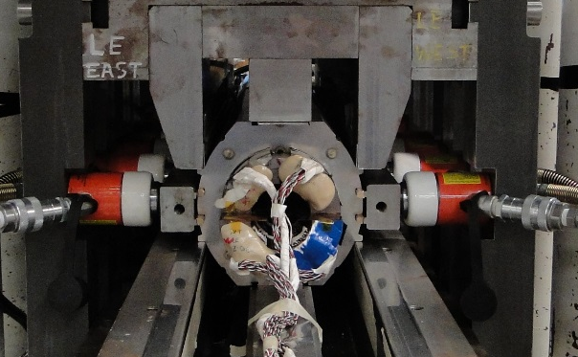
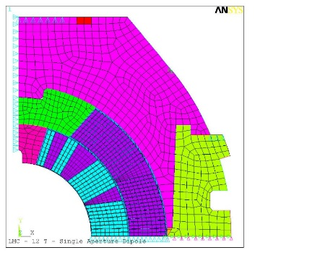
Collaring
Press gradually increase vertical pressure on a contact tooling to open collar keyways.
Tapered keys are hydraulically pressed into the collars
Press released with coil spring-back
Parameter | Value
Protection shoe thickness, mm | 0.5
Protection shoe material | 304
Collar material | 316LN
Collar width, mm | 17.75
Lamination thickness, mm | 1.5
Collar pack length, mm | 38
Number of keys | 4
Key height, mm | 6
Key thickness, mm | 5
Key material | Bronze
12

Slide 13
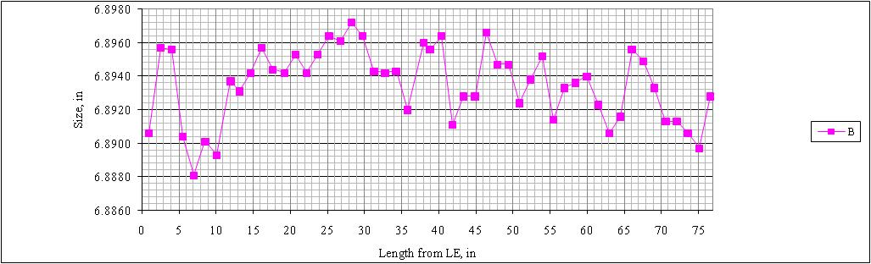
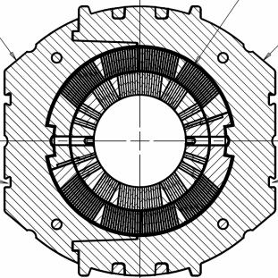
Collared Coil Mechanical Measurements
Splice block size even with magnet SS

Slide 14
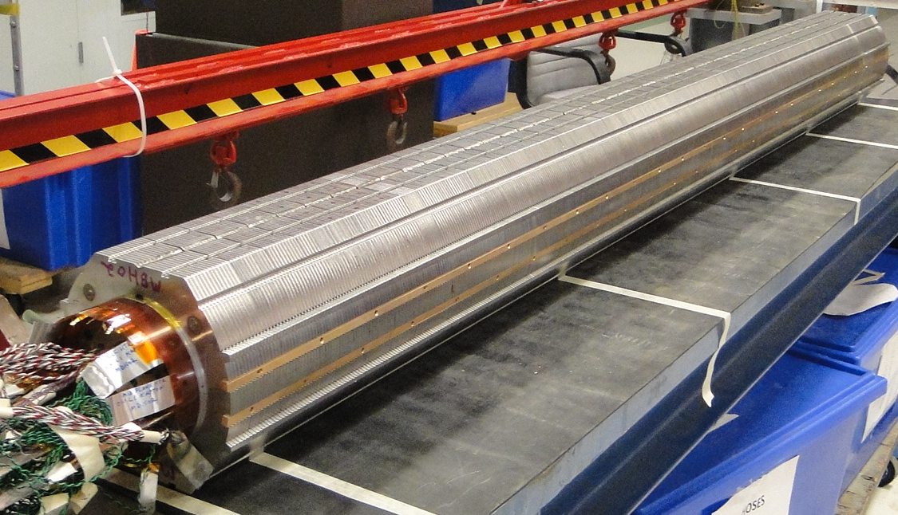
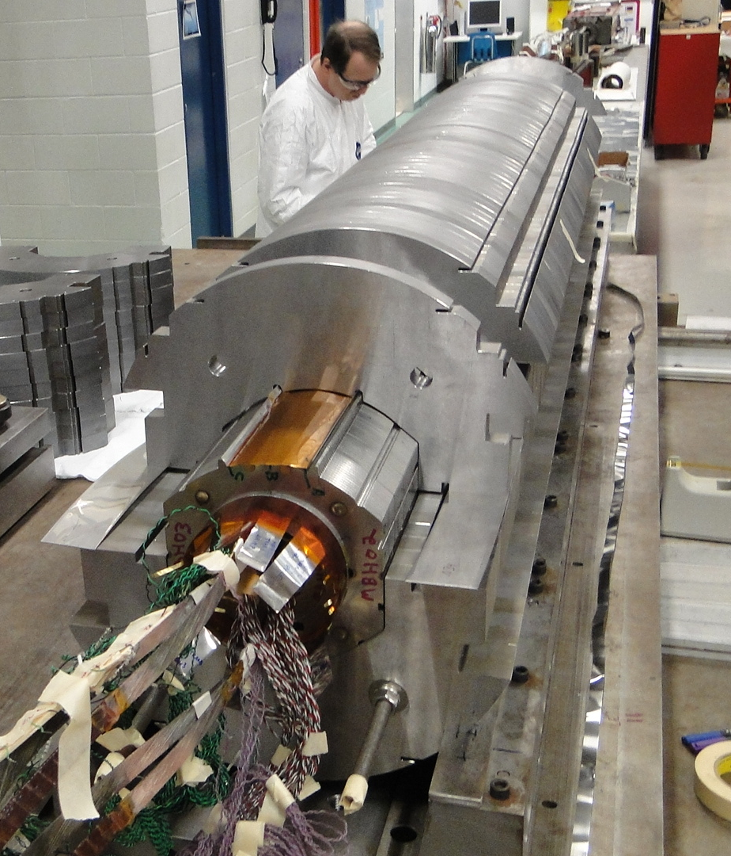
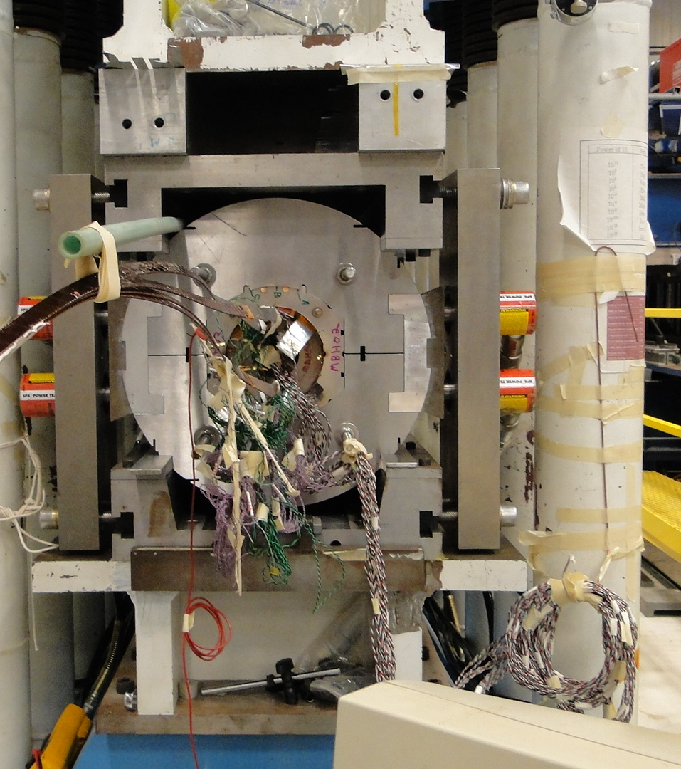
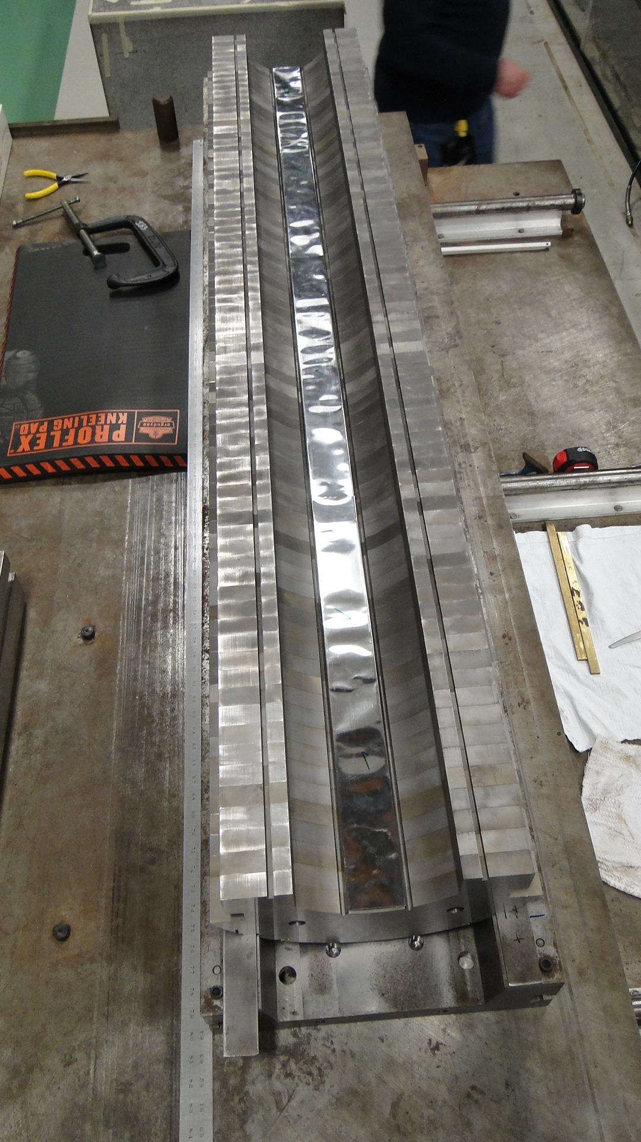
Yoking and Clamping
Collar-Yoke Shim

Slide 15
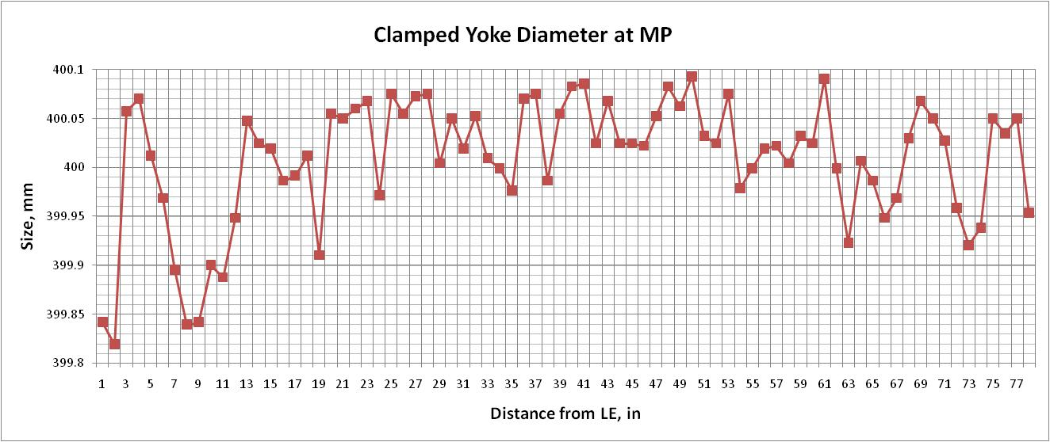
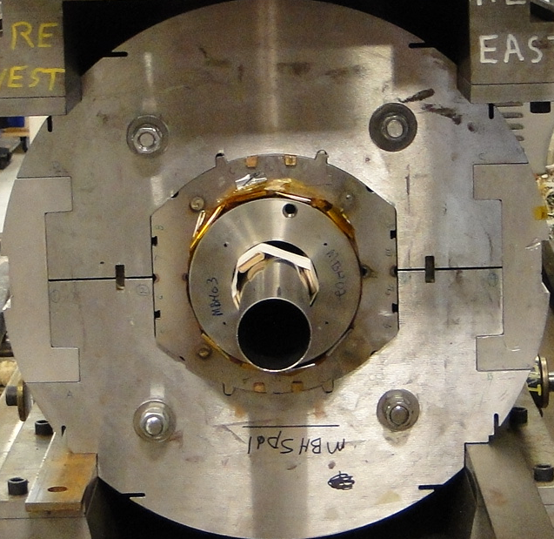
Clamped Iron Mechanical Measurements

Slide 16
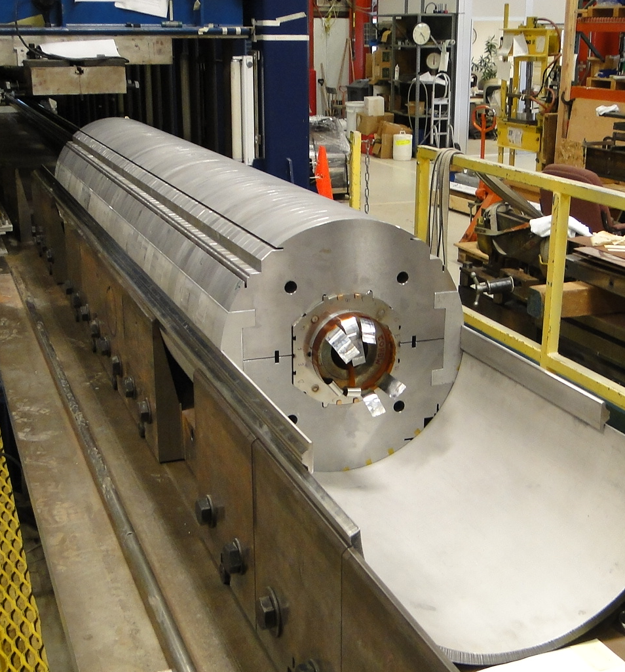

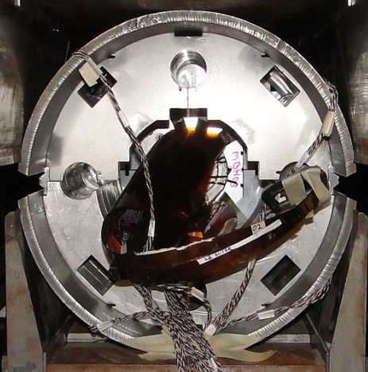
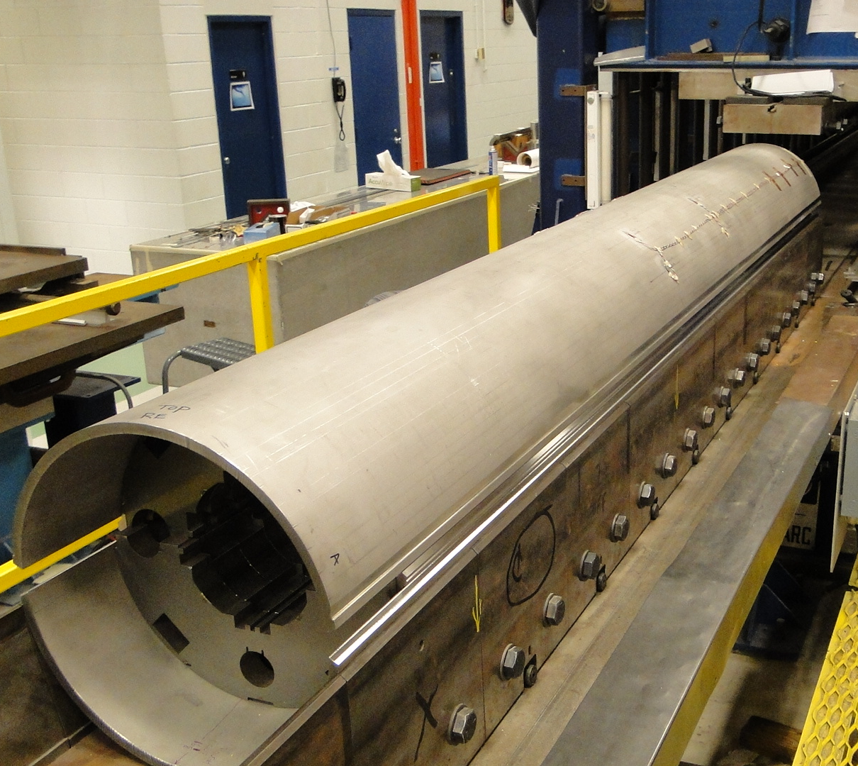
Skin Welding
Gaps
Actual gap ~3 mm (design=0.7mm)

Slide 17
MBHSP01 SG Data

Slide 18
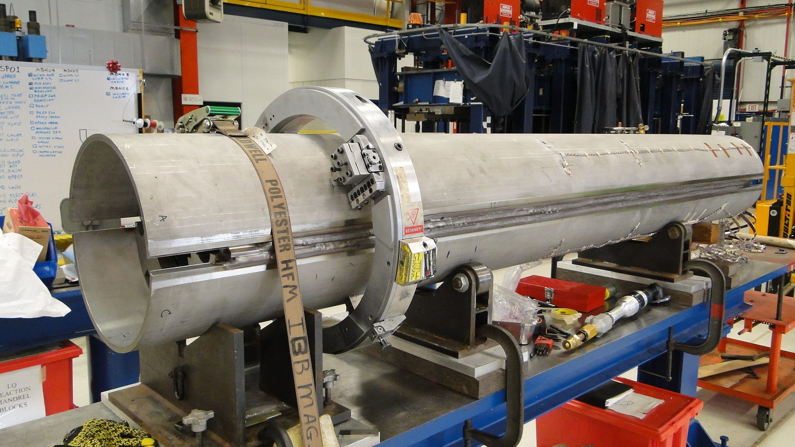
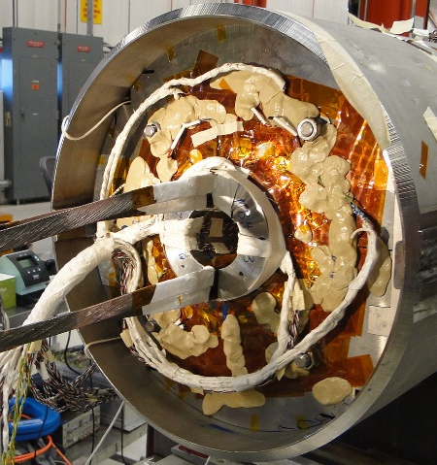
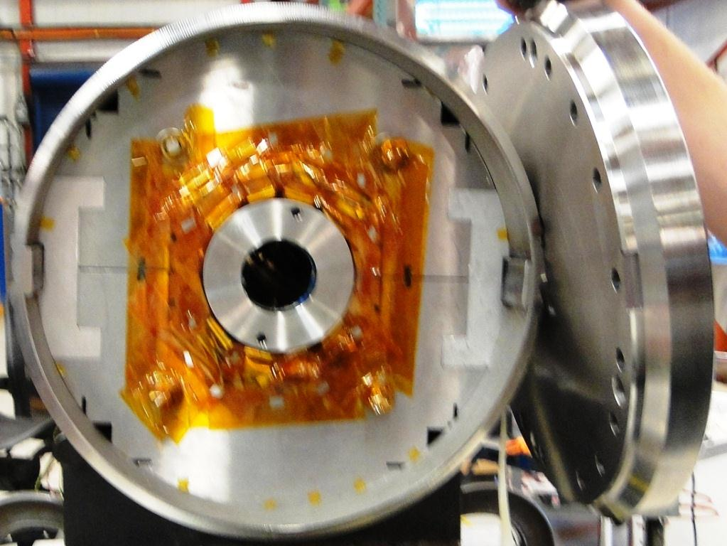
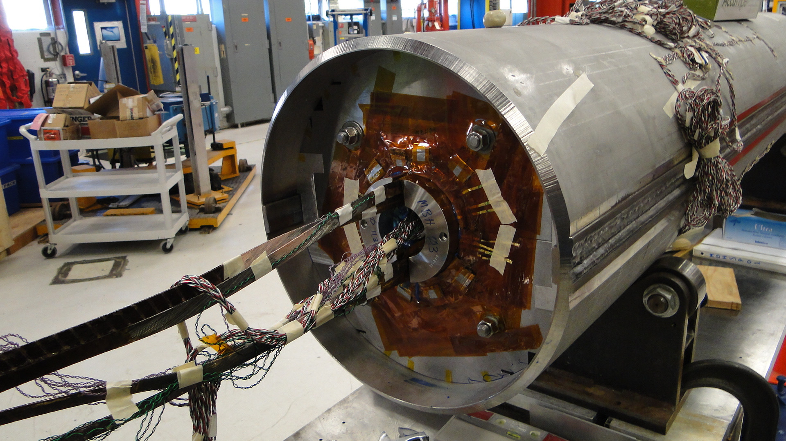
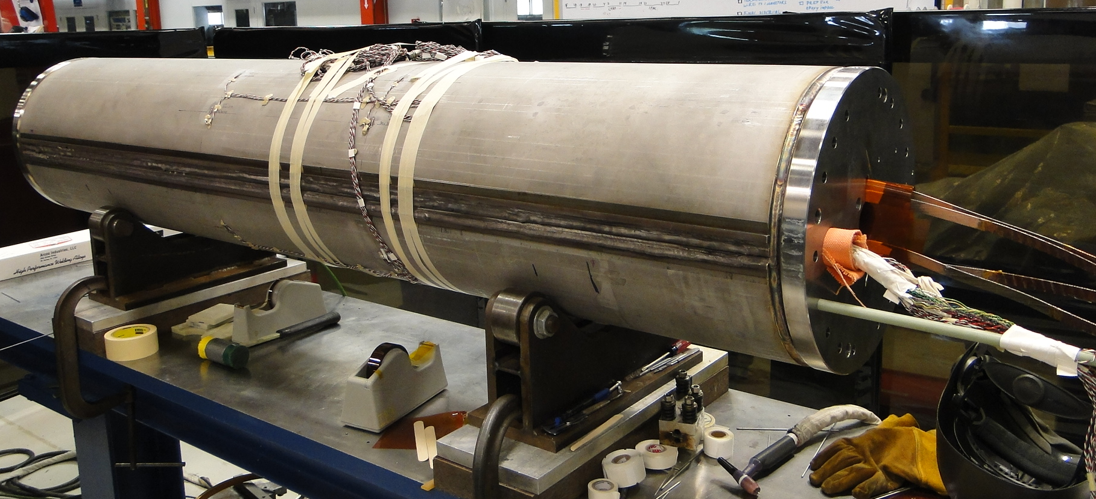
Skin Cutting and End Plate Welding

Slide 19
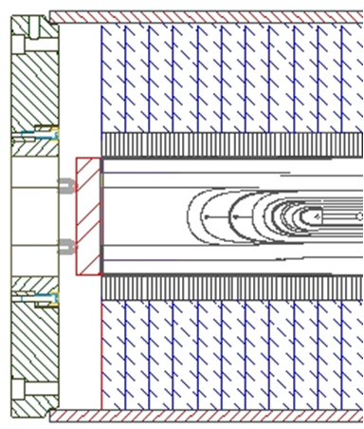
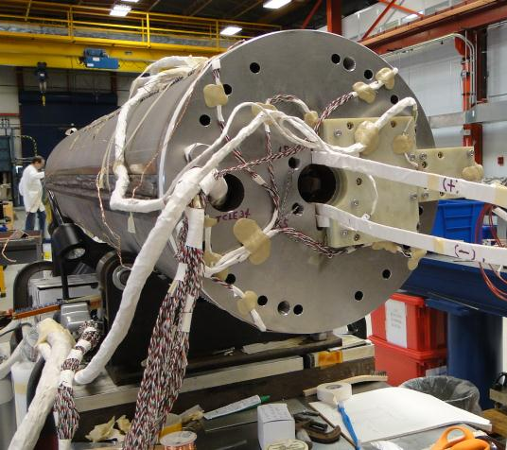
End Design
1
Parameter | Value
Yoke lam thickness, mm | 25
Yoke material | Hot rolled steel SAE 1045
Clamp material | Al 7075-T6
Skin material | 304L
Skin thickness, mm | 12.7
End plate material | 304L
End plate thickness, mm | 50
Bullets load, kN per end | 17.6
2
3
4
Return end cross section: 1 – end plate; 2 – strain gauge bullets; 3 – bullet pressure plate; 4 – skin
NbTi leads splicing
Instrumentation wiring and connectors soldering
Final electrical and hi-pot test

Slide 20
MBHSP01 Test Results
Magnet reached 10.4 T or 78 % of SSL at 1.9 K showing limited quench performance. Most quenches at low ramp rates, all holding quenches and quenches at intermediate temperatures initiated in the mid-plane block of the outer coil layer. Only few training quenches occurred in the high field area at the very beginning of test at 4.5 K and 1.9 K. Quench location, ramp rate and temperature dependence studies, and additional tests point out on the problems with coil outer-layer lead in both coils. Possible conductor damage in the mid-plane area during fabrication could cause the observed degradation.

Slide 21
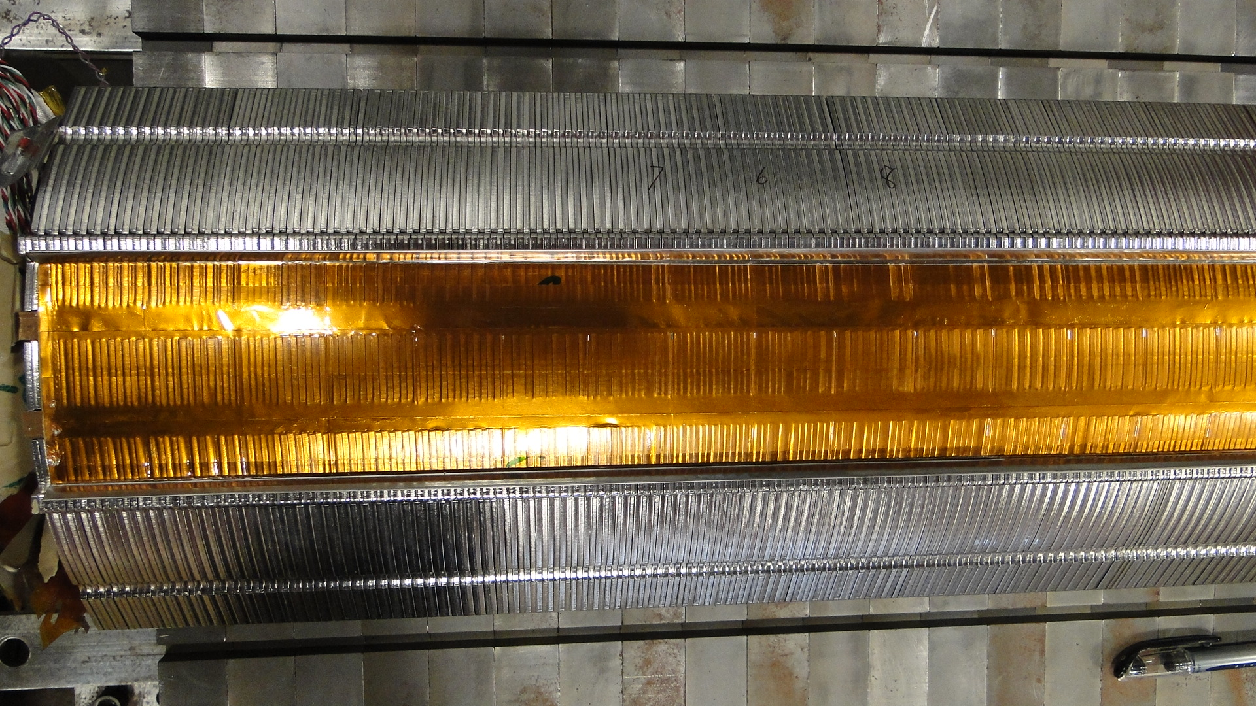
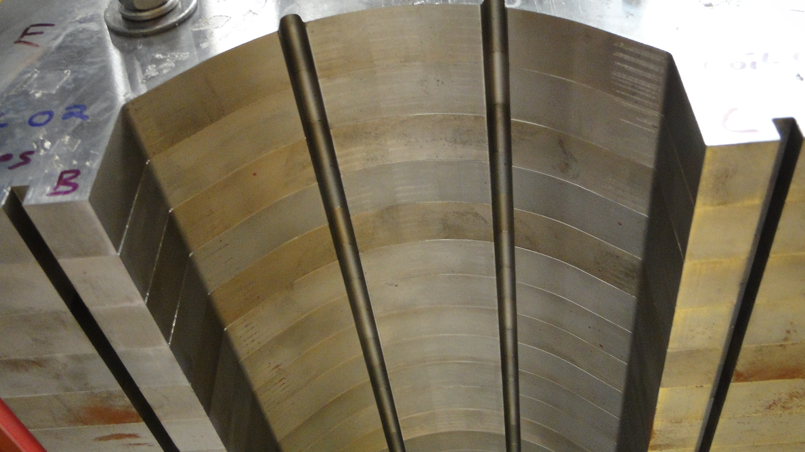
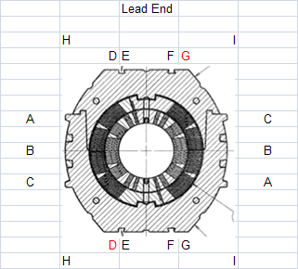
Magnet Autopsy
Collar-Yoke Shim
LE Marks on the Collar-Yoke Interface – high pressure at the magnet LE
Yoke lamination
Collared Coil Size “B”

Slide 22
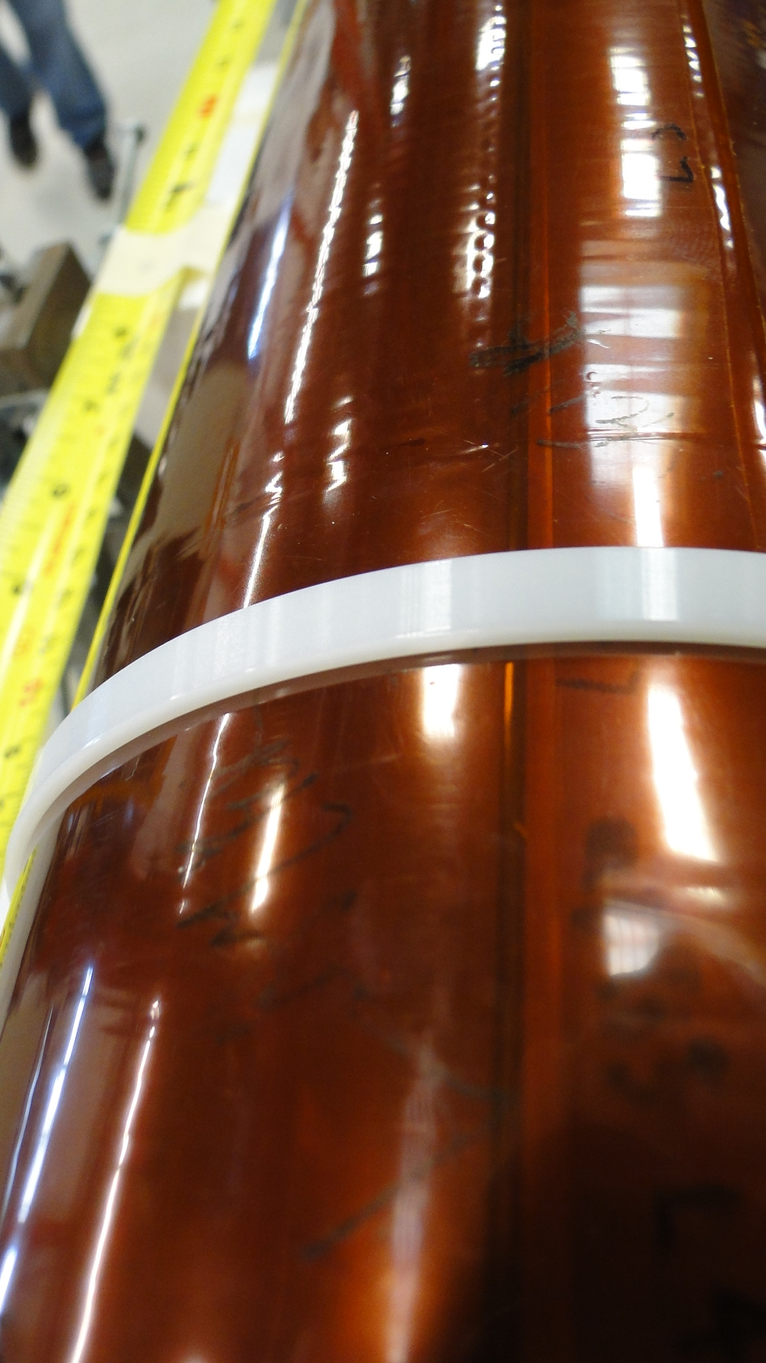
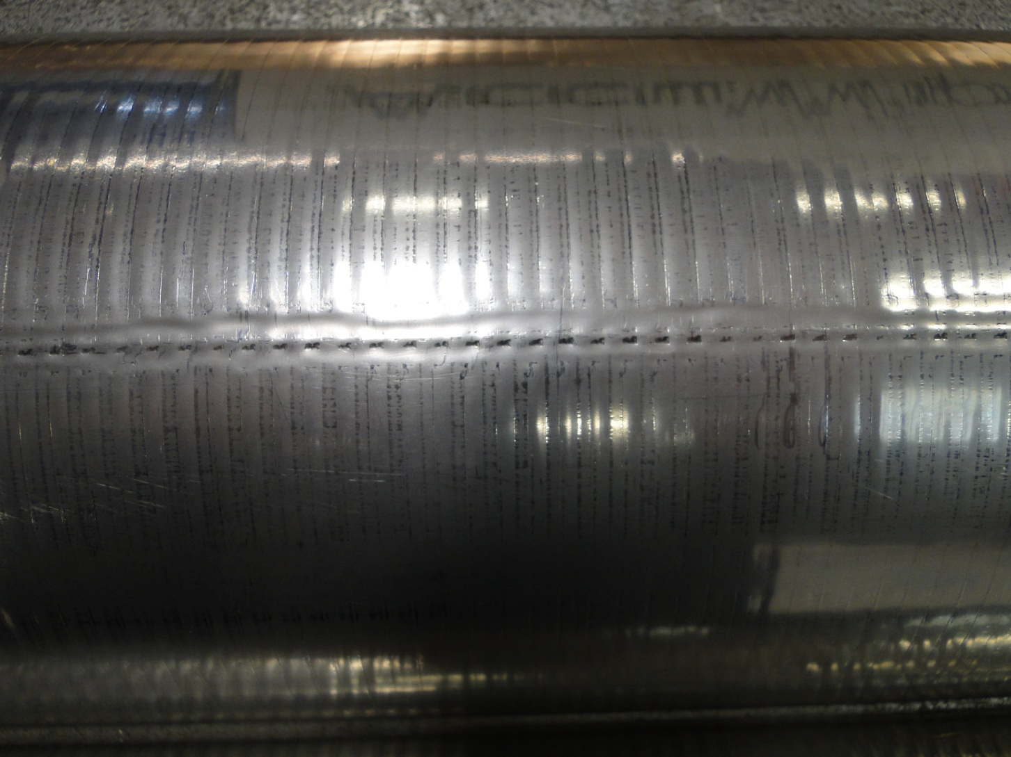

Marks on the Protection Shoe
LC Collar Pack Inner Surface at Middle Plane
Imprint on the GI and Protection shoe

Slide 23
Recommendation
Reduce skin load at the LE => reduce cold splice stress by ~40MPa
Change material for LE saddle and splice block cylinder from SS to AlBr => better match coil radial motion
Reduce radial yoke-collar shim at MP area
Bigger Collar ID
Thicker Retainer
Stamped Collars
Bolted Skin

Slide 24
MBHSP02
RRP 150/169 conductor
Core cable
Modified ends
Laser cut lams and modified collar packs
Two Collaring Iterations
Thicker radial shim
Smaller bending shim
Horizontally bolted skin
Bolted end plates
“FABRICATION AND TEST OF A 1 M LONG SINGLE-APERTURE 11 T NB3SN DIPOLE FOR LHC UPGRADES ”
presented at IPAC 2014 (Dresden, Germany)

Slide 25


Reworked Collar Packs
Reworked
1 Box = 25.4 μm
Reworked Collar Packs
for MBHSP02

Slide 26


Coil Sizes
MBHSP01
MBHSP02
MBH02
445 mm from RE
MBH05
479 mm from RE
MBH03
435 mm from RE
MBH07
467 mm from RE

Slide 27
MBHSP01 and MBHSP02 Shimming
Radial Shim
Radial Shim
7mil Kapton
Taper Yoke Shim
10mil Kapton
Uniform Yoke Shim
13mil Shim
5mil SS Shim
7.5mil Shim
8.5mil Shim
8.5mil Shim
5mil SS+3.5 Kapton
8.8mil Kapton
8.8mil Kapton
9.5mil Shim
Middle Plane
Shim
Middle Plane
Shim
8.5mil Shim
7.5mil Shim
13mil Shim
5mil SS Shim

Slide 28
MBHSP02 Test Results
  MBHSP02 demonstrated better performance than MBHSP01 and reached 11.7 T or 97.5% of its design field at 1.9 K
  Still significant quench current degradation observed
  Both magnets showed so called “holding quenches”, when magnet is quenching at a fixed current after holding it for a certain time (resistive conductor)

Slide 29
MBHSM01
RRP 109/127 conductor w core
Ordinal end parts
New coil sizing
Mirror structure
No collars
Reduced coil prestress and bending
Horizontally bolted skin
Bolted end plates
“TESTING OF A SINGLE 11 T Nb3Sn DIPOLE COIL USING A DIPOLE MIRROR STRUCTURE” presented at IPAC 2014 (Dresden, Germany)

Slide 30

Coil Sizes
MBHSP01
MBHSP02
MBHSM01
MBH02
445 mm from RE
MBH05
479 mm from RE
MBH08
447 mm from RE
Mirror Block
(1 box = 101.6 μm)
MBH03
435 mm from RE
MBH07
467 mm from RE

Slide 31

Coil Sizes
Design
contour
QC
contour
Real
contour
QC data
Coil #8
Coil #8 by 4mil smaller on OR and by 3mil bigger at MP wrt design Coil #2 by 5mil smaller on OR and by 1mil bigger at MP wrt design

Slide 32



Coil #8 Instrumentation
SG at RE
Quench Antenna

Slide 33



MBHSM01 Shimming
2.421:5x4-GIKapton
25+10mil–Shell+3K
2.446 – Yoke IRm
shim
shim
2.391 - Coil ORd
3.18mm(0.125mi)
5K+50G10+3.5aK+60G10+5K=123.5mil

Slide 34
MBHSM01 Test Results
MBHSM01 reached ~ 13 kA or (92-100)% of SSL at 4.5 K, and 14.1 kA or 89-97 % of SSL at 1.9 K
The stainless steel core, successfully implemented in this model, significantly reduced the magnet ramp rate sensitivity at the high current ramp rates
The magnet exhibited stable performance, no spontaneous quenches observed when “holding” 12 kA at 4.5 K and 13 kA at 1.9 K for ~ 25 minutes

Slide 35
MBHSP03
RRP 108/127 conductor w core
Modified ends
New coil sizing
New stamped collar with larger ID
Thicker shoe
Conservative coil prestress
Mirror as target
Less bending
Vertically bolted skin
Bolted end plates
“STATUS OF 11 T 2-IN-1 Nb3Sn DIPOLE DEVELOPMENT FOR LHC” presented at IPAC 2014 (Dresden, Germany)

Slide 36



Coil Sizes
MBHSP02
MBHSP03
MBH05
Modified
MBH 07
262 mm from RE
Coil Bigger at MP

Slide 37





Collar Packs
MBHSP02
MBHSP03
Reworked
1 Box = 25.4 μm
Larger ID (+0.48mm) for Bigger Shoe
Laser Cut
Stamped

Slide 38


Shim Plans
MBHSP02
MBHSP03
7mil
10mil
17mil Shoe
10mil Radial Shim
8.8mil MP Shim
32mil Shoe
7 and 10 mil Radial Shim
0 MP Shim

Slide 39





Magnet Assembly
Rotated 90°
MBHSP02
MBHSP03
MBHSP03
MBHSP02

Slide 40
MBHSP03 Test Results
MBHSP03 was trained to 11.2 T or 93.3% of the magnet design field.
All the training quenches at 1.9 K occurred in the inner-layer high-field blocks.
Quench current fluctuations, seen at the field level of 11 T, are likely due to epoxy cracking between the inner-layer pole blocks and coil pole turns caused by the conservative coil pre-stress in this model.
To avoid possible conductor degradation the magnet training was interrupted.

Slide 41
MBHDP01
First Nb3Sn twin aperture dipole magnet
Tested collared blocks
Symmetry of collar-yoke shimming
Welded skin
Welded end plates
“STATUS OF 11 T 2-IN-1 Nb3Sn DIPOLE DEVELOPMENT FOR LHC” presented at IPAC 2014 (Dresden, Germany)
“11 T Twin-Aperture Nb3Sn Dipole Development for LHC Upgrades” presented at ASC 2014 (Charlotte, USA)

Slide 42
Twin-aperture Dipole: Coil History
MBHSP02
MBHSP03
Load symmetry
Coil 7
Coil 10
MBHDP01
Coil 5
Coil 9
Load asymmetry
Coil 7
Coil 9
+75μm
Kapton
Coil 5
Coil 10
After test
Re-collaring
after test

Slide 43




Iron Geometry

Slide 44




Geometry Check
4mil+2mil Kapton
Red=contact
4mil+2mil Kapton
Shim=40mil
Gap=40 at 2000
Shim=40mil
Gap=14 at 2000
4mil+2mil Kapton

Slide 45







Magnet Yoking and Skinning

Slide 46


Skin Welding
Main
pressure
=1500psi
Side bars
added for
stability
Contacts

Slide 47






End Plates

Slide 48




Leads Connection
Coil 10
Coil 5
Coil 9
Coil 7

Slide 49
MBHDP01 Test Results
The magnet reached a bore field of 11.5 T at 1.9 K, which is 97% of its design field, which is less than 1% lower than the maximum bore field obtained in the single-aperture models.
The magnet demonstrated similar quench performance which was limited by large conductor degradation in the collared coil used in MBHSP02. No additional coil degradation was introduced during re-assembly of one of the collared coils and twin-aperture dipole assembly process.
Magnetic measurements in one of the two apertures will be performed in the next test run.
“QUENCH PERFORMANCE OF THE FIRST TWIN-APERTURE 11 T DIPOLE FOR LHC UPGRADES” presented at IPAC2015,( Richmond, USA)

Slide 50


Slide 51
Back Up Slides

Slide 52
MBHSP01

Slide 53



Coil Ground Insulation
112um(4.4mil) thick pre-preg Kapton ironed to the coil

Slide 54


Coil placement on the rotation station

Slide 55

Ground Insulation Final Wrap

Slide 56
FEA Result
4K
300K
Coil Straight section
-329
-132
197
dR in mic at coil MP OR before and after CD
Splice with SS cylinder
-264
-80
184
Splice with AlBr cylinder
-315
-102
213

Slide 57



Radial Load at the Magnet Lead End
Outer lead
Cable position
After CD
Splice
LE saddle
SS
Inner lead
FEA Model of the
Magnet Splice Block
Nb3Sn
NbTi
G10

Slide 58
MBHSP02

Slide 59



Reworked Collar Packs
Unused Pack
Used and Modified Pack #12
4.838
4.849
4.850
4.846
4.854
4.8575
4.859
4.856
4.856
4.854
4.853

Slide 60



Reworked Collar Packs
Used and Modified Pack #21

Slide 61
MBHSP02 SG Data

Slide 62




MBHSP02
Collared Coil Size
Coil #5
B
MBHSP01
Coil #7
D
G

Slide 63


Clamped Iron Mechanical Measurements
MBHSP01 after test

Slide 64
Skin Stress
MBHSP01

Slide 65
MBHSM01

Slide 66



Iron Laminations

Slide 67

Skin Stress
MBHSP02

Slide 68

MBHSM01 SG Data after Skin Bolting

Slide 69
MBHSP03

Slide 70
Coil Sizes
MBHSP01
MBHSP02
MBHSM01
MBHSP03
MBH02
445 mm from RE
MBH05
479 mm from RE
MBH08
447 mm from RE
Mirror Block
(1 box = 101.6 μm)
MBH03
435 mm from RE
MBH07
467 mm from RE

Slide 71

After Skin Bolting

Slide 72



OD after Collaring
MBHSP02
MBHSP03
Design
Collared twice
with radial shim increase
by 3mil=75um
Main pressure 6000psi
Key pressure 8000psi
Main pressure 4000psi
Key pressure 10000psi

Slide 73


After Yoke Clamping
MBHSP02
MBHSP03
Main pressure 2500psi
Key pressure 3500psi
Main pressure 3000psi
Key pressure 3500psi

Slide 74




Bullets
MBHSP02
MBHSP03

Slide 75
MBHDP01

Slide 76
Collared Coil Shims
MBHSP02
MBHSP03a
10mil
13mil
17mil Shoe
10mil Radial Shim
8.8mil MP Shim
32mil Shoe
10 and 13 mil Radial Shim
0 MP Shim

Slide 77

Collared Coil Geometry
design

Slide 78


Iron Geometry Check
Measured gap 10-15mils (design~40 mils)
At the ends ~0, locally at ss ~20
Witness marks on opposite sides
“0” gap on Bars
1.503-1.505

Slide 79

Skin SG Readings
Stress, MPa
Massaging
Welding

Slide 80

MBHDP01 SG Data

Slide 81

MBHDP01 SG Data

Slide 82
Bullets Loading

